Slide 1
Chapter 3
Central tendency and variation
Chong Ho Yu

Slide 2
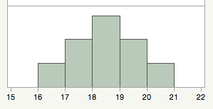
Frequency distribution
A frequency distribution is graphical depiction of all distinct values of a variable and the number of times they occur.
If the data are continuous, it is a histogram.
Today we should call it hertogram!
Variable: Age
Distinct values: 16, 17, 17, 18, 18, 18, 19, 19, 20
Tick marks: between 16 and 17, between 17 and 18…etc.

Slide 3
Central tendency
Central: The concentration of the data at the center
Tendency: Propensity, what is typical?
The average GPA of psychology majors is 3.54. Most GPAs concentrate on the high end. If I randomly select a psychology student, he or she tends to be a high-performing student.

Slide 4
Central tendency
Mean: Average (sum of all numbers/sample size)
Median: middle (rank the scores from lowest to highest, the median is at 50%)
Mode: Most recurring frequency (What is the most popular car among APU students? What is the most common GPA?)

Slide 5
Normal distribution
The mean works very well when we have a normal (symmetrical) distribution (More information about Normal curve will be given in the next unit (Unit 4).

Slide 6
Skewed distribution
However, when you have skewed distributions, the mean might be misleading.
Skewed: the data concentrate on one side (left or right), not on the center.

Slide 7
Skewed distribution
The positions of mean, median, mode in skewed distributions.

Slide 8
Let’s practice!
Semi-hand-calculation or full hand-calculation
Open the file “Exercise_3_1.docx” in Unit 3 folder for the instruction.
Open the data file “Exercise_3_1.xlsx”
Do Part 1 only
We will do Part II together in Excel. If you don’t have Excel, you can use Open office, Google sheet, or do it on pencil and paper.

Slide 9
Questions
The median savings account balance of American households is $5,200. The average, or mean balance is $33,766.49.
Which one is more representative of the US population?
How about household income?

Slide 10
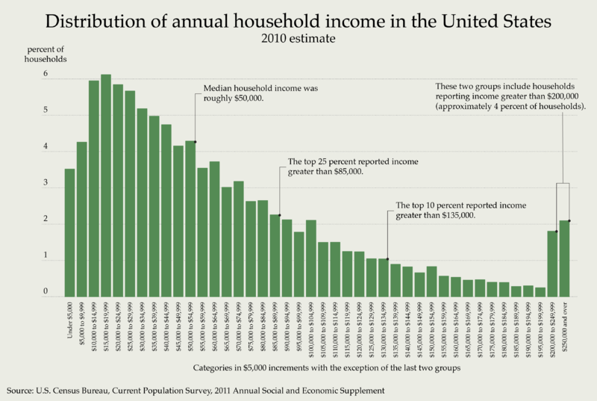

Slide 11
Resistance!
If you report the mean, our income may look much higher than what it should be. The super-rich would pull up the average.
Both the median and the mode are resistant against outliers.

Slide 12
Resistance!
The mode is more resistant than the median.
But usually the median is used more than the mode.
If you report the mode, our income may look much worse than what it should be. We may look like a third-world country.

Slide 13
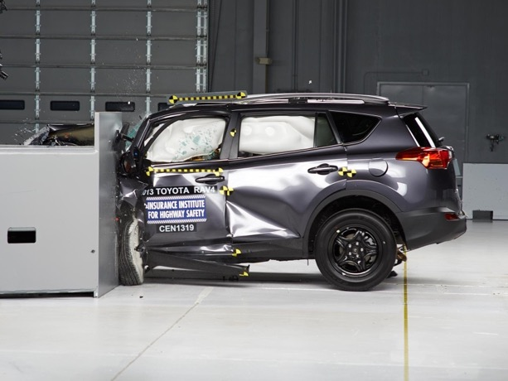
Crash test
I test-crashed a Toyota Highlander, a Ford Explorer, and a Benz GLK. Assume that all tests were conducted properly. I report that Toyota Highlander is the most crash-resistant vehicle. Is it a valid conclusion?

Slide 14
Variation
Variation: dispersion, distribution, not everyone is the same.
Variation is expected to be observed among humans, and thus it is dangerous to use one single point (e.g. mean, median, or mode) to represent the whole group.
In statistics it could be expressed by
  Variance
  Standard deviation

Slide 15
SD and variance
Start from a reference point or baseline (mean)
Deviation score: Subtract the mean from every score (X – bar X)
Squared deviation: But if I sum all the deviation scores, I got zero! No deviation? I need to square each deviation.
Adjust the Squared deviation: But if I have a bigger sample size, then the squared deviation scores will be bigger. The sample size must be taken into account → variance
Square root of variance → SD

Slide 16
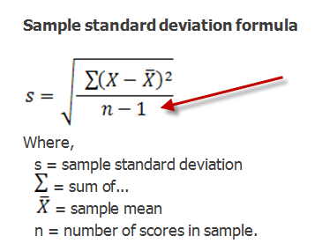
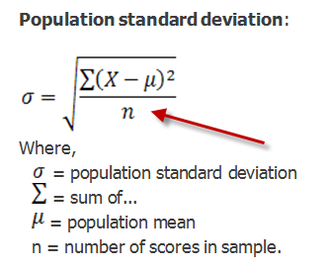
N – 1 = degrees of freedom = effective sample size

Slide 17
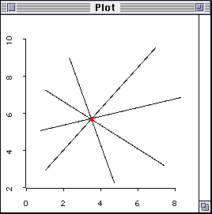
Sample is for estimation
When we have access to the population, we know exactly what the population value is.
When we have a sample only, we need to estimate the population value based on the sample value. Can we do any estimation with one and only one observation?

Slide 18
Useful information
The degree of freedom is zero (df = n - 1 = 1 - 1 = 0). There is no way to make any meaningful estimation.
Df is the effective sample size; it tells you how many pieces of useful information you have at hand. For example, if you have 10 subjects, df = 10 – 1 = 9. “1” does not count as a piece of useful information.
In the population you don’t need to do any estimation. You use n instead of n-1.

Slide 19
Computation: Excel
Mean: =average(from cell to cell)
Median: =median(from cell to cell)
Mode: = mode(from cell to cell)
Sample SD: =STDEV.S(from cell to cell)
Population SD: =STDEV.P(from cell to cell)
We will also go through the semi-hand-calculation of SD and variance.

Slide 20
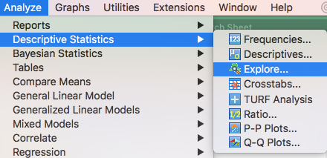
Computation: SPSS
Your screen may not look exactly the same (depends on software version and the computer OS)
Analyze → Descriptive statistics → Explore

Slide 21
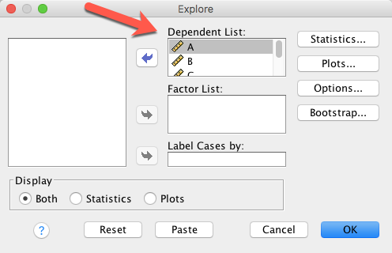
Computation: SPSS
Put the variable(s) that you want to compute into the dependent list

Slide 22
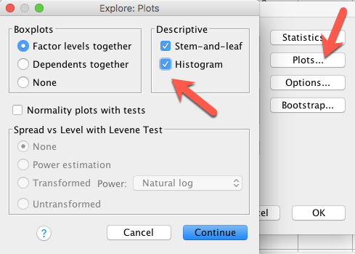
Computation: SPSS
Select histogram so that you can also see the frequency distribution.

Slide 23
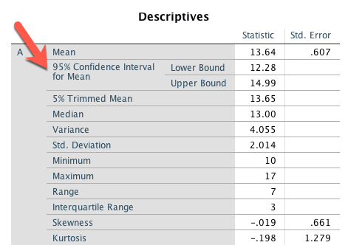
“95% upper bound and lower bound” is the same as “Upper 95% ad lower 95% mean.” We will talk about this and also skewness/kurtosis in later chapters.

Slide 24
Assignment 3 (Canvas)
Download the data set “central” from Unit 3 folder. There are two versions: Excel and SPSS. Download all.
Use Excel function to obtain the mean, the median, the mode, and the sample SD for Variable B-E.
In SPSS, open central.sav and compute the mean, the median, and the SD of Variable B-E.

