Slide 1

Health and Health Disorders
Eighth Edition
Chapter 1
Introduction to Adult Development

Slide 2
Learning Objectives (1 of 3)
1.1 Explain adult development in terms of 'stability and change' and 'stages and continuity' (Who am I or what am I?)
1.2 Explain sources of change that influence adult development as per gradations of age and history and life events
1.3 Explain sources of stability that influence adult development as per genetic and environment

Slide 3
Learning Objectives (2 of 3)
1.4 Illustrate adult development in terms of biological, social, psychological and chronological ages
1.5 Identify adult development as life long and the adult is exposed to multiple environments
1.6 Analyze research methods, behavioral measures and analyses methods and experimental design

Slide 4
Learning Objectives (3 of 3)
1.7 Express the quest to know the universal rules and processes that influence aging

Slide 5
Basic Concepts in Adult Development
Objective 1.1 – Explain adult development in terms of 'stability and change' and 'stages and continuity'
Notes:
Based on empirical evidence
Stability – Important parts of our lives that make up a consistent core
Change – Opposite of stability
What happens over time
Continuity – Slow and gradual
Stages – Abrupt changes

Slide 6
Sources of Change
Objective 1.2 – Explain sources of change that influence adult development as per gradations of age and history and life events

Slide 7
Sources of Change (1 of 2)
Learning Objective 1.2 Explain sources of change that influence adult development as per gradations of age and history and life events
Normative Age-Graded Influences
  Biology
  Shared experiences
  Internal change processes
Normative History-Graded Influences
  Cultures
  Cohort
Notes:
Normative Age-Graded Influences
Point 1 – Biology
Biological clock
Point 2 – Shared experiences
Social clock
Ageism
Family life
Point 3 – Internal change processes
Changes linked to both biological and social clocks
Normative History-Graded Influences
Point 1 – Cultures
Large social environments
Point 2 – Cohort
Common historical experience
Great Depression

Slide 8

Photo 1.1
The terrorist attacks of September 11, 2001, is surely a defining moment for the cohorts who experienced it.
https://www.youtube.com/watch?v=y1AH7D0LsaU
https://www.youtube.com/watch?v=JfxIAgw5ml0
Notes:
9/11/2001 is an example of a normative history-graded influence

Slide 9
Sources of Change (2 of 2)
Learning Objective 1.2 Explain sources of change that influence adult development as per gradations of age and history and life events
Nonnormative Life Events
  Unique aspects
Can you share what event(s) substantively change your life (optional)?
Notes:
Nonnormative Life Events
Point 1 – Unique aspects
Timing of an event

Slide 10
Sources of Stability
Objective 1.3 – Explain sources of stability that influence adult development as per genetic and environment

Slide 11

Sources of Stability
Learning Objective 1.3 Explain sources of stability that influence adult development as per genetic and environment
Genetics
  Behavior genetics
  Twin studies
Environment
  Early family experience
  Margaret Mead’s Samoa study
Interactionist View
  Epigenetic inheritance
https://www.youtube.com/watch?v=IPZsrLAkpKM
Notes:
Genetics
Point 1 – Behavior genetics
Heredity
Broad range of behaviors
Point 2 – Twin studies
Monozygotic vs. Dizygotic twins
Environment
Point 1 – Early family experience
Grant Study of Harvard Men
Interactionist View
Point 1 – Epigenetic inheritance
Genes are modified by environment
DNA methylation

Slide 12
A Word About "Age"
Objective 1.4 – Illustrate adult development in terms of biological, social, psychological and chronological ages
Notes:
Chronological age
Biological age
Psychological age
Social age
Functional age

Slide 13

Psychology of Adulthood: Introductory Overview: Nine Stages of Adult Development
early early adulthood 18-24
middle early adulthood 25-32
late early adulthood 33-38
early middle adulthood 39-44
middle middle adulthood 45-53
late middle adulthood 54-62
early late adulthood 63-72
middle late adulthood 73- 82
late late adulthood 83-100
  Note: Different theorists will have minor variations in these ages

Slide 14
Setting the Course: Some Guiding Perspectives
Objective 1.5 – Identify adult development as life long and the adult is exposed to multiple environments
Group discussion: We are in multiple environments: family, school, church, work, peer groups…etc. Which one is more influential to you?

Slide 15
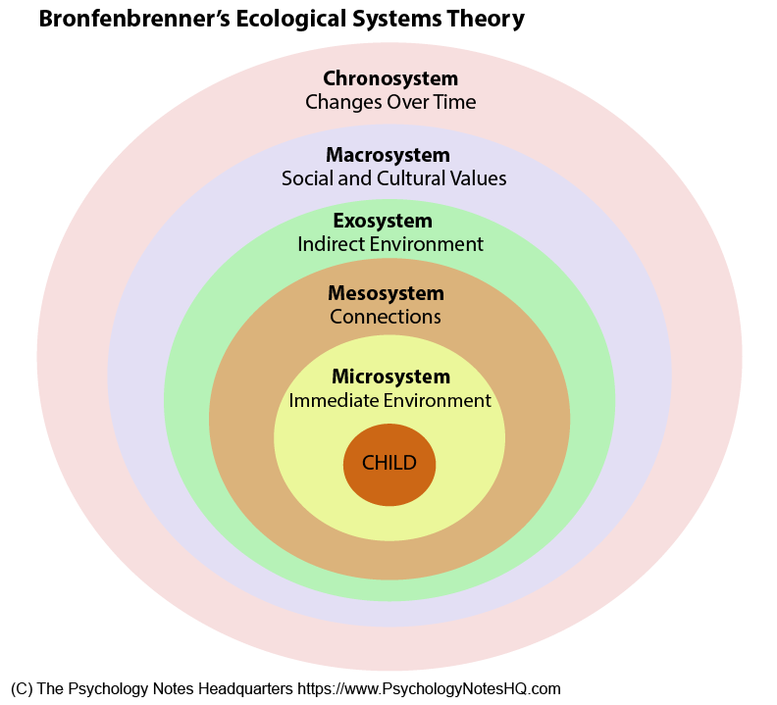
Setting the Course: Some Guiding Perspectives
Learning Objective 1.5 Identify adult development as life long and the adult is exposed to multiple environments
Life-Span Developmental Psychology Approach
  Development is lifelong
Bioecological Model of Development
  Multiple environments
  Five systems
Activity: Google search for an example for each
Notes:
Life-Span Developmental Psychology Approach
Point 1 – Development is lifelong
Multidimensional
Complex
Bioecological Model of Development
Point 1 – Multiple environments
Biological
Social
Psychological
Point 2 – Five systems
Microsystem
Exosystem
Macrosystem
Mesosystem
Chronosystem

Slide 16
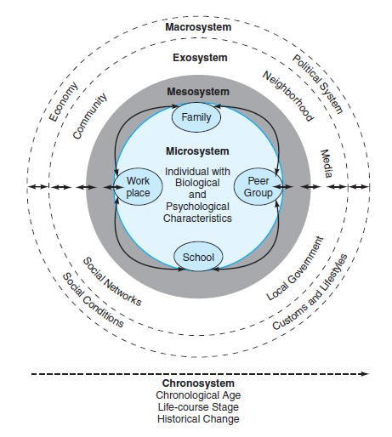
Figure 1.1
Bronfenbrenner’s Model of Ecological-Systems
Bronfenbrenner’s model of the ecological-systems approach to studying development. He suggested that researchers look beyond behavior in laboratory settings and consider how development takes place within multiple environments and through time.
Notes:
Development is interactive and complex
Source: Based on Bronfenbrenner (1979)

Slide 17
Developmental Research
Objective 1.6 – Analyze research methods, behavioral measures and analyses methods and experimental design

Slide 18
Developmental Research (1 of 2)
Learning Objective 1.6 Analyze research methods, behavioral measures and analyses methods and experimental design
Methods
  Cross-sectional study (One-time)
  Longitudinal study (Over a long period of time)
  Sequential study (Multiple longitudinal)
Measures
  Personal interviews
  Survey questionnaire
  Standardized tests
Notes:
Methods
Point 1 – Cross-sectional study
Data gathered at one time
Multiple groups
Midlife in the United States National Study
Point 2 – Longitudinal study
Same group of people over a period of time
Age-related changes
Galambos, Barker, and Krahn Study (2006)
Demonstrates change
Drawbacks
Point 3 – Sequential study
Series of longitudinal studies at different points of time
Longitudinal and cross-sectional data
Whitbourne Study (1992)
Measures
Point 1 – Personal interviews
Structured, open-ended, or both
Advantages
Drawbacks
Point 2 – Survey questionnaire
Large scale
Advantages
Drawbacks
Point 3 – Standardized tests
Established
Advantages
Disadvantages
Validity
Reliability

Slide 19
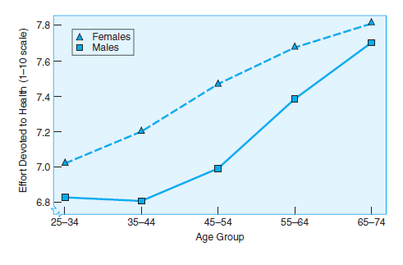
Figure 1.2
Example of Cross-Sectional Data
Cross-sectional data showing that the amount of effort spent on personal health care increases with age and is greater for women than for men at every age.
Notes:
Effort spent on personal healthcare is higher for women and increases with age
Source: Cleary, Zaborski, & Ayanian (2004)

Slide 20
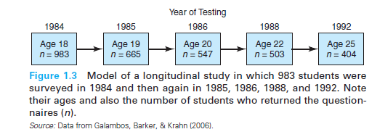
Figure 1.3
Example of Longitudinal Data
Model of a longitudinal study in which 983 students were surveyed in 1984 and then again in 1985, 1986, 1988, and 1992.
Can you see something funny?
Notes:
Note their ages and also the number of students who returned the questionnaires (n)
Source: Data from Galambos, Barker, & Krahn (2006)

Slide 21

What is cohort?An Introductory Overview: The Influences of Cohort Groups
Cohorts are groups of people born at or near the same time in a particular culture. Both culture and time of birth influence cohort effects. For example APU students designate a culture (APU community), and age designates a time period (students at APU born between 1990 and 1993).
One must always consider culture and time of birth to determine cohort effects. For example APU students is not a strong enough designation to constitute a cohort. APU students who attended APU in 1989, 1999, 2009, and now in 2019 are not the same students, nor are they the same culture or cohort group.

Slide 22
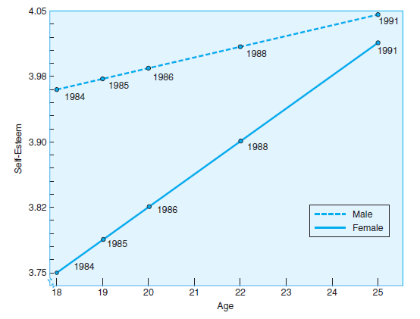
Figure 1.4
Example of Longitudinal Data
Young adults increase in self-esteem between the ages of 18 and 25, according to this longitudinal study.
Notes:
Note the different rates of increase for males and females
Source: Galambos, Barker, & Krahn (2006)

Slide 23
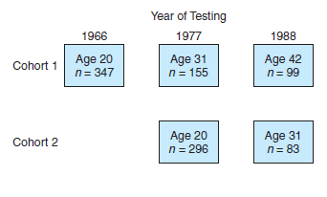
Figure 1.5
Example of Sequential Study with Two Cohorts
Model of a sequential study in which two cohorts were followed beginning at age 20. One cohort was followed for 22 years; one for 11 years.
Notes:
Note ages and number of participants (n)

Slide 24
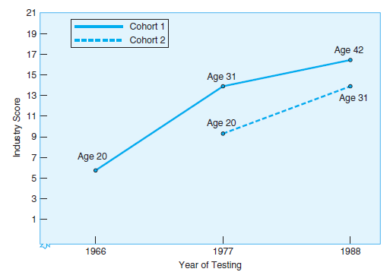
Figure 1.6
Example of Sequential Data with Two Cohorts
Results from a sequential study of two cohorts tested at three ages and at three different points in time.
Notes:
Comparing longitudinal results, Cohort 1 shows a sharper increase in industry scores between 20 and 31 years than does Cohort 2, though both have similar scores at age 31; cross-sectional results suggest that the normative history-graded influences (Vietnam War, civil rights issues) lowered the young adults’ scores in 1966
Source: Adapted from Whitbourne, Zuschlag, Elliot, et al. (1992)

Slide 25
Developmental Research (2 of 2)
Learning Objective 1.6 Analyze research methods, behavioral measures and analyses methods and experimental design
Analyses
  Comparison of means
  Correlational analysis
  Meta-analysis (meta=above and beyond)
  Optional: http://www.creative-wisdom.com/teaching/WBI/es.shtml
Designs
  Experimental design
  Descriptive research
  Qualitative research
  Quantitative research
Notes:
Analyses
Point 1 – Comparison of means
Cross-sectional
Longitudinal
Divide into smaller groups
Point 2 – Correlational analysis
Extent to which two sets of scores on the same people tend to vary together
Relationships
Not causality
Twin study
Point 3 – Meta-analysis
Combines data from a large number of studies that deal with the same research question
Designs
Point 1 – Experimental design
Control group
True experiments
Pre-preexperiments
Quasi-experiments
Point 2 – Descriptive research
Current state of participants on some measure of interest
Lack of experimenter control
Point 3 – Qualitative research
Research without numbers
Archival
In-depth
Point 4 – Quantitative research
Research with numbers

Slide 26
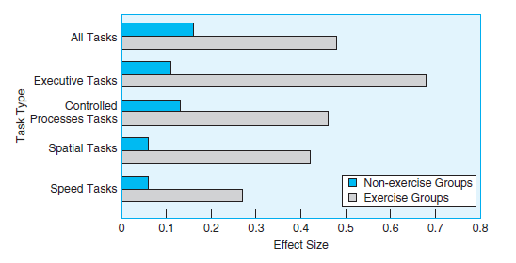
Figure 1.8
Example of Meta-Analysis Data
Meta-analysis of 18 studies shows that aerobic exercise causes better performance in older adults on four types of cognitive tasks.
Notes:
Aerobic exercise helps with cognitive abilities
Source: Colcombe & Kramer (2003)

Slide 27
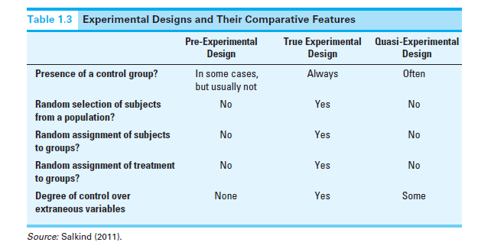
Figure 1.9
Experimental Designs and Their Comparative Features
Notes:
Comparison of experimental designs.

Slide 28
A Final Word about Adulthood Development
Objective 1.7 – Express the quest to know the universal rules and processes that influence aging
Notes:
Searching for basic rules or processes
Similarities and differences of aging processes

