Slide 1

Health and Health Disorders
Eighth Edition
Chapter 10
Stress, Coping, and Resilience

Slide 2
Stress, Stressors, and Stress Reactions
Objective 10.1 – 1. Define stress, stressors, and stress reactions 2. Discuss response-oriented viewpoint and stimulus-oriented viewpoint

Slide 3
Stress, Stressors, and Stress Reactions
Objective 10.1 1. Define stress, stressors, and stress reactions / 2. Discuss response-oriented viewpoint and stimulus-oriented viewpoint
  Stress: Set of physical, cognitive, and emotional responses displayed in reaction to demands from the environment
  Stressors: Environmental demands that cause stress

Slide 4
Stress, Stressors, and Stress Reactions
Objective 10.1 1. Define stress, stressors, and stress reactions / 2. Discuss response-oriented viewpoint and stimulus-oriented viewpoint
  General Adaption Syndrome
    Alarm reaction: Fight or flight
      https://www.youtube.com/watch?v=m2GywoS77qc
    Resistance: try to regain normality
    Exhaustion

Slide 5
Stress, Stressors, and Stress Reactions
  Evaluation
  Holmes & Rahe (1967)
  Stressors based on life-change events
  Stimulus-oriented viewpoint

Slide 6
Ungraded exercise:
Is your life stressful?
Holmes-Rahe Stress Scale
Go to https://www.stress.org/holmes-rahe-stress-inventory
Take the assessment
Are you at risk?
What are the major factors of stress?

Slide 7
Types of Stress
Objective 10.2 – Describe the characteristics of stressors and the characteristics of individuals which determines their daily well being

Slide 8
Types of Stress
  Short-term life events vs. chronic life strains
    Immediate vs. on-going
  Job-related
    Work stress: high demand, good control
    Work strain: high demand, low control
    https://www.youtube.com/watch?v=cs6vNXcMuxs

Slide 9
Types of Stress
  Major life events vs. daily stressors
    Daily stressors can be cumulative
    the last straw that breaks the camel's back
    “A seemingly small or inconsequential issue, problem, or burden that proves to be the final catalyst in causing an overworked or overburdened person, system, organization.”
Notes:
https://idioms.thefreedictionary.com/the+straw+that+broke+the+camel%27s+back

Slide 10
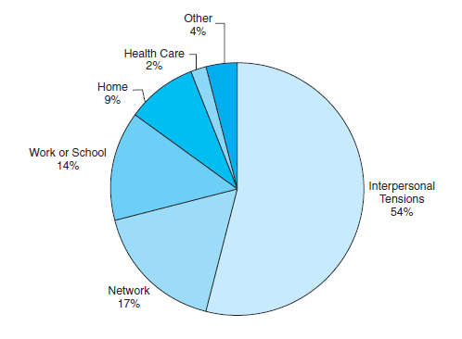
Figure 10.1
Sources of Daily Stressors
U.S. adults from 25 to 74 years report that the largest proportion of their daily stressors arise from interpersonal tensions, followed by stressful events that happen to other people in their networks and events that happen at work or school.
Notes:
Note the high percentage of stress from interpersonal tensions
Source: Data from Almeida (2005)

Slide 11
Effects of Stress
Objective 10.3 – Analyze the physical and emotional effects of stress and individual differences in stress reactions

Slide 12
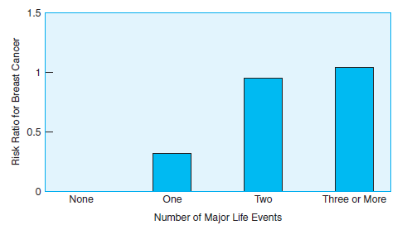
Effects of Stress
Physical Disease
  Heart disease
  cancer
  diabetes
Women who reported one, two, or three or more major life events in the previous five years were significantly more likely to be diagnosed with breast cancer during the next 15 years than those who reported no major life events.

Slide 13
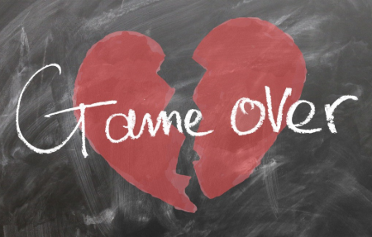
Effects of Stress
Mental Health Disorders
  Depression and anxiety
  Depends on individual reaction to stressors
  e.g. break-up in a relationship
  https://www.youtube.com/watch?v=W6BYAjhjt38
  Ask yourself: What is the worst part of it? Can I live without him/her?

Slide 14
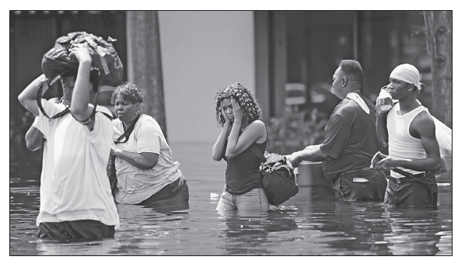
Effects of Stress
Mental Health Disorders
  Post-traumatic stress disorder (PTSD)
  About one third of people will show symptoms of PTSD immediately after a traumatic event, and about 10% will continue showing the symptoms a year later.
  e.g. Hurricane Katrina.

Slide 15
Effects of Stress
Mental Health Disorders
  Post-traumatic stress disorder (PTSD)
    About one third of people will show symptoms of PTSD immediately after a traumatic event, and about 10% will continue showing the symptoms a year later.
    e.g. military combat (shell shock), rape, terrorist attacks, natural disasters, or automobile accidents.
    https://www.youtube.com/watch?v=SS1dO0JC2EE
    does not decline over time and is not alleviated by social support; need professional help (e.g. medication and counselling)

Slide 16
Effects of Stress (2 of 2)
Individual Differences in Stress-Related Disorders
  Gender difference
  Men: financial stress
  Women: relational stress
  Some theorists believe fight or flight only relates to men.

Slide 17
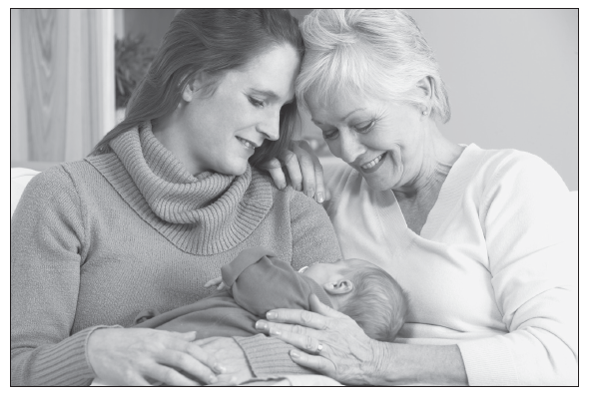
Photo 10.2
Women have the role of kinkeeper in almost all cultures. This may cause them to react to stress by “tending and befriending” instead of “fighting or fleeing”

Slide 18
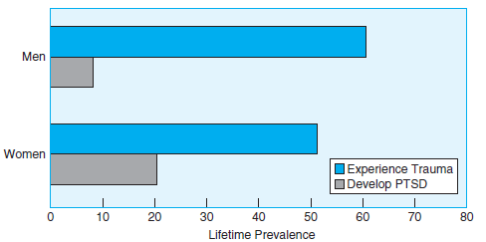
Figure 10.4
Gender and Trauma, PTSD
Men experience more trauma in their lifetimes, but women are more likely to develop PTSD.
Notes:
Women and men experience different types of trauma
Source: Data from Yehuda (2002)

Slide 19
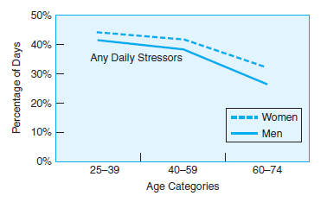
Effects of Stress (2 of 2)
Individual Differences in Stress-Related Disorders
  Stress decreases with age
  Why?

Slide 20
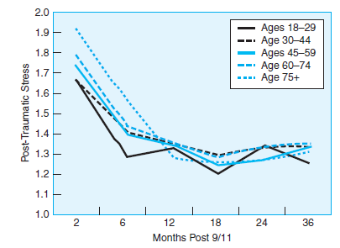
Figure 10.6
Post-Traumatic Stress and 9/11
Adults 75 years of age and older who lived in the vicinity of the World Trade Center showed more incidences of posttraumatic stress in the first 12 months, but then declined in symptoms.
Notes:
Adults older than 75 had higher incidences of posttraumatic stress, but all ages declined within a year
Source: Scott, Poulin, & Silver (2013)

Slide 21
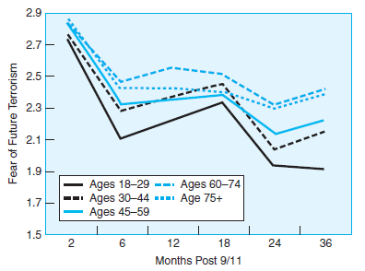
Figure 10.7
Fear of Future Terrorism and Age, Months Post 9/11
Adults 65 years of age and older continue to express fear of future terrorism more than younger adults.
Notes:
This fear starts to peak on the anniversaries of the attack for all ages
Source: Scott, Poulin, & Silver (2013)

Slide 22

Effects of Stress (2 of 2)
Objective 10.3 Analyze the physical and emotional effects of stress and individual differences in stress reactions
Stress-Related Growth
  Positive change from stress
  the Chinese word for “crisis” is made up of two characters—one meaning “danger” and one meaning “opportunity.”
  E.g. WWII veterans, breast cancer survivors

Slide 23

Stress-related growth
Older people who experienced stressful events in their younger years may show personal growth and wisdom in later years as a result.
Notes:
That which does not kill us, makes us stronger

Slide 24
Coping with Stress
Objective 10.4 – Relate stress coping with personal traits, behavior and social support

Slide 25
Coping with Stress
Problem-focused coping e.g. try to find the remedy
Emotion-focused coping: e.g. running, drinking, shopping…etc. Could lead to negative results
Meaning-focused coping: find a rational explanation and something bigger than yourself e.g. God taught me a lesson
Social coping: talk to friends

Slide 26
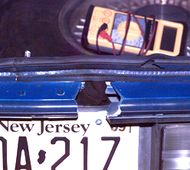
DC Sniper attack in 2002
In Oct. 2002 sniping attacks killed 10 people and injured 3 over a three-week period.
The shooters, John Muhammad and Lee Boyd Malvo, chose victims at random and brought daily life in DC to a standstill.
A hole was cut at the rear of a car as a firing port and that’s why the shooter is undetected.

Slide 27
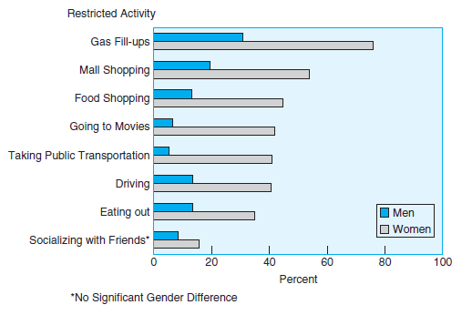
Figure 10.8
Gender and Problem Focused-Coping
Men and women in Washington, DC, used problem focused-coping with the DC sniper attacks by restricting their usual activities in many areas.
Women reduced activities significantly more than men for all types of activities except socializing with friends (a source of social support)
Notes:
Source: Data from Zivotofsky & Koslowsky (2004)

Slide 28
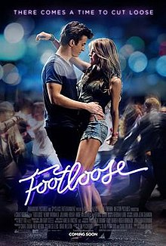
Negative sides of over-coping
Over-reaction or over-compensation: Excessive reaction to a traumatic event or a feeling of guilt.
Example: the story of “Footloose.”
After overnight partying, a young man named Bobby Moore and his friends are killed in a car accident.
The autopsy found that their bodies had alcohol and illegal drug.

Slide 29
Over-reaction or over-compensation
His father Shaw Moore is a Pastor. He persuaded the city council to pass several strict laws, including a ban on all “immoral” behaviors, such as unsupervised dancing within the city limits.
https://www.youtube.com/watch?v=20jbY6awlTw
It takes a long time for Pastor Moore to realize that he has gone too far; he has been unconsciously punishing himself and the whole city by overprotecting young people. At last he set himself free by approving dancing.

Slide 30
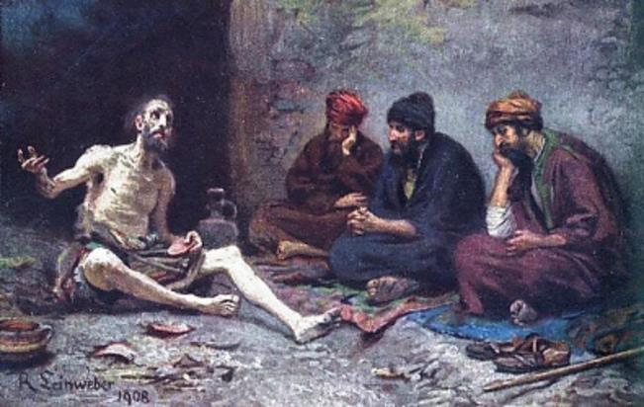
Negative sides of social support
When the support given is not what is needed, or the offer of support is perceived as criticism, or intrusion, or an insult to our independence.
Classical example: In the Old Testament Job suffered for no reason.
Friends of Job: “It is your own fault! God is punishing you!”

Slide 31
Negative sides of social support
First friend: “Consider now: Who, being innocent, has ever perished? Where were the upright ever destroyed? As I have observed, those who plow evil and those who sow trouble reap it” (Job 4:7-8).
Second friend: “Surely God does not reject one who is blameless or strengthen the hands of evildoers” (Job 8:20).
Third friend: “If iniquity is in your hand, put it far away, do not let wickedness reside in your tents. Surely then you will lift up your face without blemish; you will be secure, and will not fear.…Your life will be brighter than the noonday” (Job 11:14-15, 17).

Slide 32
Negative sides of social support
We might not accuse others as what Job’s friends did, but some well-intentional “support” could be nothing more than adding salt on the wound.
Example: “analyze” his/her case without sufficient information, giving advice (you should do this and that) but he/she had already done what you said…etc.

Slide 33
Social support
Giving appropriate social support is a skill. You need to know when to give what type of support.
Emotional support: rather than giving any advice, just listen, hug, or pat on the back.
Esteem support: “I believe in you!”
Information support: Only give people information and advice when they request it.
Tangible support: taking on responsibility e.g. give money to your friend when she lost her job. Give a student an extension for the term paper when she has a crisis.

Slide 34
Assignment
Form a small group of 3-5 to discuss the following:
Researchers at the University of Waterloo and Wilfrid Laurier University found that individuals with low self-esteem are less receptive than individuals with high self-esteem to social support.
What strategy would you use to help them (e.g. emotional support, esteem support, information support, and tangible support…etc.)
There is no right or wrong answer.

Slide 35
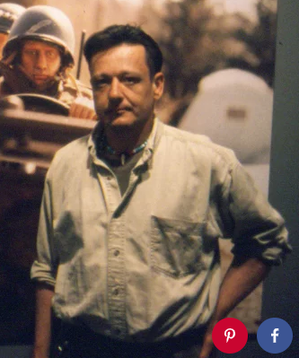
Meaning-focused copying
Finding some meaning and purpose for your life after experiencing a trauma.
Example: Mark Hogancamp and Marwencol
Occasionally he wore high heel shoes. On August 6, 2000 five men disliked his clothing style attacked him.
Hogancamp spent five days in coma. He received physical, cognitive, and occupational therapy for a year to relearn how to speak and walk.

Slide 36
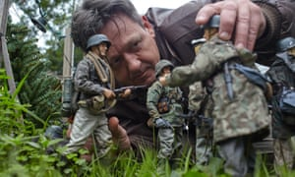
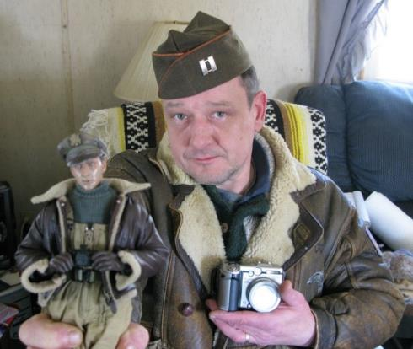
Meaning-focused copying
After a year his insurance could no longer cover the expense of his therapy.
Art became therapy: He used dolls and models to create a WWII-era town named Marwencol.

Slide 37
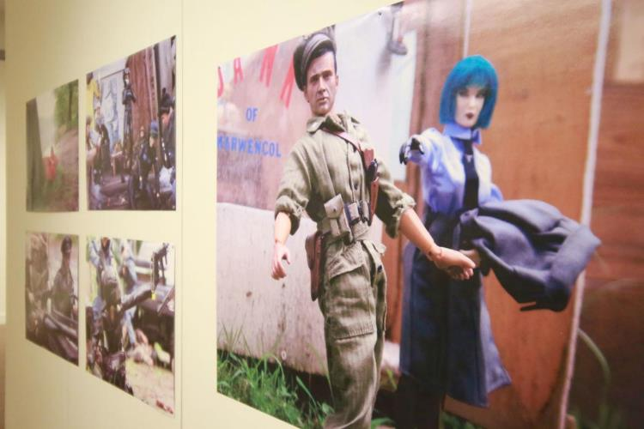

Meaning-focused copying
His work draws attention from artists and later he travels around to exhibit his work.
https://www.youtube.com/watch?v=vNKPEp6aEqQ

Slide 38
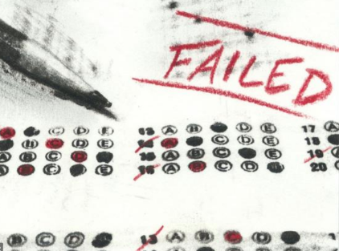

Proactive coping
Cope in advance to prevent or mute the impact of a stressful event that will happen in the future e.g. divorce, layoff, sickness…etc.
Recognize potential stressors or failures
Psychologically prepare for it (“I might fail the final exam.” “My girlfriend might break up with me.”)
Gather resources for Plan B, Plan C, or even Plan D.

Slide 39
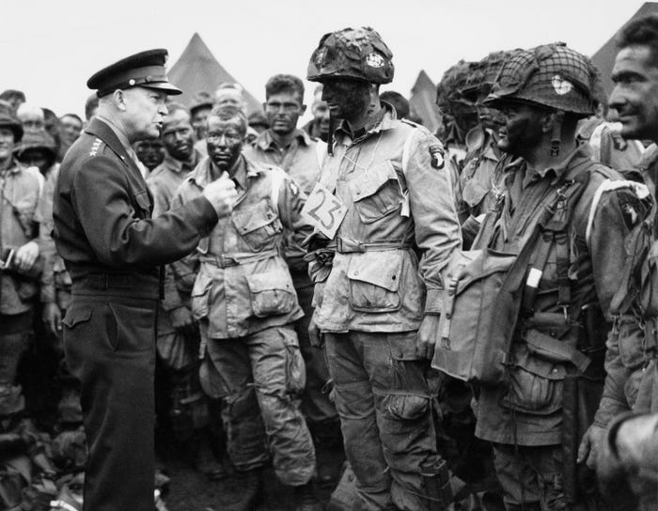
Proactive coping
Classical example: In 1944 General Eisenhower drafted two speeches for the Normandy Invasion (The D-Day).
The success of the landing was not guaranteed.

Slide 40
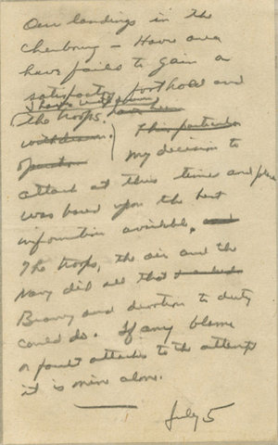
Proactive coping
Version 2: "Our landings …have failed to gain a satisfactory foothold and I have withdrawn the troops…My decision to attack at this time and place was based upon the best information available. The troops, the air and the Navy did all that bravery and devotion to duty could do. If any blame or fault attaches to the attempt it is mine alone."

Slide 41
Assignment
Form a small group of 3-5 to discuss the following:
Identify a potential stressful situation.
How could you psychologically prepare for it? For example, would you openly discuss with your boyfriend or girlfriend about the possibility of breaking up?
What is your Plan B or Plan C? What resources would you gather for Plan B or Plan C?

