Slide 1
Quantitative research design II
Chong Ho (Alex) Yu

Slide 2
Topics
Ex post facto
Observational (correlational)
Survey research

Slide 3

Ex post facto
Non-experimental: after the fact
Example: Is there a performance gap between public and private school children at Grade 10?

Slide 4
Causal-comparative
Some says it is a misnomer: not the best way to make causal inferences.
You can infer causal relationships if:
  A statistical correlation is found in the data
  The direction of causal and effect is right
  You can rule out other possible explanations
If private school children outperform their public school counterparts, what are other possible explanations?

Slide 5

Observational approach
Don’t take it literally; it doesn’t mean that the researcher must observe (look at) the subjects in the field.
Correlational
Example: What is the association between learner motivation and test performance?
Many things can go wrong!

Slide 6
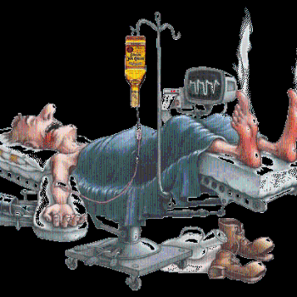
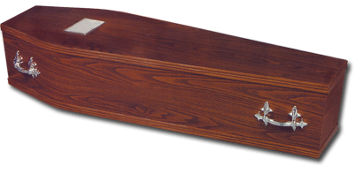
Difference between Ex post facto and observational studies
Both are non-experimental
In observational studies we collect data as the event is happening.
In Ex post facto we collect data after the event is over.

Slide 7


Correlation does not necessarily imply causation
Many children who received vaccine suffer from autism. Vaccine causes autism (sample size = 12)!
Christopher Hitchen: In history so much violence done by religious people. Religiosity inspired cruelty.

Slide 8
SAT and Expenditures
The data published in the Wall Street Journal (June 22, 1995) shows the rank of each state's average SAT score and average expenditure on education.
The data "show" the more a state spends, the worse (on average) their SAT rank is.
Does this mean spending less on education will improve SAT rank?

Slide 9
SAT and Expenditures
Problems with this analysis:
  State level data may not be true within states.
  Cost of living (and therefore expenditures) varies across the country.
  Not everyone takes the SAT.
  Infer from summary-level (state-level) data to individuals.

Slide 10
SAT and Expenditures
National Assessment of Education Progress (NAEP)
  It was designed to measure achievement.
  It is taken by a representative sample.
On contrary to the data on the Wall Street Journal, there is a positive relationship between NAEP and expenditures.

Slide 11
Direction
Some researchers hastily assign an event as the dependent variable (DV) and another one as the independent variable (IV). Later the data might seem to "confirm" this causal relationship.
Statistical data cannot tell you whether you have the right direction (X causes Y or Y causes X, or X <-> Y).

Slide 12
Direction
Married people are happier. Does marriage make people happy? Do happy people tend to get married?

Slide 13
Direction
When the economy is improving, the crime rate drops significantly.
Explanation: more and more people are employed and earn a higher salary, they don't need to anything illegal to exhort money.

Slide 14
Direction
Another explanation: We have a safer society as a result of a lower crime rate.
Investment pours in the market and thus boosting jobs and the economy.
The cause and effect relationship may be reversed or bi-directional.
Can you tell me other examples?

Slide 15
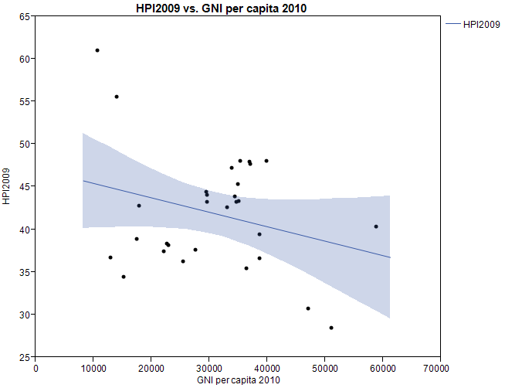
Misinterpretation of correlation:
Ecological fallacy
This graph shows a negative relationship between GNI per capita and happiness scores i.e. the more money you earn, the less happiness you have.
Should I ask my boss to cut my salary?

Slide 16
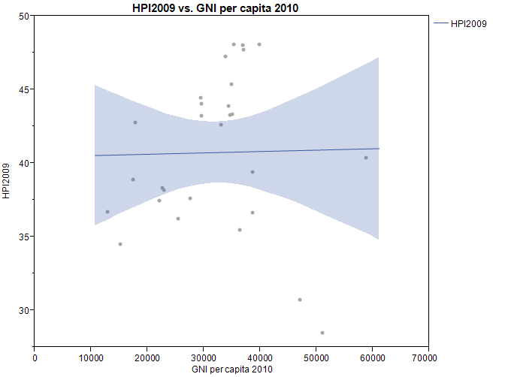
If I remove two outliers, the regression line is flat. i.e. whatever you earn, it has no impact on your happiness?
Should I sit here, enjoy my life, and do nothing?

Slide 17
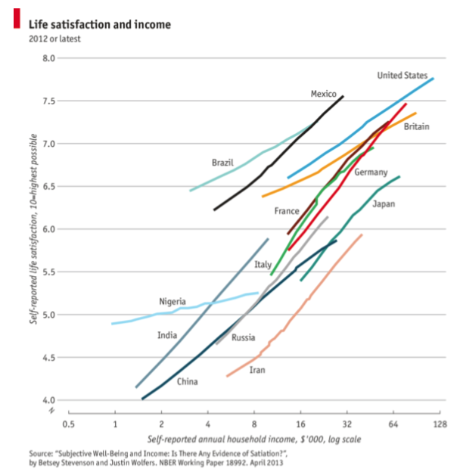
Reverse the conclusion!

Slide 18
Survey research
Also known as descriptive research
Ask people about facts (e.g. age, how often do you do binge drinking?)
Ask people about opinions (e.g. Rate the following statement using a 5-point scale, where 1 is strong disagree and 5 is strongly agree: Professor Yu is a nice man)

Slide 19
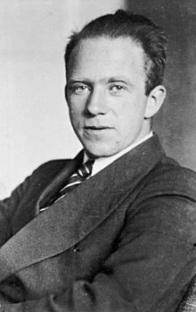
Survey can change behaviors
Physics: Heisenberg principle
The measurement by the observer can change the event.
Example: If you ask people whether they will vote one day before the election, they are more likely to vote!
Thaler, R. (2008). Nudge. Yale University Press. Bellevue, WA

Slide 20
Common mistake: Redundancy
Very long survey
People lost their patience and didn’t read the questions carefully.
“It is good to know…”
Three criteria of good research design
  Completeness
  Efficiency
  Insight

Slide 21
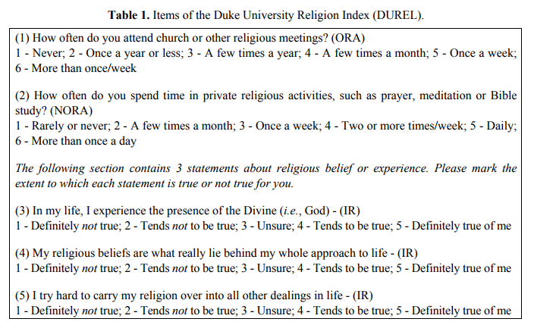
Less is more!
A five-item survey: DUREL

Slide 22
Common mistake:
Double-barreled question
"Do you agree that low enrollment in Program X is due to lack of interest among current users?"
If the user replies, "agree," it could mean:
  I agree that the enrollment is low
  I agree that people are not interested in it.
  I agree that low enrollment is caused by lack of interest.

Slide 23
Double-barreled question
I am so afraid of computers I avoid using them (Options: 5-point scale, Strong agree – Strong disagree)
Source: Earlier version of Computer anxiety test
Can you see a problem?
A better version: I try to avoid using computers whenever possible.
http://www.psych.uncc.edu/pagoolka/ComputerAnxiety.html

Slide 24
Double-barreled question
Source: New Americans Museum, San Diego
Can you see a problem in these questions? What should be done?

Slide 25
Common problem: What is “3”?
Do you agree that Trumpcare is a good policy? Rate this statement using a 5-point Likert scale:
  1=strong disagree
  2=disagree
  3=neutral (neither agree nor disagree)
  4=agree
  5=strongly agree

Slide 26
Common problem: What is “3”?
Peter, Paul, and Mary chose "3".
Peter's position: "I am not sure. There are both pros and cons in this policy."
Paul's position: "I already have my own insurance. I don't care."
Mary's position: "I am a new immigrant. I don't know what TrumpCare is. No idea!"

Slide 27
What is ”3”?
Should we assign the same value (3) to all these "neutral" answers? If not, please explain.
To rectify the situation, today many surveys use a 4-point scale: No neutrality! You are either with us or against us! Is it a good solution? Why or why not?
Form a small group to discuss this question: What other solutions would you recommend?

Slide 28
What is “0”?
Some researchers treat no answer as “0”. What is the problem?
If you asked me to rate the movie “Avengers” on a 5-point scale and I told you I never watched this movie, would you put a zero into the data file?
It should be missing (uncounted), otherwise it will drag down the average!

Slide 29
Advantages of Online Survey
Lower error rate: If you collect data using papers, you need to enter the data into the database later. Needless to say, there would be errors during the data entry process. On the other hand, an online survey directly captures the data and the error rate is virtually zero.

Slide 30
Advantages of Online Survey
Lower cost: If you collect data using papers, you need to print hard copies and then mail them to your potential participants. Because the printing and mailing fees are high, you must be very selective in sampling. However, if you use the online approach, you can reach a larger accessible population. The survey will be sent with recycled electronics.

Slide 31
Advantages of Online Survey
More freedom: Some survey engines allow you to make a question compulsory, randomize the question order or/and the option order. Prior research shows that item order would affect the participants’ responses (carry-over effect). Randomizing item order can rectify this situation. You can also do this in hard copies but it is tedious to create many versions of the same survey.

Slide 32
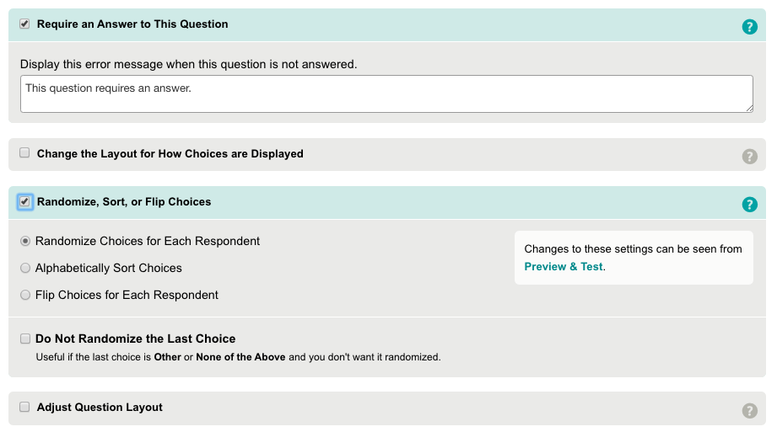
Example: Survey Monkey

Slide 33
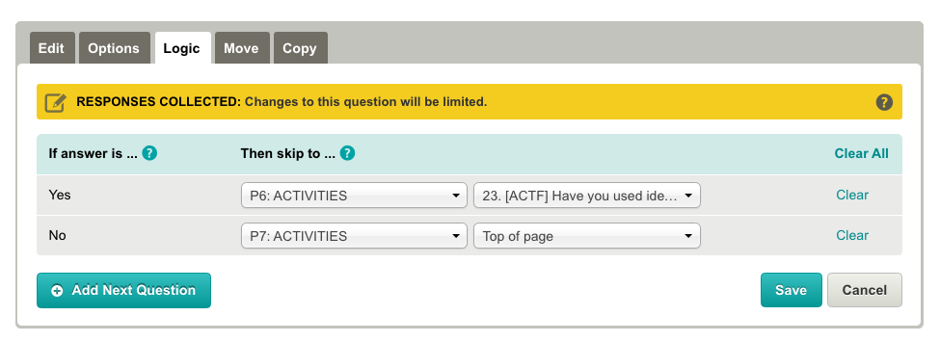
Advantages of Online Survey
More freedom: In addition, you can use skip logics in most online survey engines. It is more difficult to do so in a hard copy e.g.
If yes, go to Page 6; if no, go to Page 7.

Slide 34
Advantages of Online Survey
Higher response rate: People tend to respond to an online survey because it is easy. But if you ask the potential participant to mail back the survey, most people are unwilling to cooperate.
Higher completion rate: Some survey engines show the progress bar at the bottom. People tend to complete the survey if they can see how much longer it will take to finish.

Slide 35
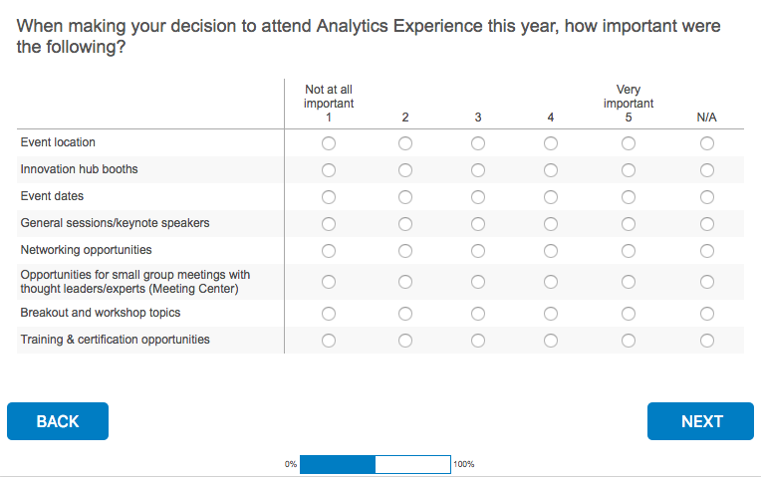
Progress bar

Slide 36
Advantages of Online Survey
Less intrusive: Unlike a phone survey, you can do an online survey anywhere anytime.
More flexibility in sampling: You can use Amazon Mturk to recruit participants from all over the world. The sample will be more diverse and the sample size will be larger.

Slide 37
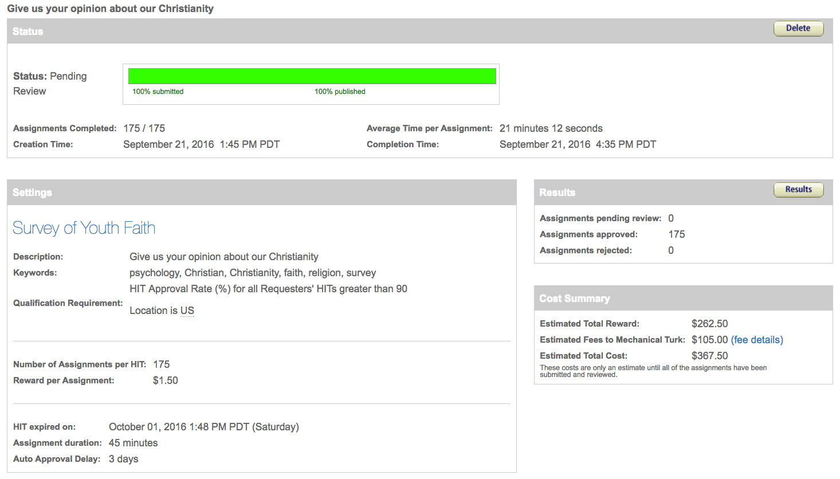
Example: Mturk

Slide 38
Pilot study
The purpose of a pilot study is to identify any additional problems with the wording of survey items, and to check the online user interface. Data collected during the pilot should not be used in the actual data analysis. Based on the pilot study, the surveys can be refined in the following ways:

Slide 39
Pilot study
Testing clarity of wording: If any item causes confusion, the item will be reworded and retested.
Testing user-interface: If any object (e.g. icon, button, menu…etc.) on the webpage causes inconvenience or confusion, the researcher should redesign the interface and retest the revised version.

Slide 40
Pilot study
Timing: Each survey is not supposed to take more than 30 minutes. If, on average, the pilot testers spend more than 30 minutes, the research team might consider shortening the survey.
Assessing whether the research protocol is realistic and functioning: If the protocol has any issues, the research team will revise it and retest the new version.

Slide 41
Pilot study
Identifying logistical problems that might occur in the process: Potential logistic problems include lack of access to computers or the Internet, incompatibility between the survey engine (e.g. SurveyMonkey) and certain platforms, etc. If any issues are discovered, the research team will find ways to resolve them.

Slide 42
Pilot study
Refining survey items and options: Most survey items provide the participants with forced options only. Based on the responses to the open-ended questions, the research team might modify the survey items, such as including new options and even creating new items.

Slide 43
Achilles’s heel
Reliability of self-report data
Will the subjects tell you the truth?
Opinion polls indicated that more than 40 percent of Americans attend church every week. However, church attendance records showed that the actual attendance was fewer than 22 percent.
http://www.creative-wisdom.com/teaching/WBI/memory.shtml

Slide 44
The seven sins of memory
(Schacter, 1999)
Transience: Decreasing accessibility of information over time e.g. forgot what happened a year ago.
Absent-mindedness: Inattentive or shallow processing that contributes to weak memories e.g. forgot where I put my car key
Blocking: The temporary inaccessibility of information that is stored in memory e.g. looks familiar, but forgot the exact information.

Slide 45
The seven sins of memory
(Schacter, 1999)
Misattribution Attributing a recollection or idea to the wrong source e.g. mixing up people or events
Suggestibility: Memories that are implanted as a result of leading questions or expectations e.g. sexual abuse in childhood
Bias: Retrospective distortions and unconscious influences that are related to current knowledge and beliefs e.g. divorcee reinterpreted his/her marriage
Persistence: Pathological remembrances-information or events that we cannot forget, even though we wish we could e.g. experience in a war zone

Slide 46

One more sin:
Desirability of outcome
Aschengrau & Seage III (2008)
The reliability of our memory is tied to the desirability of the outcome.
When a medical researcher tries to collect data from mothers whose babies are healthy and mothers whose kids are malformed, the data from the latter is usually more accurate than that of the former.
Why?

Slide 47
One more sin:
Desirability of outcome
The outcome of the latter is not desirable.
Mothers of malformed babies have been carefully reviewing every illness that occurred during the pregnancy, every drug taken, every detail directly or remotely related to the tragedy in an attempt to find an explanation.
Mothers of healthy infants do not pay much attention to this information.

Slide 48
Achilles’s heel
People lied!
In 2016 election all polls indicate that more voters prefer Clinton to Trump.
The result is opposite. Why? What happened?

Slide 49
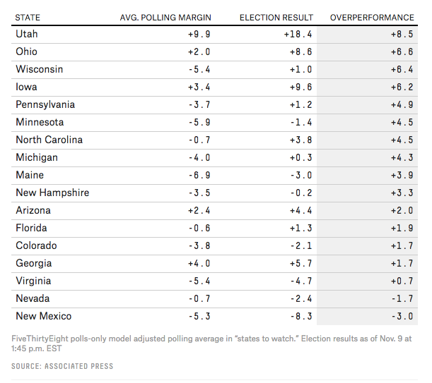
Achilles’s heel

Slide 50
I never lie

Slide 51
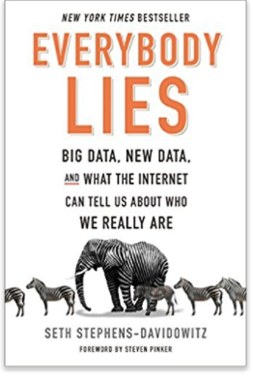
Everybody lies!
In survey most voters said that the race of the candidate doesn’t matter. Google search data show the otherwise!
https://www.youtube.com/watch?v=g0m4UQ3frws
https://trends.google.com/trends/

Slide 52
Solution
Turn to “behavioral” data e.g. Look at data in Netflix, YouTube, Amazon, Google, EBay to find out what people actually do rather than what they say.
“Google and the end of free will”: Google may know more about you than yourself.
https://www.ft.com/content/50bb4830-6a4c-11e6-ae5b-a7cc5dd5a28c?siteedition=intl

Slide 53
Sampling methods
Convenience sampling (especially online survey)
Simple random sampling (in theory only, self-selection is common)
Multi-stage sampling: Partition the accessible population into segments

Slide 54
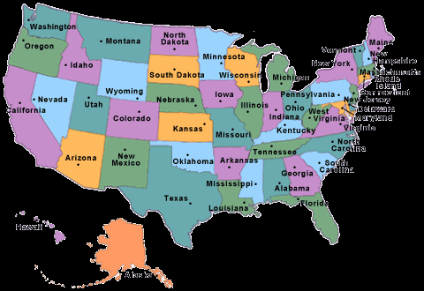
Nationwide sample
Number 1 challenge to survey research: Can the sample speak for the population?
If you randomly select subjects from USA, what would happen?

Slide 55
Survey research
You may obtain a lot of participants from New York and California, but a few or even no one from Idaho and Montana.
Use multi-stage sampling instead of simple random sampling:
  State
  County
  City
  School district
  School

Slide 56
Survey research
Sometime you don’t need to partition the population into levels or segments at all.
If I want to conduct a survey research at a big university, do I need to select samples from:
  School/college?
  Department?

Slide 57
Survey research
No! I sent email invitations to ALL students.
In the past you need to be selective because printing and mailing surveys cost money.
Now you can push a button and the emails will be sent with recycled electronics.
Carpet the entire population → more likely to get more responses.

Slide 58
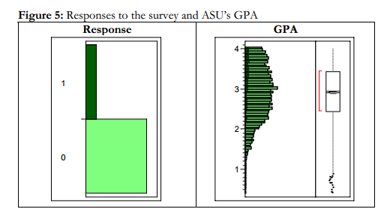
Survey research
How can I know whether the sample can represent the population?
I have access to the full population (all students). I can compare the attributes of the respondents with all other students.

Slide 59
Example
DiGangi, S., Kilic, Z., Yu, C. H., Jannasch-Pennell, A, Long, L., Kim, C., Stay, V., & Kang, S. (2007). 1 to 1 computing in higher education: A survey of technology practices and needs. AACE Journal, 15(4) Retrieved from http://www.creative-wisdom.com/pub/mirror/article_22813.pdf
Yu, C. H., Jannasch-Pennell, A., DiGangi, S., Kim, C., & Andrews, S. (2007). A data visualization and data mining approach to response and non-response analysis in survey research. Practical Assessment, Research and Evaluation, 12(19). Retrieved from http://pareonline.net/getvn.asp?v=12&n=19

