Slide 1
Qualitative research design I
Chong Ho Yu

Slide 2
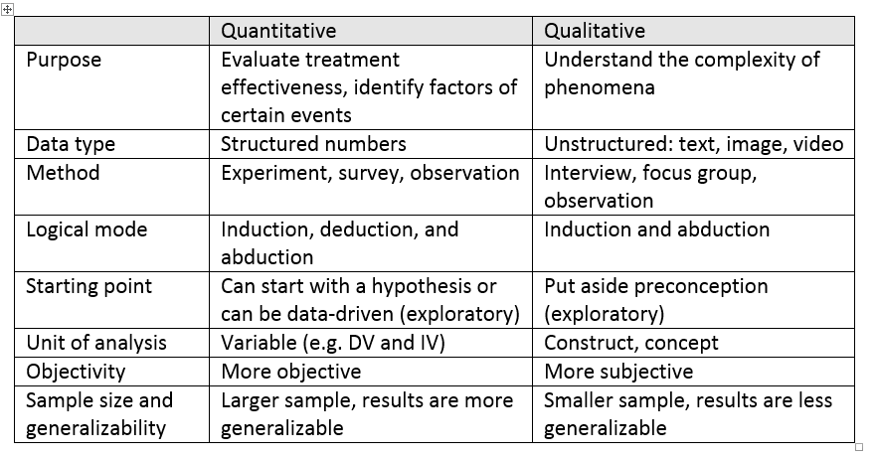
Differences between qual & quant

Slide 3
Data collection:
Structured interview
In a structured interview the interviewer wrote all questions beforehand and strictly follow the protocol.
Self-disclosure: To reduce bias, some interviewers take their own background and position into account when preparing for the interviews and also later disclose self-information into the report.

Slide 4
Data collection:
Unstructured interview
Semi-structured an flexible interviews can be used in exploratory research so that interviewees can talk about what are not on the agenda but matters most to them.
A life story interview for narrative research (will be discussed later) is a form of semi-structured interview. It is not possible for an interviewer to write all all-encompassing questions beforehand.

Slide 5
Data collection:
Focus group
6-12 participants
Led by a facilitator or moderator
shows the change of perceptions in a social context.
Originated from business marketing research: the perceptions of an individual in isolation may be different from perceptions in a group setting.

Slide 6
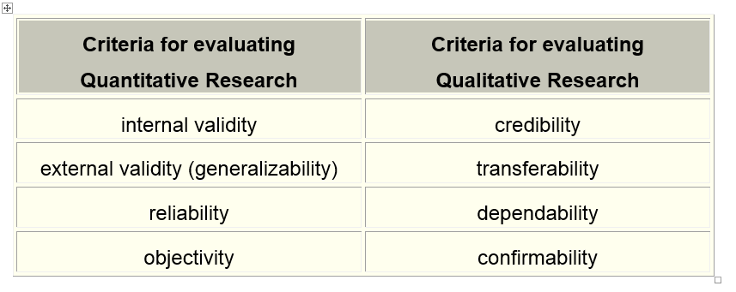
Differences between qual & quant
Question: if they mean the same things, why do we need two sets of terminology?

Slide 7
Common qualitative methods
Grounded theory
Ethnography
Narrative research
Phenomenological approach

Slide 8
Grounded Theory

Slide 9
Major ideas
Symbolic interactionism: Reality is negotiated between people, always changing, and constantly evolving.
Go beyond rich description to explanation.
Grounded the theory on data: Put aside preconception and let the concepts emerge from the data
“Return” to the ground: Like hypothesis testing; Test the theory by re-interviewing the subjects or interviewing new subjects
Interviews (more often) and observations
Good for studying a process, an action or an interaction involving many people.

Slide 10
Coding
Coding: Classify the data into categories (concepts, constructs)
Could have more than one coder: inter-coder reliability
Build a theory: (Causal pathway): A → B → C → D

Slide 11
Constant comparison
Category (concept) identification and theory generation should be an iterative process
This process will continue until the category is saturated (No additional insight can be uncovered with additional work).
In quantitative research the plan is fixed and fidelity of implementation (FOI) is important. In GT planning is not rigid.

Slide 12
Different versions of GT
Traditional version: Glaser’s version (1978) orients toward discovery of objective truths. Researchers should use more well-structured procedures.
Evolved version: Strauss and Corbin (1994) explicitly rejected the existence of a pre-existing reality that could be “discovered” (Mills, Bonner, & Francis, 2006a, 2006b).

Slide 13
Different versions of GT
Constructivist version: Charmaz (2000, 2002, 2014), and Charmaz and Mitchell (2001).
  Findings are constructed rather than discovered.
  Data are reconstructions of experience and they are not the experience itself
  Data as a product of co-construction between the interviewer and the interviewee.

Slide 14
Different versions of GT
Constructivist version:
  Data are the researcher’s own constructions of other people’s constructions.
  The constructivist school accepts participants as co-researchers.

Slide 15
Different versions of GT
Constructivist version: multiple layers!
Experience
in the memory
Participant’s
Interpretation
of his/her
experience
Researcher’s
interpretation
Reader’s
interpretation

Slide 16

What is reality?
Is reality up to our interpretation?
Can reality “evolve” over time?
Take relationship as an example
Honey Moon: “You are one in a million!”
Fine print: The divorce rate of the US is 53%.

Slide 17

What is reality?
30 years later you may retrospectively re-interpret what had happened.
“How could I marry such a…? Why was I do blind?”

Slide 18
Is it real?
You will see some pictures/statements
Decide whether it is real or not (It is up to you to define reality)
If you think it is real, go to the right side of the room.
If you think it is NOT real, go to the left side.
Explain why you think it is real or unreal.

Slide 19
The sky is blue (in a nice day as shown)

Slide 20
The sun is white in the morning and afternoon

Slide 21
The sun is red in the evening

Slide 22
The number “8” is visible

Slide 23
Wavelength spectrum

Slide 24
The wind is cool

Slide 25
A snake can see infrared

Slide 26
Some animals can hear ultrasound

Slide 27
The puzzle of Grounded theory
According to Charmaz, reality is nothing more than a social construction. Social constructionism is anti-realist i.e. there is no objective reality. Some critics charge that this position leads to relativism (all claims are valid in its own terms).
The finding yielded from grounded theory would not be communicable and generalizable.

Slide 28
The puzzle of Grounded theory
When grounded theorists deny the existence of objective reality, the “findings” by GT are highly subjective.
Psychology is supposed to be scientific and objective.
Is it possible to use grounded theory to produce a report that is meaningful to other people?
What is your view of reality?

Slide 29
References
Charmaz, K. (2000). Grounded theory: objectivist and constructionist methods. In N. K. Denzin & Y. S. Lincoln (Eds.), Handbook of qualitative research (pp.509–535). Thousand Oaks, CA: Sage Publications.
Charmaz, K. (2002). Qualitative interviewing and grounded theory analysis. In J. F. Gubrium & J. A. Holstein (Eds.), Handbook of interview research: Context and method (pp.675–694). Thousand Oaks, CA: Sage Publications.
Charmaz, K. (2014). Constructing grounded theory. Thousand Oaks, CA: Sage.

Slide 30
References
Charmaz, K. & Mitchell, R. G. (2001). An invitation to grounded theory in ethnography. In P. Atkinson, A. Coffey, S. Delamonte, J. Lofland, & L. H. Lofland (Eds.), Handbook of ethnography (pp.160–174). London: Sage Publications.
Clarke, A. (2005). Situational analysis: Grounded theory after the postmodern turn. London: Sage
Glaser, B. G. (1978). Theoretical sensitivity. Mill Valley, CA: Sociology Press.
Greckhamera, T., & Mirka, K. L. (2005). The erosion of a method: Examples from grounded theory. International Journal of Qualitative Studies in Education, 18, 729–750.

Slide 31
Summary
Use grounded theory if you want to extract concepts from textual data or/and to develop a causal theory or generate a new hypothesis..
Return to the ground until saturation
Different versions of grounded theory: Traditional, evolved, and social constructivism
Reality is a product of interaction and interpretation. Respect multiple perceptions of reality.

Slide 32
Ethnography

Slide 33
What is ethnography?
The researcher immerses himself/herself in a different culture; usually living there for a long period of time.
Different from case studies that focus on individuals; ethnography focuses on the society.
Often used by anthropologists, journalists, and cultural psychologists.

Slide 34

Red Star over China
Written by US Journalist Edgar Snow in 1937
In 1936 Snow spent several months in the Communist-controlled area of China.
Snow portrayed a very positive image of Mao Tse-tung and the Chinese Communist Party (CCP).
Today the validity of the book is questioned (staged?).

Slide 35
Red Star over China
It played a significant role in changing Americans’ opinion in favor of the Chinese Communist Party.
https://www.youtube.com/watch?v=h7X_4B2bMtc (1:17:45)
Many readers got the impression that CCP was an agrarian reformer, not the puppet of the Soviet Union, and thus the US government did not believe that CCP would side with the USSR.

Slide 36
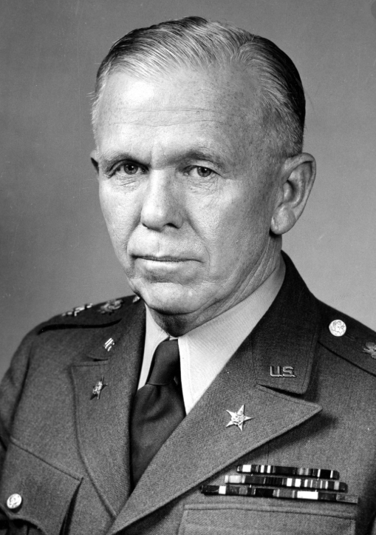
Red Star over China
At last President Truman stopped supporting the Chinese Nationalist government led by Chiang Kai Shek after World War II.
After WWII, Chinese Nationalists and CCP resumed the civil war.
At first the Nationalist troop got an upper hand. In 1946 the Nationalists decisively defeated the Red Army in Northeast China.
At the moment of victory, the Nationalist troop stopped advancing due to the pressure from USA (General Marshall).

Slide 37
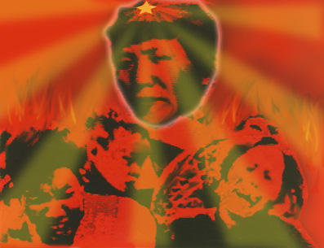
Red Star over China
USSR rearmed CCP.
CCP took over mainland China in 1949
Between 1949 and 1979 about 80 million Chinese people died of non-natural causes (Anti-right movement, Great Leap Forward, Great Cultural Revolution…etc.)

Slide 38
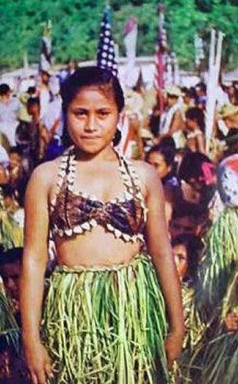
Coming age of Samoa
Margaret Mead (1928): Coming age of Samoa
Samoan youths were allowed to enjoy sexual adventures.
They were less affected by sexual neuroses than their Western peers.
Not even a single case of rape was reported, perhaps due to open access to sex.

Slide 39
Implications
Mead (1966) proposed a two-step plan for single adults
  First step: trial marriage
  Second step: determine to withdraw or continue
Cadwallader (1966): cohabiting free couples from feeling trapped for life.
Provide support for sex revolution in the 1960s.

Slide 40
Criticism
Freeman (1983), who is fluent in the Samoan language, challenged Mead’s findings.
His counter-arguments are based on six years of fieldwork in Samoa and extensive research of archives spanning across 40 years.
Mead was unable to speak the native language and thus her account of the Samoan culture relied on interpreters, resulting in many inaccuracies.

Slide 41
Criticism
Freeman traced the source used by Mead and found that either some Samoans didn’t tell the truth or Mead misunderstood their humor.
When those girls told Mead that they flirted with boys at night for fun, it was meant to be a joke, but Mead took it seriously.

Slide 42
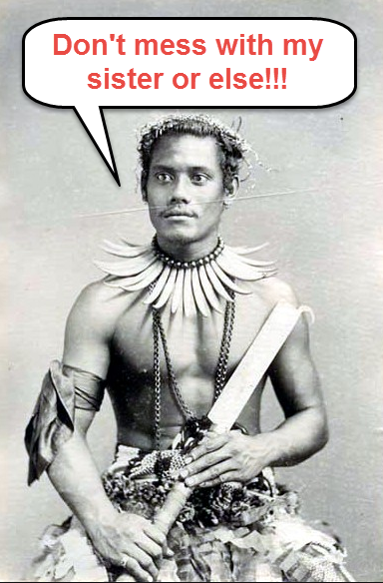
Criticism
In contrast to Mead’s claim that virginity didn’t matter in Samoa, it was found that female virgins were highly valued in the island.
Brothers of virgin girls devoted efforts to protect their sisters’ chastity.

Slide 43
Criticism
It was untrue that open sex eradicated sexual assaults.
According to the police records, the rate of sex crime was 60 per 100,000 in West Samoa while during the same period of time this rate in America was 30 per 100,000

Slide 44
Criticism
Margaret Mead and Samoa (1988):
https://www.youtube.com/watch?v=GOCYhmnx6o8
From start to 10:30
37:00 to 46:00

Slide 45
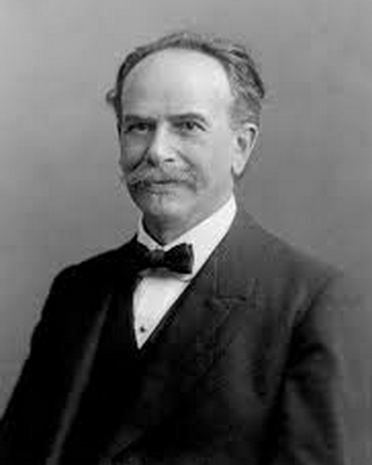
Preconception
1920s debate on nature vs. nurture: scholars argue about whether human conception and behaviors are shaped by fixed human nature or malleable cultural factors.
Mead’s dissertation advisor, Franz Boas, believe in the nurture theory and thus he instructed Mead to find a culture that can prove his position

Slide 46

Mangaia of Polynesia
Around the age of 13 or 14, boys are given instruction of how to sexually please a girl.
Two weeks later the boy has sex with an older, experienced woman in order to fine-tune his skill.

Slide 47

Mangaia of Polynesia
Girls, also at the age of 13 or 14, are taught by older women on how to get multiple orgasm. Next, girls practiced with men.
In this island people have many sexual experiences before marriage

Slide 48
Assignment
Ethnographic studies that support sexual diversity does not end after Freeman’s criticism against Mead. Similar studies are still prevalent (e.g. Mangaia). Form a group of 3-4 people to discuss the following:
  How can you evaluate the credibility and implications of these studies?
  How can researchers avoid preconception and bias?
  Post a short report on Canvas

Slide 49
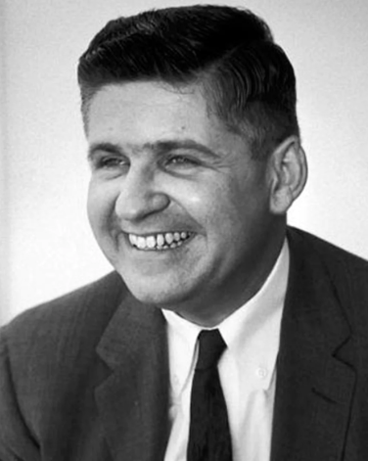
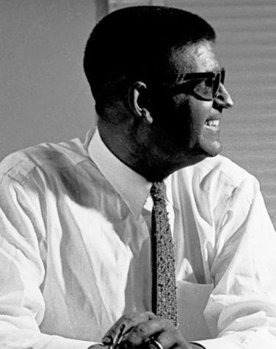
Successful example
In 1950 a white man named John Howard Griffin asked his doctor to turn his skin color black.
He submerged himself into the Deep South as a black man to study racism.
He authored a book “Black like me”

Slide 50
Successful example
Griffin wanted to test the claim that although the southern US was segregated it was peaceful and just (so-called separate but equal).
It was not true.
Main point: Blend in, don’t let people be aware that you are different.

Slide 51
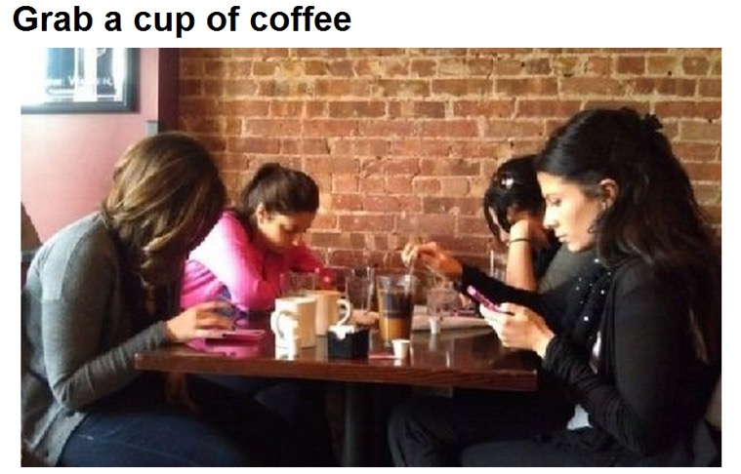
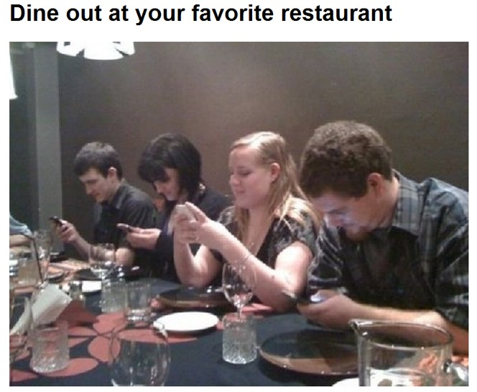
Is it really happening?

Slide 52
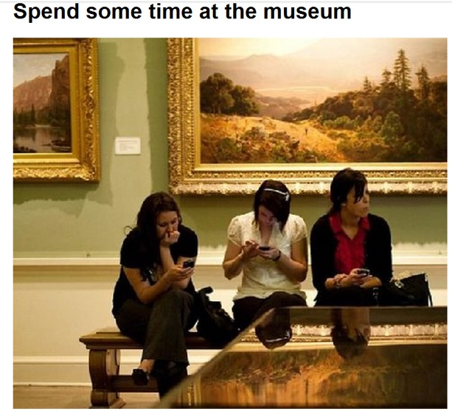
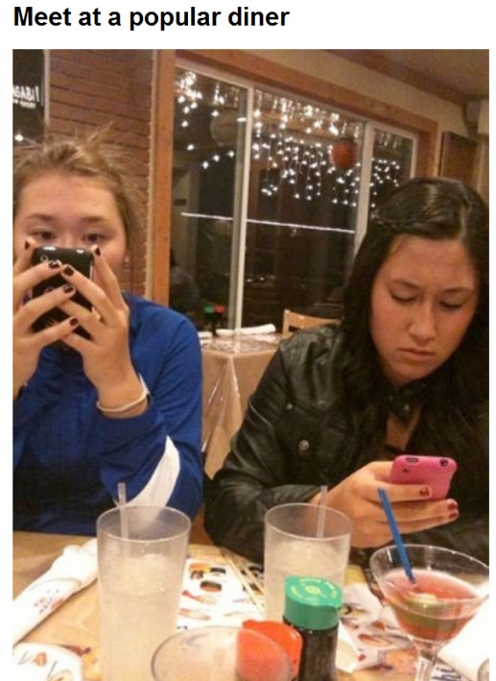
Is it really happening?

Slide 53
Field study Assignment
(Quasi-ethnography)
Form a small group of 2-3 people. Go to a crowded place (e.g. café, restaurants…etc.). If the setting is situated in a foreign culture (e.g. Korean town, China town), it will be great. If not, it is fine, too.
In each place, spend at least 20 minutes to observe how digital devices, including laptops, Kindles, iPads, smart phones, MP3 players…etc., affect people’s interactions.
Each person will do the observation independently. Compare the notes later. After finishing the field observation, post a brief report on Canvas and give a brief verbal report in class

Slide 54
Field study Assignment
(Quasi-ethnography)
Do people talk to each other or look at their device all the time?
If they talk to each other, how often are they interrupted by phone calls or texting?
Are there any systematic patterns? E.g. Do males ignore their friends more often than females? How about race, age, and other factors?
Blend in: Do not let people be aware that you are observing them, otherwise they may change their behaviors. Move your eyes away from them once a while and you have to act “naturally” (e.g. talk to each other in your group) to avoid their suspicion.

Slide 55
Summary
Use the immersion approach (ethnography) if you want to study a different culture or a community that you are not familiar with.
Get first-hand experience. But if you go there with preconception, your report may not be any better than a paper based on second-hand data.
Use counter-measures: learn the language, blend in or hide your intention, go there with a diverse team, triangulation (check multiple sources), self-disclosure before the interview and in the book…etc.

