Slide 1
Qualitative research design
Chong Ho Yu

Slide 2
Narrative research

Slide 3
Which one can move you?
A: “According to the Centers for Disease Control and Prevention (CDC), between 2001 and 2014, 440,095 people died by firearms in America.”
B: “Jane was a 23-year old college senior. She was accepted at Harvard Medical School and planned to join Doctors without Borders after graduation. But her dream was shattered when she got shot in the head during a mass shooting in a shopping mall.”

Slide 4
Story telling
Can be conducted in the modes of:
  Descriptive: What? Present the story of the victims as is.
  Explanatory: Why? Killers can get guns from gun shows and private owners with registration.
  Critical: What next? Social injustice
Very often focus on individuals, not the whole group.
Can gain a deep understanding of how and why things happen to an individual given the context.
Make sure to include relevant information only.

Slide 5
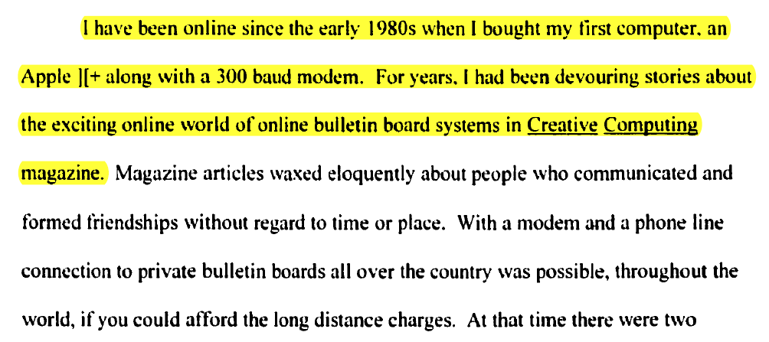
Example
Doctoral dissertation: The effects of trained moderation in online asynchronous distance learning

Slide 6
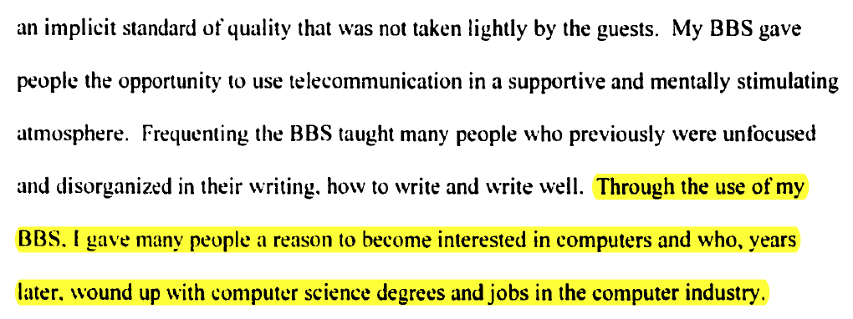
Example

Slide 7
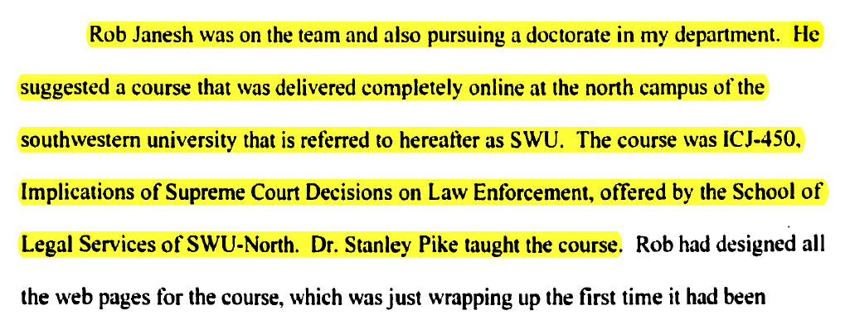
Example

Slide 8
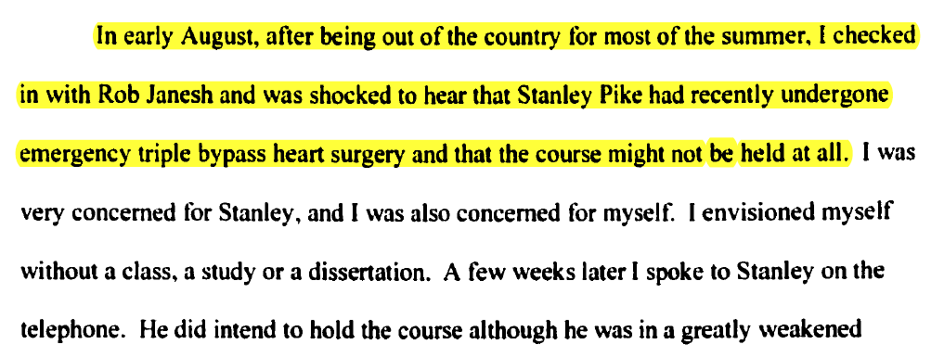
Example

Slide 9
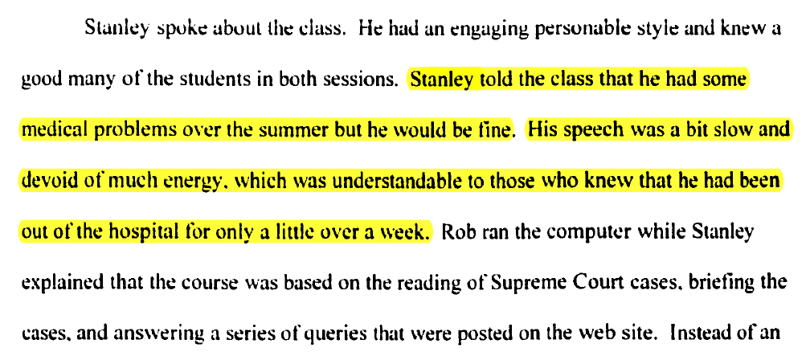
Example

Slide 10
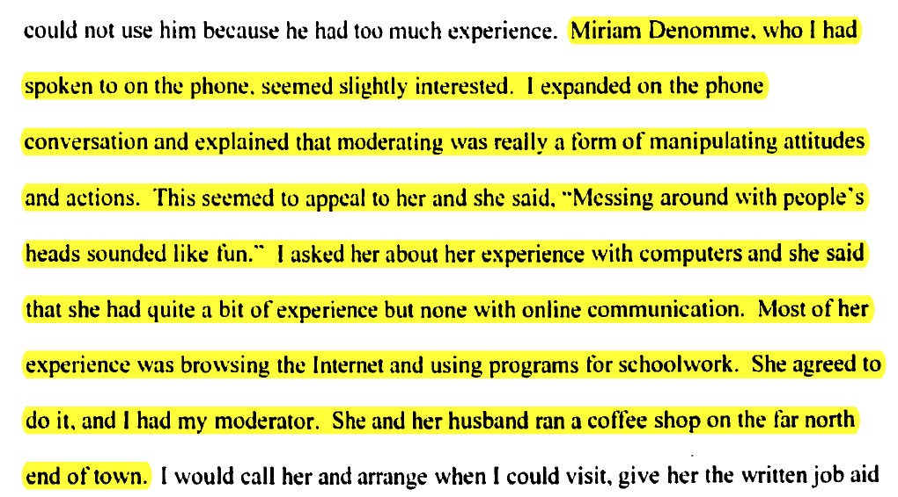
Example

Slide 11
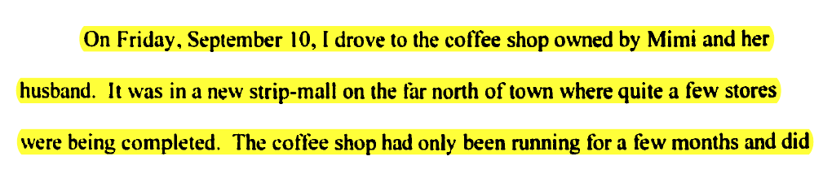
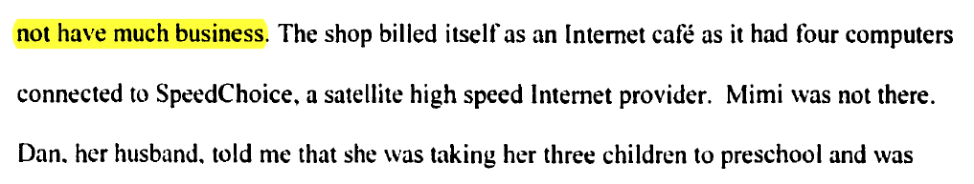
Example

Slide 12
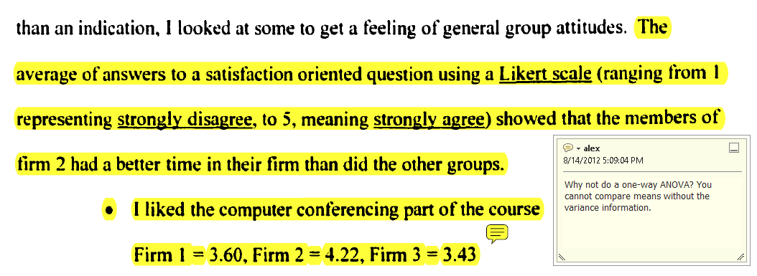
Example

Slide 13

38-Witnesses
A classic in social psychology
According to A. M. Rosenthal, on March 13, 1964 38 people in Queens, New York, watched a murderer stabbing a woman named Kitty Genovese to death in three separate attacks, but no one did anything to help.

Slide 14
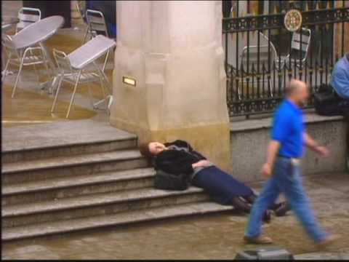
Bystander effect
The story of “38 witnesses” inspires social psychologists to study the bystander effect: The greater the number of people present, the less likely people are to help person in distress
https://www.youtube.com/watch?v=OSsPfbup0ac&t=4s

Slide 15

Bystander effect
It also inspires Philip Zimbardo’s the Heroic Imagination Project
https://www.youtube.com/watch?v=Y-2c5LZsscw

Slide 16

The story is inaccurate!
40 years later, Kitty’s brother investigated the story and found that the official account is nothing more than an urban legend.
https://www.youtube.com/watch?v=-8UV63AFtxM

Slide 17
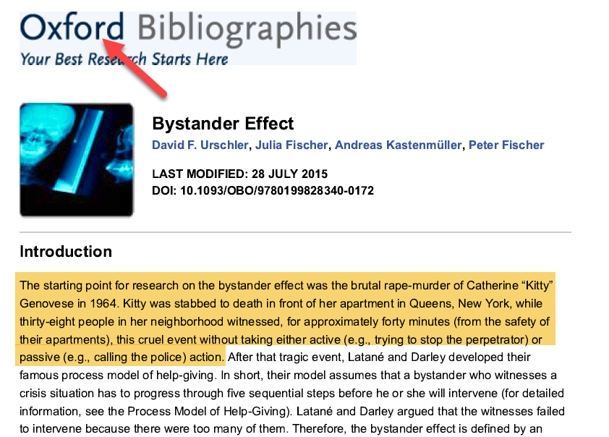
The urban legend continues…

Slide 18
What went wrong?
People living in big cities like New Yorkers experience alienation and loneliness.
The story of “38 witnesses” fits the narrative of alienation, and readers immediately accept the truthfulness of the story.
For 40 years no one has done any fact-checking.

Slide 19
Defense
There are two versions of “truth”: One is “truth” (facts) and the other is “Truth” (a higher level of reality).
The story of Kitty Genovese might not be highly accurate, but the bystander effect is true.
Nonetheless, this story inspires several noble movements in social psychology e.g. Heroic Imagination Project (HIP).

Slide 20
Defense
The bystander effect is one of most-cited effects in introductory psychology textbooks (Griggs & Proctor, 2002).
Without the story of “38 witnesses” today psychological studies could have been very different!
Griggs, R. A., & Proctor, D. L. (2002). A citation analysis of who’s who in introductory textbooks. Teaching of Psychology, 29, 203–206.

Slide 21

Defense
Recent example: June 2018 Time Magazine.
But the crying kid on the cover was not separated from her mother under the zero-tolerance policy.
It is not factually true.

Slide 22
Defense
Time stood by the decision to use this controversial photo in spite of being accused of spreading fakes news.
There is a higher Truth: indeed at least 2,300 children were separated from their families.
‘

Slide 23
In-class activity
Some scholars argue that even though the story of 38 witnesses is not factual, this narrative inspires research in the bystander effect and Zimbardo’s HIP, resulting in saving many people in distress.
How would you evaluate the value of the book “38 witnesses” (good or bad)?
When a researcher writes a story, should he/she put the weight on facts (descriptive) or on inspiration (critical)?

Slide 24
Summary
Use a story-telling approach (narrative research) if your objective is to call for courses of action.
You can disclose your background information to let the readers be aware of your preferences and bias.
Be selective! Include relevant information only.
Although an emotional story tends to be more appealing, find a balance between description and inspiration.

Slide 25
Phenomenology or
Phenomenological Approach (PA)

Slide 26
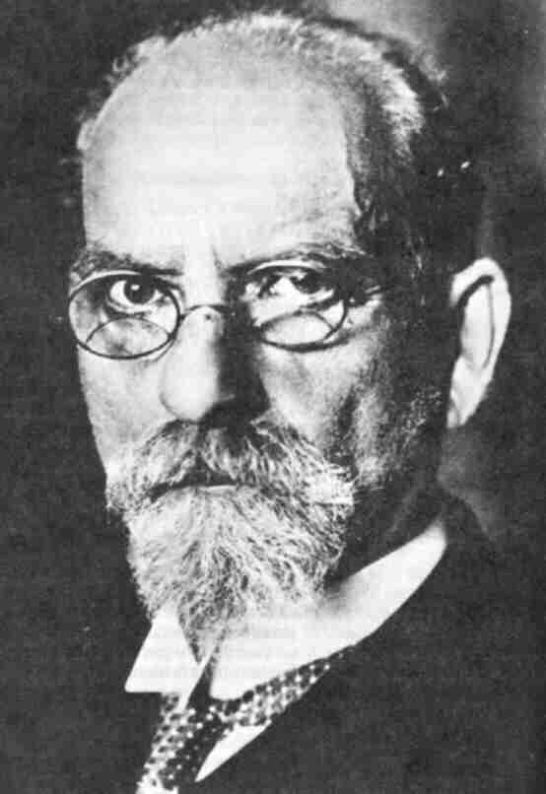
Edmund Husserl
Attempt to resolve the conflict between human sciences (e.g. psychology) and the basic sciences (e.g. physics).
Phenomenon: the world of complex experience could not be explained by examining causal relationships, but instead need to be studied AS IS.

Slide 27
Edmund Husserl
Experience must be described in a naïve way and cannot studied by statistical methods
Use reduction to assist in exploring the meaning of a person’s experience.
Moustakas expands Husserl’s ideas to transcendental phenomenology.

Slide 28

Lived experience
“Lived” suggests everyday experiencing, which is pre-reflective. That means that the phenomenon for the research study must be something that people experience in their everyday lives BEFORE any reflection .
How does a person experience anger at that moment – not when one reflects on the experience afterwards?

Slide 29
Phenomenon : conscious experience
Do not focus on actual happenings (who said what in the class or an objective account of the facts) or “experiences” in terms of external objective occurrences.
A topic that appears in the external world but not in a person’s consciousness is NOT an appropriate subject matter for a phenomenological study.

Slide 30
Different version of PA
Moustakas:
  Member check: The participant is a co-researcher and we need to let the participant check the finding.
  Triangulation: we may need another researcher to triangulate (check) the findings.
Gigori: we don’t need objective check or triangulation for subjective experience

Slide 31

Epoche
To suspend
to keep steady or hold steady
In a study about religious experience, the researcher may have strong beliefs about what it is like to be spiritual. One of the subjects may say, “God talks to me every day and I know what God’s will is; I will be the chosen one to save the world.” The researcher may think that she is delusional, but he should suspend his judgment.

Slide 32
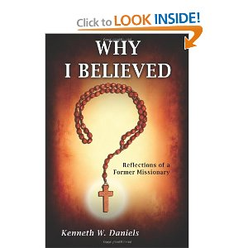


In another study related to religious experience, the interviewee may say, “I was a pastor, but in graduate school after going through rigorous intellectual examinations, I found that Christian faith is illusory. Now I am an atheist and I feel very good. I am intellectually honest.” Again, the interviewer should never pass any judgment. Instead, he or she must listen carefully in order to “enter” his world to understand his lived conversion experience from a Christian to an atheist.

Slide 33
“When you talk to God, you are religious. When God talks back, you are crazy!”
Put aside all judgment and preconception

Slide 34
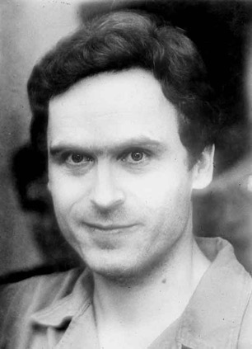
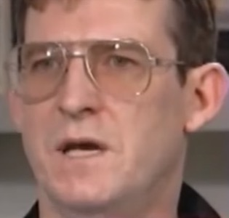
Disturbing and repulsive data
If you study psychopathy, criminal psychology, or terrorism, the interviewee (e.g. serial killer, serial rapist, suicide bomber) might tell you something very disgusting.
Warning: The content of the following video is very disturbing.
https://www.youtube.com/watch?v=fmQrnexYpLk

Slide 35
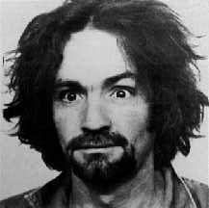
Disturbing and repulsive data
Charles Manson: “Remorse of what?”
https://www.youtube.com/watch?v=y2Eu_fUjNig
Your natural response might be stop listening or passing your moral judgment.
You should show a poker face and keep listening.

Slide 36
Do we really understand?
Are serial killers or psychopaths “crazy”?
Can they feel people’s pain or are they apathetic?
Is there a possibility of rehabilitation?

Slide 37

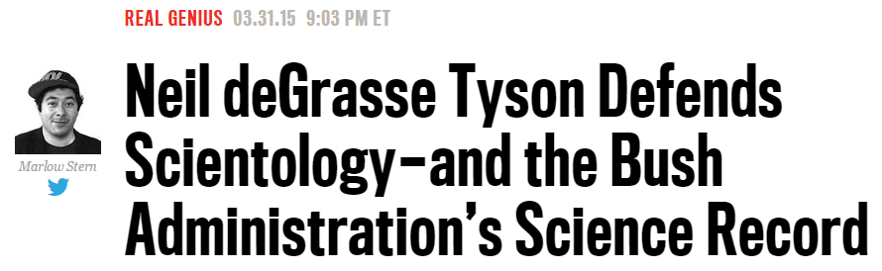
Easy to say but hard to do

Slide 38
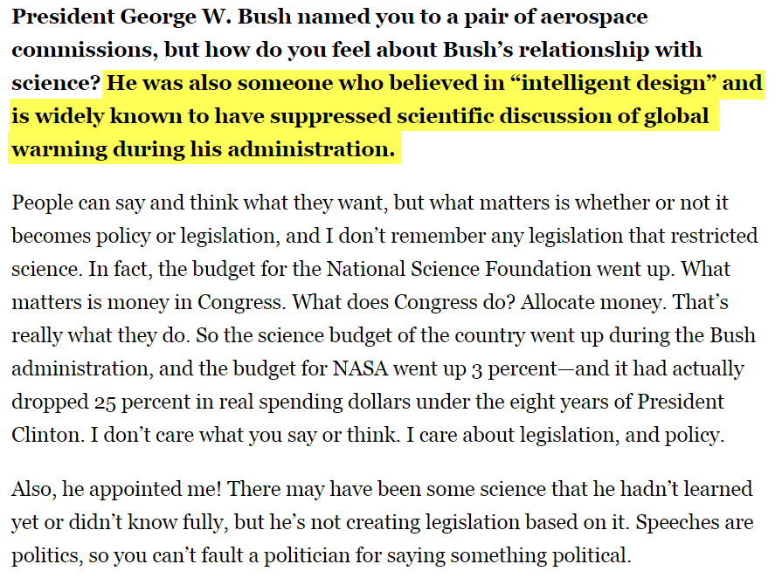

Slide 39
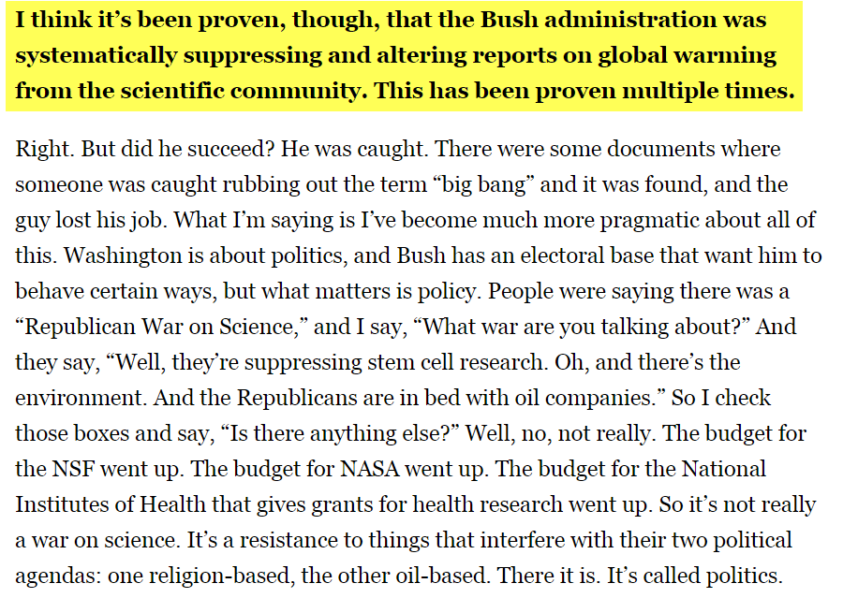

Slide 40
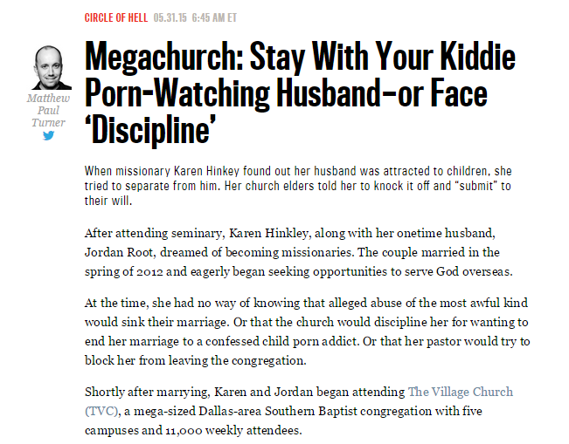
What are the research questions?

Slide 41
Complicated, deep, and paradoxical
You are a pastor or a theologian. You want to study this problem: People are hurt by the church that follows certain doctrines (e.g. “divorce is sinful”)
Will you obtain fruitful information by asking Karen: “Using a scale from 1 to 10, how hurtful is your experience”?

Slide 42
Complicated, deep, and paradoxical
Karen used to be a role model (a missionary), but now…
  How would Karen relate to God?
  How would Karen relate to the Church?
  How would Karen relate to herself? …etc.
The researcher needs to understand her pre-reflective feeling now, not a year later (People re-interpreted the past based on our current knowledge and situation).

Slide 43
In-class activity (Epoche)
Pair with a partner and interview each other. The interviewee pretends to be someone that holds a view opposite to the interviewer’s position (e.g. does not believe in climate change, pro-life, pro-choice…etc.) or someone has an unusual personality type (e.g. gangster, psycho-killer, terrorist…etc.).
Afterwards, post a report to describe your experience as an interviewer and an interviewee.

Slide 44
Summary
Use the phenomenological approach (PA) if you want to understand certain complicated experiences that may not be fully captured by numeric data.
Unlike grounded theory, the target in PA is pre-reflective and pre-interpreted experience.
Different versions: Moustakas and Giorgi
Suspend your judgment and report it as is.

