Slide 1
Qualitative Research Guide
Chong Ho Yu
Research Methods
362

Slide 2
Components
Introduction
  Research Problem
  Research purpose
  Research question
  Hypothesis (if there is any)
  Guiding theory
Literature review (Background information)
Method
  Research design
  Population and sample
  Instrument for data collection
  Data analysis
Results
  Findings
Conclusion
References

Slide 3
Problem and Purpose
What is the overall objective of this study?
Example: According to “You lost me” written by David Kinnaman, 59% of young people who were raised in a Christian family lost their faith by the age of 30. This qualitative study aims to understand why they gave up their belief.
Descriptive ad exploratory?
Critical?
Explanatory?

Slide 4
Research question
The RQ could be about what (descriptive), or how and why (explanatory and critical).
Examples:
  Grounded theory: What are the concepts and constructs related to this phenomenon? What is the plausible theory to explain this phenomenon?
  Ethnography: What is the social and cultural context of deconversion?
  Narrative research: What are the stories of deconverted Christians in a holistic context?
  Phenomenology: What is the lived experience of deconverted Christians?

Slide 5
No hypothesis or guiding theory
Qualitative research is exploratory in nature.
There is no hypothesis.
Data-driven, not theory driven: Let the data speak for themselves. You don’t need a guiding theory beforehand.

Slide 6

Literature review
You still need prior research related to this topic.
Provide background information that can help the readers understand the issue.

Slide 7
Literature review
References should be reliable sources (e.g. scholarly books, professional journals…etc.).
Introductory textbooks/books, newspaper reports, magazine articles, and websites that are not affiliated with authoritative organizations can only be cited with caution.

Slide 8
Research design
What is the research design? What is the rationale? Why is it a good fit to the RQ?
Make sure to state which version, if there are variants.
Examples:
  Grounded theory:
  Phenomenology:
Traditional?
Evolved?
Constructivist?
Moustakas?
Gogori?

Slide 9
Sampling
Usually qualitative researchers do not use quantitative sampling methods, such as random sampling and multi-stage sampling
Purposeful sampling: Selects participants that meet specific criteria e.g. age, gender, race, SES. culture, experience.
Example: qualified participants are those who are raised in a Christian family and decided to give up the Christian faith by the age of 30.

Slide 10
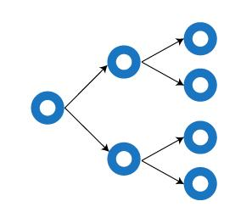

Sampling
Snowball sampling
Recruit more subjects from among their acquaintances.
Social networking
I interviewed A and then asked A, “Do you know any friend that fits into the profile and may be willing to participate in my project?”
Grow like a rolling snowball

Slide 11
Sample size
Sometimes there is no pre-determined sample size.
Sampling is done until redundancy in data is reached (saturation): additional data cannot add more insight into the research project.
Vertical (how deep), not horizontal (how wide): How big the sample size is less important when you intend to understand the dynamic of the phenomenon instead of generalizing the result to a broader population.

Slide 12


Data collection
Observation in the field (e.g. Attend skeptics Society, Atheist Alliance, Secular Coalition…etc.)

Slide 13

Data collection
Interview
  Structured interview
  Semi-structured interview
Focus group
Document review e.g. Media reports (TV shows, newspapers, books, magazines, journals, websites, such as Facebook, YouTube, blogs, online forums…etc.)

Slide 14
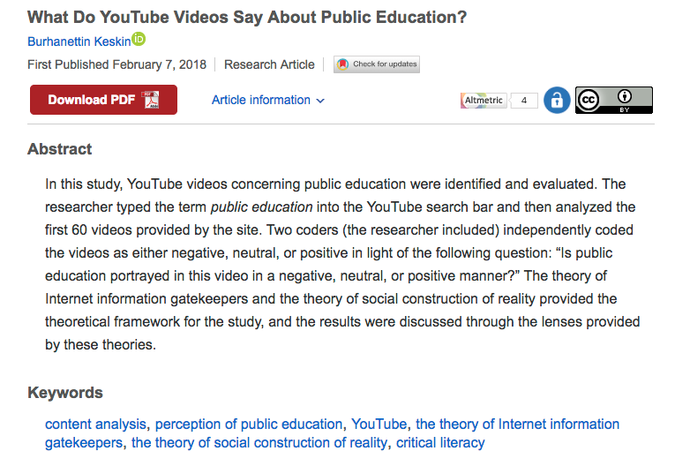

Slide 15
Design: Criteria
Theoretical significance?
  Would a meaningful and insightful picture of the phenomena under study emerge?
  Avoid “so what” or “now what” conclusion
Did you do anything to limit or avoid bias?
  Disclose your background information in the report (Ethnography and narration)
  Put aside preconception (Grounded theory), Suspend judgment (Phenomenology)
  Member check (Phenomenology)
  Blend in or hide your intention
  Use a research team

Slide 16

Criteria
Credibility
  Can the data and data analysis support the conclusion?
  Is there any researcher triangulation (more than one researcher code and/or interpret the data)? Data triangulation? Method triangulation?
  Transferability: similar to generalizability (less important)
  Dependability: Consistency between the data and the findings (similar to reliability in quantitative research)
  Confirmability: e.g. return to the ground while using grounded theory

Slide 17
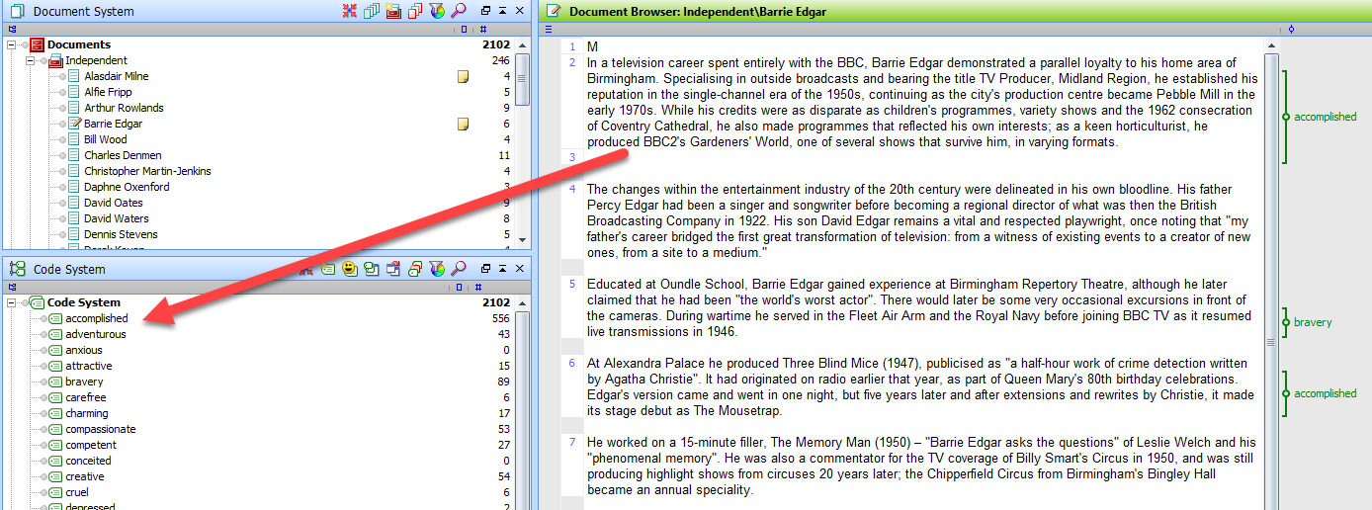
Data analysis
Select data to write the story (narrative research)
Coding (grounded theory)

Slide 18
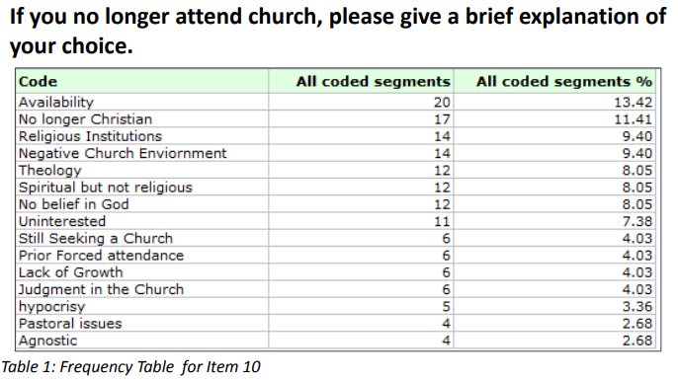
Results
Example of coding results

Slide 19
Results
Cite direct quotations to illustrate the concept e.g.
“Christians are too full of hate. They fight against so many things, abortions, gay marriage. They say those are sins becaue they are in the Bible and yet they ignore other things in the Bible, like stoning a woman if she marries without being a virgin or not wearing mixed cloth.”
If there is any typo (“becaue”), leave it as is”

Slide 20
Conclusion
Should not include new information.
Concisely summarize the finding and the thesis statement.
Suggest a course of action or further research.

Slide 21
Conclusion (Example)
Using qualitative research methods, the research team was able to gather a broader and deeper understanding of this phenomenon as a panel coded the responses of participants regarding their deconversion from the church. Common themes of discontent were found from coding, including, judgement, the prosperity gospel, narrow-mindedness and misinterpretation. This is consistent with other research that young members of the church are interested in trust and salinification (Waters, 2012). While steps in order to change the environment of the church are complex and difficult, the end goal should be one of love and acceptance.

Slide 22
References
Follow the APA style.
Re: the checklist attached to the end of the syllabus.
Writing center: http://apu.edu/writingcenter/resources

