Slide 1
Quantitative research design Guide
Chong Ho Yu
Department of Psychology, APU
362: Research Method

Slide 2
Components
Introduction
  Research Problem
  Research purpose
  Research question
  Hypothesis (if there is any)
  Guiding theory
Literature review (Background information)
Method
  Research design
  Population and sample
  Instrument for data collection
  Data analysis
Results
  Findings
Conclusion
References

Slide 3
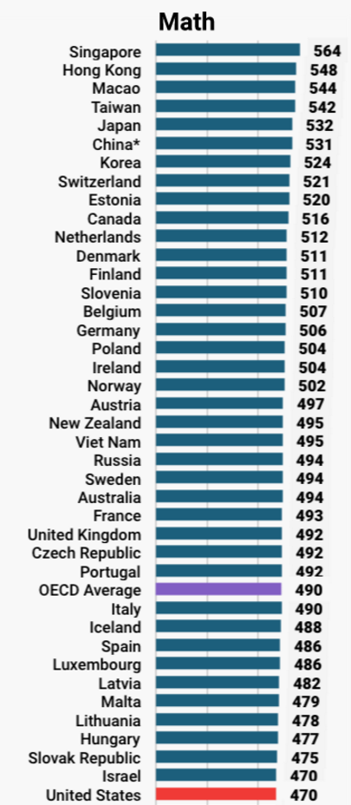
Research problem
An issue that is significant enough to require our attention.
Example:
  International assessments, such as Program for International Student Assessment (PISA) and Trends for International Math and Science Study (TIMSS), indicate that American students are far behind our international peers in math & science test performance.

Slide 4

Research problem
What you are interested in may not be an issue to others.

Slide 5

Research problem
What you are interested in may not be an issue to others.

Slide 6

Research purpose
What do you want to accomplish? What is the rationale of doing so?
This is not a reason: “There is a gap in the literature. No one has done it before.” Perhaps no one has done it before because it is not important.
  Example: Identify an effective treatment program to improve student learning in math and science.

Slide 7



Research question
A testable question
  Example: Can visualization of mathematical and scientific concepts improve comprehension of math and science, as measured by objective tests?
A non-testable question
  Example: How can cosmic karma alter our fate?

Slide 8
Theoretical framework
In program evaluation the question is about whether the treatment works or not.
In academic research the researcher needs to go one step further: How and why? What is the theory behind the observed effect?
  Example: Cognitive psychology indicates that humans absorb information via multiple channels. Information encoded in text, number, and graph can reinforce comprehension and retention.
Guiding theory and lit review can be put together.

Slide 9
Hypothesis
Testable null and alternative hypotheses (if needed)
Example:
  Null: There is no significant difference between learners who use visualization tutorials and those who don't in understanding math and science, as measured by objective tests.
  Alternate: There is a significant difference between learners who use visualization tutorials and those who don't in understanding math and science, as measured by objective tests.

Slide 10

Literature review
Prior research related to this topic.
Background information that can help the readers understand the issue.
References should be reliable sources (e.g. scholarly books, professional journals…etc.).
Introductory textbooks/books, magazine articles, and websites that are not affiliated with authoritative organizations can only be cited with caution.

Slide 11
Methodology: Research design
What are the dependent variable and independent variable?
  Example: DV – Test score; IV –Type of tutorials
What is the research design and the rationale?
  Example: This is a pre- and post-test between-subject design. Subjects will be randomly assigned into two groups. One group will use visualization tutorials to learn vector geometry and the other will use conventional textbooks and lectures. A pretest will be used as a baseline (covariate) for adjusting the posttest performance.

Slide 12
Research design
What are the potential threats against the internal and external validity of this design? How can these threats be minimized?
Internal: History, drop out, Rosenthal effect…etc.
External: Generalization to other settings
Check the course PowerPoint slides

Slide 13
Population and sample
What is the target population to which your inference is made?
  Example: All American Grade 10 students.
What is the accessible population from which you will draw samples?
  Example: Grade 10 students in a local high school.
What is your sampling method?
  Example: Convenience sampling. I will go to several classes in Azusa High School to recruit subjects who are willing to participate in this study.

Slide 14
Sample size justification
How will you choose the alpha level, effect size, power level, and sample size? (Optional: do this if you learned power analysis in applied stat)
  Example: Given that the alpha level is .05, the effect size is .25, and the power level is .80, the desirable sample size should be 128.
If you use archival data, the sample size may be very big. You don’t need to justify the sample size.

Slide 15
Instrument
If you took Tests and assessments, you can discuss the psychometric properties of the test chosen for data collection.
Do not make up your own test or survey. Adopt a widely accepted test or survey that had been psychometrically validated.
Discuss the psychometric properties of the survey or the test adopted, such as reliability and validity (optional).

Slide 16
Data analysis
Report descriptive statistics e.g. mean, standard deviation, frequency…etc.
Inferential statistics e.g. Analysis of covariance (ANCOVA).
If you have big data (e.g. CCMH), report the pattern in the data. There is no need to run a traditional statistical test (e.g. t-test, ANOVA)

Slide 17
Results
Report the statistical results following the APA style e.g.
The sample was relatively young (M = 18.32, SD = 2.33).
There was a significant treatment effect, F(1, 128) = 6.44, p = .00125.

Slide 18
Conclusion
Summarize the findings. Do not introduce any new information.
Ask a further question that your work raises or to note areas where further research might be necessary

Slide 19
References
Follow the APA style.
Re: the checklist attached to the end of the syllabus.
Writing center: http://apu.edu/writingcenter/resources

