Slide 1

Perception
Our current perceptions are rooted in the past

Slide 2
Some Questions to Consider
Why can two different people experience different perceptions in response to the same stimulus?
How does perception depend on a person’s knowledge about characteristics of the environment?
How does the brain become tuned to respond best to things likely to appear in the environment?
How are perception represented in the brain?

Slide 3
Perception Is…
Experience resulting from stimulation of the senses
  http://www.michaelbach.de/ot/mot-adaptSpiral/index.html
  https://www.youtube.com/watch?v=26XYEFRn0GE
Basic concepts
  Perceptions can change based on added information
  Involves a process similar to reasoning or problem solving
  Perceptions occur in conjunction with actions

Slide 4
Approaches to Understand Perception
Direct perception theories
  Bottom-up processing
  Perception comes from stimuli in the environment
  Parts are identified and put together, and then recognition occurs
Constructive perception theories
  Top-down processing
  People actively construct perceptions using information based on expectations

Slide 5
The Complexity of Perception
Bottom-up processing
  Perception may start with the senses
  Incoming raw data: data-driven
  Energy registering on receptors
Top-down processing
  Perception may start with the brain: Conceptual data
  Person’s knowledge, experience: Expectation-driven
https://www.youtube.com/watch?v=TLHlfPTRekA

Slide 6
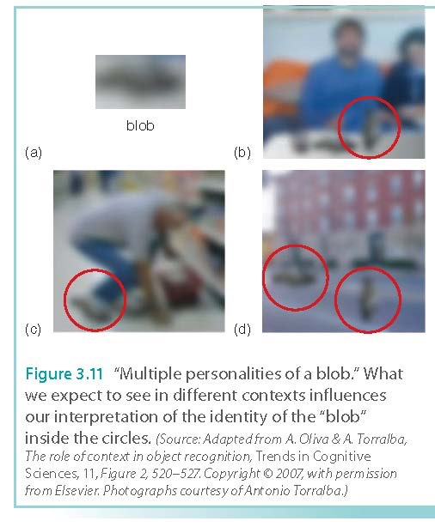
The Complexity of Perception

Slide 7
Why can’t you tickle yourself?

Slide 8
Why can’t you tickle yourself?
The feeling of being tickled causes us to go into a minor panic mode, which is a natural defense mechanism against creepy crawlers like insects.
When you tickle someone else, he or she cannot anticipate which part of the body will be touched. This “panic” generates uncontrollable laughter.
When you tickle yourself, you have the expectation: you know exactly which area of the body will be touched.
Your sensation is tied to your expectation!

Slide 9
Optional and Ungraded “experiment”
You can opt-out if you don’t feel comfortable about this informal “experiment”.
Find a same-gender partner.
Tell him or her which part of the body you will tickle him or her.
The person being tickled watches the movement of the hand of the tickler.
Did the person being tickle laugh? Why or why not?

Slide 10
Experiencing Pain
Direct Pathway model
  An early model that emphasized nociceptors that would send pain messages directly to the brain
  A bottom-up processing model
  More recent models have found that expectations, attention, and distraction (what my dentist did) can affect how we experience pain in a “top-down” manner
    The Placebo Effect
    Pain is “subjective”?
  https://www.youtube.com/watch?v=TFv-Zsi1bp0
  https://www.youtube.com/watch?v=V0wHMAfOGJs
  https://www.youtube.com/watch?v=2UeLZtQrW0U

Slide 11
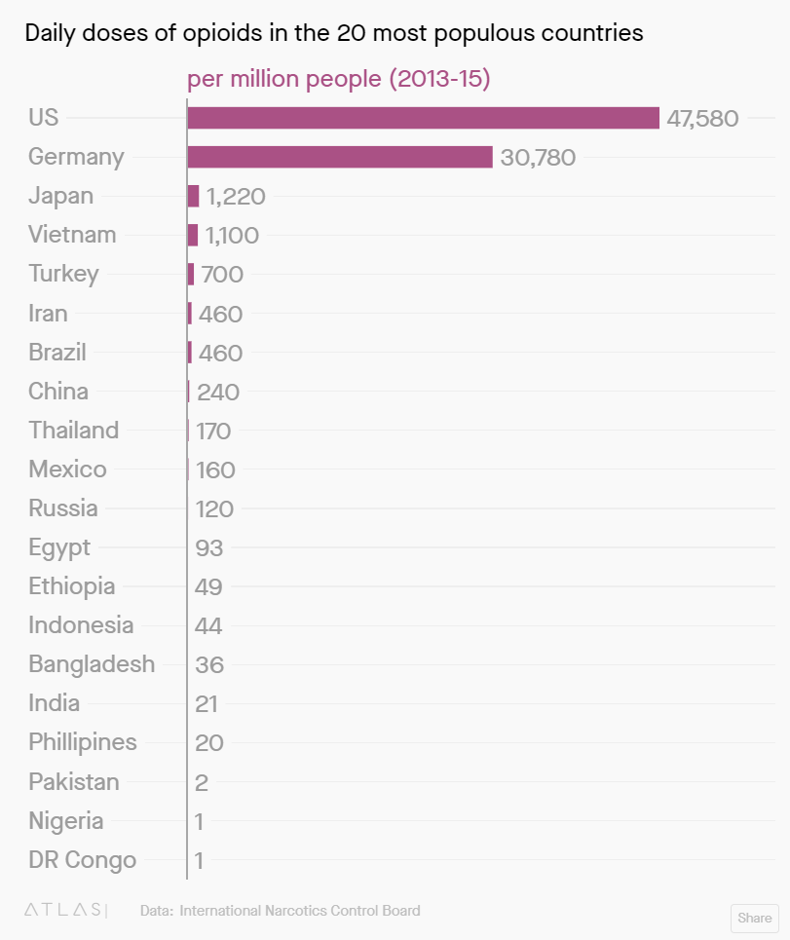
Opioid Epidemic in USA
Opioids are substances that can produce morphine-like effects for pain-killing and pleasure-seeking.
US is number 1 in terms of opioid consumption.
More than 50% higher than Germany
Why?

Slide 12
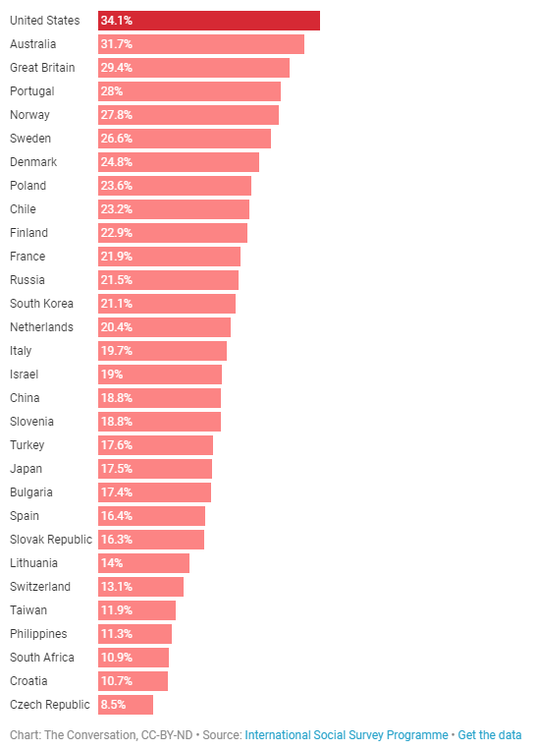
Perception of pain around the world
A survey showed that about 34% of Americans experienced bodily aches or pains "often" or "very often" during the past month.
Number 1 in the world

Slide 13
Discussion
USA is number 1 in both opioid consumption and perception of pain. Are they related? Why or why not?
https://qz.com/1198965/the-surprising-geography-of-opioid-use-around-the-world/
http://theconversation.com/what-the-us-can-learn-from-other-countries-in-dealing-with-pain-and-the-opioid-crisis-97491
Form a group of 3-5 to discuss: Can changing people’s perception of pain (endurance-training like martial arts and high-intensity exercises) be an effective way of countering the opioid epidemic? Why or why not?
Post your individual answer, not group paper, on Canvas (0.5 – 1.5 pages).

Slide 14
Helmholtz’s Theory Of
Unconscious Inference (~1860)
Top-down theory
Some of our perceptions are the result of unconscious assumptions we make about the environment.
We use our knowledge to inform our perceptions. We infer much of what we know about the world
Likelihood principle: we perceive the world in the way that is “most likely” based on our past experiences

Slide 15
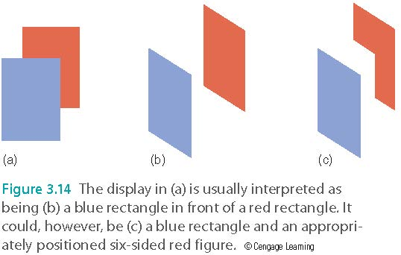
Helmholtz’s Theory Of
Unconscious Inference (~1860)
  https://www.youtube.com/watch?v=hCV2Ba5wrcs (Ames Room)

Slide 16
Perceiving Size:
Taking Distance into Account
Perceived size is a function of both bottom-up and top-down processing
Bottom-up processing
  the size of the image on the retina
Top-down processing
  the perceived distance of the object
  the size of the object relative to other objects in the environment

Slide 17
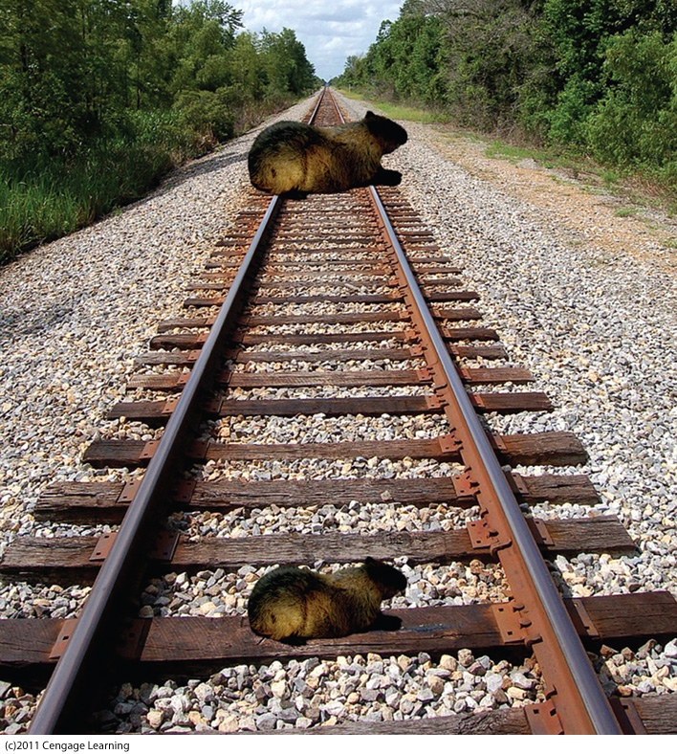

Slide 18
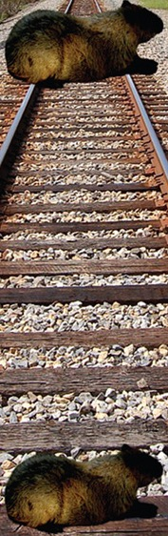

Slide 19
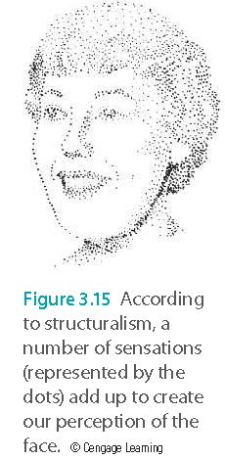
Perceptual Organization
“Old” view – structuralism
  Perception involves adding up sensations
“New” view – Gestalt psychologists
  The mind groups patterns according to laws of perceptual organization

Slide 20
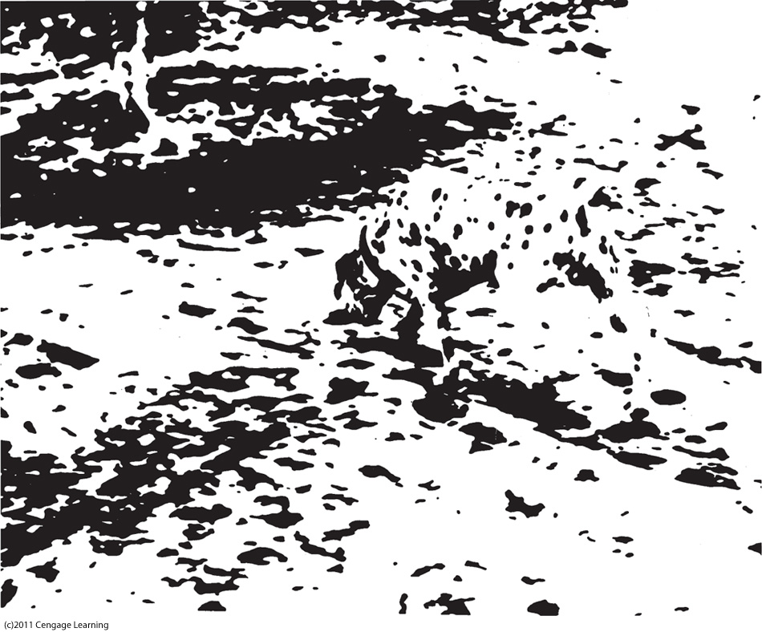

Slide 21
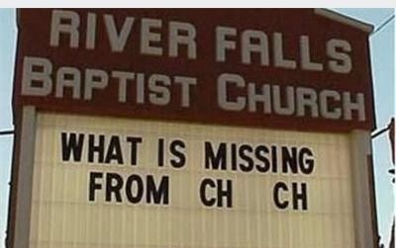
We are able to fill in missing information by the context and by expectation

Slide 22
Gestalt Laws of Perceptual Organization
Law of good continuation
  Lines tend to be seen as following the smoothest path

Slide 23
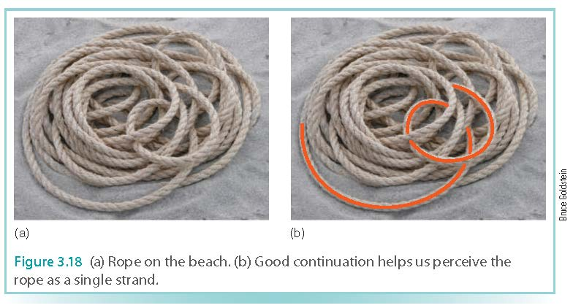
Gestalt Laws of Perceptual Organization
Law of good continuation
  Lines tend to be seen as following the smoothest path
http://www.michaelbach.de/ot/cog_letters-ink/index.html

Slide 24
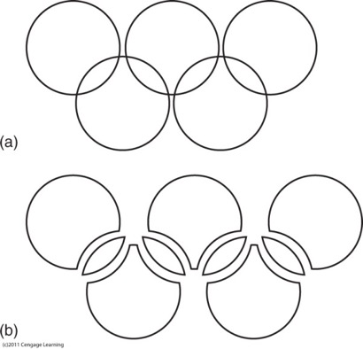
Gestalt Laws
Law of good figure (simplicity or prägnanz)
  Every stimulus pattern is seen so the resulting structure is as simple as possible
Caption: Law of simplicity. We see five circles, as in (a), not the more complex array of nine objects, as in (b).

Slide 25
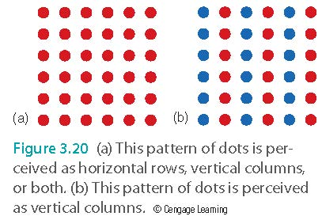
Gestalt Laws of Perceptual Organization
Law of similarity
  Similar things appear grouped together

Slide 26
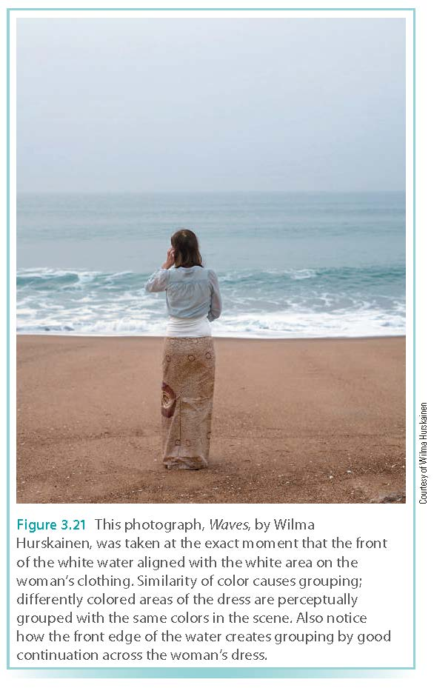
Gestalt Laws of Perceptual Organization

Slide 27
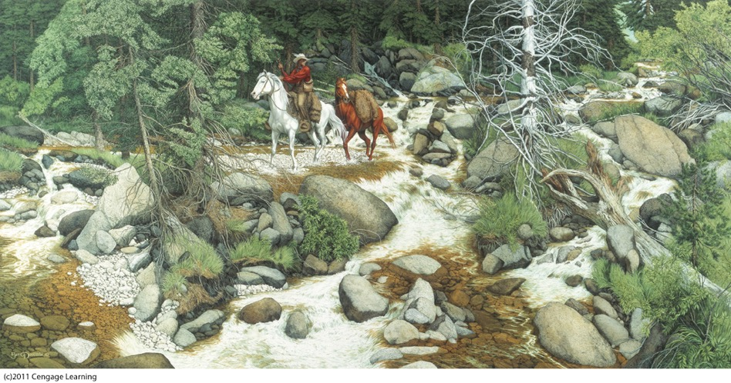
Gestalt Laws
Law of familiarity
  Things are more likely to form groups if the groups appear familiar or meaningful
Caption: The Forest Has Eyes by Bev Doolittle (1985). Can you find 13 faces in this picture? (Source: “The Forest Has Eyes” 1984 Bev Doolittle, courtesy of The Greenwich Workshop, Inc.)
Notes:
Hollow face maybe

Slide 28
We always see faces!

Slide 29
Gestalt Laws
Law of proximity
  Things near each other appear grouped together
Law of common fate
  Things moving in the same direction appear to be grouped together
  http://www.michaelbach.de/ot/cog_hiddenBird/index.html

Slide 30
Gestalt Laws
Gestalt laws often provide accurate information about properties of the environment
  Reflect experience
  Used unconsciously
  Occasionally misleading
Gestalt laws are heuristics (mental shortcuts)
We need mental shortcuts to function everyday!

Slide 31
Heuristics and Algorithms
Heuristic: “rule of thumb”
  Provides best-guess solution to a problem
  Fast
  Often correct
Algorithm: procedure guaranteed to solve a problem
  Slow
  Definite result

Slide 32
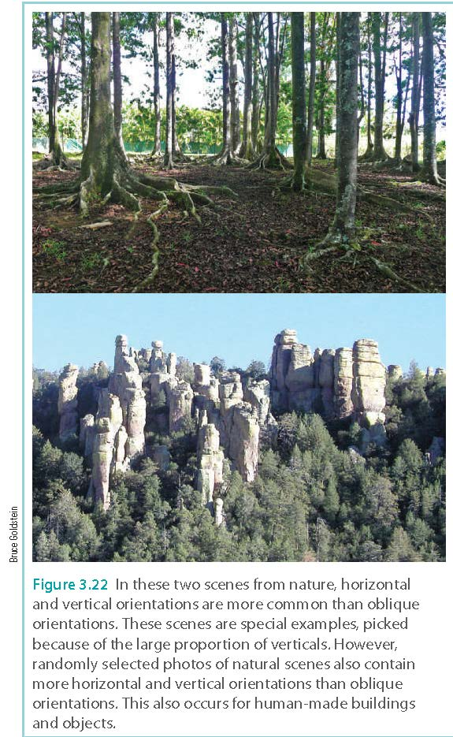
Physical Regularities
Oblique effect
  People can perceive verticals and horizontals more easily than other orientations

Slide 33
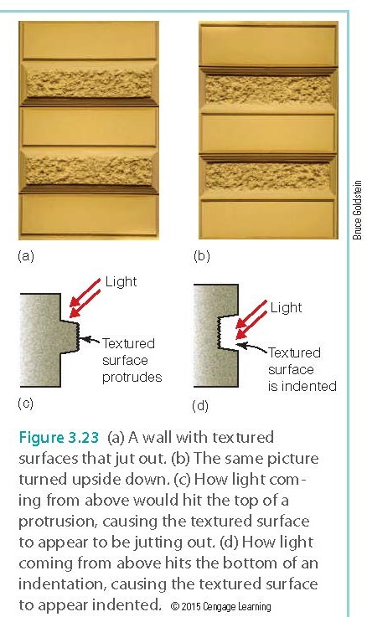
Physical Regularities
Light-from-above heuristic
  Light comes from above is common
  We perceive shadows as specific information about depth and distance

Slide 34
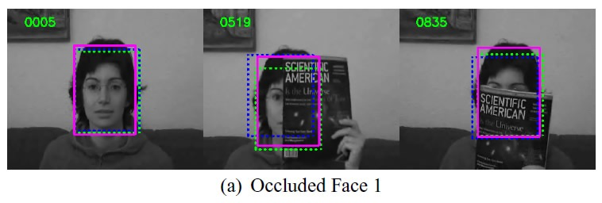
Physical Regularities
Occlusion heuristic
  When object is partially covered by a smaller occluding object, the larger one is seen as continuing behind the smaller object.

Slide 35
Physical Regularities
Occlusion heuristic
  Is this a pretty face?

Slide 36

Physical Regularities
Occlusion heuristic
  Half of the human body is obscured by the table. You assume you will see the other half later, right?
  https://www.youtube.com/watch?v=KmD1U6S60sQ

Slide 37
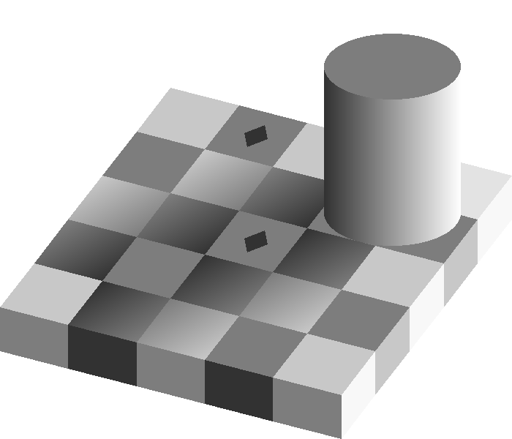
Physical Regularities
http://www.michaelbach.de/ot/fcs_hollow-face/index.html (Normal face)
https://www.youtube.com/watch?v=z9Sen1HTu5o (Shade Illusion)

Slide 38
Neurons and the Environment
Neurons become tuned to respond best to what we commonly experience or occur regularly in the environment
Experience-dependent plasticity.
We need to expose ourselves to new experience and new environment.

Slide 39
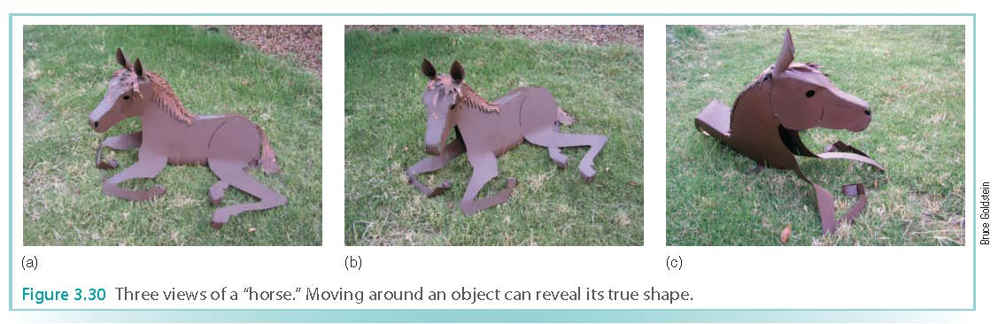
Movement Facilitates Perception
Movement helps us perceive things in our environment more accurately than static, still images
  For example, a horse in the distance standing still may be more difficult to discern than the horse walking across the field
  Walking around that same horse to see it from different angles will also facilitate accurate perception

Slide 40
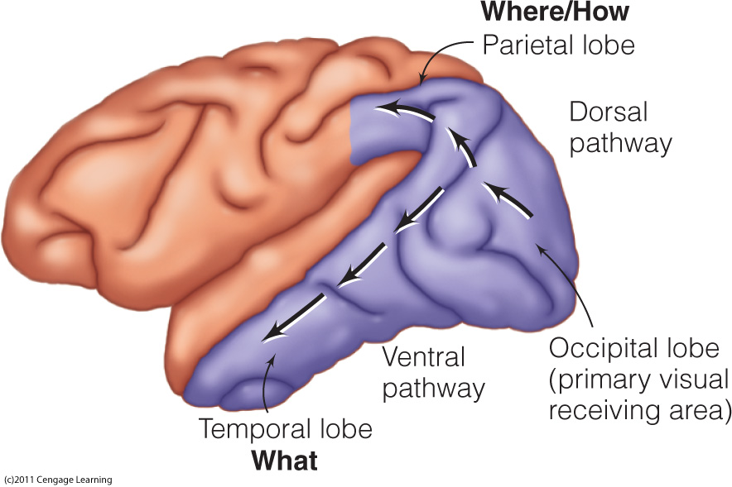
Perception and Action:
What and Where
What stream: identifying an object
Where stream: identifying the object’s location

Slide 41


Photoshop disasters: Against regularities and expectations

Slide 42

Photoshop disasters: Against regularities and expectations

Slide 43
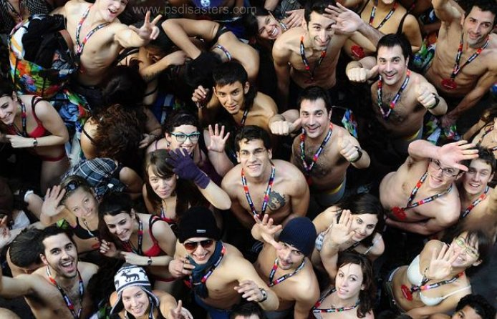
Photoshop disasters: Against regularities and expectations

Slide 44
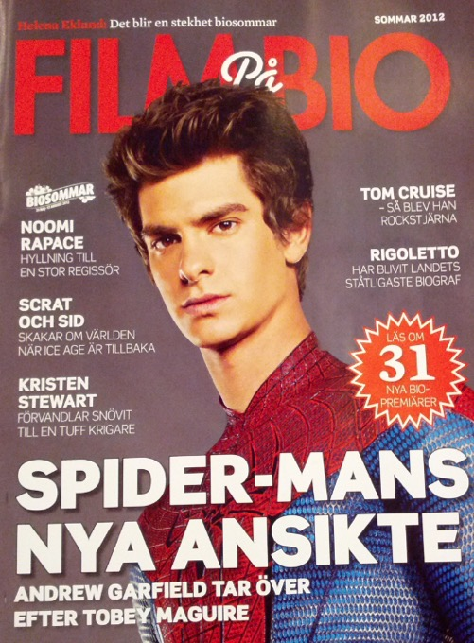
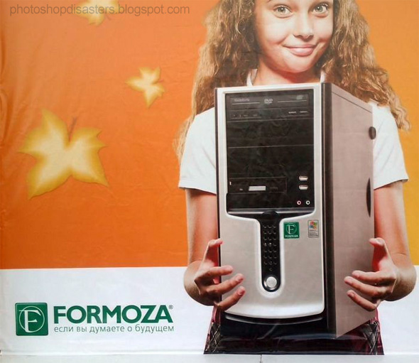
Photoshop disasters: Against regularities and expectations

Slide 45
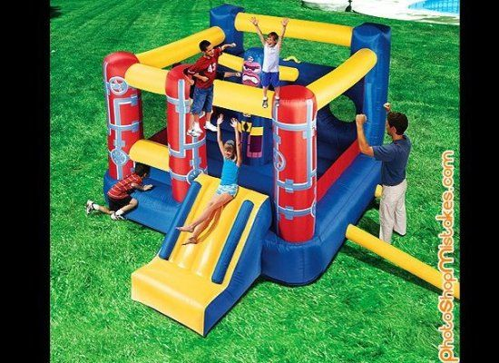
Photoshop disasters: Against regularities and expectations

Slide 46
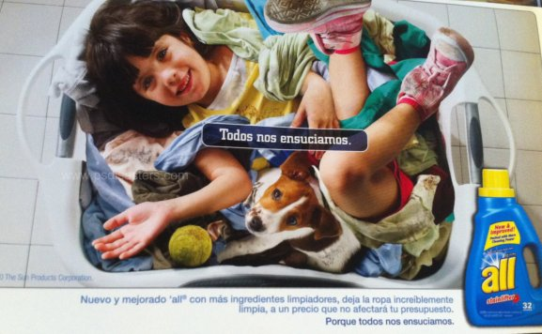

Slide 47
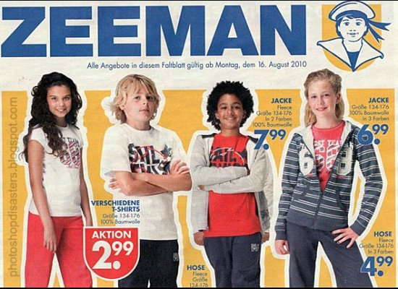
Photoshop disasters: Against regularities and expectations

Slide 48

Photoshop disasters: Against regularities and expectations

Slide 49
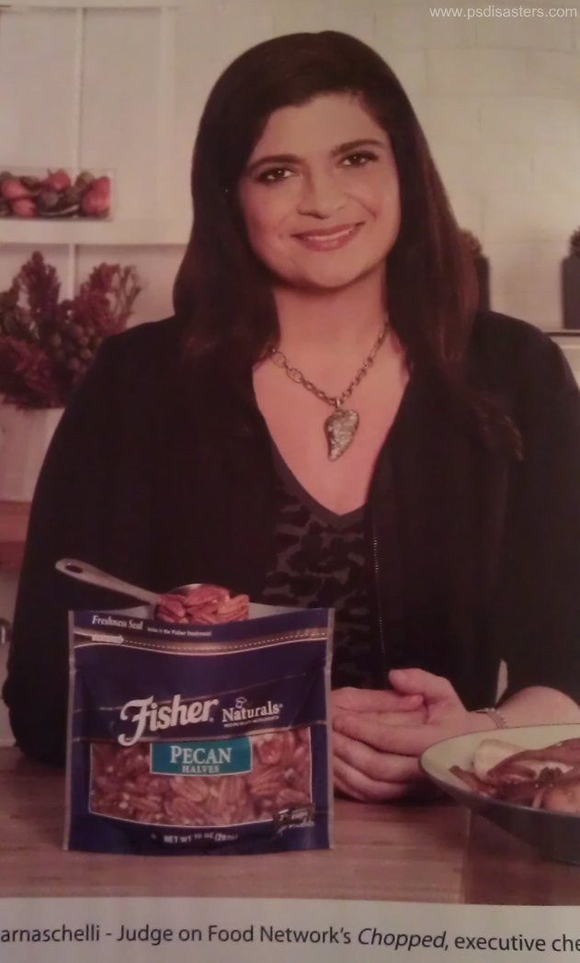
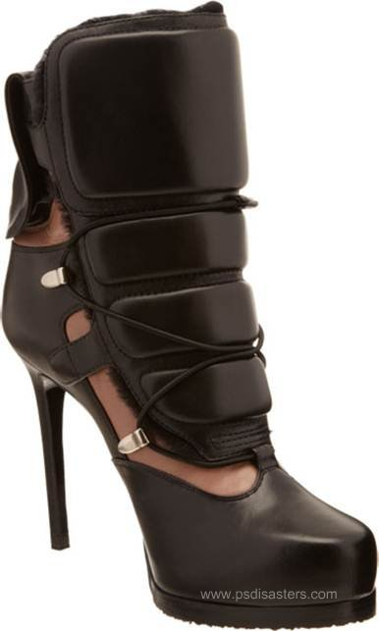

Slide 50

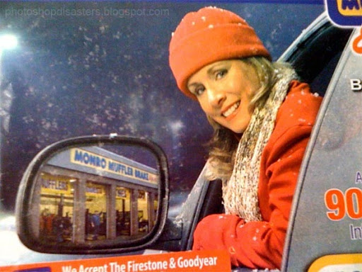

Slide 51

Photoshop disasters: Against regularities and expectations

Slide 52
Ungraded assignment
You need to understand psychology to be a good artist. A Photoshop disaster happens when the image cannot concur with our perceptual expectation.
Use the keyword “Photoshop disaster” or something similar to search for strange images.
Form a small group to share your finding and then vote for the worst.
Share your finding with the class.

Slide 53
Faith & Perception
How does Faith inform your perception?
We don’t see things as they are; we see them as we are.
-Anaïs Nin
In faith there is enough light for those who want to believe and enough shadows to blind those who don't.
-Blaise Pascal

