Slide 1
Long-Term Memory: Structure
Connecting then with now; so that the present is not an island.

Slide 2
Some Questions to Consider
How does damage to the brain affect the ability to remember what has happened in the past and the ability to form new memories of ongoing experiences?
How are memories of personal experiences, like what you did last summer, different from memories of facts, like the capital of your state?
How do the different types of memory interact in our everyday experience?
How can you better-encode information into your long term memory?
How has memory loss been depicted in popular films?

Slide 3
Long-Term Memory
“Permanent storage”: Like a library or a hard drive; “archive” of information about past events and knowledge learned
Works closely with working memory (RAM)
Storage stretches from a few moments ago to as far back as one can remember
More recent memories are more detailed

Slide 4
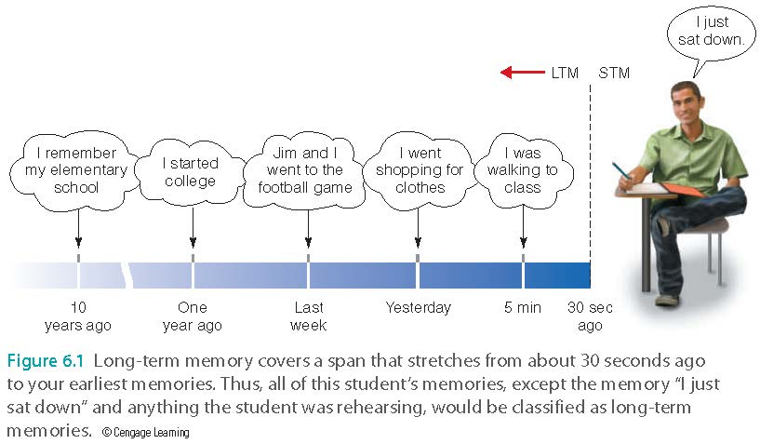
Long-Term Memory
Notes:
Things I remember. German exchange student name heather. Lauren Williams who I made cry.

Slide 5
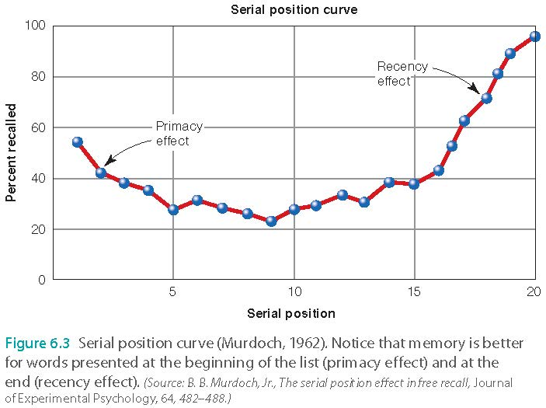
Serial Position
Murdoch (1962) studied the distinction between short-term and long-term memories using the serial position curve
Read stimulus list, write down all words remembered
Notes:
One major topic in memory research and how to design studies to make distinctions between memory systems.

Slide 6
Serial Position Curve
Memory better for stimuli presented at the beginning
Primacy effect gave more time to rehearse info, more likely to enter LTM

Slide 7
Serial Position Curve
Memory better for stimuli presented at end of list
  Recency effect
  Stimuli still in STM (holds it for 15-20 seconds)
  It is readily accessible for you to rehearse it to make it stick.

Slide 8
Application
What are the implications and applications of the primacy and recency effects?
How is the following movie clip related to theory of memory?
https://www.youtube.com/watch?v=FWrecLbn4KE (2:30)

Slide 9
Application
Primacy effect: James Bond movie
In the past most movies started with rolling the boring credit.
Since the 1960s, the beginning of all James Bond movies has been packed with actions and special effects.
The audience is very impressed.

Slide 10
Application
The same strategy is used by Steven Spielberg in “Saving Private Ryan.”
In the past most war movies just showed the preparation for war at the beginning.
Saving Private Ryan had an epic opening in the first 24 minutes: Omaha Beach landing

Slide 11
Application
The recency effect is also used in most movies.
The best is placed at the end.

Slide 12
Application
When you are gathering information about a new product that you would like to buy, you’re most likely to pay attention to the first impression and the last thing you learned about it.
Advertisers utilizes the recency effect by ensuring that the beginning and the end of ads are attractive.

Slide 13
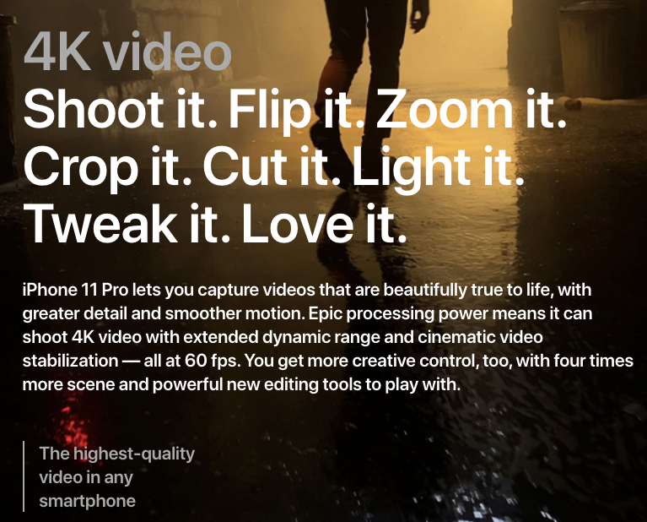
Application
What do you remember? Chances are: You will remember “4K video” at the beginning and “The highest-quality video in any smartphone” at the end.

Slide 14
Application
Ungraded discussion: How can we use the primacy and recency effects to enhance learning?
What can I do? Emphasize key information at the end: That’s why we have a review session at the end of each topic.
What can you do? Review the materials right before the exam (if it is a close-book exam) when the information is still recent and fresh.

Slide 15
Locating Memory in the Brain
Neuropsychology
  The hippocampus is responsible for one’s ability to encode new long-term memories
  Henry Molaison (HM) – surgery (lobotomy) for epilepsy
    https://www.youtube.com/watch?v=_7akPs8ptg4
  Victims include famous families: Kennedy
    https://www.youtube.com/watch?v=hrVEzgIQioQ
  Clive Wearing (CW)- encephalitis
    https://www.youtube.com/watch?v=WmzU47i2xgw
  KF – brain injury in a motorbike accident to the parietal lobe: Recognition of sounds was impaired, but not visual stimuli

Slide 16
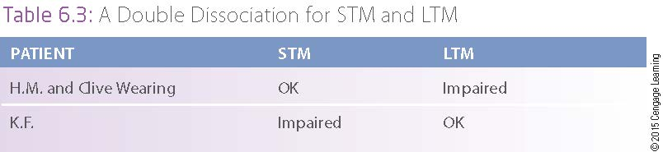
Locating Memory in the Brain

Slide 17

Types of Long-Term Memory
Episodic: memory for personal events
  My family and I spent a memorable vacation in Europe in 1995
Semantic: facts and knowledge
  The capital of Texas is Austin
  But this can be integrated with episodic memory. How?

Slide 18
Types of Long-Term Memory
Episodic involves mental time travel: you try to replay the movie inside your head
  No guarantee of accuracy
Semantic does not involve mental time travel
  General knowledge
In most cases episodic and semantic show a double dissociation: seems to function independently.

Slide 19
Separation of Episodic and Semantic Memories
K.C. damaged hippocampus (Motorcycle Accident)
  No episodic memory, cannot relive any events of his past
  Semantic memory intact, can remember general information about the past
  What He Knew:
    Brother had died two years prior.
    Location of kitchen utensils.
Notes:
But why? Because remembering is reconstruction, not the retrieval of one assembled item. KC and italian women, memory olympics.

Slide 20
Separation of Episodic and Semantic Memories
Italian woman (Encephalitis)
  Impaired semantic memory
    What She didn’t know:
      Couldn’t recognize familiar people or famous people
      Couldn’t remember the meaning of words on shopping list or where things were.
  Episodic memory for past events was preserved

Slide 21
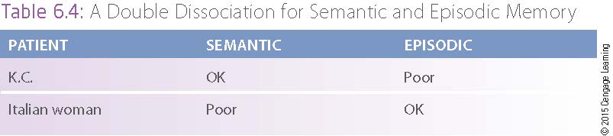
Separation of Episodic and Semantic Memories

Slide 22
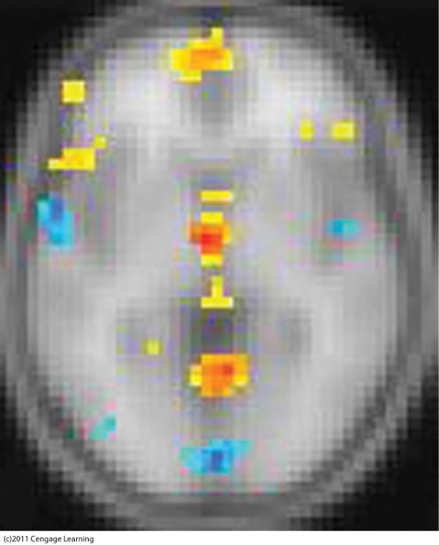
Separation of Episodic and Semantic Memories
Evidence from brain-imaging experiments that retrieving episodic and semantic memories activate different areas of the brain

Slide 23
Interactions Between Episodic and Semantic Memories
Episodic can be lost, leaving only semantic
  Acquiring knowledge may start as episodic but then “fade” to semantic
  I remember that Austin is in Texas but forgot when, where, from whom I learn it (If I learn it in a classroom, it will fade away. If you were there, it tends to stay)
Semantic can be enhanced if associated with episodic
  Autobiographical memory: memory of specific experiences, includes semantic and episodic e.g. the first time driving a car
  Personal semantic memory: semantic memories that have personal significance e.g. My girlfriend’s name is Betty.

Slide 24

Application I: Be there
Get first hand experience for your learning e.g. travel
This is semantic memory only: “Pyramids of Giza were built around 2550 to 2490 BC.”
If you were there, semantic and episodic memories married and you will remember!

Slide 25

Application II: Failure
“If you never failed, you haven’t tried hard enough.” – Jennifer Cruise
According to the manual, if the focal length of a photographic lenses is longer than 500mm, you should use a tripod.
Hand-holding the lenses may cause shaking, resulting in blurry image.

Slide 26
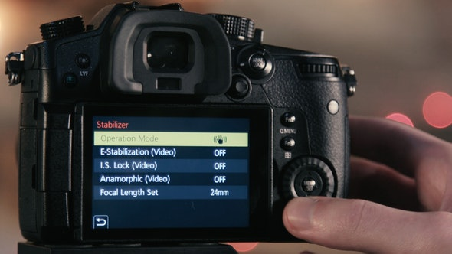
Application II: Failure
My new camera has the feature of built-in image stabilization that can compensate for shaking
I want to hand-hold a 500mm lenses to find out what would happen when I turn on image stabilizer.

Slide 27

Application II: Failure
Oh! It works under bright light only.
When the light is weak, the image becomes blurry!
Semantic memory: “Hand-holding a long lenses with image stabilization can work to some extent. When the scenery is too dark, I still need a tripod.”
Episodic memory: “I messed up a few pictures in a studio located in LA, back in 2010.” (personal failure)

Slide 28
Application II: Failure
My semantic memory and episodic memories married.
“If you never failed, you haven’t tried hard enough.”
I didn’t fail. Why?
If hand-holding a long lenses without a tripod can work, I generate new knowledge by discovering a short cut.
If it doesn’t work, next time I avoid the same mistake.
This information is memorable; it tends to stay in my LTM.

Slide 29
Assignment
Form a small group of 3-5 to discuss the following question:
On one hand, semantic and episodic memories are dissociated (work independently). On the other hand, we can have personal semantic memory that carry features of both semantic memory and episodic memory. We tend to remember the information when it is personal.
How can you apply this information into your field (education, counselling…etc.)? How can you help your students or patients remember important information and eventually change their behaviors?
There is no right or wrong answer. Be creative! If you never failed, you haven’t tried hard enough!
Post a brief report (0.5-1.5 page) into Canvas.

Slide 30
Imagining the Future
Constructive episodic simulation hypothesis
  Episodic memories are extracted and recombined to construct simulations of future events.
  Making a new movie inside your head
  KC had problems imagining future personal events
  Patients with semantic dementia had problems imagining future personal events.

Slide 31
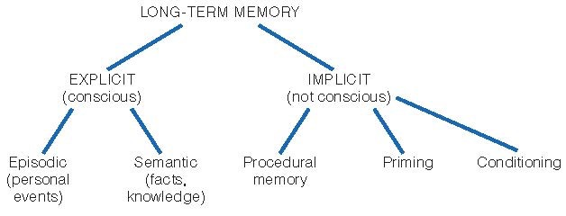
Types of Long-Term Memory

Slide 32
Types of Long-Term Memory
Implicit: memory that unconsciously influences behavior
Procedural memory e.g. muscle memory
Skill memory: memory for actions
No memory of where or when learned
Perform procedures without being consciously aware of how to do them
People who cannot form new LTMs can still learn new skills (e.g., H.M.)

Slide 33

Types of Long-Term Memory
  Classical conditioning: Pairing, association
  e.g. if the instructor of data analysis treats you badly, you associate statistics with fear.
  The opposite is true: If you like the instructor, you like the subject matter and pick up statistical procedures easily.
  That’s why I try to make you like me. If you are not laughing, you are not learning!

Slide 34
Implicit Memory: Priming
Priming: Repetition
Faked news: When it is repeated and spread, people believe it.
Advertisement
Perfect and Askew (1994)
  Propaganda effect: more likely to rate statements read or heard before as being true
    Occupy Wall Street
    http://www.youtube.com/watch?v=131eNW8-yik

Slide 35
Implicit Memory in Everyday Experience
Product placement in movies
You don’t even know it is advertisement!
Yu, C. H. (2006). Ethical issues of product placement and manipulation. In Prateek Kanchan (Ed.), In-film advertising: Brand positioning strategy (pp. 90-100). Hyderabad, India: ICFAI University Press.

Slide 36
Examples of product placement

Slide 37
How to enhance long-term memory
Context-dependent memory
Recall better when the contexts of encoding and retrieval are the same.
Experiment: Testing information-recalling
Perform well if Encode information and take the test at the beach.

Slide 38
How to enhance long-term memory
Perform well if encode information and take the test under water.
Performance drop if the contexts switch: Encode on the beach and test under water, or vice versa

Slide 39
Same for procedural memory?
Home-field advantage
Prior research indicates that athletes and sport teams tend to win when they play at a familiar location (home field, host nation)
There are different explanations (e.g. your fellow citizens support you), but practicing and playing at the same context is a plausible explanation.

Slide 40
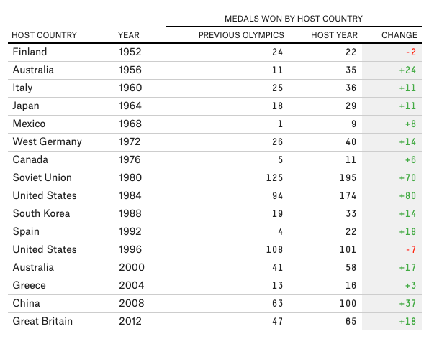
Source: https://fivethirtyeight.com/features/is-there-home-field-advantage-at-the-olympics/

Slide 41
Emotional state
State-dependent learning
Prior research shows that if you are happy when you encode the information, you can better recall the information with a joyful mind.

Slide 42

Application
To maximize your test performance, study at the classroom where the exam will be held later
Encode information and take the test in the same environment.

Slide 43
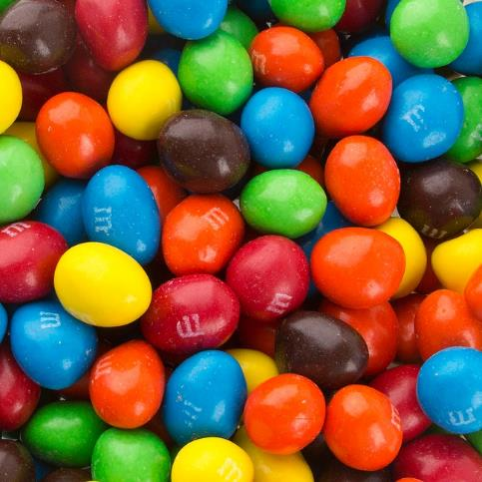

Application
Learn the information in a fun setting. Do something joyful while studying (eating M&M, drinking Starbucks Frappuccino). Bring M&M and coffee to the exam center
Encode information and take the test under the same mood.

Slide 44
Application
If you are a member of the APU sport team, try to host the game at APU, or practice at the location where the contest will be hosted.

Slide 45
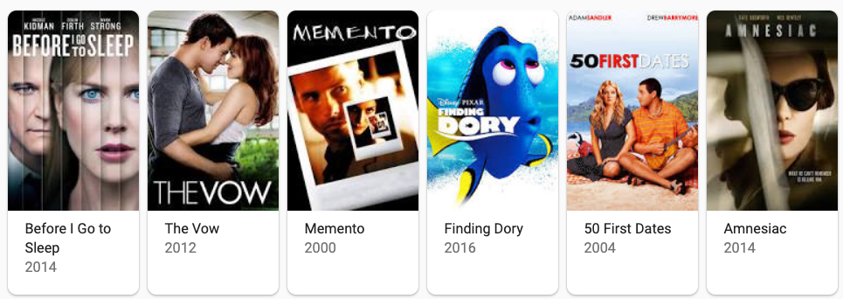
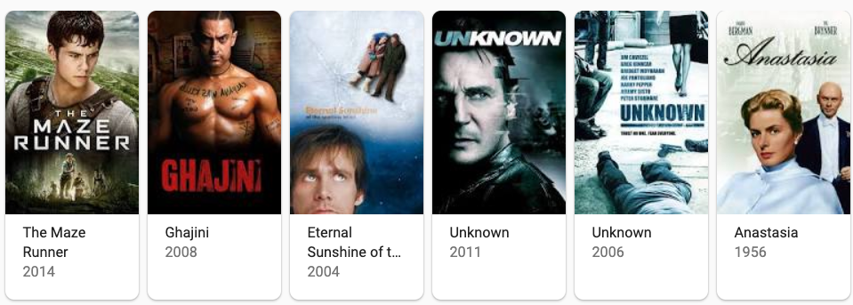
amnesia in Movies

Slide 46
The vow
A true story
On September 18, 1993, Kim and Krickett Carpenter, who had been married just 10 weeks earlier, were involved in a car crash.
Krickett’s head injury erased her memory. She could not recognize her husband.
She had to learn to love Kim again and rebuild the relationship.

Slide 47
secret Obsession
A woman woke up after a car accident. She could not remember information in LTM.
A man claimed to be her husband and took her home from the hospital.
The truth is: The man murdered her husband and tried to take advantage of her memory loss.
In real life, caregivers could advantage of patients suffering from memory loss.

Slide 48
Secret agents
A CIA agent could not remember his past (lost his episodic memory).
But his semantic and procedural memories are intact.
Similar plot in Jackie Chan’s “Who am I”?
It is possible?
Psychogenic fugue or dissociative fugue

Slide 49
Memento
Lenny keeps forgetting what has just happened to him.
He uses a camera to record everything to remind himself.
The movie said he has problems with short-term memory. Is it correct?
STM is memory lasts 15-20 seconds.
Lenny’s STM is fine. His problem is that he could not form new LTM.

Slide 50
50 first dates
A woman named Lucy can only remember the events of a single day.
Every morning her memory “resets”.
Her boyfriend Henry starts a new “date” with her every morning.
Is it possible?
A 51-year-old woman named FL was treated for a head injury from an automobile accident; every time she awoke she had no memory for the previous day.

