Slide 1
Long-Term Memory: Encoding, Retrieval, and Consolidation
Do you remember? How it all began, It just seemed like heaven. So, why did it End?
-the King of Pop

Slide 2
Some Questions to Consider
What is the best way to store information in long-term memory?
What are some techniques we can use to help us get information out of long-term memory when we need it?
How is it possible that a lifetime of experiences and accumulated knowledge can be stored in neurons?
How can the results of memory research be used to create more effective study techniques?

Slide 3
Getting Information Into LTM
Encoding: acquiring information and transforming it into memory
Retrieval: transferring information from LTM to working memory
Maintenance rehearsal
  Repetition of stimuli that maintains information but does not transfer it to LTM
Elaborative rehearsal
  Using meanings and connections to help transfer information to LTM

Slide 4

Levels of Processing Theory
Memory depends on how information is encoded
  Shallow processing (passive observation)
    little attention to meaning
    focus on apparent features
    poor memory
  Deep processing (active engagement)
    close attention to meaning
    better memory
    No pain, no gain! No free lunch!

Slide 5
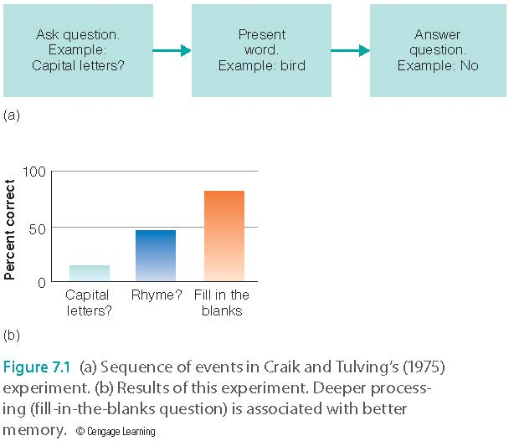
Levels of Processing Theory

Slide 6
Beware of Circular Reasoning!
Which task causes deeper processing?
  Using a word in a sentence
  Deciding how useful an object might be on a desert island
Depth of processing has not been defined independently of memory performance
  Therefore, this is circular reasoning

Slide 7
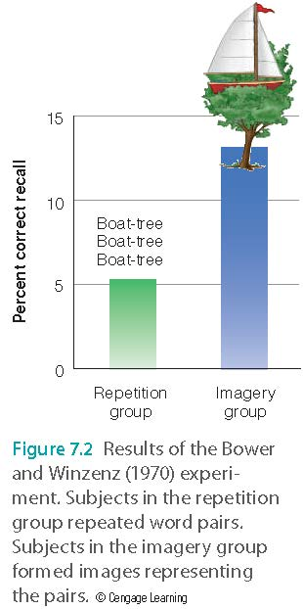
Other Factors that Aid Encoding
Visual imagery
  Paired-associate learning procedure (e.g. My PowerPoint slides)
Self-reference effect (Relevancy)
  Question: Does this word describe you? Happy.
Generation effect (Active engagement)
  Fill in the blank with a word that is related to the first word. King-cr_____; horse-sa_____; lamp-sh _______

Slide 8
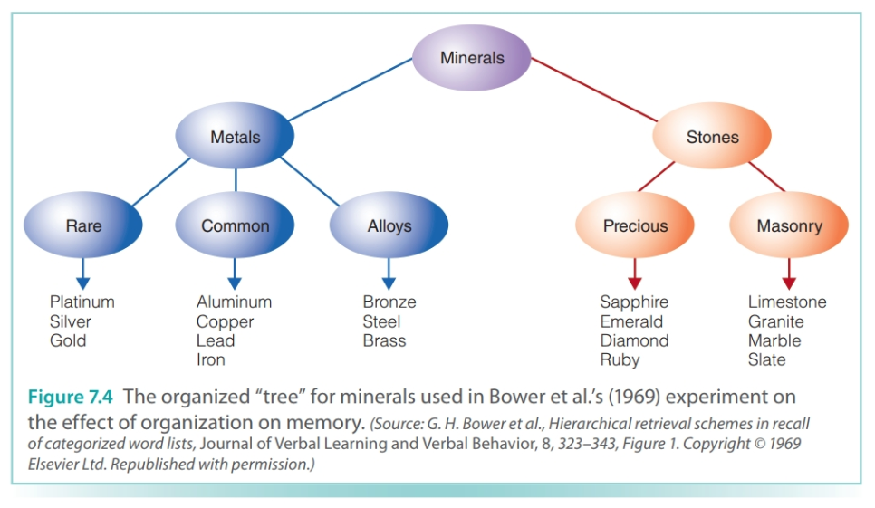
Other Factors that Aid Encoding
Organizing to-be-remembered information
  Words are recalled in an organized manner.
  Recall of random words vs. words in categories.

Slide 9
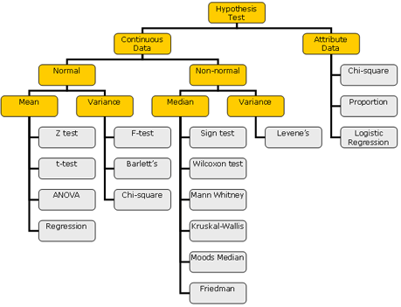
Example: Tree of statistical procedures

Slide 10
Other Factors that Aid Encoding
Relating words to survival value (relevancy, importance, significance)
  Imagine that you are stranded in the grasslands of a foreign land without any basic survival materials. Rate on a scale of 1-5 how relevant each word below would be for finding steady supplies of food and water and protection from predators:
  Umbrella
  Exercise
  Forgiveness
  Rock
  Hamburger
  Sunlight
  Coffee
  Bottle

Slide 11
Retrieval Practice
Which results in a stronger memory trace? A or B
  A: Re-reading the material
  B: Being tested on the material
Roediger and Karpicke (2006) had participants read a passage and then either
  Reread the passage (rereading group)
  Take a recall test (testing group)
Then tested recall after a delay; testing group performed better
Testing Effect (not the same idea in 362 Research Methods: a threat against internal validity)
That’s why we have review sessions. Active engagement leads to better retention of information

Slide 12
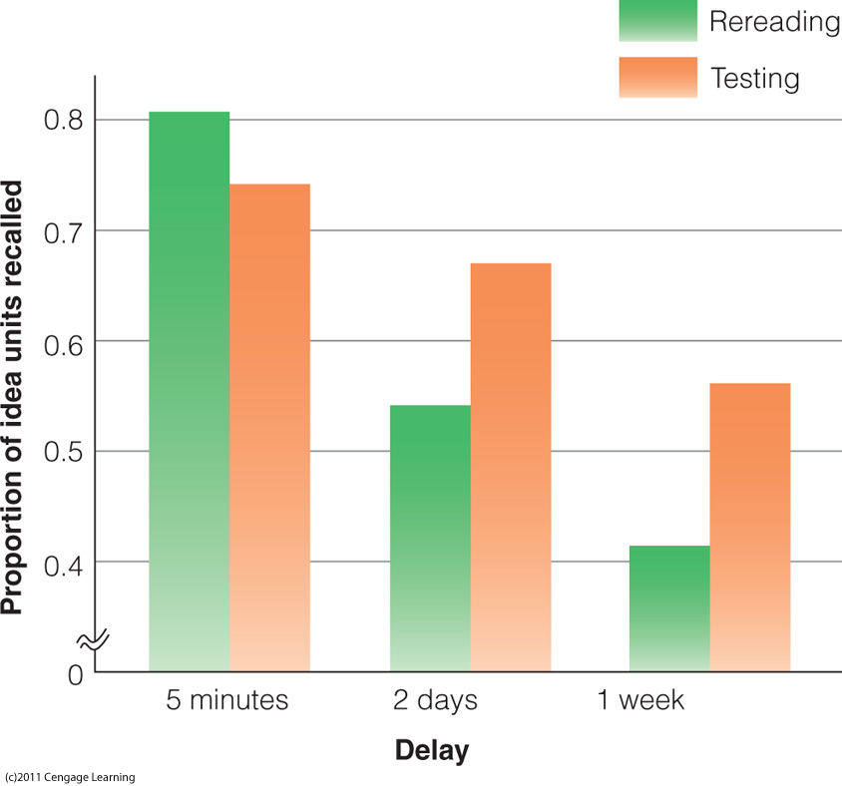
Results of the Roediger and Karpicke (2006) experiment. Note that at longer times after learning, the performance of the testing group is better than the performance of the rereading group.

Slide 13
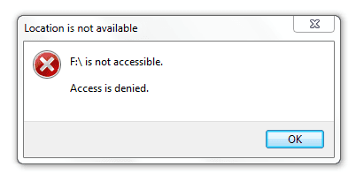
Retrieving Information from LTM
Retrieval: process of transferring information from LTM back into working memory (consciousness)
Most of our failures of memory are failures to retrieve
A damaged or blocked hard drive. The data are there but the computer cannot read it

Slide 14
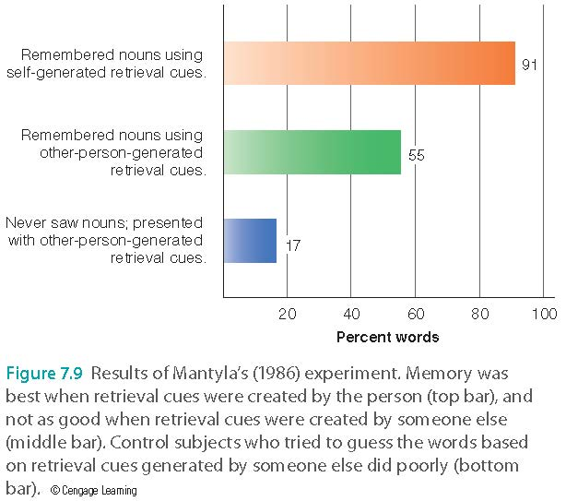
Retrieving Information from LTM
Cued-recall: cue presented to aid recall
  Increased performance over free-recall
  Retrieval cues most effective when created by the person who uses them
  Example: Subjects were asked to write three attributes of a noun. Banana: yellow, bunches, edible. Better recall!

Slide 15
Retrieving Information from LTM
Cued-recall: cue presented to aid recall
Example: password or pin cues
Related to apartment number, birthday, hometown…etc.
Drawback: Easy to crack if somebody knows your birthday, apt. no…etc.
Necessary risk.
Why?

Slide 16

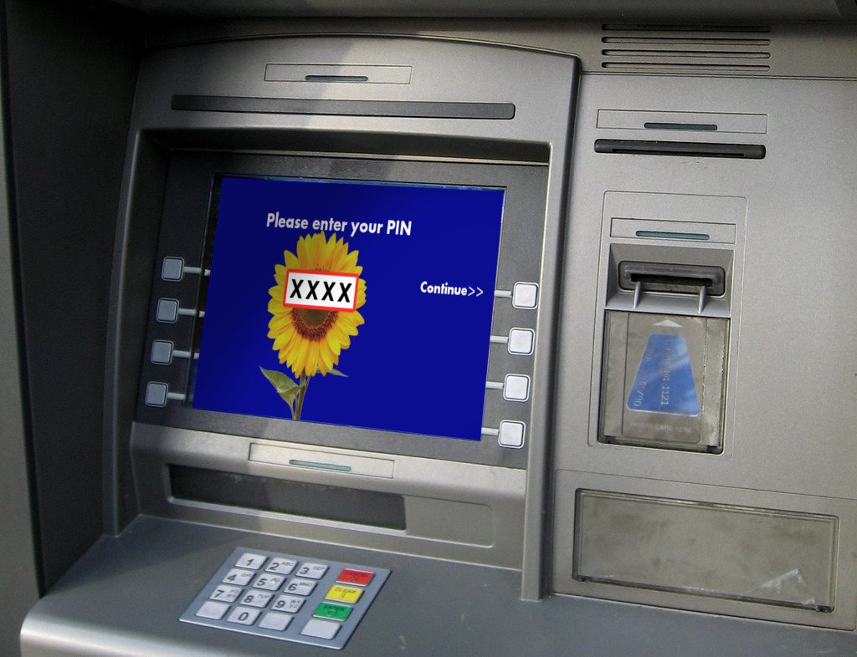
Retrieving Information from LTM
If you forgot your computer password, you can ask the tech support to reset it.
If you forgot your luggage lock passcode while traveling…
You ran out of cash while traveling and you forgot the pin of your debit card…

Slide 17
Ungraded discussion
Format a small group of 3-5 to discuss the following:
Today most people might have multiple passwords or passcodes to multiple systems (email account, Facebook, Amazon, bank account pin, locker…etc.)
What is your strategy of managing multiple logins and passwords? Do you use a cue system or something else?
What work best?

Slide 18
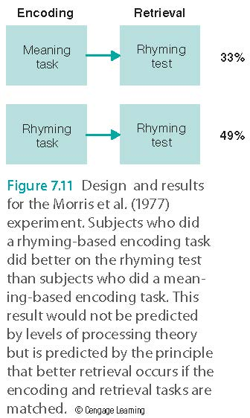
Matching the Cognitive Task
Transfer-appropriate processing: Retrieval is better if the same cognitive tasks are involved during both encoding and retrieval.
Morris et al. (1977)
Encoding
  Meaning: The ____ had a silver engine. (Train?)
  Rhyming: _____ rhymes with pain. (Train?)
Retrieval: Same is better
Implication: Consistent test format

Slide 19
Consolidation
Transforms new memories from fragile state to more permanent state
  Synaptic consolidation occurs at synapses, occurs within the first few hours after learning or encoding.
  Systems consolidation involves gradual reorganization of circuits in brain; where hippocampus-dependent memories become independent of the hippocampus over a period of weeks to years

Slide 20
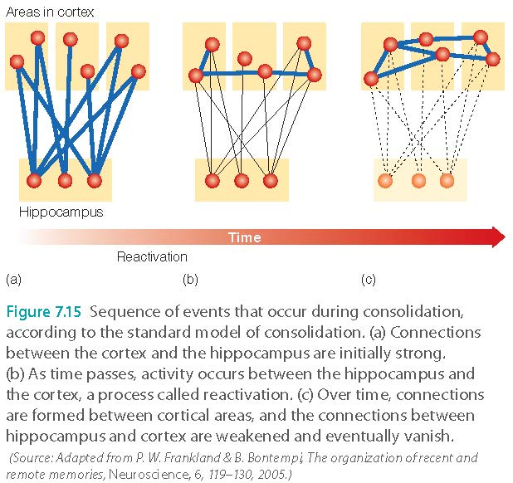
Consolidation
Standard model of consolidation
  Retrieval depends on hippocampus during consolidation; after consolidation hippocampus is no longer needed

Slide 21
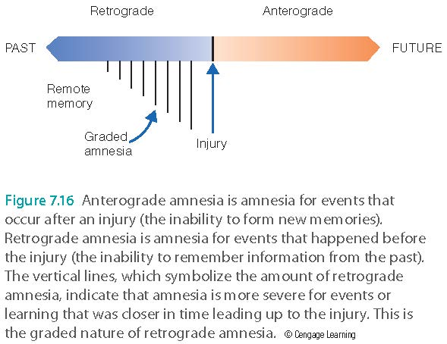
The Fragility of New Memories
Retrograde amnesia: loss of memory for events prior to the trauma
Graded amnesia: memory for recent events is more fragile than for remote events
Korsakoff’s syndrome

Slide 22
Consolidation
All scientific conclusions are inconclusive!
Multiple trace hypothesis
  Questions the assumption that the hippocampus is important only at the beginning of consolidation
  The hippocampus has been shown to be activated during retrieval of both recent and remote memories (Gilboa et al., 2004)
  The response of the hippocampus can change over time (Viskontas and coworkers, 2009)
  Hippocampus activity is less active for semanticized memories.

Slide 23
Re-consolidation
Existing memories are retrieved and then actively consolidated again
to enhance or revise memories that have already been stored in LTM
Study, reflection, application…etc.
Use it or lose it.

Slide 24
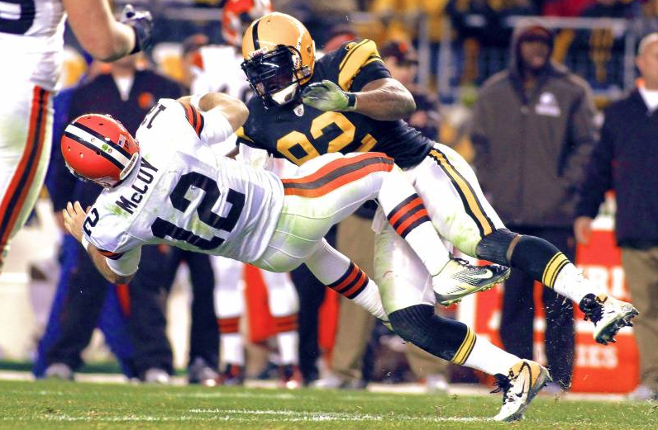
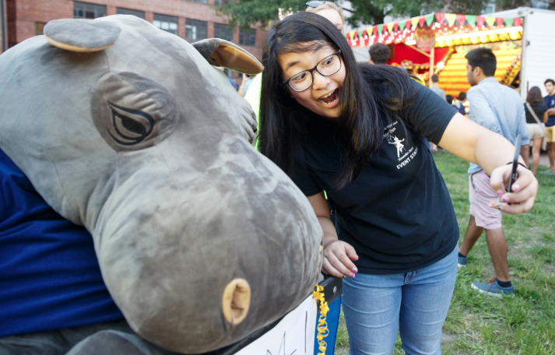
Improving Learning and Memory
Elaborate - associate what you are learning to what you already know
  Proactive interference: A professional football player smashes everything when he runs forward.
  Hippocampus and long term memory: The hippo that goes to the campus has a good memory.
  Can you create an example?

Slide 25
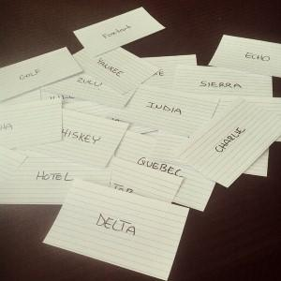
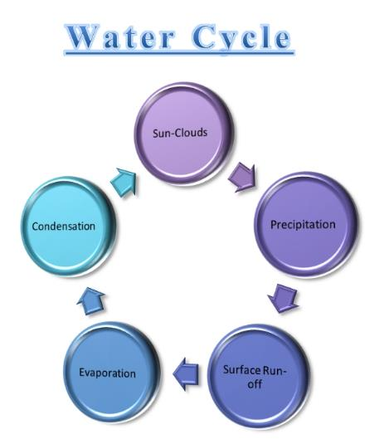
Improving Learning and Memory
Generate and test: Generation effect:
  Test yourself e.g. Flash card (especially learning a new language)
  Know what you know and what you don’t know
  Increase memory
Organize (especially visual organizer)

Slide 26

Improving Learning and Memory
Take breaks
  Memory is better for multiple short study sessions (the spacing effect, no cramping)
  Good breaks: take a walk, stretch, talk to a friend, take a quick shower, run a quick errand, get light snack…etc.
  Bad breaks: take a long nap, eat junk food, watching TV, surfing the web aimlessly, play video games, drink excessive coffee.
  Consolidation is enhanced if you sleep after studying (no all nighters!)
  https://www.youtube.com/watch?v=WpkfMuXJnWI

Slide 27
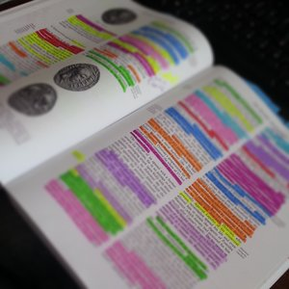
Improving Learning and Memory
Avoid the “illusion of learning”
  Re-reading: Familiarity does not mean comprehension
  Highlighting:
  it looks like elaborative processing (active engagement), but it often becomes automatic behavior that involves moving the hand rather than deep processing.

Slide 28
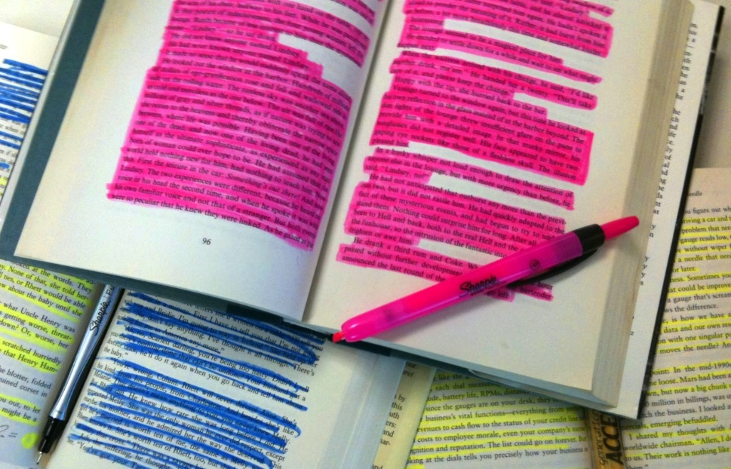
Improving Learning and Memory
Blanchard and Mikkelson (1987) and Johnson (1988): Learners who highlighted text performed better on questions related to the content they highlighted but performed worse on that they did not highlight.
How about highlight every word? Why not?
Still important: you can go back to what are important and relevant.

Slide 29
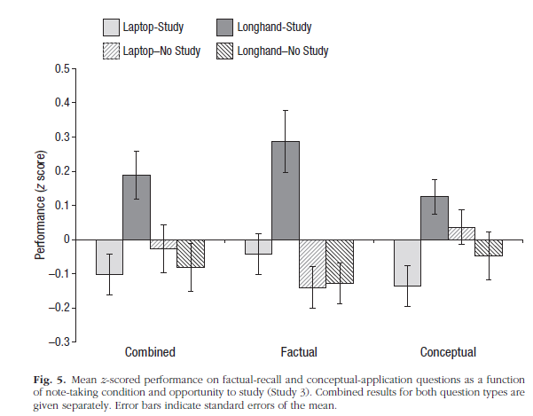
The Pen is Mightier than the Keyboard
https://www.youtube.com/watch?v=pu0PSZ_EwII

Slide 30
Assignment
Format a small group to discuss the following:
On one hand, there are multiple strategies for enhancing memory and learning (e.g. elaborate, self-test, visual organizer, take break…etc.).
On the other hand, prior research showed that some commonly used strategies are ineffective (e.g. highlighting, using laptop to take notes)
In your opinions, which work may best for you? Which one may not or did not work for you? Why?
Can you modify and improve one or several of these strategies? There is no right or wrong answer. You are welcome to be creative.

