Slide 1
Knowledge
C. H. Alex Yu
Notes:
Begin with photos of Red pandas

Slide 2
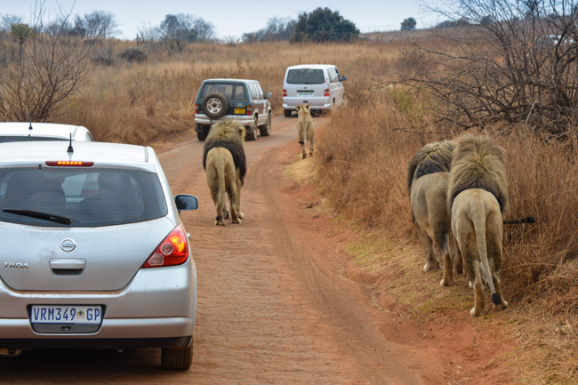
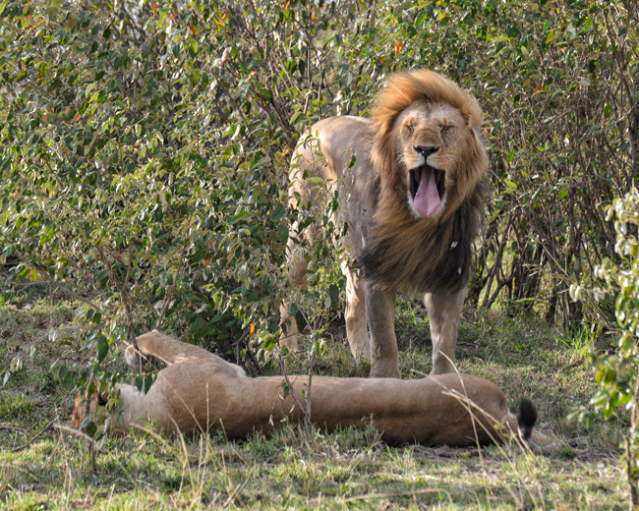
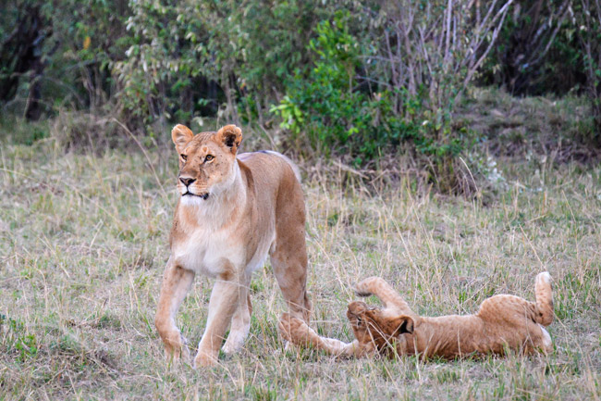
Are you afraid of CATS?

Slide 3
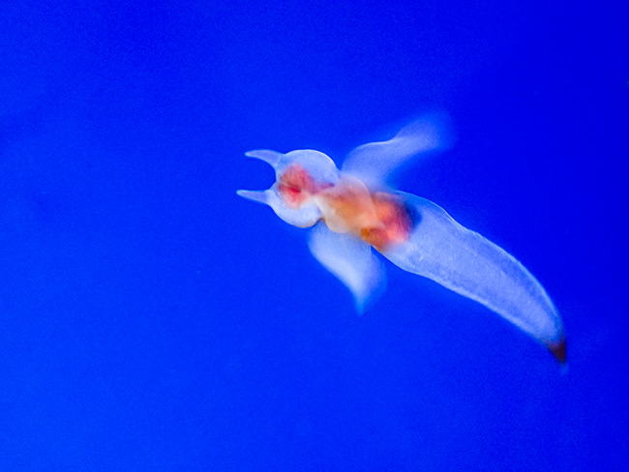
What is it?
Hints: It is real. It is NOT created by PhotoShop

Slide 4
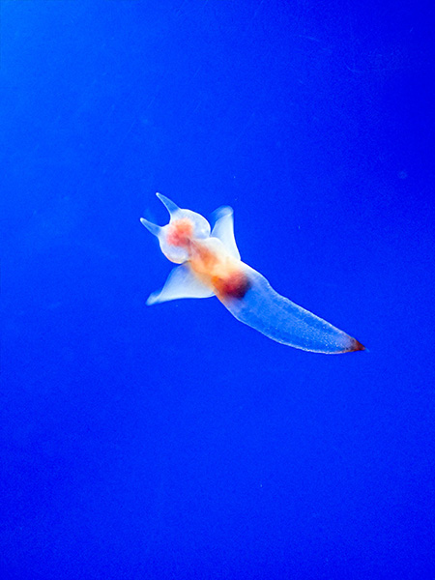
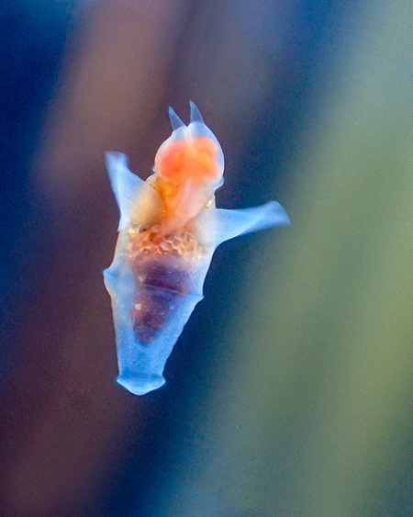
More hints: I took these photos in Northern Japan using a Camera with a macro lenses.

Slide 5
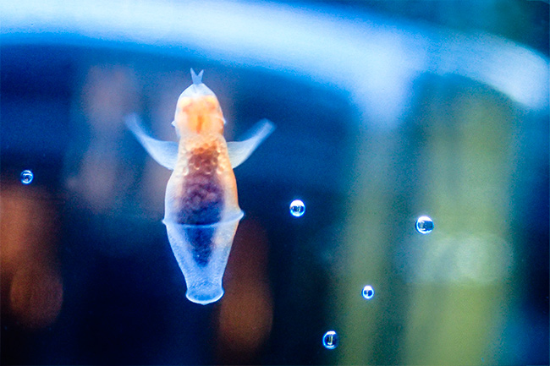
Clione limacine 流冰天使
Also known as naked sea butterfly or sea angel.
It lives in the Arctic Ocean and cold regions of the North Atlantic Ocean.
It may be difficult for you to recognize what it is because you have no knowledge or concept corresponding to this.

Slide 6
Some Questions to Consider
Why is it difficult to recognize something that does not seem to fit into our existing concepts or categories?
Why is it difficult to decide if a particular object belongs to a particular category, such as “chair,” by looking up its definition?
Why do we tend to reject new idea that cannot fit into our existing concept?
How are the properties of various objects “filed away” in the mind?
How is information about different categories stored in the brain?

Slide 7
Knowledge
Conceptual knowledge: knowledge that enables us to recognize objects and events and to make inferences about their properties
Concept: mental representation of a class of entities, or the meaning of objects, events, and abstract ideas.
Categorization is the process by which things are placed into groups called categories, which are all possible examples of a particular concept.
Notes:
Concept – A mental representation of a class of entities.

Slide 8
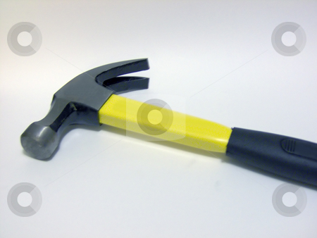
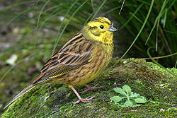
Why Categories Are Useful?
Help to understand individual cases not previously encountered
“Pointers to knowledge”
  Categories provide a wealth of general information about an item
  Allow us to identify the special characteristics of a particular item
Notes:
We navigate the world based on generalizations.

Slide 9
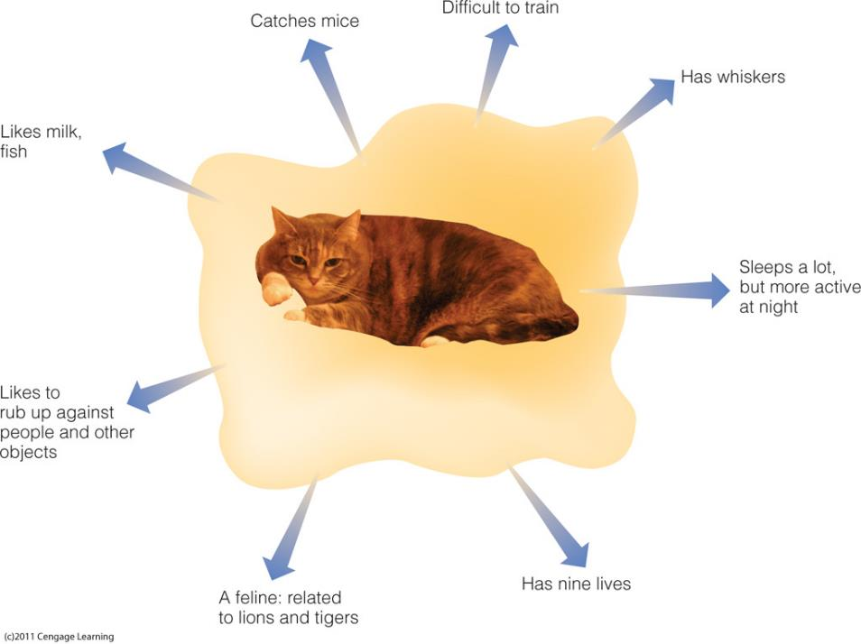
Knowing that something is in a category provides a great deal of information about it.

Slide 10
Definitional Approach to Categorization
Determine category membership based on whether the object meets the definition of the category
Does not work well
Not all members of everyday categories have the same defining features
Family resemblance: Things in a category resemble one another in a number of ways

Slide 11
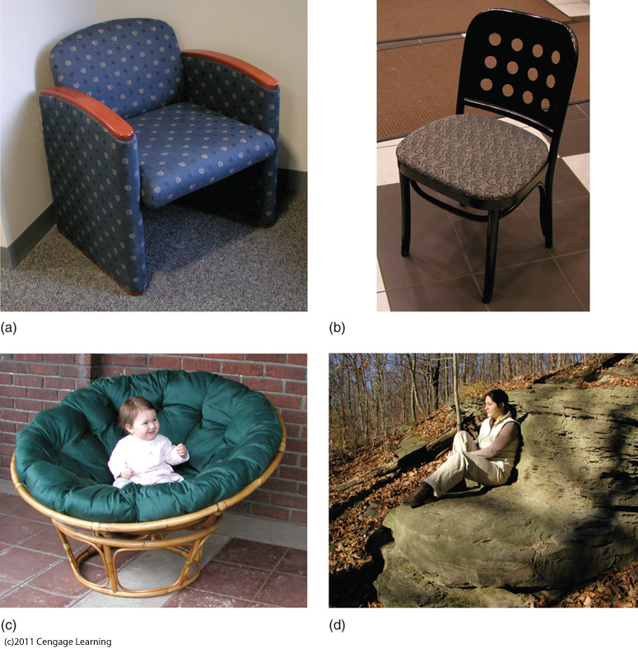
Different objects, all possible “chairs.”

Slide 12
Pop quiz: Why categories are useful?
Help to compare the attributes across different entities
Help to understand new cases that are not previously encountered
Help to draw a logical deduction from the premise to the conclusion.
All of the above

Slide 13
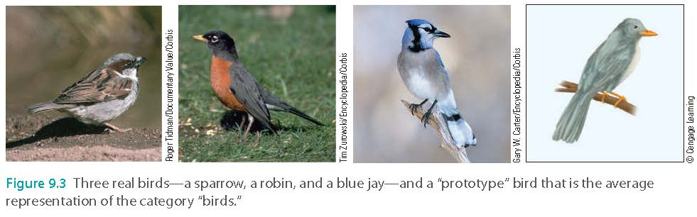
The Prototype Approach
Prototype = “typical”
An average representation of the “typical” member of a category
Characteristic features that describe what members of that concept are like (most salient features)
An average of category members encountered in the past

Slide 14
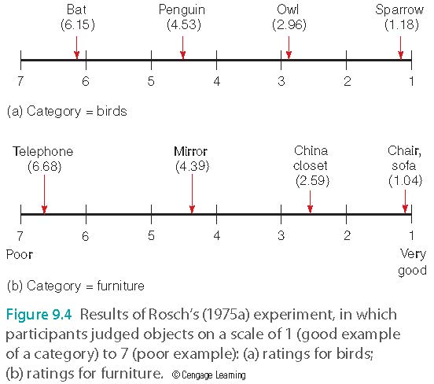
The Prototype Approach

Slide 15
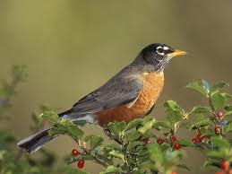
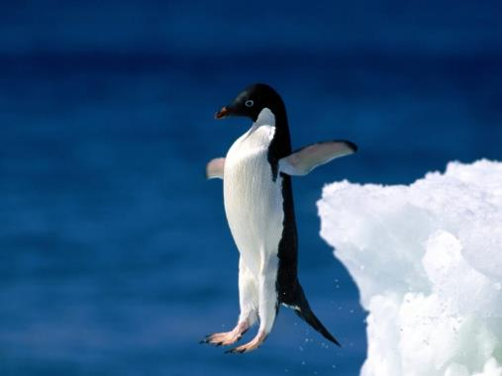
The Prototype Approach
High-prototypicality:
Low-prototypicality:
category member closely resembles category prototype
  “Typical” member
  For category “bird” = robin
category member does not closely resemble category prototype
  For category “bird” = penguin

Slide 16
The Prototype Approach
Strong positive relationship between prototypicality and family resemblance
When items have a large amount of overlap with characteristics of other items in the category, the family resemblance of these items is high
Low overlap = low family resemblance

Slide 17
The Prototype Approach
Typicality effect: prototypical objects are processed preferentially
  Smith et al. (1974)
    Highly prototypical objects judged more rapidly
  Rosch (1975b)
    Prototypical objects are named more rapidly and named first
    Prototypical category members are more affected by a priming stimulus
    Hearing “green” primes a highly prototypical “green”

Slide 18
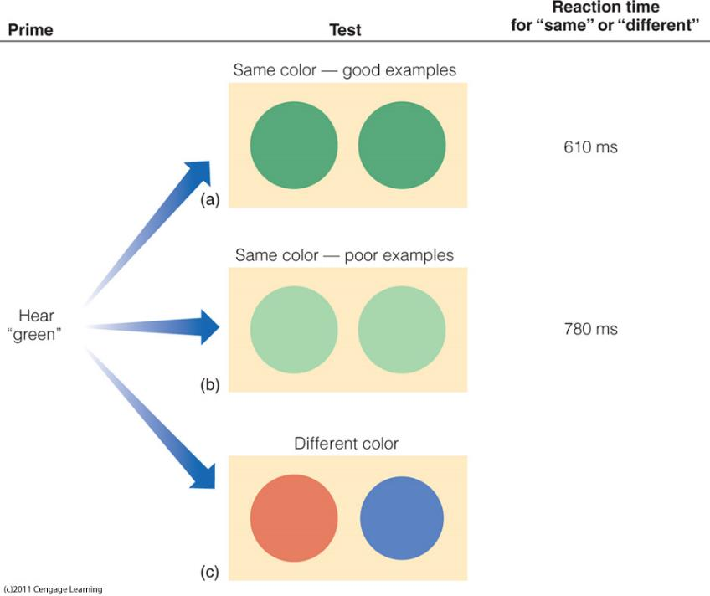
Caption: Procedure for Rosch’s (1975b) priming experiment. Results for the conditions when the test colors were the same are shown on the right. (a) The person’s “green” prototype matches the good green, but (b) is a poor match for the light green.

Slide 19
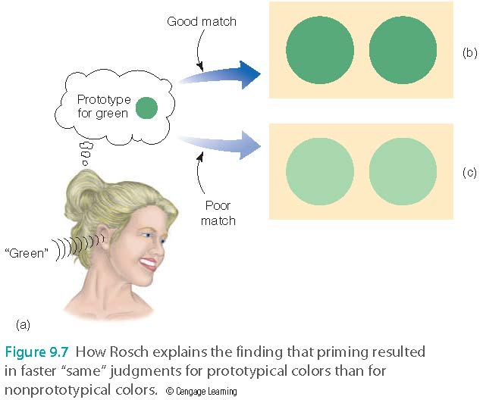
The Prototype Approach

Slide 20
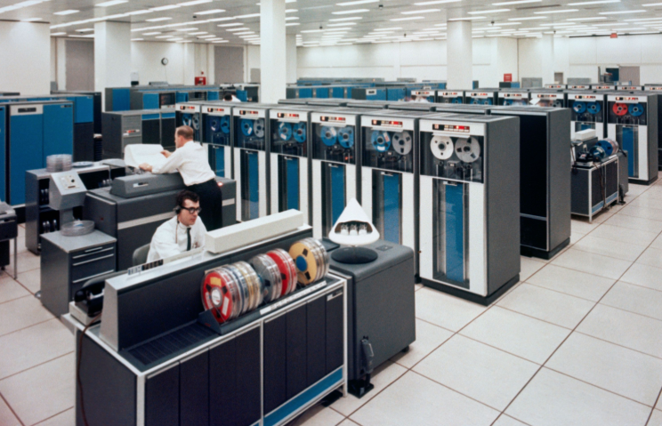
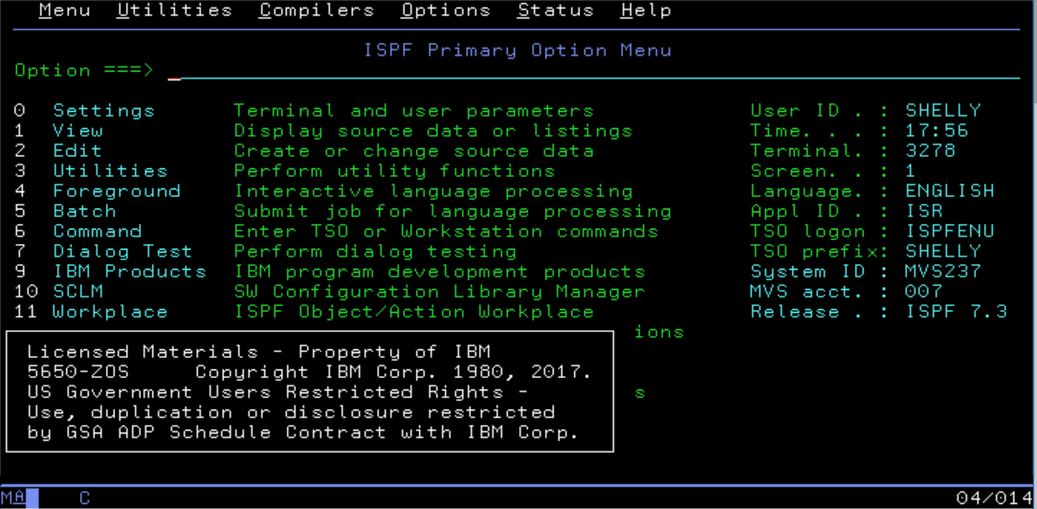
Caution:
Preconception could “close” your mind
What is a “typical” computer during the 1980s?

Slide 21
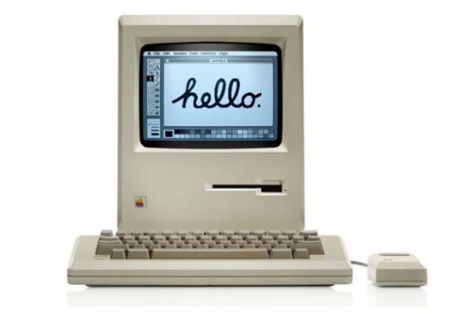
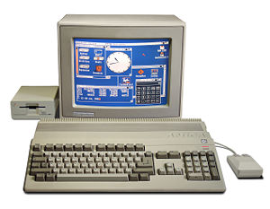
Caution:
Preconception could “close” your mind
When we see something “atypical: or cannot fit into our existing concepts/categories, we are skeptical or even reject it.
In 1984 Apple Inc. introduced Macintosh.
In 1984 Commodore Corp. introduced Amiga.

Slide 22
Caution:
Preconception could “close” your mind
Mac is the first commercial computer that includes graphical user interface.
Amiga is the first that introduced multi-processing: one chip can work on playing music in the background and at the same time a compressed animation is also running smoothly by another chip.
Apple struggled many times. Today Mac OS has 9.65% of the desktop OS market share.
Commodore filed for bankruptcy in 1994.
We tend to question or reject anything that looks unfamiliar or atypical.
You don’t know what you don’t know!

Slide 23
Caution:
Preconception could “close” your mind
Example 2: Traditional statistics vs. Modern data science
Traditional statistics was developed around late 19th and middle 20th centuries. At that time most studies use a small sample size.
In late 20th and early 21th centuries many new and more efficient algorithms, which are based on machine learning had been developed to deal with bigger data sets.
But machine learning methods do not look like the “typical” statistics that people have been using for more than a century.

Slide 24
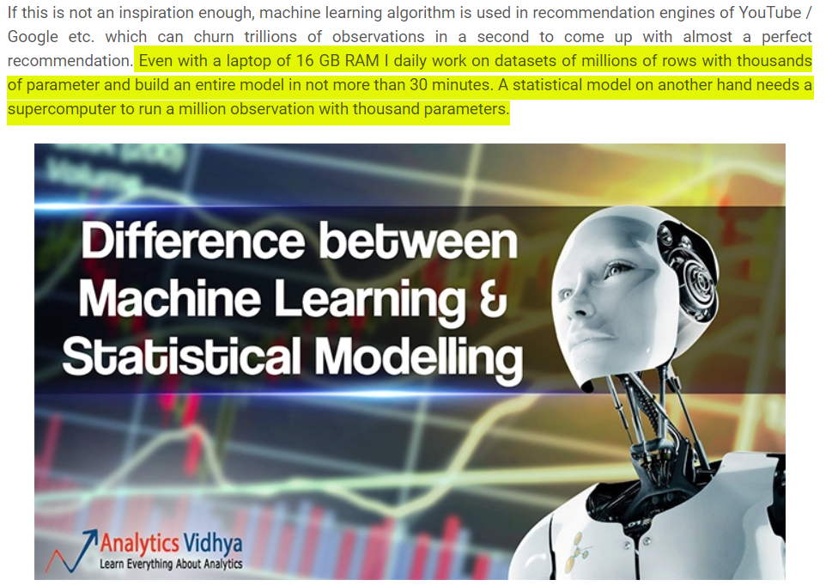
https://www.analyticsvidhya.com/blog/2015/07/difference-machine-learning-statistical-modeling/

Slide 25
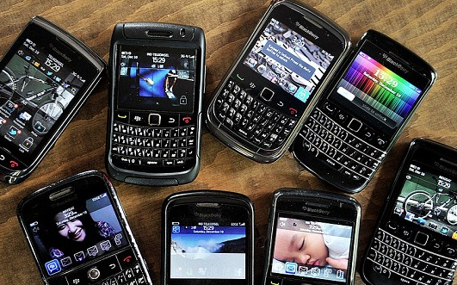
Caution:
Preconception might confine or misguide you
Even if we are open to new concepts, we tend to fit the new phenomenon into our existing prototype or category, rather than trying to approach the new idea on its own term.
Example: What is a keyboard?
In 1985 Research in Motion (RIP) introduced the first smart phone called Blackberry.

Slide 26
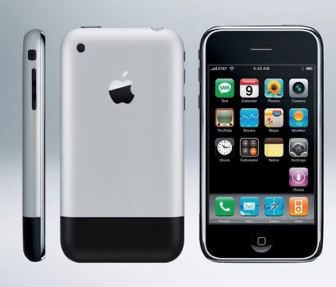
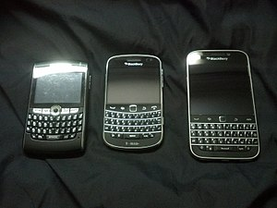
Caution:
Preconception might confine or misguide you
RIM smart phones have a physical keyboard.
In 2007 Apple introduced the iPhone and replaced the physical keyboard with touch screen.
At its peak in 2013, there were 85 million BlackBerry subscribers worldwide.
A keyboard must have physical buttons! RIM refused to remove the keyboard.
In 2016 the market share of RIM is 0.2%

Slide 27
Break-out session: Assignment
Form a small group of 3-5 to discuss the following:
In your experience, have you ever encountered people who rejected new and good idea because the new concept could not fit into their existing prototype or category? Please share your example.
What can you do to promote open-mindedness and to market your new idea? There is no right or wrong answer.

Slide 28
What is a Tomato?
Fruit
  A structure of a plant that contains it’s seeds.
Vegetable
  An edible part of the plant, Leaf, stem, or root, but not fruit or seeds.
Nix v. Hedden, 149 U.S. 304 (1893)
Botanically speaking, tomatoes are the fruit of a vine, just as are cucumbers, squashes, beans and peas. But in the common language of the people, whether sellers or consumers of provisions, all these are vegetables, which are grown in kitchen gardens, and which, whether eaten cooked or raw, are, like potatoes, carrots, parsnips, turnips, beets, cauliflower, cabbage, celery and lettuce, usually served at dinner in, with or after the soup, fish or meats which constitute the principal part of the repast, and not, like fruits generally, as dessert.
Notes:
What about cucumbers? What about squash? Bell peppers.

Slide 29
The Exemplar Approach
Concept is represented by multiple examples
(rather than a single prototype)
Examples are actual category members
(not abstract averages)
To categorize, compare the new item to stored examples.

Slide 30

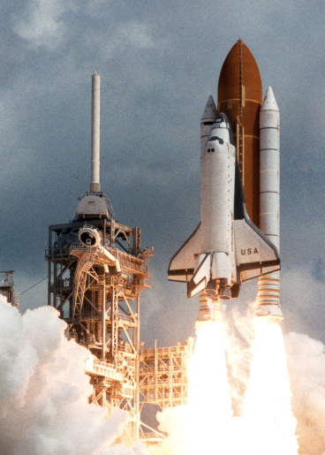

The Exemplar Approach
What is a “space ship”? Different examples might not have many common features.

Slide 31
The Exemplar Approach
Similar to prototype view
  Representing a category is not explicitly defining it in an operationalized fashion.
  Operationalized definition: X is nothing but A + B + C
Different: representation is concrete, not abstract
  Descriptions of specific examples
  More open-ended as we might have new examples.
The more similar a specific exemplar is to a known category member, the faster it will be categorized (family resemblance effect)

Slide 32

The Exemplar Approach
Explains typicality effect
  Items more like exemplars are classified faster.
Easily takes into account atypical cases (e.g. we can still recognize a UFO as a spaceship)

Slide 33
Prototypes or Exemplars?
May use both
Exemplars may work best for small categories e.g. US Presidents, mountains taller than 15,000 feet.
Prototypes may work best for larger categories e.g. birds, cars

Slide 34
Pop quiz: Which of the following statements is true?
Prototypes may work best for small categories e.g. US Presidents, mountains taller than 15,000 feet.
Exemplars may work best for larger categories e.g. birds, cars
Operationalized definition is open-ended.
The more similar a specific exemplar is to a known category member, the faster it can be categorized

Slide 35
A Hierarchical Organization
To fully understand how people categorize objects, one must consider
  Properties (features) of objects
  Learning and experience of perceivers

Slide 36
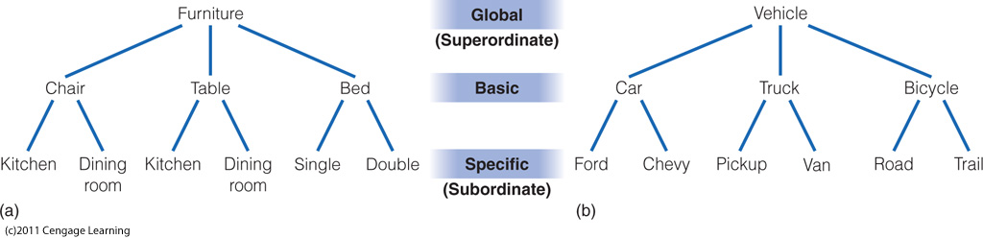
Hierarchical Organization
Caption: Levels of categories for (a) furniture and (b) vehicles. Rosch provided evidence for the idea that the basic level is “psychologically privileged.”

Slide 37
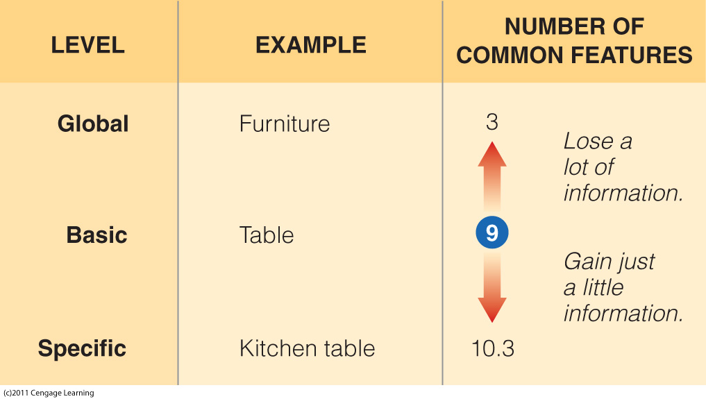
Caption: Left column: category levels; middle column: examples of each level for furniture; right column: average number of common features, listed from Rosch, Mervis et al.’s (1976) experiment.

Slide 38
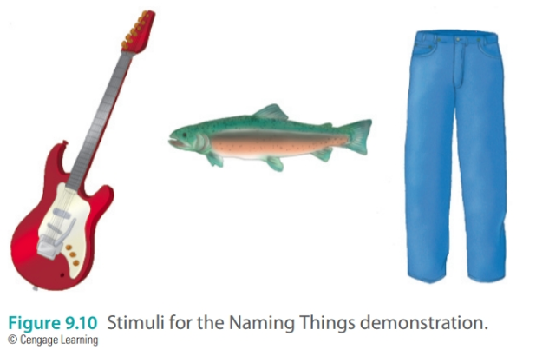
Basic level is more common/important
Guitar rather than musical instrument
Fish rather than animal or Salmon
Pants rather than clothing or jeans

Slide 39
Semantic Networks
Concepts are arranged in networks that represent the way concepts are organized in the mind
Collins and Quillian (1969)
  Node = category/concept
  Concepts are linked
  Model for how concepts and properties are associated in the mind

Slide 40
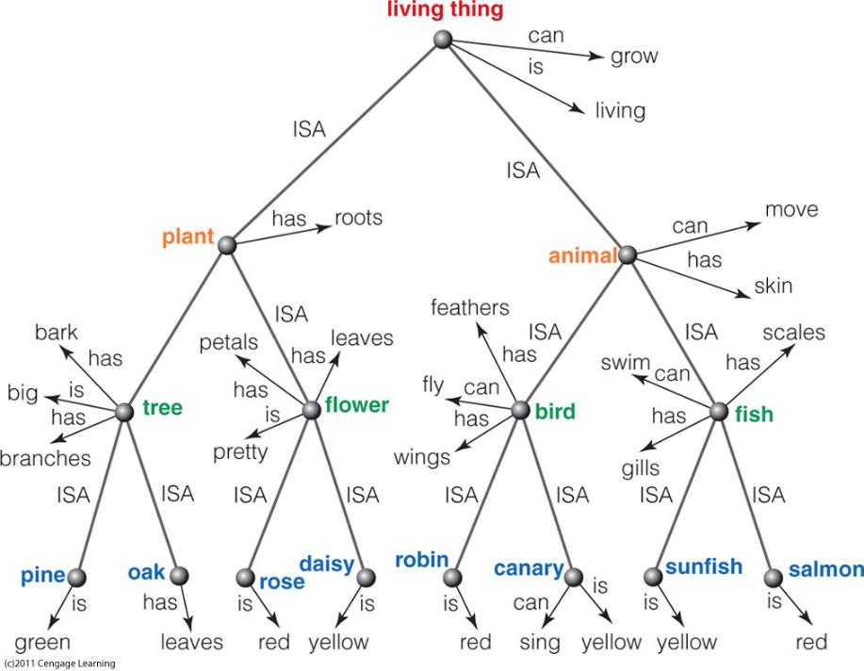
Caption: Collins and Quillian’s (1969) semantic network. Specific concepts are indicated in blue. Properties of concepts are indicated at the nodes for each concept. Additional properties of a concept can be determined by moving up the network, along the lines connecting the concepts. For example, moving from “canary” up to “bird” indicates that canaries have feathers and wings and can fly.

Slide 41
Semantic Networks
Cognitive economy: shared properties are only stored at higher-level nodes
Exceptions are stored at lower nodes
Inheritance
  Lower-level items share properties of higher-level items

Slide 42
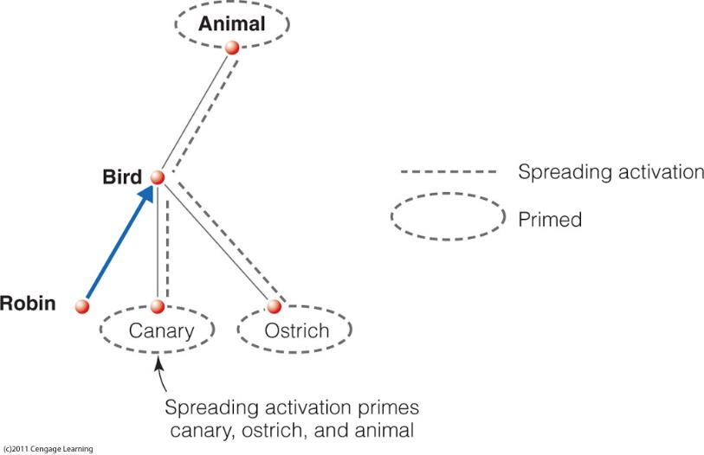
Semantic Networks
Spreading activation
  Activation is the arousal level of a node
  When a node is activated, activity spreads out along all connected links
  Concepts that receive activation are primed and more easily accessed from memory

Slide 43
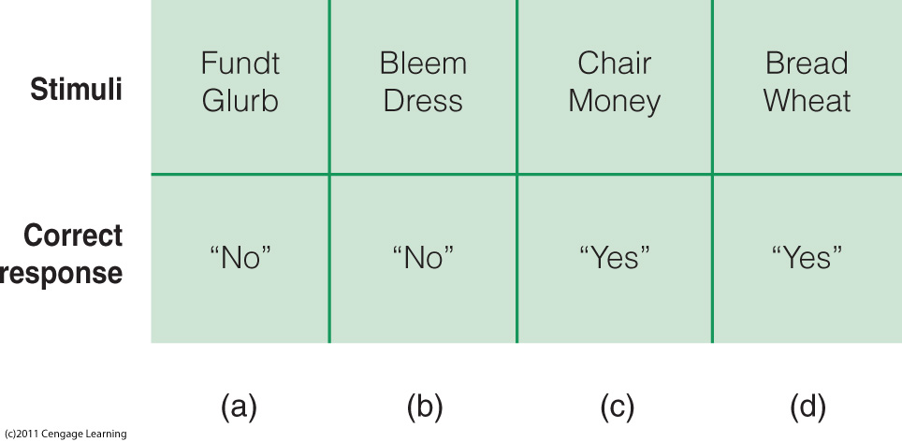
Semantic Networks
Lexical decision task
  Participants read stimuli and are asked to say as quickly as possible whether both items are words or not
  Myer and Schvaneveldt (1971)
    Associated words received faster responses than non-associated words.

Slide 44
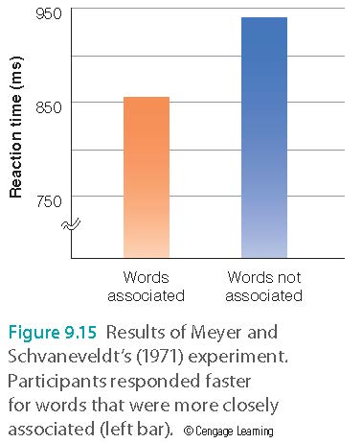
Semantic Networks
Meyer and Schvaneveldt (1971)
  “Yes” if both strings are words; “no” if not
  Some pairs were closely associated
  Reaction time was faster for those pairs
    Spreading activation

Slide 45
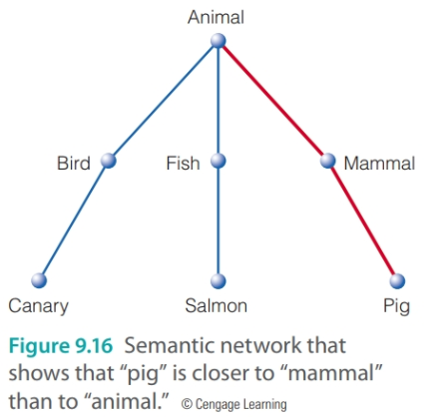
Criticism of Collins and Quillian
  Cannot explain typicality effects
    RT for A canary is a bird < RT for An Ostrich is a bird
  Cognitive economy?
  Some sentence-verification results are problematic for the model
    RT for A canary is a bird < RT for An Ostrich is a bird
    A pig is a mammal = 1,476 ms
    A pig is an animal = 1,268 ms (faster)

Slide 46
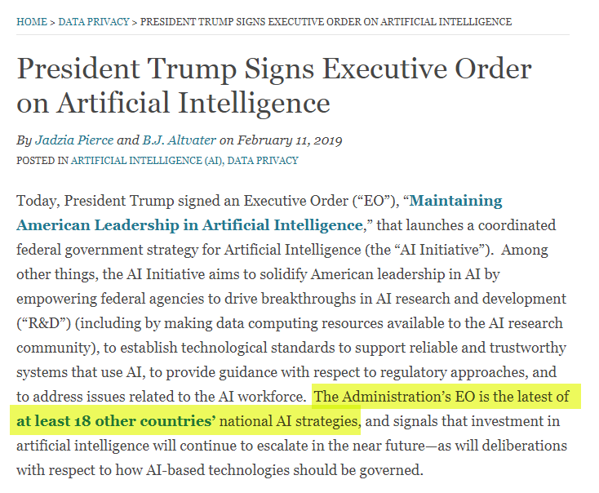
Application in Artificial intelligence: the most crucial technology?
https://www.insideprivacy.com/data-privacy/president-trump-signs-executive-order-on-artificial-intelligence/

Slide 47
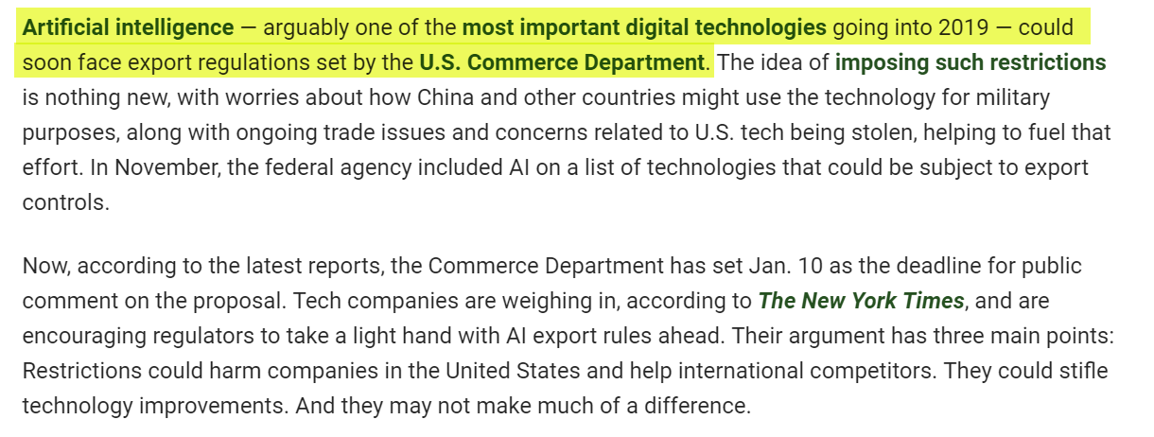
US bans exporting AI to China
https://www.pymnts.com/news/regulation/2019/artificial-intelligence-china-digital-technology/

Slide 48
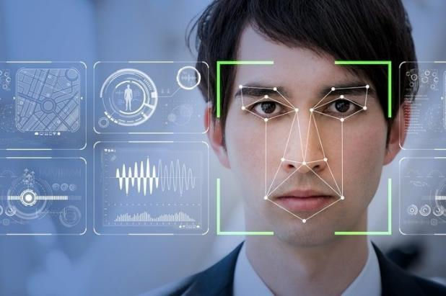
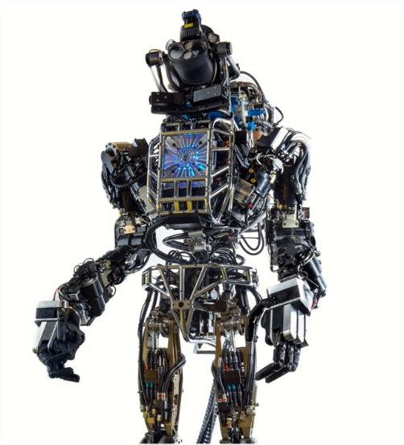
Application in Artificial intelligence
AI: A branch of computer science dealing with the simulation of intelligent behavior in computers.
Machine learning: an application of AI that enables the computer to automatically learn and improve from data without explicit instruction e.g. facial recognition, robotics

Slide 49
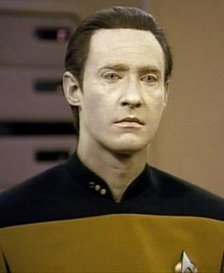
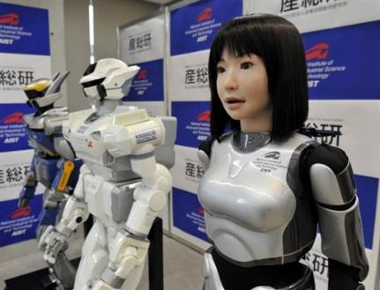

Application in Artificial intelligence
Semantic networks became popular in AI and natural language processing because this theorizes how knowledge is represented and how reasoning is supported.
Natural language processing: concerned with how to enable a computer to analyze human language so that the computer can interact with humans.
The semantic network is more natural than the logical notations (e.g. (∀x)[(D(x) & O(p,x) ⊃ B(p,x)]).

Slide 50
Schools of machine learning
Name | Origin | Approach
Symbolists | Logic, philosophy | Some form of logical deduction (e.g. if-then-else)
Connectionists | Neuroscience | Networking/linking of nodes, pathway (e.g. Neural networks)

Slide 51

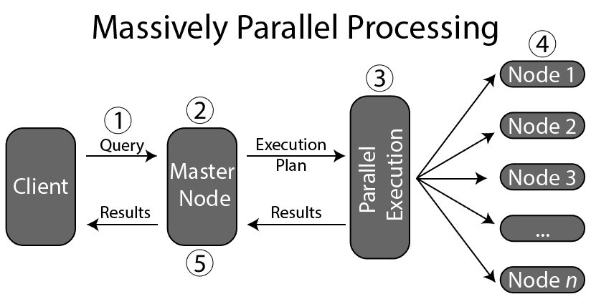
The Connectionist Approach
https://www.youtube.com/watch?v=whlODvf-SVk
Creating computer models for representing cognitive processes
Parallel distributed processing: Massively parallel processing
Knowledge represented in the distributed activity of many units
Weights determine at each connection how strongly an incoming signal will activate the next unit

Slide 52
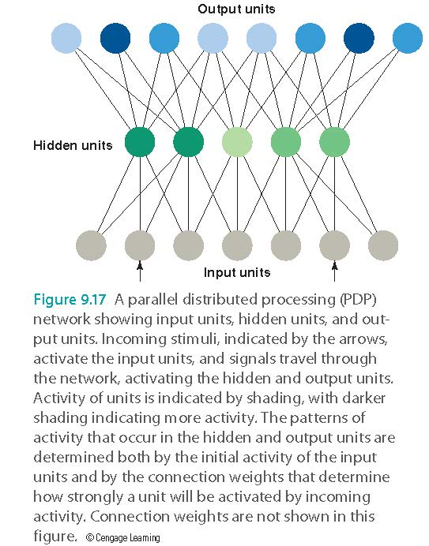
The Connectionist Approach
“Units”
  Input units: activated by stimulation from environment
  Hidden units: receive input from input units
  Output units: receive input from hidden units

Slide 53
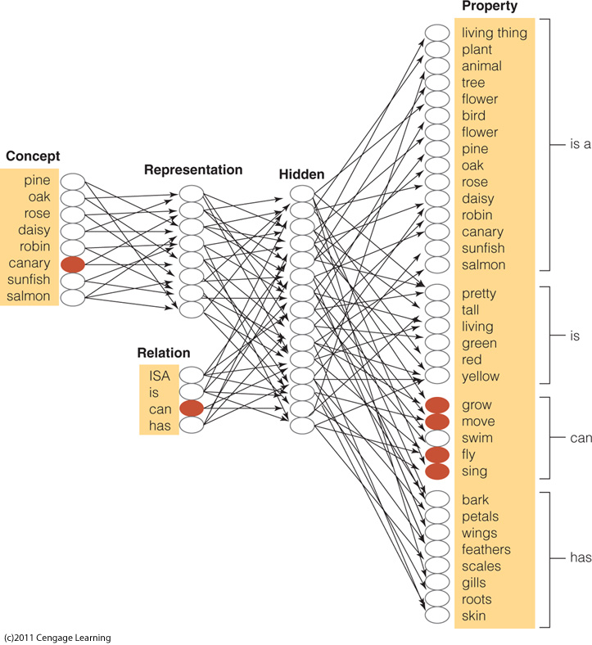

Slide 54
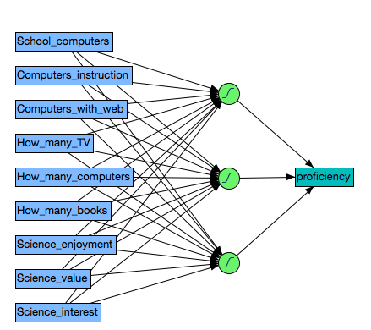
Artificial neural network (ANN)
This is what we do in computing!
A typical neural network is composed of three types of layers
  input layer: data
  hidden layer: data transformation and manipulation
  output layer
If there are multiple hidden layers, it is called deep learning.

Slide 55

The Connectionist Approach
How learning occurs
  Network responds to stimulus
    A Yellowhammer is: →
  But that is wrong, so we learn the correct concept.
  An error signal is sent back through the units to adjust the connection weights appropriately.
    A Yellowhammer is: →
Notes:
How did the Llama get its name.

Slide 56
The Connectionist Approach
Error signal
  Difference between actual activity of each output unit and the correct activity
Back-propagation: error signal transmitted back through the circuit
Indicates how weights should be changed to allow the output signal to match the correct signal
The process repeats until the error signal is zero

Slide 57
Support for Connectionism
Graceful degradation: performance disruption occurs gradually as parts of the system are damaged
  Network operation is not totally disrupted by damage
Explains generalization of learning
  Training system to recognize properties of one concept provides information about related concepts
  Machine learning is similar to human learning process; we cannot program every instruction into the computer.

Slide 58
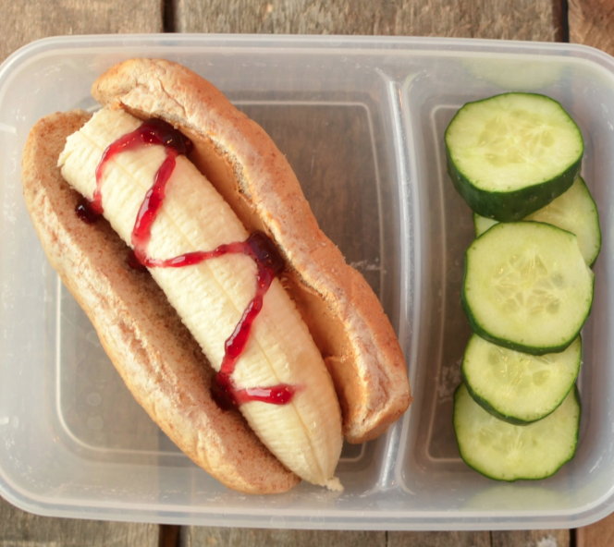
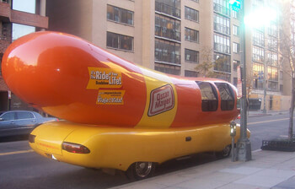
Machine learning is still imperfect
Image recognition learned many example of “hot dog” but you can still fool an AI computer.

Slide 59
Pop quiz: Which of the following artificial intelligence (AI) is true?
The connectionist approach to AI is based on logic.
The symbolic approach of AI is based on neuroscience
The logical notation is more natural than the semantic network
AI is not perfect. You can still fool the computer to recognize a banana as a hot dog.
All of the above

Slide 60
Break out session: Ungraded discussion
Form a small group of 3-5 to discuss the following
Data scientists and AI researchers attempt to make computers as smart as humans based on our knowledge of cognitive science (e.g. semantic network, neuro network).
Do you think eventually there will be AI that is better than human intelligence?
What would be the potential problems if too many things in our society are operated by AI?

Slide 61
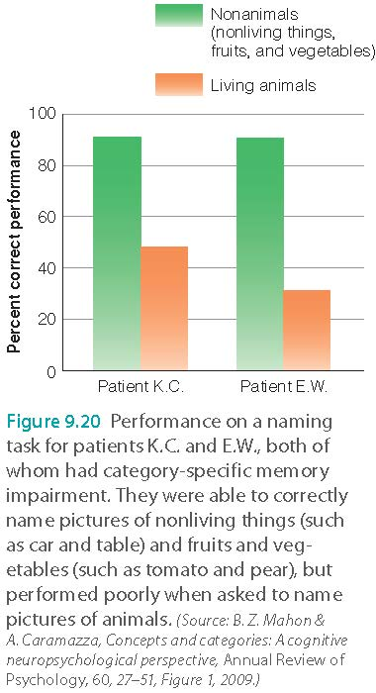
Sensory-Functional Hypothesis
Different brain areas may be specialized to process information about different categories
  Double dissociation for categories “living things” and “nonliving things” (artifacts)
Category-specific memory impairment
Sensory-functional hypothesis:
  living things → sensory properties
  artifacts → functions

Slide 62
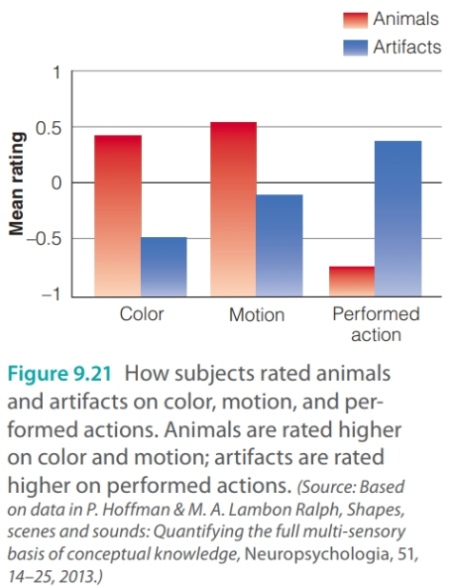
The Multiple-Factor Approach
The focus is NOT on the brain area or clear-cut features
We use multiple features to categorize
  Animals → motion and color
  Artifacts → actions (using, interacting)
Crowding:
  animals share many properties (like eyes, legs, and the ability to move).
  artifacts like cars and boats share fewer properties (they are both vehicles).

Slide 63
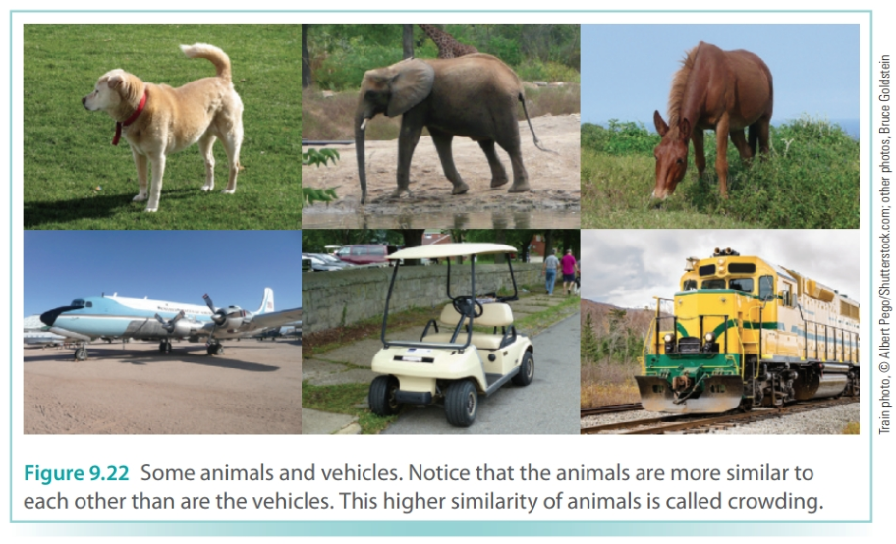
The Multiple-Factor Approach

Slide 64
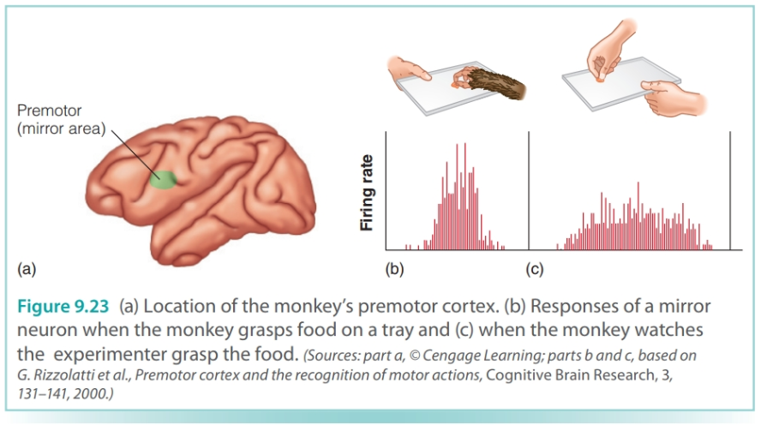
The Embodied Approach
Our knowledge of concepts is based on reactivation of sensory and motor processes that occur when we interact with the object
Mirror neurons: Neurons that fire when we do a task or when we observe another doing that same task
Might explain empathy (I feel your pain) and how we learn from other people
YouTube Movie

Slide 65

The Embodied Approach
Semantic somatotopy:
Areas of the brain involved in movement and sensation, as well as movement itself, influence mental processes such as language comprehension

