Slide 1
Language
If you talk to a man in a language he understands, that goes to his head. If you talk to him in his language, that goes to his heart.
Nelson Mandela
The most terrifying words in the English language are: I'm from the government and I'm here to help.
Ronald Reagan
Man acts as though he were the shaper and master of language, while in fact language remains the master of man.
Martin Heidegger

Slide 2
Count the number of Fs
FINISHED FILES ARE THE RESULT OF YEARS OF SCIENTIFIC STUDY COMBINED WITH THE EXPERIENCE OF YEARS.
Don’t look at the next slide!
Notes:
6

Slide 3
Count the number of Fs
The correct answer is 6!
Most people found 3 only.
There is a tendency for us to ignore prepositions and therefore we do not count the “f” in “of”.
Perhaps it is because it sounds like “ov” or we focus on “lexical” words rather than “grammatical” words.
Lesson: Even though language seems “natural,” we still have certain cognitive bias.
Notes:
6

Slide 4
Some Questions to Consider
How do we understand individual words, and how are words combined to create sentences?
How can we understand sentences that have more than one meaning?
How do we understand stories?
Does language affect the way a person perceives colors?

Slide 5
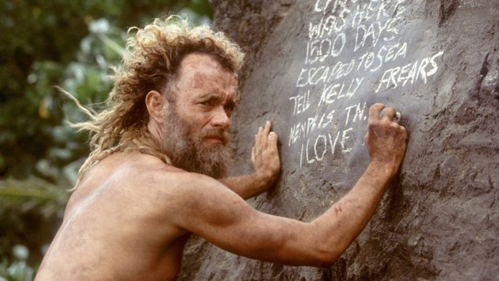
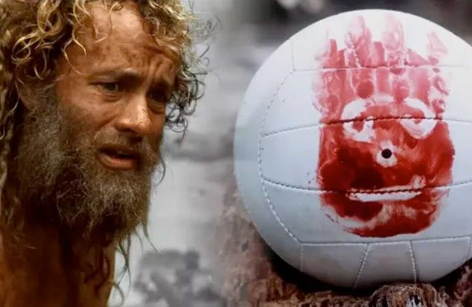
What Is Language?
System of communication using sounds or symbols
Express feelings, thoughts, ideas, and experiences
Your life is difficult without using any language: Imagine that you are trapped in a barren island after a ship wreck. You have no one to talk to.
Tom Hanks: Cast away (2000)
He created “Wilson” but lost him when he attempted to escape from the island.
https://www.youtube.com/watch?v=GGp03lY3_pc

Slide 6
The Creativity of Human Language
Hierarchical system
  Components that can be combined to form larger units
  Characters/letters → words → sentences → paragraphs
Governed by rules
  Grammar: Specific ways components can be arranged
Notes:
What makes language distinct from communication is that it is regular – or governed by rules (grammar) – and it is productive – infinite combinations of things can be expressed in it.

Slide 7
The Universality of Language
Deaf children invent sign language
All cultures have a language
Language development is similar across cultures
    Europe – 230 spoken languages
    Asia – 2, 197 spoken languages
    Papua-New Guinea – 832 languages (3.9 million people)
    North America – 165 indigenous languages, only eight are spoken by as many as 10,000 people. (Stephen R. Anderson)

Slide 8
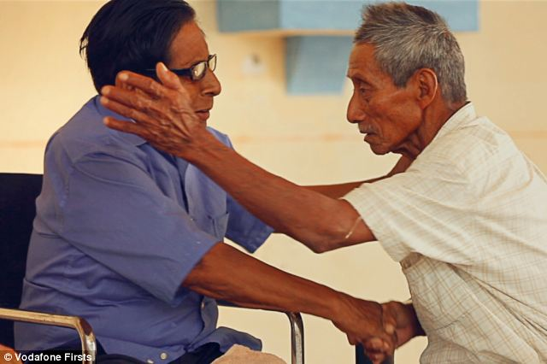
The Universality of Language
Ayapaneco – Last two speakers live 1,640 feet away
  Manuel Segovia (Age 82?)
  Isidro Velazquez (Age 76?)
  http://www.dailymail.co.uk/news/article-2632996/Separated-common-language-no-Last-two-speakers-dying-tongue-decades-long-feud-help-bring-brink-extinction.html

Slide 9
The Universality of Language
Languages are “unique but the same”
  Different words, sounds, and rules
  All have nouns, verbs, negatives, questions, past/present tense
Even the same language, different ways
  Southern: https://www.youtube.com/watch?v=twmuOnKgEJ0
  Australian: https://www.youtube.com/watch?v=yDb_WsAt_Z0
Notes:
Language is also a representation of culture.

Slide 10
Studying Language in Cognitive Psychology
B.F. Skinner (1957) Verbal Behavior
  Language learned through reinforcement
Noam Chomsky (1957) Syntactic Structures
  Human language coded in the genes
  Underlying basis of all language is similar
  Children produce sentences they have never heard and that have never been reinforced
  http://www.ted.com/talks/patricia_kuhl_the_linguistic_genius_of_babies.html

Slide 11
Studying Language in Cognitive Psychology
Psycholinguistics: discover psychological process by which humans acquire and process language
  Comprehension
  Speech production
  Representation
  Acquisition

Slide 12
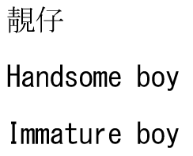
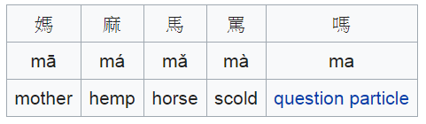
Perceiving and Understanding Words
Lexicon: all words a person understands
Phonemes: shortest segments of speech that, if changed, changes the meaning of the word
  11 in Hawaiian
  47 in English
  60 in some African Dialects

Slide 13
Perceiving and Understanding Words
Morphemes: smallest units of language that has meaning or grammatical function
  Free: standalone e.g. eat, date, weak
  Bounded: cannot standalone e.g. Restart, disregard

Slide 14
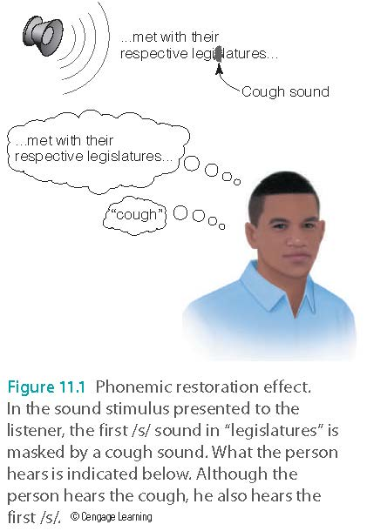
Perceiving and Understanding Words
Phonemic restoration effect
  “Fill in” missing phonemes based on context of sentence and portion of word presented
  Example of Top-Down Processing
https://www.youtube.com/watch?v=UlJs24j3i8E

Slide 15
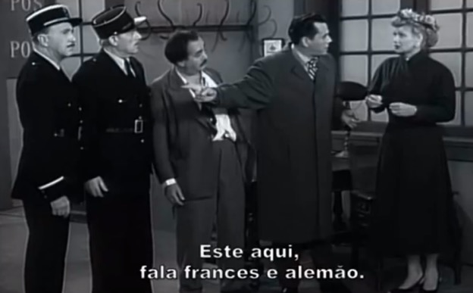
Perceiving and Understanding Words
Speech segmentation
  Context
  Understanding of meaning
  Understanding of sound and syntactic rules
  Statistical learning
https://www.youtube.com/watch?v=Xtbbo_lHqAs

Slide 16
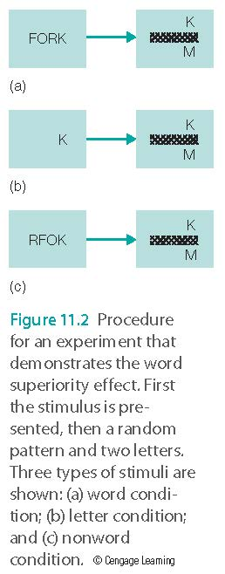
Reading: The Word Superiority Effect
The finding that letters are easier to recognize when they are contained in a word than when they appear alone or are contained in a nonword

Slide 17
Understanding Words
Word frequency effect
  Respond more rapidly to high-frequency words
Eye movements while reading
  Look at low-frequency words longer

Slide 18
Understanding Words
Lexical ambiguity
  Words have more than one meaning
  Context clears up ambiguity after all meanings of a word have been briefly accessed
    i.e. rusty
      After the game, Jim had to admit that he was a bit rusty.
      Susan considered going to the dance with Rusty.
      I bought an old bicycle with rusty gears.
      I bought an old bicycle with Rusty Geers.
Notes:
Tea

Slide 19
Understanding Words
Meaning dominance – The fact that some words are used more frequently than others
  Biased dominance
    When words have two or more meanings with different dominance
  Balanced dominance
    When words have two or more meanings with about the same dominance

Slide 20
Examples of Lexical Ambiguity
The Cast (Cook) worked into the night.
  Longer fixation
The tin (gold) was bright and shiny.
  Same fixation
The miners went to the store and saw that they had beans in a tin (gold).
  Longer fixation
The miners went under the mountain to look for tin (gold).
  Same fixation

Slide 21
Understanding Sentences
Garden path sentences
  Sentences that begin by appearing to mean one thing, but then end up meaning something else
Temporary ambiguity
  When the initial words are ambiguous, but the meaning is made clear by the end of the sentence
After the musician played the piano was wheeled off the stage.
After the musician played, the piano was wheeled off the stage.

Slide 22
Understanding Sentences
Semantics: meanings of words and sentences
Syntax: structures and rules for combining words into sentences

Slide 23
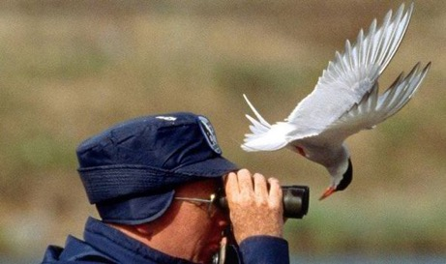
Understanding Sentences
Interactionist approach to parsing
  Semantics and syntax both influence processing as one reads a sentence
  The spy saw the man with the binoculars
  The bird saw the man with the binoculars
  The man saw the bird with the binoculars

Slide 24
Ungraded Pop quiz: Which of the following statements is true?
How we interpret a sentence depends on its meaning and context.
How we interpret a sentence depends on its grammatical structure.
How we interpret a sentence depends on the processing speed of our working memory.
Both A and B

Slide 25
What does it mean?
Soviet Virgin Lands Short of Goal Again
It could mean the landings of Virgin Airline operated in Russia could not meet expectations (bumpy landing)

Slide 26
What does it mean?
Soviet Virgin Lands Short of Goal Again
In 1953 the Virgin Lands campaign was launched in an attempt to boost the Soviet Union’s agricultural production by utilizing unused lands.

Slide 27
What does it mean?
The poor living conditions caused many workers to leave the Virgin Lands.
Very little infrastructure existed in the Virgin Land provinces. When harvesting began there were minimal storage facilities for the crops. A large amount of the crop left in the fields to rot.

Slide 28
What does it mean?
British Left Waffles on Falkland Island
It could mean: British people are so nice that they left a lot of food on the island when they left.

Slide 29
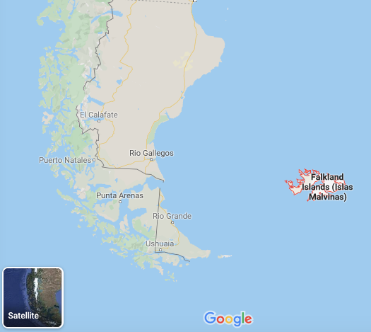
What does it mean?
British Left Waffles on Falkland Island
British Left Waffles on Falklands” was an actual news headline in the UK’s Guardian newspaper when the UK and Argentina fought a war over the ownership of the Falkland Islands in 1982.

Slide 30
What does it mean?
British Left Waffles on Falkland Island
The UK political parties in England argued how to respond to the crisis.
In British English, an indecisive state is referred to as “waffling.”

Slide 31
Can you figure out what these mean?
The student failed the professor
Eye drops off shelf
Farmer Bill Dies in House
Police begin campaign to run down jaywalkers
Teacher strikes idle kids
Iraqi head seeks arms
Kicking baby considered to be healthy
President Reagan wins on budget, but more lies ahead
Two sisters reunite after eighteen years at checkout counter
Ousted Ambassador to Ukraine Testifies in House

Slide 32
Culture, Language, & Cognition
Sapir-Whorf hypothesis: language influences thought
Example: How the Chinese language influences mathematical reasoning:
https://www.youtube.com/watch?v=KZDCCHwGDpI

Slide 33
2012

Slide 34
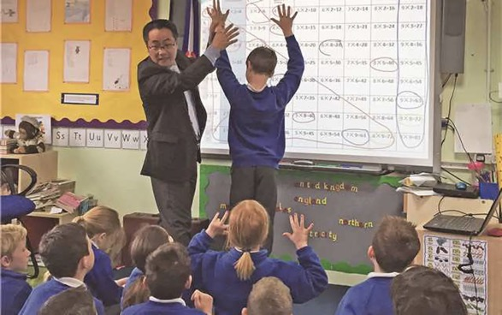
Culture, Language, & Cognition
In 2014, the British government sent a team to Shanghai to learn how mathematics was taught there.
Later the UK invited about 70 math teachers from Shanghai to teach in England.
After the pilot study, the UK adopted the Shanghai math teaching methods in 8,000 primary schools.
35 math teaching centers were established throughout the country to promote the Chinese method.

Slide 35
Culture, Language, & Cognition
British schools try to replicate that success by using translated textbooks identical to those in public elementary schools around Shanghai.
Problem: The two language systems are vastly different. Even if the UK students use translated Shanghai textbooks, the thought processes in mathematics are not the same.

Slide 36
Breakout sessions: Assignment
Form a group of 3-5. At least one team member is bilingual or multi-lingual.
Discuss how different languages influence the thought process. Please give concrete examples.
Post a short report (0.5-1 page) to Canvas.

