Slide 1
Problem-Solving
Vanquishing Ganondorf & rescuing Princess Zelda

Slide 2
Some Questions to Consider
What makes a problem hard?
How can analogies be used to help solve problems?
How do experts in a field solve problems differently than non-experts?

Slide 3
What Is a Problem?
An obstacle between a present state and a goal
Not immediately obvious how to get around the obstacle

Slide 4
What Is a Problem?
Well-defined: correct answer, certain procedures will lead to solution (what we usually do at school)
Ill-defined: path to solution is unclear, no one has the “correct” answer
https://www.youtube.com/watch?v=v9wdn0tQiPQ
http://www.youtube.com/watch?v=aIGTyANMFb4

Slide 5
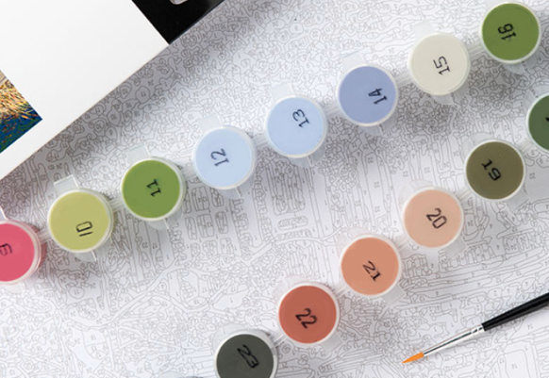
The problem of well-defined problem
US math educator Paul Lockhart (2009)
In an art class, the teacher shows the students a worksheet of “Paint-by-Numbers.” There are numbers corresponding to pigments on a piece of paper. All that the students need to do is to paint the color on the paper by following the assigned numbers!
This is how we learn math: plug the numbers into the formula.

Slide 6
Productive failure
Kapur: the instructor asks the learners to solve an ill-defined problem with ill-structured information while withholding guidance and feedback. It is expected that the learners will be frustrated, confused, and generate misconceptions, but at that point the instructor corrects their misconceptions and consolidates their knowledge.
Why?

Slide 7
Productive failure: Training problem solving skills
In the real world, usually the problem is ill-defined, some variables are missing, the data are messy, and there is no apparent structure.
In conventional classrooms, learners might develop a false sense of competence by just following a step-by-step guideline to solve an easy problem. However, procedural based, hands-on exercises are vastly different from real science inquiry.
When learners acquire concepts in a well-structured fashion, they might not understand why the concepts are organized in the way that they are.

Slide 8
problem solving: What it takes
Jonassen (2010): Problem solving entails multiple qualities such as a consistent and passionate curiosity toward an unseen problem and a sparkling creativity in the ways the solver approaches the problem.
Discernment: the problem-solver must understand the nature of the problem before carrying out any action.
When a man holds a hammer, every problem is a nail.

Slide 9
Breakout: Ungraded discussion
Form a small group of 3-5 to discuss the following:
Some educators assert that a good structure, such as aligning the instruction and the assessment, is the key to effective learning. Follow this line of reasoning, a good instructor should provide as many guides as possible to the students. Other educators argue that it is better for the students to learn how to solve ill-defined and ill-structured problem that are more common in the real world.
What do you think? There is no right or wrong answer.

Slide 10
Gestalt Approach
How to solve a problem depends on how to representing a problem in the mind
Restructuring: changes the problem’s representation
Kohler’s problem
https://www.youtube.com/watch?v=6-YWrPzsmEE

Slide 11
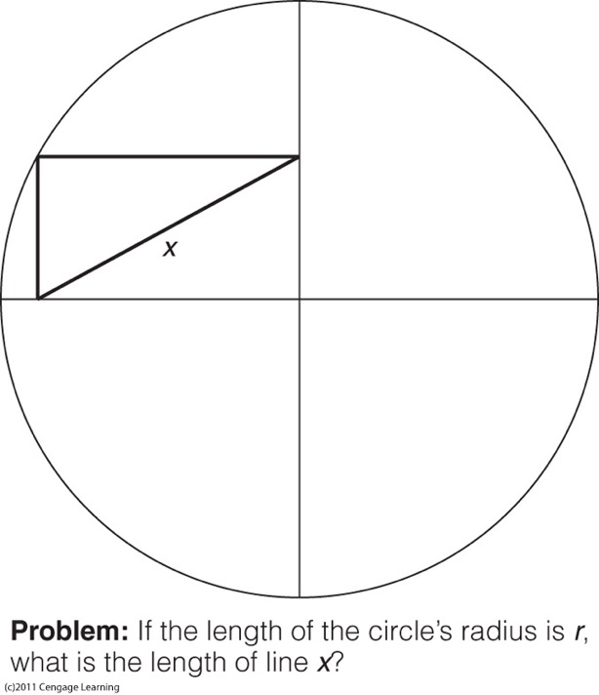
Hints: You may be searching for mathematical theorems and equations.
Actually you don’t need advanced math to solve this problem.

Slide 12
Re-define or re-structure the problem
Hot dog eating contest
Original question: How can I eat as many hot dogs as possible within a short period of time?
Re-framed question: How a large amount of hot dogs can fit into a human’s stomach as soon as possible?

Slide 13
Solomon Method
Takeru Kobayashi
2012: set the new world record at the State Fair of Texas for eating 60 hot dogs in 2 minutes 35 seconds.
Eat hot dogs by dipping the buns in water, and then stuffing it in his mouth.
https://www.youtube.com/watch?v=Bj0CXP_xSL4

Slide 14
Insight (Ah! HA!) in Problem-Solving
A bat and a ball cost $1.10 in total. The bat costs $1 more than the ball. How much does the ball cost?
Most people respond by saying that the ball must cost 10 cents. If the ball cost 10 cents and the bat costs $1.00 more than the ball, then the bat would cost $1.10. The grand total would be $1.20.
Correct answer: The ball costs 5 cents and the bat costs $1.05 so that the grand total is $1.10.

Slide 15
Insight in Problem-Solving
A lily pad on a pond doubles in size every day. It took at total of 30 days for the lily pad to completely cover the pond. How many days did it take the lily pad to cover half of the lake?
This is an exponential growth: If the lily pad covers the entire pond on the 30th day, and it is doubling in size everyday, then the day before (the 29th day) it covered half of the pond.

Slide 16
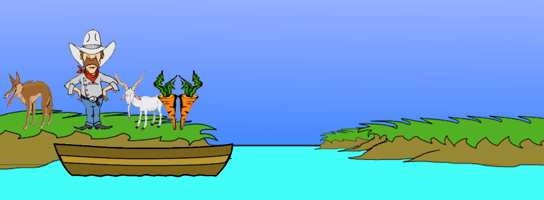
Challenges
Marsha and Marjorie were born on the same day of the same month of the same year to the same mother and the same father yet they are not twins. How is that possible?
They are part of a set of triplets.
River crossing problem
http://www.transum.org/software/River_Crossing/Level1.asp

Slide 17
Insight in Problem-Solving
Metcalfe and Wiebe (1987)
  Insight problems solved suddenly (ah-ha!)
  Non-insight problems solved gradually (e.g. Wright brothers need to study the engineering aspect of every component of an airplane).

Slide 18
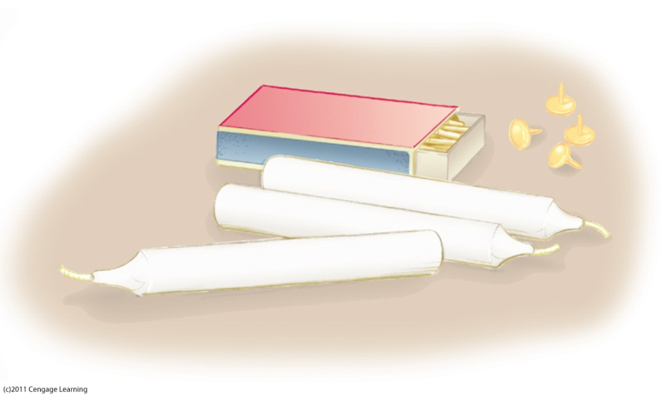
Obstacles to Problem-Solving: Functional Fixedness
How would you mount the candle on a cork board so that the wax does not drip on the floor?

Slide 19
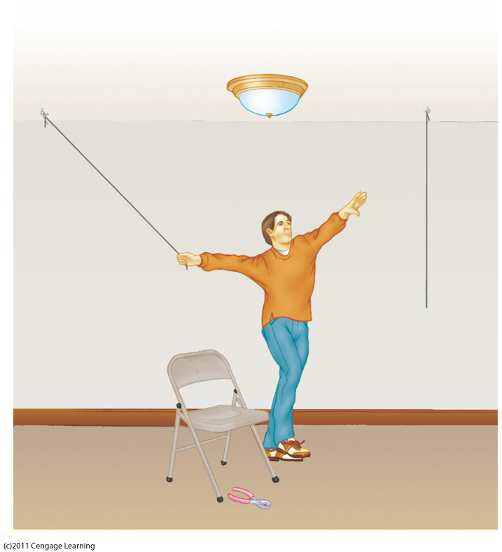
Obstacles to Problem-Solving: Functional Fixedness
How would you tie the two strings that are very far part from each other?

Slide 20
Obstacles to Problem-Solving
Functional fixedness: restricting use of an object to its familiar functions
  Candle problem: seeing boxes as containers inhibited using them as supports
  Two-string problem: function of pliers gets in the way of seeing them as a weight

Slide 21
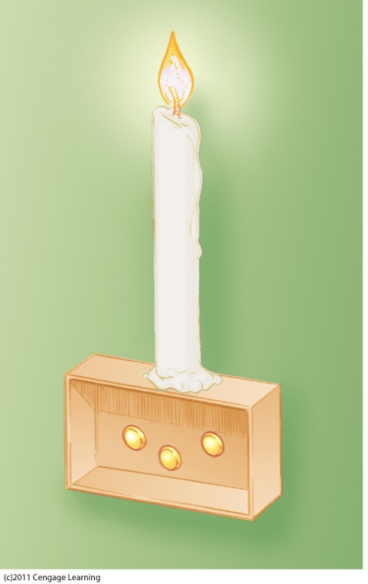
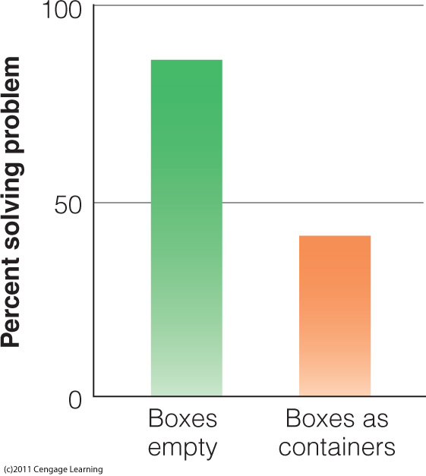

Slide 22
Information-Processing Approach
Newell and Simon: Problem space
    Initial state
    Intermediate state(s): Sub-goals
    Goal state: Ultimate goal
  Means-end analysis: reduce differences between initial and goal states
  Sub-goals: create intermediate states closer to goal

Slide 23
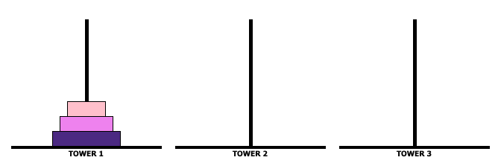
Information-Processing Approach
Tower of Hanoi
Operators: rules specify which moves are allowed and which are not
http://vornlocher.de/tower.html
64 discs on peg one
18,446,744,073,709,600,000

Slide 24
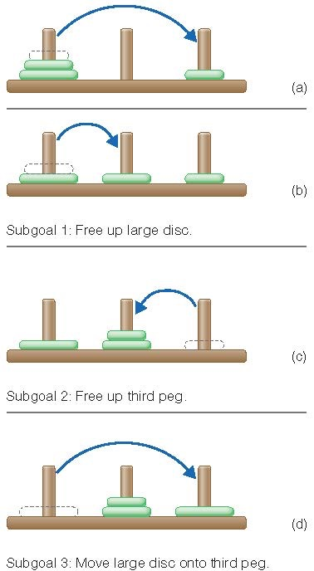
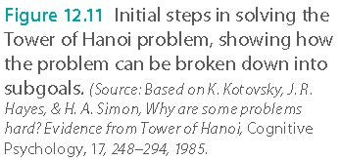
Information-Processing Approach

Slide 25
The Importance of How a Problem Is Stated
Think-aloud protocol
  Also known as mental protocol
  Say aloud what one is thinking
  Shift in how one perceives elements of a problem

Slide 26
Pop quiz: Which of the following is true?
    A problem space can be divided into three states: Initial state, sub-goals, and ultimate goal.
    One can use optimal means analysis to reduce differences between the initial and goal states.
    Sub-goals are intermediate states that can be closer to or farther away from the ultimate goal.
    All are true.

Slide 27
The goal of having the participants think aloud is to reveal what information is kept in short-term memory (STM) during the problem solving process.
STM corresponds the "voice" one is aware of during self-talk.
STM is the working space for problem solving and a place holder for transferring information to long-term memory, the think aloud protocol can be used for understanding cognitive processes for diagnosis.

Slide 28
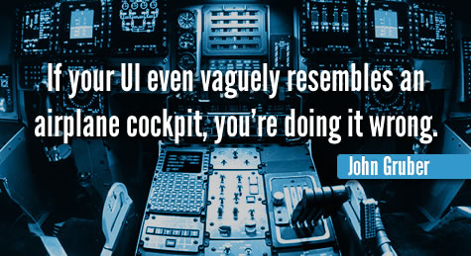
User interface design and ergonomics
A method to collect data for testing usability or user interface
Introduced by Clayton Lewis at IBM
The user verbalize what he or she is thinking while performing the task

Slide 29
Think-aloud protocol
User interface design: what do users think during the process?
Diagnostic tool: What are the learners thinking? What are their misconceptions?
Instructional design and assessment design: How do the experts solve the problem?
Assessment tool: Does the learner really know what he is doing?

Slide 30
Using Analogies to Solve a Problem
Using a solution to a similar problem guides solution to new problem
Analogical problem solving
Analogical transfer: The transfer from the source problem to target problem

Slide 31
Duncker’s Radiation Problem
Suppose you are a doctor faced with a patient who has a tumor in his stomach. It is impossible to operate on the patient, but unless the tumor is destroyed the patient will die. There is a kind of ray that can be used to destroy the tumor. If the ray reaches the tumor at a sufficiently high intensity, the tumor will be destroyed. Unfortunately, at this intensity the healthy tissue that the ray passes through on the way to the tumor will also be destroyed. At lower intensities the ray is harmless to healthy tissue, but it will not affect the tumor either. What can you do?

Slide 32
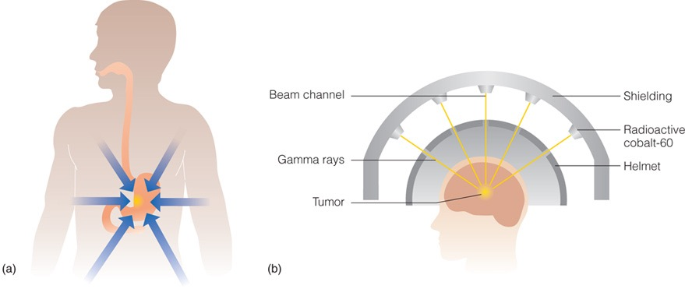
Solution: To bombard the tumor with a number of low-intensity rays from different directions, which destroys the tumor without damaging the tissue the rays are passing through.

Slide 33
Lightbulb problem
  In a physics lab at a major university, a very expensive lightbulb, which would emit precisely controlled quantities of light, was being used in some experiments. One morning Ruth, the research assistant, came into the lab and found that the lightbulb no longer worked. She noticed that the filament inside the bulb had broken into two parts. The sur- rounding glass bulb was completely sealed, so there was no way to open it. Ruth knew that the lightbulb could be repaired if a brief, high-intensity laser beam could be used to fuse the two parts of the filament into one.

Slide 34
Lightbulb problem
  However, a high-intensity laser beam would also break the fragile glass surrounding the filament. At lower intensities the laser would not break the glass, but neither would it fuse the filament. What type of procedure might be used to fuse the filament with the laser and at the same time avoid breaking the glass?
  Mapping the two problems by their structural features, not surface features.

Slide 35
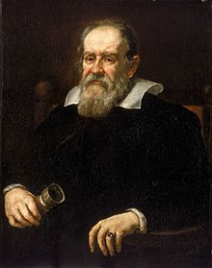
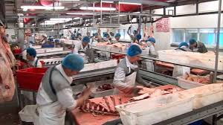
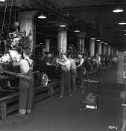
Analogical Thinking
Henry Ford ‘s assembly line is borrowed from butchers’ conveyor belt system
Galileo did NOT invent the telescope. He used spyglass for the military in astronomy

Slide 36
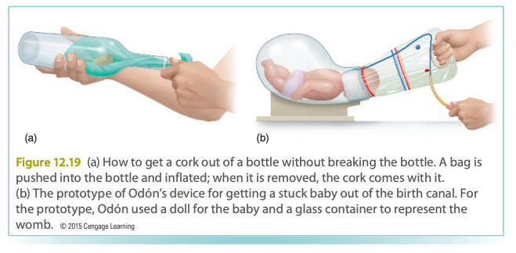
Analogical thinking: Odon device
A device to deal with life-threatening situation of a baby stuck in the birth canal.
Invented by Jorge Odon, a car mechanic (not a doctor), after he watched a YouTube movie about how to use an inflated plastic bag to get a cork out of a bottle.

Slide 37
How Experts Solve Problems
What is an expert?
  “A person who, by devoting a large amount of time to learning about a field and practicing and applying that learning, have become acknowledged as being extremely knowledgeable or skilled in that field.”

Slide 38
How Experts Solve Problems
Experts solve problems in their field faster and with a higher success rate than beginners
Experts possess more knowledge about their fields
But sometime too much knowledge hinders the expert from trying new ideas.
Tension between problem solving and innovation.

Slide 39
How Experts Solve Problems
Knowledge is organized so it can be accessed when needed to work on a problem.
Novice: surface features
Expert: structural features

Slide 40
How Experts Solve Problems
Experts spend more time analyzing problem
Experts are no better than novices when given problems outside of their field.
E.g. Noam Chomsky: Linguistics
Wrote many books and articles on politics without thorough research on the subject matter (e.g. China)

Slide 41
How Experts Solve Problems
Experts less likely to be open to new ways of looking at problems
Hinder creativity?
Linus Pauling: “If you want to have good ideas you must have many ideas. Most of them will be wrong, and what you have to learn is which ones to throw away”
Problem: He has too many wrong ideas!

Slide 42
Linus Pauling
The founder of molecular biology due to his discovery of the spiral structure of proteins.
Won the Nobel Prize in Chemistry in 1954.
But he proposed the incorrect model of DNA.
He thought high dose vitamin C could be a cure for numerous diseases, including cancer.

Slide 43
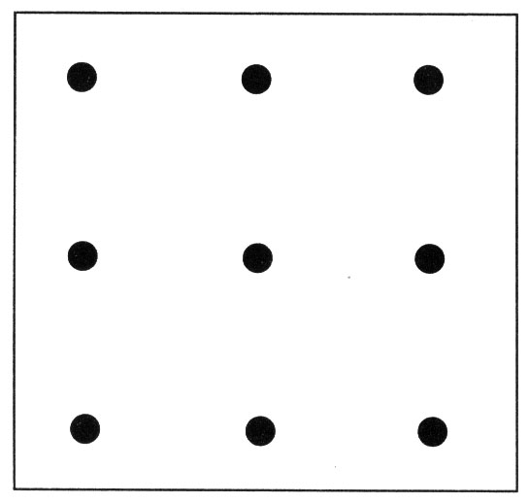
Nine Dot Problem
The goal of the puzzle is to link all 9 dots using four straight lines or fewer, without lifting the pen and without tracing the same line more than once.
Think outside the box: https://www.youtube.com/watch?v=Rq3ta6SvlTo

Slide 44
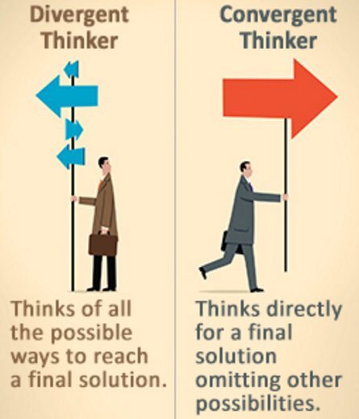
Creativity: Divergent thinking
A type of mindset that can find more than one possible solution to a problem
4 Different aspects:
Fluency- ability to produce numerous ideas
Originality- ability to produce different/unusual ideas
Flexibility- ability to produce a variety of ideas
Elaboration- ability to embellish ideas

Slide 45
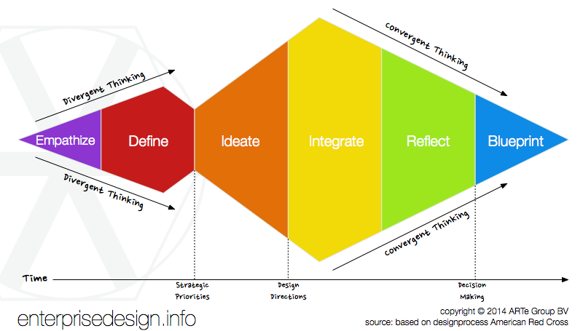
Convergent thinking
Encourages students to explore solutions before selecting the most viable solution.
The instructor can assess and bring awareness of the available heuristics to the learner
Convergent thinking is part of the creative process. ( i.e. Convergent ->Divergent thinking-> Convergent)
Notes:
Working together in groups in order to create common ideas to build the best idea possible
Ex: Team sports

Slide 46

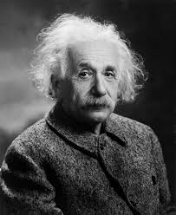
Counterfactual Thinking
COUNTERACTUAL REASONING
Factual: existing
Counter-factual: does not exist
to create possible alternatives that is contrary to what actually happened.
When Albert Einstein was 16, he asked, “What if I could chase after a light beam?”
helps to create a new thought that can replace the uncomfortable thought. Encourage them to accept the new thought.
Notes:
Let’s add Albert Einstein’s quote about chasing light… being counterfactual thinking.
Similar to the idea of false memories
You are human and imperfect. That's ok. Beware of people trying to change history.
http://changingminds.org/explanations/theories/counterfactual_thinking.htm

Slide 47

Counterfactual thinking
What are two parallel lines?
Is there another way?

Slide 48
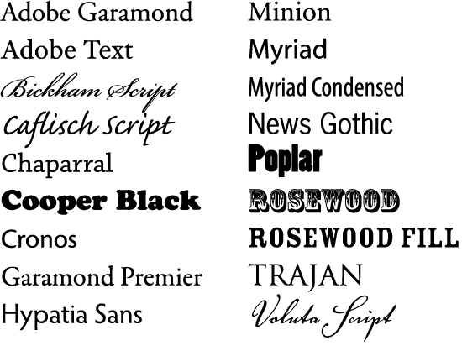
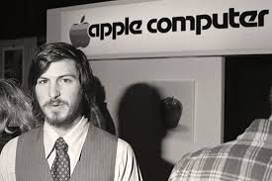
Combinational Thinking
Similar to analogical thinking: Put seemingly unrelated things together to make a new thing
Steve Jobs combined artistic topology and computing into Mac’s user interface.

Slide 49
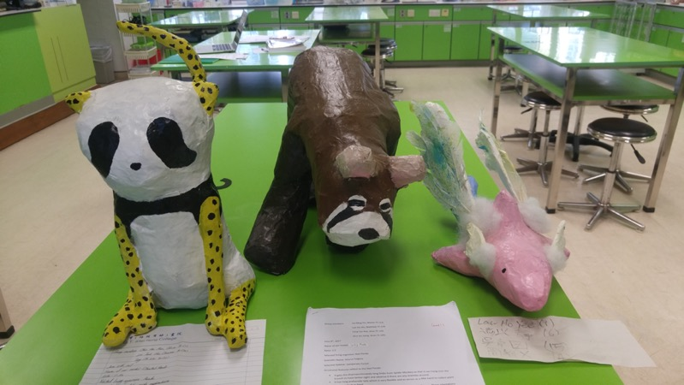
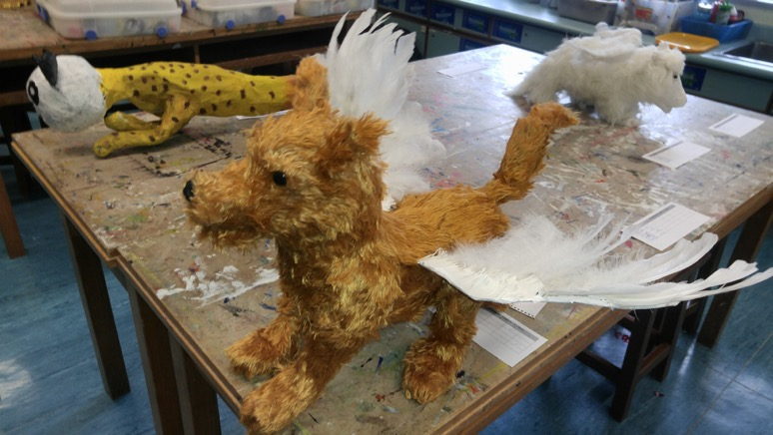
Training for combinational thinking
Create hybrid animals in a Hong Kong high school

Slide 50
Creative Destruction
In order to create something new, we must go through the process of letting go of our current paradigms.
- For example, today we invest R&D into green energy but by doing so coal miners will lose their jobs.
-Similarly, some researchers want to do more data science/data mining but by doing so people who don't know the new skills are threatened.
- The idea of creative destruction is similar to the idea of using a fire to destroy areas of land, but having newer plant life being able to grow and thrive in said environment.

Slide 51
Creative Problem-Solving
Creative cognition: technique to train people to think creatively
Pre-inventive forms: ideas that precede creation of finished creative product
http://www.ted.com/talks/ken_robinson_changing_education_paradigms
http://www.ted.com/talks/ken_robinson_says_schools_kill_creativity#t-310139

Slide 52
Assignment
Form a small group to discuss the following: On one hand experts are able to solve problems better and faster than novices. On the other hand preconceptions (expertise) might hinder experts from thinking outside the box.
Linus Pauling tried to resolve the dilemma between problem–solving and creativity by trying many new ideas, but at the end he produced many bad ideas (e.g. high dose Vitamin C).
How can you achieve the optimal balance between expertise and creativity? There is no right or wrong answer.

