Slide 1
Unit 1: Introduction

Slide 2
Modern psychology vs. Folk psychology
Modern psychology: A product of science
Folk psychology: Unscientific, based on personal experience, observation, and reflection.
‘The reflections in the Bible belong to the category of “folk psychology” or “lay psychology,” since they do not constitute a systematic and comprehensive exploration of human nature generated for the purpose of contributing to human knowledge.’

Slide 3
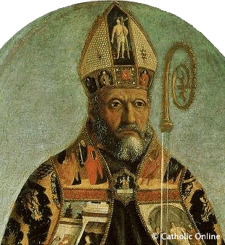

Augustine of Hippo: The first Christian “psychologist”?
Augustine of Hippo: On Christian Teaching, On Catechizing the Uninstructed, On the Trinity, and the Confessions.
recognized the sinful nature of humans
wrote psychologically about his personal struggle to know, love, and enjoy God.

Slide 4
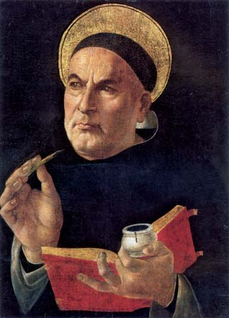
Thomas Aquinas:
Saint of evolutionary psychology?
Aquinas integrated the Augustinian and Aristotelian schools and produced an influential body of psychological ideas, covering the appetites, the will, habits, the virtues and vices, the emotions, memory, and the intellect.
He believed humans were created out of the same basic materials used for all creatures and therefore we were connected.
Humans are animals!

Slide 5
Thomas Aquinas:
Saint of evolutionary psychology?
He rejected mind-body dualism, an idea that our mind (soul) is totally independent of our body.
Our body affects our mind and vice versa: “some men have bodies of better disposition, their souls have greater power of understanding”
Males and females stay together after sex because they need to take care of their children together: the long-term bonding theory is also found in modern evolutionary psychology.

Slide 6
Thomas Aquinas:
Saint of evolutionary psychology?
Unlike Augustine, Aquinas did not see human nature as inherently sinful. In alignment with Aristotle he asserted tha we are social animals that want to get along in community: Another core idea of evolutionary psychology.
https://www.huffingtonpost.com/matt-j-rossano/thomas-aquinas-evolution_b_757973.html

Slide 7
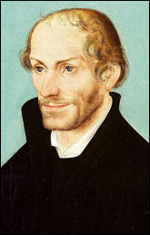
Reformers started psychology?
Reformers like Luther and Calvin reflected deeply on sin, grace, knowledge, faith and the nature of the Christian life. Their focus is pastoral care.
Philip Melanchthon attempted to build a God-centered approach to psychology.
“Psychology, as a discipline, does not find its origin in Sigmund Freud or the Psychoanalytic theory. Philip Melanchthon who played a significant role in the Reformation sought to observe the discipline of philosophy and all of its “branches,” such as psychology, from a theological worldview desiring to establish the discipline in its proper place.”
https://www.calvary.edu/reclaiming-historical-behavioral-science-reformation-laid-groundwork-biblical-psychology/

Slide 8
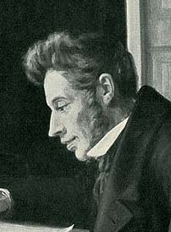
Soren Kierkegaard (1813-1855)
The founder of existential philosophy
“Possibly the most significant Christian psychology author since the Middle Ages was Søren Kierkegaard, who used the word psychology to describe some of his works.”
Wrote about the nature of personhood, sin, anxiety and despair, and the unconscious.

Slide 9

Soren Kierkegaard (1813-1855)
His approach is philosophical, not scientific (based on personal observation and reflection).
Existential problem: Anxiety arises from “Who am I? Why am I here? What will I become? How can I choose?”
We need leap of faith to overcome doubt and anxiety.
https://www.youtube.com/watch?v=mLjgfMj2W6k&t=128s
Do you agree or disagree? Let’s go to four corners.

Slide 10
Christian contribution to psychology
“So if we define psychology broadly as a rigorous inquiry into human nature and how to treat its problems and advance its well-being, Christians have been thinking and practicing psychology for centuries.”
It depends on how we define psychology
Modern psychology: Scientific
Folk psychology or philosophical psychology: Personal observation and reflection.

Slide 11
Modernism
Special revelation and tradition can no longer be regarded as ultimate authorities.
Human reasoning
Objective and universal understanding
Natural science is the best way of inquiry
  Systematic empirical data
  Logical and mathematical deduction

Slide 12
Secularism
The exclusion of religious discourse from the public square, including government and science (e.g. no prayer in public schools)
The reduction in religious belief and practice in daily life.
Diversity and pluralism: other worldview options.

Slide 13
Secularism contribution to modernity
“Many of the shapers of Western culture over the past hundred years have publicly disparaged traditional religious perspectives (e.g., Marx, Nietzsche, Freud, H. G. Wells, John Dewey, Bertrand Russell, Jean-Paul Sartre, Michel Foucault, Richard Rorty, Daniel Dennett and Richard Dawkins).
Who are they? Can you Google and share what you found with the class?

Slide 14
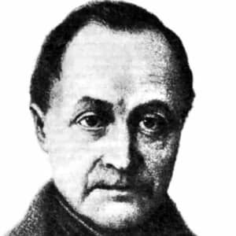
Positivism
Auguste Comte (1798-1857)
The founder of modern sociology and positivism (don’t mix up positivism and logical positivism)
Applied scientific principles to study of society
Knowledge must be something that can be verified as true or false.
Ethical and metaphysical claims (about the nature of human beings and God) are not knowledge; they are just opinions that cannot be scientifically confirmed or disconfirmed.

Slide 15
Christianity was put aside
“As the impetus to turn psychology into a natural science grew across the West, biblical study and philosophical reflection were systematically excluded as sources of knowledge about human nature, in favor of the empirical investigation of the structures and processes of the senses, mind, memory and behavior.”
“The new psychology promised to offer a better basis for understanding human life and the improvement of humankind without religion.”

Slide 16
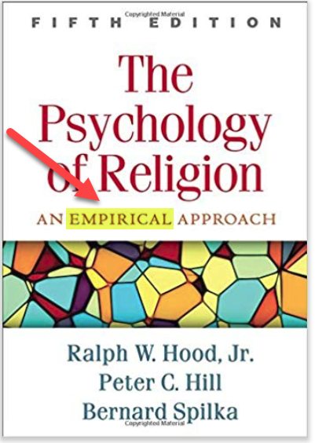
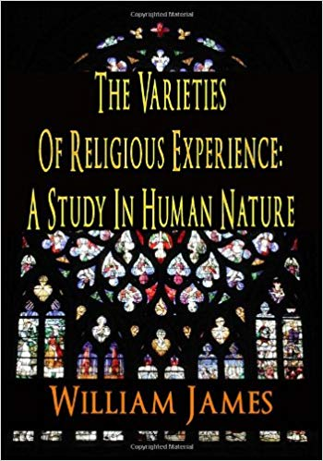
Religion became a subject matter
Psychology of religion
William James: The varieties of religious experience
Empirical, scientific, not based on theology, philosophy, or any “speculation”.

Slide 17
Intellectual crisis?
New psychology: empirical, scientific
“To state the obvious, it has been largely one-directional: the Christian community has had very little explicit, constructive influence on the contemporary psychological scene, and what influence it has had was accomplished by playing according to the rules of late modernism and not by being explicitly Christian.”

Slide 18
Responses to modernism
Liberalism Protestants embrace modernism and scientific methods.
Conservatives (fundamentalists) moved away it. They are not interested in cultural issues, higher learning and scholarship. Rather they are interested in soul-winning.

Slide 19
What is fundamentalism?
A movement reacting to those who questioned the inspiration and authority of Scripture.
A reaction to rationalist liberalism and other 19th Century “modernist” trends
1892 – The Princeton Definition of Biblical Inspiration: “The Bible is the fully, verbally inspired and inerrant Word of God”
1978 - Chicago Statement on Biblical Inerrancy
Biblical inerrancy and Biblical infallibility are different. Can you Google and tell me their difference?

Slide 20
Evangelical responses
In 1956 a group of Christians formed the Christian Association for Psychological Studies (CAPS): https://www.caps.net/
Fuller Theological Seminary was the first evangelical school to begin a doctoral program in clinical psychology (1964).
Rosemead School of Psychology initiated the Journal of Psychology and Theology (1973).
Jay Adams wrote Competent to Counsel (1970) in an attempt to put Christian faith at the center of counseling: Nouthetic counseling.

Slide 21
Discussion: Let’s move to four corners
If we accept the notion that modern psychology is scientific and anything else is less (folk psychology, philosophical psychology), then Augustine, Thomas Aquinas, reformers, Kierkegaard, and other Christian intellectuals had contributed very little to psychology.
Do you think that psychology must be scientific?
Do you think those Christian thinkers had made substantive contribution to psychology?
Do you approve or disapprove the fundamentalist responses to modernism? Why or why not?

