Slide 1
Unit 2 Levels of explanation

Slide 2

New atheist movement
Sam Harris: Religion is both false and dangerous
https://www.youtube.com/watch?v=R110CdeeLo0
In the debate Rabbi David Wolpe argued against Sam Harris that there could be true knowledge that is inaccessible by reason, such as intuition. Sam Harris said that it is unscientific.
Can you give an example that you know something is true but you cannot explain it or prove it by reason?

Slide 3

New atheist movement
Richard Dawkins: faith is not only wrong; it is a mental virus.
https://www.youtube.com/watch?v=SK48AsRIMM8
In the dialog between Brian Greene and Richard Dawkins, Dr. Dawkins argued that if we invoke a complicated super-being (God) to explain the world, then we need to explain that complicated super-being. Science should not make any supernatural assumption.
Do you agree that science should be totally naturalistic? Why or why not?

Slide 4
David Meyers
Science cannot explain away religion.
John Polkinghorne: Reality is a multi-layered unity
“A brain state is causing the emotion of love or that the emotion is causing the brain state. The emotional and physiological views are simply two complementary perspectives”
Andrew Greeley (1976): “psychology cannot explain the purpose of human existence, the meaning of human life, the ultimate destiny of the human person.”

Slide 5

Levels of explanation

Slide 6
C. S. Lewis
Our preconceived ideas or world views guide our theory development.
“What we learn from experience depends on the kind of philosophy we bring to experience”
Which level to choose for explanation depends on our philosophy.

Slide 7
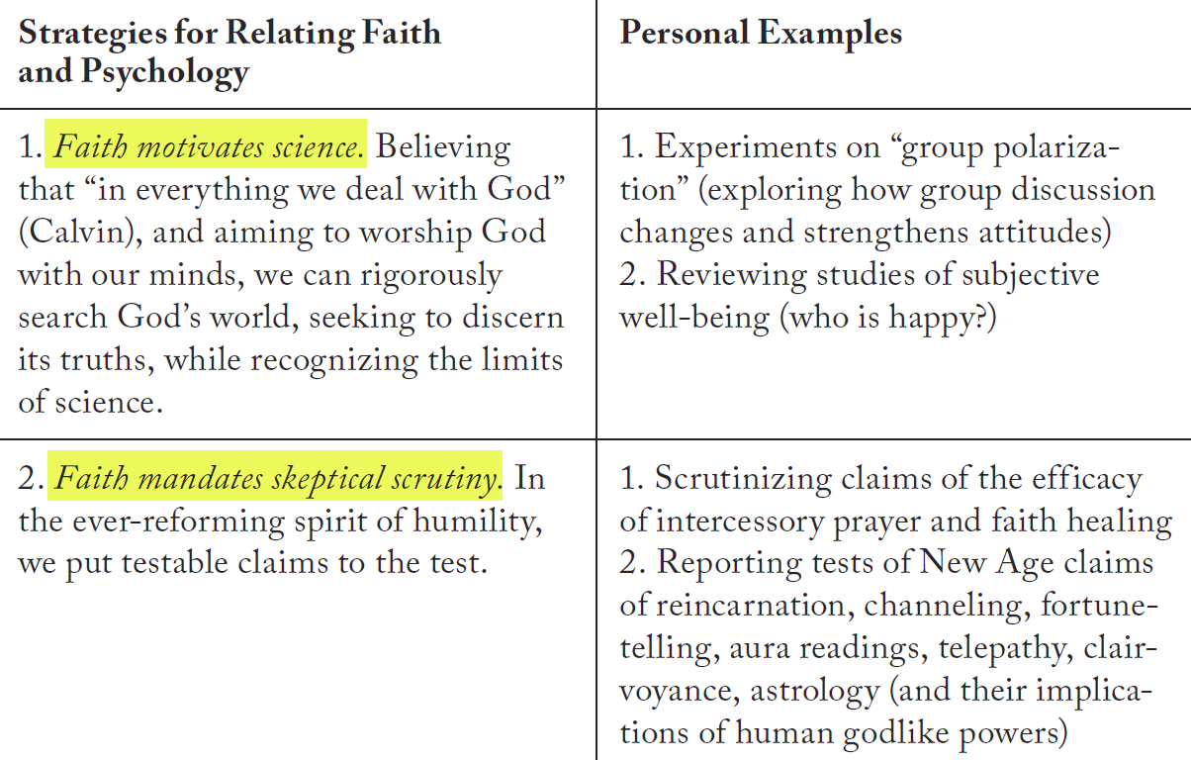
Seven ways to relate faith & psychology
All knowledge is God’s knowledge!

Slide 8
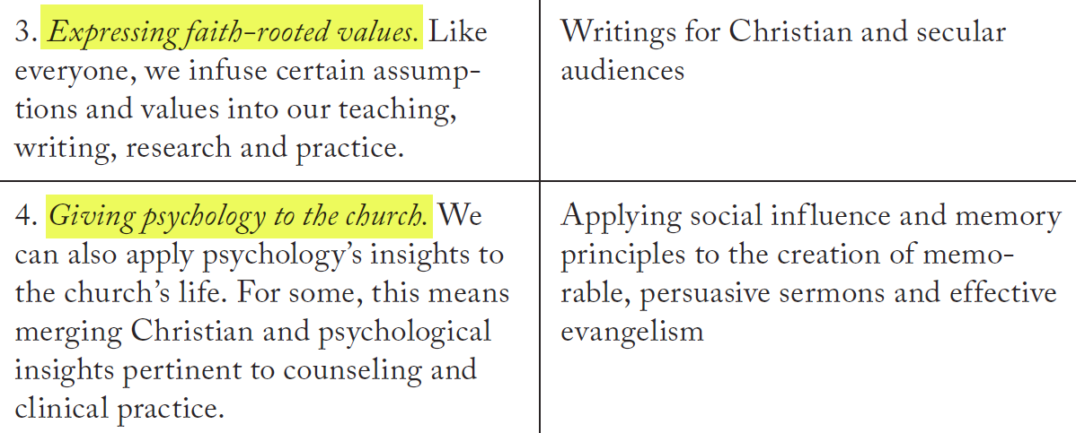
Seven ways to relate faith & psychology

Slide 9
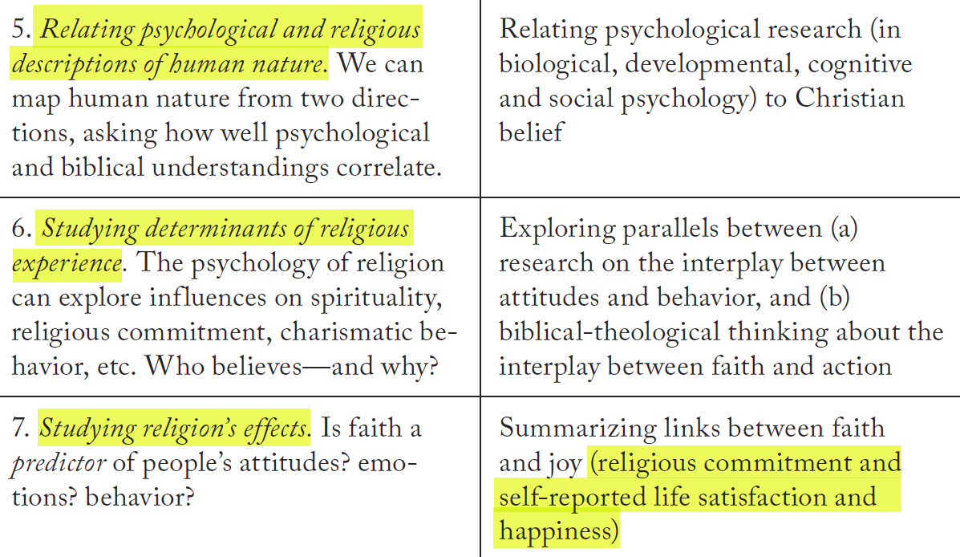
Seven ways to relate faith & psychology

Slide 10
Examples of parallel between faith and psychology
 | Psychology | Christian faith
Study human nature | “People experience life through a self-centered filter” | Self-righteous pride is the fundamental and original sin.
To liberate from self-condemnation | Unconditional positive regard in Rogerian counseling method. | Agape: Divine grace in Christianity
Well-intentioned people in evil situations | Evil pressures overwhelmed good intentions (e.g. Milgram’s study, Zimbardo’s prison experiment | Reinhold Niebuhr’s Moral man and immoral society

Slide 11
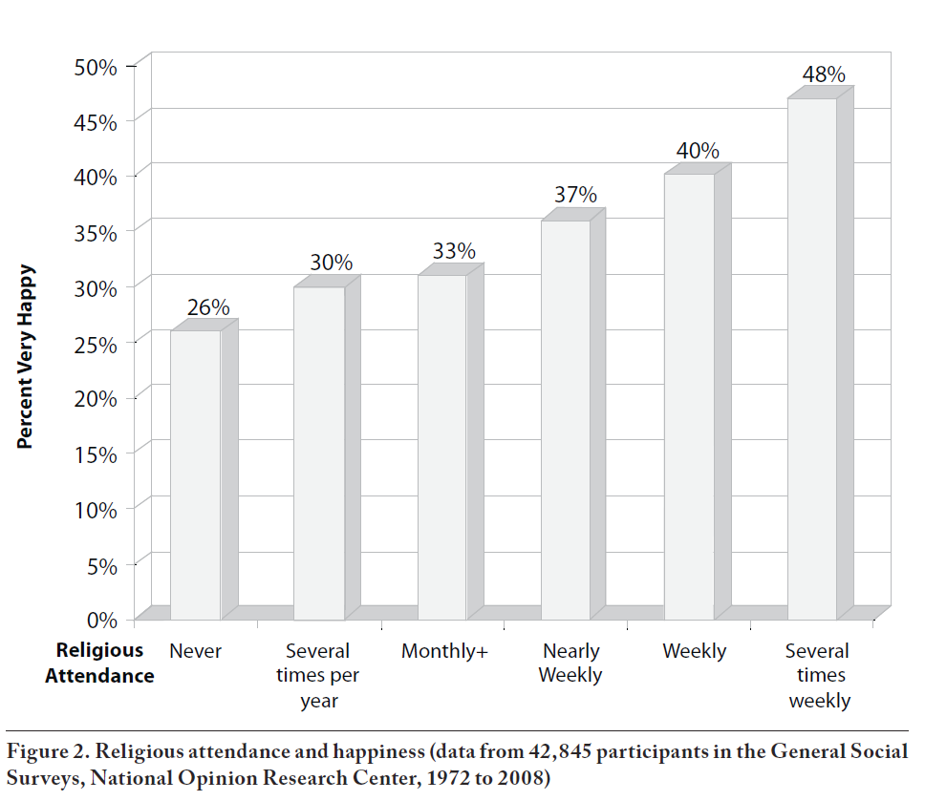
Case study: Faith and well-being
David Meyers argued that an active faith correlates with social and personal health and well-being.
My response: It might be true in the individual level (feel happy).
But is faith correlated with collective (social) wellbeing?

Slide 12
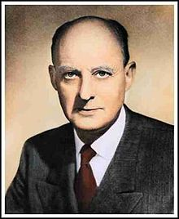
Moral man and immoral society
Moral Man and Immoral Society: A Study in Ethics and Politics is a 1932 book by American Protestant theologian Reinhold Niebuhr.
Later he said his book should be title Immoral Man and Even More Immoral Society
Unchecked capitalism is destructive to society
He criticized the egoism and the hypocrisy of nations and classes. It is time for Christians to have a deeper understanding of sin.
A need for government intervention for the well being of the poor.

Slide 13
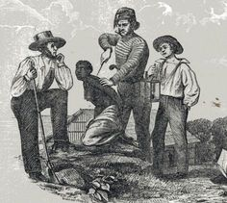
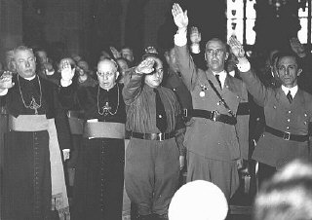
The situation overpowers the individuals
Urban legend: If more and more people are converted to be Christians, it can make a better world.
Even if individual men (humans) are moral, the collective society could still be immoral.
For example, during the 1860s many Southerners in the US were Christians, but they still support slavery.
During World War II, most Christians support anti-Semitism of Nazi Germany. Anti-Semitism was historically widespread throughout Europe and had deep roots in Christian history.
Agree or disagree to (2), (3) and (4)? Let’s go to four corners.

Slide 14
Case study: Is prayer effective
Many scientific studies indicate that intercessory prayer has no effect on health or recovery from illness.
2006 Study of the Therapeutic Effects of Intercessory Prayer (STEP) sponsored by John Temptation Foundation shows that some prayed-for patients were worse than those who did not receive prayers. In The God Delusion, evolutionary biologist Richard Dawkins wrote, "It seems more probable that those patients who knew they were being prayed for suffered additional stress in consequence: 'performance anxiety', as the experimenters put it.”
Meyers argued that we cannot put God under experiment.
However, when we study whether religion can increase well-being, is it the same as using science to study God’s effects on humans? Are we cherry-picking the findings that favor us?

Slide 15
Case study: Sexual orientation
David Myers: “There is no known parental or psychological influence on sexual orientation. Factors once believed crucial actually seem not to matter. Sexual orientation appears not to be influenced by child abuse, social example, overprotective mothering, distant fathering or having gay parents.”
“Unlike sexual behavior and other moral behaviors, sexual orientation appears unaffected by an active faith.”

Slide 16
Case study: Sexual orientation
“Today’s greater tolerance seems not to have amplified homosexuality. Homosexuals are a small minority, roughly two or three percent of the population, and their numbers appear not to have grown with the emergence of a gay rights movement or with the passage of gay rights laws.”
Conclusion: Sexual orientation (most clearly so for males) is a natural disposition, not a voluntary moral choice. Therapy cannot change sexual orientation.
Choose either one of these position: Agree or disagree to the preceding conclusion.
Debate: Switch your position and agree for the opposite side. The objective is to let you consider the otherwise.

Slide 17
Summary
In contrast to what New Atheists say, psychology as a science can be related to faith.
There are different levels of explanation with regard to human behaviors. Which level we chose depends on our philosophy (Worldviews).
Faith and psychology can address certain topics together, such as human sinful nature, how human behaviors are influenced by situations, and sexual orientation.

