Slide 1
Integration view

Slide 2
Stephen J. Gould
Non-overlapping magisteria (NOMA)
“Science gets the age of rocks, and religion the rock of ages; science studies how the heavens go, religion how to go to heaven.”
National Academy of Science: ““Religion and science are separate and mutually exclusive realms of human thought whose presentation in the same context leads to misunderstanding of both scientific theory and religious belief”

Slide 3
Demarcation?
Christina faith
Psychology as a science
Psychology as a science
Science is about facts and religion is about meaning.
This cannot stand!
Jay Adams: They overlap and at odds.
“Drop out of your training”

Slide 4
Big questions
Where do we come from?
What are we?
Where are we going?
“Psychology as a science and as professional practice can never escape such questions.”

Slide 5
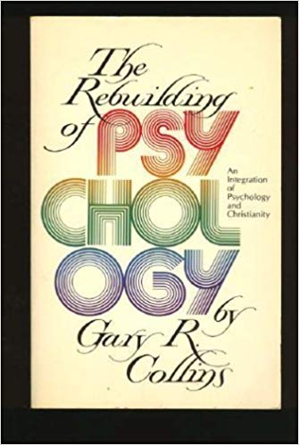
Integration
Gary Collins (1977): The rebuilding of psychology
Re-evaluate and rebuild psychology on a Christian foundation
Don’t have to totally accept the humanistic and secular assumptions by default.
But science is still useful to inform Christian psychologists.

Slide 6
Human nature in the image of God (Imago Dei)
The substantive understandings of the imago Dei focus on what we are.
The functional understandings of the imago Dei focus on what we do.
The relational understandings of the imago Dei focus on our unique relationship to God.
What are the implications?

Slide 7
Implications
Substantive: We are God’s creation, and therefore we have inalienable rights. A person should never be a means to an end.

Slide 8
Implications
Functional: We have missions and vocations e.g. care of creation.
Relational: We are related to God and thus we are accountable to the higher law. We are made to be able to love and to respond appropriately to others.

Slide 9
Counter-argument
Existentialism
Jean Paul Sartre: Existence precedes essence
No pre-determined, immutable human nature and destiny.
Humans—through their consciousness—create our own values and determine a meaning for their life

Slide 10
Question
Non—Christians might not subscribe to the notion that human are made in the image of God and therefore we carry immutable and inalienable essence.
While most people are not familiar with existential philosophy or the work of Jean Paul Sartre, they might still embrace the idea that existence precedes essence: It is up to me to build the meaning for my life.
If you are a Christian counselor, how can you apply ”imago Dei” into counselling when your clients do not accept this theological concept?

Slide 11
Thesis statement
“Approaches to psychotherapy necessarily go far beyond the limits of what could be called scientific theory in order to answer questions that must be framed in the context of ultimate meaning”.
“We ought to frame our broader understandings of the client in terms of the Christian understanding of our nature, purpose and calling.”

Slide 12
Summary
Reject the demarcation; Science is about facts and religion is about meanings.
Question Jay Adams’s simplistic solution: drop out of psychology
Built in Gary Collins’s “rebuild of psychology” by integrating psychology and faith.
Christian psychologists can help humanity based on the premise that we are made in the image of God.

Slide 13
Criticism by Robert Roberts
The term “integration” means “whole” or “entire”
Stan Jones’s integration approach is a dualistic approach: psychology and Christianity remain two separate entity. They just inform each other.
No clear methodology
Whole: Two become one

Slide 14
Perspective of William Whitney
  What is it we are trying to integrate?
    Integrating Disciplines (Inter-disciplinary Integration)
      Science (Psychology) and Religion (Christian Theology)
    Integrating within the Discipline of Psychology (Intra-disciplinary Integration
      Psychology as theory / ideology; counseling practice; research / science
    Interpersonal Integration
      Beliefs and Ethics combined: That is how we live out what we think in our daily lives

Slide 15
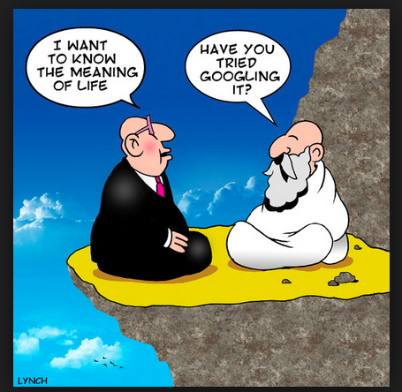
Perspective of William Whitney
Working Definition: Integration is an attempt to clarify our own Christian worldview and faith in light of insights given by psychology into a coherent unified whole, in addition to letting our study and research in psychology be informed by our Christian faith.

Slide 16

Perspective of William Whitney
Christian faith integration with psychology is a two-way dialogue.
The Christian faith can contribute something to psychology (while also at times critiquing some of psychology’s features)
Psychology can also contribute something to the Christian faith by clarifying aspects of human thought and behavior

Slide 17
Discussion
Form a small question of 3-4 people to discuss the following question:
What does the term “integration” mean to you?
If you can use two circles to depict the integration approach, how would you draw the picture?

