Slide 1
Ungraded quiz
Unit 5

Slide 2
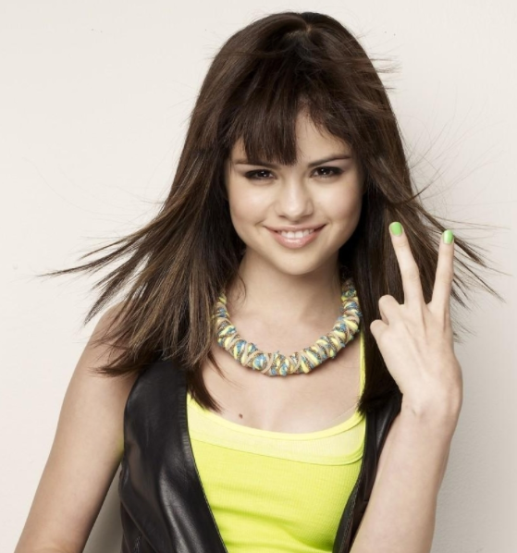
Show me your fingers
Do not shout out the answer, or your classmates will follow what you said.
Use your fingers
  One finger (the right finger) = A
  Two fingers = B
  Three fingers = C
  Four fingers = D
  No finger = I don’t know. I didn’t study

Slide 3
What is the core idea of transformational psychology?
Due to the fall of humans we are spiritually impaired though we are still highly rational.
Doing science and psychology is an act of love and thus non-Christians cannot fully achieve this goal.
Psychological theories should be universal and a-historical.
All of the above

Slide 4
Which examples inform us that psychological theories are tied to cultural and historical contexts?
Sigmund Freud used the metaphor of steam power to describe human internal drives.
Social psychology is based on human-computer analogy.
Piaget’s developmental psychology is tied to Victorian ethics.
All of the above.

Slide 5
Which of the following scholars propose that getting behind the veil can achieve a fairer outcome?
B. F. Skinner
John Rawls
David Meyers
Robert Roberts

Slide 6
Which components must be included into transformational psychology?
Virtual reality
Scientific realities
Christian realities
Ontological reality

Slide 7
How did David Meyers respond to transformational psychology?
There is no clear or strict line between spiritual and psychological well-being, or between spiritual and psychological knowledge
A “non-naturalistic methodology in science” is non-science in science
Can a cognitive psychologist study human mental structure and process for the sake of knowing without love?
None of the above

Slide 8
How did Robert Roberts respond to transformational psychology?
There is no clear or strict line between spiritual and psychological well-being, or between spiritual and psychological knowledge
A “non-naturalistic methodology in science” is non-science in science
Can a cognitive psychologist study human mental structure and process for the sake of knowing without love?
None of the above

