Slide 1
Ungraded quiz
Unit 6

Slide 2
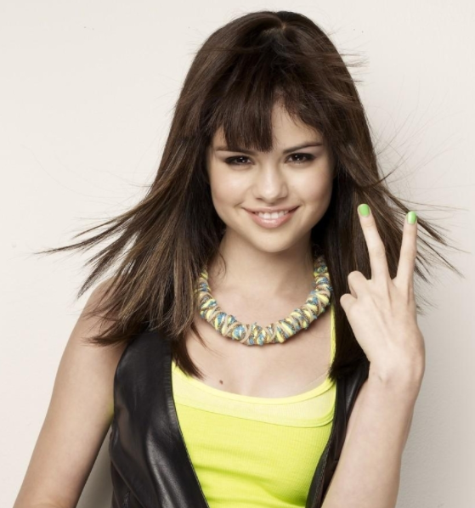
Show me your fingers
Do not shout out the answer, or your classmates will follow what you said.
Use your fingers
  One finger (the right finger) = A
  Two fingers = B
  Three fingers = C
  Four fingers = D
  No finger = I don’t know. I didn’t study

Slide 3
Which of the following is NOT the core idea of Biblical counselling?
Christian faith is a psychology.
Christian ministry is a psychotherapy.
Christianity makes claims about human nature and what a complete human should be.
Restoration of humanity can be achieved by Christian faith and psychotherapy simultaneously.

Slide 4
Which three strands of the Nicaean Creed are cited by Powlison to support Biblical counseling?
Trinity, incarnation, and atonement.
Trinity, creation, and judgment.
Creation, judgement, and redemption.
Creation, incarnation, and Communion.

Slide 5
Psych-1 is ….
Human experience
Organized knowledge
Interpretive and explanatory model
Psychotherapeutic models

Slide 6
Psych-2 is …
Psychotherapeutic models
Organized knowledge
Ethos
Mental health system

Slide 7
Psych-3 is …
Organized knowledge
Interpretive and explanatory model
Psychotherapeutic models
Mental health system

Slide 8
Psych-4 is …
Human experience
Organized knowledge
Interpretive and explanatory model
Mental health system

Slide 9
Psych-5 is …
Human experience
Organized knowledge
Interpretive and explanatory model
Mental health system

Slide 10
Psych-6 is …
Human experience
Organized knowledge
Popular culture
Mental health system

