Slide 1
Biblical counseling

Slide 2
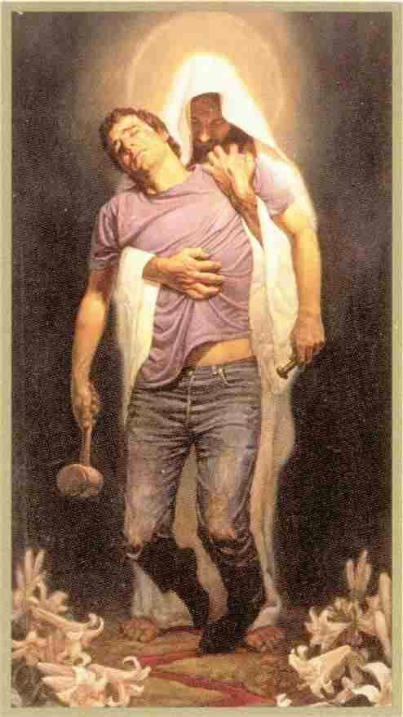
Thesis statements
Christian faith is a psychology.
Christian ministry is a psychotherapy.
The Christian faith makes claims about human nature, who we are, how we behave, and what a fully healthy and complete human should be in Jesus Christ.
We should be restored in Christ so that ultimately we can be whole and complete.

Slide 3
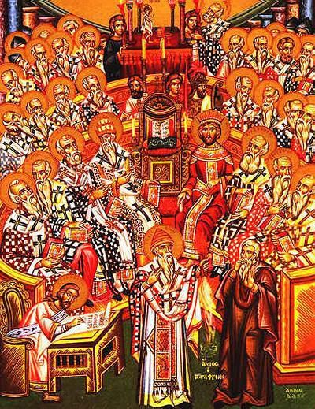
Three strands of the Nicene Creed
Three major strands
  God is the creator.
  God is is judge of the living and the dead.
  Christ came down for us and for our salvation.
Why does it matter today?
  https://www.youtube.com/watch?v=W7zfuf8_HkQ

Slide 4

How is the Nicene Creed related to psychology?
“Maker, Judge and Savior orient us as we seek to make sense of the psychological functioning of creatures who are made, judged and redeemable.”
We are created for a purpose.
We are accountable for what we do.
We fail, but there is a hope.

Slide 5
What is psychology? Psych-1
The stuff of life: How we operate in the world we live.
Description of our feelings: fear, anxiety…etc.
Unintentional intentions: just act out of our feelings without knowing the consequence.
Example: Passive-aggressive behavior: ignoring people, constantly being late…etc.
https://www.youtube.com/watch?v=Sm6NCwyBrqg

Slide 6

Psych-1
“Christian faith is about Psych-1. That’s why Jesus, Luke, Paul, David and the writer of Job are so often recognized as master psychologists.”
Diagnosis of human experience.

Slide 7
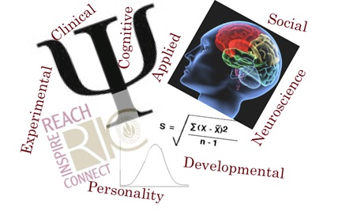
Psych-2
Organized knowledge, close observations and systematic descriptions of human functioning.
What we think of as science.

Slide 8
Psych-3
“An interpretive and explanatory model that organizes and weighs the torrent of Psych-1 experience and Psych-2 information.”
“Christian faith is a psychology in exactly the same way that it is a theology. True knowledge of people and true knowledge of God correlate.”

Slide 9
Psych-4
Various psychotherapeutic models and skills aiming to remediate problems in living.
“One cannot intend to help another change without some ideal for human functioning, usually explicit, and easy to tease out when implicit.”
“All counseling attempts pastoral work, shepherding the souls of wandering, suffering sheep.”
Speaking truth in love

Slide 10
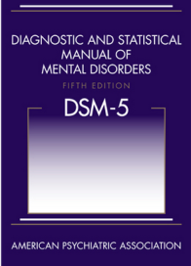
Psych-5
Institutional and professional arrangements: A mental health system that changes or shapes people.
“If a sociologist tried to change society, or a historian tried to change history, we’d call it politics, not good social science. If an anthropologist tried to change a primitive and perceivedly dysfunctional culture, we’d call it cultural imperialism.”
DSM-5 determines what is normal and what is disorder. Is it OK to do so?

Slide 11
What had been changed in DSM-5?
Gender identity disorder is called gender dysphoria.
Childhood bipolar disorder is renamed to Disruptive Mood Dysregulation Disorder.
Narcissistic Personality Disorder: removed
”Substance abuse" and ”substance dependence" are two separate categories.
Catatonia is removed as a subtype of schizophrenia.

Slide 12
Can Christians have a say about mental health?
Controversy: https://www.youtube.com/watch?v=n27YaehttLc
The mental health system is part church, part social-welfare agency and part research institute.
Ephesians 3:14–5:2.
“God calls his people to mobilize as a countercultural community characterized by transformative mutual counseling.”

Slide 13
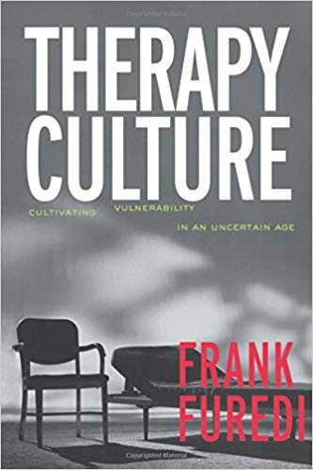
Psych-6
An ethos pervading popular culture, a zeitgeist, beyond the academic world.
Example:
  Consumerism
  Therapy culture
  The culture of narcissism
Christians need to transform the ethos

Slide 14
Summary
The Nicene Creed tells us how we should be related to God, the creator, the judge, and the redeemer.
Christian psychologists should aim to restore humans in Christ accordingly and to interact with psychology at all levels
Psych-1: Human experience
Psych-2: Organized knowledge
Psych-3: Interpretive and explanatory model
Psych-4: Psychotherapeutic models
Psych-5: Mental health system
Psych-6: Ethos, popular culture

Slide 15
Response by David Myers
Psychology should be the science of behavior and mental processes.
When mentioning different levels of psychology, Myers feels “like an economist asked to critique a business manager, or a social researcher asked to comment on a social worker’s ideas. We’re simply in different fields.”
Need scientific evidence to support that Biblical counseling is more effective than secular methods.

Slide 16
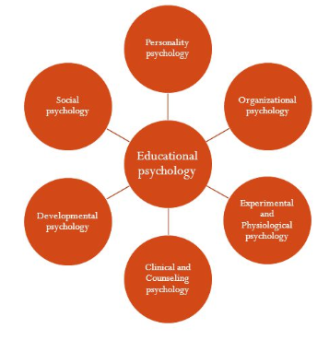
Response by P. J. Watson
Do Christian psychologists do counseling only?
How is biblical counseling different from other Christian approaches?

