Slide 1
Gaining understanding through five views

Slide 2
Diversity arises from sin?
Abraham Kuyper (1898): “schools of thought” are a consequence of sin, because God does not provide the central unifying motive of human life, we seek to find it in ourselves and our conceptual systems.
Agree or disagree?

Slide 3
Openness
No single perspective is totally right; we should be humble and open to each other.
Openness does not imply that all five perspectives are equally valid.
Post-modernism

Slide 4
Location! Location! Location!
Context! Context! Context!
Each perspective is developed within a specific context.
Those who advocate the levels-of-explanation approach are academic psychologists who study tightly defined and closely specified aspects of human behavior (e.g. David Myers, Malcolm Jeeves)

Slide 5
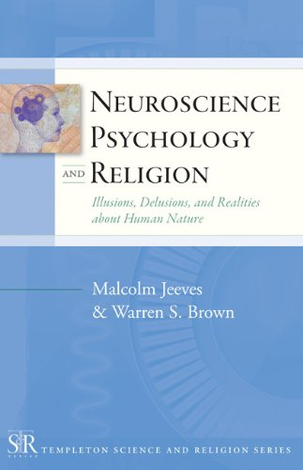
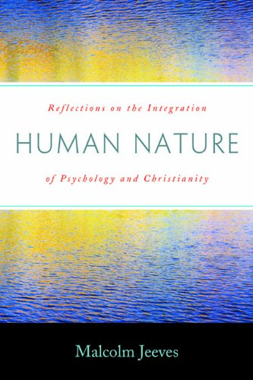
Academic psychologists
Academic psychologists emphasize explanation (how and why)
Malcolm Jeeves on Neuroscience, psychology, and religion.
The Bible does not explain brain function.
https://www.youtube.com/watch?v=CnRfSIrL7WA

Slide 6
Pastoral psychologists
People! People! People!
Pastoral psychologists focus on well-being of people (what works).
Powlison is theologically trained, and he is most concerned about the strategies and tactics that should be used in the church to deal with sin and the problems of living as God’s people.
https://www.youtube.com/watch?v=lzeqUwyfH_s

Slide 7

How to ask a good question?
“We should not simply ask “Is this the correct view,” but rather turn that question into a more flexible, conditional one: “Is this a good view for understanding how my Christian faith relates given this specific aspect of human life or this setting?” (p.298)
Is it good or bad? The best answer: It depends!

Slide 8
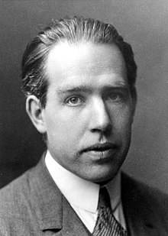
Copenhagen interpretation
Niels Bohr's study of quantum mechanics.
One should not answer any question in this form: "What is really happening when ...?“
One can answer questions of the form: "If the experiment is performed, what are the possible results and their probabilities?“
The question format is: Given such as such condition or context, what is…?

Slide 9
Individual difference
Some people are more interested in analytical issues.
Some are more person-oriented
Some are more synthetic.
One size cannot fit all.

Slide 10

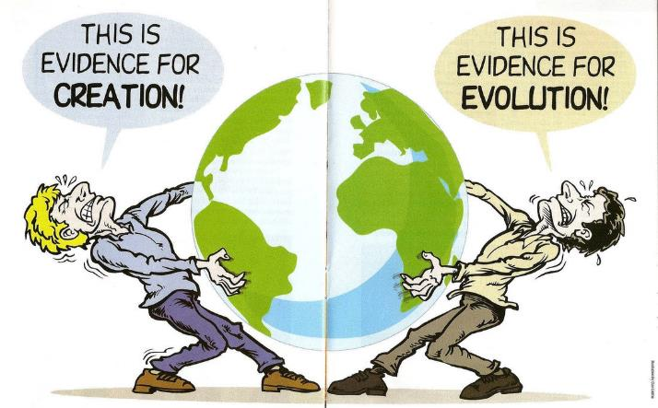
Dialog
Russian Orthodox social and literary theorist Mikhail Bakhtin.
Dialogue between people is essential in the development of our own understanding.
Easy to say but hard to do, especially in a self-centered culture.

Slide 11

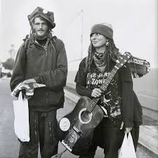
Communal tradition
Alasdair MacIntyre
“An intellectual tradition must be most faithful to its own resources or it risks its own self-destruction through absorption into a rival tradition.”
He rejects both collectivism (e.g. Marxism) and liberal individualism.
Renew moral sense and rationality through small-scale communities.
Question: what is the optimal scale? What is/are your community/communities?

Slide 12
Conclusion
Appreciate multiple perspectives
Dialog: to understand the other side and yourself
Develop your own philosophy within your community
Critical evaluation

