Slide 1
Unit 8
Science and religion
Chong Ho Yu

Slide 2
Why should we care?
How can this topic fit into the “big picture”?
Psychology is said to be a science.
Essentially the relationship between psychology and Christianity is about the relationship between scientific methods and Christianity.

Slide 3
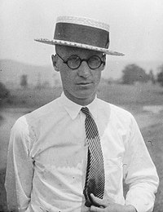
Science vs. religion
1925 John Scopes Trial (a.k.a. Monkey Trial)
The State of Tennessee prohibited teaching evolution in any state school.
A substitute teacher named John Scopes violated the law and was charged.
The trial is a classical example of the conflict between modernism and fundamentalism
https://www.youtube.com/watch?v=NYCfo4hVolQ (1:11-1:27)

Slide 4

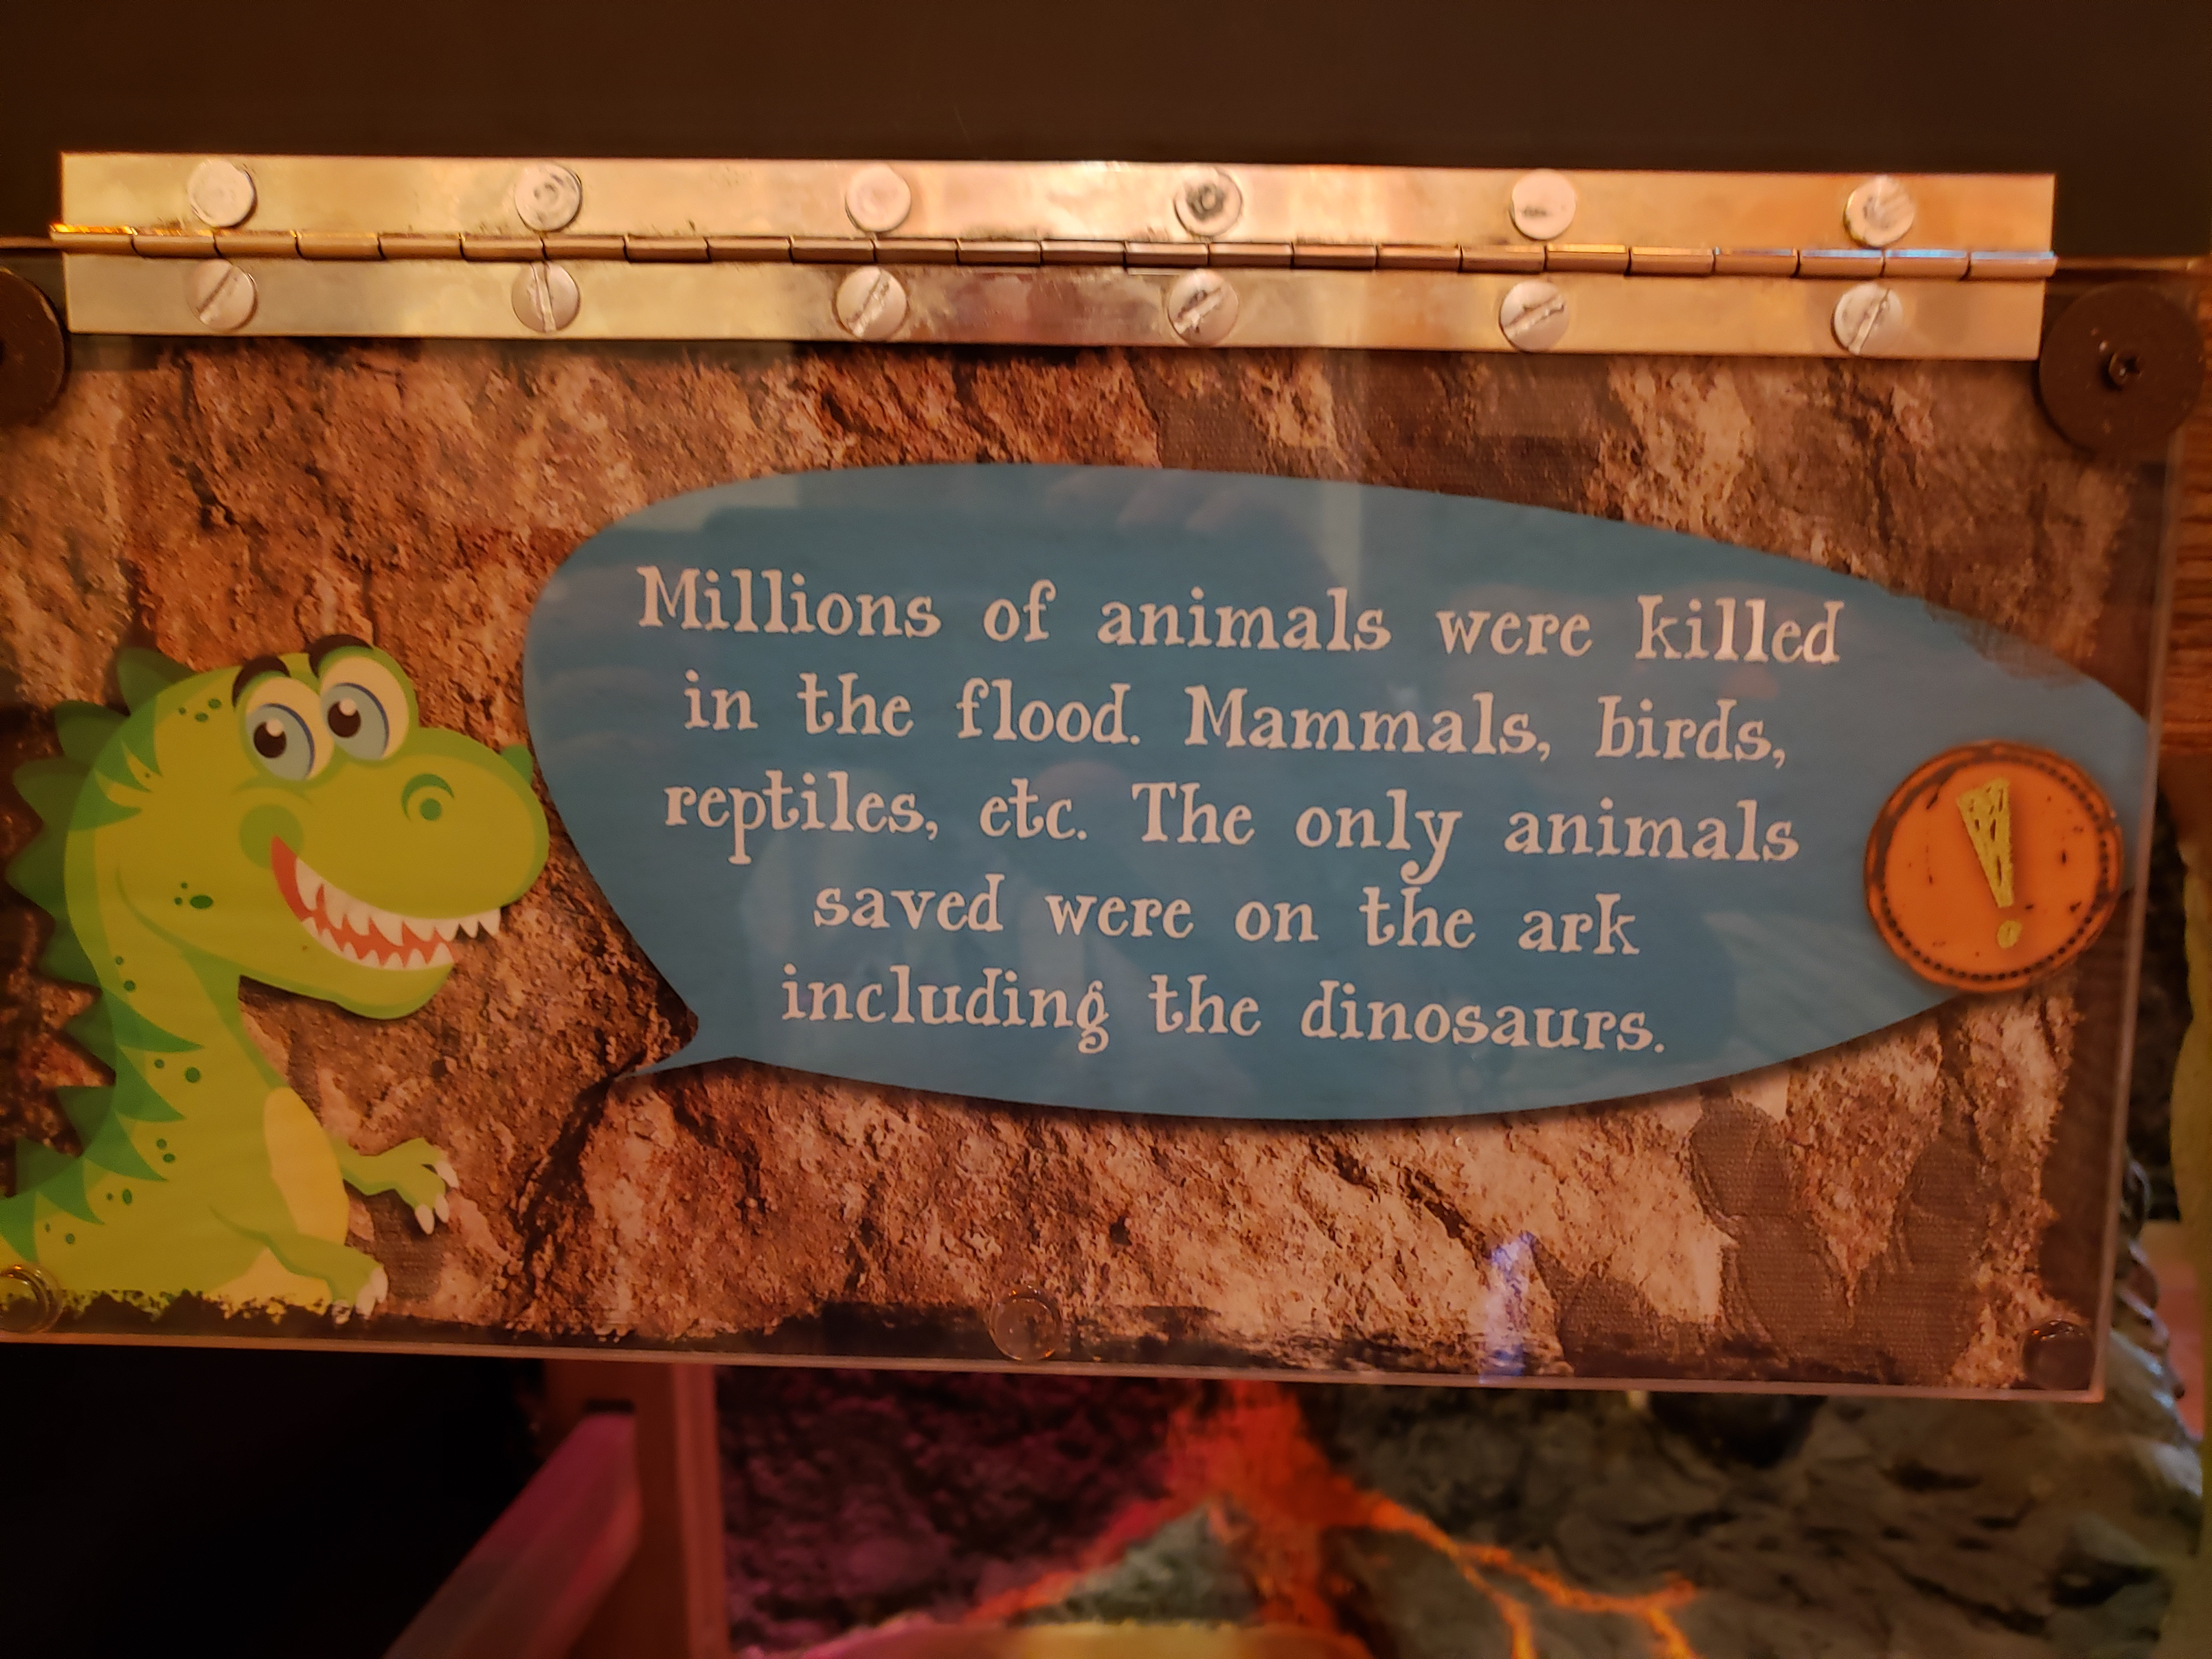
Fundamentalism/Young earth creationism
Young earth creationists believe that the earth has a short history (6000-10,000) and thus humans and dinosaurs co-existed at one time.

Slide 5
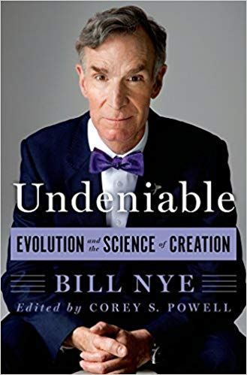
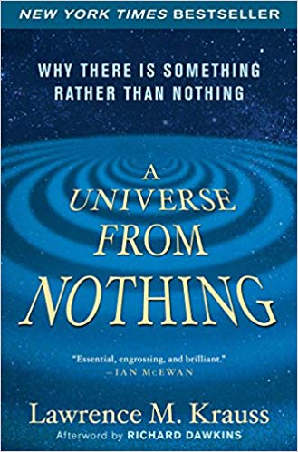
Fundamentalism/literal approach
Bill Nye and theoretical physicist Lawrence Krauss question whether religious education is at odds with science education since religiosity might lead to an anti-science mentality.

Slide 6
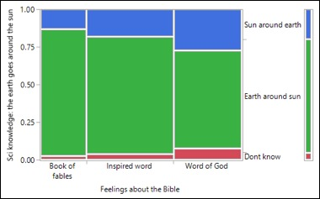
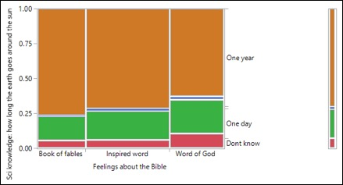
Fundamentalism
NORC data
Participants who viewed the Bible as the Word of God in a literal sense earned lower test scores in objective science tests and were less interested in taking science courses than those who did not hold this view.

Slide 7
Evangelicals also see a conflict
The survey data collected by Elaine Ecklund and Christopher Scheitle show that 29.4% Evangelical respondents regard science and religion conflicts with each other and they considered themselves to be on the side of religion. This figure is higher than all other categories.
Ecklund, E., & Scheitle, C. (2018). Religion vs. science: What religious people really think. Oxford, UK: Oxford University Press.

Slide 8
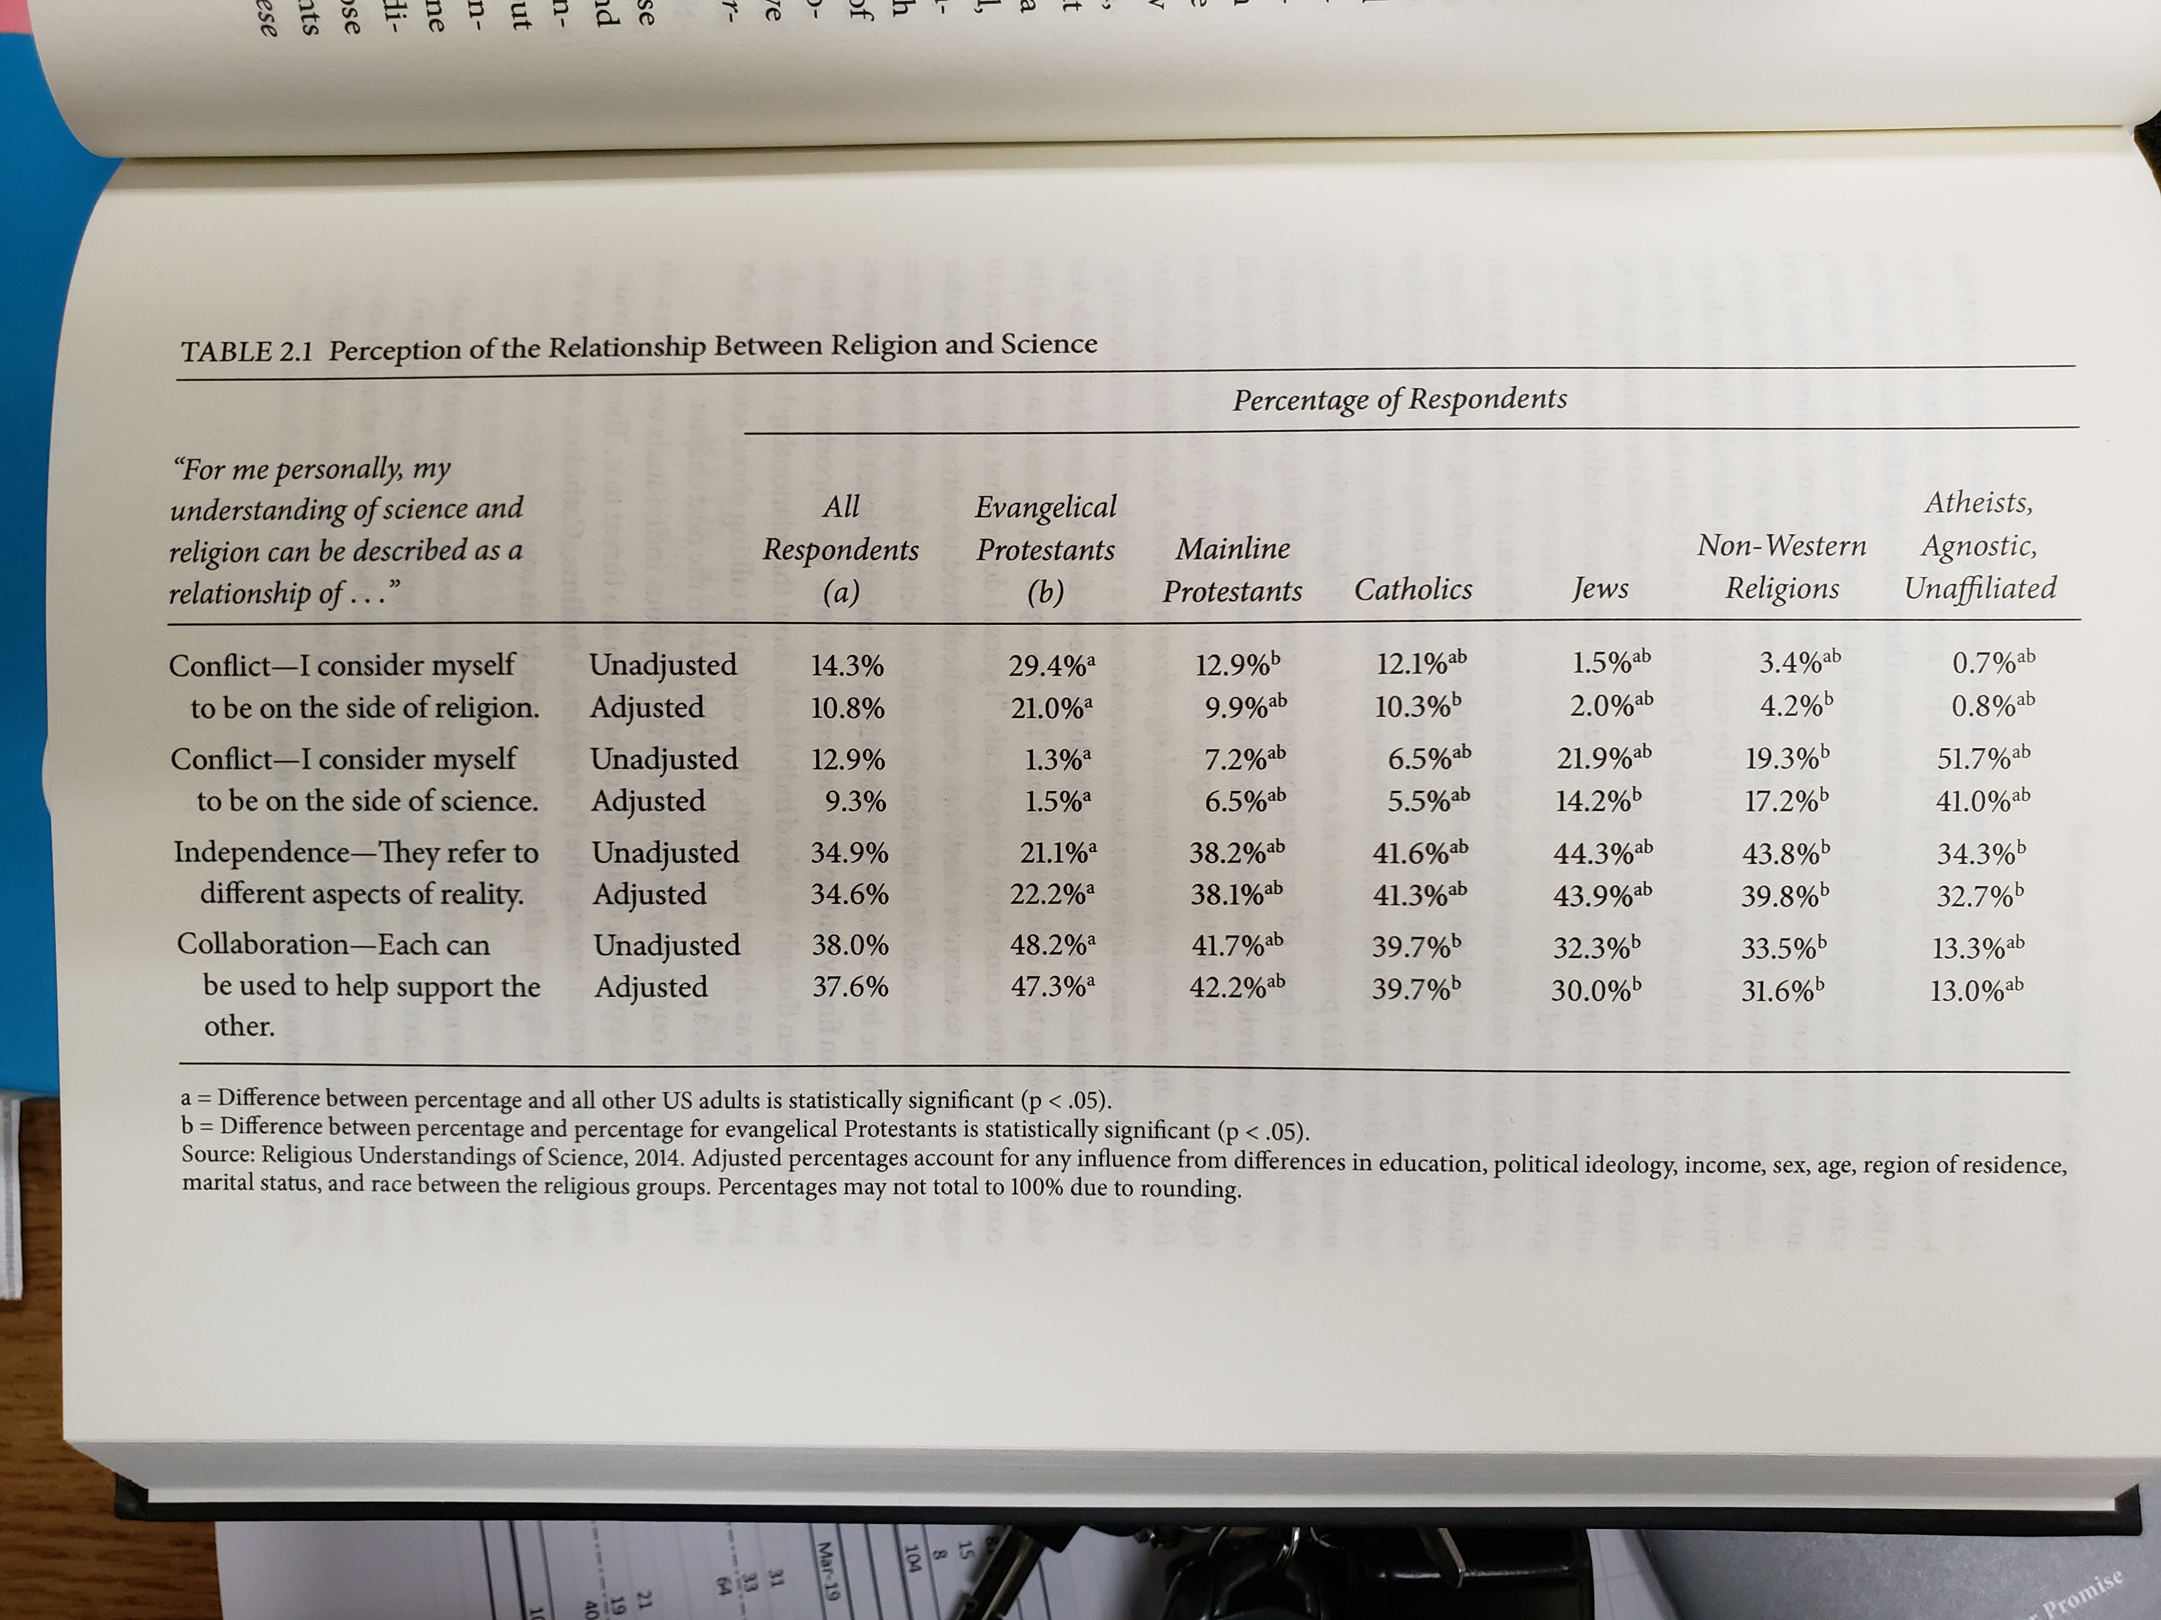
Evangelicals see a conflict

Slide 9
Concordism
Scripture as the Word of God contains scientific truths.
The scientific layer of those passages can affirm the validity of Scripture.
My position: The Bible is not a science textbook!

Slide 10
Hugh Ross:
Big Bang and expanding universe
Job 9:8, “He (God) alone stretches out the heavens and treads on the waves of the sea.”
This implies an ongoing expansion.

Slide 11
Dark matter and dark energy
Job 38:19: “What is the way to the abode of light? And where does darkness reside?”
This implies dark matter and dark energy
74% of the Universe is occupied by dark energy whereas dark matter makes up about 22% of the universe.
Dark matter is an invisible matter that does not emit light or energy while dark energy is a property of space.

Slide 12
George Lemaître
None of those scientists ever said that their research is connected with the Bible.
Belgian priest George Lemaître proposed the big bang theory in 1927.
Lemaître was opposed to Pope Pius XII's proclamation that the theory of cosmic expansion could scientifically validate Catholicism.
He asserted that there was neither a connection nor a contradiction between the big bang theory and Catholicism

Slide 13
Edwin Hubble
The big bang theory is supported by Edwin Hubble’s discovery of the Red Shift phenomenon in 1929.
Hubble was raised as a Christian, but as he grew up he became skeptical of his faith and eventually distanced himself from religion.

Slide 14
Allan Sandage
After Edwin Hubble died in 1953 his student Allan Sandage continued Hubble’s research.
A year later Sandage revised the estimate of the Hubble constant.
Although Allan Sandage was a born-again Christian, he explicitly stated that his religious conversion did not occur because of reasoning or intellectual inquiry. Rather, he acted on the will to believe.

Slide 15
Arno Penzias
In 1964 the big bang theory is further verified by Arno Penzias and Robert Wilson’s discovery of cosmic microwave background radiation.
Arno Penzias is a Jew. But he explicitly rejected the connection between his discovery and the Old Testament.
He admitted that he didn’t experience any tie between his spiritual progress and his scientific research.

Slide 16
Arno Penzias
‘I have no problem with scientists saying that there is no God. But for them to say, “This is God,” annoys me. It is blasphemy. It annoys me because they’re misusing the word, which is at the very least disrespectful. They haven’t got a clue what God is.’

Slide 17
Vera Rubin
Jewish scientist Vera Rubin played a key role in discovering dark matter.
In 1996, when Rubin was interviewed by the Catholic EWTN network, she said: “In my own life, my science and my religion are separate. I’m Jewish, and so religion to me is a kind of moral code and a kind of history. I try to do my science in a moral way, and, I believe that, ideally, science should be looked upon as something that helps us understand our role in the universe.”

Slide 18
Alan Guth
Alan Guth is credited as one of the scientists who advocated the theory of dark energy.
He declared that he saw no evidence of design in the universe and thus invoking a designer would not help advance science at all.

Slide 19
After the fact!
We can easily find some verses in the Bible that seem to be compatible with modern scientific concepts.
This type of retrofit has no predictive power at all.
It is not the case that scientists predicted cosmic expansion, dark matter, and dark energy based on their Biblical knowledge. Rather, Christian apologists claimed the credit after the fact.

Slide 20
How about counter-examples?
In the Book of Job there are verses that appear to contradict with modern science.
Job 38: 4, “Where were you when I (God) laid the earth’s foundation?”
Atheists quoted this verse to accuse the Bible of supporting the notion of an unmoved earth.

Slide 21
How about counter-examples?
Psalm 104: 5, “He [God] set the earth on its foundations, so that it should never be moved”
It was quoted as evidence to support the notion that the earth is a stationary planet.
During the 16th and 17th centuries when Copernicus and Galileo introduced the heliocentric model of the universe, both Catholics and Protestants rejected this idea.
In their view the geocentric model, which regarded earth as the immobile center of the universe, seemed to be in alignment with the Bible.

Slide 22
John Lennox’s defense
British mathematician
“God the Creator has built certain very real stabilities into the planetary system that will guarantee its existence so long as is necessary to fulfill his purposes. Science has been able to show us that the earth is stable in its orbit over long periods of time, thanks in part to the obedience of gravity to an inverse square law, to the presence of the moon, which stabilizes the tilt of earth’s axis, and to the existence of the planet Jupiter, which helps keep the other planets in the same orbital plane.”

Slide 23
John Lennox’s defense
Lennox also tried to reconcile Genesis and science by offering a scientific explanation of Day Four.
During the first three days the atmosphere was so thick that the sun light could not penetrate the cloud. Eventually On Day 4 the Sun appeared on Day four when the cloud dissipated.
Recently scientists found that early atmosphere was much closer to the conditions of our current atmosphere. If this is true, then Lennox’s scientific explanation becomes invalid.
Is it futile for apologists to keep mapping the Bible to scientific findings?

Slide 24
Acid test
No matter whether the earth is immovable or orbiting around the sun, those Bible verses are still considered compatible with science.
Karl Popper: If a theory can never be falsified, then it has no scientific merit.
Retrospectively fitting scientific data into Bible verses is easy. The acid test of concordism is whether today Christian scientists can develop a scientific theory based on the Bible, and have the theory be verified with empirical data in the future as well.

Slide 25
Could make things worse
Attempting to defend Christianity by mapping Bible verses and scientific concepts would make matters worse.
Skeptics and atheists could use these examples to portray Christians as opposed to science.

Slide 26
Michael Ruse
Philosopher and critic of religion
“Christians have long been in the business of interpreting things allegorically, and the point is that in both Big bang story and the Genesis story we have a beginning. The problem, rather is that if the science changes or is modified, then you may well find that you have committed to something that is not religion-friendly. In this case, if pre-Big bang stories gain traction, you are worse off than before.”

Slide 27
Dead end?
What if there were no dark matter or dark energy?
What would happen if someday scientific data support the cosmogony that the universe has no definite beginning; rather, our existing universe is one of many worlds in unceasing cycles of cosmic expansion and contraction (like Hindu or Buddhist cosmology)?
Christian apologists might cite other Bible verses or re-interpret the verses that previously supported the outdated cosmogony in order to accommodate the new theory.
This “mapping” approach would lead to a dead end.

Slide 28
Summary
There are different approaches to establish the relationship between psychology/science and Christian faith.
Fundamentalists accept a literal approach (e.g. The Bible said the earth was created 6,000 years ago).
Some evangelicals do not take the Bible literally, but they use concordism to map scientific findings into Bible verses (e.g. dark matter, dark energy…etc.)

