Slide 1
School of thoughts in Psychometrics:
CTT, IRT, and Rasch
Chong Ho (Alex) Yu

Slide 2
Review of True Score Model
True score model (TSM) is also called classical test theory (CTT) for its history could be traced back to Spearman (1904). The equation of TSM is expressed as:
X = T + E
where
X = fallible, observed score
T = true score
E = random error

Slide 3
Review of True Score Model
Ideally, the true score reflects the exact value of the respondent's ability or attitude.
It assumes that traits are constant and the variation in observed scores is caused by random errors, which resulted from numerous factors such as guessing and fatigue.
These random errors over many repeated measurements are expected to cancel out each other (e.g. sometimes the tester is so lucky that his observed scores are higher than his true scores, but sometimes he is unlucky and his observed scores are lower).

Slide 4
Review of True Score Model
When the error term is zero, the observed score is the true score:
  X = T + 0
  X = T
If an instrument is reliable, the observed scores should be fairly consistent and stable throughout repeated measures. Many popular reliability estimates, such as split-half, Cronbach coefficient alpha, test-retest, and alternate forms are based upon this rationale.
What is the limitation?

Slide 5
Review of True Score Model
Wilson (1998) stated that the true score model is a only mathematical abstraction. Under this model, errors are indicated by the discrepancy between estimates, not between estimates and the hypothetical true score. If the true score doesn't exist in the real world and cannot be measured directly, the score should not be regarded as "true.”
Wilson, N. (1998). Educational standards and the problem of error. Education Policy Analysis Archives, 6(10).

Slide 6
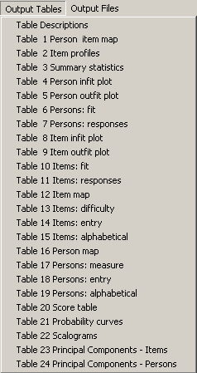
IRT and Rasch
TSM does not provide information about how testers at different ability levels perform on the item.
There is no Cronbach Alpha for a single item. At most you can see the pass rate or the mean of each item.
Item response theory (IRT) and Rasch modeling were developed to overcome the preceding shortcoming. It provides test-level, item-level, and person-level information.
In IRT/Rasch a test is unbiased if all testers having the same skill level have an equal probability of getting the item correct regardless of group membership.

Slide 7
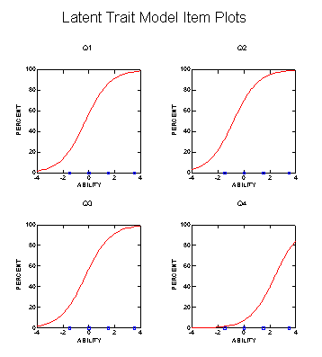
IRT and Rasch
IRT is also called latent trait theory because the theory assumes the existence of a latent trait, which is a tester characteristic that leads to a consistent performance on a test.
It can be a replacement of factor analysis.

Slide 8
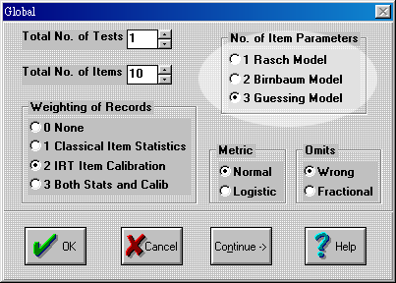
IRT and Rasch
Some researchers treat Rasch as a simplified IRT model:
  1-parameter IRT model : Rasch model.
  2-parameter IRT model: Birnbaum model
  3-parameter IRT model: Guessing model
But Rasch modelers disagree!

Slide 9
IRT and Rasch
Although IRT and Rasch are similar to each other in terms of computation, their philosophical foundations are vastly different from each other.
There is an ongoing tension between fitness and parsimony (simplicity).
If the researcher is intended to create a model that reflects or fits "reality," the model might be very complicated because the real world is "messy" in essence.
Some researchers seek to build an elegant and simple model that has more practical implications.
IRT leans towards fitness whereas Rasch inclines to simplicity.

Slide 10


IRT and Rasch
IRT modelers might use up to three parameters, but Rasch stays with one parameter only.
IRT is said to be descriptive because it aims to find a model to fit the data. Rasch is prescriptive for it emphasizes fitting the data into the model.
Which one should you use?
It depends on whether you want to fit the body into the pant (e.g. join a weight loss program) or to tailor the pant to fit the body.

Slide 11
IRT and Rasch
Rasch modeling has gained more popularity than IRT, because of its low demand in sample size, relative ease of use, and simple interpretation.
A short test built by Rasch analysis can provide more reliable assessments than a longer test made by other methods. Prior research showed that even as few as 30 items administered to 30 participants can produce a valid assessment.
Psychometricians warned that complex IRT models might result in variations in scoring. In some peculiar situations three-parameter IRT models might fail to properly estimate the likelihood functions.

Slide 12
IRT and Rasch
No clear-cut answer to this debate. It depends!
Many educators agree that assessment tests are often multidimensional rather than unidimensional, which necessitates multidimensional IRT models.
3-parameter modeling is applicable to educational settings, but not to health-related outcomes, because it is hard to imagine how guessing could be involved in self- or clinician-reported health measures (
When standardization is a priority, Rasch modeling is preferred, because its clarity facilitates quick yet informed decisions.

