Slide 1
Item-Person Map
Chong Ho Alex Yu

Slide 2
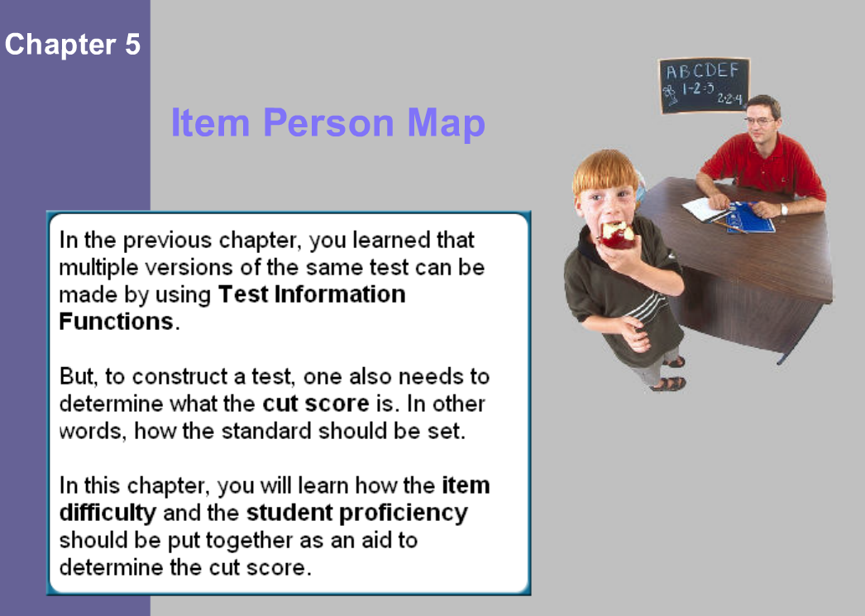

Slide 3
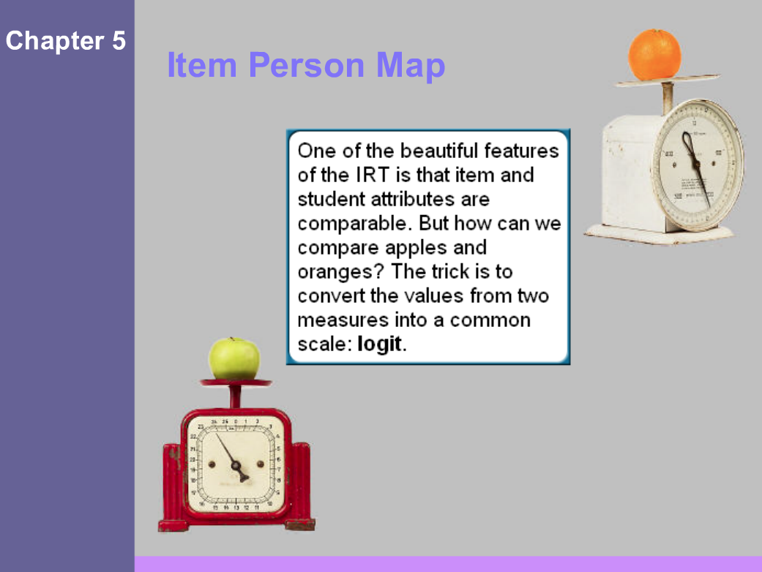

Slide 4
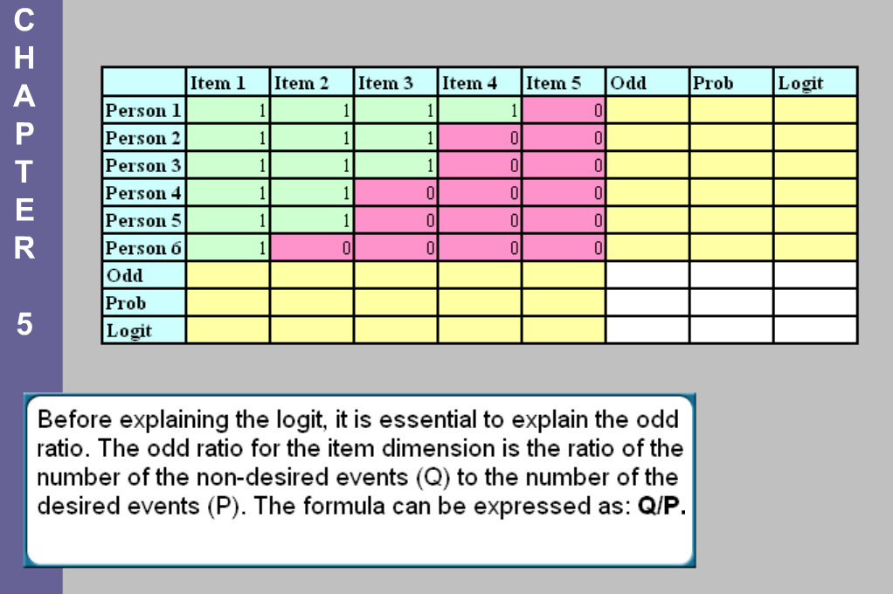
Before explaining the logit, it is essential to explain the odds. The odds for the item dimension is the ratio of the number of the non-desired events (Q) to the number of the desired events (P). The formula can be expressed as: Q/P.

Slide 5
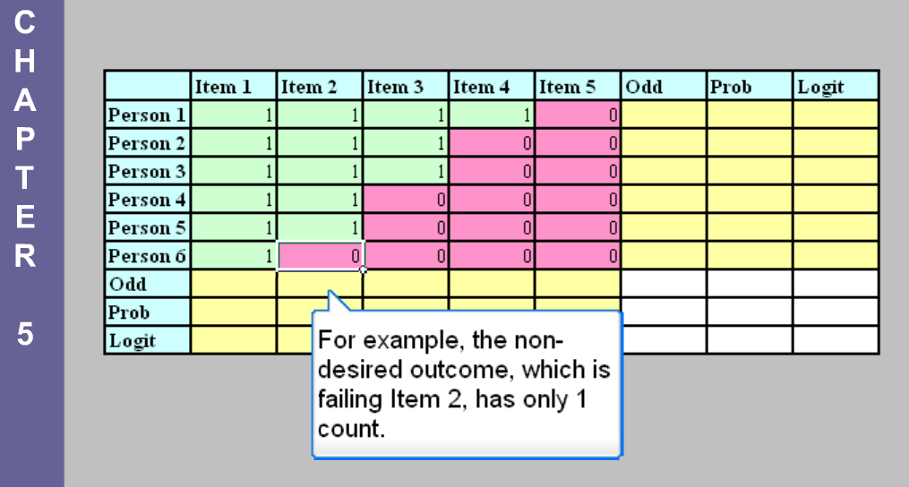

Slide 6
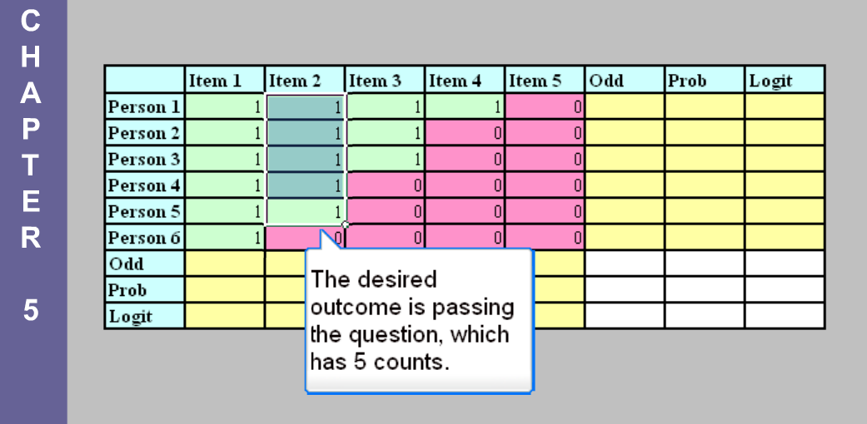

Slide 7
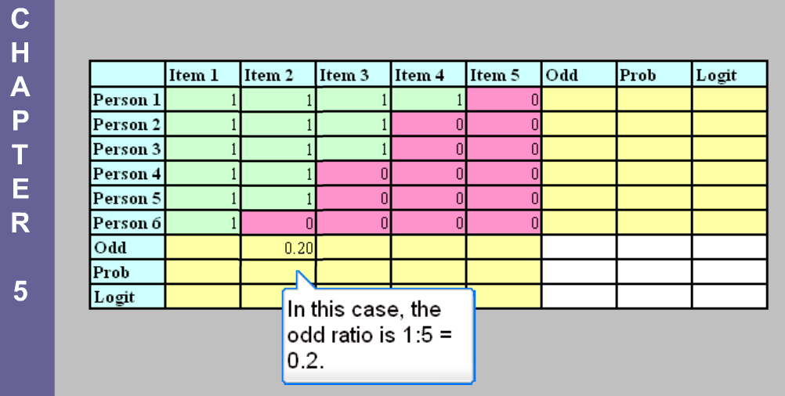
In this case the odds is 1:5 = 0.2.

Slide 8
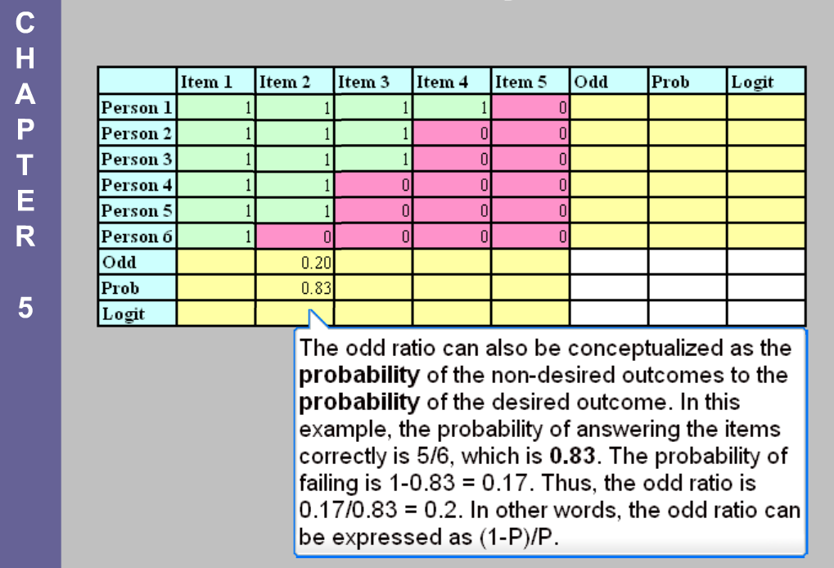
The odds can also be conceptualized as the probability of the non-desired outcomes to the probability of the desired outcome. In this example, the probability of answering the item correctly is 5/6=0.83. The probability of failing is 1–0.83=0.17. Thus, the odds is 0.17/0.83 = 0.2. In other words, the odds can be expressed as (1-P)/P.

Slide 9
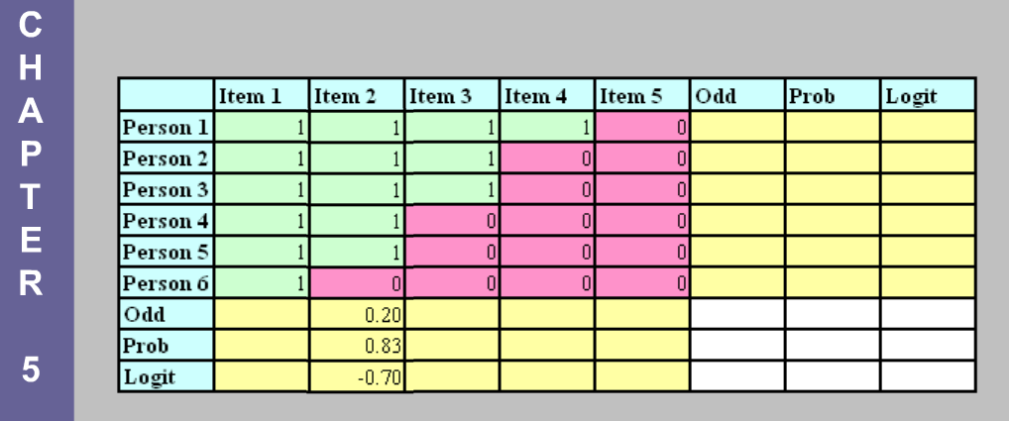
The logit is the logarithmic scale of the odds:
Logit = Log(odds).
For Item 2 the logit is -0.7. When the logit is far below zero, the item is considered very easy.

Slide 10
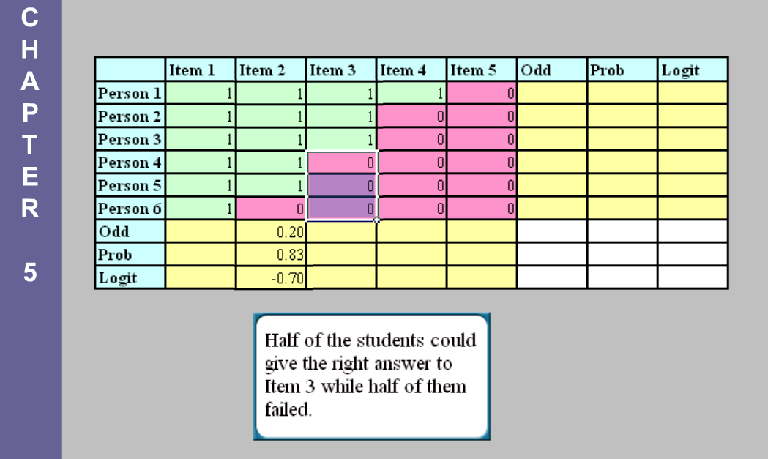

Slide 11
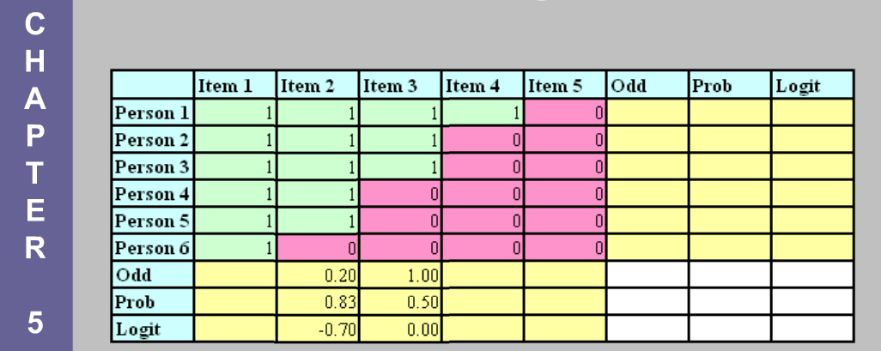
The pass rate (probability) of Item 3 is 50% (1,1,1,0,0,0). The odds is 1 and the logit is 0. As mentioned in Chapter 2, zero means average. This item is neither too difficult nor too easy.

Slide 12
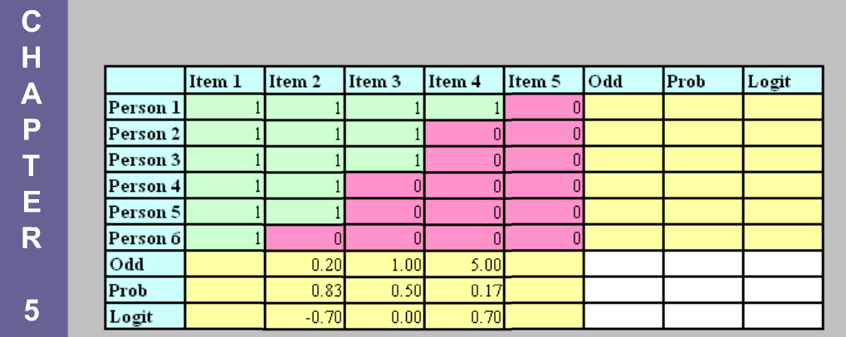
The pass rate (probability) of Item 4 is 17% (1 out of 6). The odds is 5 while the logit is 0.7. When the logit is way above zero, the item is considered difficult.

Slide 13
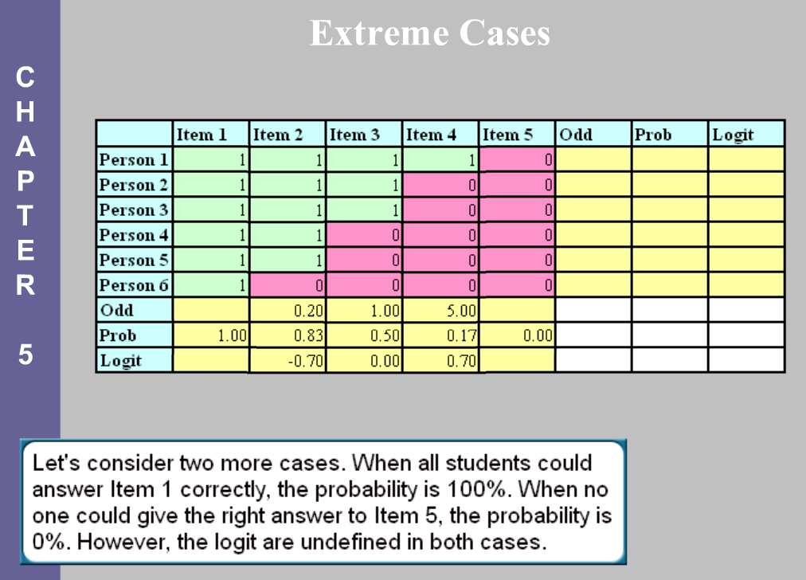

Slide 14
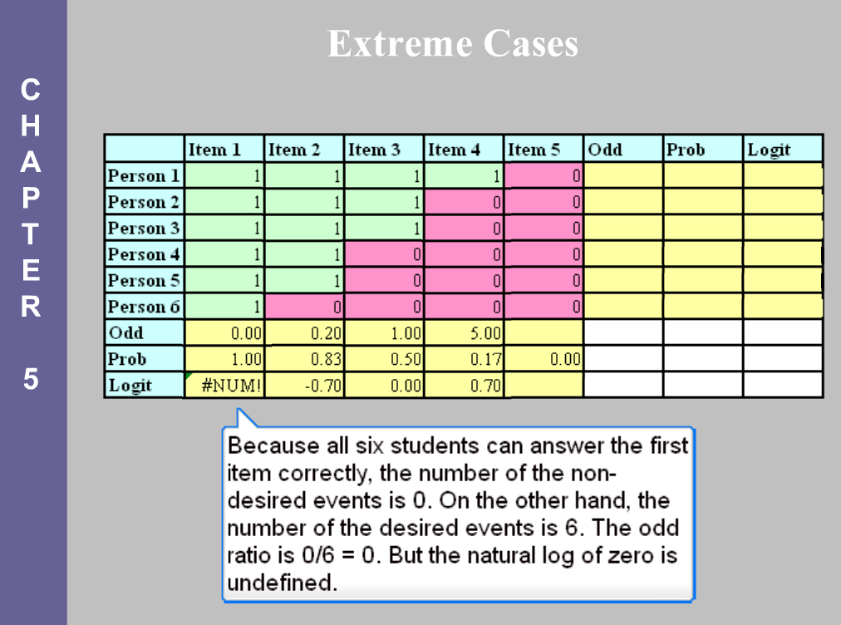

Slide 15
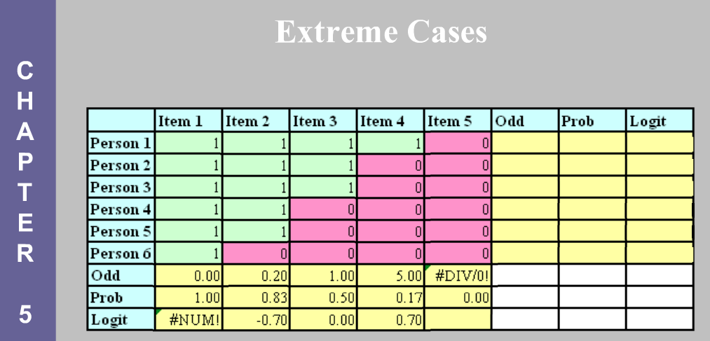
No student can give the right answer to Item 5, and the odds, 6/0, is undefined. Therefore it logit is also undefined.

Slide 16
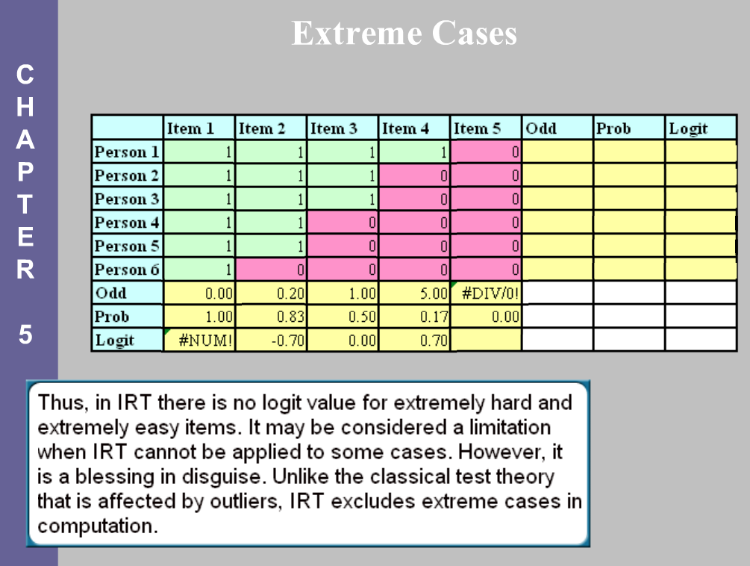

Slide 17
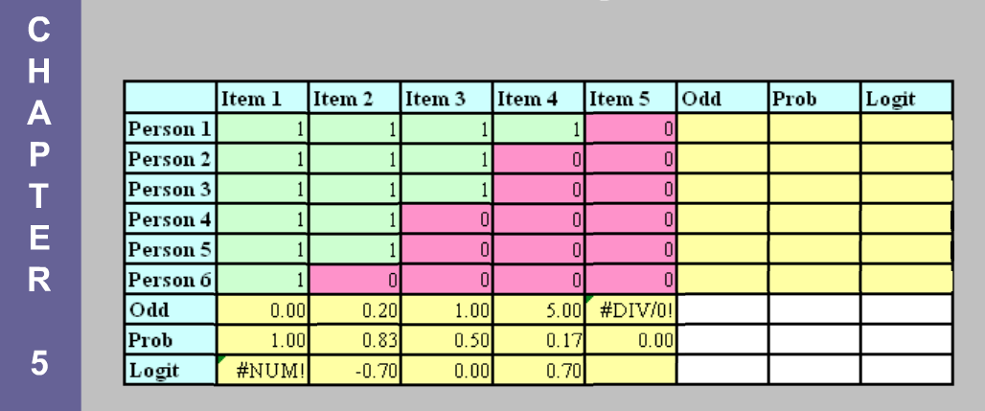
As mentioned before, the logit is a common scale for both item and person attributes. For persons the odds is P(1-P) whereas for items that is (1-P)/P. For students the desirable outcome is beating the items but for items the desirable outcome is beating the students.

Slide 18
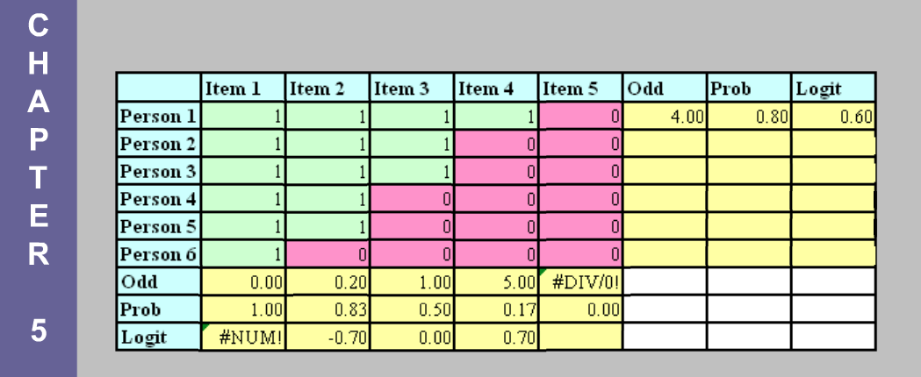
In this example, for the first student the odds of beating the exam is 4/1=4, the probability of answering all items correcting is 4/5=0.8, and the logit is 0.6. A positive logit indicates that this student is proficient.

Slide 19
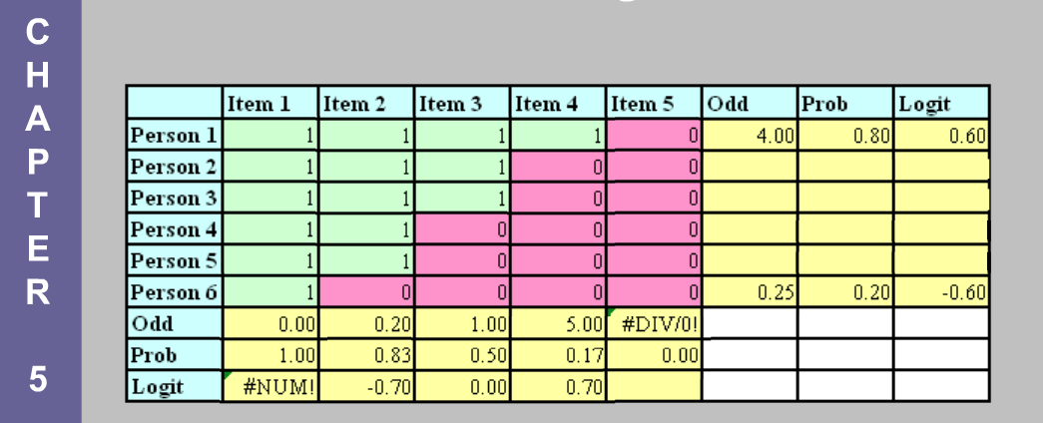
Student 5 answered only one out of five questions correctly (20% or 0.2). The odds is 1/4 =0.25 and the logit is -0.6. A negative logit indicates a low proficiency level.

Slide 20
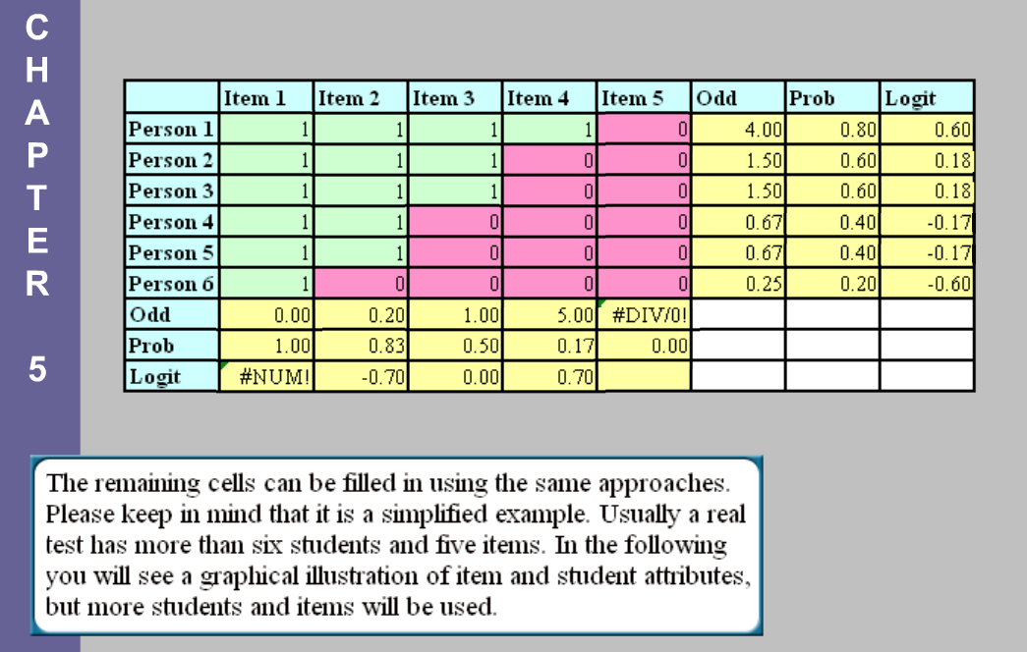

Slide 21
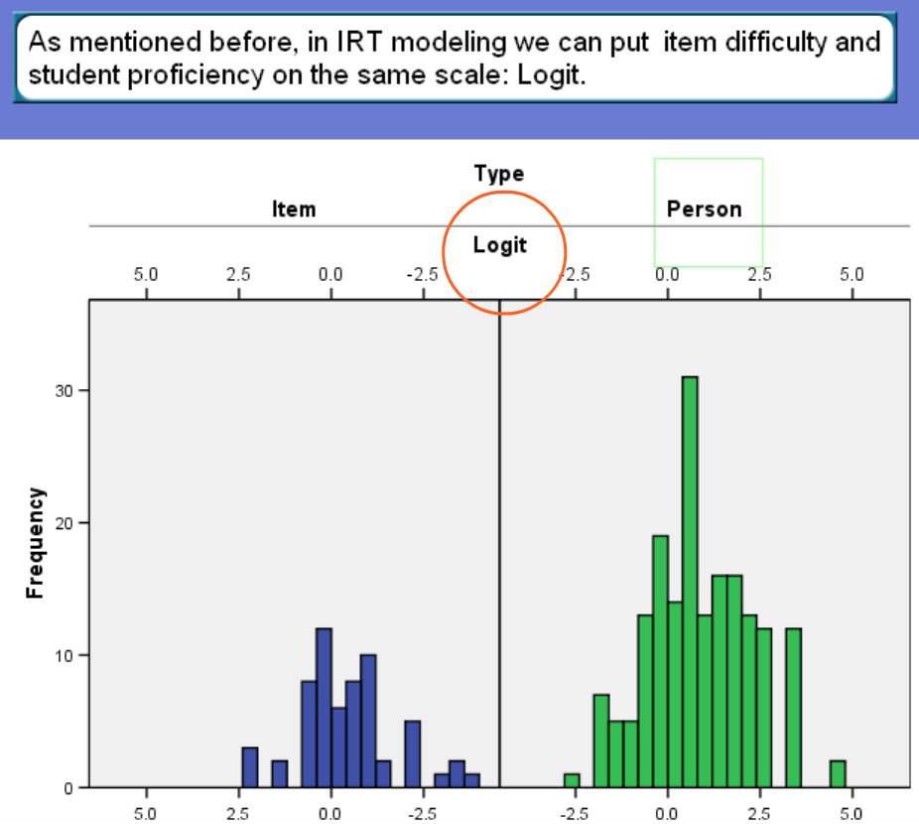

Slide 22
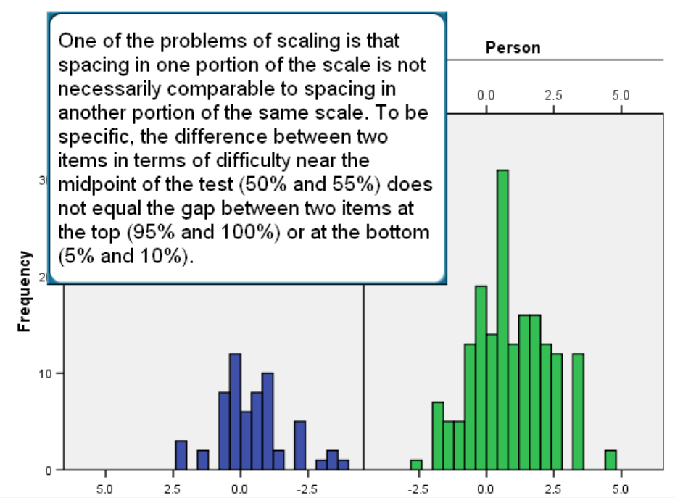

Slide 23
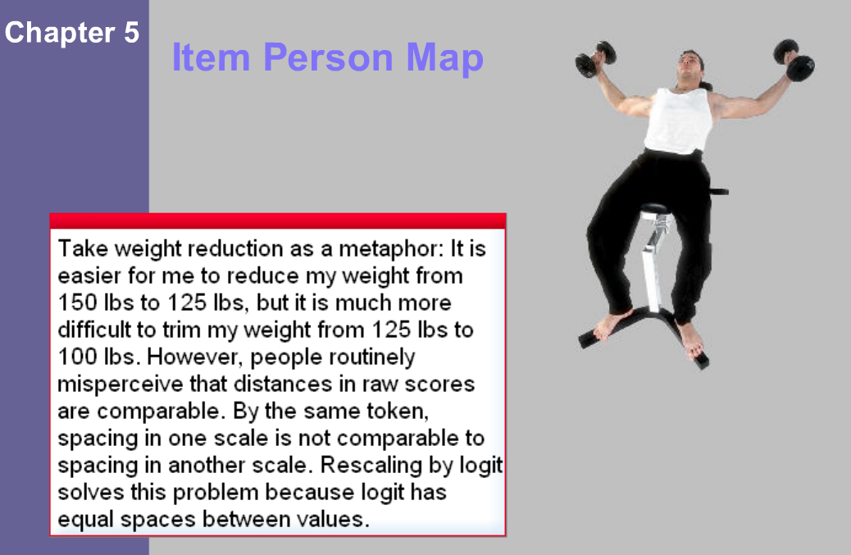

Slide 24
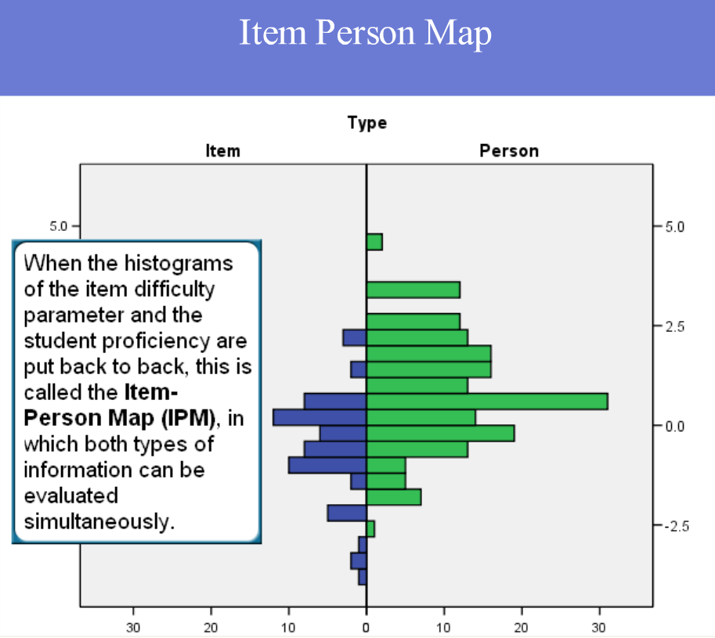

Slide 25
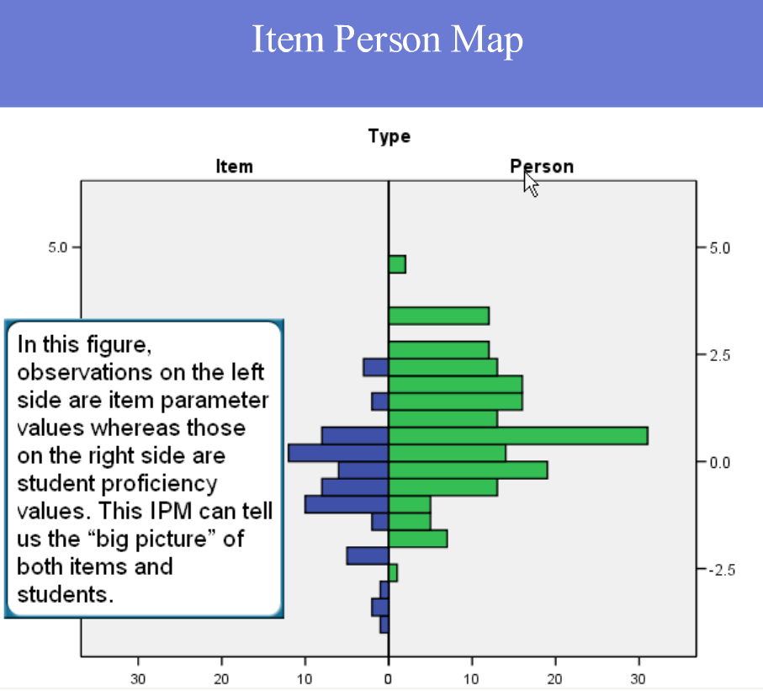

Slide 26
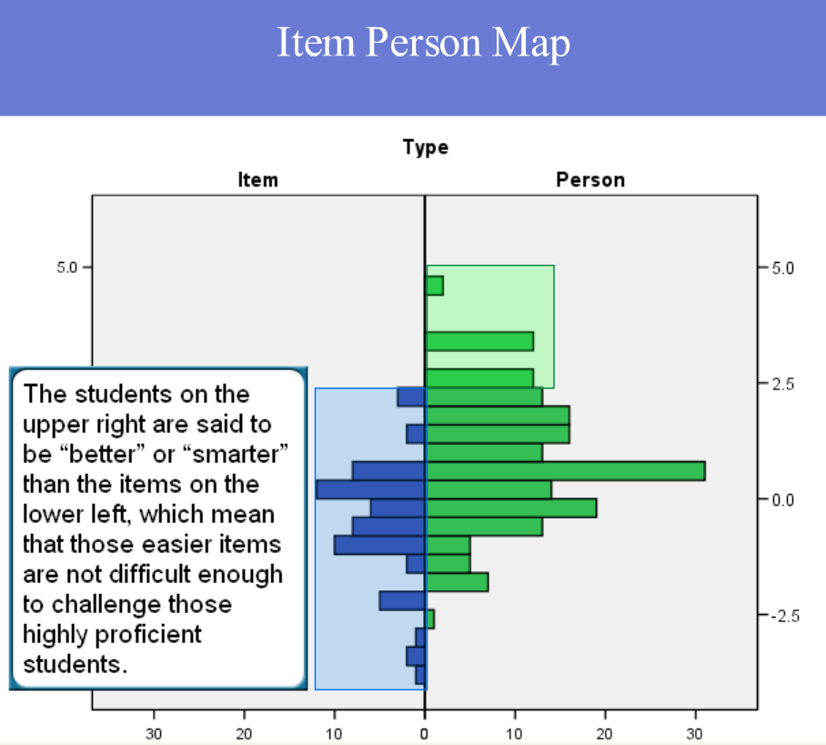

Slide 27
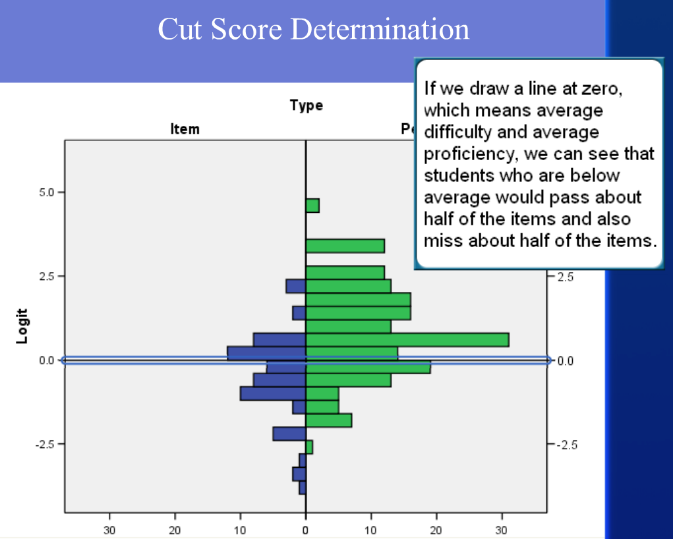

Slide 28
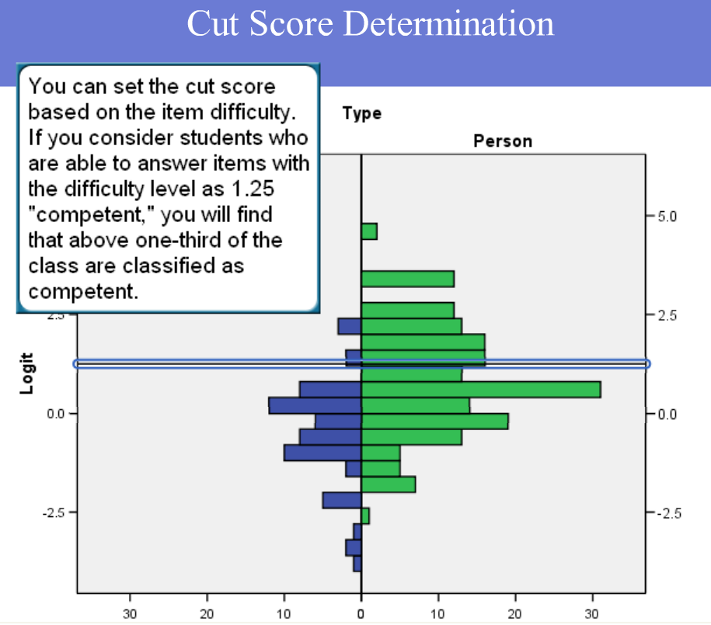

Slide 29
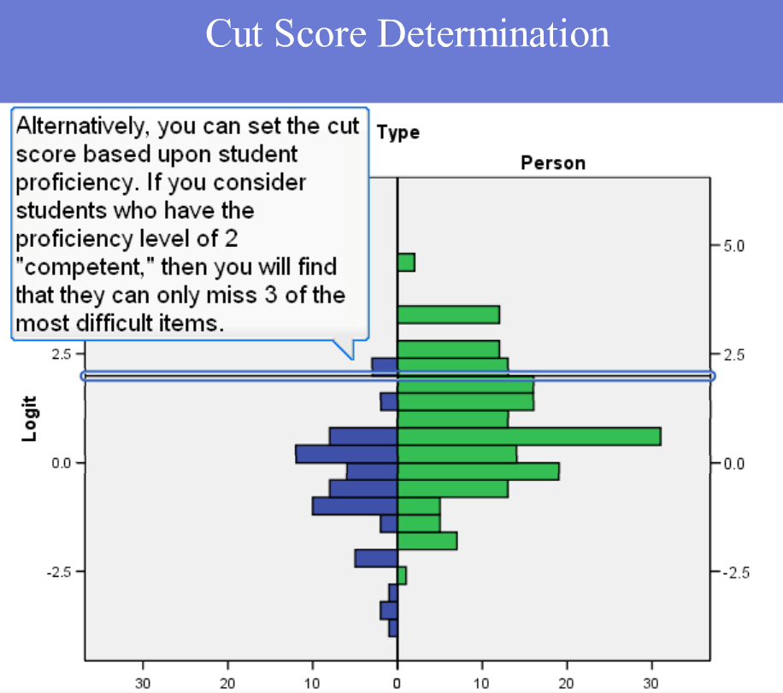

Slide 30
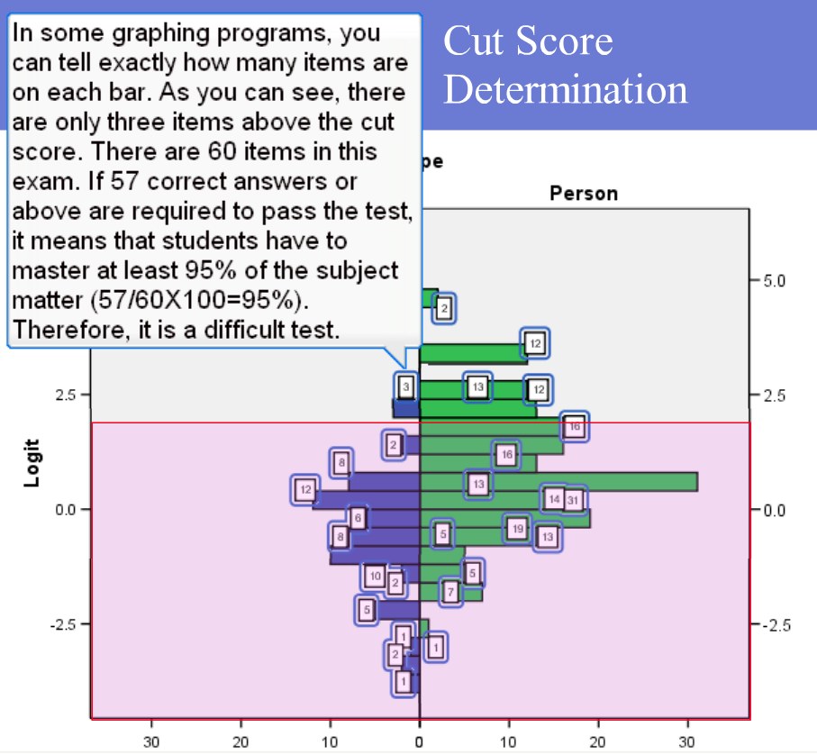

Slide 31
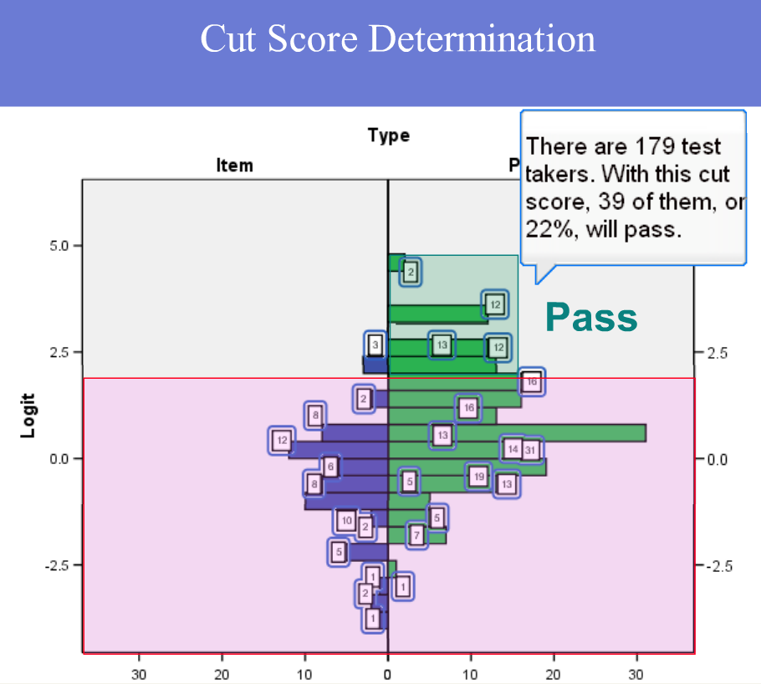

Slide 32
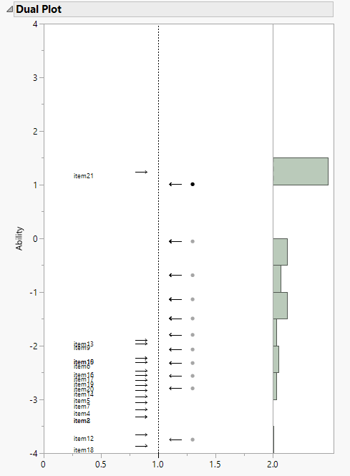
Many IRT software applications can generate item-person map but the names are different.
For example, in JMP (SAS Institute) it is called Dual plot. “Dual” means items and persons.

Slide 33
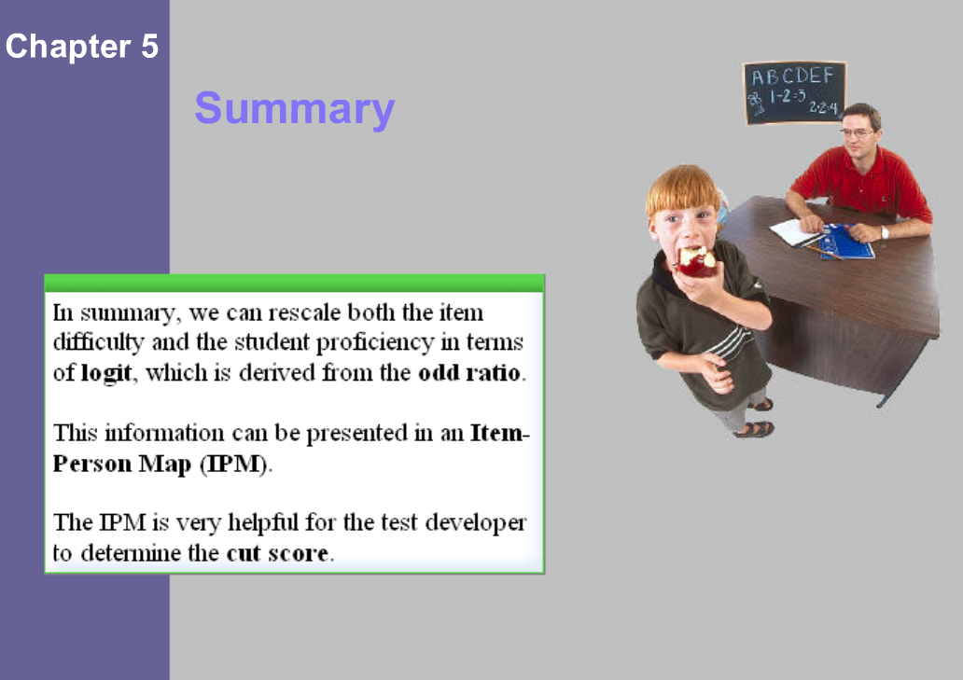

Slide 34
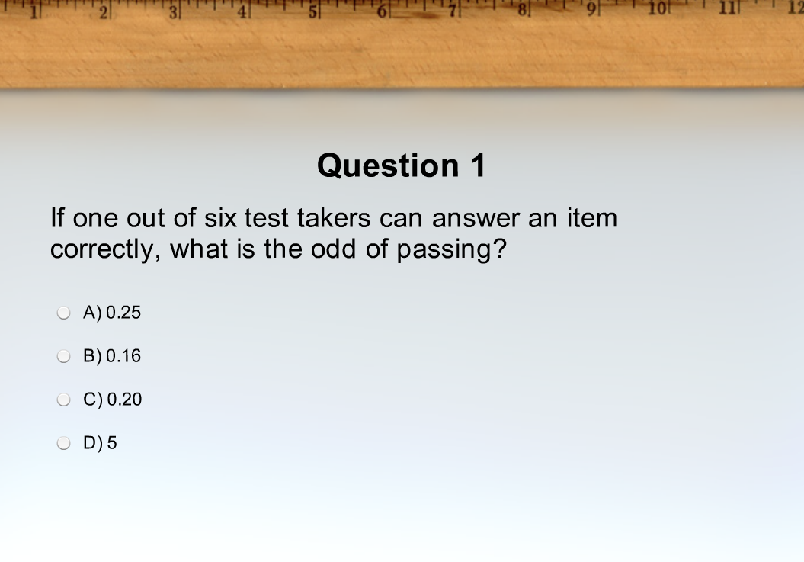

Slide 35
