Slide 1

Chong Ho Alex Yu

Slide 2
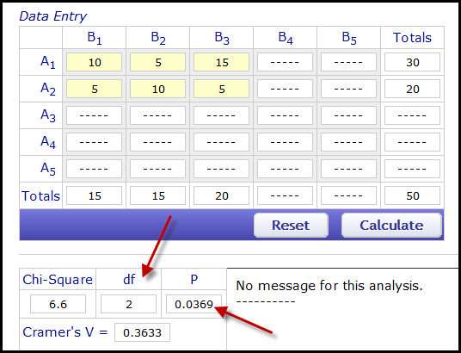
Online Chi-square calculator
Chi-square analysis is subject to degrees of freedom.
DF of X²: (Row -1) X (Column - 1) = (3-1)* (2-1) = 2 * 1 = 2
http://vassarstats.net/newcs.html

Slide 3
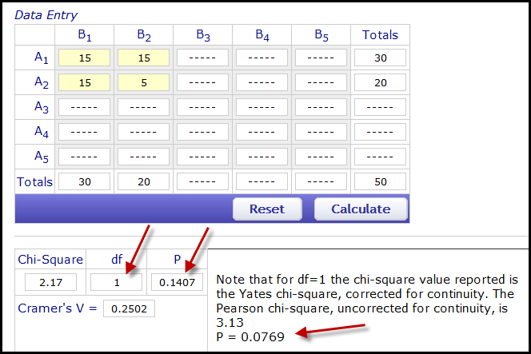
What if changing the number of levels?
What would happen if we decide to use two levels only (competent, not competent) by collapsing “more skilled” and “average” into one group (“competent”)?
DF of X²: (Row -1) X (Column - 1) = (2-1)* (2-1) = 1 * 1 = 1

Slide 4
The number of levels may vary
In this simplified example we partition the students into two or three groups by their skill level.
In the actual computation of misfit, examinees are not typically divided into only three groups and more levels may be used. There is no common consent about the optimal numbers of intervals. Yen (1981) suggested using 10 grouping intervals. Some item analysis software modules, such as (RUMM, Rasch Uni-dimensional Measurement Model) adopts 10-level grouping as the default.

Slide 5
Degrees of freedom
In 1913 Pearson and his assistants (Elderton et al., 1913) published a paper regarding the association between family size and the place in birth order using the Chi-square-based reasoning.
This paper was a response to a hot topic of that era: Nature vs. nurture. The position taken by Pearson is eugenics. He believed that the association between high fertility and big family size was a consequence of low social value; eventually this trend, if unchecked, could lead to de-evolution of the national population (Stiger, 1992). Research utilizing Chi-square was considered a tool to expose the problem.

Slide 6
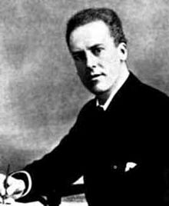
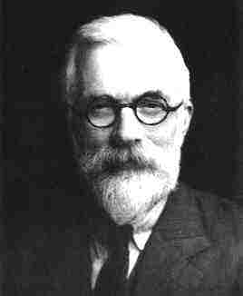

Clash of two giants
The clash between Fisher and Pearson on Chi–square happened when Fisher introduced degrees of freedom to modify Chi–square in 1922.
Fisher argued that in terms of causal explanation every free parameter reduces one degree of freedom.

Slide 7
Pearson didn’t admit mistakes
In 1927 and 1929 Harris and his colleagues published two papers highlighting the limitations of Pearson's coefficient of contingency. They bluntly asserted that an extremely naive use of Pearson's Chi-square would produce misleading conclusions.
In 1930 Pearson replied to the challenge by saying “I venture to think that my friend Professor Harris has overlooked the essential nature of contingency…I do not think those methods are at all applicable…I do not think they form any real limitation to the use of contingency methods” (cited in Stiger, 1992, p.573). Simply put, Pearson rejected their suggestions and insisted upon the validity of the original Chi-square analysis.

Slide 8
Ungraded In-class assignment
Use the same data set given in the Chi-square example. Collapse the “average” and “less skilled” into one group.
  Compute the expected cell counts, compute the discrepancy in each cell, and then sum all discrepancies into the overall Chi-square.
  Use the online chi-square calculator to rerun the Chi-square analysis. What is the result?

Slide 9
MS= Chi-SQ/DF
Porter (2004) argued that perhaps there is also something in Pearson’s attitude that reflects a long standing notion of favoring data at hand over model.
For Pearson, the Chi-square fit was nothing more than constructing a convenient model to approximate the observed frequencies in different cells of a contingency table.
Pearson was on the wrong side of history. Chi–square analysis is now applied as Fisher argued it ought to be.
In IRT/Rasch, we use the mean square to evaluate fitness and to identify misfit. MS = Chi-SQ/DF

Slide 10
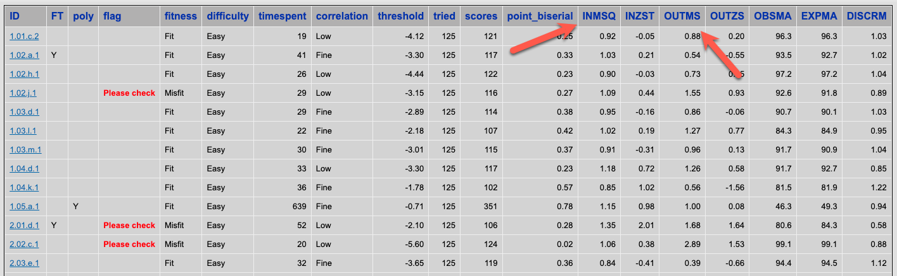
MS= Chi-SQ/DF
“IN.MSQ” and “OUT.MSQ” stand for “infit mean squared” and “outfit mean squared.”

Slide 11
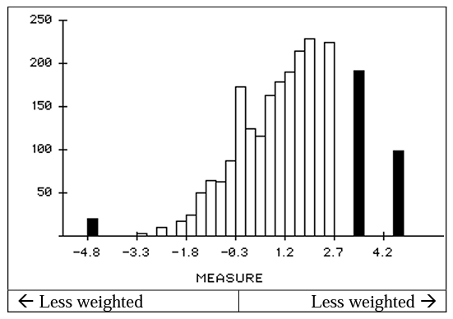
INfit
The infit mean-squared is the Chi-squared/degrees of freedom with weighting.
In the actual computation of misfit there may be many groups of examinees partitioned by their skill level, but usually there are just a few observations near the two ends of the distribution. Do we care much about the test takers at the two extreme ends? If not, then we should assign more weight to examinees near the middle during the Chi-squared computation

Slide 12

Outfit? Not the one in the picture
Another way of conceptualizing “infit mean square” is to view it as the ratio between observed and predicted variance. For example, when infit mean square is 1, the observed variance is exactly the same as the predicted variance. When it is 1.3, it means that the item has 30% more unexpected variance than the model predicted.
The outfit mean squared is the converse of its infit counterpart: unweighted Chi-squared/df.

Slide 13
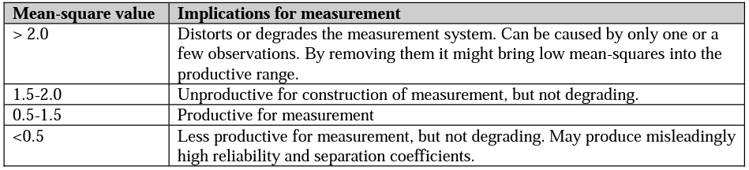
Interpretation of different levels of mean-square values
Caution: don’t treat them as absolute cut-off points

Slide 14
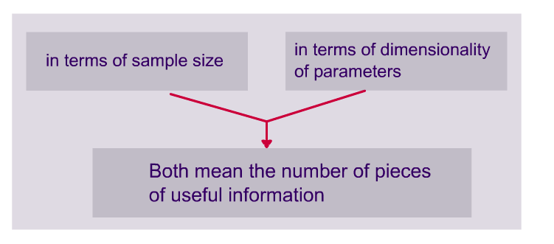
Degrees of freedom

Slide 15
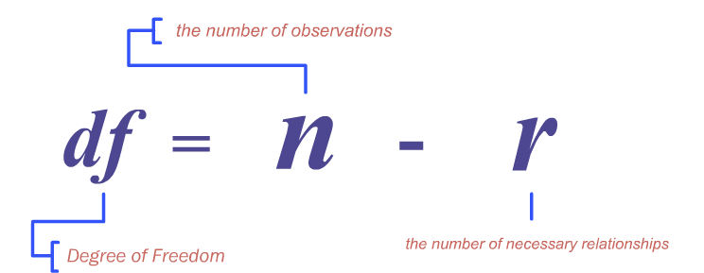
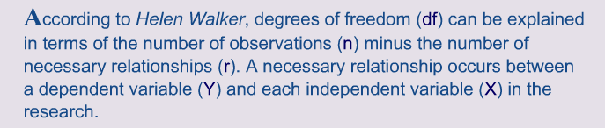

Slide 16
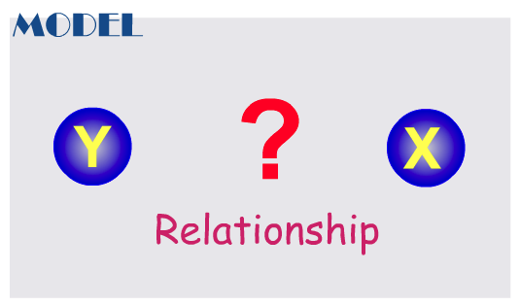
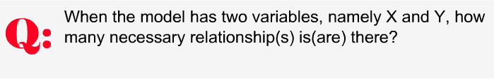

Slide 17
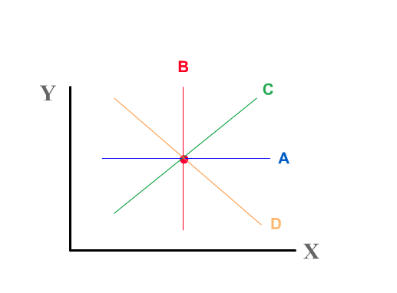
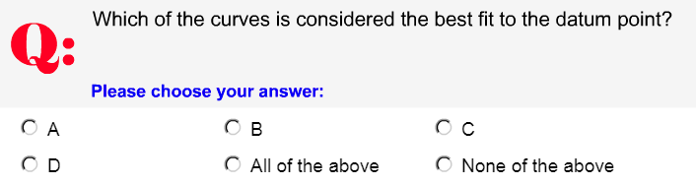

Slide 18
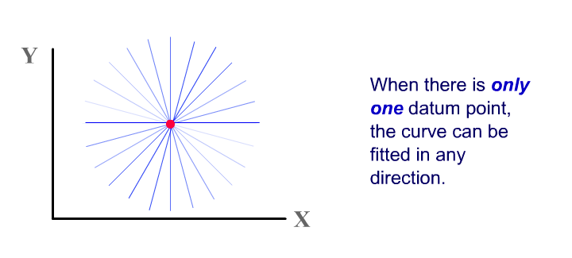
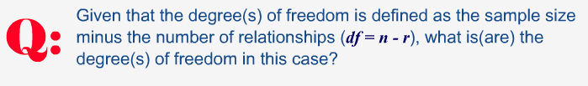

Slide 19
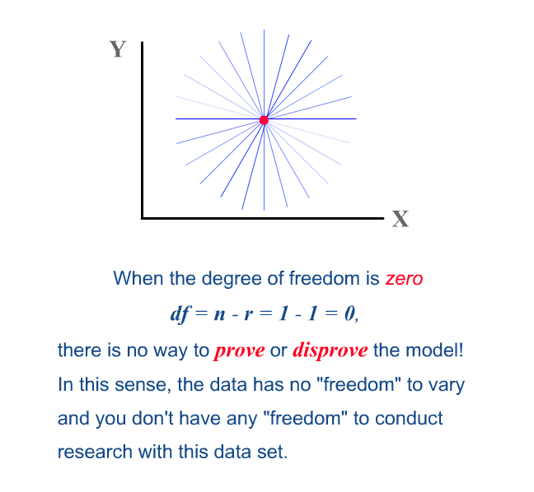

Slide 20
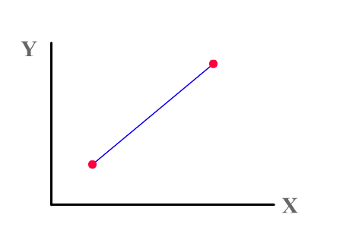
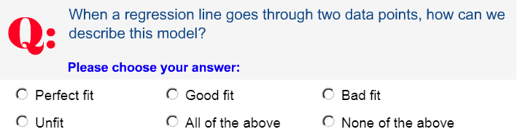

Slide 21
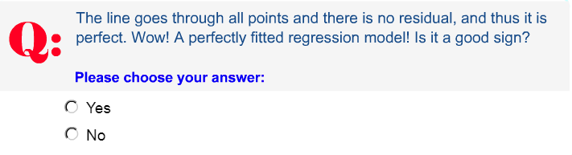

Slide 22


Slide 23
DF = 2 – 1 = 1. This is a bit better than the previous model, which has one datum point and no degree of freedom. However, it is still undesirable.
If DF = 1 and the fit is perfect, there is no room (freedom) for other plausible alternate models. Again, this model is “always right” and cannot be falsified.

Slide 24
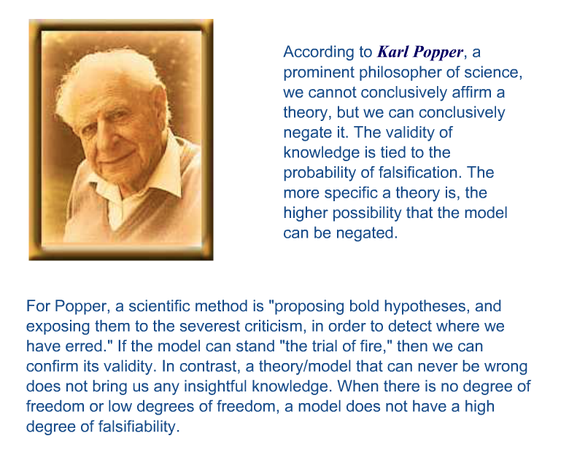

Slide 25
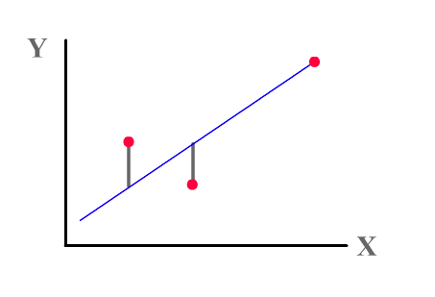
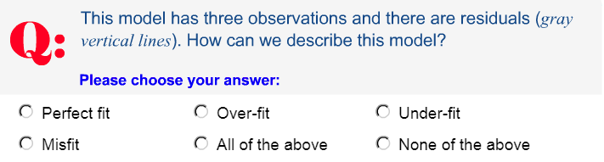

Slide 26
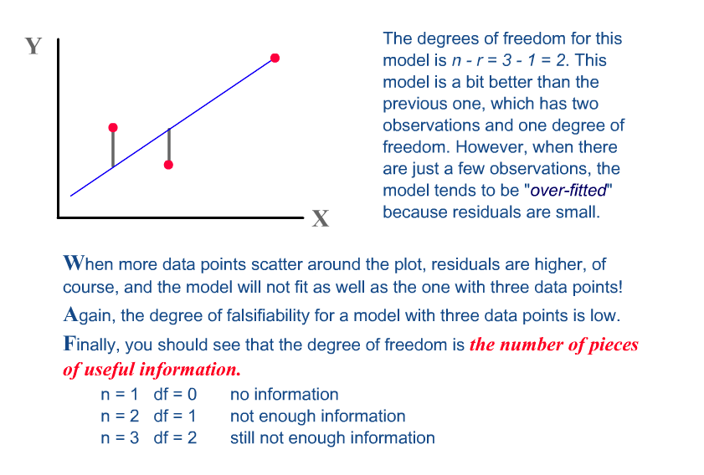

Slide 27
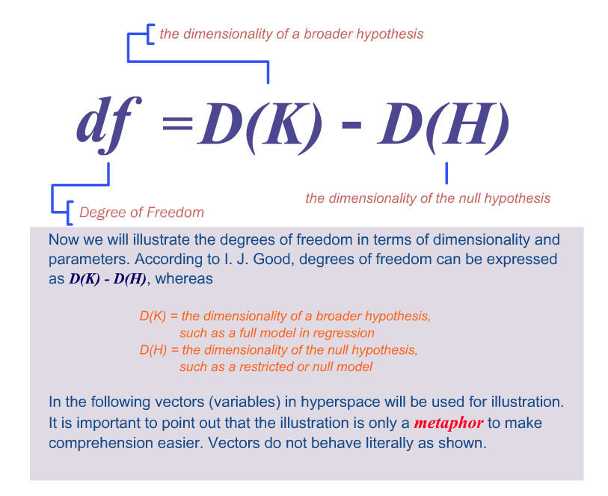

Slide 28
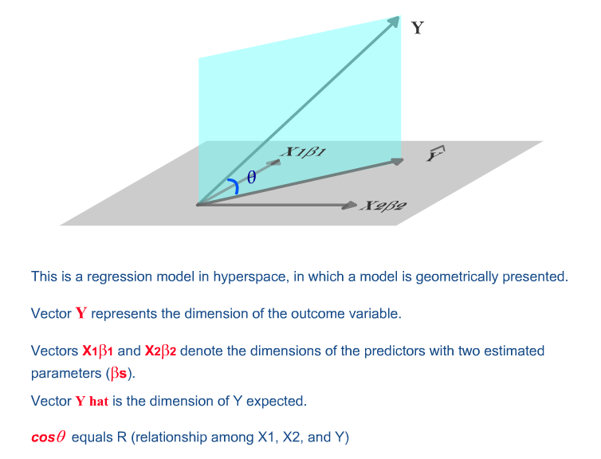

Slide 29
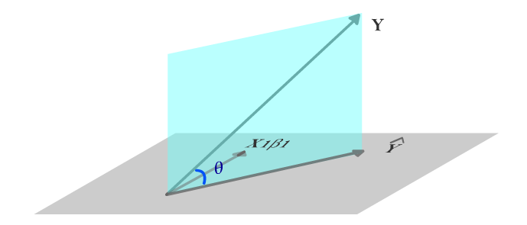


Slide 30
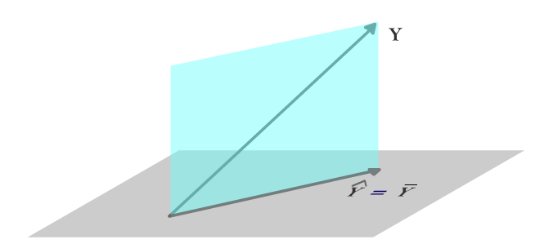


Slide 31
The right answer is “none.” In a null model, the number of parameters to estimate is zero. The expected Y score is equal to the mean of Y. There is no beta weight (regression coefficient or slope) to be estimated.

Slide 32
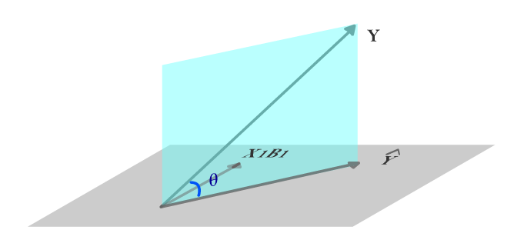


Slide 33
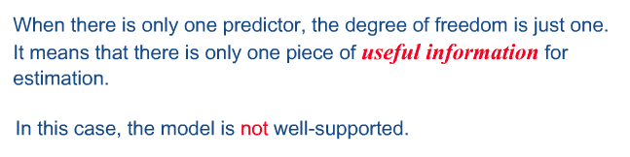

Slide 34
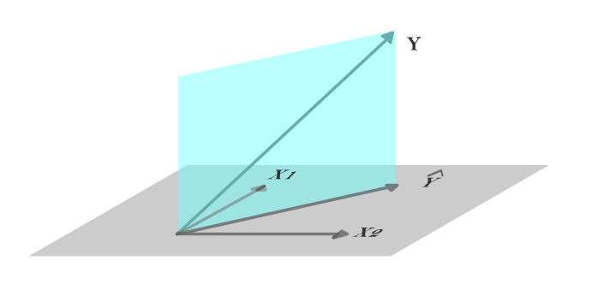


Slide 35


Slide 36
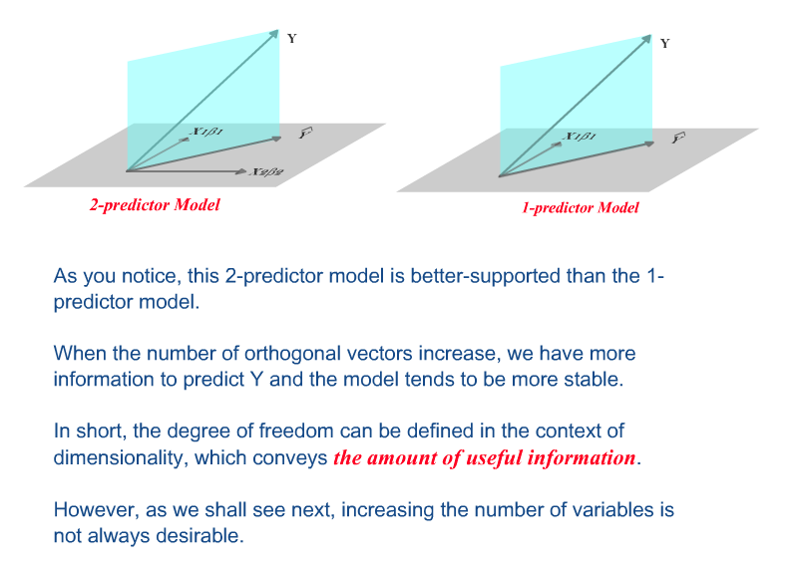

Slide 37
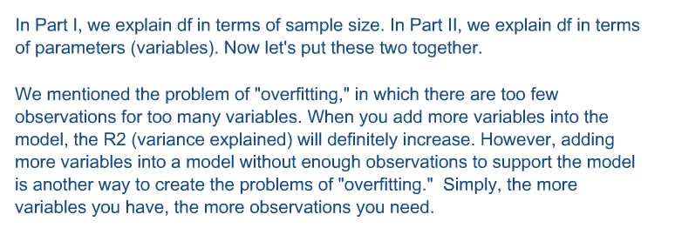

Slide 38
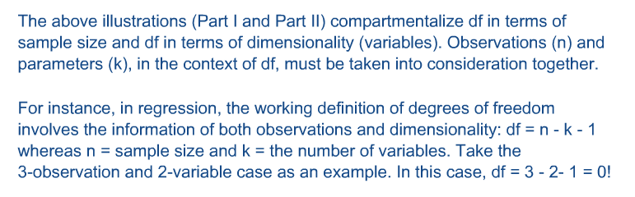

Slide 39
