Slide 1
Bias detection:
Differential item functioning
Chong Ho (Alex) Yu

Slide 2
Statistical disparity <> Bias
A statistical disparity does not necessarily imply test or item bias. For example, when some people do better than other groups in a test, perhaps they work harder or they are gifted with certain traits.
You need to read the test items and evaluate the situation in order to find out whether some elements there bias against certain groups.

Slide 3
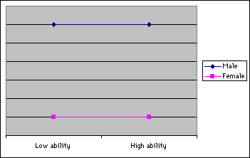
Uniform bias
The difference of the probability of success between groups is consistent across all levels of ability. For example, the item favors all males regardless of ability.

Slide 4
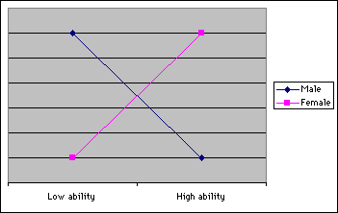
Non-uniform bias
The difference of the probability of success between groups is not constant across ability levels. In other words, there is an interaction effect between group membership and ability. For example, the item favors males of low ability while favoring females of higher ability.

Slide 5
DIF
Non-IRT DIF
  Cochran Mantel Haenszel (CMH) or Mantel Haenszel (MH) test.
  Logistic regression
IRT-based DIF
  Lord’s model
  Raju’s method

Slide 6
CMH using SAS
/* Use IRT_demo.jmp
Non-IRT DIF method 1a: CMH procedure
Student ability is NOT taken into account. NOT recommended!
Check whether gender would make a difference in the item score
regardless of student ability in terms of total score*/
PROC FREQ DATA=ALEX.IRT;
/* You can do a batch of items using (item1-item2) */
TABLES Gender * item20 /CMH noprint;
RUN;

Slide 7
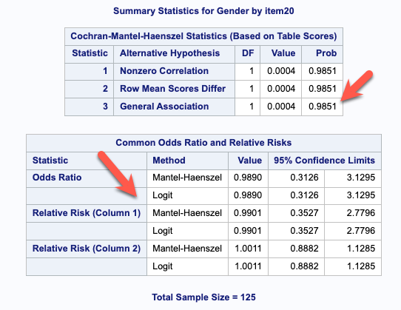
CMH using SAS
Null hypothesis: There is no relationship between gender and the item responses regardless of student ability.
p = .9851, failed to reject the null → no gender bias.
Logit = .989 (1: no difference)

Slide 8
CMH using SAS
Non-IRT DIF method 1b: CMH procedure
Student ability is taken into account
Students were stratified on total scores using PROC RANK */
PROC RANK DATA=ALEX.IRT OUT=DIF group=5;
VAR total;
RANKS stratum;
RUN;
PROC FREQ DATA=DIF;
/* You can do a batch of items using (item1-item2) */
TABLES stratum * Gender * item20 /CMH noprint;
RUN;

Slide 9
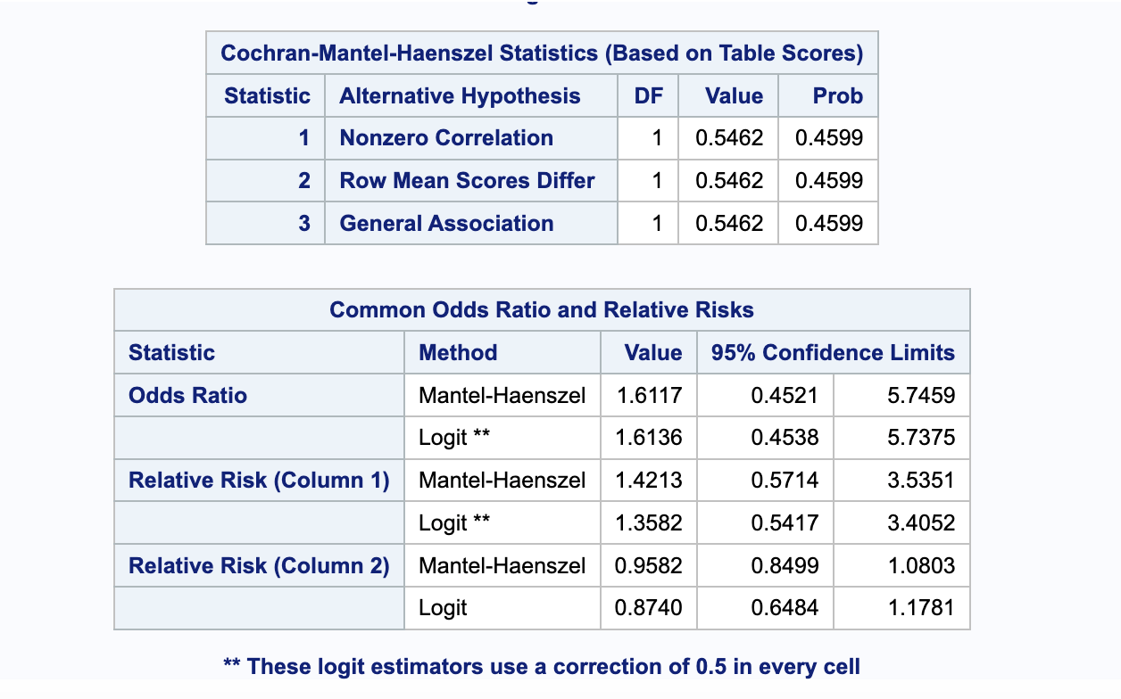
CMH using SAS
Null hypothesis: There is no relationship between gender and the item responses across different strata of student ability in terms of the total score.
Fail to reject the null → no gender bias.

Slide 10
CMH using SAS
The odds ratio is 1.61, meaning that the odds of male students answering the question correctly to this item are slightly higher than that of female students (1 : difference, > 1: more likely, < 1: less likely)

Slide 11
Logistic regression using SAS: Uniform DIF
/* Non-IRT DIF method 2a: logistic regression */
/* Model 2a looks at uniform DIF without the interaction
between gender and student ability*/
PROC LOGISTIC DATA=DIF;
class gender;
MODEL item20=total gender / LINK=logit;
RUN;

Slide 12
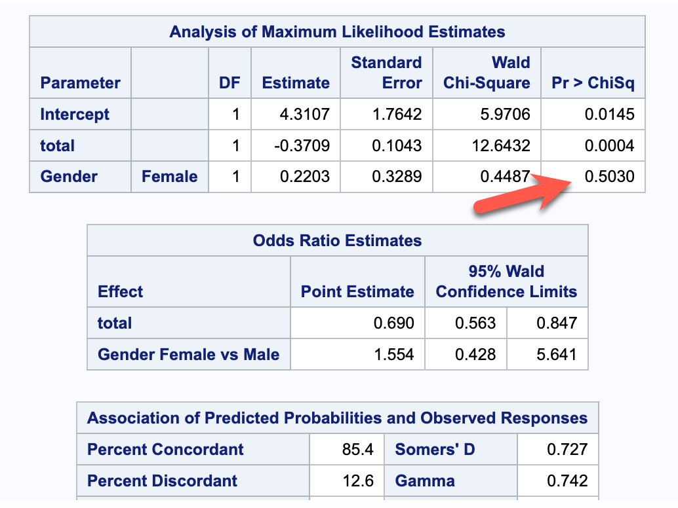
Logistic regression using SAS
Null hypothesis: Gender cannot predict item score without taking student ability into account
Failed to reject (p = .5)
No gender bias

Slide 13
Logistic regression using SAS
/* Non-IRT DIF method 2b: logistic regression */
/* Model 2b looks at non-uniform DIF. The interaction
between student ability and gender is taken into account*/
PROC LOGISTIC DATA=DIF;
class gender;
MODEL item20=total gender total*gender / LINK=logit;
RUN;

Slide 14
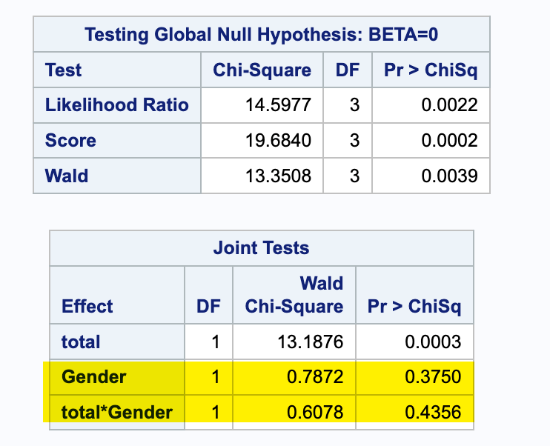
Logistic regression using SAS
No gender effect
No interaction effect of gender and ability (in terms of ranking of total score)

Slide 15
Non-IRT DIF method in R: CMH or MH
install.packages("readxl")
library("readxl")
df <- read_excel(file.choose()) # use IQ.xlsx
# run 25 iterations to suppress
install.packages("difR")
library(difR)
# drop the age variable
df2 <- df[, -27]
# if gender is ‘male’ and ‘female’, they must be converted to numeric like 1 and 2
# iteratively locate DIF-free item(s) as anchor(s), and then the located DIF-free item(s) are used to identify DIF items. Analogy: iteratively select best papers as the reference to grade other papers
MHDIF <- difMH(df2, group='gender', focal.name=1, purify=TRUE, nrIter=25)

Slide 16
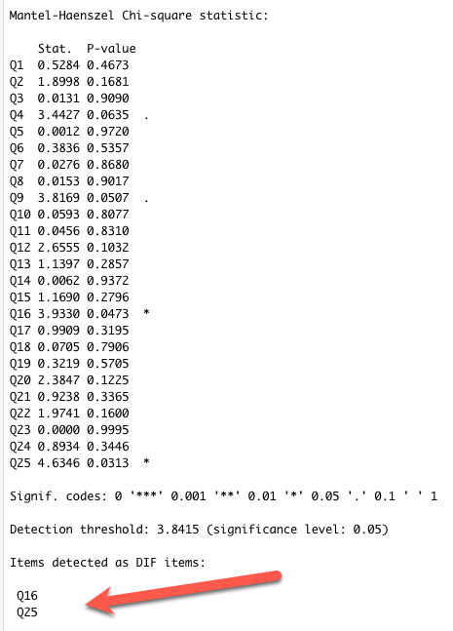
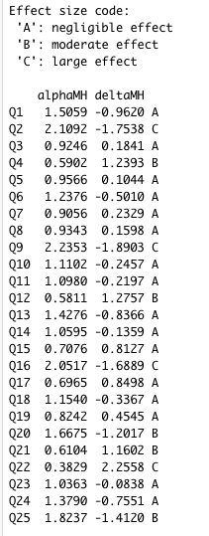
The non-IRT MH method identified 2 items as DIF items.

Slide 17
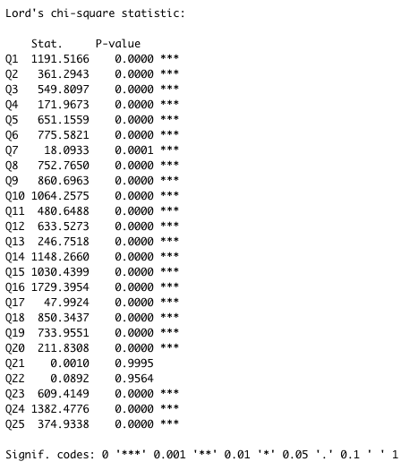
IRT DIF method in R:
Lord’s 2PL Model
IRTDIF <- difLord(df2, group='gender', focal.name =1, model='2PL',purify=TRUE, nrIter=25)
23 out of 25 items are identified as DIF items!
Is Lord’s model over-sensitive? My Lord!

Slide 18
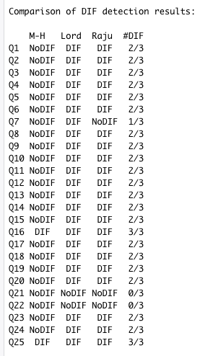
Compare Non-IRT and IRT DIFs
ALL3 <- dichoDif(df2, group='gender', focal.name =1, method=c('MH','Lord','Raju'),model='2PL', purify=TRUE, nrIter=25)

Slide 19
Assumptions of DIF (1)
It is assumed that test items measure a single trait. What if there are multiple traits behind the scene?
A math test may consist of items in both numeric and essay forms. A tester who is low in math skills but high in reading skills may answer difficult math questions expressed in a numeric form correctly, but fail to answer easy questions expressed in an essay form. This dual-trait situation is unavoidable because almost all tests require reading skills.
When a skill involves multiple traits other than the content and the language, DIF may not be useful.

Slide 20
Assumptions of DIF (2)
It is assumed that the overall test is fair and only several items are biased. Therefore the total score is used as a reference to classify testers into high and low ability groups. However, what if more than half of the items are biased? If so, then item anchoring and item purification will not work.

Slide 21
Assumptions of DIF (3)
It is assumed that abilities are equivalently distributed across groups. Therefore, certain test score differences are due to unfair questions rather than genuine group differences. Statistical disparity does not necessarily imply bias and unfairness. It should be open to scientific investigation rather than settling down by political correctness.

Slide 22
Criticisms of DIF
Hills (1999) is stated that many years of DIF research (e.g. Roznowski & Reith, 1999) has never demonstrated that removing biased items could remove the test bias and bring mean scores together. An exception is the differences in mean scores on intellectual tests for males and females, where the differences were very small in the first place.
Reise and Flannery (1996) asserted that in personality psychology the solution for the response bias (over-correction) was worse than the problem.
Challenging items are removed and everyone can get an “A”! The test has no discriminant ability.

