Slide 1

Introduction to SAS

Slide 2

Read and create data
files.
Manipulate, transform
data.
Course
Objectives
Create basic detail
and summary reports
Identify and correct
syntax and programming
logic errors.
using
Base
SAS
procedures.

Slide 3
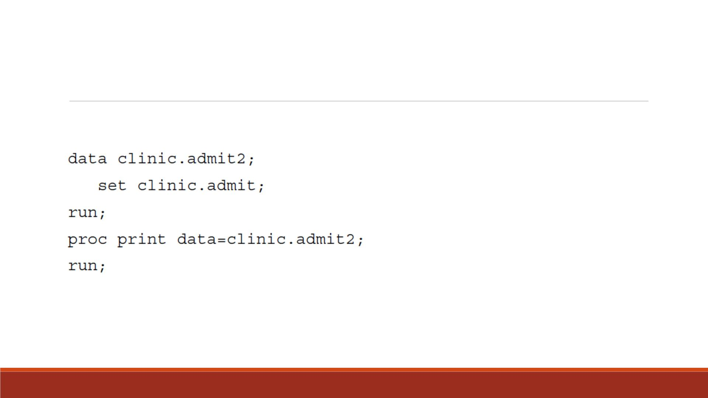
SAS Programs
▪You can use SAS programs to access, manage, analyze, or present your data. For example,
▪It creates a new SAS dataset from an existing SAS dataset and then prints a listing of the new dataset.
▪A SAS data set is a data file that is formatted in a way that SAS can understand.

Slide 4
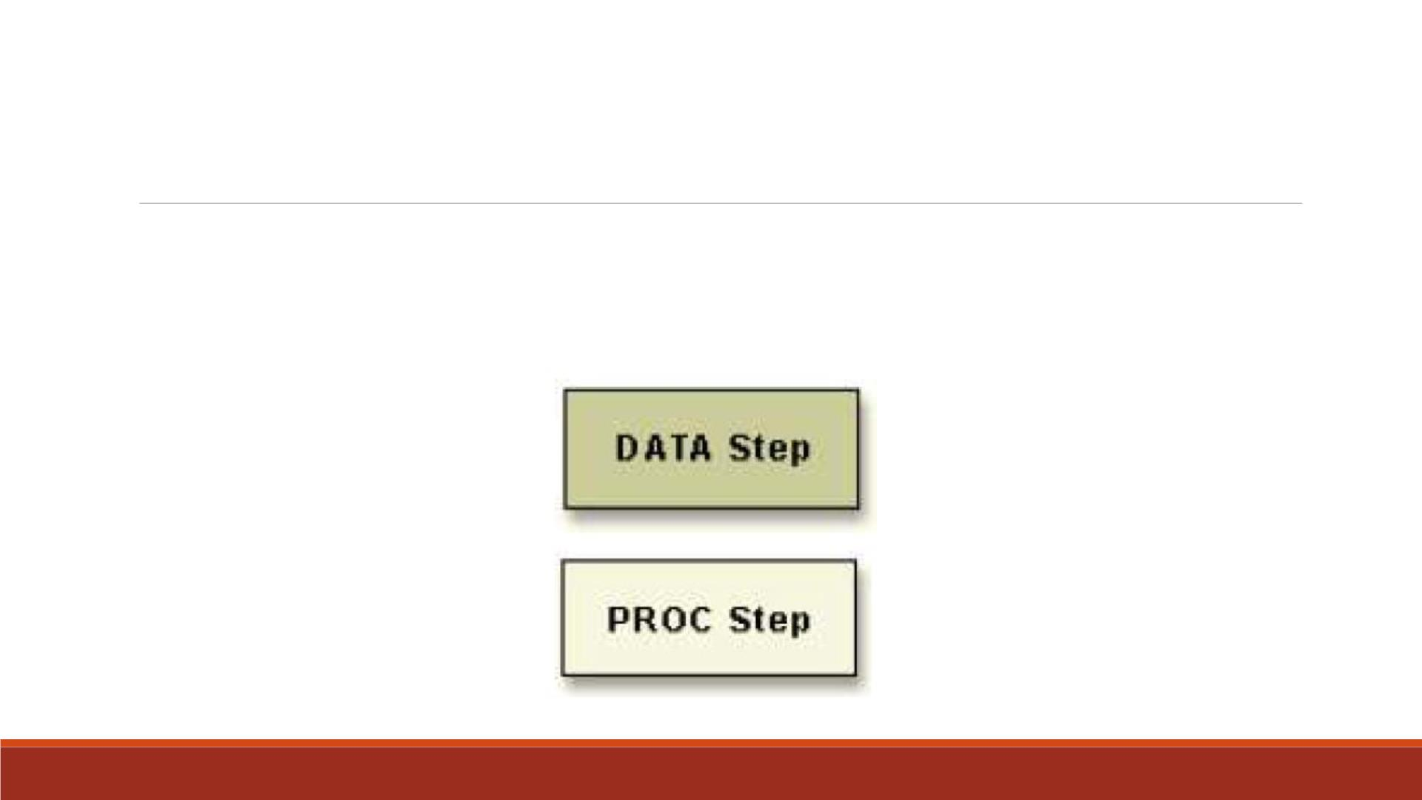
Components of SAS Programs
▪Our sample SAS program contains two steps: a DATA step and a PROC step.
▪These two types of steps, alone or combined, form most SAS programs.

Slide 5
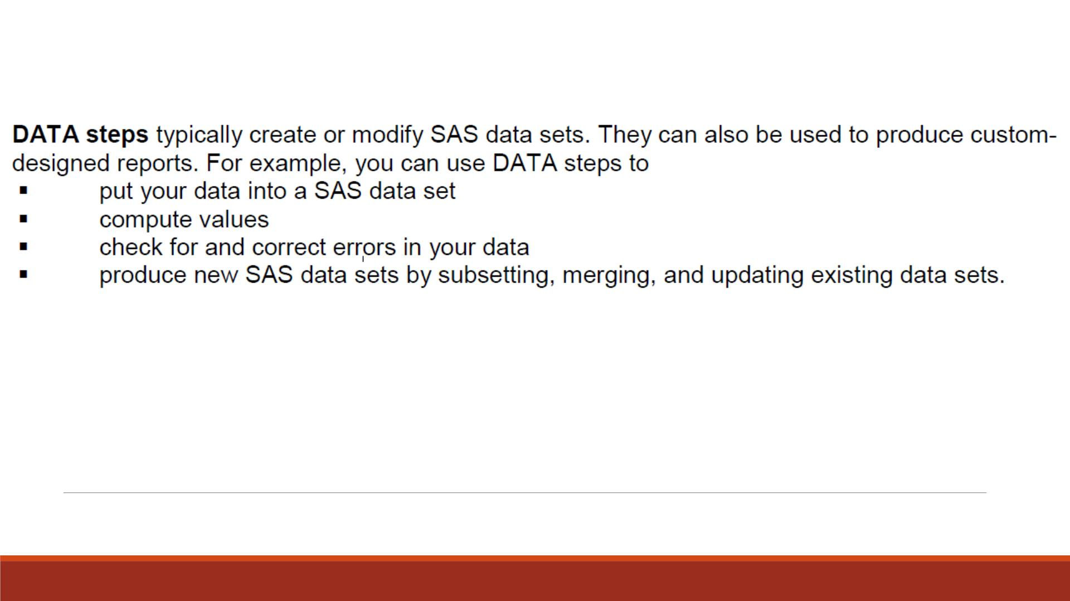
D ATA Step

Slide 6
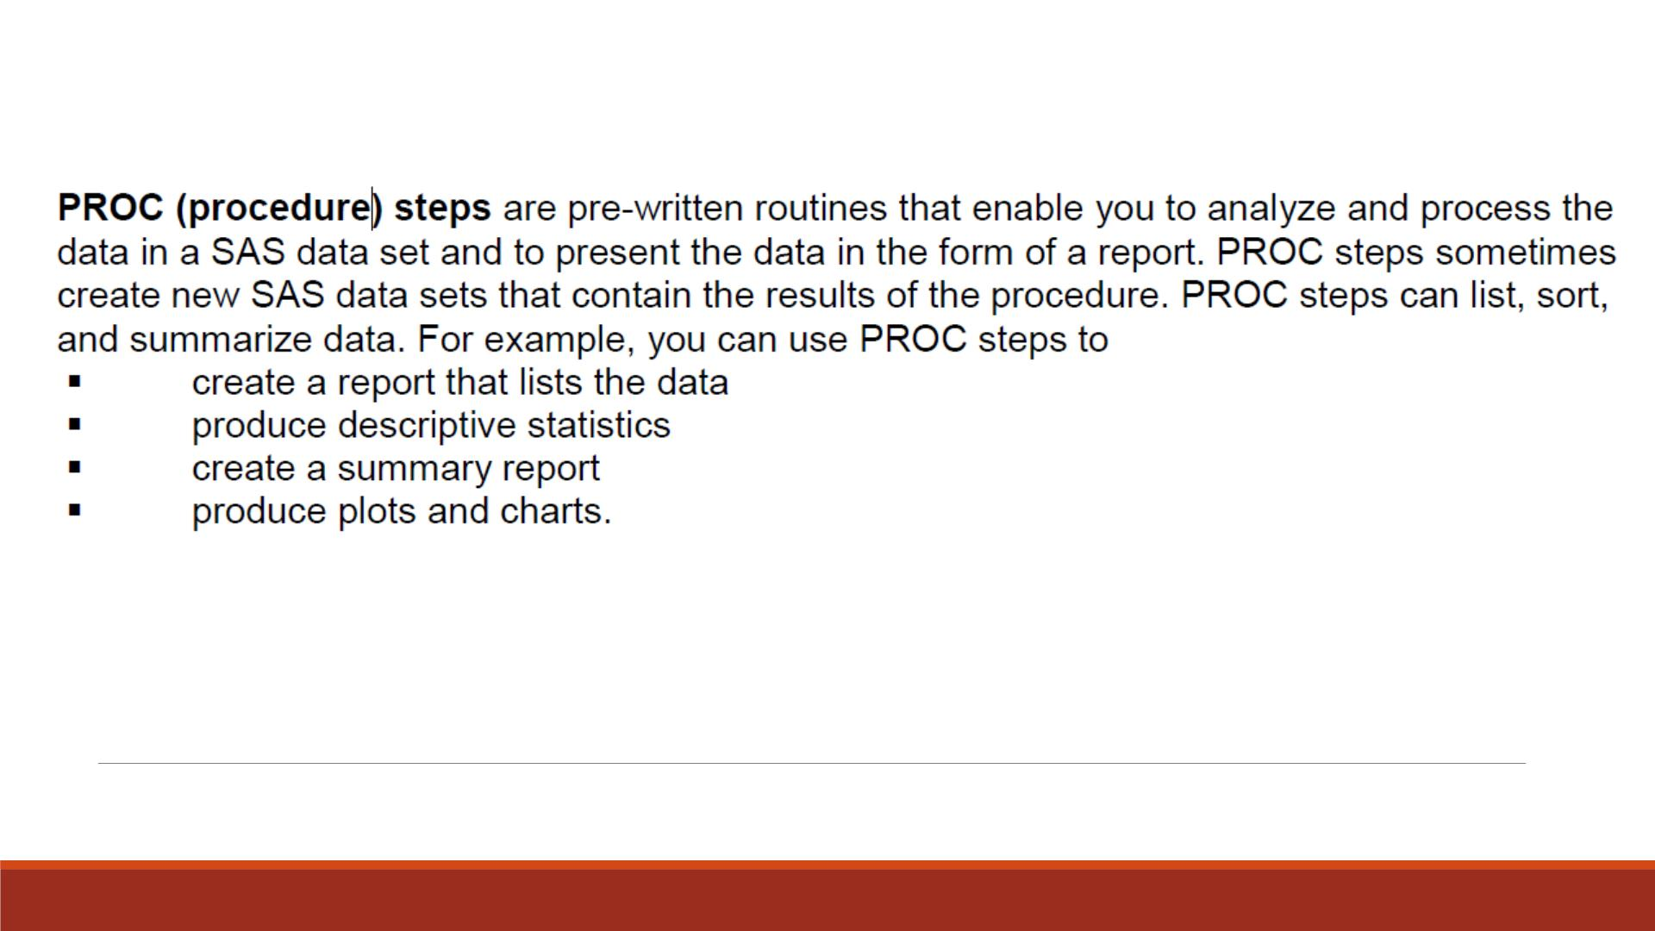
PROC Step

Slide 7
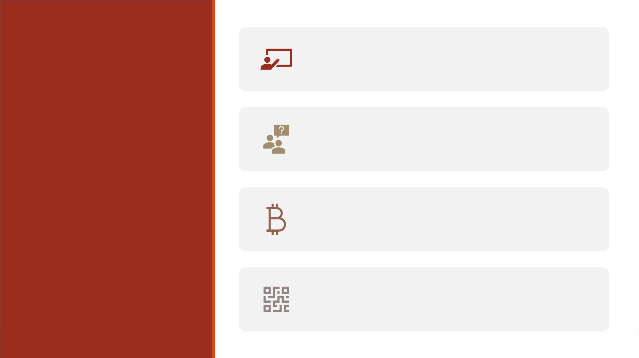
SAS programs consist of SAS statements.
Characteristics
of SAS
A SAS statement has two important
characteristics:
Programs
It usually begins with a SAS keyword.
It always ends with a semicolon.

Slide 8
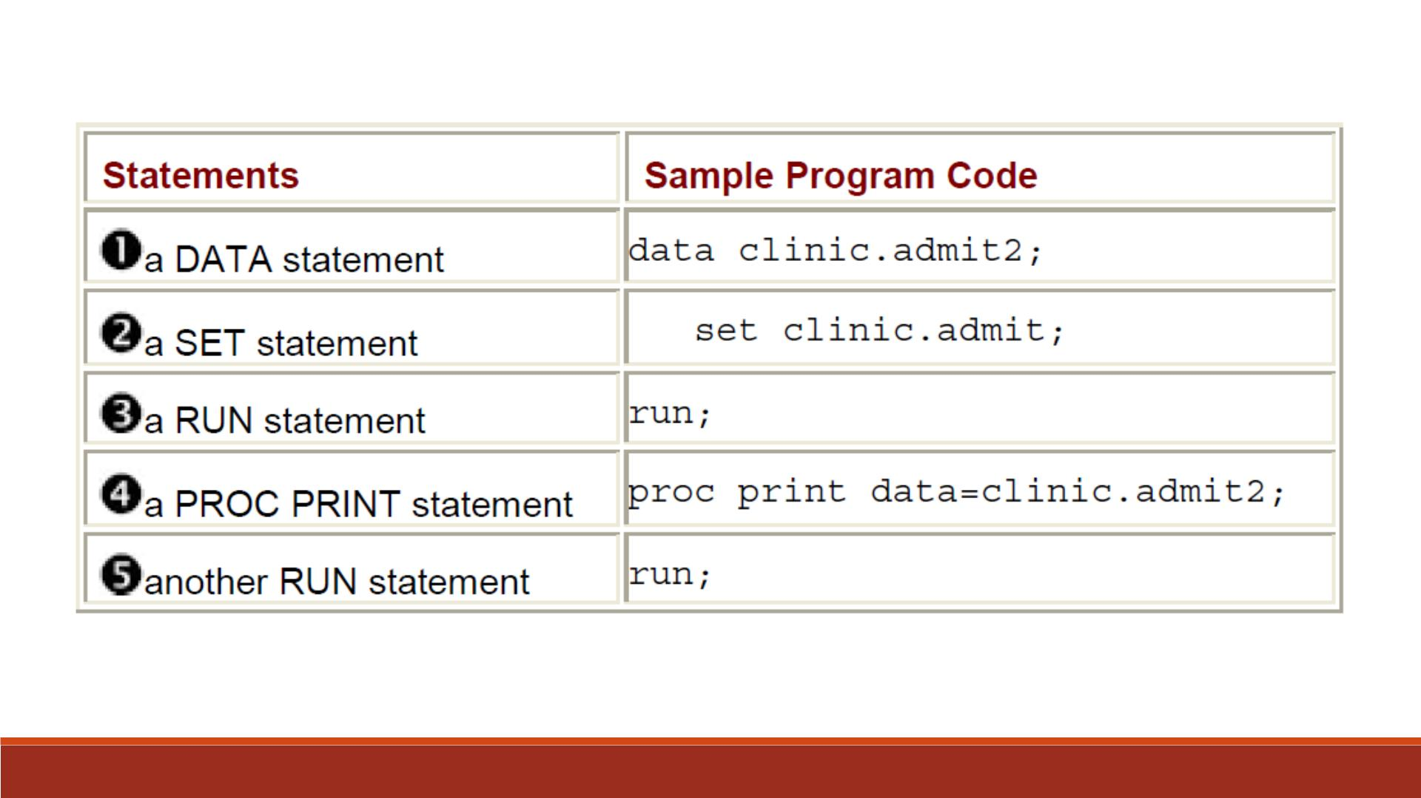

Slide 9
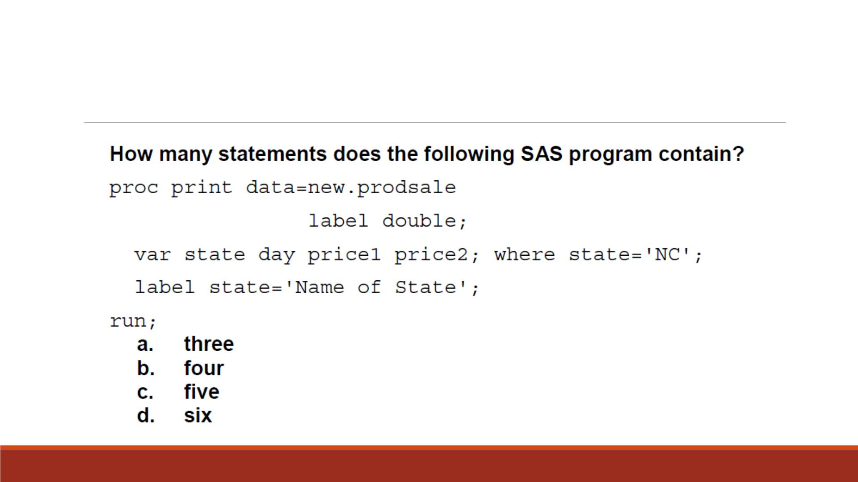
Question 1

Slide 10

Layout for SAS Programs
SAS statements are in free format. This means that
▪they can begin and end anywhere on a line
▪one statement can continue over several lines
▪several statements can be on a line.

Slide 11
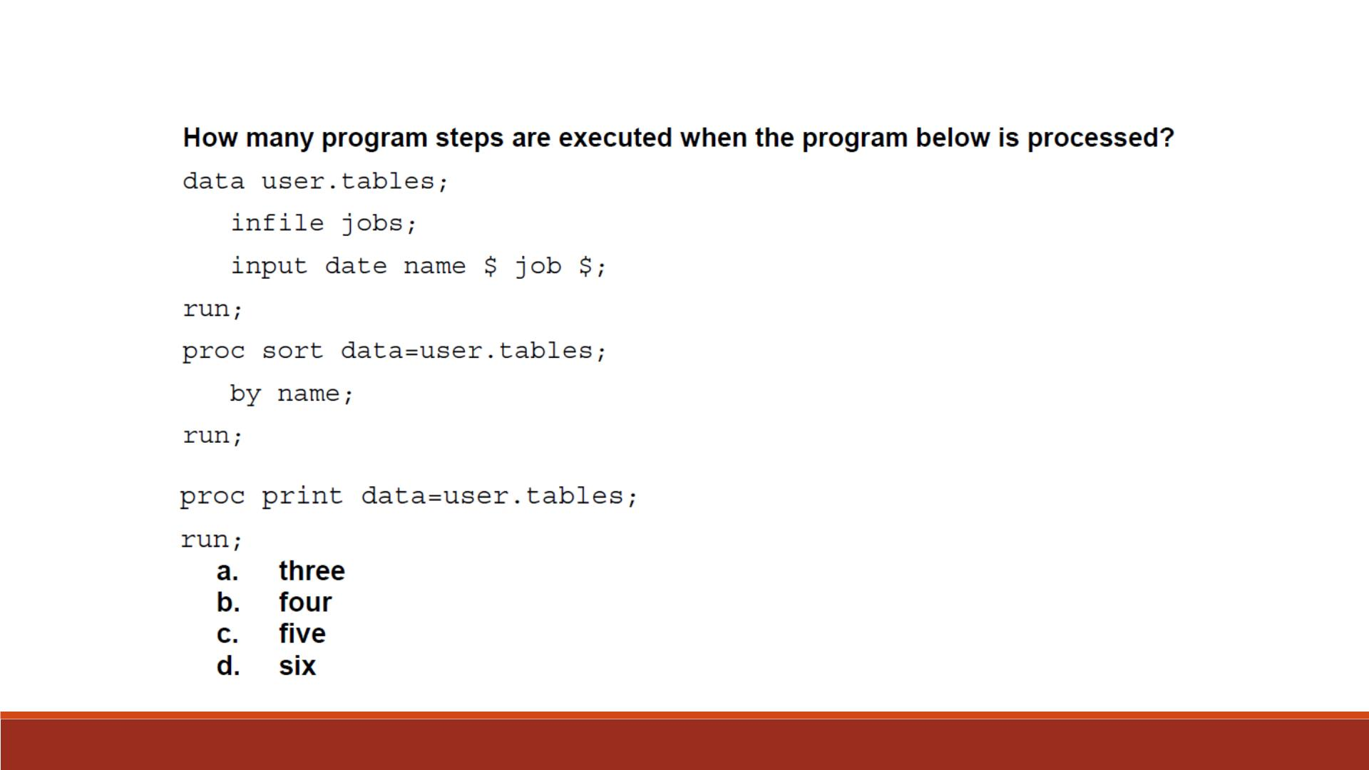
Question 2

Slide 12
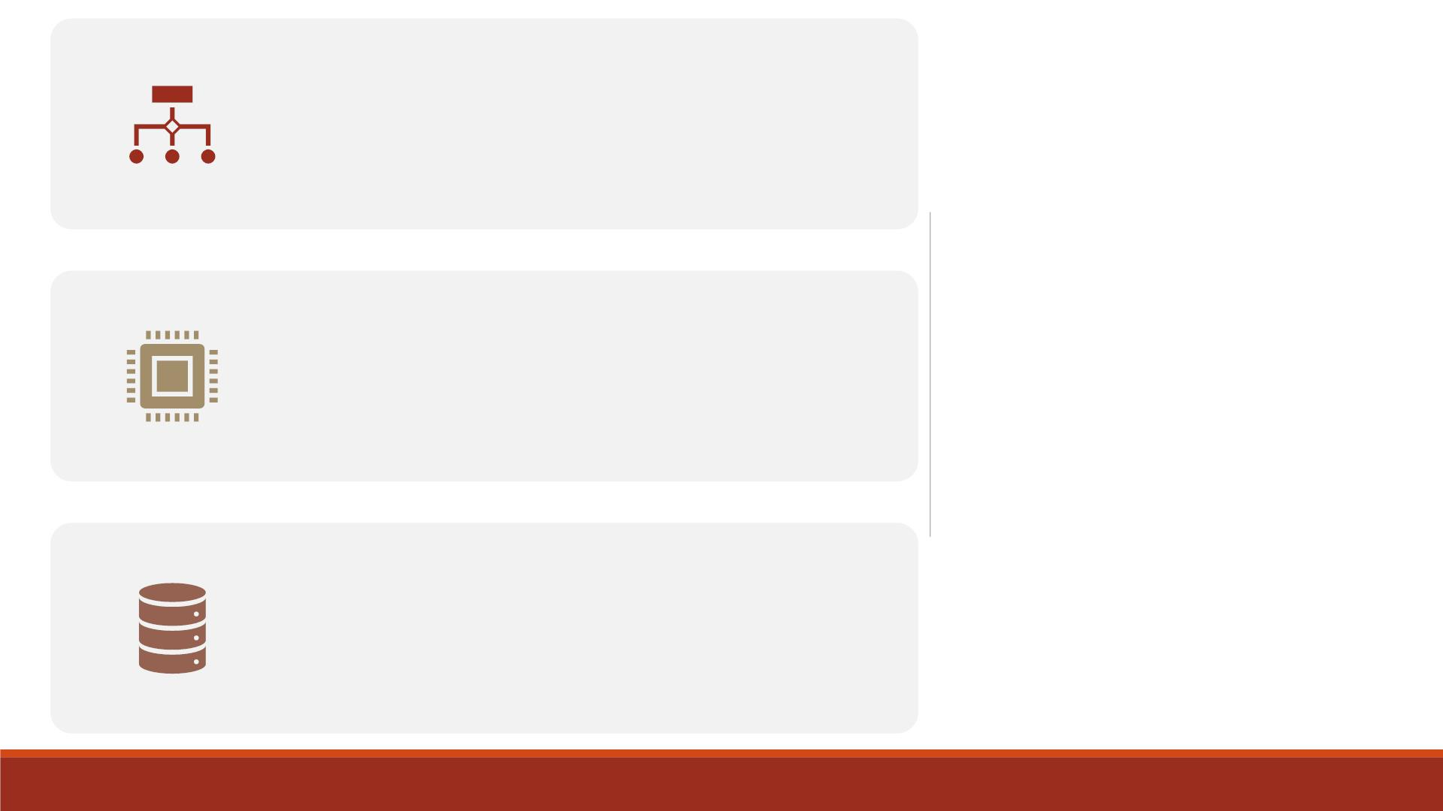
Each time a step is executed, SAS generates
a log of the processing activities and the
results of the processing.
Log
Messages
The SAS log collects messages about the
processing of SAS programs and about any
errors that occur.
Note: Though the RUN statement is not
always required between steps in a SAS
program, using it can make the SAS program
easier to read and debug.

Slide 13
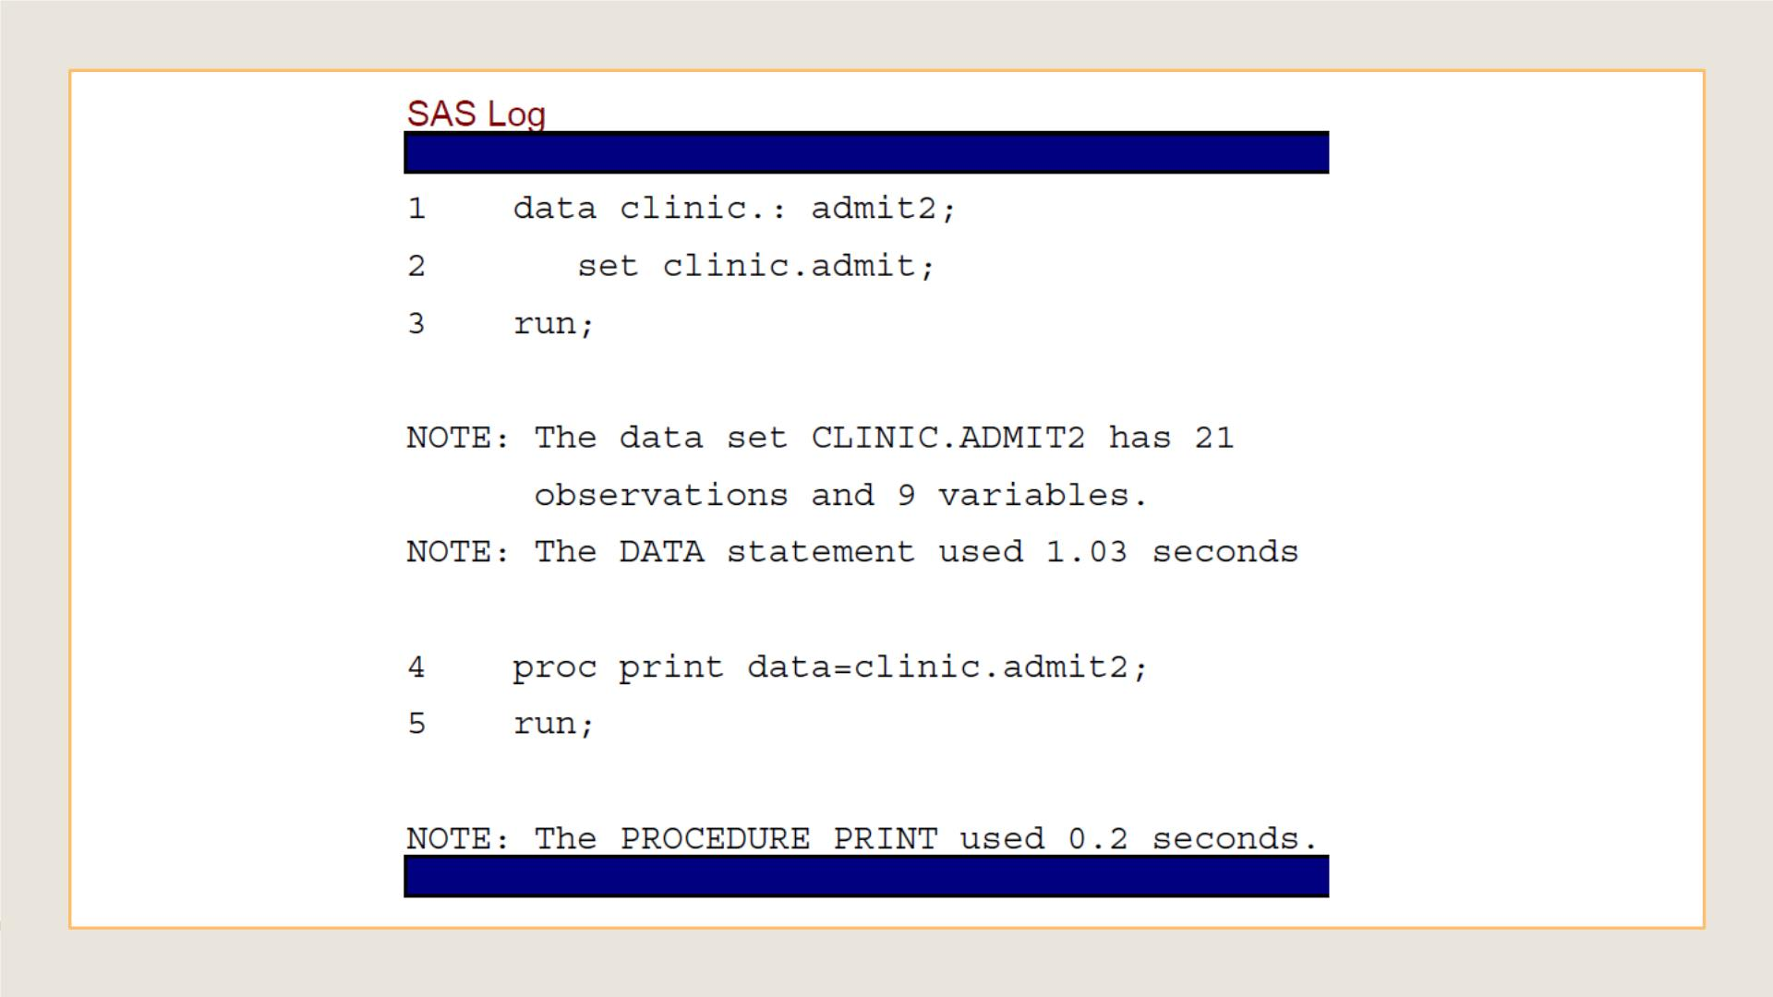

Slide 14
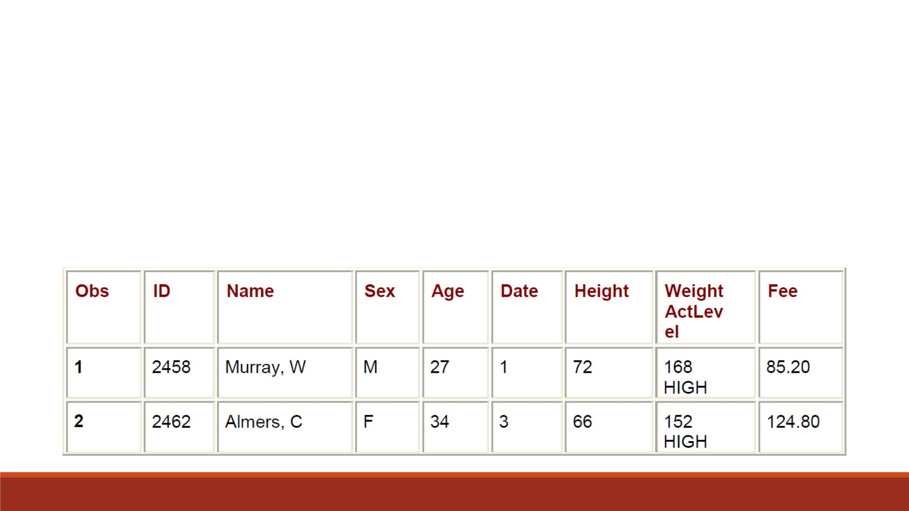
▪The sample program creates the SAS data set Clinic.Admit2 in the D ATA step.
▪The D ATA step produces messages in the SAS log, but it does not create a
report or other output.
Results of
Processing
▪PROC PRINT creates the following HTML report of the SAS data set
Clinic.Admit2:

Slide 15
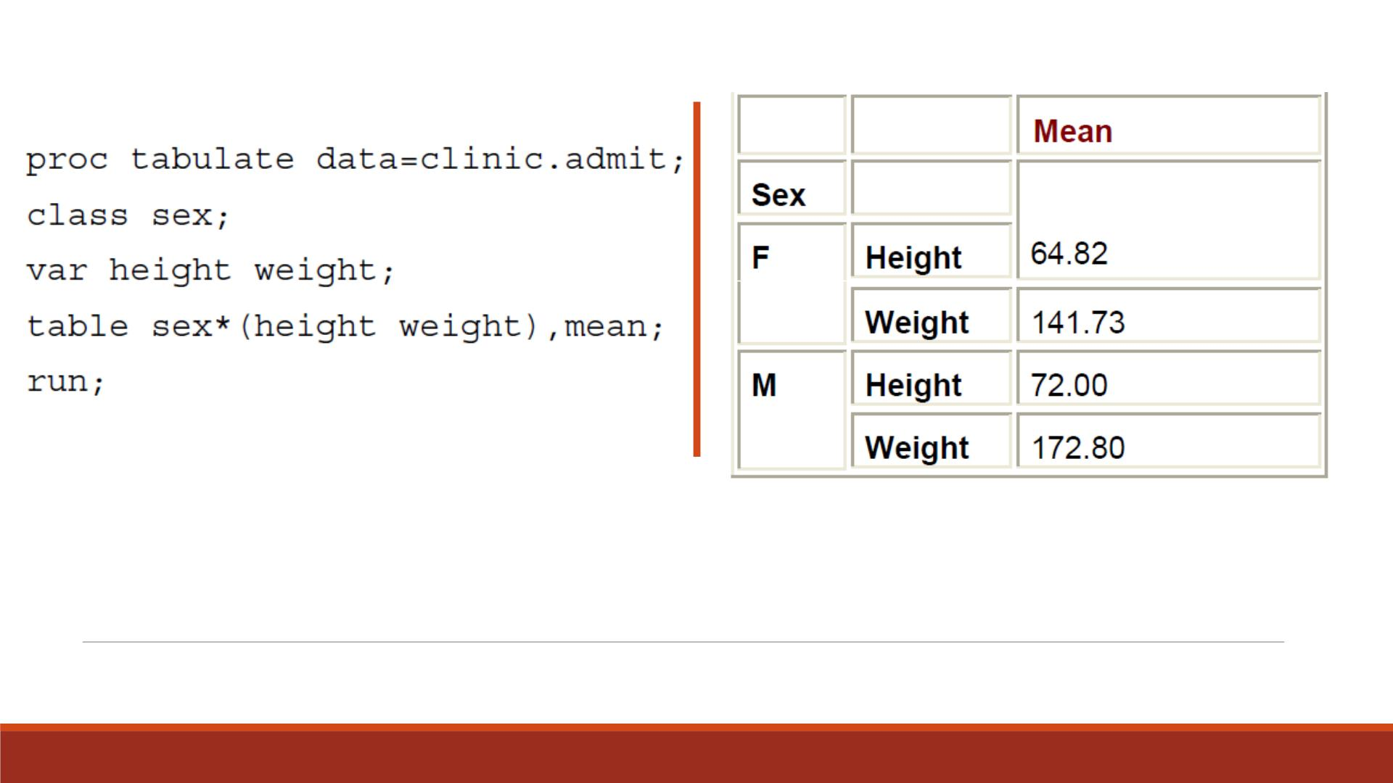
Other Sample Result

Slide 16
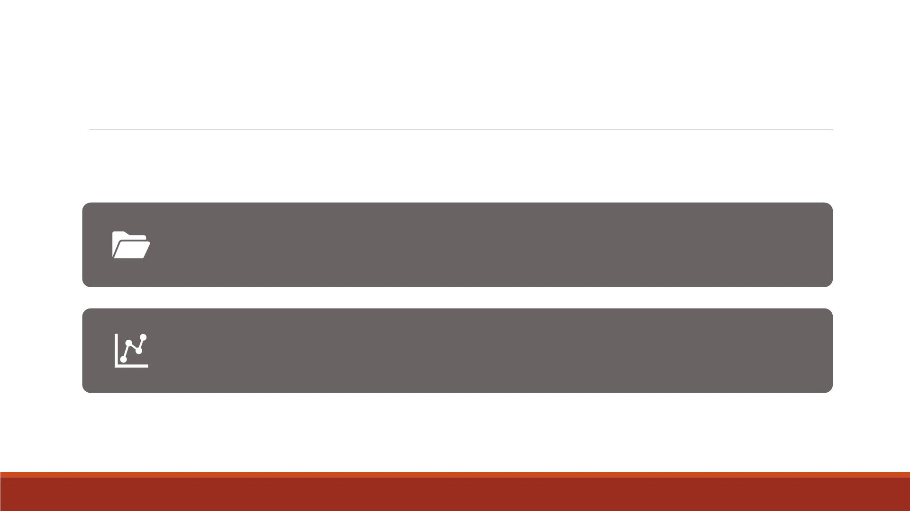
SAS Libraries
Every SAS file is stored in a SAS library, which is a collection of SAS
files. It is like a folder in your desktop computer.
A SAS data library is the highest level of organization for information
within SAS.

Slide 17
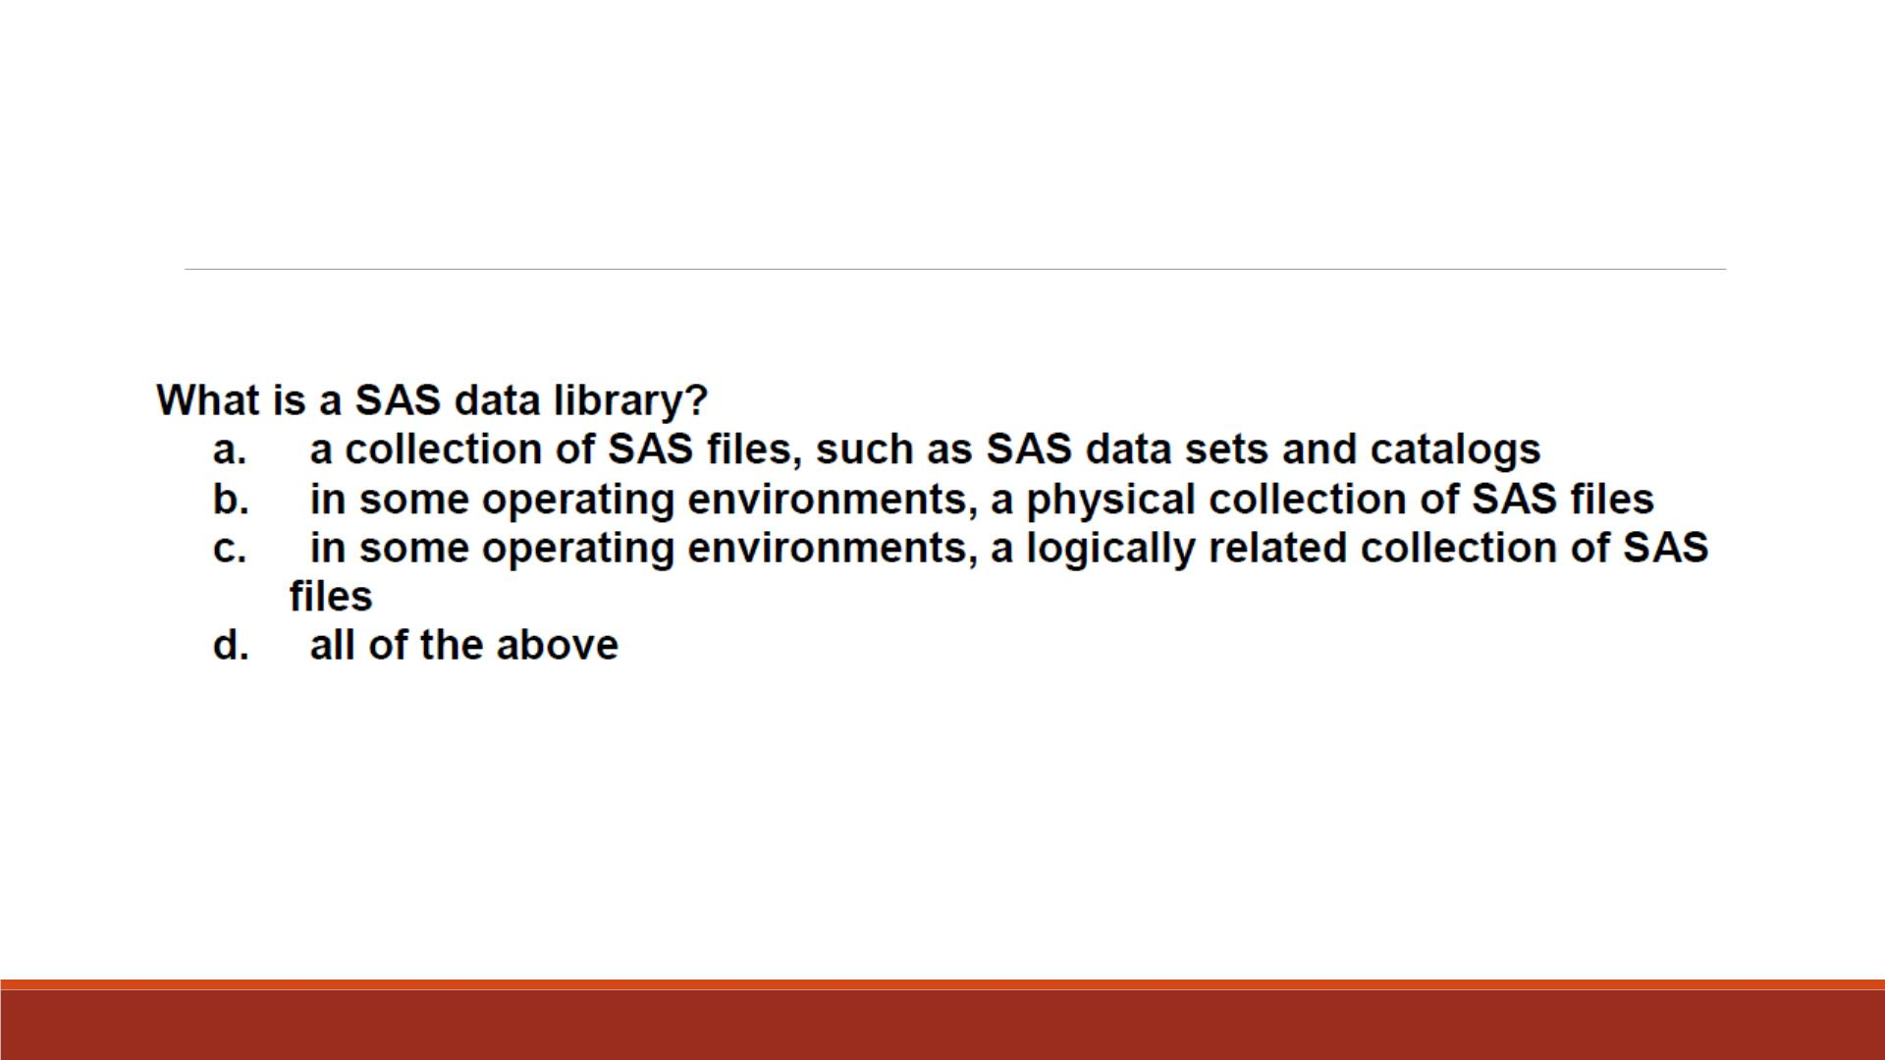
Question 3

Slide 18
Storing Files Temporarily or Permanently
▪If you don't specify a library name when you create a file (or if you specify the library name Work),
the file is stored in the temporary SAS data library.
▪When you end the session, the temporary library and all of its files are deleted.
▪To store files permanently in a SAS data library, you specify a library name other than the default
library name Work.

Slide 19
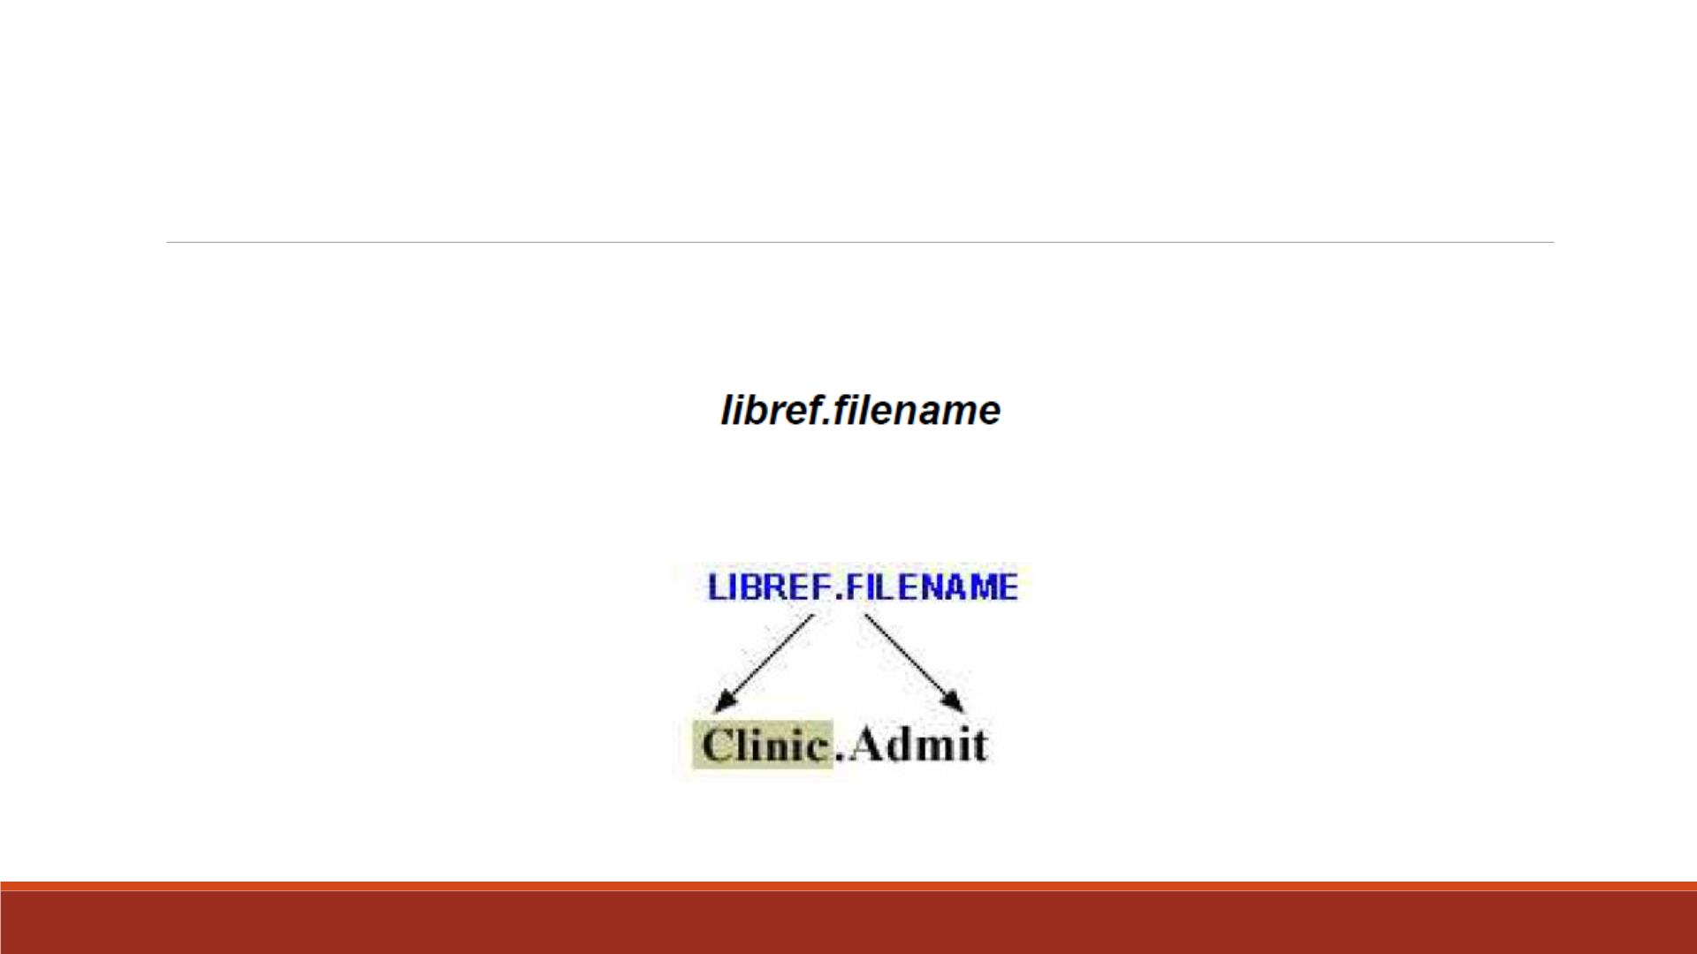
Referencing SAS Files
To reference a permanent SAS data set in your SAS programs, you use a two-level name:
For example,

Slide 20
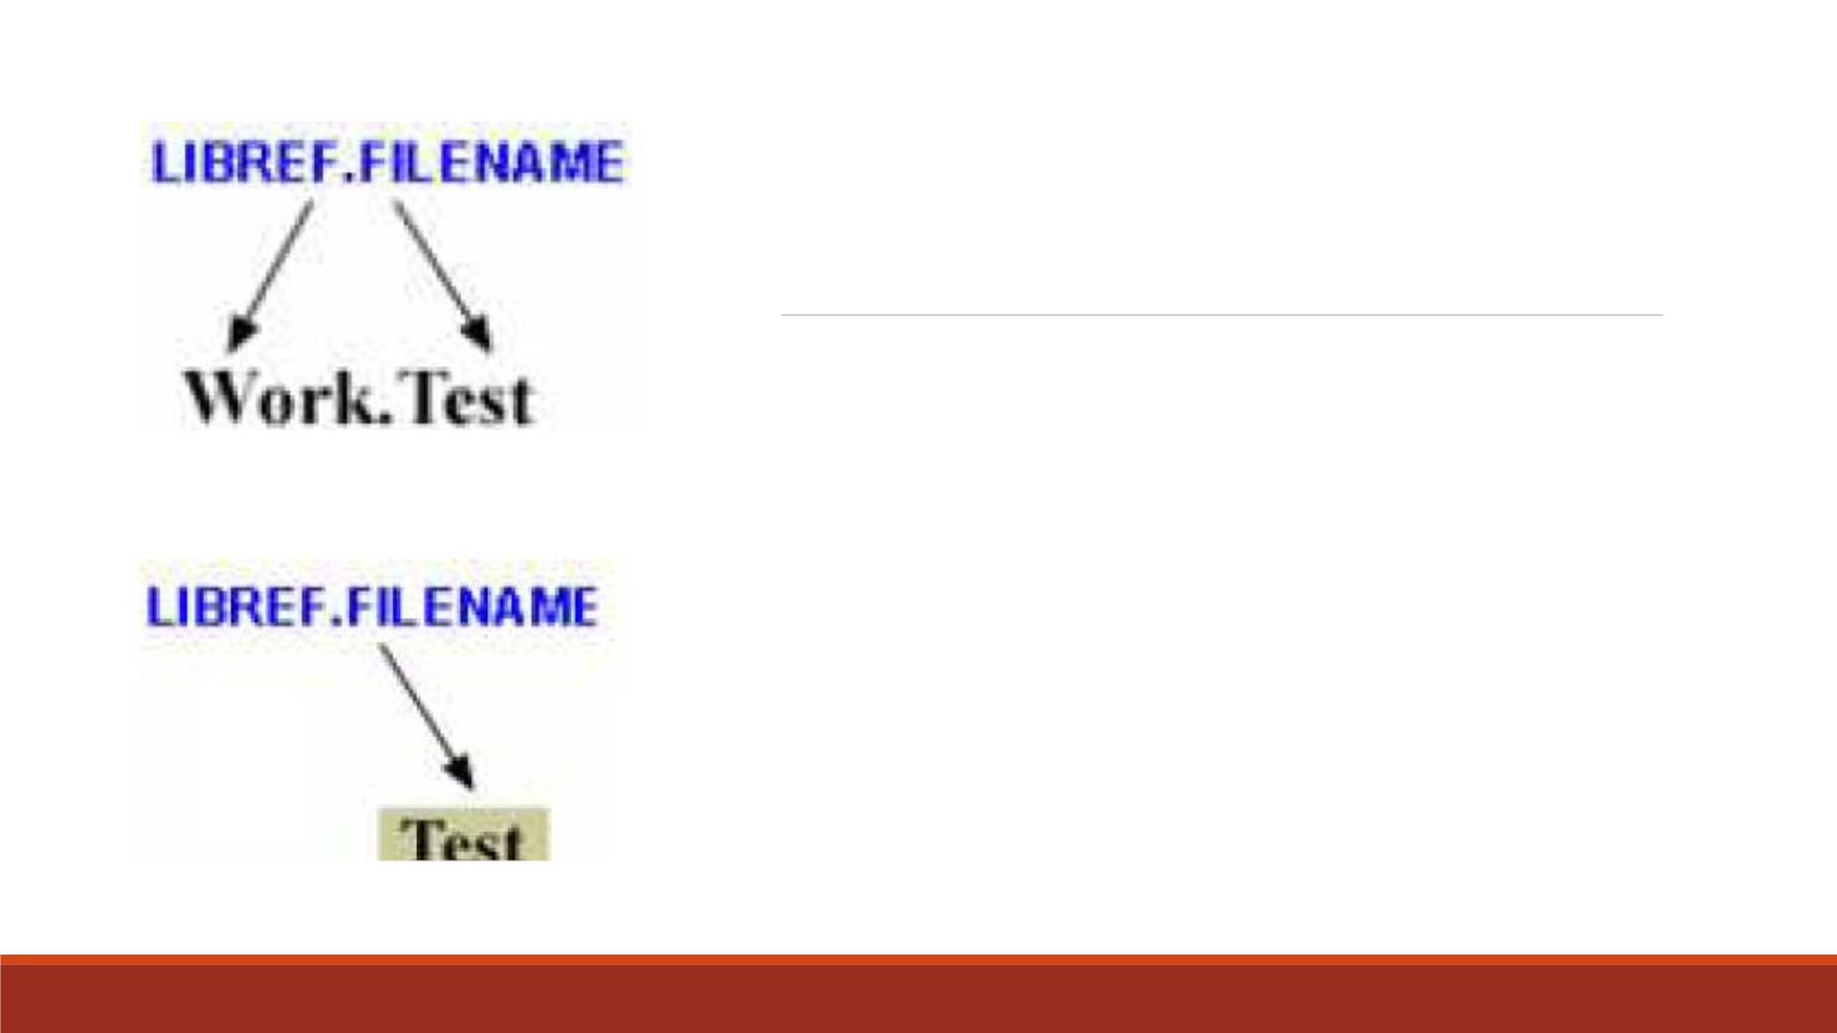
Referencing Temporary
SAS Files
▪To reference temporary SAS files, you can specify the
default libref Work, a period, and the filename.
▪Alternatively, you can use a one-level name (the
filename only) to reference a file in a temporary SAS
library.

Slide 21
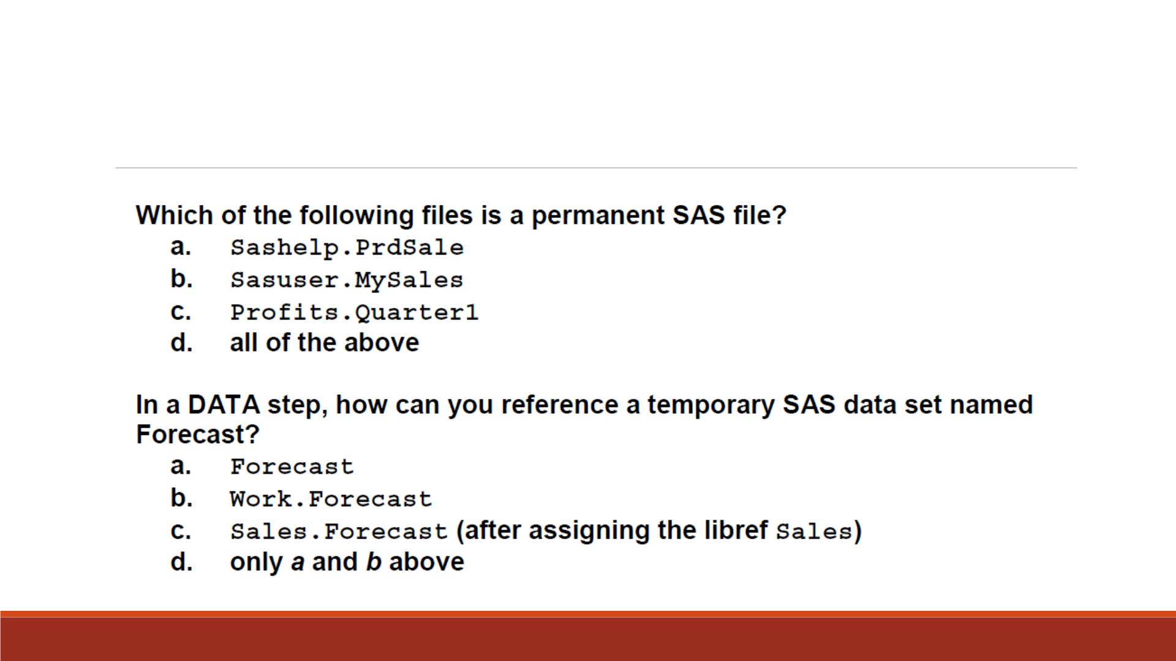
Question 4 and 5

Slide 22
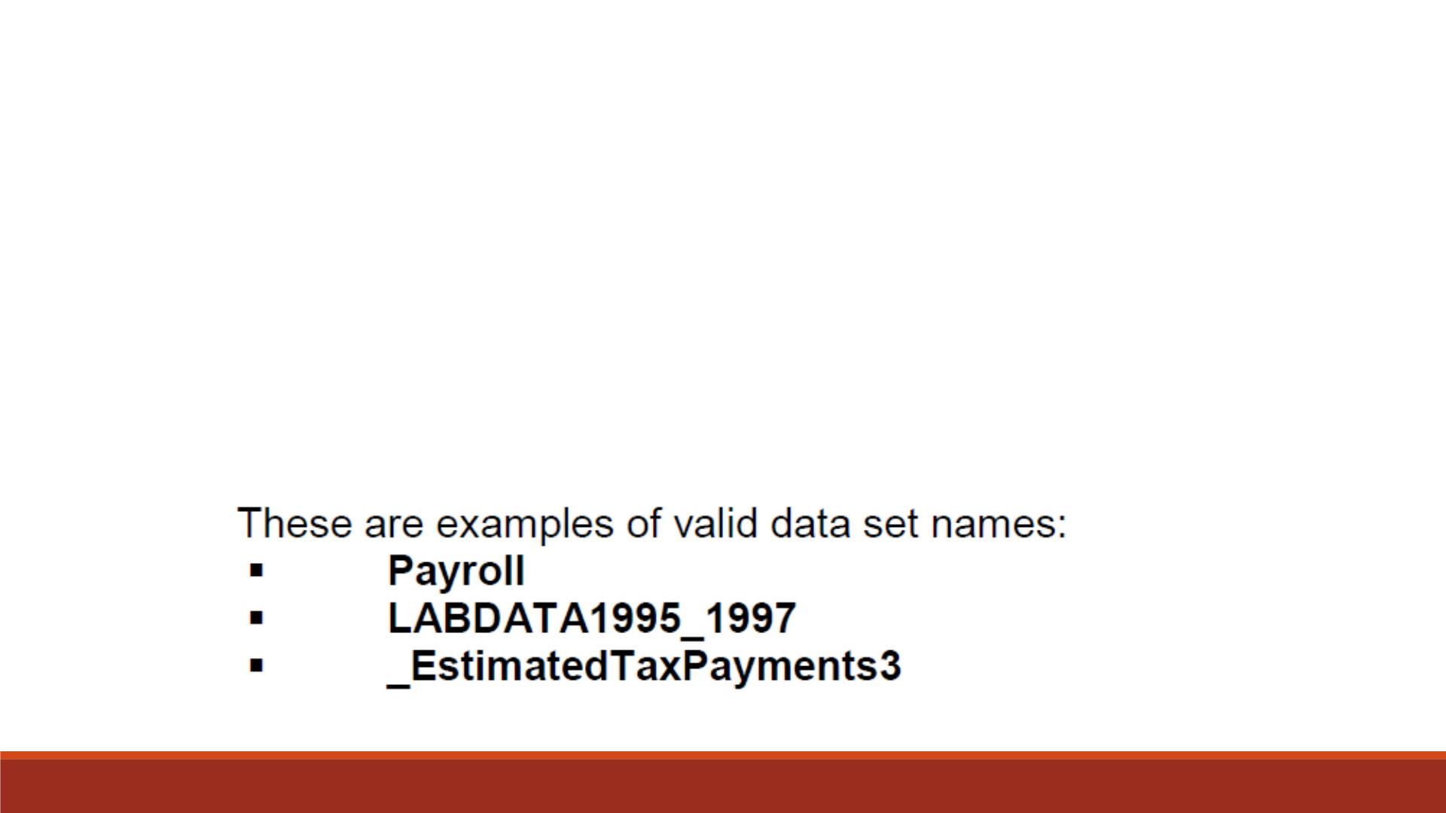
SAS data set names
Rules fo r SAS
Names
▪can be 1 to 32 characters long
▪must begin with a letter (A–Z, either uppercase or lowercase) or an
underscore (_)
▪can continue with any combination of numbers, letters, or underscores.

Slide 23
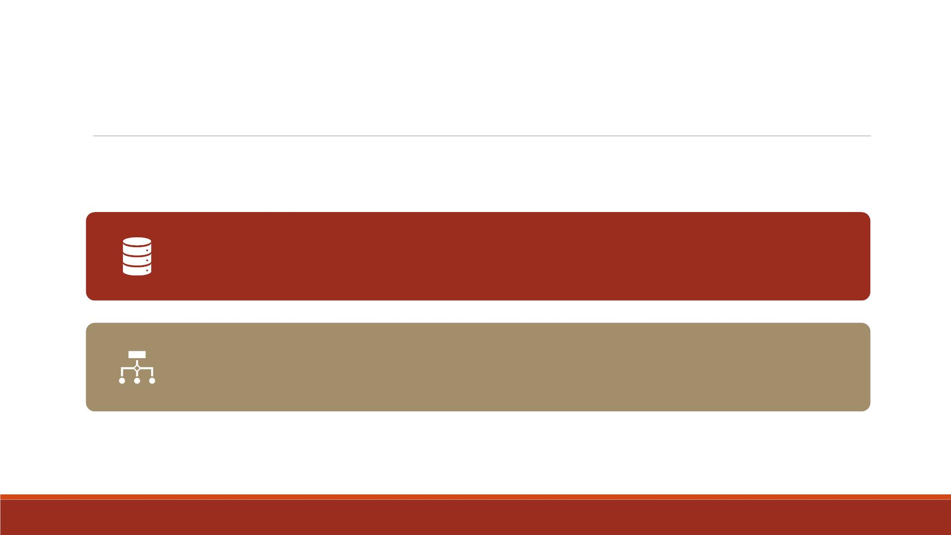
SAS Data Sets
A SAS data set is a file that consists of two parts: a descriptor portion (meta-data or data of data) and a data portion.
For many procedures and for some D ATA step statements, data must
be in the form of a SAS data set to be processed.

Slide 24
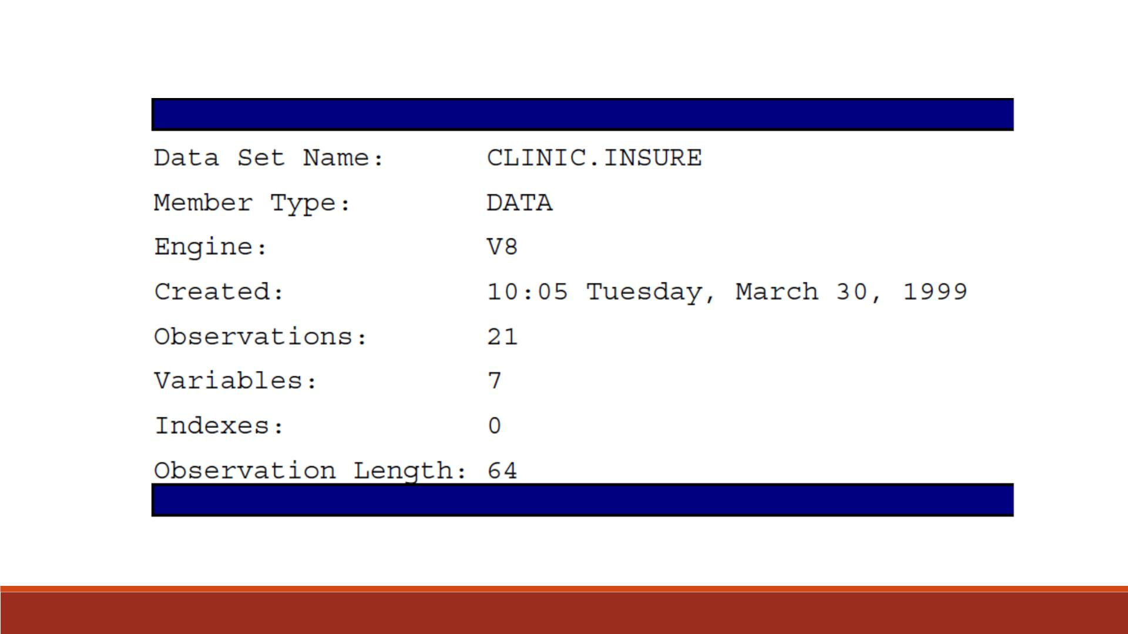

Slide 25

The descriptor portion of a SAS data set contains
information about the data set, including
▪the name of the data set
Descriptor
Portion
▪the date and time that the data set was created
▪the number of observations
▪the number of variables.

Slide 26
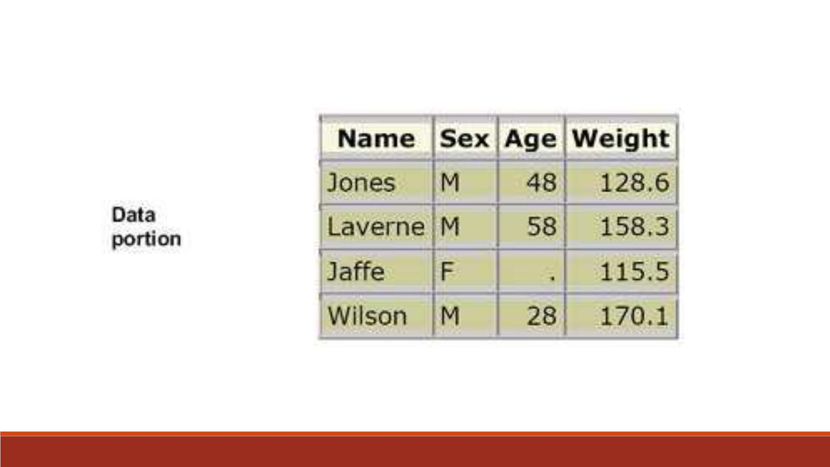

Slide 27
Data Portion
▪In the example, the name Jones is a data value, the weight 158.3 is a data value, and so on.
▪Rows (called observations) in the data set are collections of data values that usually relate
to a single object.
▪The values Jones, M, 48, and 128.6 constitute a single observation in the data set show.

Slide 28
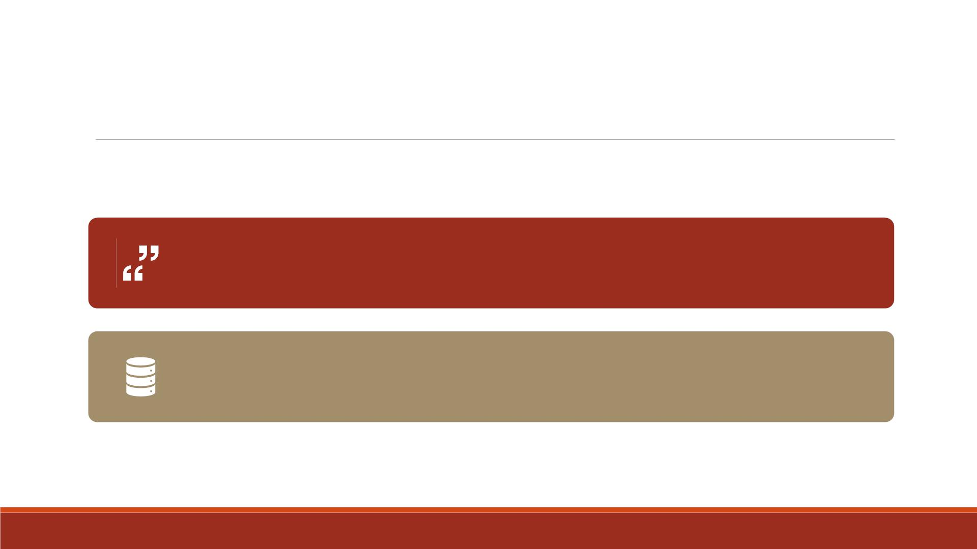
Variable Attributes
The descriptor portion contains information about the attributes of each
variable in the data set. The attribute information includes the variable's
name, type, length, format, informat, and label.
For example, you might need to combine SAS data sets that contain same-
named variables. In this case, the variables must be the same type (character
or numeric).

Slide 29
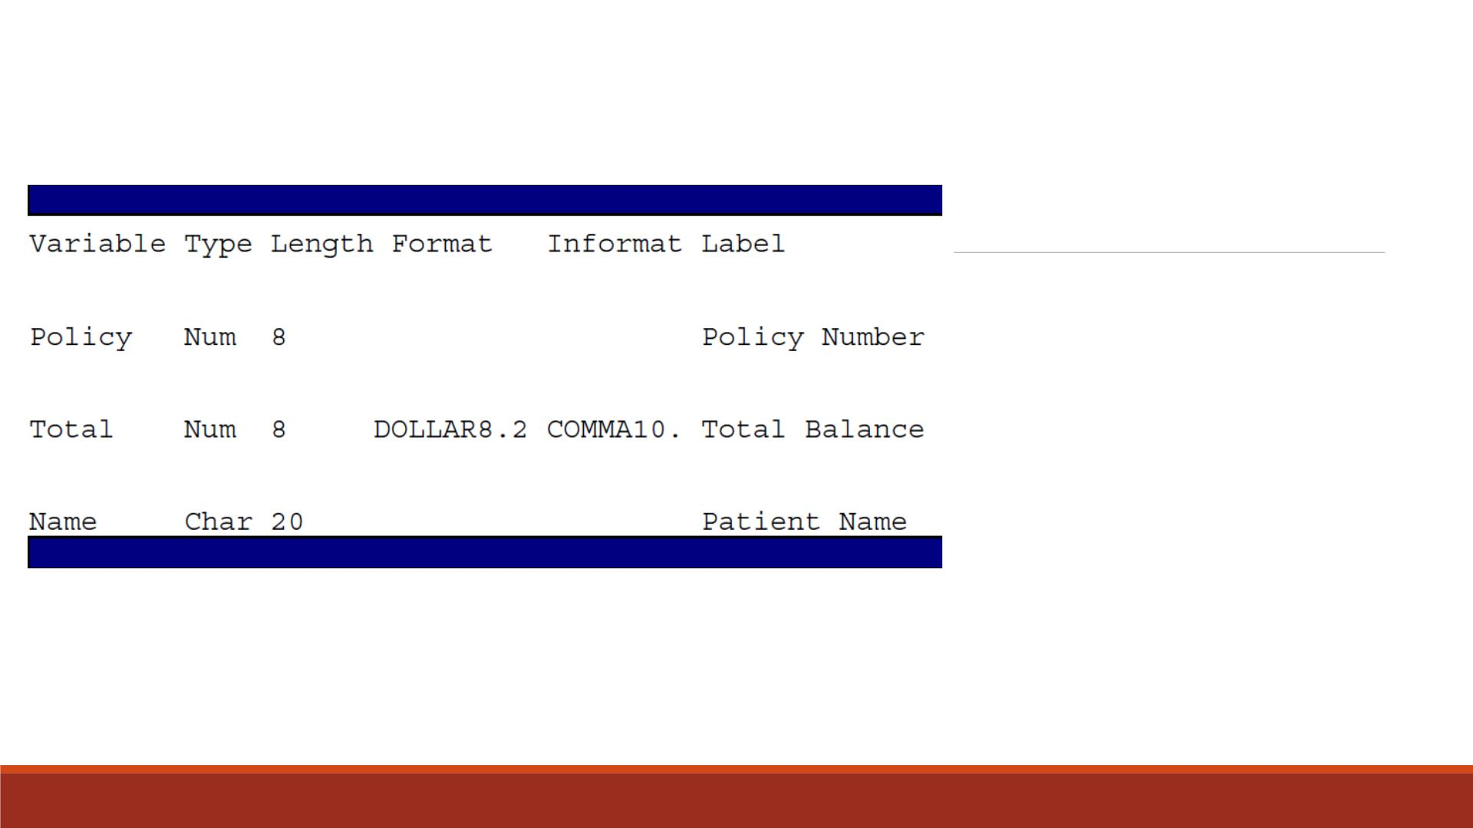
Attribute
Example
This is a partial listing of the attribute
information in the descriptor portion
of the SAS data set Clinic.Insure. Let's
look at the name, type, and length
variable attributes.

Slide 30
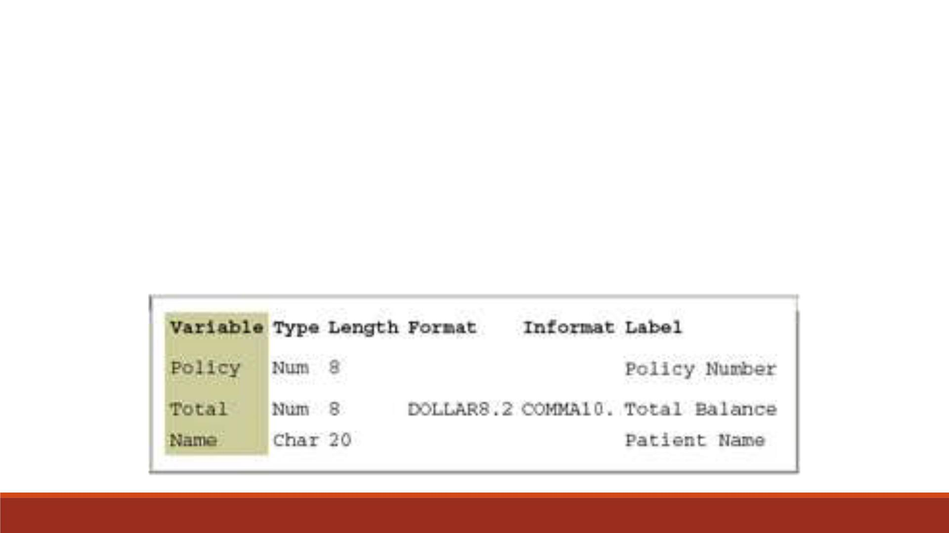
Variable names follow exactly the same rules as SAS data set names. Like data set
names, variable names
Variable
Name
▪can be 1 to 32 characters long
▪must begin with a letter (A–Z, either uppercase or lowercase) or an underscore (_)
▪can continue with any combination of numbers, letters, or underscores.

Slide 31
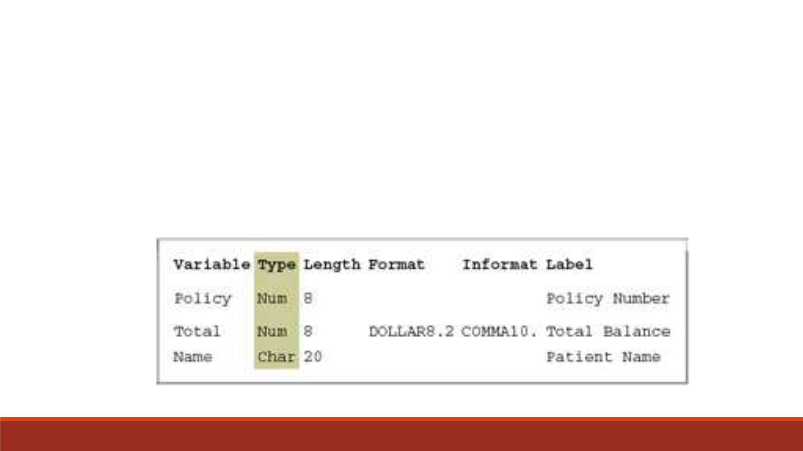
A variable's type is either character or numeric.
Variable
Type
▪Character variables, such as Name (shown below), can contain any values.
▪Numeric variables, such as Policy and Total (shown below), can contain only
numeric values (the digits 0 through 9, +, -, ., and E for scientific notation).

Slide 32
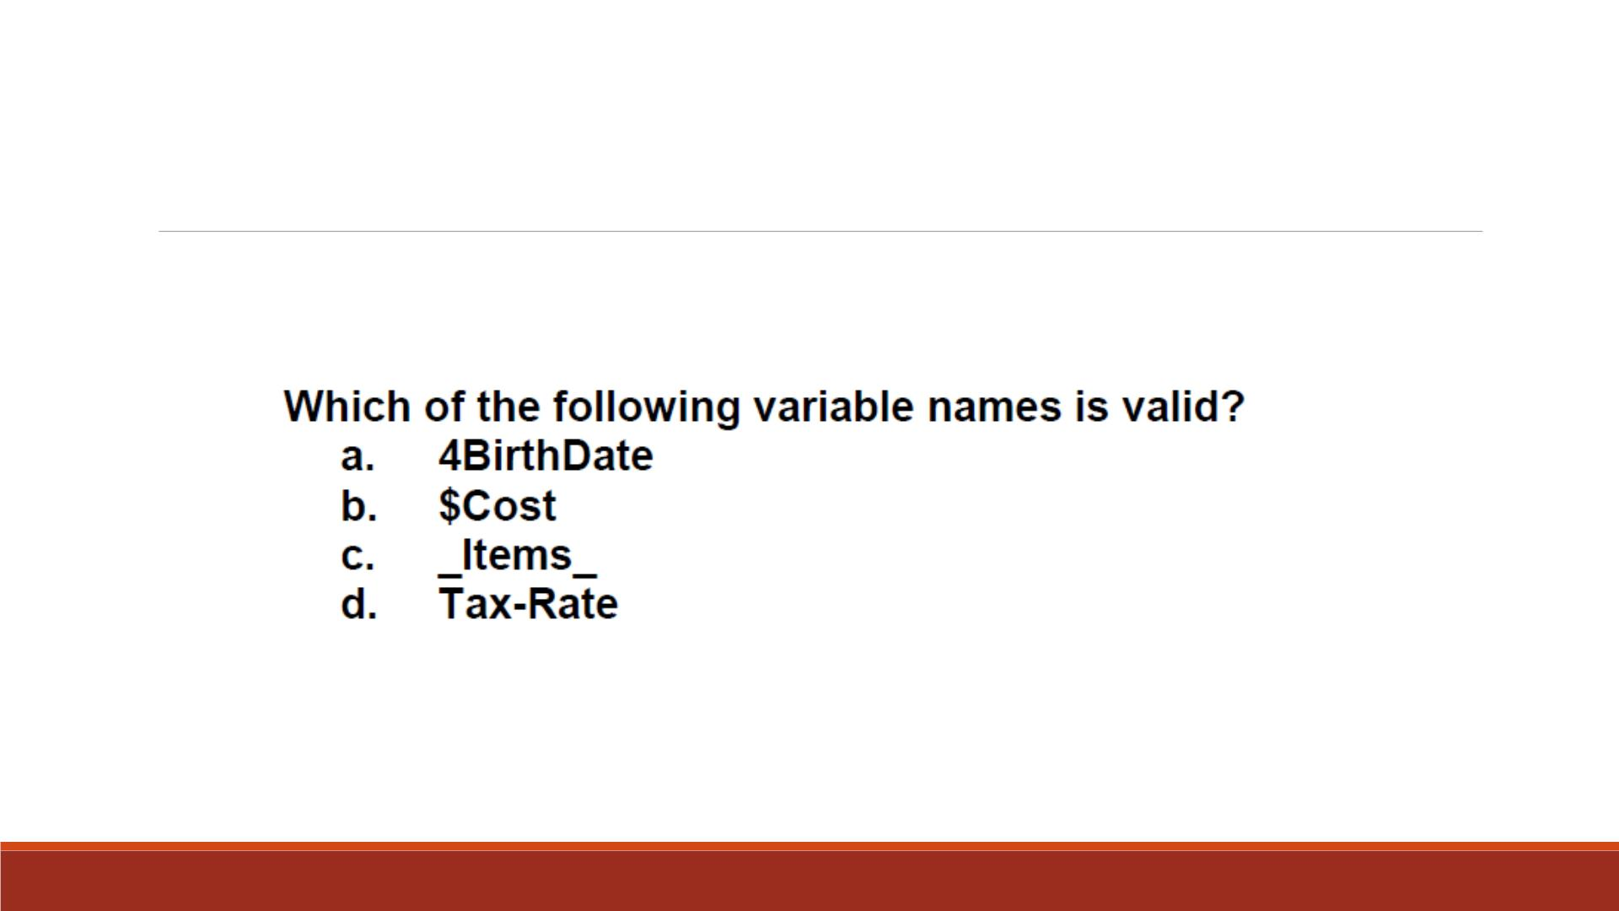
Question 6

Slide 33
Question 6b
I want to print the variables of a data set. Which of the following is/are valid?
Proc print; var _all_;
Proc print; var _numeric_;
Proc print; var _char_;
None. It is invalid to start any variable name with an underscore (“_”)
All can work.

Slide 34
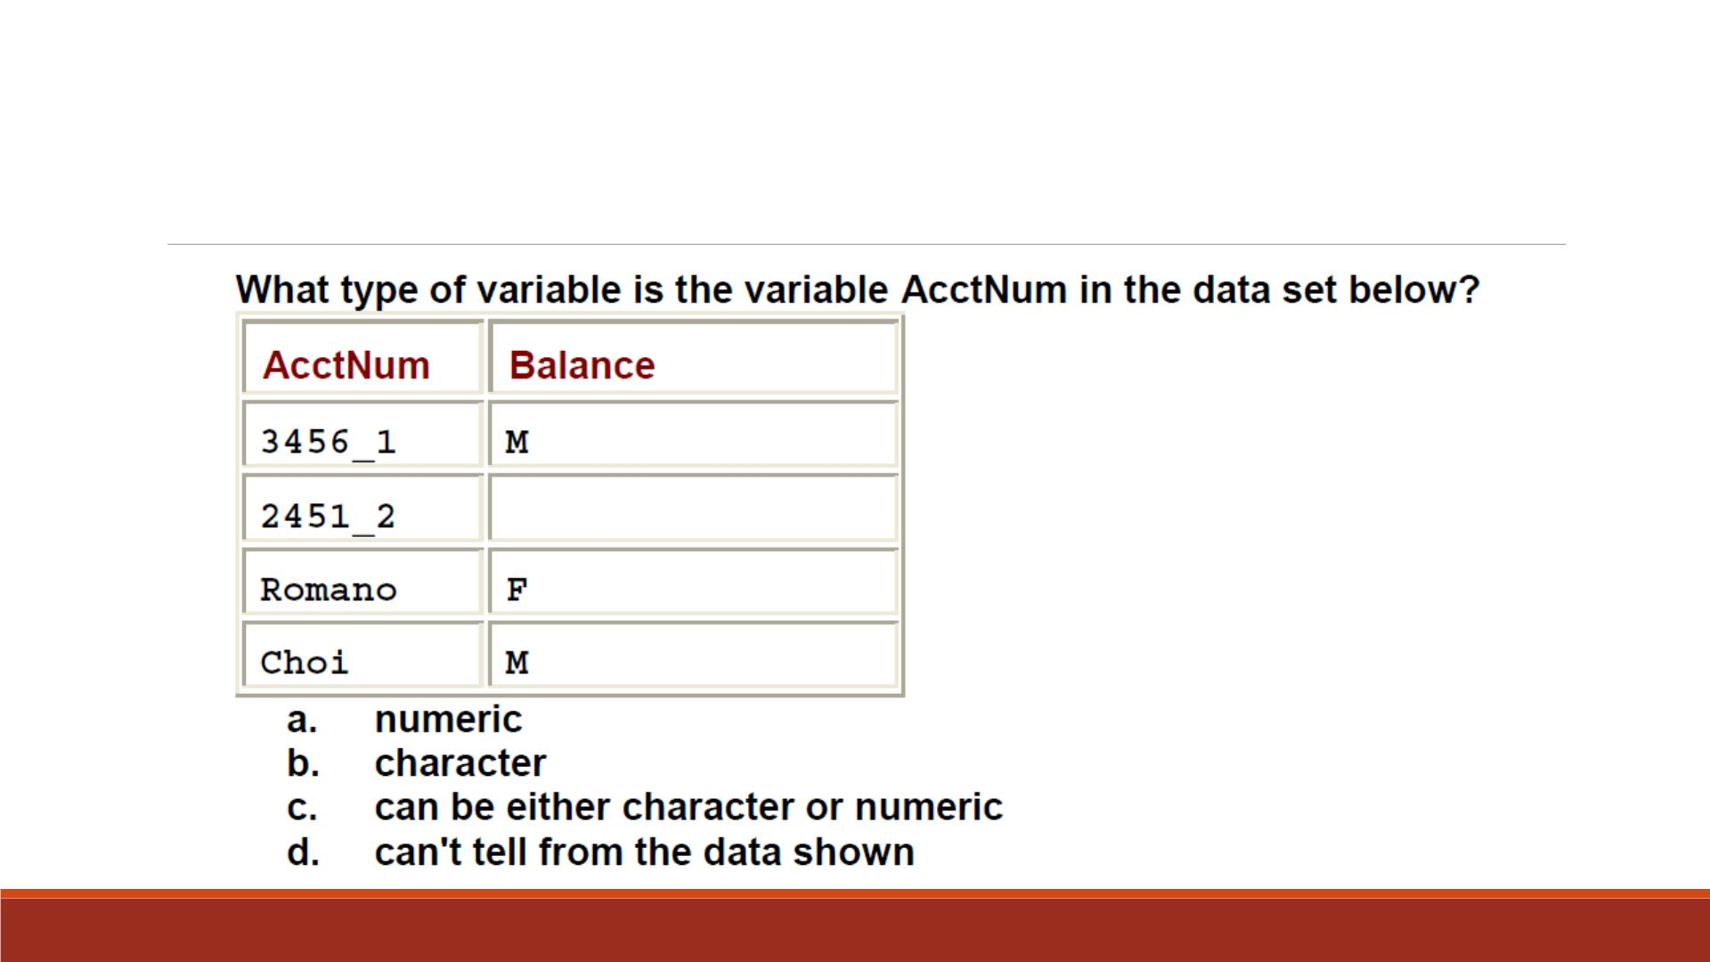
Question 7

Slide 35
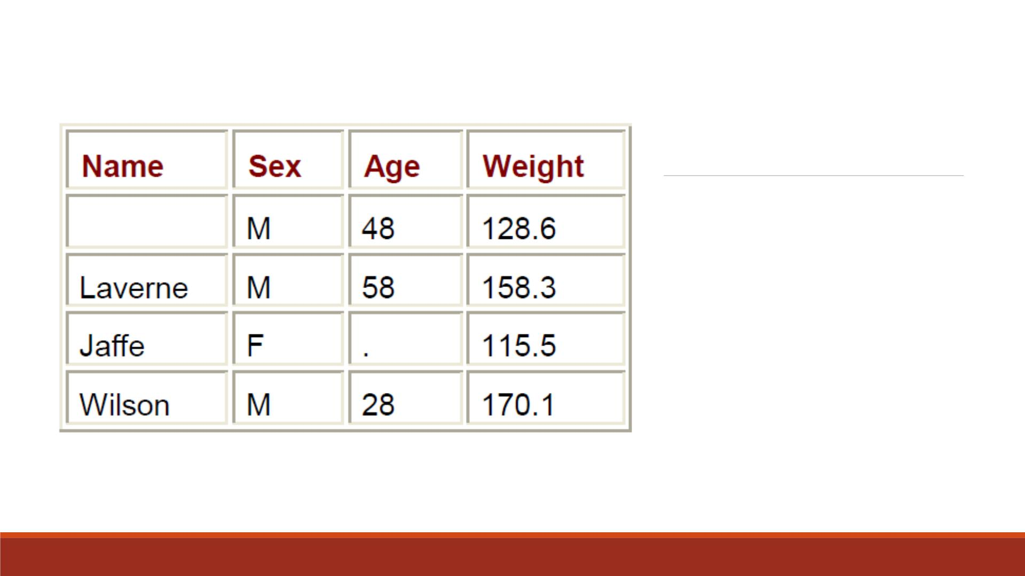
Missing Values
A variable's type determines how missing
values for a variable are displayed.
▪For character variables such as Name, a
blank represents a missing value.
▪For numeric variables such as Age, a
period represents a missing value.

Slide 36
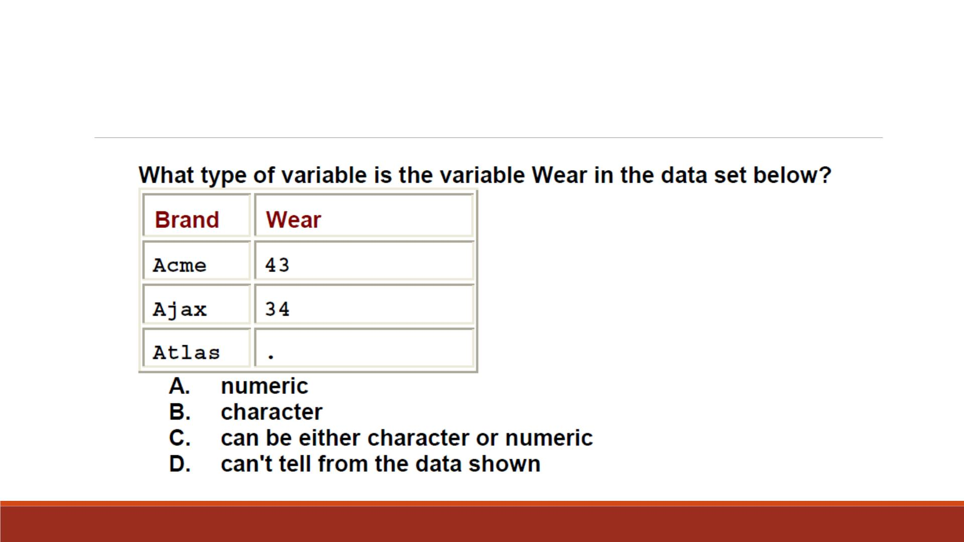
Question 8

Slide 37
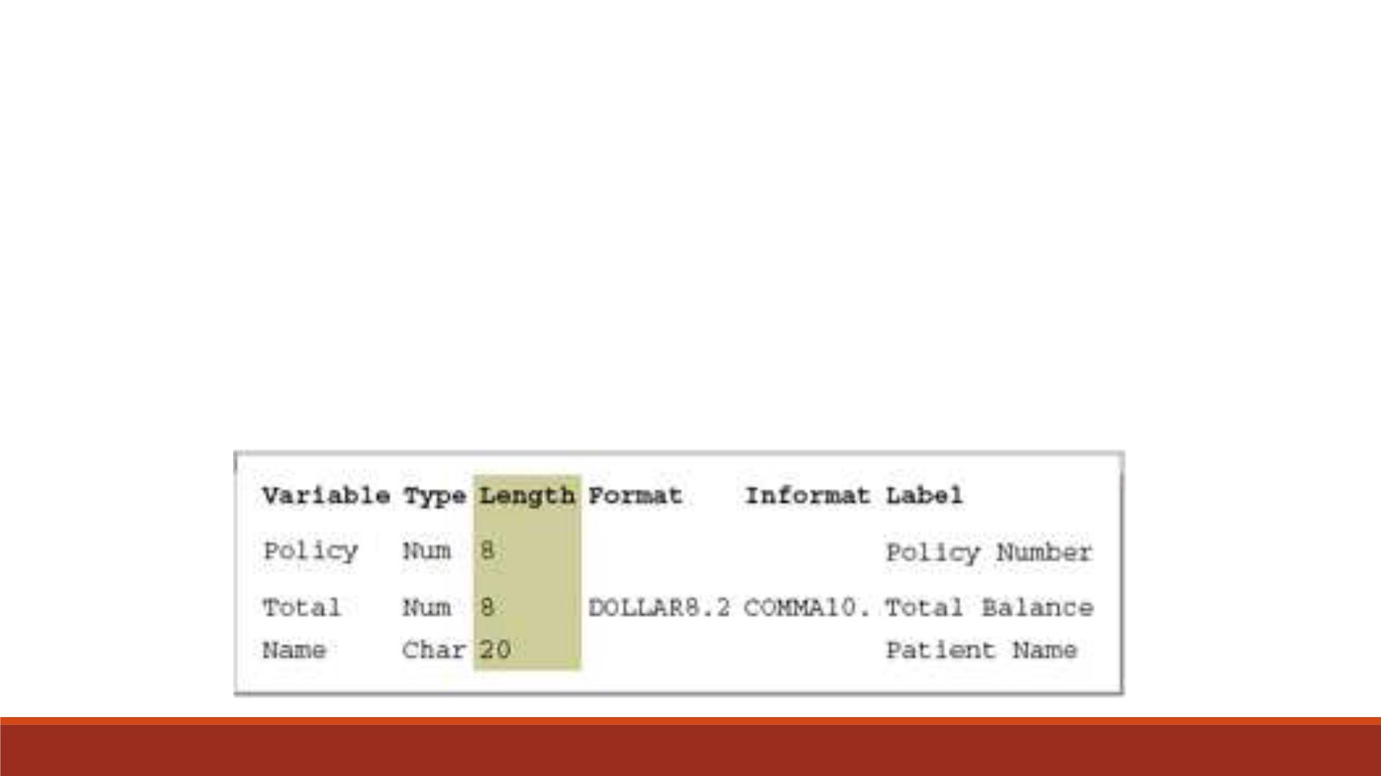
A variable's length (the number of bytes used to store it) is related to its type.
▪In the example below, Name has a length of 20 characters and uses 20 bytes of storage.
▪All numeric variables have a default length of 8. Numeric values (no matter how many
digits they contain) are stored as floating-point numbers in 8 bytes of storage, unless
you specify a different length.
Variable
Length

Slide 38
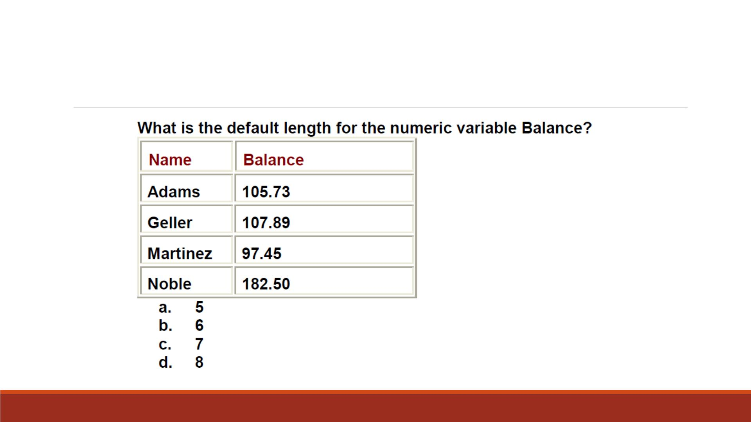
Question 9

Slide 39
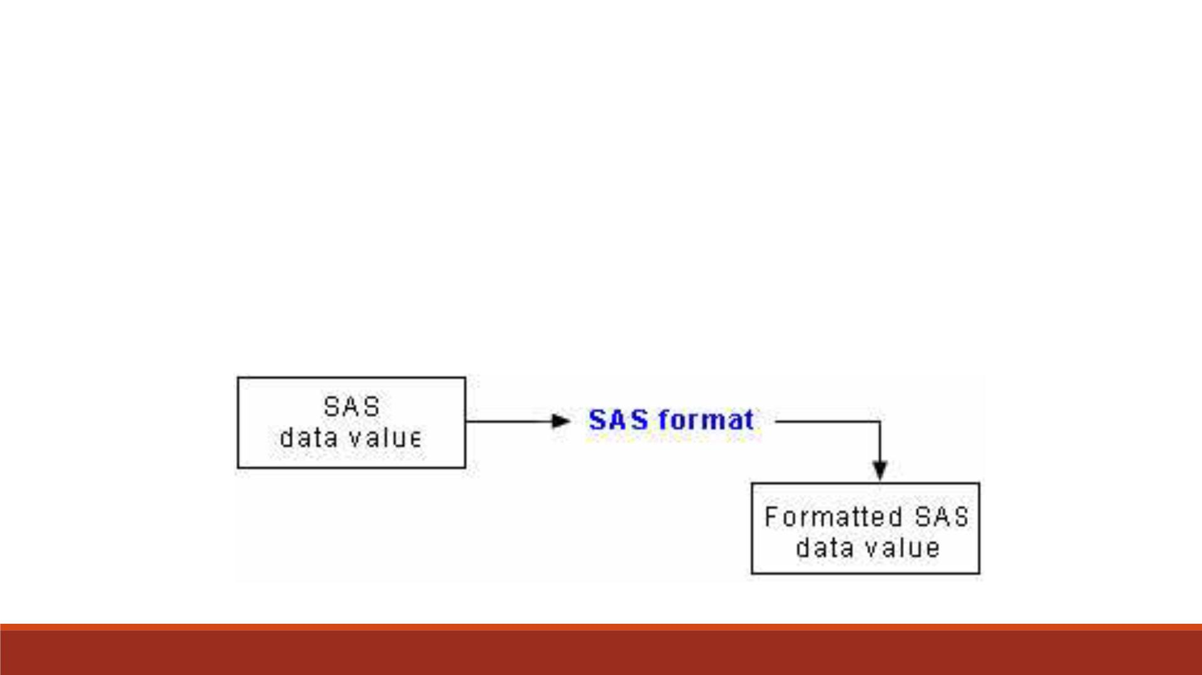
▪Formats are variable attributes that affect the way data values are written.
▪SAS software offers a variety of character, numeric, and date and time formats.
▪Yo u can also create and store your own formats.
Variable
Format
▪To write values out using a particular form, you select the appropriate format.

Slide 40
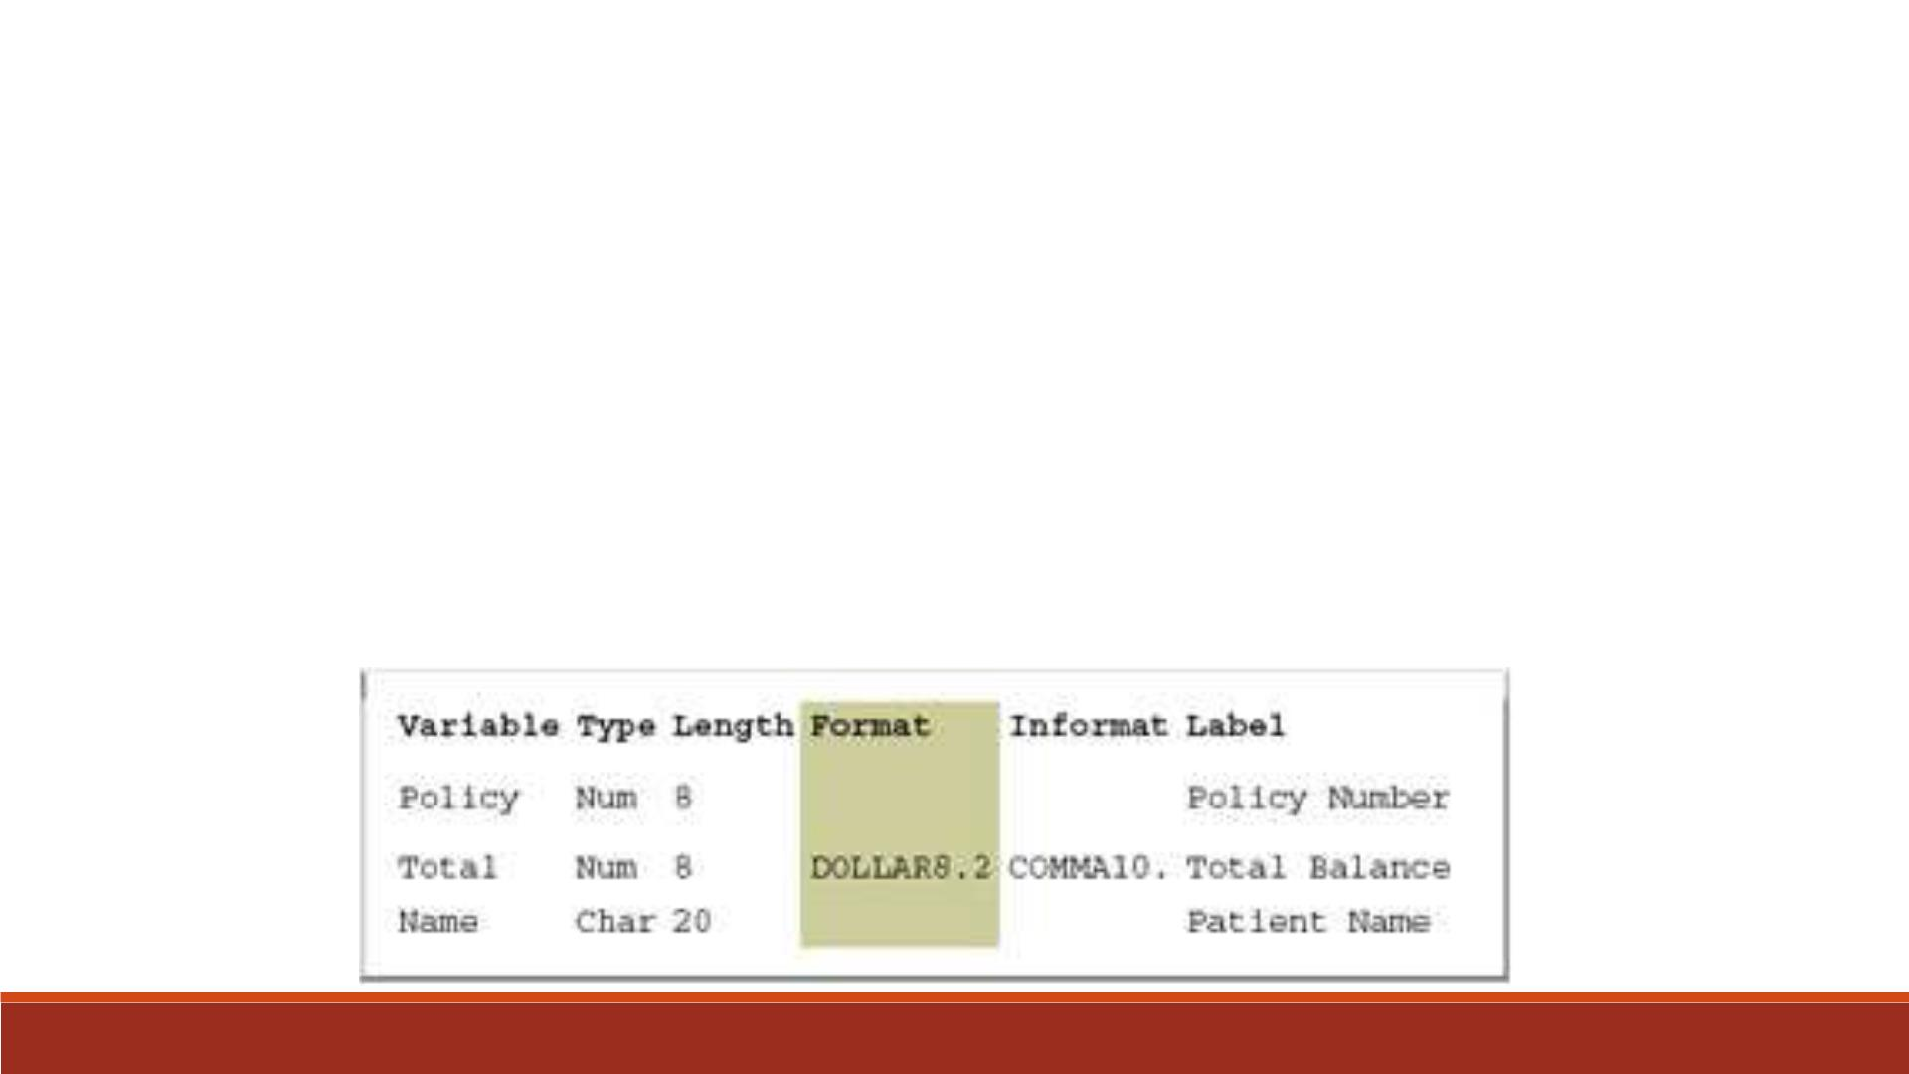
▪For example, to display the value 1234 as $1234.00 in a report, you can use the DOLLAR8.2 (Total shown below).
▪You specify the maximum width (w) of the value to be written. You might also need to specify the number of
decimal places (d) to be written.
▪For example, to display the value 5678 as 5,678.00 in a report, you can use the COMMA8.2 format, which
specifies a width of 8 including 2 decimal places.
▪You can permanently assign a format to a variable in a SAS data set,
▪or you can temporarily specify a format in a PROC step to determine the way the data values appear in output.

Slide 41
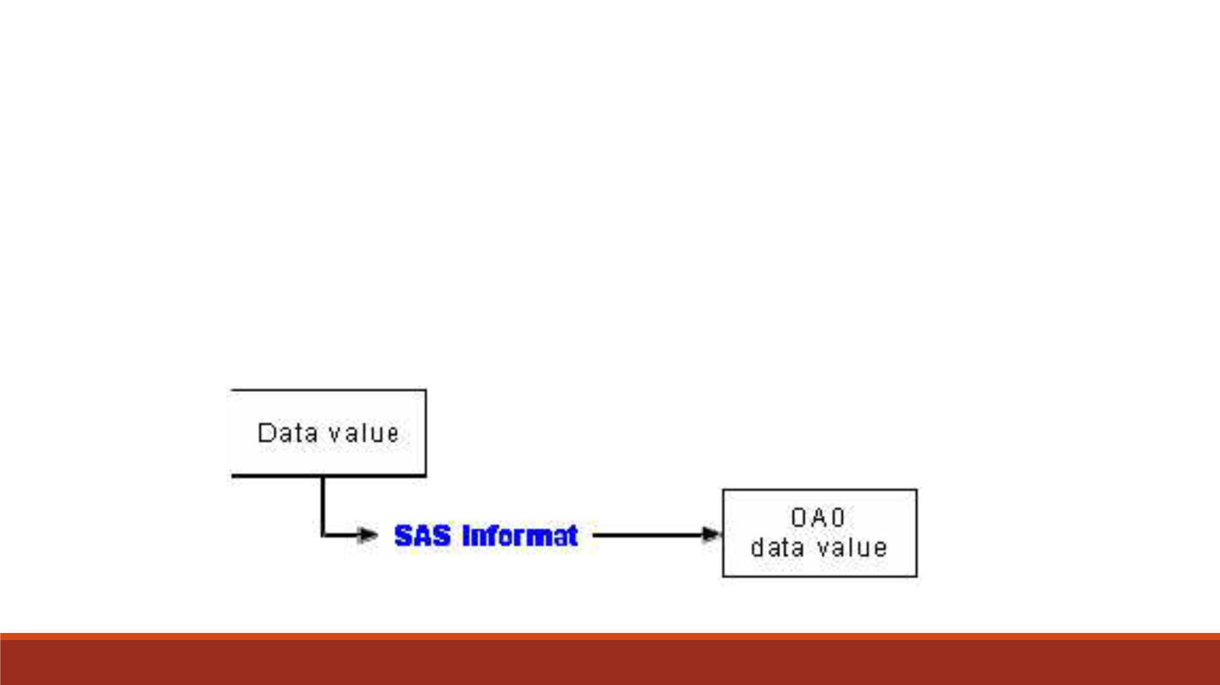
▪Whereas formats write values out by using some particular form, informats read
data values in certain forms into standard SAS values.
Variable
Informat
▪Informats determine how data values are read into a SAS data set.
▪Yo u must use informats to read numeric values that contain letters or other
special characters.
SAS

Slide 42
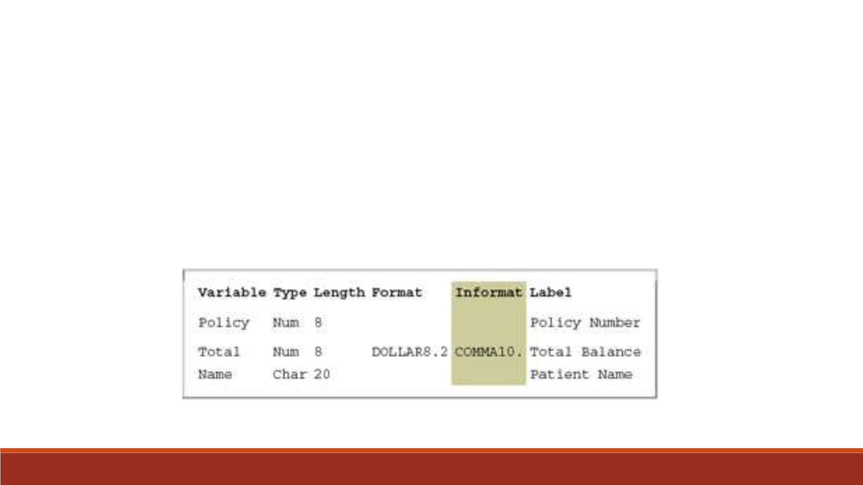
▪For example, the numeric value $1,234.00 contains two special characters, a dollar sign ($) and a comma (,).
▪Yo u can use an informat to read the value while removing the dollar sign and comma, and then store the
resulting value as a standard numeric value.
▪For Total below, the COMMA10. informat is specified.

Slide 43
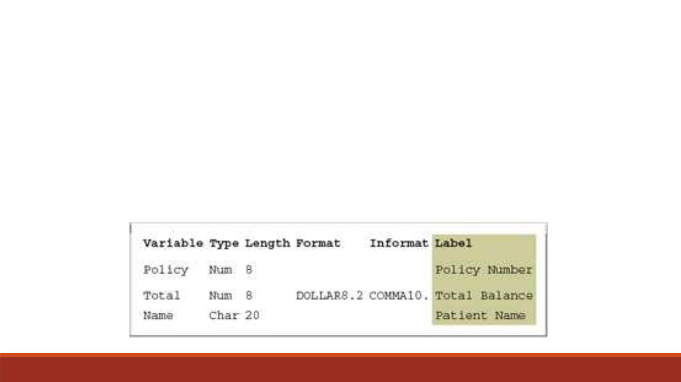
▪A variable can have a label, which consists of descriptive text up to 256 characters long.
▪By default, many reports identify variables by their names. You might want to display
more descriptive information about the variable by assigning a label to the variable.
▪For example, you can label Policy as Policy Number, Total as Total Balance, and Name
as Patient Name to display these labels in reports.
Variable
Label

Slide 44
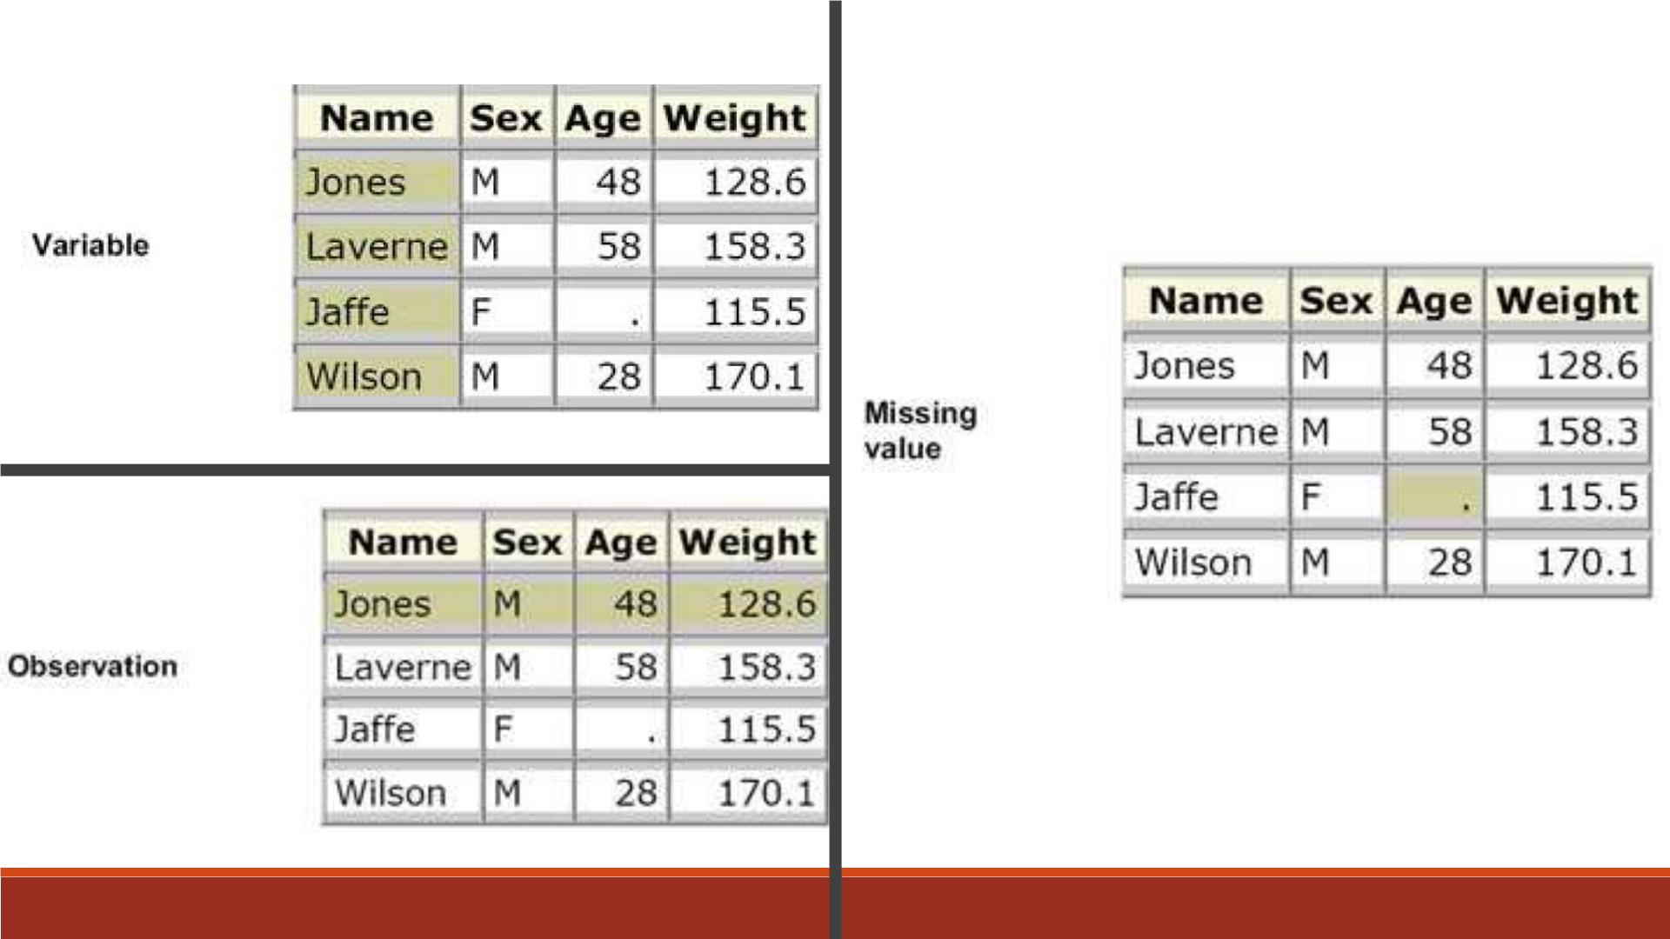

Slide 45
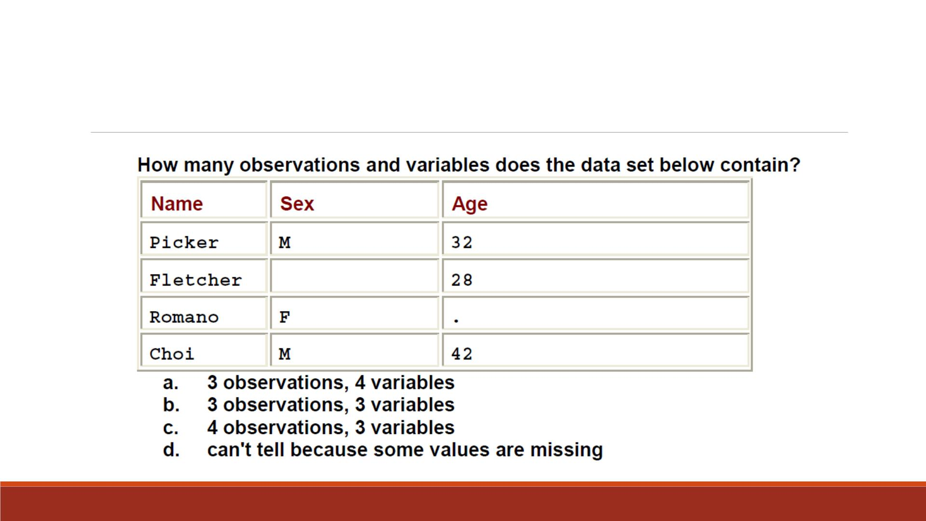
Question 10

Slide 46
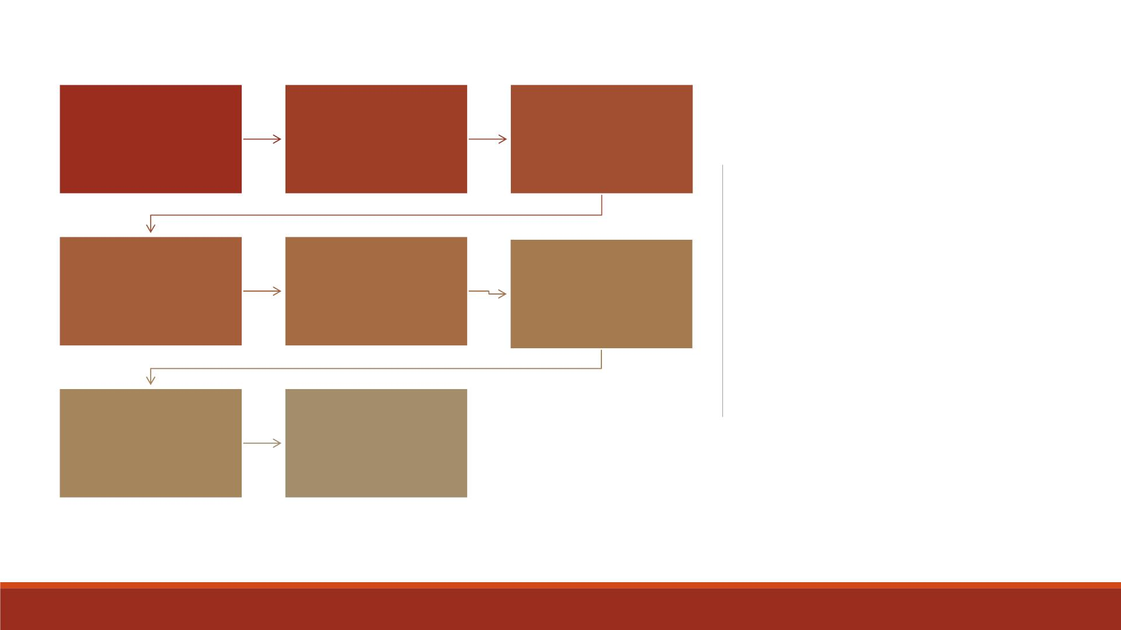
Components
of SAS
Characteristics
of SAS
SAS
Installation
Programs
Programs
Processing SAS
Programs
Referencing
SAS Files
Summary
SAS Libraries
Overview of
SAS Data Sets
Variable
Attributes

Slide 47

Q1: C Q2: A Q3: D Q4: D Q5: D
Q6: C Q7: B Q8: A Q9: D Q10: C
Answers

Slide 48
Access to SAS
▪APU license (Only available for Microsoft Windows)
https://support.apu.edu/hc/en-us/articles/221901528-Downloads-Free-University-
Software
Can take several hours to download and install!

Slide 49
Which components should be installed?
Recommended: Accept the default (left all checked boxes as is) although you do not need all of them.
See the list “SAS modules for installation” in the Lecture 1 folder.
You definitely need Base SAS, SAS/STAT, SAS/GRAPH. It is nice to have SAS Add-on for Microsoft Excel if your Excel is 64-bit.
For 553 you need SAS Enterprise Guide and Enterprise Miner.

Slide 50
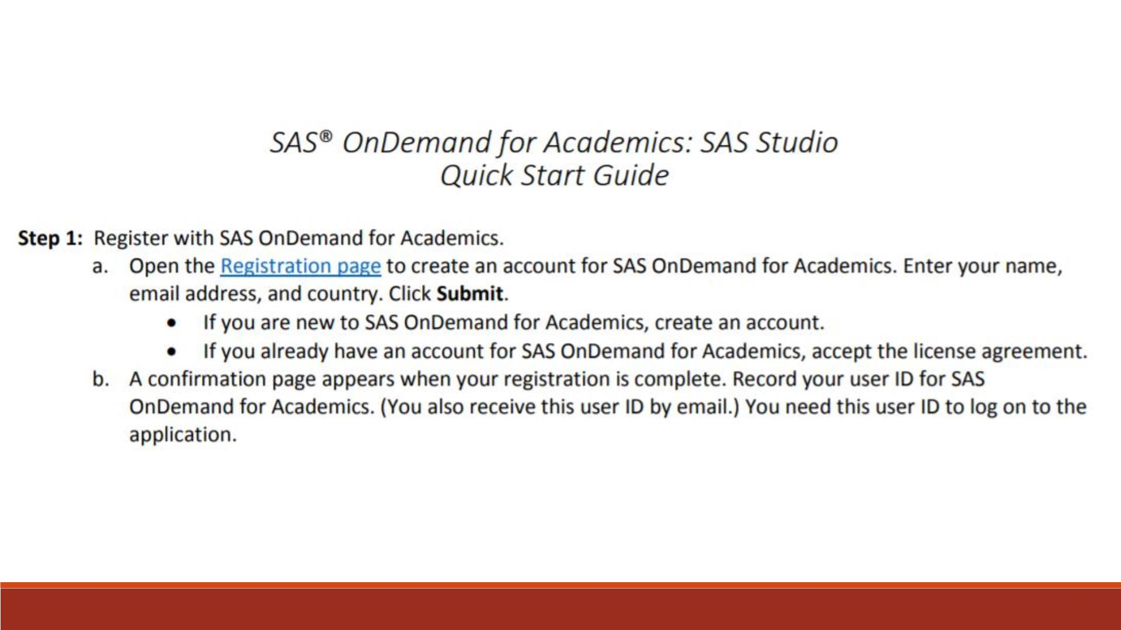

Slide 51
Create an Account
▪Official website: https://www.sas.com/en_us/software/on-demand-for-academics.html
▪Click on “Access Now”
▪On the login page, click on “Don’t have a SAS Profile”
▪Fill the info on profile page, then click on “create profile”
▪Wait for a verification email
▪Click on the link in verification email, then enter your APU email and create a password

Slide 52
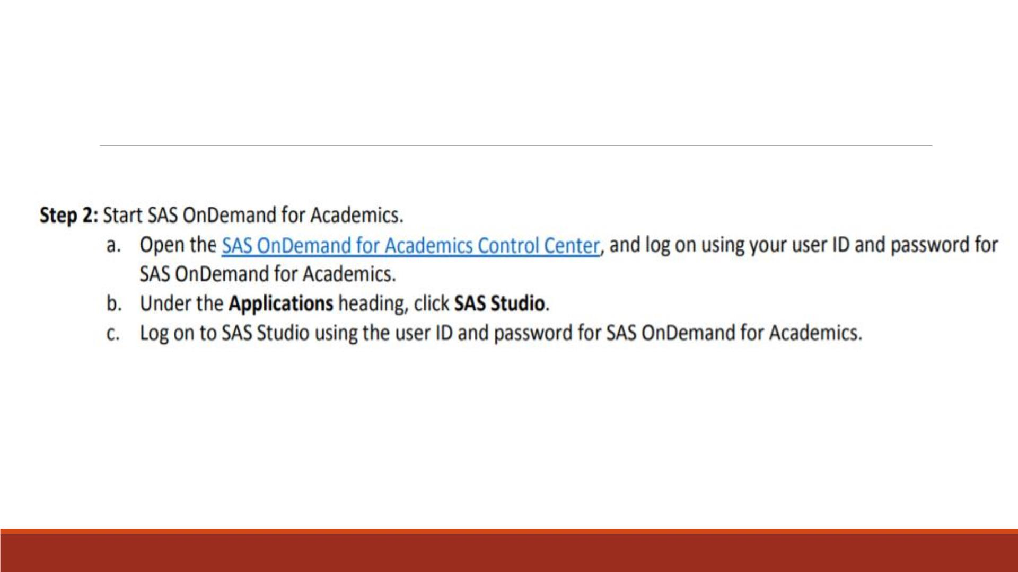
Sign into SAS Studio
Sign in link: http://odamid.oda.sas.com

Slide 53
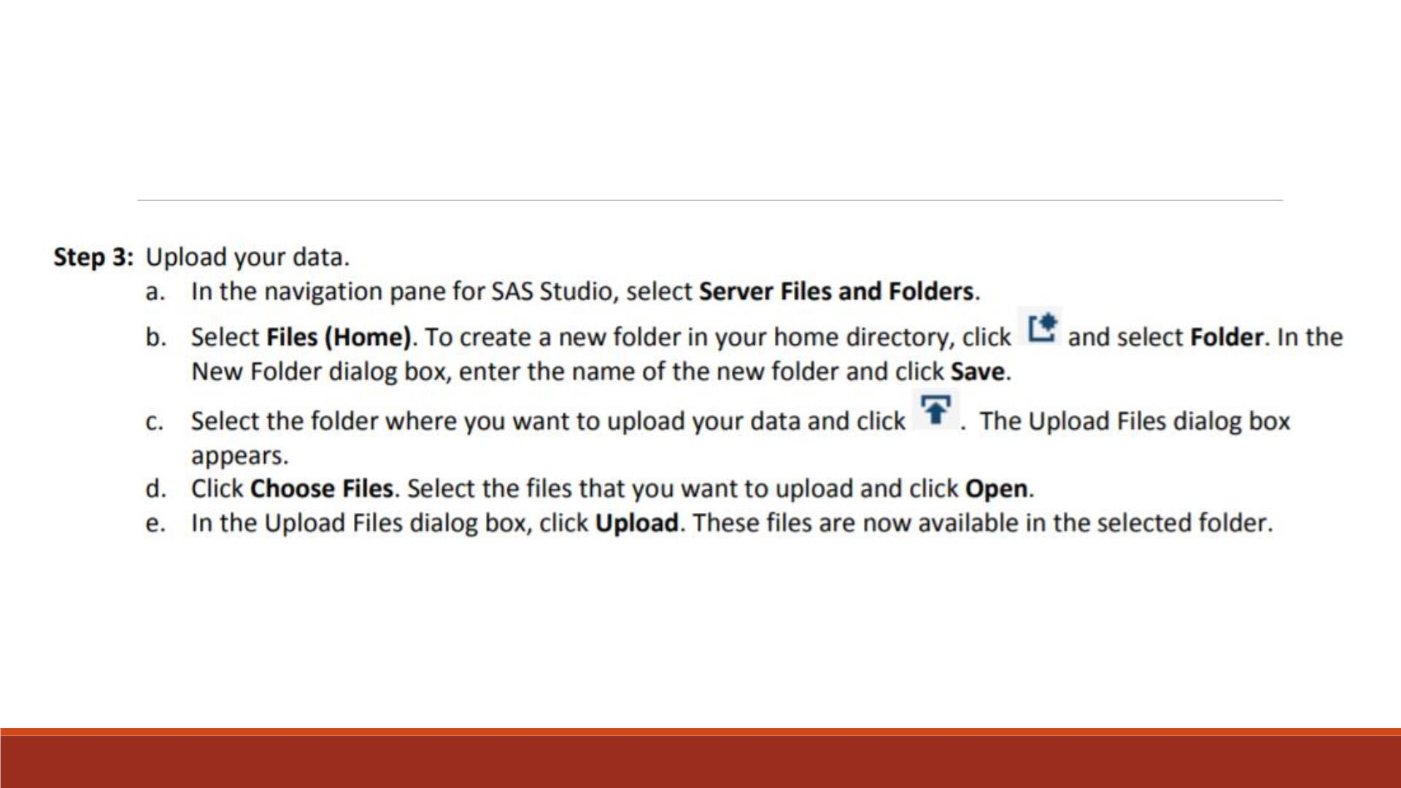
Upload Your Files
SAS program files and data files will be sent along this course.

