Slide 1

Getting D ata into SAS
YU

Slide 2

Read data delimited by blanks, commas, any delimiters or no delimiters.
Read data in fixed fields using column input
Read data using formatted input
Outline
Readings: Base Exam Guide
Create internal SAS data using DATALINES statement
Assign SAS library and create permanent data set
Use PROC IMPORT to import Excel data

Slide 3
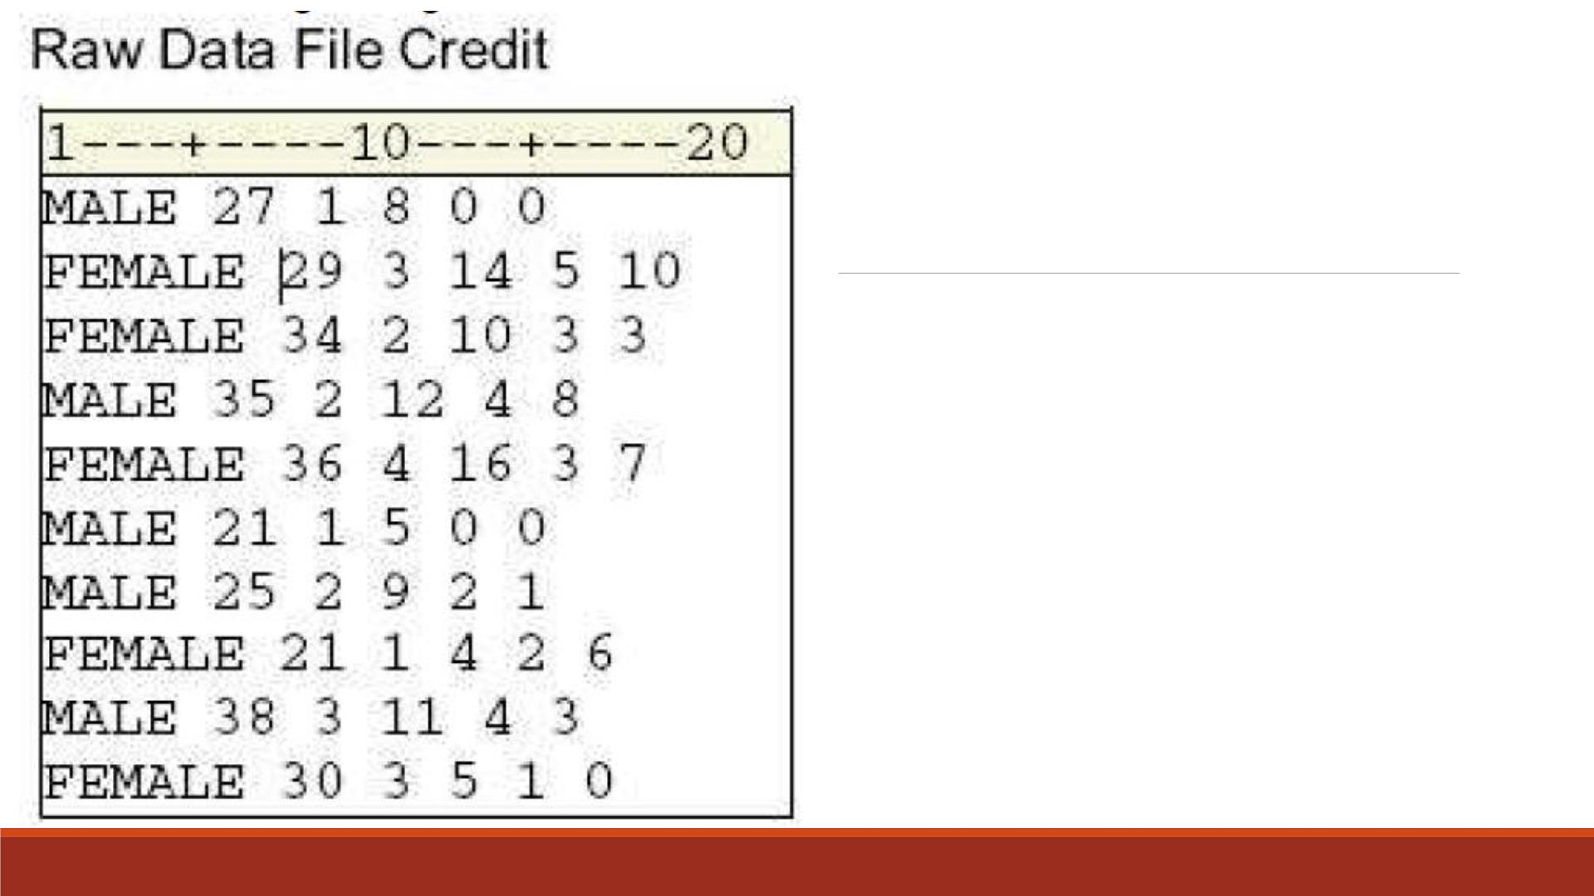
Blank-Delimited
Raw Data Example
You need to read the data values for
▪gender
▪age
▪number of bank credit cards
▪bank card use per month
▪number of department store credit cards
▪department store card use per month

Slide 4
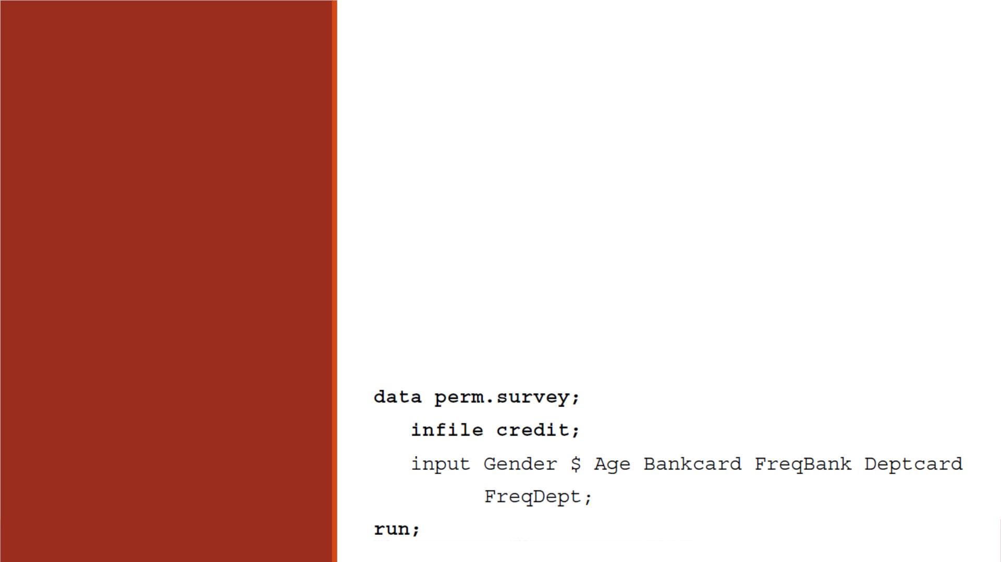
General form, INPUT statement using list input:
INPUT variable <$>;
where
▪variable specifies the variable whose value the INPUT statement
is to read.
List Input
▪$ specifies that the variable is a character variable.

Slide 5
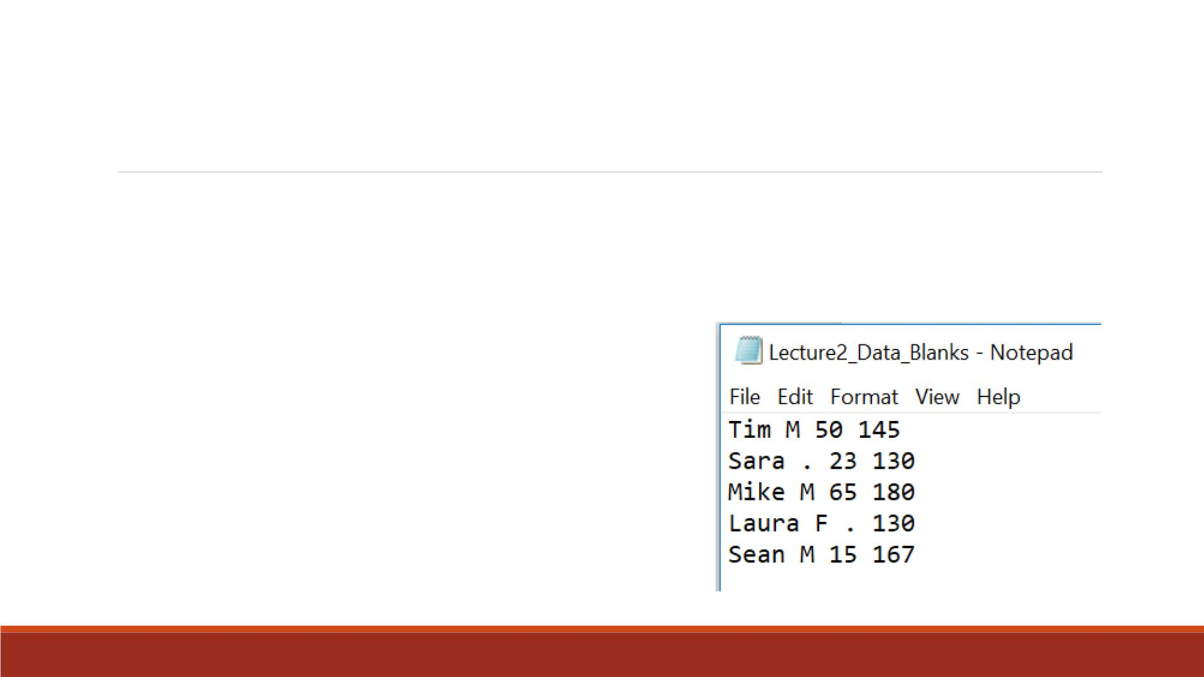
Exercise—Blank Delimiter
▪Import the raw data “Lecture2_Data_Blanks.txt” into SAS
▪Name the variables from left to right as “name”,
“gender ”, “age”, “weight”
▪Print out the imported data set
Note: Missing values are in periods.

Slide 6
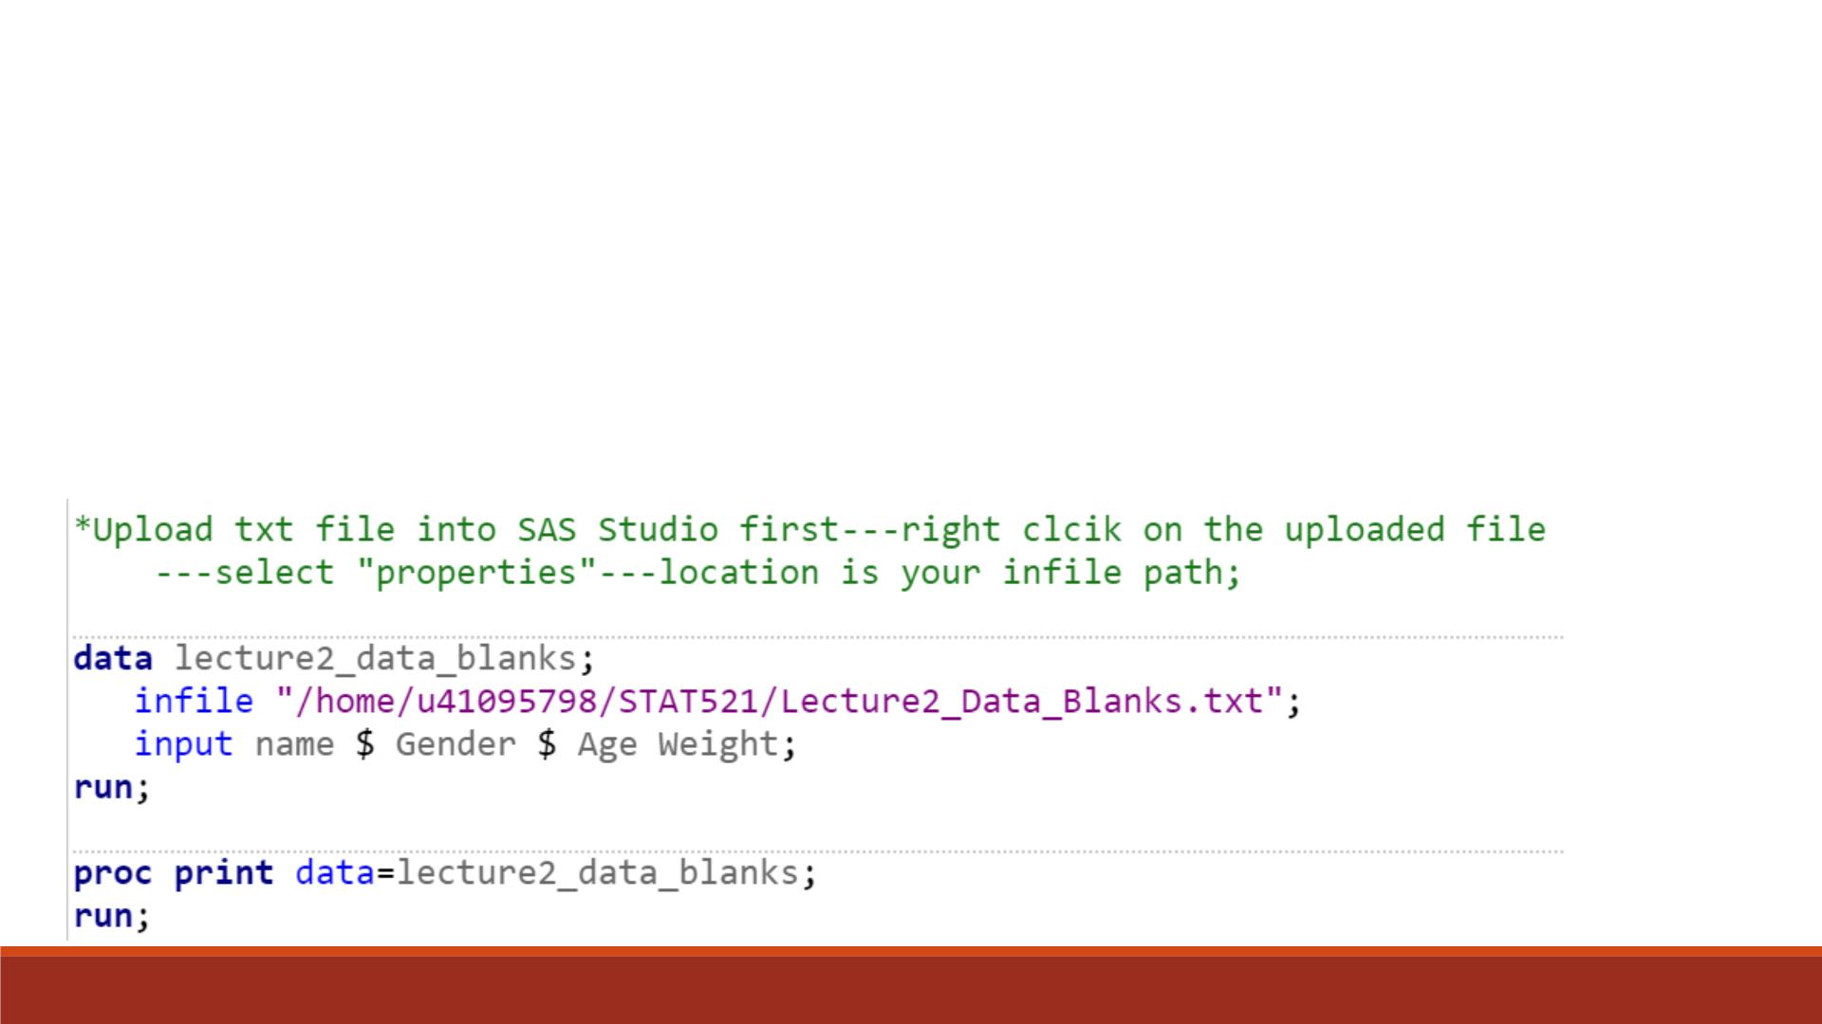
Note:
1. Change your INFILE path according to the green comments
2. Two ways to write comments in SAS (not executed)
*COMMENT;
Code
/*COMMENT*/

Slide 7
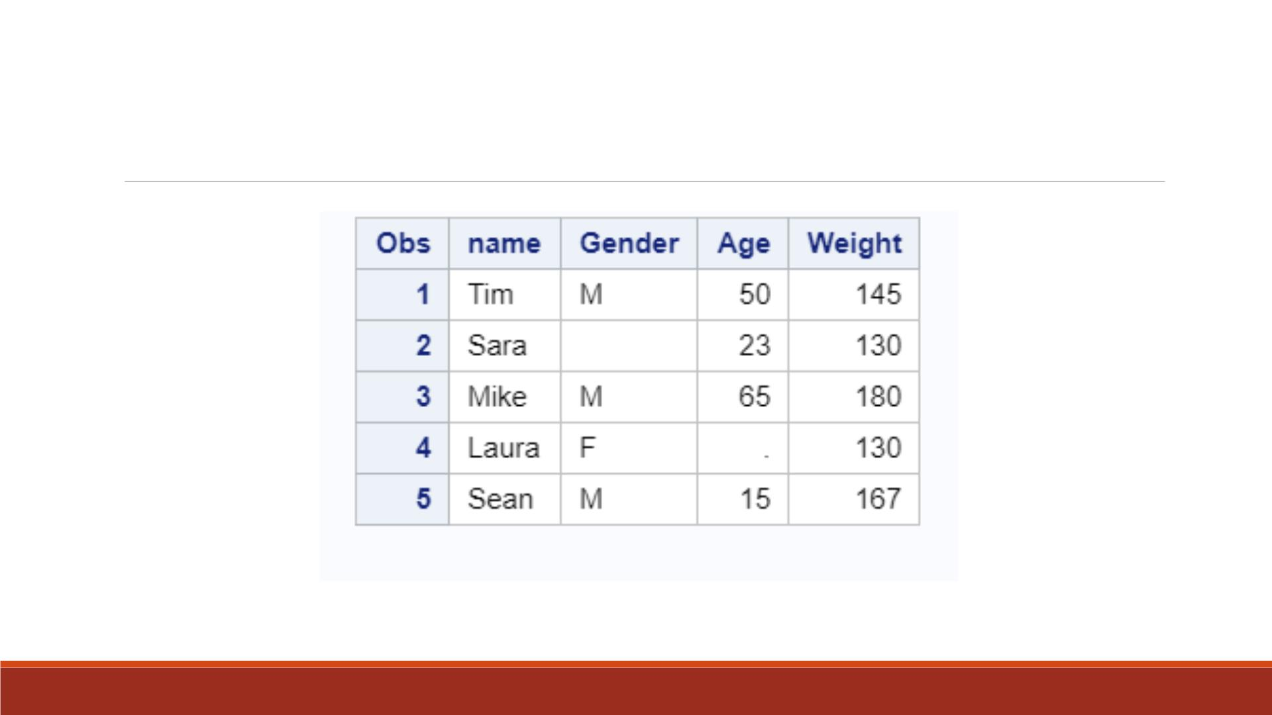
Proc Print Result
Note: In SAS datasets, missing character value is in blank, while missing numeric value is in period.

Slide 8
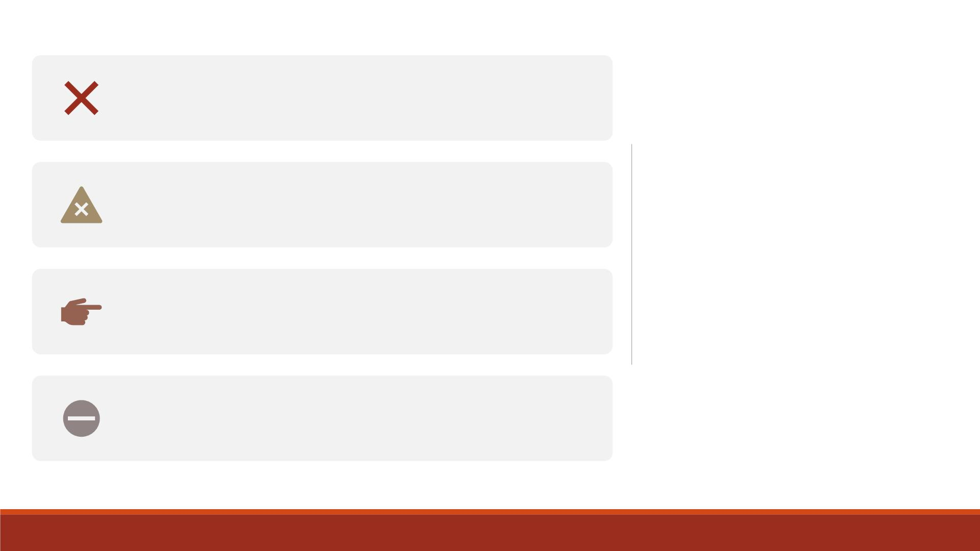
Because list input, by default, does not specify
column locations,
1. all fields should be separated by at least one
blank or other delimiter
Disadvantages
of List Input
2. fields must be read in order from left to right
3. you cannot skip or re-read fields.

Slide 9
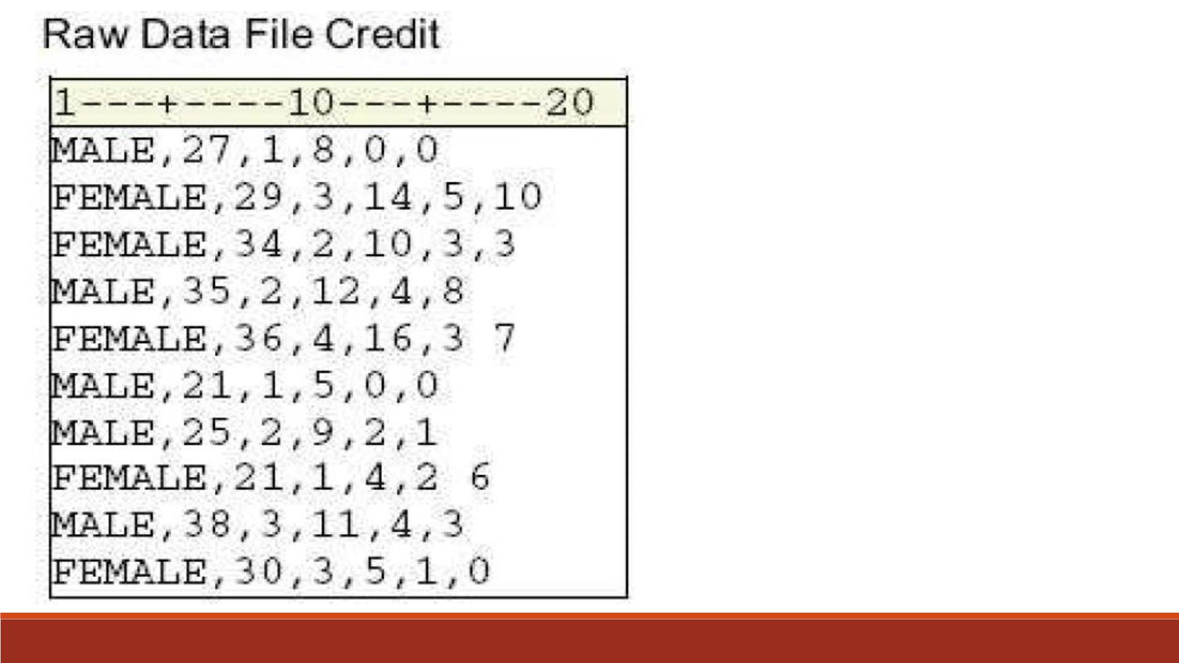
Comma-Delimited
Raw Data Example

Slide 10
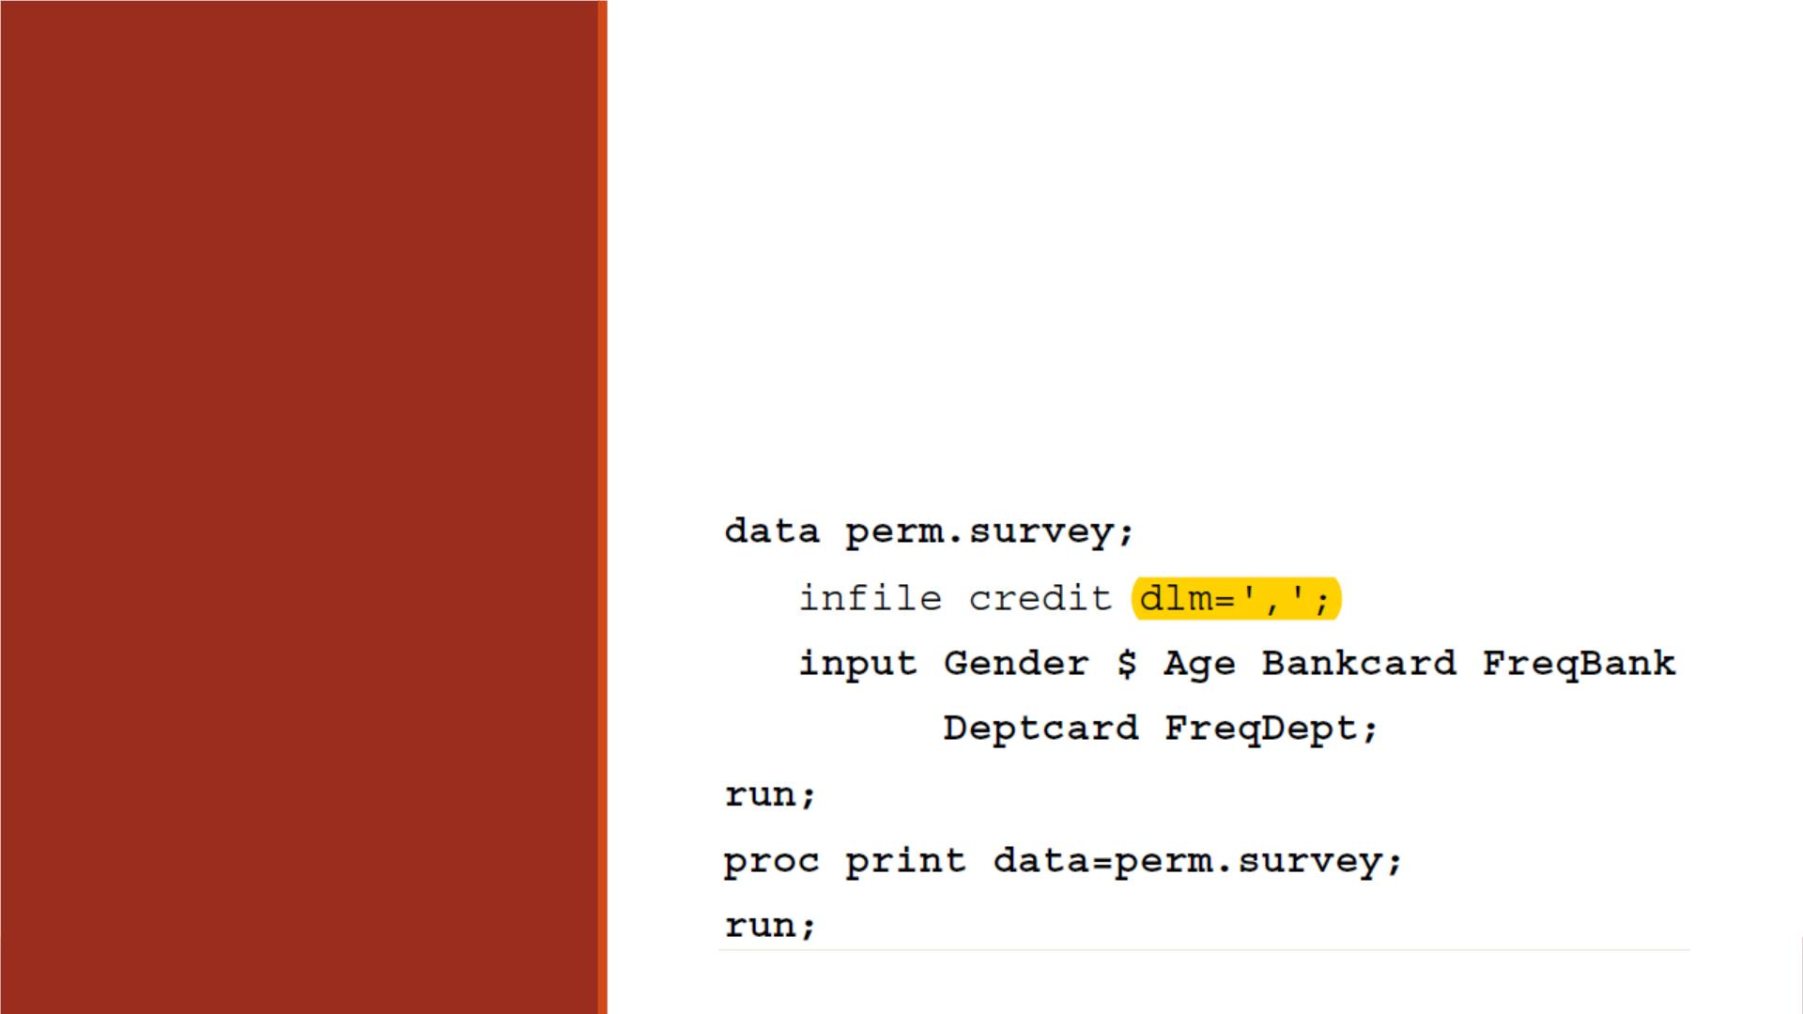
General form, DLM= option:
DLM=delimiter(s)
where delimiter(s) specifies a delimiter for list input, and must be
enclosed in quotation marks.
Use DLM=
Option

Slide 11

Exercise—Comma Delimiter
▪Import the raw data “Lecture2_Data_Commas.csv” into SAS
▪Name the variables from left to right as “name”, “gender ”, “age”, “weight”
▪Print out the imported data set

Slide 12
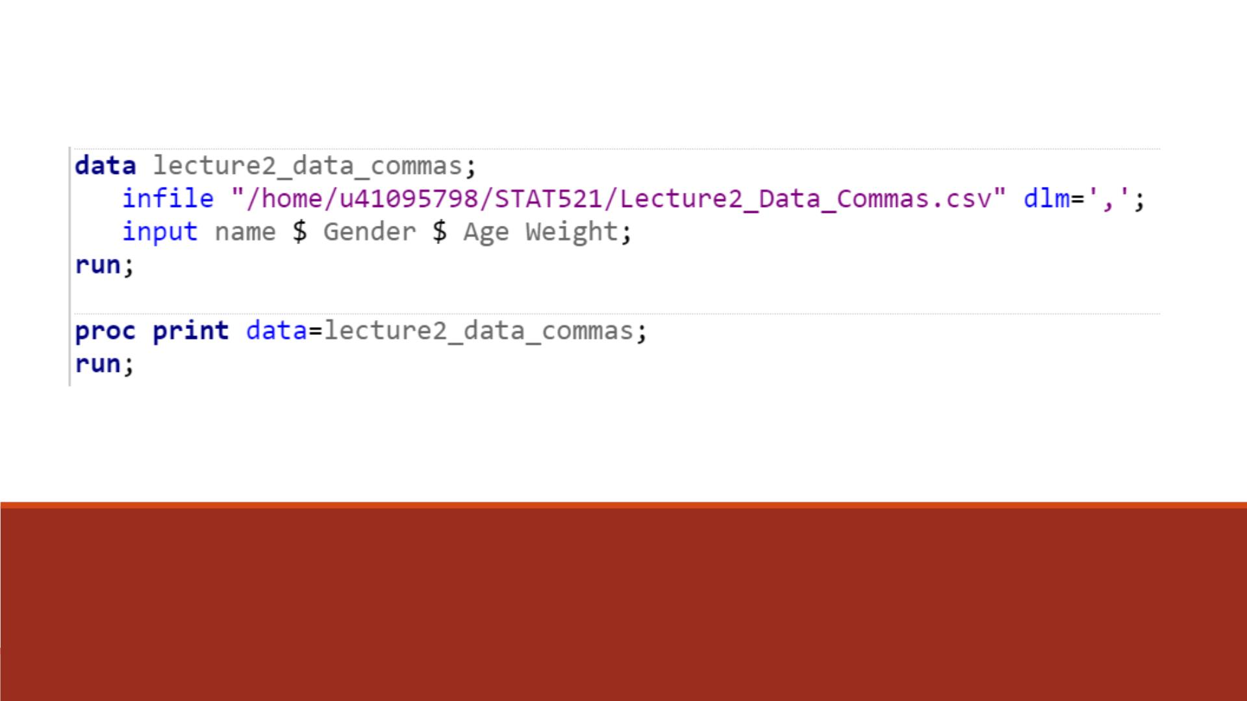
Code
Repeat the same exercise by importing the text dataset
“Lecture2_Data_Commas.txt”

Slide 13
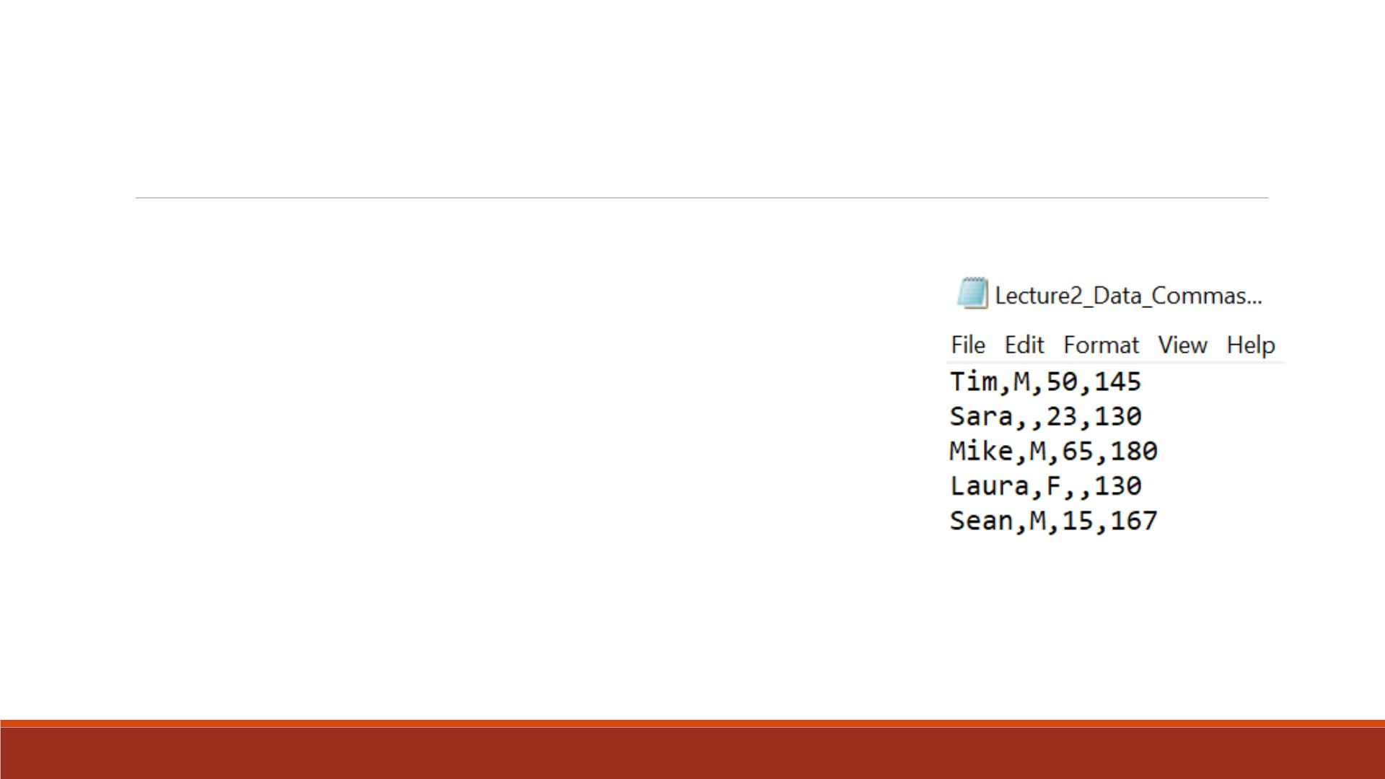
DSD Option
▪DSD: delimiter sensitive data
▪With DLM=‘,’ only, SAS reads two consecutive commas as one.
▪With DSD option, SAS reads two consecutive commas a
missing value.

Slide 14
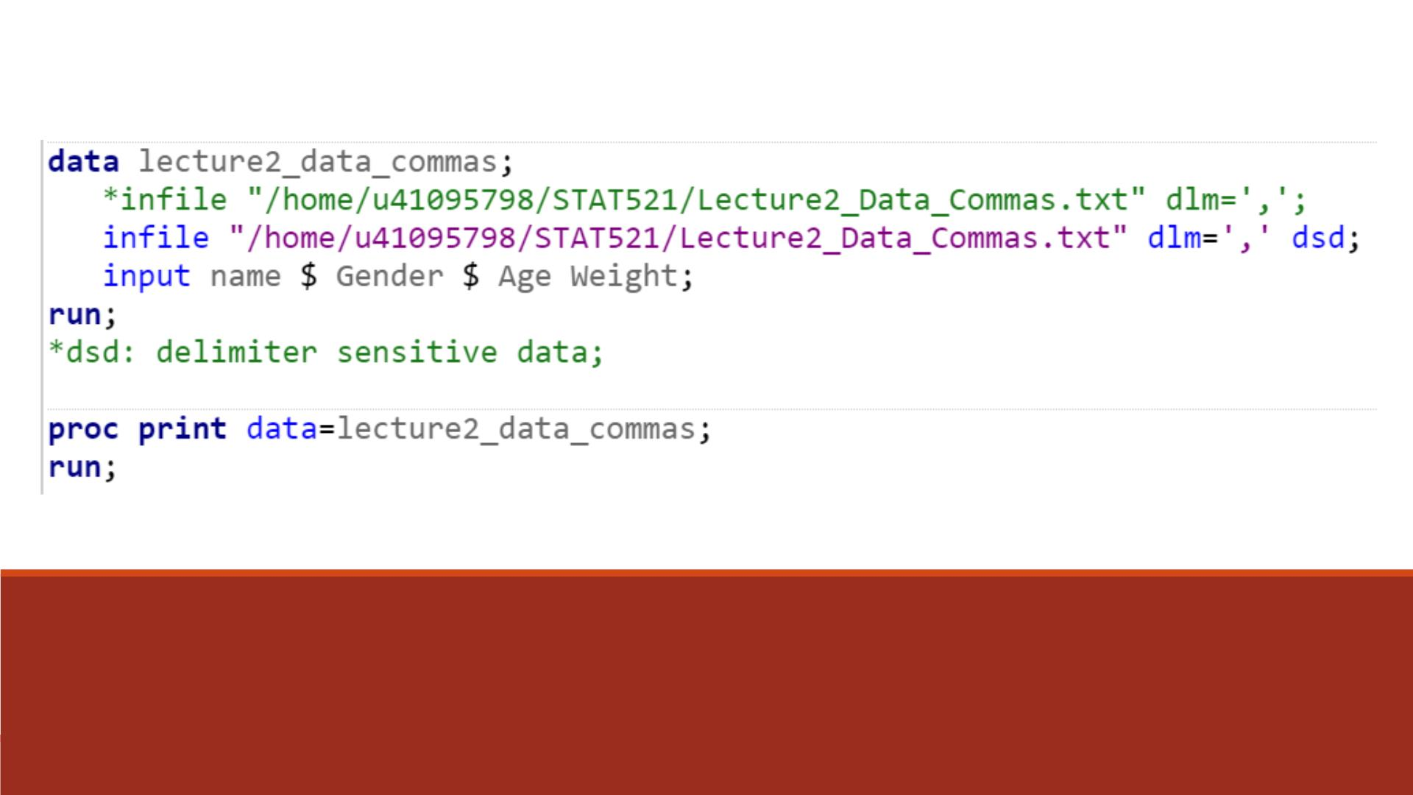
Code
Compare the result with DSD option and without DSD option!

Slide 15
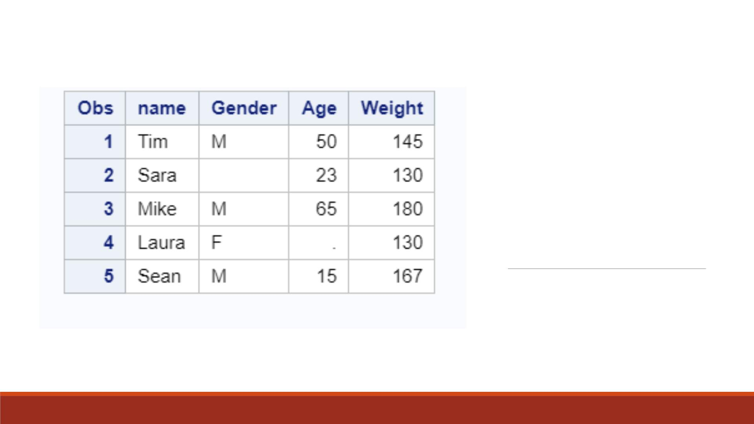
Proc Print
Result

Slide 16
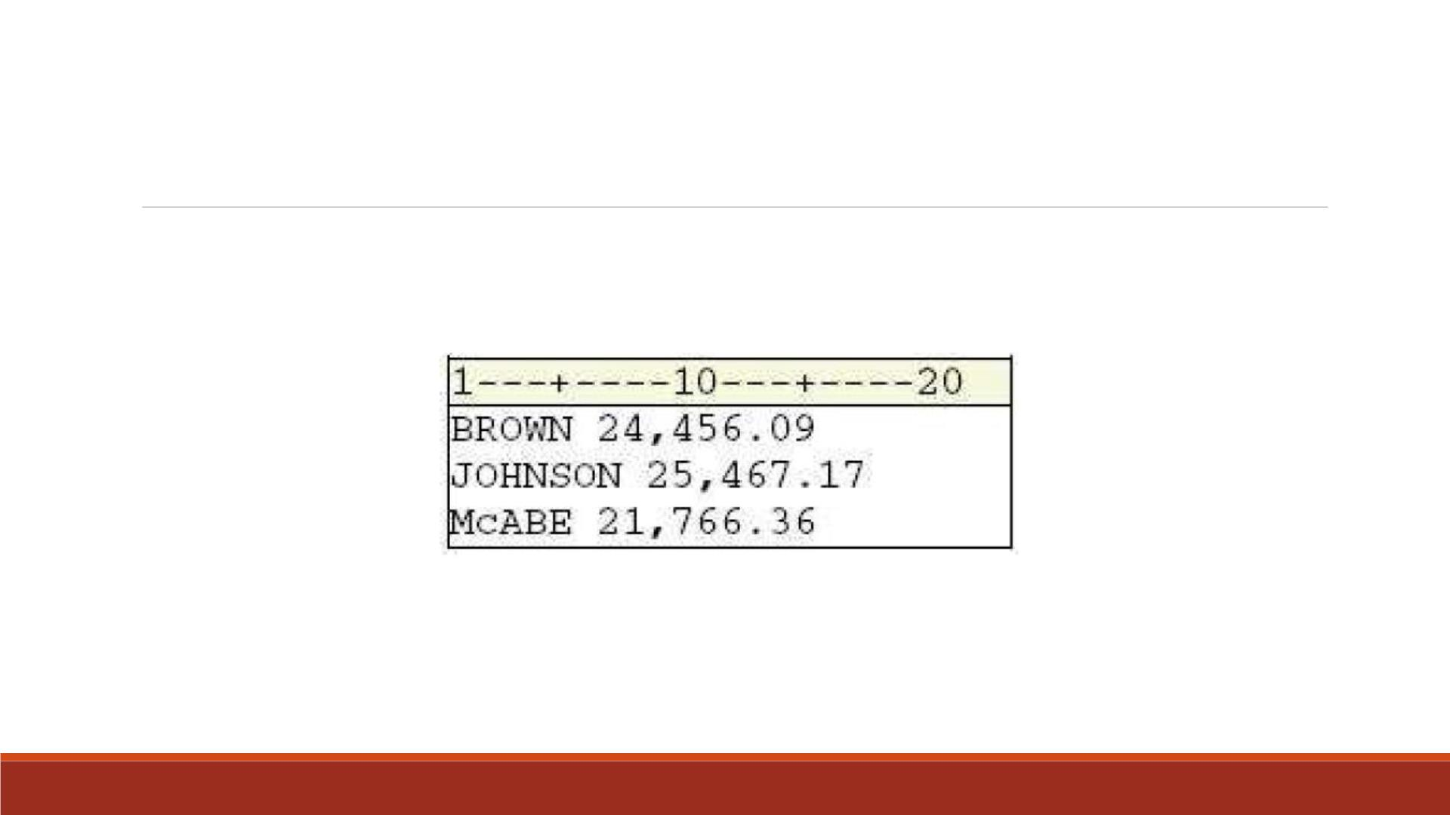
Warning
The field delimiter must NOT be a character that occurs in a data value.
Notice that the values for Salary contain commas.

Slide 17
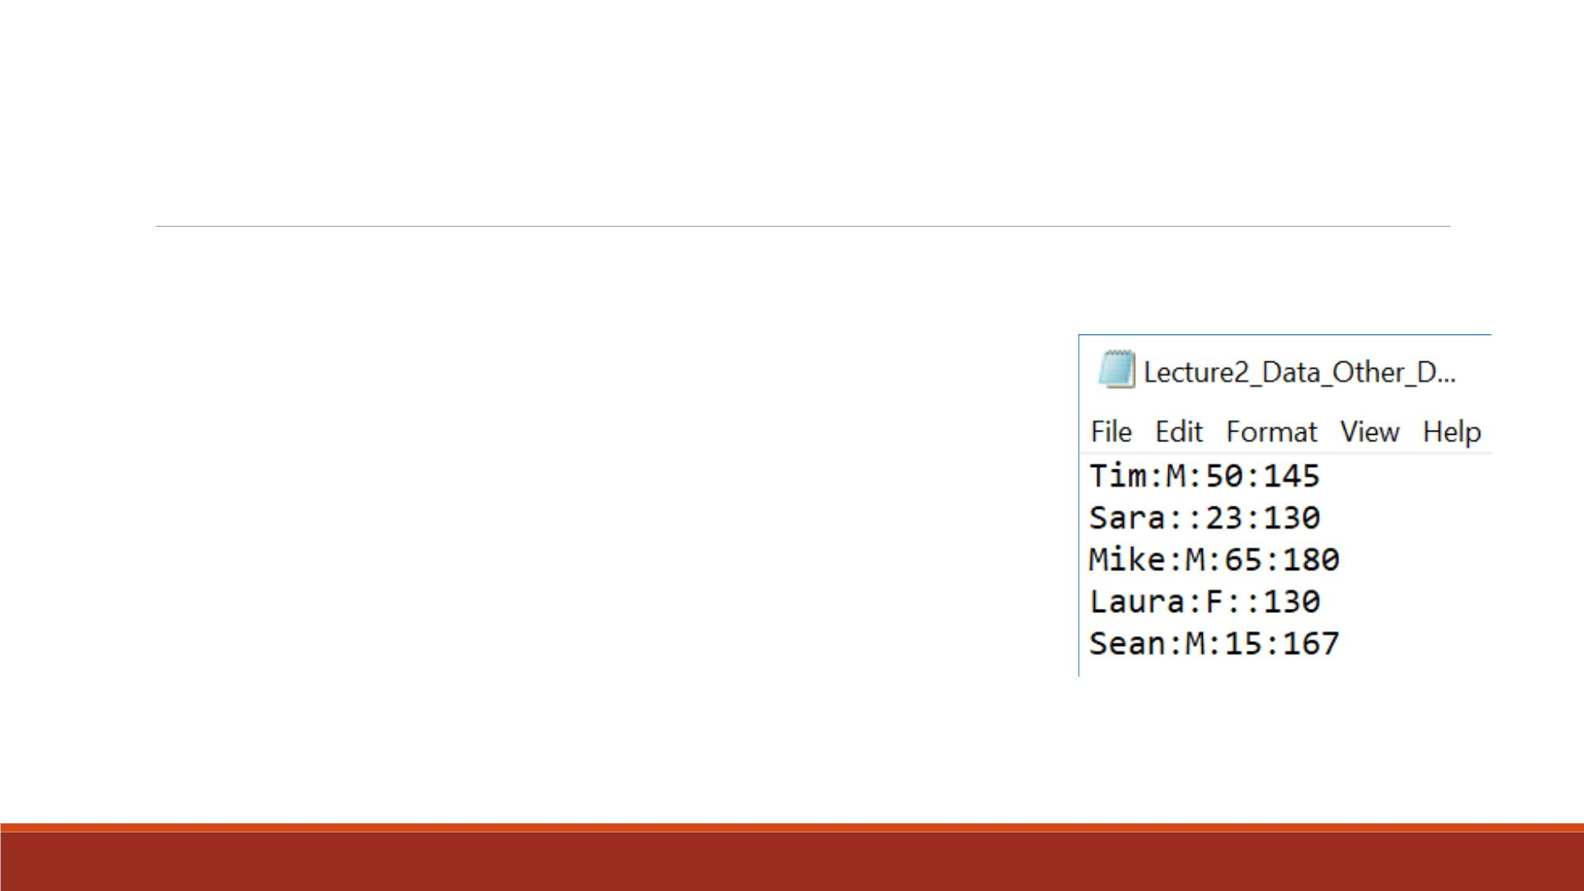
Other Delimiter Raw Data Exercise
▪Import the raw data “Lecture2_Data_Other_Del.txt” into SAS
▪Name the variables from left to right as “name”, “gender ”,
“age”, “weight”
▪Print out the imported data set
Note: Two consecutive colons should denote a missing value in
between.

Slide 18
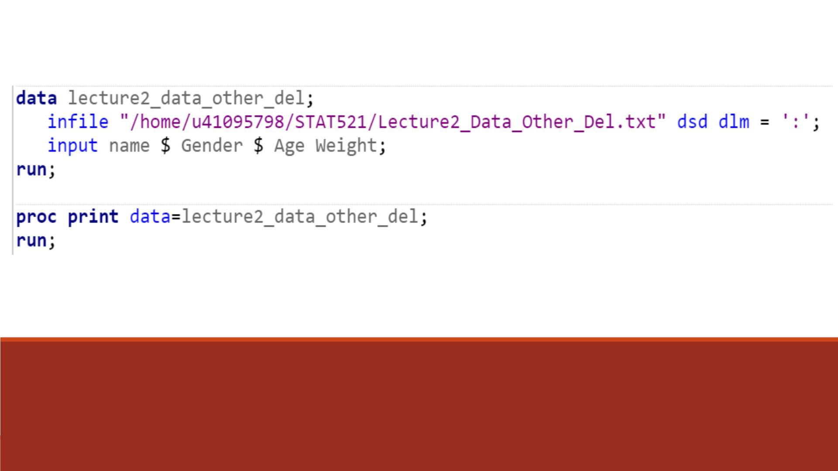
Code

Slide 19
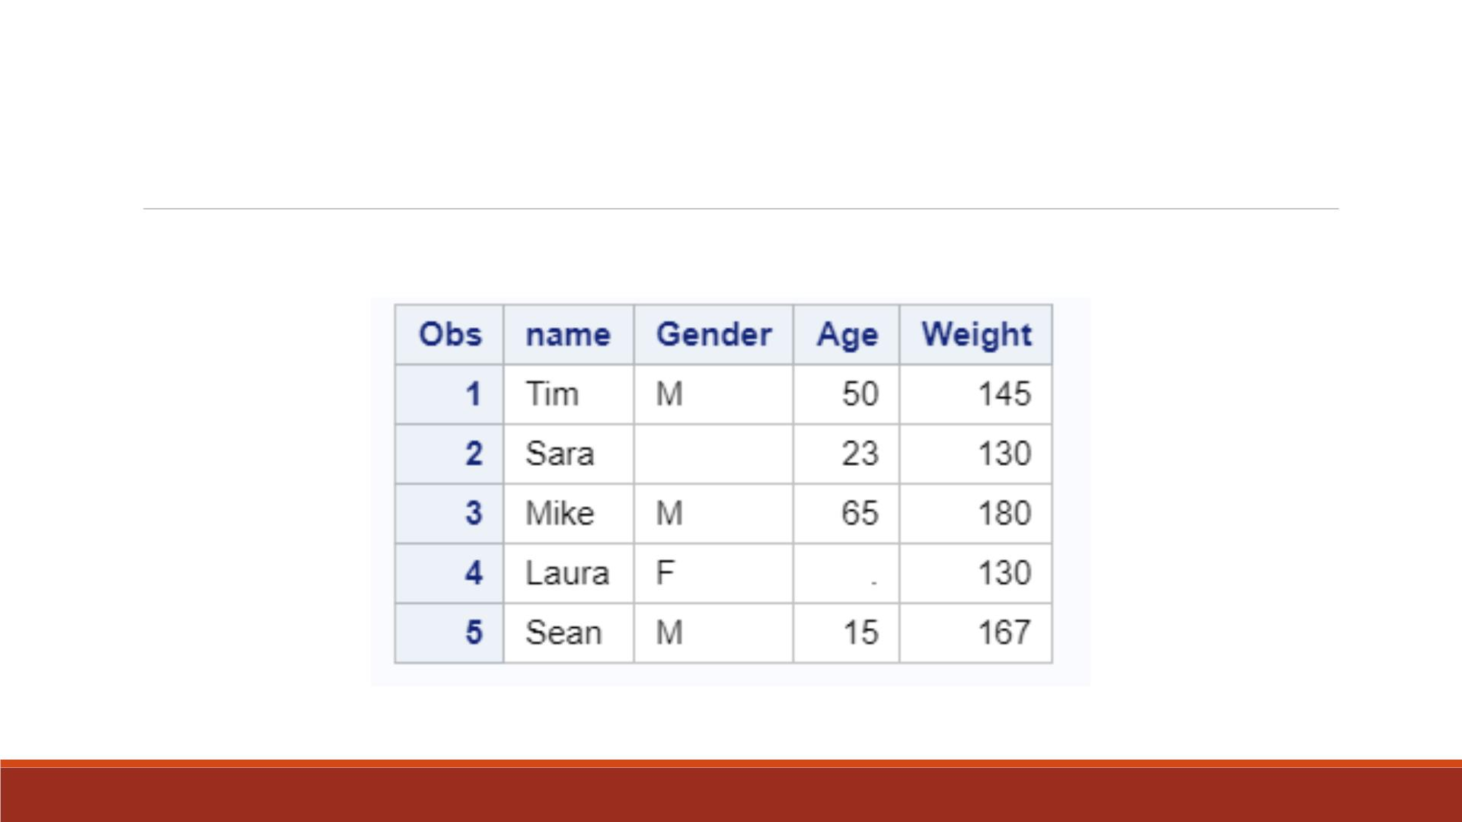
Proc Print Result

Slide 20
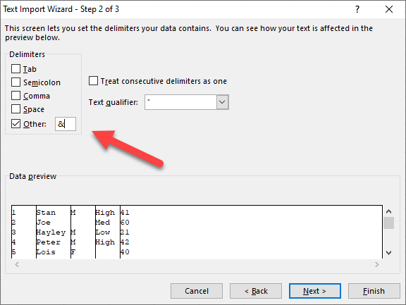
Easy/lazy way to deal with any delimiter and missing values
Use Excel to import the data. Excel can be read by virtually any statistical programs (e.g. SAS, SPSS, Tableau, R, Python…etc.)
Open the text file into Excel
Accept the default “Delimited”
Specify the delimiter.

Slide 21
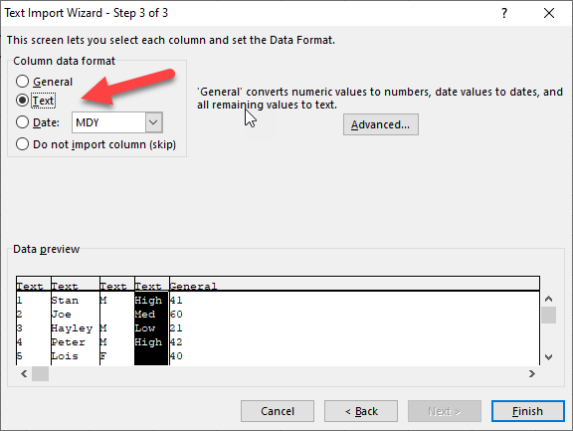
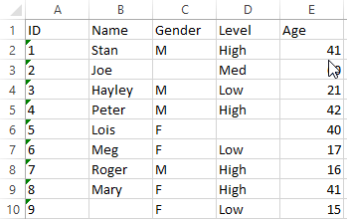
Easy/lazy way to deal with any delimiter and missing values
Define the variable as text or general (numeric). Click Finish.
Name the variable header.
The file is ready to be imported into any system.

Slide 22
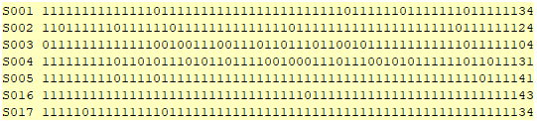
The best delimiter is…
No delimiter! Why?
When you have an extra comma, semi-colon, or missing a comma, semi-colon anywhere, the whole data set will be off! You may spend hours to fix the file.
It is common for test vendors (e.g. Pearson) to put all test data side by side without any delimiter.
But how can I know the position at the end? Should I count it?

Slide 23
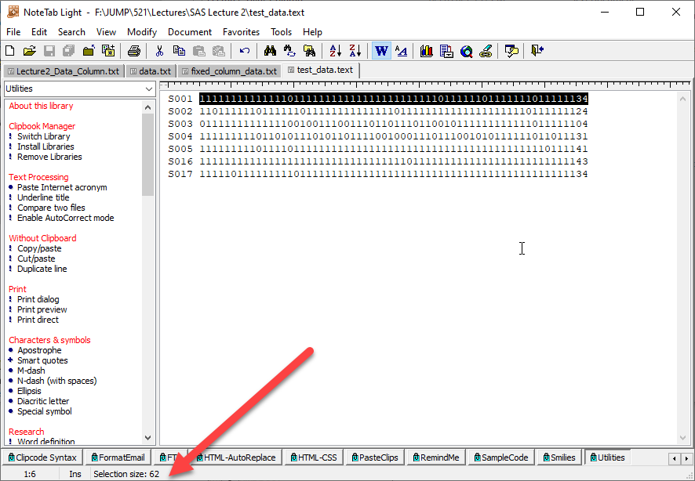
Use Notetab Light (Freeware)
When I select the test scores, I can see the selection size at the bottom of Notetab Light. In this file, there are 62 questions.

Slide 24
SAS Program
See the program “Read_score.sas”
In the SAS Program the data are read by:
data one; input ID$1-4 @6 (Q1-Q62) (1.0);
SAS read the ID first.
At Column 6 it starts reading the test scores.
There is no delimiter. SAS read the scores one by one until the end (Column 62).
(1.0)= 1 means read one column at one time. 0 means no decimal.

Slide 25
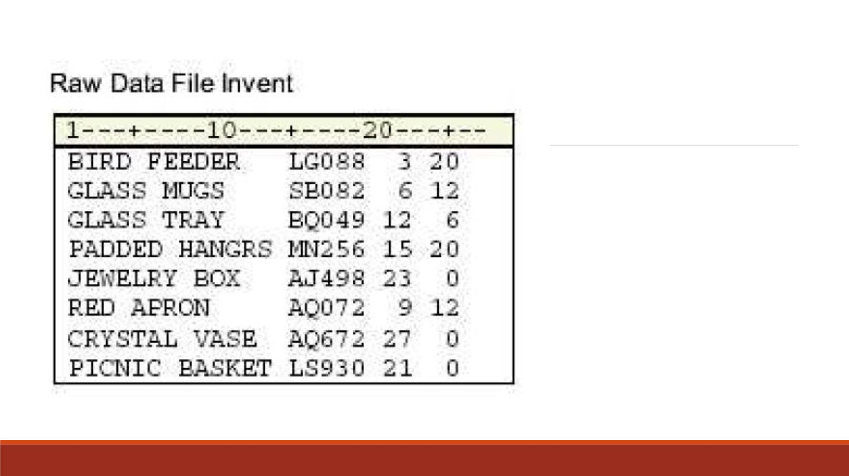
Raw Data in Fixed
Fields Example
▪Data that is arranged in columns
or fixed fields.
▪Yo u can specify a beginning and
ending column for each field.

Slide 26

I can feel your pain!
Programming could be very frustrating. You could get stuck by one minor error.

Slide 27
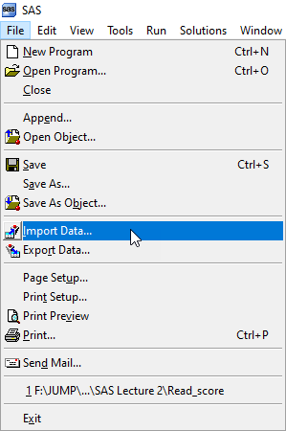

Point and click
Good news! There are always alternate ways. Rather than spending hours to debug the program, try other ways, or try the easier way first! Why not?
Use Import Data from File.

Slide 28
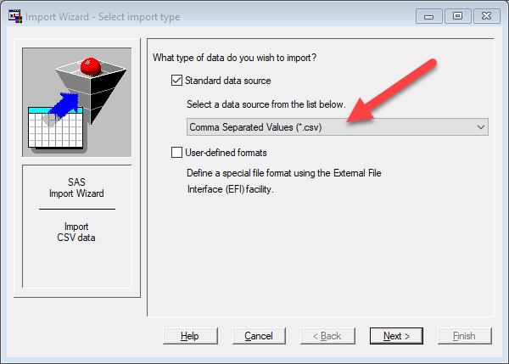
Point and click
Select Comma Separated Values (CSV)

Slide 29
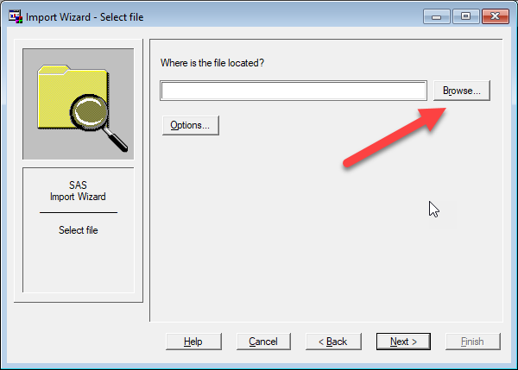
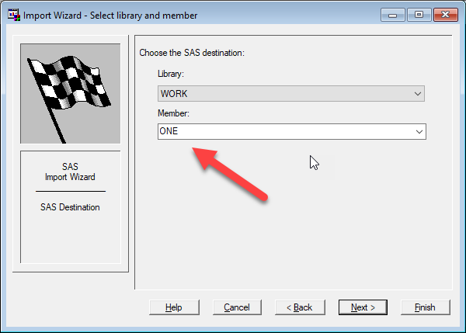
Specify the file location by Browse and then click Next
Specify the library and the file (member) name. By default the library is WORK.
Click Finish.

Slide 30
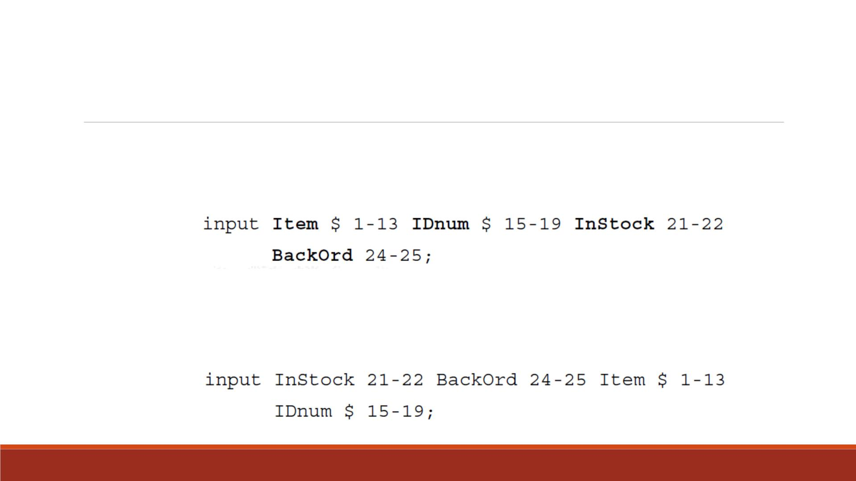
Column Input
You can use column input to read the values for Item, IDnum, InStock, and BackOrd from the raw
data file “Invent ”.
Note: INPUT statement lists the variables with their corresponding column locations. Column
input can read fields in any order.

Slide 31

You don’t have to worry about missing values. If you do not have a
value, you can leave it blank.
Advantages
of Column
Input
When you write your INPUT statement, you can choose which
variables to read, and in what order to read them.
This input method can read character and standard numeric values,
such as positive or negative numbers and numbers in exponential
form.
Note: Column input cannot handle numeric values with commas or
dollar signs or other special symbols. E.g. Yo u can read dates only as
character values when using column input method. (Next part)

Slide 32
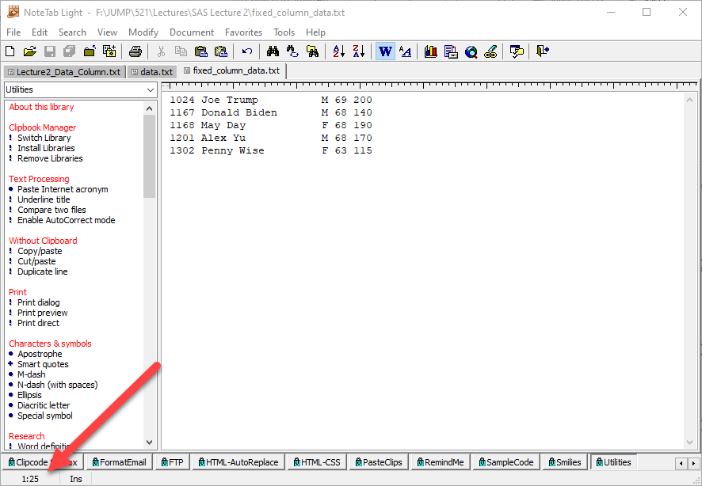
How can you know the exact column position?
Counting?
Use Notetab Light Place the cursor at the positon and look at the bottom
e.g. 1 row 25 column

Slide 33
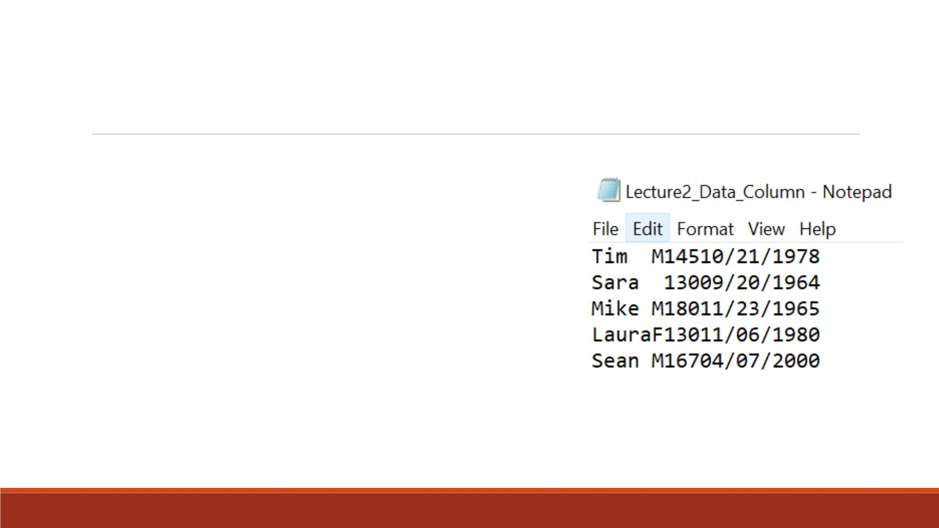
Exercise—Column Input
▪Import the raw data “Lecture2_Data_Column.txt” into SAS
▪Name the variables from left to right as “name”, “gender ”,
“weight ”, “DOB”
▪Print out the imported data set
Note: DOB contains “/”. It can only be read as character
value.

Slide 34
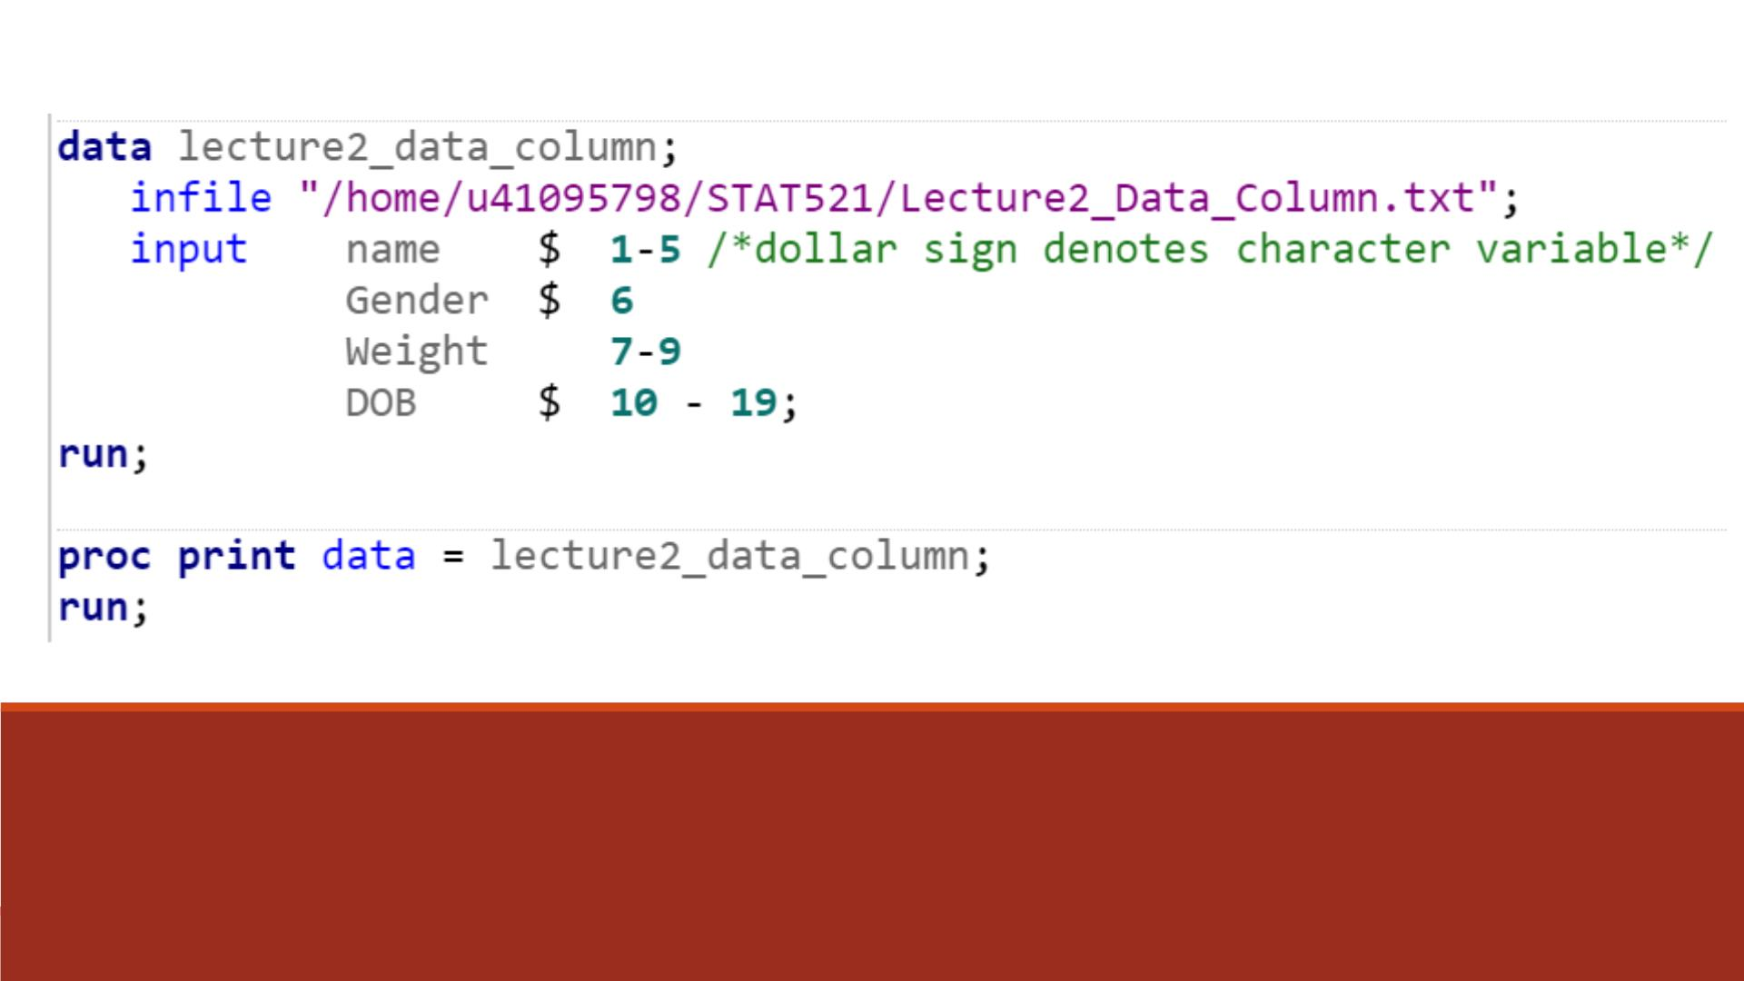
Code
Note: Change the INFILE path in your own code

Slide 35
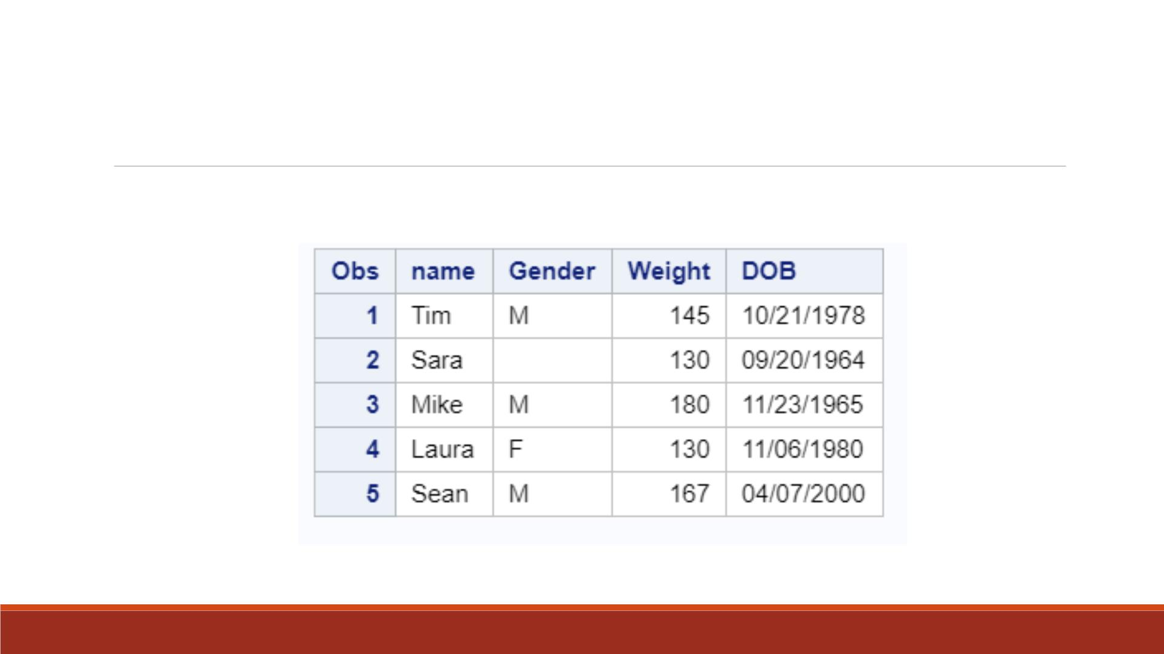
Proc Print Result

Slide 36

Read standard and nonstandard numerical
values, such as numbers with dollar signs
and commas
Using
Formatted
Input
Read dates in different formats, unlike
column input which can only read dates as
character values
Any time you have nonstandard data in
fixed columns, consider using formatted
input

Slide 37
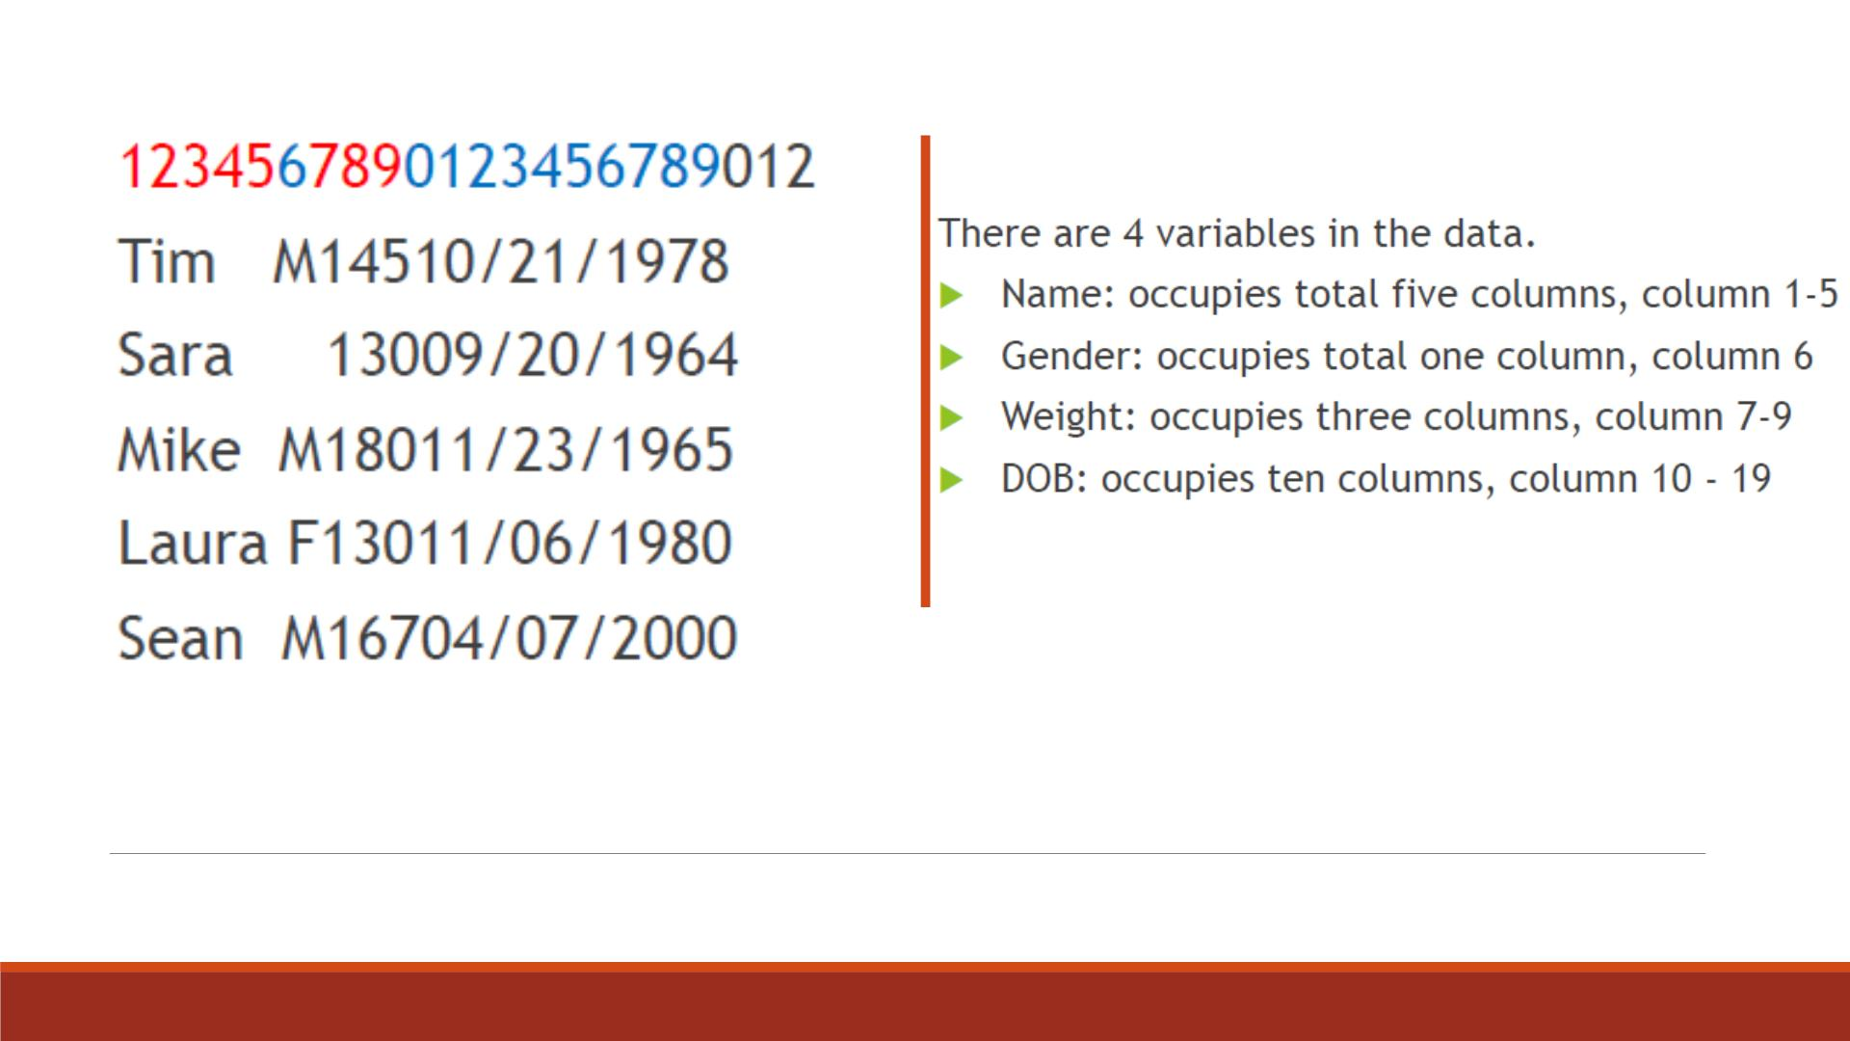
Example: Data with Dates

Slide 38

The date you are reading is in the
mm/dd/yyyy form.
10 means this date form takes up 10
columns including 8 digits and 2 slash
signs.
MMDDYY10.
Informat
For example, the variable DOB has
values like 10/21/1978.
Note: Informats are built-in
instructions that tell SAS how
to read a data value.
SAS reads the mm/dd/yyyy date and
converts it into a SAS date.

Slide 39

w.d Informat
w tells SAS how many
columns to read. (Decimal
point takes one column.)
The optional d tells SAS
that how many decimal
places in the value.
The w.d informat reads
standard numeric values.
Example: Value 2.1 takes up
Example: Variable “Weight”
contains 3 digits (such as
145) has an informat of 3.
3 column spaces, 2 digits +
1 decimal place. It has an
informat of 3.1

Slide 40
$w. Informat
▪Reads standard character data values.
▪$ denotes character value.
▪w specifies the width of the input field, i.e. how many digits.
▪You must specify w because SAS does not supply a default value.
▪There can be spaces between $ and w.

Slide 41
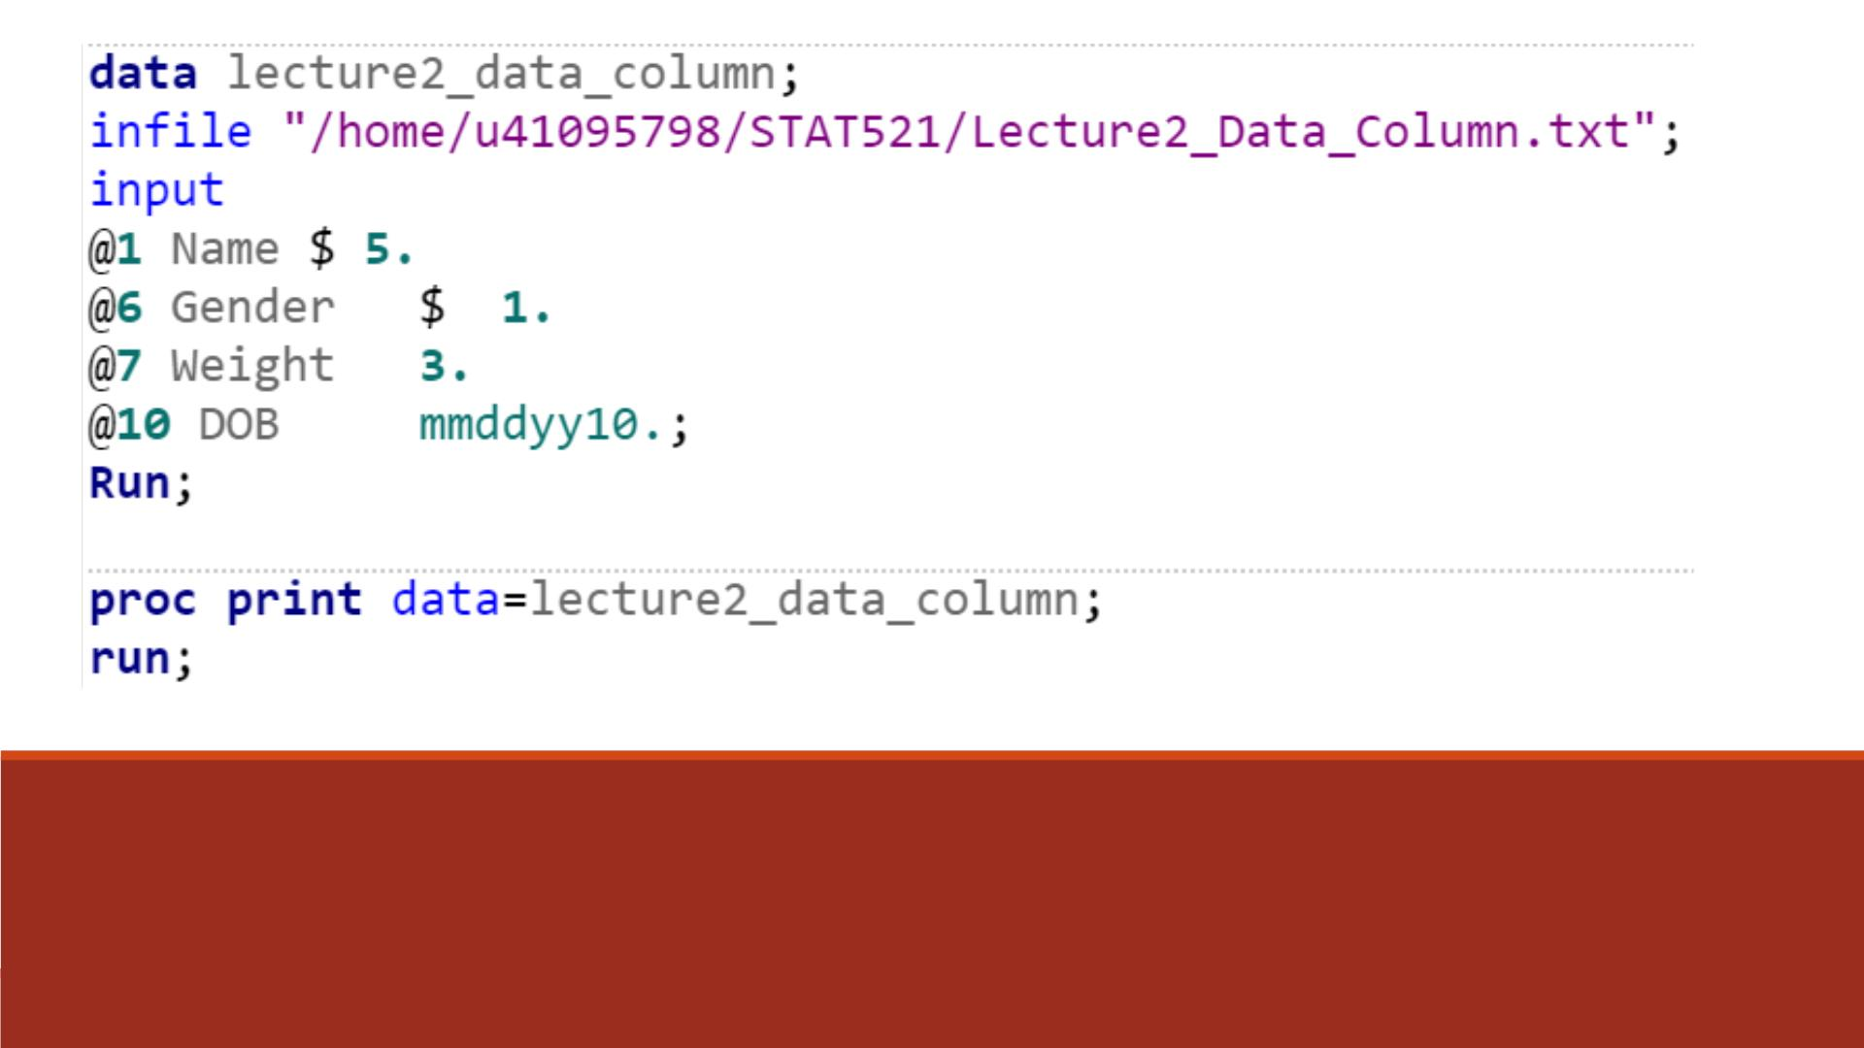
Previous Exercise with SAS Informat
Use @ to point to the starting column, followed by informat for each variable

Slide 42
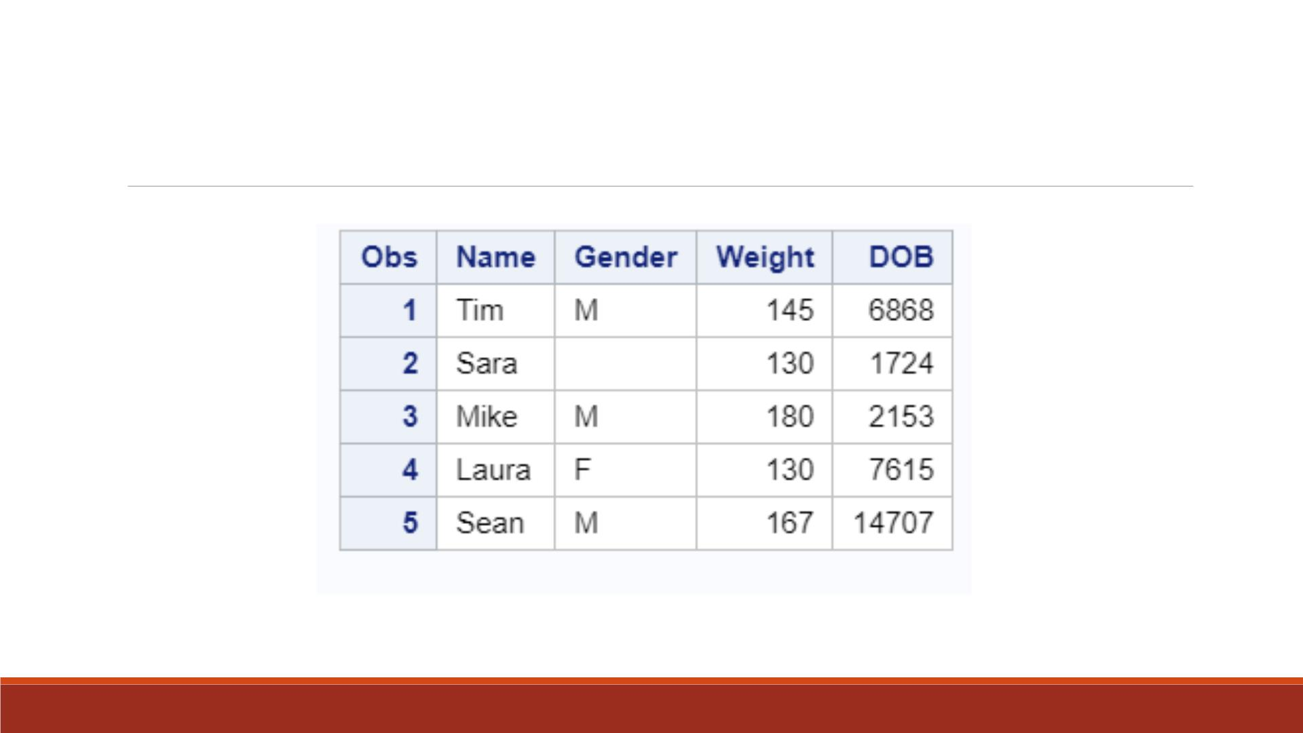
Proc Print Result
Note: DOB is in standard numeric values!

Slide 43
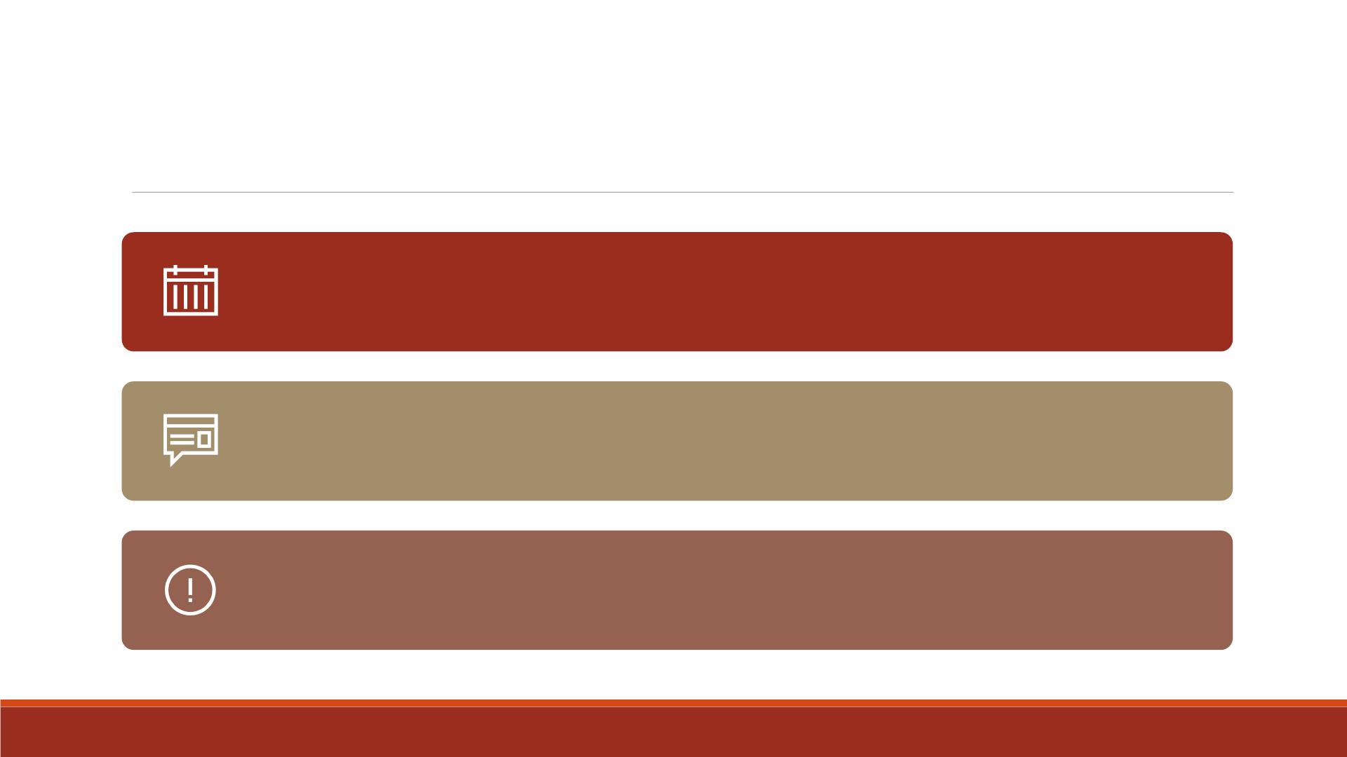
SAS Dates
SAS stores dates as numeric values equal to the number of days
from January 1, 1960.
If you read the value 01/01/1960 with the MMDDYY10. informat,
SAS stores a date value of 0.
The date 01/02/1960 read with the same informat would result in
a SAS date value of 1, etc.

Slide 44
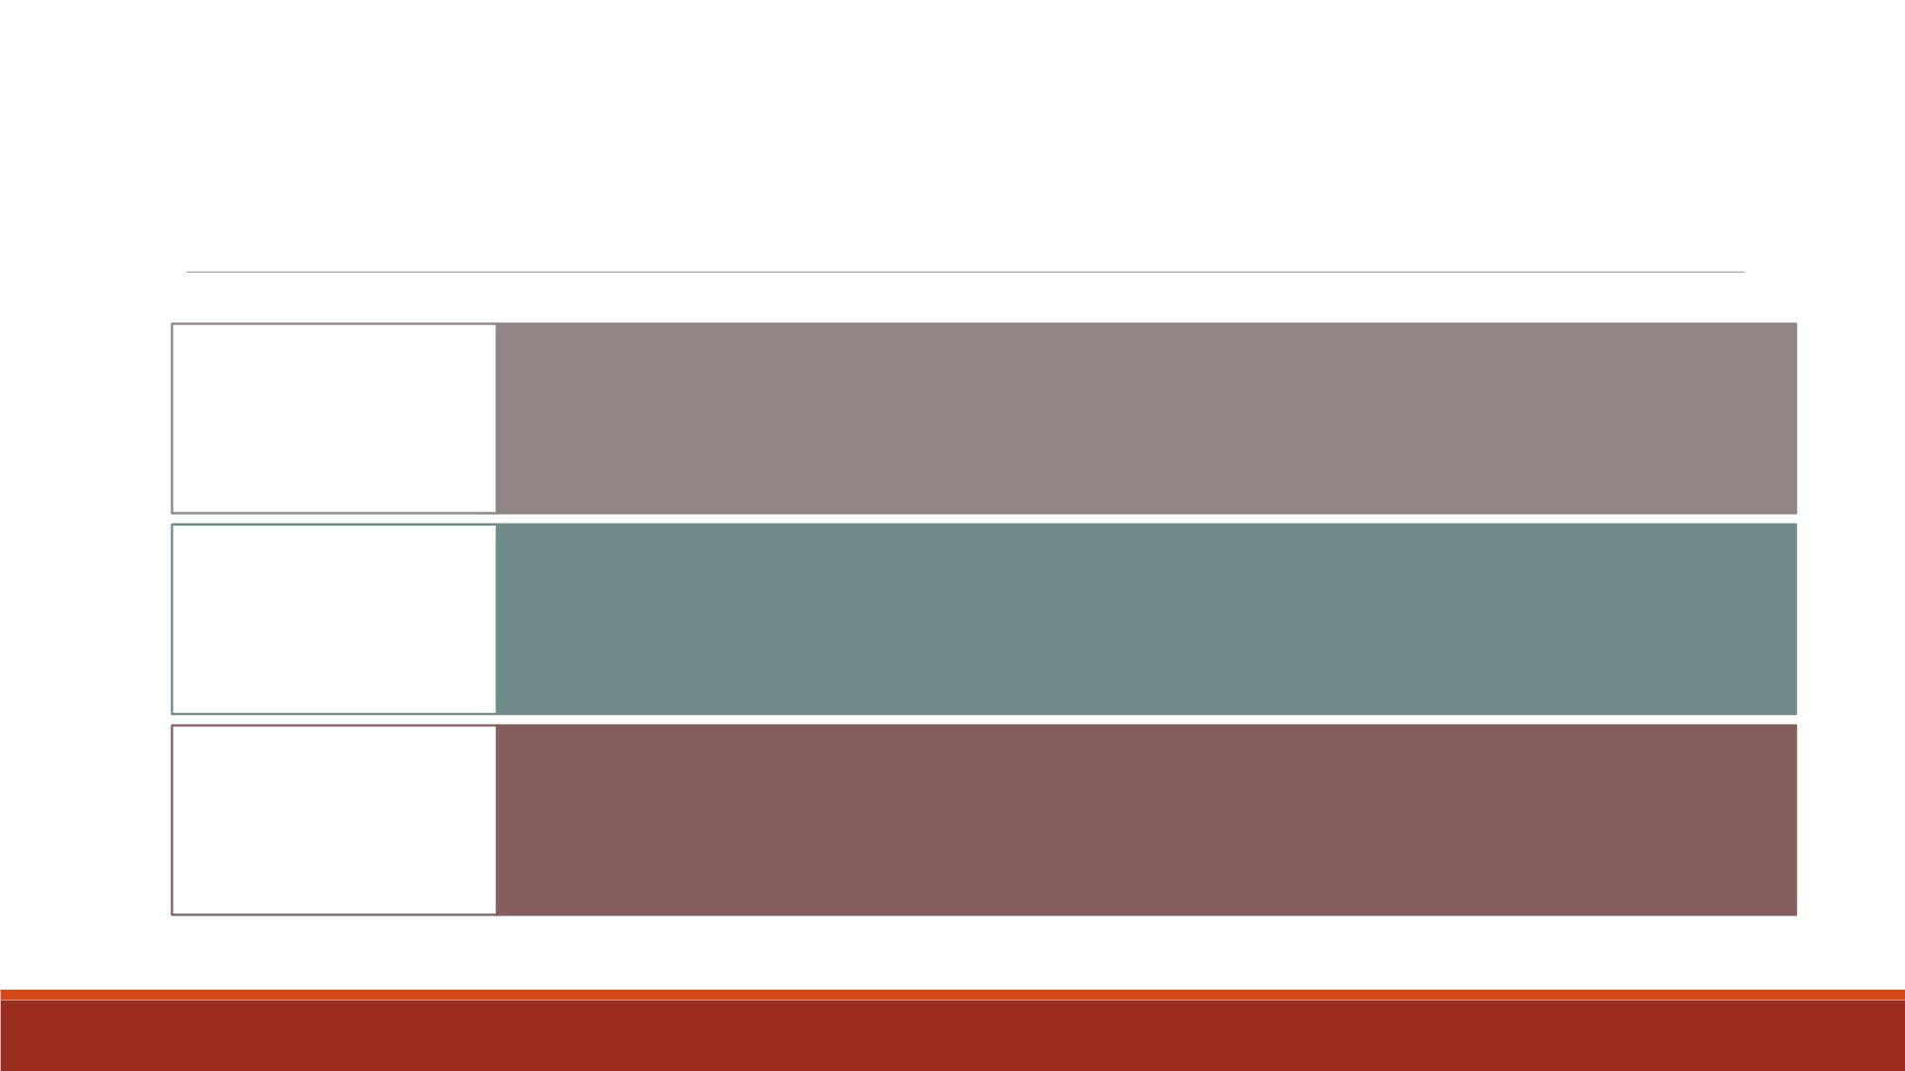
Use SAS Format to Display Dates
date9.
Display dates in ddmmmyy format, e.g. 18AUG2000
Display dates in mm/dd/yyyy format, e.g. 08/18/2000
Display dates in mm/dd/yy format. e.g. 08/18/00
mmddyy10.
mmddyy8.

Slide 45
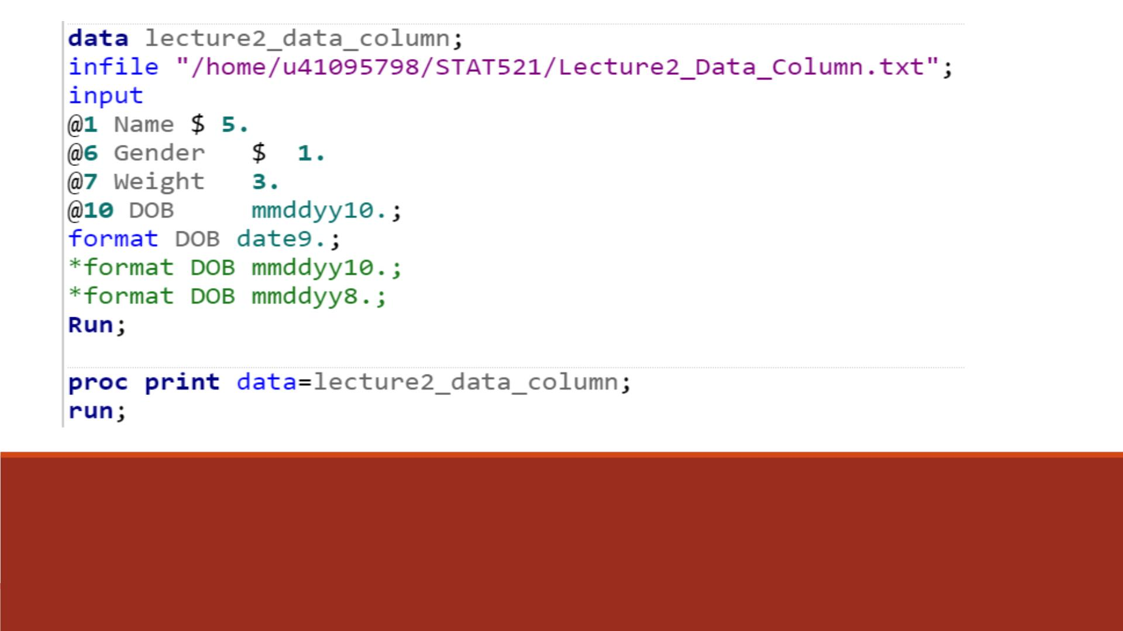
SAS Format in D ATA Step
Note: Run the three format lines
respectively and compare the results.

Slide 46
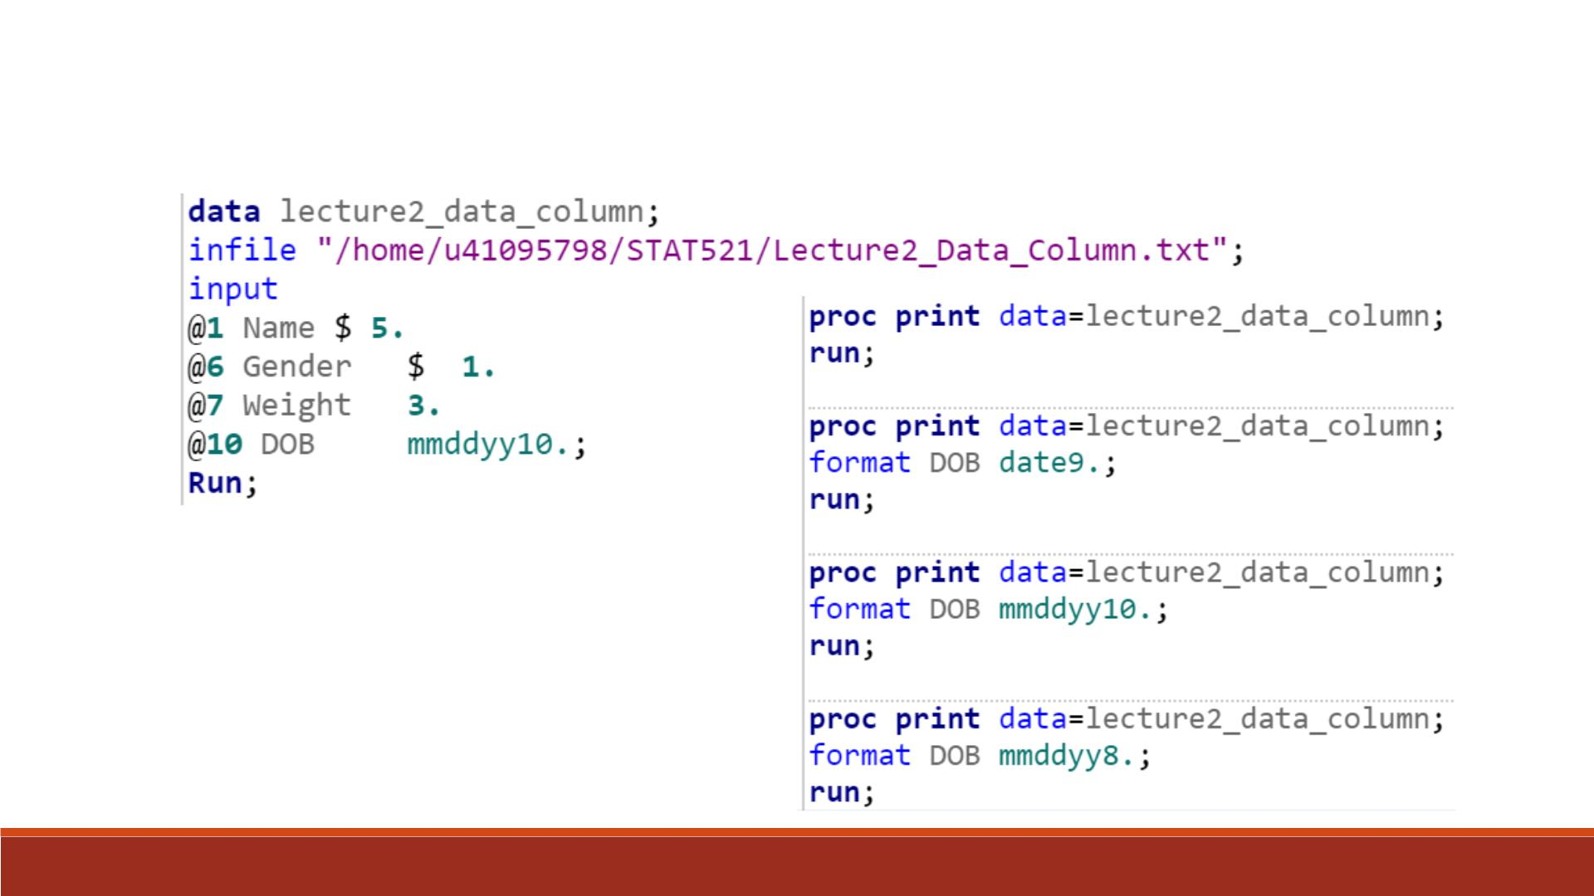
SAS Format in Proc Print

Slide 47
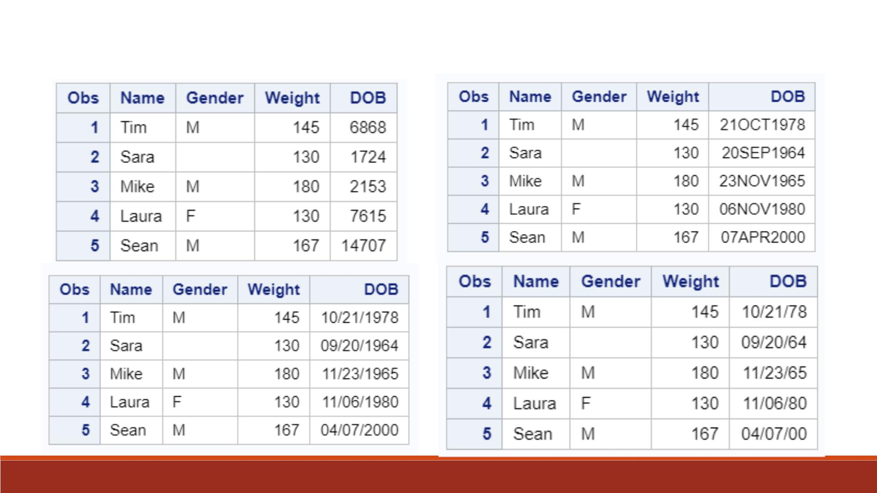
Results from 4 Proc Print

Slide 48
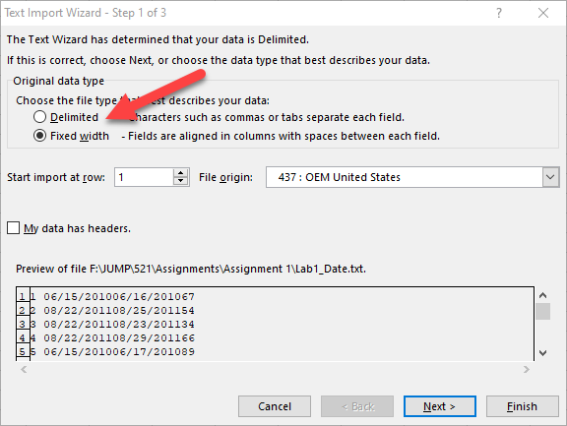
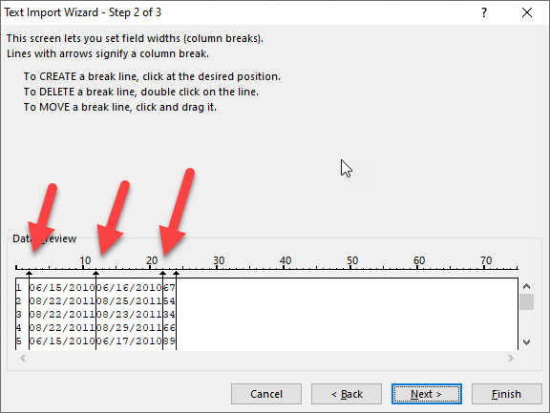
Easy/lazy way to read date
Open the text in Excel
Choose Fixed width
Define the separator

Slide 49
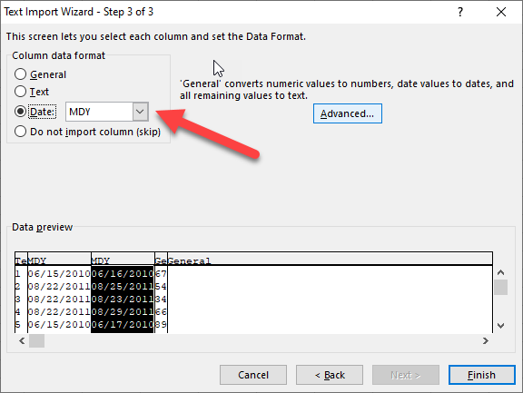
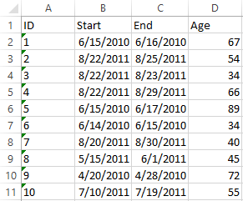
Easy/lazy way to read date
Specify the date variable
Name the header of each variable
Save the file and it is ready to be imported into any program.

Slide 50

DATALINES Statement
Read instream data
Create data and test
Rather than data
that is stored in
an external file
lines that you enter
directly in your SAS
program
your programming
statements on a few
observations

Slide 51
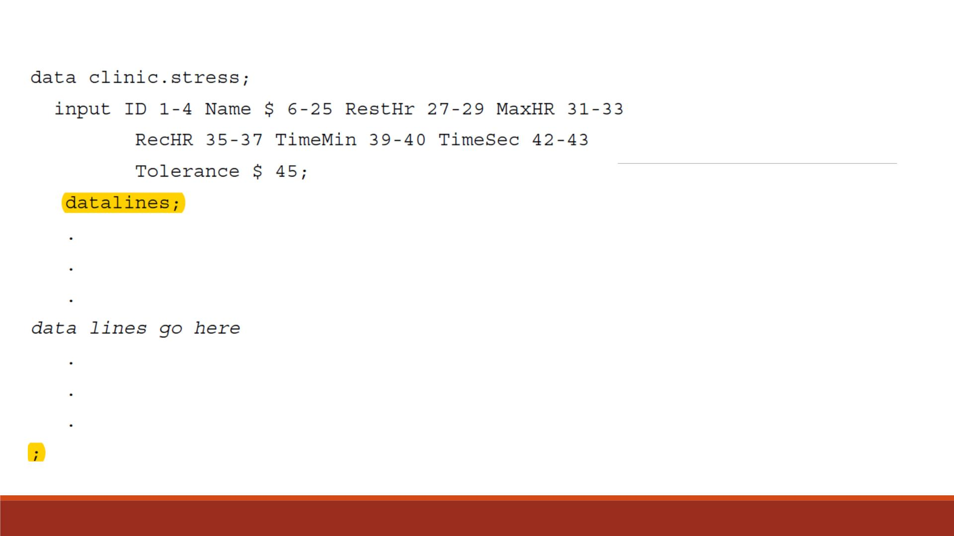
DATALINES
Example
Note: A null statement (a
single semicolon) is used to
indicate the end of the input
data, which must be placed
at a new line.

Slide 52
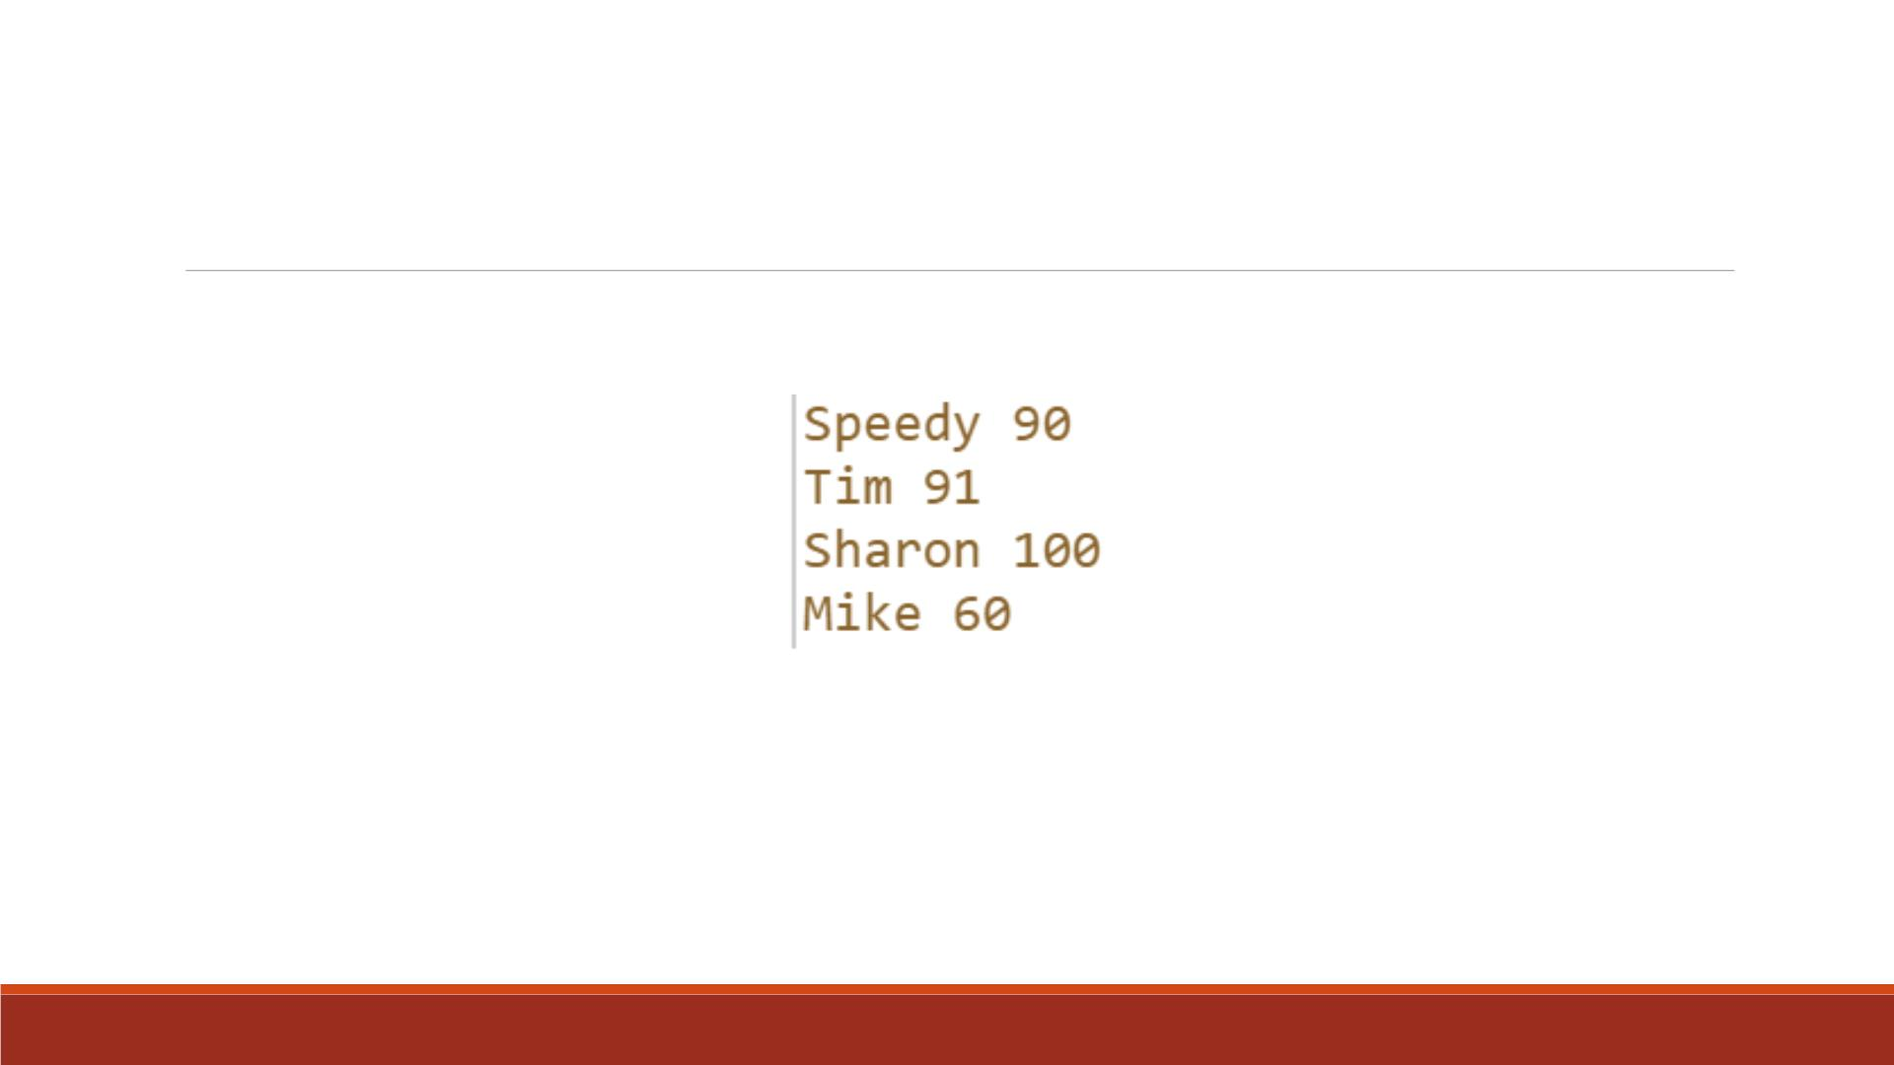
Exercise--DATALINES
▪Use DATALINES statement to enter the following data into SAS
▪Name the two variables as “stu_name” and “math_score”
▪Name the dataset as “lecture2_stu_math”
▪Print the dataset

Slide 53
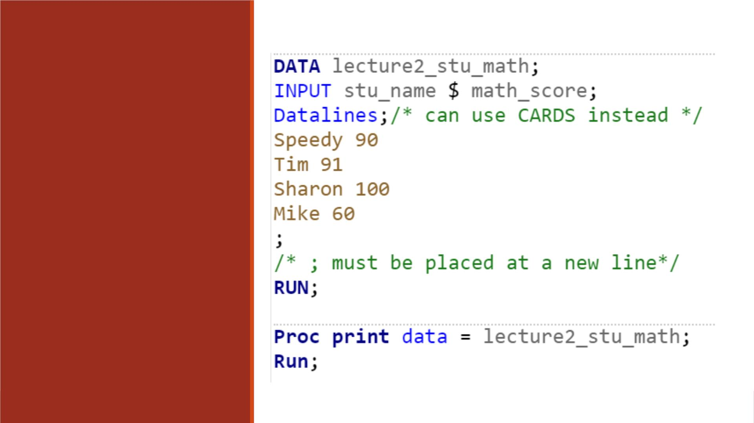
Code
DATALINES can be
replaced as CARDS.

Slide 54

SAS dataset names have two-parts:
SAS
Datasets
and
Libraries
libref.dataset-name
• libref (short for library reference):
The name of the library, SAS datasets are stored in
libraries.
• dataset-name:
Identifies the dataset ’s name that you want

Slide 55

Temporary SAS Datasets
A dataset with a name
without a period
Stored in a SAS default library called
‘WORK’ (created by SAS automatically
every time you open a SAS session)
Example: data test;
data WORK.test;

Slide 56

Permanent SAS datasets:
▪SAS datasets with library name other than ‘WORK’
▪It stays in its library permanently when the current SAS session is closed.
Create
Permanent
SAS
datasets via
LIBNAME
LIBNAME statement:
▪Starts with the LIBNAME keyword
▪Followed by the library name (libref)
▪The library name (libref) must not be more than 8 characters in length
and must be a valid SAS name.
Library directory
▪After the library-name, the directory of the library is written in quotes.
▪Run the same LIBNAME statement in a SAS new session to use the
permanent SAS datasets

Slide 57

Review of Valid SAS Names
Names must be 32 characters or fewer in length.
Names must start with a letter or an underscore _
Names can contain only letters, numbers, or underscores _
Names can contain upper-and lowercase letters. SAS is insensitive to cases,
e.g. ‘score’ is same as ‘Score’ to SAS.

Slide 58
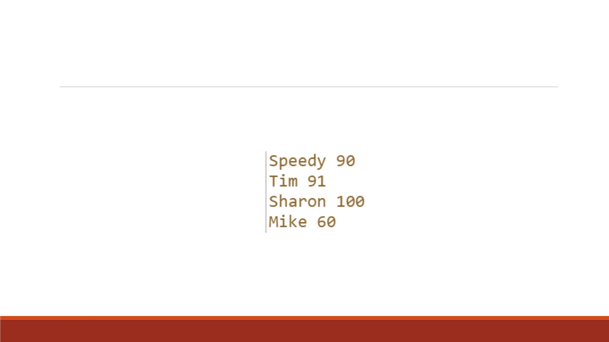
Exercise—Create a Permanent Dataset
▪Create a library named “score”
▪Enter the following data values into a SAS dataset named “lecture2_stu_math”, which is stored
in library “score”
▪Name the variables as “stu_name” and “math_score”
▪Print the result

Slide 59
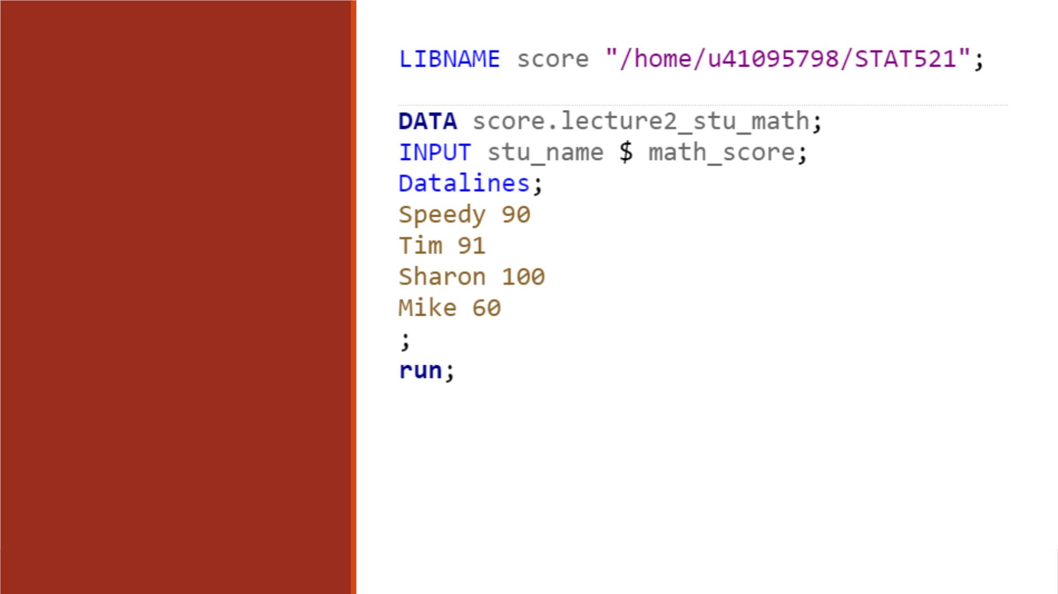
Create a
Permanent
Library
Note:
▪ Select a folder for the library named “score”.
Remember to use your own path.
▪ LIBNAME statement here creates a new library.
▪ Need to use a two-level name for the dataset.

Slide 60
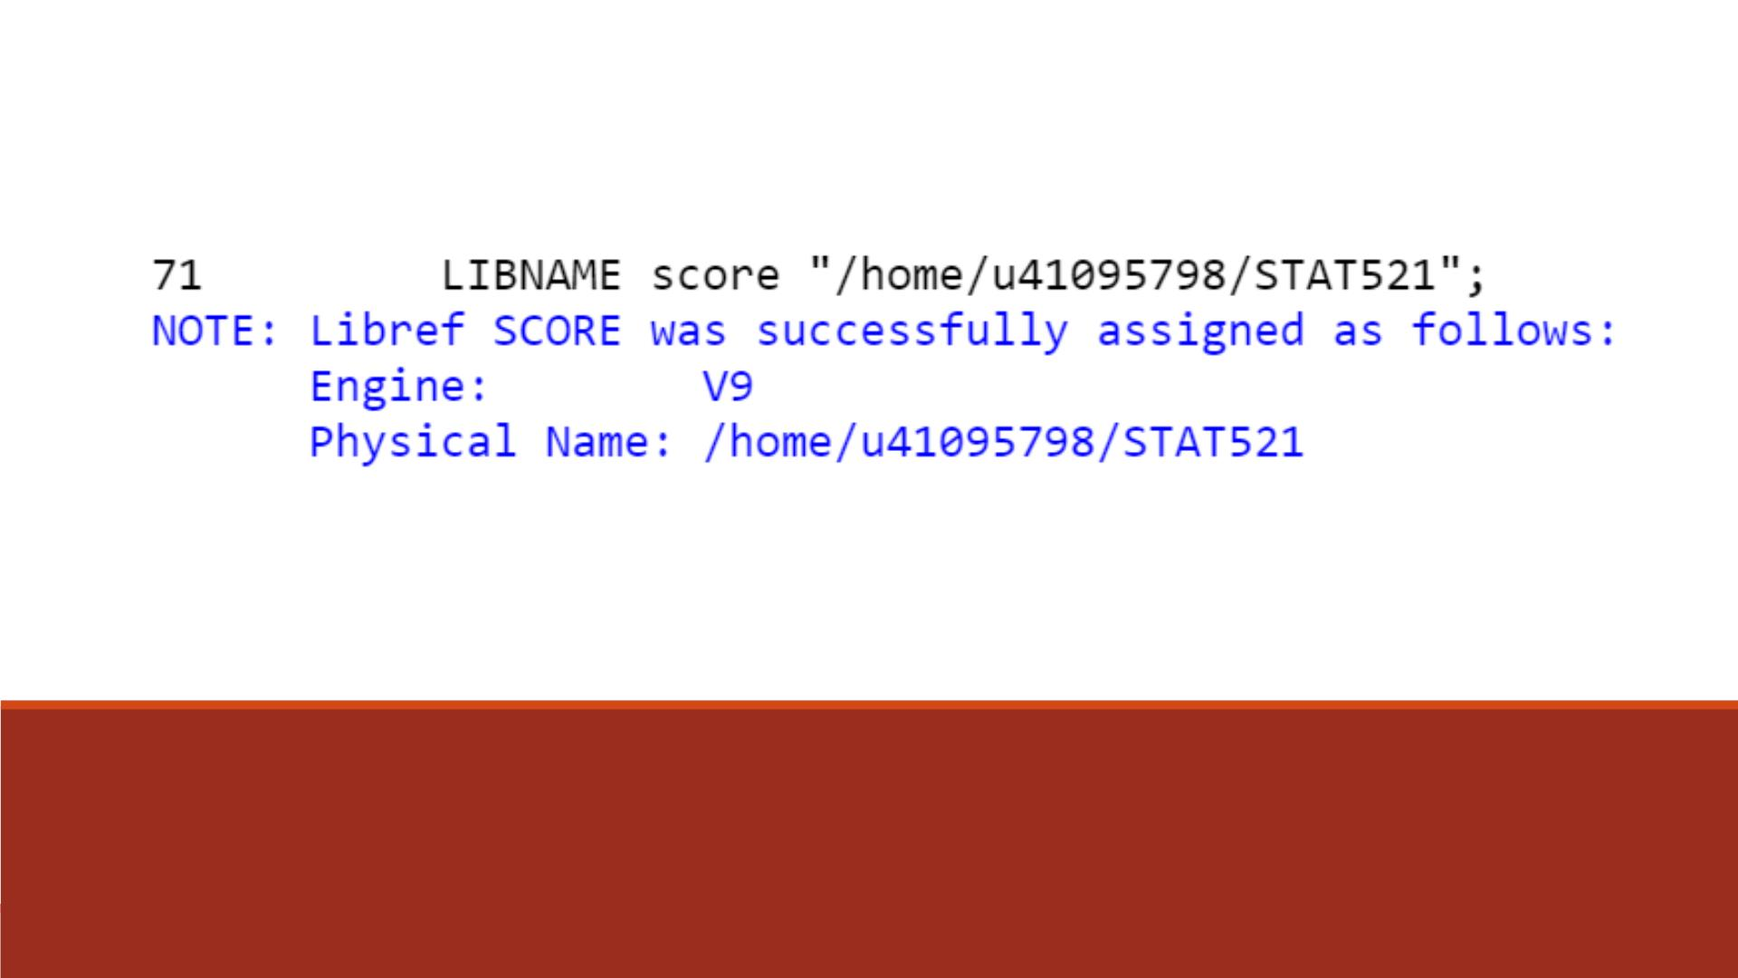
Log Message

Slide 61
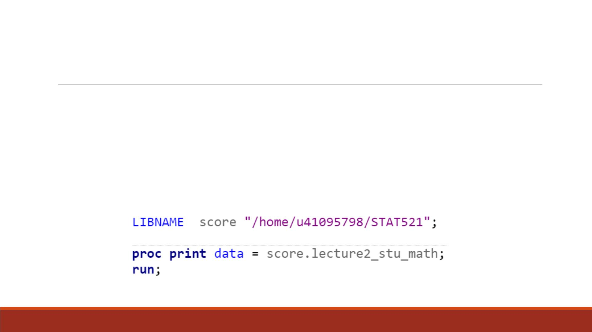
Refe r to the Permanent Dataset
▪Sign out of SAS Studio and sign back in
▪Need to use LIBNAME statement to refer to the permanent library first, then use
the dataset saved inside.
▪LIBNAME statement here searches for the earlier created library.

Slide 62

Proc Print
Result

Slide 63
PROC IMPORT DATAFILE = 'filename' OUT = data-set
DBMS = option REPLACE;
▪Datafile= ‘filename’: ‘filename’ specifies the complete path and filename
that is read into SAS.
Proc Import
▪Out = Data-set: Data-set is the name of the SAS data set you want to
create from reading in the Excel file.
▪DBMS=option: The type of Excel file to read. E.g. If an excel file has .xlsx
as its file extension, DBMS = XLSX. (Database management system)
▪The REPLACE option: Replace the SAS data set named in the OUT= data-
set option if it already exists. You often need to read updated data to
replace the older versions.

Slide 64

SHEET = "sheet-name";
If you have more than one sheet in your Excel file, specify which
sheet to read.
Optional
Statements
RANGE = "sheet-name$UL:LR";
If you want to read only specific cells in the sheet, you can specify a
range (upper-left and lower-right cells).
GETNAMES = NO;
By default, PROC IMPORT takes the variable names from the first row
of the spreadsheet. You can add this statement to change default.

Slide 65
Exercise—Proc Import
Use PROC IMPORT to enter data values in the Excel file “Lecture2_Proc_Import_Data”
1. Use PROC IMPORT without any optional statement, name the imported dataset as
“lecture2_excel_data1”
2. Use PROC IMPORT without getting variable names, name the imported dataset as
“lecture2_excel_data2”
3. Use PROC IMPORT to enter data from “name_class” sheet, name the imported dataset
as “lecture2_excel_data3”
4. Use PROC IMPORT to enter data from “name_class” sheet from A1 to B6 fields, name
the imported dataset as “lecture2_excel_data4”
5. Print the above 4 datasets and compare

Slide 66

Code

Slide 67

Code

Slide 68

Proc Print Results

Slide 69


Import Excel by Drag n Drop
Upload the Excel file to SAS on Demand (SAS Studio). You can put it under “Files”.
Open a new program or a new SAS program or new import data.

Slide 70

Import Excel by Drag n Drop
Drag the file the blank canvas.

Slide 71


Import Excel by Drag n Drop
The SAS program has been written for you!
Run it and it is done!
Is it cheating? No, this is efficient programming.

Slide 72


Import Excel by Point n Click
It works if and only if your MS Excel is a 64-bit version.
It does not work with 32-bit Excel.

Slide 73

Point and click: JMP to SAS
Debugging a program can be frustrating.
There are alternate ways.
While in Excel, Use JMP as the bridge

Slide 74


Point and click
No need to specify the connection to SAS.
JMP can automatically recognize your SAS program.

Slide 75

Point and click
Select a SAS library e.g. SASuser
Click Export
Go back to SAS and the data file is there.

Slide 76

Save as
In JMP you can save data as a SAS file.
But you need to set up a library pointing to the location of the SAS file e.g. libname alexyu “f:\sasfile”;

