Slide 1

Working with D ata in SAS

Slide 2

Outline
ASSIGNMENT
STATEMENTS
SAS FUNCTIONS
IF-THEN
STATEMENT
IF-THEN-ELSE
STATEMENT
Reading: Base Exam
Guide (past version)
Ch11, Ch15, Ch16
IF-THEN-DELETE
STATEMENT
ONE-DIMENSIONAL
ARRAYS
ARRAYS WITH DO
LOOPS

Slide 3

Assignment Statements

Slide 4
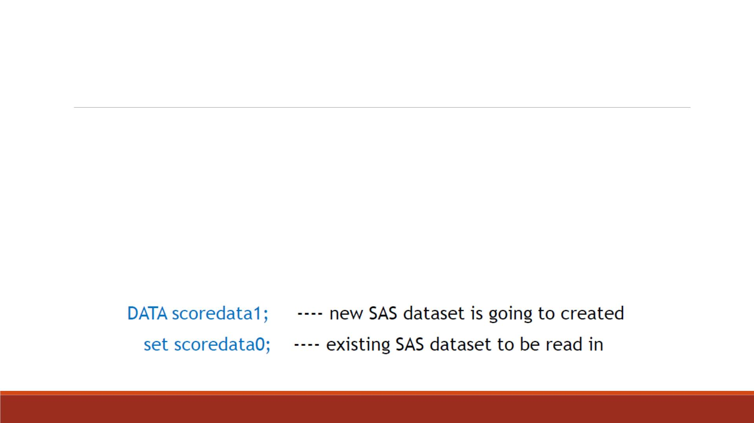
SET Statement
▪SAS data sets can also be used as input to a D ATA step.
▪For example, we want to use the information in an existing SAS data set to compute
new variables.
▪We can use SET statement to read in observations from an existing SAS dataset.

Slide 5

The basic form of the assignment statements:
Assignment
Statements
variable = expression;
On the left: a variable name, either a new or an existing
variable in the current dataset
On the right: a constant, another variable, or a
mathematical expression

Slide 6
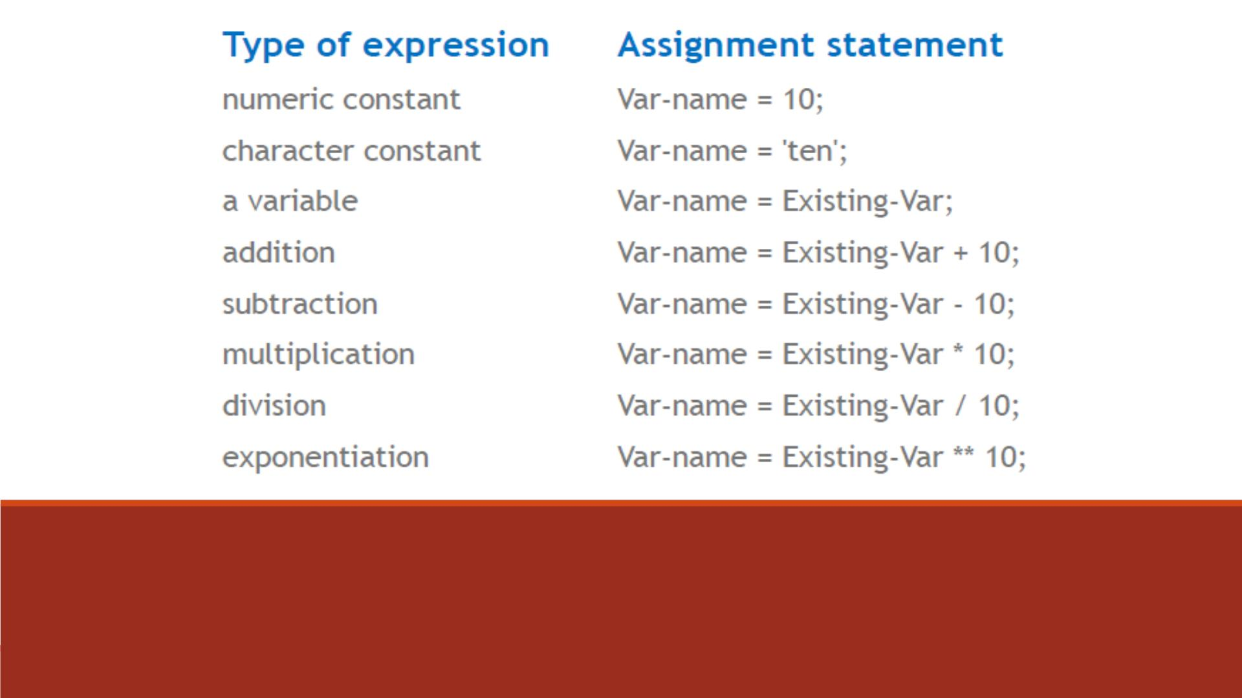
Examples of Assignment Statements
Note: Using “10” as an example

Slide 7
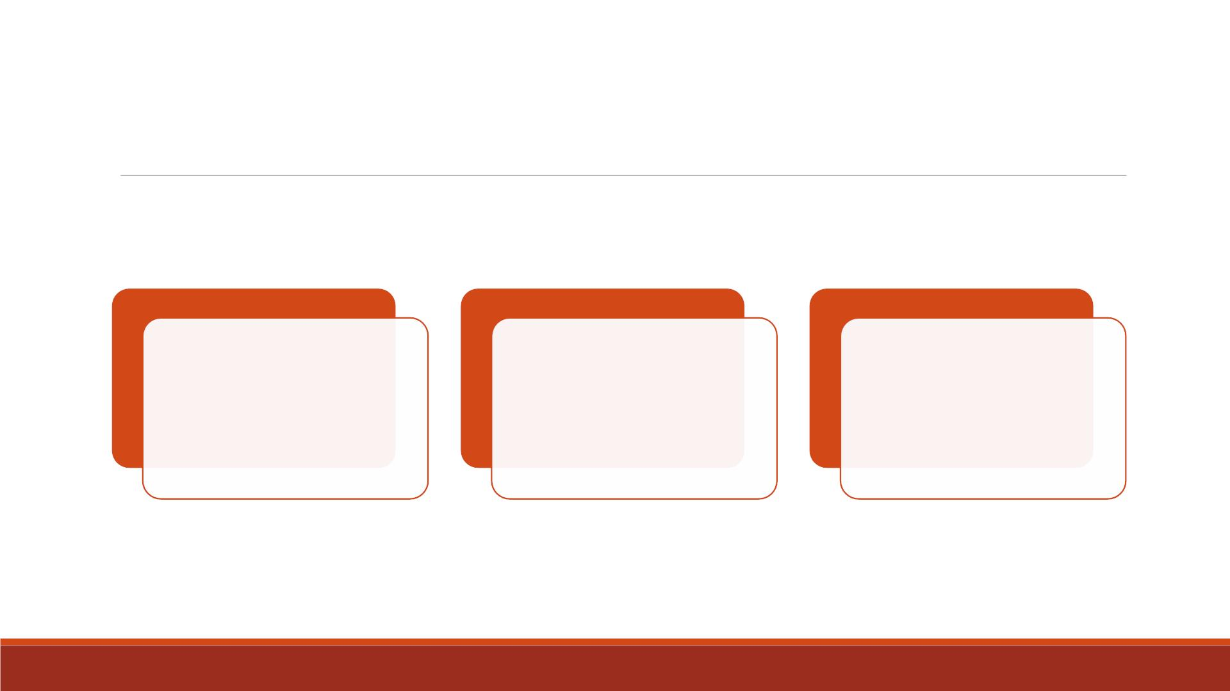
SAS Variables
Whether the variable
Va r is numeric or
character depends on
the expression that
defines it.
When the expression is
numeric, Var will be
numeric.
When it is character,
Var will be character.

Slide 8

SAS Computation
When deciding how to interpret your expression, SAS follows the standard mathematical rules
to precede:
1. SAS performs exponentiation first
2. then multiplication and division
3. followed by addition and subtraction
You can use parentheses to override that order, which makes programs will be easier to read.

Slide 9

Exercise—SET and Assignment
▪Import the dataset “Lecture3_score_data.xlsx” into SAS
▪Name the imported dataset as “lecture3_scoredata0”
▪Create a new SAS dataset named “lecture3_scoredata1” by
1. Adding a new numeric variable “Grade” equals “7”
2. Adding a new character variable “ScoreType” equals “Math Scores”
3. Compute the total score of “score1-3”, name as “TotalScore”
4. Compute the average score of “score1-3”, name as “AverageScore”
▪ Print the new dataset “lecture3_scoredata1”

Slide 10
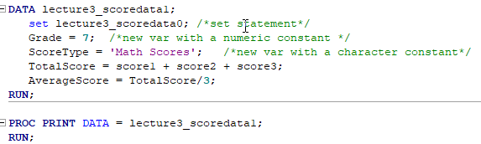
Code

Slide 11
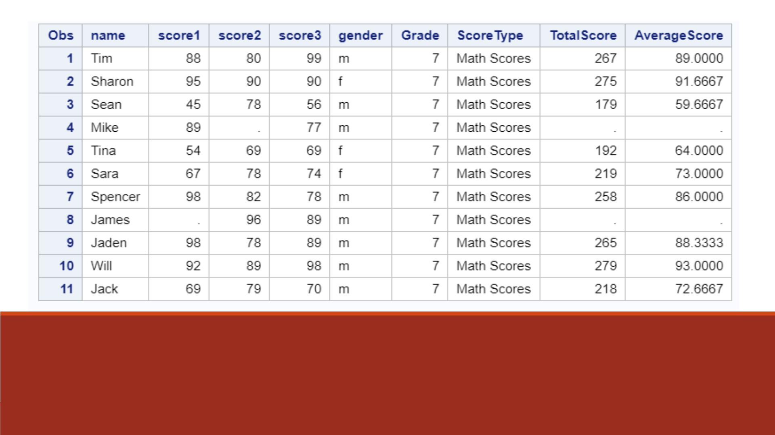
Proc Print Result
Note: “TotalScore” and “AverageScore”
contain missing values.

Slide 12
SAS Functions

Slide 13

SAS functions perform a calculation or transformation on the
arguments given in parentheses following the function name.
General form:
Using SAS
Functions
function-name(argument, argument, ...)
▪All functions must have parentheses
▪Arguments are separated by commas
▪Arguments can be variable names, constant values such as
numbers or characters enclosed in quotation marks, or
expressions

Slide 14
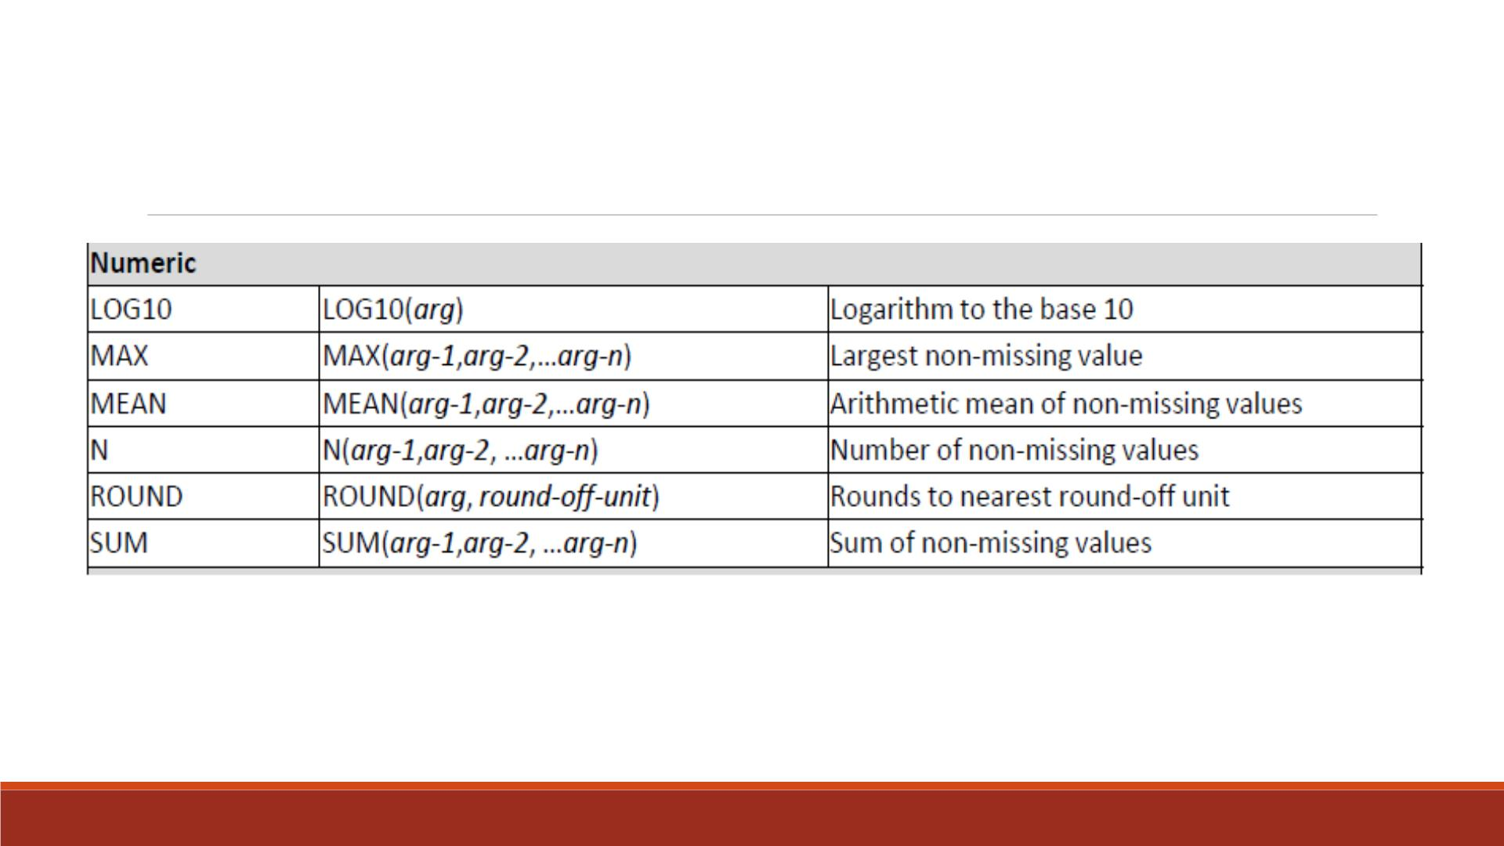
Examples of Numeric Functions
▪ Natural log function: LOG(arg)
▪ Find the minimum: MIN(arg-1, arg-2,…,arg-n)
▪ ROUND(arg, 0.1) means rounding to the nearest one decimal place.

Slide 15
Exercise—Using SUM and MEAN Functions
▪Import the dataset “Lecture3_score_data.xlsx” into SAS
▪Name the imported dataset as “lecture3_scoredata0”
▪Create a new SAS dataset named “lecture3_scoredata2” by
1. Adding a new numeric variable “Grade” equals “7”
2. Adding a new character variable “ScoreType” equals “Math Scores”
3. Compute the total score of “score1-3” using SUM function, name as “TotalScore”
4. Compute the average score of “score1-3” using MEAN function, name as “AverageScore”
▪Print the new dataset “lecture3_scoredata2”

Slide 16
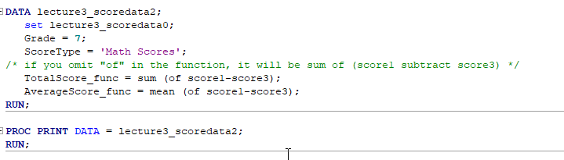
Code

Slide 17
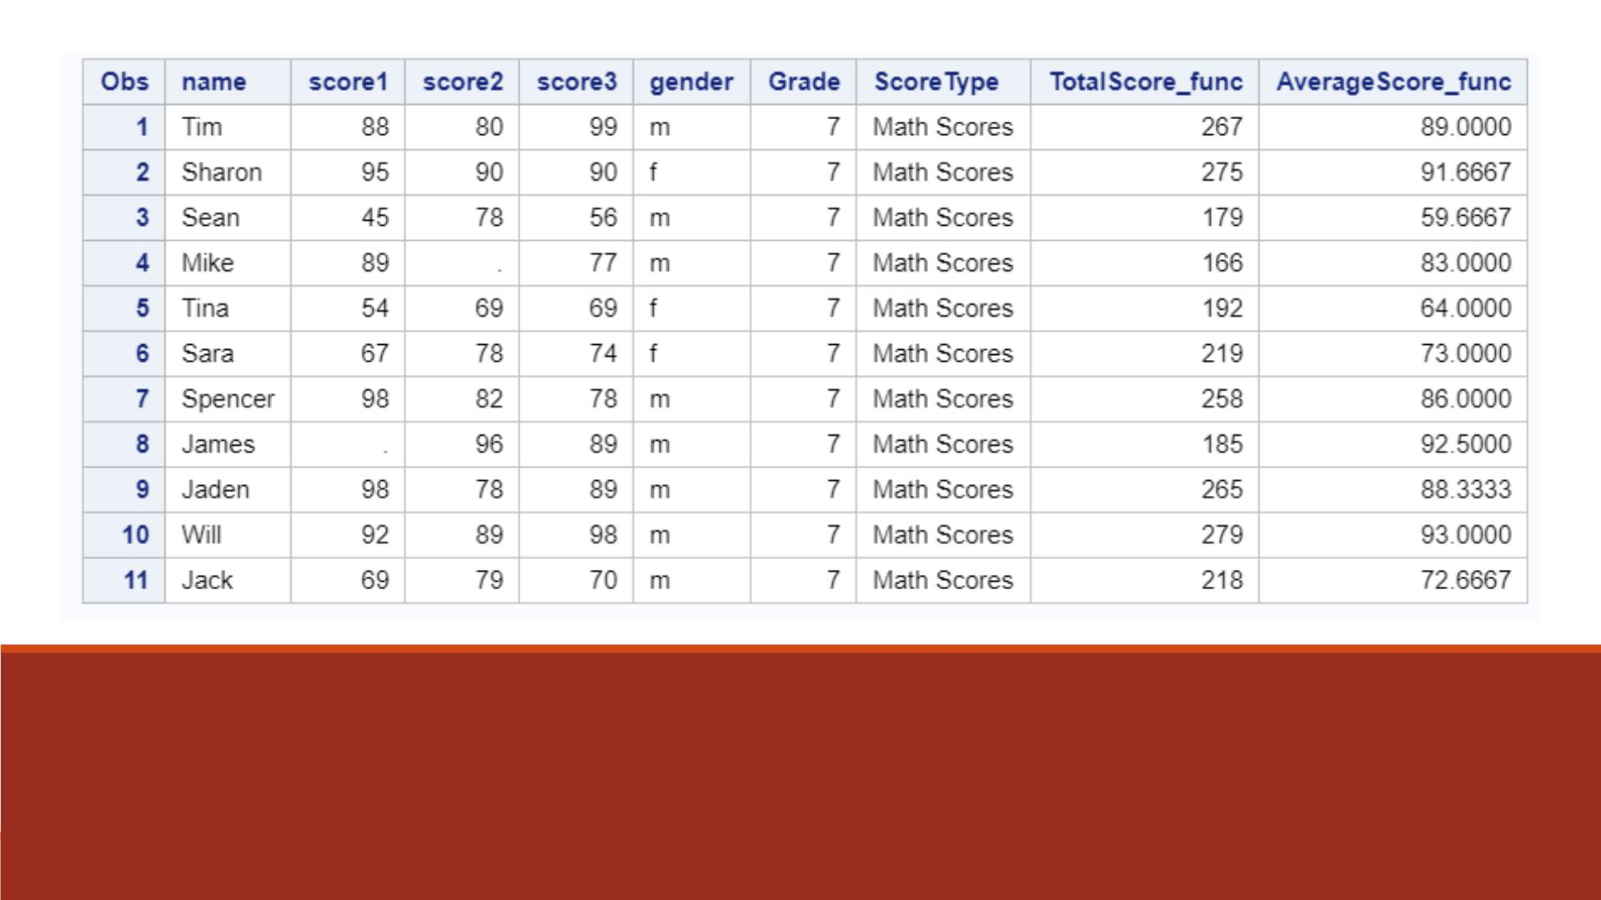
No missing if you use the sum and mean functions
Easier: If there are 10 assignments, you don’t need type each of them. Use score1-score10.
Fairer: If a student misses some assignments (e.g. the instructor drops the lowest grade or allows skipping some assignments), he/she still has a grade.

Slide 18
If-Then Statement

Slide 19

Conditional processing allows programs to make decisions
based on data values, general form:
IF-THEN
Statements
IF condition THEN action;
The condition is an expression comparing one thing to
another.
The action is what SAS should do when the expression is
true, often an assignment statement.

Slide 20

If gender = ‘m’ then gender_num= 1;
IF-THEN
Example
This statement tells SAS to set the variable
“gender_num” equal to 1 whenever the variable
“gender ” equals “m”.

Slide 21
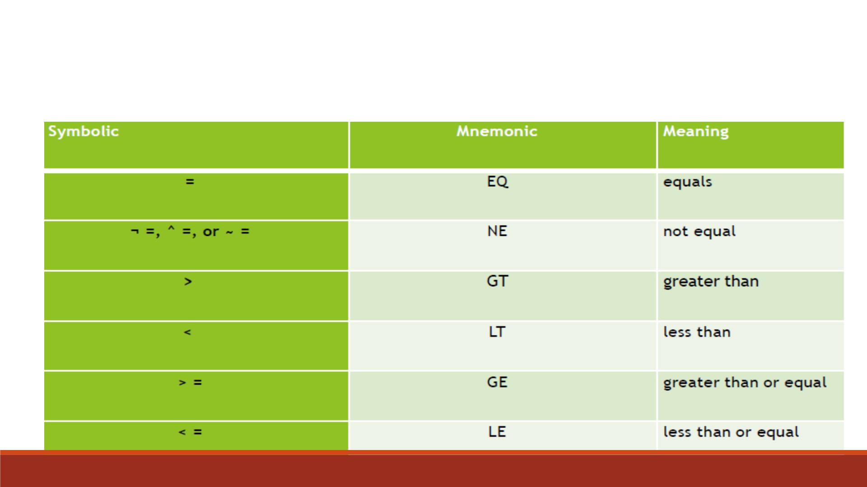
Comparison
Operator
▪The terms on either side of the comparison may be constants,
variables, or expressions.
▪Comparison operators may be either symbolic or mnemonic.

Slide 22
IN Operator
▪The IN operator also makes comparisons by comparing the value of a variable to a list of values.
▪Example:
IF type IN (‘apple’, ‘grape’) THEN new_type= ‘fruit’;
▪This statement tells SAS to set the variable “new_type” equal to “fruit” whenever the value of
type is “apple” or “grape”.

Slide 23
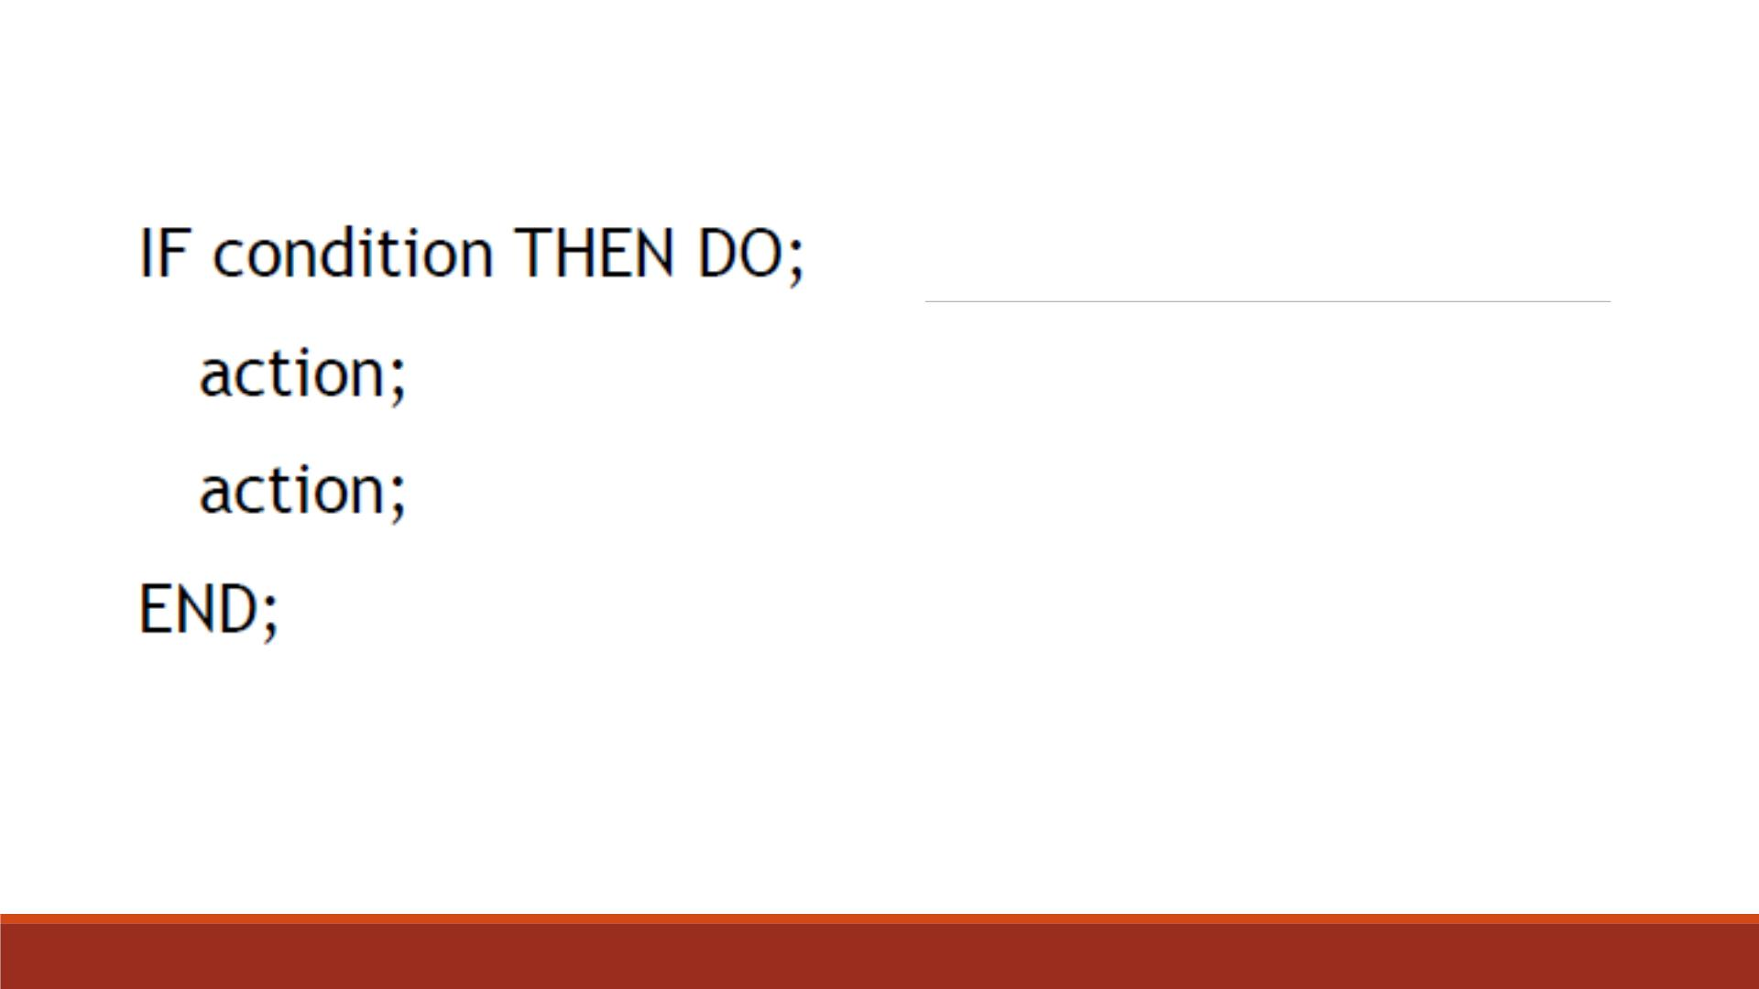
IF-THEN DO; END;
▪A single IF-THEN statement can have only one action.
▪Adding the keywords DO and END, we can execute
more than one action.
▪The DO statement causes all SAS statements coming
after it to be treated as a unit until a matching END
statement appears.

Slide 24
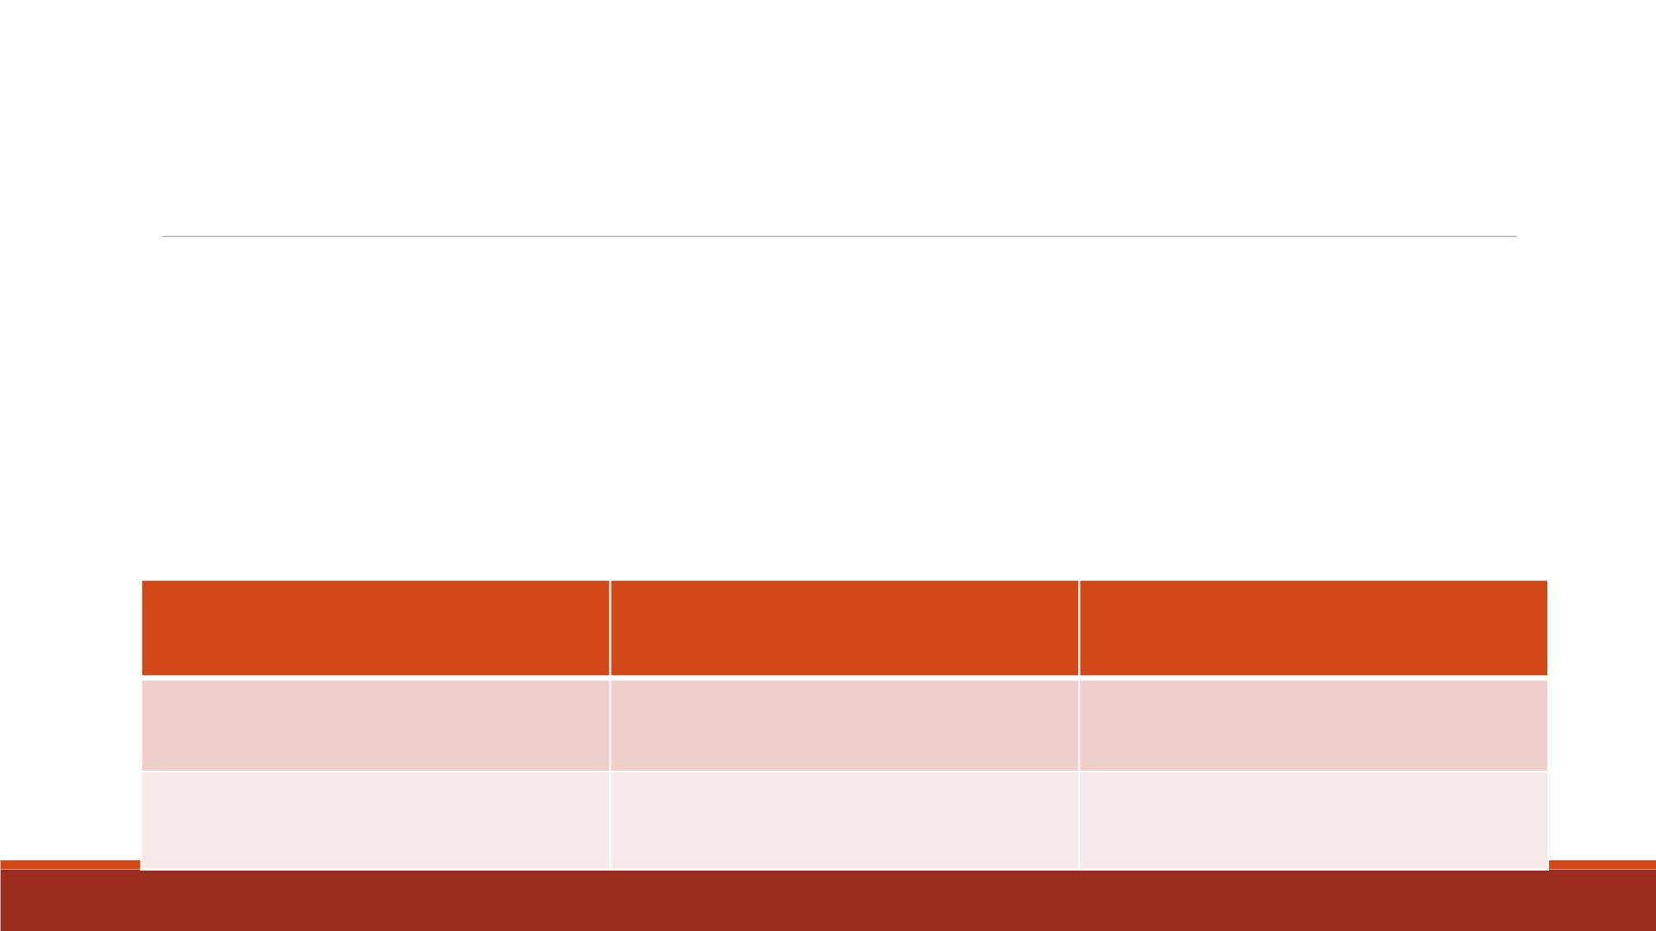
Specifying Multiple Conditions
▪We can also specify multiple conditions with the keywords AND and OR
IF condition AND condition THEN action;
▪For example:
IF score1 NE . AND score2 NE . AND score3 NE . THEN take = ‘complete’;
▪Like the comparison operators, AND and OR may be symbolic or mnemonic:
Symbolic
&
Mnemonic
AND
Meaning
All comparisons must be true.
Only one comparison must be
true.
|, or !
OR

Slide 25
Exercise—IF-Then Statements
▪Import the dataset “Lecture3_score_data.xlsx” into SAS
▪Name the imported dataset as “lecture3_scoredata0”
▪Create a new SAS dataset named “lecture3_scoredata3” by
1. Computing the total score of “score1-3” using SUM function, name as “TotalScore”
2. Computing the average score of “score1-3” using MEAN function, name as “AverageScore”
3. Set “gender_num” variable equal to 1 when “gender” takes value “m”
4. Set “take” variable equal to “complete” when none of “score1-3” is missing
5. Set “grade” variable equal to “A ”, “pass” variable equal to “pass” when the average score is at least 90
▪Print the new dataset “lecture3_scoredata3”

Slide 26
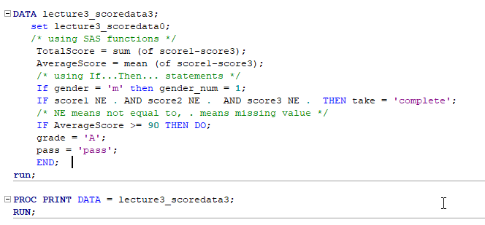
D ATA Step Code

Slide 27
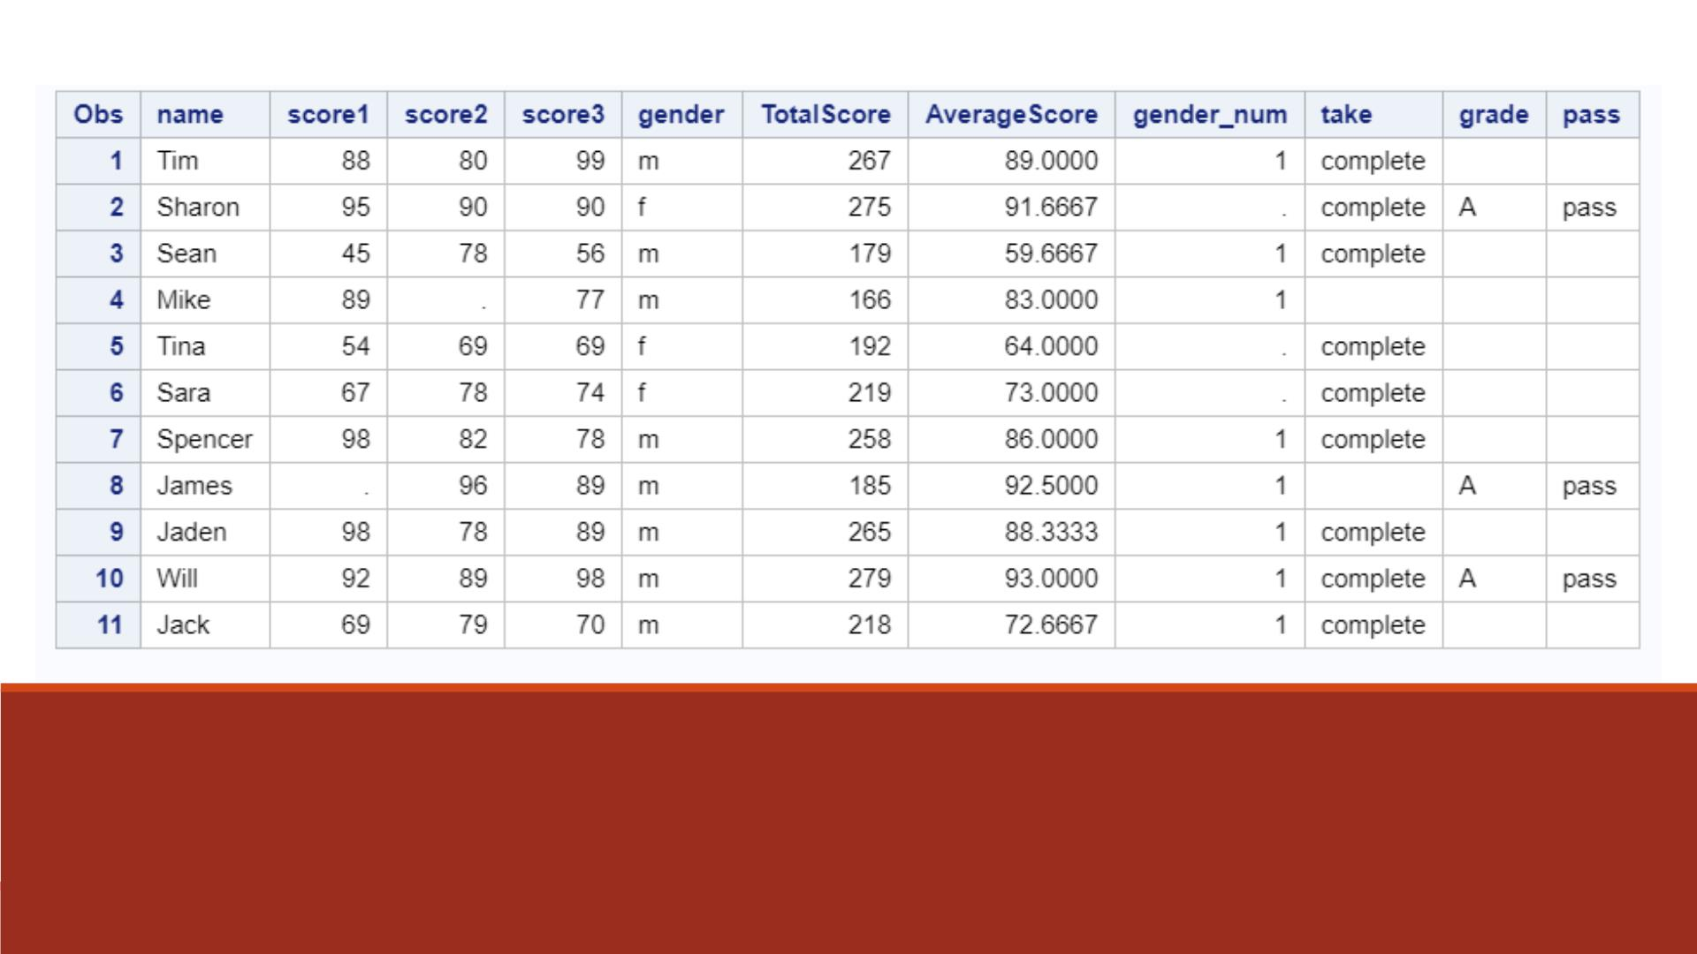
Proc Print Result
Note: The last 4 columns contain missing values.

Slide 28
If-Then-Else Statement

Slide 29
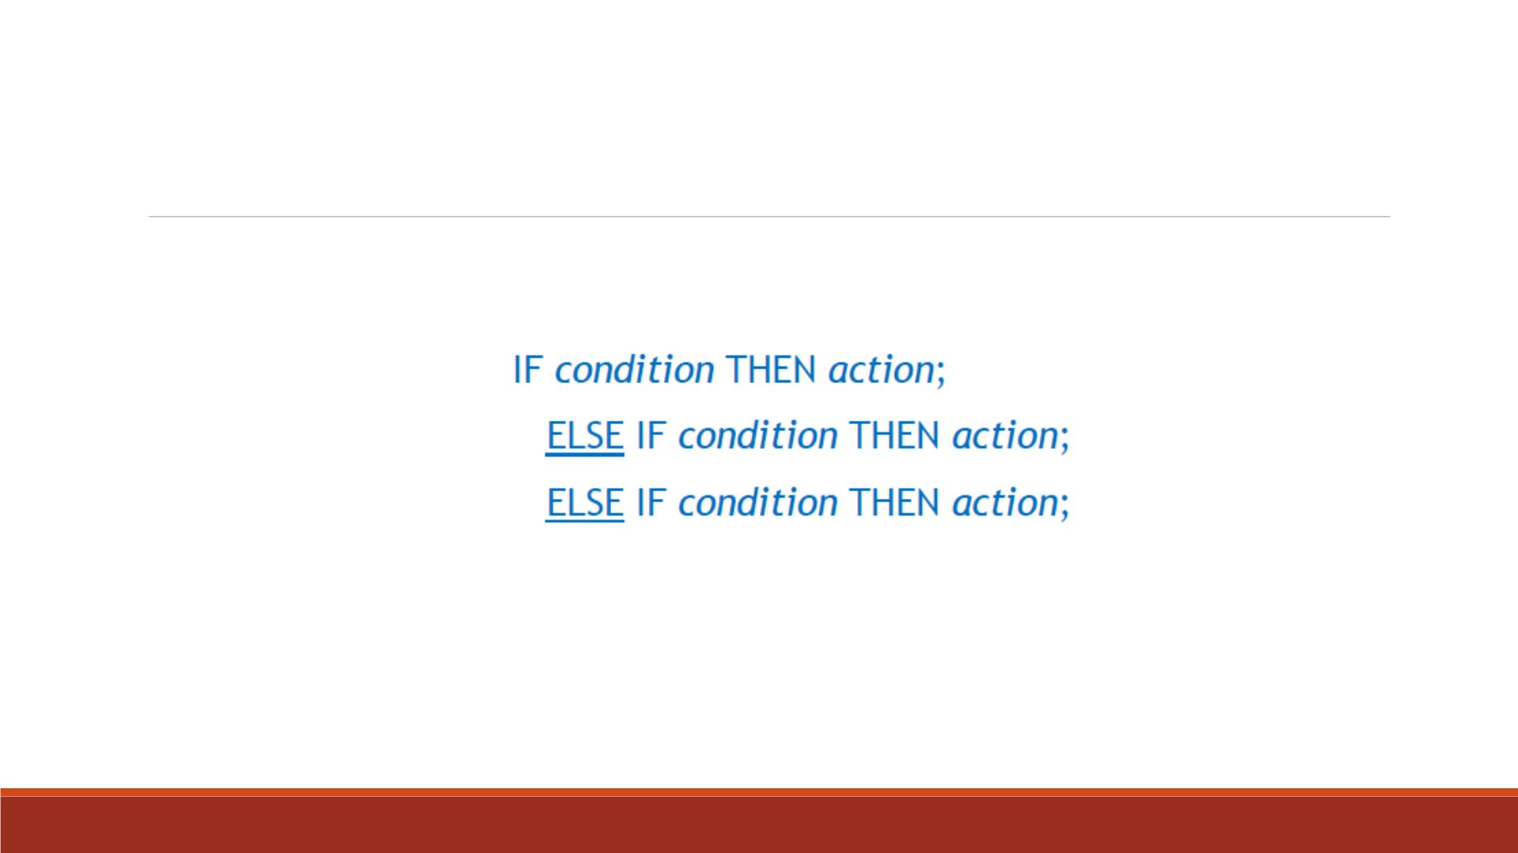
IF-THEN-ELSE
IF-THEN/ELSE logic takes this basic form:
▪Notice that the ELSE statement is simply an IF-THEN statement with an ELSE tacked
onto the front. Yo u can have any number of these statements.

Slide 30
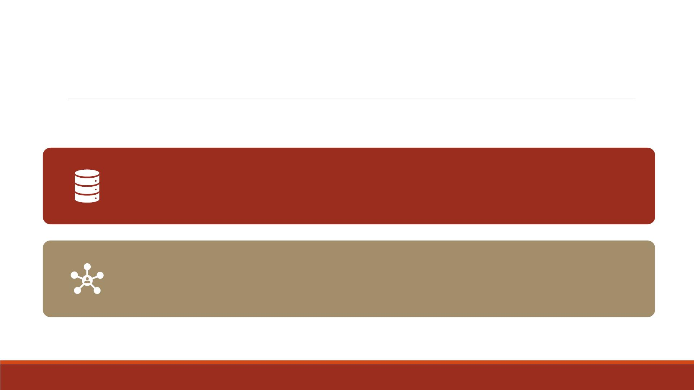
Advantages
It is more efficient, using less computer time. Once an observation
satisfies a condition, SAS skips the rest of the series.
ELSE logic ensures that your groups are mutually exclusive, so you don't
accidentally have an observation fitting into more than one group.

Slide 31
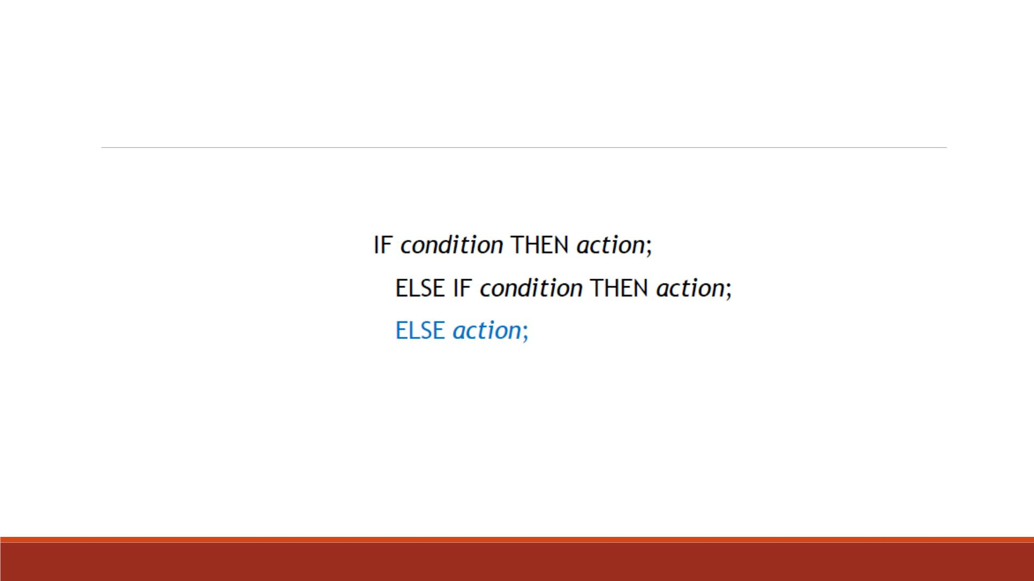
Last ELSE Statement
Please note the final ELSE statement in this series below:
▪An ELSE of this kind becomes a default which is automatically executed for all observations
failing to satisfy any of the previous IF statements.
▪You can only have one of these statements, and it must be the last in the IF-THEN/ELSE series.

Slide 32
Exercise—IF-THEN-ELSE
▪Import the dataset “Lecture3_score_data_miss.xlsx” into SAS
▪Name the imported dataset as “lecture3_scoredata0”
▪Create a new SAS dataset named “lecture3_scoredata4” by
1. Computing the total score of “score1-3” using SUM function, name as “TotalScore”
2. Computing the average score of “score1-3” using MEAN function, name as
“AverageScore”

Slide 33
Exercise—IF-THEN-ELSE
3. Set “gender_num” variable equal to 1 when “gender” takes value “m”;
set “gender_num” variable equal to 0 when “gender” takes value “f ”;
set “gender_num” variable equal to . when “gender” takes all other values.
4. Set “take” variable equal to “complete” when none of “score1-3” is missing;
set “take” variable equal to “incomplete” for all other cases.

Slide 34
Exercise—IF-THEN-ELSE
5. Set “grade” variable equal to “A ”, “pass” variable equal to “pass” when 푎푣푒푟푎푔푒 푠푐표푟푒 ≥ 90;
set “grade” variable equal to “B”, “pass” variable equal to “pass” when 80 ≤ 푎푣푒푟푎푔푒 푠푐표푟푒 < 90;
set “grade” variable equal to “C ”, “pass” variable equal to “pass” when 70 ≤ 푎푣푒푟푎푔푒 푠푐표푟푒 < 80;
set “grade” variable equal to “D”, “pass” variable equal to “pass” when 60 ≤ 푎푣푒푟푎푔푒 푠푐표푟푒 < 70;
set “grade” variable equal to “F”, “pass” variable equal to “fail” when 0 ≤ 푎푣푒푟푎푔푒 푠푐표푟푒 < 60;
set “grade” variable and “pass” variable to missing for all other cases.
▪Print the new dataset “lecture3_scoredata3”

Slide 35
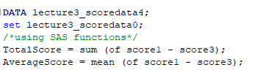

Code—D ATA Step 1-2

Slide 36
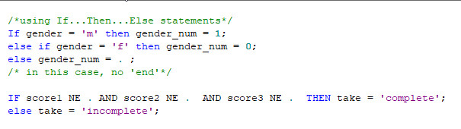

Code—D ATA Step 3-4

Slide 37

Else If averageScore >= 60 then do;
grade = 'D';
pass = 'pass';
END;
Else If 0 =< averageScore < 60 then do;
grade = 'F';
pass = 'fail';
END;
ELSE DO;
grade = ' ';
pass = ' ';
END;
run;
IF AverageScore >= 90 THEN DO;
grade = 'A';
pass = 'pass';
end; /*in this case, 'end' is needed*/
Else If averageScore >= 80 then do;
grade = 'B';
pass = 'pass';
END;
Else If averageScore >= 70 then do;
grade = 'C';
pass = 'pass';
END;
Code—D ATA Step 5

Slide 38
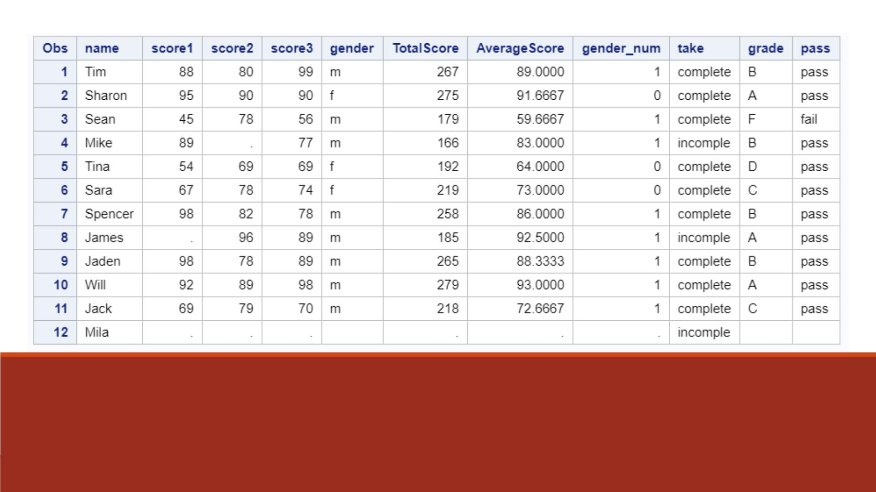
Proc Print Result

Slide 39
If-Then-Delete Statement

Slide 40
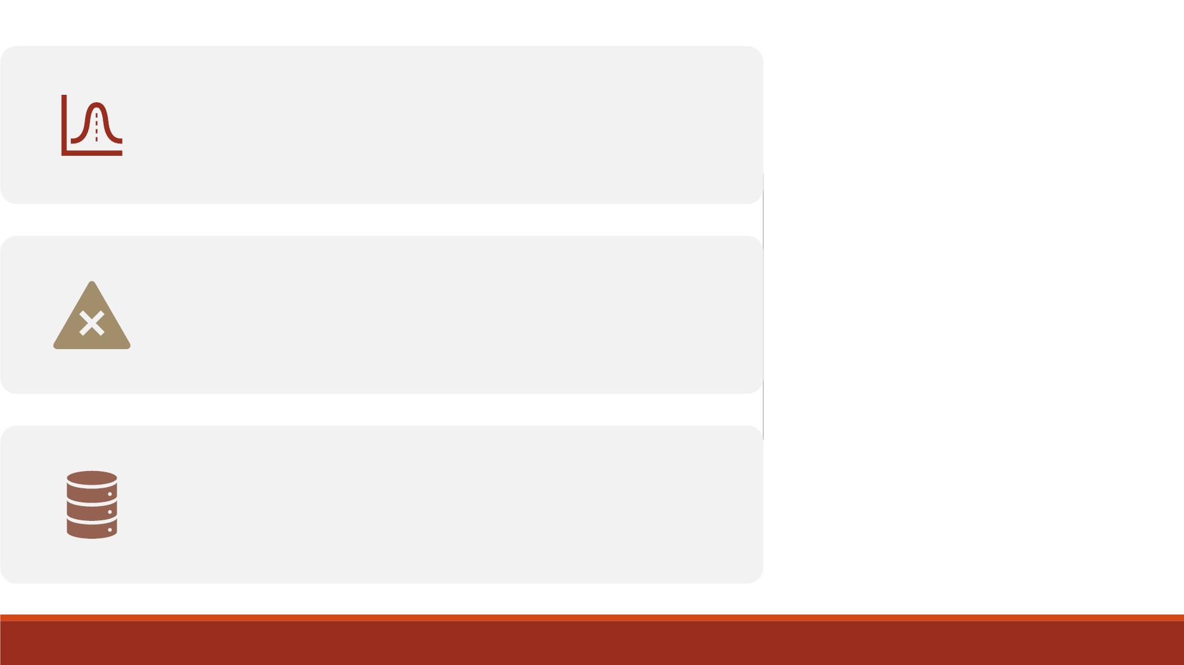
If one expression is true, then SAS
continues with the D ATA step.
IF-THEN-
DELETE
If one expression is false, then no further
statements are processed.
That observation is not added to the
dataset being created. SAS moves on to the
next observation.

Slide 41
IF-THEN-DELETE Example
▪The DELETE statement tells SAS which observations to exclude. The basic form is:
IF expression THEN DELETE;
▪The following two statements are equivalent (assume there are only two values for the variable
Gender with no missing data):
IF Gender = 'f ’; IF Gender = 'm' THEN DELETE;
▪Generally, we use the subsetting IF when it is easier to specify a condition for including
observations.
▪And use the DELETE statement when it is easier to specify a condition for excluding observations.

Slide 42
Exercise—IF-THEN-DELETE
▪Import the dataset “Lecture3_score_data_miss.xlsx” into SAS
▪Name the imported dataset as “lecture3_scoredata0”
▪Create a new SAS dataset named “lecture3_scoredata5” by
1. Setting “take” variable equal to “complete” when none of “score1-3” is missing;
2. setting “take” variable equal to “incomplete” for all other cases.
▪Create a new dataset “lecture3_scoredata6 by selecting only observations with “take”
equals “complete” using IF statement
▪Create a new dataset “lecture3_scoredata7 by selecting only observations with “take”
equals “complete” using IF-DELETE statement
▪Print the results of “lecture3_scoredata6” and “lecture3_scoredata7”

Slide 43
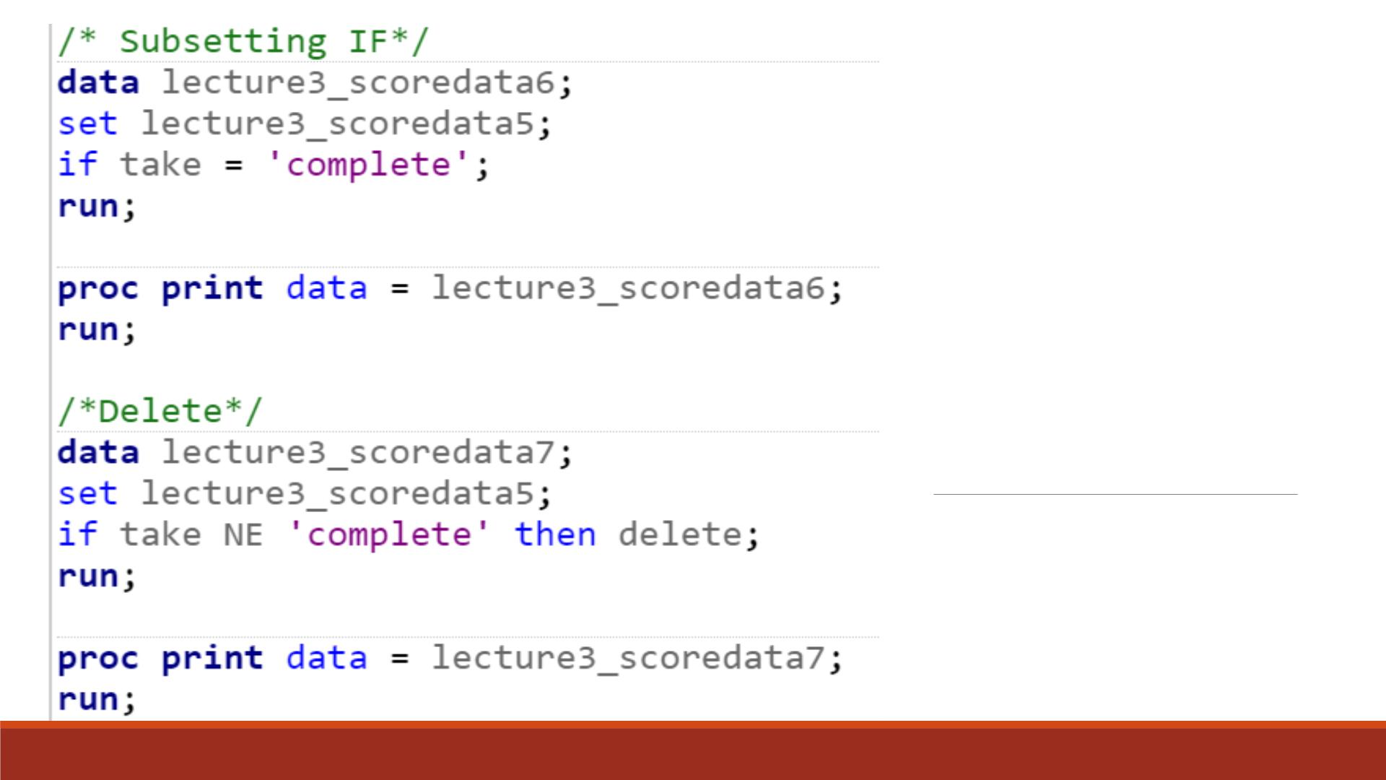
Code

Slide 44
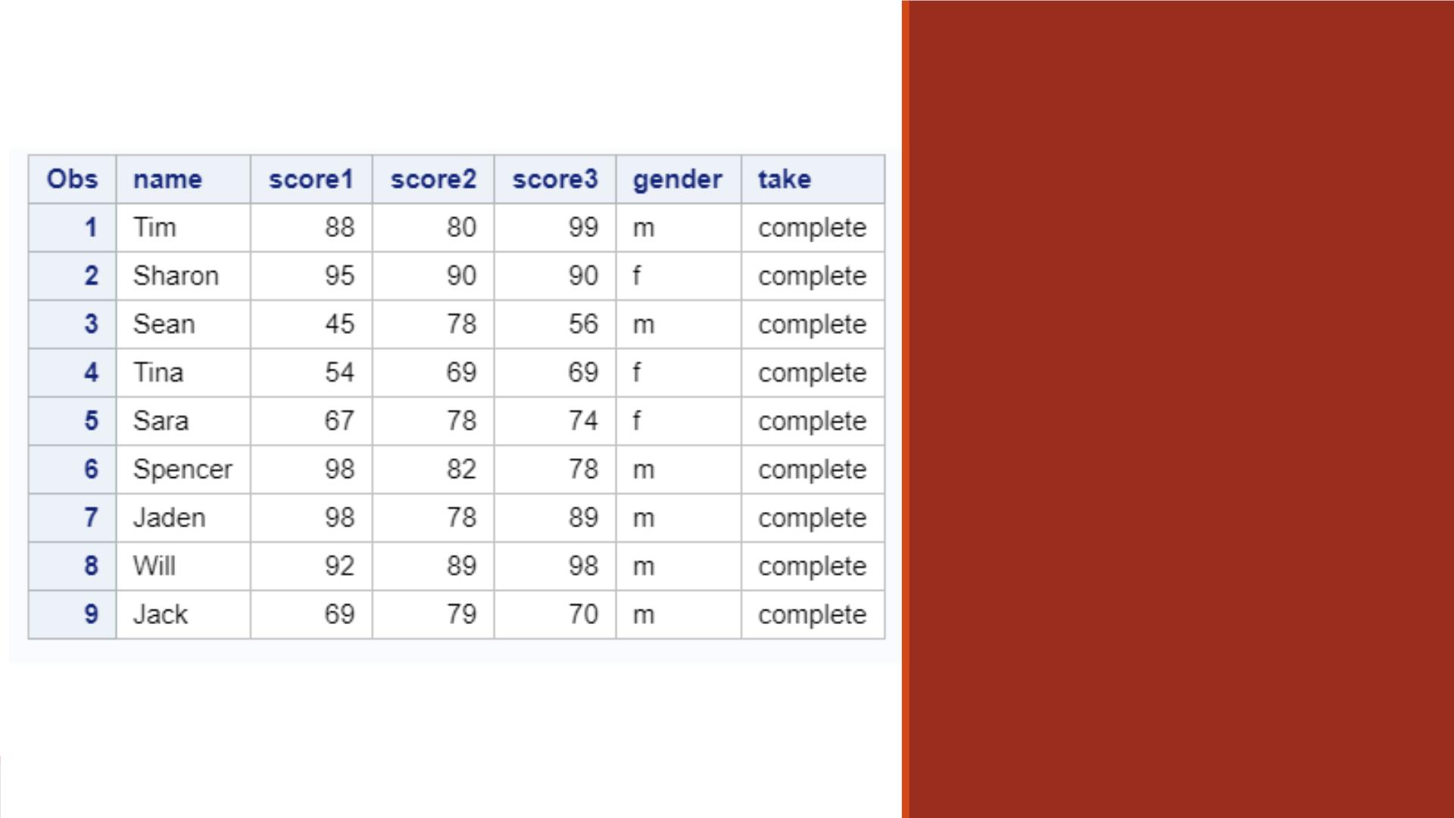
Proc Print
Result
Note: lecture3_scoredata6
and lecture3_scoredata7
have the same results.

Slide 45
One-Dimensional A r rays

Slide 46
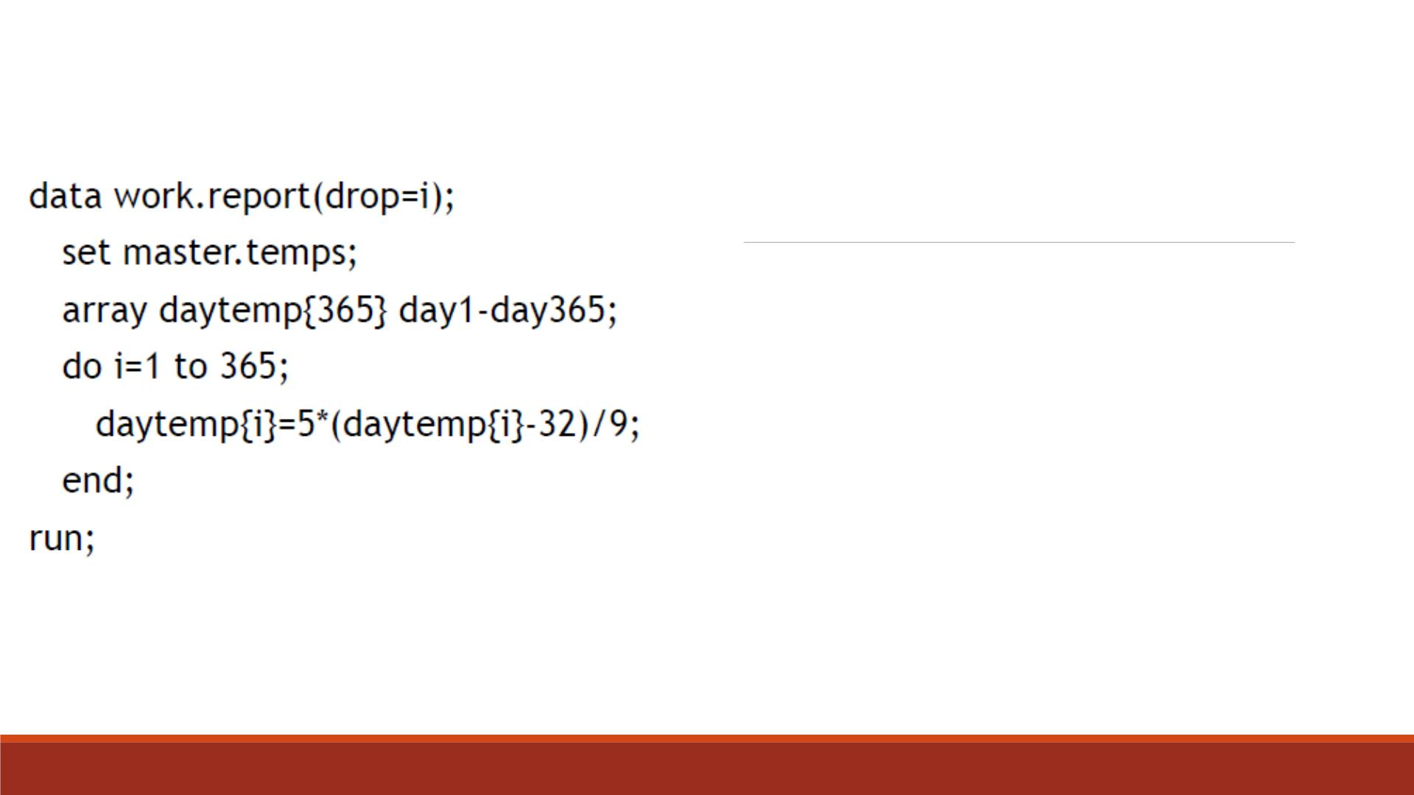
Creating One-
Dimensional Arrays
▪We often need to perform the same action on more
than one variable.
▪It is easier to handle them as a group using array
processing than individually.
▪For example, we convert the daily temperature from
Fahrenheit to Celsius for the year using an array and
DO loop.

Slide 47
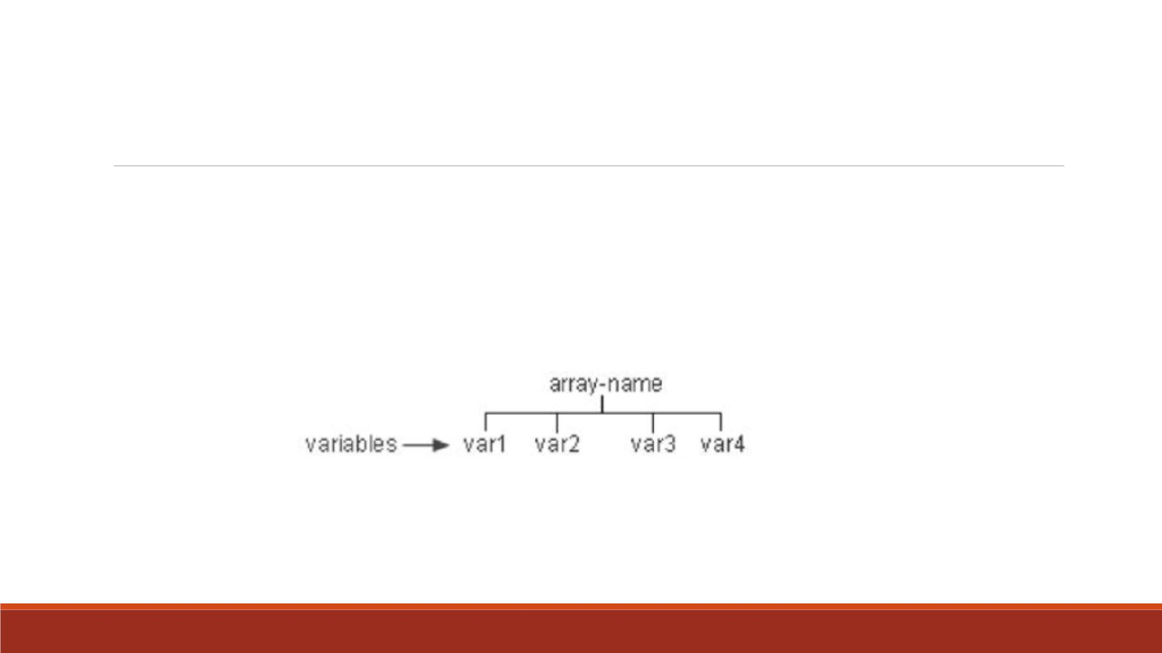
Understanding SAS Arrays
A SAS array is a temporary grouping of SAS variables under a single name. An array
exists only for the duration of the D ATA step.

Slide 48
Defining an Array
General form of ARRAY statement:
ARRAY array-name{dimension} <elements>;
▪array-name specifies the name of the array
▪dimension describes the number and arrangement of array elements.
▪elements lists the variables to include in the array. Array elements must be either all numeric
or all character. If no elements are listed, new variables will be created with default names.

Slide 49
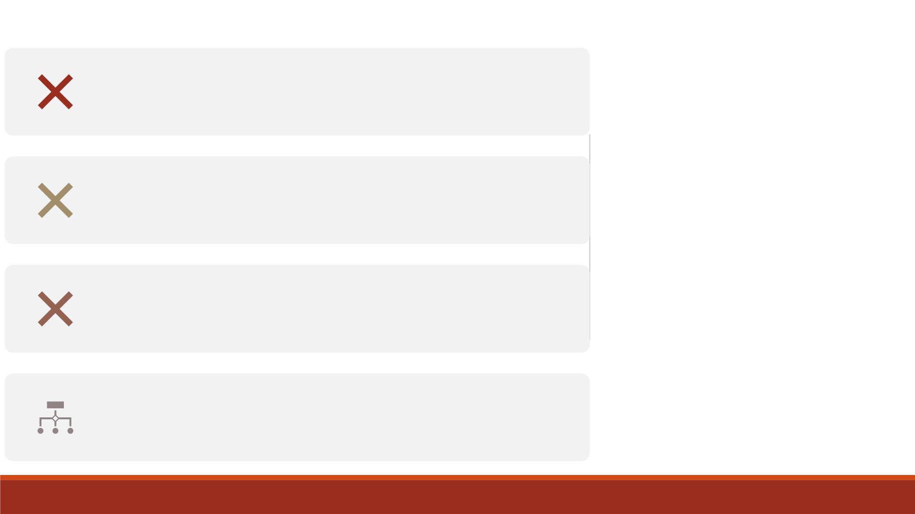
Do not give an array the same name as a variable in the
same D ATA step.
Avoid using the name of a SAS function, otherwise you
won't be able to use the function in the same D ATA step.
Caution
You cannot use array names in LABEL, FORMAT, DROP,
KEEP, or LENGTH statements.
Arrays exist only for the duration of the D ATA step.

Slide 50
Specifying the Array Name
▪To group the variables in the array, first give the array a name.
▪For example, make the array name sales.
array sales{4} qtr1 qtr2 qtr3 qtr4;

Slide 51
The dimension describes the number and arrangement of elements in
the array. Several ways to specify a one-dimensional array:
▪Simply specify the number of array elements (variables that you want
to reference and process). Example:
Specifying
the
Dimension
array sales{4} qtr1 qtr2 qtr3 qtr4;
▪Specify a range of values for the dimension when you define the array
instead of total number of elements. Example:
array sales{96:99} totals96 totals97 totals98 totals99;
▪Use an asterisk *, then SAS determines the dimension by counting the
number of elements. Example:
array sales{*} qtr1 qtr2 qtr3 qtr4;
▪Enclose the dimension in either parentheses(), braces{}, or brackets[].

Slide 52
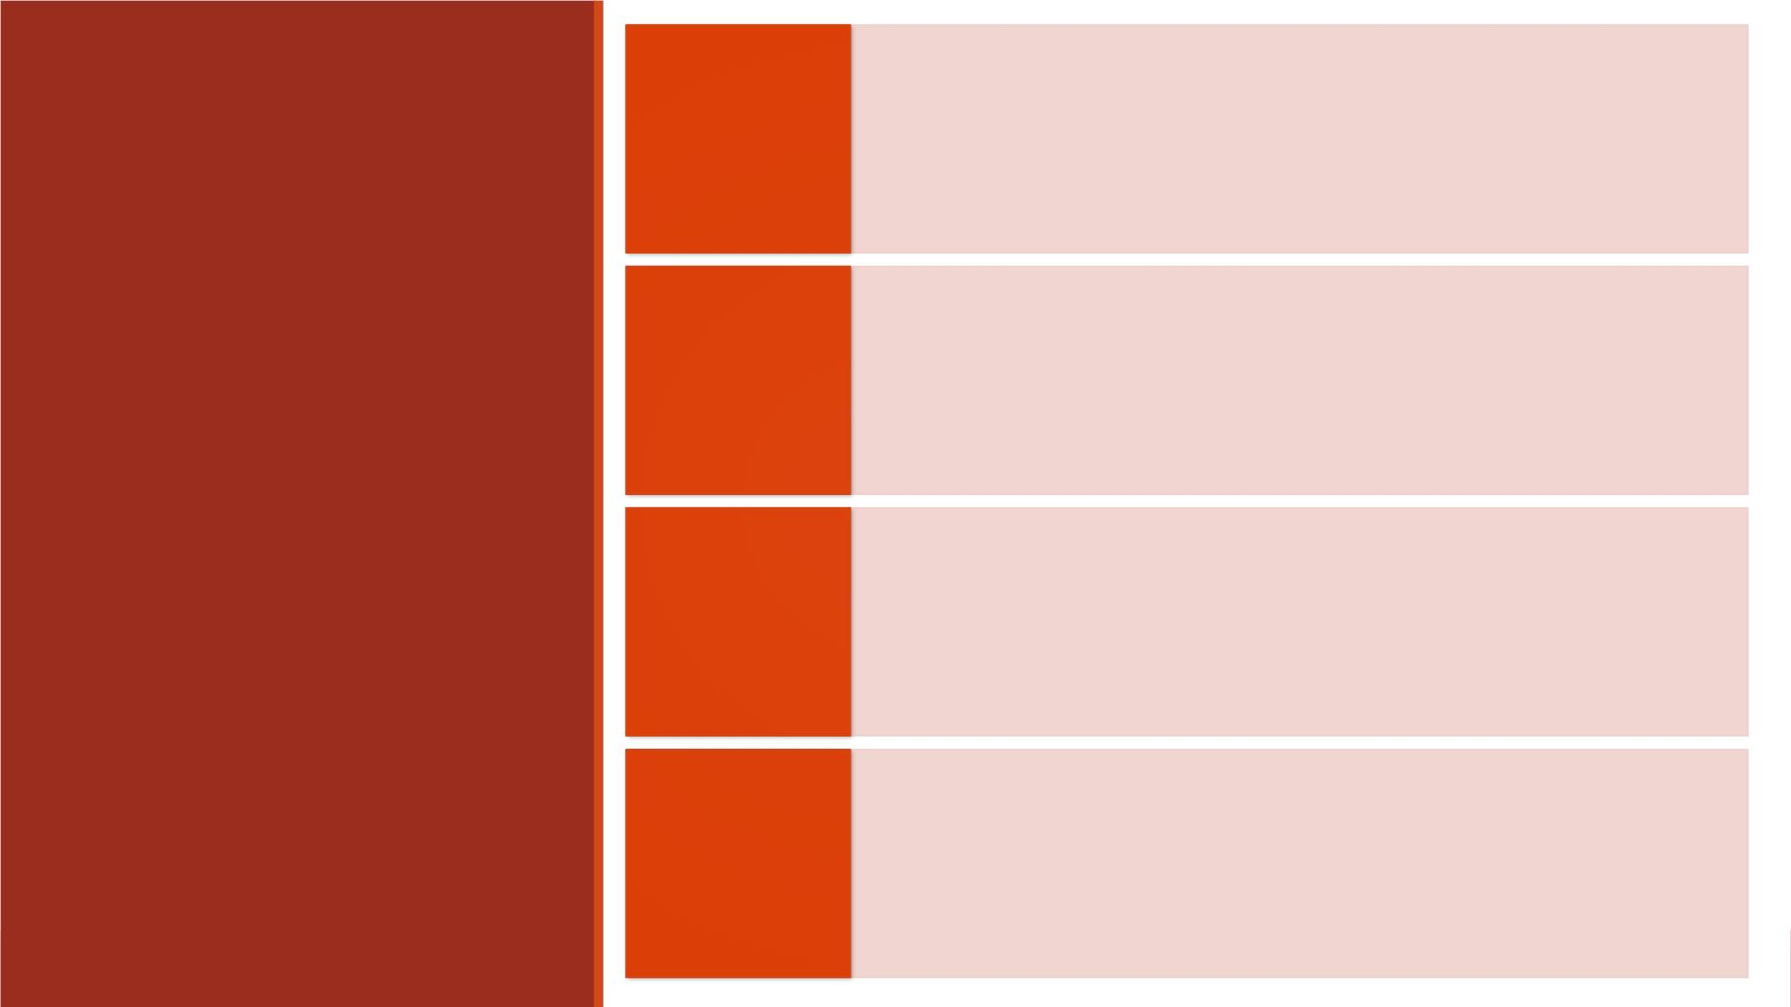
List each variable name that you want to include in
the array. When listing, separate each element with
a space, then end with a semicolon (;).
Specifying
Array
Elements
array sales{4} qtr1 qtr2 qtr3 qtr4;
Use a variable list.
array sales{4} qtr1-qtr4;

Slide 53
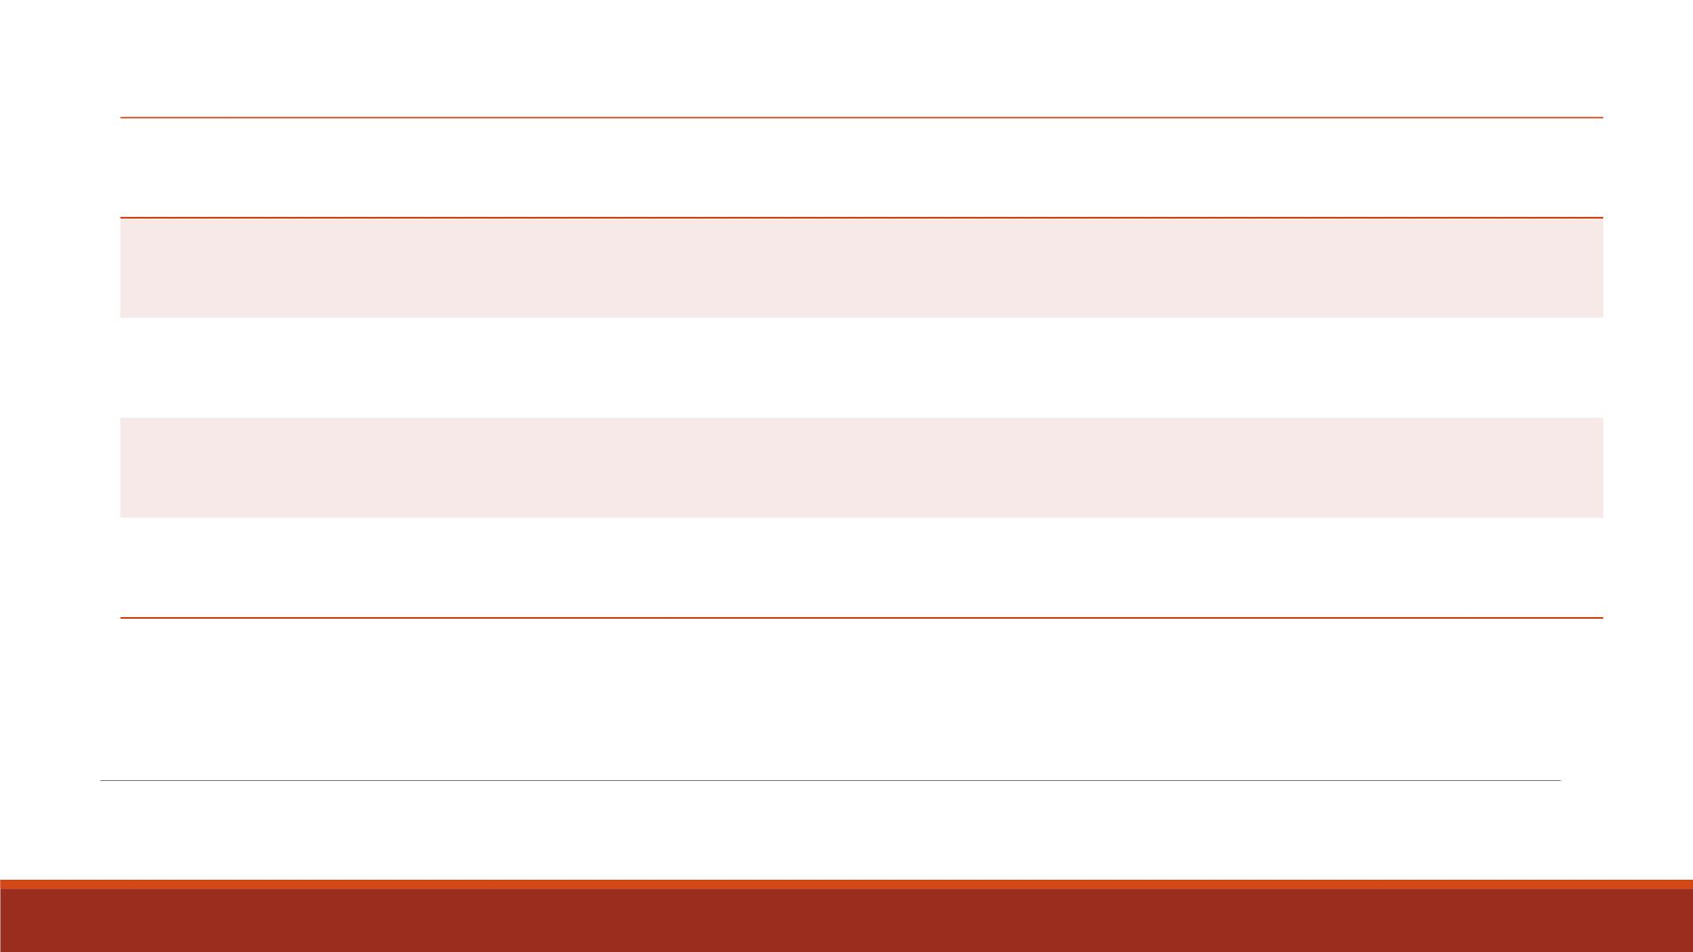
Variables
Form
a numbered range of variables
all numeric variables
Var1-Varn
_NUMERIC_
_CHARACTER_
_ALL_
all character variables
all character or all numeric variables
Variable Lists as Array Elements

Slide 54
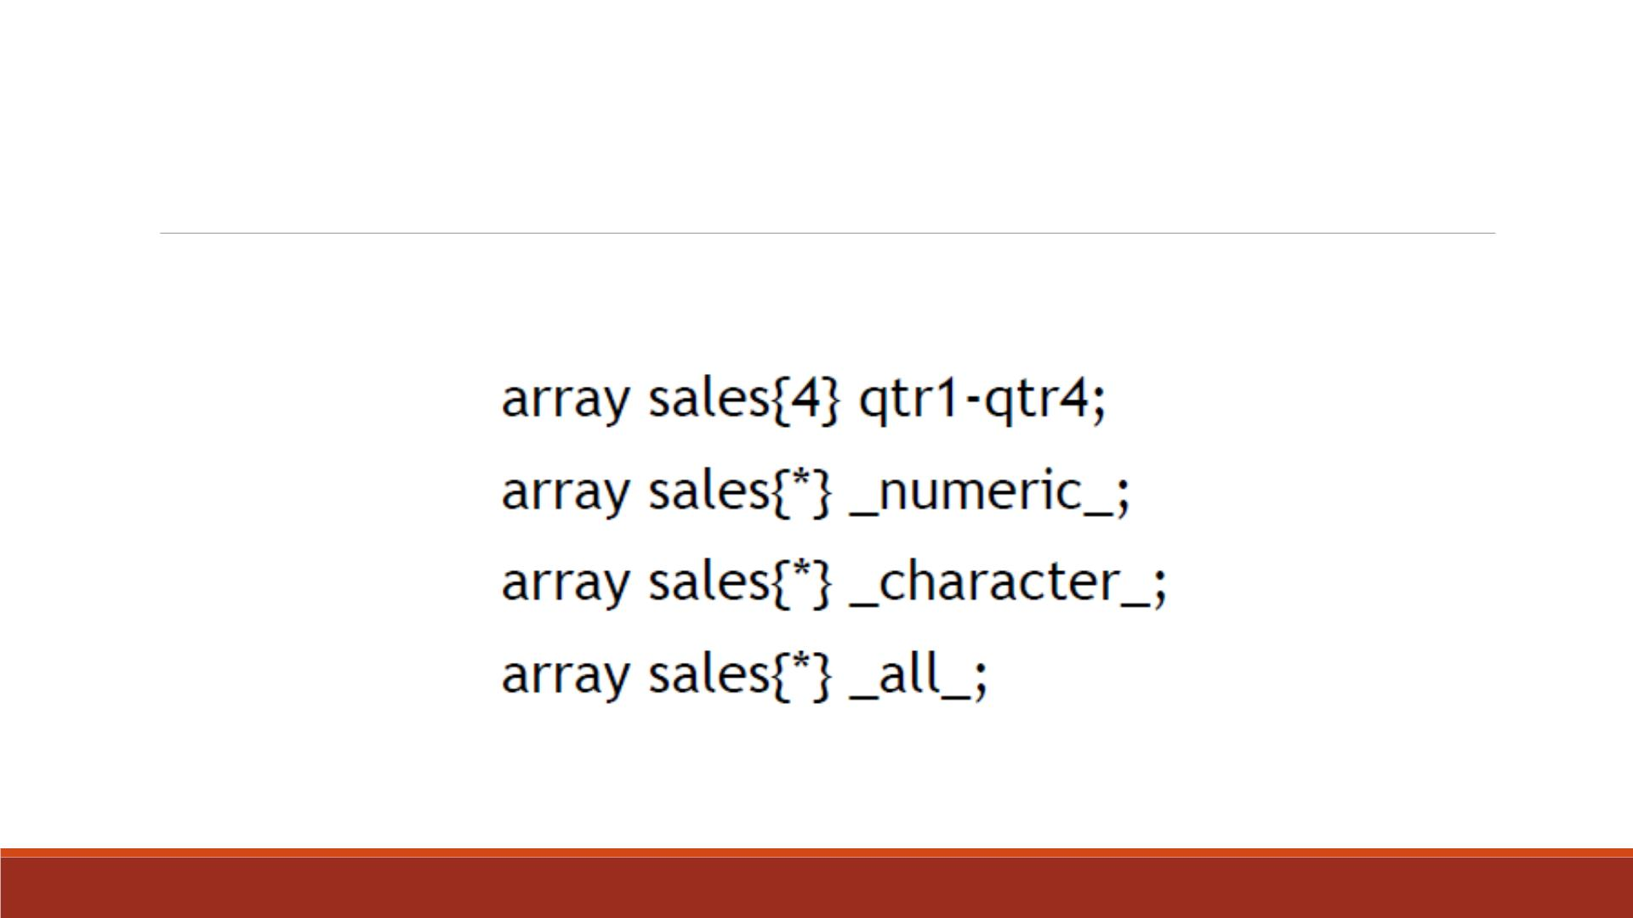
Variable List Examples

Slide 55
To reference an array element in the D ATA step, specify the name of
the array, followed by a subscript value enclosed in parentheses.
General form:
Referencing
Elements of
an Array
array-name(subscript)
where subscript
▪is enclosed in parentheses, braces, or brackets
▪specifies a variable, a SAS expression, or an integer
▪is within the lower and upper bounds of the dimension of the array.

Slide 56
Do Loops

Slide 57
Arrays with DO Loops
▪Typically arrays are used with DO loops to process multiple variables and repetitive calculations.
▪When used in a DO loop, the index variable of the iterative DO statement can reference each
element of the array.
▪For example, the DO loop below increments the index variable i from the lower bound of the
quarter array 1, to the upper bound 4.
array quarter{4} jan apr jul oct;
do i=1 to 4;
YearGoal=quarter{i}*1.2;
end;

Slide 58
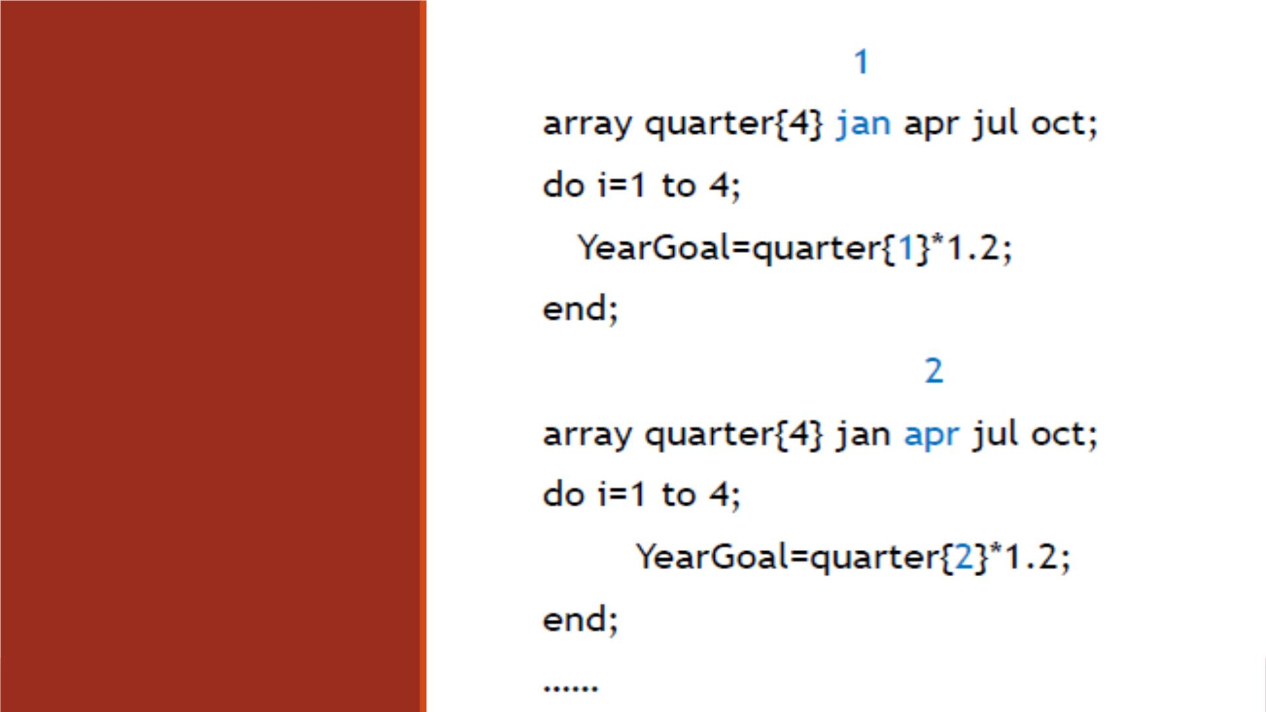
DO Loop
Processing
Steps

Slide 59
DIM Function
▪We use the DIM function to specify the TO clause of the iterative DO statement.
▪For a one-dimensional array, specify the array name as the argument for the DIM function.
▪The DIM function returns the number of elements in the array.
▪General form:
DIM (array-name)
where array-name specifies the array.

Slide 60
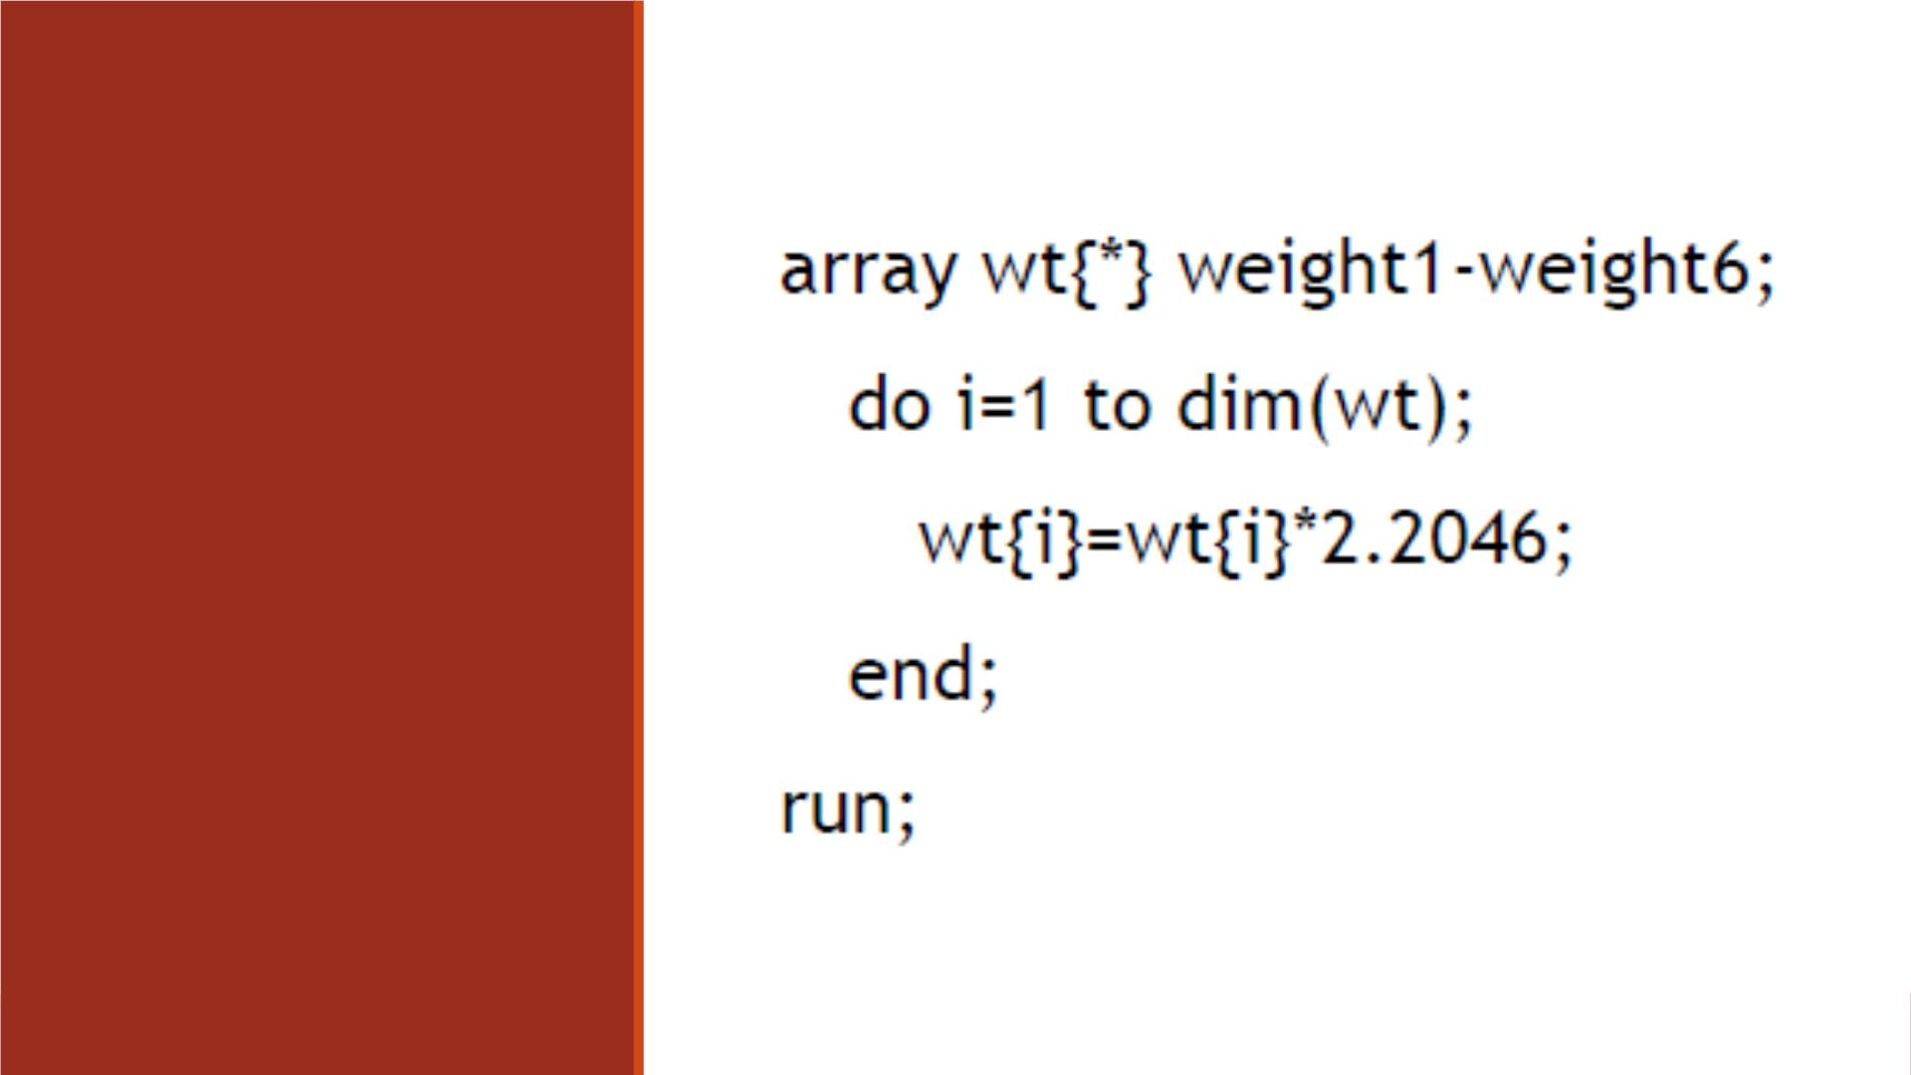
DIM Function
Example
Note: When you use the DIM
function, you do not have to re-
specify the stop value of an iterative
DO statement if you change the
dimension of the array.

Slide 61
Exercise—Arrays and DO Loops
▪Import the dataset “Lecture3_score_data_miss999.xlsx” into SAS
▪Name the imported dataset as “lecture3_scoredata0”
▪Create a new SAS dataset named “lecture3_scoredata8” by
1. Creating an array named “score_var” which contains variables score1, socre2, score3
2. Using a DO Loop and IF-THEN statement to change the observations with value 999 to .
▪Print “lecture3_scoredata8” and title it “Missing values are shown as periods”
▪Print “lecture3_scoredata0” and title it “Missing values are shown as 999”

Slide 62
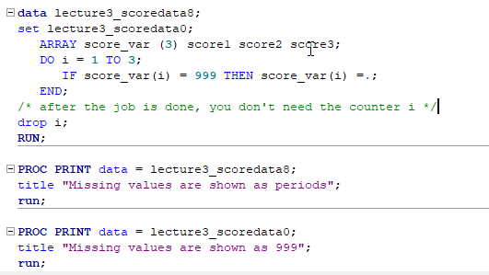
Code

Slide 63
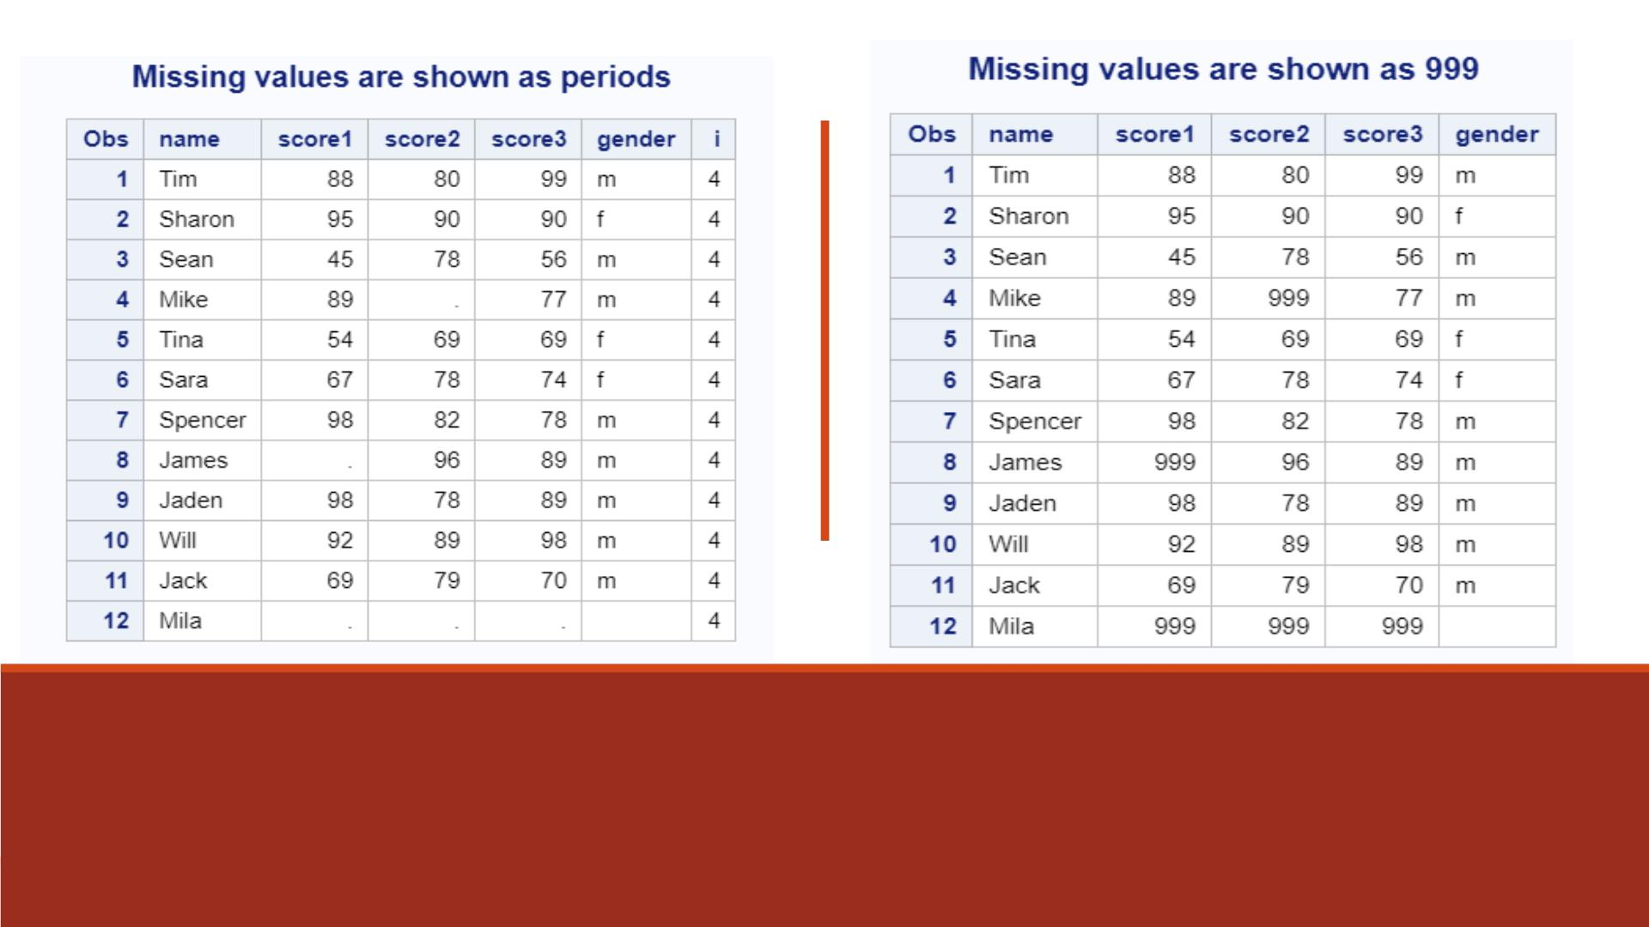
Proc Print Results

