Slide 1

Generating Data with DO Loops

Slide 2

Outline
ITERATIVE DO LOOPS
CONDITIONAL DO
LOOPS
Reading: Base Guide
(past version) Ch15
CONDITIONAL AND
ITERATIVE DO LOOPS

Slide 3

Iterative DO Loops

Slide 4
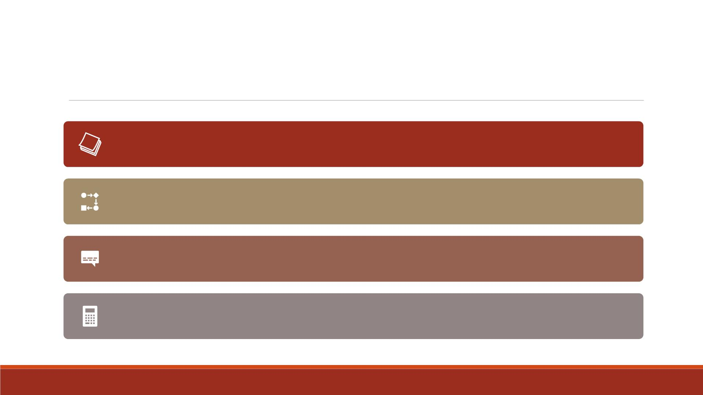
Generating Data with DO Loops
Execute SAS statements repeatedly by placing them in a DO loop
DO loops can execute any number of times in the D ATA step.
Write concise D ATA steps that are easier to change and debug
Greatly reduce the number of statements required for a repetitive calculation

Slide 5

Constructing DO Loops
To construct a DO loop, use the DO and END statements along with other SAS statements.
General form:
DO index-variable = start TO stop BY increment;
SAS statements
END;

Slide 6

▪The start, stop, and increment values
❑are set upon entry into the DO loop
Constructing
DO Loops
❑cannot be changed during the processing of the DO loop
❑can be numbers, variables, or SAS expressions.
▪The END statement terminates the loop.
▪The value of the index variable is changed within the loop.

Slide 7
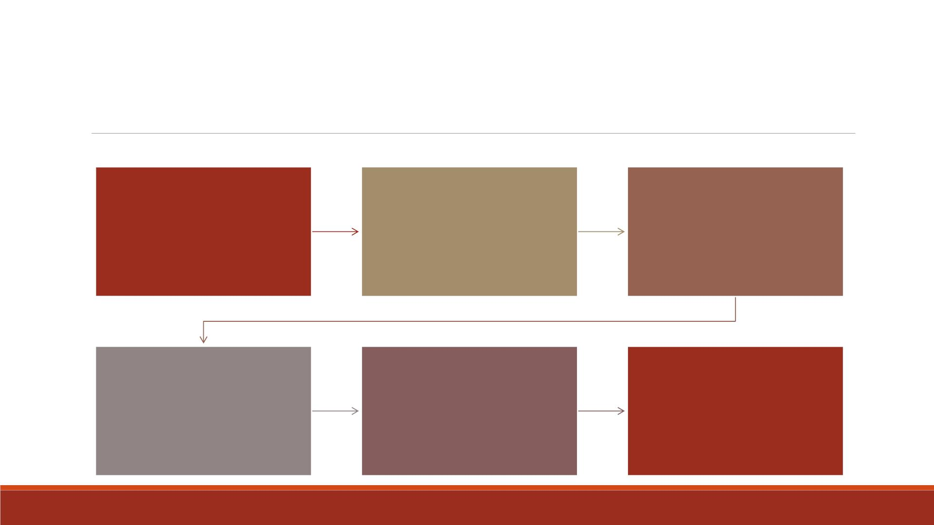
DO Loop Components
index variable: stores
conditions to execute
DO loop: contain a start
value, a stop value, and
an increment value
the value of the current
iteration of the DO loop,
must be a valid SAS
name
start value: the initial
value of the index
variable
TO clause: the stop
value, the last index
value that executes the
DO loop
optional BY clause: an
increment value for the
index variable
If you do not specify a
BY clause, the default
increment value is 1.

Slide 8

The specification increments the index variable by 1, resulting
in quiz values of 1, 2, 3, 4, and 5:
do quiz=1 to 5;
Examples
The specification increments the index variable by 2, resulting
in rows values of 2, 4, 6, 8, 10, and 12:
do rows=2 to 12 by 2;

Slide 9
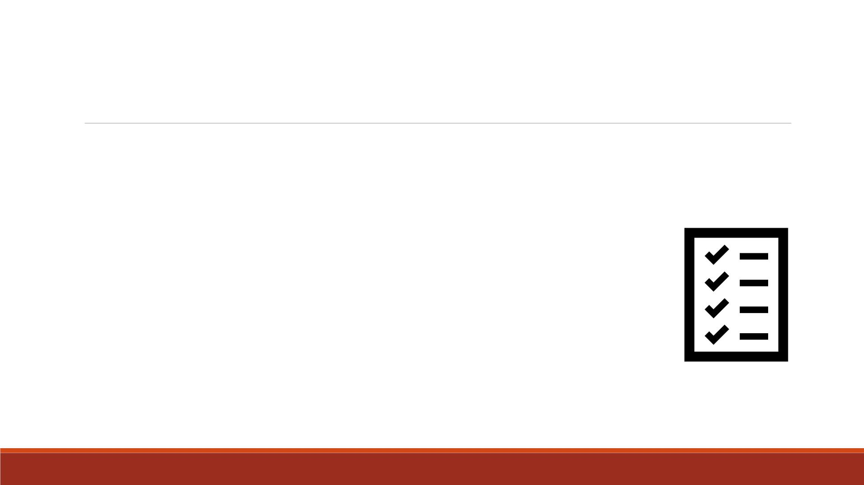
Demo—Without Do Loops
Compute the total amount of money you will have if you start with $100 and
invest it at a 3.75% interest rate for 3 years.
1. Write the program without DO Loops
▪Create a SAS dataset named lecture4_earnings1
▪Contain variables “Interest_rate”, “ Total” and “Year ”
▪Assign “dollar10.2” format to the variable “ Total”
▪Print the dataset and title it “Listing of earnings without DO loops”

Slide 10
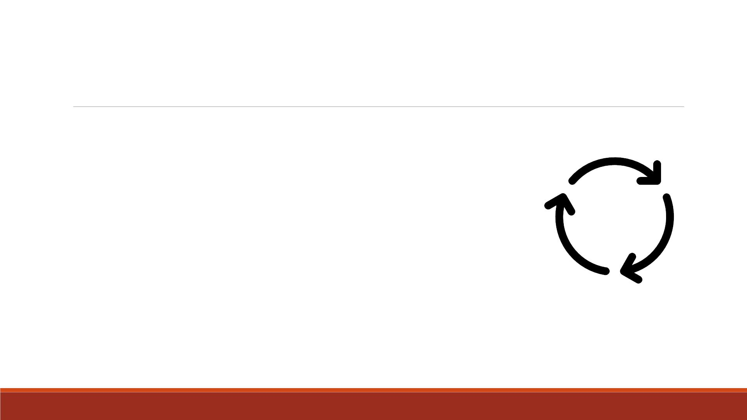
Demo—Constructing Do Loops
2. Write the program with DO Loops
▪Create a SAS dataset named lecture4_earnings2
▪Contain variables “Interest_rate”, “ Total” and “Year ”
▪Assign “dollar10.2” format to the variable “ Total”
▪Print the dataset and title it “Listing of earnings with DO loops”

Slide 11
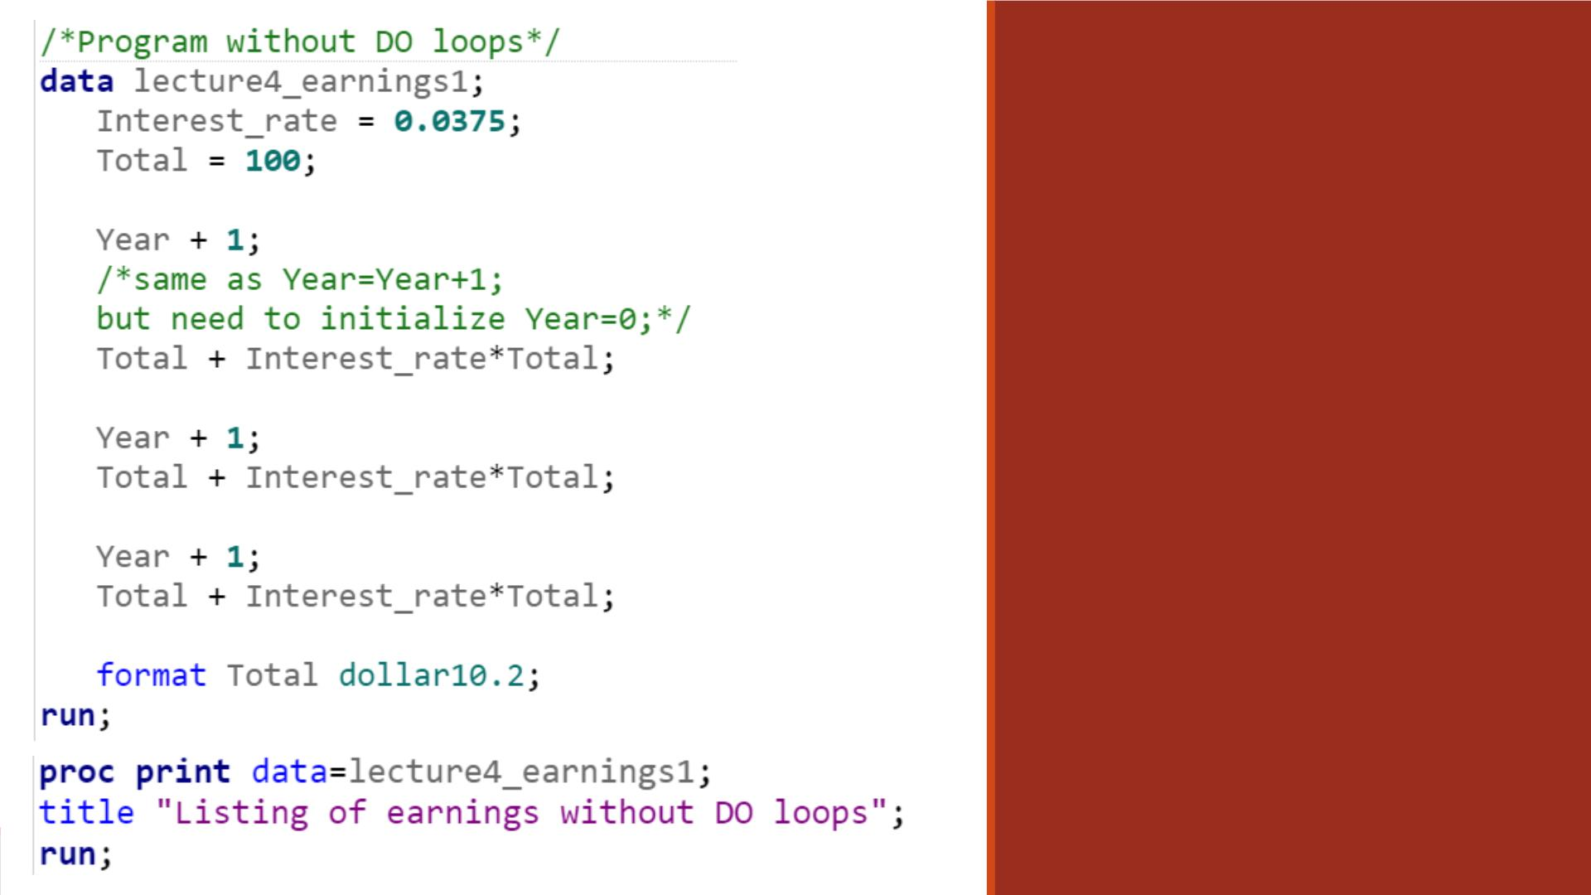
Code—Without
DO Loops
▪ “ Year+1” is equivalent to
“ Year=Year+1” .
▪ If you write “ Year=Year+1”,
need to initialize Year=0
before. Otherwise, SAS
assigns a missing value to
the variable Year.
▪ If you write “ Year+1”, the
initial value of Year is set to
0 by default.

Slide 12
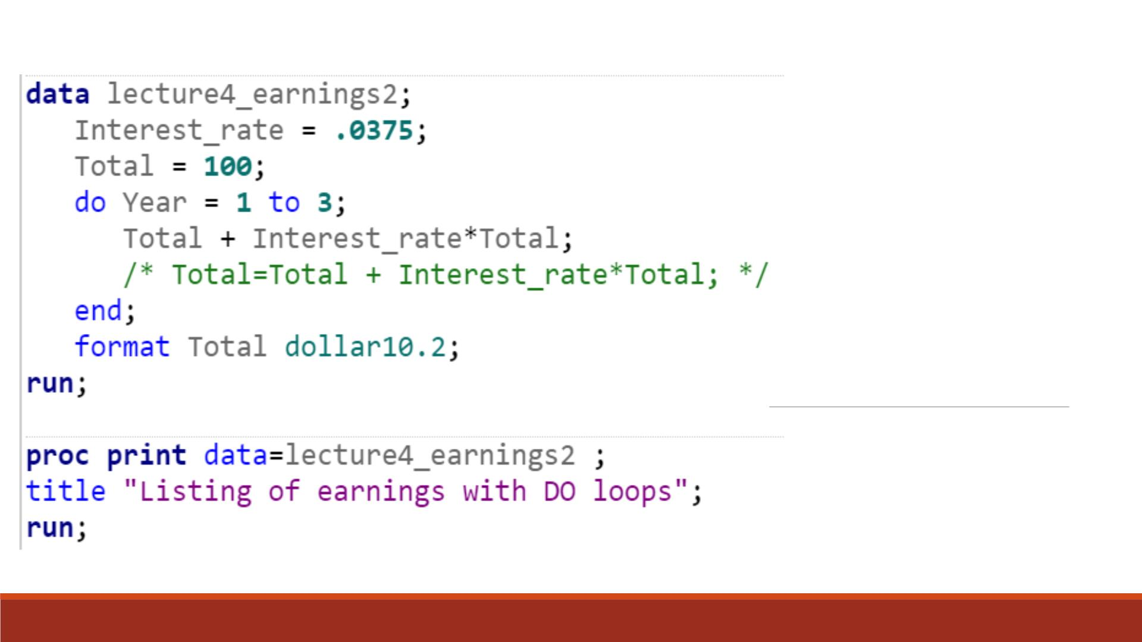
Code—With
DO Loops

Slide 13
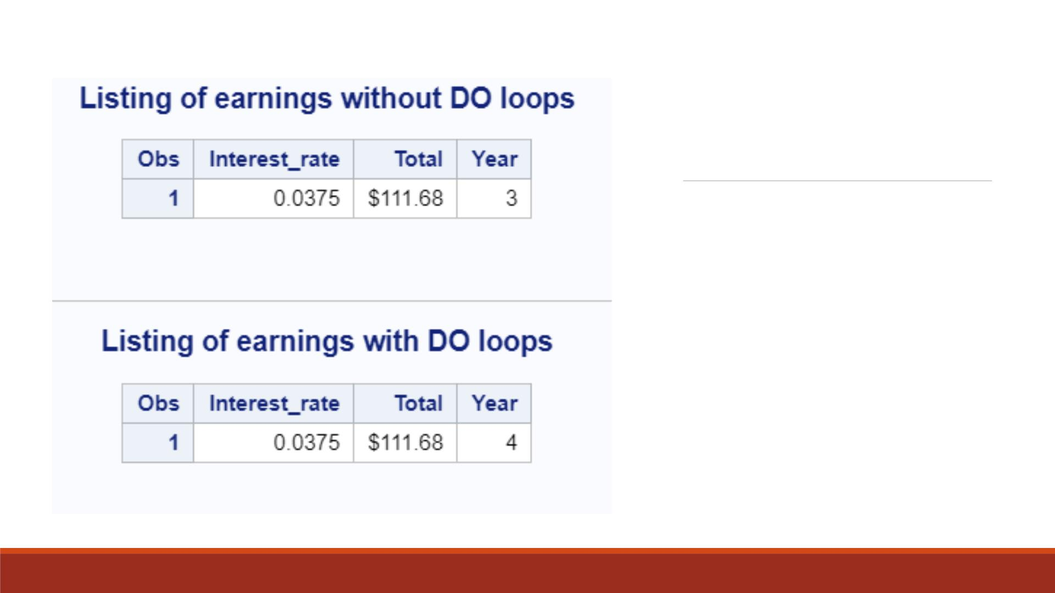
Proc Print
Result
Note: With DO Loops,
“Year ” takes the value 4
instead of 3.

Slide 14
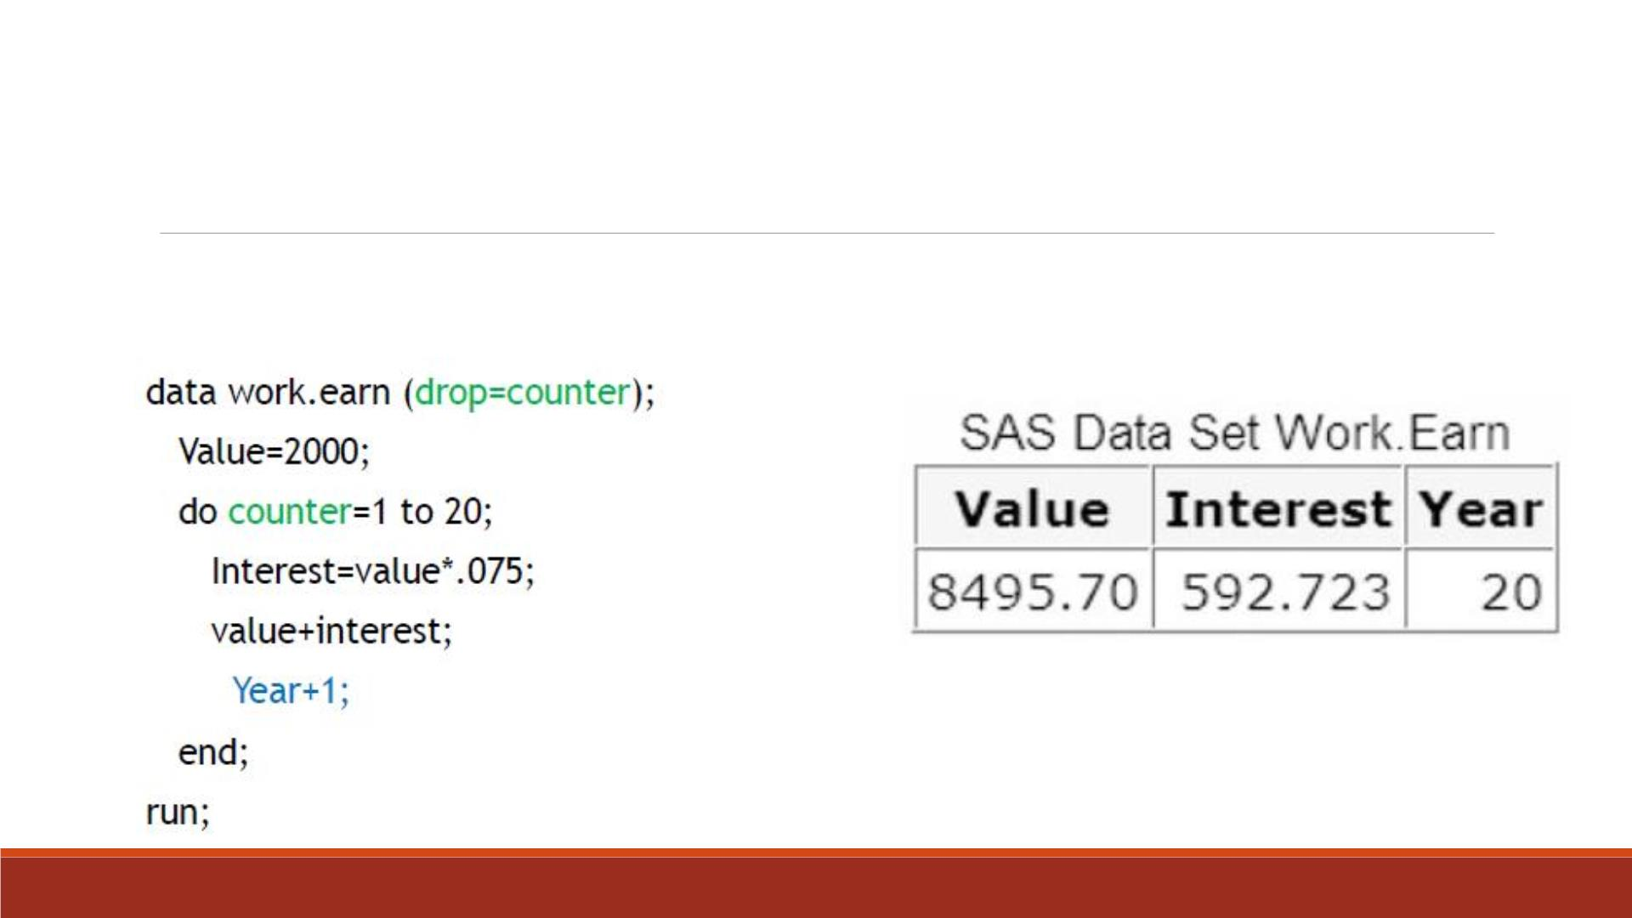
Drop the Index Variable
It is useful to create an index variable to count and store the number of iterations
in the DO loop. You can also drop the index variable from the data set.

Slide 15
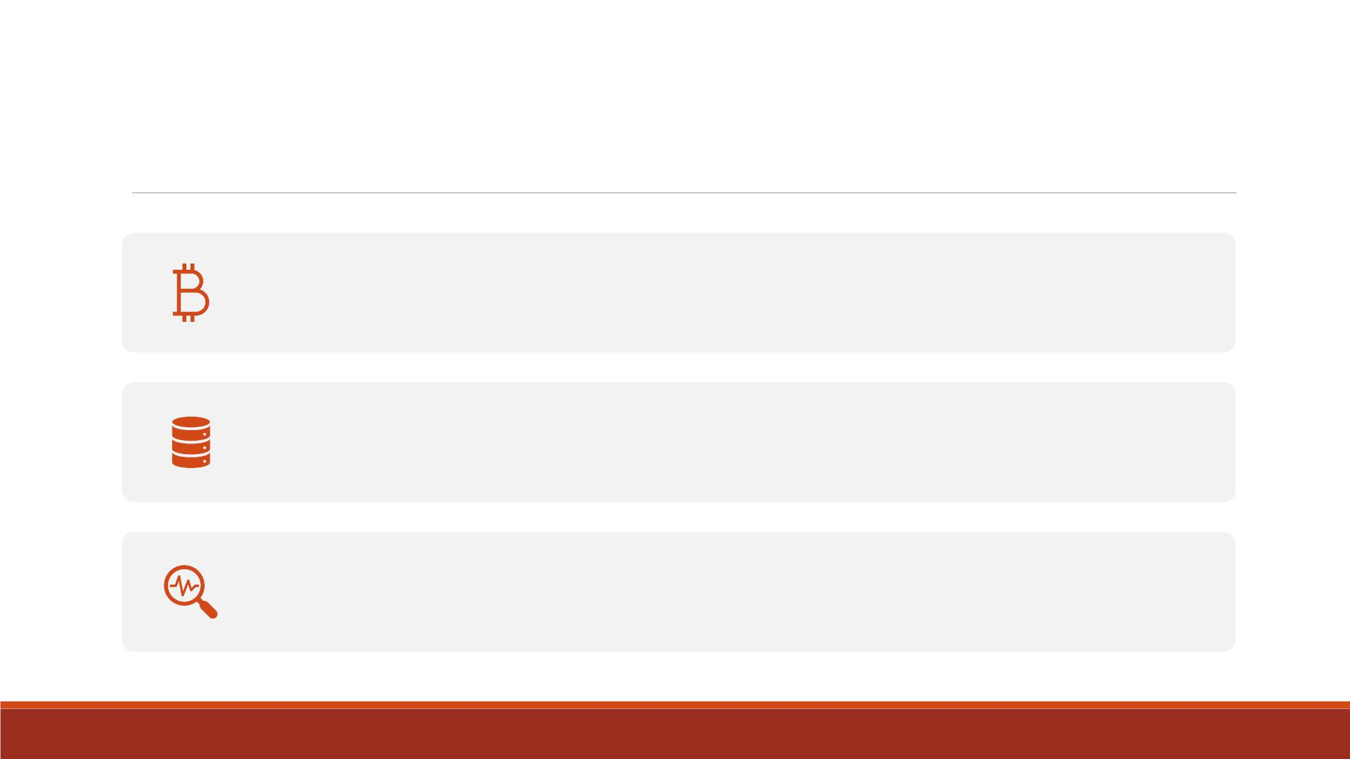
Drop the Index Variable
The sum statement “Year+1” accumulates the number of iterations
of the DO loop and stores the total in the new variable “Year ”.
The final value of “Year ” is stored in the data set, whereas the index
variable “counter ” is dropped.
The data set has only one observation.

Slide 16
Demo—Drop the Index Variable
Compute the total amount of money you will have if you start with $100 and
invest it at a 3.75% interest rate for 3 years. Write the program with DO Loops
and drop the index variable “counter”.
▪Create a SAS dataset named lecture4_earnings3
▪Contain variables “Interest_rate”, “ Total” and “Year ”
▪Assign “dollar10.2” format to the variable “ Total”
▪Print the dataset and title it “Listing of earnings with DO loops”

Slide 17
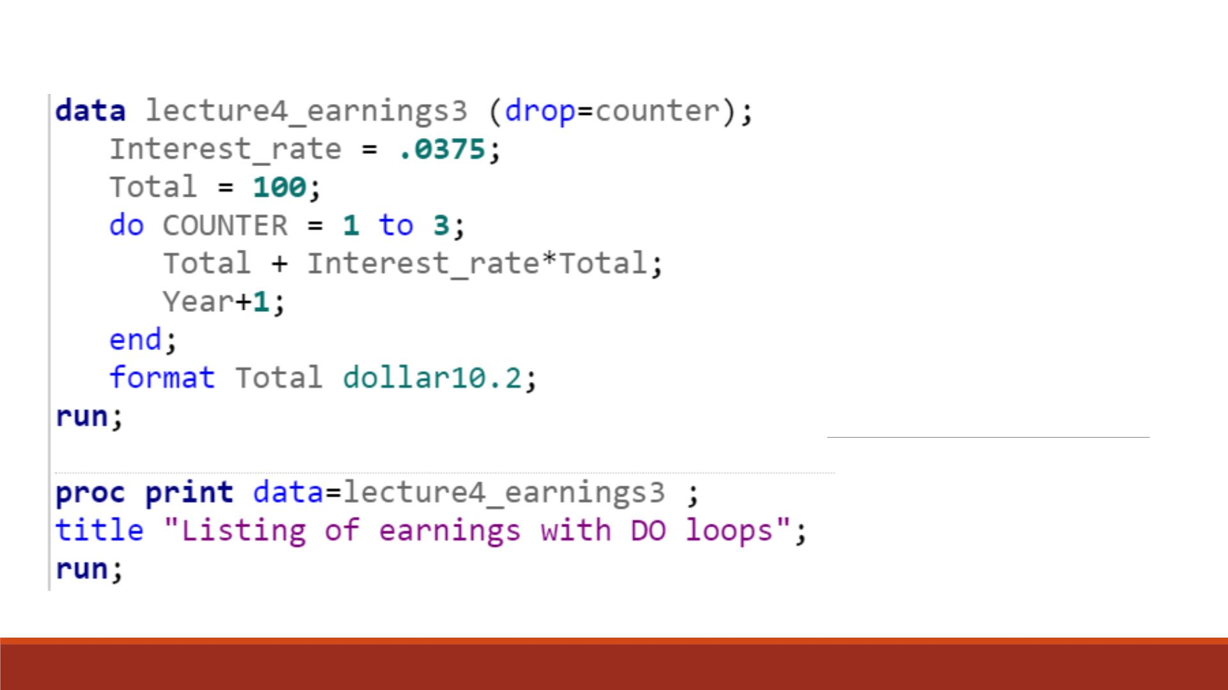
Code

Slide 18
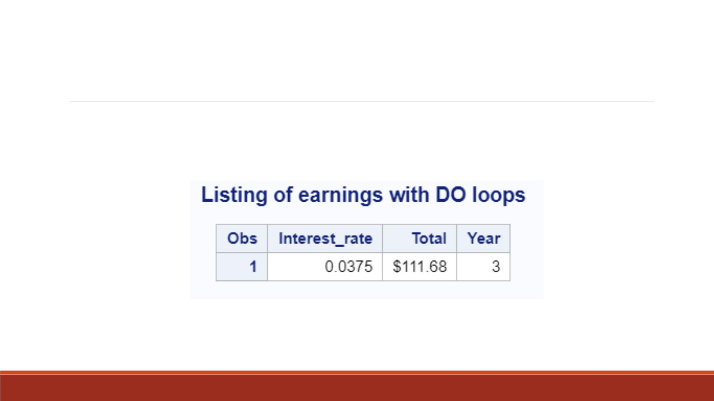
Proc Print Result

Slide 19
DROP= and KEEP= Dataset Options
▪Use the DROP= and KEEP= dataset options to specify the variables to drop or keep.
▪Use the KEEP= option instead of the DROP= option if more variables are dropped
than kept.
▪General form:
(DROP=variable(s))
(KEEP=variable(s))
▪The DROP= or KEEP= option, in parentheses, follows the name of the data set that
contains the variables to be dropped or kept
▪Variable(s) identifies the variables to drop or keep.
▪Can be used in both D ATA steps and PROC steps.

Slide 20
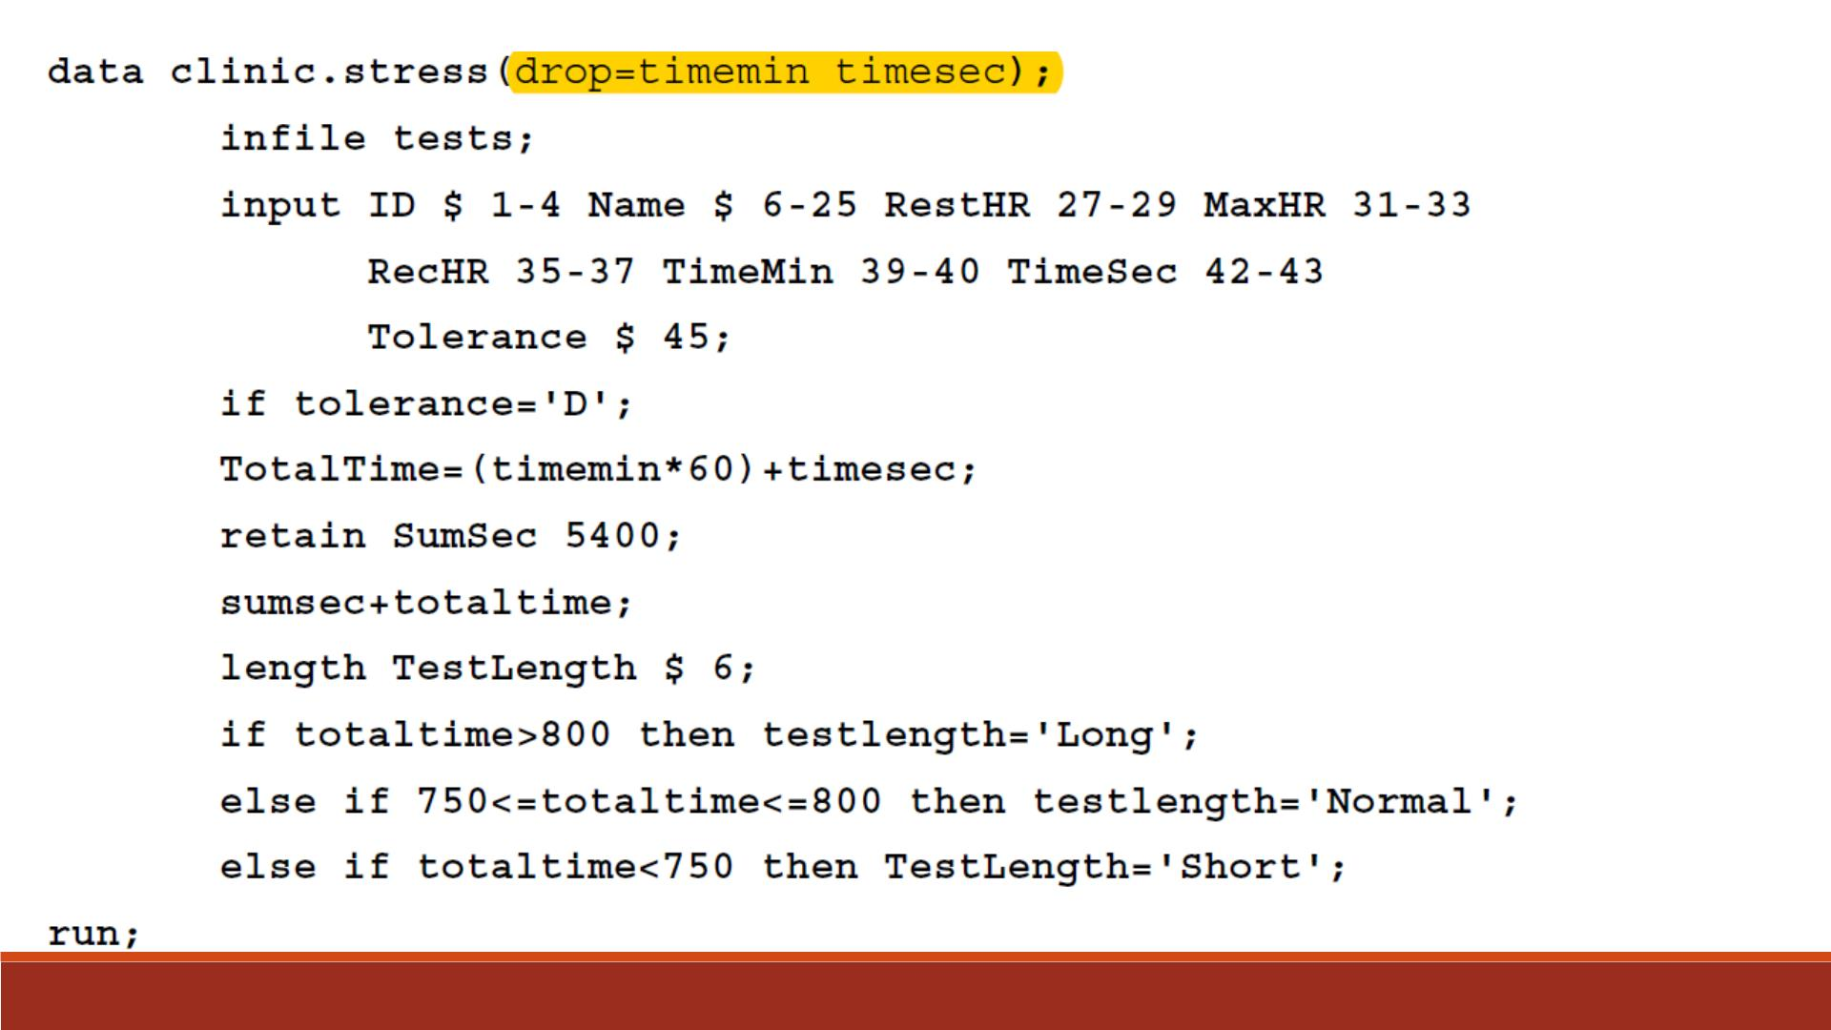
Example

Slide 21
▪Another way to exclude variables from your dataset is to use the DROP
statement or the KEEP statement.
▪Use the KEEP statement instead of the DROP statement if the number
of variables to keep is significantly smaller than the number to drop.
▪General form:
DROP/KEEP
Statement
DROP variable(s);
KEEP variable(s);
▪variable(s) identifies the variables to drop or keep.
▪If the variable names are consecutive, then either way is fine no matter how many variables you have e.g.
Drop Q2-Q100; keep Q2;

Slide 22
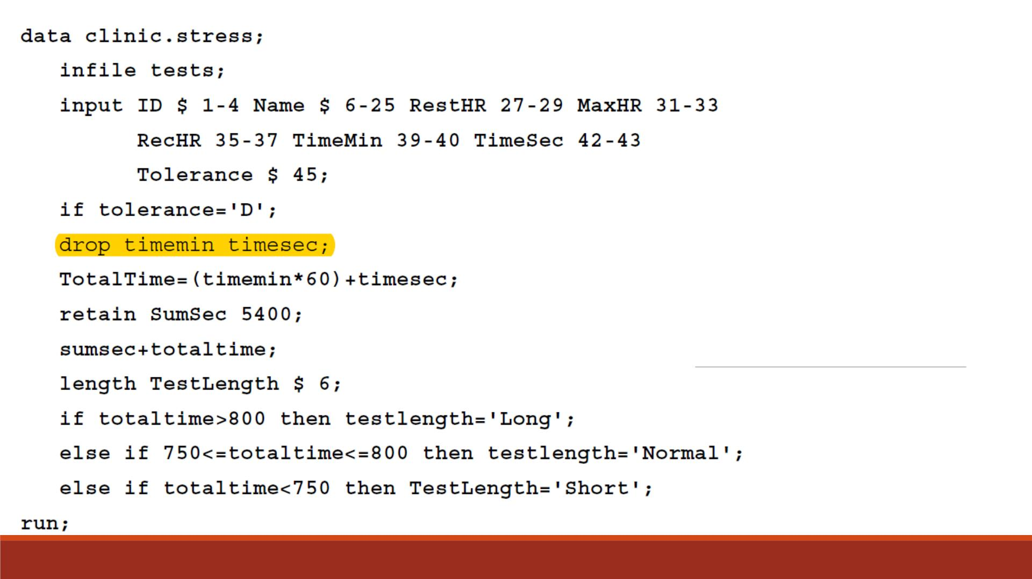
Example

Slide 23
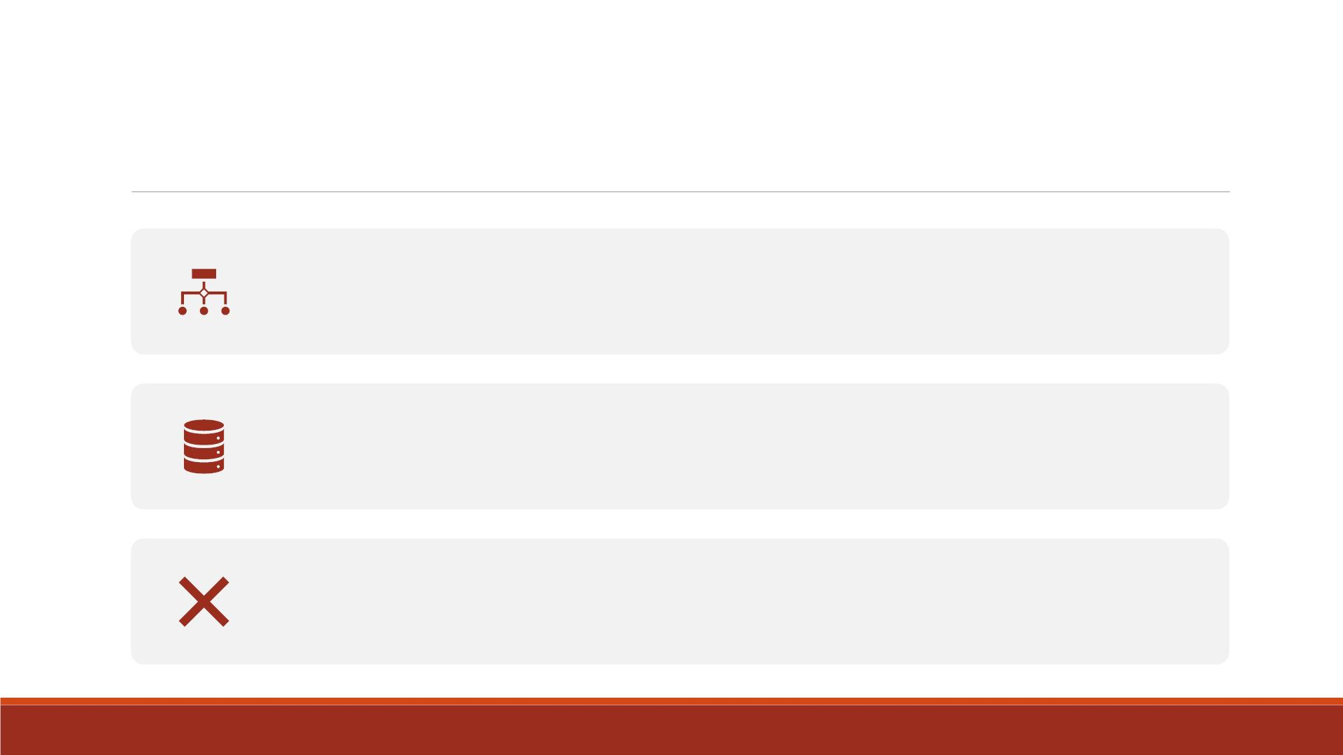
Warnings
Yo u cannot use the DROP statement in SAS procedure steps.
The DROP statement applies to all output datasets that are named in the
D ATA statement.
To exclude variables from some datasets but not from others, place the
appropriate DROP= dataset option next to each dataset name that is
specified in the D ATA statement.

Slide 24
OUTPUT Statement
▪To create an observation for each iteration of the DO loop, place an OUTPUT statement
inside the loop.
▪By default, every D ATA step contains an automatic OUTPUT statement at the end of the
D ATA step.
▪But placing an explicit OUTPUT statement in a D ATA step overrides automatic output.
▪SAS adds an observation to the data set only when the explicit OUTPUT statement is
executed.

Slide 25
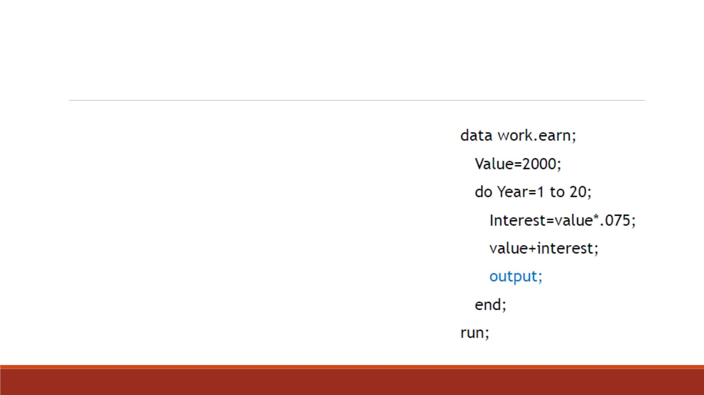
OUTPUT Example
▪The previous example created one observation
because it used automatic output at the end of
the D ATA step.
▪In this example, the OUTPUT statement
overrides automatic output, so the D ATA step
writes 20 observations.

Slide 26
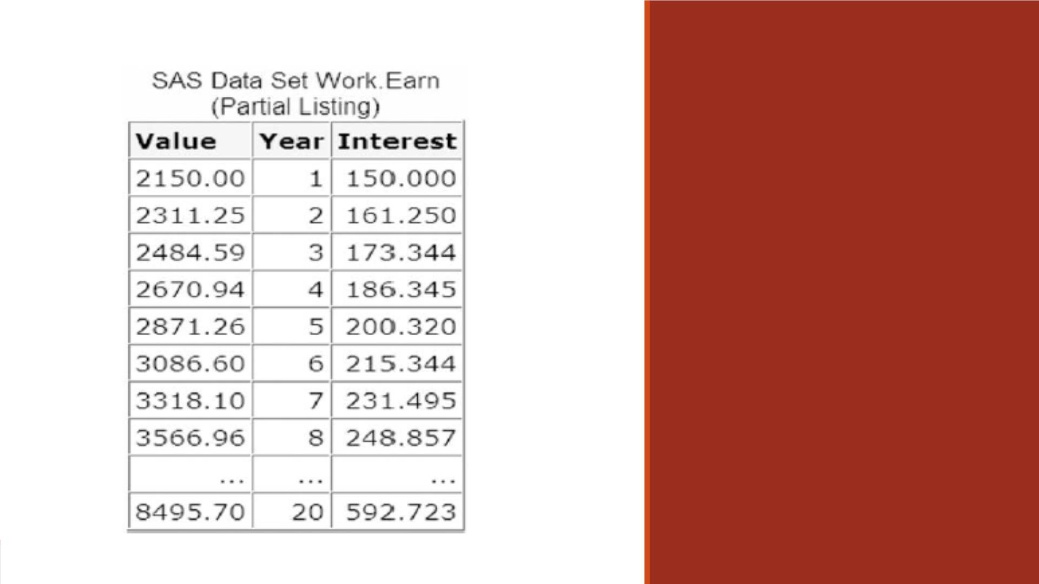
OUTPUT
Example

Slide 27
Demo—OUTPUT Statement
Compute the total amount of money you will have if you start with $100 and
invest it at a 3.75% interest rate for 3 years. Write the program with DO Loops
and drop the index variable “counter”.
▪Create a SAS dataset named lecture4_earnings4
▪List one observation for each iteration using OUTPUT statement
▪Contain variables “Interest_rate”, “ Total” and “Year ”
▪Assign “dollar10.2” format to the variable “ Total”
▪Print the dataset and title it “Listing of earnings with DO loops_every year”

Slide 28
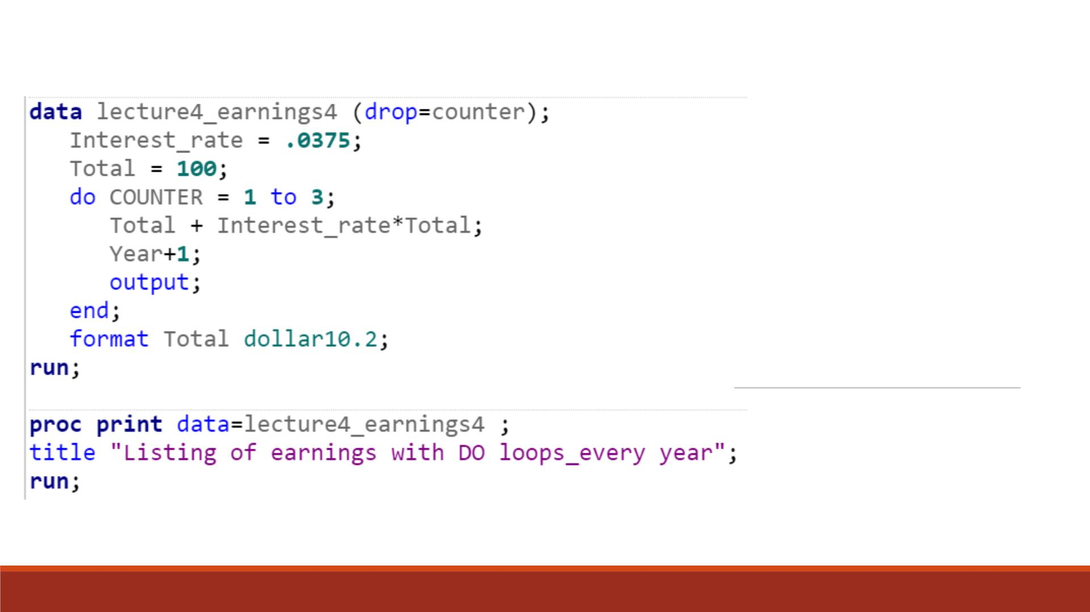
Code

Slide 29
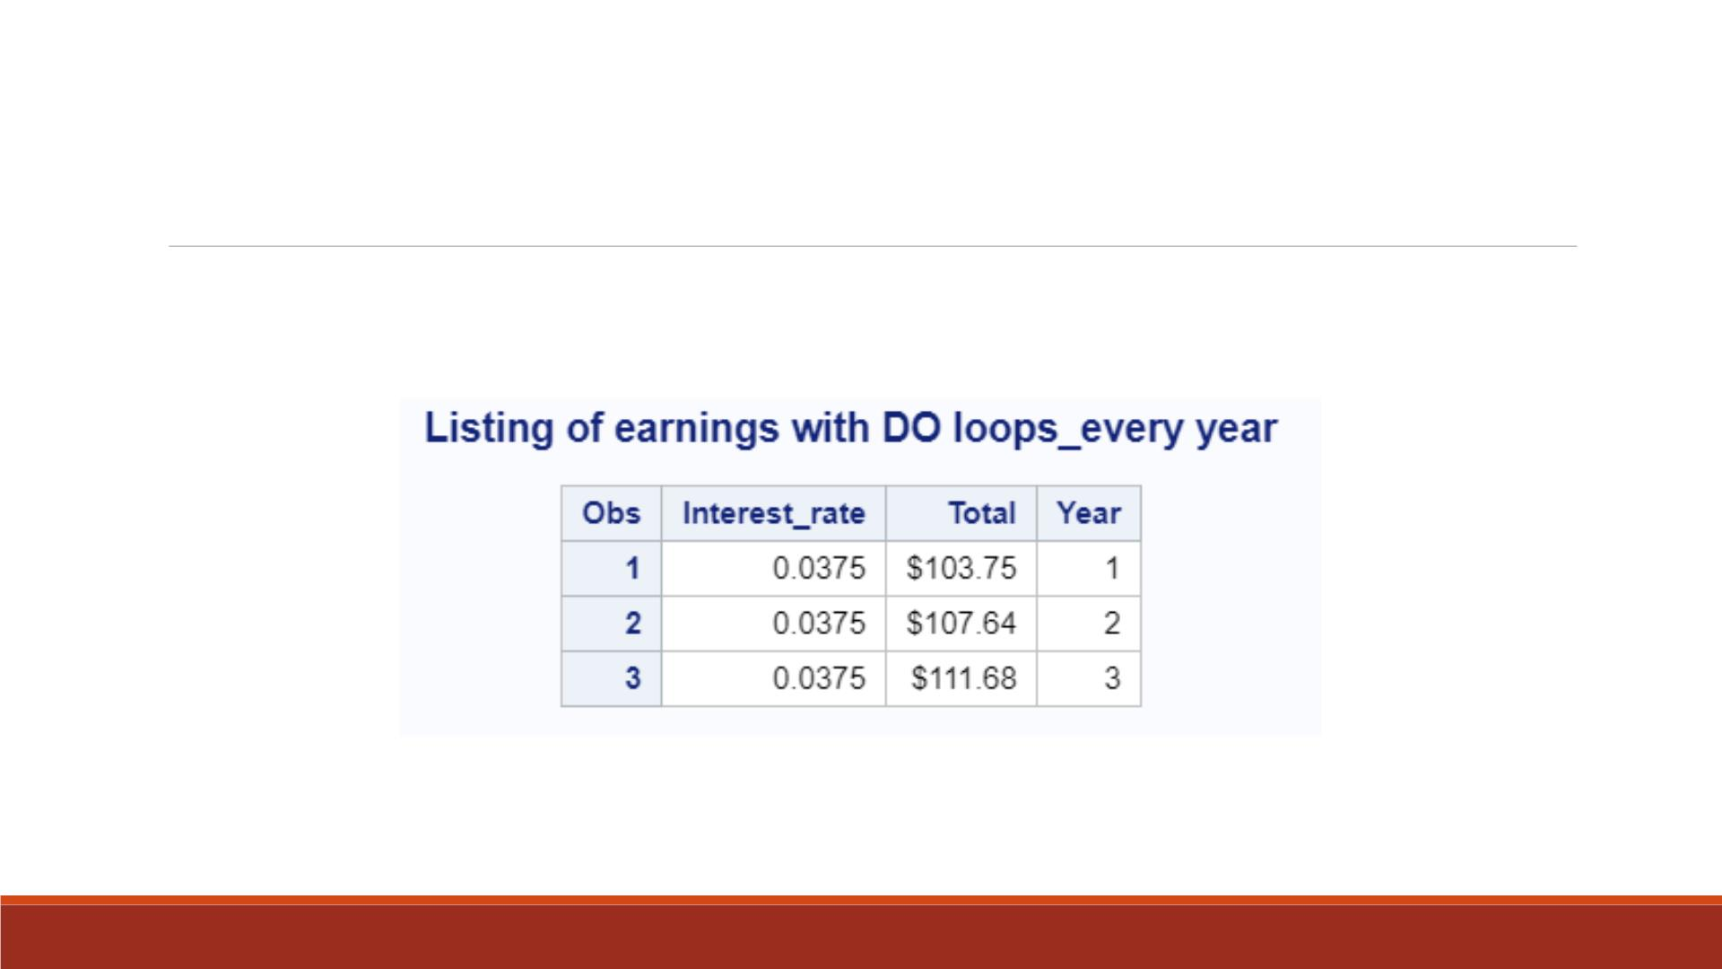
Proc Print Result

Slide 30
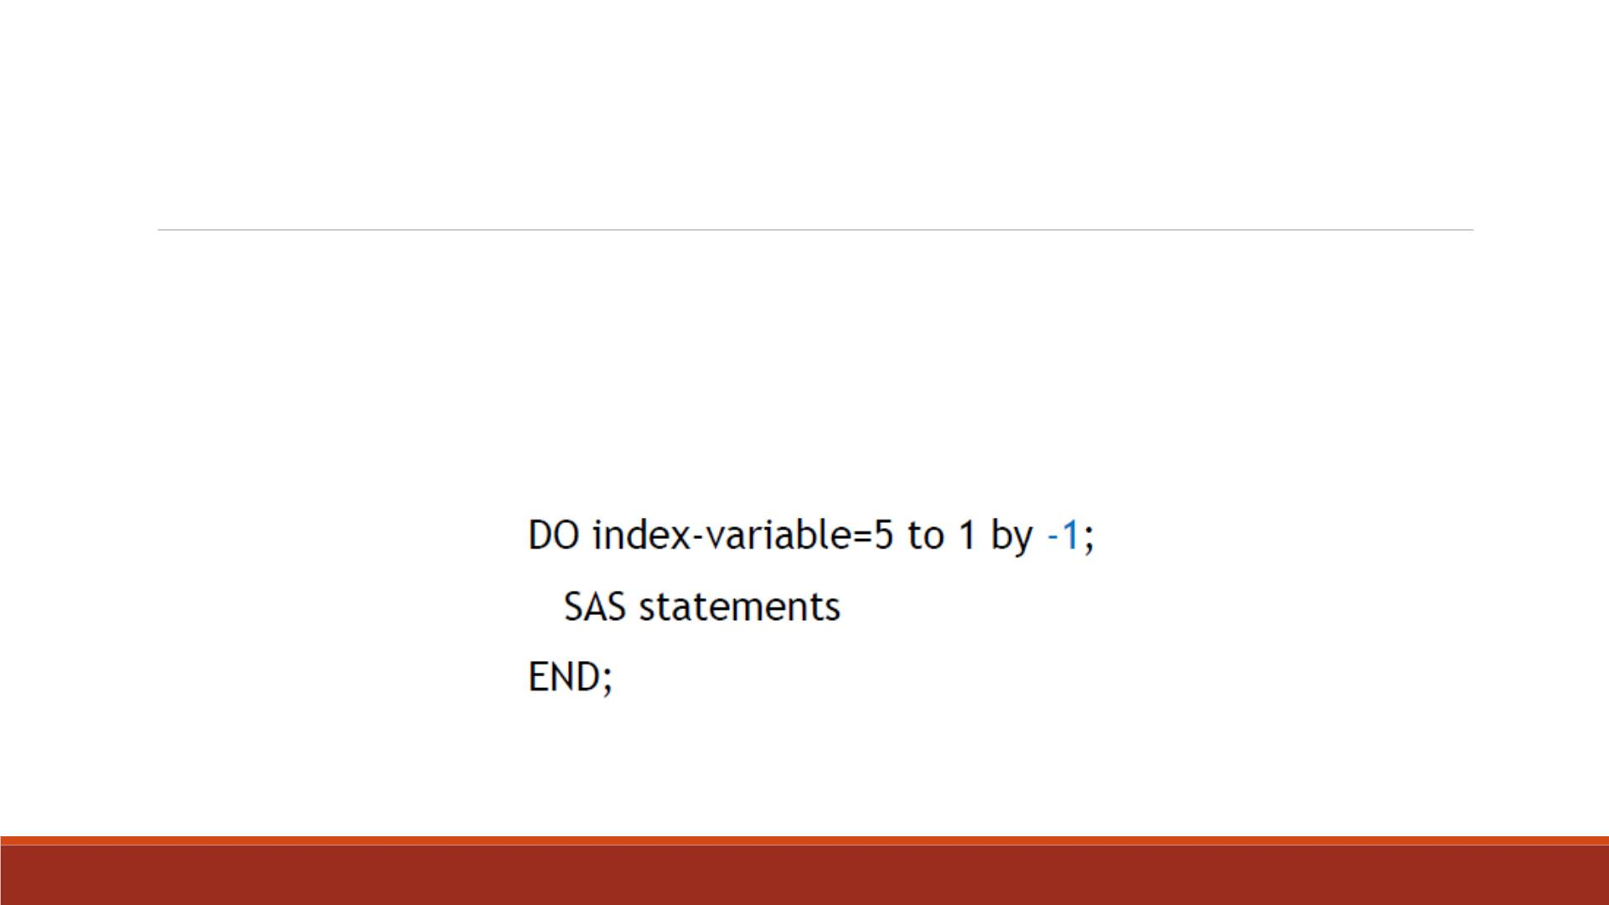
Decrementing DO Loops
▪You can decrement a DO loop's index variable by specifying a negative value for the BY clause.
▪For example, the specification in this iterative DO statement decreases the index variable by 1,
resulting in values of 5, 4, 3, 2, and 1.
▪When you use a negative BY clause value, the start value must always be greater than the stop value.

Slide 31
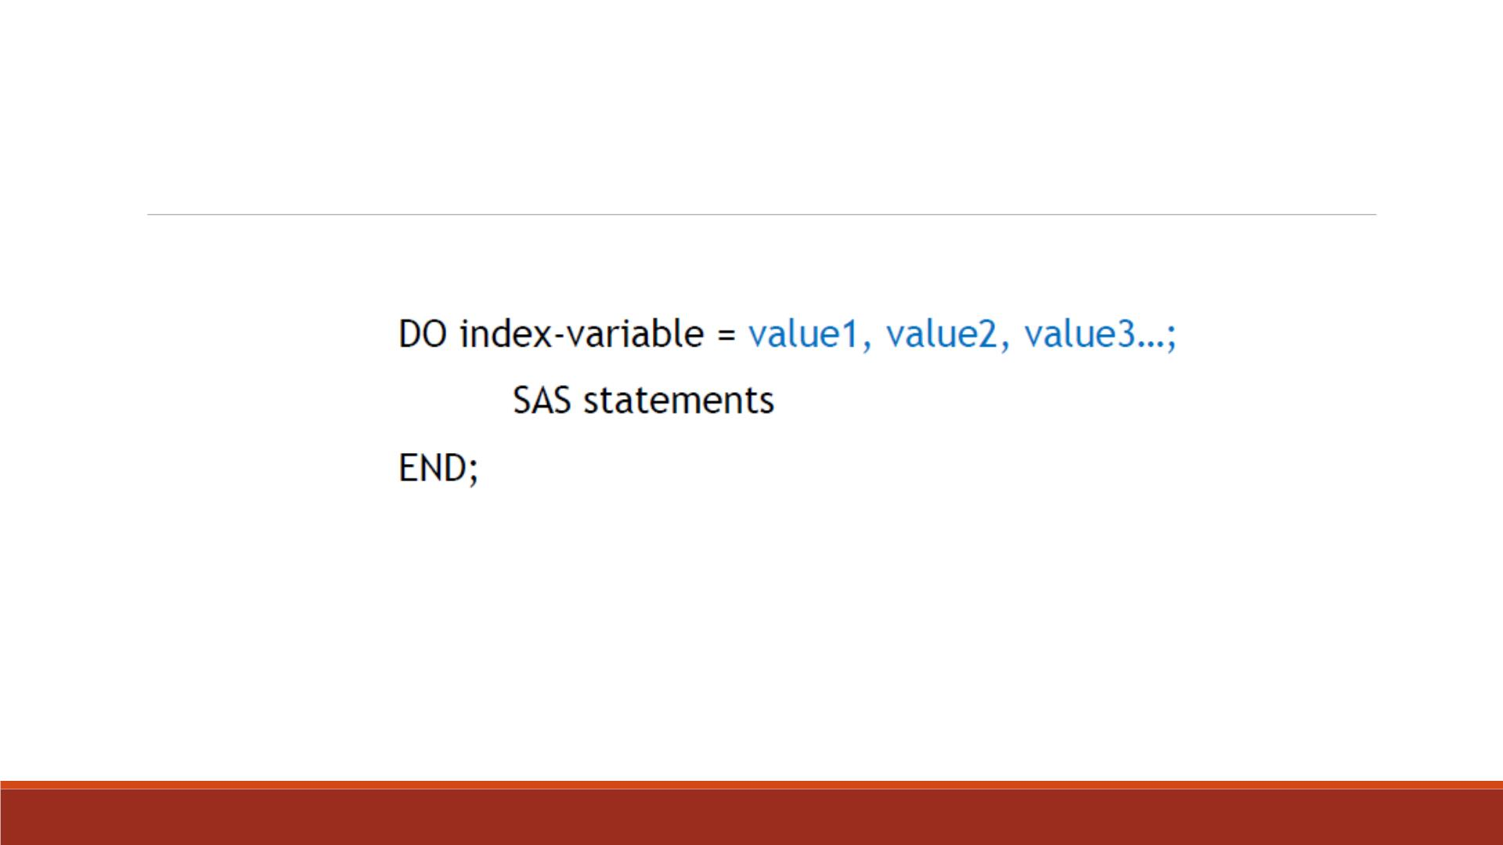
Specifying a Series of Items
▪General form:
▪Values can be character or numeric.
▪When the DO loop executes, it executes once for each item in the series.
▪Use commas to separate items in the series.

Slide 32
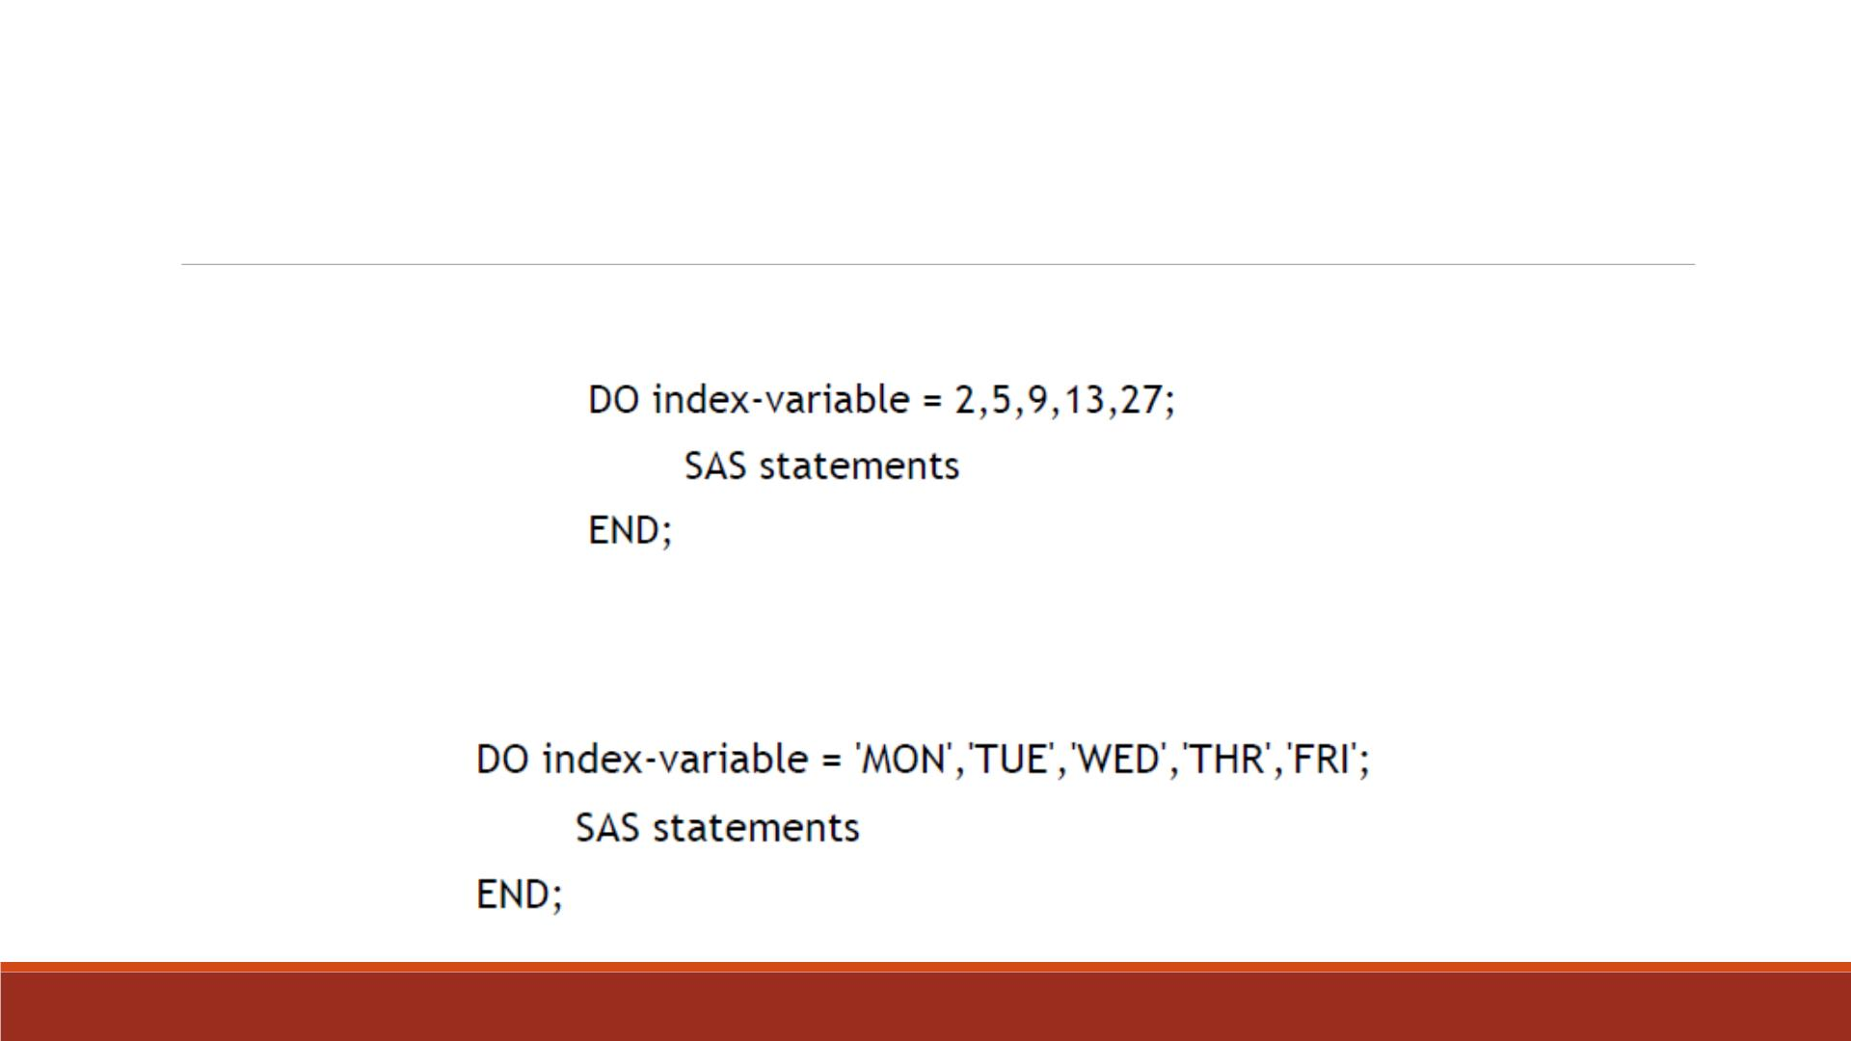
List Items in a Series
▪all numeric values
▪all character values, with each value enclosed in quotation marks

Slide 33
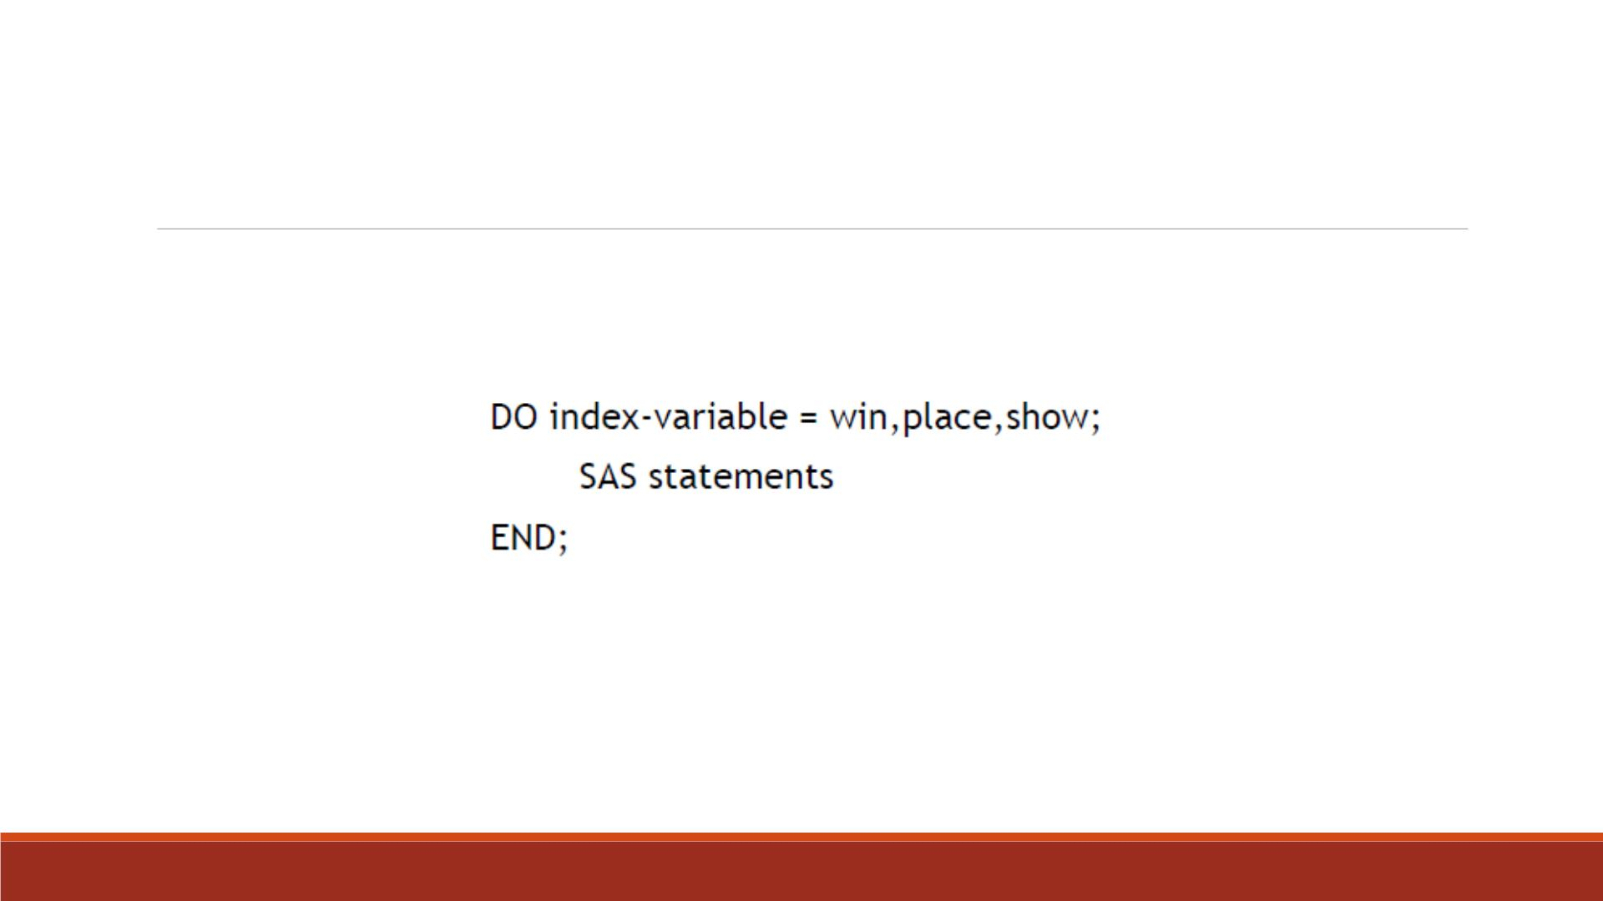
List Items in a Series
▪all variable names—the index variable takes on the values of the specified variables.
Note: Variable names must represent either all numeric or all character values. Do not
enclose variable names in quotation marks.

Slide 34
Conditional DO Loops

Slide 35
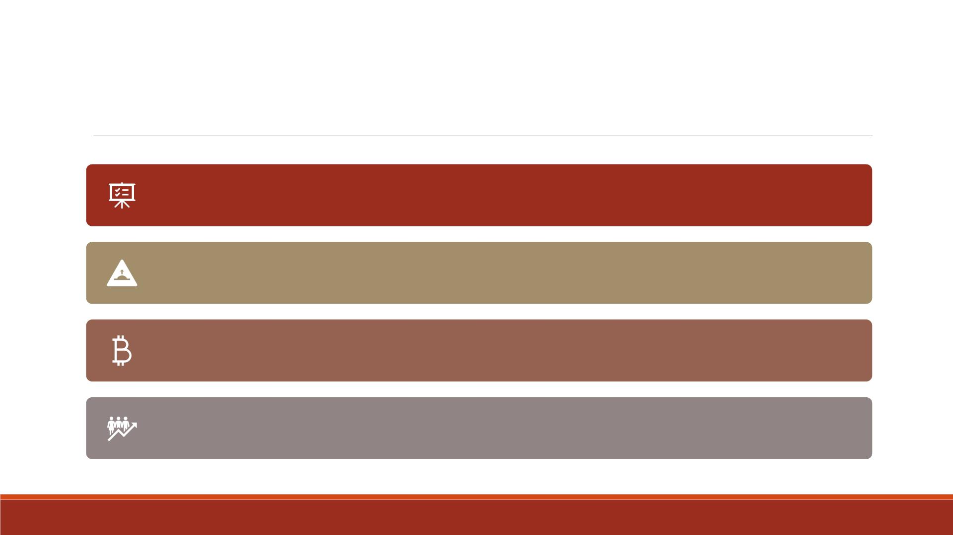
Conditionally Executing DO Loops
The iterative DO statement specifies a fixed number of iterations for the DO loop.
There are times when you want to execute a DO loop until a condition is reached
or while a condition exists, but you don't know how many iterations are needed.
Suppose you want to calculate the number of years required for an investment to
reach $50,000.
Using an iterative DO statement is inappropriate because you are trying to
determine the number of iterations required to reach $50,000.

Slide 36
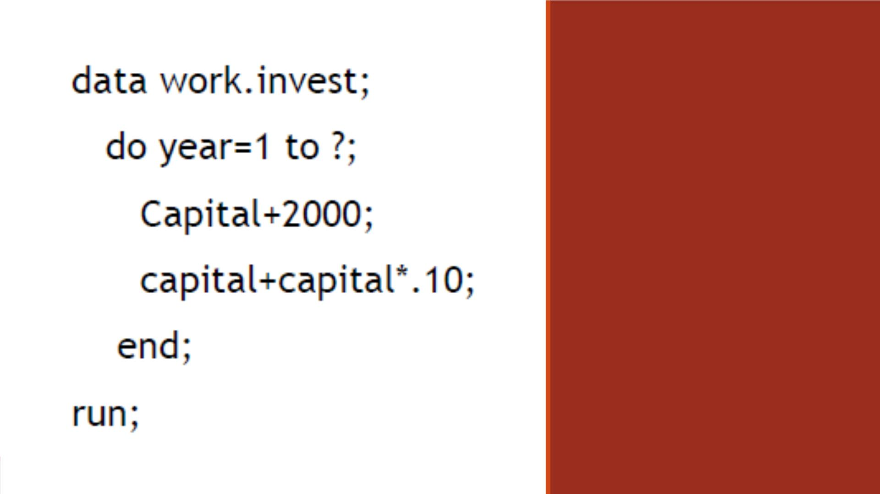
Conditional
DO Loops
DO WHILE and DO UNTIL
statements enable you to
execute DO loops based on
whether a condition is true
or false.

Slide 37
DO UNTIL Statement
▪Executes a DO loop until the expression becomes true
▪General form:
DO UNTIL(expression);
SAS statements
END;
▪Expression is a valid SAS expression enclosed in parentheses.
▪The expression is not evaluated until the bottom of the loop, so a DO UNTIL loop always
executes at least once.
▪When the expression is evaluated as true, the DO loop stops.

Slide 38
DO WHILE Statement
▪Execute a DO loop while the expression is true
▪General form:
DO WHILE(expression);
SAS statements
END;
▪Expression is a valid SAS expression enclosed in parentheses.
▪An important difference between the DO UNTIL and DO WHILE statements is that the DO
WHILE expression is evaluated at the top of the DO loop.
▪If the expression is false the first time it is evaluated, the DO loop never executes.

Slide 39
Demo—Conditional DO Loops
You want to know how many years it will take to earn $50,000 if you deposit $2,000
each year into an account that earns 10% interest.
▪Use DO UNTIL statement
▪Name the dataset lecture4_invest
▪Contain variables “Capital” as the total amount of deposit, “Year ”
▪Repeat the same code with DO WHILE statement and see what happens

Slide 40
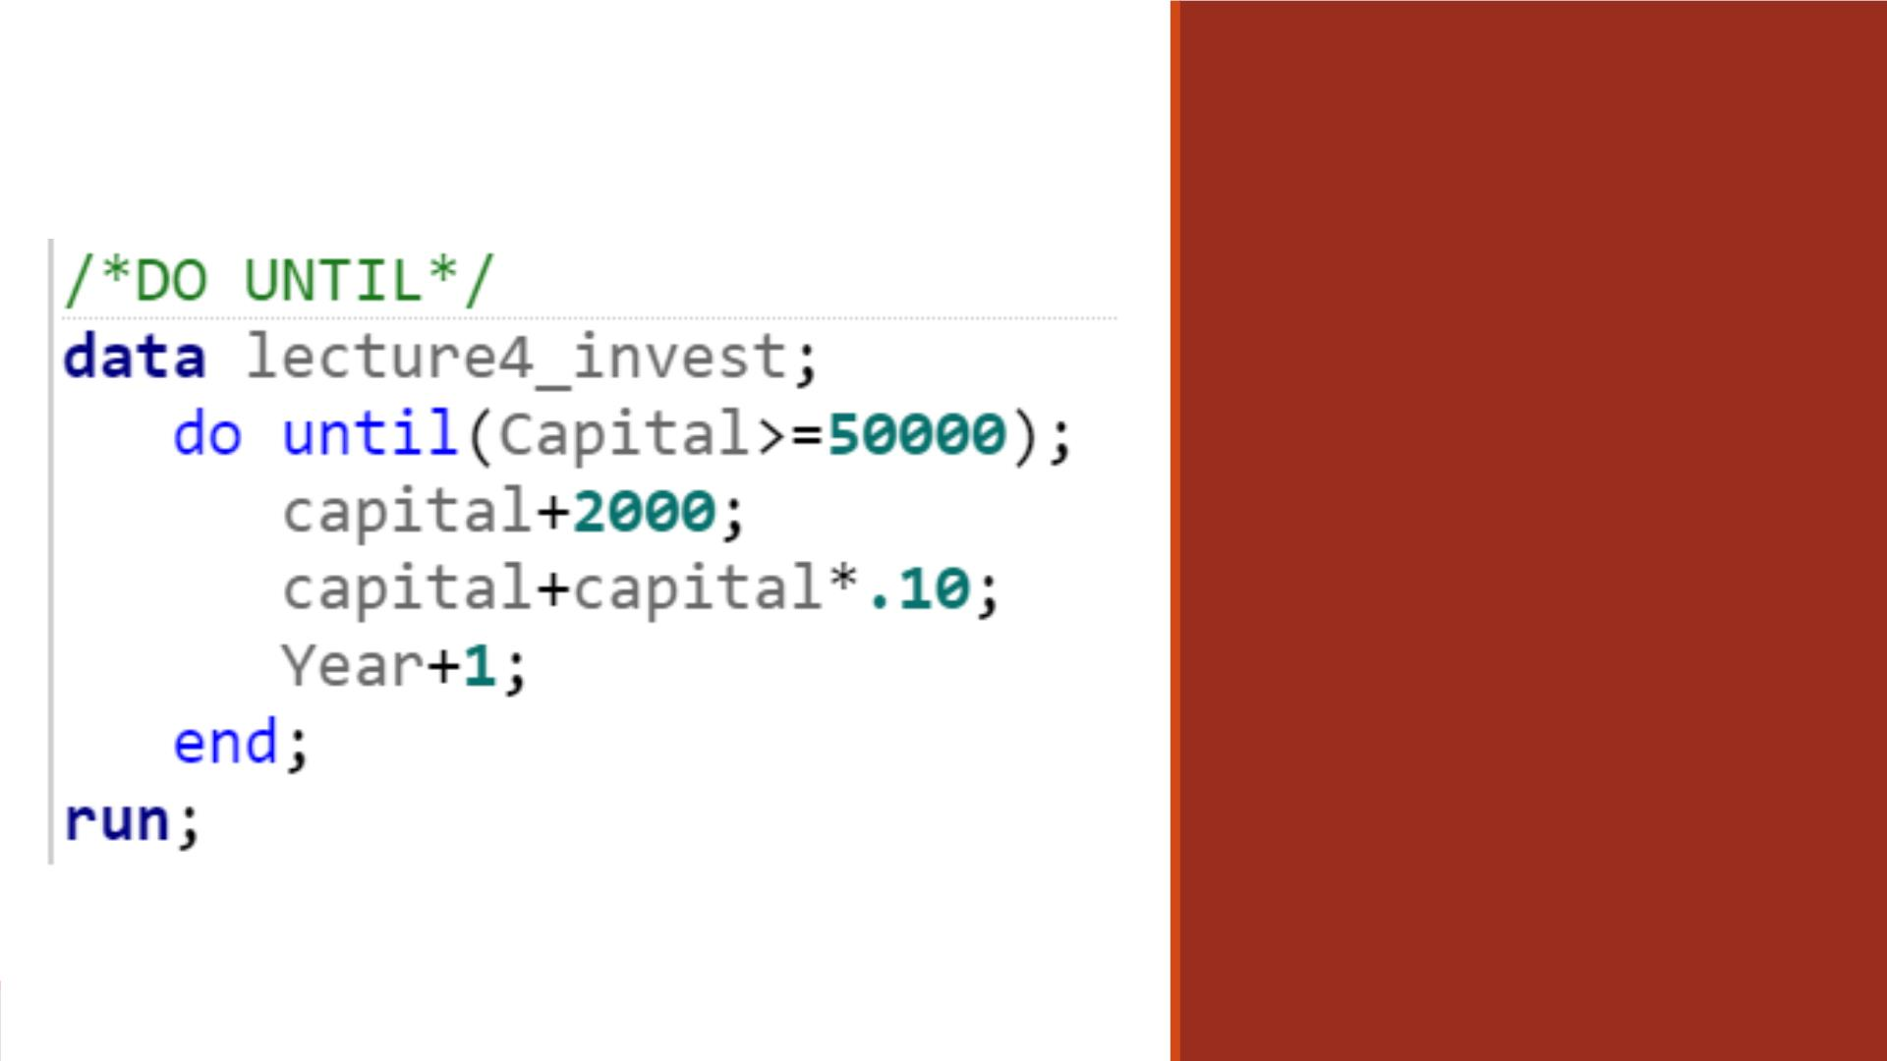
Code

Slide 41
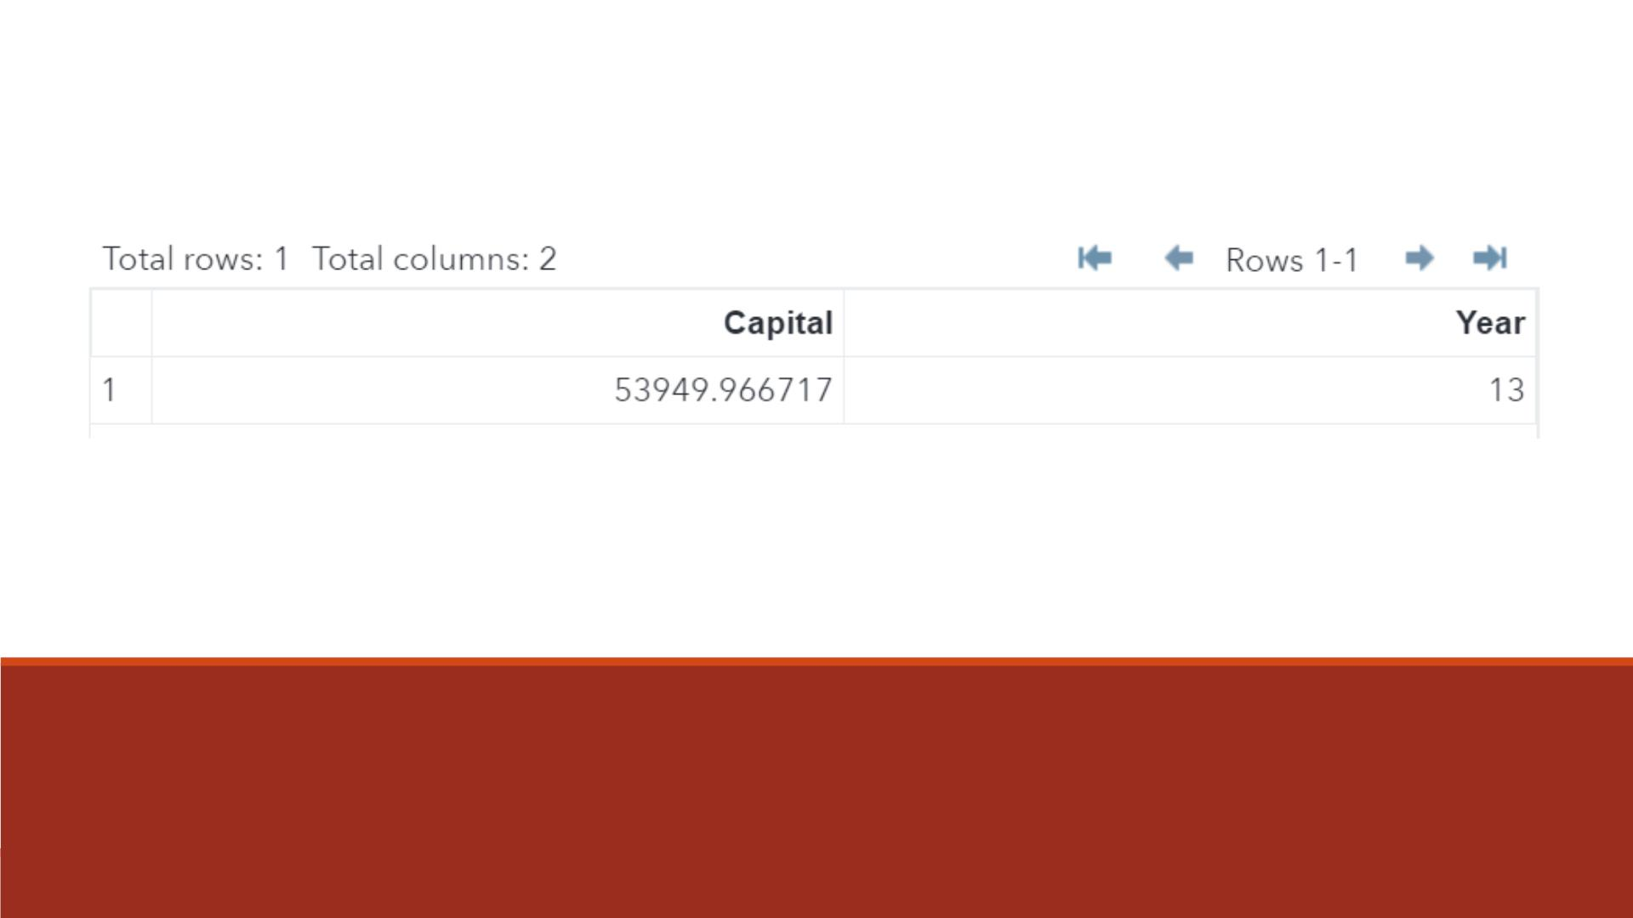
Data

Slide 42
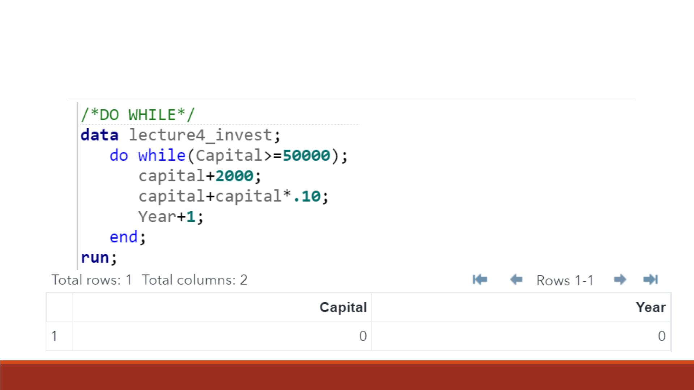
DO WHILE
Note: Do loop is never
executed.

Slide 43
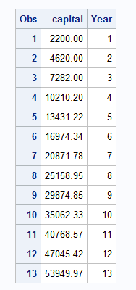
Correct DO-WHILE
data lecture4b_invest;
capital = 0;
do while(capital < 50000);
capital+2000;
capital+capital*.10;
Year+1;
output;
end;
run;
proc print data=lecture4b_invest;
title "Listing of earnings with DO-WHILE loops: It works!";
run;

Slide 44
Conditional and Iterative DO Loops

Slide 45
Conditional and Iterative DO Statement
▪DO WHILE and DO UNTIL statements enable you to execute statements conditionally.
▪Iterative DO statement enables you to execute statements a set number of times
unconditionally.
DO WHILE(expression);
DO UNTIL(expression);
DO index-variable=start TO stop BY increment;

Slide 46
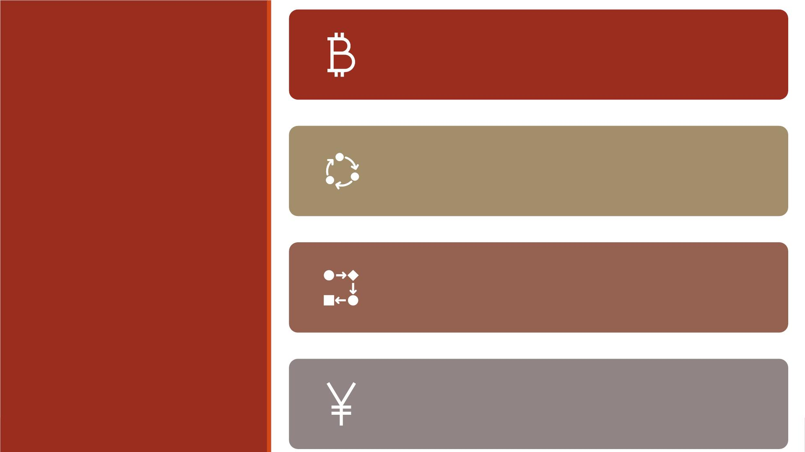
Yo u want to determine how many years it takes for an
investment to reach $50,000 and limit the number of
years you invest your capital to 10 years.
Yo u can add the UNTIL or WHILE expression to an
iterative DO statement to further control the number
of iterations.
Example
The iterative DO statement enables you to execute the
DO loop until “Capital” is greater than or equal to
50000 or until the DO loop executes ten times,
whichever occurs first.
do year=1 to 10 until(Capital>=50000);

Slide 47
Conditional and Iterative Do Loops
▪Both statements require a valid SAS expression enclosed in parentheses.
DO index-variable=start TO stop BY increment UNTIL(expression);
DO index-variable=start TO stop BY increment WHILE(expression);
▪The UNTIL expression is evaluated at the bottom of the DO loop, so the DO loop always
executes at least once.
▪The WHILE expression is evaluated before the execution of the DO loop. So, if the condition is
initially false, the DO loop never executes.

Slide 48
Exercise—Conditional and Iterative DO
▪Yo u want to determine how many years it takes for an investment to reach $50,000 and
limit the number of years you invest your capital to 10 years. Yo u invest $2000 every year.
▪Create a dataset named lecture4_invest with variables “Capital” and “Year ”
▪What if you invest $4000 every year?

Slide 49
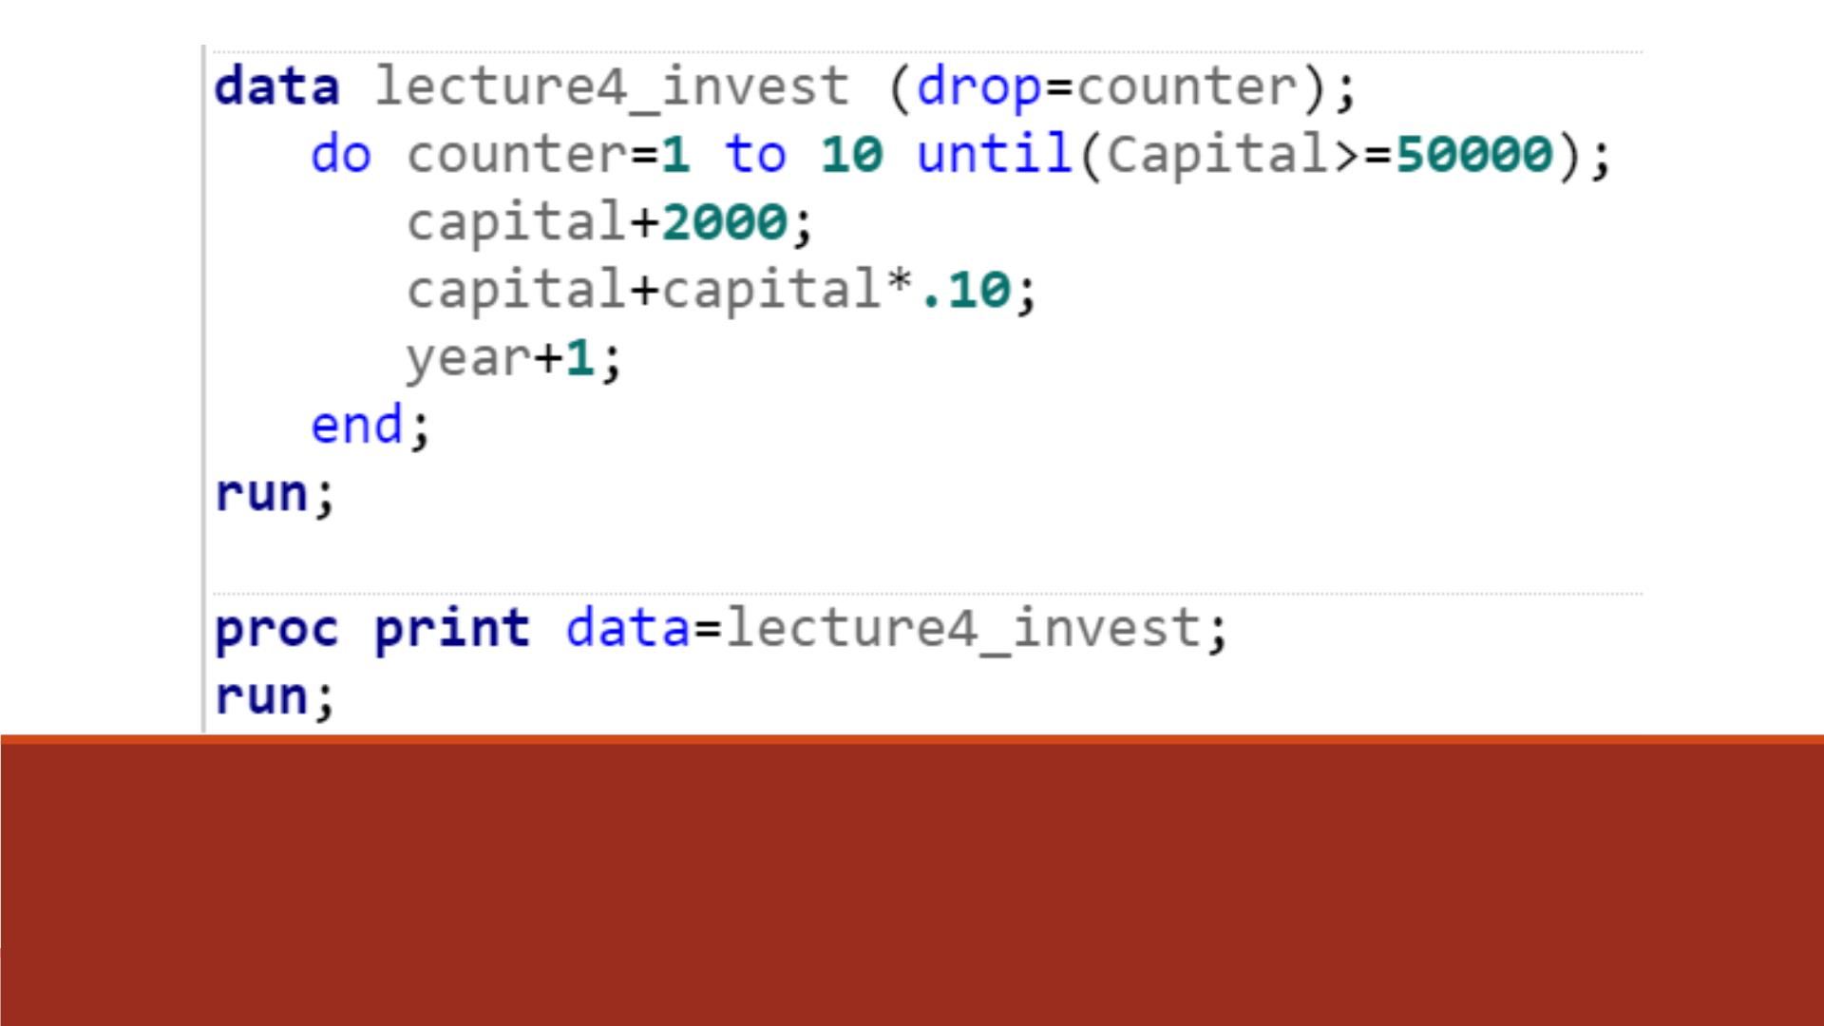
Code—DO UNTIL ($2000)

Slide 50
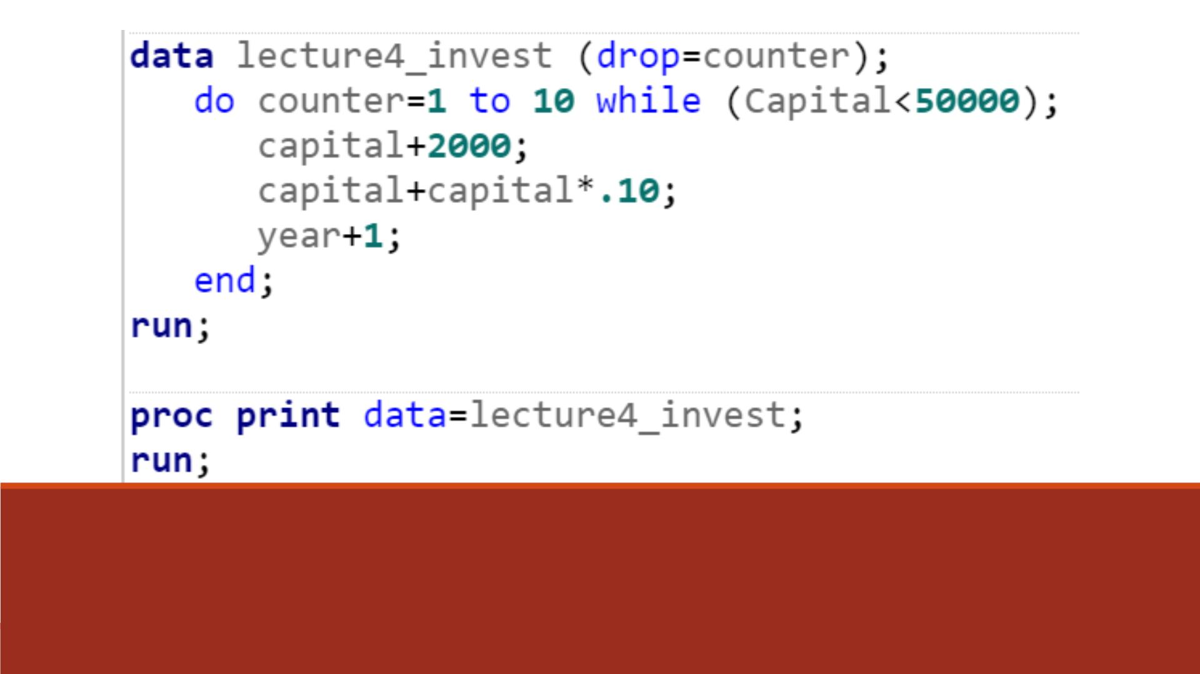
Code—DO WHILE ($2000)

Slide 51
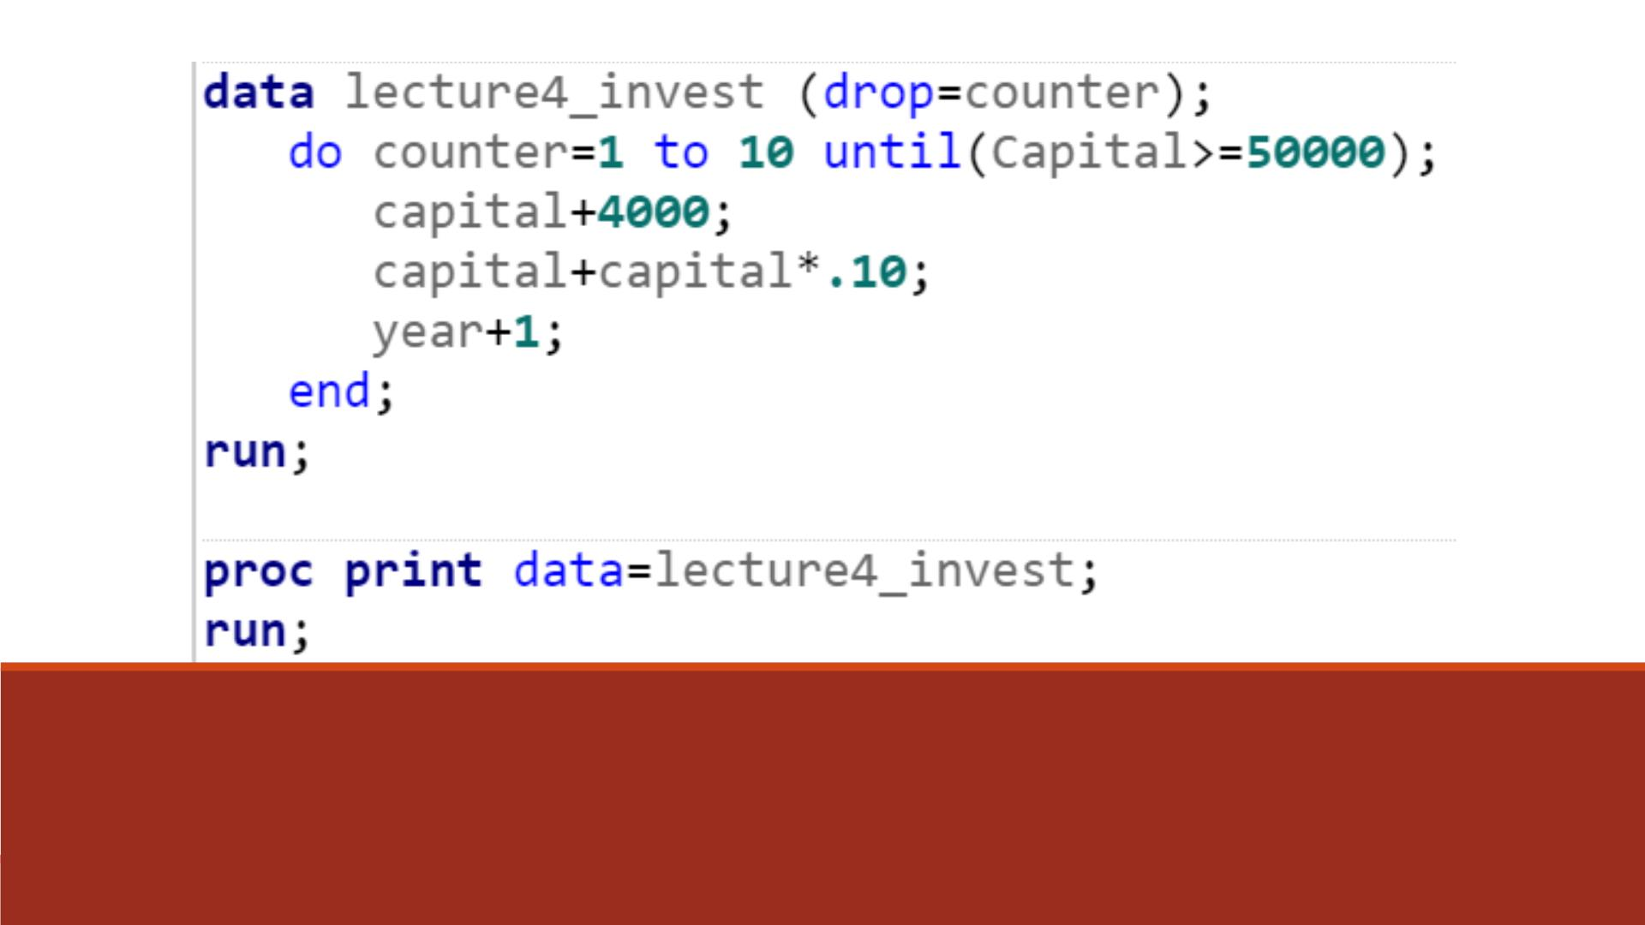
Code—DO UNTIL ($4000)

Slide 52
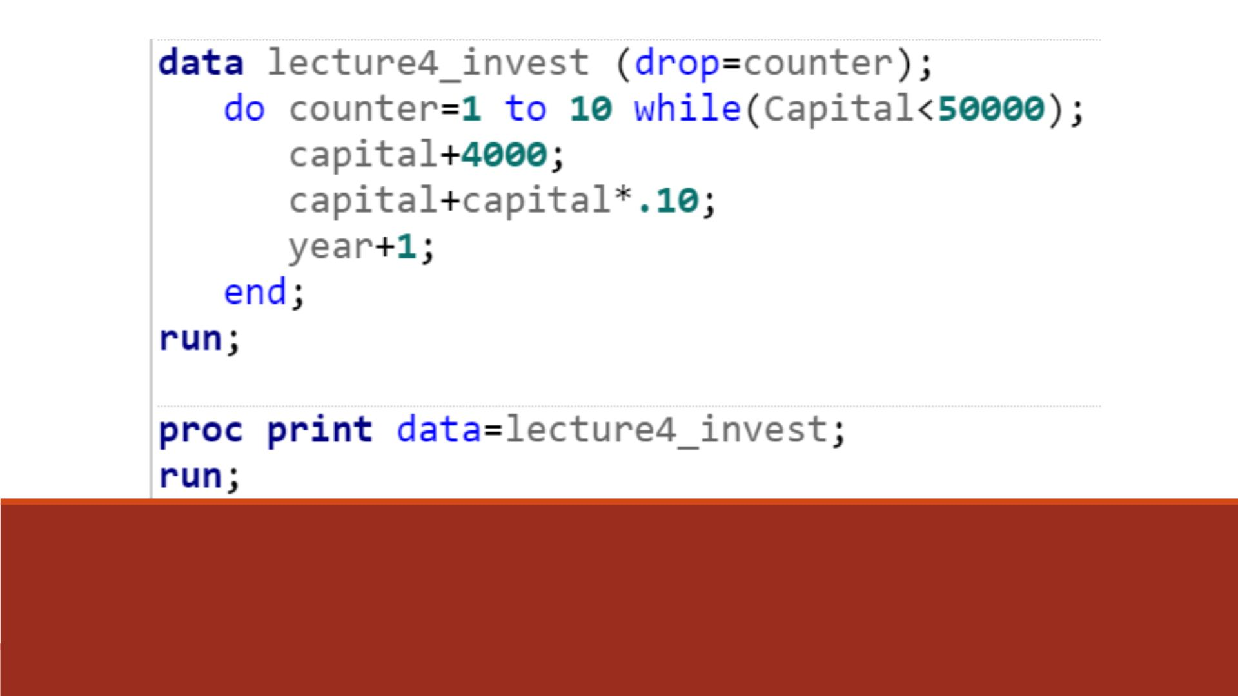
Code—DO WHILE ($4000)

Slide 53
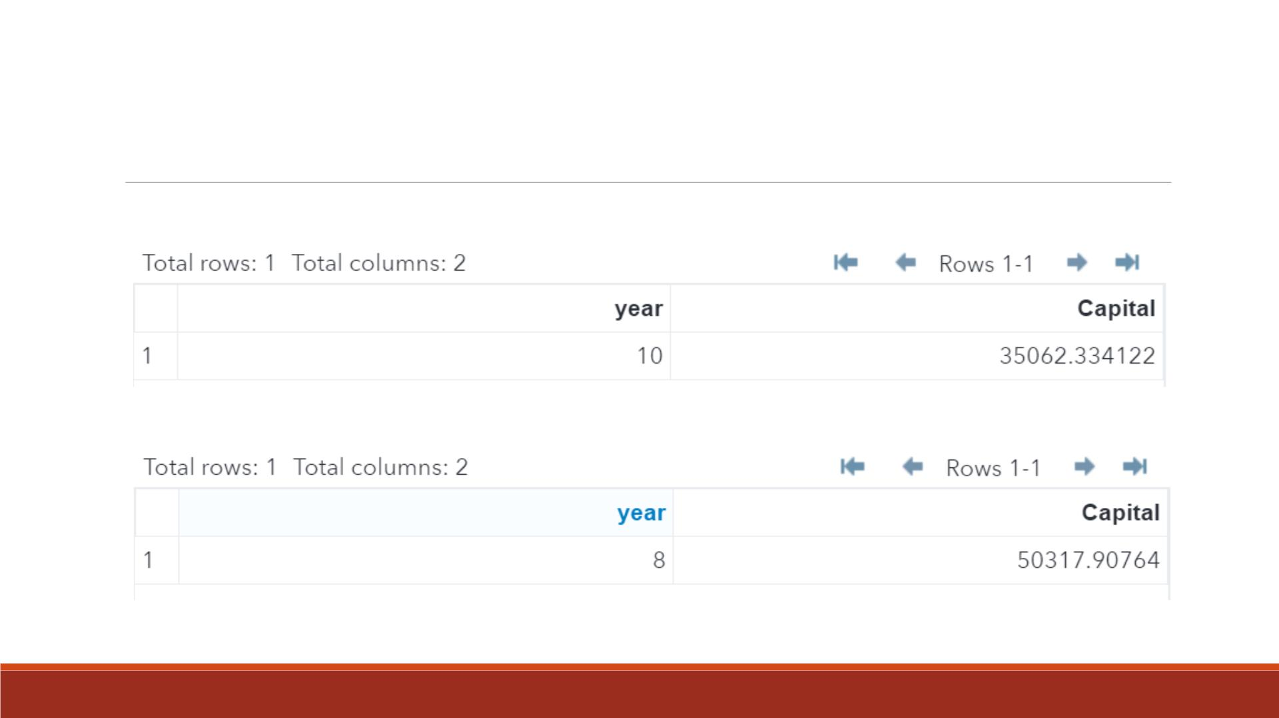
Data

