Slide 1

Processing Variables with
A r rays

Slide 2
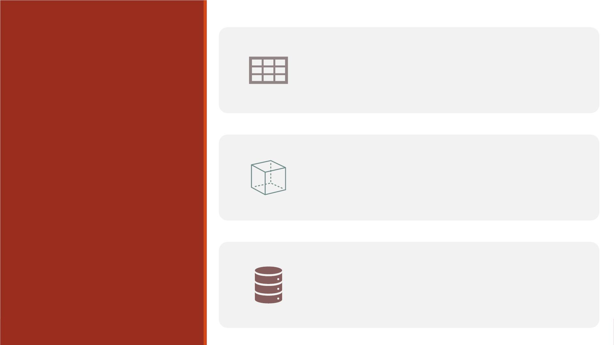
One-dimensional arrays
Outline
Nested DO Loops with two-dimensional
arrays
Reading: Base Guide (past
version) Ch15, Ch16
Rotating a table using arrays in D ATA
Step

Slide 3

One-Dimensional A r rays

Slide 4

Defining an Array to Create Variables
General form of ARRAY statement:
ARRAY array-name{dimension} <elements>;
▪array-name specifies the name of the array
▪dimension describes the number and arrangement of array elements.
▪elements lists the variables to include in the array. They can be existing variables, or
new variables to be created.
▪Array elements must be either all numeric or all character. If no elements are listed,
new variables will be created with default names.

Slide 5
Default Variable Names
▪When creating variables in an ARRAY statement, you do not need to specify array elements
if you specify how many elements will be in the array.
Array WageDiff{5};
▪The default variable names are created by concatenating the array name and the numbers
1, 2, 3, and so on, up to the array dimension.
Array score_var(3);
The new variable names will be score_var1, score_var2, score_var3.
▪If you prefer, specify individual variable names.
array score_var(3) score1 score2 score3;

Slide 6
Arrays of Character Variables
▪To create an array of character variables, add a dollar sign ($) after the array dimension.
array firstname{5} $;
▪By default, all character variables that are created in an ARRAY statement are assigned a
length of 8. Yo u can assign your own length by specifying the length after the dollar
sign.
array firstname{5} $ 24;
▪The length (24 in the above example) that you specify is automatically assigned to all
variables that are created by the ARRAY statement.

Slide 7
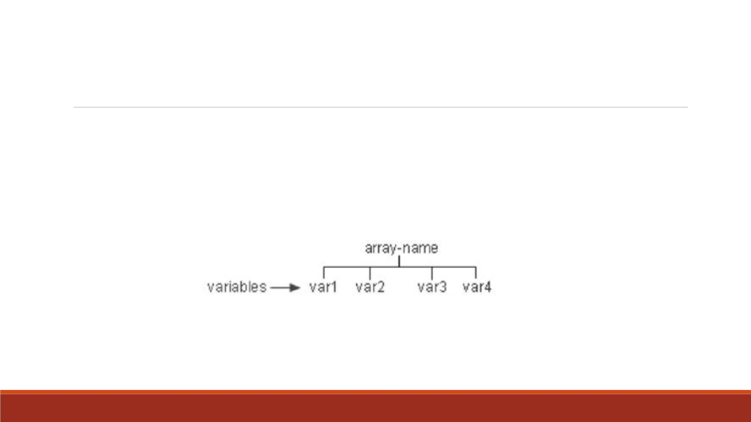
Understanding SAS Arrays
A SAS array is a temporary grouping of SAS variables under a single name. An array
exists only for the duration of the D ATA step.

Slide 8
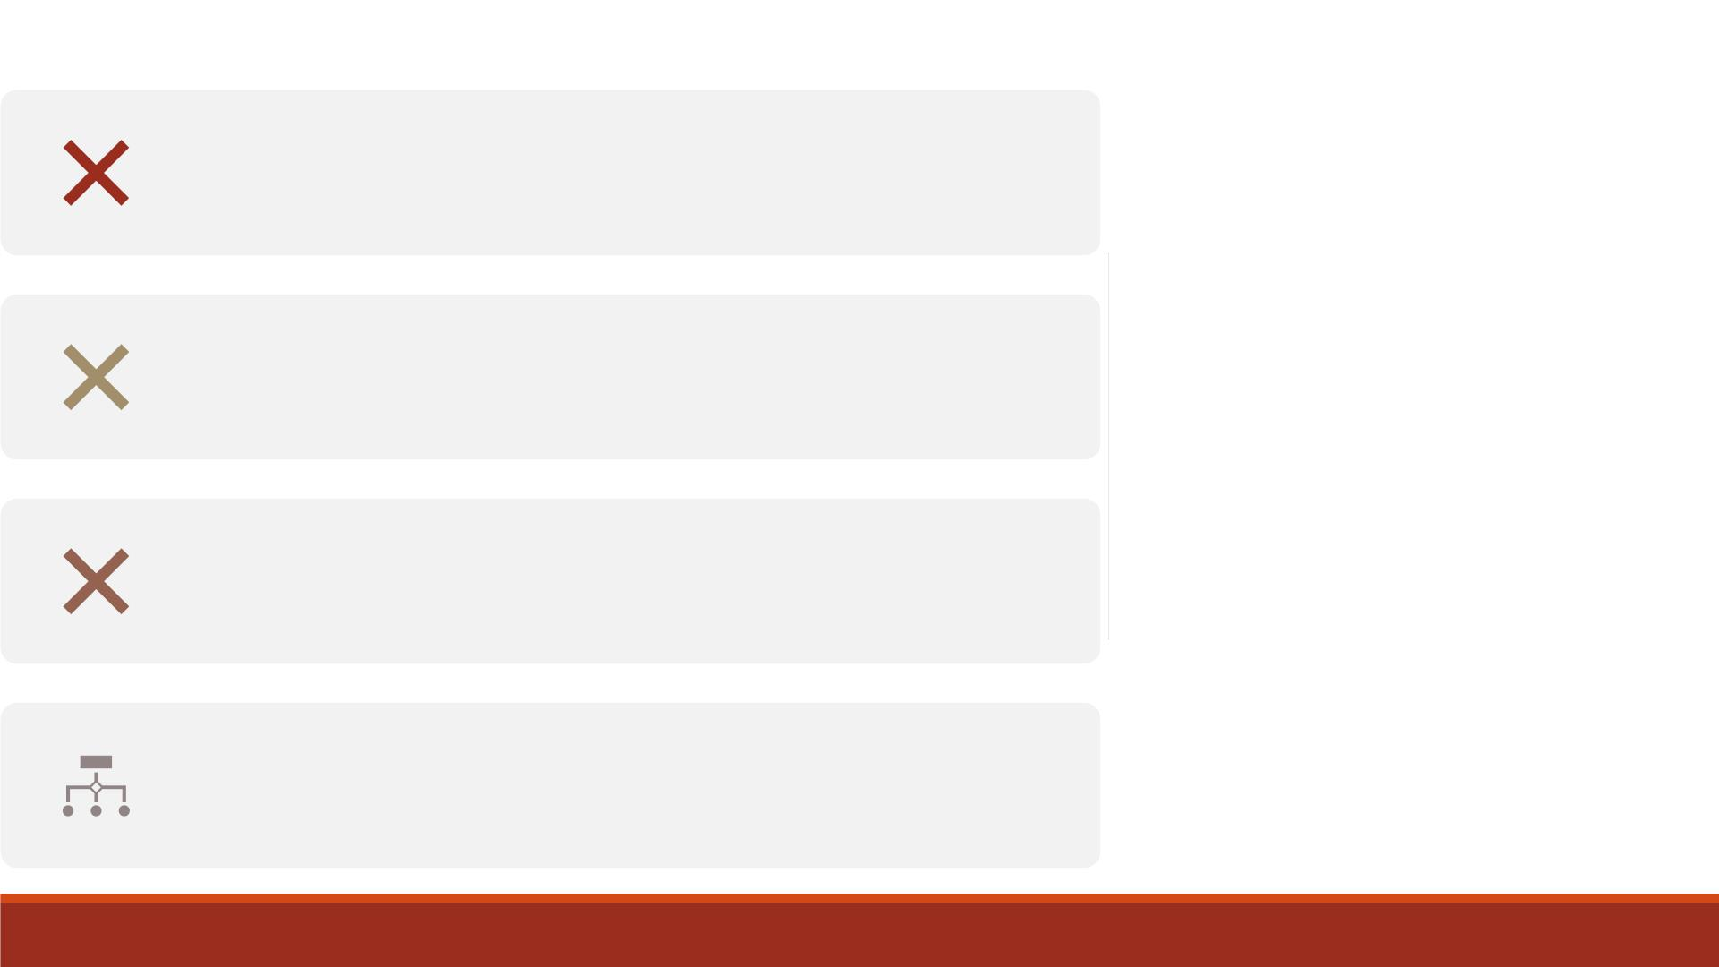
Do not give an array the same name as a variable in the
same D ATA step.
Avoid using the name of a SAS function, otherwise you
won't be able to use the function in the same D ATA step.
Caution
Yo u cannot use array names in LABEL, FORMAT, DROP,
KEEP, or LENGTH statements.
Arrays exist only for the duration of the D ATA step.

Slide 9

The dimension describes the number and arrangement of
elements. Several ways to specify a one-dimensional array:
▪Simply specify the number of array elements. Example:
array sales{4} qtr1 qtr2 qtr3 qtr4;
Specifying
the
Dimension
▪Specify a range of values for the dimension when you
define the array instead of the total number. Example:
array sales{96:99} totals1 totals2 totals3 totals4;
▪Use an asterisk *, then SAS determines the dimension by
counting the number of elements. Example:
array sales{*} qtr1 qtr2 qtr3 qtr4;
▪Enclose the dimension in either parentheses(), braces{}, or
brackets[].

Slide 10
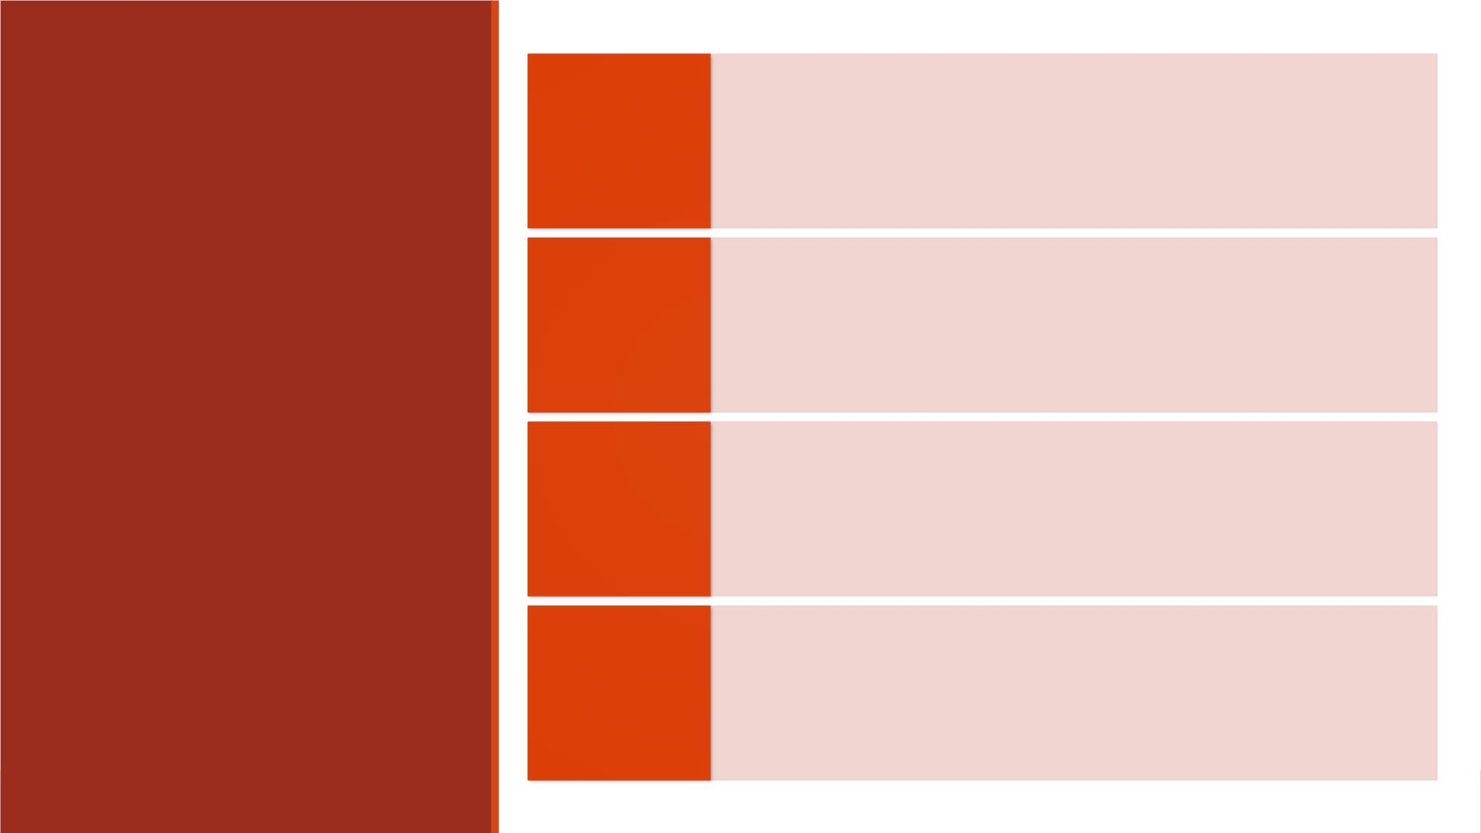
List each variable name that you want to include
in the array. When listing, separate each element
with a space, then end with a semicolon (;).
Specifying
Array
Elements
array sales{4} qtr1 qtr2 qtr3 qtr4;
Use a variable list.
array sales{4} qtr1-qtr4;

Slide 11
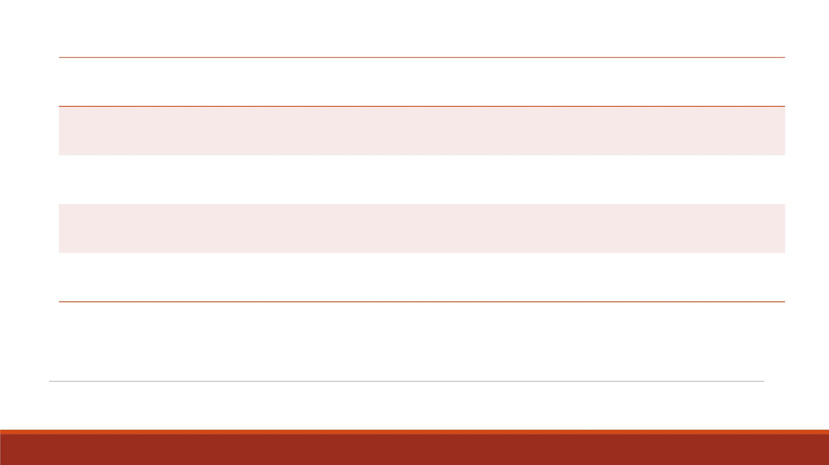
Variables
Form
a numbered range of variables
all numeric variables
Var1-Varn
_NUMERIC_
_CHARACTER_
_ALL_
all character variables
all character or all numeric variables
Variable Lists as Array Elements

Slide 12
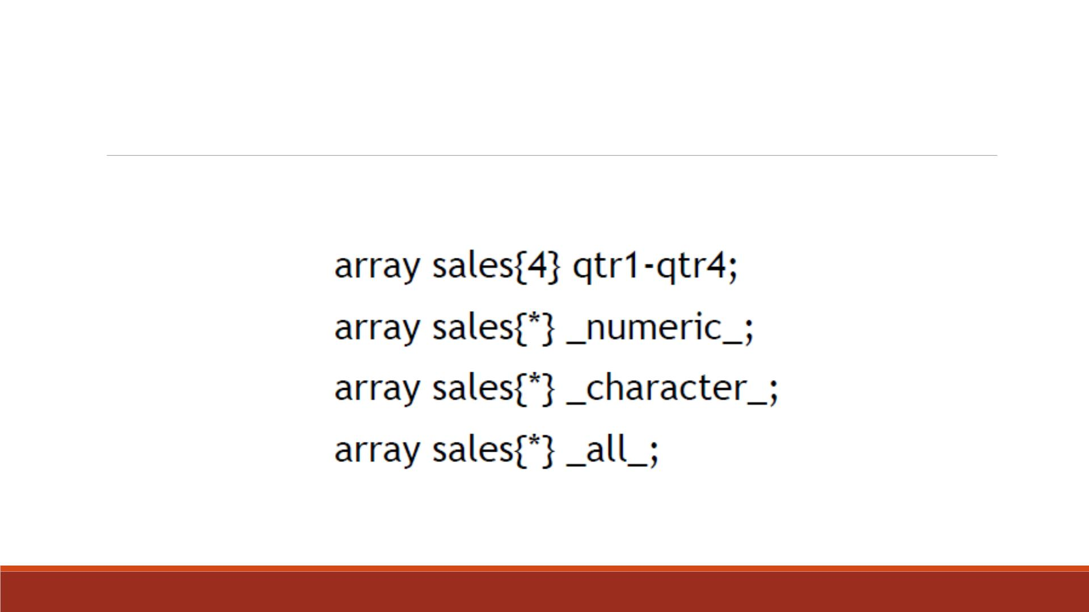
Variable List Examples

Slide 13
▪To reference an array element (a variable) in the D ATA step,
specify the name of the array, followed by a subscript value
enclosed in (), [] or {}.
Referencing
Elements of
an Array
▪General form:
array-name(subscript)
where subscript
❑is enclosed in parentheses, braces, or brackets
❑specifies a variable, a SAS expression, or an integer
❑is within the lower and upper bounds of the array dimension.

Slide 14
Additional information
Documents:
  SAS help center: Array statement: https://documentation.sas.com/doc/en/pgmsascdc/9.4_3.5/lestmtsref/p08do6szetrxe2n136ush727sbuo.htm
  Arrays made easy: https://support.sas.com/resources/papers/proceedings/proceedings/sugi30/242-30.pdf
YouTube:
  SAS array made easy: Syntax and example: https://www.youtube.com/watch?v=DgFtYQZJrJQ
  Arrays in SAS: https://www.youtube.com/watch?v=2JKBZPh_F6o

Slide 15
Arrays with DO Loops
▪Typically arrays are used with DO loops to process multiple variables and repetitive
calculations.
▪When used in a DO loop, the index variable of the iterative DO statement can reference
each element of the array.
▪For example, the DO loop below increments the index variable 푖 from the lower bound
of the quarter array 1, to the upper bound 4.
array quarter{4} jan apr jul oct;
do i=1 to 4;
YearGoal=quarter{i}*1.2;
end;

Slide 16
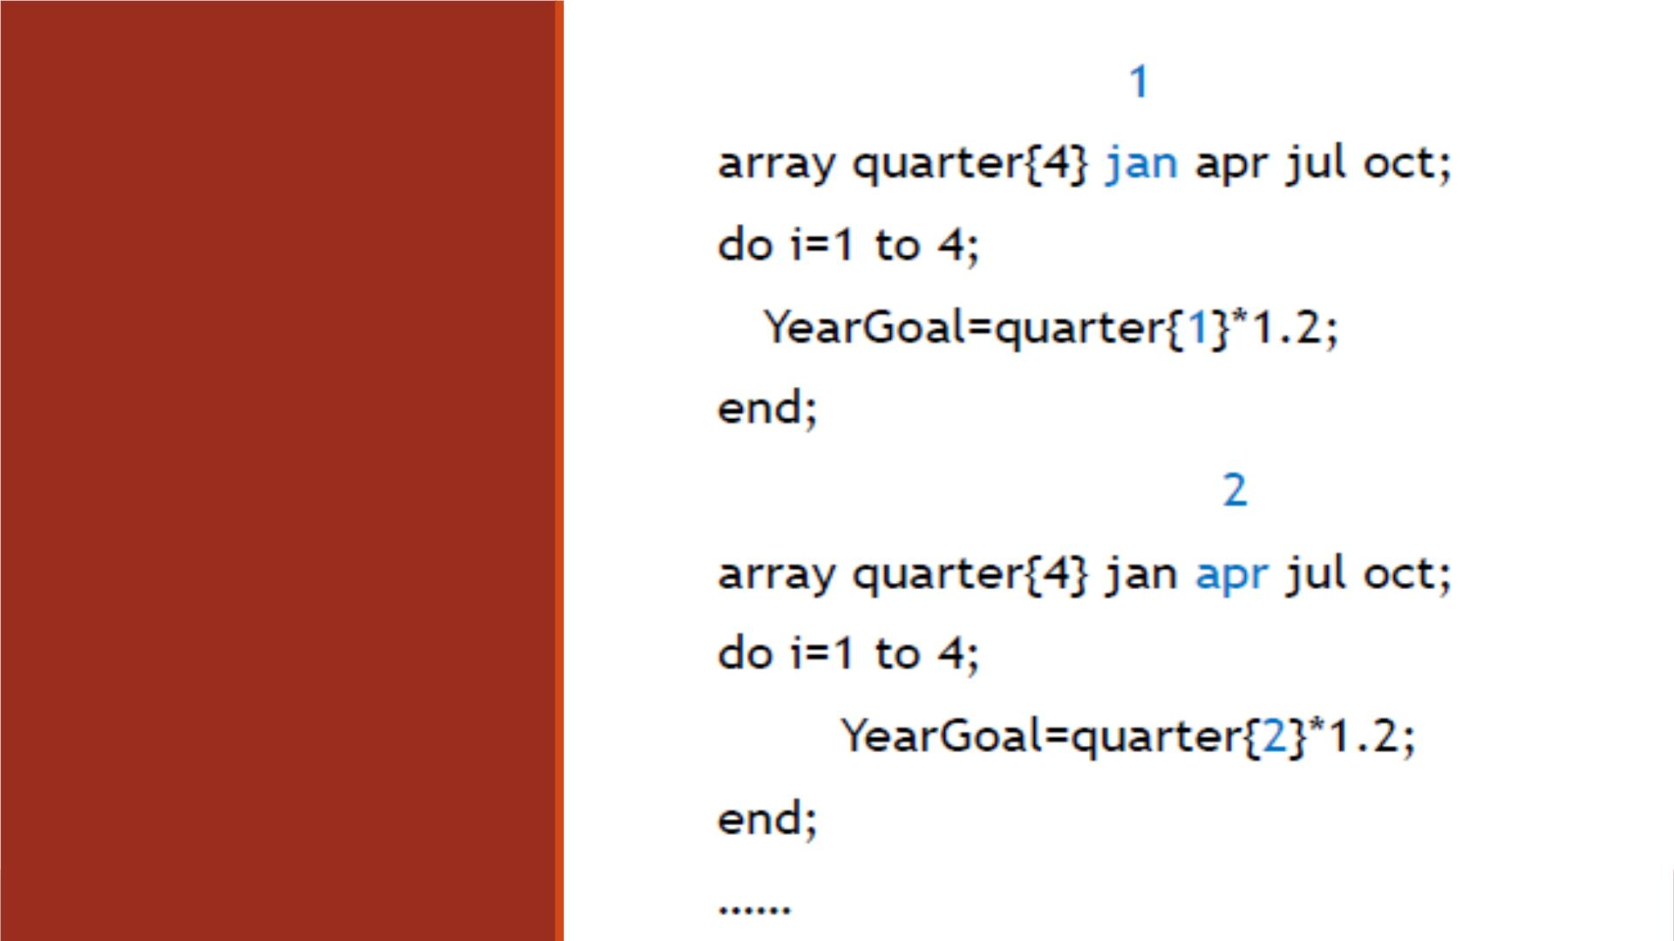
DO Loop
Processing
Steps

Slide 17
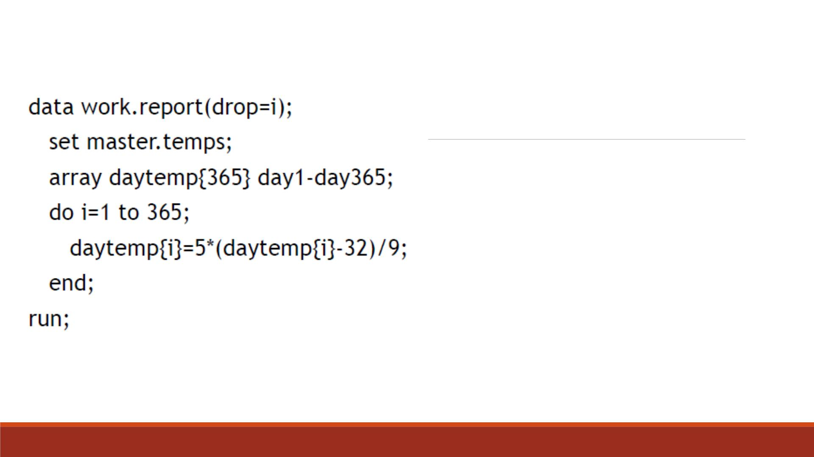
Example
▪We often need to perform the same
action on more than one variable.
▪It is easier to handle them as a group
using array processing than individually.
▪For example, we convert the daily
temperature from Fahrenheit to Celsius
for the year using an array and DO loop.

Slide 18
Demo 1—Create Array Variables
▪Import the Excel datafile “Lecture3_score_data_miss999.xlsx” into SAS, name it
“lecture5_scoredata0”
▪Create a SAS dataset “lecture5_scoredata1” based on “lecture5_scoredata0”
1. Create an array “score_var” with three variables named “score1”, “score2” and
“score3”
2. Use a DO loop to replace the score values 999 with . and drop the index variable
3. Compute the average of score 1-score3 for each observation
▪Print “lecture5_scoredata1” and title it “Missing values are shown as periods”
▪Print “lecture5_scoredata0” and title it “Missing values are shown as 999”

Slide 19
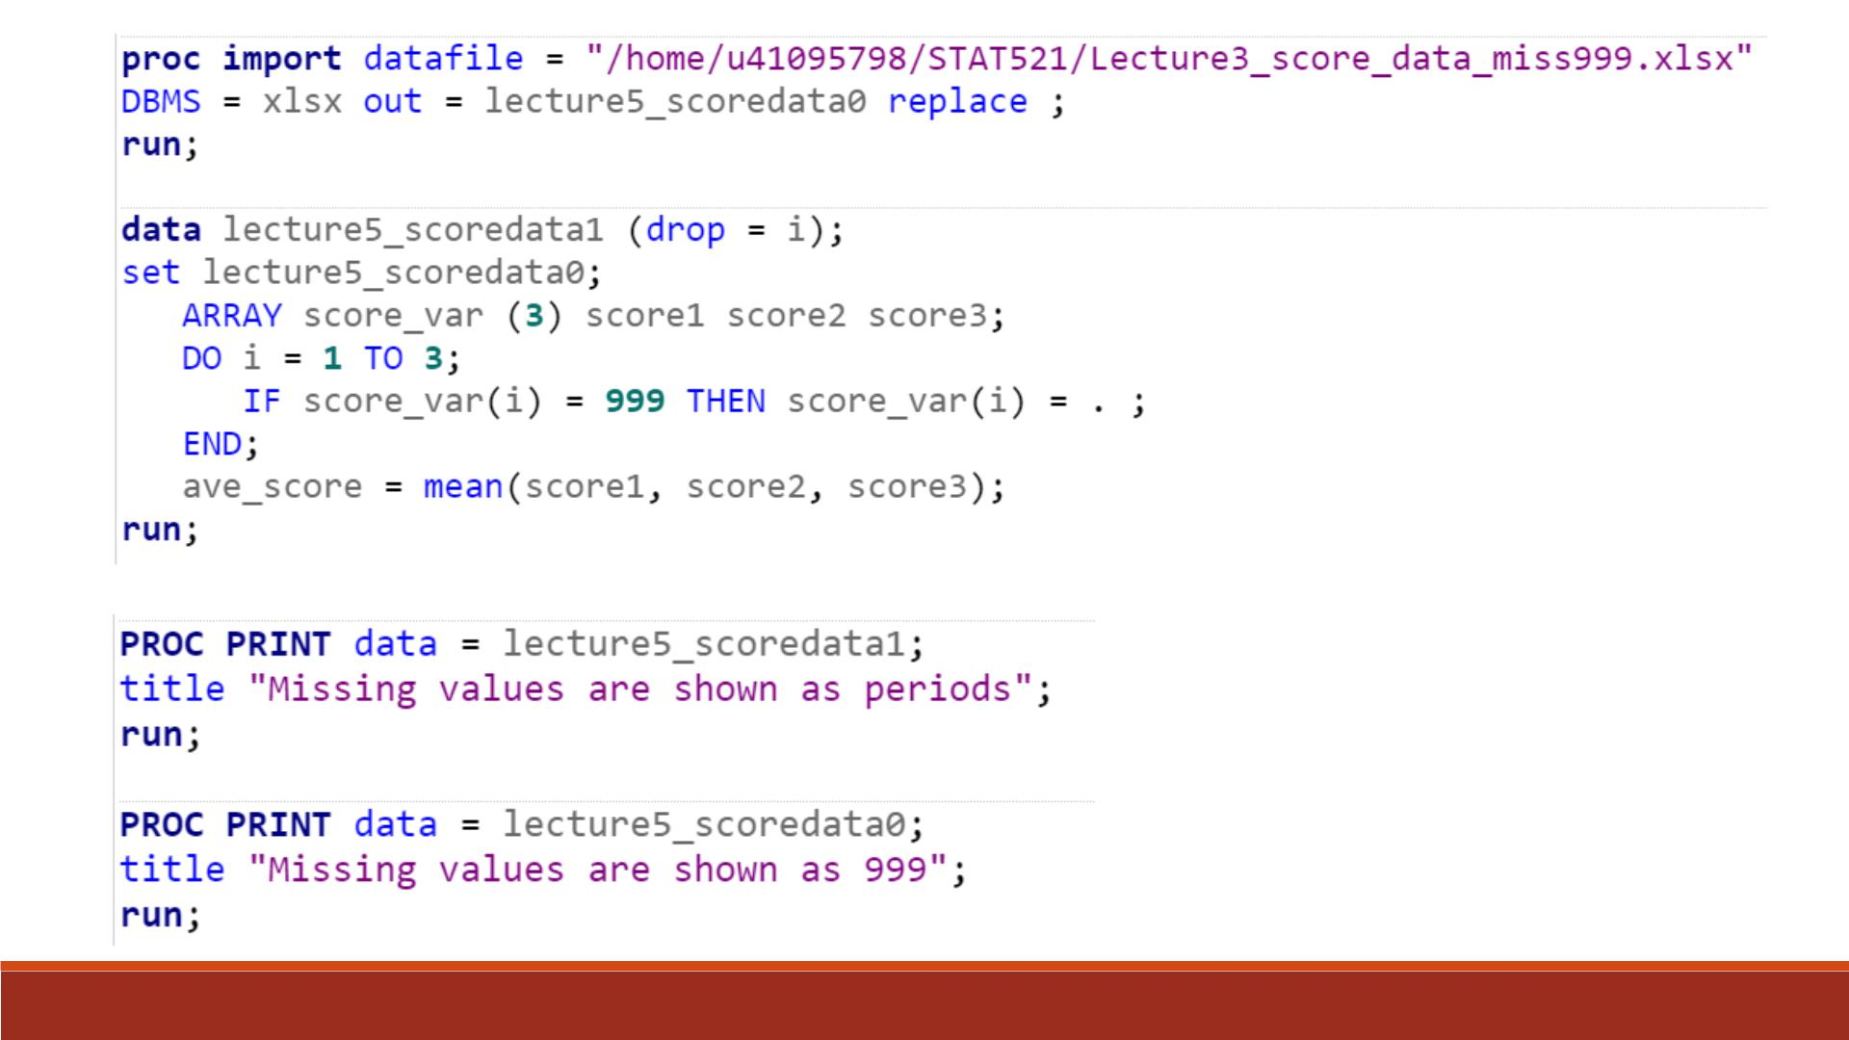
Code
o

Slide 20
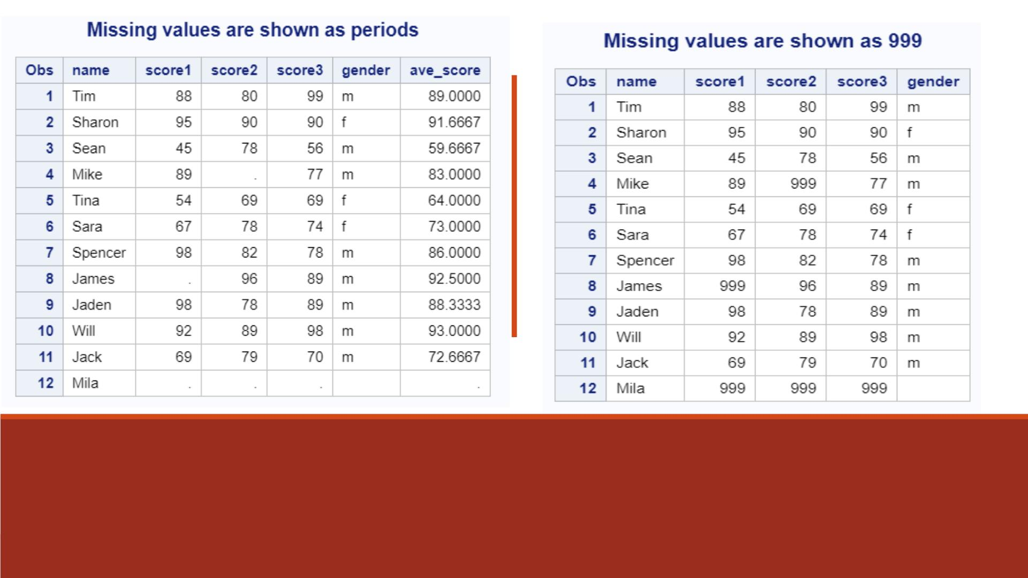
Proc Print Results (scoredata1, scoredata0)

Slide 21
Demo 2—Repetitive Calculations
Create a SAS dataset “lecture5_scoredata2” based on “lecture5_scoredata1”
1. Put the three existing variables score1-score3 into an array named “score”
2. Use a DO loop to compute the difference between each of score1-score3 and the
average score for each observation, drop the index variable
3. Store the differences into an array named “score_diff” with three variables
4. Print the dataset “lecture5_scoredata2”

Slide 22
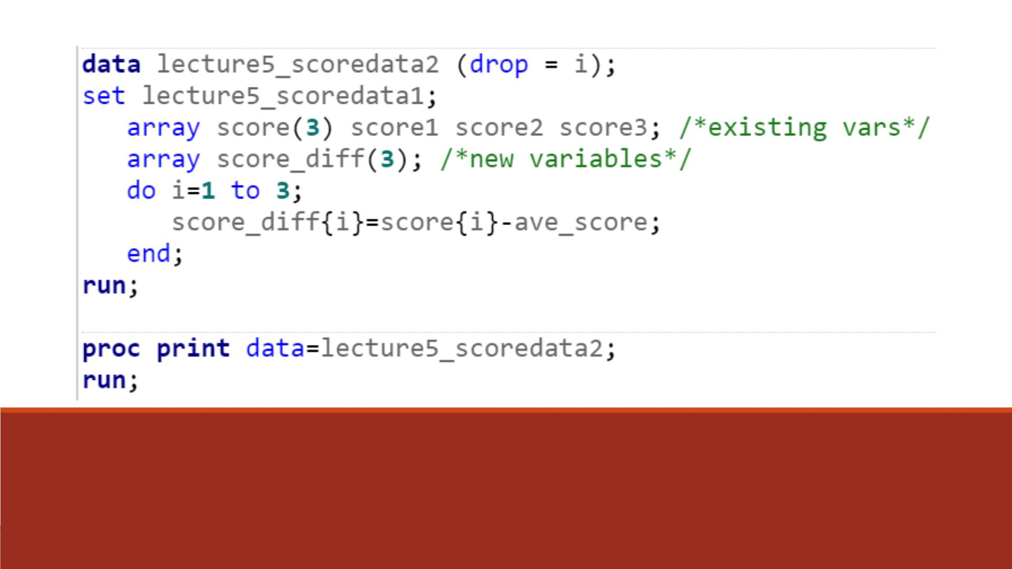
Code

Slide 23
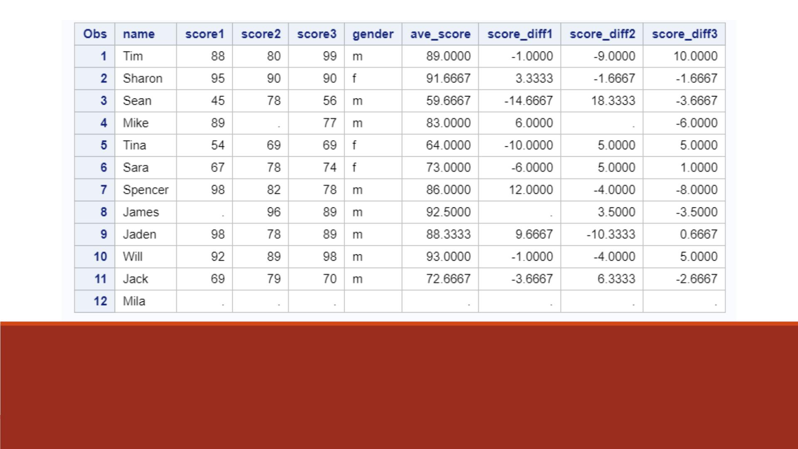
Proc Print Results (scoredata2)

Slide 24
Assigning Initial Values to Arrays
To assign initial values in an ARRAY statement:
▪Place the values after the array elements, e.g.
Array goal{4} g1 g2 g3 g4 (9000 9300 9600 9900);
▪Specify one initial value for each corresponding array element.
▪Separate each value with a comma or blank.
▪Enclose the initial values in parentheses.
▪Enclose each character value in single quotation marks, e.g.
Array col{3} $ color1-color3 (‘red’, ‘green’, ‘blue’);

Slide 25
Assigning Initial Values to Arrays
▪We can also assign initial values to an array without specifying each array element.
▪The following statement creates the default variables Var1, Var2, Var3, and Var4, and
assigns them initial values of 1, 2, 3, and 4 :
array Var{4} (1 2 3 4);

Slide 26
Creating Temporary Array Elements
▪Sometimes the variables created in an array statement do not need be stored in the dataset if
they are only for calculations.
▪In this case, we may create temporary array elements.
▪To create temporary array elements for D ATA step processing without creating new variables,
specify _TEMPORARY_ after the array name and dimension.
▪Temporary array elements do not appear in the resulting dataset. E.g.
array goal{4} _temporary_ (9000 9300 9600 9900);

Slide 27
Demo 3—Assigning Array Initial Values
Create a SAS dataset “lecture5_scoredata3” based on “lecture5_scoredata1”
1. Place the three variables score1-score3 into an array named “score”
2. Create an array “average” with class average score values 79.5, 81.9 and 80.8
3. Use a DO loop to compute the difference between each score value and the class
average score for each observation, drop the index variable
4. Store the differences into an array named “score_diff” with three variables
5. Print the dataset “lecture5_scoredata3”

Slide 28
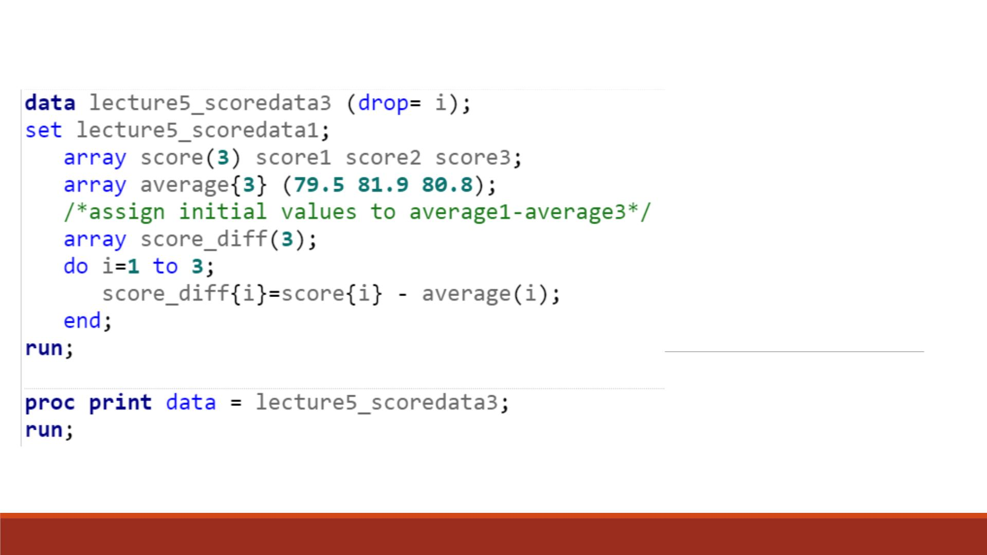
Code

Slide 29
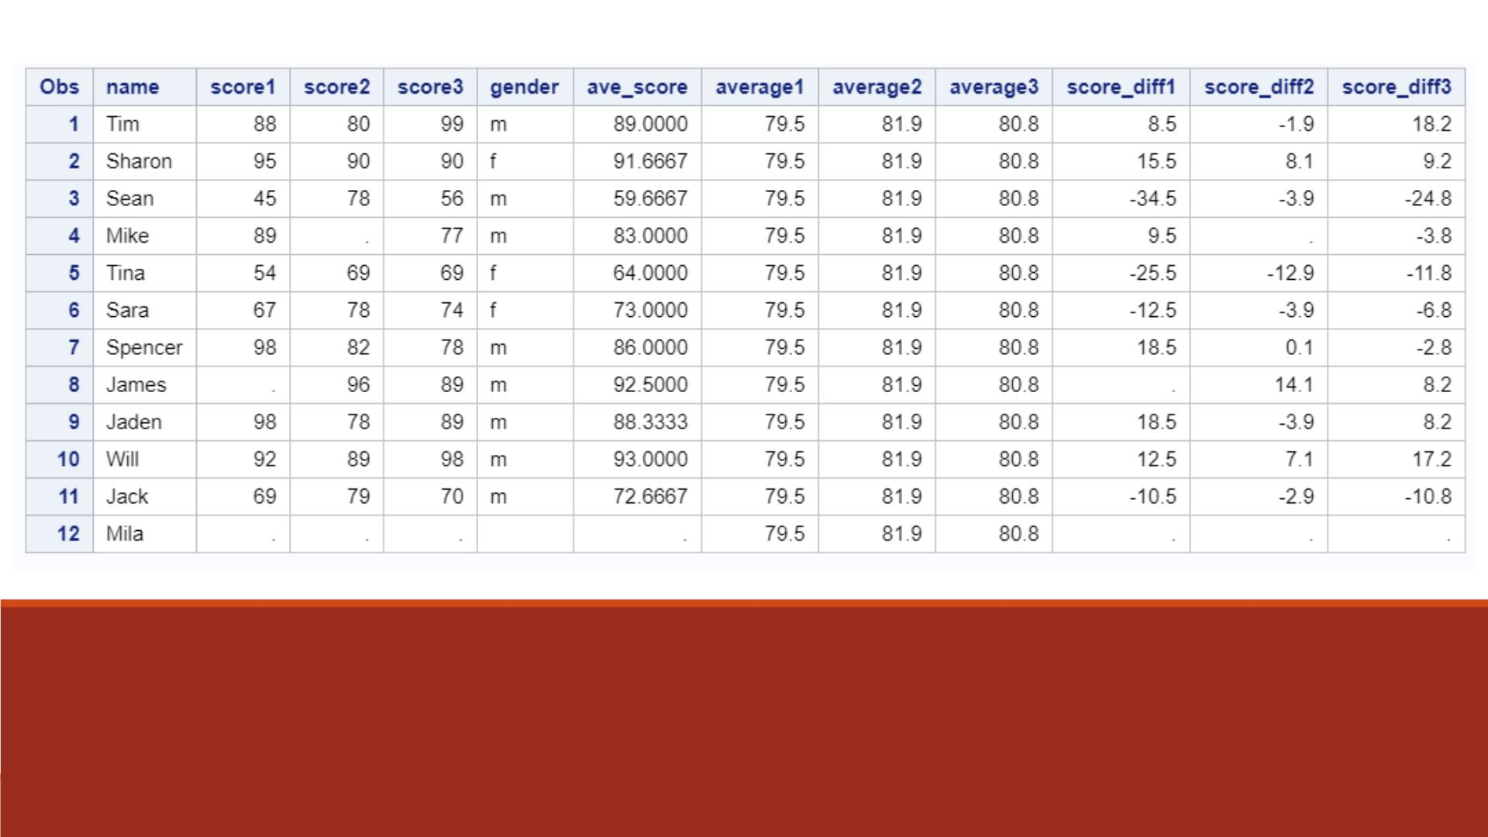
Proc Print Result (scoredata3)

Slide 30
DEMO 4—Temporary Array Values
Create a SAS dataset “lecture5_scoredata4” based on “lecture5_scoredata1”
1. Place the three variables score1-score3 into an array named “score”
2. Create a temporary array “average” with class average score values 79.5, 81.9 and 80.8
3. Use a DO loop to compute the difference between each score value and the class
average score for each observation, drop the index variable
4. Store the differences into an array named “score_diff” with three variables
5. Print the dataset “lecture5_scoredata4”

Slide 31
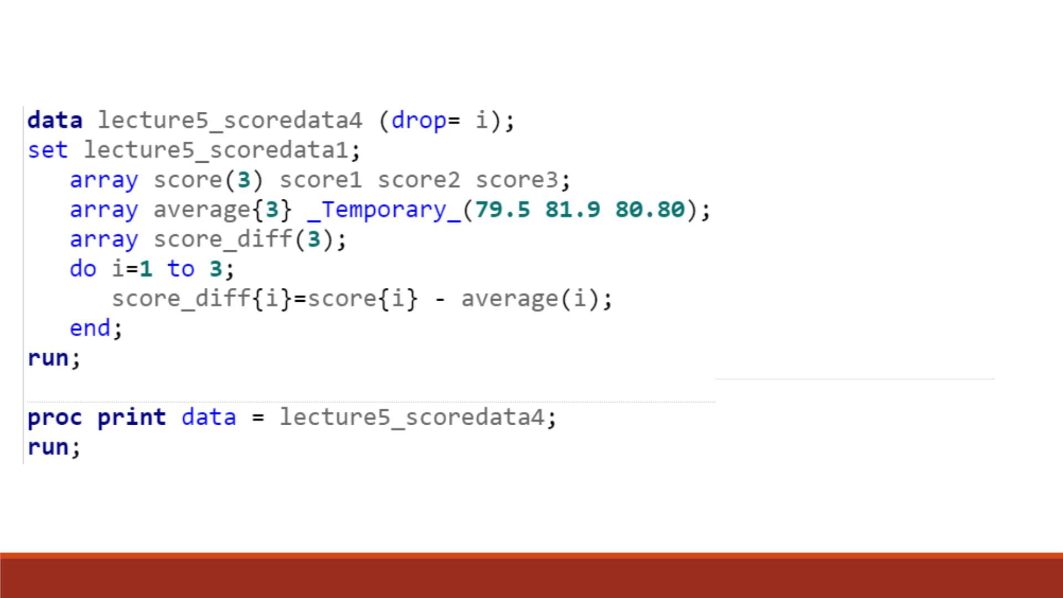
Code

Slide 32
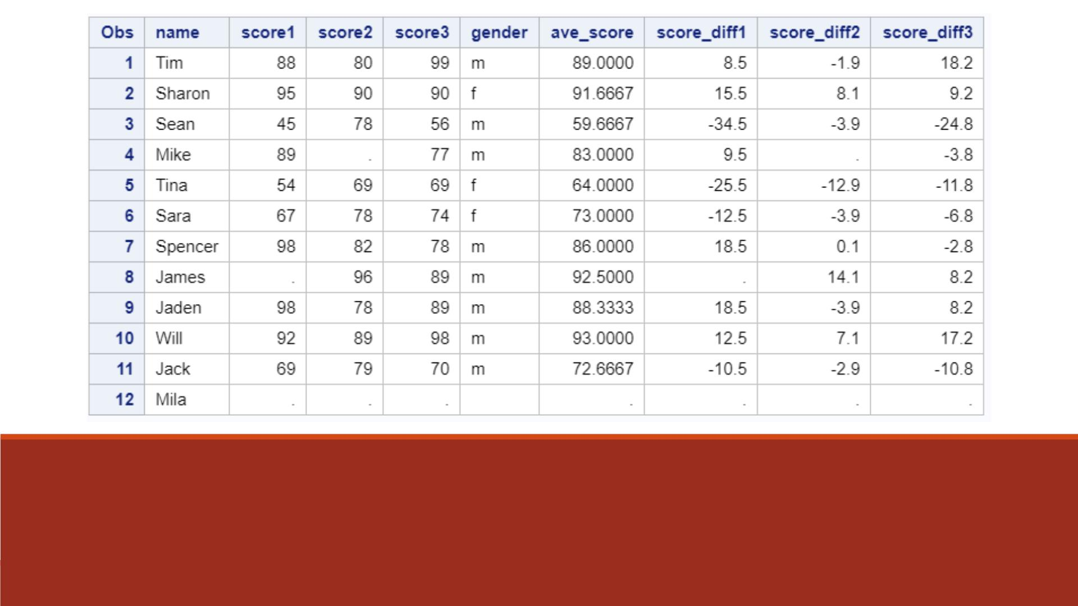
Proc Print Result (scoredata4)

Slide 33
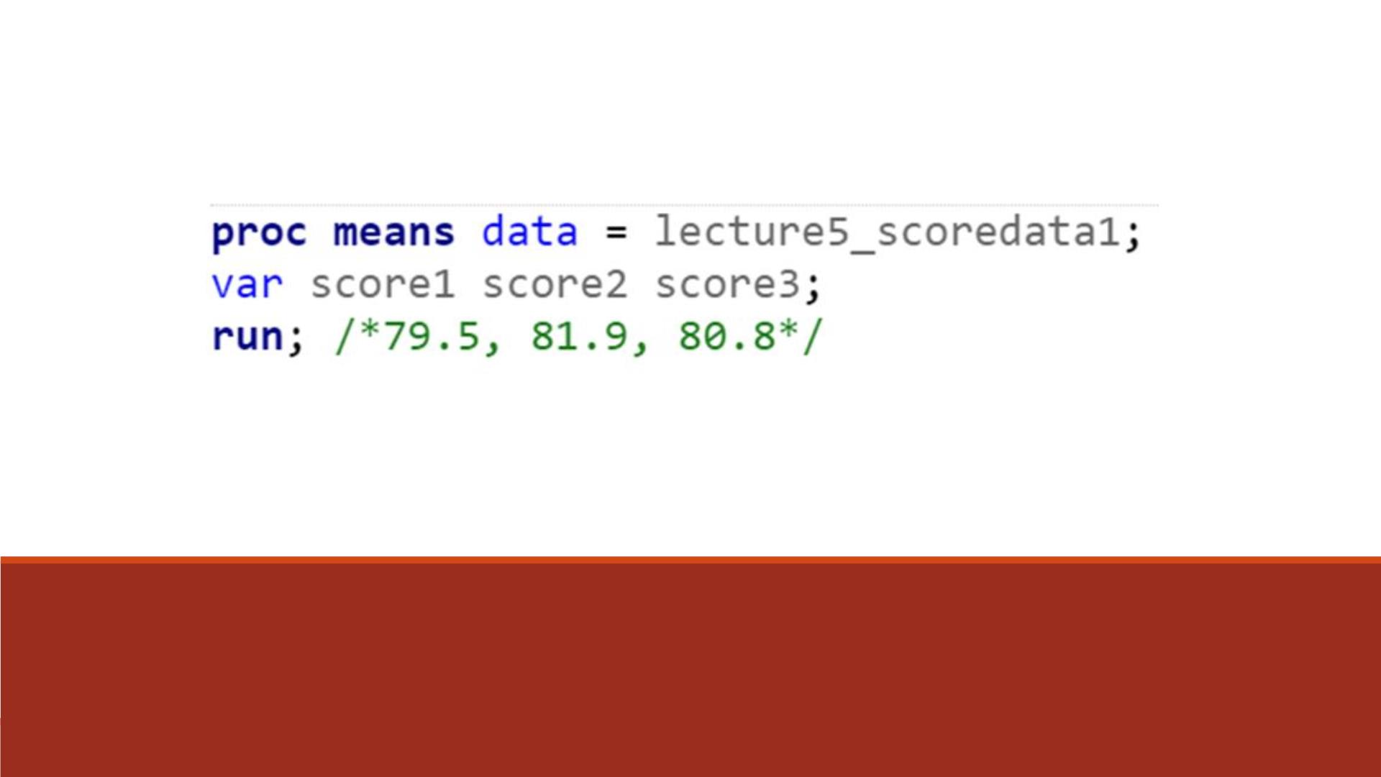
Note
Descriptive statistics of score1-score3 is computed
from using PROC MEANS, which we will learn in
later chapters.

Slide 34
Additional information
Document:
  SAS help center: DIM -- https://documentation.sas.com/doc/en/pgmsascdc/9.4_3.5/lefunctionsref/p18toxpk18mlr1n1x7yihyj8o8jb.htm
YouTube:
  SAS two-dimensional array: https://www.youtube.com/watch?v=MZL53aDlu00

Slide 35
DIM Function
▪We use the DIM function to specify the TO clause of the iterative DO statement.
▪For a one-dimensional array, specify the array name as the argument for the DIM function.
▪The DIM function returns the number of elements in the array.
▪General form:
DIM (array-name)
where array-name specifies the array.

Slide 36
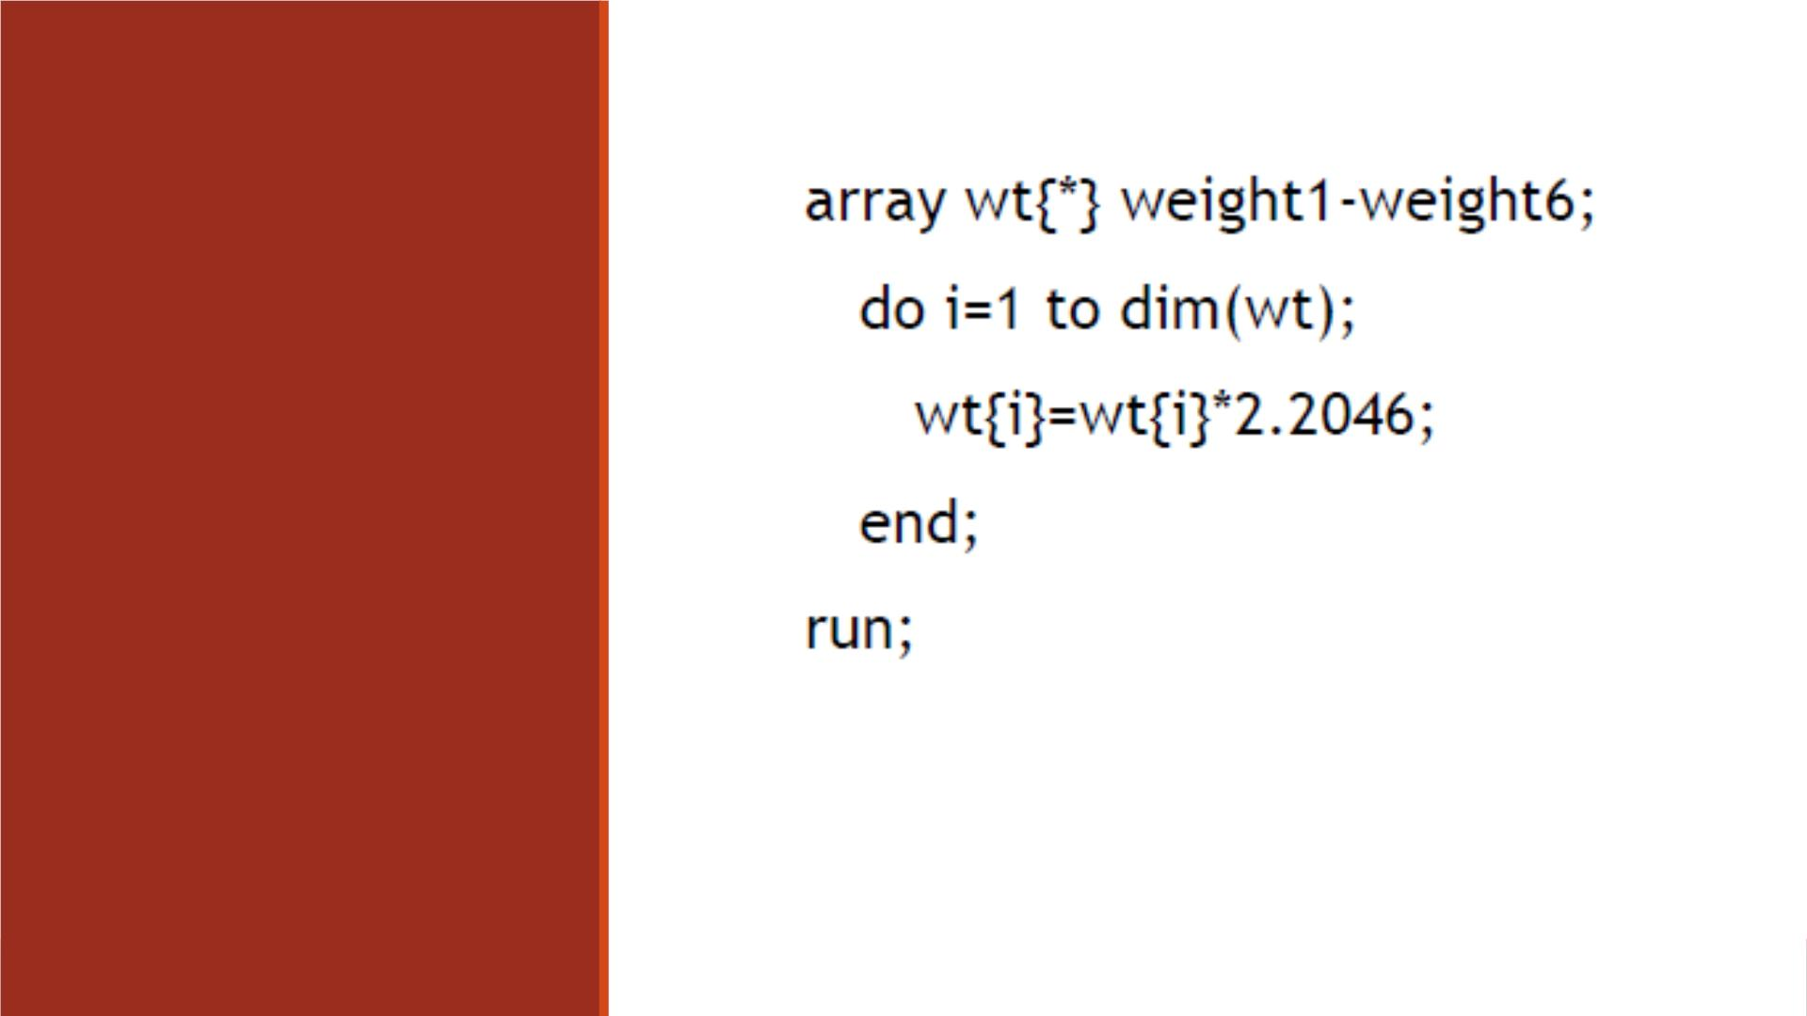
DIM Function
Example
Note: When you use the DIM function, you do not have to
respecify the stop value of an iterative DO statement if you
change the dimension of the array.

Slide 37
Two-Dimensional A r rays

Slide 38
Defining a Multidimensional Array
▪To define a multidimensional array, you specify the number of elements in each
dimension separated by a comma.
▪This ARRAY statement defines a two-dimensional array:
array new{3,4} x1-x12;

Slide 39
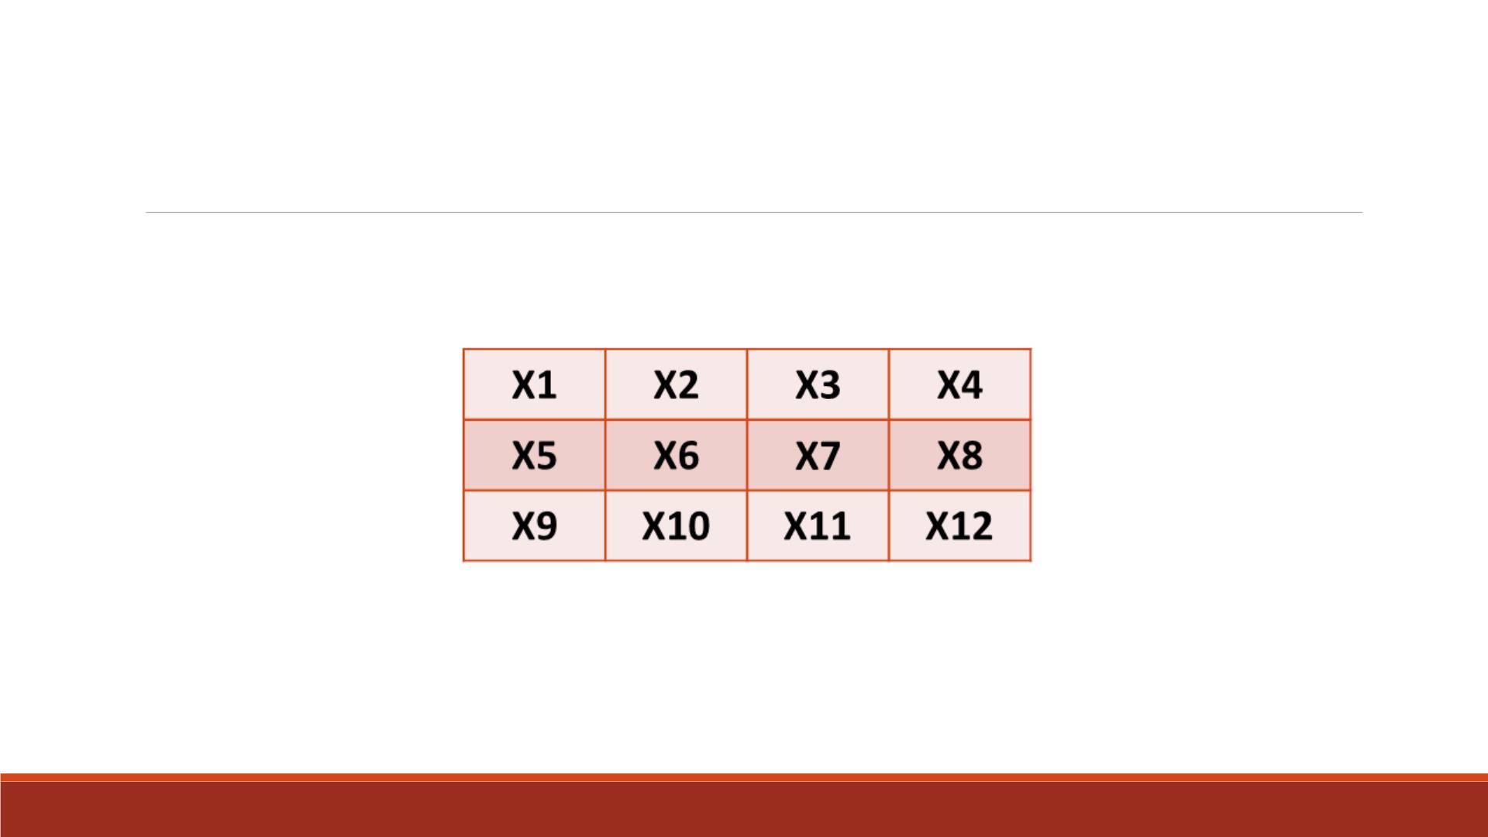
Defining a Two-Dimensional Array
▪In a two-dimensional array, the two dimensions can be thought of as a table of rows and
columns.
▪The first dimension in the ARRAY statement specifies the number of rows.
▪The second dimension specifies the number of columns.

Slide 40
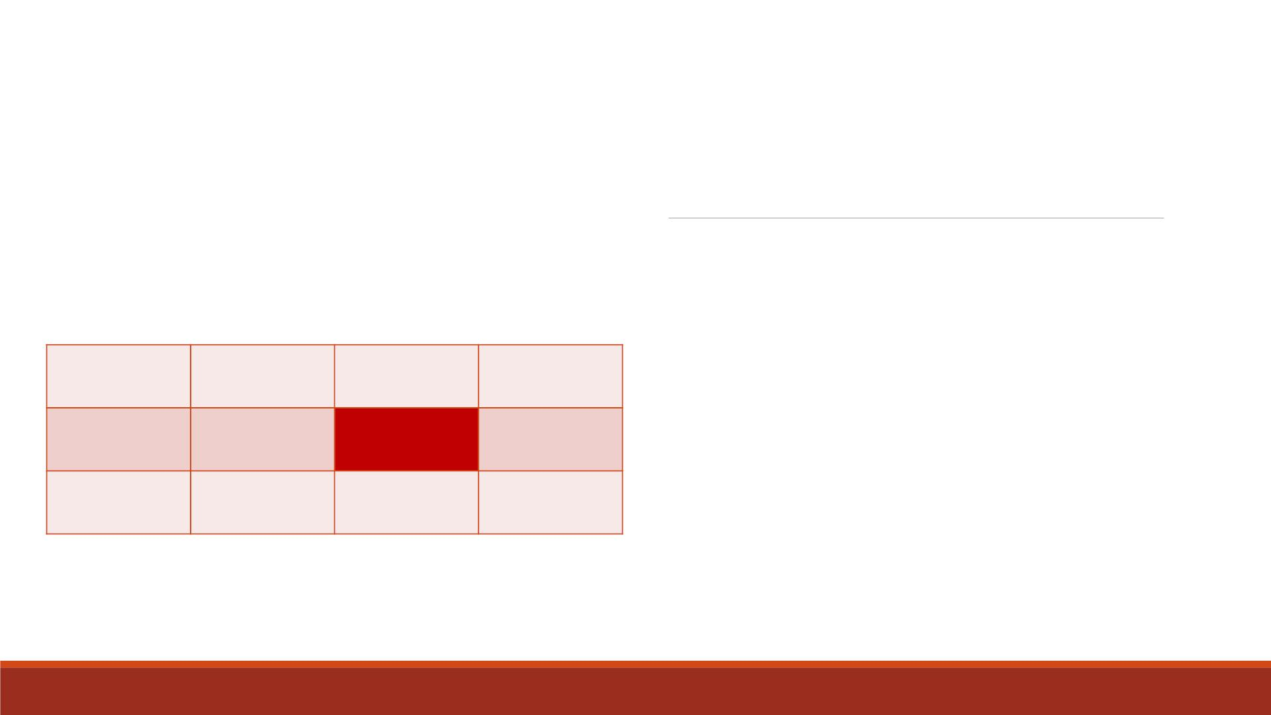
Reference Array
Elements
array new{3,4} x1-x12;
new(2,3)=0;
▪You can reference any element of the array by
specifying the two dimensions.
X1
X5
X9
X2
X6
X3
X7
X4
X8
▪For example, you can perform an action on the
variable x7 by specifying the array reference
new(2,3), like Excel cell number (C2).
X10
X11
X12
▪You can easily locate the array element in the
table by finding the row (2), then the column (3).

Slide 41
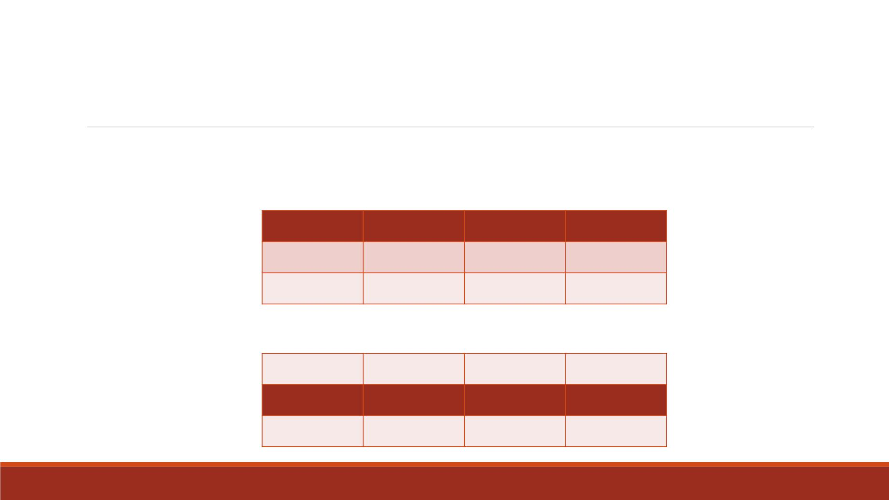
Two-Dimensional Arrays
▪The array elements are grouped in the order in which they are listed in the ARRAY statement.
▪For example, the array elements x1 through x4 can be thought of as the first row of the table.
X1
X5
X9
X2
X6
X3
X7
X4
X8
X10
X11
X12
▪The elements x5 through x8 become the second row of the table, and so on.
X1
X5
X9
X2
X6
X3
X7
X4
X8
X10
X11
X12

Slide 42
Demo 5—Two Dimensional Arrays
▪Import the Excel datafile “Lecture5_monthly” into SAS, name it “lecture5_monthly”
▪ Create a new dataset “lecture5_quarters” based on “lecture5_monthly”
1. Group the variables month1-12 into a 4-by-3 two-dimensional array named “m”
2. Use nested DO Loops to calculate the total sales in every quarter (sum of sales every
three months) for each year, drop the index variables
3. Store the quarterly totals in a one-dimensional array “Qtr” with 4 variables
▪Print the dataset “lecture5_quarters” and keep only variables “Year ”, “Qtr1-4”.

Slide 43
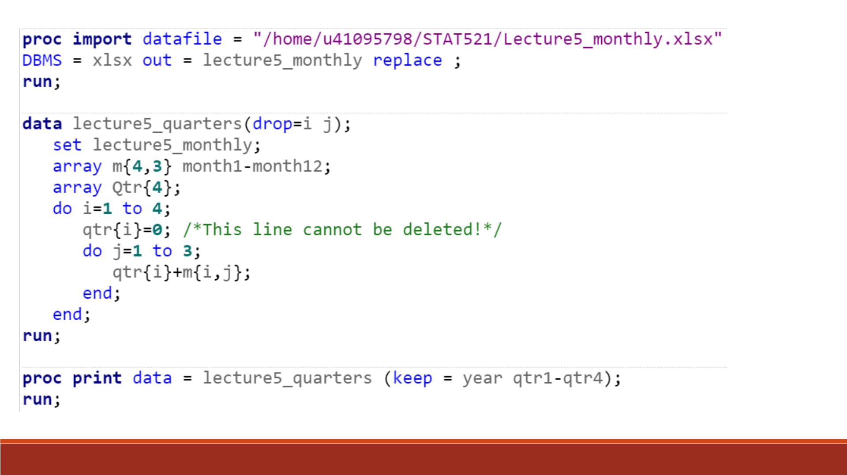
You can try to delete the
initialization statement qtr{i}=0.
What happens in the output table?
C

Slide 44
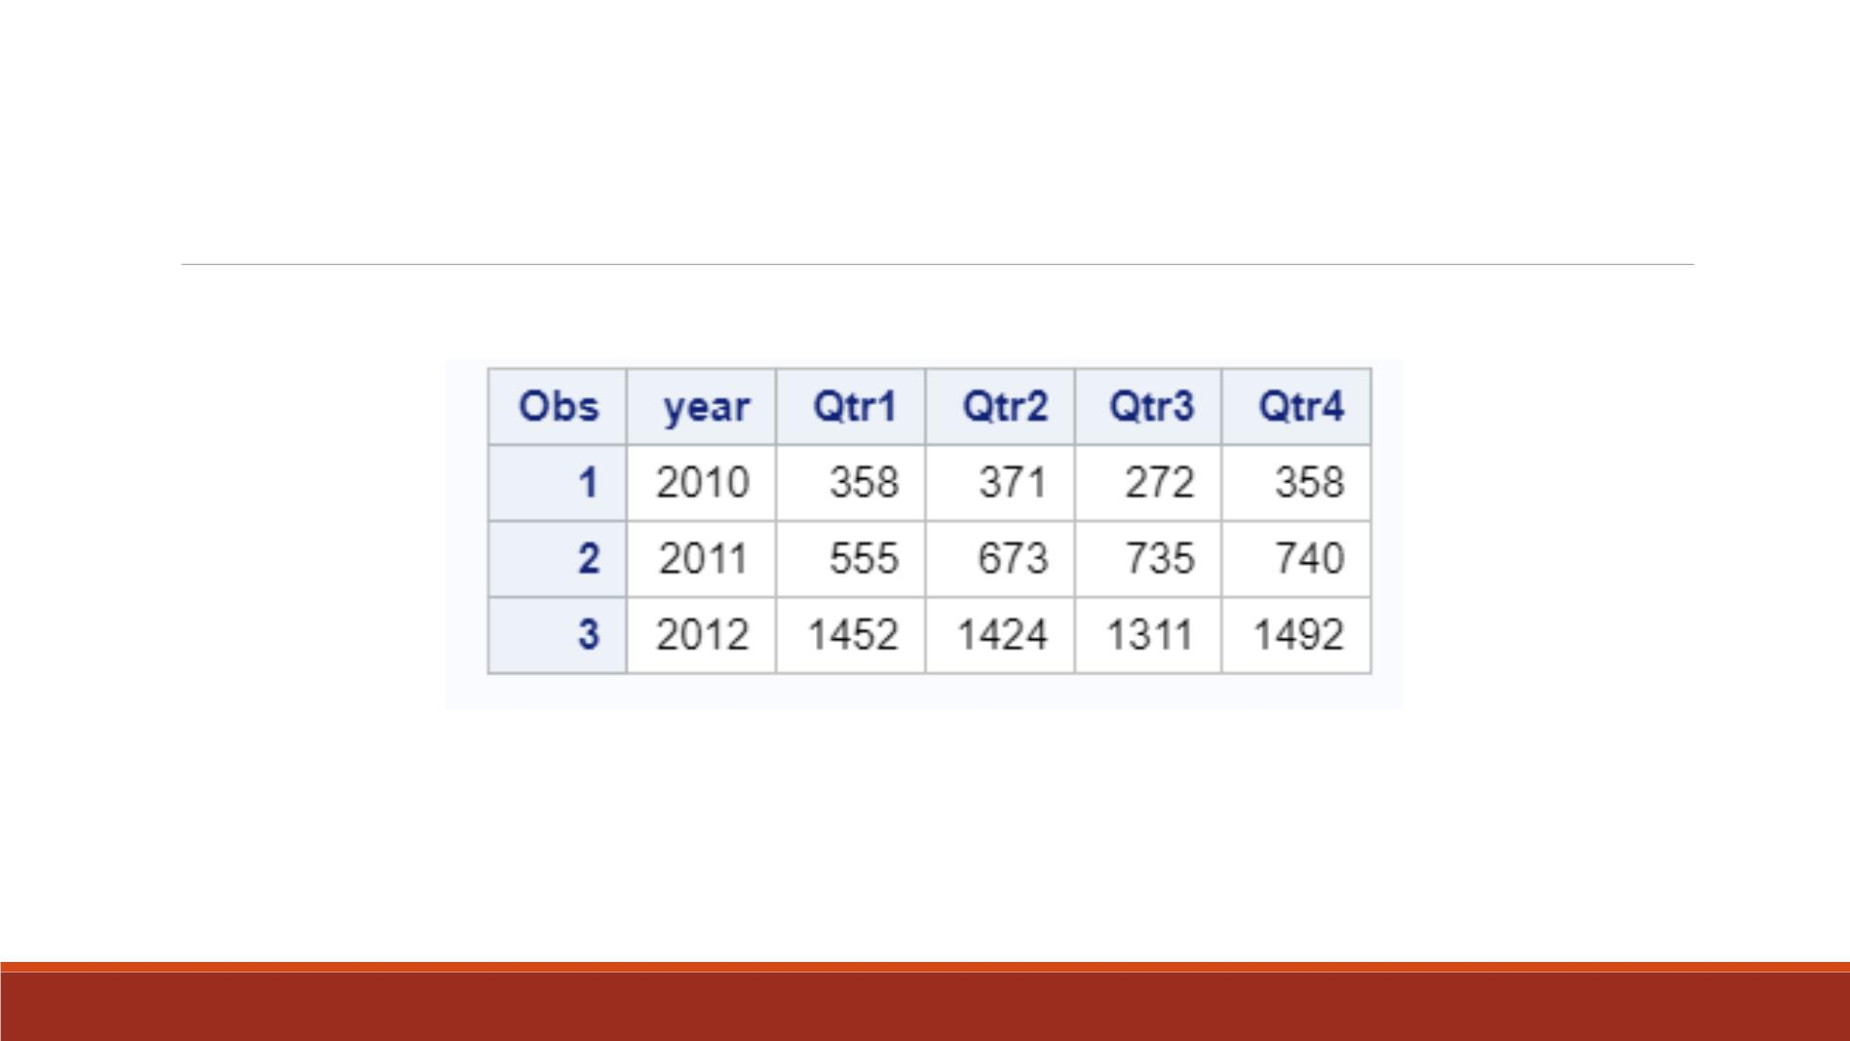
Proc Print Result
Note: KEEP= option in PROC PRINT step only changes the display of “lecture5_quarters”
table. It does not modify the variables in the dataset.

Slide 45
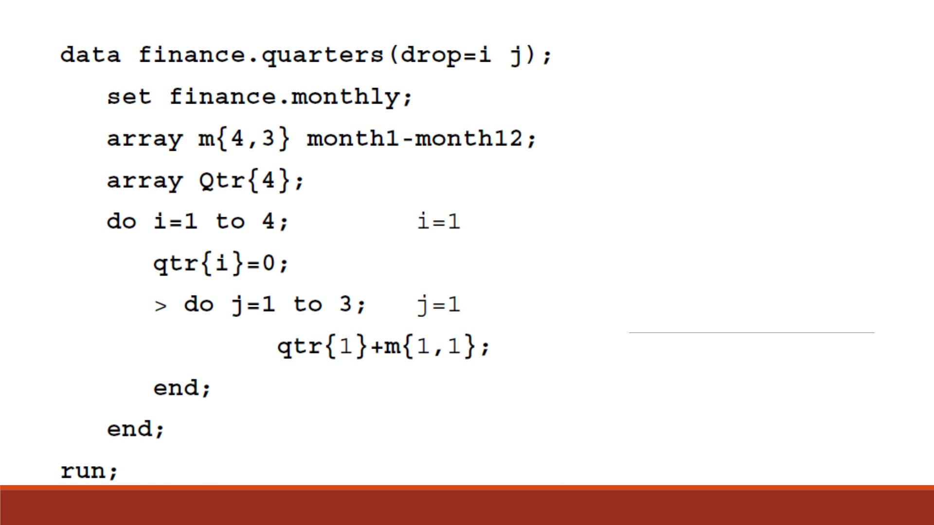
Iteration 1

Slide 46
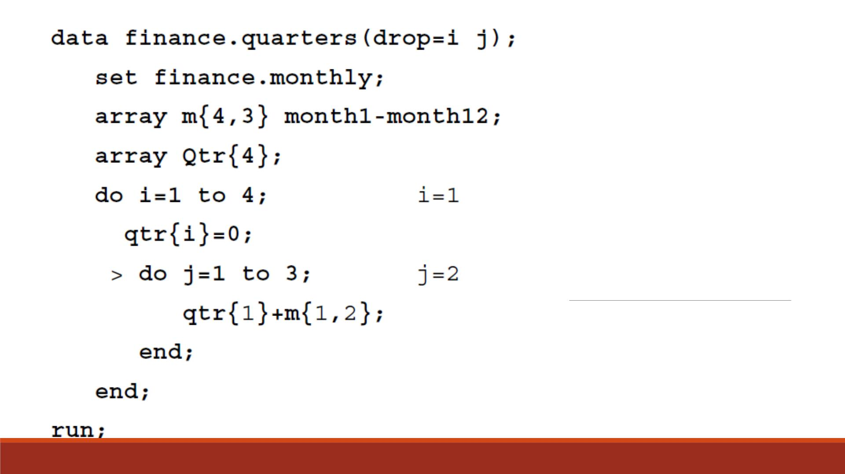
Iteration 2

Slide 47
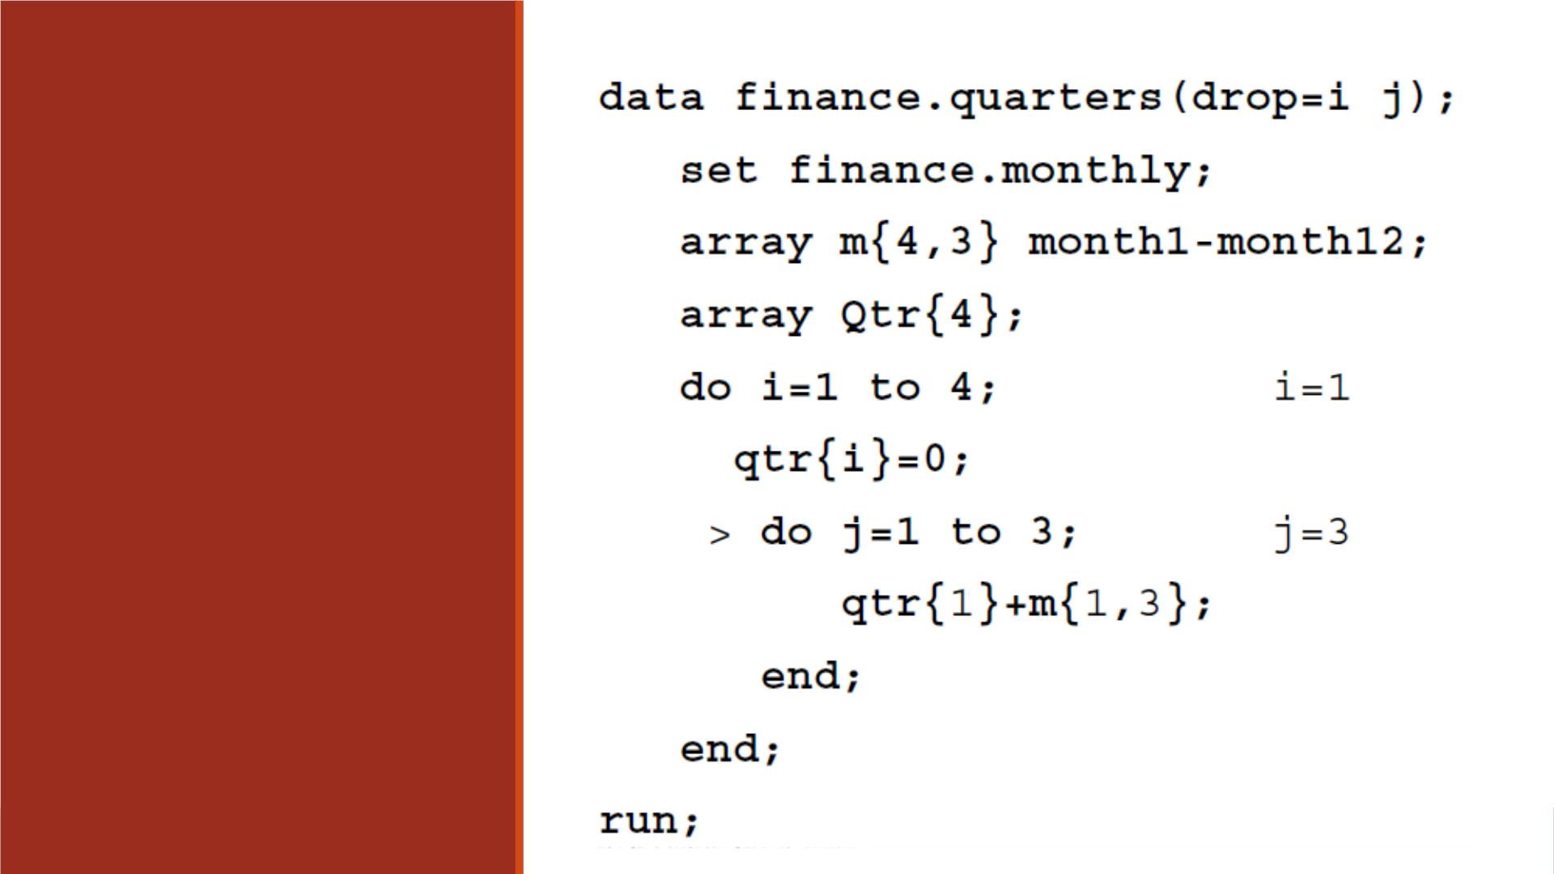
Iteration 3

Slide 48
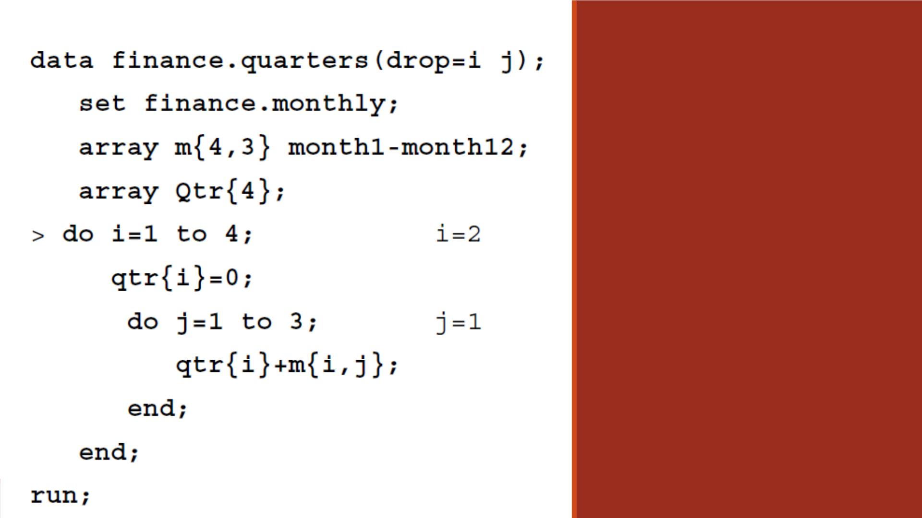
Iteration 4
After the outer DO loop
completes execution, the end
of the D ATA step is reached.

Slide 49
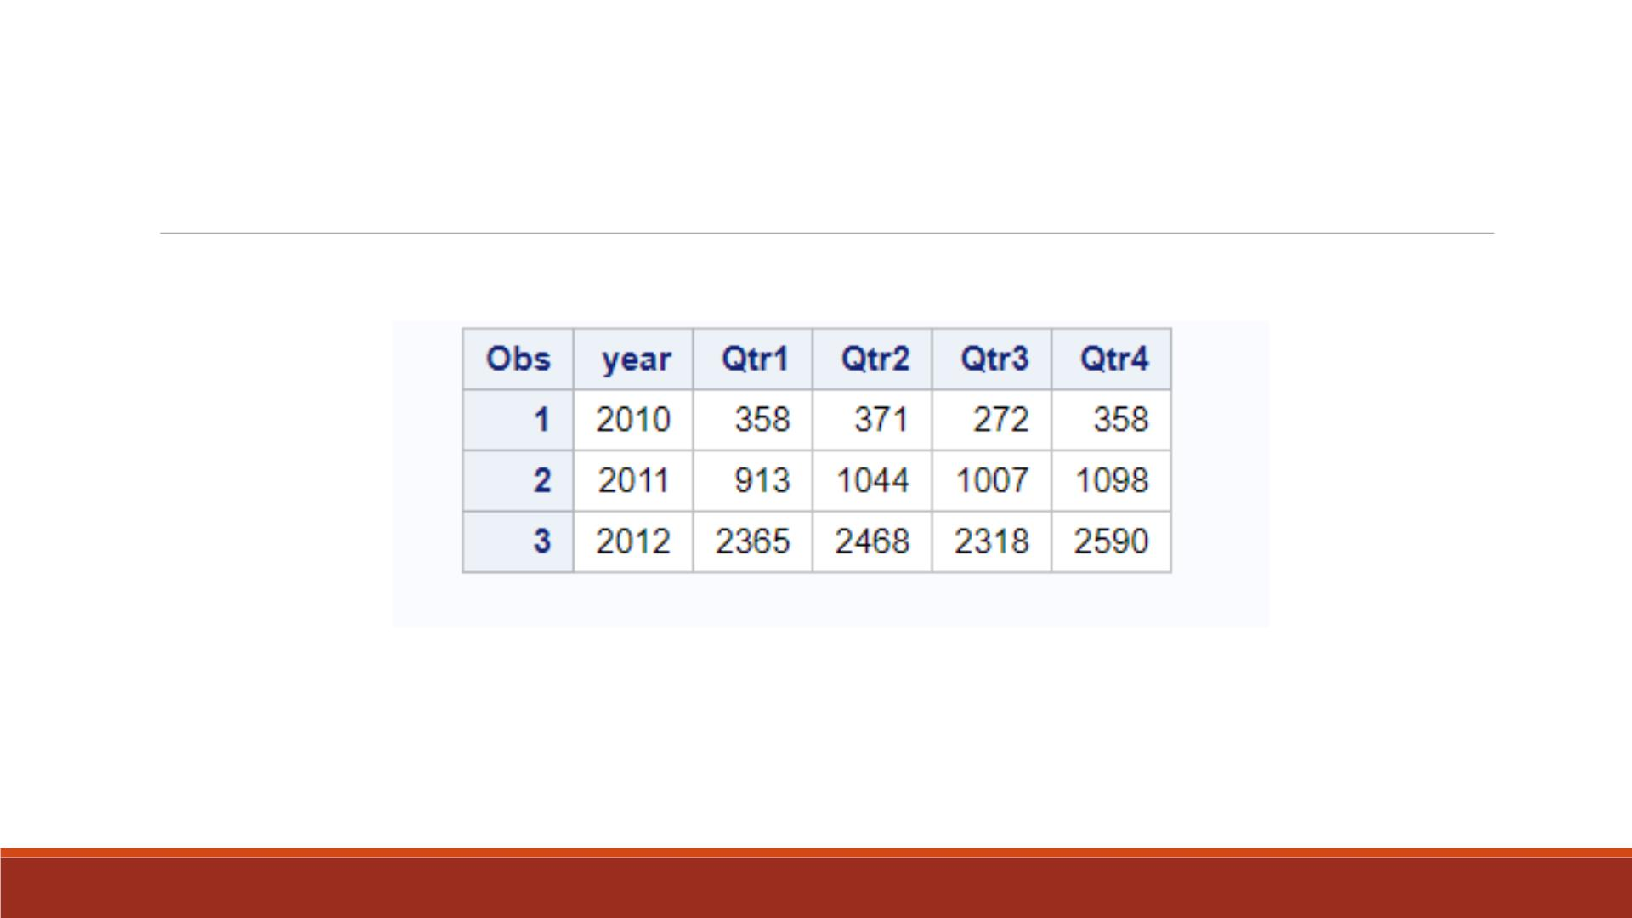
If Delete the Initialization Statement
The values of Qtrl, Qtr2, Qtr3,and Qtr4 would accumulate
across iterations of the D ATA step (each year)!

Slide 50
Additional information
Document:
  SAS arrays and do loop made easy: https://www.listendata.com/2016/01/sas-arrays-and-do-loop-made-easy.html
YouTube:
  A beginner guide to using arrays and do loops (SAS Global Forum): https://www.youtube.com/watch?v=eVKMbQw-wjU
  Array and do loop in SAS: https://www.youtube.com/watch?v=CyhDL4C8QcI

Slide 51
Rotating a Table Using A r rays

Slide 52
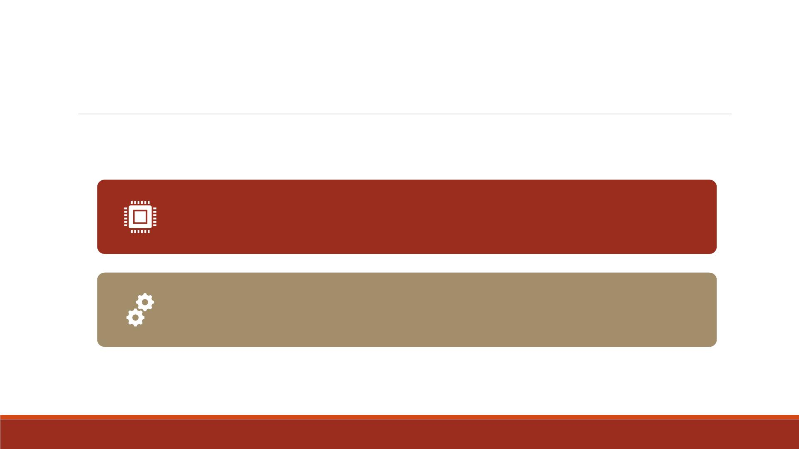
Rotate a Table
You can also use arrays for rotating (transposing) a SAS dataset.
(More details in a later lecture)
When you rotate a SAS dataset, you change variables to
observations or observations to variables.

Slide 53
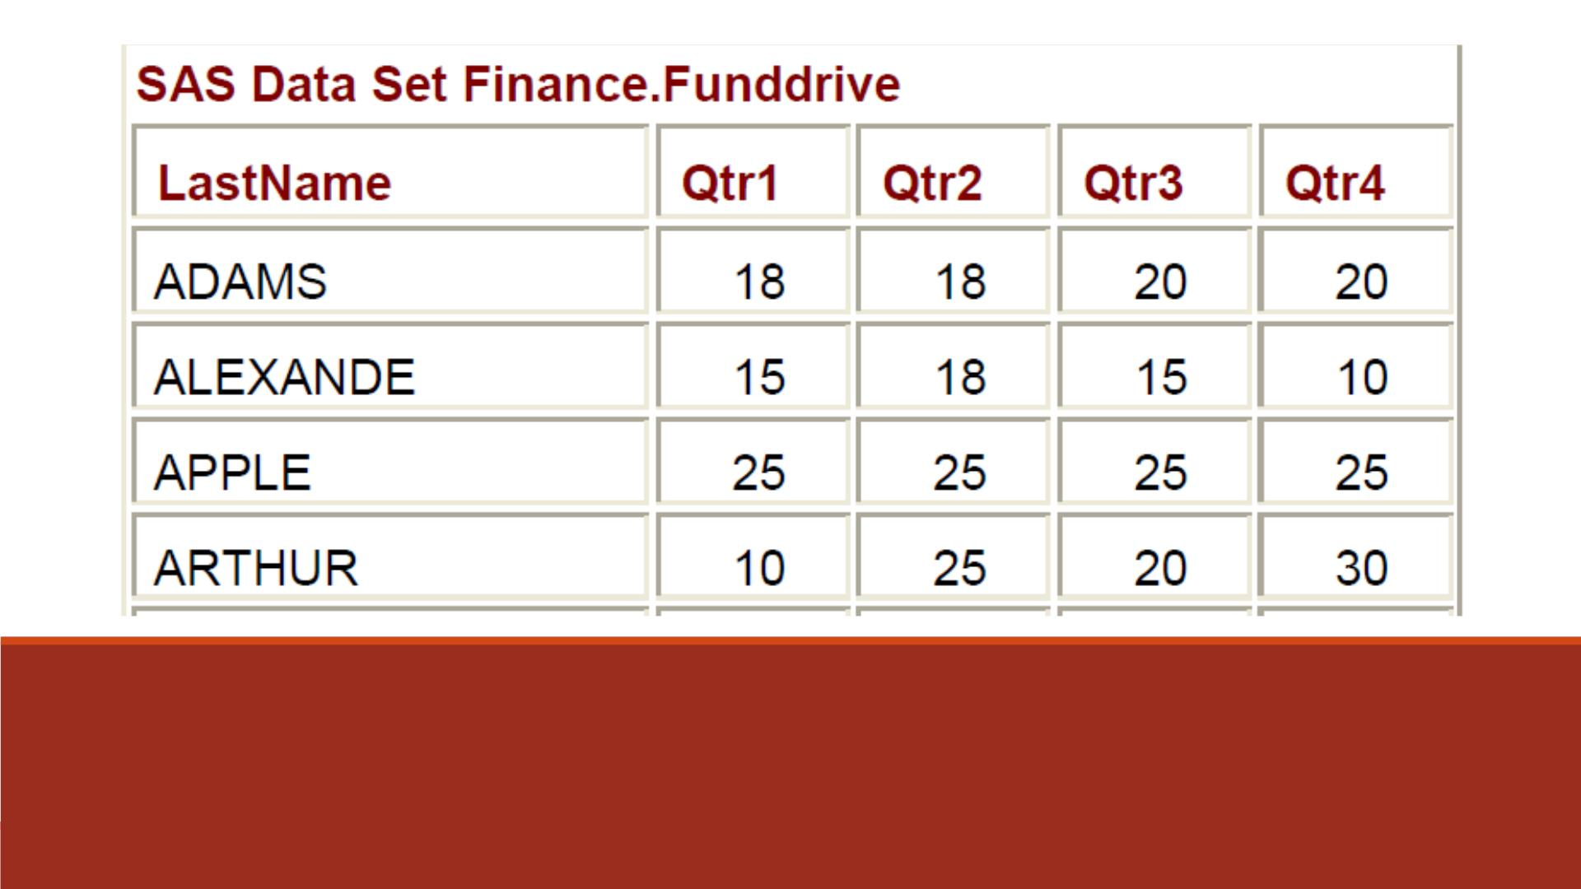
Example
Suppose you want to rotate the “Finance.Funddrive”
dataset to create four output observations from each
input observation.

Slide 54
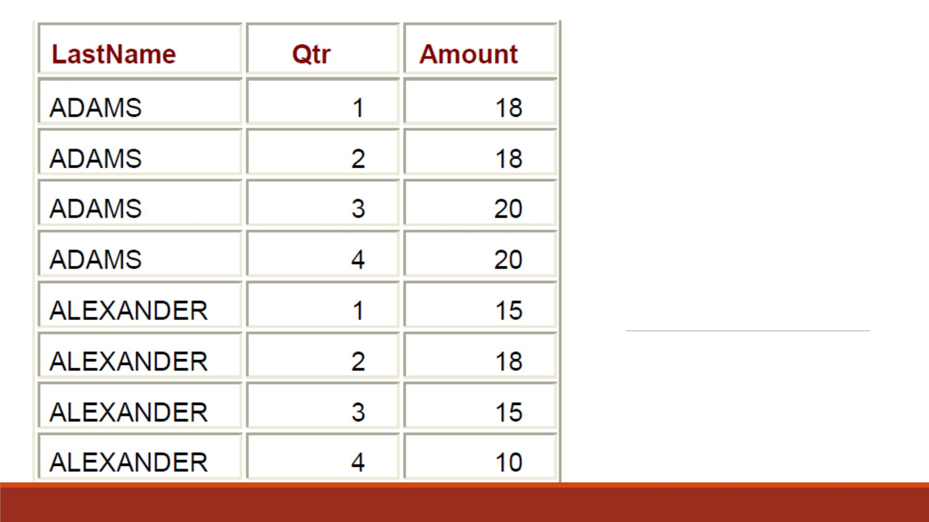
Desired Output
(Partial)

Slide 55
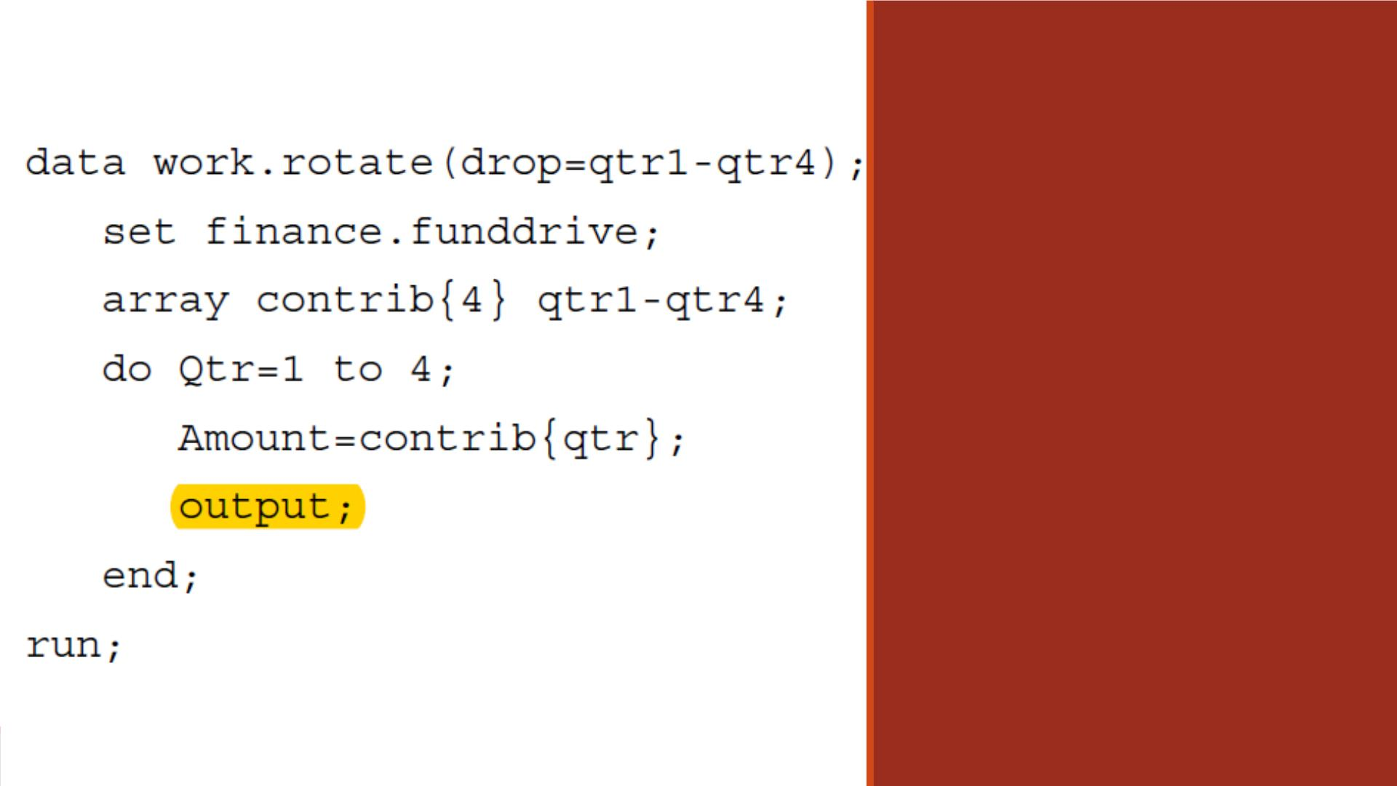
D ATA Step
Code

Slide 56
Better ways to transpose
JMP Pro
SAS’s PROC TRANSPOSE
(These will also be illustrated in 551. If there are easy ways and hard ways. Pick the easiest way.)

Slide 57
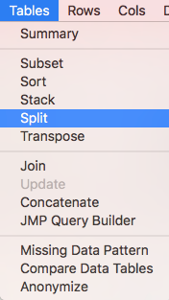
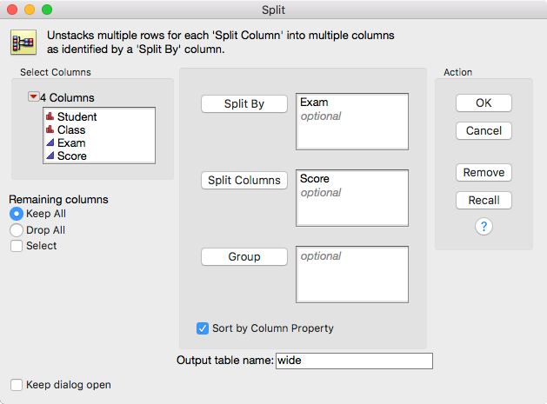
Tall-structure and wide-structure
TS and WS are inter-convertible.
Example: tall_nomiss.jmp
From tall to wide:
Keep all remaining columns

Slide 58
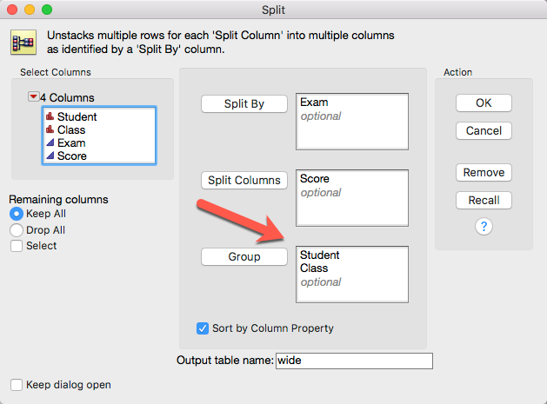
Tall-structure and wide-structure
Alternatively, you can put the variables that you want to keep into Group.

Slide 59
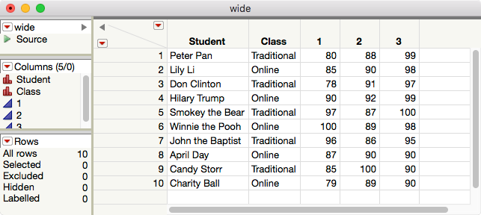
Tall-structure and wide-structure

Slide 60
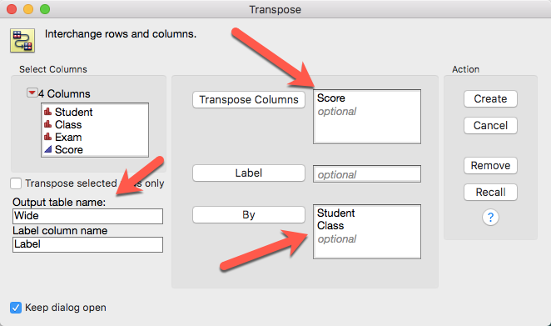
Transpose

Slide 61
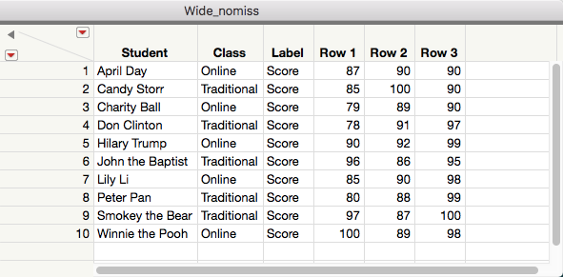
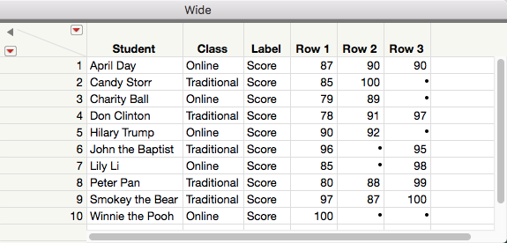
Transpose
It doesn’t matter whether there are missing data or not.
Transpose yields the correct wide structure.

Slide 62
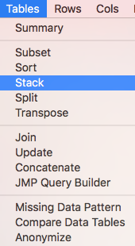
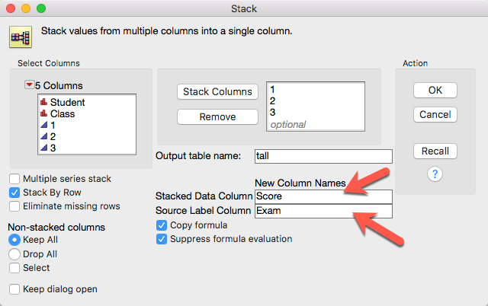
Convert from wide to tall

Slide 63
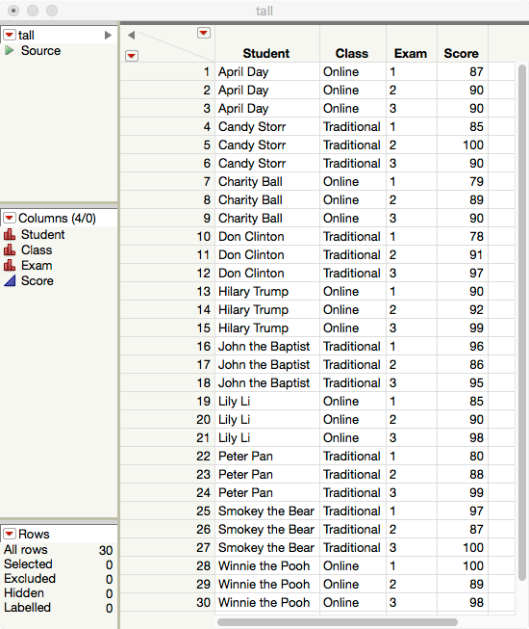
Back to tall

Slide 64
PROC TRANSPOSE in SAS
The conversion can be done by SAS programming.
It works no matter there are missing data or no missing.
When the conversion procedure becomes a routine, it is better to do it by programming.
Open the SAS data set “tall_missing”
If you use traditional SAS programming environment, the default library is TMP1. If you use SAS Studio, it may be different.
Open the SAS program “transpose.sas” You need to right-click to download.

Slide 65
PROC TRANSPOSE in SAS
proc sort data=tmp1.tall_missing; by Student; run;
/* No need to sort if the Student ID is in order */
proc transpose data=tmp1.tall_missing out=tmp1.wide(drop= _NAME_) prefix=exam; by Student; id exam; var score;
copy class; run;
proc sort nodupkey data=tmp1.wide; by Student class; run;

