Slide 1

Creating User-Defined
Formats

Slide 2
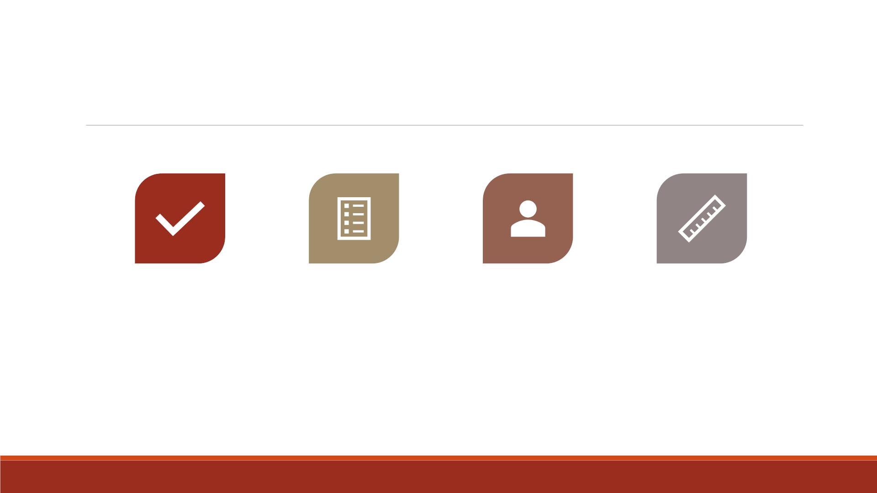
Outline
LABEL
STATEMENTS
ASSIGNING
FORMATS
USER-DEFINED
FORMATS
SPECIFYING
LENGTH
Readings: Base Guide Ch4, Ch7

Slide 3

Creating Labels

Slide 4
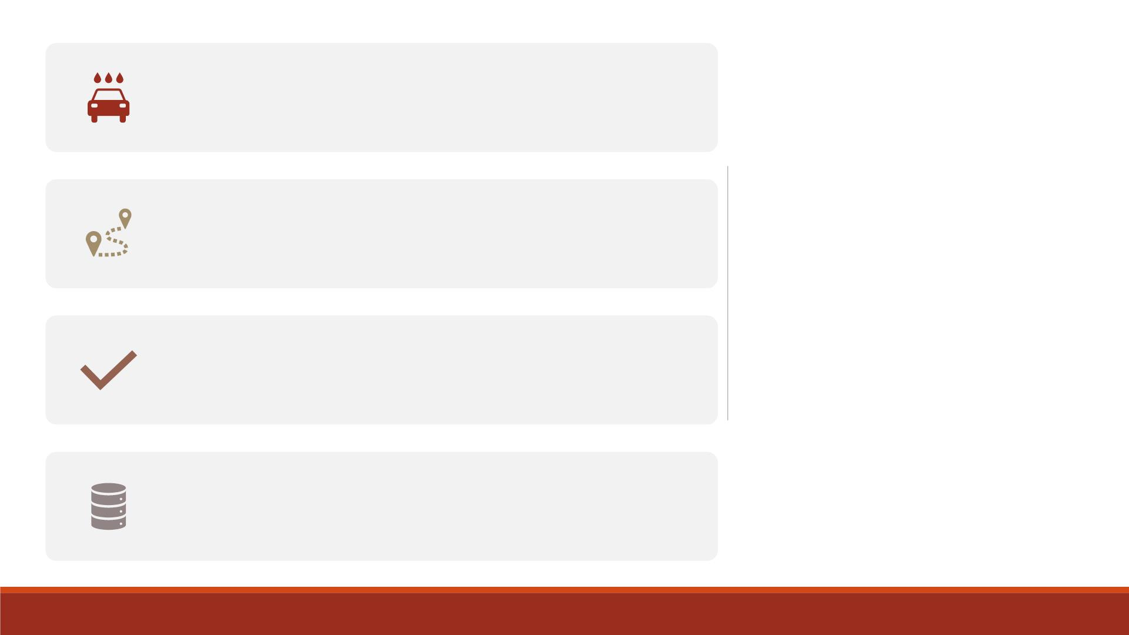
Yo u may want to make the output more readable
when producing listings and reports.
Labels help you remember what each variable
represents.
Adding Labels
to Variables
Many SAS procedures use variable labels to
improve readability.
Yo u can create labels either in a D ATA or PROC
step.

Slide 5
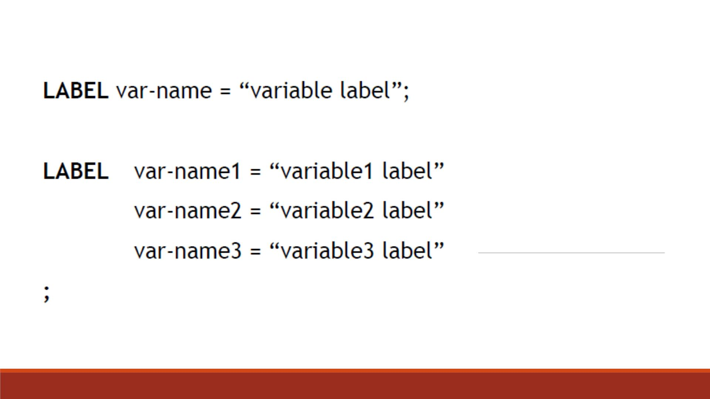
LABEL
Statement

Slide 6
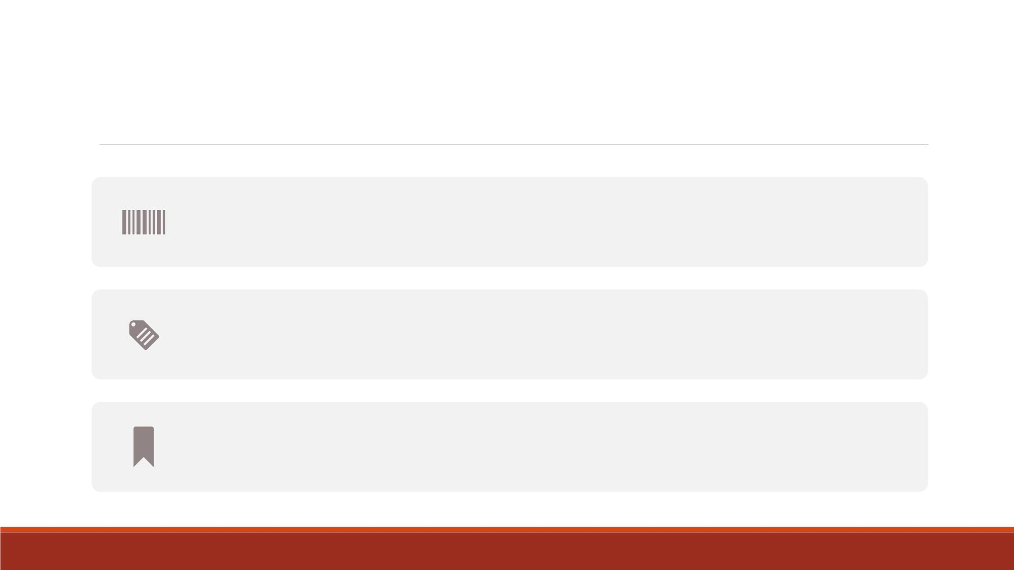
Temporary v.s. Permanent Labels
If LABEL statement is in the D ATA step, the labels remain associated
with the respective variables permanently in the data.
If LABEL statement is in a PROC step, the labels are used only for that
procedure temporarily.
For labels created in D ATA step, add LABEL keyword in PROC PRINT
step to display.

Slide 7

Demo1—Creating Labels
▪Import the Excel datafile “Lecture3_score_data_miss.xlsx” into SAS, name it
“lecture6_scoredata0”.
▪Create a new dataset “lecture6_scoredat1” based on “lecture6_scoredata0”
▪Create permanent labels for variables score1-3 as “Math Score”, “Science
Score” and “English Score”.
▪Print the dataset “lecture6_scoredata1” with the (permanent) labels displayed.

Slide 8
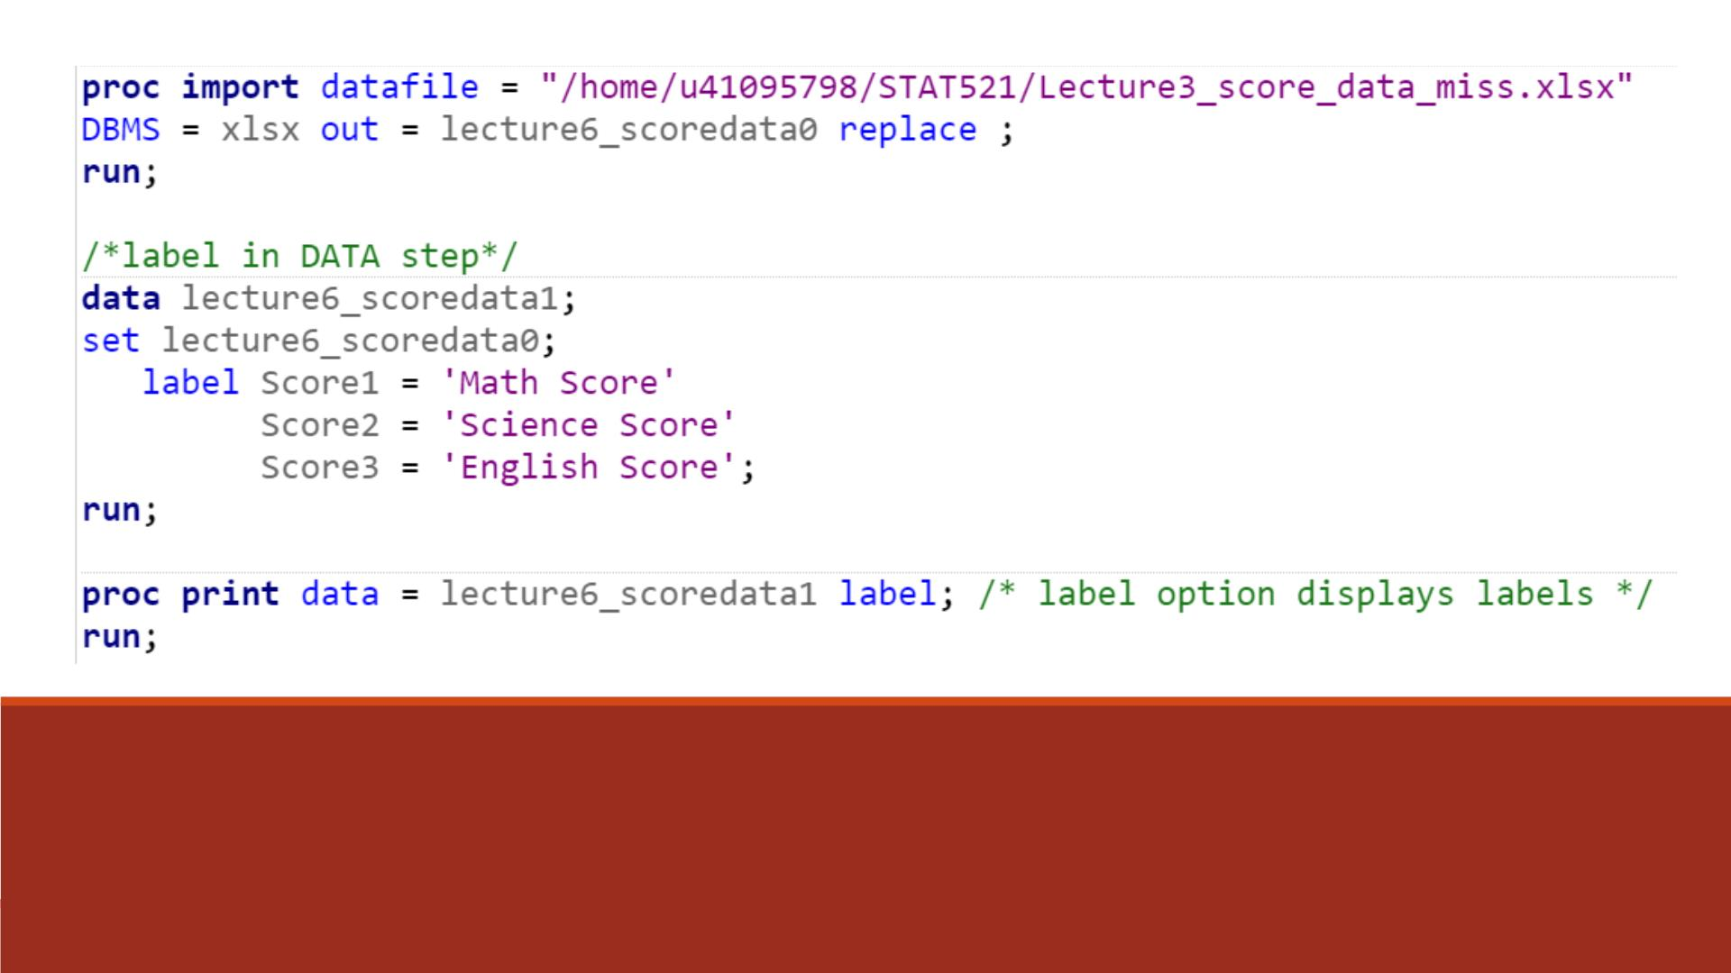
Code

Slide 9
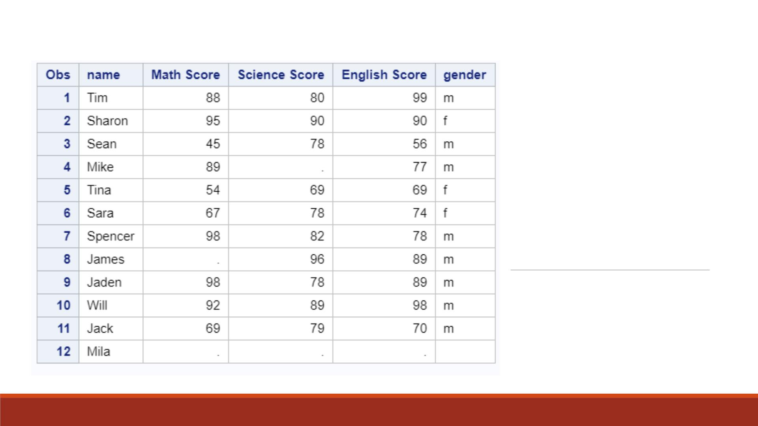
Proc Print
Result

Slide 10
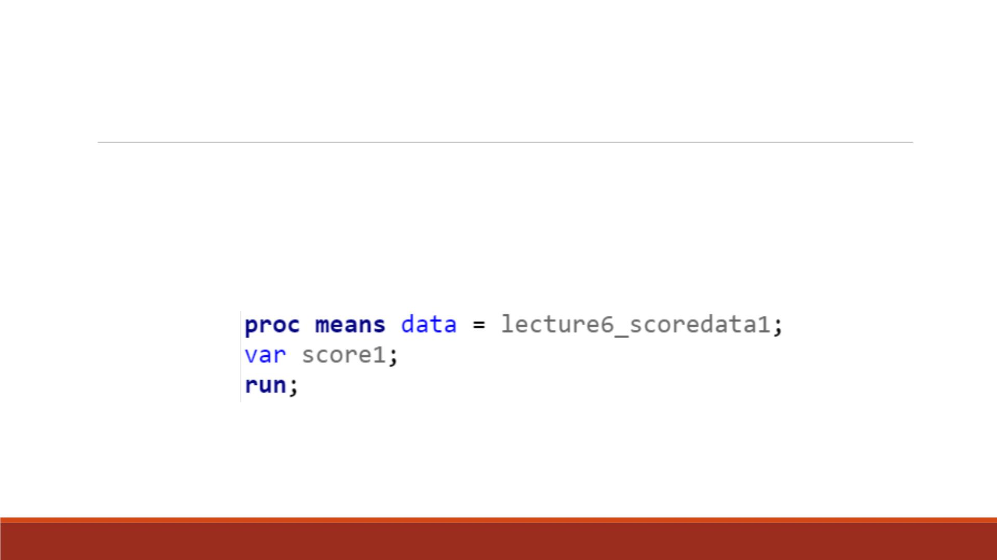
Demo 2: —Permanent Labels
Compute the descriptive statistics of variable score1 and check whether its
previously created label still exists.

Slide 11
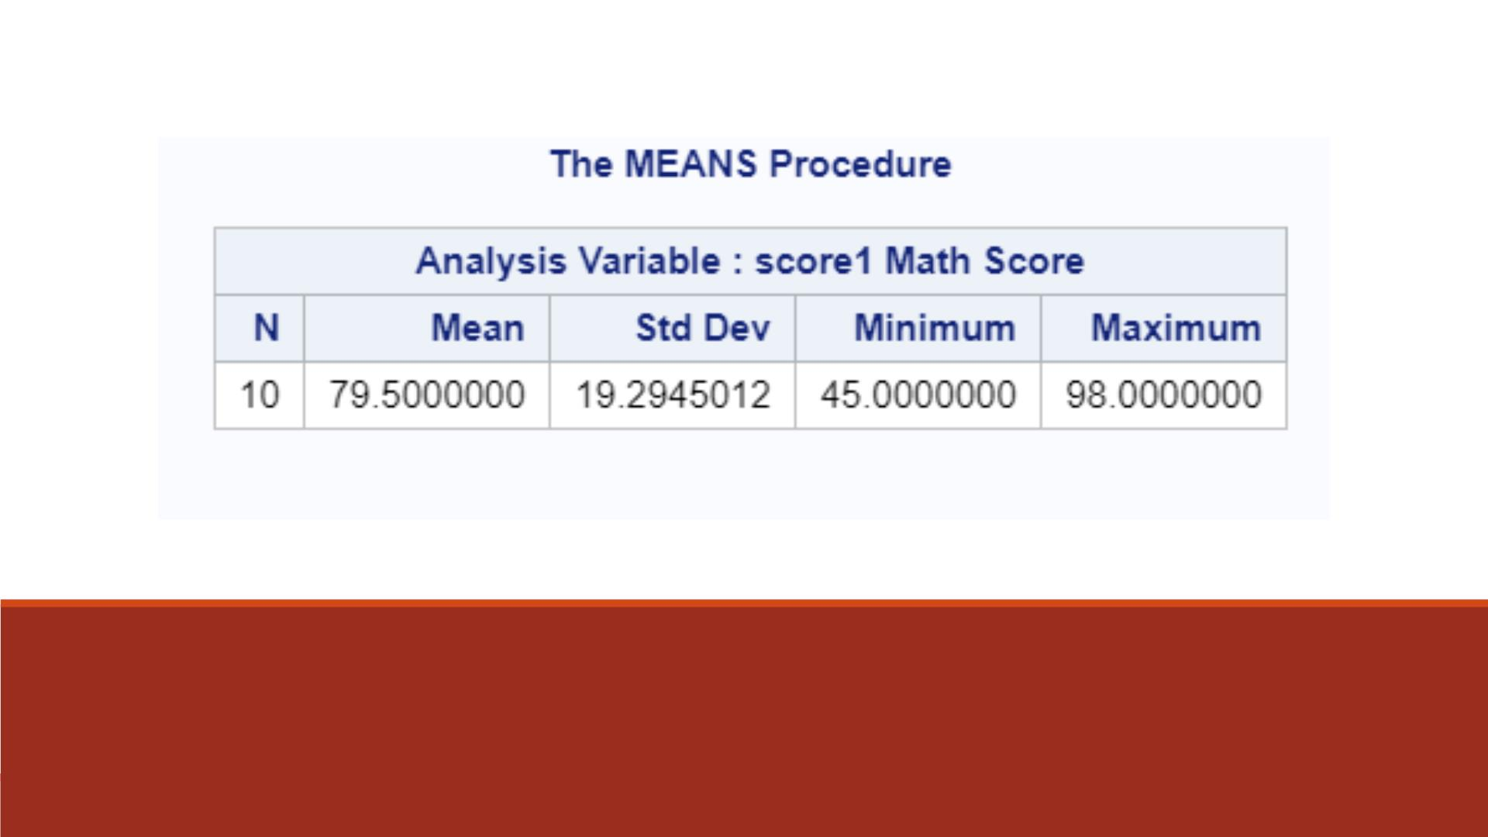
Proc Print Result

Slide 12
Demo 2—Temporary labels
▪Print the dataset “lecture6_scoredata1” with the permanent labels displayed.
▪Create a temporary label for the variable name as “student name”.

Slide 13
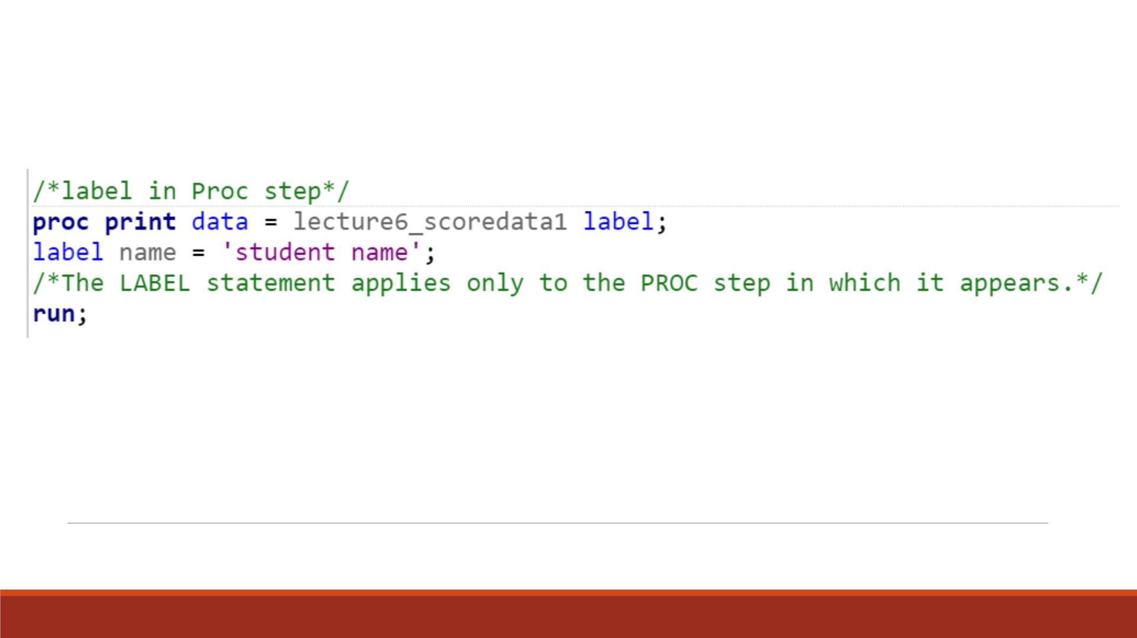
Code

Slide 14
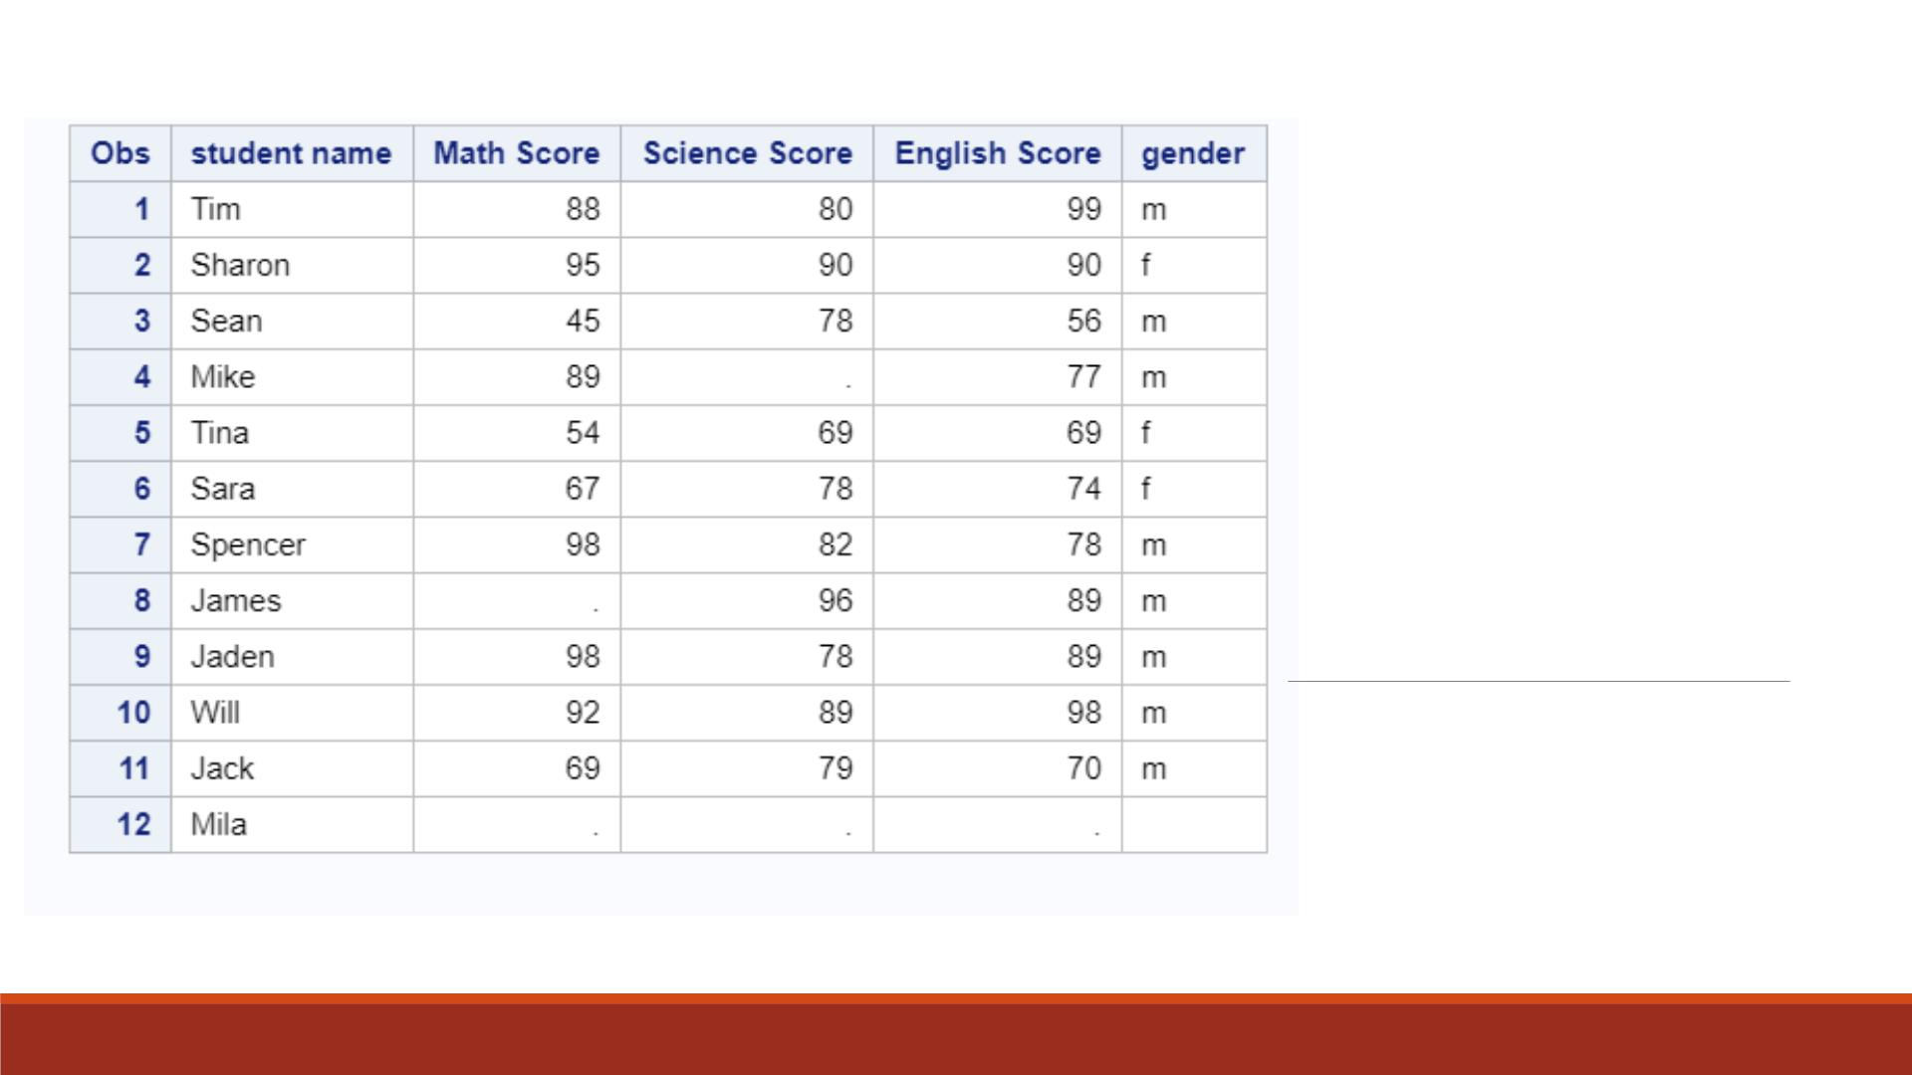
Proc Print
Result

Slide 15
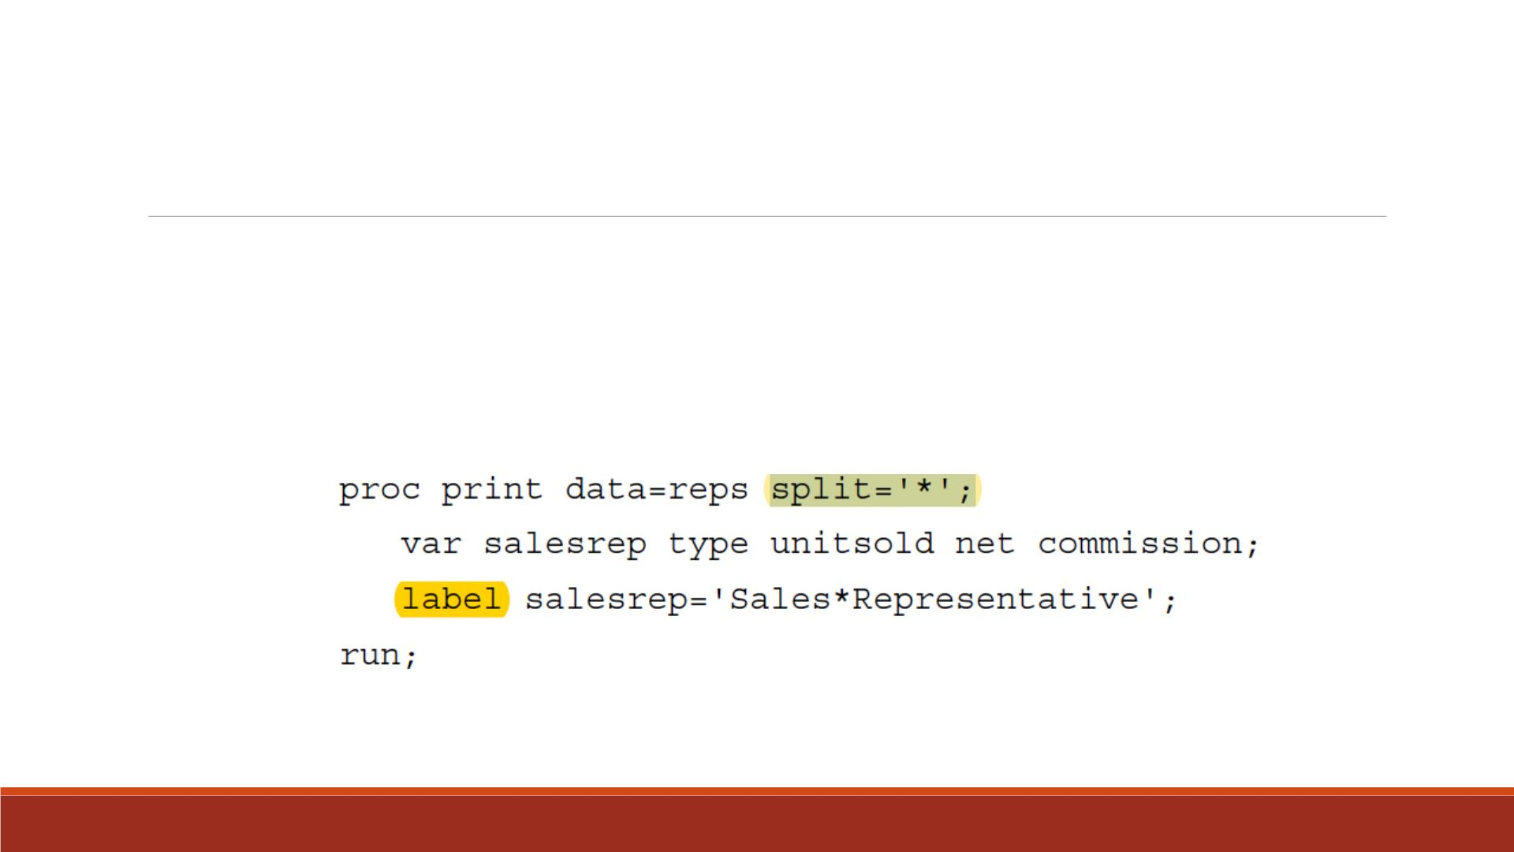
SPLIT= Option
▪Split long labels across multiple lines.
▪Define a split character by using the SPLIT= option.
▪Example:
▪Note: Similar to DLM= Option in Lecture 2.

Slide 16
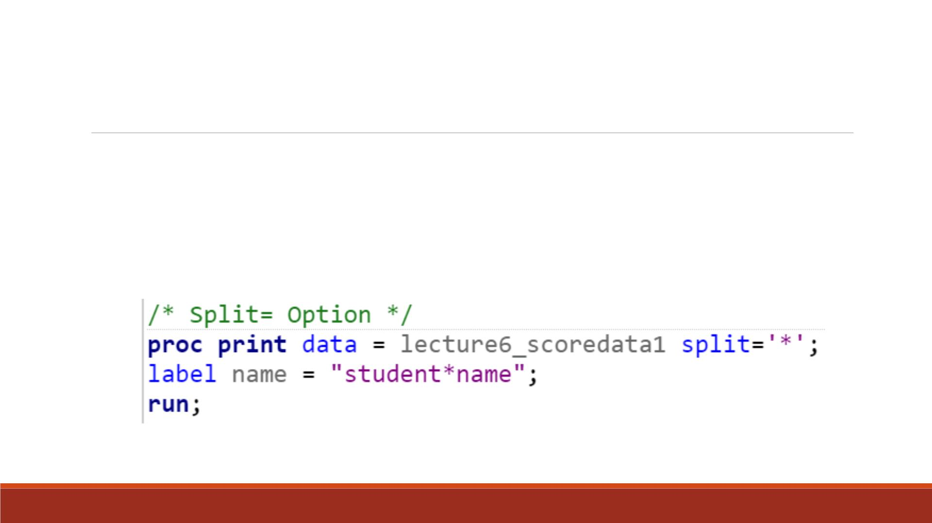
Demo3 —Split= Option
▪In PROC PRINT step, create a temporary label “student name” for the variable
name, which displays in two lines.
▪Code:

Slide 17
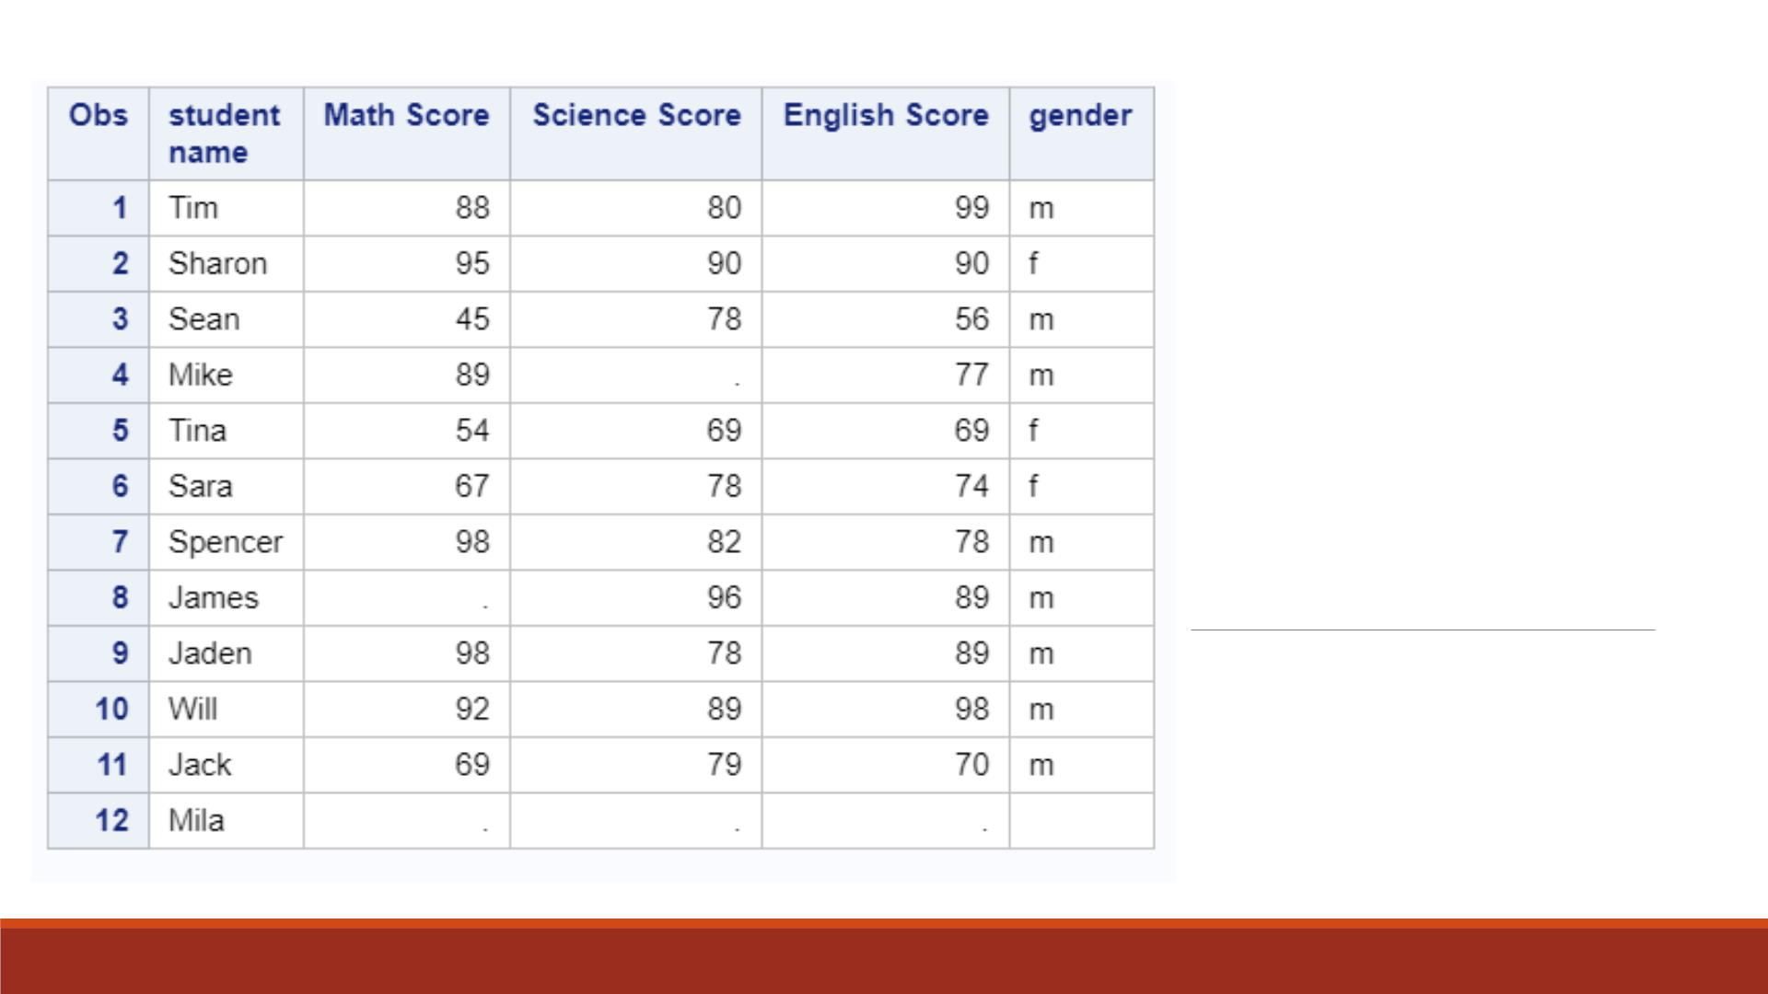
Proc Print
Result

Slide 18
Assigning Formats

Slide 19
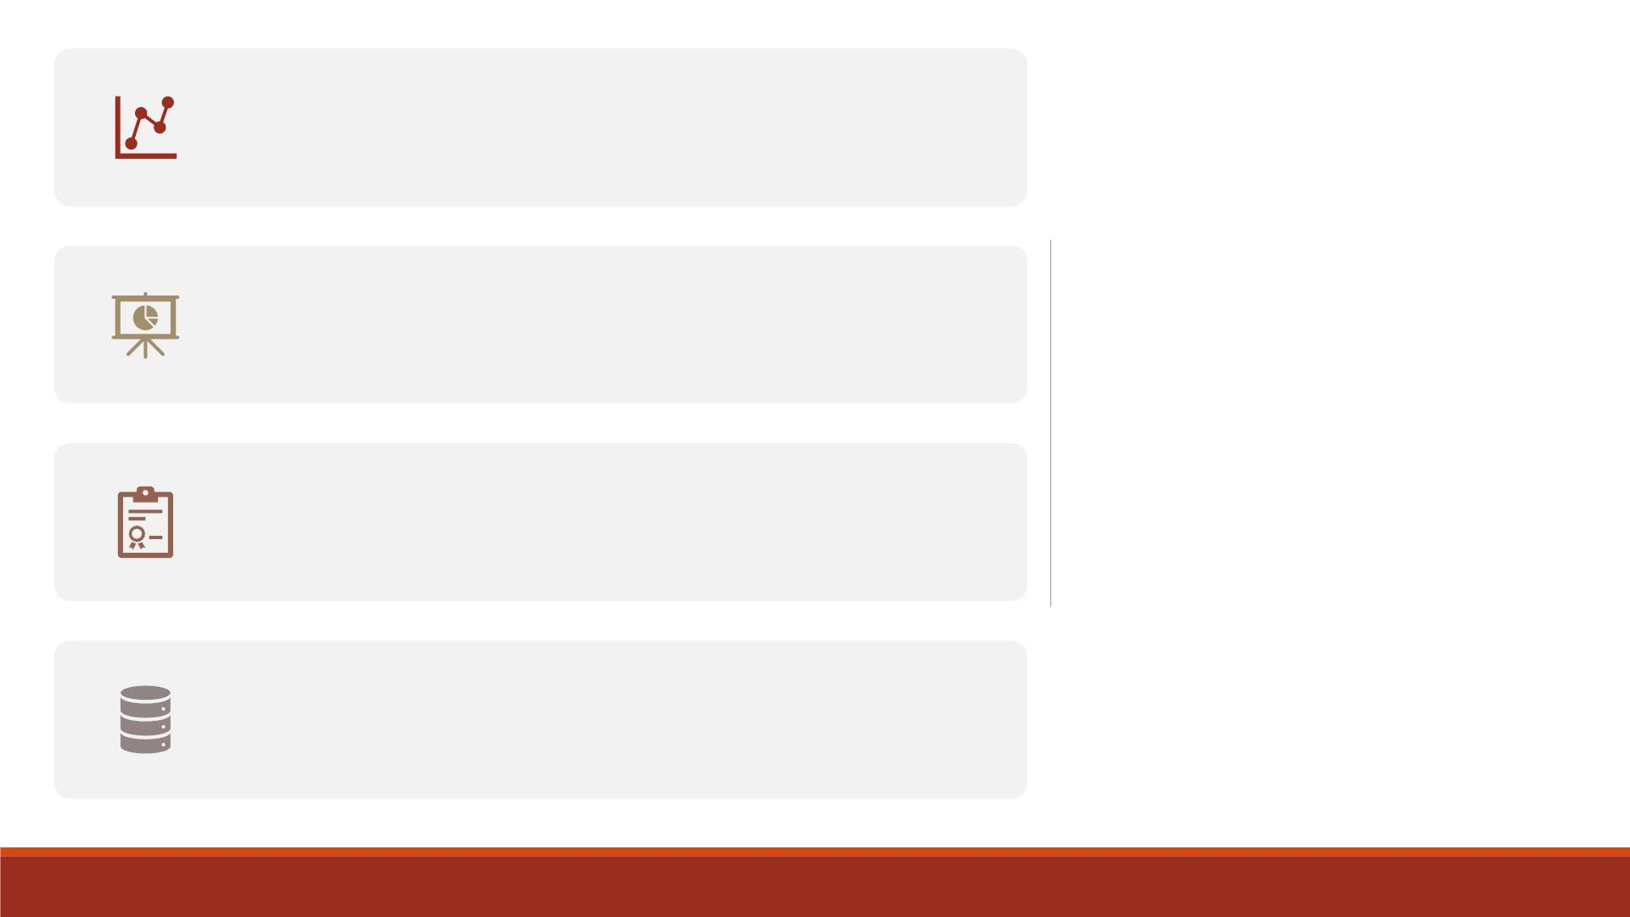
In your SAS reports, formats control how the data
values are displayed.
Formats make data values more understandable
when they are displayed in your PROC output.
Assigning
Formats to
Variables
Yo u can use the FORMAT statements to associate
formats with variables.
Formats affect only how the data values appear in
output, not the actual data values as they are
stored in SAS.

Slide 20
FORMAT statement
General form:
FORMAT variable(s) format-name;
▪variable(s) is the name of one or more variables whose values are to be written
according to a particular pattern.
▪format-name specifies a SAS format or a user-defined format that is used to write out.
the values. Example:
format fee dollar4.;

Slide 21
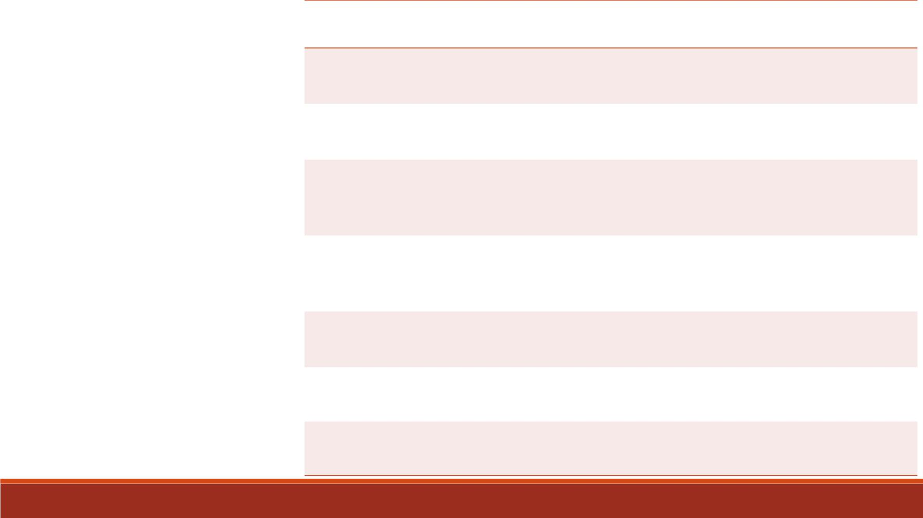
Format
Specifies values
Example
that contain commas and decimal
places
comma8.2
(5,678.90)
SAS Built-in
Formats
COMMAw.d
that contain dollar signs, commas, and
decimal places
dollar 6.2
($23.12)
DOLLARw.d
MMDDYYw.
date values like 09/12/97 (MMDDYY8.)
or 09/12/1997 (MMDDYY10.)
mmddyy10.
(09/12/1997)
Note:
▪ w: field widths;
▪ d: decimal places
date values like 16OCT99 (DATE7.) or
16OCT1999 (DATE9.)
date9.
(16OCT1999)
DAT Ew.
▪ Only the last one is for
rounded to the nearest integer in w
spaces
character variables.
w.
4. (1347)
5.2 (12.67)
$12.
▪ All the rest are for
numeric variables!
w.d
$w.
rounded to d decimal places in w spaces
character values in w spaces

Slide 22
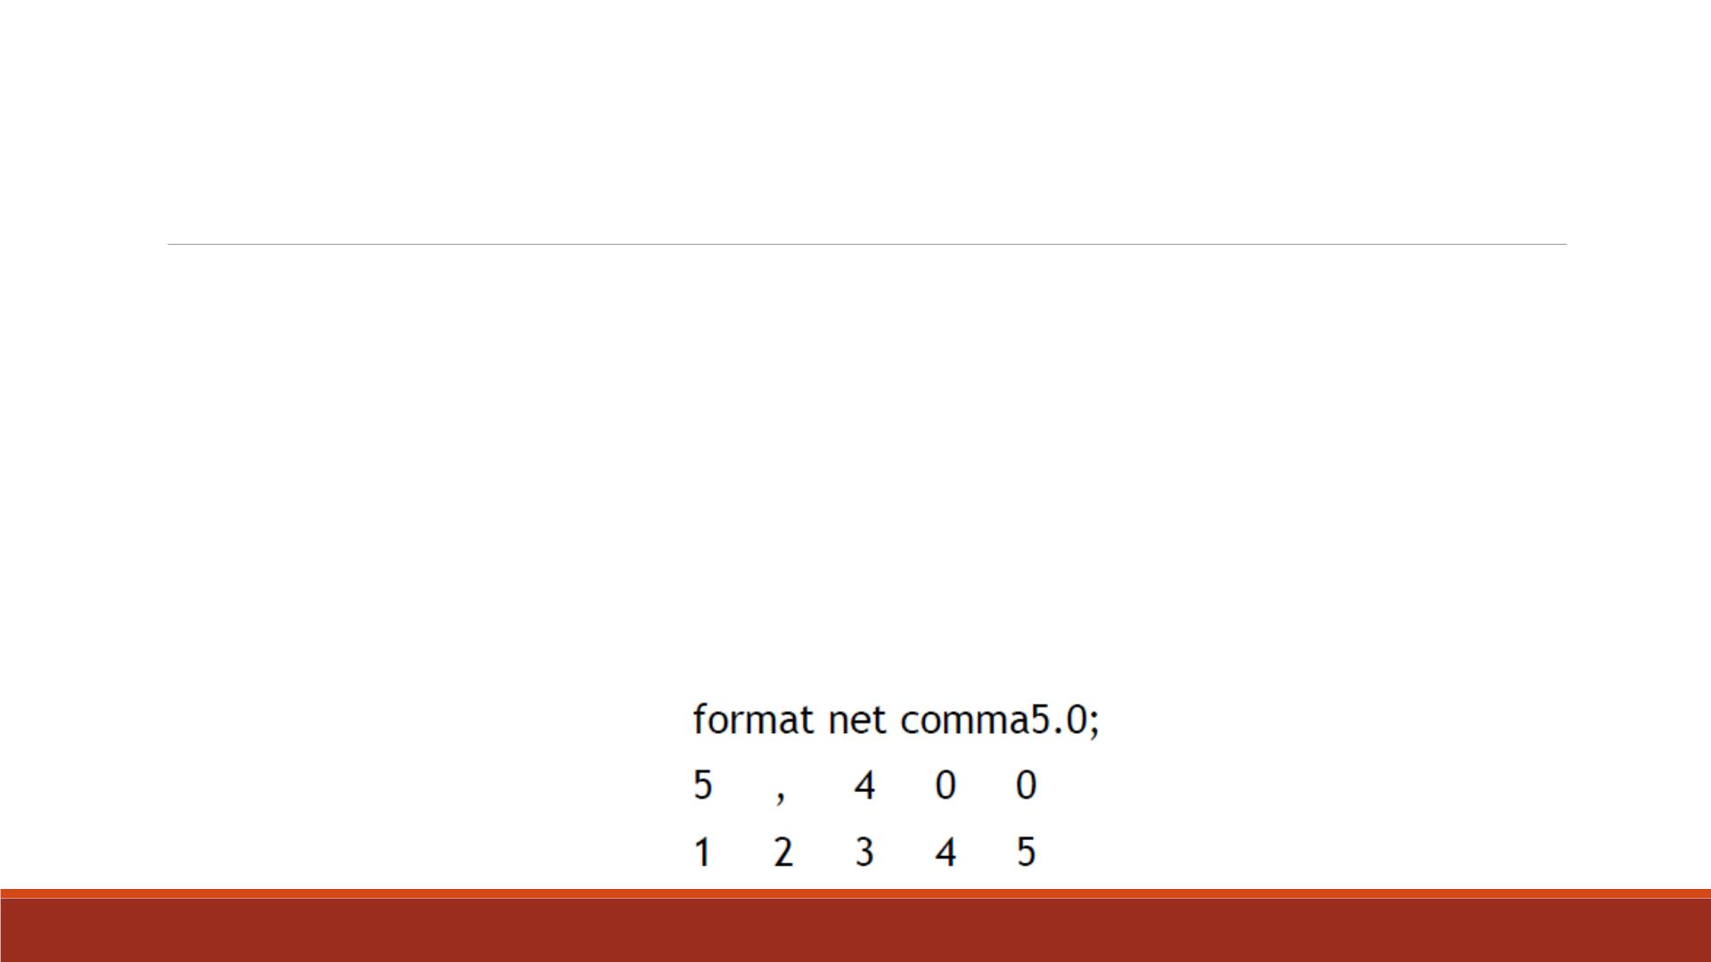
Field Widths (w)
▪All SAS formats specify the total field width (w) that is used for displaying values.
▪For example, suppose the longest value for the variable Net is a four-digit number, such
as 5400.
▪To specify the COMMAw.d format for Net, you specify a field width of 5 or more.
▪Yo u must count the comma, because it occupies a position in the output.
▪Caution: When you use a SAS format, be sure to specify a field width (w) that is wide
enough for the longest possible value. Otherwise, values might not be displayed properly.

Slide 23
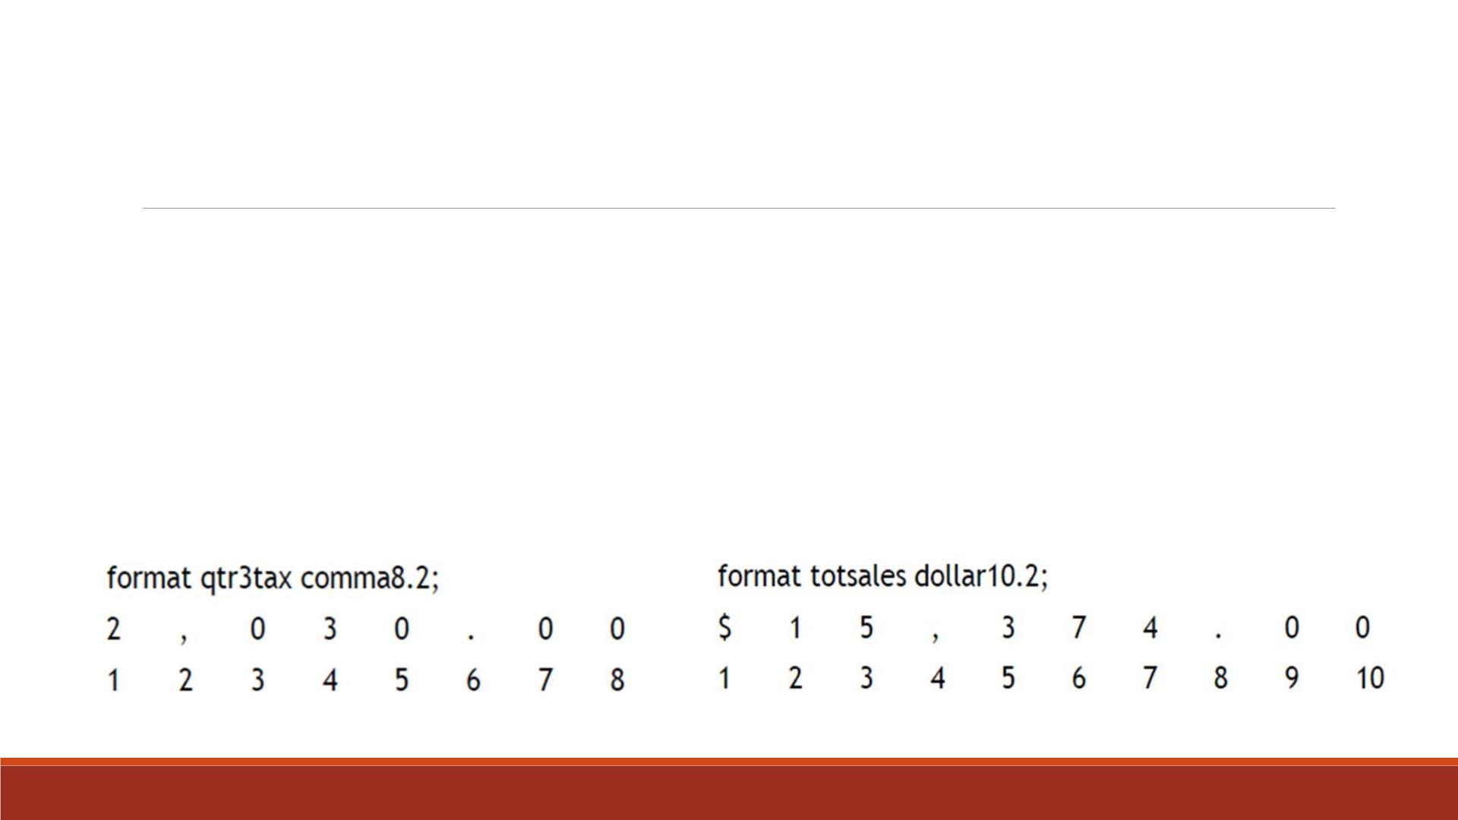
Decimal Places (d)
▪For numeric variables you can also specify the number of decimal places (d) to be
displayed if any.
▪Numbers are rounded to the specified number of decimal places.
▪Write 2030 as 2,030.00 requires 8 print positions, including 2 decimal places and the
decimal point.
▪Format 15374 with a dollar sign, commas, and 2 decimal places requires 10 print positions.

Slide 24
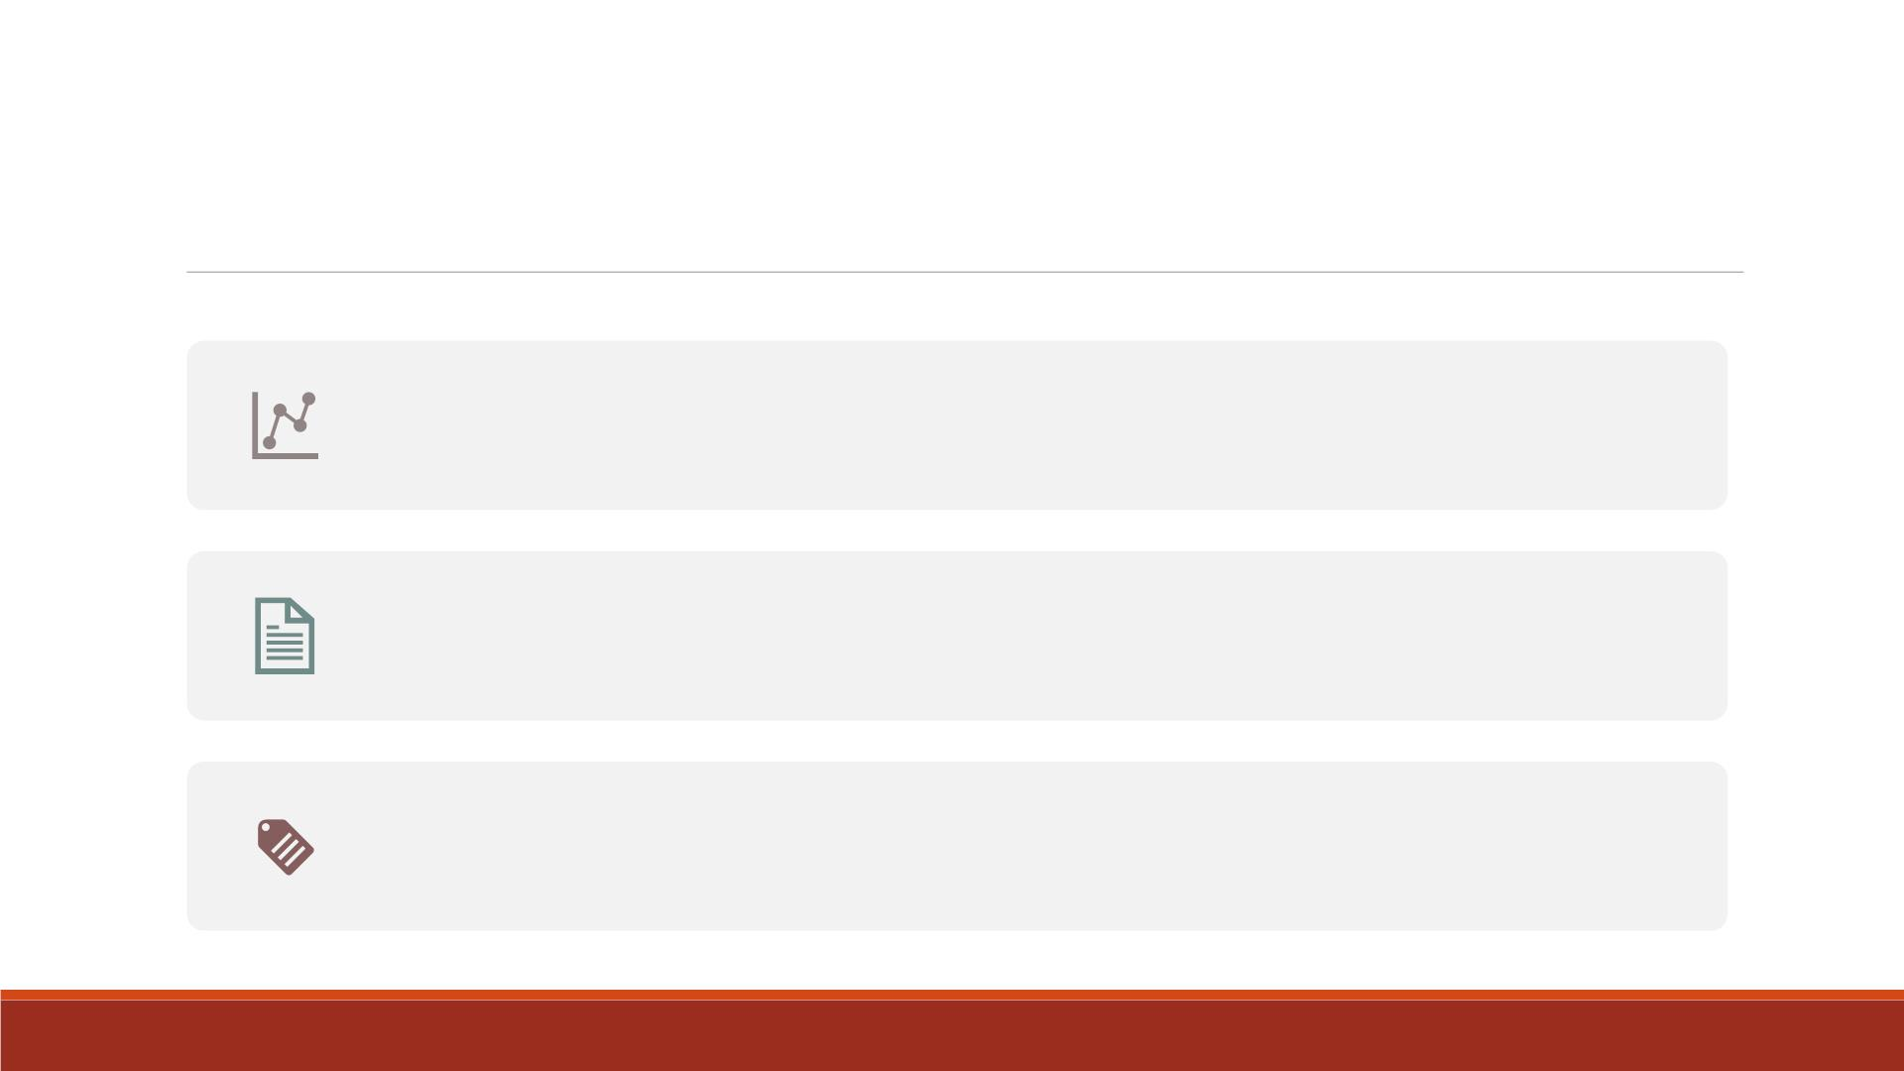
Temporary vs. Permanent Formats
If FORMAT statement is in the D ATA step, the formats remain associated
with the respective variables permanently.
If FORMAT statement is in a PROC step, the formats are used only for that
procedure temporarily.
Note: If you assign temporary labels or formats within a PROC step, they
override any permanent labels or formats that were previously assigned
during the D ATA step.

Slide 25
Demo 4—Format in D ATA Step
▪Import the Excel datafile “Lecture3_score_data_miss.xlsx” into SAS, name it
“lecture6_scoredata0”.
▪Create a SAS dataset “lecture6_scoredata1” based on “lecture6_scoredata0”
by creating two new variables— “TotalScore” and “AverageScore” using SUM
and MEAN functions.
▪Create a SAS dataset “lecture6_scoredata2” based on “lecture6_scoredata1”
where only two decimal places are displayed for the variable “AverageScore”.

Slide 26
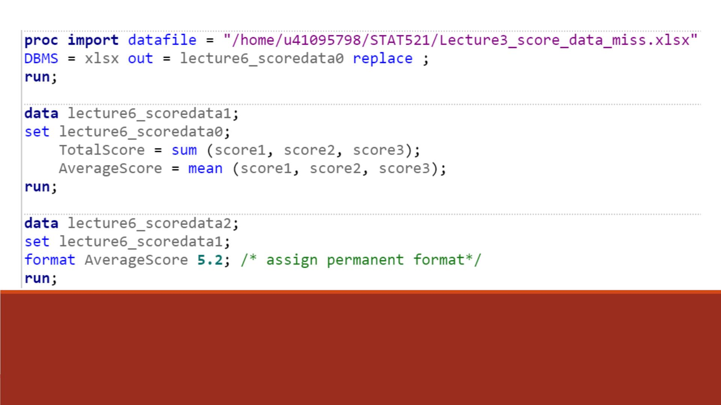
Code

Slide 27
Demo 7—Format in PROC Step
▪Print the SAS dataset “lecture6_scoredata2”, title it “Permanent format for
Averagescore”.
▪Print the SAS dataset “lecture6_scoredata2” with a temporary format which
display only one decimal place of “AverageScore” variable, title it “ Temporary
format for Averagescore”.
▪Compare the two printed results.

Slide 28
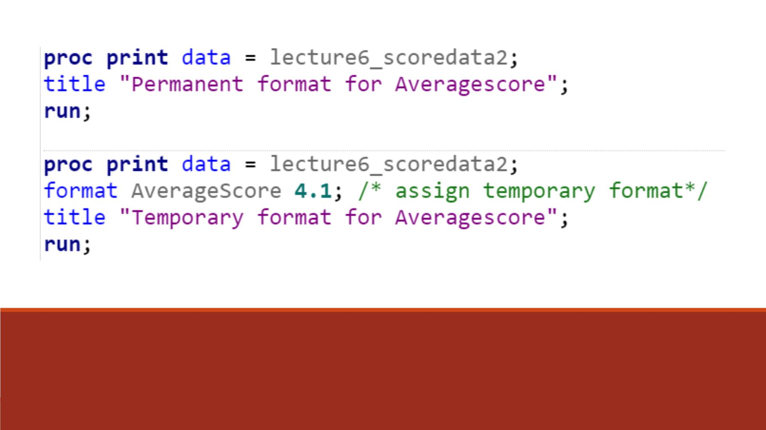
Code

Slide 29
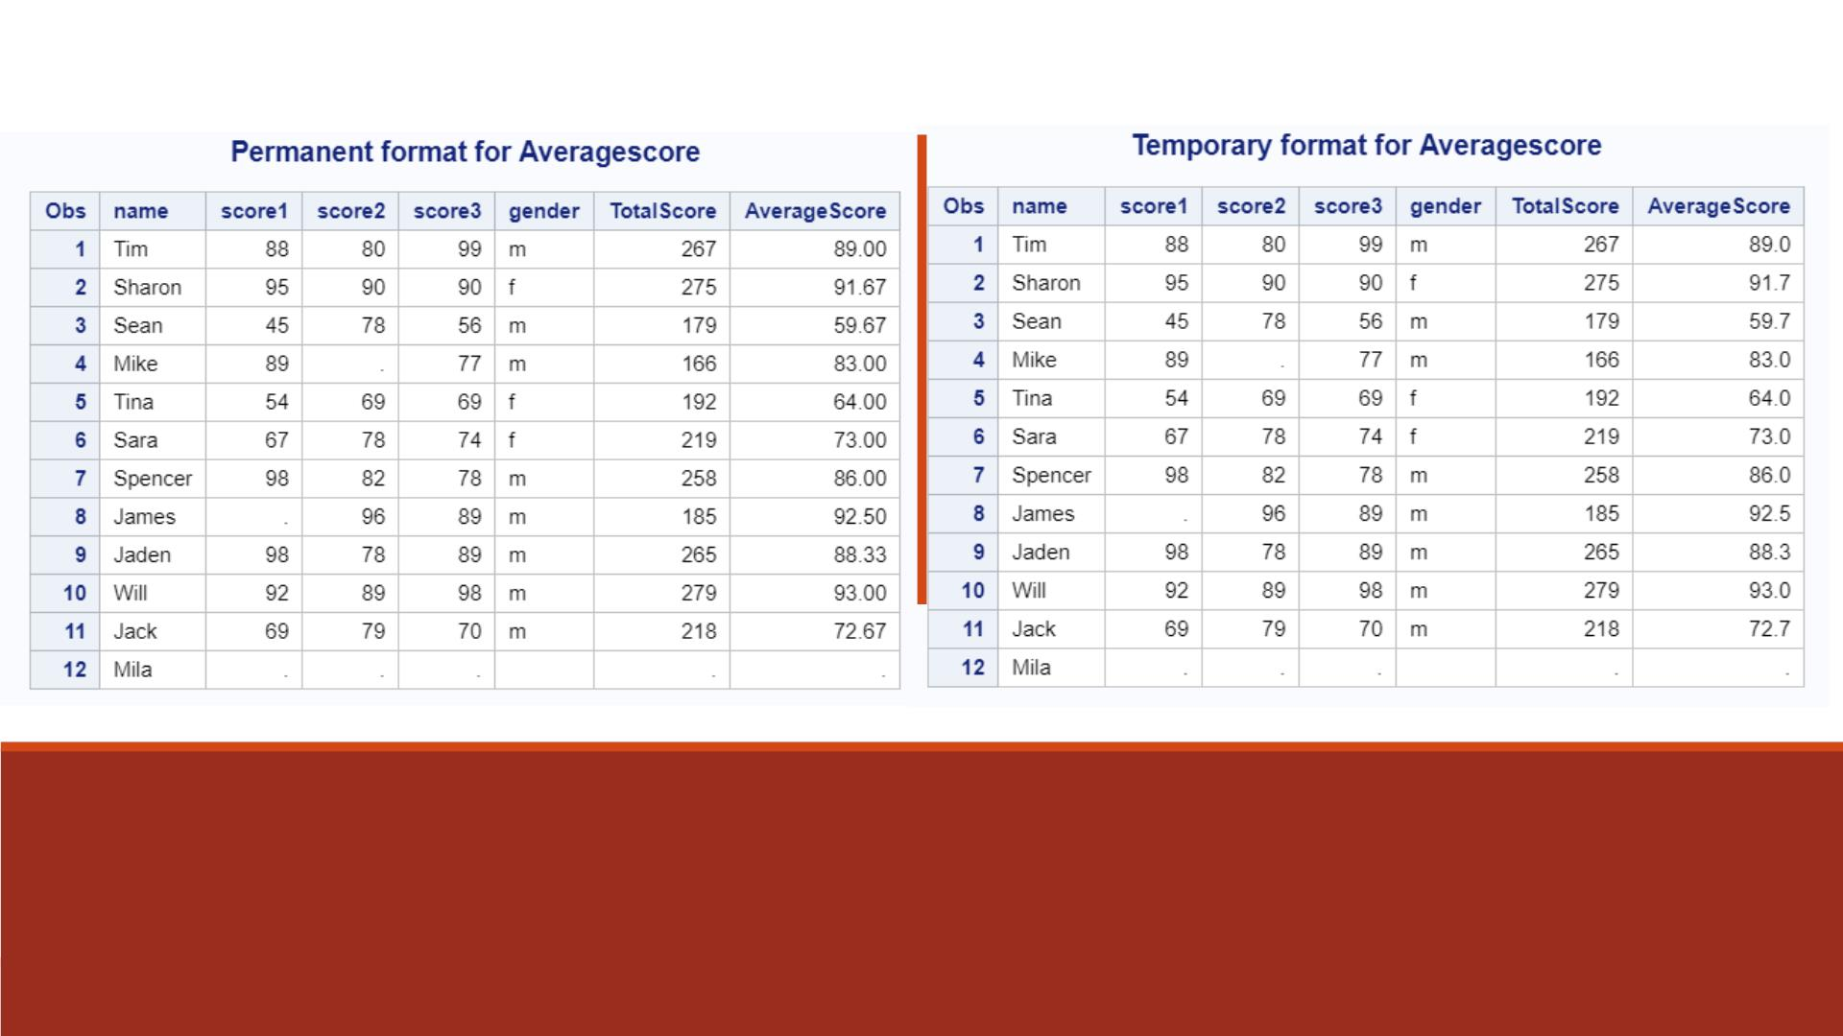
Proc Print Results

Slide 30
Creating User-Defined Formats

Slide 31
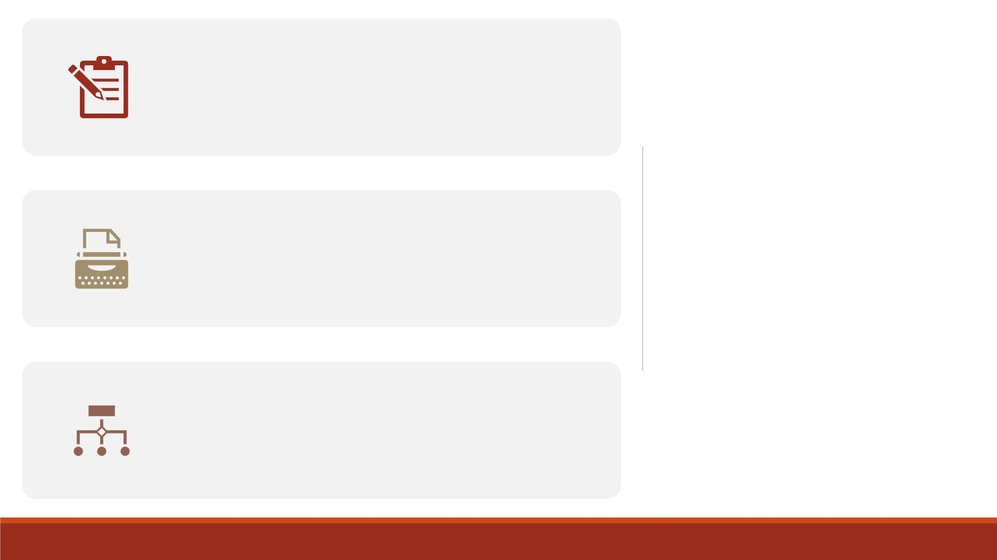
Using PROC FORMAT, you can define your
own formats for variables.
User-Defined
Formats
PROC FORMAT creates formats that will
later be associated with variables in a
FORMAT statement.
The procedure starts with the statement
PROC FORMAT and continues with one or
more VALUE statements.

Slide 32
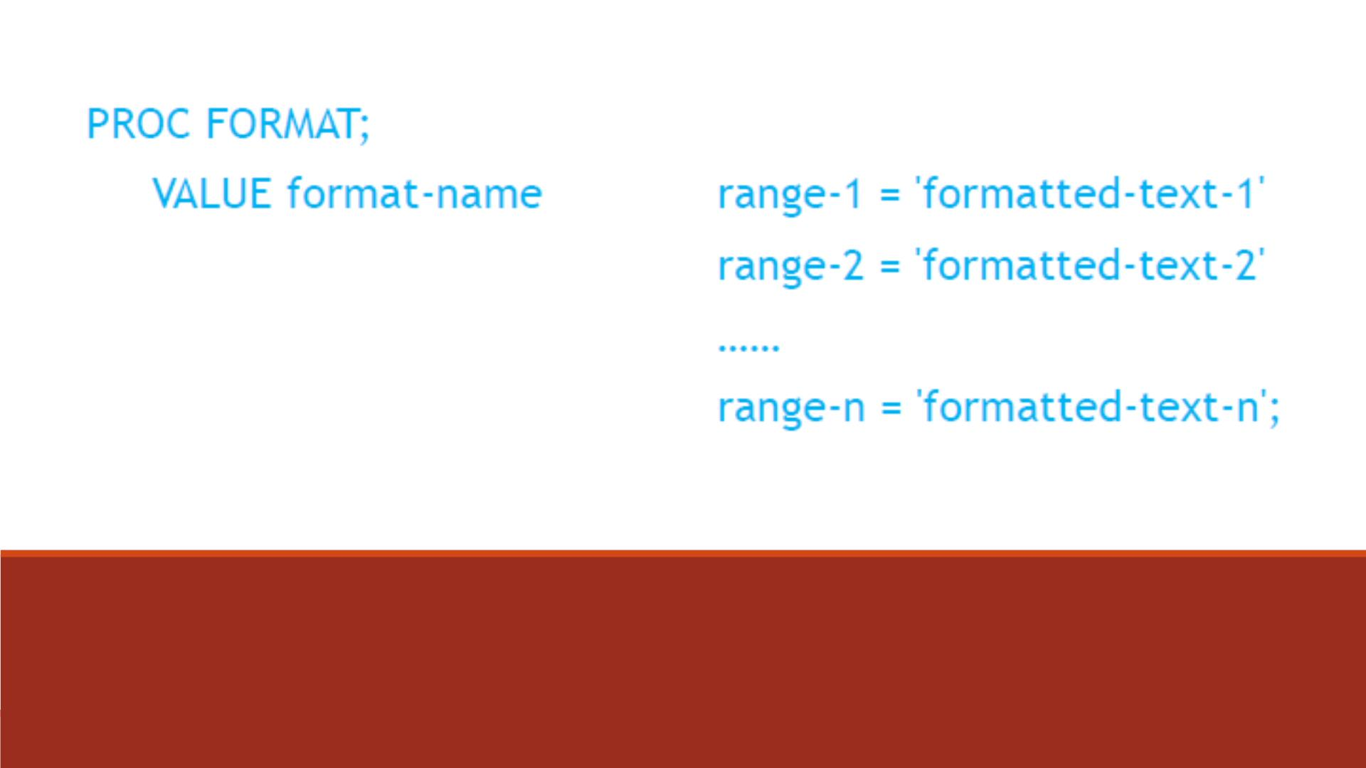
PROC FORMAT

Slide 33

Format Name
must begin with a dollar
sign ($) if the format
applies to character data
cannot be the name of an
existing SAS format
must be a valid SAS name
With SAS®9, a numeric
format name can be up to
32 characters in length. A
character format name
can be up to 31.
does not end in a period
when specified in a VALUE
statement
cannot end in a number

Slide 34
Range of Variable Values
▪Each range is the value of a variable that is assigned to the text given in quotation marks
on the right side of the equal sign.
▪Character values should be enclosed in quotation marks (e.g. ‘A' = ‘Asia’).
▪For more than one value in the range, separate the values with a comma or use the
hyphen (-) for a continuous range. (e.g. 1, 3, 5, 7, 9 = ‘Odd’).
▪SAS Keywords LOW and HIGH are used in ranges to indicate the lowest and the highest
non-missing numeric values(e.g. 500000-HIGH = 'Not Affordable’).
▪Yo u can also use the less than symbol (<) in ranges to exclude end point of the range.
(e.g. 13 -< 20 = 'Teenager ’).
▪The OTHER keyword can be used to assign a format to any values not listed in the VALUE
statement. (e.g. OTHER = ‘Bad Data’).

Slide 35
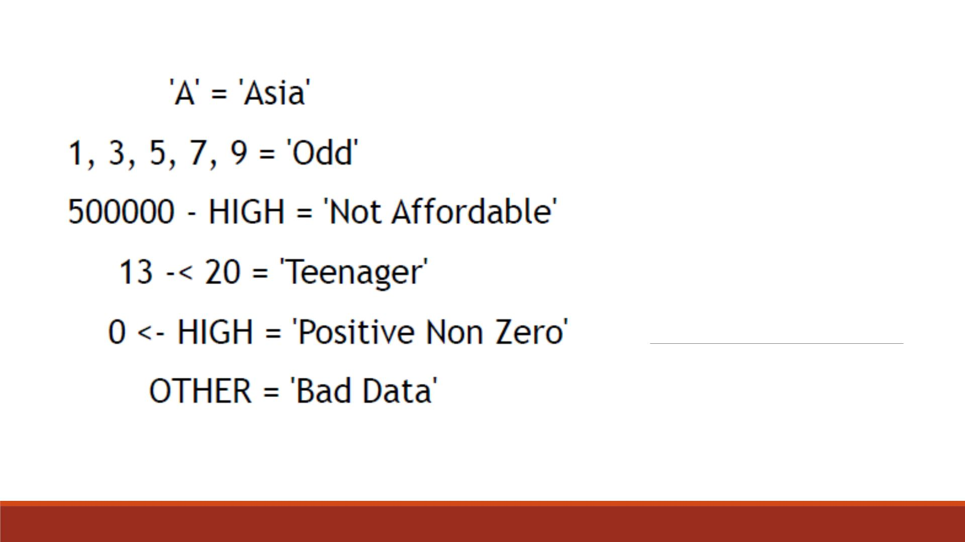
Examples

Slide 36
Assign User-defined Formats to Variables
You assign a user-defined format to a variable in a FORMAT statement. When
associating a format with a variable. Unlike if-then-else, formatting changes the appearance of the output, not the original data.
▪use the same format name in the FORMAT statement that you specified in
the VALUE statement.
▪place a period . at the end of your user-defined format name when it is used
in the FORMAT statement. (Note: A period is not required at the end of the
SAS built-in formats.)
▪If you do not format all of a variable's values, those not listed in the VALUE
statement are printed as their original values in SAS dataset.

Slide 37
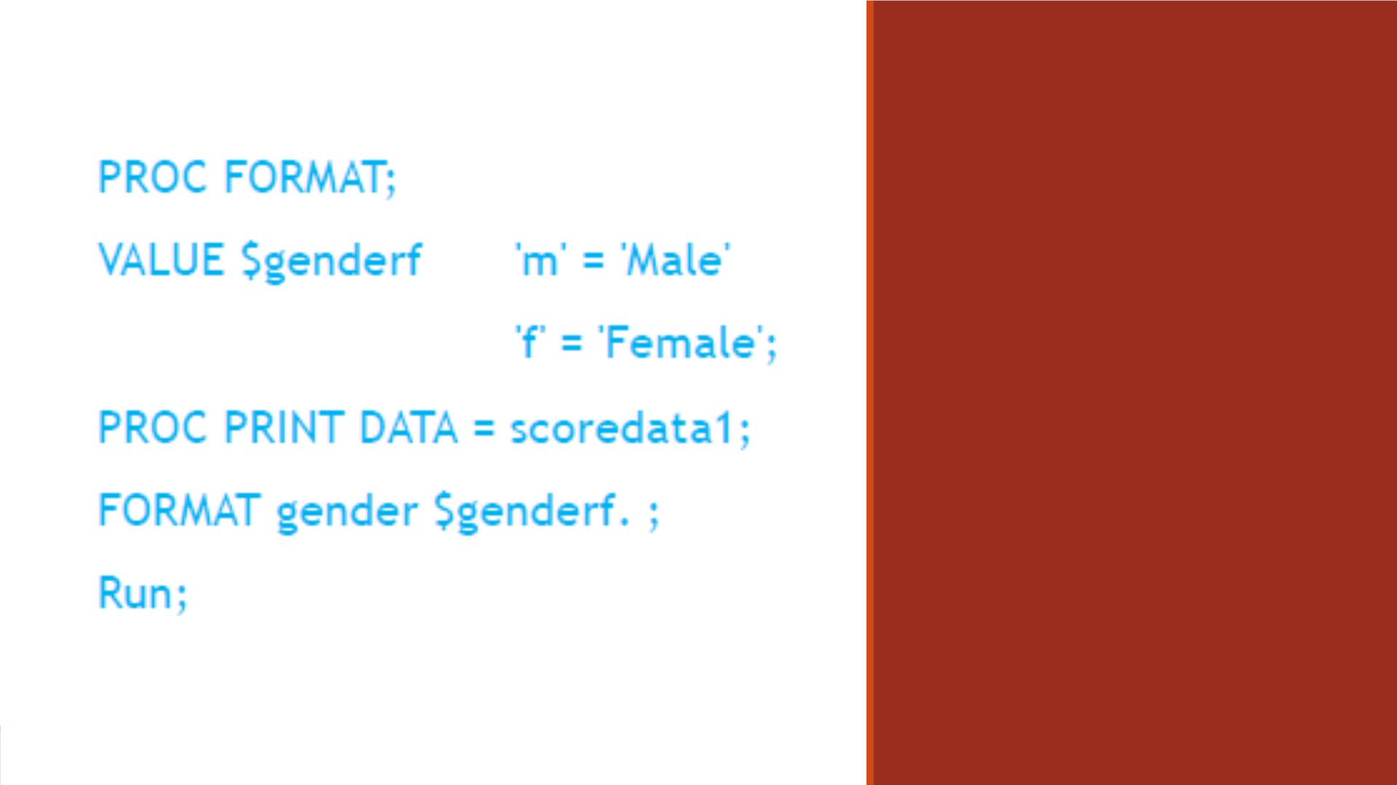
FORMAT
Statement

Slide 38
Demo 8-Create User-defined Formats
Having created the SAS dataset “lecture6_scoredata1”,
▪Create two user-defined formats:
1. Character format named “genderf”: display ‘m’ as ‘Male’, display ‘f’ as ‘Female’
2. Numeric format named “asgroup”: display scores in [0, 60) as ‘F’, [60, 70) as ‘D’,
[70, 80) as ‘C ’, [80, 90) as ‘B’, >=90 as ‘A ”, all other values as ‘Missing’
▪Print “lecture6_scoredata1” without any formats, title it “Results Printed without
User-Defined Formats”.
▪Print “lecture6_scoredata1” and assign format “genderf” to variable “gender,
“asgroup” to variable “AverageScore”, title it “Results Printed with User-Defined
Formats”.

Slide 39
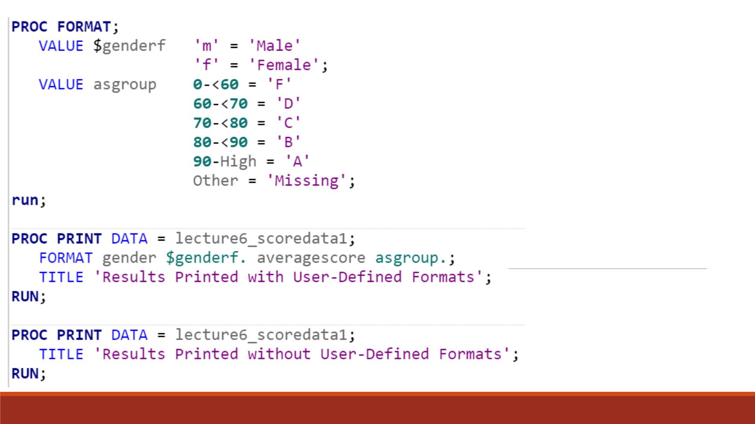
Code

Slide 40
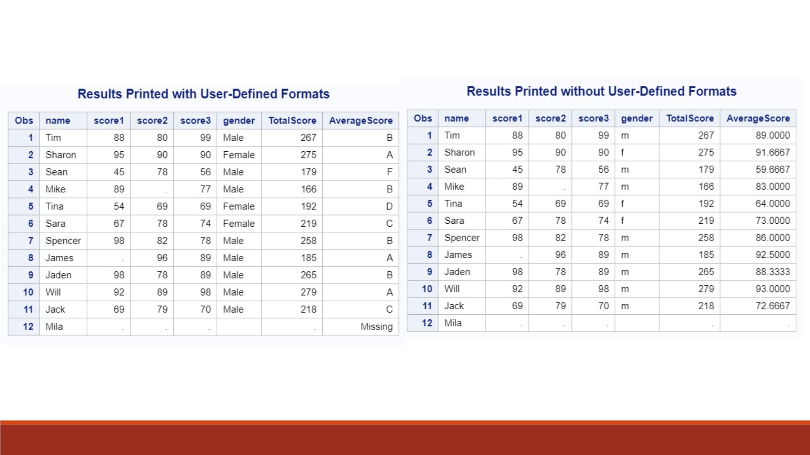

Slide 41
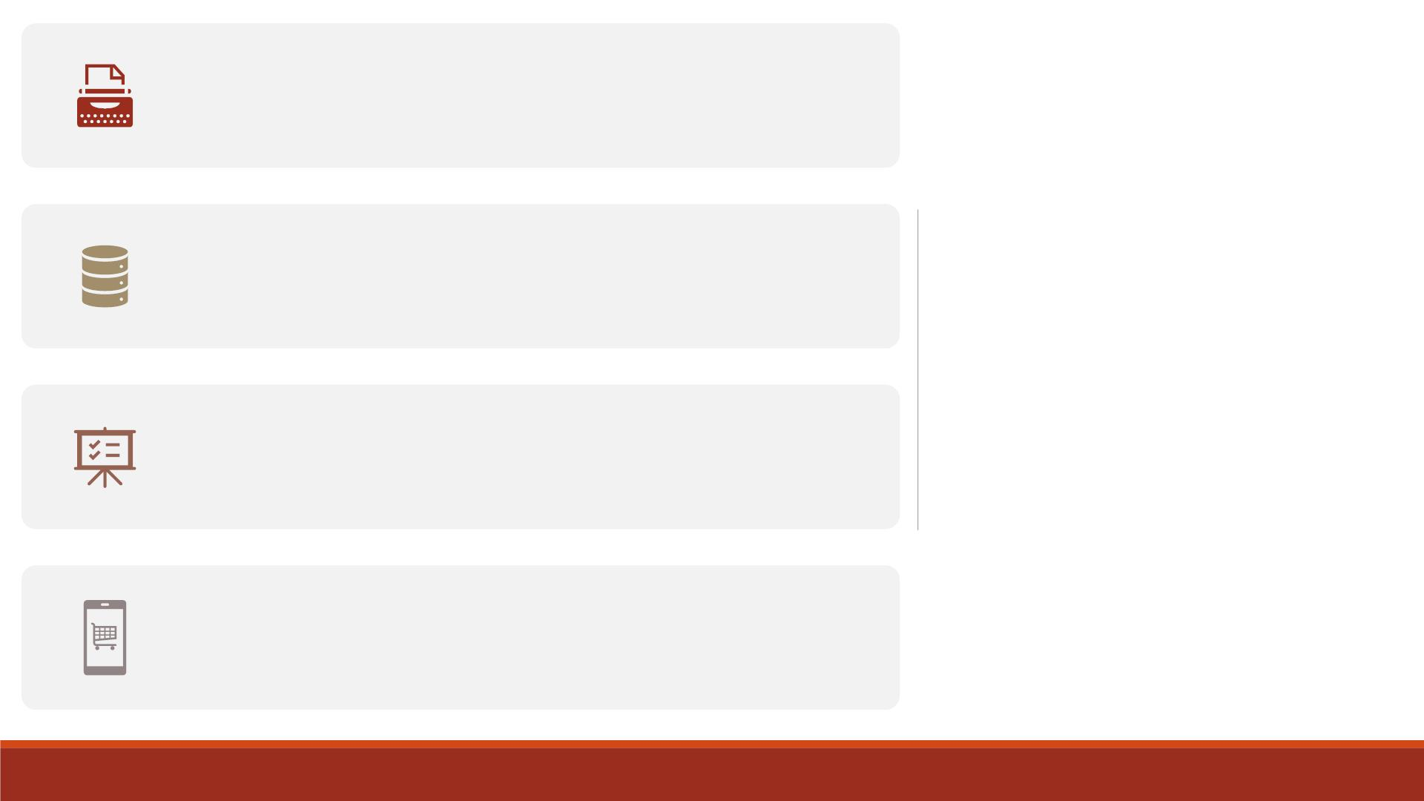
Any time you use PROC FORMAT to create a format,
the format is stored in a format catalog.
Temporary
v.s.
Permanent
Formats
SAS automatically creates a default format catalog
named Work.Formats.
Any format stored in Work.Formats is a temporary
format that exists only for the current SAS session. At
the end of the current session, the catalog is erased.
We need to store user-defined formats permanently
so that they can be used in a new SAS session without
re-creating them.

Slide 42
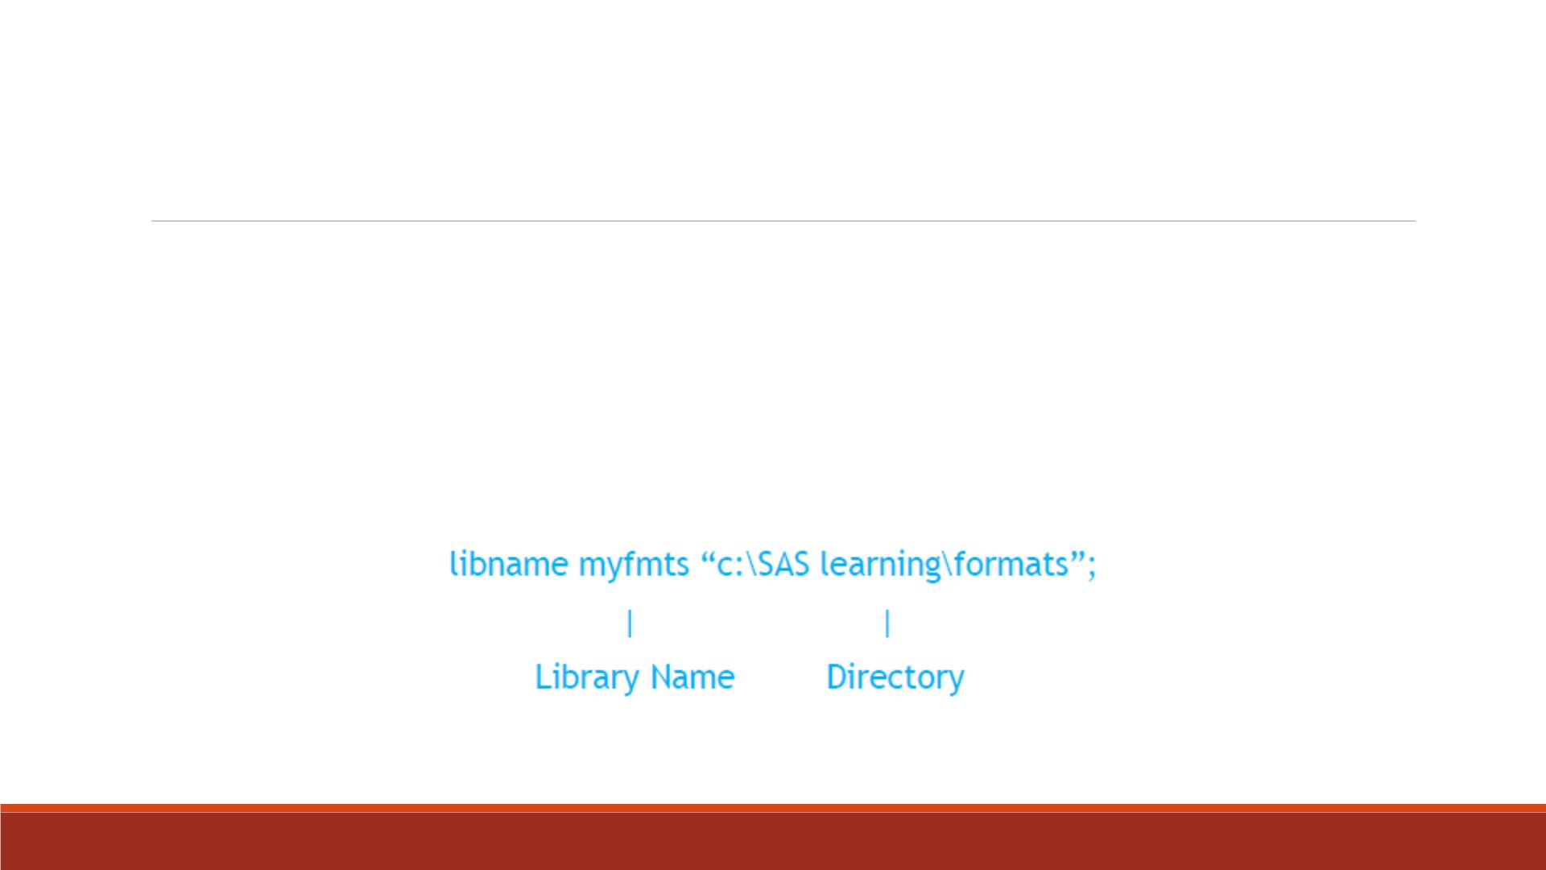
Store User-Defined Formats Permanently
1. Create a library reference (libref, name of the library) to indicate where you want to
store your SAS formats using Libname statement. This can be the same library where
you store your permanent SAS datasets.

Slide 43
Store User-Defined Formats Permanently
2. Use the option LIBRARY=libref when you run PROC FORMAT. (Note: Yo u only need to
run this procedure once to create the format.)
Proc format library=myfmts;
value $genderf ‘M’ = ‘Male’
‘F’ = ‘Female’;
run;

Slide 44
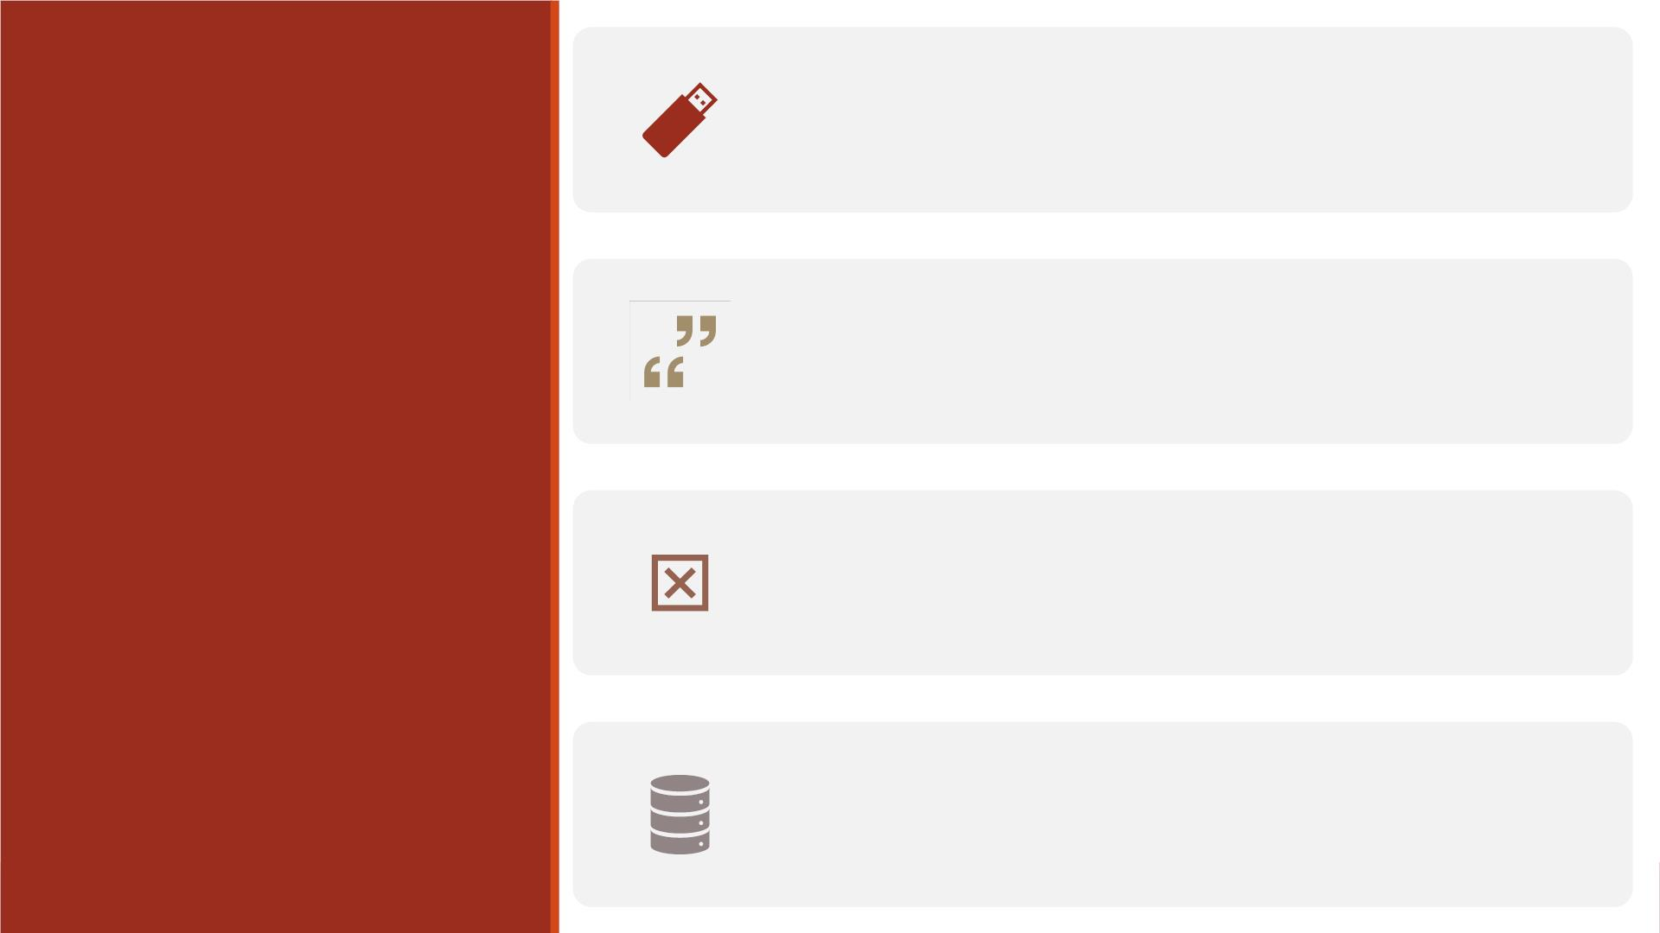
Anytime you want to use a user-defined format in a
new SAS session, you need to tell SAS where to look
for these formats.
Assign the same libref again using Libname
statement, in the previous example library name is
Myfmts.
Reference
User-defined
Formats
Issue a FMTSEARCH= option to tell SAS to look in
one of your own libraries
Place the FORMAT statement in either a D ATA step
or a PROC step to associate a format with a variable
permanently or temporarily.

Slide 45
Example
Libname Myfmts 'c:\SASlearning\formats’;
options fmtsearch=(myfmts);
Proc print data = score;
format gender $genderf.;
run;

Slide 46
Displaying Format Definitions
▪FMTLIB option in PROC FORMAT creates a listing of each format in the specified library with
the ranges and labels.
▪For example, to display the definitions of all the formats in your Myfmts library, you would
submit the following code:
Proc format library = myfmts fmtlib;
title "Format Definitions in the MYFMTS Library";
run;

Slide 47
Demo 9—Store User-defined format Permanently
▪Create a permanent library named “myfmts” (create it under our course folder).
▪Create two user-defined formats and store them in “myfmts” library
1. Character format named “genderf”: display ‘m’ as ‘Male’, display ‘f’ as ‘Female’
2. Numeric format named “asgroup”: display scores in [0, 60) as ‘F’, [60, 70) as ‘D’,
[70, 80) as ‘C ’, [80, 90) as ‘B’, >=90 as ‘A ”, all other values as ‘Missing’
▪Display the definitions of all the formats stored in “myfmts” library.
▪Title the output as “Format Definitions in the MYFMTS Library“.

Slide 48
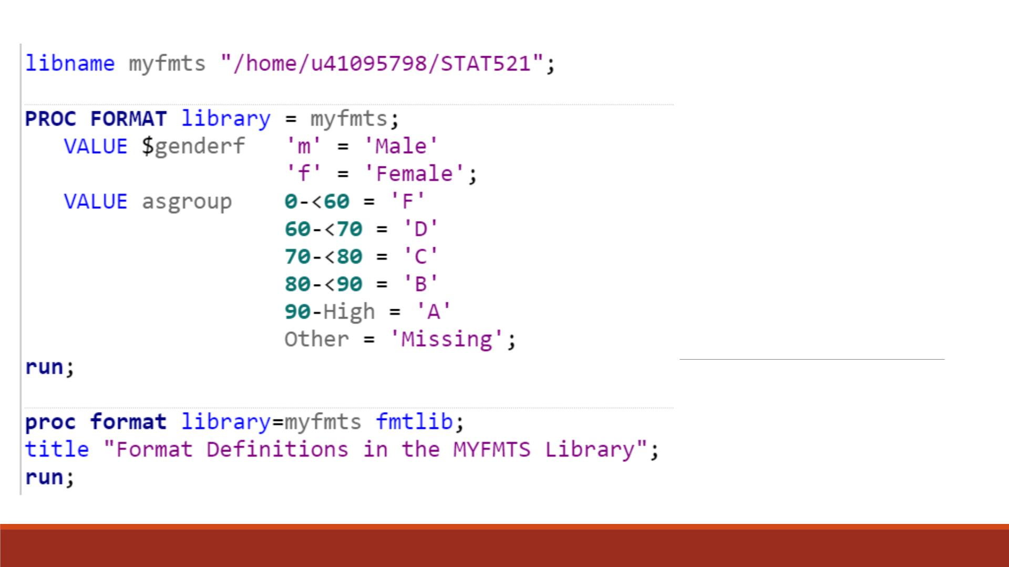
Code

Slide 49
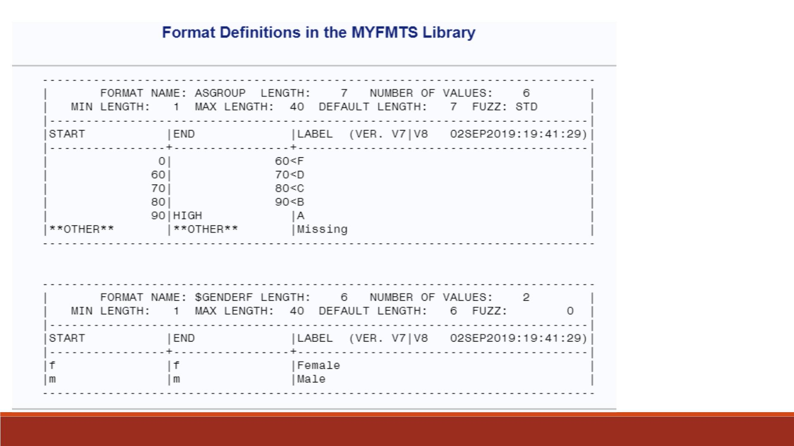
Proc
Format
Result

Slide 50
Demo 10—Reference User-defined Format
▪Import the Excel datafile “Lecture3_score_data_miss.xlsx” into SAS, name it
“lecture6_scoredata0”
▪Create a SAS dataset “lecture6_scoredata1” based on “lecture6_scoredata0” by
creating two new variables— “TotalScore” and “AverageScore” using SUM and
MEAN functions.
▪Print “lecture6_scoredata1” and assign format “genderf” to variable “gender,
“asgroup” to variable “AverageScore”
▪Note: Search for “myfmts” library.

Slide 51
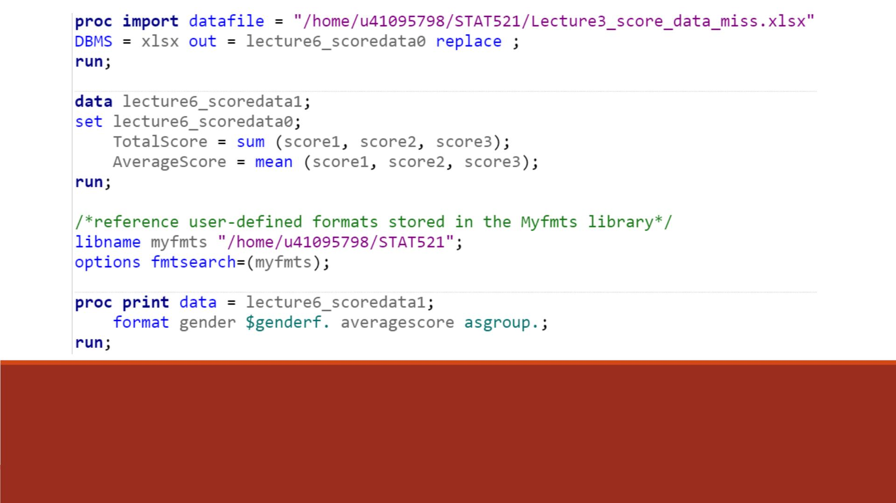
Code

Slide 52
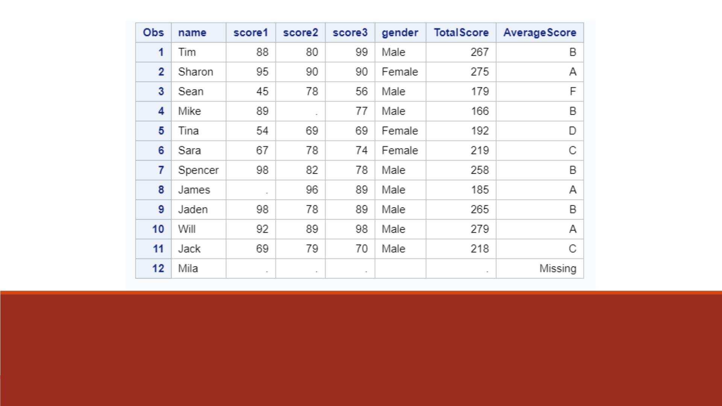
Proc Print Result

Slide 53
Additional information
Document:
  Proc format in action: https://support.sas.com/resources/papers/proceedings/proceedings/sugi27/p056-27.pdf
  Labeling: https://stats.idre.ucla.edu/sas/modules/labeling/
YouTube:
  Proc format in SAS: https://www.youtube.com/watch?v=89h-kzxYa8U

Slide 54
Specifying Length

Slide 55
Specifying Lengths for Variables
▪When creating a new character variable in an assignment statement, SAS
allocates as many bytes of storage space (length) as there are characters in the
first value that it encounters.
▪Any values that are longer than the first value will be truncated.
▪To avoid this, you need to use LENGTH statement to specify the lengths for
variables.
▪Use a LENGTH statement before a character variable’s first value is referenced
elsewhere in the D ATA step to accommodate the longest value.

Slide 56
LENGTH Statement
▪General form:
▪Example:
LENGTH variable(s) <$> length;
length gender_full $7;
▪$ is specified if the variable is a character variable
▪length is an integer that specifies the length of the variable.
▪Note: Make sure the LENGTH statement appears before any other reference of the variable
in the D ATA step. If the variable has been created by another statement, then a later use of
the LENGTH statement will not change its length.

Slide 57
Demo 11—Length Statement
▪Import the Excel datafile “Lecture3_score_data_miss.xlsx” into SAS, name it
“lecture6_scoredata0”.
▪Create a SAS dataset “lecture6_scoredata1” based on “lecture6_scoredata0” by
generating a new variable “gender_full”, which takes value “Male” for “m”,
“Female” for “f ”, all the other values as “missing ”, using IF-THEN statements.
▪Create a SAS dataset “lecture6_scoredata2” based on “lecture6_scoredata0” by
generating a new variable “gender_full”, which has a length of 7.
▪Print the two datasets “lecture6_scoredata1 & 2” and compare the results.

Slide 58
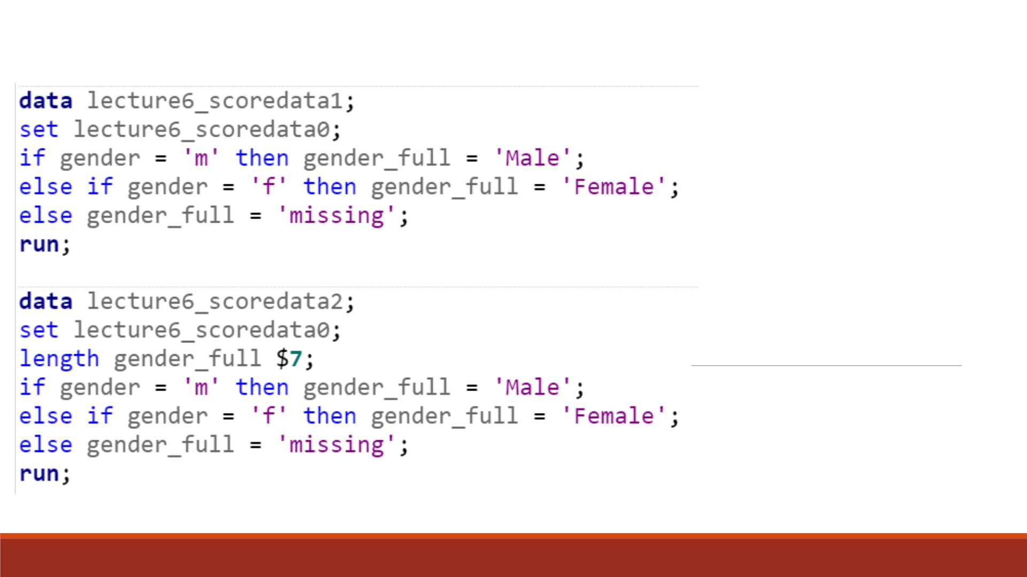
Code—D ATA
Step

Slide 59
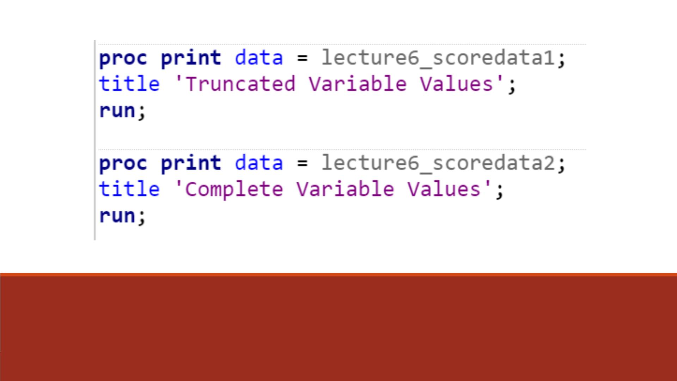
Code—Proc Print Step

Slide 60
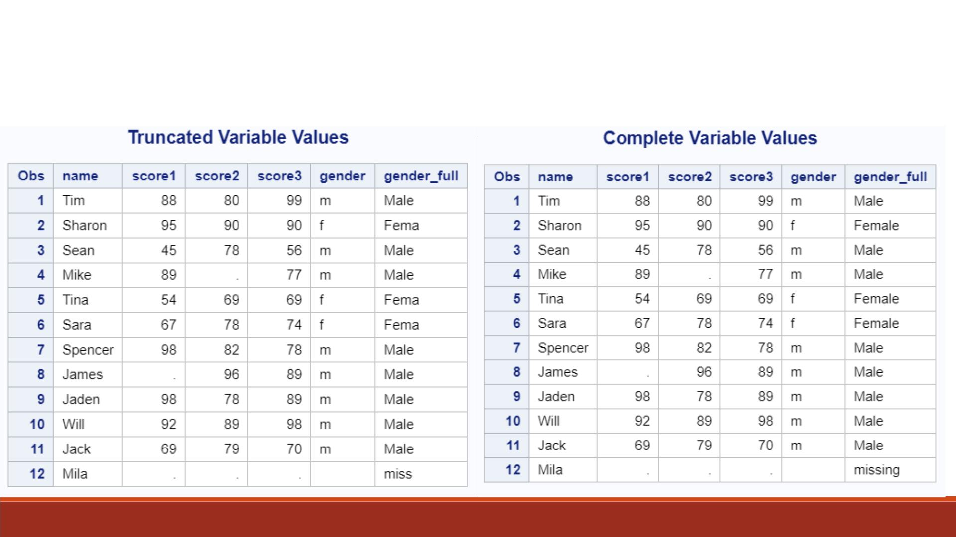
Proc Print Results

Slide 61
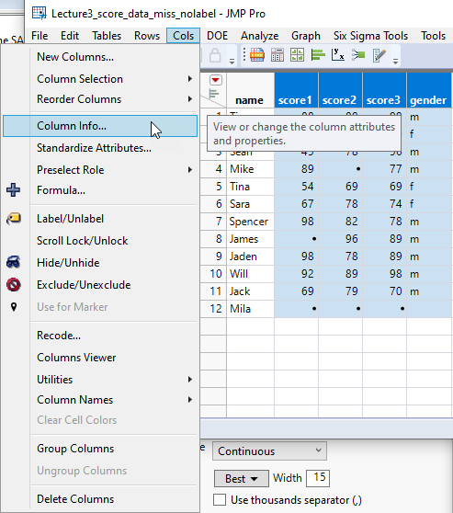
Alternate way to do value, format…etc.
Besides label, format, and length, a SAS variable has many other attributes. It is difficult to remember all of them.
JMP can read SAS file without conversion.
For a quick fix, you can do it in JMP instead.
In JMP, open the SAS file “Lecture3_score_data_miss”
Select the variables that you want to change the attributes.
From the pull down menu Cols select Column Info.

Slide 62
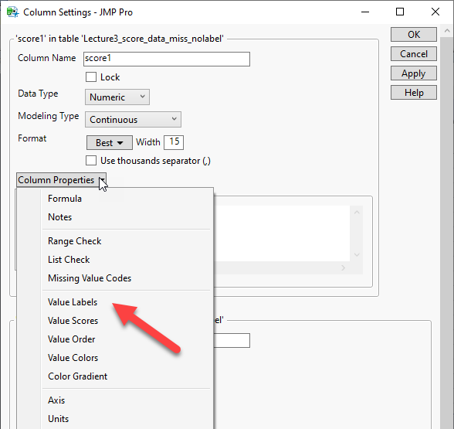
Column properties
In each variable you can manipulate the variable attribute from the pull down menu Column Properties.
For example, you can assign value labels.

