Slide 1

Creating List Reports

Slide 2
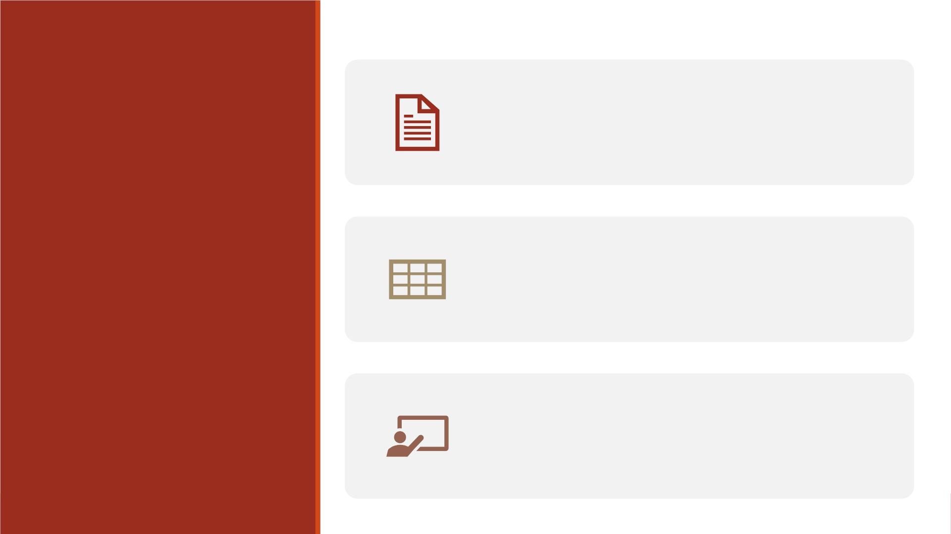
Creating a simple report using Proc Print
Sorting your data using Proc Sort
Creating an enhanced report
Outline
Reading: Base Guide Ch4

Slide 3

Creating a Simple Report
Using Proc Print

Slide 4
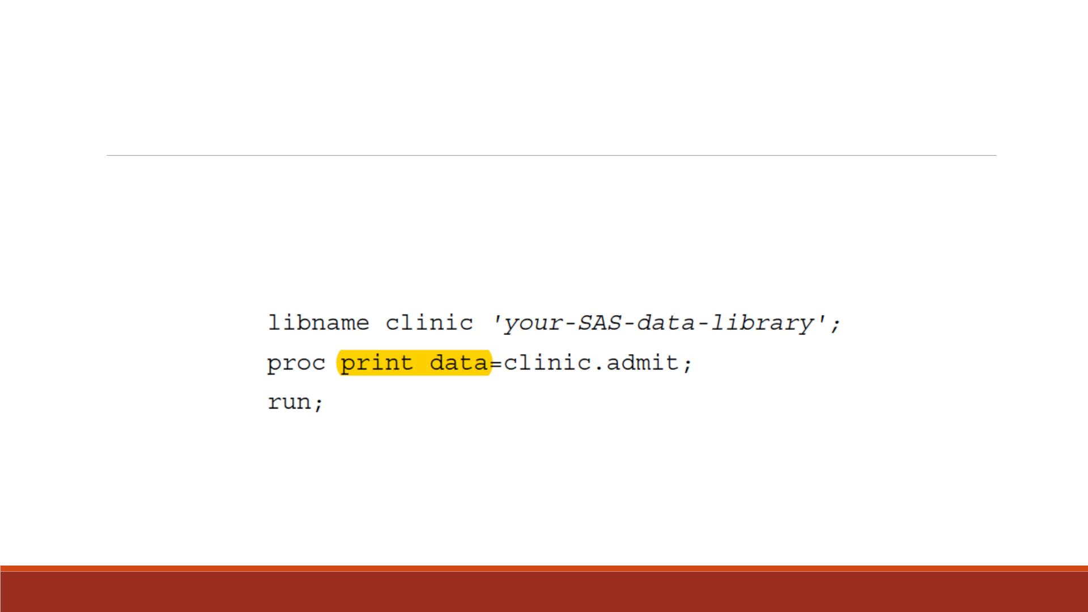
Create Simple Reports with Proc Print
▪Yo u can easily list the contents of a SAS data set by using a simple program like the one
shown below.
▪All the variables and observations will be printed.

Slide 5
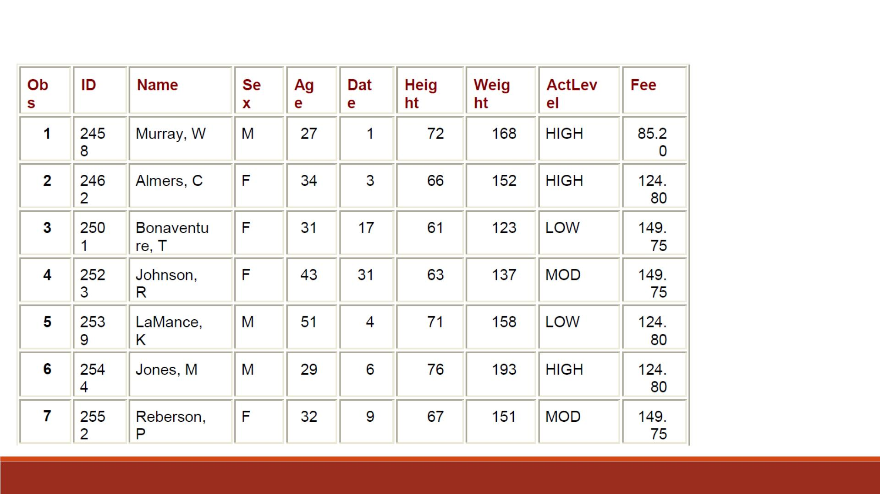
Partial
Output

Slide 6

OBS= in Proc Print
▪Yo u can change the name of the default Obs column (first column in Proc Print) with
Obs=‘ ’ option.
▪For example,
proc print data=clinic.admit obs=‘Observation Number’;

Slide 7
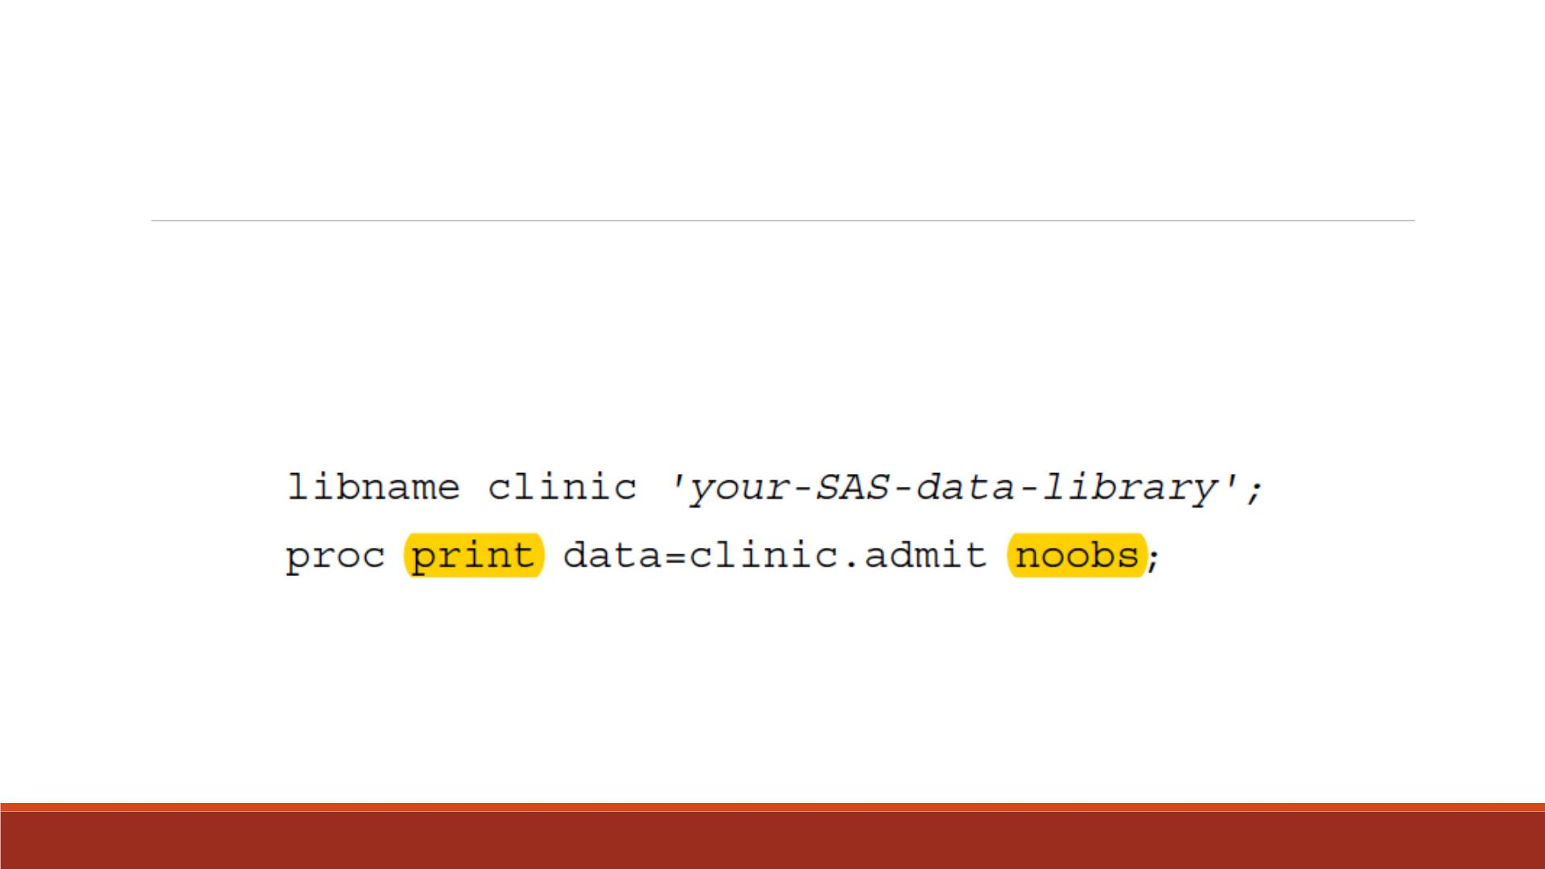
NOOBS Option
Yo u can remove the default Obs column that displays observation numbers.

Slide 8
Demo 1—Simple Report with Proc Print
▪Import the Excel dataset “Lecture7_score_data_id_class.xlsx” into SAS, name
it “lecture7_scoredata0”
▪Print “lecture7_scoredata0” without any extra options.
▪Print “lecture7_scoredata0” and change the default column Obs to
“Observation Number ”.
▪Print “lecture7_scoredata0” with showing the default column Obs

Slide 9
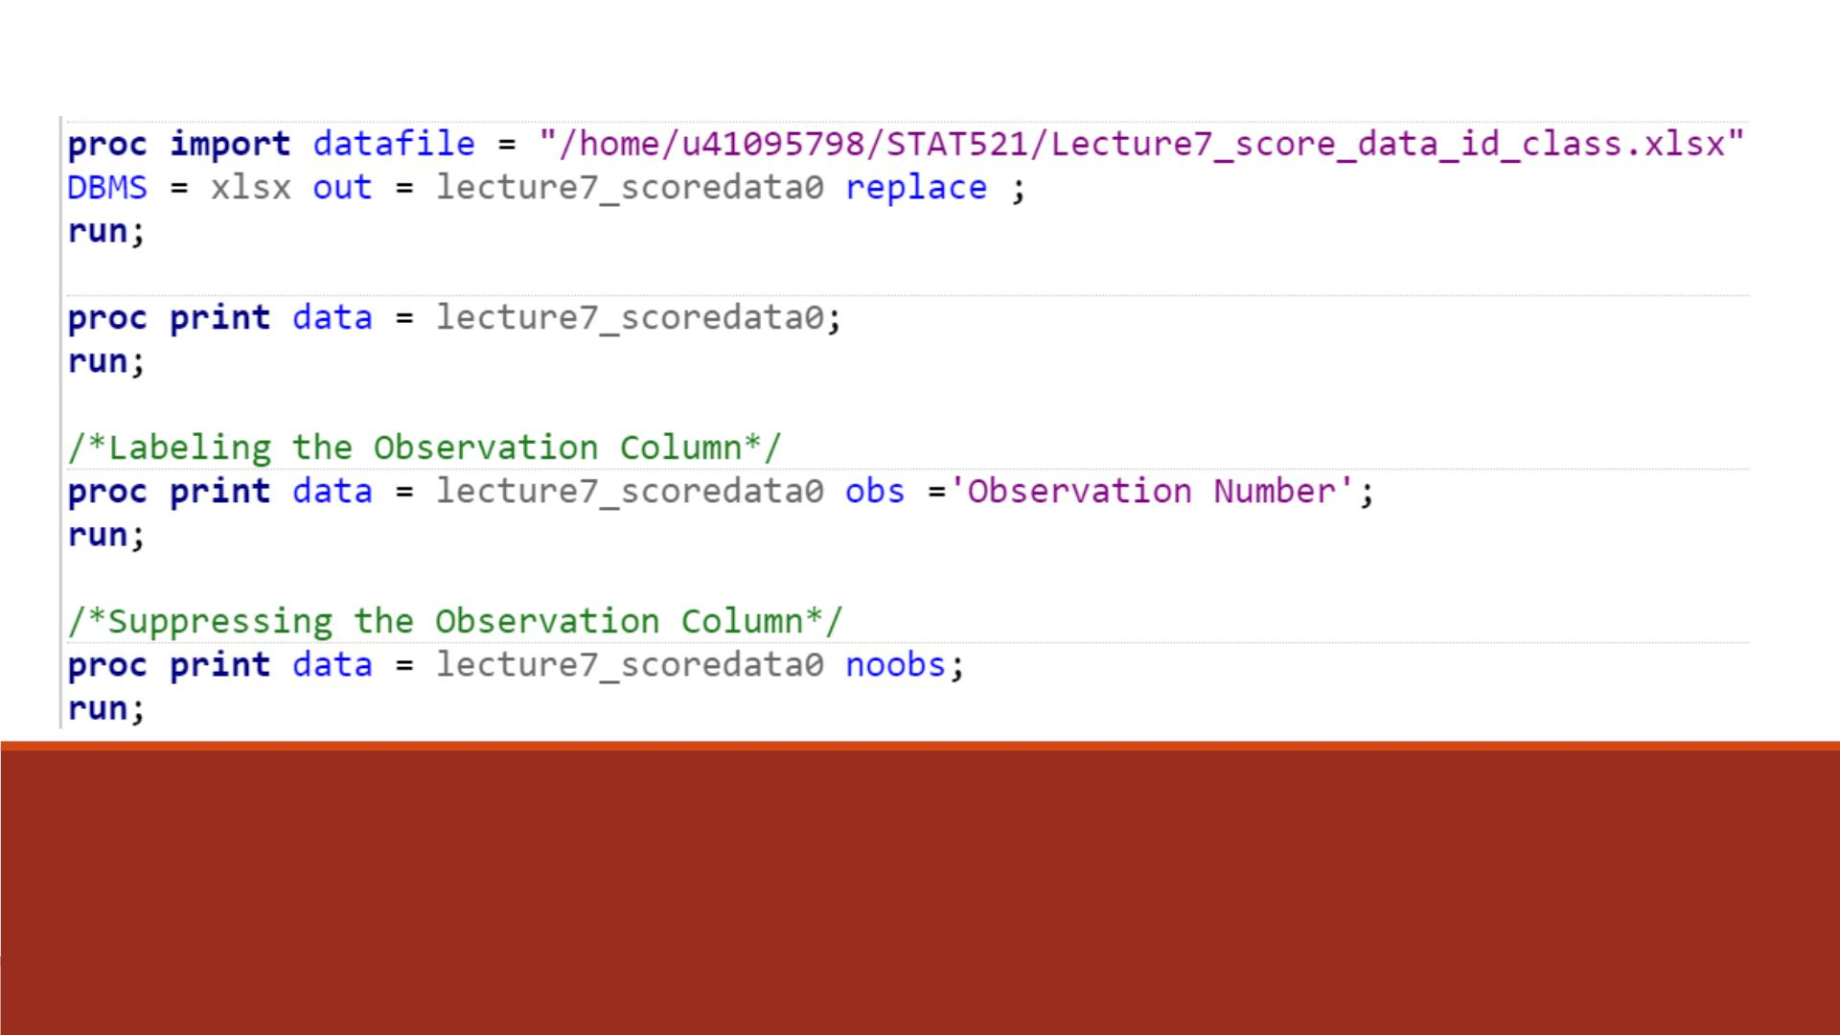
Code

Slide 10
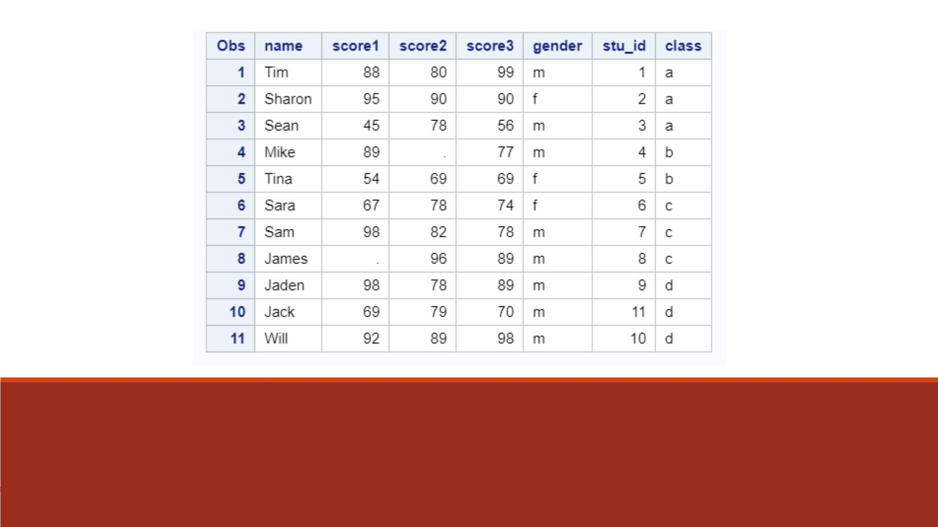
Proc Print Result 1

Slide 11
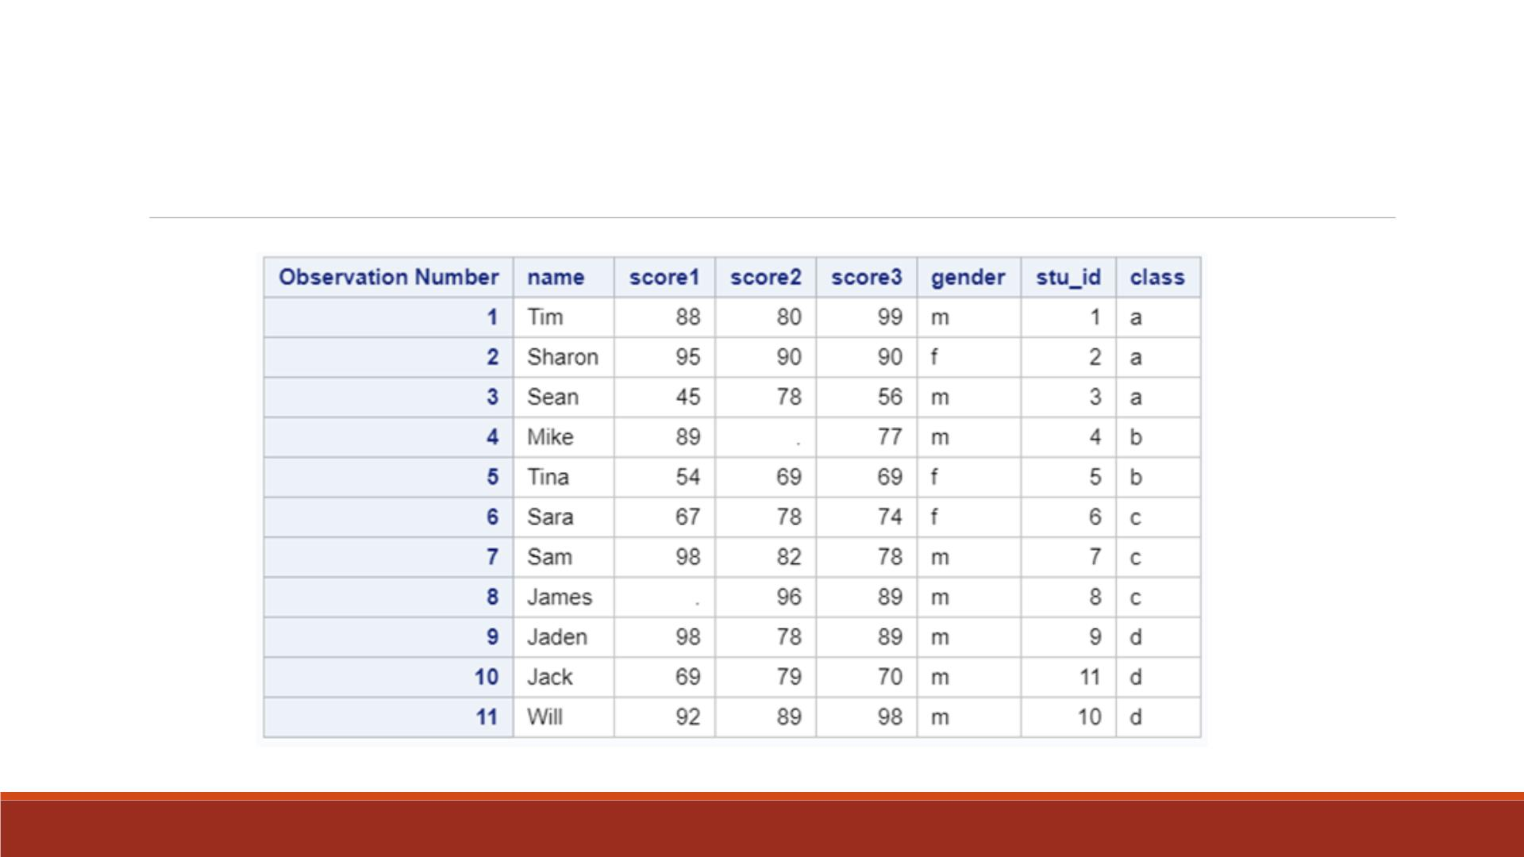
Proc Print Result 2

Slide 12
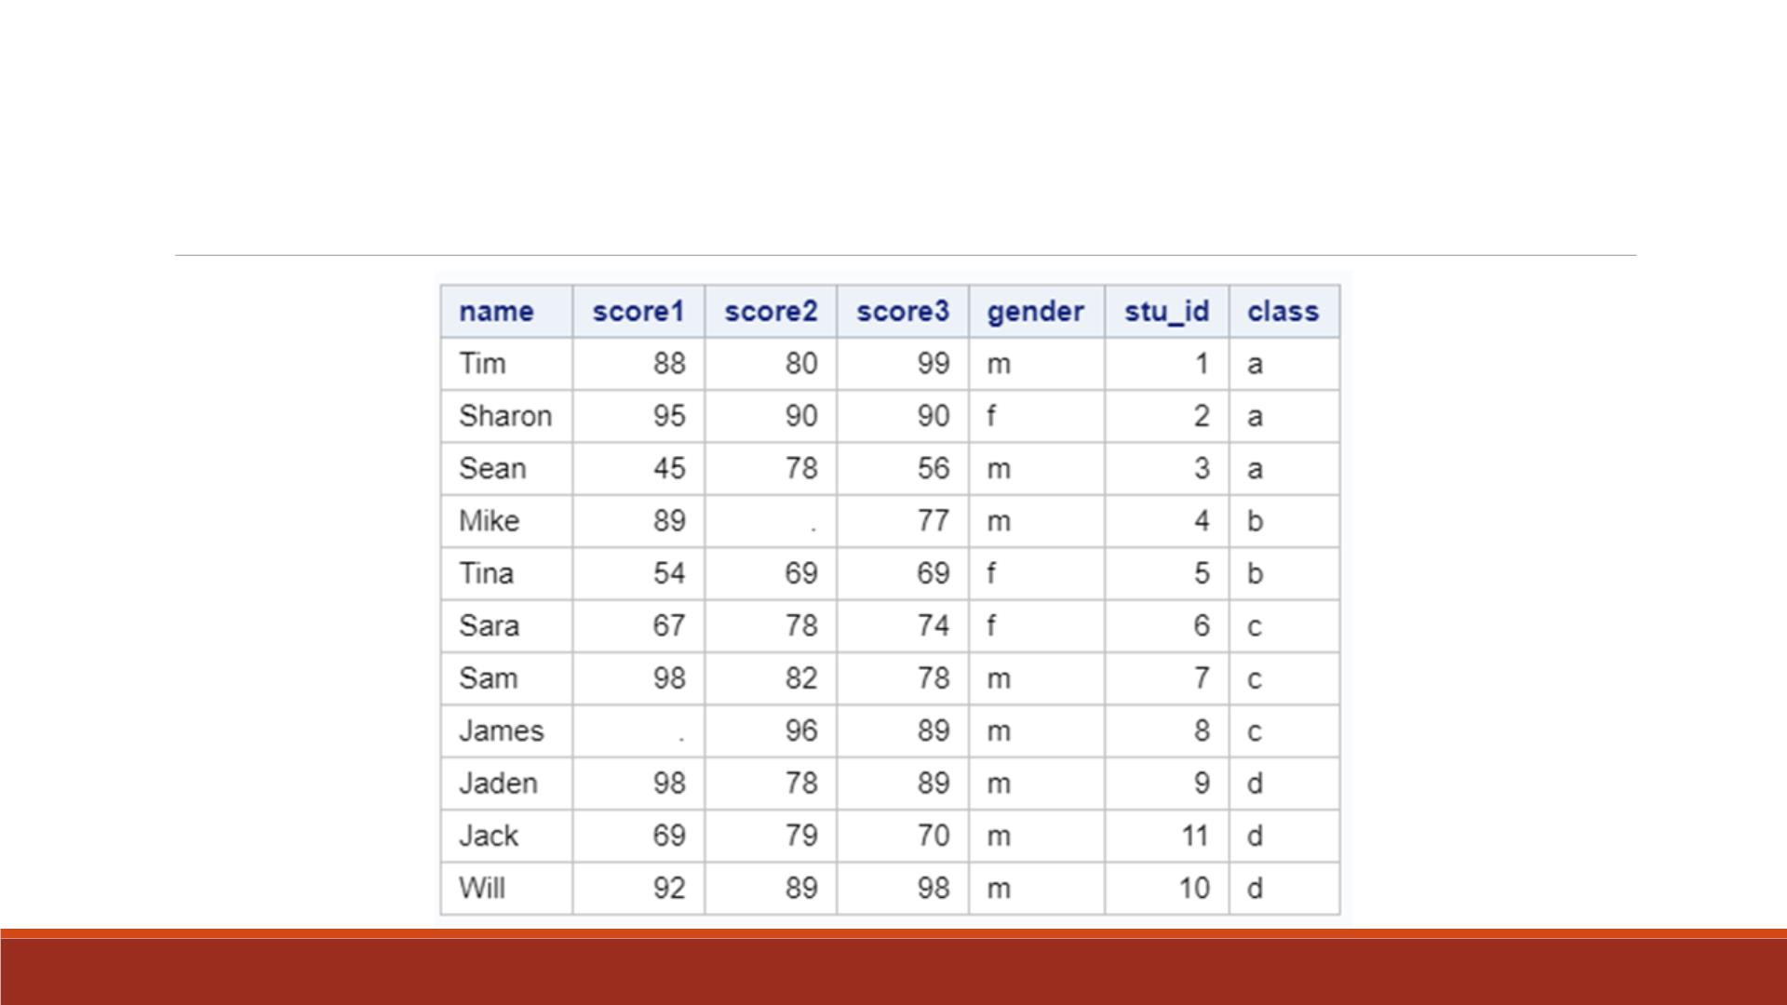
Proc Print Result 3

Slide 13
Create ID
If there is no ID in the data set, you can create the ID variable using the order of the observations.
_N_ is the order
data lecture7_scoredata1; set lecture7_scoredata0;
ID = _N_; run;

Slide 14
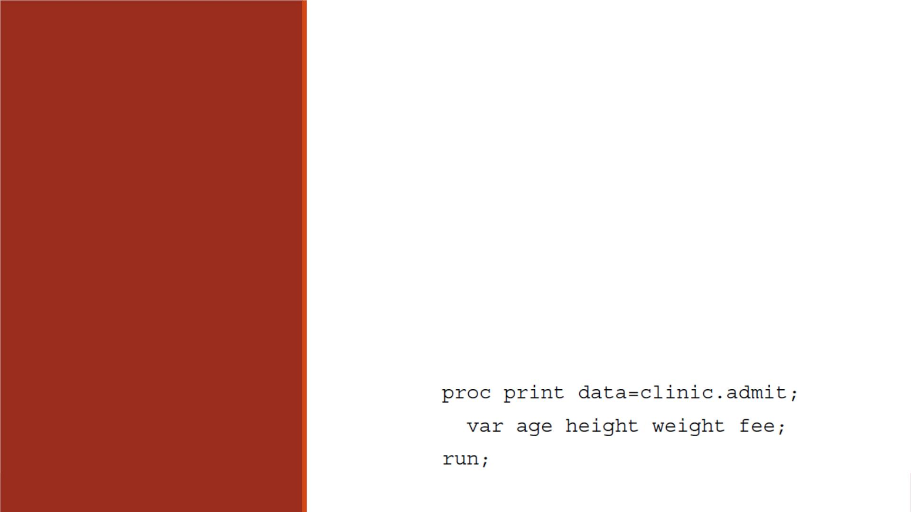
▪By default, a PROC PRINT step lists all the variables in a data set.
▪Yo u can select variables and control the order in which they appear
by using a VAR statement in PROC PRINT.
VA R
Statement
in Proc Print
▪General form:
VA R variable(s);
▪where variable(s) is one or more variable names, separated by blanks.
▪For example,

Slide 15
ID Statement in Proc Print
▪To specify which variables should replace the default Obs column, use the ID statement.
▪This technique is particularly useful when observations are too long to print on one line.
▪General form, ID statement:
ID variable(s);
▪where variable(s) specifies one or more variables to print instead of the observation
number at the beginning of each row of the report.

Slide 16
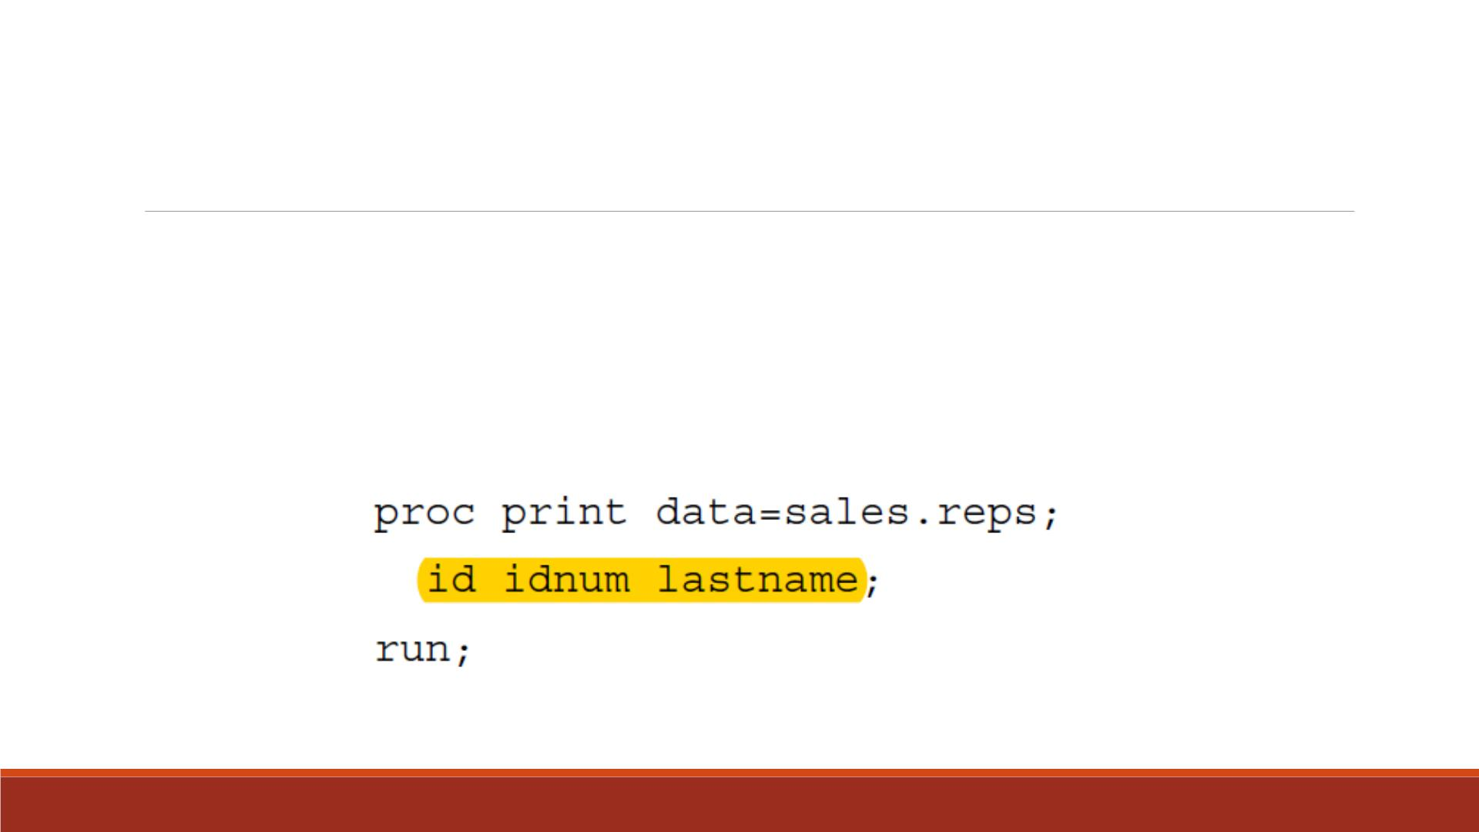
Example—ID Statement
To replace the Obs column and identify observations based on an employee's ID
number and last name, you can submit the following program.

Slide 17
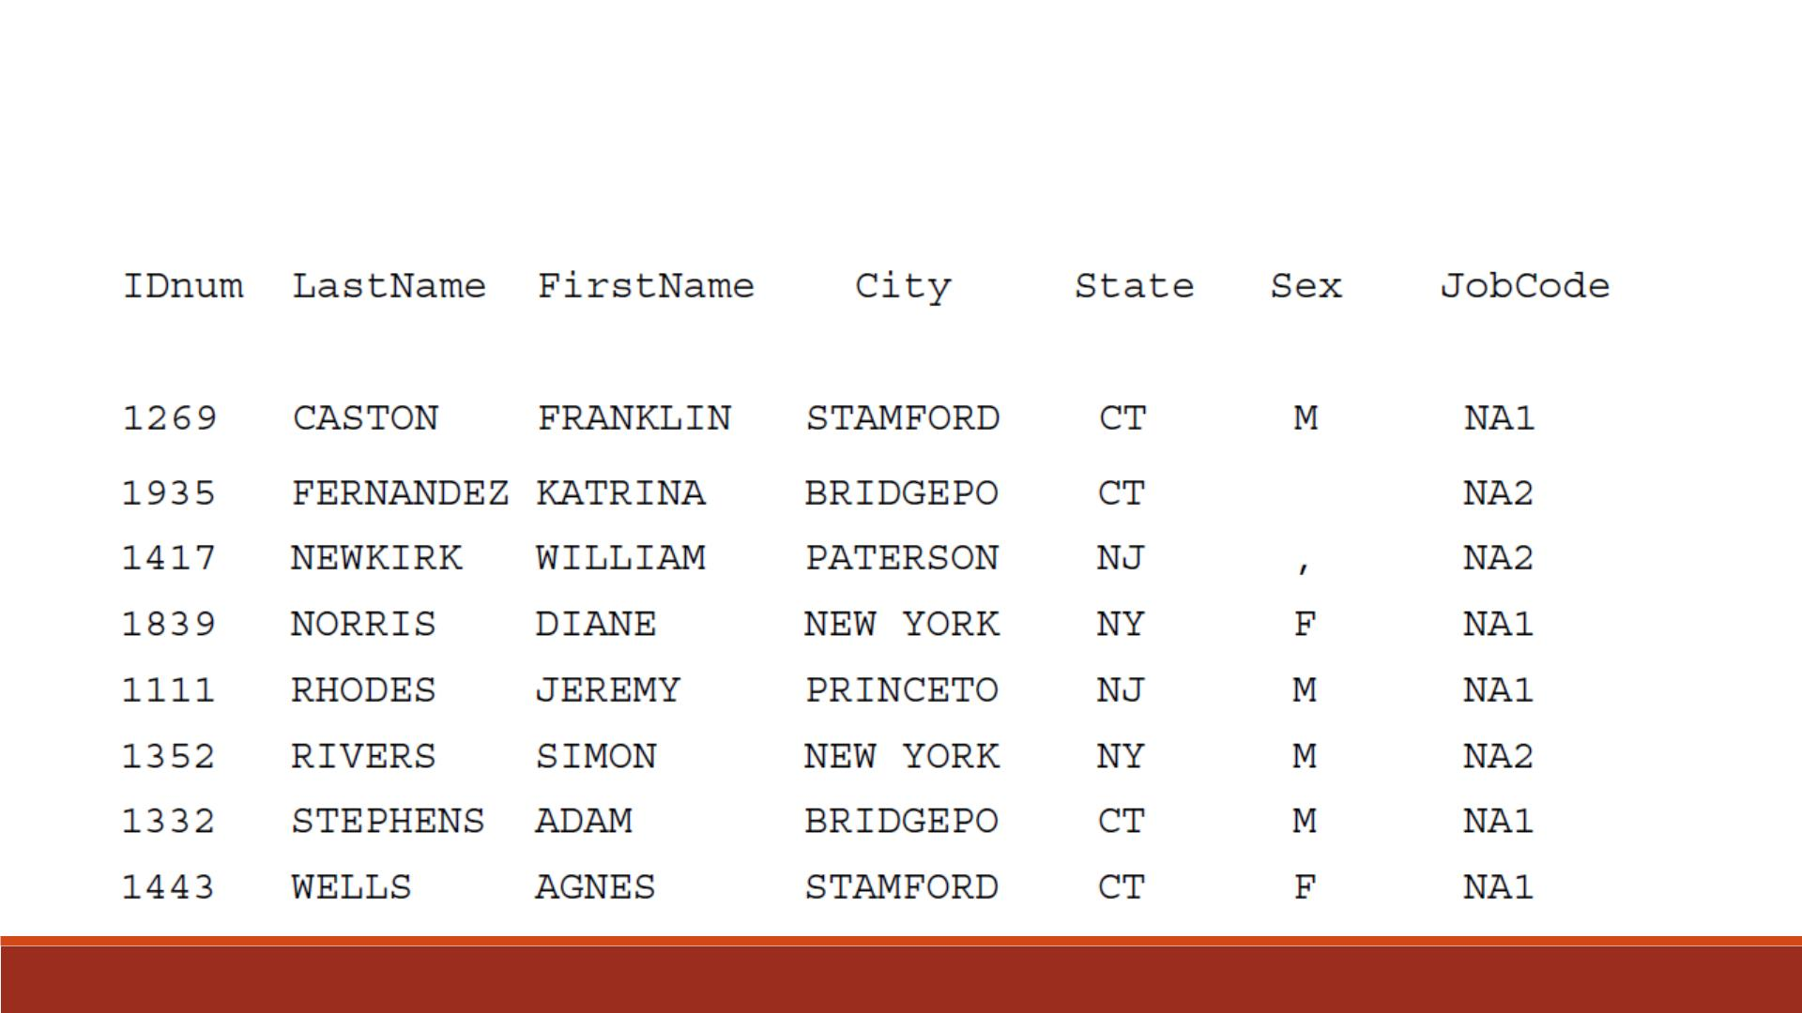
Partial Output

Slide 18
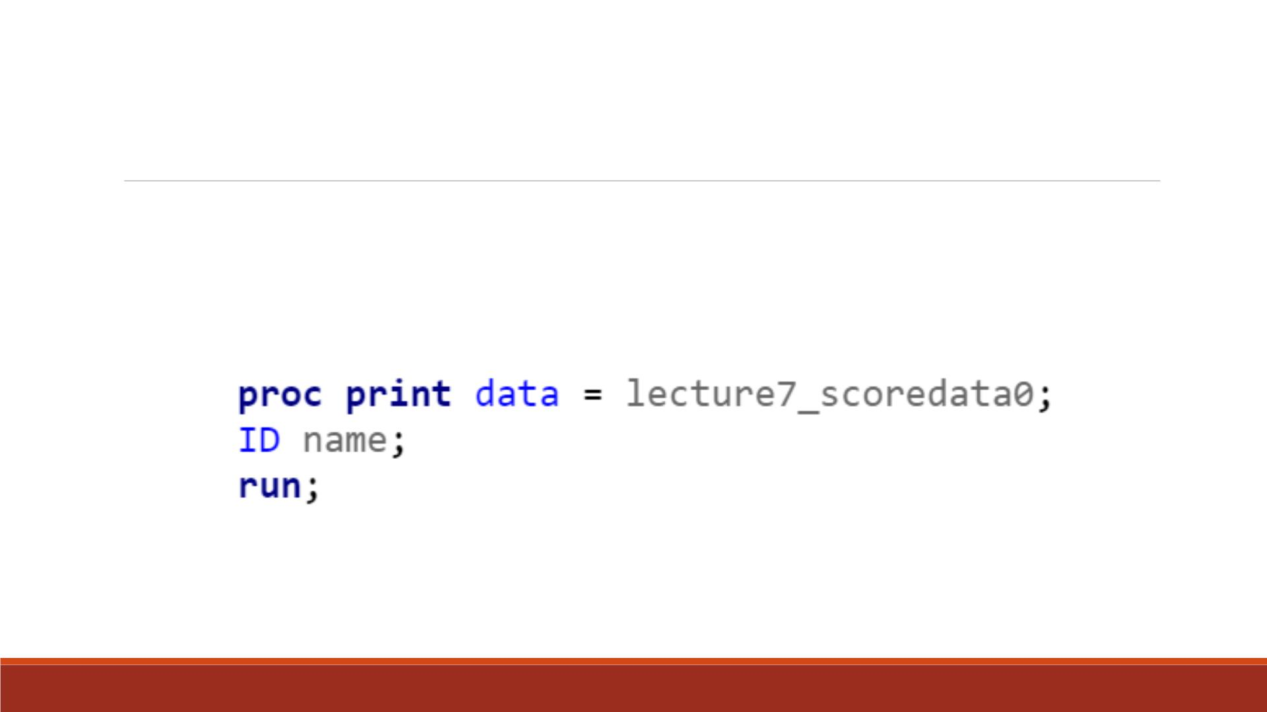
Demo 2—ID Statement
▪Print “lecture7_scoredata0” and replace the default Obs column with variable “name”

Slide 19
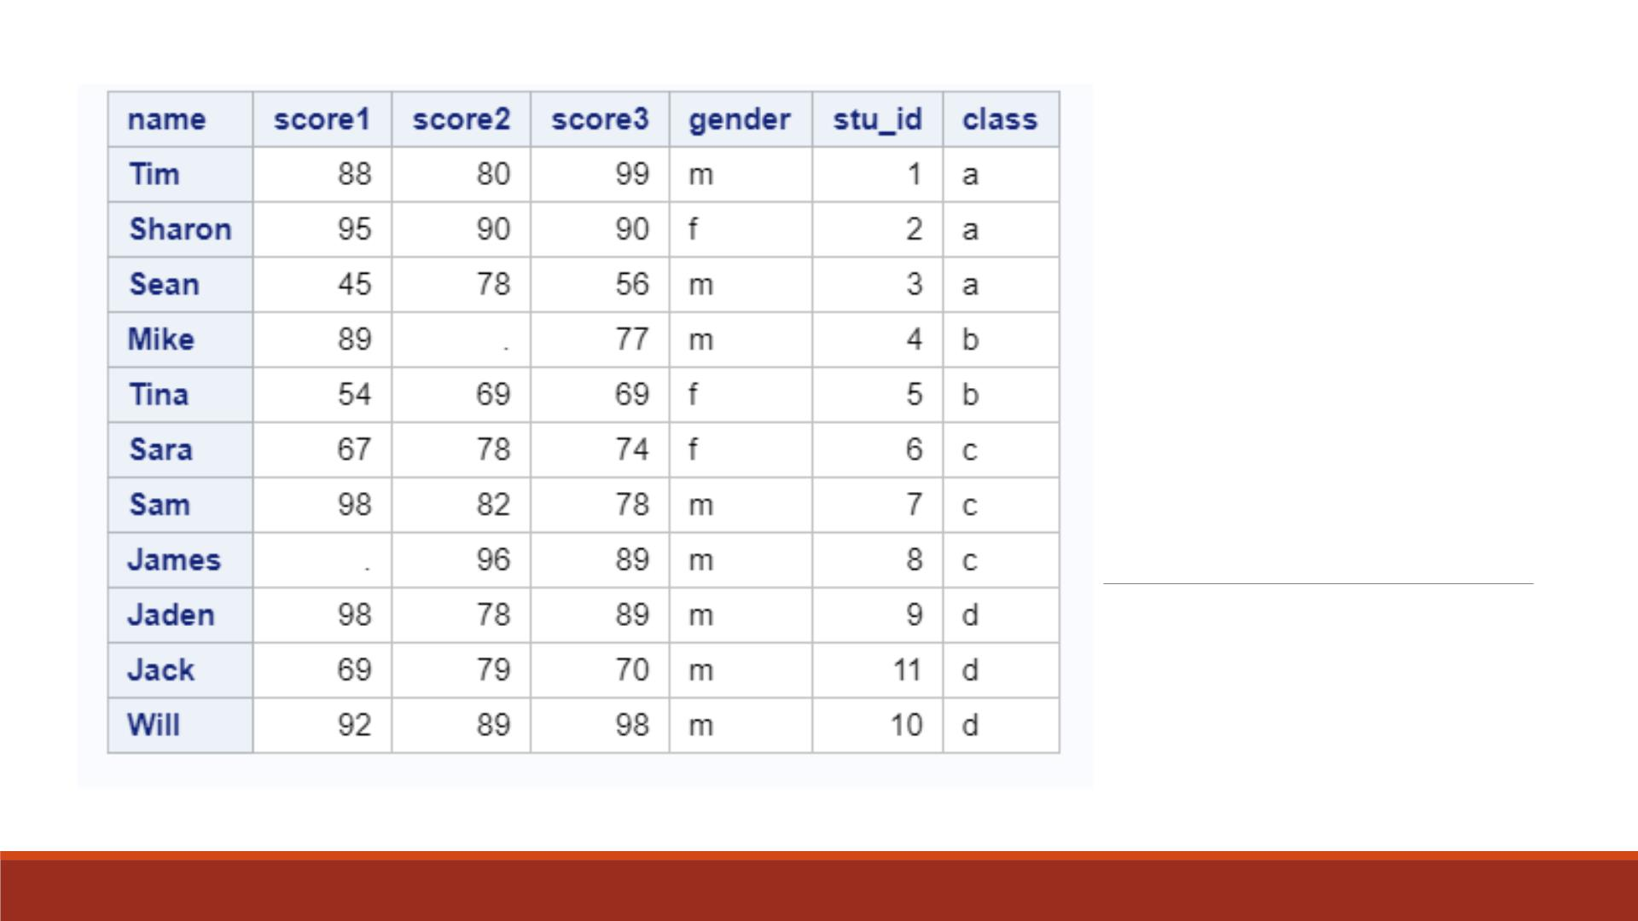
Proc Print
Result

Slide 20
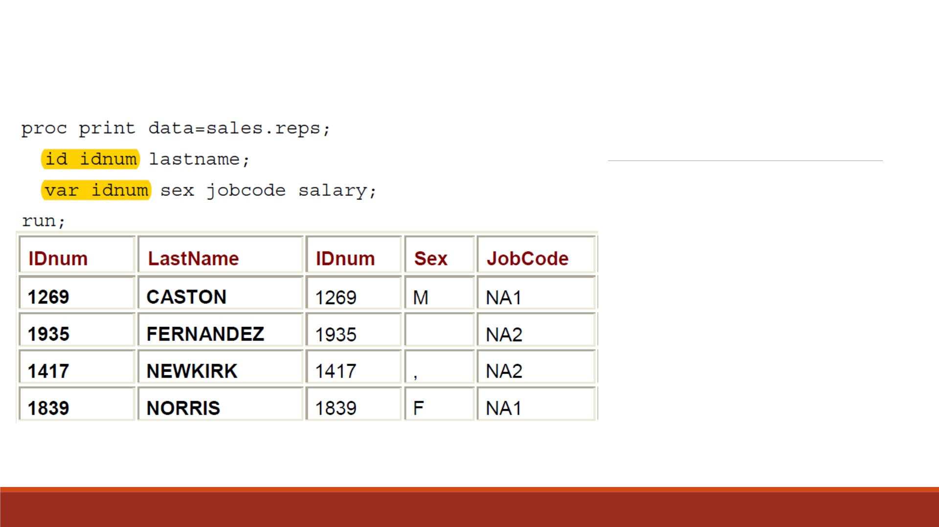
ID and VA R
Combined
▪If a variable in the ID statement
also appears in the VAR statement,
the output contains two columns
for that variable.
▪In the example, the variable IDnum
appears twice.

Slide 21
Demo 3—ID and VA R Statements
▪Print the dataset “lecture7_scoredata0” to
1. Only show variables “stu_id”, “gender ”, “class”
2. Replace the default OBS column with variables “name” and “stu_id”

Slide 22
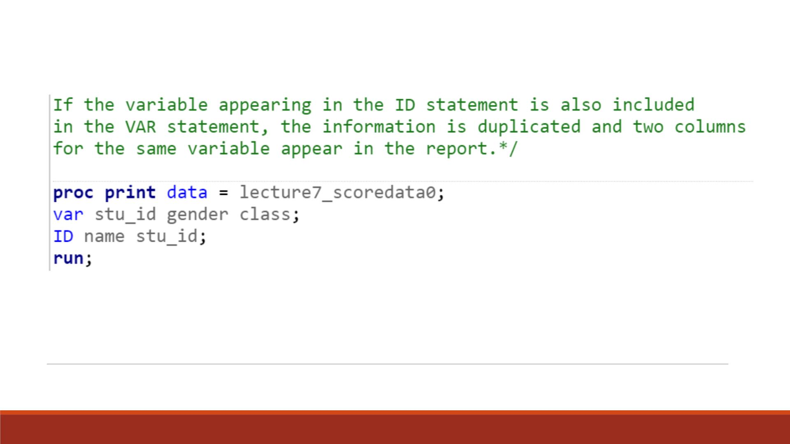
Code

Slide 23
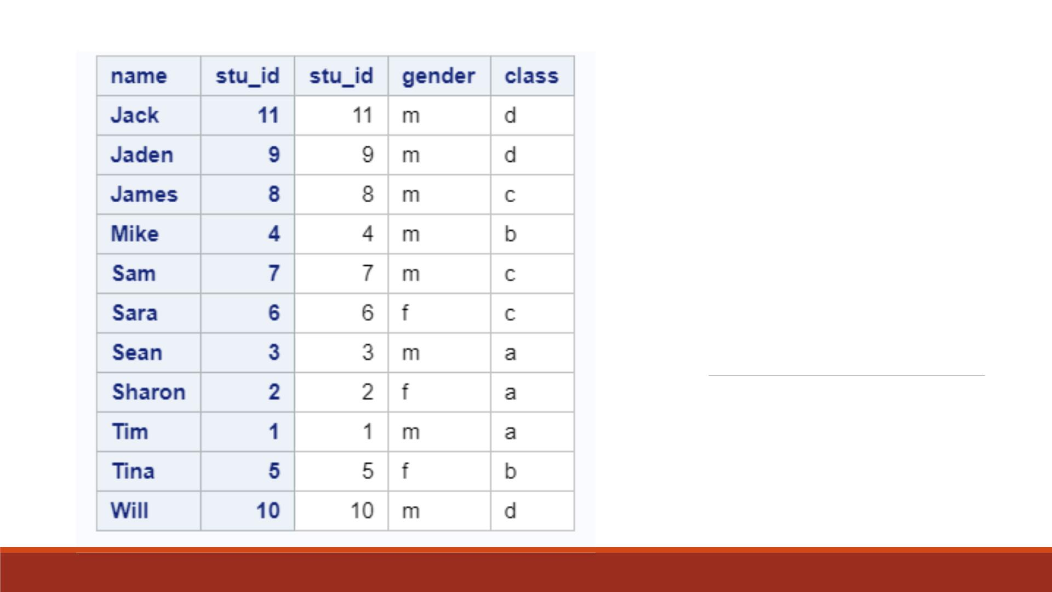
Proc Print
Result

Slide 24
WHERE Statement in Proc Print
▪By default, a PROC PRINT step lists all the observations in a data set.
▪You can control which observations are printed by adding a WHERE statement to your
PROC PRINT step.
▪There can be only one WHERE statement in a step.
▪General form, WHERE statement:
WHERE where-expression;
▪where where-expression specifies a condition for selecting observations. The where-
expression can be any valid SAS expression.

Slide 25
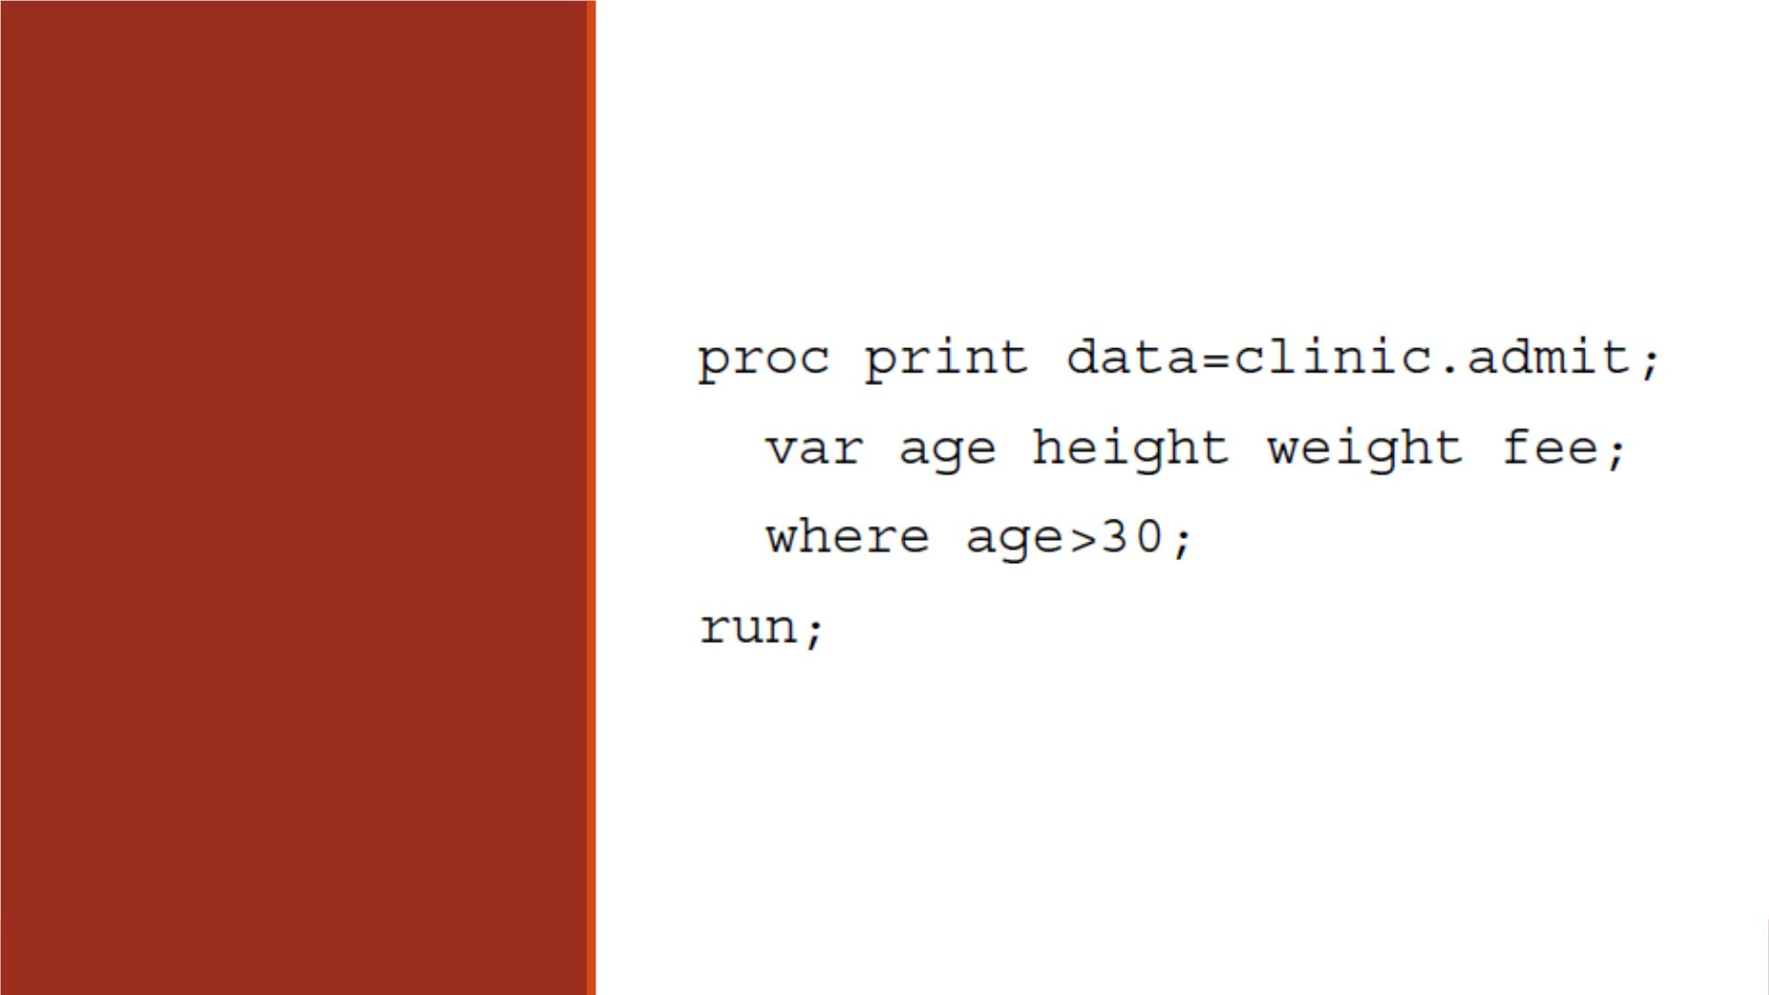
Example
The WHERE statement
selects only observations
for which the value of
Age is greater than 30.

Slide 26
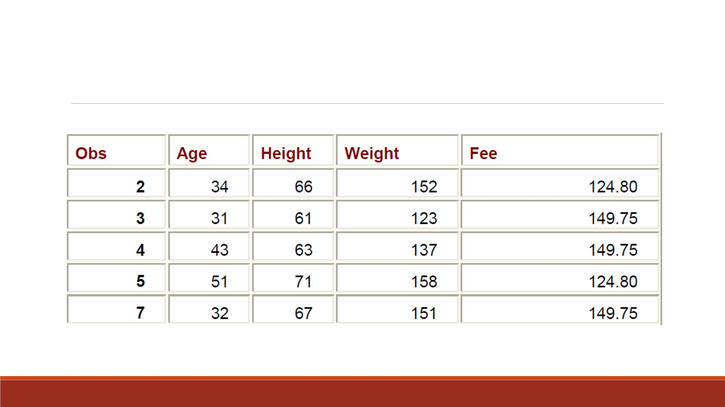
Partial Output

Slide 27
Specifying WHERE Expressions
▪In the WHERE statement you can specify any variable in the SAS dataset, not just the
variables that are specified in the VA R statement.
▪The WHERE statement works for both character and numeric variables.
▪To specify a condition based on the value of a character variable, you must
❑enclose the value in quotation marks
❑write the value with lowercase and uppercase letters exactly as it appears in the dataset.

Slide 28
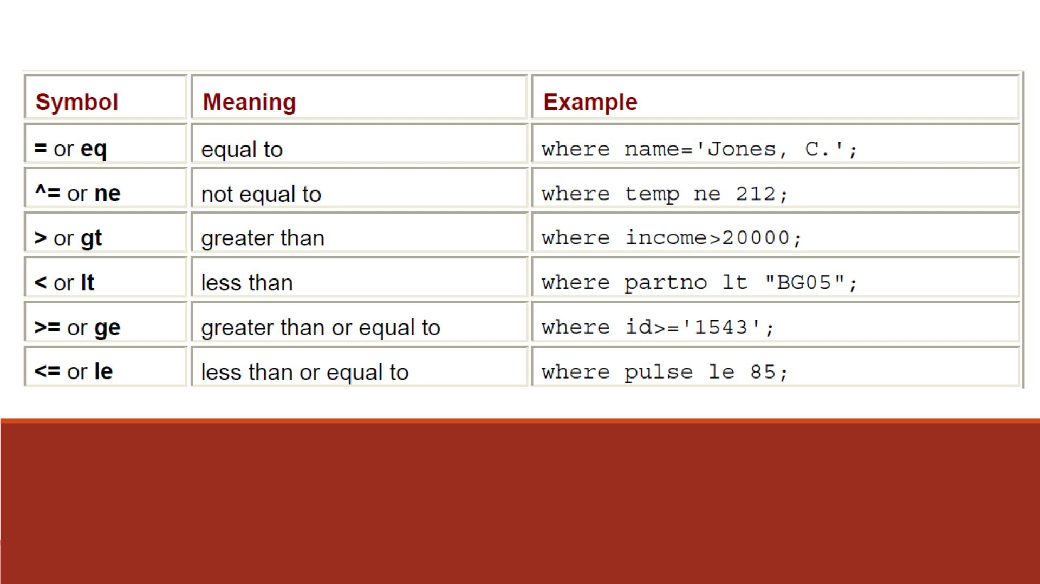
Comparison Operators

Slide 29
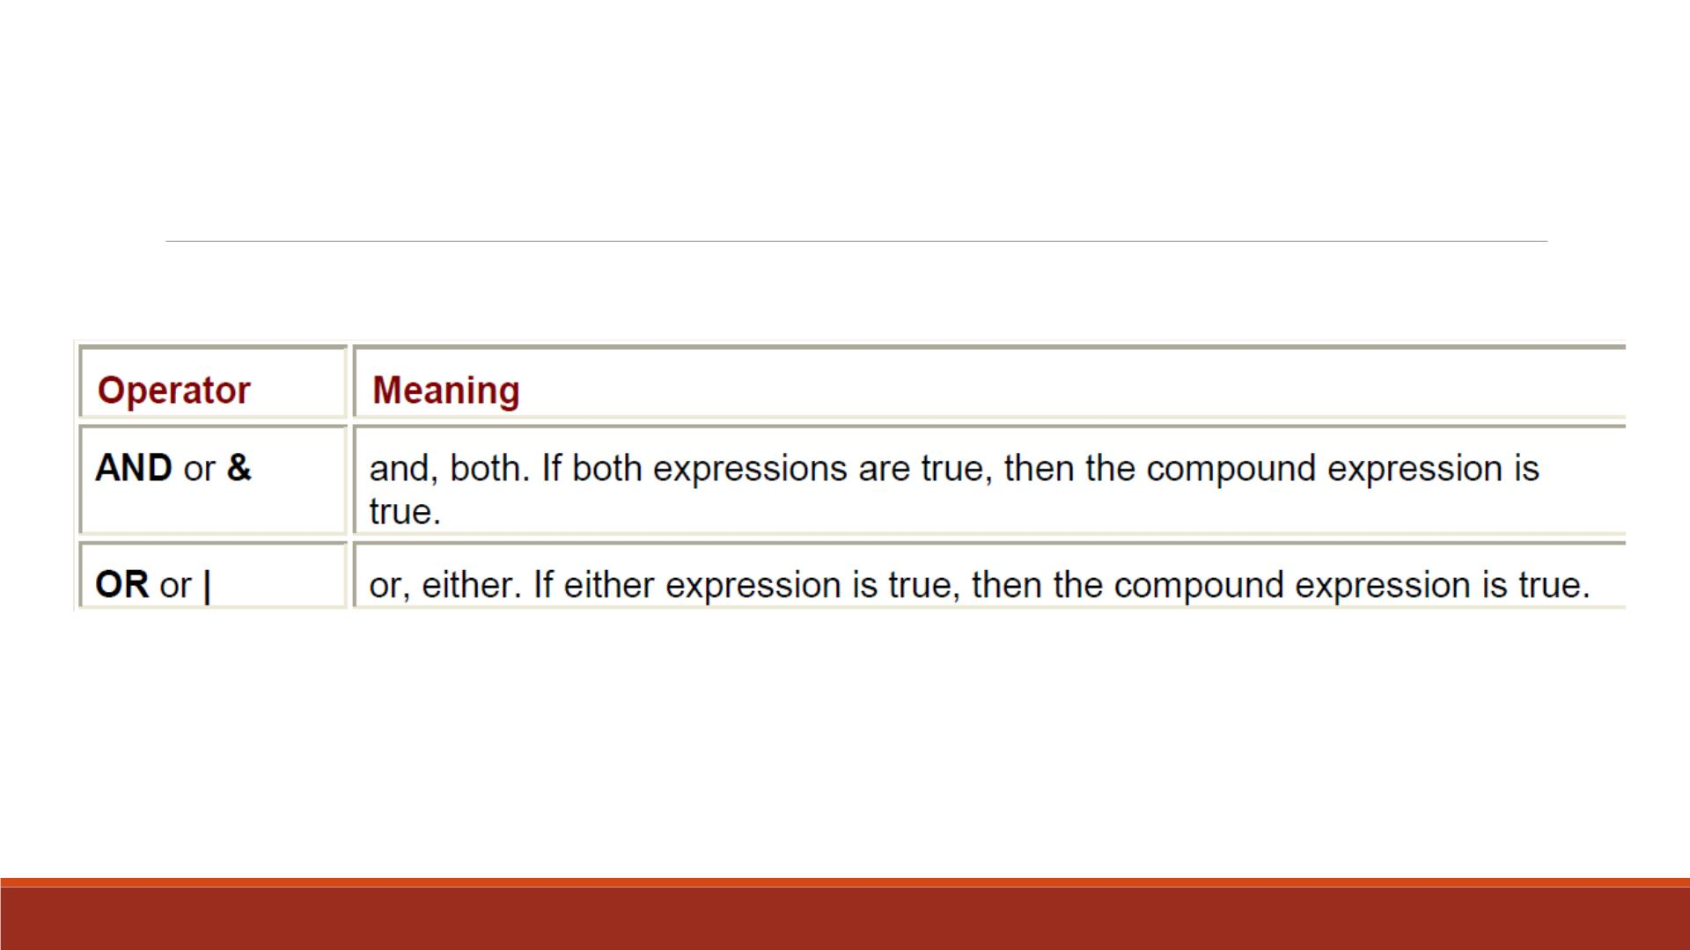
Logical Operators

Slide 30
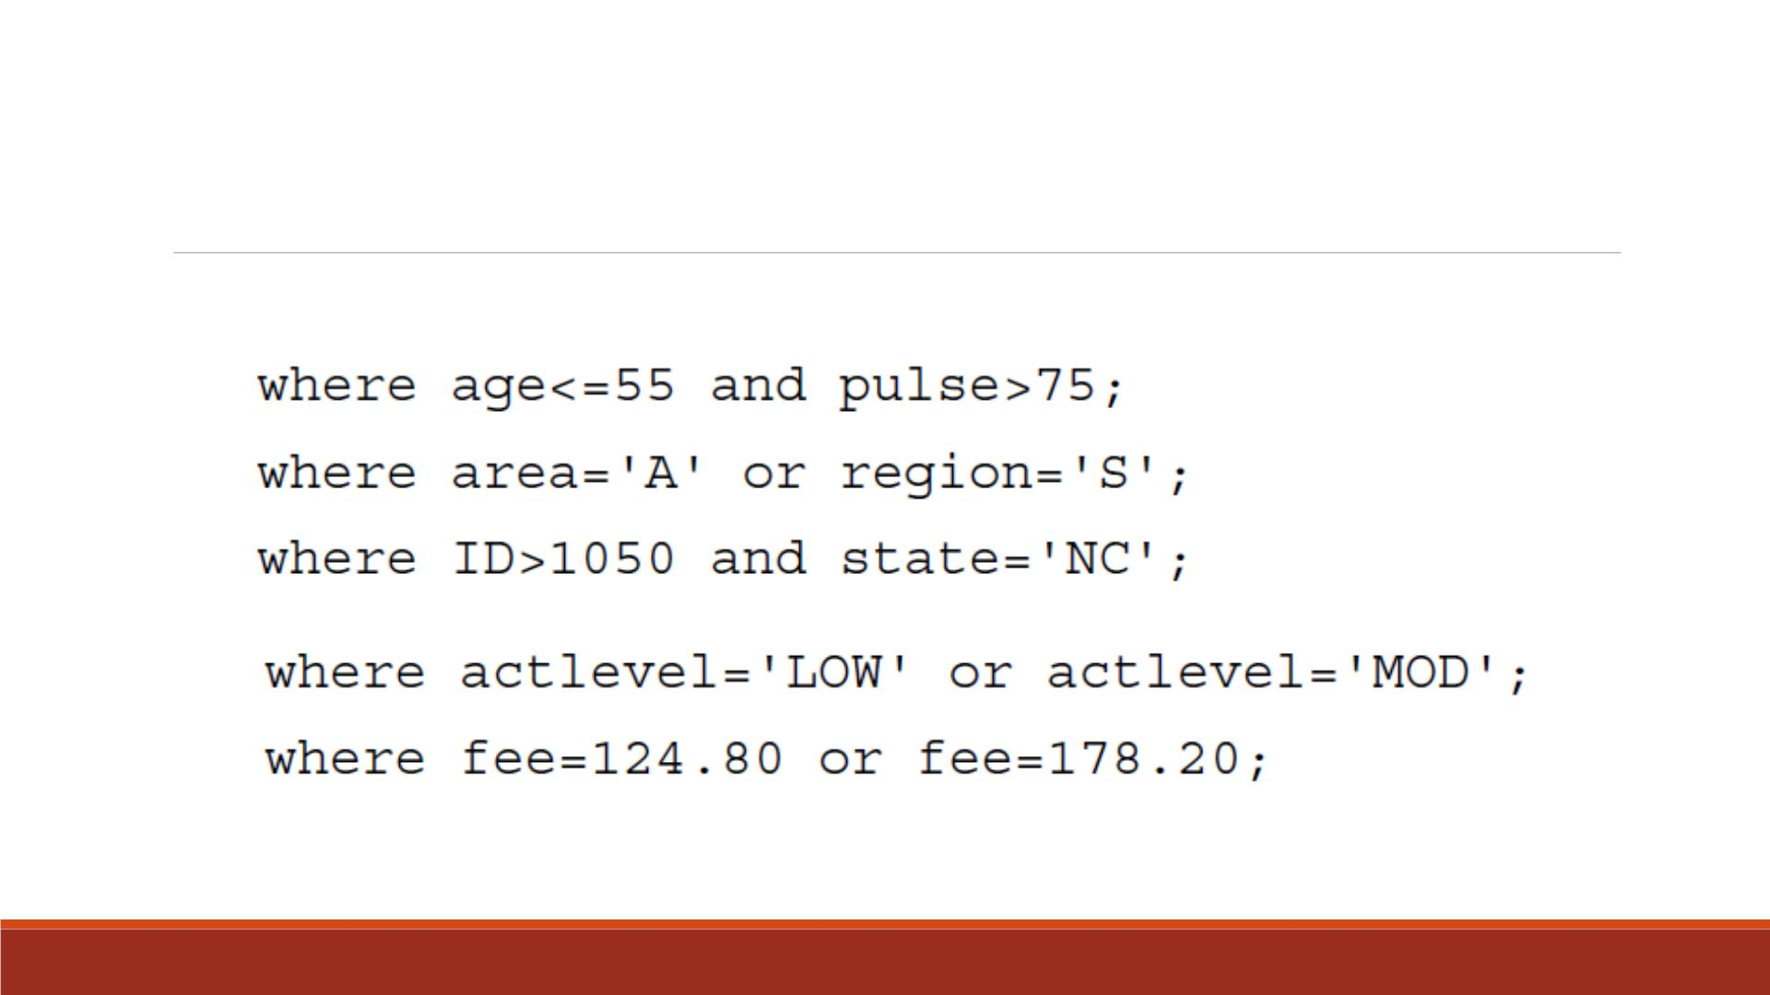
Examples of WHERE Statements

Slide 31
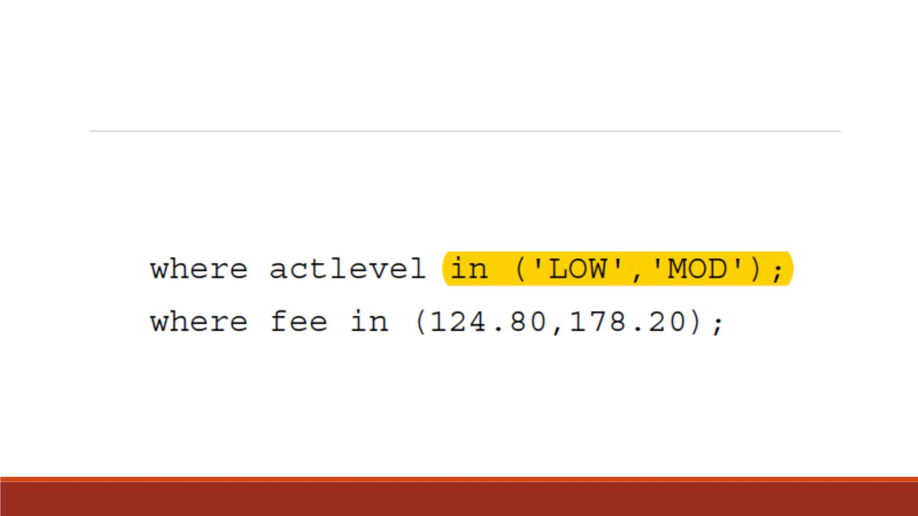
IN Operator
▪You can use the IN operator as a convenient alternative:
▪Note: Character values are in quotation marks.

Slide 32
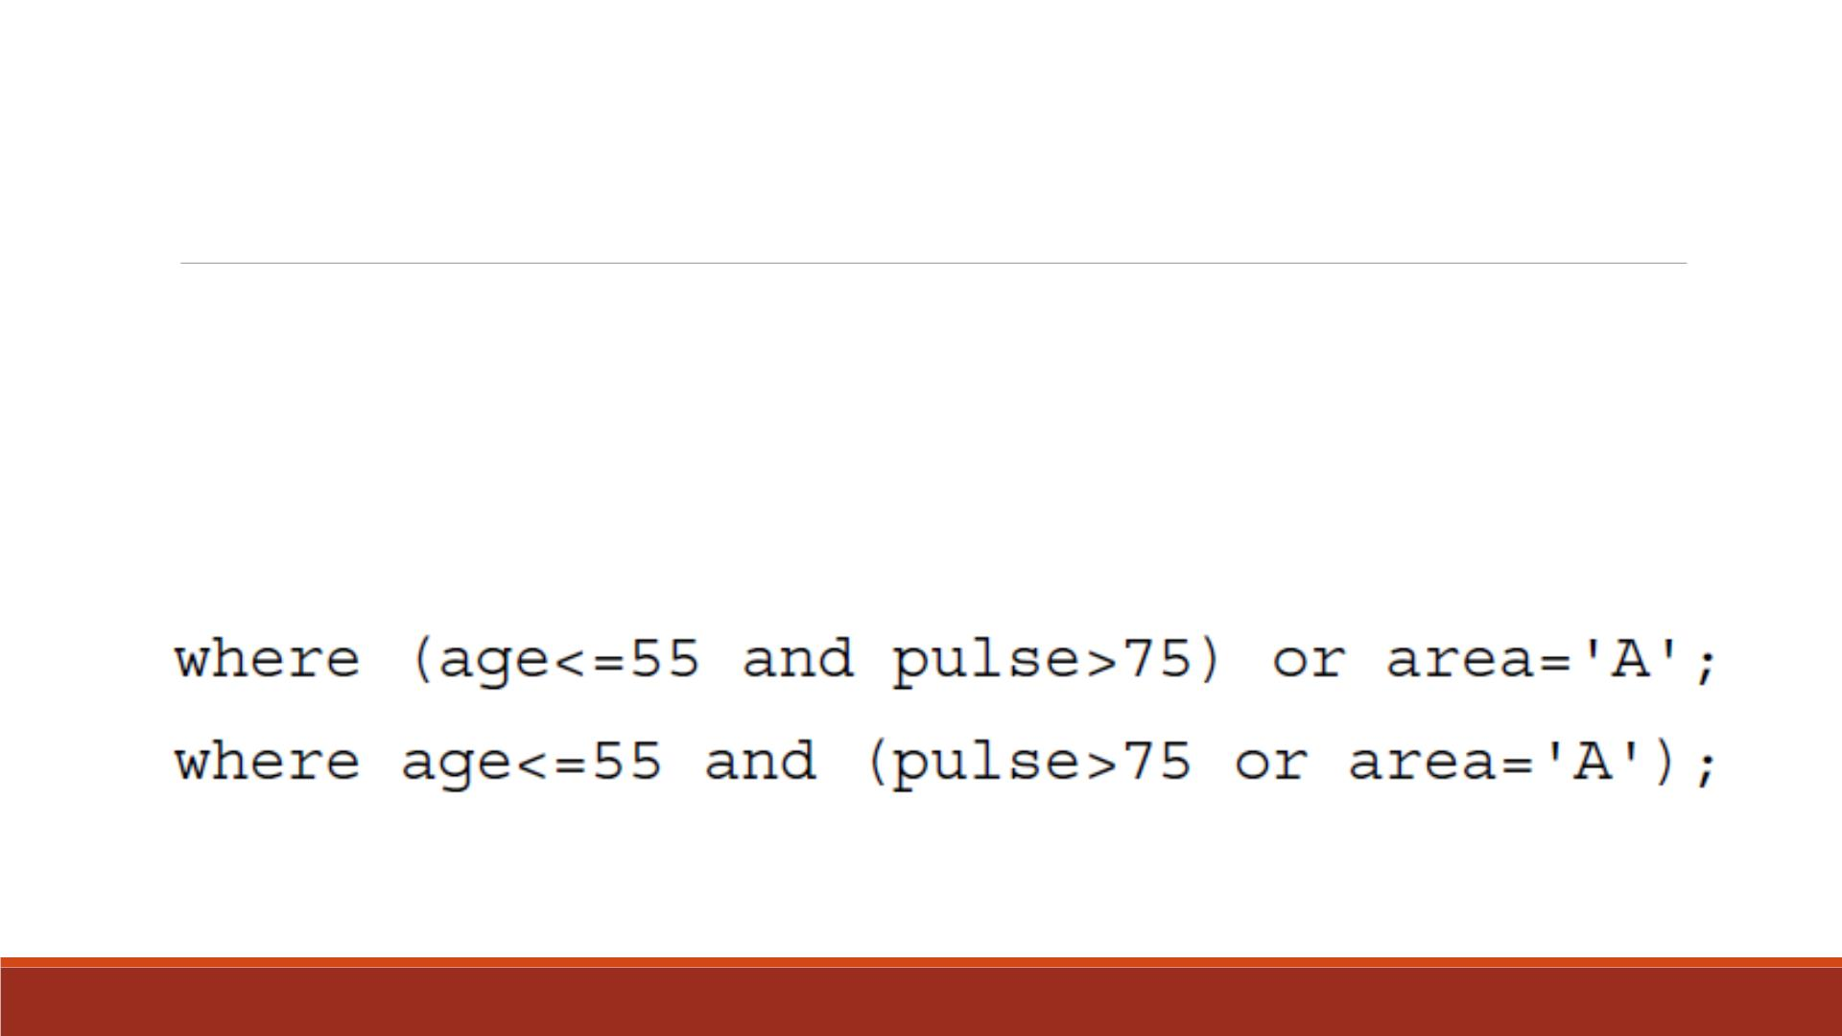
Control Compound Expressions
▪To control the way compound expressions are evaluated, you can use
parentheses (expressions in parentheses are evaluated first):

Slide 33
Demo 4—WHERE Statement
▪Print the SAS dataset “lecture7_scoredata0” to
1. Only include variables “name”, “stu_id”, “gender ”, “class”
2. Replace the default OBS column with variable “name”
3. Only show observations with “gender ” taking the value “m”, and “class”
taking the value “a” or “c ”.

Slide 34
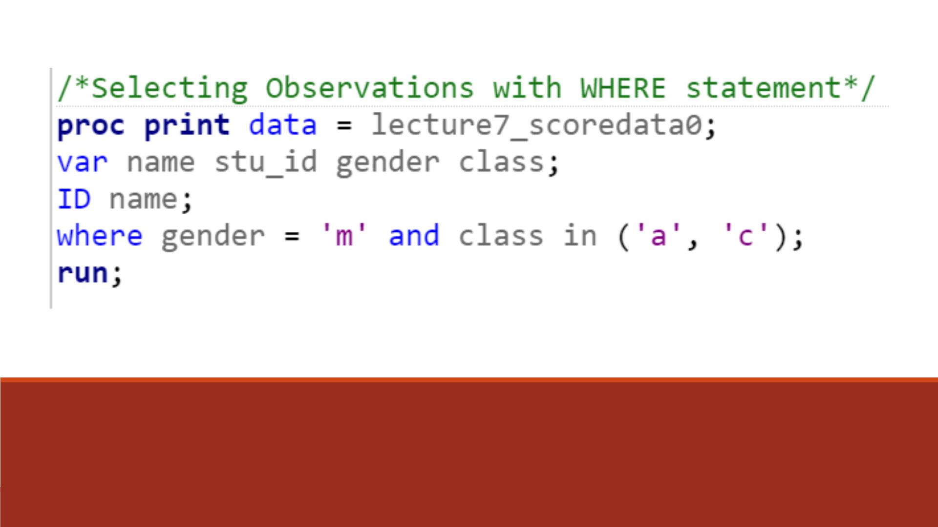
Code

Slide 35
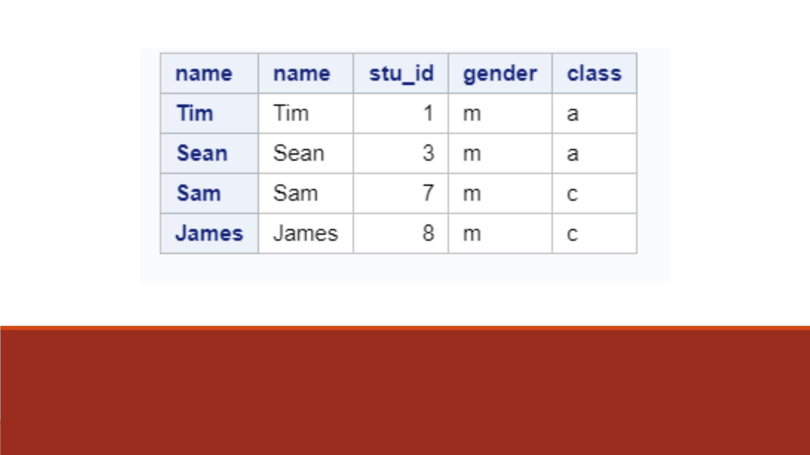
Proc Print Result

Slide 36
CONTAINS Operator
▪The CONTAINS operator selects observations that include the specified substring.
▪Substrings should be placed under quotation marks.
▪The mnemonic equivalent for the CONTAINS operator is ?.
▪Yo u can use either the CONTAINS keyword or the mnemonic equivalent in your code,
as shown below.
where firstname CONTAINS 'Jon';
where firstname ? 'Jon';

Slide 37
Sorting Datasets

Slide 38
Sorting Your Data with PROC SORT
▪Often, we need to sort our data, we can use Proc Sort to do that.
▪The basic form of this procedure is
PROC SORT;
BY variable-list;
▪The variables named in the BY statement are called BY variables.

Slide 39
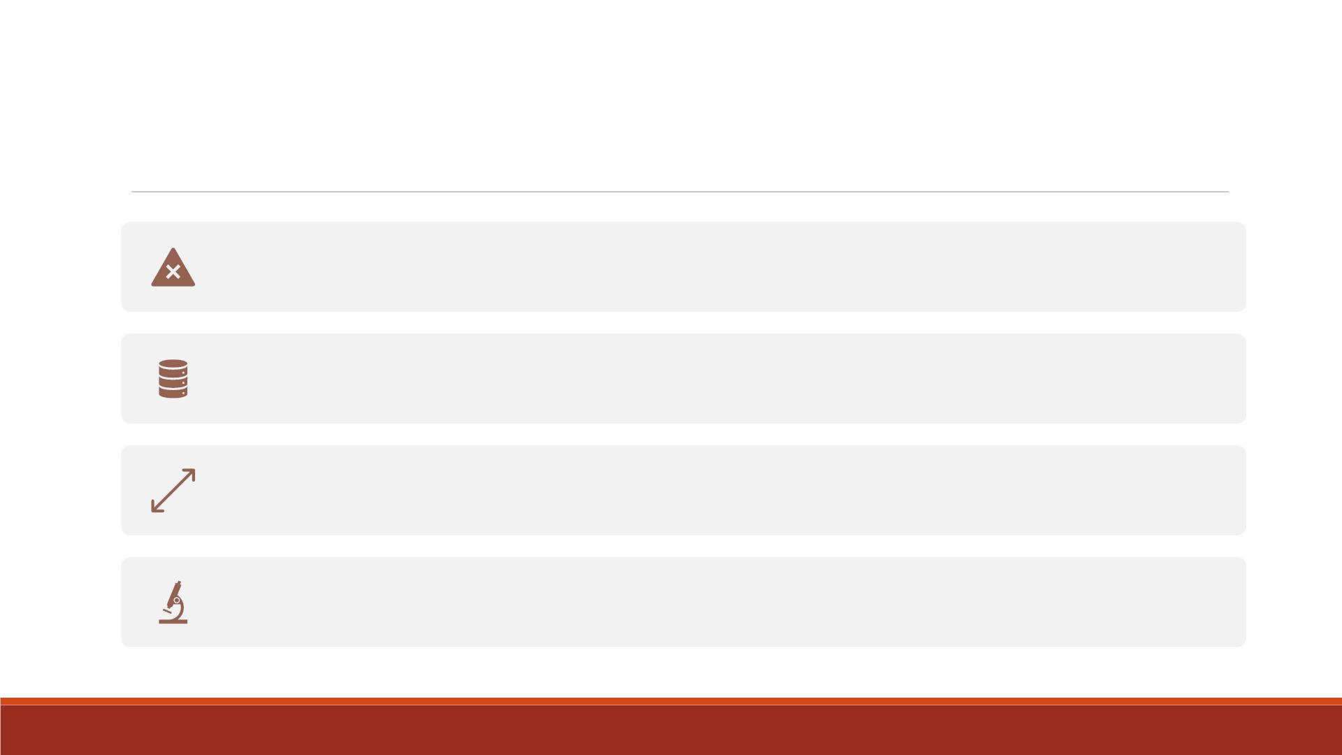
BY Statement
Yo u can specify as many BY variables as you wish.
With one BY variable, SAS sorts the data based on the values of that variable.
With more than one variable, SAS sorts observations by the first variable, then
by the second variable within categories of the first variable, and so on.
A BY group is all the observations that have the same values of BY variables.

Slide 40

▪General form:
PROC SORT D ATA = input-data OUT = output-data;
Input and
Output
Datasets
▪The DATA = and OUT= options specify the input and output data sets.
▪If you don't specify the DATA = option, then SAS will use the most
recently created data set.
▪If you don't specify the OUT= option, then SAS will replace the
original data set with the newly sorted version.
▪For example:
PROC SORT D ATA = messy OUT = neat;

Slide 41
Eliminate Duplicate Observations
▪The NODUPKEY option tells SAS to eliminate any duplicate observations that have the
same values for the BY variables.
▪If you specify the DUPOUT= option, then SAS will put the deleted observations in that
dataset.
▪To use these options, just add them to the PROC SORT statement:
PROC SORT D ATA = messy OUT = neat NODUPKEY DUPOUT = extraobs;

Slide 42
Ascending v.s. Descending
▪By default SAS sorts data in ascending order, from lowest to highest values.
▪To have your data sorted in the opposite order, add the keyword DESCENDING to the
BY statement before each variable that should be sorted in reverse order.
▪This statement tells SAS to sort first by State (from A to Z –default ascending order) and
then by City (from Z to A –descending order) within State:
BY State DESCENDING City;

Slide 43
Demo 5—Proc Sort
▪Import the Excel file “Lecture3_score_data_miss.xlsx”. Name it “lecture7_scoredata0”.
▪Create a new SAS dataset named “lecture7_socredata1” based on “lecture7_scoredata0”
by computing
1. A variable “ TotalScore” (sum of score1-score3)
2. A variable “AverageScore” (average of score1-score3)
▪Sort the dataset “lecture7_scoredata1” by ascending order of “Gender” and descending
order of “AverageScore”. Name the sorted dataset as “lecture7_scoredata2”
▪Print the sorted dataset.

Slide 44
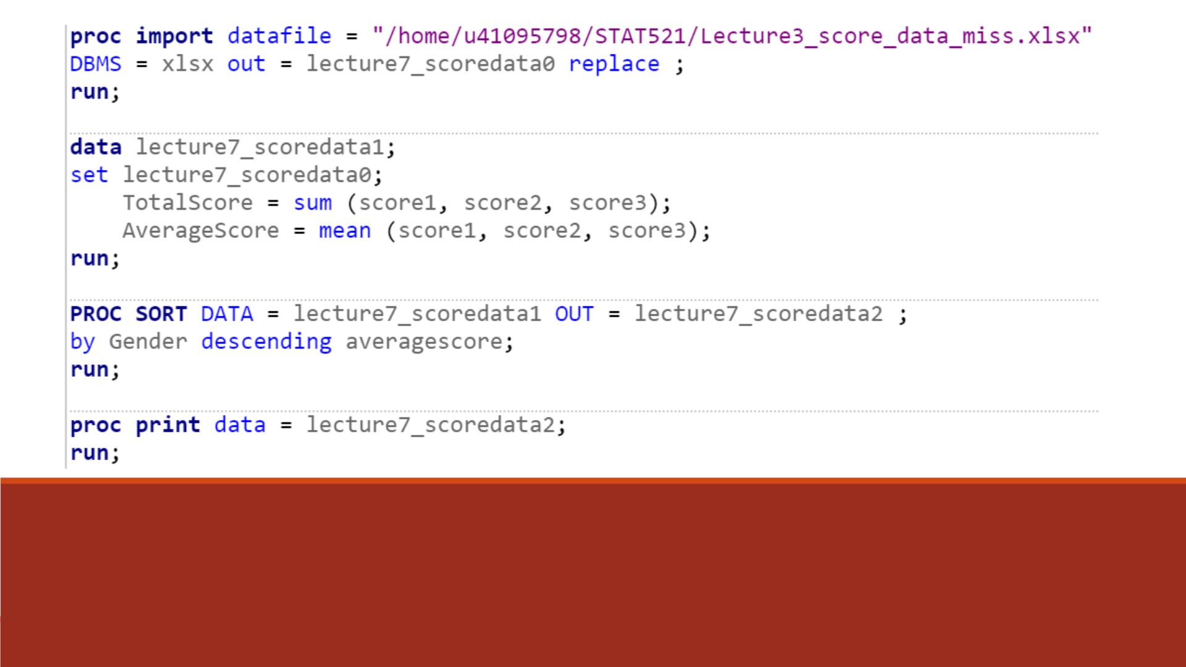
Code

Slide 45
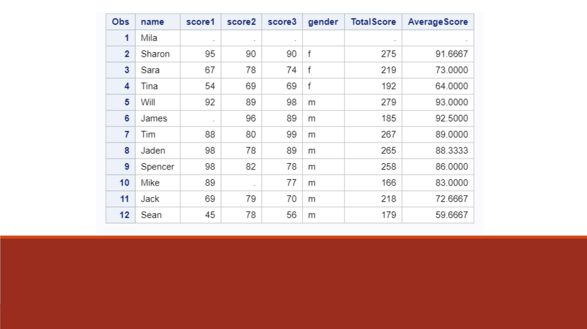
Proc Print Result
For both numeric and character variables, missing values are the smallest.

Slide 46
Demo 6—Proc Sort
▪Sort the dataset “lecture7_scoredata1” by ascending order of “Gender” and eliminate
any duplicate observations, name the sorted dataset “lecture7_scoredata3”.
▪Place all the duplicate observations in a dataset named “extraobs”.
▪Print the datasets “lecture7_scoredata3” and “extraobs”.

Slide 47
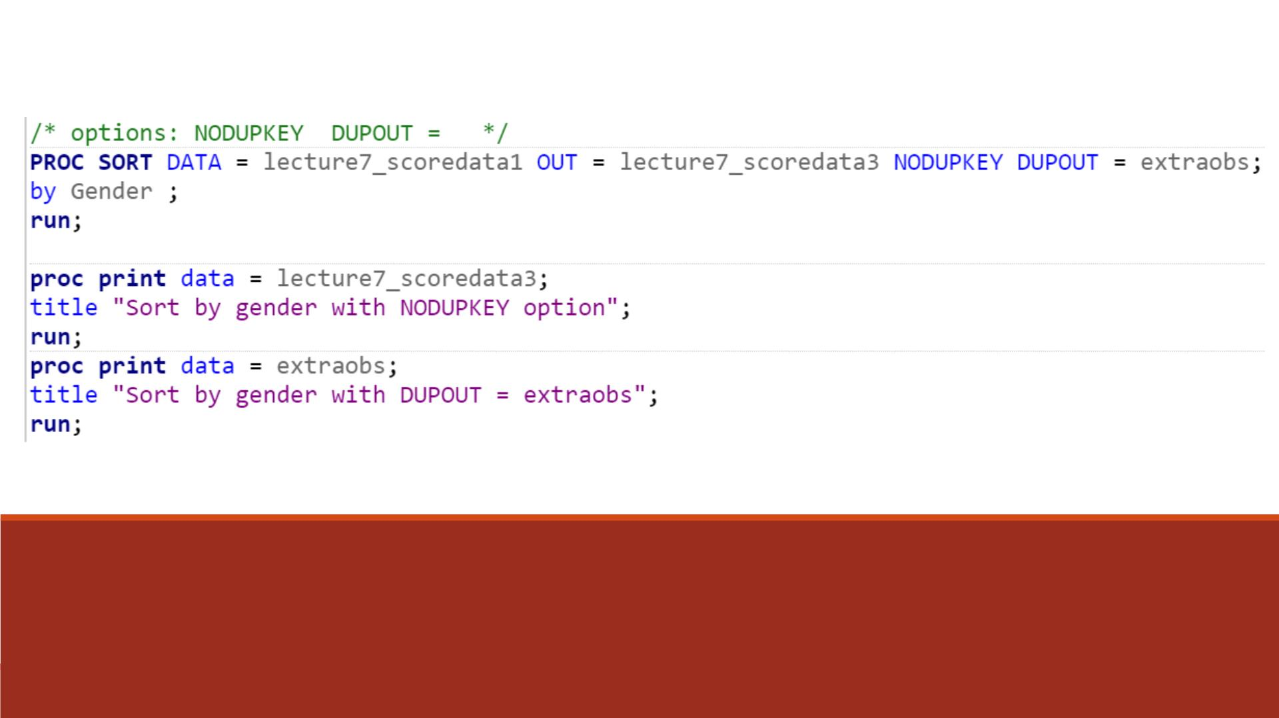
Code

Slide 48
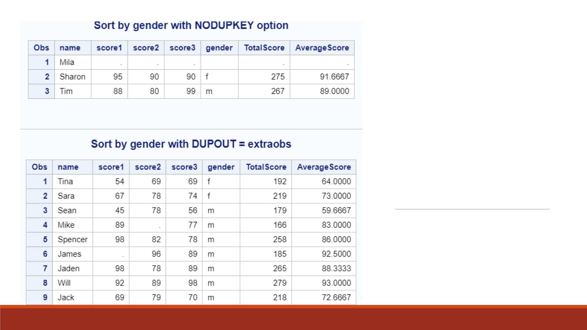
Proc Print
Results

Slide 49
Creating an Enhanced Report

Slide 50
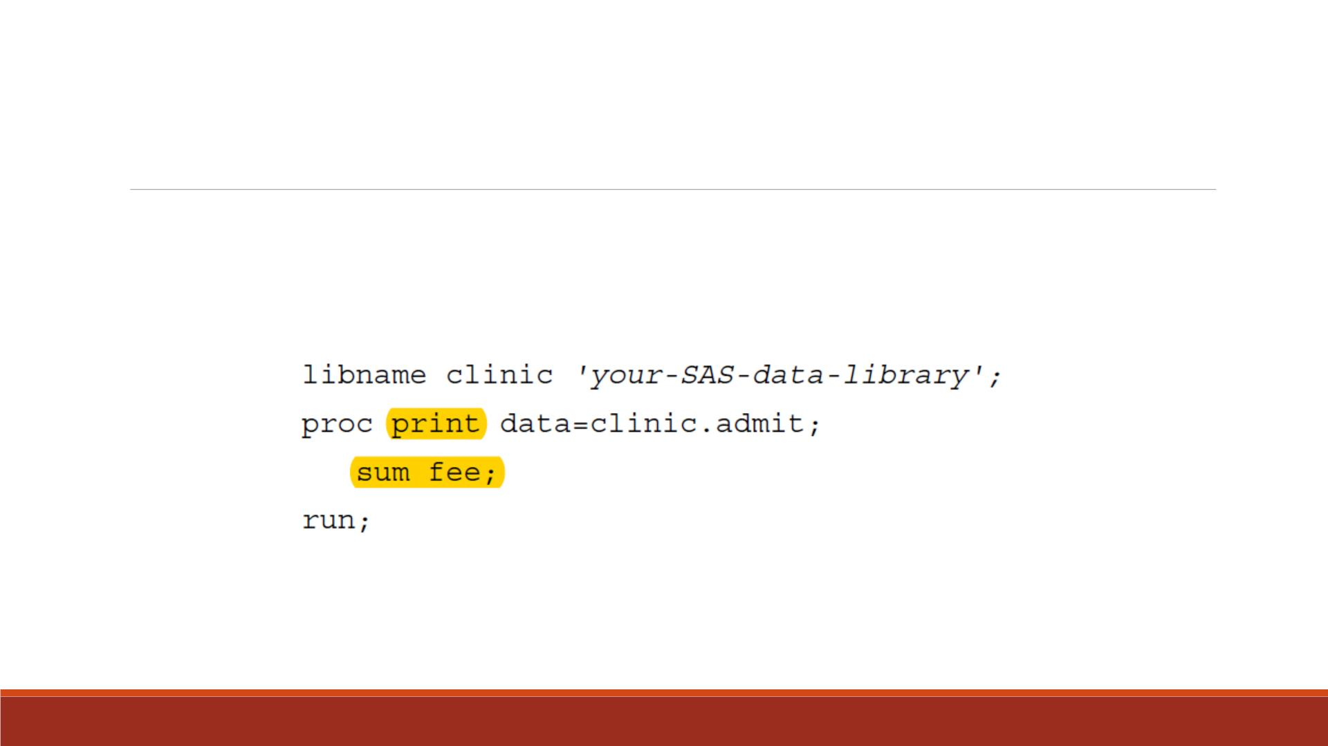
Generating Column Totals
Yo u can produce column totals for numeric variables within your report.

Slide 51
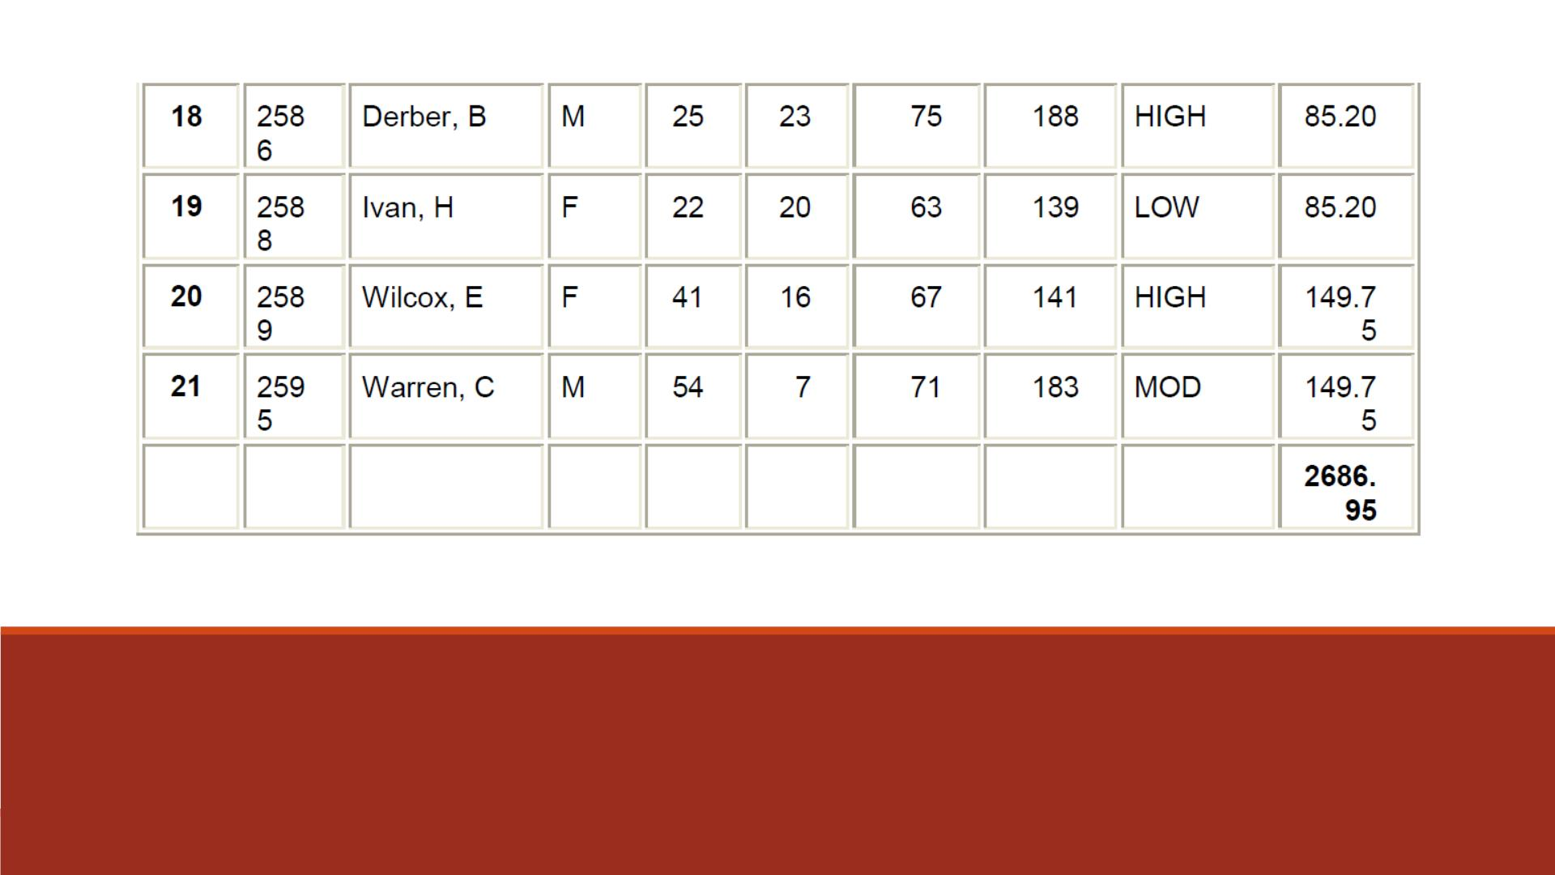
Partial Output

Slide 52
SUM Statement
▪To produce column totals for numeric variables, you can list the variables to be
summed in a SUM statement in your PROC PRINT step.
▪General form, SUM statement:
SUM variable(s);
▪where variable(s) is one or more variable names, separated by blanks.
▪Yo u do not need to name the variables in a VAR statement if you specify them
in the SUM statement.

Slide 53
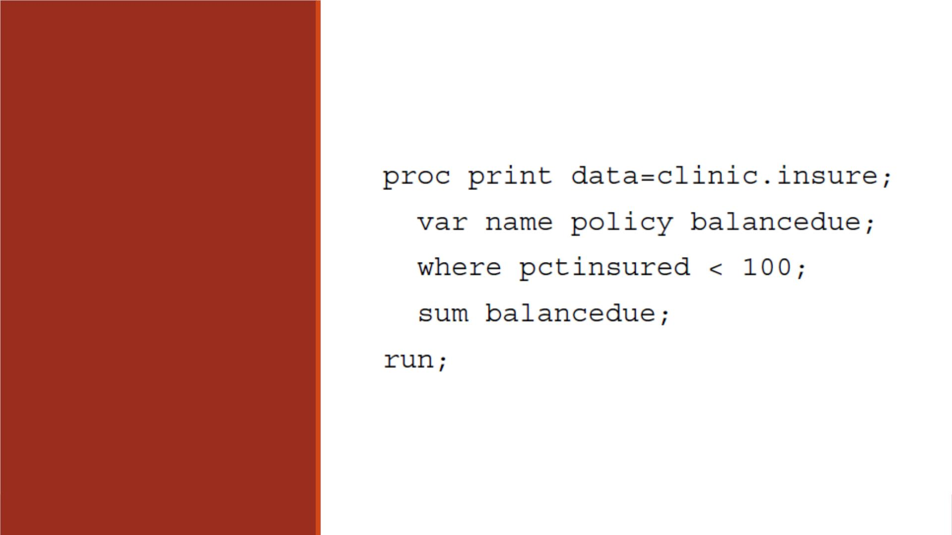
Example
The SUM statement in the
following PROC PRINT step
requests column totals for
the variable BalanceDue.

Slide 54
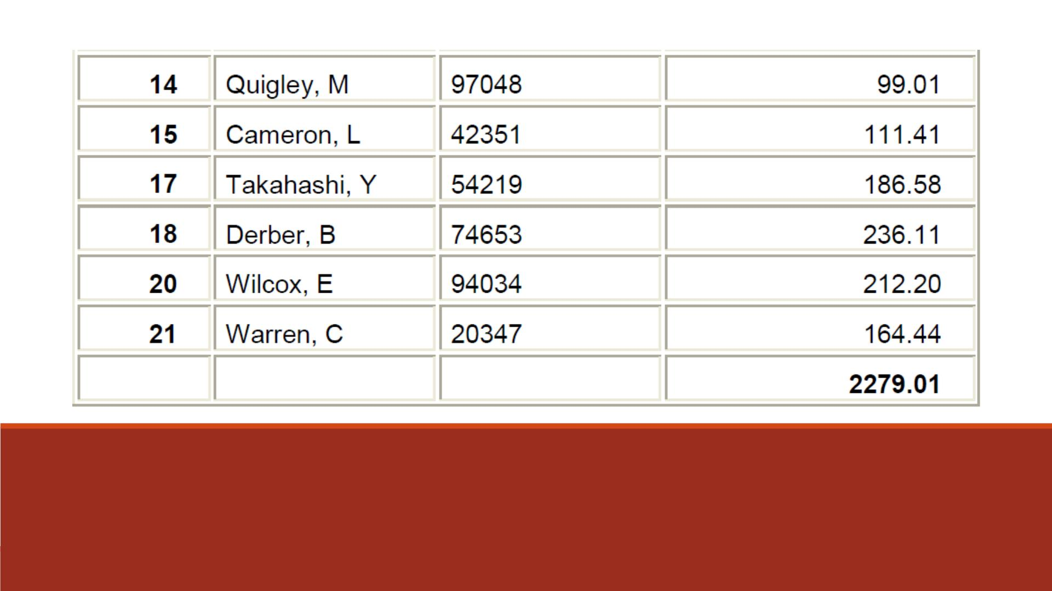
Partial Output

Slide 55
Demo 8—Computing Column Total
▪Import the Excel datafile “Lecture7_fund_data_id_class.xlsx” into SAS, name it
“lecture7_fund0”
▪Print the dataset “lecture7_fund0
1. Without showing the default OBS column,
2. To only show variables “name”, “stu_id”, “gender ”, “class”, “fund”,
3. To compute the column total of “fund” variable,
4. To display the “fund” variable with dollar5.1 format.

Slide 56
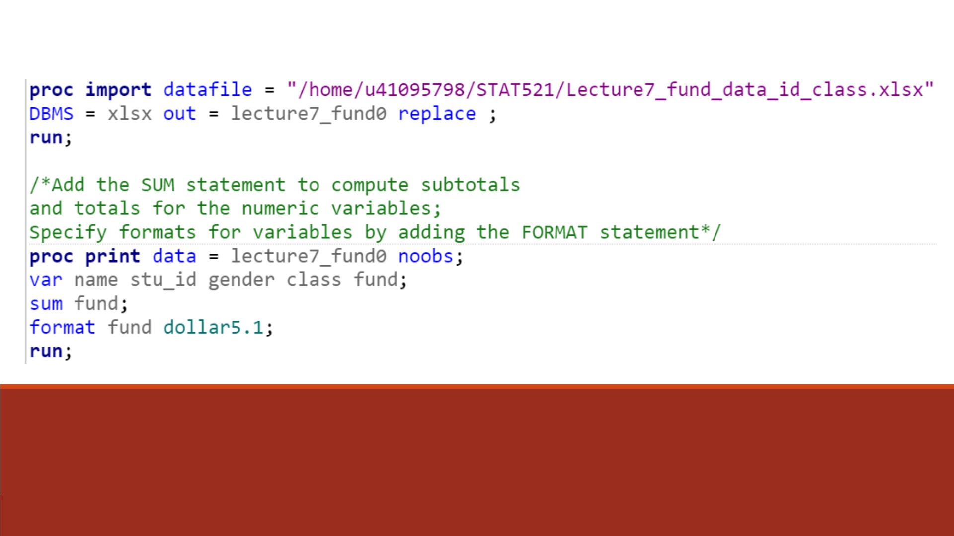
Code

Slide 57
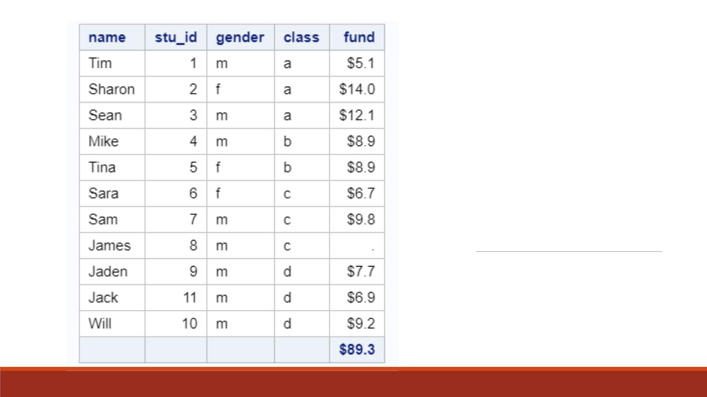
Proc Print
Result

Slide 58
Requesting Subtotals
▪To produce subtotals, add both a SUM statement and a BY statement to your PROC PRINT step.
▪General form:
BY <DESCENDING> BY-variable-1
<...<DESCENDING> <BY-variable-n>>
<NOTSORTED>;

Slide 59
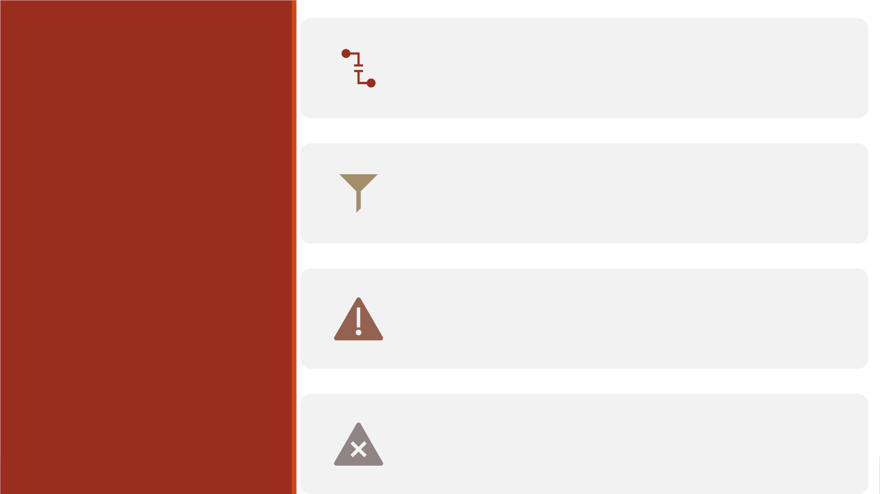
BY-variable specifies a variable that the procedure
uses to form BY groups. You can specify more than
one variable, separated by blanks.
The DESCENDING option specifies that the dataset
is to be sorted in descending order by the variable
that immediately follows.
General
Form
Components
The NOTSORTED option specifies that the
observations are not necessarily sorted in alphabetic
or numeric order.
Warning: If you do not use the NOTSORTED option
in the BY statement, the observations in the dataset
must be sorted by all the variables that you specify.

Slide 60
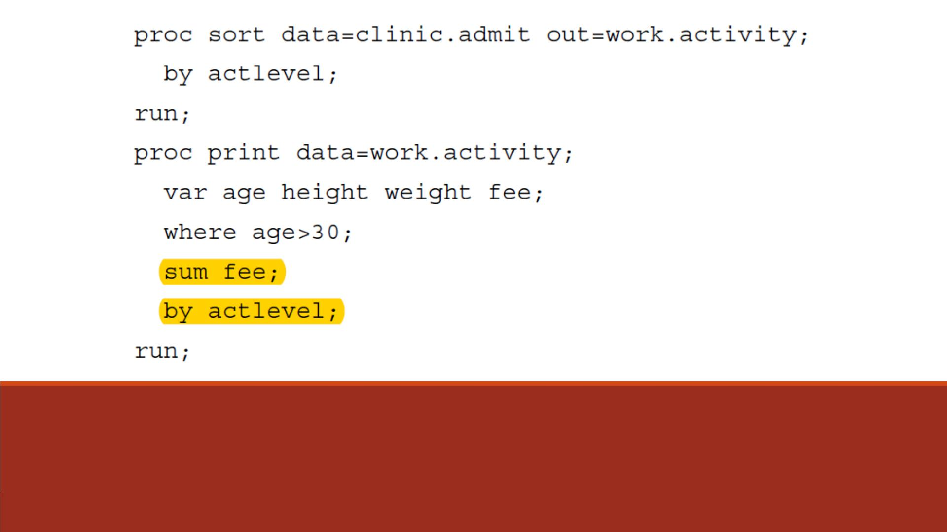
The SUM statement in the PROC PRINT step requests
column totals for the variable Fee, and the BY statement
produces a subtotal for each value of ActLevel.
Example

Slide 61
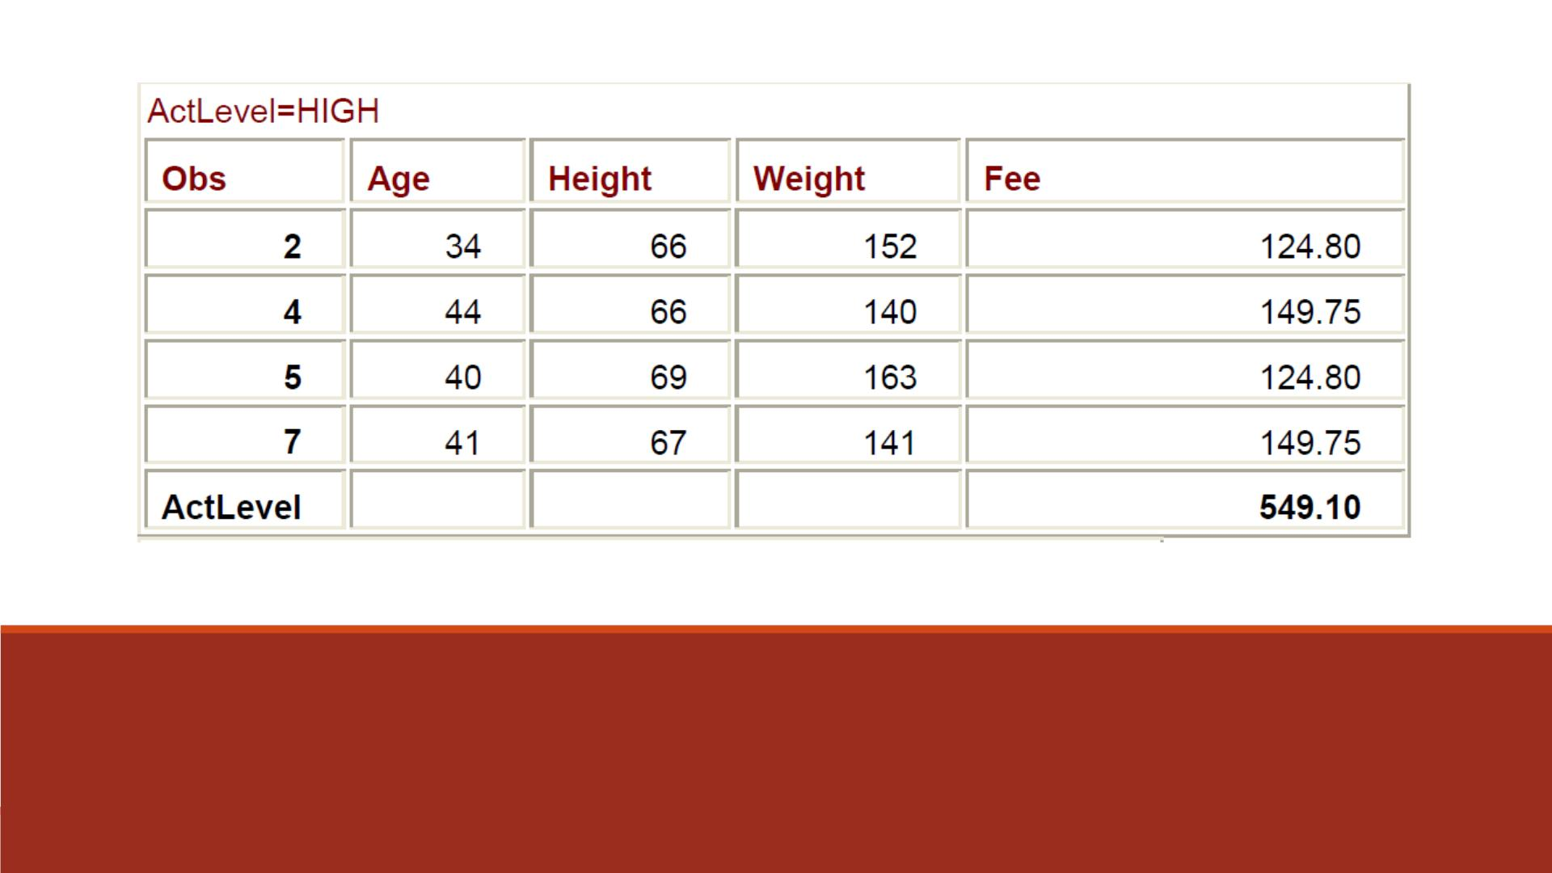
Output
In the output, the BY variable name and value appear
before each BY group. The BY variable name and the
subtotal appear at the end of each BY group.

Slide 62
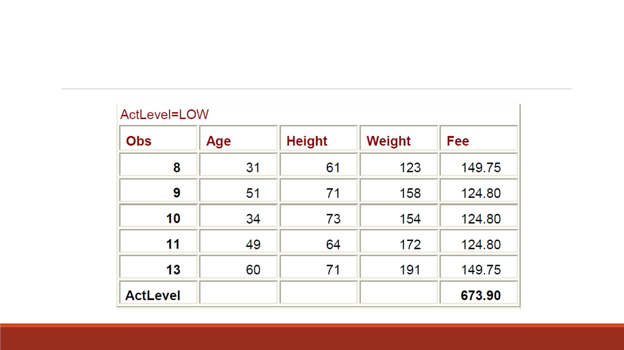
Output (Continued)

Slide 63
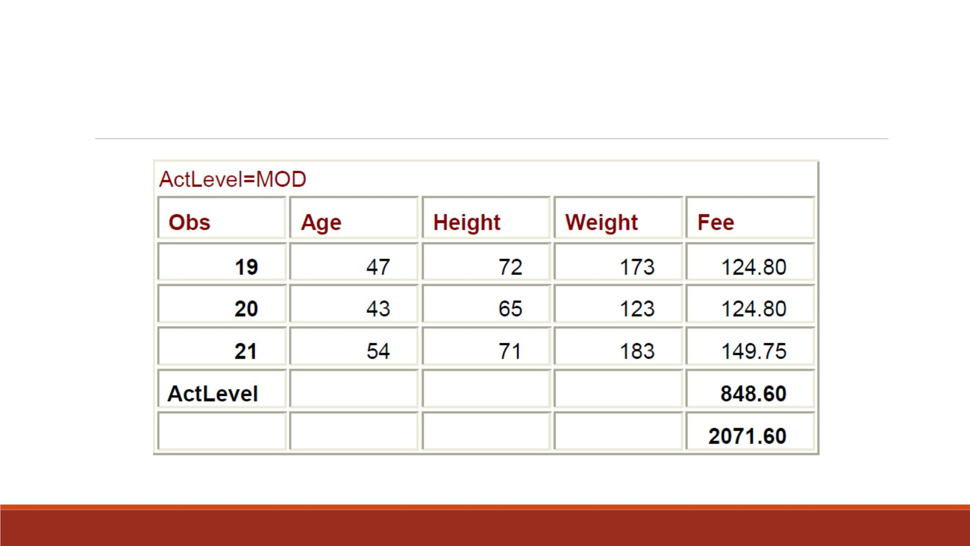
Output (Continued)

Slide 64
Demo 8—Computing Subtotals
▪Sort the dataset “lecture7_fund0” by ascending order of variable “class” to
replace its original version.
▪Print the sorted “lecture7_fund0”
1. To only show variables “name”, “stu_id”, “gender ”, “class”, “fund”,
2. To compute the column total of “fund”,
3. To compute the subtotal of “fund” by each value of “class”.

Slide 65
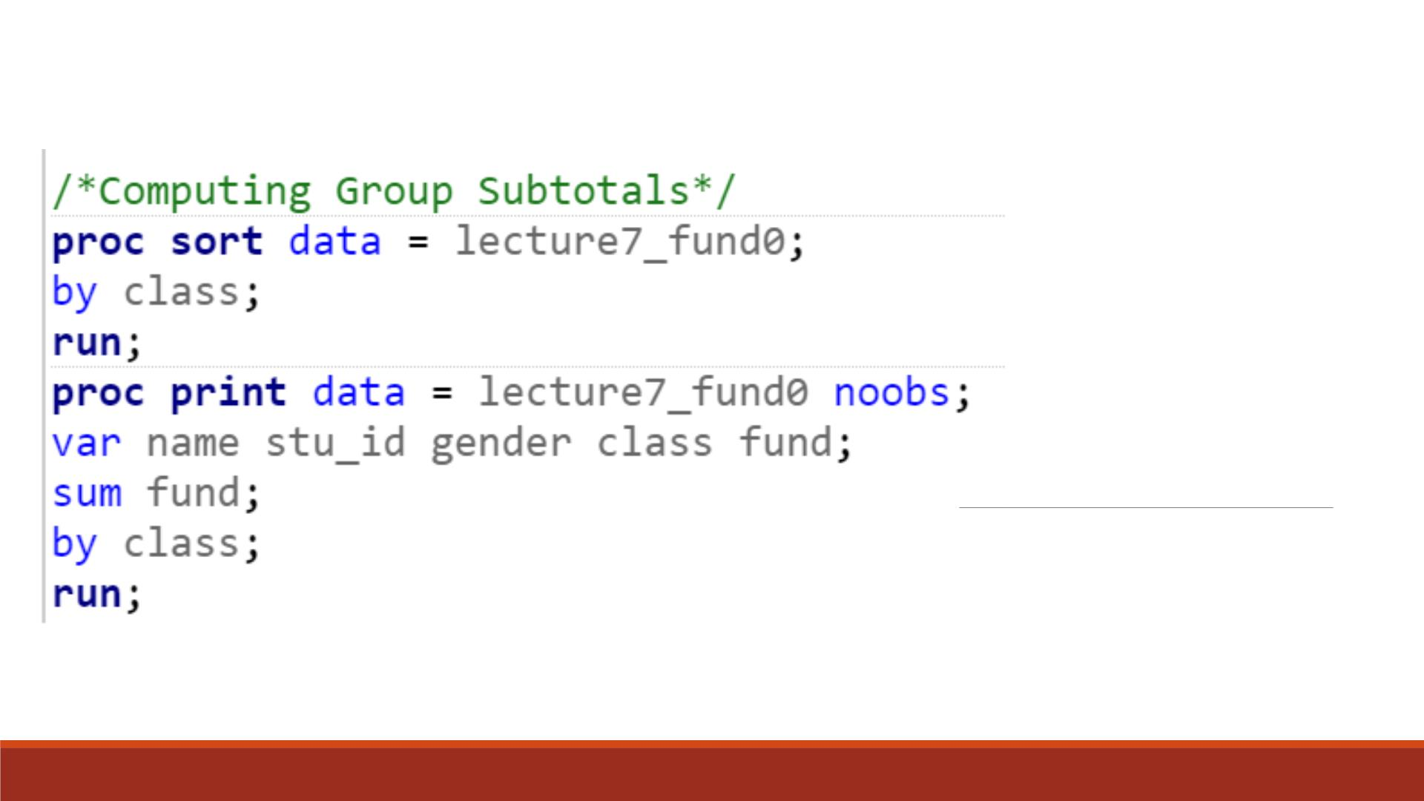
Code

Slide 66
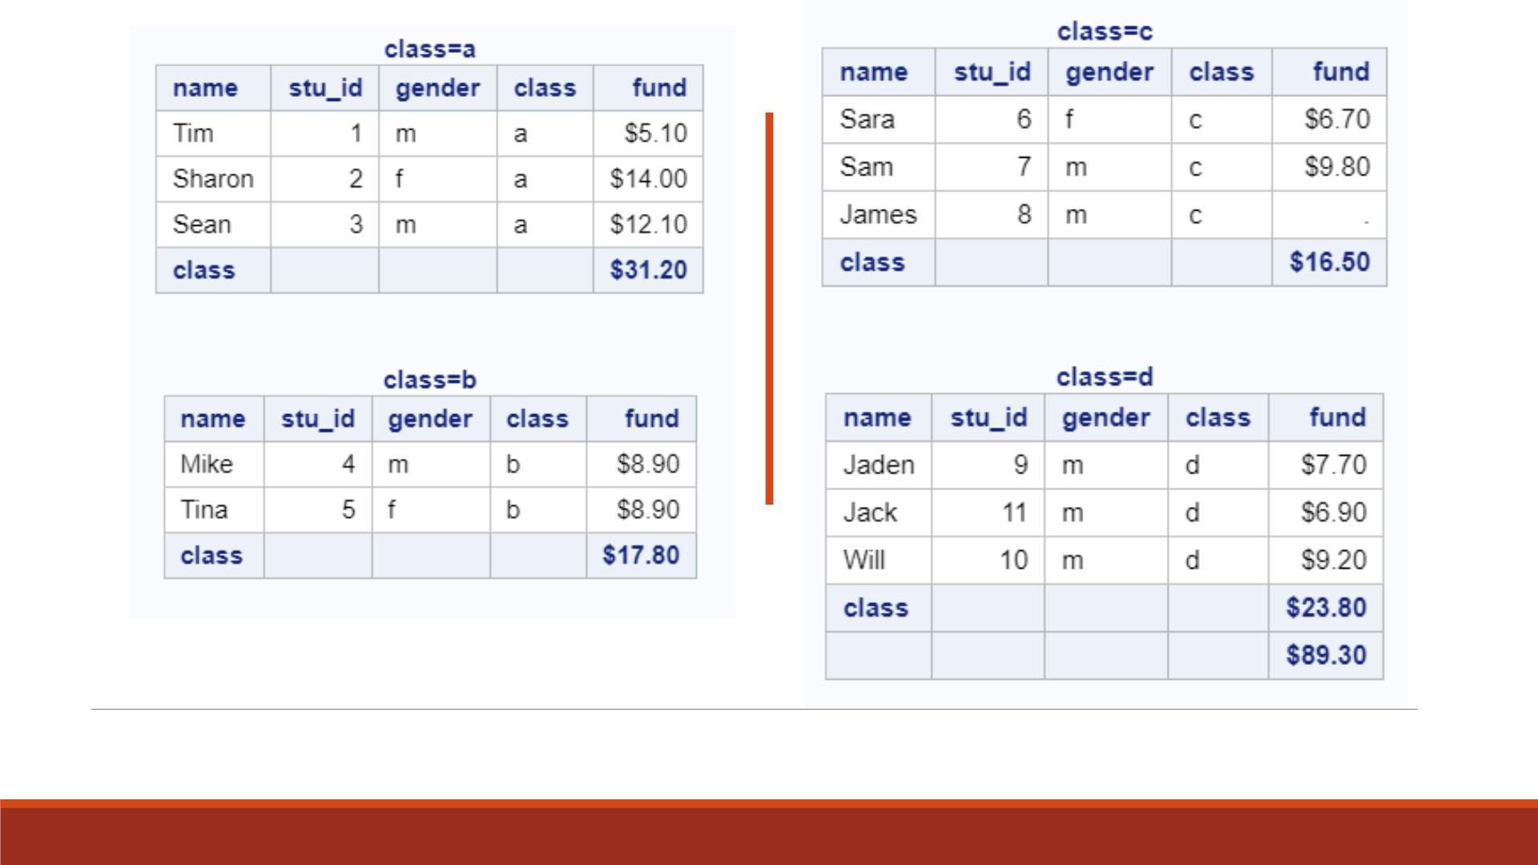
Proc Print Result

Slide 67
Customized Layout with BY and ID
▪To show the BY variable heading only once in first column, you can use an ID statement
and a BY statement together with the SUM statement.
▪When an ID statement specifies the same variable as the BY statement,
1. the default Obs column is suppressed
2. the ID/BY variable is printed in the left-most column
3. each ID/BY value is printed only at the start of each BY group and on the line that
contains that group's subtotal.

Slide 68
Example
proc sort data=clinic.admit out=work.activity;
by actlevel;
▪ The ID variable is listed only once
for each BY group and once for
each sum.
run;
proc print data=work.activity;
var age height weight fee;
where age>30;
sum fee;
▪ The BY headings are suppressed.
▪
Instead, the value of the ID
variable, ActLevel, identifies each
BY group.
by actlevel;
id actlevel;
run;

Slide 69
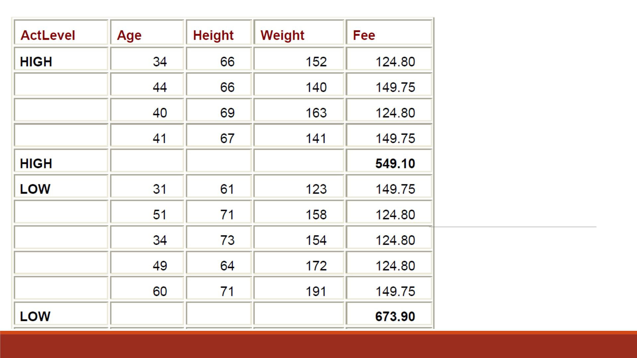
Output

Slide 70
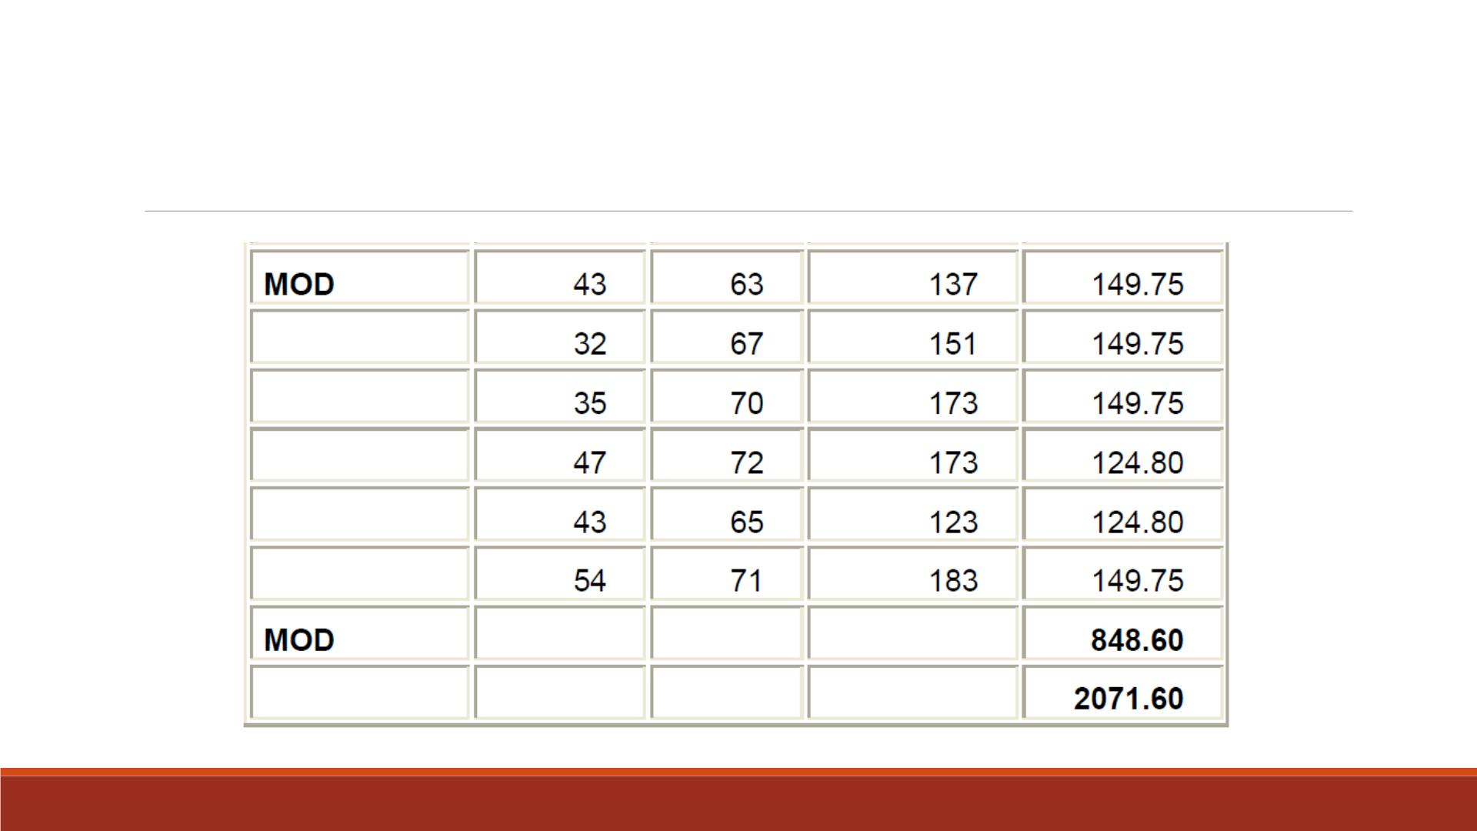
Output (Continued)

Slide 71
Demo 9—Customized Layout
▪Print the sorted “lecture7_fund0”
1. To only show variables “name”, “stu_id”, “gender ”, “class”, “fund”,
2. To compute the column total of “fund”,
3. To compute the subtotal of “fund” by each value of “class”.
4. To display each “class” value only at the start of each class group in the first column,
5. To avoid displaying “class” variable twice.

Slide 72
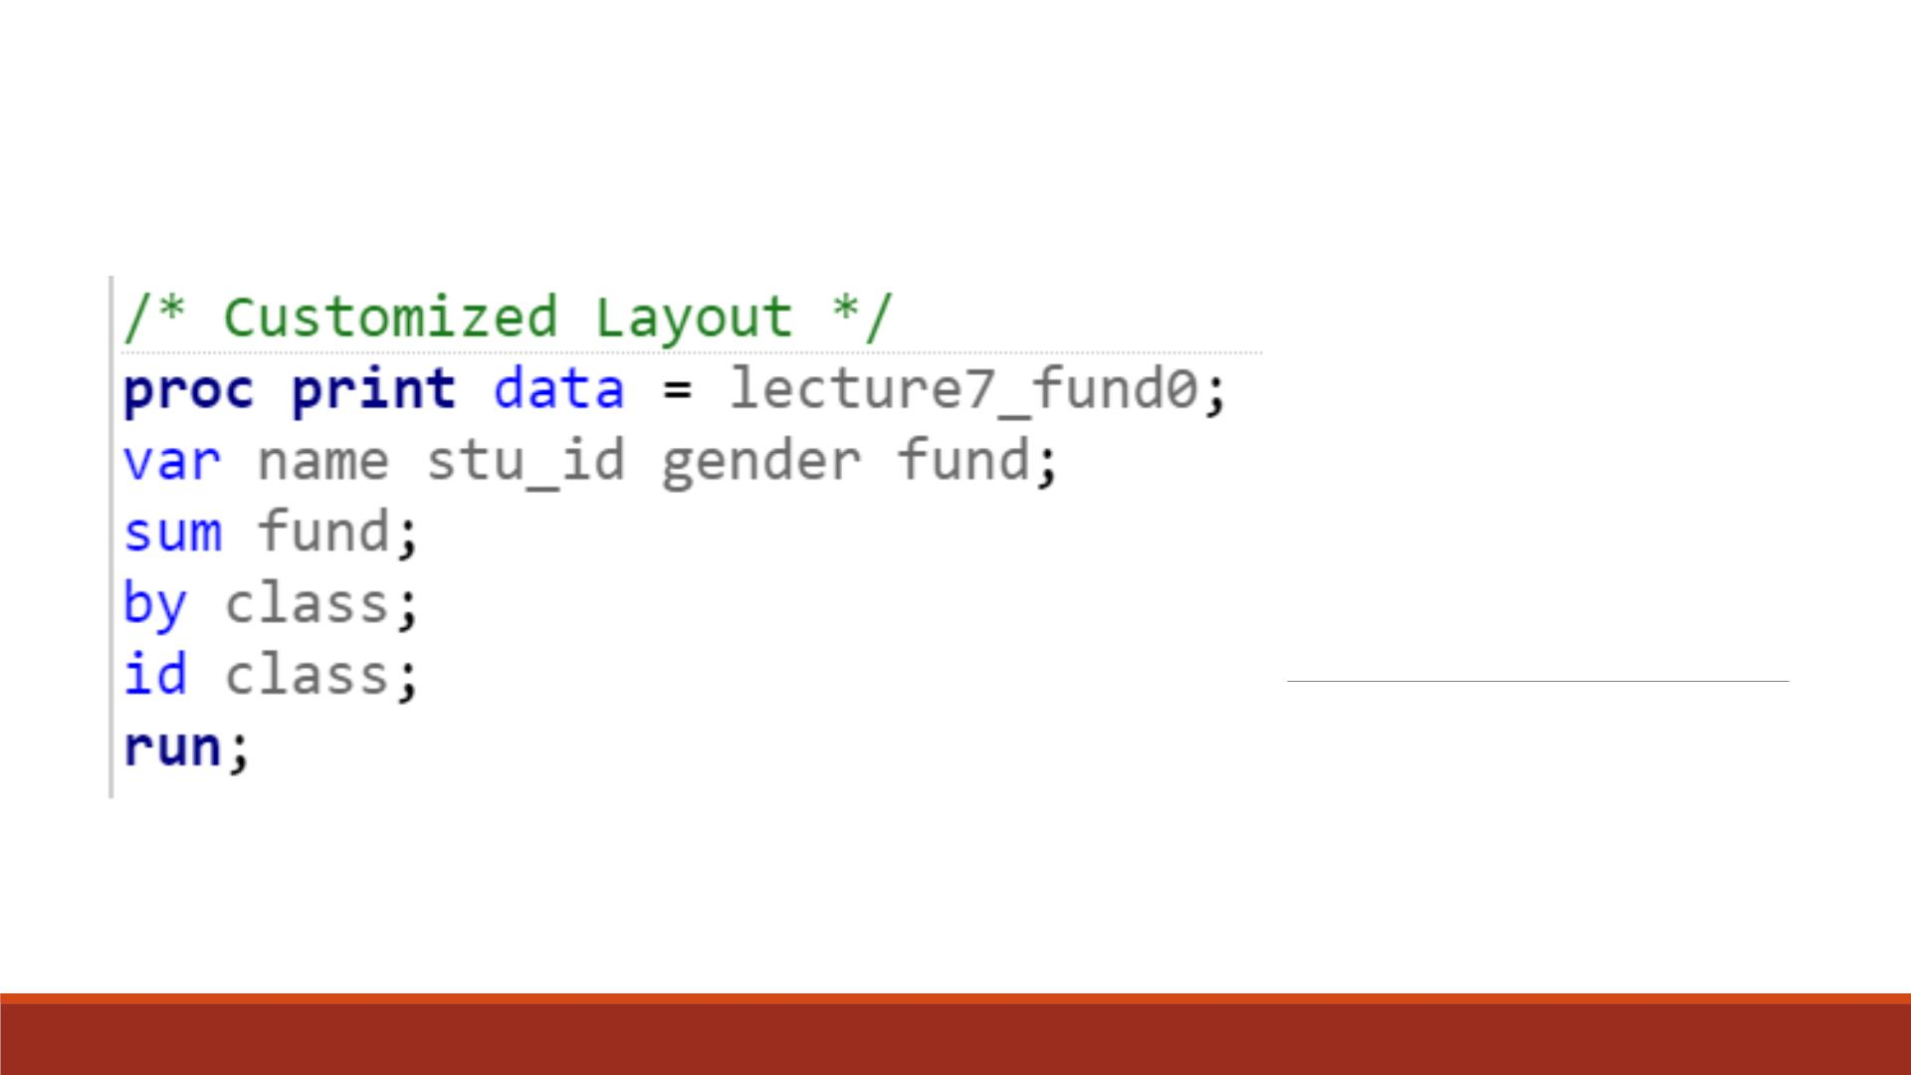
Code

Slide 73
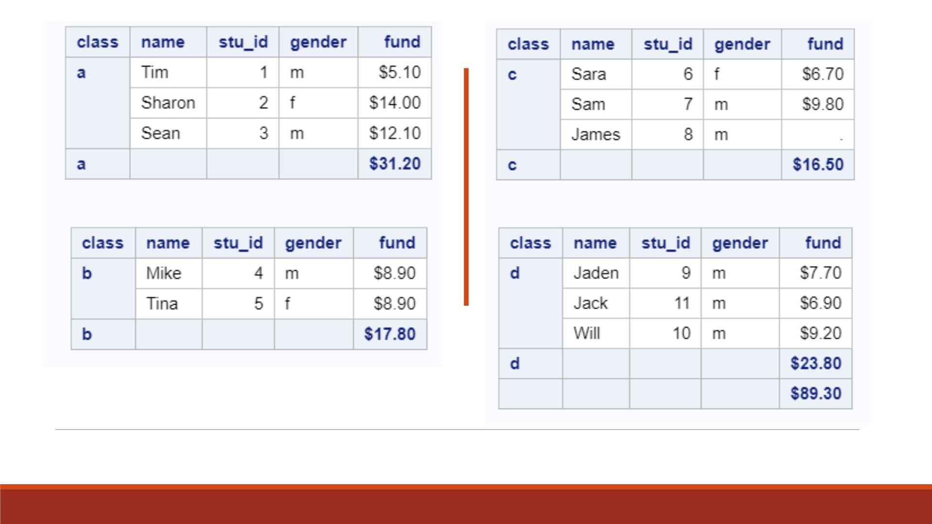
Proc Print Result

Slide 74
Labeling Subtotals and the Grand Total
▪The previous example uses the default labels for the subtotal and the grand total labels.
▪The subtotal default label is the BY variable, and the grand total default label is no label.
▪Yo u can use
❑the SUMLABEL= option to replace the default subtotal label
❑the GRANDTOTAL_LABEL= option to replace a blank grand total label.
▪Note: See Lecture 6 for assigning labels and formats.

Slide 75
Demo 10—Labeling Totals
▪Print the sorted “lecture7_fund0”
1. To only show variables “name”, “stu_id”, “gender ”, “class”, “fund”,
2. To compute the column total of “fund”, label it “Grand Total Fund Raised“,
3. To compute the subtotal of “fund” by each value of “class”, label it “ Total Fund Raised”,
4. Title the output as “Fund Raised by Class”.
▪Repeat Steps 1-3 to display results in a customized layout same as in previous exercise.
▪ Change the title of output as “Fund Raised by Class with Customized Layout ”.

Slide 76
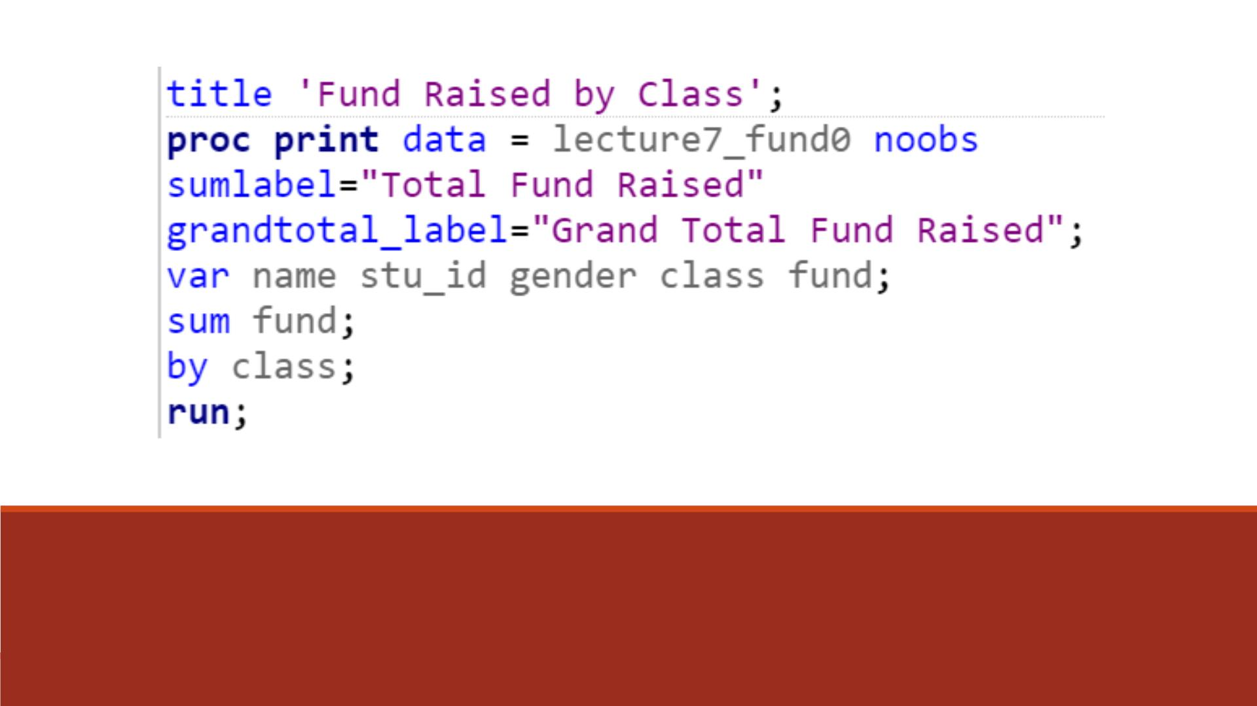
Code

Slide 77
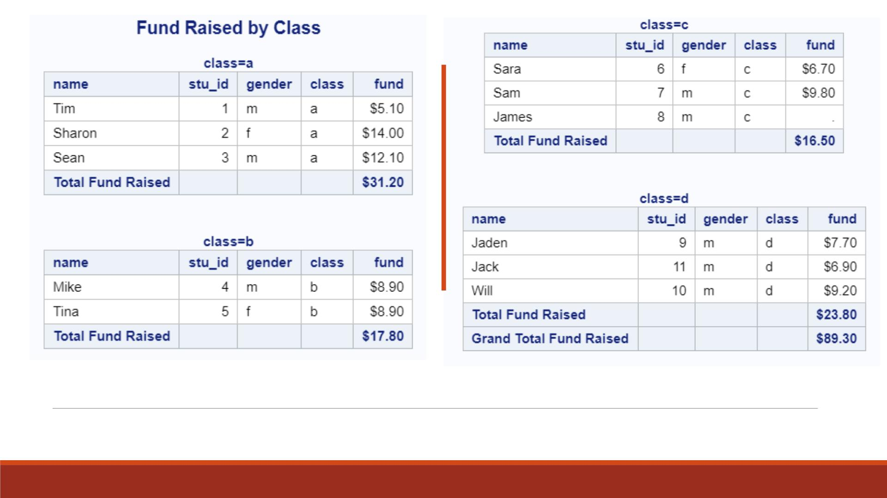
Proc Print Result

Slide 78
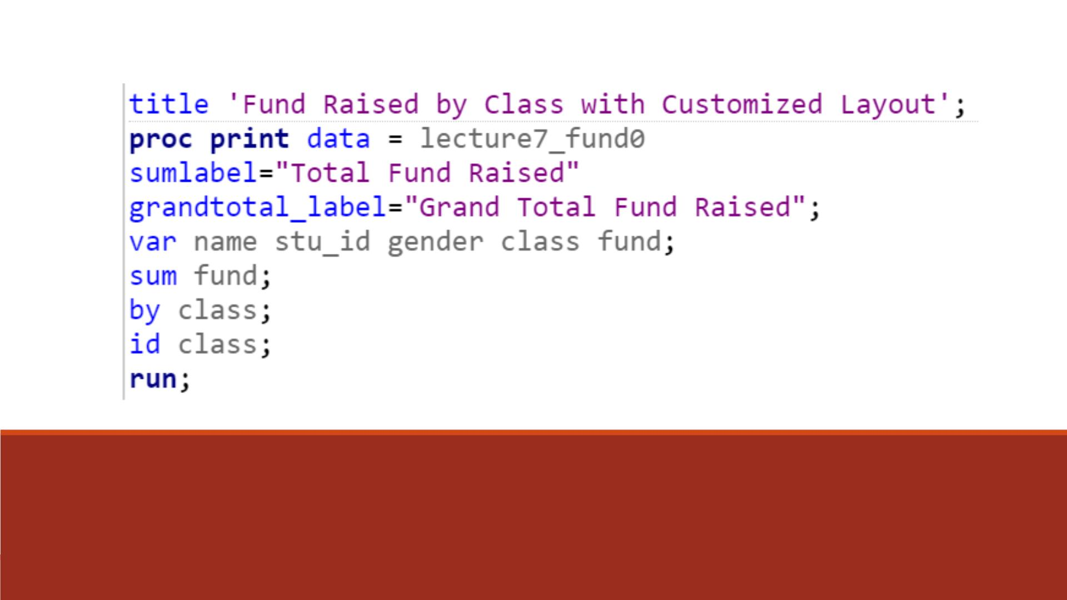
Code—Customized Layout

Slide 79

Proc Print Result

Slide 80

Requesting
Subtotals on
Separate Pages
You can request that each BY group be printed on a separate page by using the PAGEBY statement. It is less relevant today when most reports are webpages on the Internet.

Slide 81

Double-Spacing Listing Output
▪To double-space, specify the DOUBLE option in the PROC PRINT statement.
▪Note: Double-spacing does not apply to HTML output. (More details in a later chapter)

Slide 82
▪Yo u can specify up to 10 titles and 10 footnotes with PROC
output by using TITLE statements before the PROC step.
▪Global TITLE and FOOTNOTE statements: place them before
PROC PRINT.
Specifying
Titles and
Footnotes
▪Titles and footnotes are assigned as soon as TITLE or FOOTNOTE
statements are read; they apply to all subsequent output.
▪General form:
TITLE<n> ‘title content';
FOOTNOTE<n> ‘footnote content’;
▪n is a number from 1 to 10 that specifies the title or footnote line
(optional, when having several titles or footnotes)

Slide 83

Modifying and Canceling Titles and Footnotes
After you define a title or footnote, it remains in effect until you modify it,
cancel it, or end your SAS session.
Re-defining a title or footnote line cancels any higher-numbered title or
footnote line, in that order.
To cancel all previous titles or footnotes, specify a null TITLE or FOOTNOTE
statement (a TITLE or FOOTNOTE statement with no number or text).

Slide 84

Bonus: Quick way to output online report (HTML)
SAS uses ODS to output results. By default the report is a HTML webpage.
Right click on the report and select View Source.
There is an option “Export to Microsoft Excel” but it requires a lot of clean-up.

Slide 85

Bonus: Quick way to output online report (HTML)
The html code will pop up in your text editor.
Save it as a webpage with the extension “htm” or “html” e.g. “report.html”

Slide 86

Bonus: Quick way to output online report
The report will be exactly the same as the one in SAS.
If you want to share the report with others, you have to send or upload the html file.
Sending the path (e.g. file:///C:/Users/Owner/Documents/report.html) will NOT work before it points to a location in your hard drive.

Slide 87


Bonus: Quick way to output online report
You can use MS word, any HTML editor or even a text editor to edit the report

