Slide 1
Computing tools for data science:
What are the hot skills out there?
Chong ho Alex Yu
2022

Slide 2
These are the buzzwords
Machine learning (Artificial science)
Deep learning
Big data analytics
Data mining
Data science
Data visualization
Business intelligence
All are new and emerging technologies. We will cover them in detail in STAT 553)

Slide 3
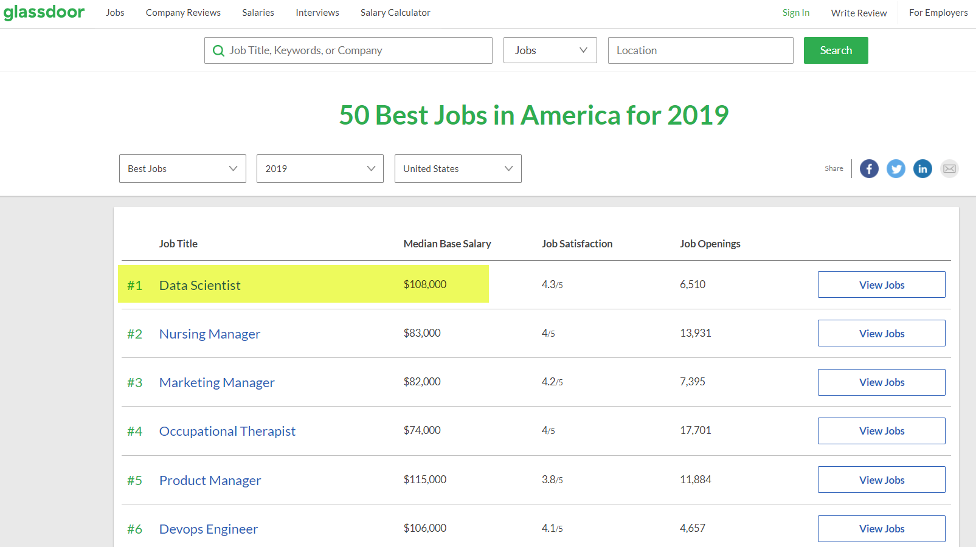
What is the best job in 2019?
How can I get there? What skill set do I need?

Slide 4
General-purpose vs. specialized
General-purpose beyond data analysis/analytics (DAA): e.g. Python
  for developing desktop GUI applications, websites, web applications, and data analysis.
General-purpose in DAA: SAS, SPSS, Stata
Semi-general-purpose in data analysis: Excel
Specialized in specific DAA e.g.
  Tableau: Data visualization
  Mplus, EQS: Structural equation modeling
  Bilog, Winsteps, RUMM: Item response theory and Rasch modeling

Slide 5
Open source vs. Commercial software
 | Open source | Commercial
Example | R, Python, MySQL, NoSQL | SAS/JMP, SPSS, Stata, Tableau
Cost | Free or almost free, but might need to hire programmers to create and maintain the system | $$$$$$$. The user must pay the license fee, but some are free to faculty and students.
Architecture | Open and can be modified | Proprietary
User-friendliness | Usually user-interface is not tested; most of them require coding. | Usability is tested by experts; most include graphical user interface.
Security | Less secure because it Is not developed in a controlled environment; no peer-review | More secure because it is developed in a controlled environment and is validated before release.
Service & Support | By the open source community, but no one is ultimately responsible. | By the tech support; guaranteed response.
Compatibility | Components may not be fully compatible with each other (i.e., sometimes there are too many cooks in the kitchen). | Like Apple, all components that are made by the same vendor can work seamlessly. And many types of hardware require specific drivers.

Slide 6
Open source vs. Commercial software
 | Open source | Commercial
Example | R, Python, MySQL, noSQL | SAS/JMP, SPSS, Stata, Tableau
Time of deployment | In an open community anyone can contribute e.g. You can get the latest features very fast (drawback: It may not be tested thoroughly). | It takes longer for a software company to releases a new version.
R & D | There is no coordinated R & D in the open source community, but cutting-edge technologies can come to the market quickly. | Software companies have more structured R & D resources e.g. SAS used about 20-30% of its revenue into R&D. But the pace may be slower.
Computing efficiency | Some open source, such as R, requires more computing power. | SAS has many high performance procedures and is good at sequential processing and multi-threading processing.
Longevity | Overall open source packages tend to stick around, but some are outdated, too (e.g. Xlisp-Stat, Hadoop) | Some companies ceased to exist (e.g. BMDP) and some products were discontinued by the company.

Slide 7
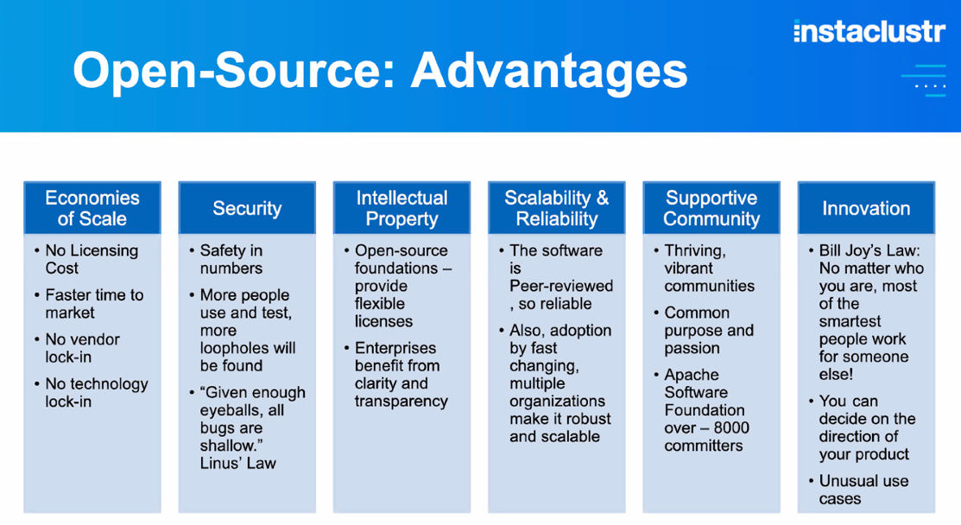
??
Source: 2022 Data Con LA, “Modern data architecture”, “Key open-source databases strategies that shape business in 2022”, and “Open source or open core? What needs to be evaluated before diving in”

Slide 8
Assumption
The foundational philosophy of open-source resembles Socialism: it is assumed that most people are willing to share expertise, efforts, and resources selflessly while people can take what they need without paying.
Profit-minded behaviors are frowned upon.

Slide 9

A case against open source
AI bots: computer programs that act as humans.
To prevent social media from being abused, bot detection algorithms are employed for evaluating whether social media accounts are operated by real humans or bots.
When both bot algorithms and bot detection algorithms are open source, programmers who create the former could easily evade detection by studying bot detection algorithms.
Brinkley (2021) viewed it as a case against open source. In this case, bot detection algorithms must be proprietary.

Slide 10

Myth 1
Open source software becomes more and more popular. Eventually it will replace commercial software packages.
Fact: It is true that usage of R and Python had surpassed SAS (Statistical Analysis System) in small and medium companies, but big corporations still count on the tech support of commercial systems. If you are the chief information officer (CIO) of a big corporation, would you hand over your crucial data to open source?
SAS is still used by most Fortune 500 companies and highly regulated industries (e.g. banking, healthcare/pharma)

Slide 11
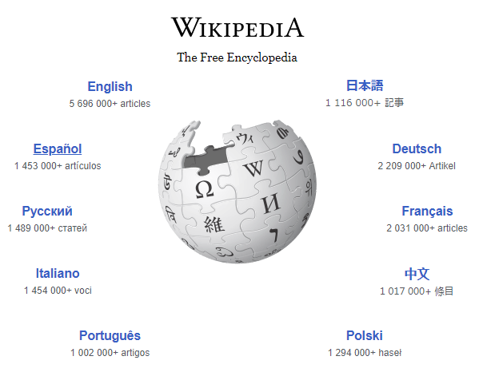



Analogy
Wikipedia is free. It is contributed and supported by the open community.
But probably your professors do not allow you to cite Wiki as your reference in academic papers. You still need references from commercial publishers.
If you dare to submit a wiki-based paper to me…

Slide 12
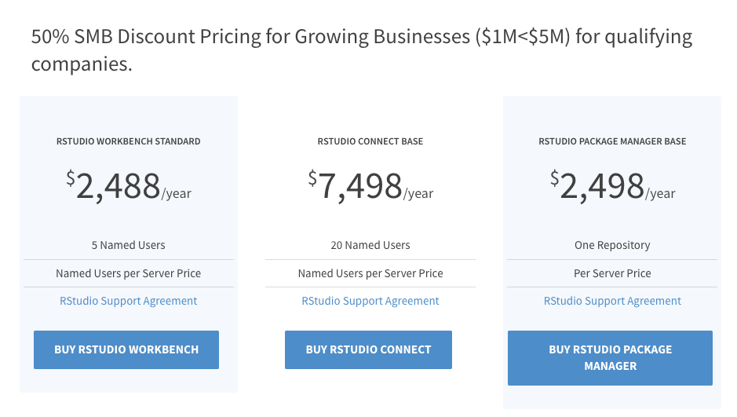
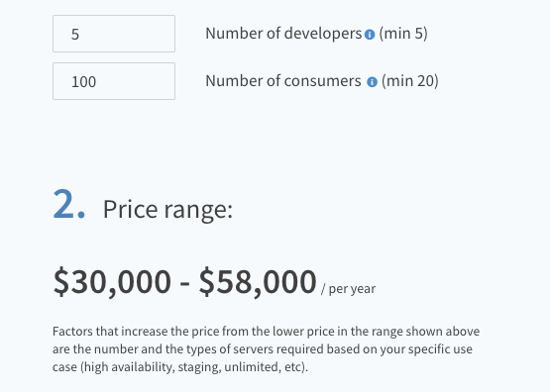
Myth 2
Open source is completely free.
You need to hire programmers to develop applications.
https://rstudio.com/pricing/

Slide 13
Myth 2
Although open-source software does not require licensing, some vendors build open-core products by adding proprietary features on top of open-source codes and then charge customers for licensing fees.
There are many open-source databases in the market, including mySQL, PostgreSQL, and MongoDB. Some software vendors re-package and enhance these open-source DBs, and then sell them as DataBase as a Service (DBaaS). At the end it is not different from proprietary software.

Slide 14
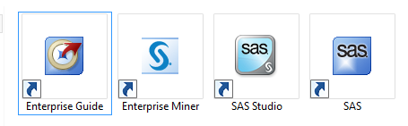
Myth 3
SAS is a programming language. It is very difficult to learn and use.
Fact: SAS consists of a suite of products. Many SAS packages have graphical user interface (GUI).
  Base SAS: Traditional programming environment
  Enterprise Guide
  SAS Studio
  Enterprise Miner
  Visual Statistics/Visual Analytics
  SAS Viya

Slide 15
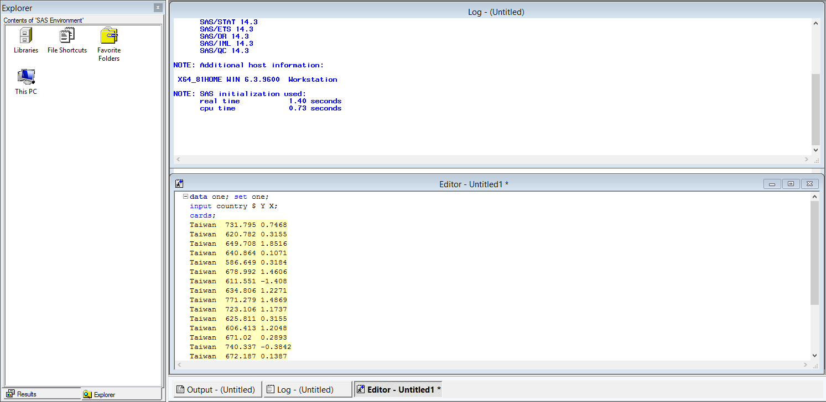
SAS programming environment

Slide 16
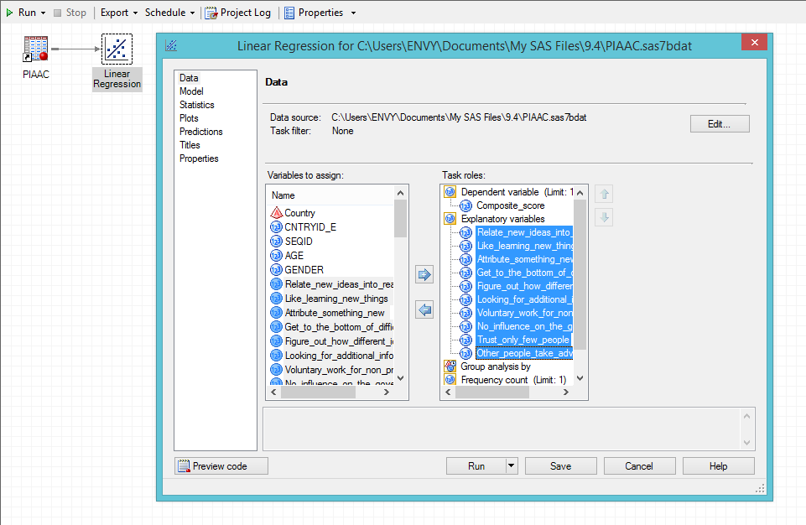
SAS Enterprise Guide
If you don’t like programming…
Drag-n-drop, point-n-click
Flow chart interface: a diagram of the sequence of actions in a complex system (e.g. computer program).
Auto-documentation
You can go back easily.

Slide 17
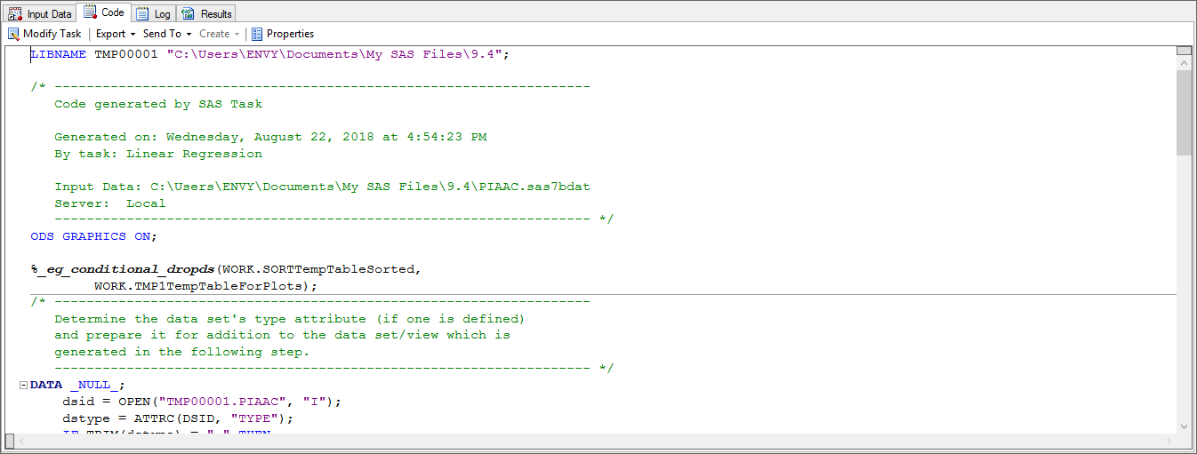
SAS Enterprise Guide
If you want to see the SAS syntax and the result, double-click the icon.

Slide 18
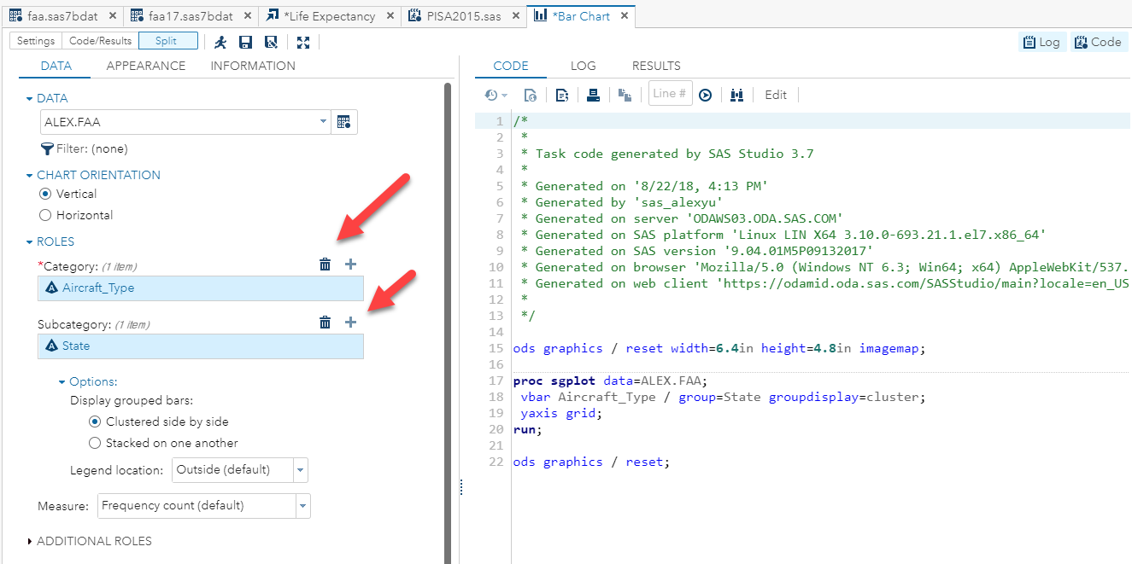
SAS Studio
Use a Web browser
Cross-platform (Windows and Mac)
A good learning tool
Drag-n-drop, point-n-click on the left
Studio generates the syntax on the right (on the fly).

Slide 19
SAS Studio
SAS Studio can be run on both Windows and Mac.
If you are a Mac user, you cannot run the “real” SAS. You can use either SAS on Demand via a Web Browser.
Free but requires an Internet connection.

Slide 20
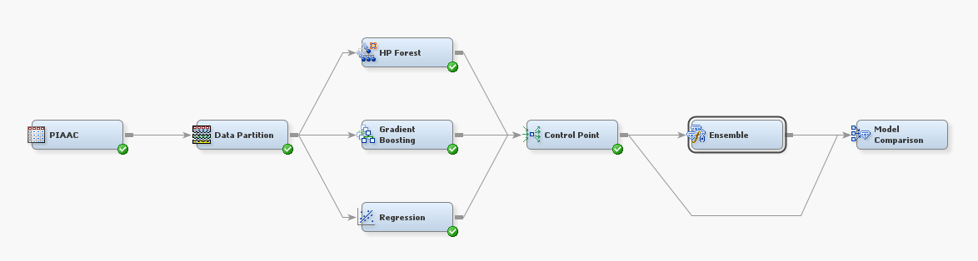
SAS Enterprise miner
Built for data mining and predictive modeling
Use a flow-chart interface
Each step is depicted by a node (icon).

Slide 21
SAS Visual Statistics/Visual Analytics
Multi-panel
Dynamic graph: All panels are inter-linked. Changing one would update others
Interactive exploration by asking what-if question.

Slide 22
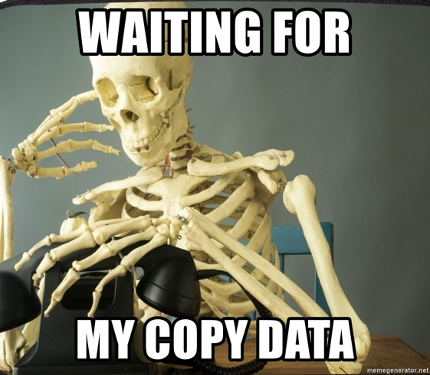

SAS Viya (via: From here to there)
Coexist with R, Python…etc.
In-memory Analytics platform for cloud computing
In-memory analysis: Traditionally, data analysis is done with data in a hard drive. When you have extremely big data, transferring the data from one server to another one is time-consuming. In-memory analysis is done in the server's random access memory (RAM).
Cloud computing: In the past we stored data in the hard drive. When the data analyst is on vacation, oooop! In cloud computing, storage, analytics, and more are done over the Internet.
https://www.zdnet.com/article/sas-is-on-the-brink-of-generation-change/
Notes:
https://www.sas.com/en_us/insights/data-management/cloud-computing.html

Slide 23
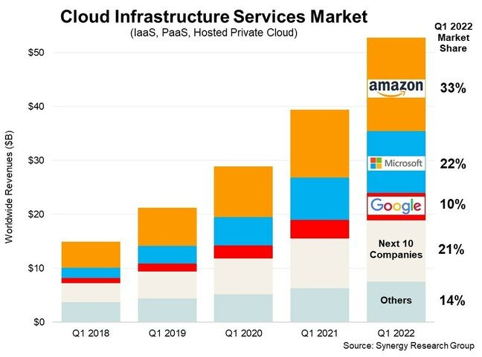
Cloud computing
The big three are Amazon Web Services (AWS), Microsoft Azure, and Google Cloud.
SAS partners with Microsoft to offer cloud solutions via Azure.
Notes:
https://www.theregister.com/2022/05/02/cloud_market_share_q1_2022/

Slide 24
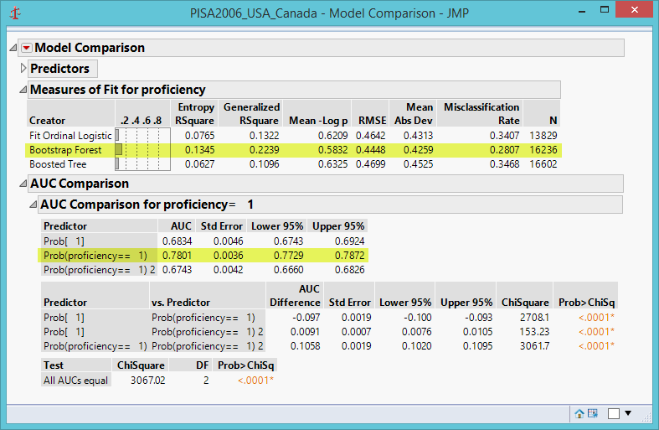
JMP
A product of SAS; fully compatible with SAS
Different versions:
  JMP: offer basic predictive modeling tools
  JMP Pro: Includes and advanced predictive analysis

Slide 25
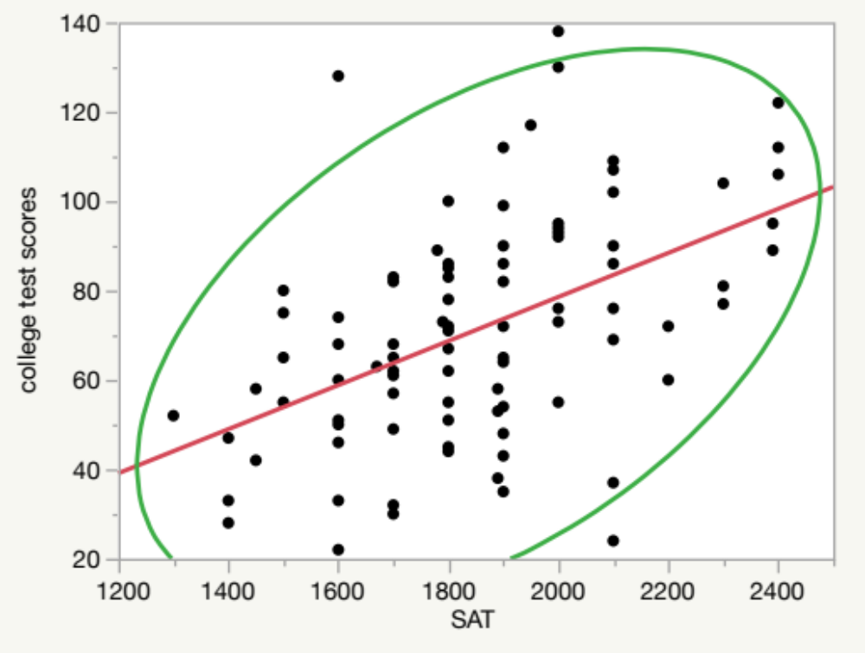
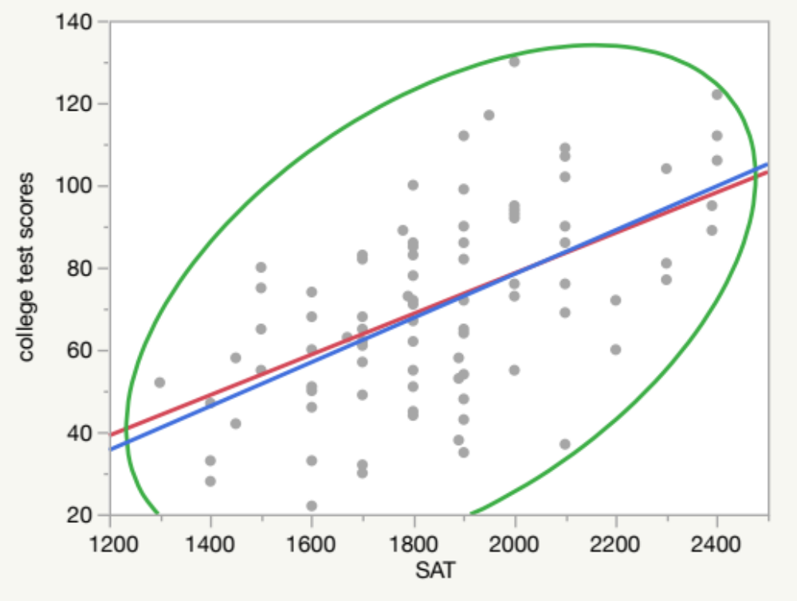
JMP
Include traditional statistical procedures and tools for exploratory data analysis (EDA), data visualization, data mining, and predictive modeling.

Slide 26
SAS Certification Exams
SAS offers 23 credentials across seven categories
Foundation Tools
Advanced Analytics
Business Intelligence and Analytics
Data Management
Administration
JMP
Partners
e.g. SAS Certified Specialist Base Programming using SAS 9.4​
e.g. SAS Certified Data Scientist Using SAS 9​
e.g. SAS Certified BI Content Developer for SAS 9.4
e.g. SAS Certified Big Data Professional Using SAS 9
e.g. SAS Certified Platform Administrator for SAS 9
e.g. JMP Certified Specialist: JMP Scripting Using JMP 14​
e.g. SAS Certified Deployment Specialist for Visual Analytics 7.3
https://www.sas.com/en_us/certification.html
https://www.businessnewsdaily.com/10716-sas-certification-guide.html

Slide 27
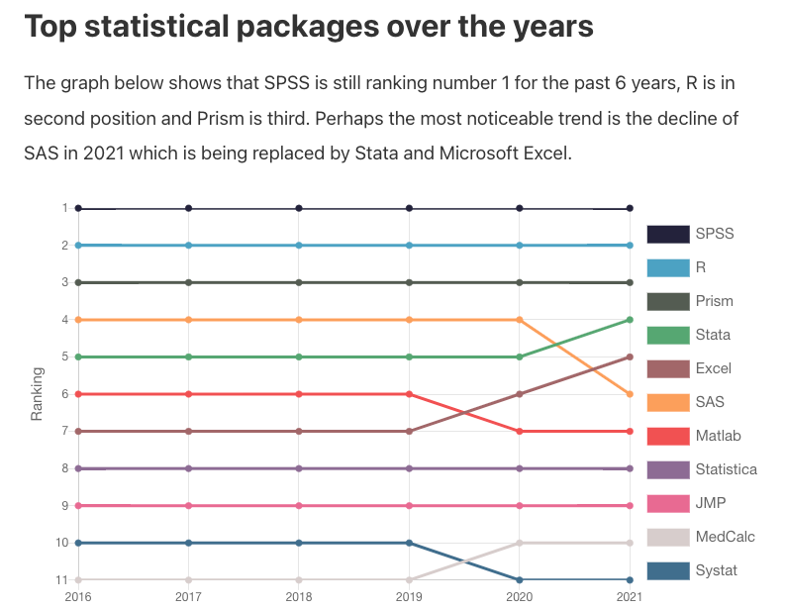
SPSS Statistics
SPSS Statistics is widely used in academic. Most scholarly articles are written with findings produced by SPSS
SPSS Statistics was not designed for data science though its recent versions include some data mining features.
It lacks dynamic (interactive) data visualization features.
Source: https://quantifyinghealth.com/statistical-software-popularity-in-research/

Slide 28



You need to go beyond SPSS Statistics!
You need modeling!
Not this kind of modeling.

Slide 29
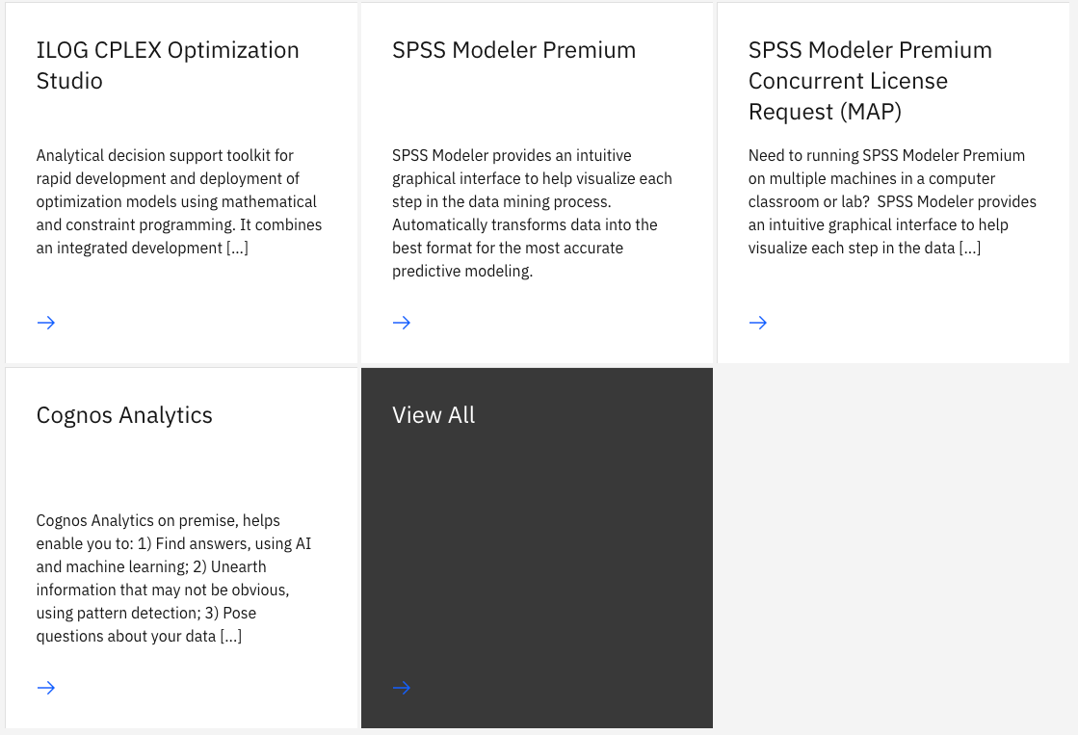
IBM data science resources
SPSS Modeler Premium (will be taught in STAT 553)
Cognos Analytics
SPSS Statistics is not on the list.

Slide 30
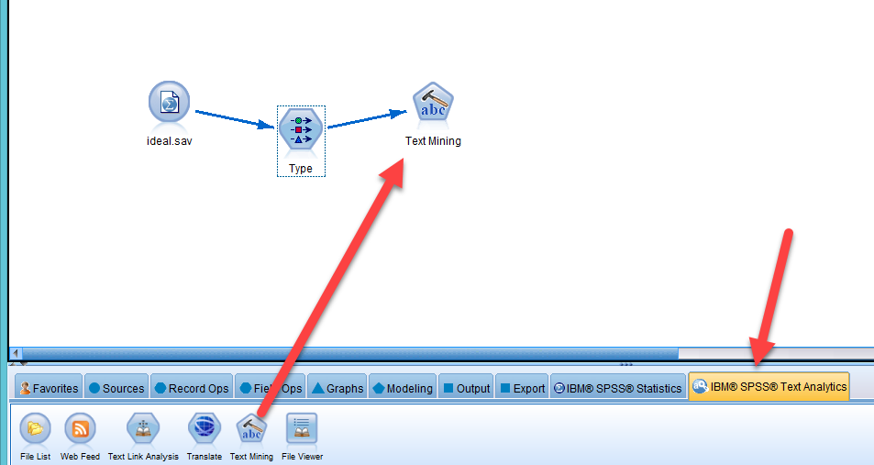
IBM SPSS Modeler
SPSS Modeler and SPSS Statistics are two different products.
For data mining and predictive analysis
Use a flow-chart interface.

Slide 31
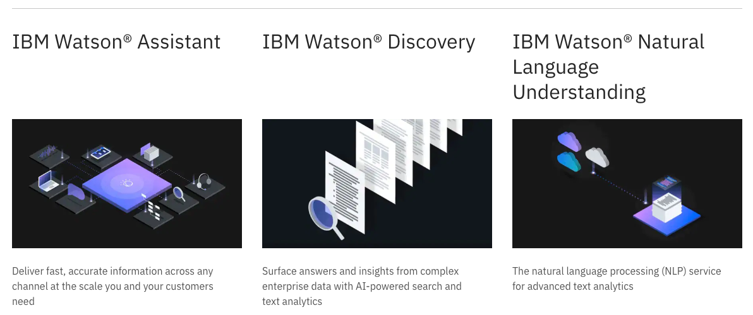
IBM Watson
Notes:
https://www.ibm.com/watson/products-services

Slide 32
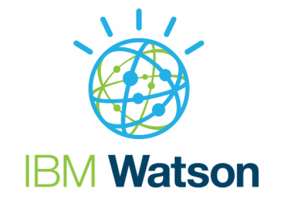
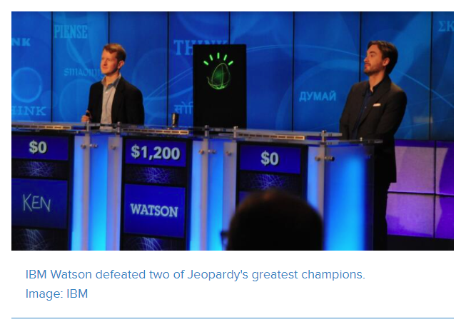
IBM Watson Studio
Although IBM Watson Studio is not the same as IBM Watson, both of them are built on IBM’s AI technology.
Notes:
https://www.ibm.com/analytics/data-science?p1=Search&p4=43700050329259837&p5=b&gclid=Cj0KCQjwna2FBhDPARIsACAEc_W-DNQWcLDDNcT32rAKZLhA3x3pp0-Biq36zF656Q6Y7fPHAg7X_6AaAufCEALw_wcB&gclsrc=aw.ds
https://www.techrepublic.com/article/ibm-watson-the-inside-story-of-how-the-jeopardy-winning-supercomputer-was-born-and-what-it-wants-to-do-next/

Slide 33
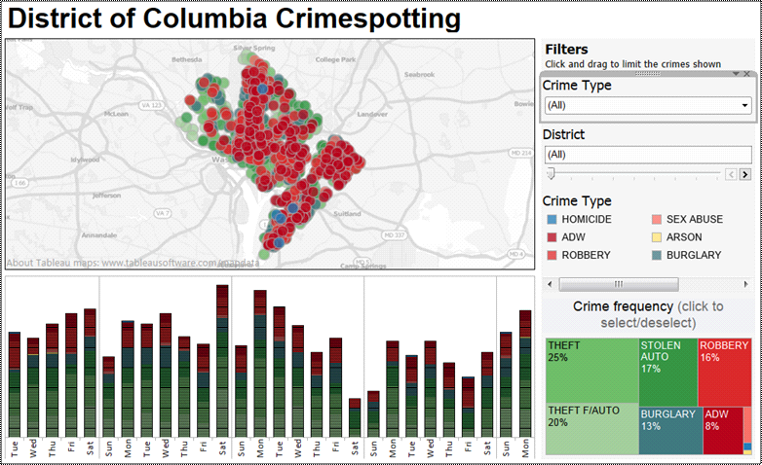
Tableau
Fairly new, founded in 2003.
Powerful software for data visualization
Include advanced dynamic graphing tools, such as Geographical Information System (GIS), time-series, and dashboard.

Slide 34
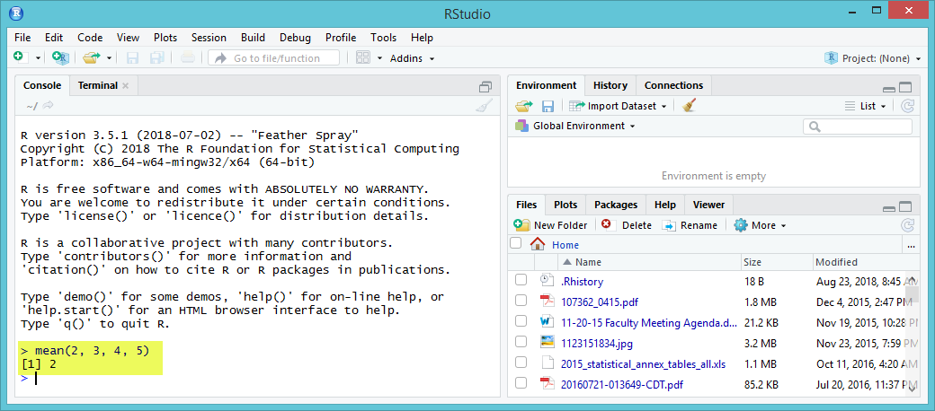
R Language
An interpreted programming language: Run the instruction directly without compiling the program into an executive program e.g. type “mean (2, 3, 4, 5)” at the prompt and it returns “2”
PowerPoint, PhotoShop…etc. are compiled (e.g. PPTX.exe, PhotoShop.exe). You cannot see the original source code.
R Studio offers a nicer interface, but still no drag and drop.

Slide 35
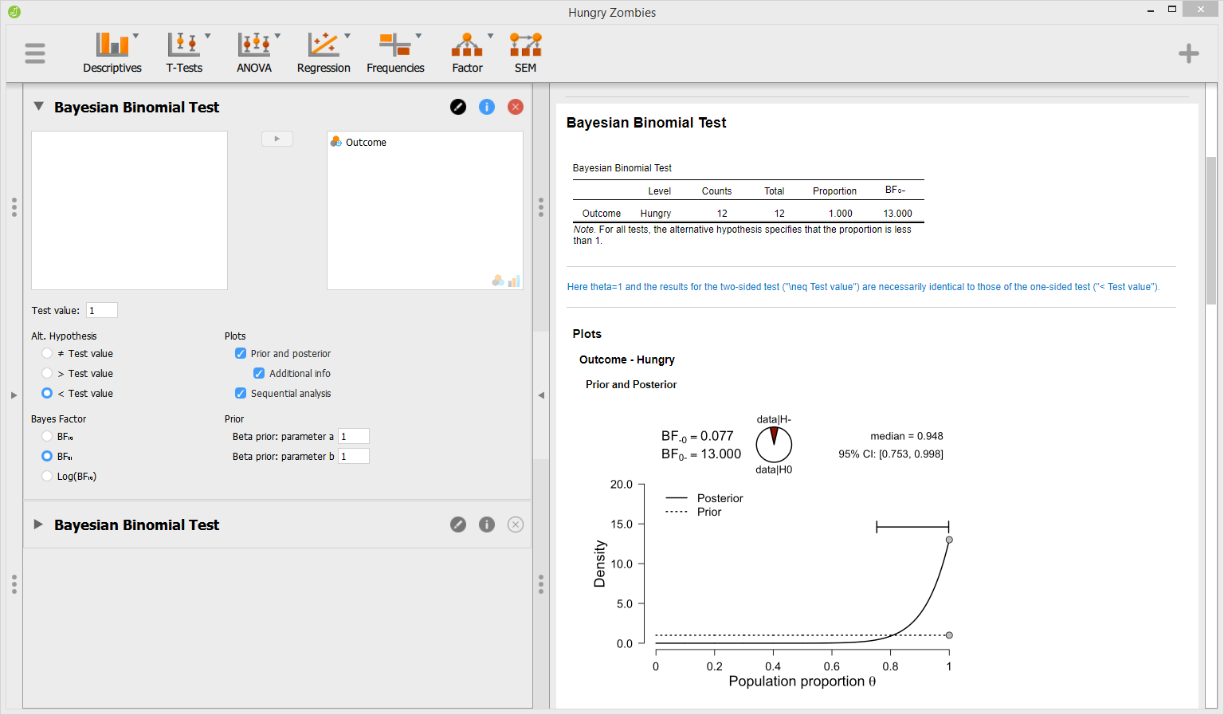
Graphical User Interface for R
Some developers created GUI-based statistical programs e.g. JASP

Slide 36
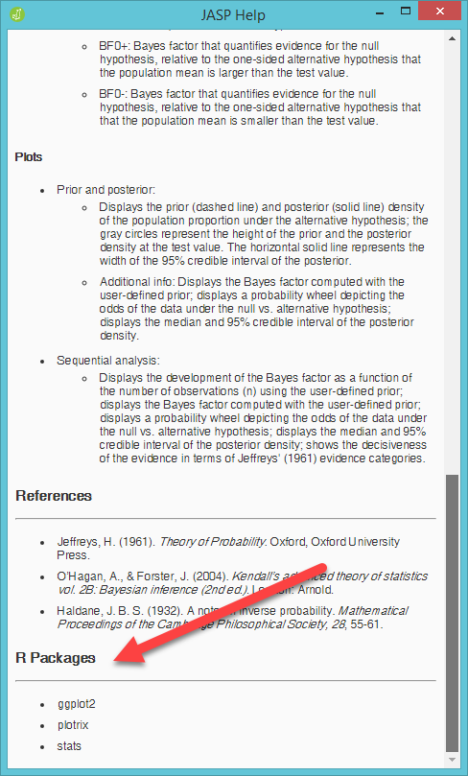
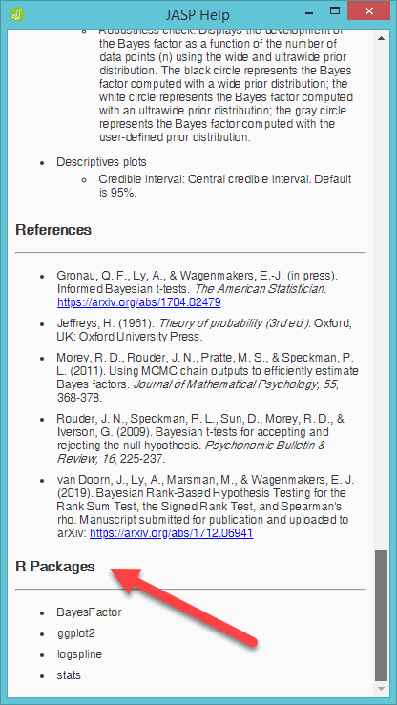
GUI for R
R has a very steep learning curve.
Good news: Behind the scene, many statistical computing in JASP are performing by calling R package.

Slide 37
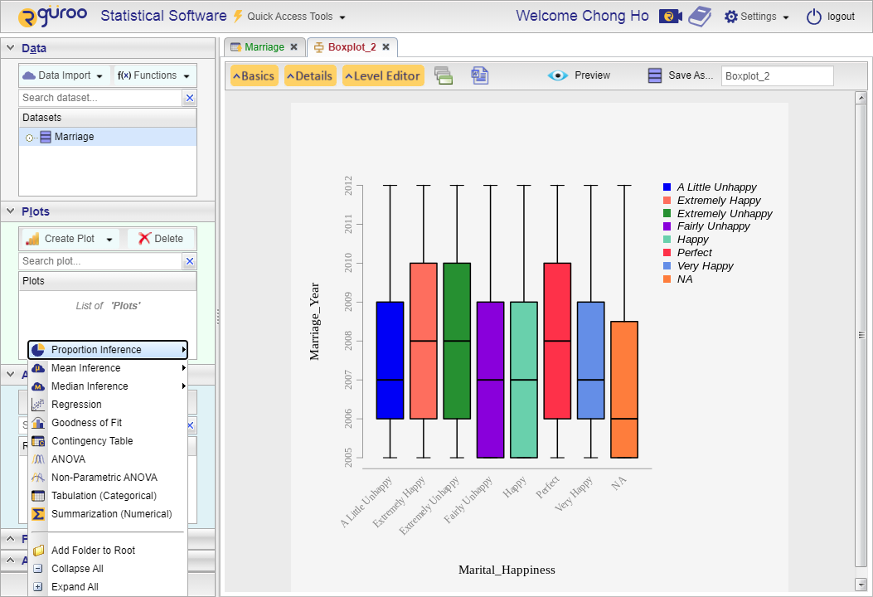
GUI for R
Rguroo
Point-n-click
Semi-dynamic data visualization
Traditional statistical procedures only

Slide 38
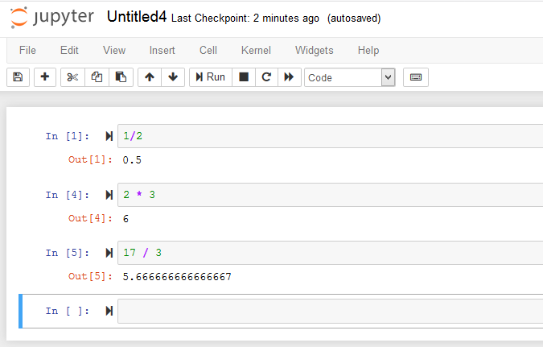

Python
Also an interpreted language.
Besides data analytics, it is a train for all tracks; it is used in almost everything: Webpages, multimedia, databases, networking, automation, image processing.

Slide 39
Pros and cons of Python
Advantage:
  Free
  Easy to learn
Disadvantages
  Its simplicity encourages users to cut corners. For example, in Python you can simply define a variable by writing x = “Hello”, without specifying the data type.
  excessive memory consumption
  tedious to type, not as fast as drag and drag
  Not good at dynamic data visualization

Slide 40
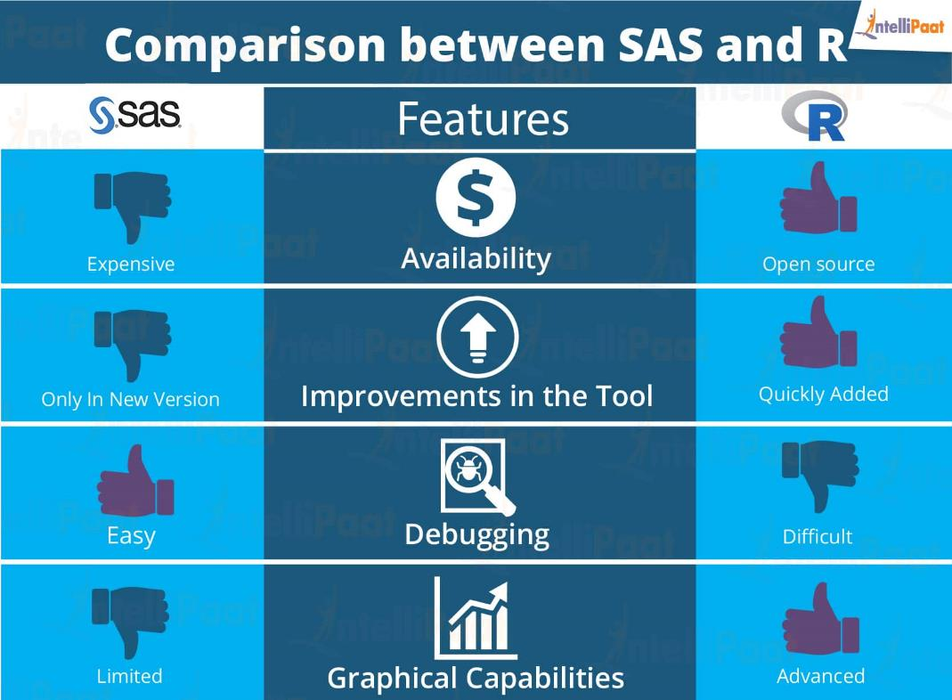
Be careful of some information from the Internet
When you compare between tools, don’t assume that everything on the Web is accurate.
According to IntlliPaat, “SAS is not great at graphical capabilities. Though Base SAS has some graphical capabilities improvisation, these capabilities are not widely known, and so R gets a clear lead in this aspect.”
Source: https://intellipaat.com/blog/sas-versus-r/

Slide 41
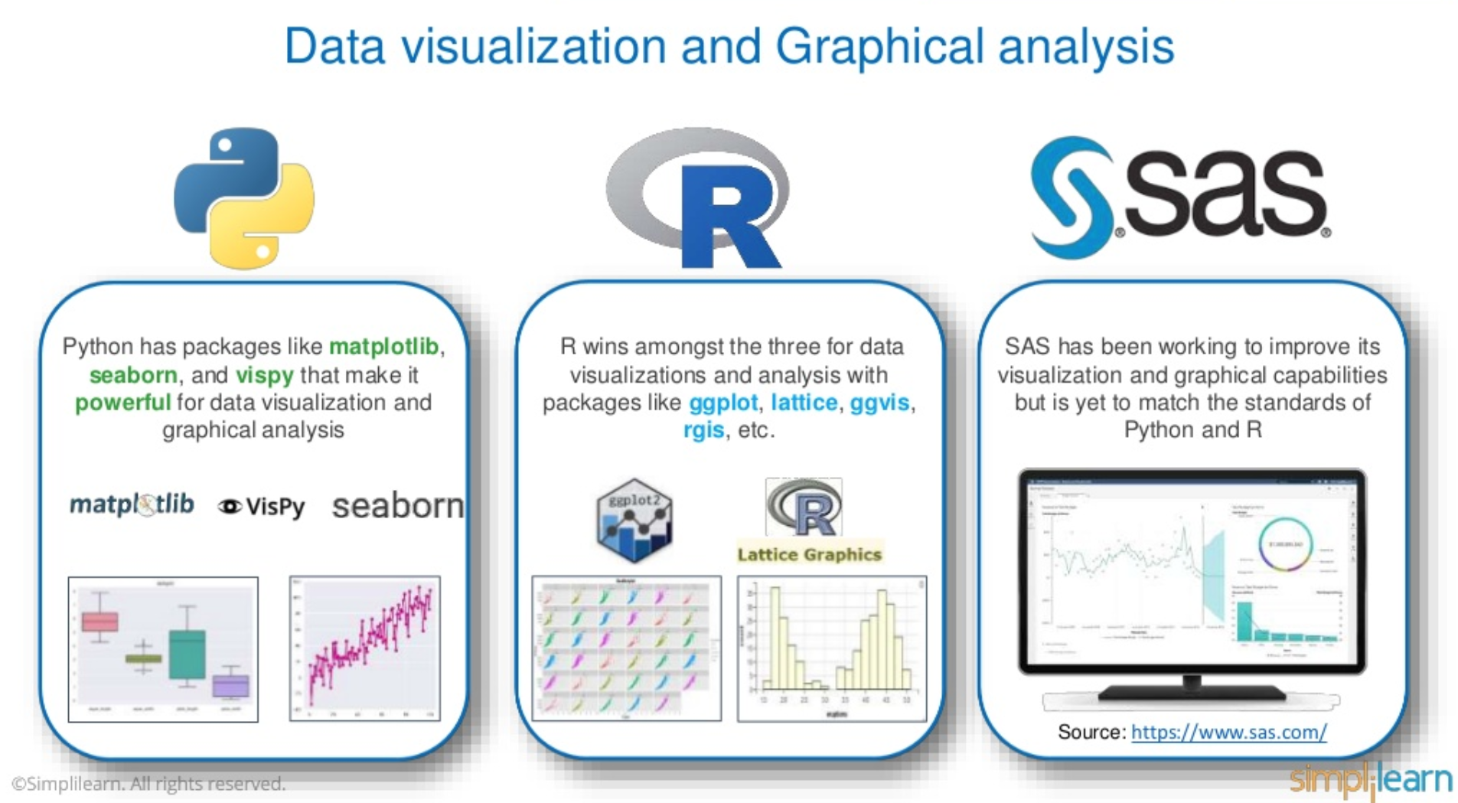
Be careful of information from the Internet

Slide 42
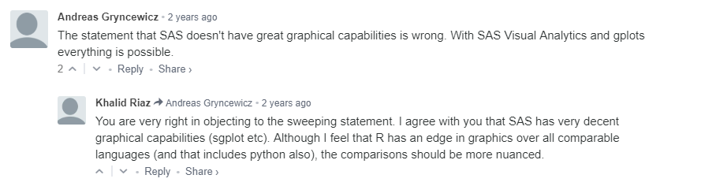
Be careful of information from the Internet
And JMP and SAS Visual Analytics are very advanced in data visualization!

Slide 43
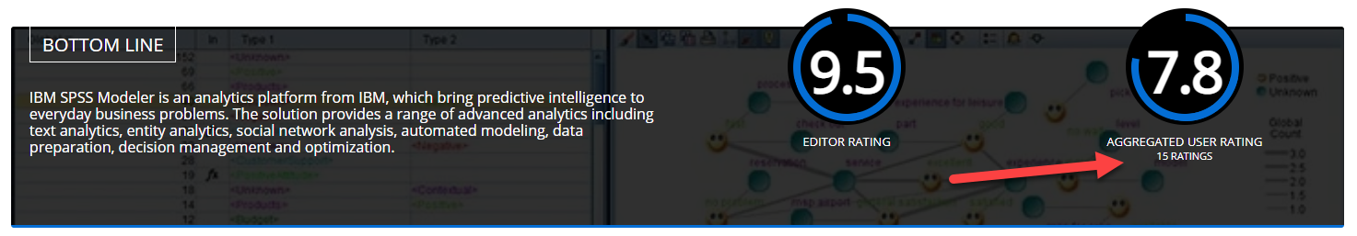
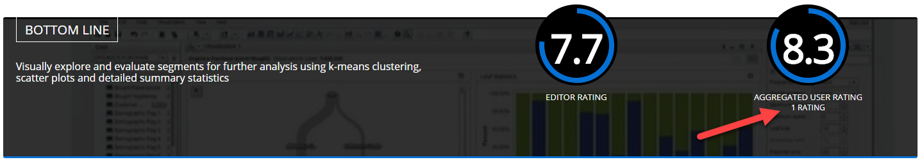
Be careful of information from the Internet
Rating by a sample size of 1-15
Notes:
https://www.predictiveanalyticstoday.com/top-statistical-software/

Slide 44
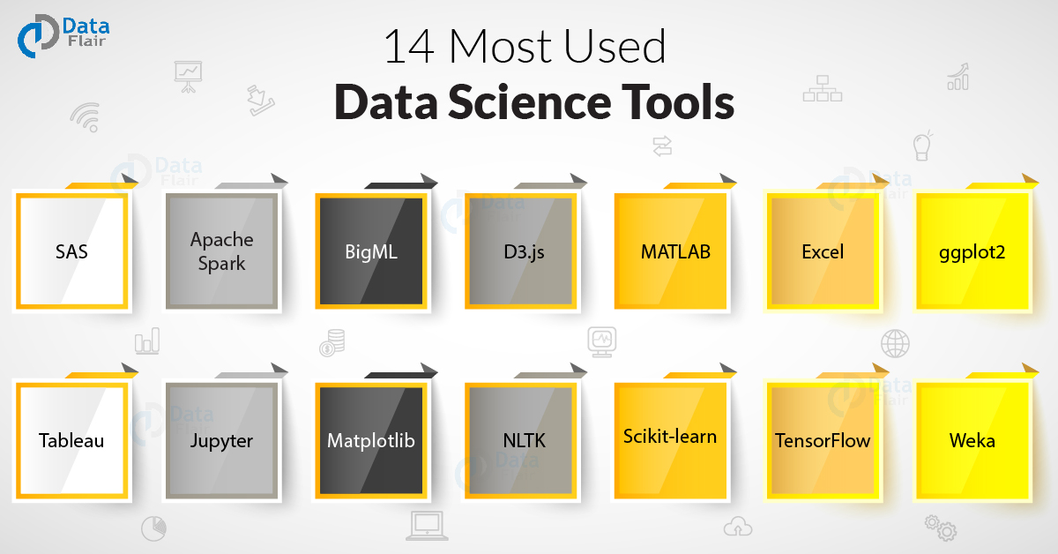
Most used data science tools for 2022
Source: https://data-flair.training/blogs/data-science-tools/

Slide 45
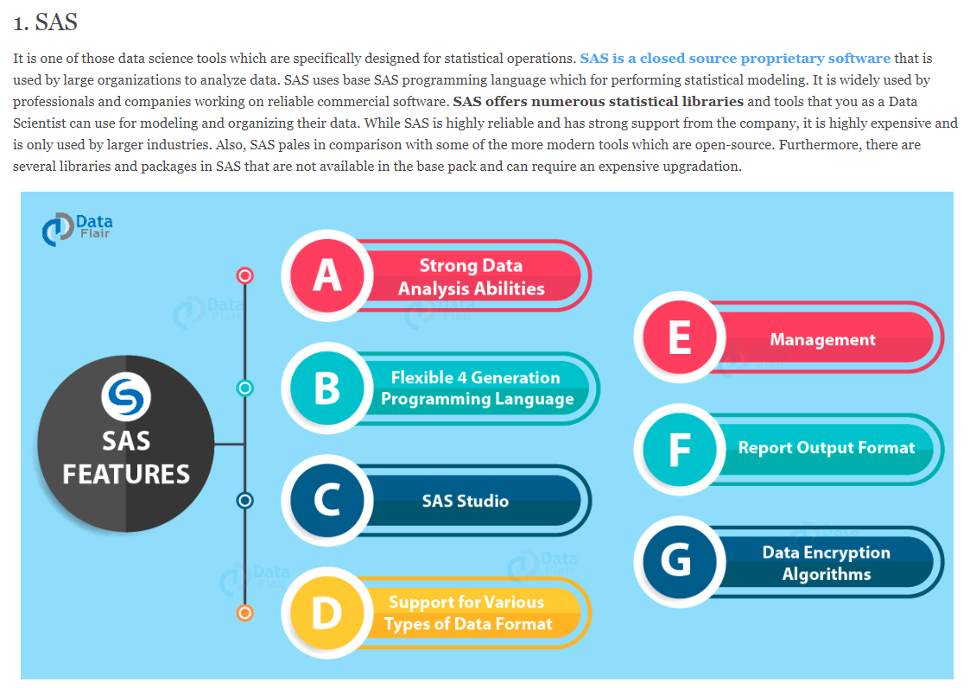
Most used data science tools for 2022
Source: https://data-flair.training/blogs/data-science-tools/

Slide 46
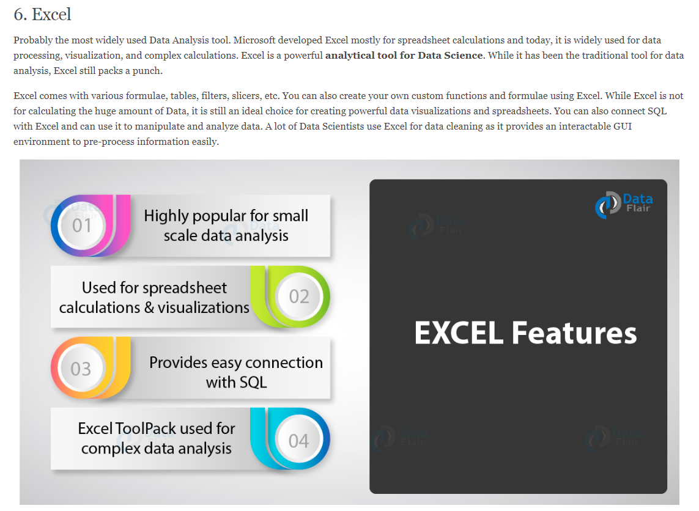
Most used data science tools for 2022
Source: https://data-flair.training/blogs/data-science-tools/

Slide 47
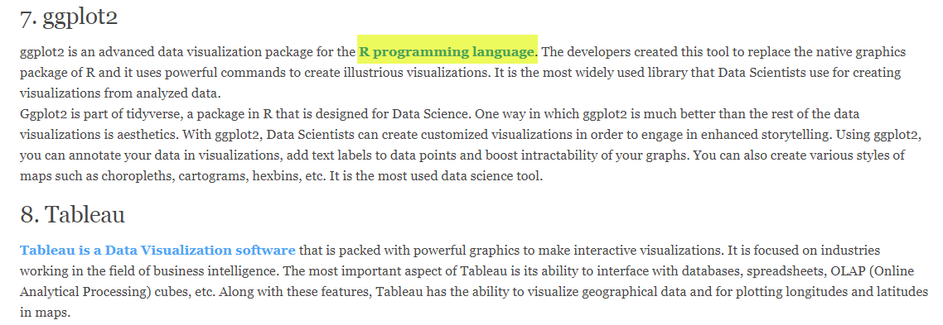
Most used data science tools for 2022
Source: https://data-flair.training/blogs/data-science-tools/

Slide 48
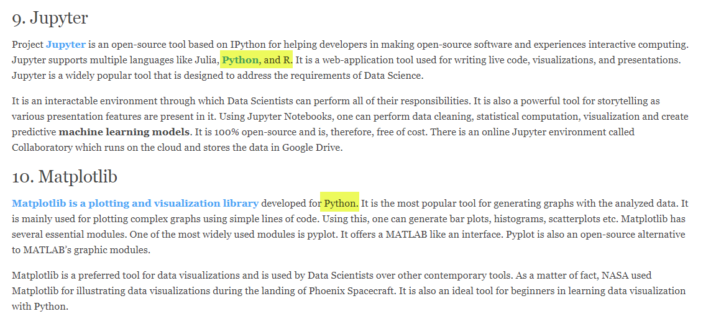
Most used data science tools for 2022
Source: https://data-flair.training/blogs/data-science-tools/

Slide 49
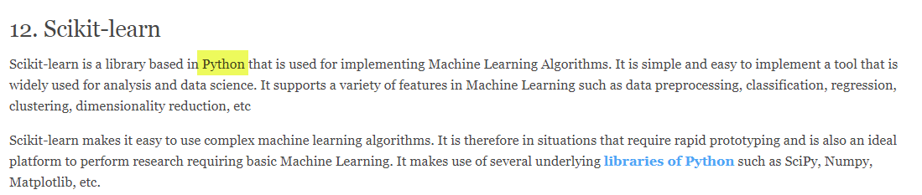
Most used data science tools for 2022
Source: https://data-flair.training/blogs/data-science-tools/

Slide 50
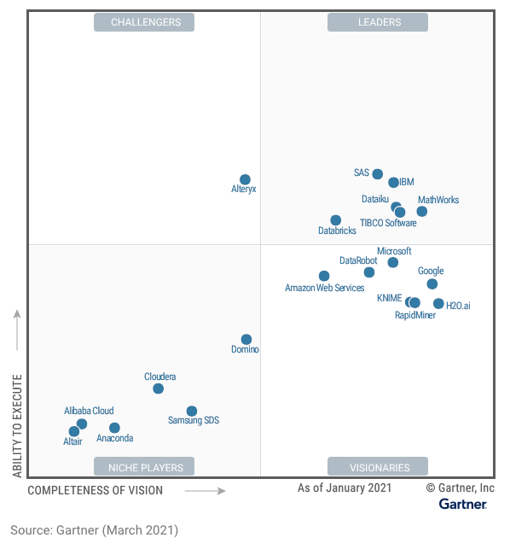
2021 Gartner Report
Gartner is a leader in corporate consulting.
“SAS is the longest-standing Leader in this Magic Quadrant. It maintains a strong and adaptive position, given its keen understanding of the market and its thought leadership in key areas such as composite AI, MLOps and decision intelligence.”

Slide 51
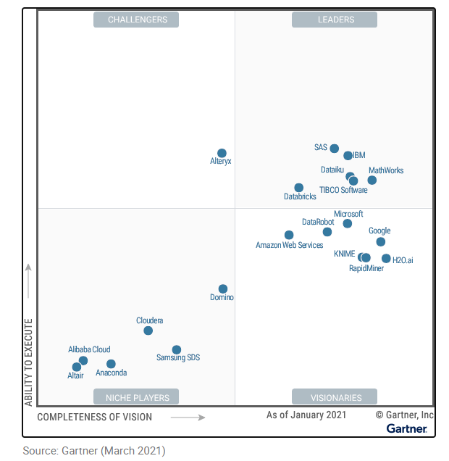
2021 Gartner Report
SAS is the only vendor named a leader in the Magic Quadrant for Data Science and Machine Learning Platforms for all eight years of its existence.
Notes:
https://www.gartner.com/doc/reprints?id=1-25D1UHYX&ct=210302&st=sb

Slide 52
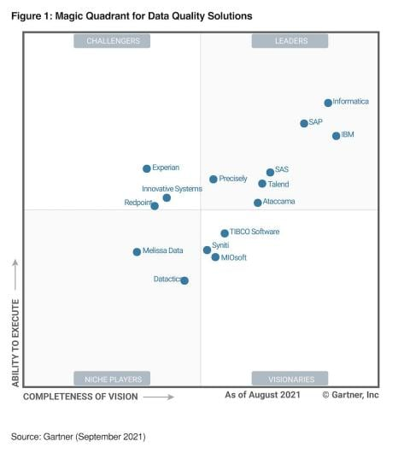
2022 Garter report
In terms of data quality solutions, the leaders are Informatics, SAP, IBM, and SAS.
Notes:
https://www.sas.com/en_us/news/analyst-viewpoints/gartner-magic-quadrant-data-quality-solutions.html?utm_source=google&utm_medium=cpc&utm_campaign=sasviya-us&utm_content=GMS-193141-sas-eya-us&dclid=&gclid=Cj0KCQjw9ZGYBhCEARIsAEUXITUC-8WQ93sZYy7IpgWodtrKmD33uMIVmB-00iZPSyH1AYL225DhjbMaAg70EALw_wcB

Slide 53
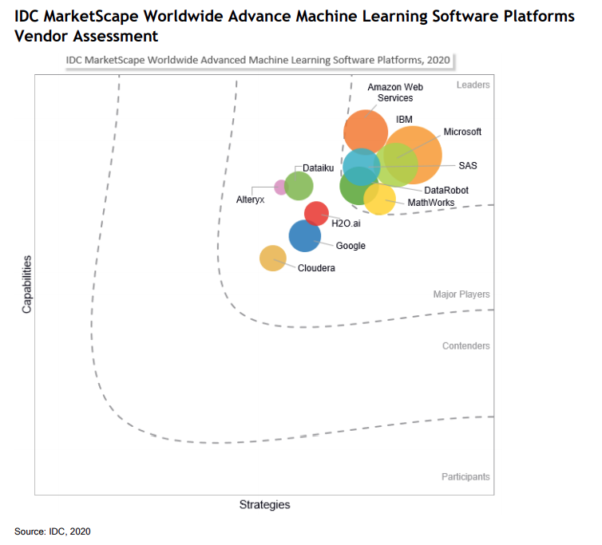
2020 IDC Report
Google is behind Microsoft, IBM, SAS, and Amazon.
Notes:
https://infotech.report/featured-news/sas-a-leader-in-idc-marketscape-for-advanced-machine-learning-software-platforms
https://www.datarobot.com/blog/datarobot-a-leader-in-worldwide-advanced-machine-learning-software-platforms/

Slide 54
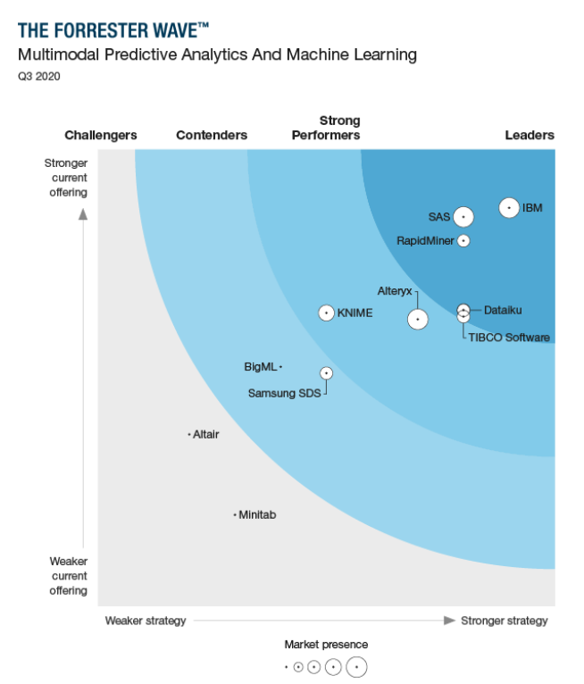
2020 Forrester Wave Report
IBM
SAS
RapidMiner
Dataiku
TIBCO
Notes:
https://reprints2.forrester.com/#/assets/2/202/RES157465/report

Slide 55
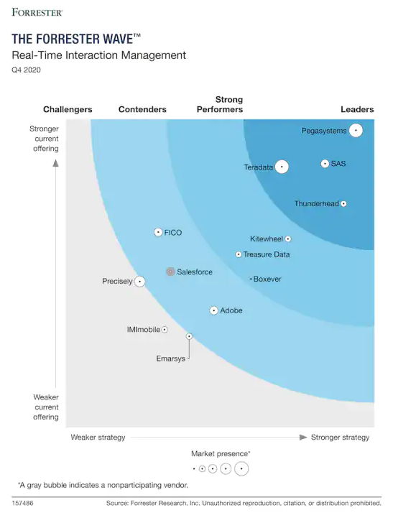
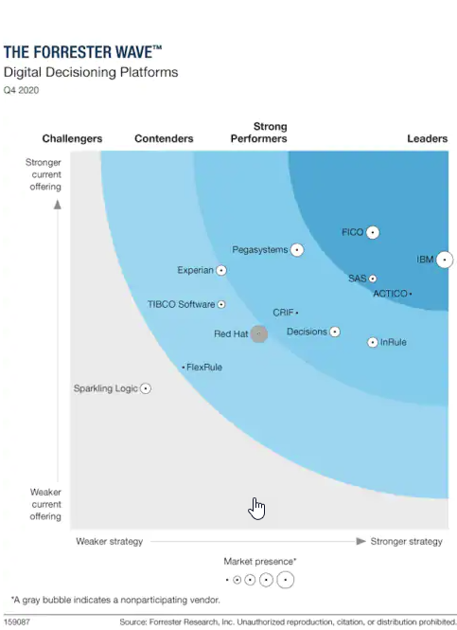
Other Forrester Wave reports
Notes:
https://www.sas.com/en_us/news/analyst-viewpoints/forrester-names-sas-leader-in-cross-channel-campaign-mgmt-emss-modules.html
https://www.sas.com/en_us/news/analyst-viewpoints/forrester-names-sas-leader-in-digital-decisioning-platforms.html
https://www.sas.com/en_us/news/analyst-viewpoints/forrester-names-sas-leader-in-real-time-interaction-management.html

Slide 56
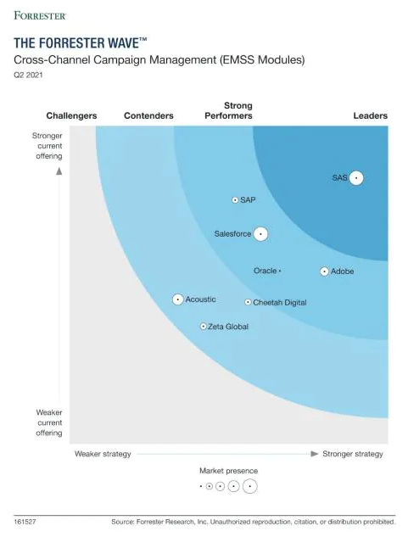
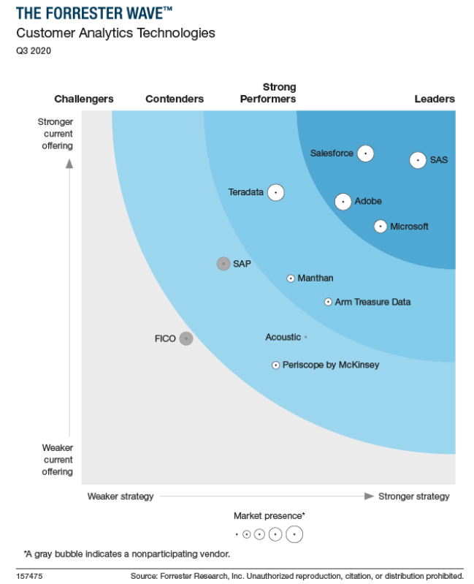
Other Forrester Wave reports
Notes:
https://www.sas.com/en_us/news/analyst-viewpoints/forrester-names-sas-leader-in-cross-channel-campaign-mgmt-emss-modules.html
https://www.sas.com/en_us/news/analyst-viewpoints/forrester-names-sas-leader-in-digital-decisioning-platforms.html
https://www.sas.com/en_us/news/analyst-viewpoints/forrester-names-sas-leader-in-real-time-interaction-management.html
https://reprints2.forrester.com/#/assets/2/202/RES157475/report

Slide 57
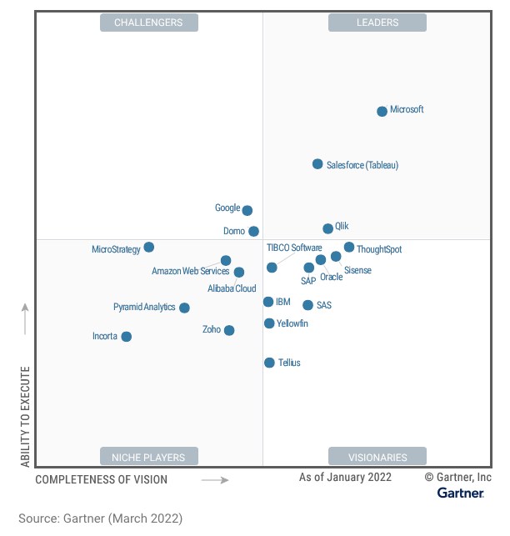
2002 Gartner report for Analytics and Business Intelligence
“Salesforce (Tableau) is a Leader in this Magic Quadrant. It offers a visual-based exploration that enables business users to access, prepare, analyze and present findings in their data. Tableau CRM, formerly Einstein Analytics, provides augmented analytics capabilities for analysts and citizen data scientists.”

Slide 58

2022 IDC MarketScape US Intelligence and Analytics
The leaders are Microsoft, Tableau, and Oracle.
SAS, IBM, Amazon, and Google are in the second-tier.

Slide 59

TIOBE Index
Notes:
https://www.tiobe.com/tiobe-index/

Slide 60

Stack
Overflow
Notes:
https://survey.stackoverflow.co/2022/#section-most-loved-dreaded-and-wanted-programming-scripting-and-markup-languages

Slide 61

PYPL
PopularitY of Programming Language
Notes:
https://pypl.github.io/PYPL.html

Slide 62

RedMonk
Notes:
https://redmonk.com/sogrady/2022/03/28/language-rankings-1-22/

Slide 63

2021 Burtch Works survey
Notes:
https://www.burtchworks.com/2021/08/03/2021-survey-python-the-tool-of-choice-for-data-scientists-analytics-pros/

Slide 64
Burtch Works’ recommendation
“The best thing you can do is to take a look at the job descriptions for the industries or companies where you think you might want to work and see what they’re looking for. Regardless of which tool you learn, if you only know one tool your options may be limited.”

Slide 65
Return on Investment: Coursea
 | Start a new career after completing the training program | Got a pay increase or promotion
SAS | 21% | 50%
Microsoft Azure | 17% | 50%
Python | 34% | 23%
Google | 41% | 20%
IBM DS Professional | 39% | 19%
R language | 38% | 15%
Tensor Flow | 40% | 12%
Tableau | 34% | 12%

Slide 66

EMSI labor market data
https://economicmodeling.com/job-posting-dashboard/
Notes:
https://economicmodeling.com/job-posting-dashboard/

Slide 67

EMSI labor market data
https://economicmodeling.com/job-posting-dashboard/
Notes:
https://economicmodeling.com/job-posting-dashboard/

Slide 68


Glassdoor in 2021
The pandemic may take a toll on the job market

Slide 69



Python is a general-purposed tool. Without the key word “data science” or “data analytics”, it will return a much larger number.
The letter “R” is too vague. You need to use “R language” or “R data science,” otherwise the website would return many jobs irrelevant to R programming

Slide 70

Indeed.com in 2022

Slide 71

Indeed.com in 2022

Slide 72

Indeed.com in 2022
The letter “R” is too generic.
It is better to include the word “language” while searching.

Slide 73

Indeed.com in 2021
Python is a general-purposed language.
It is better to include the term “data science” while searching.

Slide 74

Indeed.com in 2022

Slide 75

Indeed.com in 2022

Slide 76

Job announcements
A senior position is well-paid, of course.
But even a junior position is very well-compensated.

Slide 77

Pay Scale in 2022
SPSS: $61K
Tableau Software: $77K
SAS: $79K
R: $81K
Python: $94K
AWS: $110K

Slide 78

Pay scale by certification in 2022
CIO
Data Resident
Hackr
Recruiting Blogs
Datamation
Forbes
IBM Data Science Professional Certificate Program does not use SPSS.
Notes:
https://www.cio.com/article/230640/15-data-science-certifications-that-will-pay-off.html
https://dataresident.com/best-data-science-certifications/
https://hackr.io/blog/data-science-certification
https://recruitingblogs.com/profiles/blogs/top-7-data-science-certifications-to-elevate-your-career-in-2022
https://www.datamation.com/careers/data-science-certifications/
https://www.forbes.com/advisor/business/best-data-analytics-certifications/

Slide 79

IBM Data Science Professional Cert.
The IBM Data Science Professional Certificate Program covers Python and open source, not SPSS Modeler or IBM Watson.
  What is data science?
  Tools for data science: Jupyter Notebooks, RStudio IDE, Apache Zeppelin
  Data Science Methodology
  Python for Data Science, AI & Development
  Python Project for Data Science
  Databases and SQL for Data Science with Python
  Data Analysis with Python: Pandas, Numpy and Scipy
  Data Visualization with Python
  Machine Learning with Python: Sci-kit learn and SciPy
  Applied Data Science Capstone

Slide 80

Shortage of talents
1 out of 3 data scientists working in the US were foreign-born.
Why are these jobs so well-paid yet there is a shortage of skilled workers?
Notes:
https://www.analyticsinsight.net/4-major-reasons-for-lesser-demand-of-data-scientists-in-the-industry/#:~:text=Shortage%20of%20Data%20Scientist%20Demand&text=Indeed%2C%20the%20survey%20predicts%20a,not%20meet%20the%20industry's%20needs.

Slide 81
Advantage?
In terms of predictive accuracy and other model benchmarks, neither proprietary programs (e.g. SAS) nor open source codes (e.g. Python) had significant advantages over the other.
In a benchmarking study comparing between high performance partition trees and partition trees utilizing sklearn in Python (2021), their outcomes measured by the true positive rate are virtually identical.
Similar results are found in comparing random forest in SAS and Python.

Slide 82

Advantage?

Slide 83

Partition tree and random forest will be covered in 553.

Slide 84


Conclusion
You don’t have to choose either this or that. To obtain a skill set to meet what the job market needs, it is better to learn all of them.
Commercial software packages (e.g. SAS and SPSS) can work with open source (e.g. Python and R) side by side e.g.
You can run a SAS program inside the Python environment.
You can also run a Python program inside IBM SPSS modeler.

