Slide 1

Unit 2: Exploratory data analysis
Detective Chong Ho (Alex) Yu

Slide 2
Questions
Why do we need statistical graphs? Why don’t we report the numbers only (e.g. p value)?
Why do we need to explore the data? Why don’t we start a project with a hypothesis and then confirm/disconfirm hypothesis (confirmatory data analysis?
What is the relationship between exploratory data analysis (EDA) and data mining (DM)?
What is the relationship between DM and data visualization (DV)?

Slide 3
What isn't EDA
EDA does not mean lack of planning or messy planning.
  “I don't know what I am doing; just ask as many questions as possible in the survey; I don't need a well-conceptualized research question or a well-planned research design. Just explore.”
EDA is not fishing or p-hacking
EDA is not opposed to confirmatory data factor (CDA) e.g. check assumptions, residual analysis, model diagnosis.

Slide 4
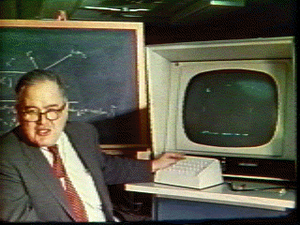
What is EDA?
A philosophy about how data analysis should be carried out, rather than being a fixed set of techniques.
Pattern-seeking
Skepticism (detective spirit)
Abductive reasoning
John Tukey (not Turkey): Explore the data in as many ways as possible until a plausible story of the data emerges (Like a detective).
The precursor of data mining

Slide 5
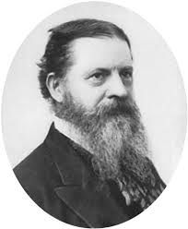
Abduction
Introduced by Charles Sanders Pierce.
  The surprising phenomenon, X, is observed.
  Among hypotheses A, B, and C, A is capable of explaining X.
  Hence, there is a reason to pursue A

Slide 6
Abduction
At most, abduction could provide a conjecture or a potential hypothesis A to pursue, but it would not confirm or disconfirm A
Inference to the best explanation (IBE): similar to abduction, modified by Harmon. But it is not the same.
After inquiry, we found multiple competing theories that can explain the phenomenon. Pick the best one!
Criterion: most explanatory power

Slide 7

IBE: Pick the best!
When you shop, you explore different options an then pick the best.

Slide 8
Elements of EDA: 4Rs
Velleman & Hoaglin (1981):
  Residual analysis
  Re-expression (data transformation)
  Resistant
  Display (revelation, data visualization)

Slide 9
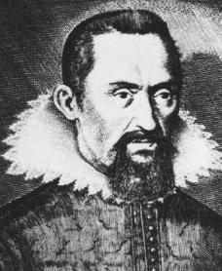
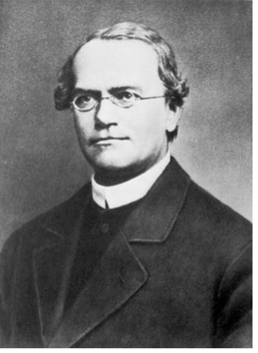
Residual
Data = fit + residual
Data = model + error
Data = signal + noise
Residual is a modern concept.
In the past many scientists ignored it. They reported the “fit” only
  Johannes Kepler
  Gregor Mendel
  Arthur Eddington

Slide 10
Johannes Kepler (1571-1630)
Proposed that the earth and other planets orbit around the sun in an elliptical fashion.
Kepler worked under another well-known astronomer, Brahe, who collected a huge database of planetary orbits. Using Tycho Brahe's data, Kepler found data to fit into the elliptical hypothesis.
Almost 400 years later when William Donahue redid Kepler's calculation and found that the orbit data and the elliptical model do not fit each other as claimed.

Slide 11
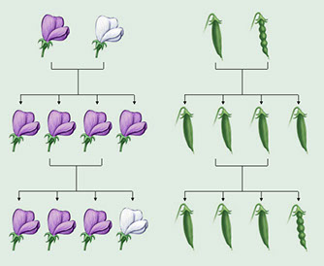
Gregor Mendel (1824-1884)
The founder of modern genetics
Physical properties of species are subject to heredity.
Mendel conducted a fertilization experiment to confirm his belief.
R. A. Fisher (1936) questioned the validity of Mendel's study. Fisher pointed out that Mendel's data seemed "too good to be true."
Using Chi-square tests, Fisher found that Mendel's results were so close to what would be expected that such agreement could happen by chance less than once in 10,000 times.

Slide 12
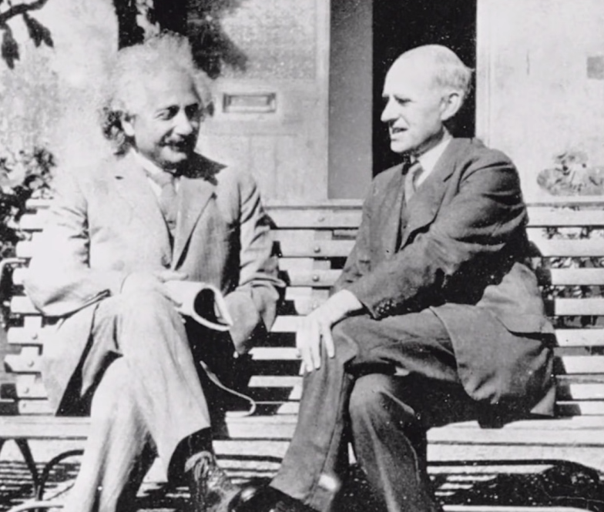
Arthur Eddington (1882-1944)
Substantiated Einstein’s theory of general relativity by observing the positions of stars during the 1919 solar eclipse (remote light will blend in the presence of gravity)

Slide 13
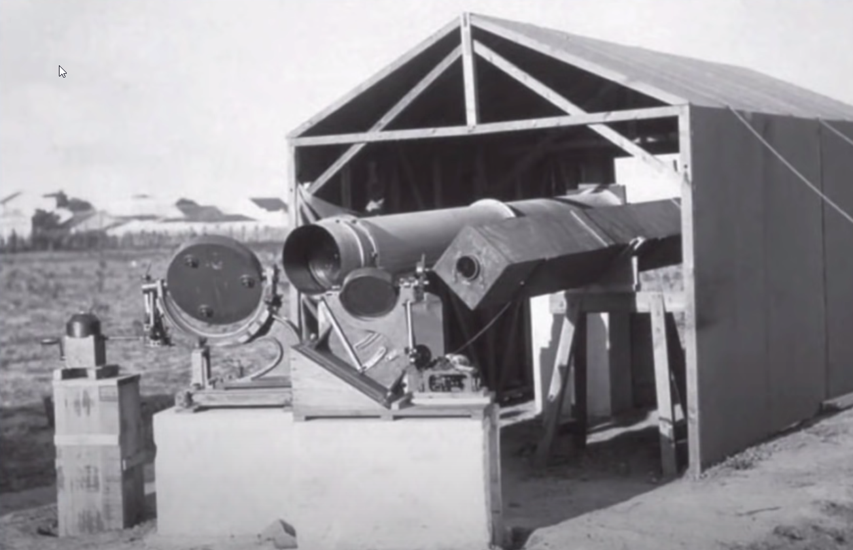
Rudimentary equipment

Slide 14
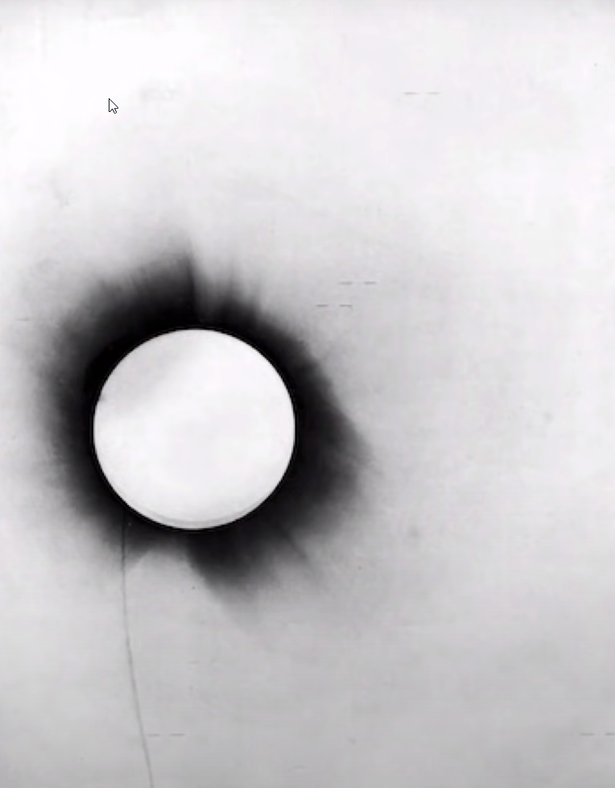
The line indicates the exact positions of the stars.

Slide 15
All or none?
In the 1980s scholars found that Eddington did not collect sufficient data to reach a conclusion. Rather, he distorted the result to make it fit the theory.
Did they falsify data? Not necessary. They might not understand every model could have residuals.

Slide 16
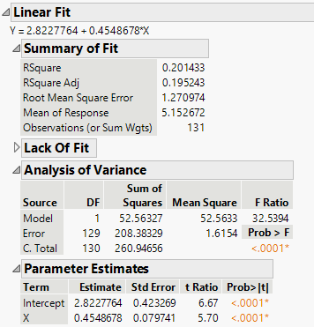
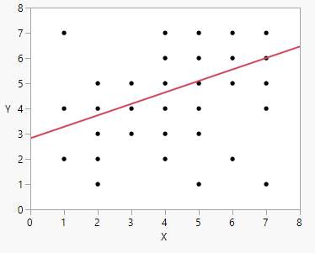
Is it a good or useful regression?

Slide 17
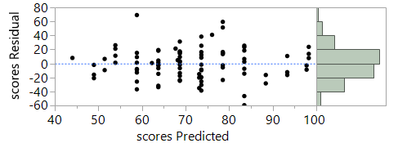
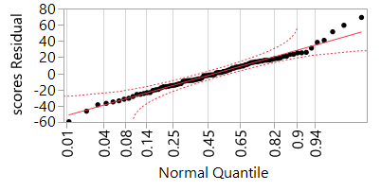
Random residual plot
Ideally speaking, no systematic pattern
Normal distribution
The mean of residuals is close to zero.

Slide 18
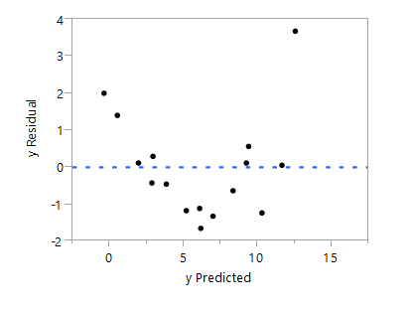
Strange residual patterns
Non-random, systematic
Check the data!

Slide 19
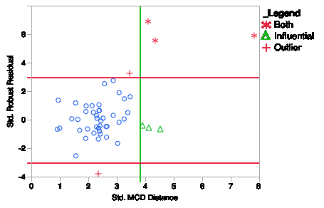
Robust residual
Robust regression in SAS
The residual plot tags the influential points (less severe) and outliers (more severe).

Slide 20
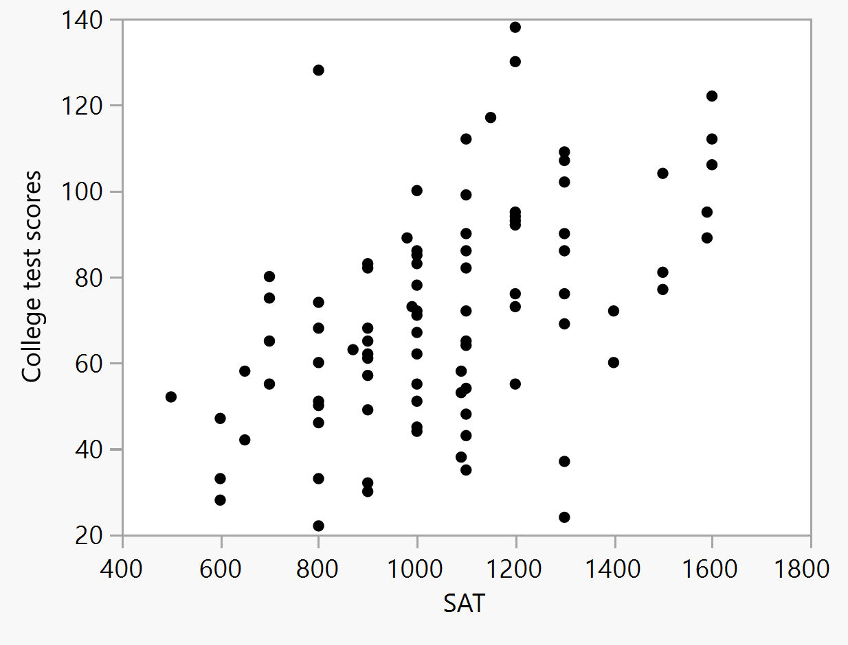
Example
Download and open “visualization_data.jmp”
Can SAT predict college academic performance?
Open Analyze from the pull down menu
Put SAT into X and college test scores into Y, Press OK
Unlike SPSS, SAS/JMP shows the scatterplot: It forces you to check the data pattern.
Contextual menu: What will be done next depends on the current context (What is observed now).

Slide 21
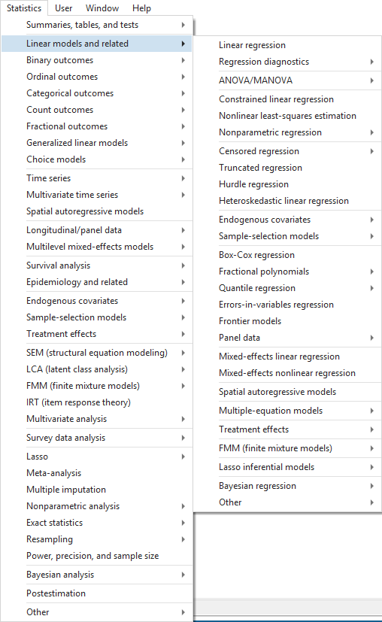
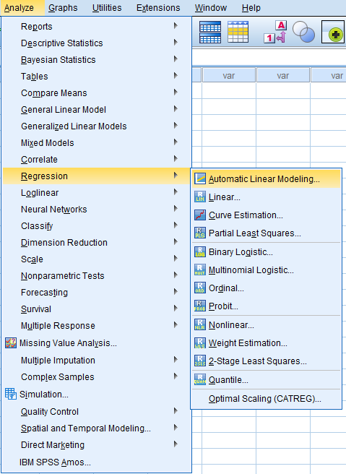
Examples of non-contextual menu

Slide 22
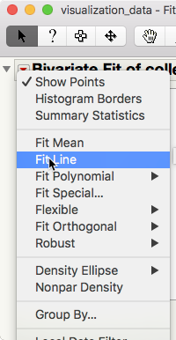
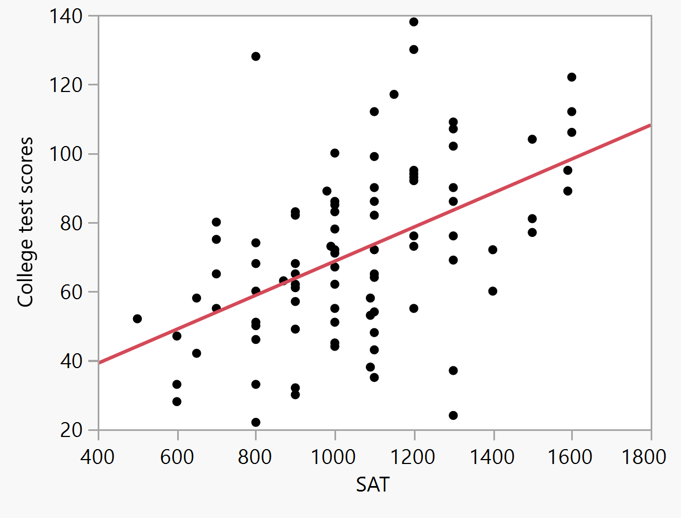
Contextual menu

Slide 23
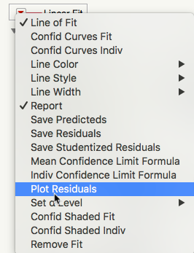
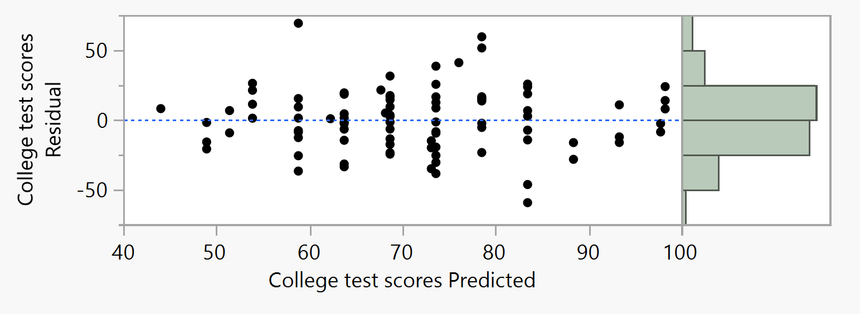
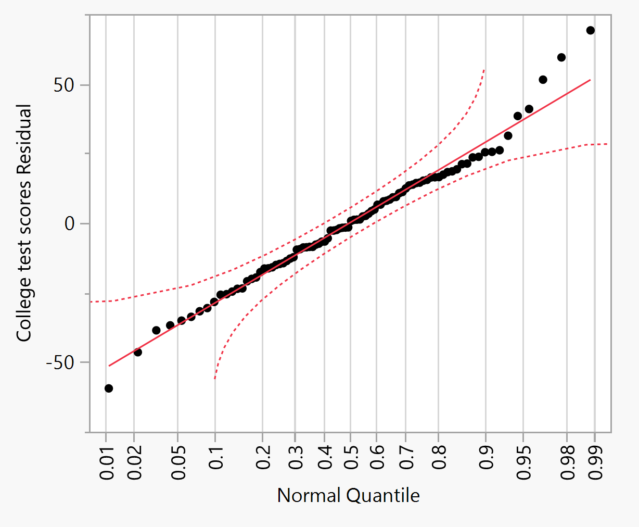

Slide 24
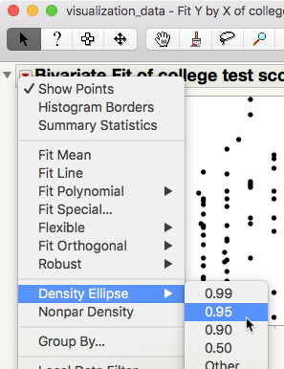
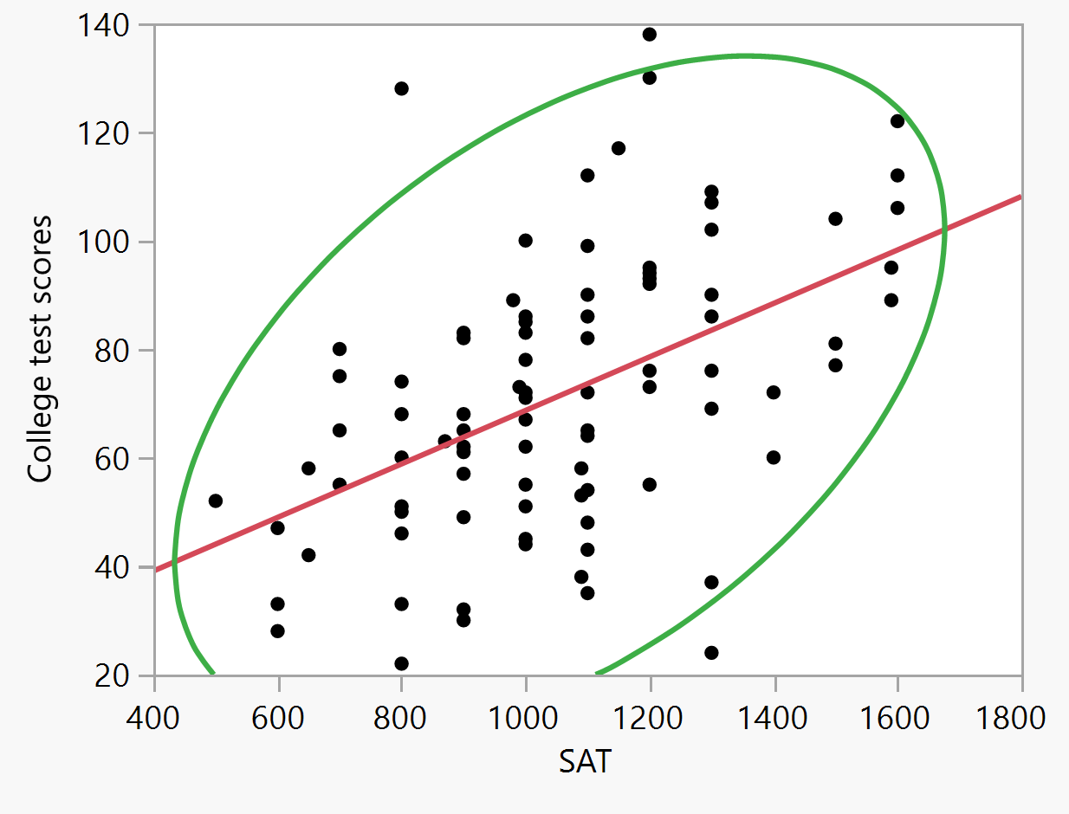
95% density ellipse: Assume bivariate normality, stretching from the centroid the ellipse covers 95% of the data. The data points outside the coverage are considered outliers.

Slide 25
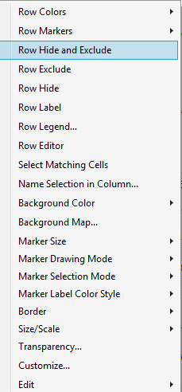
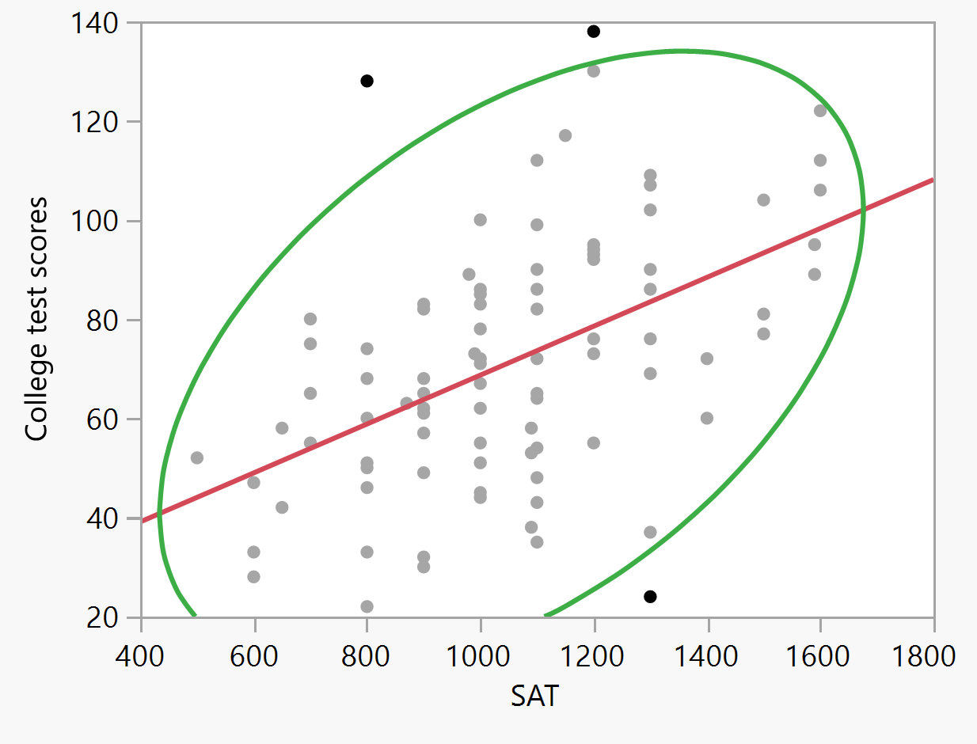
Click on any extreme case.
Hold down the control key or the shift key and select all three one by one.
Right-click on the extreme cases, select Row Hide and Exclude.

Slide 26
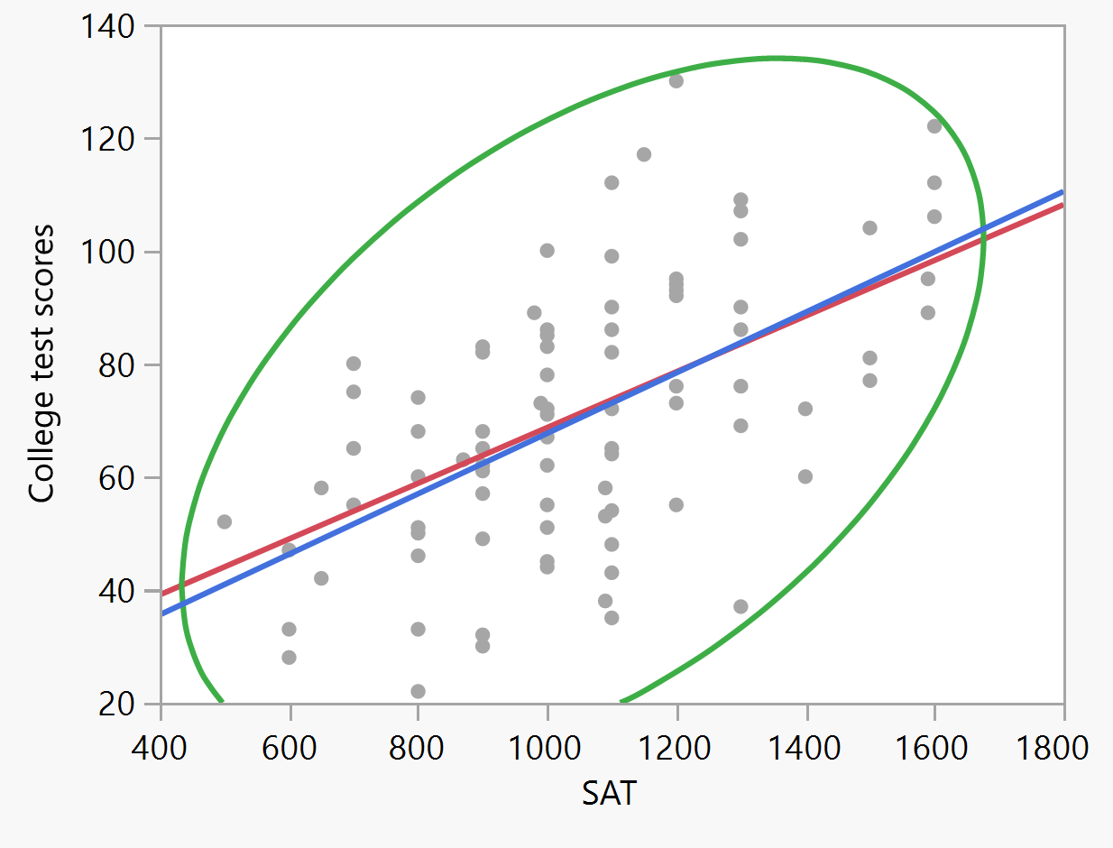
Example
Choose Fit Line again from the reversed red triangle.
There will be another regression line generated with the data without outliers.
Caution: Do it once only. If you keep repeating this, you may always find some outliers because every time the center of the data is reset.

Slide 27
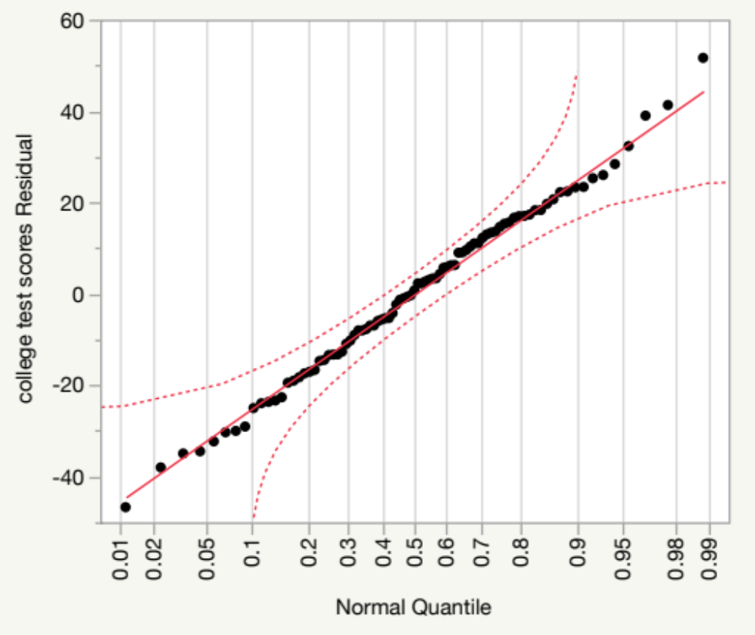
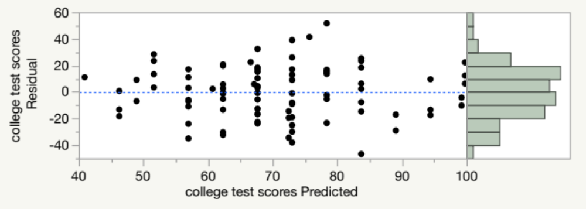
Example
Choose Plot Residuals from the Second Linear Fit.
Now are the residuals better?

Slide 28
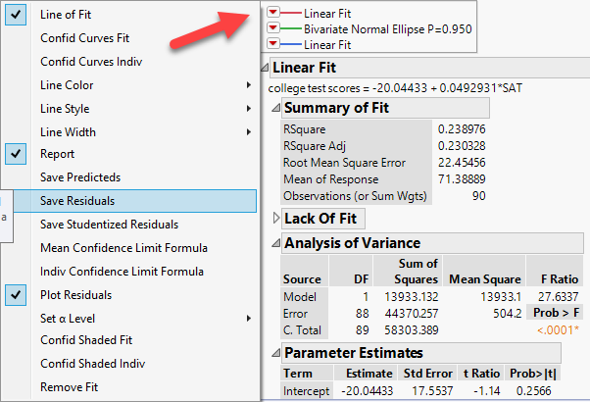
Example
The normal quantile plot should be sufficient. But if you are a perfectionist, you can output the residuals from the two linear fits into data columns.
From Linear fit choose Save residuals.

Slide 29
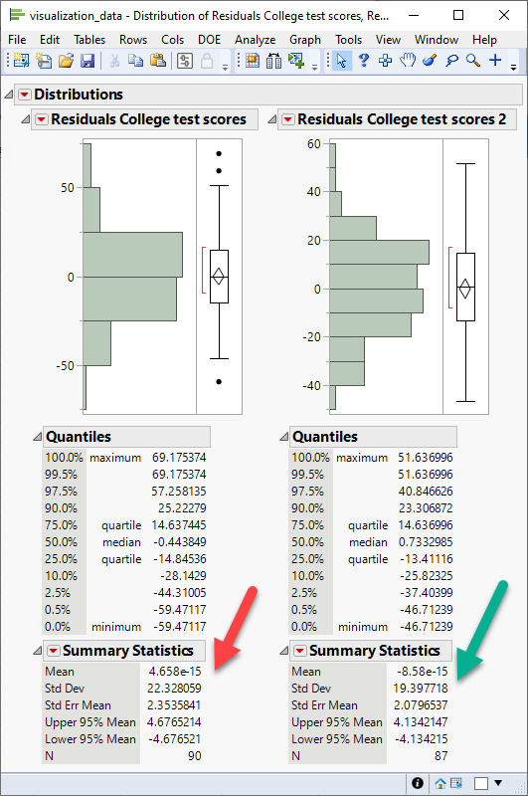
Example
The residuals are output to the data table.
Clear row state.
Select both residuals, choose Distribution from Analyze, and press OK.
SAS/JMP use the e-notation. The mean of the second residuals is closer to zero.

Slide 30
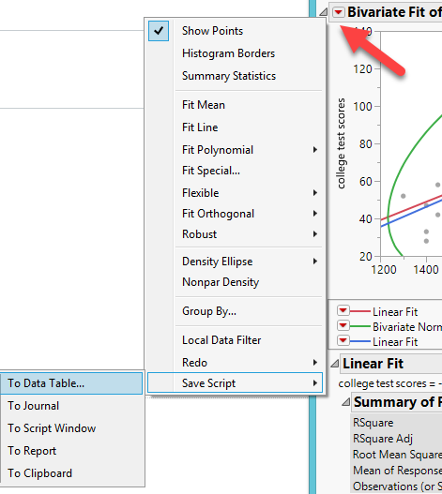
Save the script
If you don’t want to re-run everything the next time, you can save the script.

Slide 31
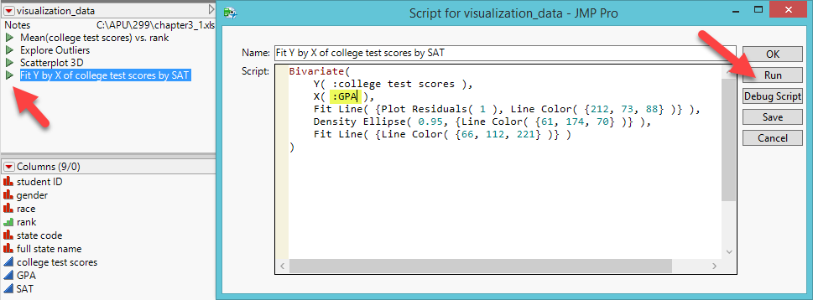
Run the script
Next time you can click on the green arrow at the upper left to run the script.
You can also open and edit the script if you need to change your analysis (e.g. change the independent variable from SAT to GPA).

Slide 32
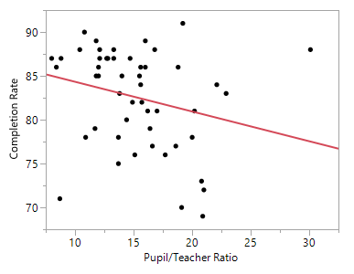
A more complicated example: Exploration and comparison
Some people assert that class size has nothing to do with education outcome. Is it true?
“Factors affecting HS completion rate”
Choose Fit Y from X from the pull down menu Analyze
Put Pupil/teacher ratio into X and Completion rate into Y
From the inversed red triangle choose Fit line
Is the result significant?

Slide 33
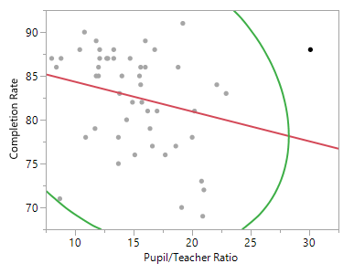
A more complicated example: Exploration and comparison
From the inversed red triangle choose Density Ellipse: .99
Remove the outlier and run a regression model again.

Slide 34
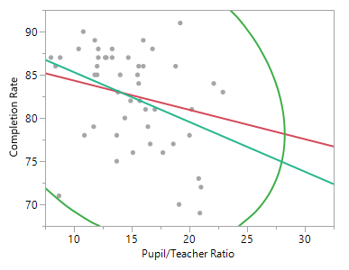
A more complicated example: Exploration and comparison
Now it is significant.
Save residuals.
What would happen if you change Density Ellipse to .95?
You need to put back the outlier and open a new Fit Y by X panel because if you do it on the existing one, the calculation of 95% is based on the data set without the outlier that you have just removed.

Slide 35
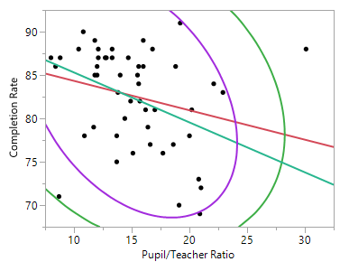
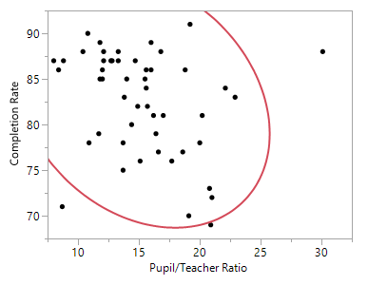
A more complicated example: Exploration and comparison
The left (purple line) is done with the existing graph and the right (red line) is done with all data.
They are similar but the right is more accurate. I will remove one more outlier.

Slide 36
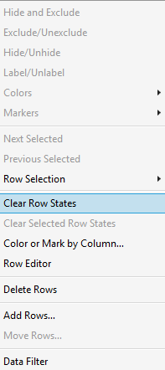
A more complicated example: Exploration and comparison
To put back the outlier and start a new one, in the data table from the reversed red triangle choose Clear row state.
To re-run the analysis, in Fit Y by X choose Recall.

Slide 37
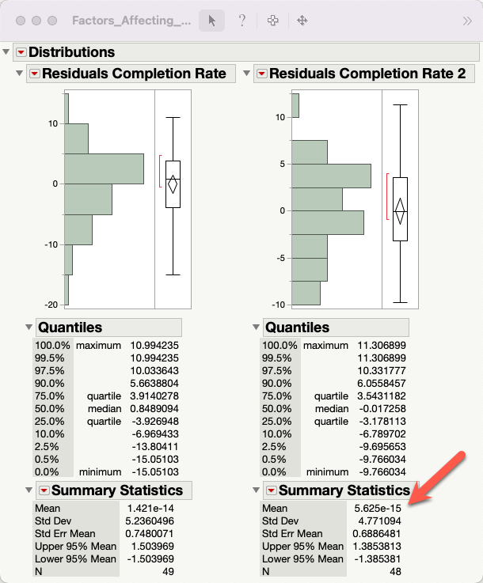
A more complicated example: Exploration and comparison
Clear row states, otherwise some residuals will be excluded.
The model without two outliers have a mean of residual very close to zero.

Slide 38
Exception 1
When you are working with a finite population, the assumption of random, independent, and normally distributed residuals is not required for regression analysis.
For example, in a program evaluation for your university, you want to know whether the program is working fine in your school. You have no intention to generalize the result to an infinite population (e.g. all universities in the past, present, and future).
You need a special SAS procedure called PROC SURVEYREG. The regular regression analysis and residual analysis are not applicable to this situation.

Slide 39
Exception 2
Using residual analysis to remove outliers is appropriate to small samples.
Do not do so for big data. If you have 10,000 or a million observations, and you use density ellipse to identify outliers, you might exclude thousands of observations.
In data science there are other ways, such as downweigh extreme cases.

Slide 40
Assignment 2.1
Download and open “Factors affecting HS completion rate”
Choose Fit Y from X from the pull down menu Analyze
Put Pupil/teacher ratio into X and Completion rate into Y
Press OK
From the inversed red triangle choose Fit line
From the inversed red triangle choose Density Ellipse: .90
Remove the outlier(s) and run a regression model by choosing Fit Line
Save residual.
Is this model better than the one without two outliers in terms of residuals?

Slide 41
Re-expression or transformation
Parametric tests require certain assumptions e.g. normality, homogeneity of variances, linearity...etc.
When your data structure cannot meet the requirements, you need a transformer (ask Autobots, not Deceptions)!

Slide 42
Transformers!
Normalize the distribution: log transformation or inverse probability
Stabilize the variance: square root transformation: y* = sqrt(y)
Linearize the trend = log transformation (but sometime it is better to use nonlinear fit, will be discussed later)

Slide 43
Log transformation
Logarithm is the inverse of exponential (raise power)
10 raises power to 3 is 10³: 10X10X10 = 1,000
The log base can be any integer. It could be log2, log5, log10.
Log2(64) = 6 because 64 = 2⁶ = 2X2X2X2X2X2
Log() is called natural log
Log10 is called common log

Slide 44
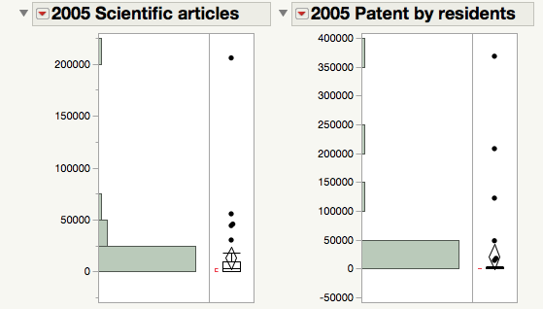
Skewed distribution
Open Worldbank_data.
I want to know whether publication of scientific studies and patents can predict GDP per worker.
The distributions of publication of scientific studies and patents are skewed. A few countries (e.g. US, Japan, Korea) have the most.
But I cannot remove these “outliers” because they are major nations.

Slide 45
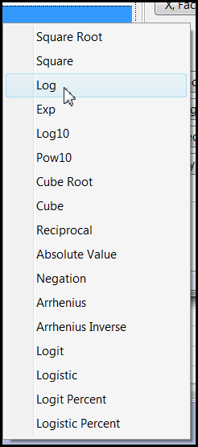
Solution: Data transformation
You can create the transformed variable while doing analysis by right-clicking the original variable.
Faster, but will not store the new variable.
You cannot preview the distribution.

Slide 46
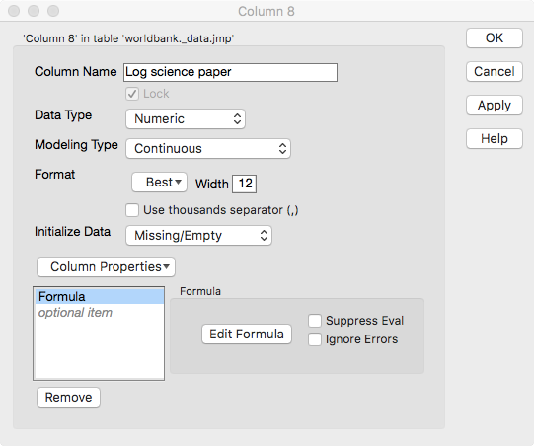
JMP
Create a permanent new variable for re-analysis later.
Double-click on a new column.
Choose Formula in Column properties.
Click Edit formula.

Slide 47
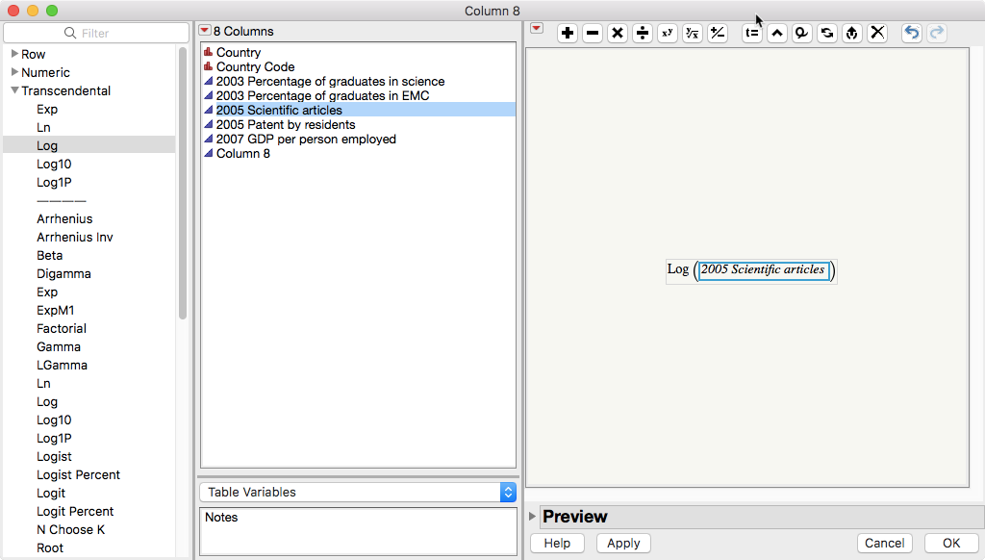

Slide 48
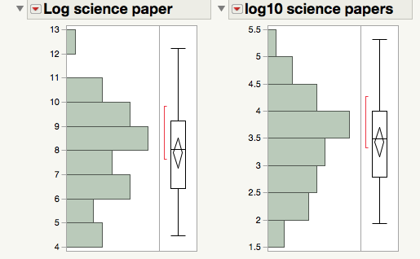
Explore different transformation options
The key of exploratory data analysis is: Explore!
I tried both log and log10 transformation
Log10 is better
If you want to try other log number, put a comma and the number at the end e.g. Log( :”2005 Scientific articles"n, 5 ). Same in Excel.

Slide 49
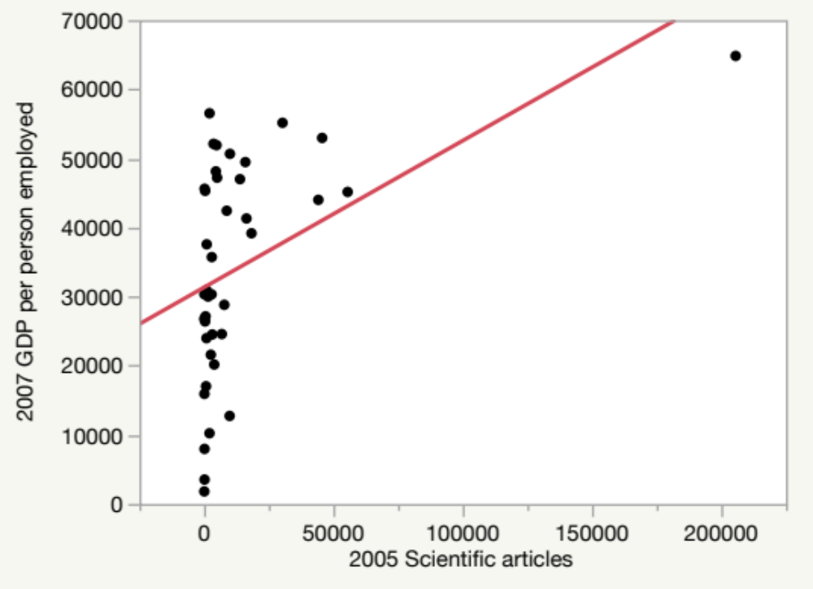
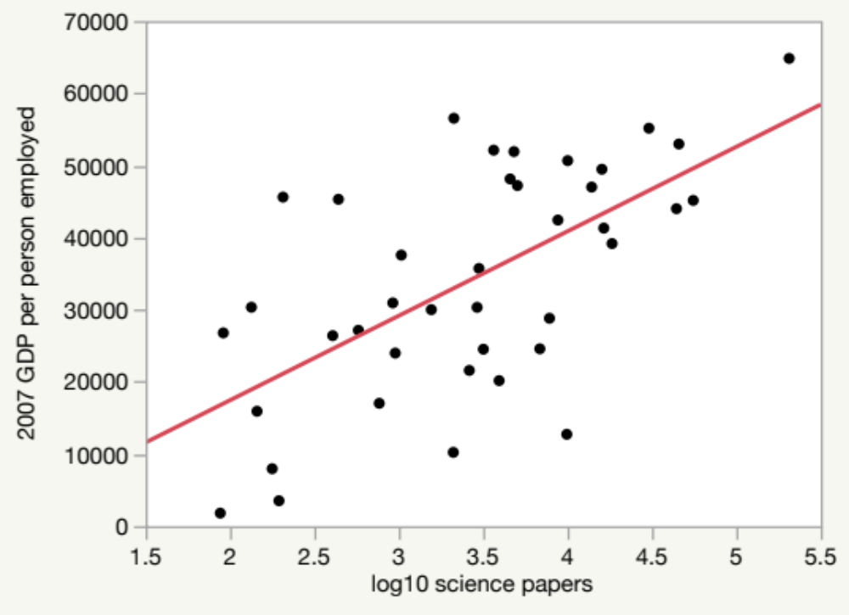
Before and after
Regression with transformed variables makes much more sense!

Slide 50
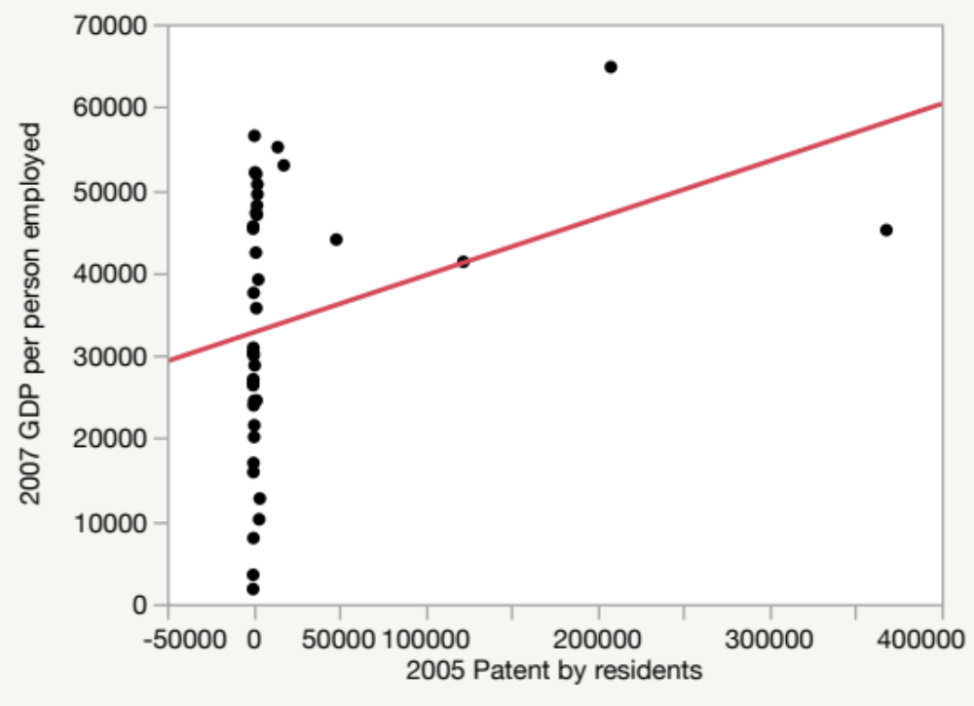
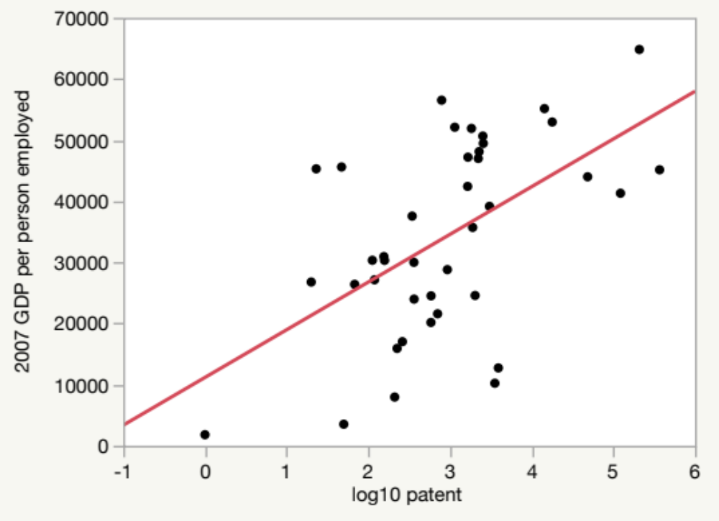
Before and after
Regression with transformed variables makes much more sense!

Slide 51
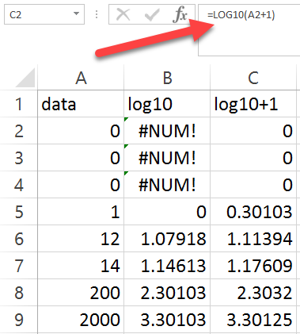
Trick
If there are “0”s in the data, log transformation will not work.
You can remediate it by adding 1 to every observation.

Slide 52
Assignment 2.2
Use the same data set “Worldbank_data.jmp”
Try different transformation options for 2005 patents by residents.
Pick the best transformed variable to predict 2007 GDP per person employed. Log, log10, or something else?
Which one is the best? Or are they the same?

Slide 53
Transforming the data vs. transforming the function.
What if the data are not non-normal after trying different ways of transformation?
You can transform the linear function to non-linear function.
Function: a relation between two data sets.

Slide 54


A simple and easy example
Question: Is household income a good predictor of test performance? Can money buy a better grade?
“OECD Better Life Index 2016”
OECD: Organization for Economic and Cooperation Development
PISA: Program for International Student Assessment

Slide 55

A simple and easy example
Choose Fit Y by X
Y: Average PISA score
X: Household net adjusted disposable income
Can we fit a linear regression model?

Slide 56

A simple and easy example
By visualizing (viewing) the data, we can tell that there is one “turn” in the curve (going up and then down).

Slide 57

A simple and easy example
Bingo! By transforming the linear regression function to a nonlinear one, every observation is accounted for.
For some countries, more income → better grade
For some, more money → worse
Who are they? Why can’t we simply remove these outliers?

Slide 58

A simple and easy example
In the variable column, right click to label “country.”

Slide 59

A simple and easy example
In the graph select all observations by dragging the cursor.
Right click to select Row Label.

Slide 60

A simple and easy example
The labels are cluttered.
Resize the graph.
In USA and Luxembourg more household income do not necessarily result in better test performance.

Slide 61
A simple and easy example
You can remove these two outliers and fit a linear model.
But USA is a major nation. A model that does not account for USA is incomplete.
This generates a new research question: Why are USA and Luxemburg so special?

Slide 62


Complicated xample from JMP
Sample data set “Corn.jmp” (under Nonlinear modeling)
DV: yield
IV: nitrate

Slide 63

Skewed distributions
Both DV and IV distributions are skewed. What regression result would you expect?

Slide 64

Remove outliers?
Three observations are located outside the boundary of the 99% density ellipse (the majority of the data)
Only one is considered an outlier.

Slide 65
Remove outliers?
Removing the two observations at the lower left will not make things better.
They fall along the nonlinear path.

Slide 66

Transform yield only
Remove the outlier at the far right.
It doesn’t look any better.

Slide 67

Transform nitrate only
The regression model looks linear.
It is acceptable, but the underlying pattern is really nonlinear.

Slide 68

Graph Builder: Interactive nonlinear fit

Slide 69

Linear model is too simplistic and underfit

Slide 70

Overfit and complicated model

Slide 71

Smooth things out: Almost right
Lambda: Smoothing parameter
Not a bad model, but the data points at the lower left are neglected.

Slide 72

Fit polynomial (nonlinear fit)
Quadratic = 2 turns
Cubic = 3 turns
Quartic = 4 turns
Quintic = 5 turns, take the lower left into account, but too complicated (too many turns)

Slide 73

Fit spline
Flexible: Fit Spline
Like Graph Builder, in Fit Spline you can control the curve interactively.
It shows you the R-square (variance explained), too.
It still does not take the lower left data into account.

Slide 74

Kernel Smoother
Local smoother: take localized variations and patterns into account.
Interactive, too
But the line still does not go towards the data points at the lower left.

Slide 75

No data points left behind!

Slide 76

Fit Curve
Specialized modeling: Fit curve
MM has the lowest AICc and it takes the data points at the lower left into account. Should we take it?
MM is a specific model of enzyme kinetics in biochemistry.

Slide 77


Fit nonlinear
Specialized modeling: Nonlinear
Custom-made formula for data transformation.
You need prior research to support it. You cannot makeup a transformation or an equation.

Slide 78


Fit special
Those seemingly complicated transformations are like the following.
You obtain similar results like Fit Nonlinear, but you need to try many different combinations of X and Y transformation. Tedious!

Slide 79

I am the best transformer!

Slide 80

Assignment
Transform yourself into a Pink Volkswagen or a GMC truck.

Slide 81
Caution! Difficult to interpret
Osborne (2002) advises that transformation should be used appropriately;
Many transformations reduce non-­normality by changing the spacing between data points, but this raises issues in data interpretation.
If transformations are done correctly, all data points should remain in the same relative order as prior to the transformation. In this way the interpretation of the scores is not affected.
It might be problematic if the original variables were meant to be interpreted directly, such as annual income and age. After the transformations, the new variables may become significantly more complex to interpret.

Slide 82


Resistance
Resistance is not the same as robustness.
Resistance: Immune to outliers
Robustness: immune to parametric assumption violations
Use median, trimean, winsorized mean, trimmed mean to countermeasure outliers, but it is less important today (will be explained next).

Slide 83
Data visualization: Revelation
Today some people still refuse to use graphing methods. Data visualization is the primary tool of EDA. Without “seeing” the data pattern,...
  how can you know whether the residuals are random or not?
  how can you spot the skewed distribution, nonlinear relationship, and decide whether transformation is needed?
  how can you detect outliers and decide whether you need resistance or robust procedures?
DV will be explained in detail in the next unit.

Slide 84

Data visualization
One of the great inventions of graphical techniques by John Tukey is the boxplot.
  It is resistant against extreme cases (use the median)
  It can easily spot outliers.
  It can check distributional assumption using a quick 5-point summary.

Slide 85

Data visualization
Boxplot can be used in median-smoothing when there are too many data.
These are 14,819 responses to the Consideration of Future Consequences Scale (CFCS).
When the n is huge, even random numbers might appear to be good.
To demonstrate the problem, Q13 and Q14 are randomly generated.
The Cronbach Alpha looks good! No bad items!

Slide 86

Data visualization
Data visualization can distinguish patterns from noise.
Open Graph Builder
I want to know whether Q1 is strongly correlated with the total scale (Q2-Q14).
Q1 is not included into total because Q1 is correlated with itself.
Put Total without Q1 into Y
Put Q1 into X
Too many data points!

Slide 87

Data visualization
Change the display option to Boxplot.
Now the median of the total by each category of Q1 is shown.
There is a positive relationship between Q1 and all other items.

Slide 88

Data visualization
When I use median –smoothing to check the association between Q13 and total without Q13., it was found that there is no relationship.
The number may fool your mind, but the graph cannot fool your eyes!

Slide 89
Assignment 2.3
Download and open the data set “CFCS.jmp”
Open Graph Builder
Put Total without Q2 into Y
Put Q2 into X
Change the display to boxplot
Is there a strong relationship between Q2 and all other items (Total without Q2)?
Do the same to Total without Q14 and Q14
Is there a strong relationship between Q14 and all other items (Total without Q14)?
Save both scripts to data tables

Slide 90
NIST Semantech’s Taxonomy of EDA
Some are overlapped and some are vague
  Maximizing insight
  Uncovering underlying structure
  Extracting important variables
  Detecting outliers and anomalies
  Testing underlying assumptions
  Developing parsimonious models
  Determining optimal factor settings

Slide 91
Issues of classical EDA taxonomies
Some classical EDA techniques are less important because today many new procedures...
  do not require parametric assumptions or are robust against the violations (e.g. decision tree, generalized regression).
  Are immune against outliers (e.g. decision tree, two-step clustering).
  Can handle strange data structure or perform transformation during the process (e.g. artificial neural networks).

Slide 92
Issues of classical EDA taxonomies
The classical taxonomy of EDA is tied to both the attributes of the data (e.g., distribution, linearity, outliers, measurement scales, etc.) and the final goals (e.g., detecting clusters, patterns, and relationships).
However, understanding the attributes of the data is just the means instead of the ends.

Slide 93
Goal-oriented taxonomy of EDA
Detecting data clusters (the detail will be explained in the unit “Cluster analysis” of 553)
Screening variables : e.g. Predictor screening (will be explained in the units about generalized regression, decision tree, bagging, and boosting of 553)
Recognizing patterns and relationships (will be discussed in Stat 553 Data mining)

Slide 94
Predictor screening
2015 Programme for International Student Assessment (PISA)
USA and East Asian students only (n = 54978)
I want to know what factors can predict math performance
There are too many variables. I need preliminary screening (variable selection).
With this large sample size, running regression is problematic.
Analyze → Screening → Predictor Screening

Slide 95

Predictor screening

Slide 96

Predictor screening

Slide 97
EDA and data mining
EDA | Data mining (will be covered in 553)
Residual analysis | Boosting: Check the discrepancy between the model and the data in each attempt, and gradually reduce the bias in a sequence of models.
Re-expression: Transformation | Artificial neural network: Transform the data in the hidden layer
Revelation: Data visualization | Everywhere

Slide 98
EDA and data mining
Same:
  Data mining is an extension of EDA: it inherits the exploratory spirit; don't start with a preconceived hypothesis.
  Both heavily rely on data visualization.
Difference:
  DM: Use machine learning and resampling
  DM: More robust
  DM: Deal with much bigger sample size

Slide 99
EDA and business intelligence (BI)
BI: uses utilizes technology to transform data into actionable insights that inform decision-making.
Bourdeau, C. (2022 August). How to become a business intelligence analyst. Paper presented at 2022 Data Con LA, Los Angeles, CA.
Youtube: https://www.youtube.com/watch?v=pdNJmz7uQi4

Slide 100


Slide 101

EDA and business intelligence (BI)

Slide 102
EDA and business intelligence (BI)
Today many academicians still treat EDA and data visualization as optional components of research; some even reject them altogether.
For data analysts in industry both are indispensable.

