Slide 1


Data visualization: Dancing with the data
Chong Ho (Alex) Yu

Slide 2
Agenda
What is data visualization?
What isn’t data visualization?
What is the difference between dynamic, semi-dynamic, and non-dynamic (static) visualization systems?
Why do we need data visualization?
A brief history of data visualization

Slide 3
What is data visualization?
The process of exploring and displaying data in a manner that builds a visual analogy in the service of researcher insight and learning.
A common ground shared by EDA and data mining: The data visualizer should explore the data in as many ways as possible until a plausible story of the data emerges.
For the purpose of exploration the tool should be interactive and dynamic.

Slide 4
No direct analogy
Some researchers still conceptualize graphical information as some kind of “one–to–one–mapping” between the symbols and the world.
They prefer plots of raw data to plots of transformed data because the latter is not as “real” and “direct” as the former.
This view overlooks the fact that raw data produced by various measurement methods such as Likert–scale, IQ test, MPPI, and many others are also human–made representations of an object of study. These analogies are not in any sense more direct than the analogy based upon transformed data.
All visualization is based on analogy and all analogy is incomplete.

Slide 5
How DV can help EDA/data mining?
DV and EDA/data mining are by no means synonymous. Many EDA and data mining techniques are not entirely based on visual inspection though the results can be graphically presented.
Many data mining techniques are automated by machine learning. Keim (2002) argued that “for data mining to be effective, it is important to include the human in the data exploration process.” Keim (2002) proposed “visual data mining”
Some researchers also call for “graph mining” as an extension of data mining (Samatova, Hendrix, Jenkins, Padmanabhan, & Chakraborty, 2014).

Slide 6
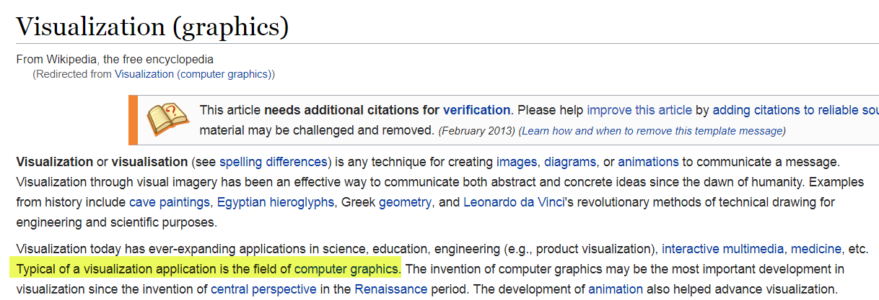
What isn’t data visualization?

Slide 7
What isn’t data visualization?
Computer graphic designers and animators devote effort to make electronic imitations of a known object or to actualize a planned draft whereas scientific visualization often deals with abstract data.
Usually data visualizers do not know how the graphical representation of the data would turn out. Because of this data–driven nature, scientific visualization is also named “data visualization.”

Slide 8
What isn’t data visualization?
DV includes components from various disciplines, such as user interface (ergonomics), cognitive/perceptual psychology, database management, statistical analysis, and data mining.
Computer graphics focus in how to display the information to the end users. Very often computer graphics aim to create a eye-catching, stunning presentation in order to impress the audience, but usually this is not the primary goal of data analysis

Slide 9
What isn’t data visualization?
A study conducted by Borkin, Vo, Bylinskii, Isola, Sunkavalli, Oliva, and Pfister (2013) reveals that the most memorable visualizations are those images containing human recognizable cartoons, photos, and fancy graphical illustrations.
The least memorable visualizations are statistical graphs, such as line charts, bar graphs, and many other less fanciful graphs.
Visualizations with thin data and thick visual densities (i.e., more chart junk and “clutter”) are more memorable than minimal, “clean” visualizations.

Slide 10
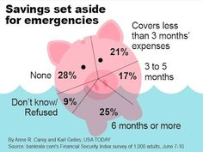
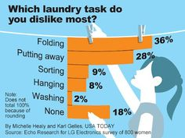
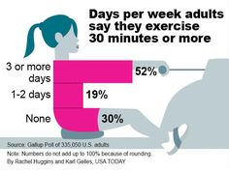
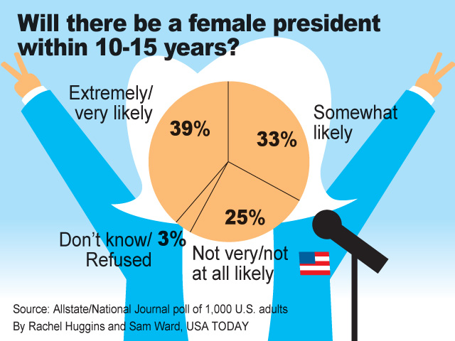
Examples

Slide 11
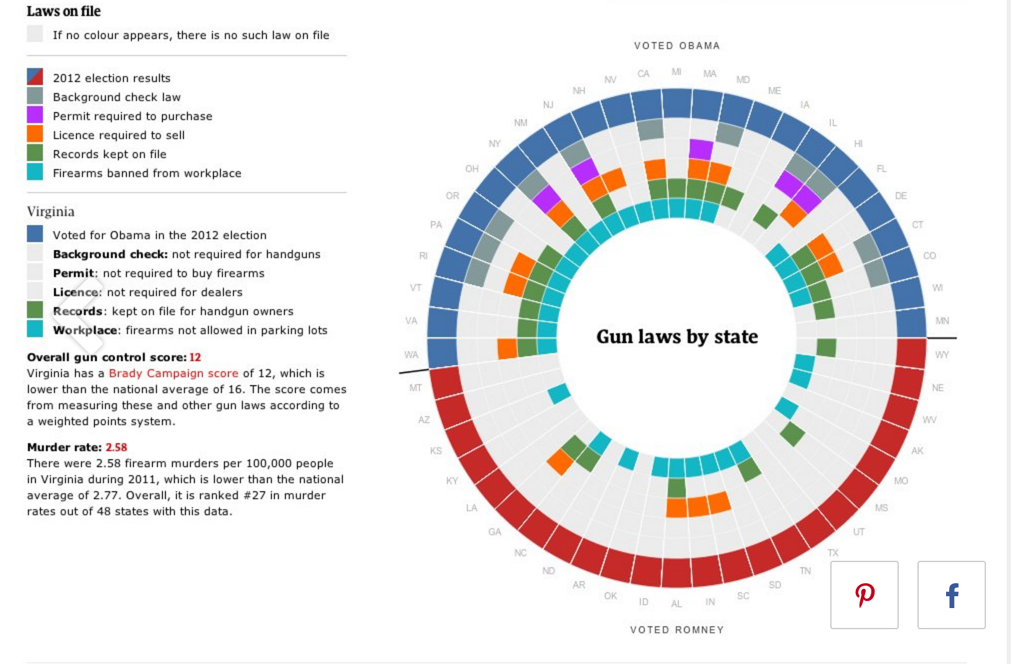
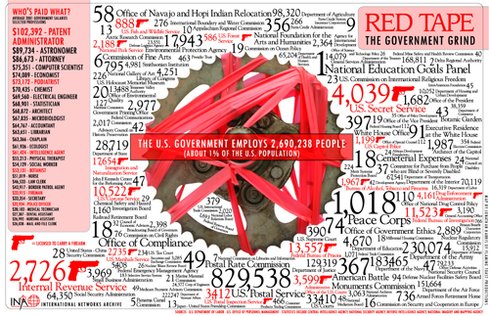
Extreme examples

Slide 12
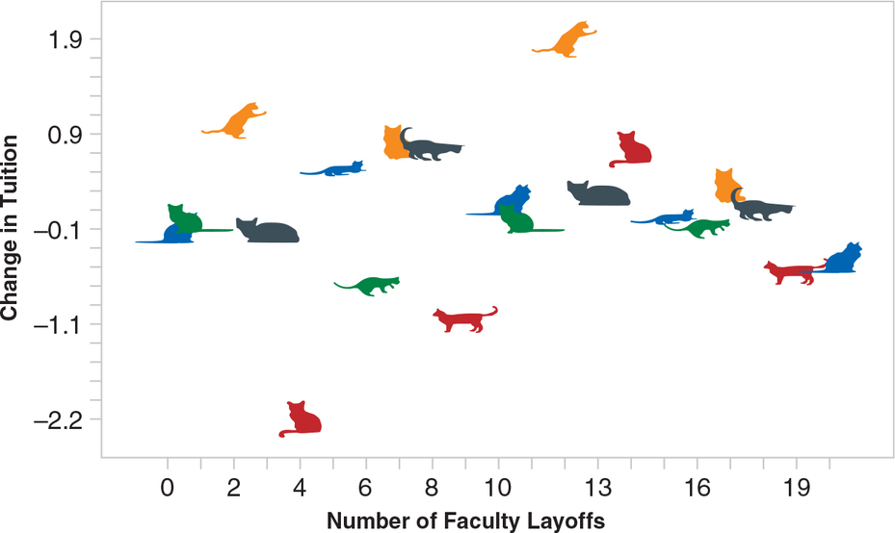
It is memorable. Is it good?
Made by Multicat() in R Language
Source: Brown, D. S. (2021). Statistics and Data Visualization Using R. Sage.
What do you think?

Slide 13
What isn’t data visualization?
When the data analyst subscribes to the goal of computer graphing by over–emphasizing on beautiful images, there is a danger of adopting a “Gee Whiz” approach (Schneiderman, 2002).
Few (2009) criticized that many business intelligence (BI) software vendors treat data visualization as a video game by producing confusing visual effects.

Slide 14
Static vs. dynamic
Static
  What you see is what you get. The graph is frozen.
  After the graph is made, you cannot manipulate the graph (changing the background color or the line width is not considered “data manipulation” because it cannot reveal any insight about the data)
Dynamic
  The data table and different graphic panels are linked. Changing one would change all others.
  You can manipulate the graph to explore the data through different perspectives.

Slide 15
Static visualization in SPSS
Data set: Unit 2 EDA/visualization_data.sav

Slide 16
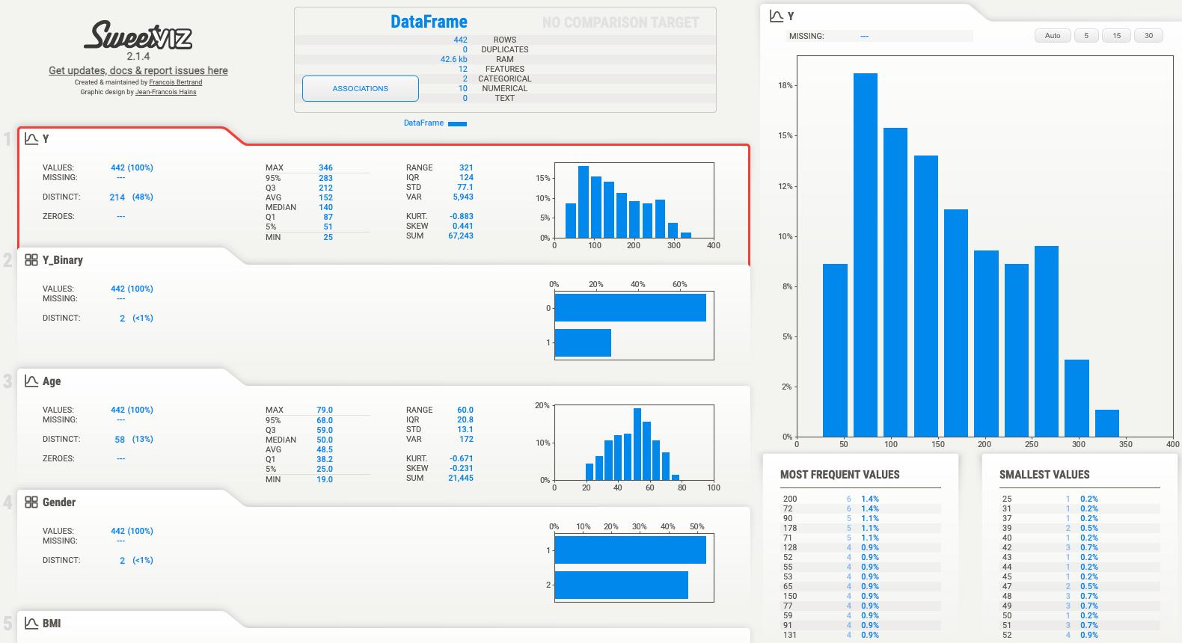
Semi-dynamic visualization in python
pip install sweetviz
import sweetviz as sv
import pandas as pd
df = pd.read_csv('/Volumes/Extreme SSD/data_science_book/datasets/Chapter6/Diabetes.csv')
my_report = sv.analyze(df)
my_report.show_html()

Slide 17
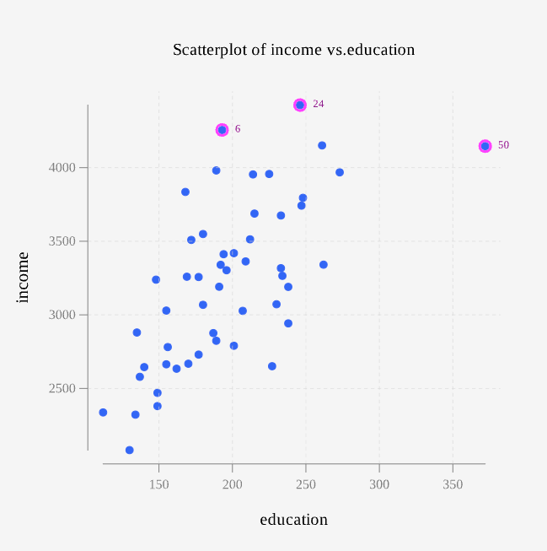
Semi-dynamic visualization in R
Rguroo is a graphical user interface of R.
After a graph is created, you can still add more features in the graph.
But it is only one way, not two-way interaction i.e. you cannot directly manipulate the objects on the graph, such as linking the observations between the graph and the data table.

Slide 18
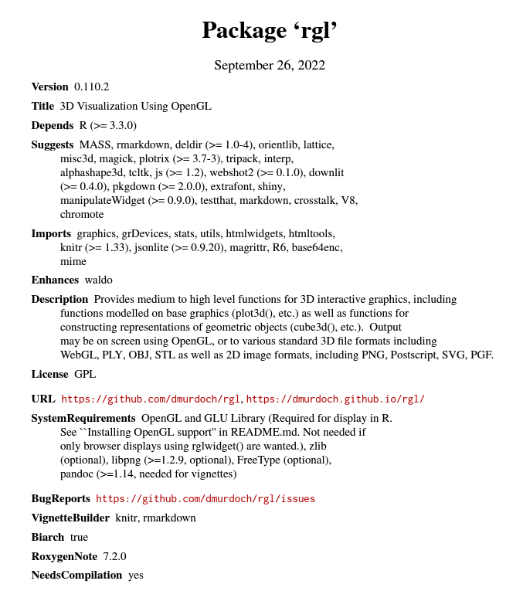
Semi-dynamic visualization in R
The package “rgl” allows semi-dynamic data visualization using R.
But it may be complicated to install and configure in certain operating systems (e.g. Mac OS).

Slide 19
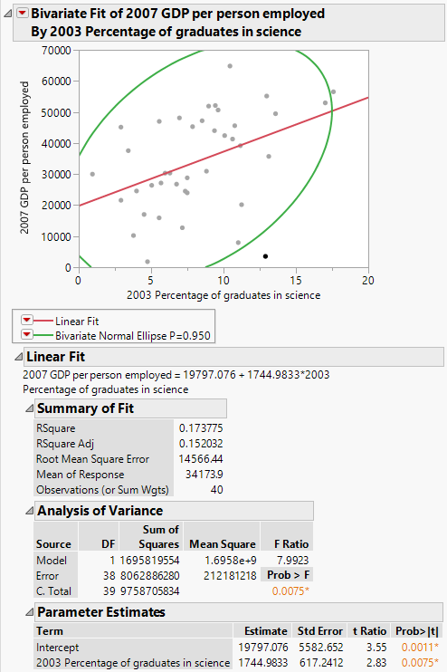
Dynamic graph: redo
Data set: worldbank.jmp in Unit 2
Drag 2003 percentage of graduates in science into X
Put 2007 GDP per person employed into Y
Fit a regression line
Use 95% density ellipse to identify outliers.
Exclude one outlier at the bottom

Slide 20
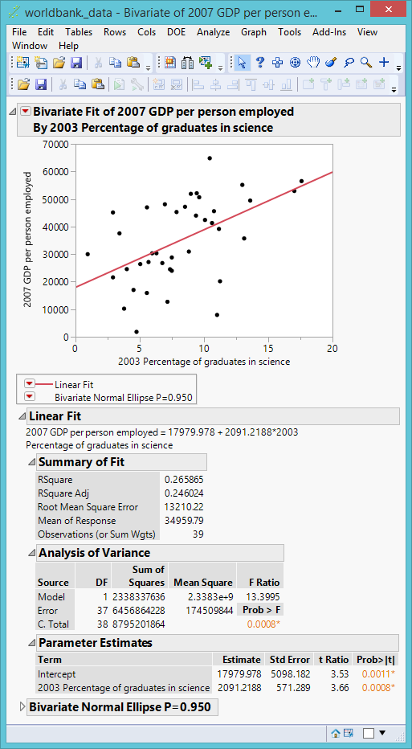
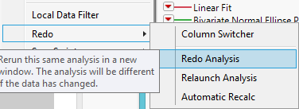
Dynamic graph: redo
From the inverse red triangle choose Redo → Redo analysis
Now you can compare the original and the new regression models side by side

Slide 21
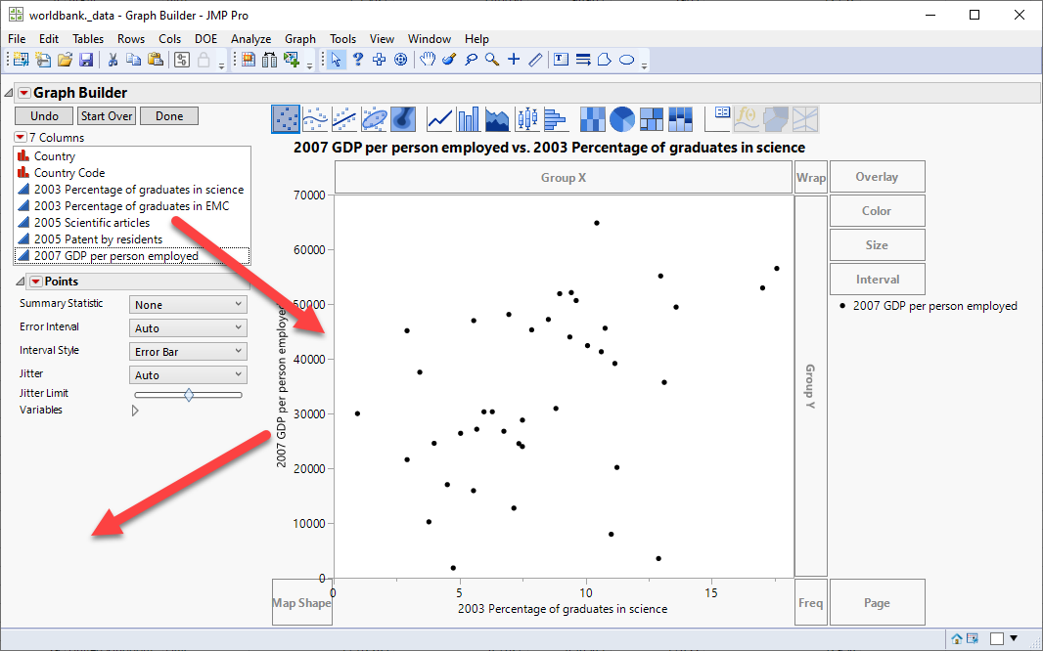
Dynamic graph: add or remove
Drag variables in and out without restarting from beginning

Slide 22
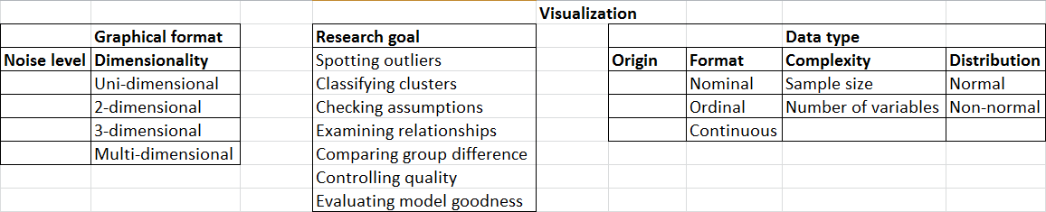
What is data visualization?
DV entails finding a balance between the detail of the raw data and the parsimony of statistical summary (noise vs. smooth).
Graphical format, research goal, and data type should be in alignment.
There are numerous combinations. No cook-book! Experience! Experience! Experience!

Slide 23
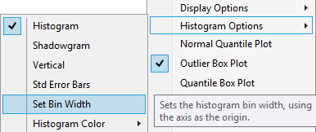
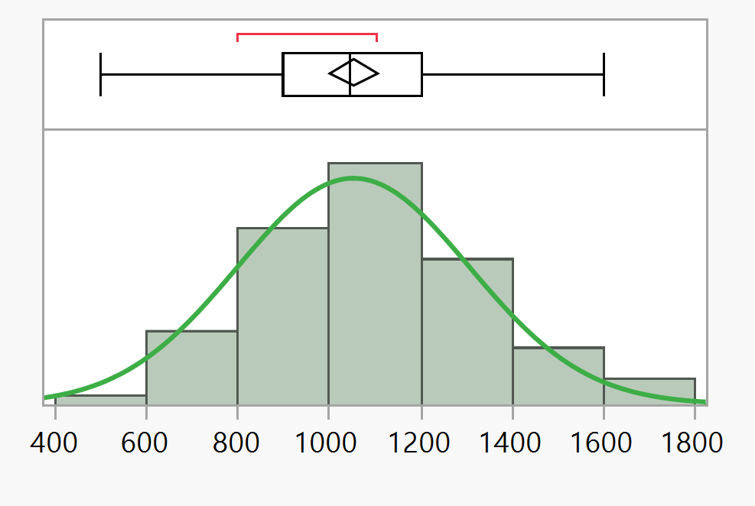
Example of noise and smooth
The appearance of a histogram is largely controlled by the number of bars used to depict the data.
In a simple histogram you can go back and forth between noise and smooth by setting the bin width (how wide each bar can be).
You can also use the hand tool to adjust the bandwidth, but it is not as precise as using the setting.

Slide 24
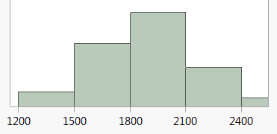
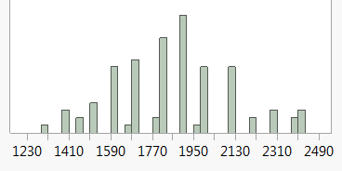
Example of noise and smooth
When many bars are used the pattern of the data may look jittery. Here the details are great and the reader may wonder if a simpler underlying form exists.
The use of too few bars may obscure patterns in the data that are important to the viewer.

Slide 25
Why not numbers only? Opposition
Fisher (1932) said:
  Diagrams prove nothing, but bring outstanding features readily to the eye; they are therefore no substitute for such critical tests as may be applied to the data.
Today many researchers insist that reporting the numbers is sufficient.
How can we spot outliers, check assumptions (e.g. linearity, normality), identify patterns (e.g. clusters), evaluate model adequacy (e.g. residuals) without looking at the data?

Slide 26
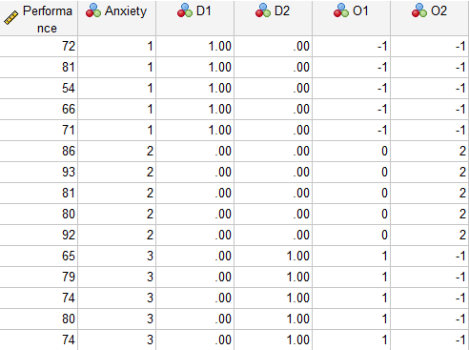
Why not numbers only?
Yes, you can use numbers (numeric output) to detect non-linearity, but it is very complicated.
Open the data set “orthogonal.sav” in SPSS Statistics.
We want to detect whether the relationship between anxiety and performance is linear or nonlinear.

Slide 27
Why not numbers only?
To test it by number, you need to re-code the data.
Positive linear
Negative linear
U-shape nonlinear: the curve will go down, and then go up
Upside down nonlinear: go up, and then go down
 | Group O₁ (positive linear) | Group O₁ (negative linear) | O₂ (U-shape) | O₂ (upside-down U)
Low | -1 | +1 | +1 | -1
Medium | 0 | 0 | -2 | +2
High | +1 | -1 | +1 | -1

Slide 28
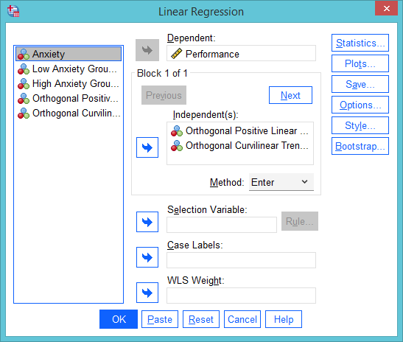
Why not numbers only?
Go to Analyze → Regression → Linear
Put Performance into Dependent
Put Orthogonal positive linear and Orthogonal Curvilinear Trend into Independent(s)

Slide 29
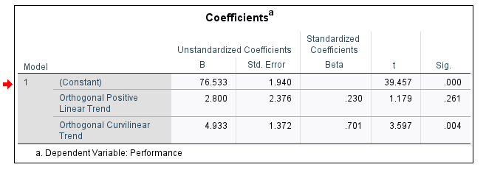
Why not numbers only?
The p value of linear trend is not significant (.261)
The p value of the curvilinear trend is significant (.004).
The relationship between performance and anxiety is nonlinear.
But is there an easier and faster way?

Slide 30
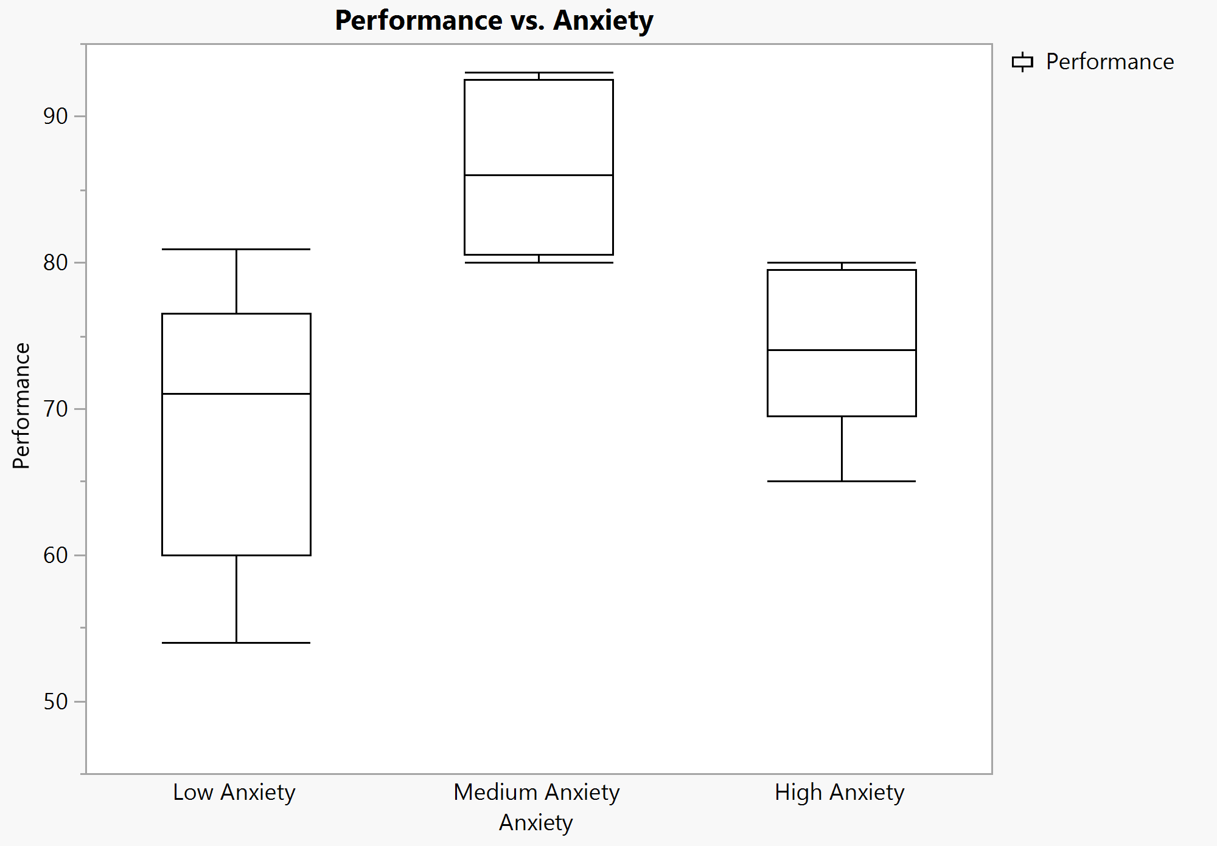
Data visualization is easier, faster, and clearer
Use “Orthogonal.jmp” to make a boxplot.
No recoding is required.
it is very difficult to imagine the data pattern by the regression coefficients (beta), but from the boxplots one can easily see that even the lowest of the medium anxiety group can be at a par to the highest of the low and high anxiety in terms of performance.

Slide 31

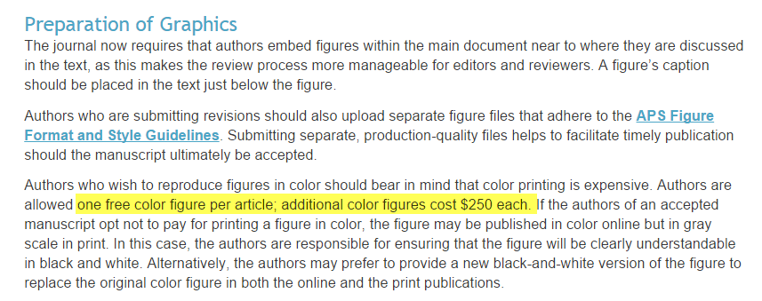
Why not numbers only? Opposition
“Many journal articles do not display graphics.”
Because it is expensive! It’ll cost you an arm and a leg!

Slide 32
Why data visualization?
See beyond the horizon!
The trend is digital and online publishing.
Multimedia and interactive modules cannot be displayed in traditional print journals?
Yu, C. H., & Stockford, S. (2003). Evaluating spatial- and temporal-oriented multi-dimensional visualization techniques for research and instruction. Practical Assessment, Research & Evaluation, 8(17). Retrieved from http://www.creative-wisdom.com/pub/PARE_2003.html or
https://scholarworks.umass.edu/pare/vol8/iss1/17/
The scientific paper is obsolete: https://getpocket.com/explore/item/the-scientific-paper-is-obsolete?utm_source=pocket-newtab

Slide 33
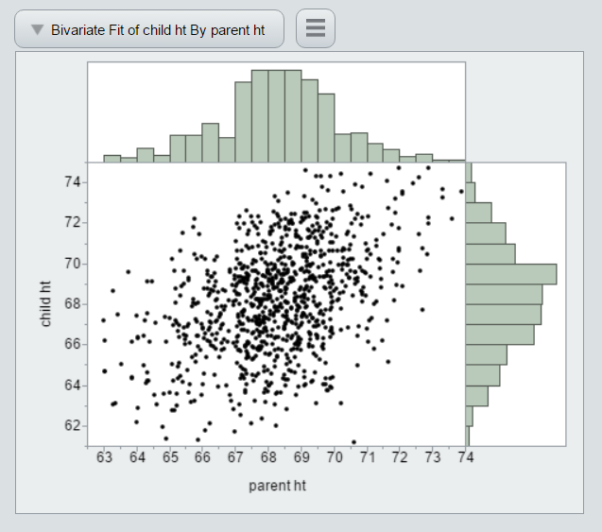
Why data visualization?
See beyond the horizon!
Help → Sample data library → Galton data: Discover regression to the mean
Fit Y by X
Inversed red triangle → Histogram borders
You can output the graph to HTML (Save as) and display the result interactively.
No plug-in for the Web browser
Can you do the following in a hard copy?
http://www.creative-wisdom.com/teaching/WBI/galton.htm

Slide 34
Assignment 3.1
Use Visualization_data.JMP
Put College test scores into Y
Put SAT into X
From the red triangle select Histogram Border.
Save the file into html format
Can you see the interactive graph in a Web browser?
Caution: the html file is still a local file stored in your hard drive (e.g. file:///H:/JUMP/551/Lecture_PowerPoint/Unit_3_DV/Fit%20Y%20by%20X.htm). If you email the “link” to other people, they will not be able to open the file in your hard drive. You need to send the html file or post it on a Web server.

Slide 35
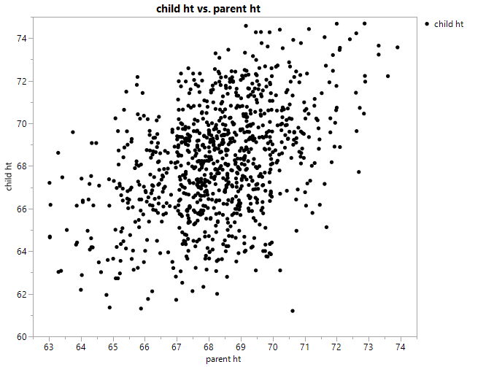
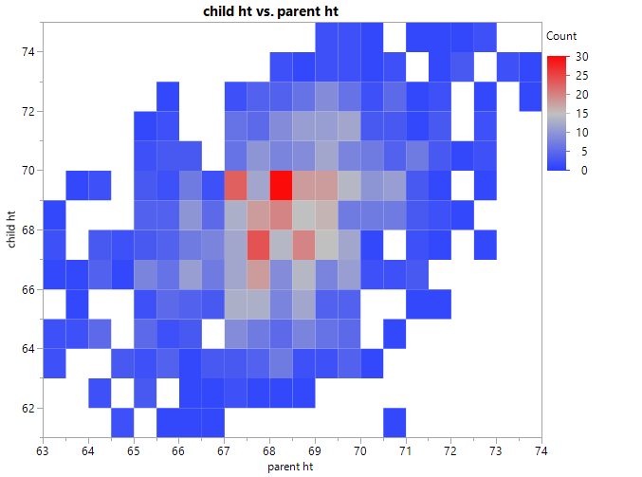
Why data visualization? See beyond the horizon!
Galton data
If using a traditional B & W scatterplot, it is hard to tell the data density, especially big data (over-plotting)
Heatmap can. Today online journals accept color graphs.

Slide 36
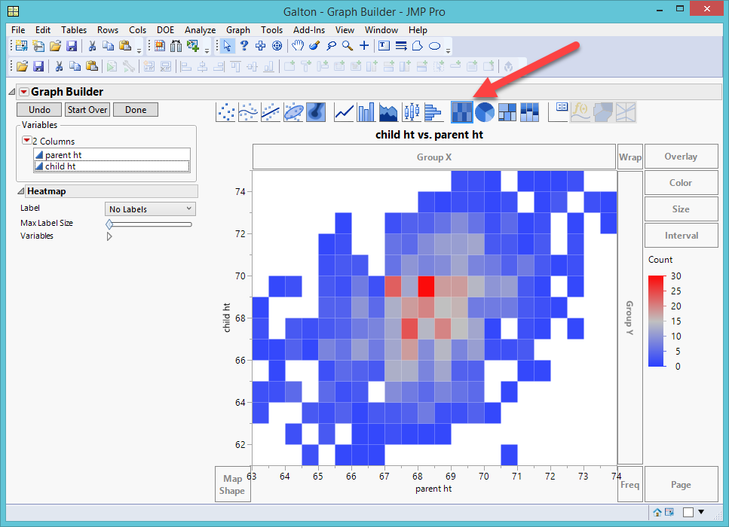
Heat map
In Graph Builder
Put child height into Y axis
Put parent height into X axis
Press the heat map button

Slide 37
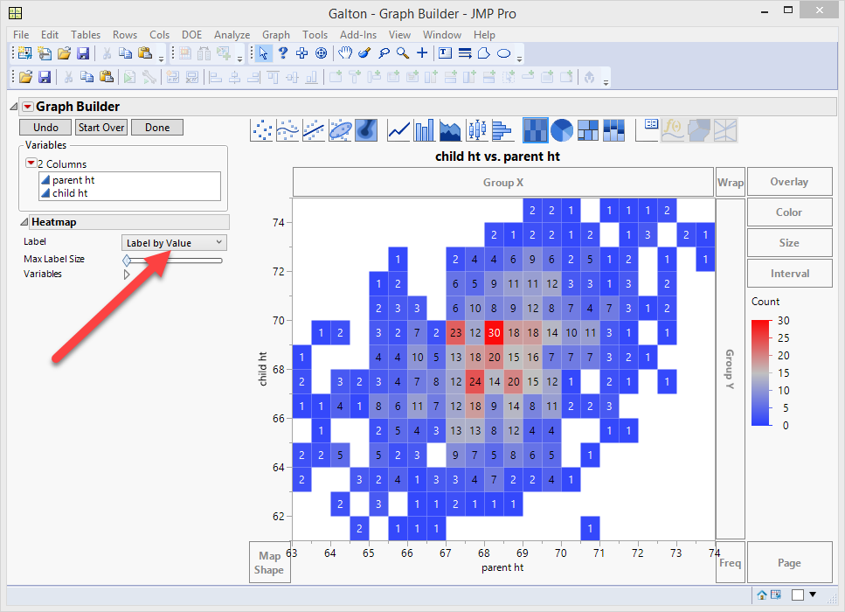
Heat map
You can view the frequency or percentage by choosing label by value or label by percentage of total values

Slide 38
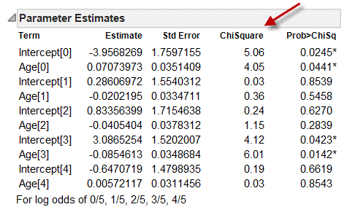
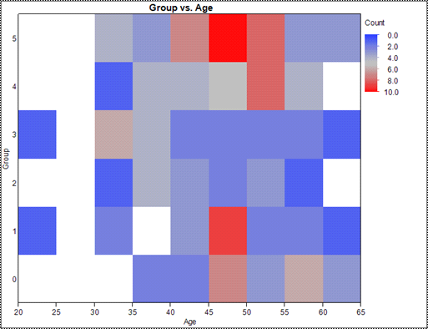
Why data visualization? See beyond the horizon!
Easier to interpret e.g. logistic regression
Aged between 45 and 50 → in group 1 and 5
http://www.creative-wisdom.com/computer/sas/jmp_heatmap.pdf

Slide 39
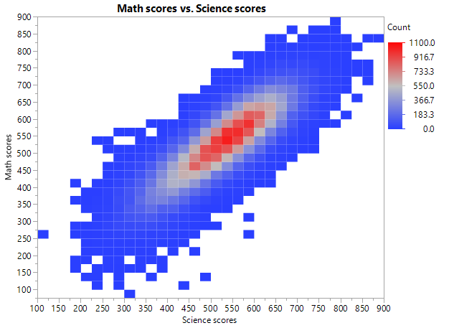
Assignment 3.2
Use PISA2015.jmp
In Graph Builder put Science scores into X and Math scores into Y
Turn the scatterplot into an image map.
Do most data concentrate at the center?

Slide 40
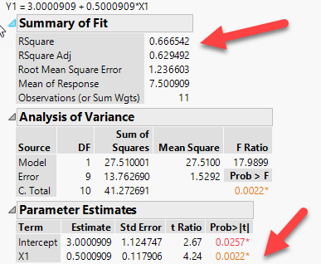
Why data visualization?
Numbers may fool you!
Open Anscombe data (1973) from the sample data library
Click on the green arrow of “The Quartet”
What do you see?
All of the them have the same result: R2 = .666; p = .0022

Slide 41
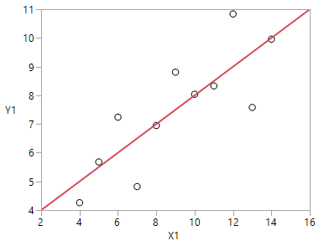
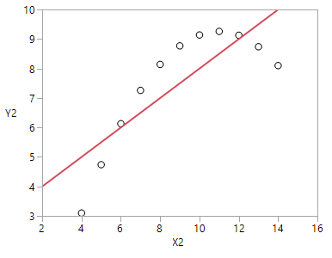
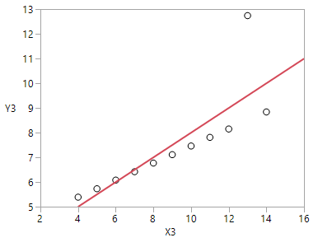
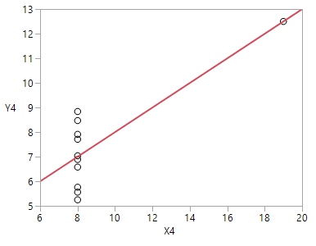
Numbers can fool you!
Same numeric results, but all four are different!

Slide 42
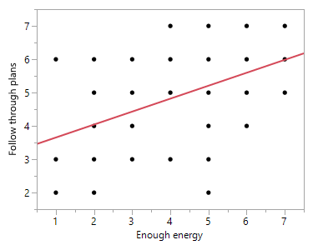
Numbers can fool you!
Use “resilience.jmp”
In this simple regression model X is used to predict Y and the p value < .0001.
The scatterplot tells a different story. If my score on X is 5, the regression model predicts my score on Y is also about 5. However, the actual score could be 2, 3, 4, 5, 6, or 7, meaning that it could be anything. Needless to say, this predictive model is practically useless.

Slide 43
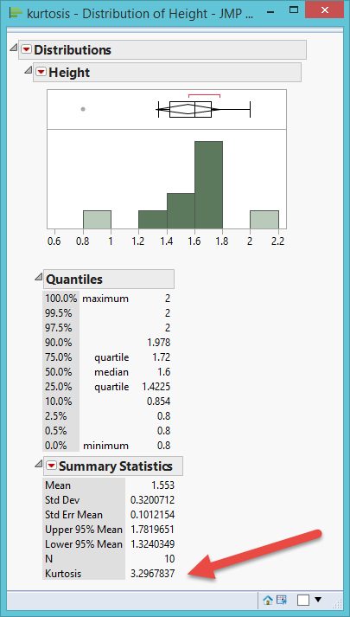
Why data visualization?
Numbers may fool you!
Another one: Kurtosis is the relative ratio of the mass of the distribution located in the center vs. in the tails. Kurtosis = 3 → Normal curve.
In this example, Kurtosis = 3.2, fairly normal, right?
No, there is a lot of central mass, but the histogram shows that the distribution is skewed and there are two outliers.

Slide 44
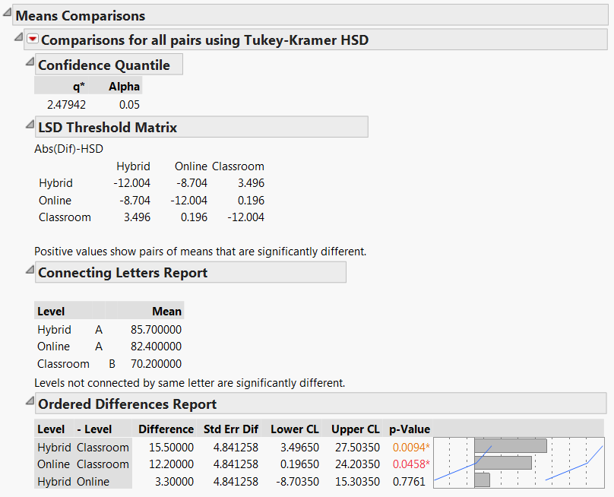
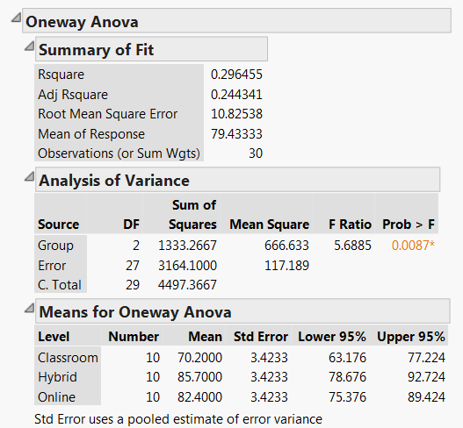
Why data visualization? It benefits even traditional statistics
Traditionally, ANOVA and multiple comparison show numeric output only.

Slide 45
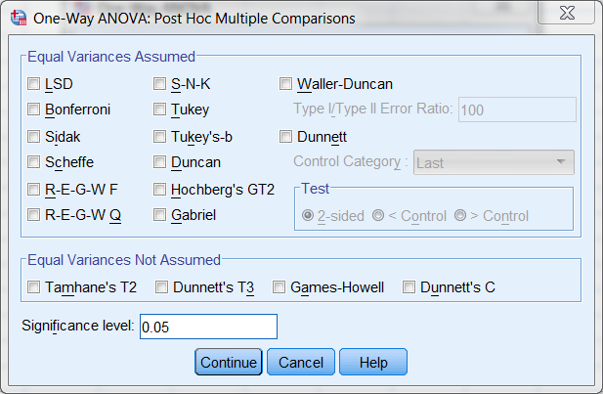
Why data visualization? It benefits even traditional statistics
It is confusing to both the analyst and the reader.
SPSS Post hoc multiple comparisons.
In SPSS you have 18 options. When I was a graduate student, I took a course on it.

Slide 46
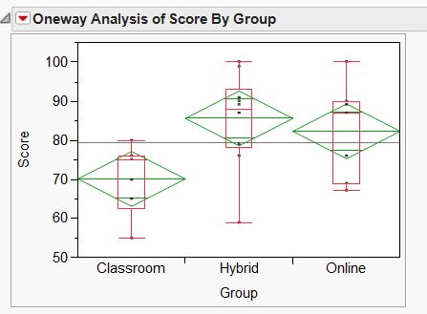
Diamond plot
Data set: One-way.jmp
There are three teaching modes: Traditional classroom, online, and hybrid.
Which one is more effective in terms of test performance?
Analyze → Fit Y by X
Inversed red triangle → Quantile (no outliers)
Inversed red triangle → Means/ANOVA

Slide 47
Diamond plot
Grand sample mean: horizontal black line
Group means: horizontal line inside each diamond.
Confidence intervals: The top of the diamond is the upper bound (the best case scenario) while the bottom is the lower bound (the worst).
Quantile: boxplot

Slide 48
Diamond plot
The hybrid group outperforms the classroom group in the population because the best case scenario of classroom cannot match the worse case scenario of hybrid.
Hybrid and Online overlap and thus they might not be different from each other in the population.
Online and classroom only overlap a bit. It is likely that Online still outperforms Classroom.
Making easier and clearer judgment by visual inspection of the data.

Slide 49
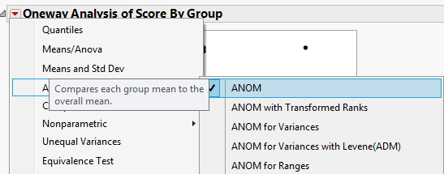
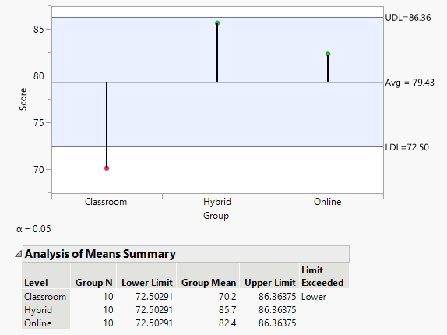
Analysis of means: Mean chart
Upper decision line (UDL) and Lower decision line (LDL) of a confidence interval (CI)
CI: sample statistics (mean) +- sampling error
The mean of the classroom group is significantly lower than the overall mean.

Slide 50
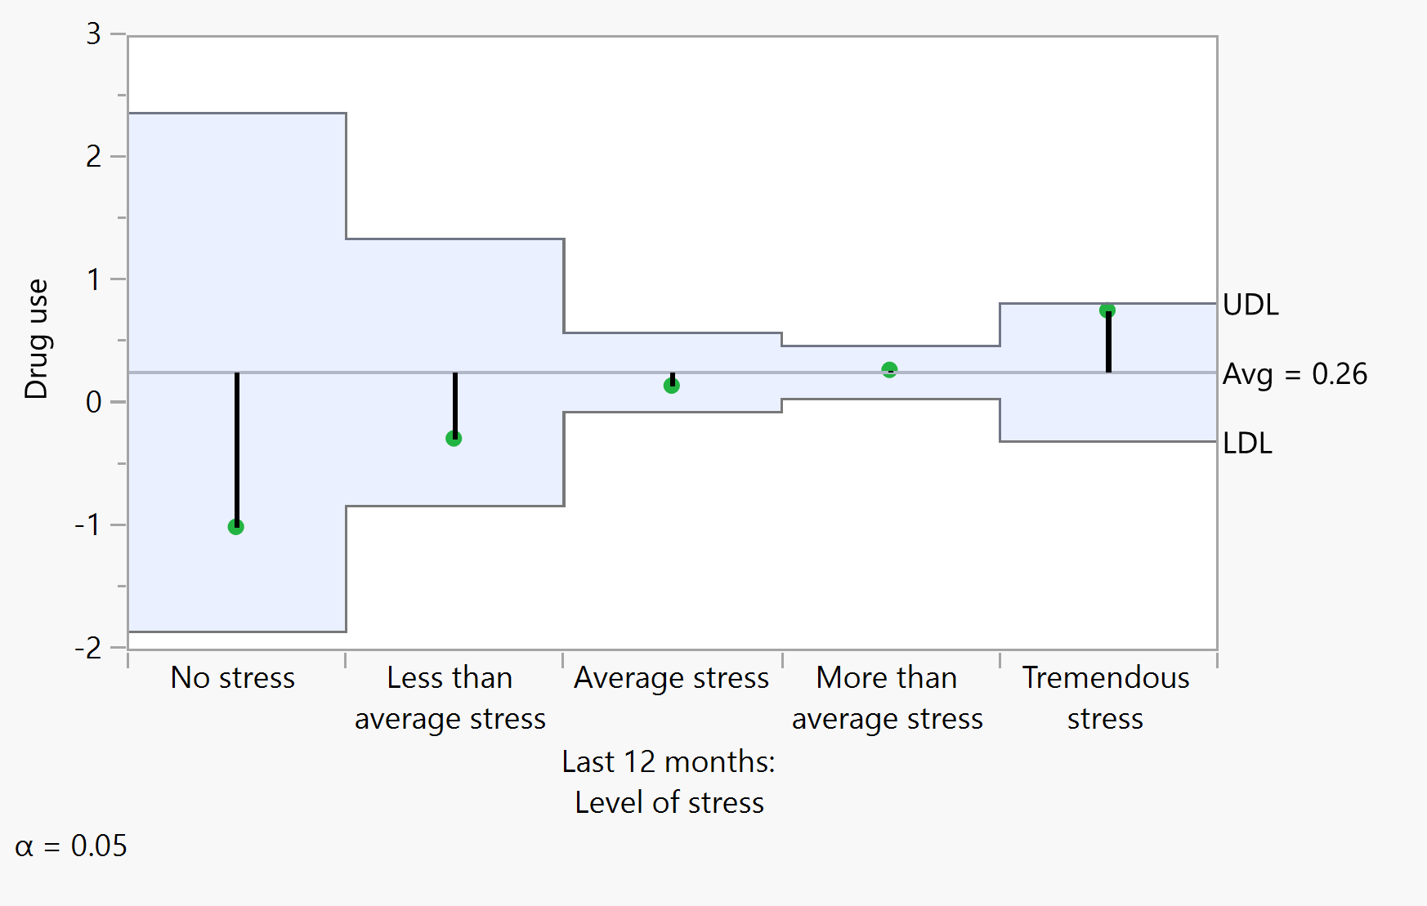
The p value may misguide you
Use the data set “drug_stress” to run ANOVA
P value = .0651, not significant!
ANOM chart reveals undeniable trend or pattern.
Drug use increases as stress goes up, like a staircase.

Slide 51
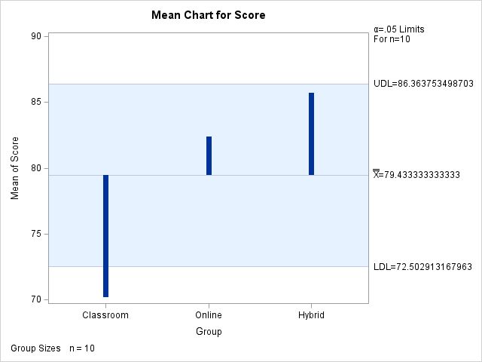
SAS Code: Mean chart
Download the SAS data set “One_way”
Download the SAS program “ANOM.sas”
In SAS programming environment the default library is TMP1. In SAS Studio you need to open the file.

Slide 52
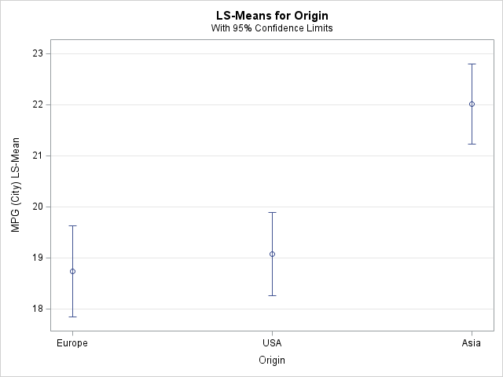
A more complicated example
Are Asian cars more fuel-efficient than US and European cars?
Download the SAS program “diffogram_example.sas” and run it.
The least square mean plot is similar to the diamond plot.
The circles are the means and the lines are confidence intervals.
How to interpret the graph?

Slide 53
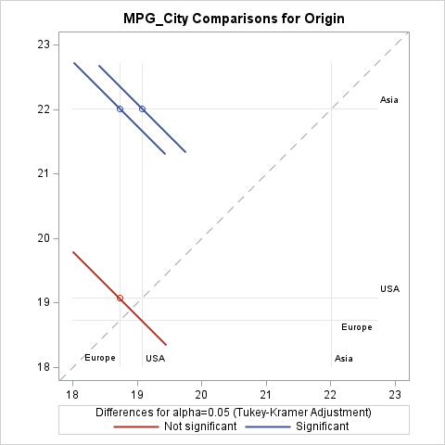
A more complicated example
If the line is touching the 45-degree diagonal line, then there is no significant difference between the pair.
For MPG in city, there is no difference between European and American cars.
There is a difference between Asia and US/European cars.

Slide 54
Ungraded assignment (optional)
Asian cars are more fuel-efficient than US and European cars in terms of MPG in city. But how about MPG in high way?
Hint: You need to change only one word in the program.

Slide 55

DV helps Chi-square analysis
Faith.jmp
I will report the data as is; I do not judge anyone.
Is a person’s faith status related to use of tobacco?
Faith status:
  I continue to attend church and have faith in Christ
  I still attend church but have serious doubts of my faith in Christ
  I have not attended church for over one year but I maintain my faith in Christ
  I am not attending church and have abandoned my faith in Christ.
Use any tobacco in last 12 moths? Yes (1) or No (0)

Slide 56

DV helps Chi-square analysis
Analyze → Fit Y by X
Use any tobacco in last 12 months → Y
Faith status → X
Because both variables are categorical, Chi-square analysis is used.
The p value is significant (< .0001), but it is hard to interpret the result.

Slide 57

DV helps Chi-square analysis
Mosaic plot can help.
We can see the proportion and the ratio of “yes” (1) and “no” (0) in different categories of faith status
In “I continue to attend church and have faith in Christ,” the ratio of 1 and 0 is about 1 to 4, meaning that if a person attend church and keep his/her Christian faith, he/she is less likely to smoke.

Slide 58
DV helps Chi-square analysis
As the faith status change, the ratio starts reversing.
If a person does not attend church but keep his/her faith, the ratio is almost 1 to 1.
But if a person stops attending church and gives up his/her faith, it is more likely for him/her to smoke (1).

Slide 59

DV helps Chi-square analysis
Graph → Graph Builder
Faith status → Y axis
Use any tobacco in last 12 months → X axis
Dot plot
We can look at the size/ratio of the circles and reach the same conclusion

Slide 60
assignment 3.3
Use faith.jmp
Is there any relationship between faith status and stress level (1 to 5, 1 = less severe, 5 = worst)
Run a Chi-square test
Can the Mosaic plot clarify the interpretation?
Can you use Graph Builder (dot plot) to clarify the interpretation?

Slide 61


Brief history of DV
Charles Joseph Minard's Visualization Of Napoleon's 1812 March to Moscow (1869)

Slide 62

A modern version
JMP Sample data: Napoleon’s March
The circle depicts the size of the French army
This is the beginning (attack)

Slide 63

A modern version
Blue circle : Retreat
This is the end!

Slide 64

1854 London Cholera Outbreak
In 1854 a severe outbreak of cholera occurred in the Soho district of London, England, killing 616 people
John Snow used a quasi-GIS method to trace the source to contaminated water, not air.

Slide 65



1856 War mortality by Florence nightingale
In 1855 Crimean War Florence Nightingale collected and displayed data to show that the staggering amount of deaths in Crimea was caused by poor medical care.
Problem: the conclusion is right but the methodology is wrong. She and William Farr computed the mortality rate by: the number of deaths in one year / the number of total patients in one day.
Lesson: You need to know where the numbers come from. Garbage in, garbage out!

Slide 66


Deming’s total quality management
1950s: Edwards Deming
TQM also uses graphical aids heavily for statistical quality control (SQC).
The goal of research on quality is to identify the pattern of changes and reduce this variation.
Deming considered hypothesis testing is one of the evils taught in statistics courses.

Slide 67

Deming’s total quality management
Toyota and many Japanese companies listened to him.
JUSE: Union of Japanese Scientists and Engineers
Helped Japan to achieve post-war economic miracle of 1950 to 1960.
He gained widespread recognition in the U.S. at the time of his death in 1993.
Variation will normally occur within six standard deviations of the mean → Six sigma program
Even today history repeats itself.

Slide 68


Six sigma in SAS/JMP
JMP has a six-sigma add in:
https://www.jmp.com/en_my/support/sample-six-sigma-menu.html

Slide 69


William Cleveland
1992: The elements of graphing data
1993: Visualizing data

Slide 70

Leland Wilkinson
Well-known for his role in APA Task Force on Statistical Inferences (1996-1999)
Hypothesis testing can still be used, but it is encouraged to report effect size and confidence interval (CI).
“Graphic inspection of data offers an excellent possibility for detecting serious compromises to data integrity.”
1999: The grammar of graphics

Slide 71




Edward Tufte
The Leonardo da Vinci of data
  Graphical Excellence: Usability
  Visual Integrity: No distortion
  Maximizing the Data-Ink Ratio: Efficiency
  Aesthetic Elegance: Simplicity

Slide 72
Edward Tufte
”What is to be sought in designs for the display of information is the clear portrayal of complexity, not the complication of the simple; rather the task of the designer is to give visual access to he subtle and the difficult – that is, the revelation of the complex.” (The Visual display of quantitative information)

Slide 73
Edward Tufte
”In 1613, when Galileo published the first telescopic observations of Saturn, word, and drawing were as one. The stunning images, never seen before, were just another sentence element. Saturn, a drawing, a word, a noun. The wonderful becomes familiar and the familiar wonderful” (Envisioning information)

Slide 74


Stephen few
A major contributor to SAS/JMP community.
Spoke in many JMP seminars.

