Slide 1
Visualization of Geographical information system (GIS)
Chong Ho (Alex) Yu

Slide 2
Expected learning outcome
You will learn how to visualizing spatial data by using GIS map at:
  Worldwide level
  State level (USA)
  Metropolitan Statistical Areas (MSA) level
  County level
  zip code level
  Street address level
You will learn how to combine time-series and GIS in visualization
You will learn how to look at multiple dimensions by adding local filters.
You will learn data preparation for GIS, such as how to
  convert region into province
  how to join tables

Slide 3
What is GIS?
Environmental Systems Research Institute (ESRI): “A geographic information system (GIS) is a framework for gathering, managing, and analyzing data. Rooted in the science of geography, GIS integrates many types of data. It analyzes spatial location and organizes layers of information into visualizations using maps and 3D scenes. ​With this unique capability, GIS reveals deeper insights into data, such as patterns, relationships, and situations—helping users make smarter decisions.”

Slide 4
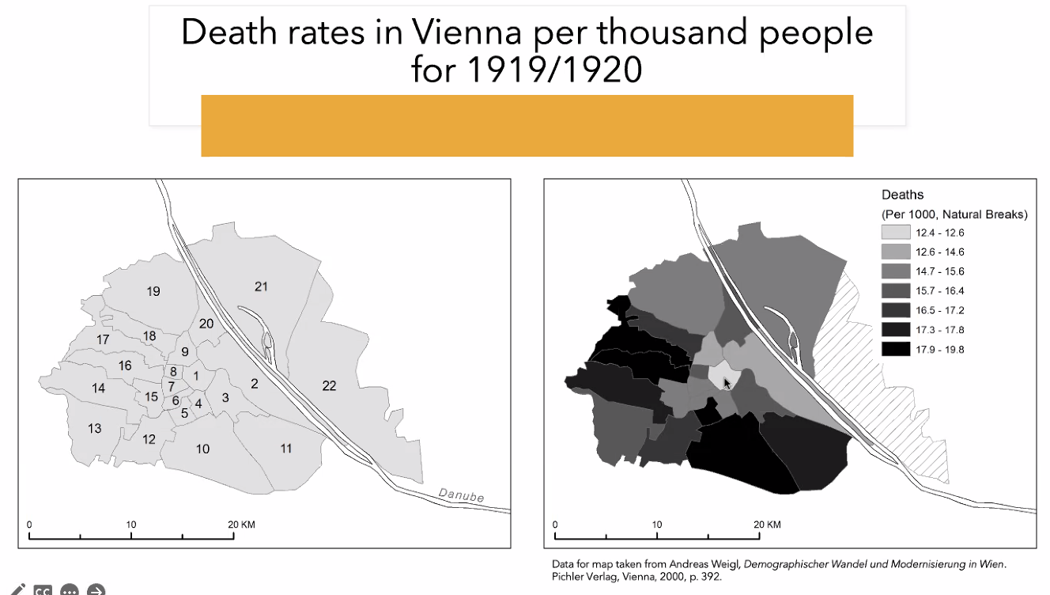
Wide applications
Used in history research.
American relief program for Europe after WWI.

Slide 5

Example
Yu, C. H., Reimer, D., Lee, A., Snijder, J-P., & Lee, H. S. (2016). A triangulated and exploratory study of the relationships between secularization, religiosity, and social wellbeing. Social Indicators Research, 131, 103-1119. DOI: 10.1007/s11205-016-1290-9.

Slide 6

Example

Slide 7

Claims in Skeptics Magazine
Gregory Paul: “unlike science, which goes where the evidence and analysis indicate and is anti-mythical in nature, religion is inherently dogmatic and opinion based, with myths being integral to the system.”
“All comprehensive cross comparisons have found that higher levels of religiosity are strongly correlated with inferior socioeconomics.”

Slide 8

Religious America is the worst?

Slide 9
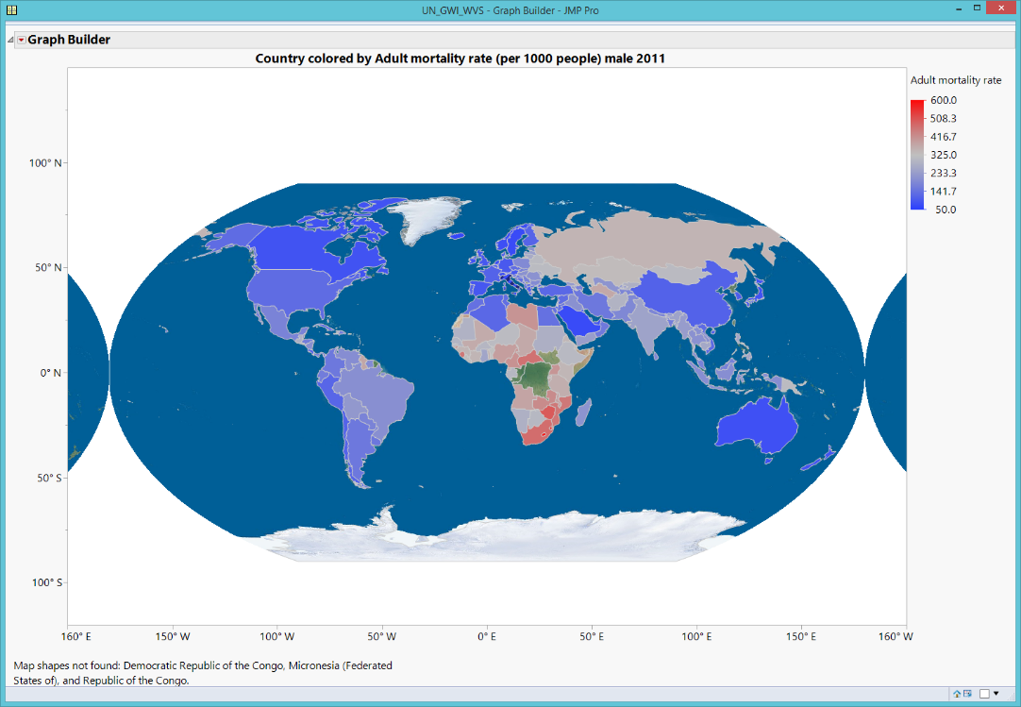
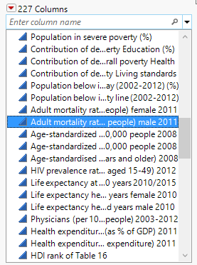
GIS Map: World_data
Use “World_data.jmp”
Open Graph Builder
Drag country into the Map shape.
Drag Adult mortality rate per 1,000 people (Male) 2011
Right-click to open Graph → Background Map
Choose Simple map for Images and World for Boundaries.
Where are the worst?

Slide 10
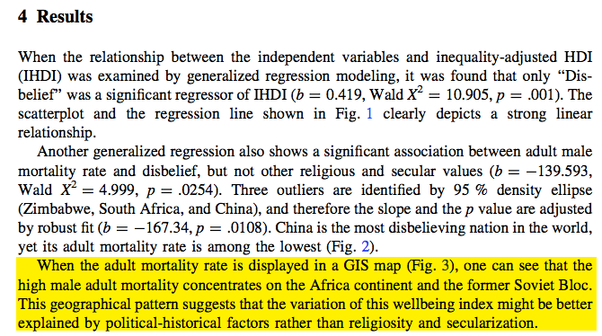
Example

Slide 11
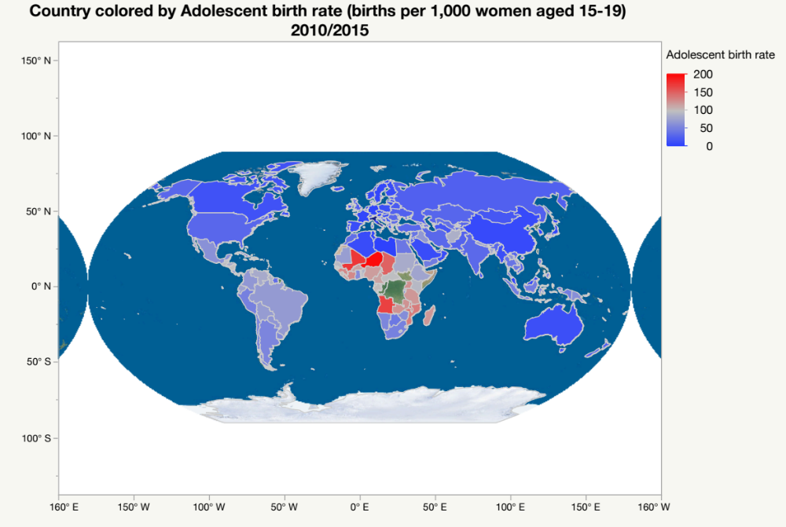
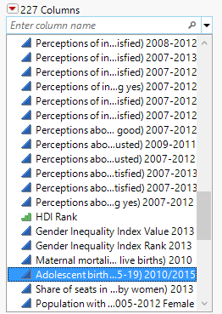
Assignment 7.1
Critics argued that the teenage pregnancy rate of religious America is higher than other developed nations.
Put Adolescent birth rate into a GIS map.
What did you observe from the GIS map?

Slide 12
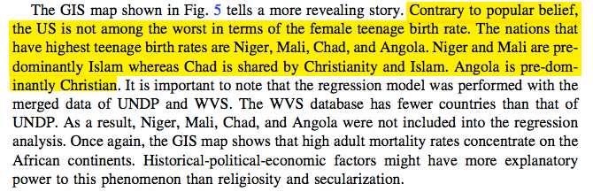
Example

Slide 13
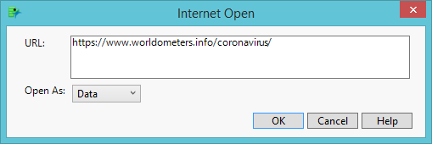
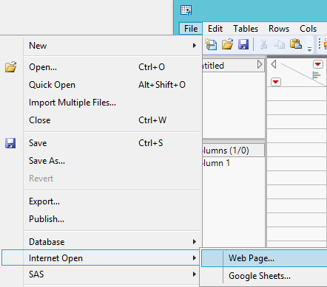
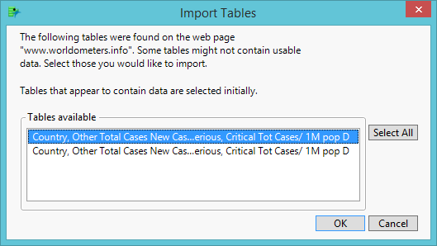
Obtain geospatial data from website
COVID19: https://www.worldometers.info/coronavirus/

Slide 14
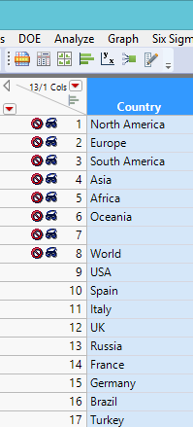
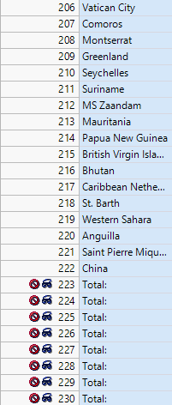
Obtain geospatial data from website
Hide and exclude observations that are not countries.

Slide 15
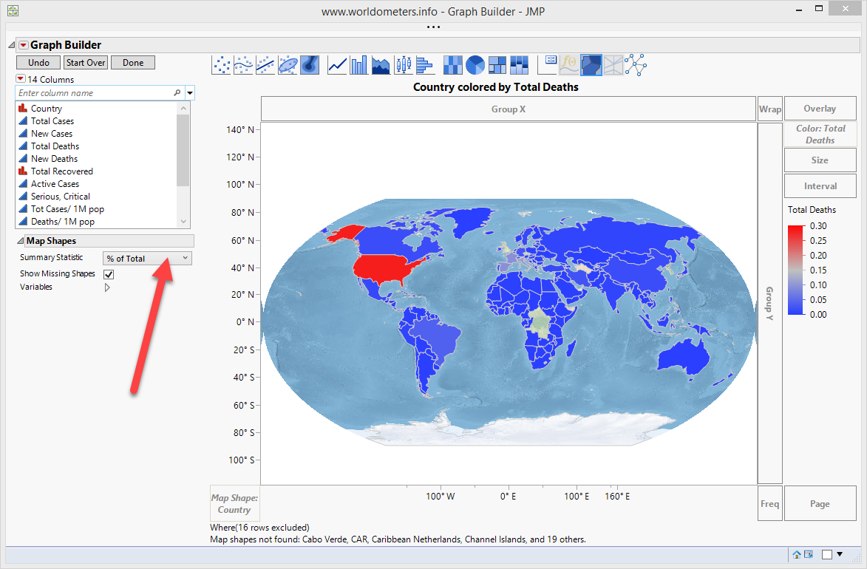
Obtain geospatial data from website
n of total deaths of a country / N of total deaths in the world
Change the display of raw data to % of grand total.

Slide 16
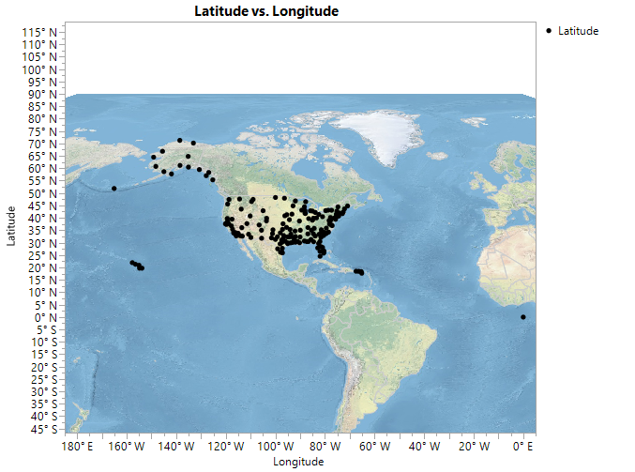
GIS map
You can use GIS to track air traffic
Use JMP Sample Data: Air Traffic or download it from U7 folder
Put Longitude into X and Latitude into Y, or drag both into the center of the canvas.
Remove the nonlinear fit line.
Right click to Graph → Background Map
Use Detailed Earth

Slide 17
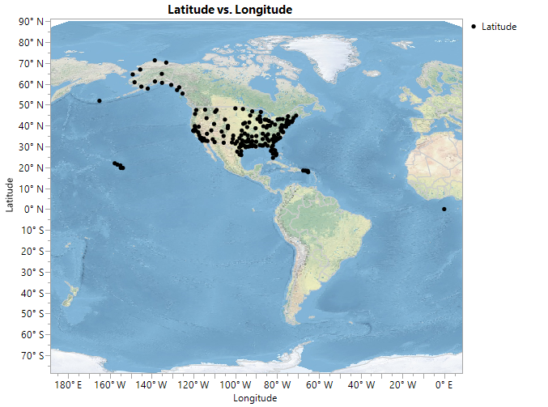
GIS map
But there are no data near the North Pole.
Move the cursor to the y axis.
The pointer turns into a hand.
Move the map upward.

Slide 18
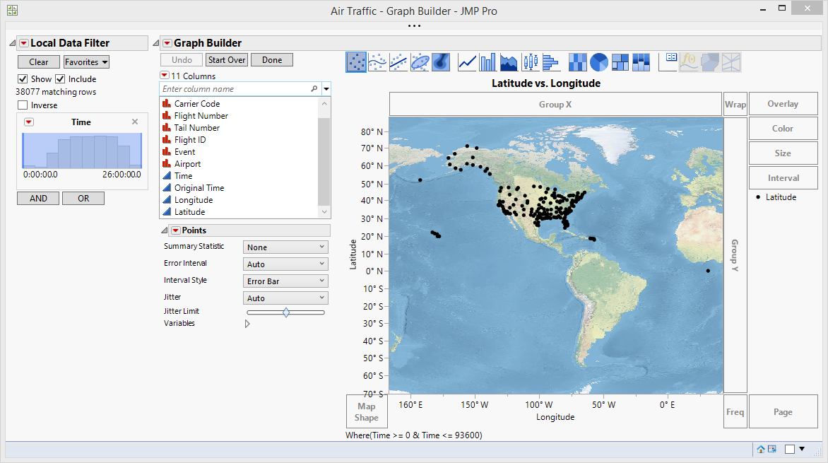
GIS MAP

Slide 19
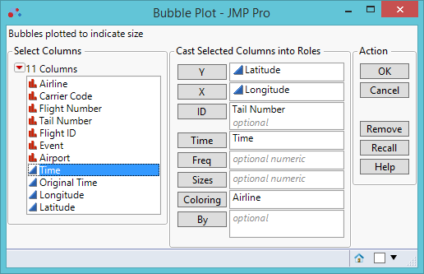
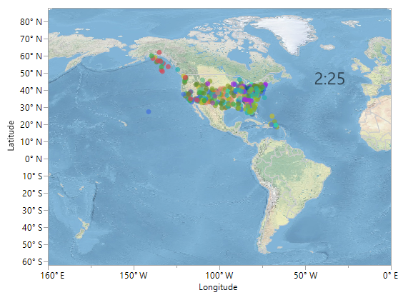
Combine time-series and GIS

Slide 20
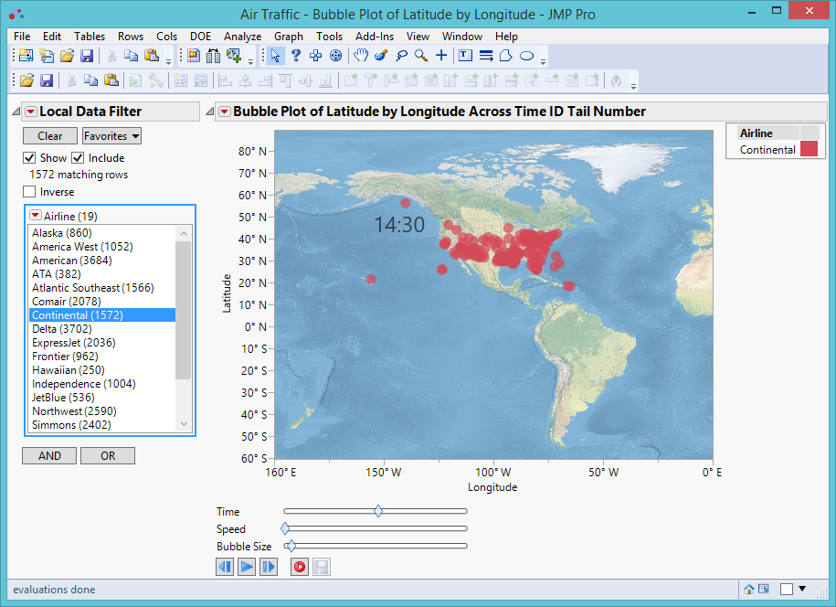
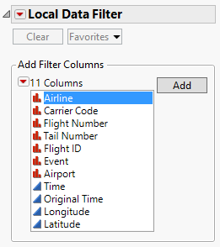
Combine time-series and GIS
Add local filter: Track by selecting airline

Slide 21
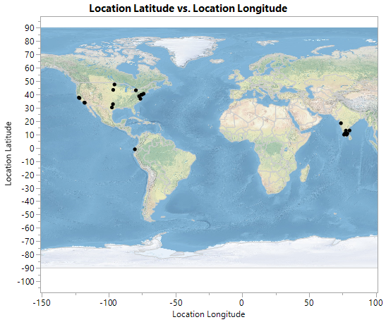
Detect cheating
Qualtrics (Online survey engine) records the longitude and latitude of the response. You can check the origins of your data.
Open the data set “US teacher survey.jmp”
Show the location of the participants.
The population should consist of US teachers. But where are their actual locations?

Slide 22

Mturk workers get paid
Why did they pretend to be US teachers?
Financial incentives could affect your data quality.
Always check the locations of online respondents!

Slide 23
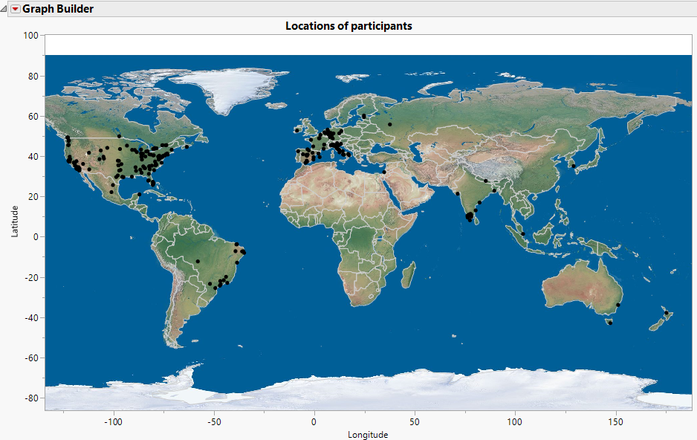
Verify your data!
Open ethics.jmp
Create a GIS map using Latitude and Longitude

Slide 24
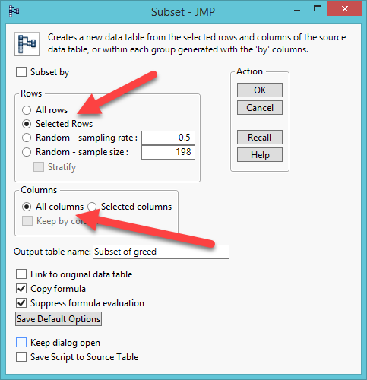
Verify your data!
On the map select South Asia
From Table choose Subset
Selected Rows
All columns

Slide 25
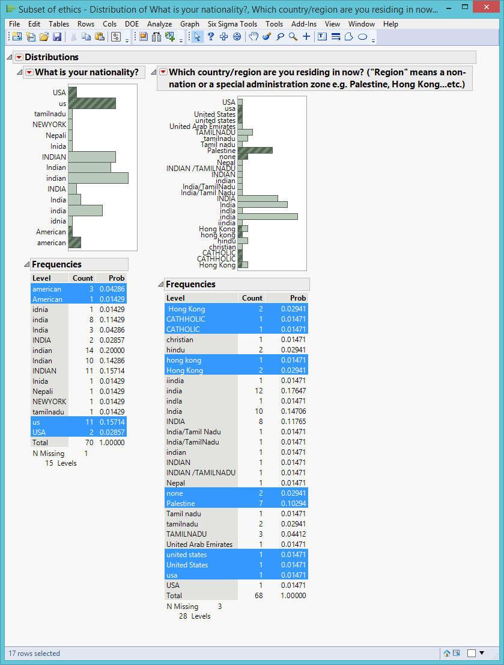
Verify your data!
Select “What is your nationality?” and “Which country/region are you residing now?”
Make Distributions
There is some discrepancy. Some people said that they are residing in Hong Kong. Their nationalities are USA and India. But the actual location is India. Some said they are America and reside in Palestine.
Qualtrics can record the IP addresses of the participants, but IRB might disapprove using IP addresses for privacy reasons.

Slide 26
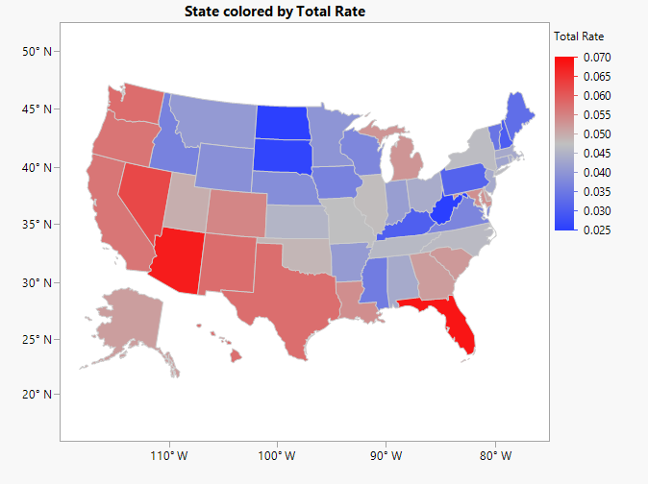
Switch variables
(Column switcher)
Open CrimeData from Sample library
Create a US map using State
Drag Total Rate into the map
I want to see the crime rate by type
No need to undo and then drag another one

Slide 27
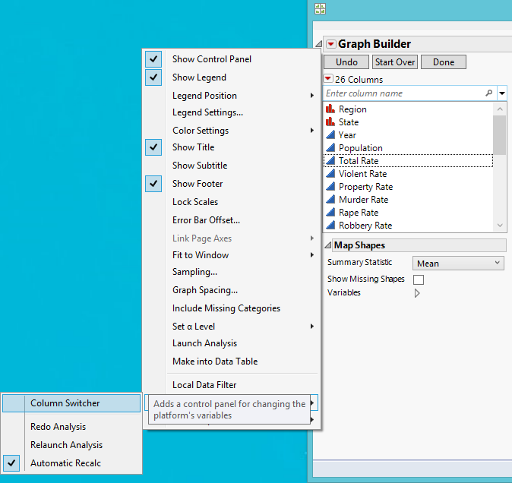
Switch variables
(Column switcher)
From the first contextual menu (reverted red triangle) choose Redo
From Redo choose Column Switcher

Slide 28
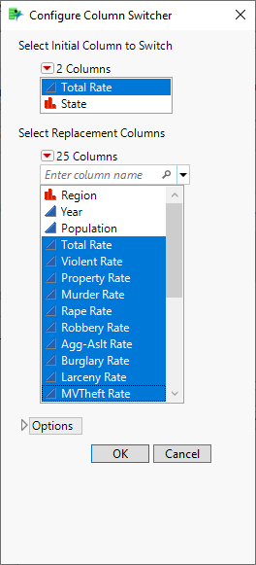
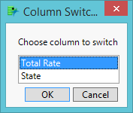
Switch variables
(Column switcher)
Choose Total Rate to switch
From the pop up menu choose all crime rates
Click OK

Slide 29
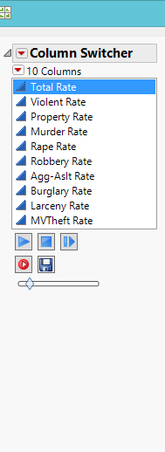
Switch variables
(Column switcher)
Press the play button to switch the columns (variables)
If you want to record the animation, press the record button. Press it again and it will stop recording.
You can adjust the pace of the animation using the slide bar
You can save and share the animation as a GIF file (Interactive HTML does no work with column switcher).

Slide 30
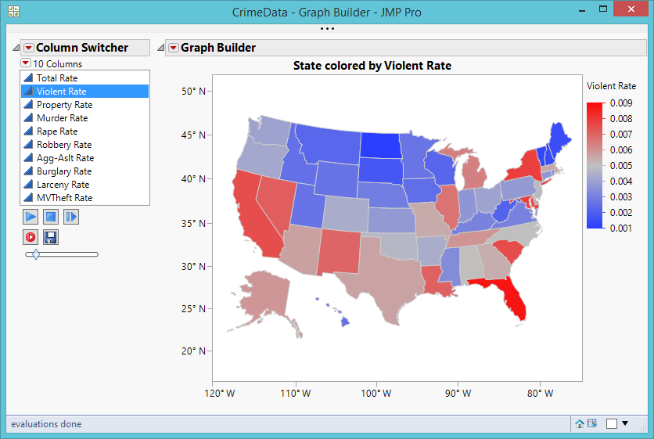
Switch variables
You can rotate the crime rate on the same map.
It is unlikely you can examine every state at the same time.
Focus on one e.g. look for which state is highest (red).

Slide 31
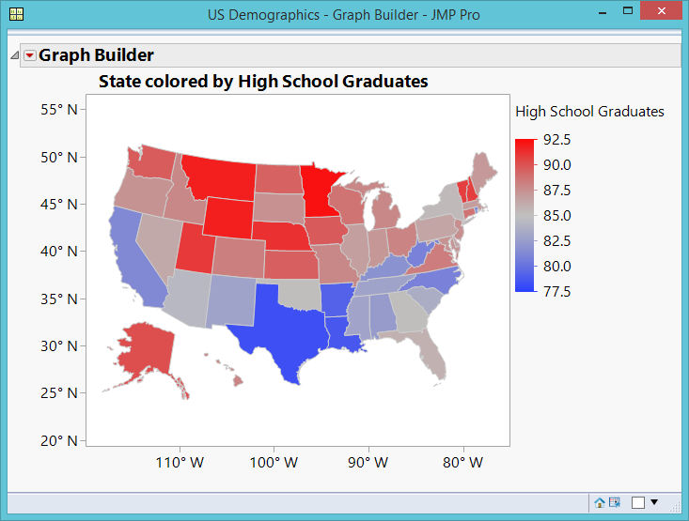
GIS Map
Sample data library: US demographics
Drag state code into Map shape (lower left)
Drag high school graduates into the map.
The Yankees (Northern states) are doing better.
But usually people perceive “red” as “risk” but higher graduation rate is a good thing.

Slide 32
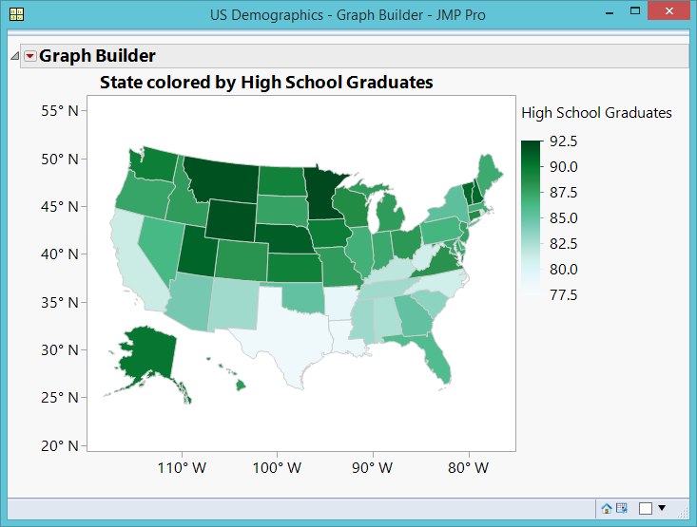
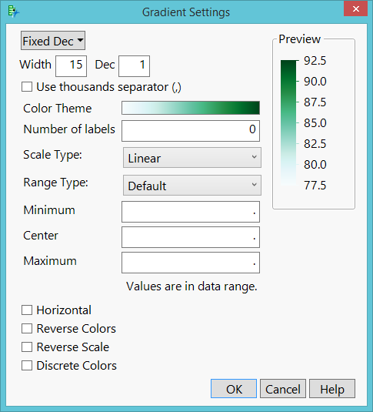
Customized GIS Map
Double-click the legend to change the color scheme.
Green means “good”

Slide 33
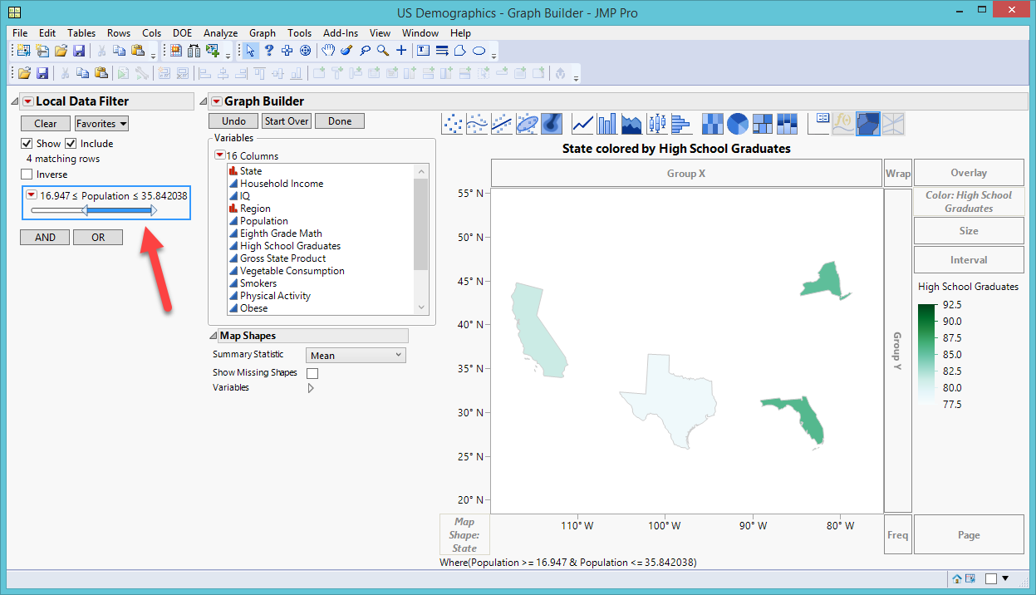
GIS Map: local filter
Wonder whether there is a relationship between population and high school graduate rate.
Add local data filter → Population
It doesn’t seem that more populated states have more high school graduates: Size doesn’t matter!

Slide 34
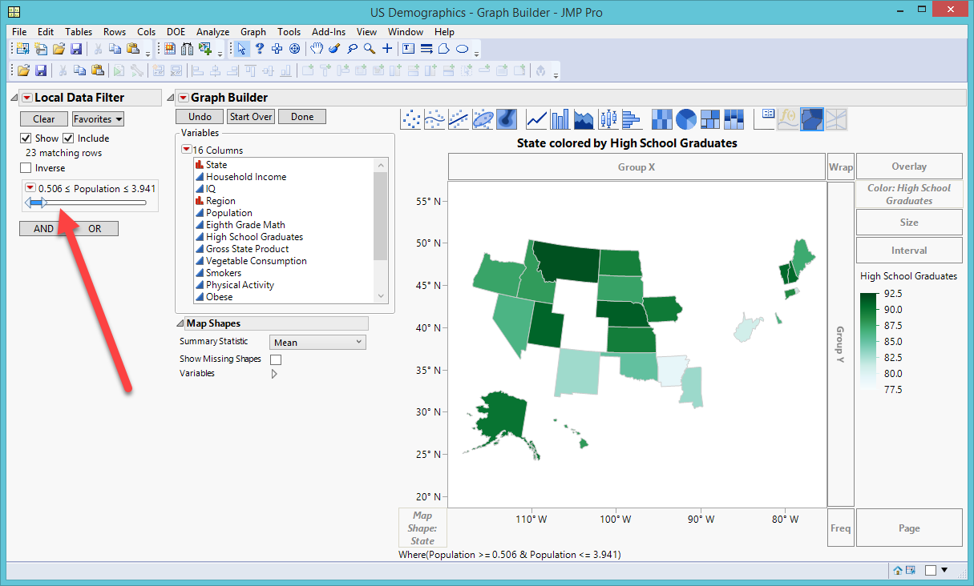
Local filter
Less populated states do not necessarily have fewer high school graduates.

Slide 35
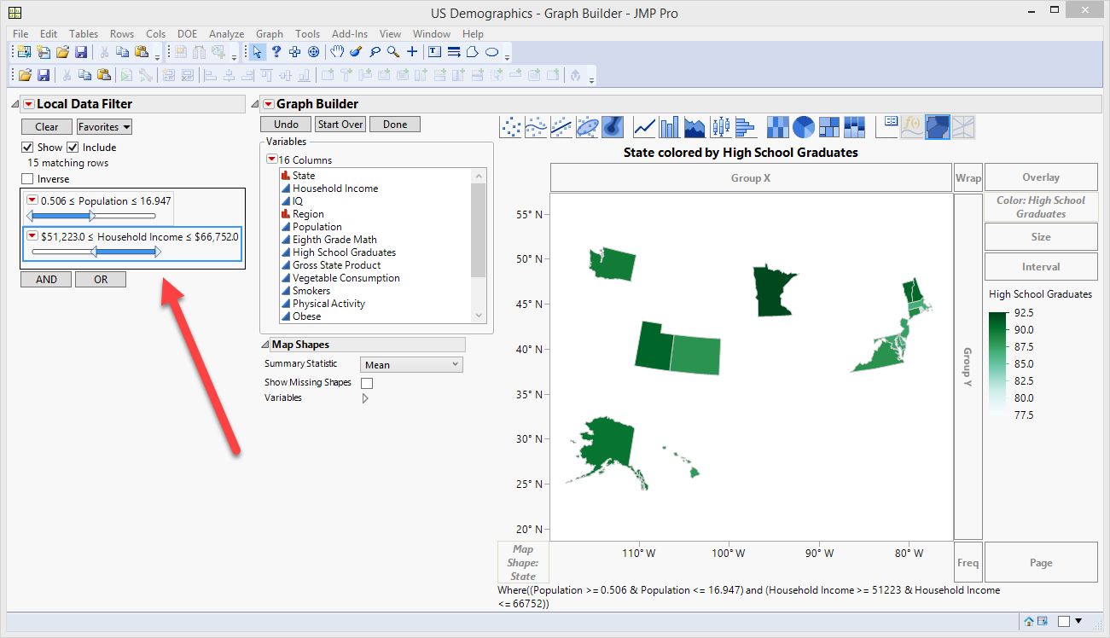
Second filter
Press AND to add a second filter
I want to see whether less populated and higher income states have a higher graduation rate.
Yes!
You can keep adding more filters

Slide 36
Ungraded Exercise
Open the data set visualization_data.jmp.
Use Graph builder to make a US map. Show college test scores on the map.
Select “Show missing shapes”
Which states have best and worst average scores?
Add local data filter. Use Rank (1 = Freshman; 4 = Senior).
Answer the same question by Rank.
Change the default color scheme to another color one.
Save the script to the data table

Slide 37
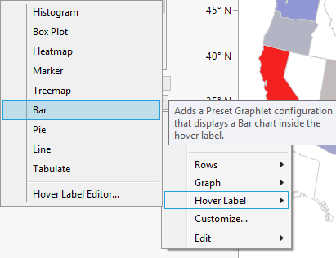
Drill down
Open Cities.jmp from Sample Data Library
Create a US Map using State
Drop Ozone into the Map
Show missing values
Right click on the map, choose Hover Label and bar.

Slide 38
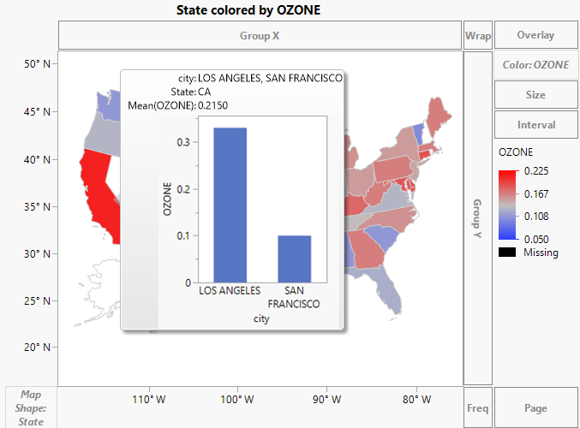
Drill down
Now when you mouse over each state, you can click open the popup to see the numbers by city.
If you choose Histogram, the bars will be horizontal.
Choosing bar chart can show vertical bars.

Slide 39
Metropolitan Statistical Areas (MSA)
“In the United States, a metropolitan statistical area (MSA) is a geographical region with a relatively high population density at its core and close economic ties throughout the area.” (Wikipedia)
“An MSA consists of one or more counties that contain a city of 50,000 or more inhabitants, or contain a Census Bureau-defined urbanized area (UA) and have a total population of at least 100,000 (75,000 in New England).” (US Census Bureau)

Slide 40
Metropolitan Statistical Areas (MSA)
From JMP Sample Data open PopulationByMSA
Open Graph Builder
Drag Metropolitan Statistical Area into Map Shape
Drag change in population into Color.
Complete the map using Background Map: Simple earth, US County.
If it is difficult to read the map, resize it.
Which MSA has the largest population growth between 2000 and 2010?

Slide 41
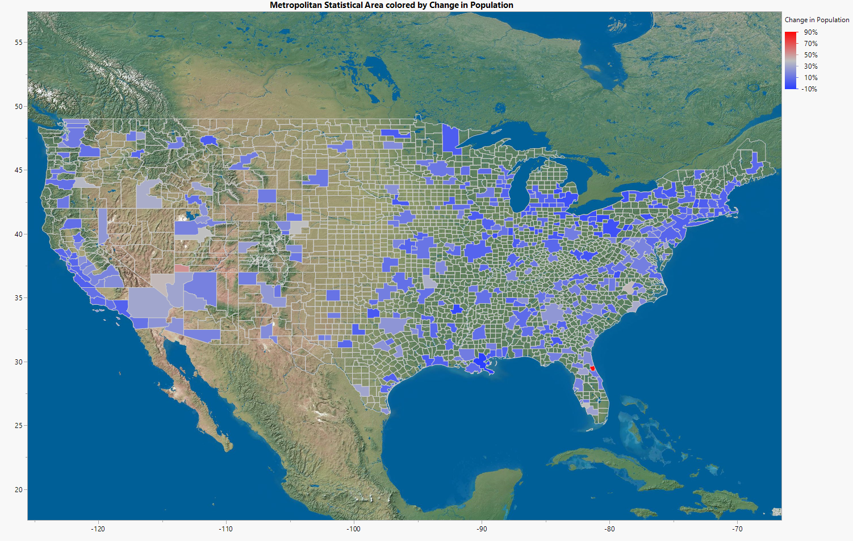

Slide 42
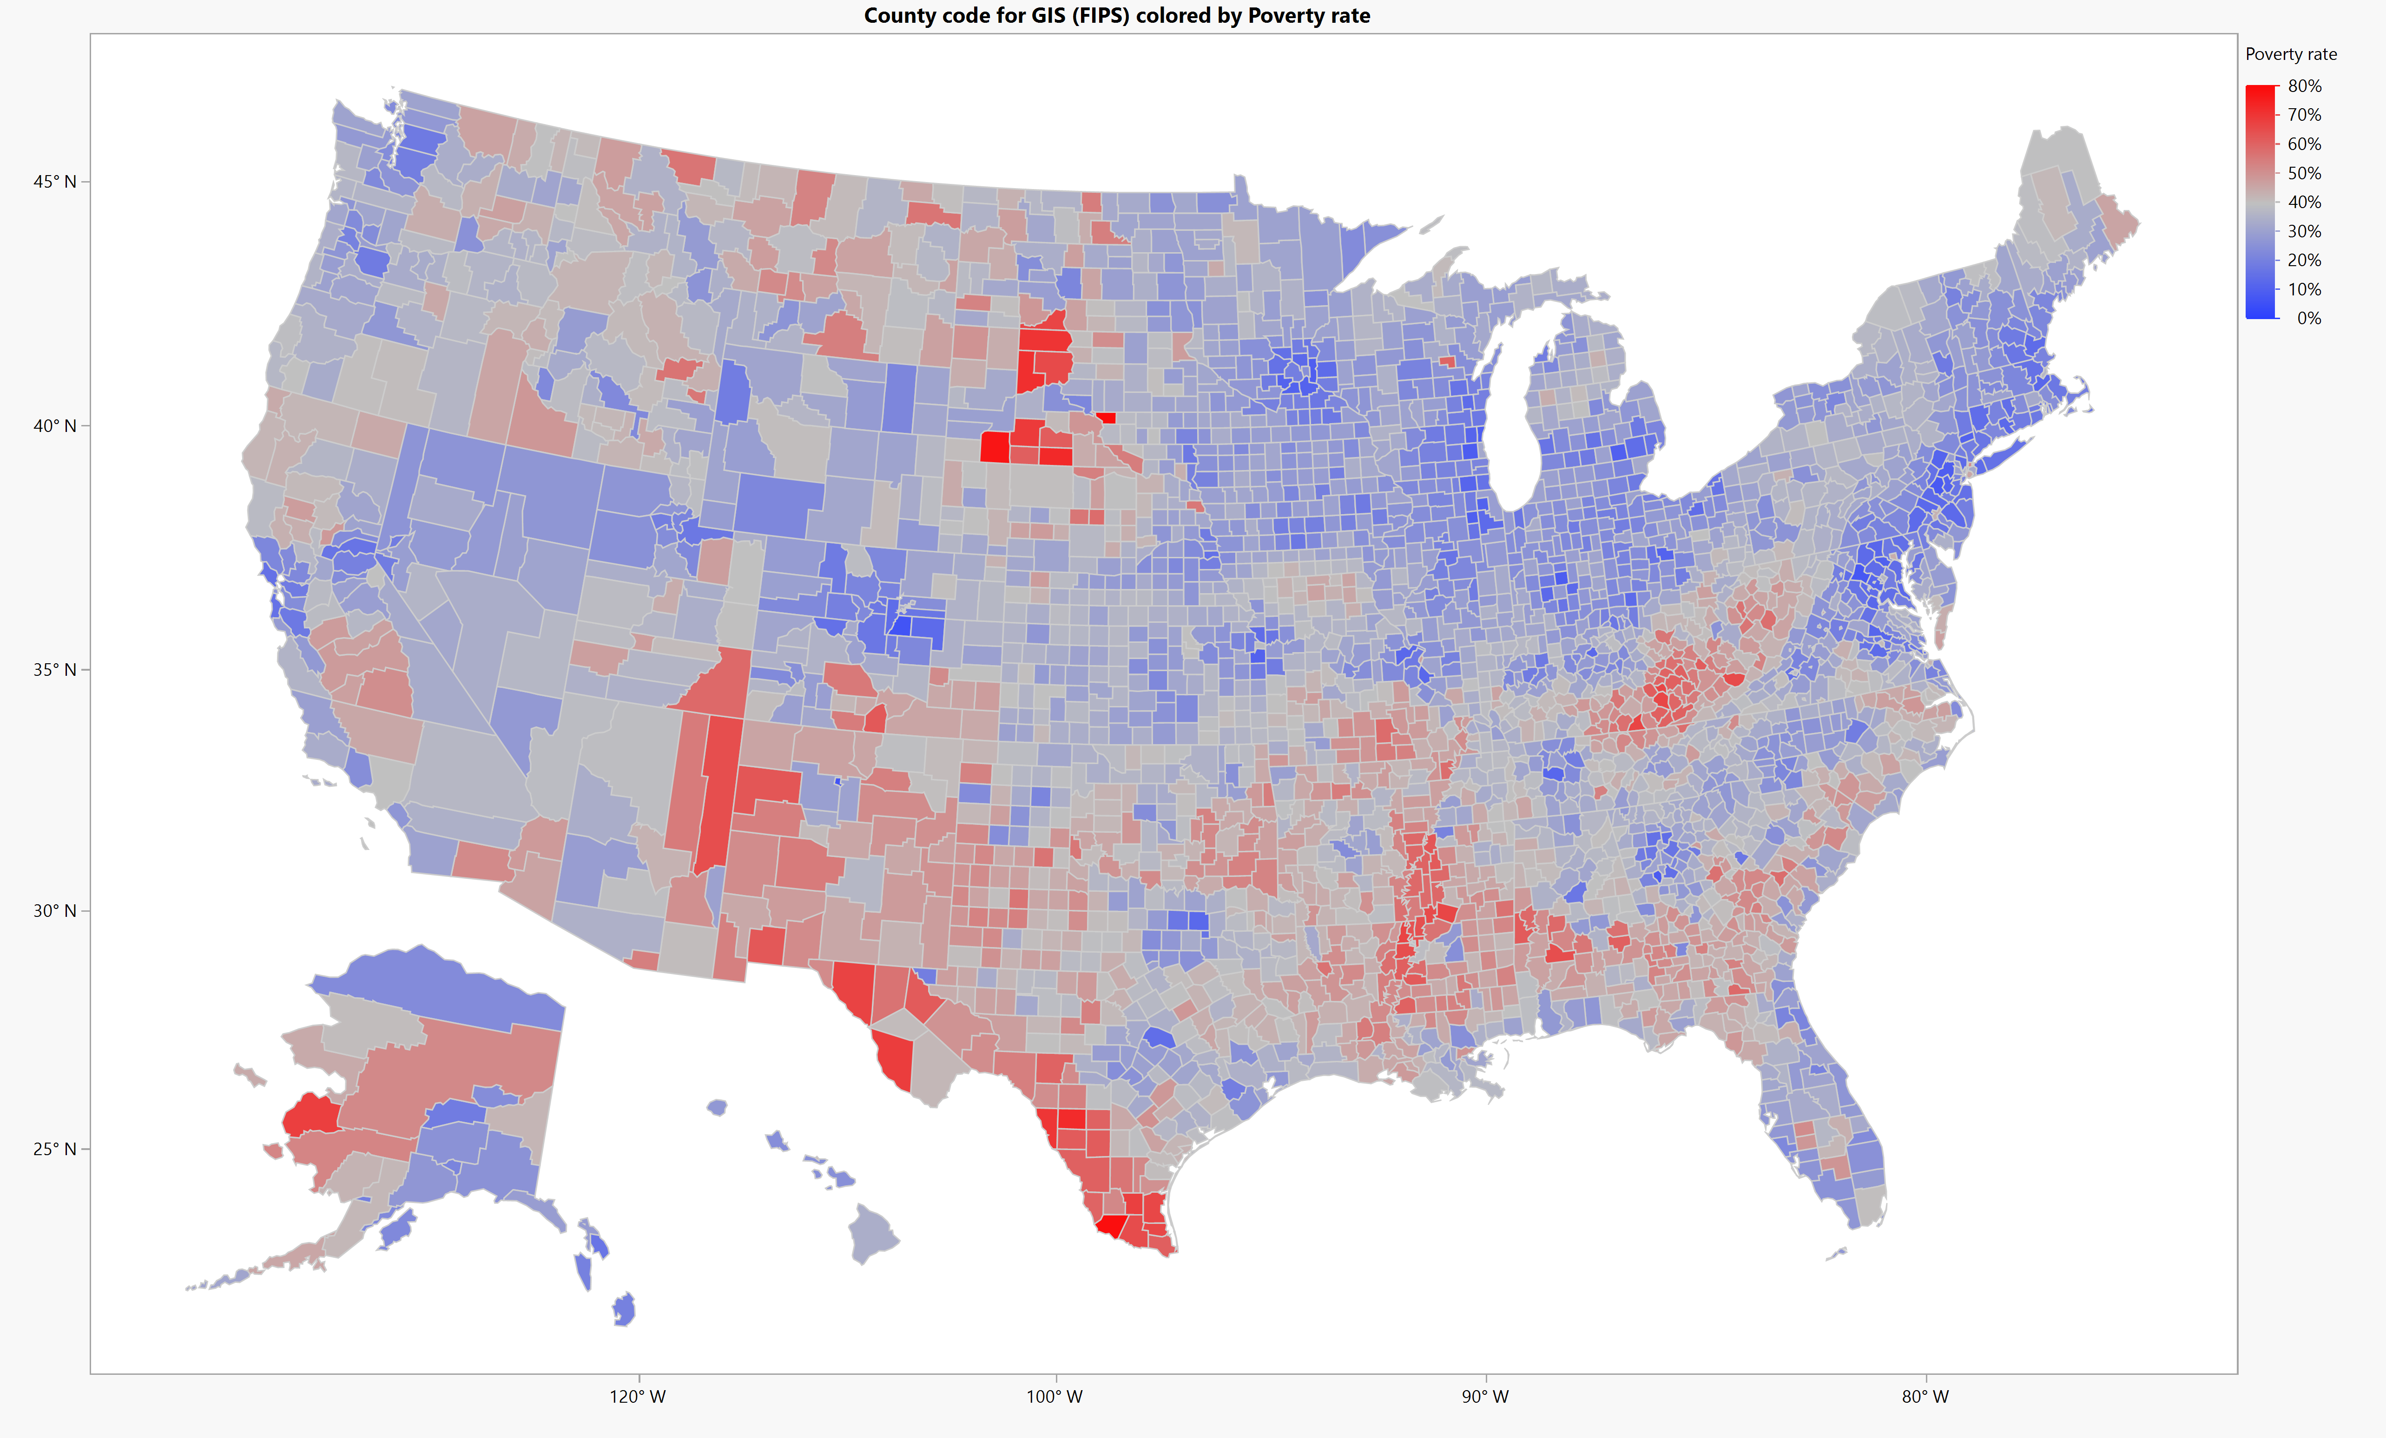
County (FIPS)
Obesity and diabetes rates for US counties: https://wiki.harvard.edu/confluence/display/hsphpophealth/Visualizing+obesity+module

Slide 43
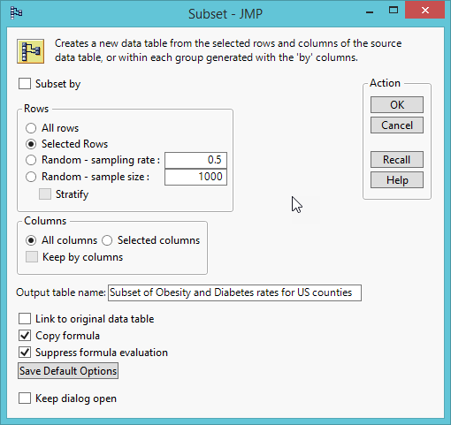
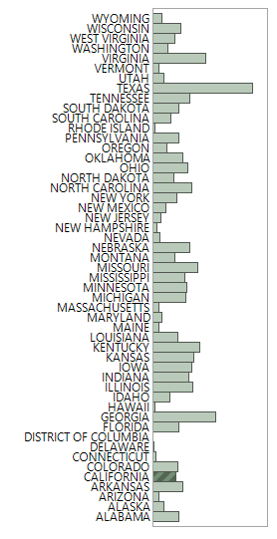
GIS Map: County
County (FIPS)
I want to look at California only. There are two ways to select a subset:
  Select CA, inverse selection, Hide and exclude others
  Create a subset from Tables

Slide 44
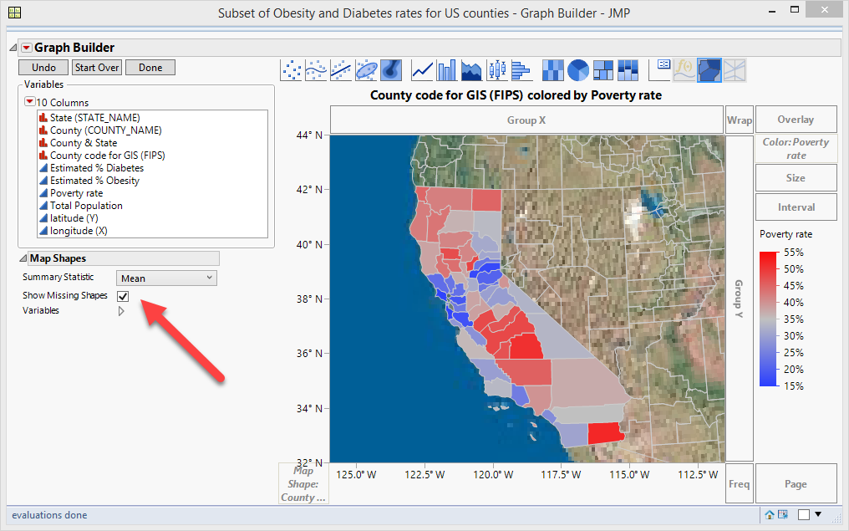
GIS Map: County
Drag County Code for GIS (FIPS) into Map Shape.
Check Showing missing shapes
Drag poverty rate into the map.
Right click to Graph → Background Map
Use Simple Earth or Detailed Earth
Use US Counties

Slide 45
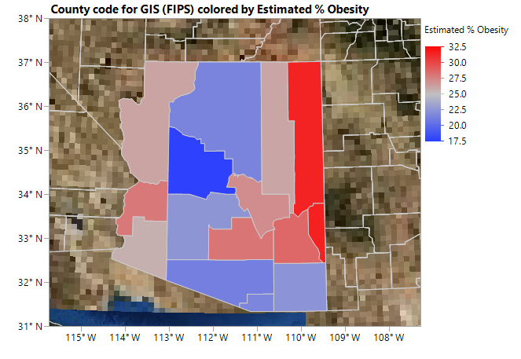
Ungraded Exercise
Download and open the dataset “Obesity and diabetes rates for US counties”
Choose Arizona data only to create a subset
Drag County code for GIS (FIPS) into the canvas
Drag estimated %Obesity into the canvas
Check “Show Missing Shapes”
Add background map
Which county has the highest obesity rate?
Which one has the lowest?

Slide 46
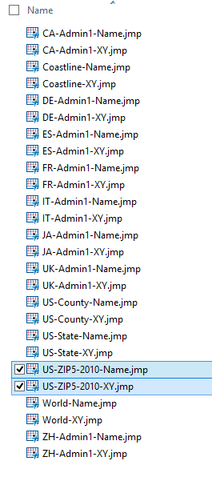
GIS Map: Zip (demo only)
Download the zip plugin (US-ZIP5-2010): https://community.jmp.com/t5/JMP-Sample-Data/US-ZIP-Code-Maps/ta-p/22545
Unzip it (Extract in Windows and double-click in Mac)
Windows: copy the two files into C:\Program Files\SAS\JMPPRO\17\Maps
Mac: From pull-down menu select Go and then Computer. Copy the two files into /MACINTOSH HD/Library/Application support/jmp/17/maps
Data set: abuse.jmp (The data set is not in public domain and thus will not be shared with you).

Slide 47
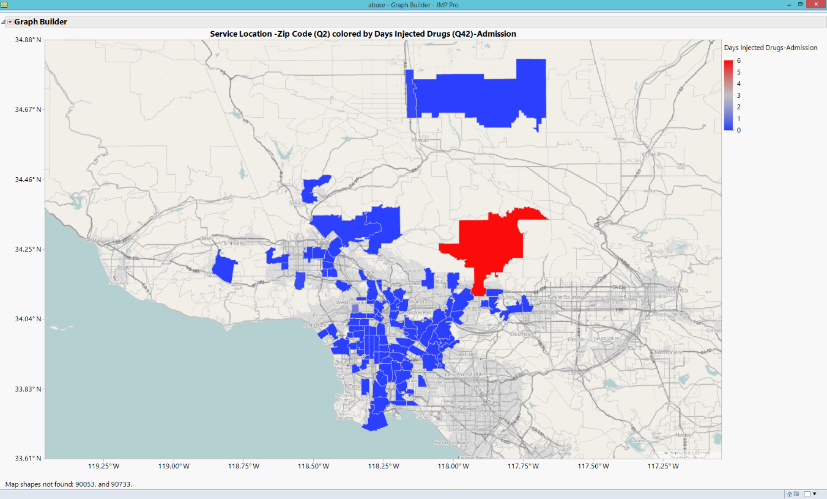
GIS Map: Zip
I want to know the geographical pattern of substance use.
Use Zip code (Q2) for map shape.
Use Street Map Service for Images and US Counties for Boundaries.
Drag Days injected drug (Q42) into the map.

Slide 48
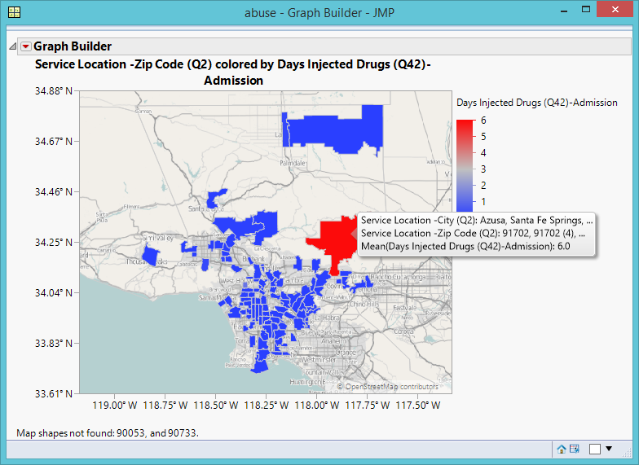
GIS Map: Zip
Keep the default color scheme because the color red signifies risk.
Wonder where the red area (highest) is.
Mouse over to show the detail.

Slide 49
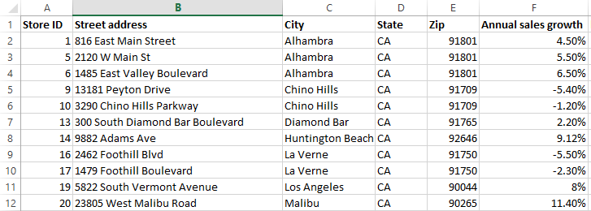
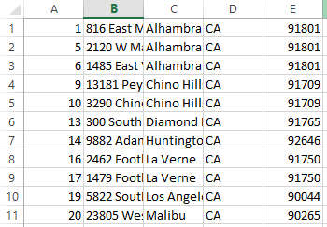
GIS Map: Street address
We can build a GIS map by street address using Geocoding
Save “store_address.xlsx” as a csv file without the header

Slide 50
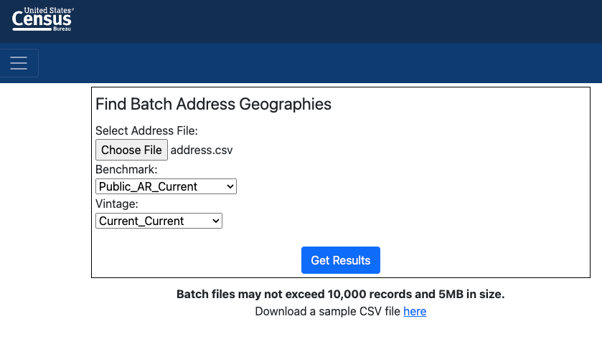
GIS Map: Street address
We pay tax and so we can use the free Geocoder made by Uncle Sam: https://geocoding.geo.census.gov/geocoder/geographies/addressbatch?form
Upload the CSV file and then click Get Results

Slide 51

Street address
Save the output and click open it.
The longitude and latitude are together.
Select the column.
Choose Text to Columns from Data.

Slide 52


Street address
Use comma as the delimiter to pull longitude and latitude apart.
Click Finish and select Replace

Slide 53

Street address
Sort the CSV data by Column A.
Copy and paste Longitude and Latitude back to the Excel file.

Slide 54


Street address
Import the Excel file into JMP and create a GIS map
Put Annual sales growth into Overlay.

Slide 55

Data preparation in Tableau
If you wish every data set is clean and well-structured, you are dreaming.
Sometimes some spatial data cannot be recognized by the GIS system.
Use data set in Tableau folder: UK-Bank-Customers.csv
Import it into Tableau (text file)
What is England?
A country or a region?

Slide 56

Data preparation in Tableau
If you drag Region into the canvas, no map is made.
You see a list of the names only.

Slide 57

Data preparation in Tableau
How about JMP?
It is a bit better. At least it can recognize England as UK, but not Northern Ireland, Scotland, and Wales.
If I drag another variable into the map, it cannot show the variation by region.

Slide 58

Data preparation in Tableau
Back to Tableau
You need to transform UK region into a new geographic role: State/Province
Afterwards, if you drag religion into the canvas, you can see a world map.
But…they are unknown!

Slide 59


Data preparation in Tableau
Click on Unknown and then Edit locations
UK regions are still unrecognizable because Tableau thinks that they are in the US.

Slide 60


Data preparation in Tableau

Slide 61

Data preparation in Tableau
Change Marks from automatic to Maps
But we need to assign different colors to different regions of UK.

Slide 62

Data preparation in Tableau
Drag Region into color

Slide 63

Basic: Frequency
To show the number of customers in each region of UK, drag UK customers (Count) into Label.

Slide 64
More on data preparation
ID | Name | Gender | Order date | Item
1 | John Smith | M | 11/11/2018 | Laptop
1 | John Smith | M | 11/12/2018 | Cell phone
1 | John Smith | M | 11/13/2018 | Power cord
1 | John Smith | M | 11/14/2018 | USB
2 | April Fu | F | 11/10/2018 | Sony camera
2 | April Fu | F | 11/11/2018 | Nikon camera
2 | April Fu | F | 11/12/2018 | Canon camera
3 | Ben Over | M | 11/13/2018 | Almay
3 | Ben Over | M | 11/14/2018 | Shanghai Vive
3 | Ben Over | M | 11/14/2018 | SK-II
3 | Ben Over | M | 11/15/2018 | Estee Lauder
4 | Eaton Mei | M | 10/10/2018 | F16
4 | Eaton Mei | M | 10/11/2018 | Rocket
4 | Eaton Mei | M | 10/12/2018 | Bible
5 | Sue Yu | F | 11/1/2018 | Honda SUV
5 | Sue Yu | F | 11/2/2018 | Toyota SUV
6 | Miles Long | M | 11/3/2018 | Ford Truck
Tableau can handle relational databases.
What is relational database?
Divide and conquer
A company has sales records of every customer.
But it is inefficient to store repeated information (e.g. demographic and contact information on every sales record)

Slide 65

Relational database
One solution is to store unique information in different tables, and then join the tables by ID when you need to combine different sources of information.
SQL or SAS
Equal join or inner join in SAS (optional):
/* method 1 */
Data file_a; ...
flag_a = 1;
proc sort; by id;
Data file_b; ...
flag_b = 1;
proc sort; by id;
Data all; merge file_a file_b; by id;
if flag_a = 1 and flag_b = 1;

Slide 66
Relational database
Equal join or inner join in SAS (optional):
/* method 2: Assume that you have affiliate ID in both files. */
Data file_a; ...
infile_a = 1;
proc sort; by id;
Data file_b; ...
proc sort; by id;
Data all; merge file_a file_b; by id;
if infile = 1;

Slide 67

Relational database: Left or right join
Left or right join in SAS (Optional)
There are two files: File A and File B. I want to merge two files but keep only the observations in File A. The join line indicates a "+=" sign rather than a "=".:
proc sort data=file_a; by id;
proc sort data=file_b; by id;
Data all; merge file_a(IN=A) file_b(IN=B); by id;
if A;

Slide 68
Relational database: Left or right join
Left or right join in SAS (Optional):
/* Method 2: Assume that you have affiliate ID in both files. */
Data file_a; ...
infile_a = 1;
proc sort; by id;
Data file_b; ...
proc sort; by id;
Data all; merge file_a file_b; by id;
if infile = 1;

Slide 69

SAS
In SAS Studio, you can choose either data steps or PROC SQL to join tables.
The two will produce identical results.
If you have two large tables, use SQL.

Slide 70


Join files in Tableau
Data set in Tableau folder: AmazingMartU2.xlsx
https://community.qlik.com/t5/QlikView-App-Development/Fact-Table-with-Mixed-Granularity/td-p/1529703
It has multiple tables
Drag ListOfOrders
Drag OrderBreakdown
The two tables are joined as many to many by matching the ID.

Slide 71

Join files in Tableau (More Control)
Drag ListOfOrders into the canvas.
From the down arrow on ListOfOrders select Open
Double-click ListOfOrders
Drag or double-Click OrderBreakdown
You can select how the tables are joined.

Slide 72

Create hierarchy
In time-series you have a temporal hierarchy for you to drill down the detail: Year, quarter, month…etc.
Similarly in GIS you can have a spatial hierarchy: Country, state/province/region, county, city…etc.
By default Tableau created a geographic hierarchy.
You can remove “Country, state, and city” and create a new one.

Slide 73

Create hierarchy
Rename “Country, state, city” to “Geography” using the down arrow

Slide 74

Create a map
Drag Geography into the canvas
You can drill down from Country to State to City by clicking on the + sign on Country → State
To return to Country only press the - sign.

Slide 75


Create a filter
Drag order Date into Filters (Use years)
Select 2012.
Right click or use the down arrow to show filters

Slide 76

Check Sales
Drag sales into size
What do you see?

Slide 77

Calculation field
Right click on Profit → Create → New calculation field
Create Profit Margin by using the formula as shown in the box.
Dag Profit Margin into Color

Slide 78

Alter color
The default color might not be intuitive
Double-click Color to edit color
Use the Red-Green Diverging
Red: low or problematic
Green: Good
Click Advanced
Change Start to -0.5 and End to 0.5

Slide 79


Slide 80

High-low by city in 2012
You can cut the empty space by zooming in.
Then use the move tool to re-position the map.

Slide 81

High-low by city in 2014
Select 2014 data
Now the unused space is cut.
But it is hard to locate so many cities in Europe.

Slide 82

High-low by city in 2014
Use the search tool to locate a city.
Type the city name in the magnifier glass e.g. Paris.
Like Google, Tableau would suggest cities whose name starts with the letter “p.”
The center dot is Paris
At mouse over, the pop-up shows the profit margin of Paris

Slide 83

Assignment 7.2
Use the data set “AmzingMartEU2”
Create a GIS map showing profit margin by country level in 2011.
The small dots are hard to see. Make the area of the whole country being marked by solid color (low or high). (Hints: Change the marks to something else, and then the back to automatic)
Make a screen capture and paste the image into a Word doc. Then Upload it to Canvas.

Slide 84

Combine GIS and time-series
Self-report data are not accurate.
http://www.creative-wisdom.com/teaching/WBI/memory.shtml
Google knows more about you than yourself!
Google pay, Gmail, Google search engine, YouTube history, Google Maps history…etc.

Slide 85

Combine GIS and time-series
Life-style analysis
Am I a green consumer (environmental care)?
Do I always eat healthy food?
Do I exercise very often?
Do I attend church regularly?

Slide 86

Combine GIS and time-series
Can be used for contact tracing or compliance analysis
In November 2020 CA Governor issued a limited stay home order in an attempt to slow the spread of COVID19.
Did people follow the stay-home order?

Slide 87


Slide 88


Slide 89

Google Street map for research
Former Google researcher Timnit Gebru used Google Street View to estimate the demographics of United States neighborhoods.
She found that socioeconomic attributes, such as voting patterns, income, race, and education can be inferred from vehicles.
If the number of pickup trucks exceeds the number of sedans, the communities are more likely to vote for the Republican party.
In December 2020 Google Manager asked her to either withdraw a pending paper pertaining to bias in language models or remove the names of all the Google employees from the paper. She refused and resigned.

