Slide 1
Data visualization of international assessment
Chong Ho Yu,
Hyun Seo Lee
Siyan Gan
Emily Lara
Azusa Pacific University, Azusa, CA

Slide 2


Slide 3
Introduction
Objective: Explore how self-efficacy in science, self-report readiness to learn, intrinsic motivation, and extrinsic motivation are correlated with test performance.
Data sources:
  2015 Programme for International Student Assessment (PISA)
  2016 Programme for International Assessment of Adult Competencies (PIAAC)

Slide 4
Limitations of Linear Models
“All models are wrong but some are useful” (George Box, 1987)
  A linear model might be wrong in that it oversimplifies a phenomenon, yet it could still have practical applications
  Both a complicated/well-fitted model and a simple model may be appropriate at different times
Psychological researchers should avoid using linear modeling prematurely
  JMP and SAS exploratory tools, are highly suitable for this task.

Slide 5

Debate in Self-Efficacy
Albert Bandura (1990, 1991, 1995, 1997) stressed the importance of self-efficacy in learning.
  One’s belief in one’s own ability can lead to success in accomplishing a task or fulfilling a goal.
Many educators boosted learners’ self-images regardless of their performance.
The ‘everybody gets a trophy’ mentality does not build true self-esteem (Twenge, 2010).
  Ego inflation and a sense of entitlement
Perhaps both views are right.

Slide 6
Programme for International Student Assessment (PISA)
PISA is administered by Organization for Economic Cooperation and Development (OECD) every four years.
Assessment of student performance in literacy, math, and science, with a different focus in each round
The 2015 focus was on science learning:
  Science self-efficacy (SSE): student’s perception of their ability to successfully complete a science-related academic task
  Science Self-belief (SSB, aka self-concept): self-evaluation of one’s general ability in a domain (Marsh & Martin, 2011).
  Ambition: measured by the degree to the statement “I see myself as an ambitious person.”

Slide 7
PISA 2015
 | Math scores |  | Science scores |  | Self-efficacy |  | Self-belief |  | Ambition
Country/Region | Mean | SD | Mean | SD | Mean | SD | Mean | SD | Mean | SD
China | 541.74 | 100.84 | 528.34 | 98.56 | 0.06 | 1.17 | 0.19 | 0.87 | 2.98 | 0.73
Hong Kong | 550.55 | 88.48 | 525.60 | 79.58 | -0.07 | 1.22 | 0.21 | 0.95 | 2.80 | 0.80
Japan | 533.30 | 88.18 | 539.03 | 93.28 | -0.46 | 1.22 | -0.51 | 1.02 | 2.64 | 0.82
Macau | 543.98 | 79.03 | 528.59 | 81.84 | -0.03 | 1.12 | -0.50 | 0.81 | 2.63 | 0.81
S Korea | 523.91 | 99.97 | 514.75 | 95.00 | -0.02 | 1.23 | 0.34 | 0.98 | 2.84 | 0.75
Singapore | 557.08 | 95.75 | 545.95 | 104.60 | 0.07 | 1.14 | 0.42 | 0.94 | 3.00 | 0.79
Taiwan | 539.20 | 103.79 | 530.85 | 99.85 | 0.19 | 1.19 | -0.01 | 0.89 | 2.92 | 0.76
USA | 474.35 | 87.92 | 502.60 | 98.04 | 0.29 | 1.29 | 0.65 | 0.95 | 3.25 | 0.72
Students in the U.S. have the lowest math and science scores but the highest scores in self efficacy in science, self-belief, and ambition.

Slide 8
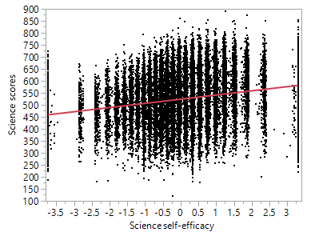
OLS Regression
The regression line is perfectly straight but this is misleading.
OLS regression model of science scores and science self-efficacy.

Slide 9
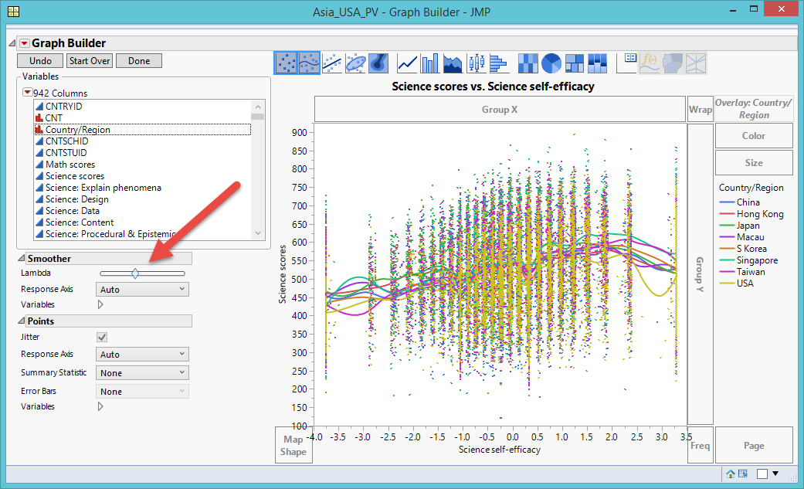
Lambda Smoothing: Over-Complicated
Default = Middle
Too complicated
Over-complicated nonlinear model.
Notes:
Specialized modeling → Fit Curve
Nonlinear fitting techniques
However, counting on numeric criteria (e.g. AICc, BIC, SSE, R-square…etc.) could result in an erroneous conclusion.

Slide 10
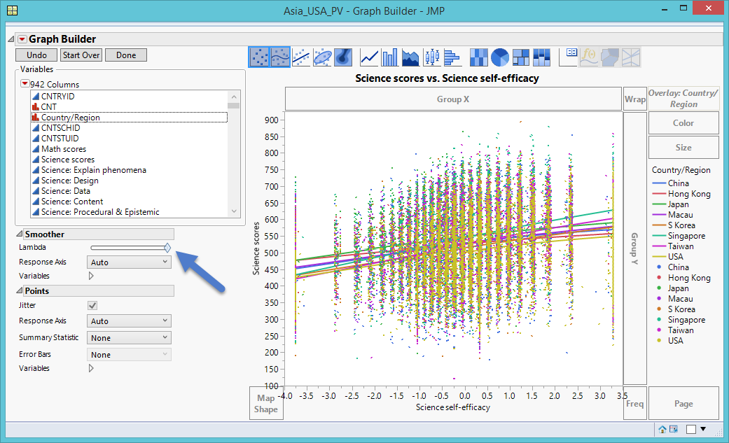
Lambda Smoothing: Over-Simplistic
Farthest Right: Shows all countries as perfectly straight
Too simplistic
Over-simplified linear model.

Slide 11
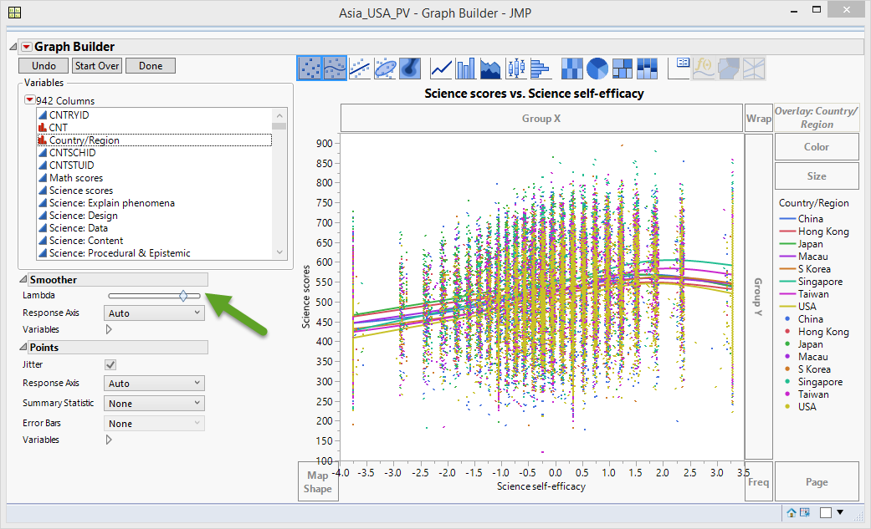
Lambda Smoothing: Non-Linear
Curvilinear relationship between science test performance and science self-efficacy
  As self-efficacy improves, science test scores increase
  After science self-efficacy passes a certain threshold, science test performance is reduced.
Useful nonlinear model
Visible in all countries/regions

Slide 12
Benefits of Non-Linear
  Useful in two ways:
    It explains why educators implementing Bandura’s theory did not produce expected results
    Necessitates a reform in our pedagogical approaches

Slide 13

Artificial Neural Network (ANN)
Neural networks try to mimic interconnected neurons in animal brains to make the algorithm capable of complex learning for extracting patterns and detecting trends.
Form of machine learning, so the artificial intelligence algorithm, not the analyst, makes the decision
(You will learn it in 553. It is a preview)

Slide 14
Artificial Neural Network (ANN)
Neural networks don’t assume linearity, and can model linearity, thus they typically outperformed regression (Somers & Casal, 2009).
Typically there are three types of layers: Input layer, hidden layer, and output layer.
Smoothing the nonlinear curves is not subjective

Slide 15
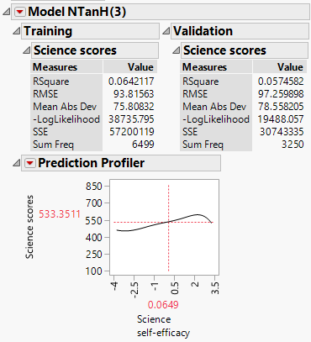
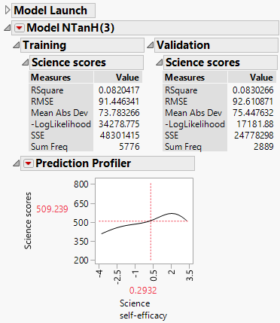
Artificial Neural Network (ANN)
ANN suggests that while enhancing self-efficacy can improve performance initially, inflating one’s self-efficacy could drag down one’s actual performance.
This pattern is common across cultures.
ANN of China’s PISA data.
ANN of USA’s PISA data.

Slide 16
PIAAC 2016
 | Numeracy |  | Problem-solving |  | Readiness to learn
Country | Mean | SD | Mean | SD | Mean | SD
Japan | 289.47 | 43.82 | 295.31 | 43.77 | 2.96 | 0.81
Singapore | 255.81 | 69.23 | 287.66 | 45.01 | 3.48 | 0.83
South Korea | 262.28 | 46.14 | 283.19 | 37.24 | 2.86 | 0.94
United Sates | 254.51 | 55.56 | 278.01 | 43.28 | 4.05 | 0.72
American participants report the highest level of readiness to learn, but the lowest test performance in numeracy and digital problem-solving.

Slide 17
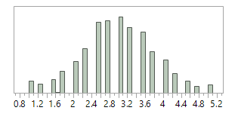
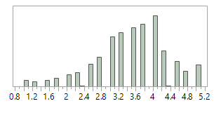
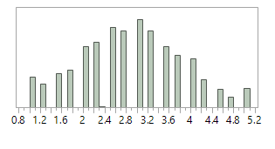
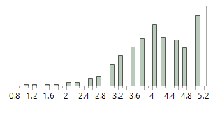
Distribution of RTL (narrow binwidth)
Japan and South Korea: Fairly normal
Singapore: Slightly skewed.
  U.S.: Skewed towards high RTL values.
  The mode is 5 meaning that most of the U.S participants view themselves as being extremely ready to learn.
Distribution of RTL of Japan
Distribution of RTL of Singapore
Distribution of RTL of South Korea.
Distribution of RTL of USA.

Slide 18
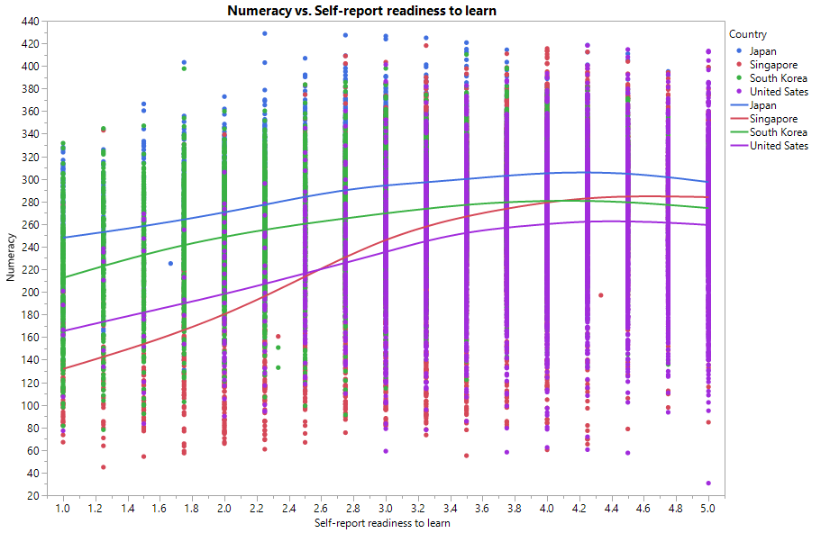
Lambda Smoothing
Curvilinear association between numeracy and RTL
  Nonlinear patterns across cultures.
Increasing perceived RTL has less adverse effect on individual’s performance.
Useful nonlinear model by Lambda smoothing

Slide 19
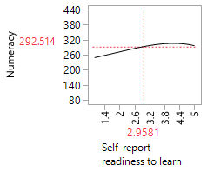
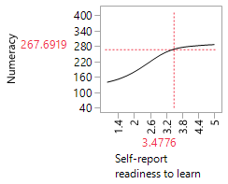
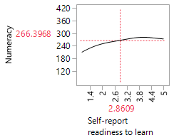
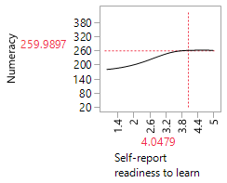
Artificial Neural Network
The findings of Lambda smoothing and ANN were congruent to each other.
ANN of Japan
ANN of Singapore
ANN of South Korea
ANN of USA

Slide 20
What PISA data reveal about motivation
PISA also collects data pertaining to instrumental motivation
The drive to learn mathematics and science based on the perception that math and science are useful to students and their future studies and careers.

Slide 21
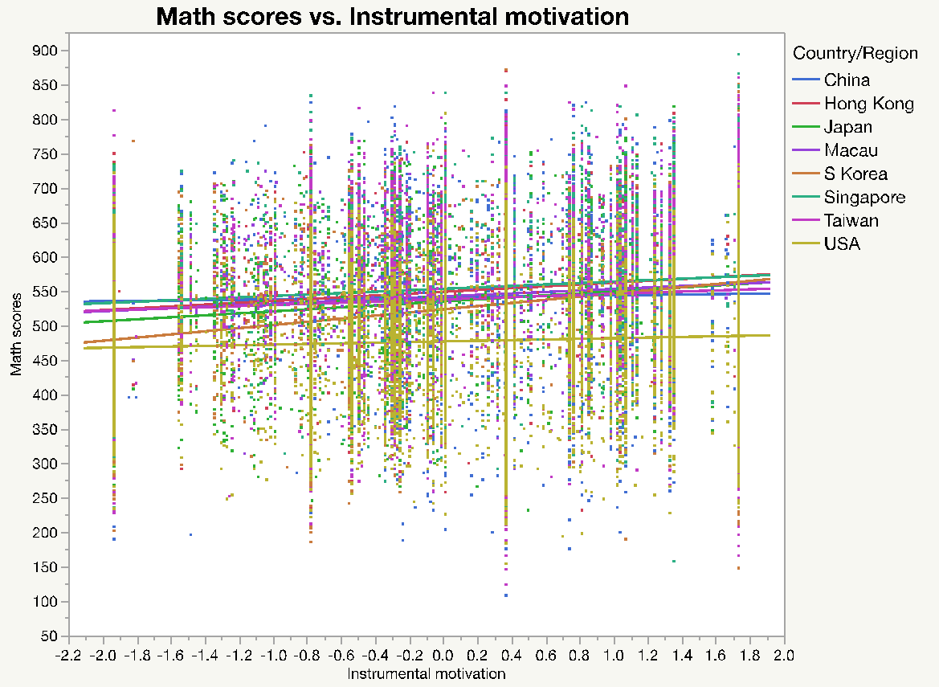
What PISA data reveal about motivation
There is a positive relationship between test performance in math and science and instrumental motivation in Asia
But not in USA
Relationship between PISA math performance and instrumental motivation

Slide 22
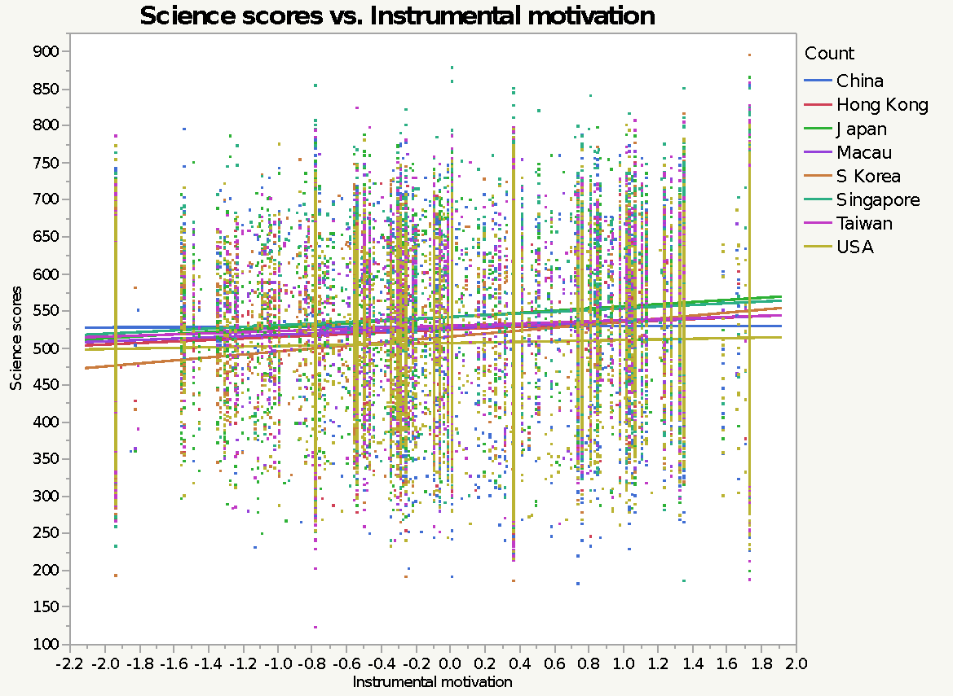
What PISA data reveal about motivation
There is a positive relationship between test performance in math and science and instrumental motivation in Asia
But not in USA
Relationship between PISA math performance and instrumental motivation

Slide 23
What PISA data reveal about motivation
Conventional wisdom: A seesaw relationship between intrinsic motivation and extrinsic motivation. While on average Americans are not extrinsically motivated, they can be intrinsically motivated.
PISA data show that there is no seesaw association between intrinsic motivation and extrinsic motivation.

Slide 24
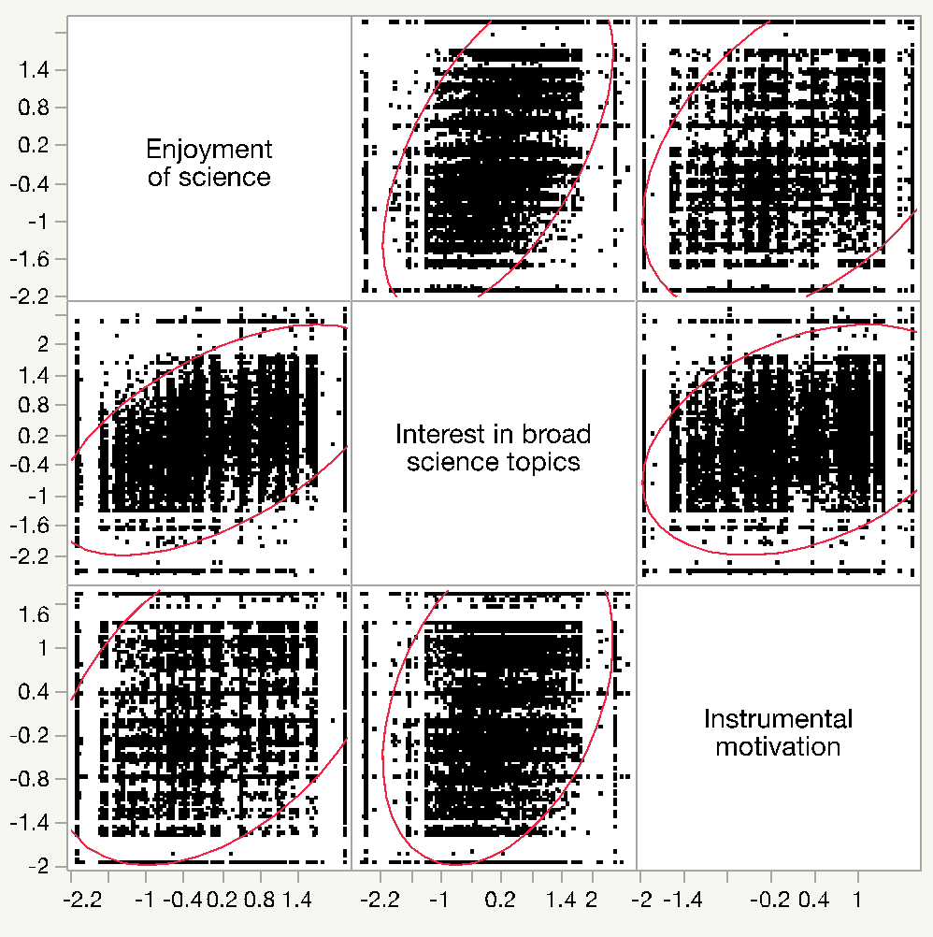
What PISA data reveal about motivation
Because of overplotting, there is a possibility that the pattern is hidden inside the data cloud.
Scatterplot matrix of variables related to intrinsic and extrinsic motivation

Slide 25
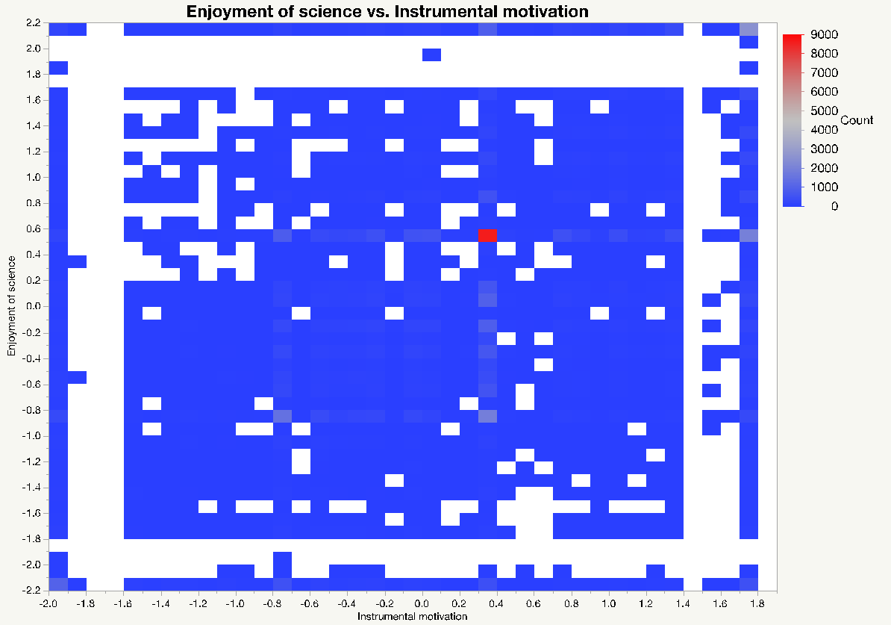
What PISA data reveal about motivation
In a heat map, if there is a high concentration of observations, the hue is closer to the red end of the spectrum
Otherwise, it is closer to the blue end of the spectrum.
Heat map of enjoyment of science and instrumental motivation

Slide 26
What PISA data reveal about motivation
If there is a hidden relationship, one could see a red-pink ellipsoid in the scatterplot.
No such pattern was found
Heat map of enjoyment of science and instrumental motivation

Slide 27
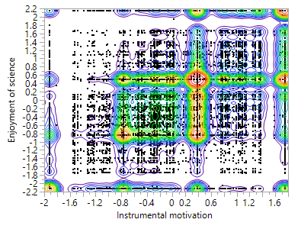
What PISA data reveal about motivation
The non-parametric contour lines verifies that there is no pattern or association between enjoyment of science and instrumental motivation.
Non-parametric contours of enjoyment of science and instrumental motivation

Slide 28
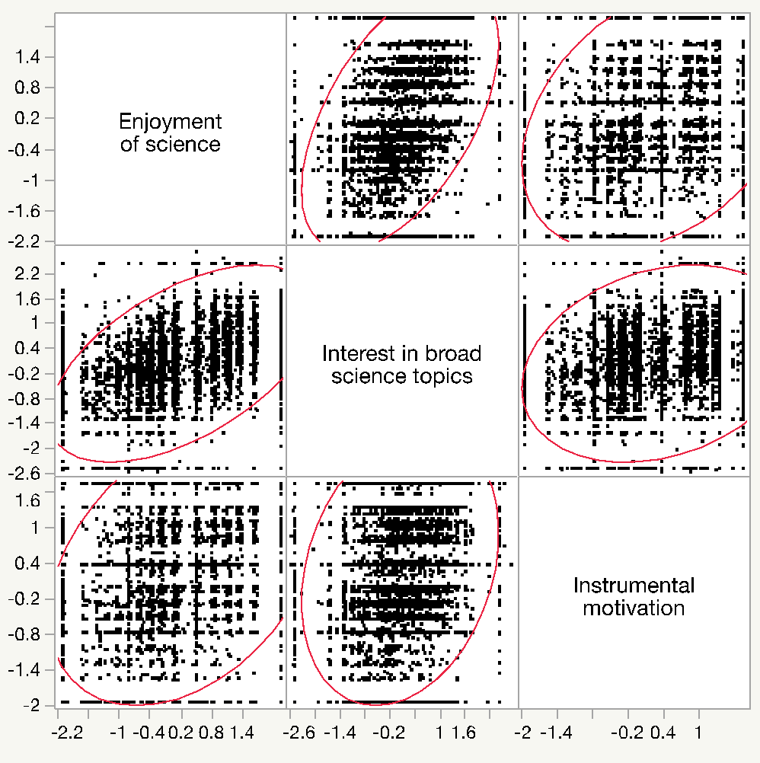
What PISA data reveal about motivation
In the US sample, no relationship is observed between intrinsic and extrinsic motivation.
There is a noticeable association between enjoyment of science and interest in broad science topics
Scatterplot matrix of variables related to intrinsic and extrinsic motivation in the US sample

Slide 29
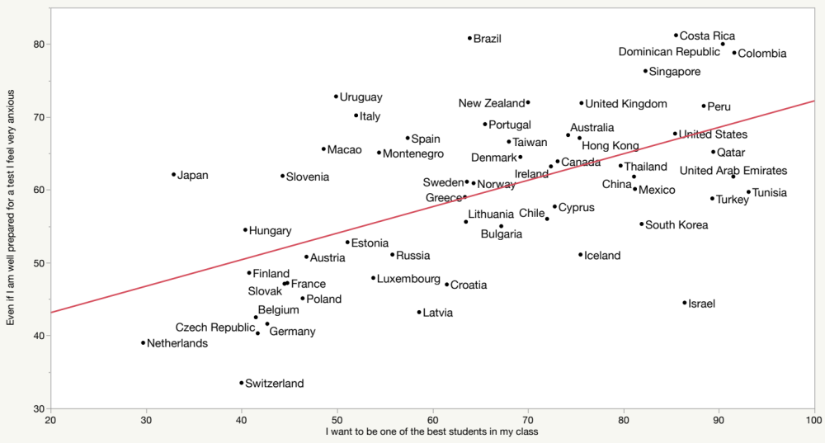
What PISA data reveal about motivation
Relationship between achievement motivation and test-related anxiety in 2015 PISA

Slide 30
What PISA data reveal about motivation
Some Eastern countries or regions rank among the top in terms of the percentage of students who reported test-induced anxiety (Singapore = 5, Hong Kong = 14, and Macao = 17), others rank near the bottom (e.g. Japan = 24, China = 27, and South Korea = 37).
Some Western countries are among the top (e.g., U.K. = 8 and US = 12) whereas others are among the lowest (e.g. Iceland = 41 and Germany = 53).

Slide 31
What PISA data reveal about motivation
US and Hong Kong have similar percentages of students who suffer from test-related anxiety (67.1% vs. 61.1%).
US has a higher percentage than Hong Kong of students who want to be one of the best (85.4% vs. 75.4%).

Slide 32
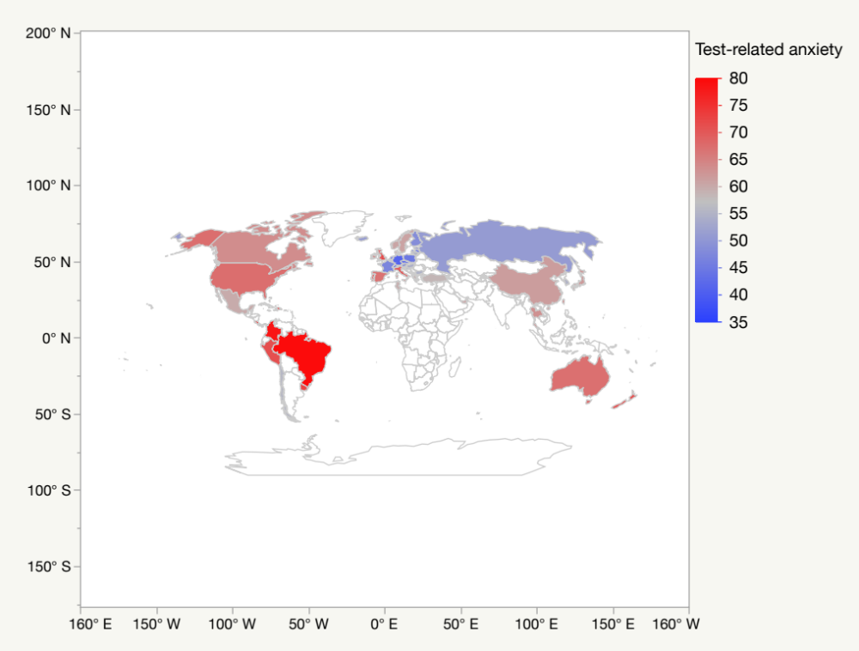
What PISA data reveal about motivation
Test-related anxiety seems to be more prevalent in North America, South America, and Australia.
But less in Western Europe, Russia, and certain Asian countries.
(GIS will be taught in Unit 7)
GIS map of test-related anxiety

