Slide 1

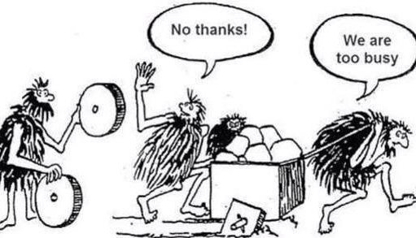
Hypothesis testing:
A die-hard tradition
Chong Ho Yu (Alex)

Slide 2
The earth is round!
Hypothesis testing is also known as confirmatory data analysis (CDA), which has been the norm in the academic world for about a century.
In 1989, when Kenneth Rothman started the Journal of Epidemiology, he discouraged over–reliance on p values. However, the earth is round.
When he left his position in 2001, the journal reverted to the p–value tradition (Nuzzo, 2014).

Slide 3
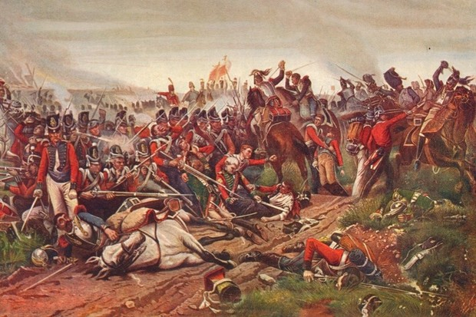
P value: Men are expendable!
Dr. John Arbuthnot (1710) argued that the sex ratio at birth was a manifestation of Divine Providence.
He pointed out that equal numbers of both genders at birth would be counter–productive to society. All soldiers were men and therefore men suffer a greater death rate than women.

Slide 4
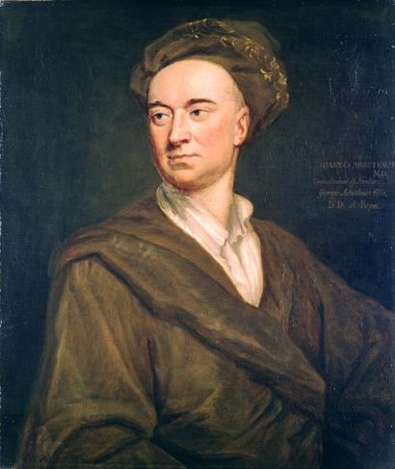
P value: Men are expendable!
There are always more males than females and this the equilibrium is reached.
Using 82-year data he computed the probability of the births of males exceeded females, under the null hypothesis that in each pregnancy the gender of the baby is independent.

Slide 5
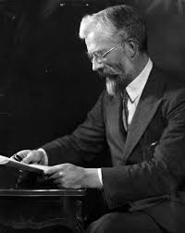
Henry Ford's Model T in Statistics
Most statistical procedures that we still use today were invented in the late 19th century or early 20th century.
The t-test was introduced by William Gosset in 1908.
ANOVA was invented by R. A. Fisher around the1920s and 30s.
The least square criterion in regression was discovered in 1805.

Slide 6

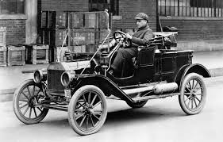

Will you do these?
Will you drive your grandfather's Ford Model T?
Will you use a Sony's Walkman instead of a MP3 player?
Will you use a VHS tape instead of Blue Ray?

Slide 7
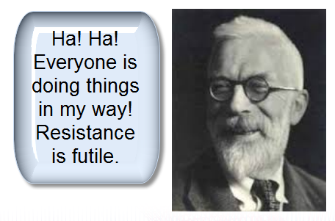
The reasons are...
“Everybody is doing hypothesis testing.” (That “everybody” may be the “everybody” you know)
“90% of the journals require hypothesis testing.”
“All textbooks cover hypothesis testing.”

Slide 8
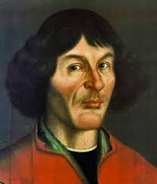
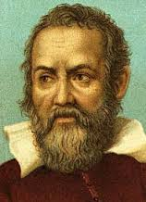
Is it a sound rationale?
“Everybody is doing this” is NOT an acceptable rationale to defend your position.
Before the 16th century, almost everyone believed that the sun, the moon, and the stars orbit around the earth (Geocentric model).
Had Copernicus and Galileo followed what everyone was doing, there would not have been any scientific progress!

Slide 9
Shortcoming 1: Does not address treatment effectiveness
Very often researchers interpret a significant p-value as evidence of treatment effectiveness.
Hypothesis testing does not evaluate how likely the hypothesis is right given the data P(H|D).
It assumes that the null hypothesis is right and examines how likely the data will occur in long run given the null is true.
It does not tell you what you want to know!

Slide 10
Shortcoming 1: Do not address treatment effectiveness
When the US President asks a four-star general to estimate the potential casualty of a possible war, he replies, "Not zero. Some soldiers will die."
Your boss wants you to give a raise and asks you how much you expect, you answer, "Not zero. I deserve more compensation."
After you have gone through a rigorous fitness program, your wife asks you how much weight you lost. You answer, "Not zero. I lost a few pounds."

Slide 11

Shortcoming 1: Do not address treatment effectiveness
Null = no
When the null hypothesis is rejected, at most the conclusion is: "The null hypothesis is false! Not null! The effect, difference, or correlation is not zero.“
You need to report the effect size (recommended by APA).

Slide 12
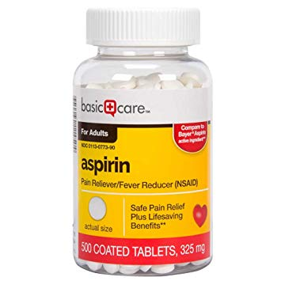
Shortcoming 1: Do not address treatment effectiveness
Study of aspirin for preventing myocardial infarction (MI).
n = 22,000
p < .00001. Yeah!!!
The study was stopped early due to the “conclusive evidence,” and aspirin was highly recommended.
Effect size: 0.77% only
Further research found even smaller effects, and the recommendation was modified.

Slide 13
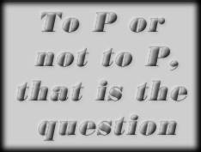
Shortcoming 1: Do not address treatment effectiveness
Hypothesis-driven
The logic of hypothesis testing is: Given that the null hypothesis is true how likely we can observe the data in the long run? P(D|H)?
What we really want to know is: Given the data what is the best theory to explain the data no matter whether the event can be repeated : P(H|D)?

Slide 14
Shortcoming 1: Do not address treatment effectiveness
Affirming the consequent
P(D|H) <> P(H|D): “If H then D" does not logically imply "if D then H".
If the theory/model/hypothesis is correct, it implies that we could observe Phenomenon X or Data X.
X is observed.
Hence, the theory is correct.

Slide 15
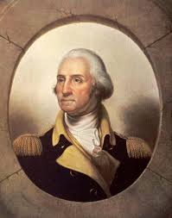

Shortcoming 1: Do not address treatment effectiveness
If George Washington was assassinated, then he is dead.
George Washington is dead.
Therefore George Washington was assassinated.
If it rains, the ground is wet.
The ground is wet.
It must rain.

Slide 16
Can we “prove” or “disprove”?
Hypothesis testing or confirmatory data analysis (CDA):
  Start with a strong theory/model/hypothesis
  Collect data to see whether the data match the model.
  If they fit each other, did you “prove” the theory?
  If they don't, did you “disprove” it?
  At most you can say whether the data and the model fit each other. In philosophy it is called “empirical adequacy.”

Slide 17
Can we “prove” or “disprove”?
In the O. J. Simpson case or the Casey Anthony's case, there is not enough evidence to convict the suspect, but it doesn't mean that we have proven the otherwise.
Failing to reject the null hypothesis does not mean that the null is true and thus we should accept it. At most we can say we fail to reject the null hypothesis because the absence of evidence is not the evidence of absence (proving the null).

Slide 18


God: Failed hypothesis
Prominent physicist Victor Stenger:
“Our bones lose minerals after age thirty, making them susceptible to fracture and osteoporosis. Our rib cage does not fully enclose and protect most internal organs. Our muscles atrophy. Our leg veins become enlarged and twisted, leading to varicose veins. Our joints wear out as their lubricants thin. Our retinas are prone to detachment. The male prostate enlarges, squeezing and obstructing urine flow.”
Hence, there is no intelligent designer.

Slide 19
Logical fallacy
Hypothesis: If there is a God or intelligent designer, he is able to design a well-structured body. To prove the existence of God, we look for such data: P(D|H)
No such data: Our bones start losing minerals after 30, and there are other flaws, and thus God is a “failed” hypothesis.
Confirmation bias: You will see what you are looking for.
But there are other alternate explanations that can also fit the data.
e.g. God did not make our body last forever, and thus dis-integration and aging is part of the design.

Slide 20


Shortcoming 2:
Easy to reject the null
Loftus (1996) mocked that "rejecting a typical null hypothesis is like rejecting the proposition that the moon is made of green cheese.
"This is a breakthrough in engineering science. Repeated experiments confirm that a Porsche 911 can outrun a Honda Civic."

Slide 21
Shortcoming 2:
Easy to reject the null
Use an inferior or do-nothing control group!
Something is better than nothing
Once a series of studies were conducted to evaluate Daisy Quest, a computerized program used to teach phonemic awareness in Grades K through I. The results were said to be positive, but in the studies (e.g., Barker & Torgesen, 1995), the control groups were not taught phonemic awareness at all.

Slide 22

Shortcoming 2:
Easy to reject the null
When the sample size is large enough, even a trivial effect seems to be significant, resulting in rejecting the null hypothesis.
In 2010-11 Daryl Bem conducted a series of experiment to assert that extrasensory perception (ESP) is real.
N = 1,000
In one study two curtains were presented to the participants and behind one of them is an erotic picture.

Slide 23
Shortcoming 2:
Easy to reject the null
By chance alone the participants should be correctly 50% but the actual hit rate is 53.1%. The p value is significant!
The explanation is: Our erotic desire enables us to predict the location of the erotic image.
3.1% better. Is it a big deal?
He reported the one-sided p value instead of the two-sided.

Slide 24
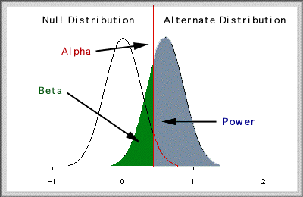
Shortcoming 3:
A fusion of two paradigms
R. A. Fisher: Significant testing (null)
Karl Pearson and Neyman: Hypothesis testing: (Alternate hypothesis, Type I error, Type II error [beta], power...etc.)
Read Philosophy of Fisherian and Pearsonian schools in Yu, C. H. (2006). Philosophical foundations of quantitative research methodology. Lanham, MD: University Press of America.

Slide 25
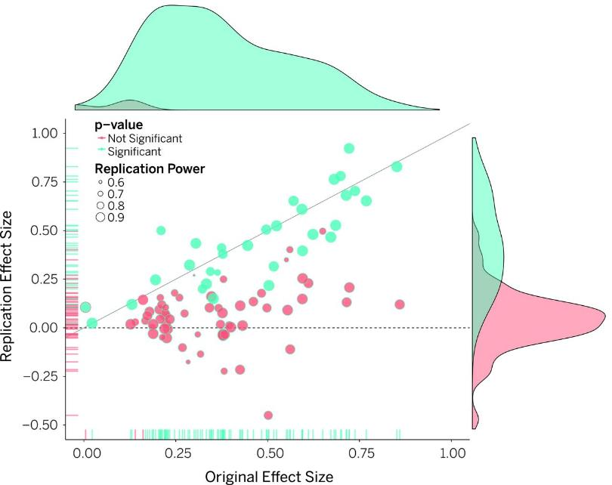
Shortcoming 4: Lack reproducibility
Open Science Collaboration (OSC) (2015) found that a large portion of the replicated results were not as strong as the original reports in terms of significance (p values) and magnitude (effect sizes).
97% of the original studies reported significant results (p < .05), but only 36% of the replicated studies yielded significant findings.
The average effect size of the replicated studies was only half of the initial studies (ES = 0.197 vs. ES = 0.403).

Slide 26
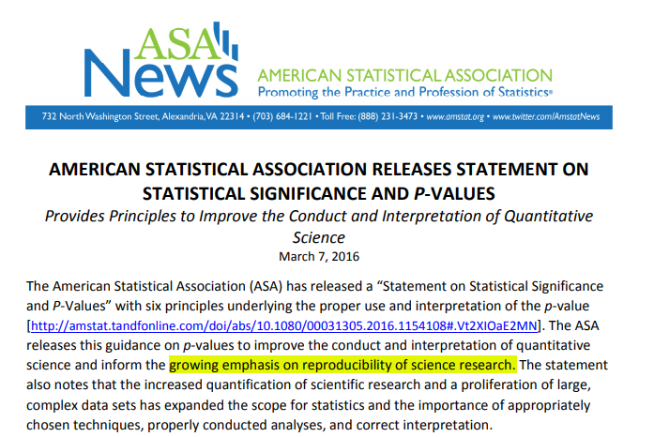
Shortcoming 4: Lack reproducibility

Slide 27
Shortcoming 5:
Parametric assumptions about data structure
Certain parametric assumptions are required. For example, in Analysis of Variance (ANOVA) there are three assumptions:
  Observations are independent.
  The sample data have a normal distribution.
  Scores in different groups have homogeneous variances.
However, very often the data structure of the sample does not meet the assumptions.

Slide 28
Shortcoming 6:
Probability as a relative frequency in long run
Hypothesis testing is based upon probability, which is defined as a relative frequency in long run.
It is problematic to apply this frequentist view of probability into a single event or a new event (Carver, 1978). For example,
  What is the probability that the universe originated from the big bang?
  What is the probability that a newly invented super-Java enabled Web-based instruction is effective in teaching computer sciences?

Slide 29
Shortcoming 7:
Count on theoretical distribution
The test statistics is compared against a “known” distribution but indeed we don’t know!
What researchers did is to make inferences from the population to the sample, but not the sample to the population.
Tukey (1986) questioned our reliance on supposedly known distributions; he asserted that progress of statistics can only be made when we move away from certainty.

Slide 30
Shortcoming 8: Point estimate
Unlike confidence interval (CI) that indicates a possible range of the population parameter, hypothesis testing yields a point estimate.
Based on the conviction that in the population there is one and only one fixed constant that can represent the true parameter.
This belief is challenged by Bayesians because in reality the population body is ever changing and thus there is no such thing as a fixed parameter.

Slide 31
Shortcoming 9: Arbitrary cutoff
Nothing "magical" about .05.
Fisher (1956) stated, "No scientific worker has a fixed level of significance from year to year, and in all circumstances, he rejects hypothesis; he rather gives his mind to each particular case in the light of his evidence of ideas" (p.41).
Rosnow and Rosenthal (1989) stated his objection against blindly using .05 in a humorous way: "God loves the .06 nearly as much as .05" (p.1277).

Slide 32
Shortcoming 9: Arbitrary cutoff
In response to mindless misuse of p values, ASA (2016) recommends:
  1. P-values can indicate how incompatible the data are with a specified statistical model (fit or unfit between the data and the model)
  2. P-values do not measure the probability that the studied hypothesis is true, or the probability that the data were produced by random chance alone.
  3. Scientific conclusions and business or policy decisions should not be based only on whether a p-value passes a specific threshold.

Slide 33
Shortcoming 9: Arbitrary cutoff
In response to mindless misuse of p values, ASA (2016) recommends:
  4. Proper inference requires full reporting and transparency.
  5. A p-value, or statistical significance, does not measure the size of an effect or the importance of a result (The effect size is needed).
  6. By itself, a p-value does not provide a good measure of evidence regarding a model or hypothesis.

Slide 34
Shortcoming 10:
Unknown error and circularity:
The p value indicates the probability of observing the statistics given the null is true.
If the null is really true, at most the Type I error rate is 5%. However, the Type II error rate would be as high as 95%!
Schmidt and Hunter (2014): If the researcher does not know whether the null is true or not, then he cannot tell whether the error is tied to Type I or Type II. But if he knows that the null is true, then there is no need to perform the test.

Slide 35
Shortcoming 10:
Incapable of performing big data analytics
Experts on data science predict that the size of digital data will double every two years; this indicates a 50-fold growth from 2010 to 2020 (Ffoulkes, 2017).
Traditional statistical procedures were designed for small-sample studies only. If the n is too large, virtually any trivial effect would be mistakenly detected as significance.

Slide 36
Shortcoming 10: Incapable of performing big data analytics
In California the average SAT score is 1055. A superintendent wanted to know whether the mean score of his students is significantly behind the state average. After randomly sampling 50 students, he found that the average SAT score of his students is 1050 and the standard deviation is 100.
The superintendent ran a one-sample t-test at: https://www.graphpad.com/quickcalcs/OneSampleT1.cfm?Format=SD

Slide 37
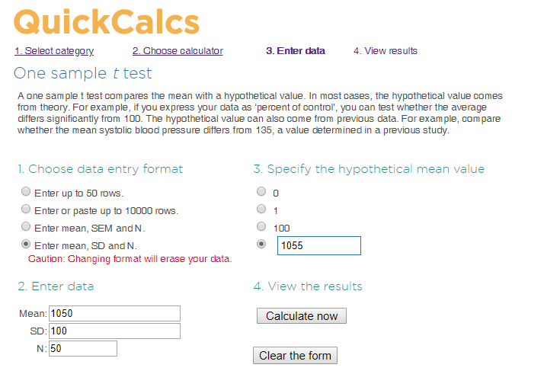

Slide 38
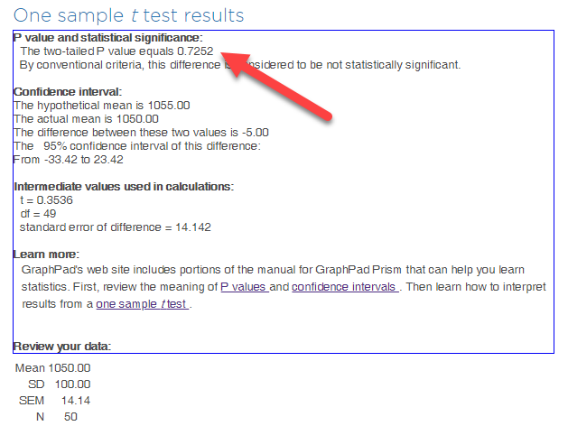

Slide 39
Shortcoming 10: Incapable of performing big data analytics
The superintendent was relaxed and said, “We are only five points out of 1055 behind the state standard. Even if no statistical test was conducted, I can tell that this score difference is not a big deal.”
But a statistician recommended replicating the study with a sample size of 500.
As the sample size increased, the variance decreased. While the mean remained the same (1050), the SD dropped to 50.

Slide 40
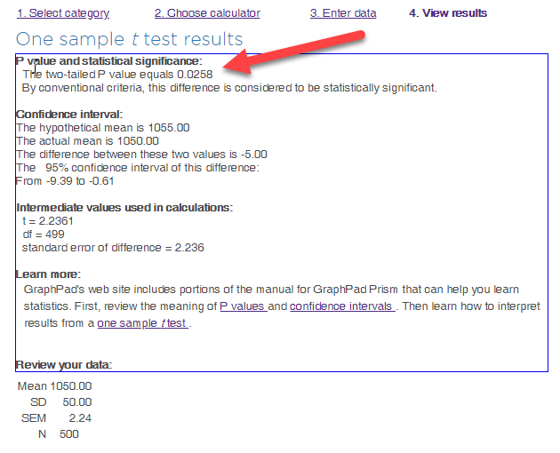

Slide 41

Shortcoming 10:
Incapable of performing big data analytics
This “performance gap” was considered to be statistically significant. The board called for a meeting and the superintendent could not sleep.
You can easily reject the null! This is the wrong tool for big data
If a sample of 500 could lead to this funny result, how about 5,000 or 50,000? How about 61 million observations?

Slide 42
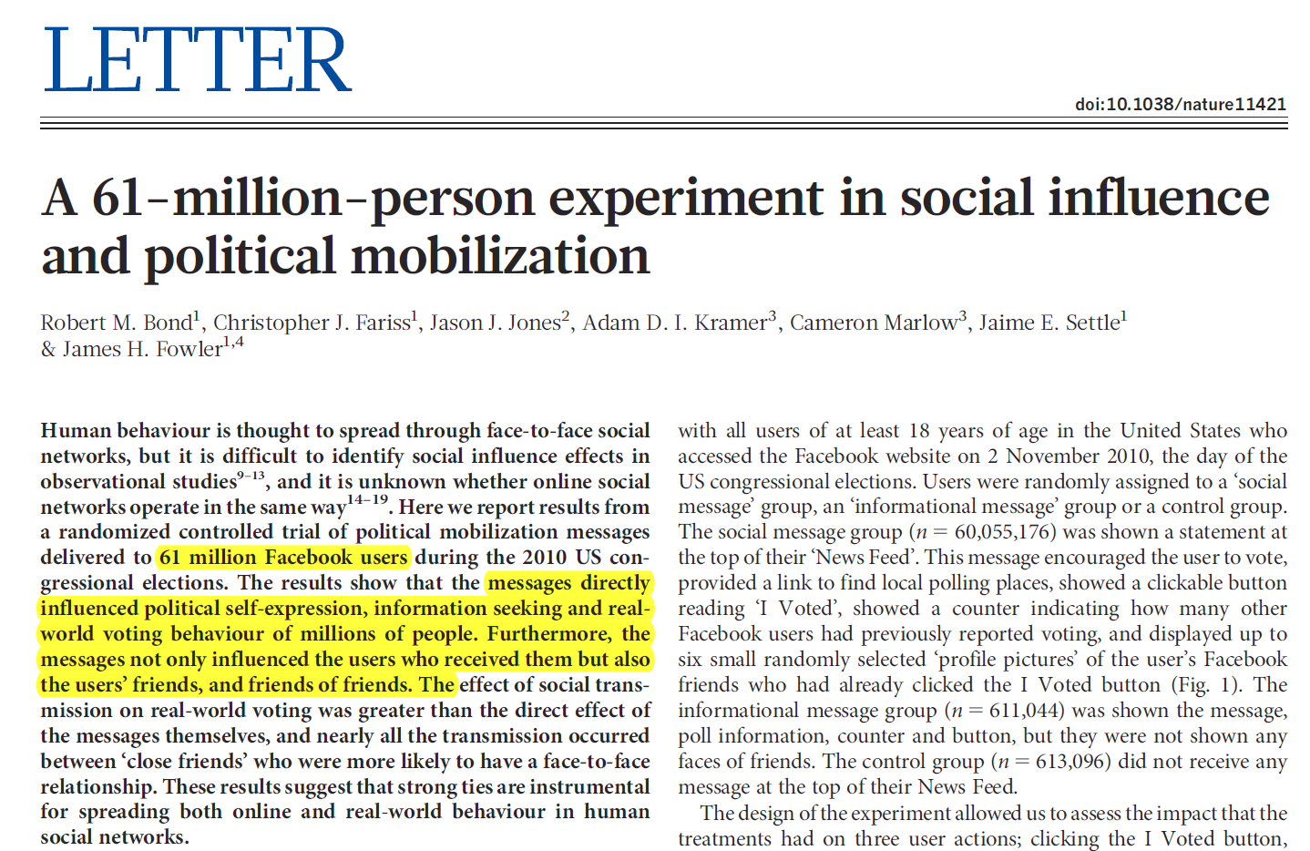
Shortcoming 10:
Incapable of performing big data analytics

Slide 43
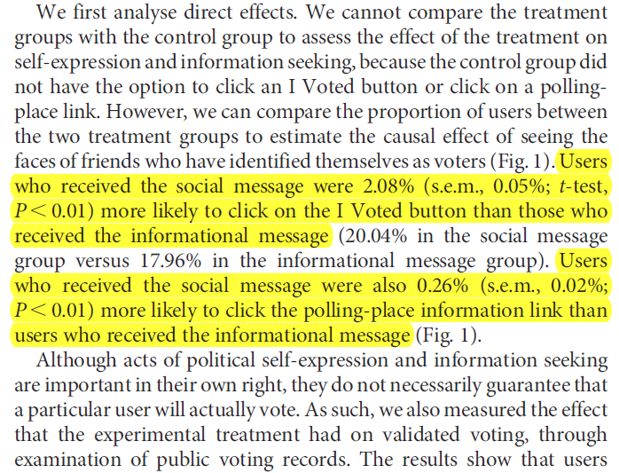
Shortcoming 10:
Incapable of performing big data analytics
Running t-tests with 61M obs!
Are the p values meaningful here?

Slide 44
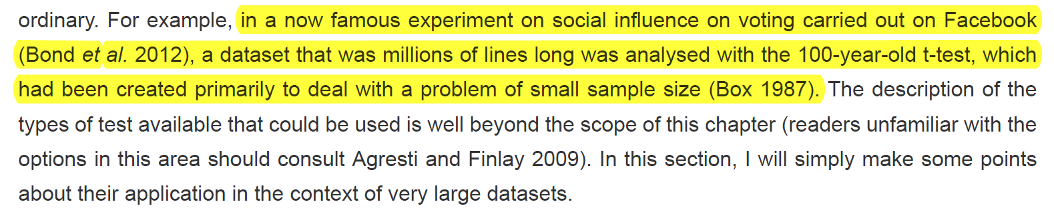
Shortcoming 10:
Incapable of performing big data analytics
Bright, J. (2017). Big social science: Doing big data in the social sciences. In Nigel G. Fielding, Raymond M. Lee & Grant Blank (Eds.). The SAGE handbook of online research methods (pp. 125-139). Sage. DOI: https://dx.doi.org/10.4135/9781473957992

Slide 45
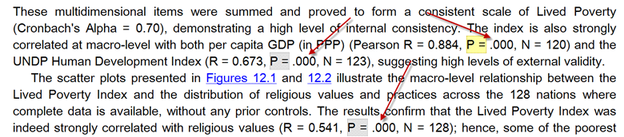
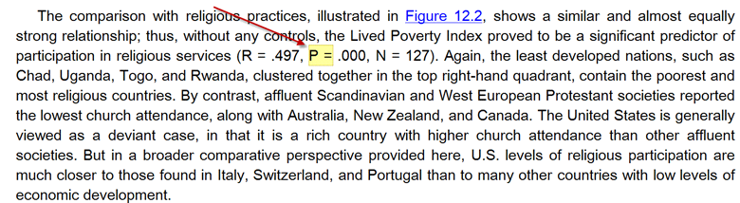
Many researchers don’t understand what a p value is!

Slide 46
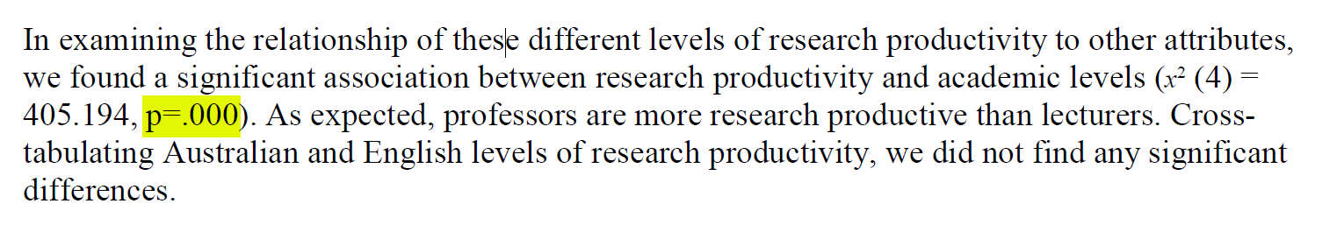
Many researchers don’t understand what a p value is!

Slide 47
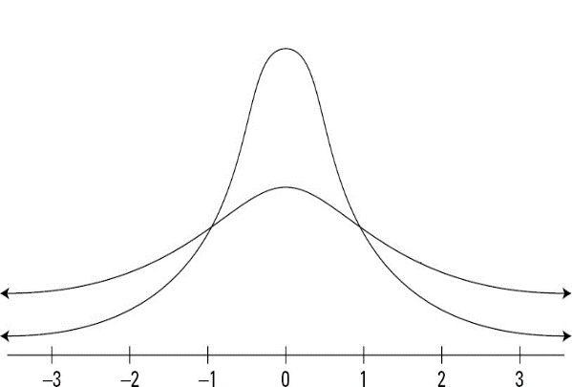
Can p be .000?
P = probability that the statistics can be observed in the long run.
“Long run” is expressed in terms of sampling distributions, in which sampling, in theory, is repeated infinitely.
The two tails never touch down the x-axes.
In an open universe anything has a remote probability.

Slide 48
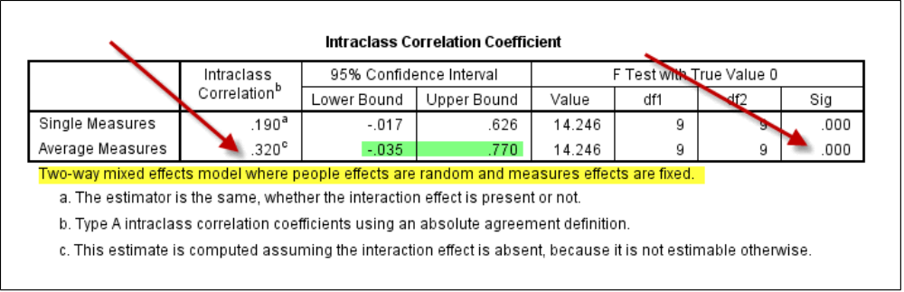
Can p be .000?
If p = 0.000, then it means there is no chance for such event to happen. Does it make any sense?
When the p value is too small, SAS uses the e-notation and JMP reports it as p < .001, but SPSS shows it as .000.

Slide 49
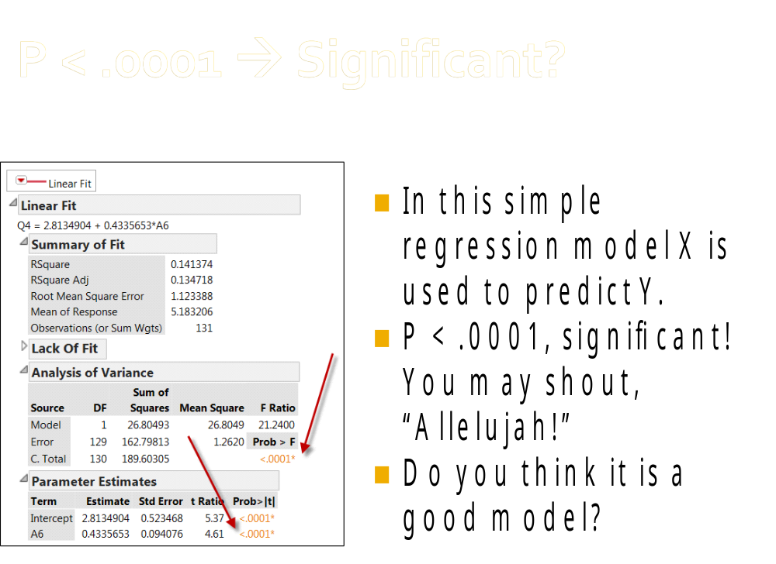

Slide 50
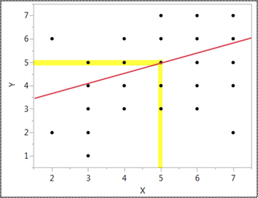
Significance: How rare the event is
If my score on X is 5, the regression model predicts that my score on Y is also 5.
Actually, it could be 3, 4, 5, 6, or 7.
Five of out of seven! This “predictive” model is usefulness!
Lesson: the p value can fool you!!!
It could be statistical artifact!

Slide 51

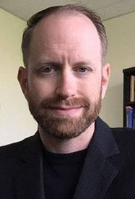
Radical remedy
In 2015 the editors of Basic and Applied Social Psychology banned reporting p values.
Trafimow and Marks said: “prior to publication, authors will have to remove all vestiges of NHST procedures (p-values, t-values, F-values, statements of ‘significant’ differences or lack thereof, and so on).
When Trafimow and Marks were asked whether any inferential statistical procedures were required, they replied, “No, because the state of the art remains uncertain.”

Slide 52
Radical remedy
However, it doesn’t work well. Authors used the effect size to present over-stated conclusions.
In an article entitled, “So you banned p-values, how’s that working for you?” Lakens (2016) reported: “The absence of p-values has not prevented dichotomous conclusions, nor claims that data support theories (which is only possible using Bayesian statistics), nor anything else p-values were blamed for in science.”

Slide 53
Nature (March 20, 2019)
800 statisticians and scientists co-signed a declaration to call for an end to judging studies by statistical significance.
https://www.nature.com/magazine-assets/d41586-019-00857-9/data-and-list-of-co-signatories

Slide 54
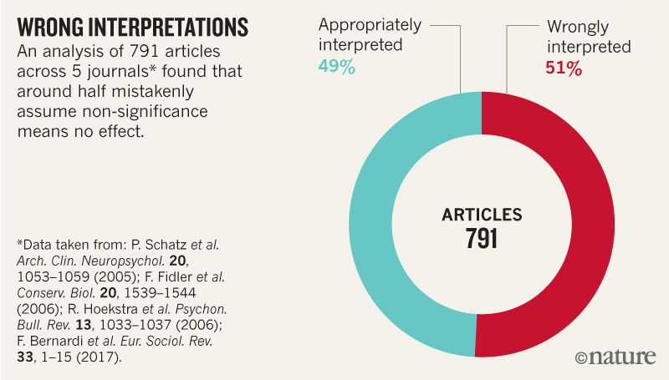
Source: V. Amrhein et al.

Slide 55
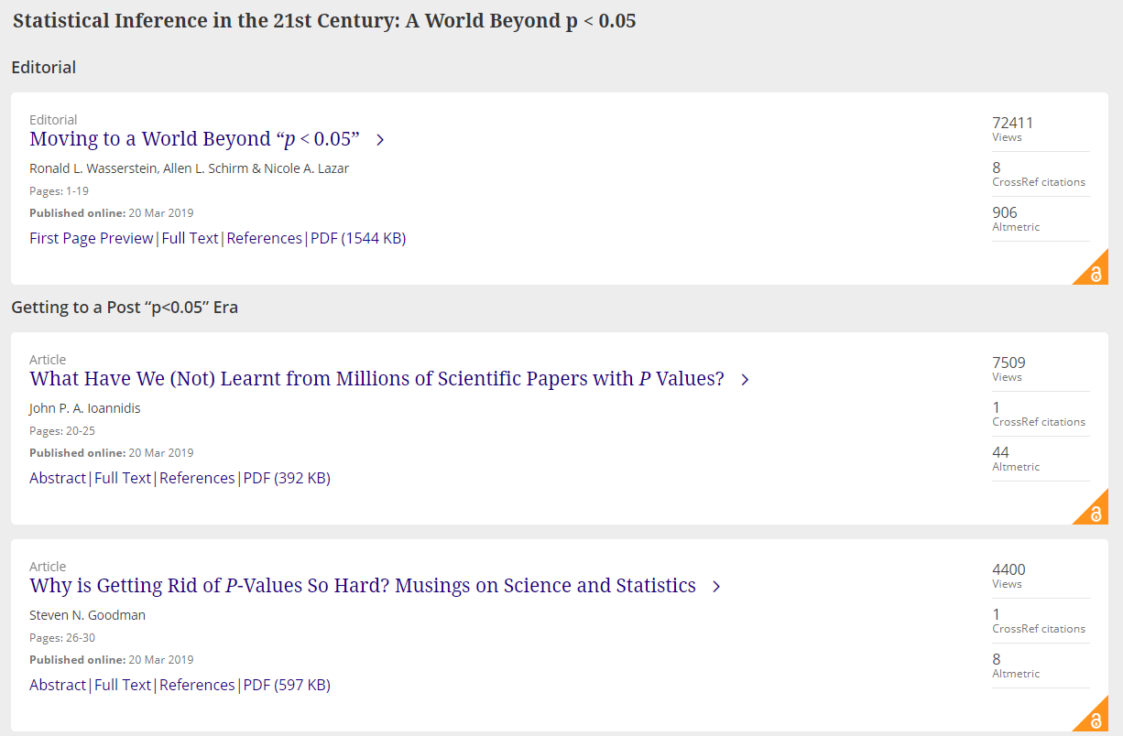
American Statisticians (2019)
43 articles exploring what scientific life might look like without p values.
https://www.tandfonline.com/toc/utas20/current

Slide 56

WE can do both
I do not suggest totally eliminating traditional statistics.
We need different tool sets.
Small-sample studies: p value, confidence interval, effect size, Bayesian inference, resampling…etc.
Big data analytics: data science, AI, machine learning…etc.

