Slide 1
Responsible conduct in data management
Chong Ho (Alex) Yu

Slide 2
Proactive!
No sophisticated statistical procedures can rescue a project flooded with faulty or/and messy data.
Good research design and good planning of data collection will make things easier and better in the subsequent stages.

Slide 3
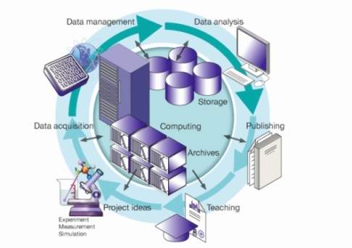
Data management
Data Selection
Data Collection
Data Handling
Data Analysis
Data Publication and Reporting
Data Ownership

Slide 4
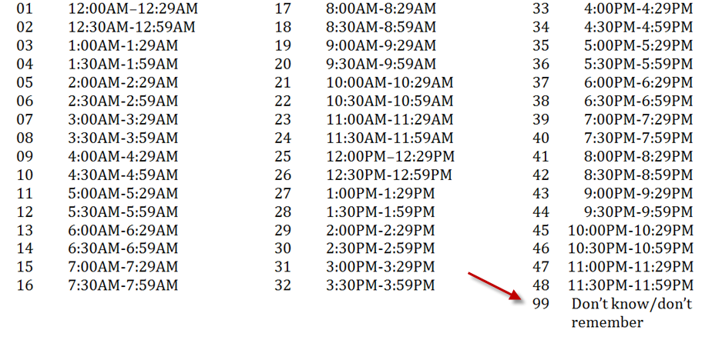
Examples
What time usually do you go to work?

Slide 5
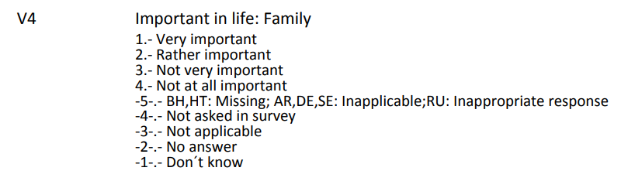
Bad examples
What is the problem?

Slide 6
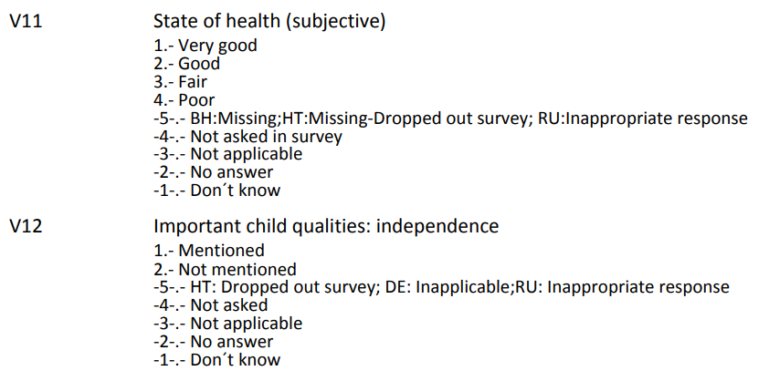
Bad examples
What is the problem?

Slide 7
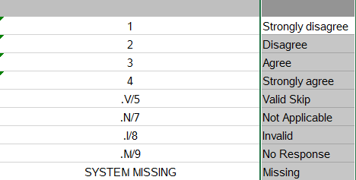
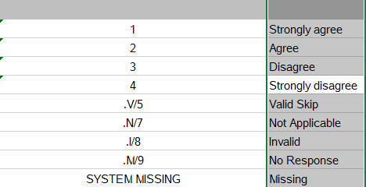
Bad examples
In the same survey! PISA

Slide 8
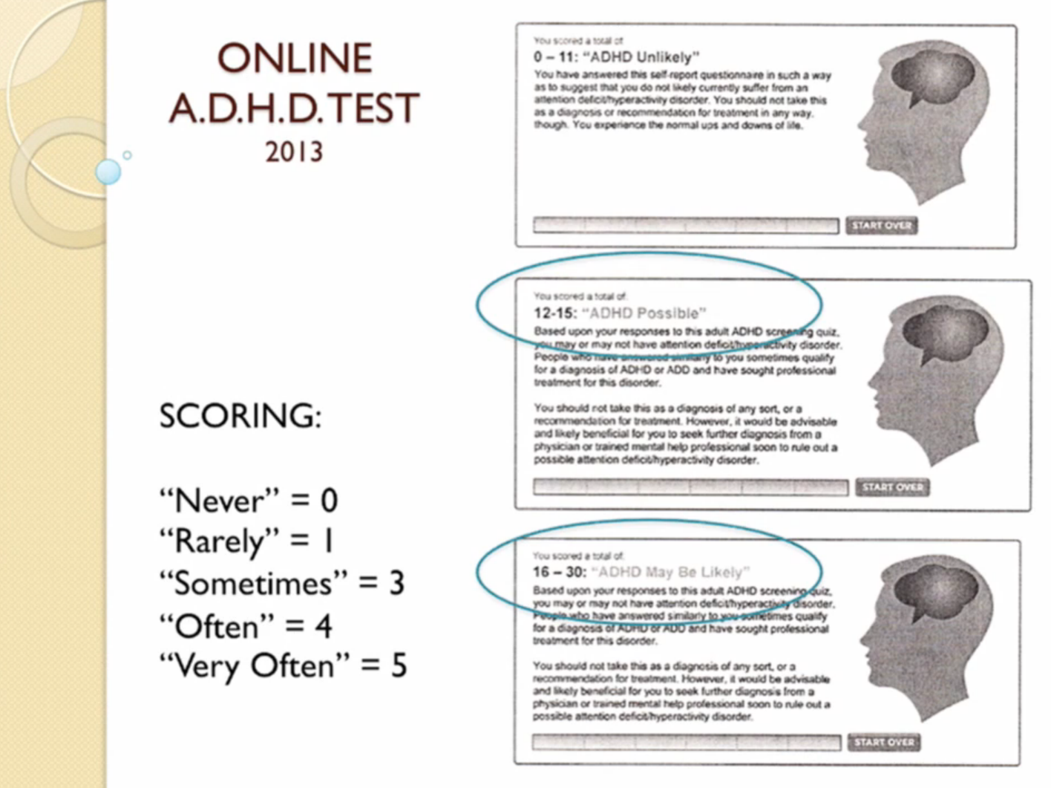
Bad Examples
Source: Alan Schwarz (2015). Keynote of SAS Global Forum. Dallas, TX

Slide 9
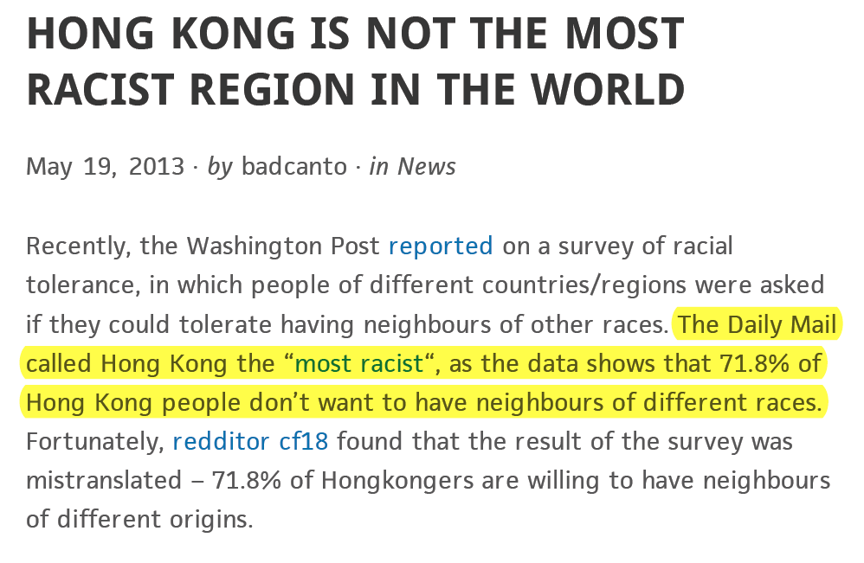
Bad Examples

Slide 10
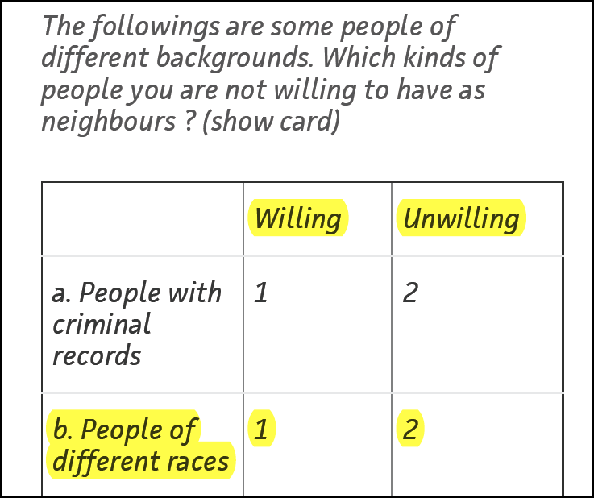
Examples
By common sense:
Yes = 1
No = 0
Why “not willing” = 2?

Slide 11
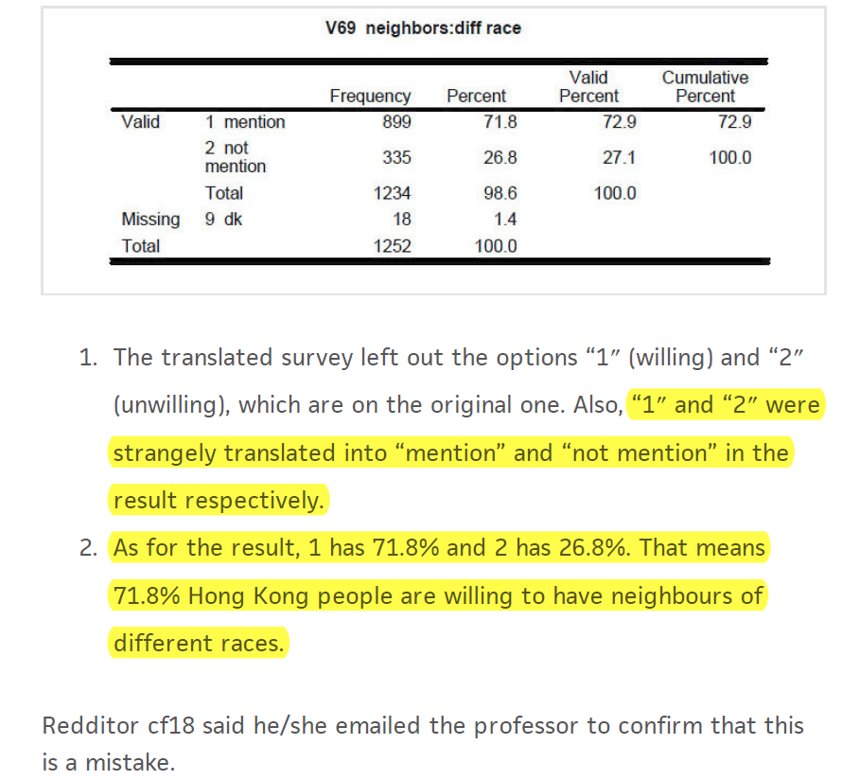

Slide 12
What is the best codebook?
The best codebook is no codebook or fewer codes!
Many people code the data in this way:
  Gender : Male = 1, Female = 2
  Race: White = 1, Black = 2, Hispanic = 3, Native American = 4, Asian = 5
Why not directly put down “M” as Male, “F” as female, “W” as white, “B” as black, “Y” as yes, and “N” as no…etc.? The letters are intuitive and you will never make any mistake by miscoding.

Slide 13
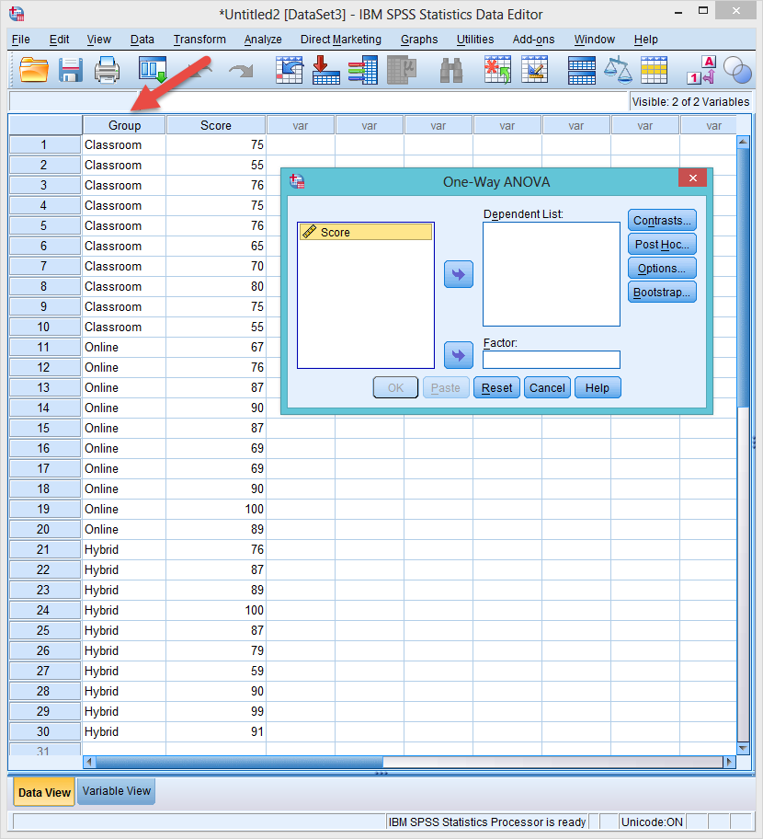
Disappearing factor
Sometimes it is understandable why people use numbers.
In SPSS when letters are used in a grouping factor, it cannot show up!

Slide 14
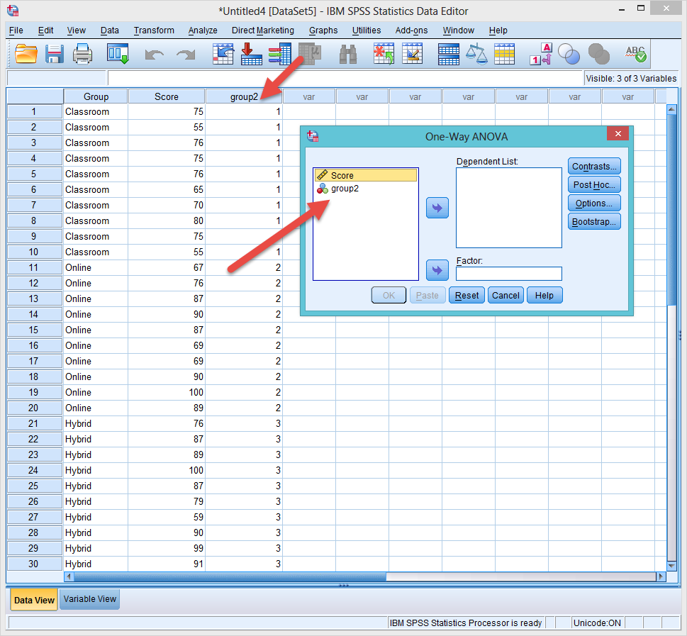
Recode to numbers
To see the grouping factor, you need to recode the letters to numbers.

Slide 15
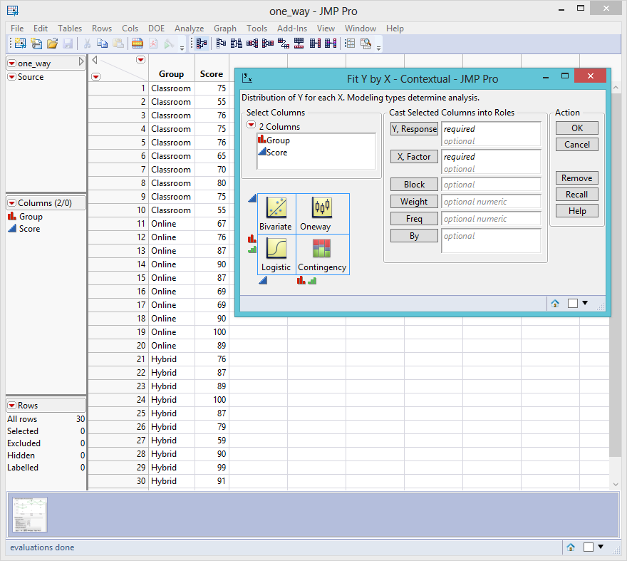
SAS and JMP are OK with numbers

Slide 16
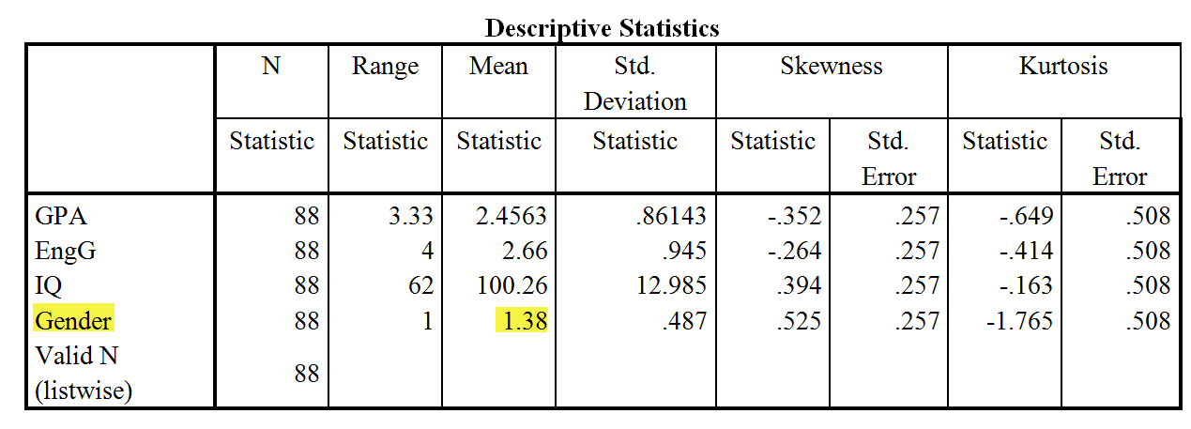
Don’t make these mistakes!
The following is a real report produced by a real student.
What’s wrong in the following table?

Slide 17
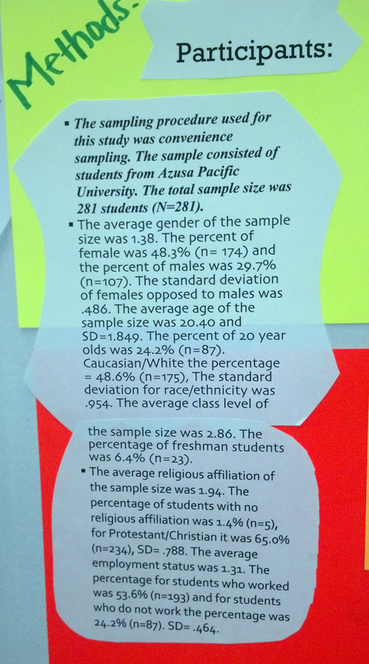
Don’t make these mistakes!
What’s wrong in this poster presentation?

Slide 18
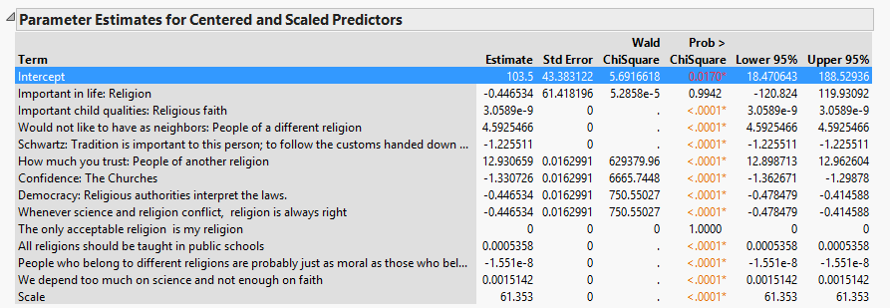
Your life is easier if…
I use very descriptive labels. I can work much faster in my analysis.
The output is ready to be pasted into the paper without changing the names.

Slide 19
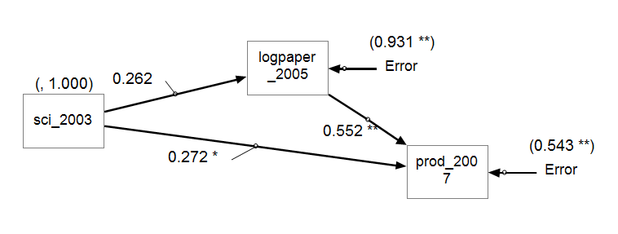
Exception 1: CFA/SEM
If you run Confirmatory Factor Analysis (CFA) or/and Structural Equation Model (SEM) in SPSS’s AMOS, JMP, or SAS, you have to use shorter labels.
  These programs cannot accept long variable names.
  Even if they can, you confuse yourself when the long names jam together on the small icons.

Slide 20
Exception 2: Programming
Data one; input Q1 Q1b Q1c Q1d Q1other Time_SH Time_Wk Com_Ex Web_Ex Res_Ex Q4a Q4b Q5c Q5d; cards; | Data one; input Q1-Q26; cards;
If you handle large databases and write programs for automation, use numbers at the end of variable names rather than characters.
In SAS you can assign variables as "Q1-Q26," but you cannot assign variables as "Qa-Qz."
If you use numeric variable names, you can be more efficient by saving time from typing and from matching the names on the hard copy and the variable names on the screen. When you have many variables, using character labels makes referencing extremely difficult.

Slide 21
Exception 2: Programming
Data one; input Q1 Q1b Q1c Q1d Q1other Time_SH Time_Wk Com_Ex Web_Ex Res_Ex Q4a Q4b Q5c Q5d; cards; | Data one; input Q1-Q26; cards;
When someday you want to rename the variables, using numeric names will be very convenient. For example, to rename Q1-Q100 as Question1-Question100, the code is: data new(rename=(q1-q100 = question1-question100));
When you want to do array manipulation, you will find that it is much easier to assign an array like array question(*) question1-question100;

Slide 22
If you use SurveyMonkey
If you use SurveyMonkey and download your data in the Excel format…
Do not write the options using a dash: “-” e.g. age group: 6-12.
When you have a “dash” in the data, Excel read it as a date: 6-12 become June 12.
Make it as “8 to 12”

Slide 23
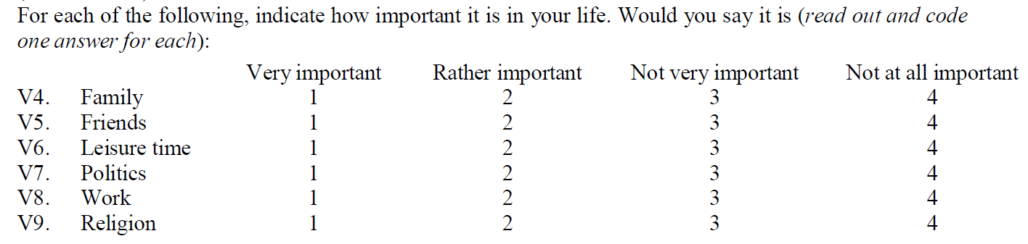
If you use numbers…
This example items are found in “World value survey”.
Sometimes you have to use numbers when you want to treat the data as continuous.
If so, use a more “natural” or “intuitive” way: bigger is better! e.g. 4 is “very important” and 1 is “not important”

Slide 24
If you use numbers…
It will be very difficult and confusing to interpret the result. You have to make mental reversal.
Sometimes you may forget and give the opposite conclusion!
One may argue that you can reverse the scale while doing data analysis. But why not do it right at the beginning?

