Slide 1
Introduction to data science
Chong Ho (Alex) Yu

Slide 2
What are these buzzwords?
Data science
Data mining
Big data analytics
Artificial intelligence
Machine learning
Business intelligence

Slide 3
Data science is the umbrella term
Data science (DS) is the fusion of statistics/data analysis, computer science, and domain knowledge.
Data mining analyzes structured data by extracting insight (mining) from a mountain of data. It is a specific application of data science. DS includes both data mining and text mining (for unstructured data)
Big data analytics deals with big data. DS includes both big, medium, and small data.
Business intelligence (BI) is the application of data mining in business settings.
Machine learning, which is based on artificial intelligence (AI) focuses on the design and evaluation of algorithms for extracting patterns from data.

Slide 4
What is data science?
A complicated approach
Communication
Domain expertise
Data ethics and regulation
Data warehousing and database
Computer science and high performance computing
Data visualization
Statistics and probability
Machine learning

Slide 5
What is data science? A simpler approach
DS consists of 4As (Saltz & Stanton, 2018):
  Data architecture: Database design
  Data acquisition: Data collection
  Data analysis: Machine learning, pattern recognition
  Data archiving: Make the data reusable.

Slide 6
What is data science? The simplest approach
Statistics/ data analysis
Computer science/ database design
Domain knowledge

Slide 7
The role of domain knowledge
Age is a continuous-scaled variable. But its precision may not be useful. The difference between age 40 and age 41 is not a big deal.
You need domain knowledge to do binning (classify ages into age ranges).
Height and weight are continuous variables but again their precision is not useful. A new variable is derived: Body Mass Index (BMI)

Slide 8
The role of domain knowledge
You need expertise (domain knowledge) in health science to classify BMI into different groups:

Slide 9
The role of computer science
In traditional research methods, statistical procedures are incapable of learning from the data. | Today computer scientists can utilize AI algorithms to make an adaptive system i.e. the model can learn from the new data to improve accuracy. For this reason, Google predicts that China might overtake USA in machine learning applications because China, as a more populated nation, has more data.

Slide 10
The role of database/data warehouse design
Traditional practice of data storage | Database or data warehouse for data mining
Data are not well-structured and usually data analysts do not receive training in database design. | The data are cleaned, well-structured, and can be accessed through structural query language (SQL). They are ready for reporting and analysis
Data are “isolated” and noncumulative. In a typical IRB application the researcher states that the data would be destroyed after 7 years in order to protect confidentiality of human subjects. | The system grows as data are appended continuously. Data are retained for long-term trend analyses

Slide 11
The role of database/data warehouse design
Challenge: As the data size is getting bigger and bigger, it is inefficient to download the data from a database to an analytical system.
Solutions:
  Hadoop:
    Distributed File System: Stores big data across a large number of linked servers.
    MapReduce: Provides in-database analytics.
  In-memory analytics: Analyze data when they are open in a computer’s random access memory (RAM), as opposed to analyzing data stored on physical disks (e.g. SAS Viya).

Slide 12
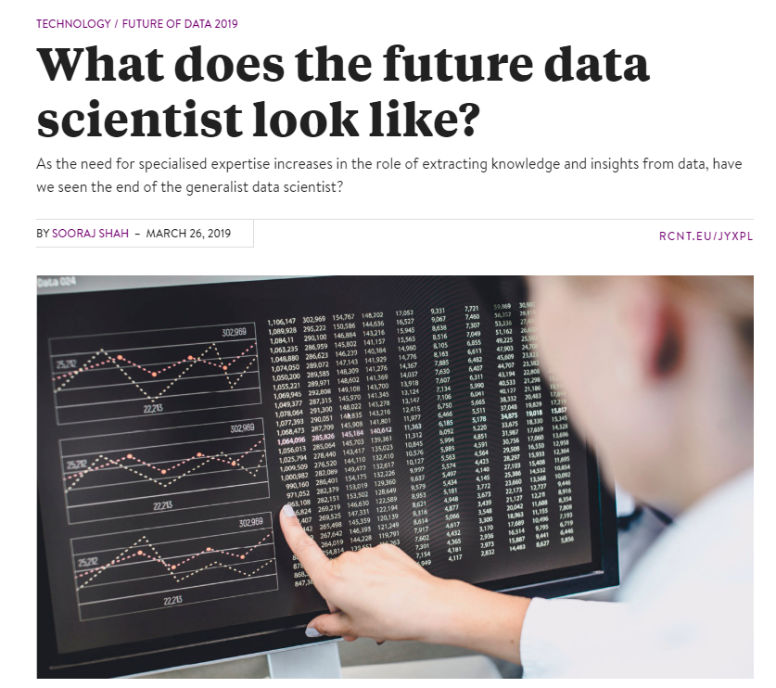

Slide 13
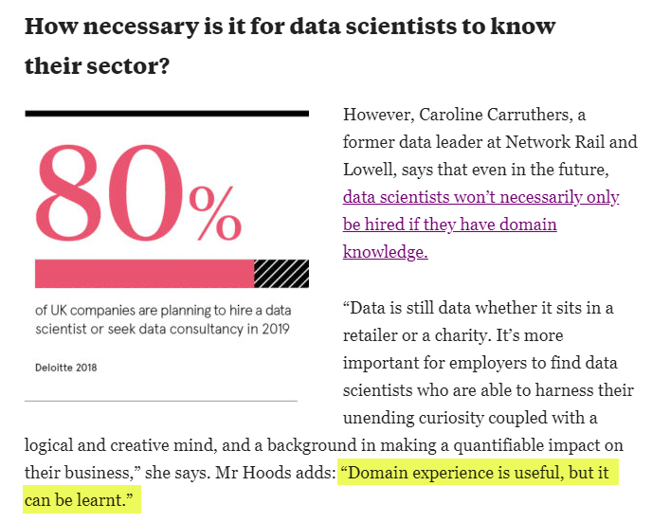

Slide 14
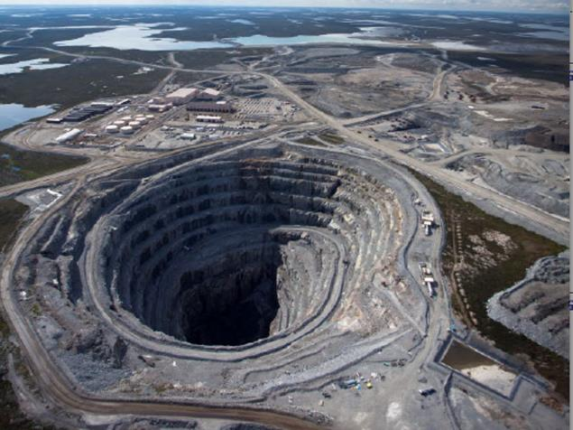
Data mining
A cluster of non-parametric techniques for automatically extracting useful information and relationships from immense quantities of data.
Assumption: the germ (knowledge) is buried by the rocks and thus it needs mining (filtering and extraction).
Usually it deals with structured data only.
For unstructured data the analyst uses text mining (the last unit of this class).

Slide 15
Business intelligence (BI)
Business intelligence (BI) is system that includes a plethora of IT applications for analyzing an organization’s data and communicate the information/insight/intelligence to end users (e.g. decision-makers).
Business
Intelligence
Data
Mining

Slide 16
Big data analytics: Deal with Big data
High volume:
  No definite cut-off, may carry thousands of rows or columns
  Challenges to data storage, data management, and data analysis.
High velocity:
  Data stream is ongoing
  Needs real-time analysis (e.g. credit card fraud detection)
High variety:
  Contains different types of data (e.g. numbers, texts, images, audio files, video clips…etc.).
  Challenges to traditional data analysts, who are accustomed to the analysis of structured data.

Slide 17
Big data analytics: Deal with Big data
High variety:
  Structured data: e.g. a row X column matrix, numbers in a relational database that are ready for reporting and analyzing.
  Semi-structured data: textual data with a discernable pattern but require some clean-up e.g. XML
  Quasi-structured data: textual data with inconsistent formats e.g. Webpage click-stream data.
  Unstructured data: Text, image, audio, or video without any structure at all.

Slide 18
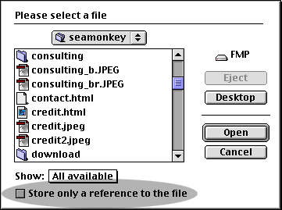
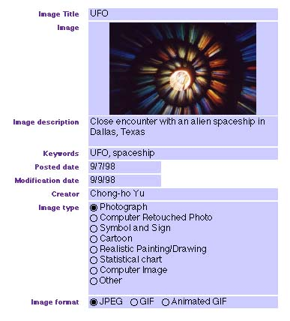
Example of High Variety:
Database with images
In the past data are numbers or texts only.
If I want to organize image files, I need to archive them outside the database, and then inserting a pointer/reference (e.g. hyperlink) to the storage location.
Not anymore!

Slide 19
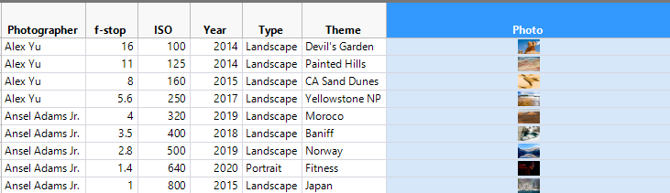
Example of High Variety:
Database with images
In this database, I can directly store images in the data table.
F-stop: How wide the aperture is.
ISO: How sensitive to light
When the ISO is low (less sensitive), the lenses needs to be wide-open.

Slide 20
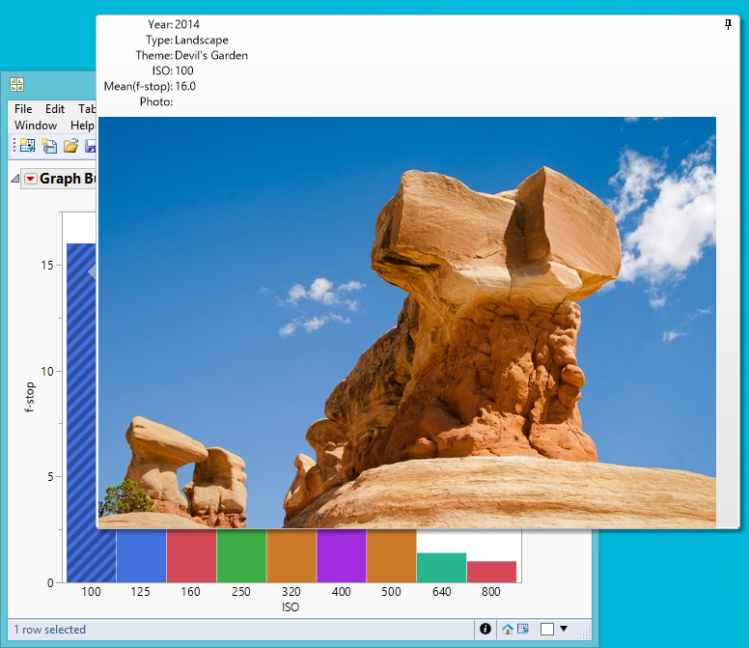
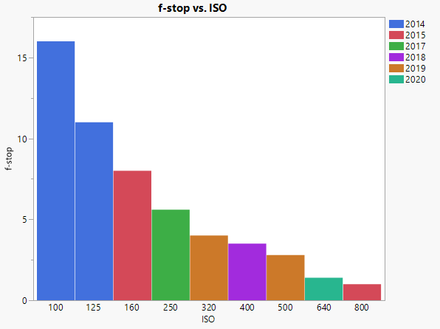
Example of High Variety:
Database with images
When the cursor is hovering on the observation, the picture and related info is displayed.

Slide 21

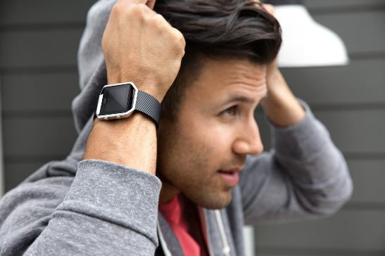
Big data analytics: Trend
Data-driven commercial operation e.g. Disney Magicbands
  Data-driven businesses are 5% more productive and 6% more profitable than others.
Quantified self-movement: Fitbit bands, Apple Watches
Sentient cities:
  Internet of things (IoT)
  Devices are connected to conduct real-time diagnosis.

Slide 22

Fayyad’s study: Social network analysis
Usama Fayyad: data scientist and co-founder of KDD conferences and ACM SIGKDD association for Knowledge Discovery and Data Mining.
He opened a Facebook account but posted very few details about himself.
He hadn’t joined any group
He didn’t comment on other people’s posts.
Facebook can accurately predict his buying decisions. How?

Slide 23
Fayyad’s study
He has friends on Facebook.
Facebook used the habits of his friends to predict Fayyad’s behaviors.
“Your friends are very likely to like what you like.”

Slide 24
Common ground
  Terms
    Data science, data mining, big data analytics, machine learning, business intelligence
  Common ground
    Data-driven, not hypothesis-driven
    Pattern seeking, not cut-off thinking
    Multiple approaches (e.g. ensemble methods), not a single one.
    Utilize artificial intelligence, not just human judgment.

Slide 25
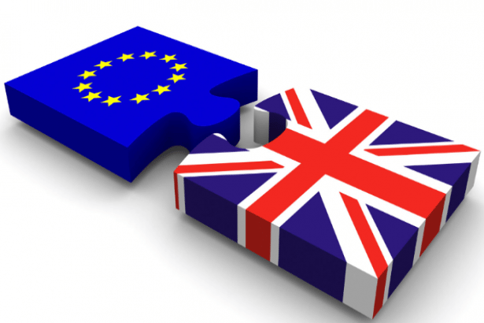
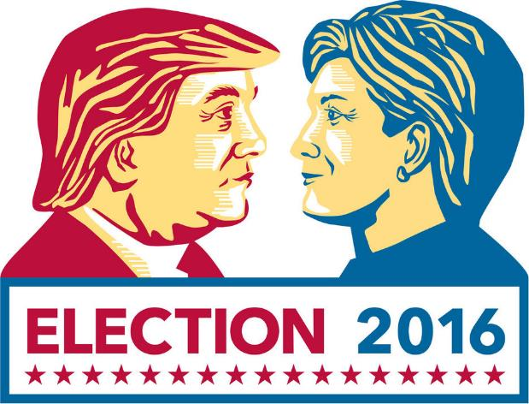
Impact on politics
“The Great Hack”: https://www.youtube.com/watch?v=iX8GxLP1FHo
Facebook passed user data to Cambridge Analytica. The company claimed that it has 5,000 data points of every American voters.
CA influenced the result of the Brexit campaign in the UK and in the 2016 U.S. Presidential Elections by bombarding the “persuadable” with information.

Slide 26
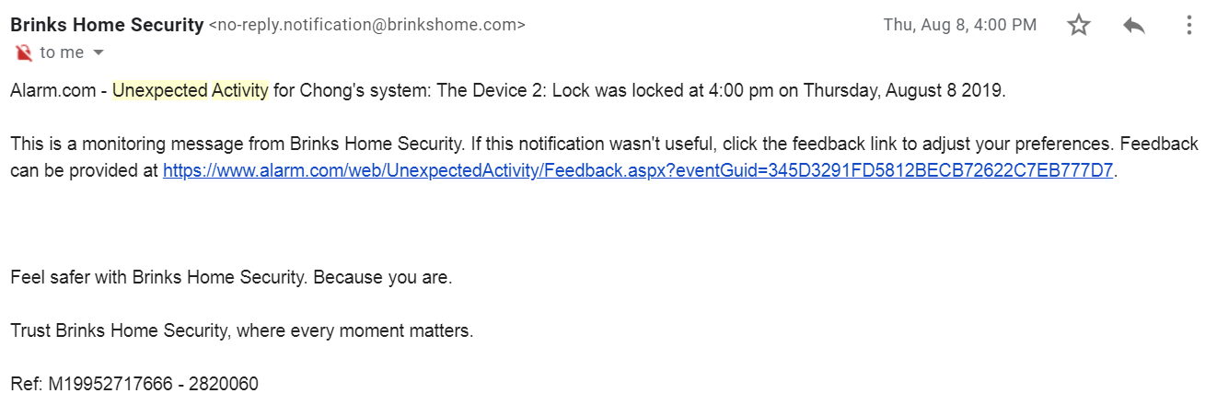
Pattern recognition in everyday life example

Slide 27
Myth 1 of data science
It is automated. Just push a button!
Gordon Linoff and Michael Berry: Data mining lets computer do what they do best – dig through lots of data. This, in turns, lets people do what people do best, which is to set up the problem and understand the results.
Data mining is an extension of exploratory data analysis (EDA). You still need to make your best judgment while exploring or mining the data.

Slide 28
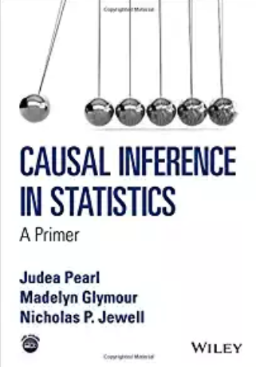
Myth 2
Every DS project needs big data or DS = big data analytics
You need the right data, not necessarily big data.
Judea Pearl: Data are dumb…you are smarter than the data, especially in causal inference.
Big data analytics is not the answer to causal inferences.

Slide 29
Myth 3
John Kelleher and Brendan Tierney, the authors of “Data science”: There is a myth that DS software is easy to use.
The preceding perception may be prevalent in industry, but I found that in academics the opposite is true: Most people think that DS software is hard to use and therefore they want to stay with traditional statistical software.
The truth is: DS software is easier than traditional stat software e.g. the flowchart interface in SAS Enterprise Miner, SAS Enterprise Guide, and IBM SPSS Modeler make it much easier to trace back what you did and to correct just one or two steps, if necessary.

Slide 30
The goal of data science

Slide 31
The goal of data science
Hierarchy:
  Data: Raw and unprocessed (e.g. test scores and related variables)
  Information: processed (e.g. findings, figures, tables)
  Knowledge or insight: a summary statement that can describe or explain the phenomenon (e.g. test performance and self-efficacy form a curvilinear relationship)
  Understanding: information that leads to practical implications for actionable items (e.g. teachers should stop inflating students’ ego)
  Wisdom (e.g. a new theory)

Slide 32
The goal of data science

Slide 33
Why data science/data mining?
We can use data science to address the issues of traditional hypothesis testing.
Shortcoming 1 of HT: Does not address treatment effectiveness or answer your question
  What people are doing now: starting with a single hypothesis and then computing the p value based on one sample: P(D|H)
  DS is data-driven, not hypothesis-driven. Let the data speak for themselves!
  Given the pattern of the data, what is the best explanation out of many alternate theories (inference to the best explanation): P(H|D)

Slide 34
Why data science/data mining?
In A Picture is Worth a Thousand p Values, Loftus observed that many journal editors do not accept the results reported in mere graphical form. Test statistics must be provided for the consideration of publication. Loftus asserted that hypothesis testing ignores two important issues:
  What is the pattern of population means over conditions?
  What are the magnitudes (effect size or predictive power) of various variability measures?
P(D|H) is prone to confirmation bias. In DS/DM you consider alternate explanations to answer your research question by using ensemble methods.

Slide 35

Why data science/data mining?
Shortcoming 2 of HT: Easy to reject the null
  BDG has built-in features to avoid over-fitting (falsely declare the effect)
  Usually the data are collected in naturalistic settings and thus there is no control group; let alone an inferior or do-nothing control group.
Shortcoming 3: A fusion of Fisherian and Pearsonian paradigms.
  DM is an extension of exploratory data analysis (EDA) and they are fully compatible.

Slide 36

Why data science/data mining?
Shortcoming 4 of HT: Lack reproducibility
  DS uses resampling-based methods (e.g. cross-validation, bootstrapping) to replicate the same analyzes in order to produce a stable conclusion.
Shortcoming 5 of HT: Parametric assumptions about data structure
  DS are non-parametric
  Assumption-free: Virtually no assumptions about the data structure are required.

Slide 37
Why data science/data mining?
Shortcoming 6 of HT: Probability as a relative frequency in long run
  DS is based on pattern recognition of the big data at hand.
  If I have 50 observations and try to infer from this small sample to the entire population, I must ask this question: “What is the chance of observing the sample statistics when I repeat the same study over and over?”
  If I have a million observations, do you need to ask this question: “What would happen if I repeat this study over and over?”

Slide 38
Why data science/data mining?
Shortcoming 7 of HT: Count on theoretical distributions
  Many DM methods do not count on a particular theoretical distribution. It uses the empirical distribution.
Shortcoming 8 of HT: Point estimate
  When ensemble methods are used, DS methods yield multiple answers, not a single answer.
Shortcoming 9 of HT: Arbitrary cutoff
  Very often decisions in DS does not rely on a cut-off (e.g. AIC, BIC). It is relative and contextual! The decision is based on model comparison.

Slide 39
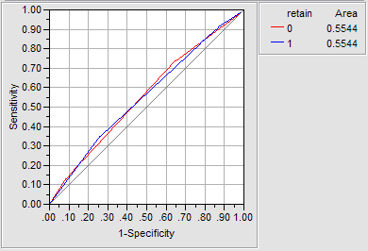
Why data science/data mining?
Shortcoming 10 of HT: Unknown error and circularity: If the researcher does not know whether the null is true or not, then he cannot tell whether the error is tied to Type I or Type II. But if he knows that the null is true, then there is no need to perform the test.
  In some DM results the error rate is expressed by area under curve (AUC) and depicted in the Receiver Operating Characteristic (ROC) curve, not Type I or Type II error.

Slide 40

Why data science/data mining?
Shortcoming 11 of HT: Incapable of performing big data analytics
  DS can handle extremely big sample sizes (count in million). Get as many observations as you can. Don’t worry about power analysis.
  Common misconception: I cannot use DS methods when I have a small sample.
  DS methods work best with big data, but some DS technqiues are still valid in small-sample studies.
  If you have a bus, you can take 50, 40, 30, 20, 10, or 5 passengers. But if you have a sedan…

Slide 41

Why data science/data mining?
Do you need power analysis to determine the sample size in data mining/BDA?
Power = the probability of correctly rejecting the null.
Is there a null hypothesis for you to test in data mining/BDA?

Slide 42
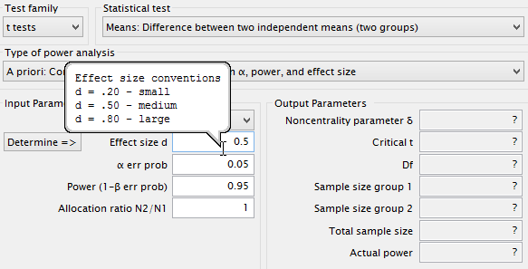
Why data science/data mining?
To perform a power analysis, you need the effect size. Small? Medium? Large?
Cohen determined the medium effect size using Journal of Abnormal and Social Psychology during the 1960s.
Welkowitz, Ewen, Cohen: One should not use conventional values if one can specify the effect size that is appropriate to the specific problem.

Slide 43
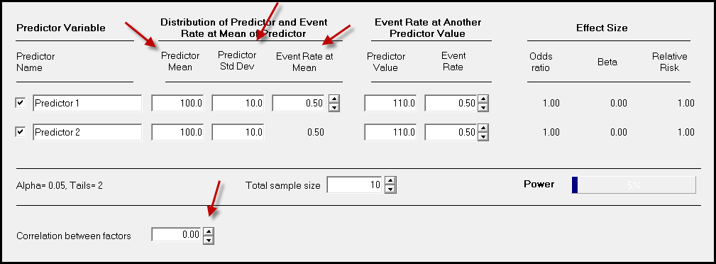
Why data science/data mining?
For example, to get the desirable sample size for logistic regression, I need to know the correlation between the predictors, the predictor means, SDs...etc. It could be very complicated.

Slide 44

Why data science/data mining?
Chicken or egg first?
The purpose of power analysis is to know how many observations I should obtain (not too many, not too few)
But if I know all those, it means I have already collected data.
One may argue that we can inquire prior studies to get the information, as what Cohen and APA suggested.
But how can we know the numbers from the past research are based on sufficient power and adequate data?

Slide 45


Why data science/data mining?
In HT, sample size determination based on power analysis is tied to Type I & Type II error, sampling distributions, alpha level, effect size...etc.
If you use DS instead of HT, do you need to care about power? You can just lie down and relax!

Slide 46
Advantages of big data
It saves time, efforts, and money, because the data are online available Forget about IRB!
It provides a basis for comparing the results of secondary data analysis and your primary data analysis (e.g. national sample vs. local sample).
The sample size is much bigger than what you can collect by yourself. Many social science studies are conducted with samples that are disproportionally drawn from Western, educated, industrialized, rich, and democratic populations (WEIRD; Henrich, Heine, & Norenzayan, 2010). Nationwide and international data sets alleviate the problem of WEIRD.

Slide 47

Advantages of big data
More importantly, the behavioral data collected in naturalistic settings (e.g. Google, Facebook) may be more accurate than experimental or survey data.
Opinion polls indicated that more than 40 percent of Americans attend church every week. However, by examining church attendance records, Hadaway and Marlar (2005) concluded that the actual attendance was fewer than 22 percent.

Slide 48

Advantages of big data
Schacter (1999) warned that the human memory is fallible.
  Transience: Forget information over time
  Absent-mindedness: Inattentive to the event
  Blocking: The temporary inaccessibility of memory
  Misattribution: Attributing a recollection to the wrong source
  Suggestibility: Implanted memories
  Bias: Retrospective distortions
  Persistence: Pathological events that we cannot forget
Or We lie

Slide 49

Advantages of big data
The dictator game: is used for studying morality and cooperative behaviors, is another good example.
In a typical experiment utilizing the dictator game, the participant is told to decide how much of a $10 pie he would like to give to an anonymous person who also signs up for the same experimental session.
The game is so named because the decision made by the giver is final.

Slide 50

Advantages of big data
Most experimental results are encouraging: Many participants were willing to share the wealth.
The result is completely different when the dictator game is conducted in a naturalistic setting.
In a study carried out by Winking and Nizer (2013) at a bus stop in Las Vegas, the researcher told some strangers that he was in a hurry to the airport and therefore he wanted to give away his $20 in casino chips.

Slide 51

Advantages of big data
The researcher explicitly suggested to the receivers to share a portion of the money to another stranger at the bus stop, who was actually a member of the research team.
No one in the naturalistic study gave any portion of the endowment to the stranger.
Winking and Nizer suspected that in the past the setting of the experimental context induced participants to choose prosocial options.

Slide 52
Advantages of big data
In 2016 election all polls indicate that more voters prefer Clinton to Trump.
The result is opposite. Why? What happened?
Many people did not want to say that they support Trump, especially after the Access Hollywood tape was released.

Slide 53
I never lie

Slide 54
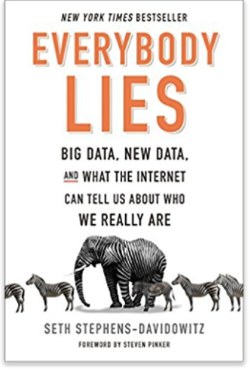
Everybody lies!
In survey most voters said that the race of the candidate doesn’t matter. Google search data show the otherwise!
https://www.youtube.com/watch?v=g0m4UQ3frws
https://trends.google.com/trends/

Slide 55
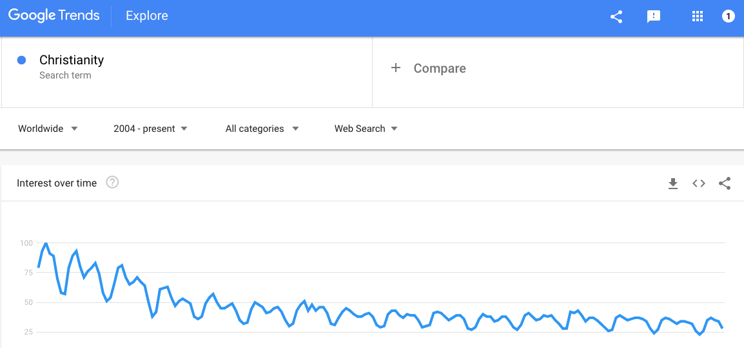
Advantages of big data
How often do people search for “Christianity” in the whole world?
There has been a mild downward trend since 2004, despite that the number of Internet users increases.

Slide 56
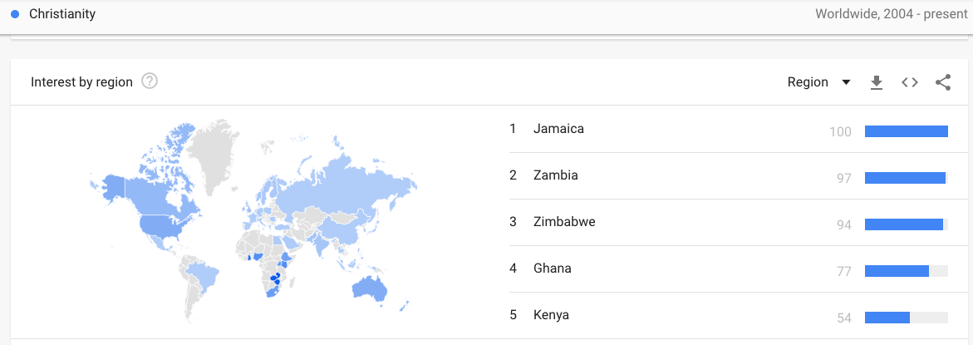
Advantages of big data
The top five countries searching for “Christianity” are developing countries.

Slide 57
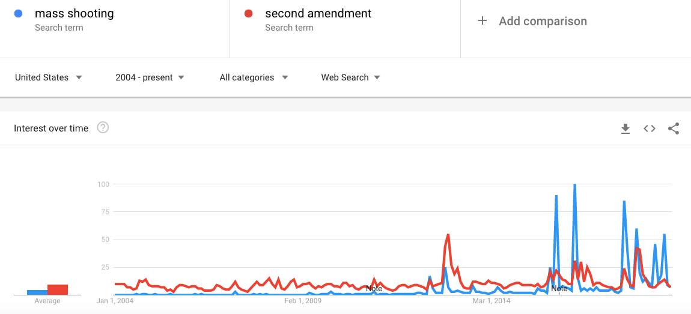
Advantages of big data

Slide 58
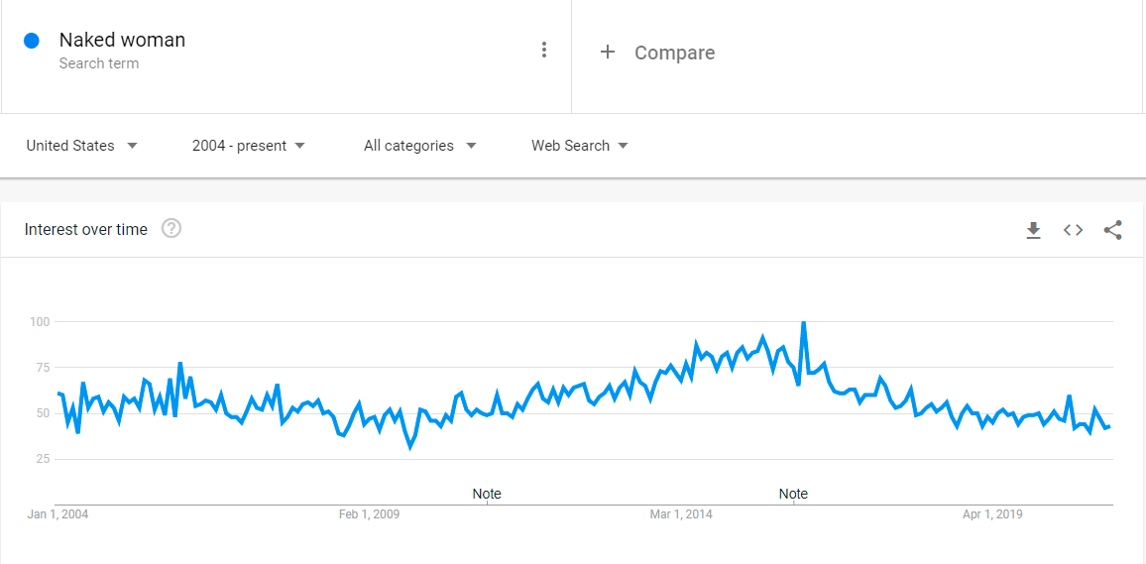
Advantages of big data
Searching for online pornography peaked at 2016.
Since then there has been a downward trend.

Slide 59
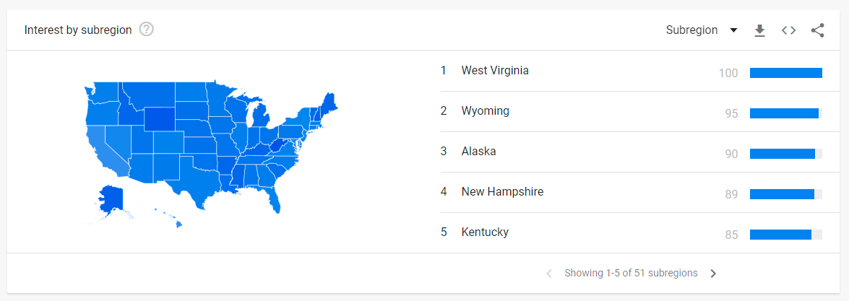
Advantages of big data
The top five states of searching for online pornography.

Slide 60

Advantages of big data
Turn to “behavioral” data e.g. Look at data in Netflix, YouTube, Amazon, Google, EBay to find out what people actually do rather than what they say.
Google, Facebook and Amazon might understand human behaviors more than what psychologists know.

Slide 61
Advantages of big data
“Facebook knows you better than anyone else”
In 2015 researchers at Cambridge and Stanford tested 17,000 Facebook users on personality and related the result to their Facebook activities. The prediction is more accurate than their parents, siblings, and spouses!
https://www.nytimes.com/2015/01/20/science/facebook-knows-you-better-than-anyone-else.html
“Google and the end of free will”: Google may know more about you than yourself.
https://www.ft.com/content/50bb4830-6a4c-11e6-ae5b-a7cc5dd5a28c?siteedition=intl

Slide 62
Caution: DS is not always right
In 2009 Google researchers published a paper in Nature.
A predictive model about the spread of influenza across the US in real time (Nowcast)
Claimed to be faster than the CDC model because Google tracked the outbreak by looking at the search terms about flu symptoms.
Later it was found that Google’s estimates were overstated by almost a factor of two.
https://www.google.org/flutrends/about/
https://www.wired.com/2015/10/can-learn-epic-failure-google-flu-trends/

Slide 63
Caution: Ethical issues
In March 2018 the Federal Trade Commission opened an investigation into Facebook.
A data analytics firm named Cambridge Analytica worked with the Trump Campaign to access FaceBook data without the the knowledge of the users.
Legally speaking, Facebook must notify users and get their approval before sharing data with any third party.
“The Good, The Bad, and The Creepy: Why Data Scientists Need to Understand Ethics”
https://www.youtube.com/watch?v=AnU0hm7uA_k&list=PLVV6eZFA22QxWxKXI1TRDKncXHQDN3v-2&index=4

Slide 64
Structural archival data
Programme for International Student Assessment (PISA): https://www.oecd.org/pisa/pisaproducts/
Programme for the International Assessment of Adult Competencies (PIAAC): http://www.oecd.org/site/piaac/publicdataandanalysis.htm
Trends for International Math and Science Study (TIMSS): http://timssandpirls.bc.edu/
United Nations Human Development Programme (UNDP): http://hdr.undp.org/en/data
World Values Survey (WVS): http://www.worldvaluessurvey.org/wvs.jsp
US Government's open data: http://data.gov

Slide 65
Structural archival data
Center for Collegiate Mental Health (CCMH):
https://ccmh-data.vmhost.psu.edu/login
European Values Survey (EVS): http://www.europeanvaluesstudy.eu/
Gallup Global Wellbeing (GGW): http://www.gallup.com/poll/126965/gallup-global-wellbeing.aspx
Happy Planet Index (HPI): http://www.happyplanetindex.org/
National Opinion Survey Center (NORC): https://gssdataexplorer.norc.org/

Slide 66






Unstructured behavioral data
Unstructured data or semi-structured outnumber structured data!
Webpages and digital footprints on social media, such as Facebook and Twitter.
Experts on data science predict that the size of digital data will double every two years; this indicates a 50-fold growth from 2010 to 2020.

Slide 67
Unstructured behavioral data
Without face-to-face interaction, the internet gives you a sense of anonymity or protection. It is more likely that how people behave behind the Wi-Fi reflects their true nature.
Collecting these data necessitates Web content mining, also known as Web scraping, which involves automated “crawling” the Internet and extracting data from Websites (Landers, Brusso, Cavanaugh, & Collmus, 2016).
But if you work for Google or Facebook, you have direct access to the data and Web scraping is not necessary.

