Slide 1
Artificial Intelligence (AI) and Machine Learning
Chong Ho (Alex) Yu

Slide 2
Outline
Why AI is very important?
Relationship between big data and AI/machine learning
Attributes of machine learning
Why artificial neural networks (ANN) are better than regression analysis?
Compare manual Lambda smoothing and automated nonlinear modeling
Cross-validation
Examples in JMP and IBM SPSS Modeler

Slide 3
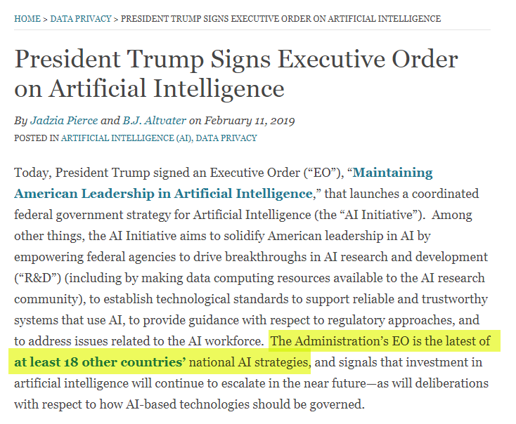
What is the most crucial technology?
https://www.insideprivacy.com/data-privacy/president-trump-signs-executive-order-on-artificial-intelligence/

Slide 4
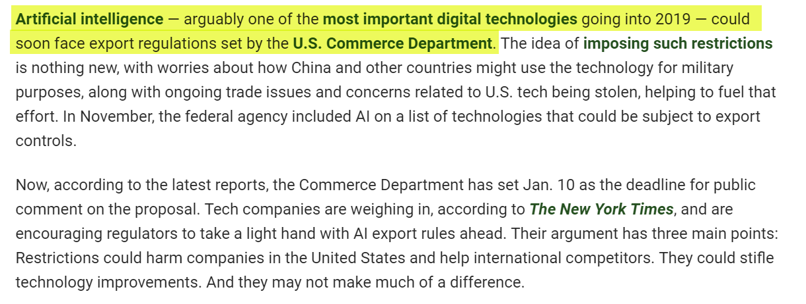
US might ban exporting AI to China
https://www.pymnts.com/news/regulation/2019/artificial-intelligence-china-digital-technology/

Slide 5
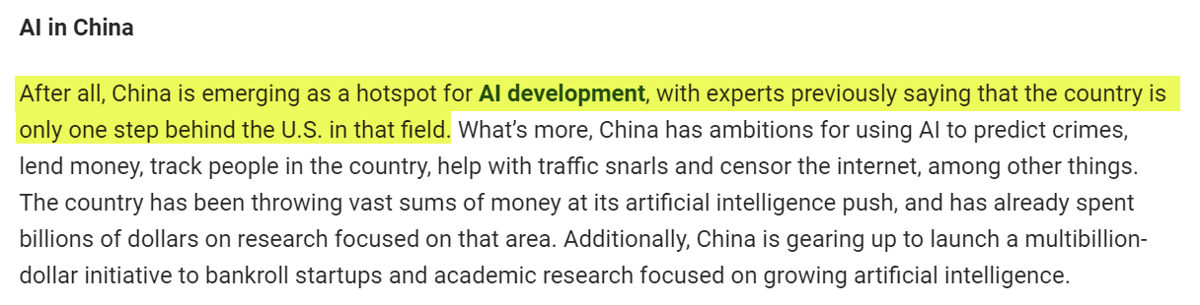
US might ban exporting AI to China
https://www.pymnts.com/news/regulation/2019/artificial-intelligence-china-digital-technology/

Slide 6
What is machine learning?
Based on artificial intelligence (AI)
Use algorithms and statistical models to progressively improve the performance on a specific task.
E.g. Artificial Neural Network (ANN)
DM inherits the spirit of exploratory data analysis (EDA) but there is a crucial difference: No machine learning in EDA.

Slide 7
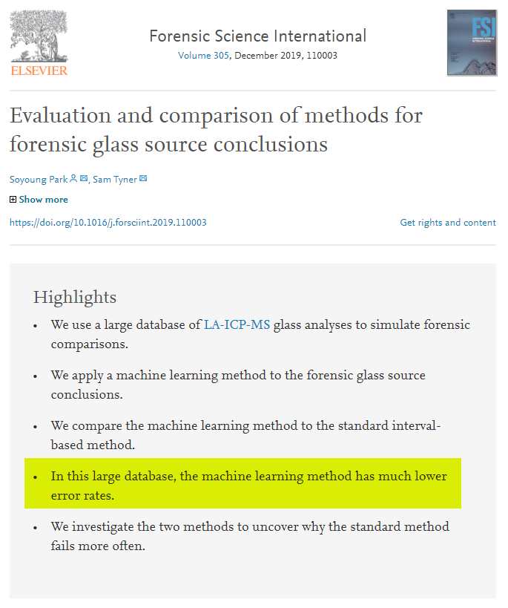
Machine learning methods outperform traditional methods.

Slide 8
Five schools of machine learning
Name | Origin | Approach
Symbolists | Logic, philosophy | Some form of logical deduction (e.g. if-then-else)
Connectionists | Neuroscience | Networking, pathway (e.g. Neuro networks)
Evolutionists | Evolutionary biology | Genetic programming
Bayesians | Statistics | Probabilistic inference (e.g. Given X, what is the chance of Y?)
Analogists | Psychology | Learn by examples (e.g. pattern recognition, computer vision)

Slide 9
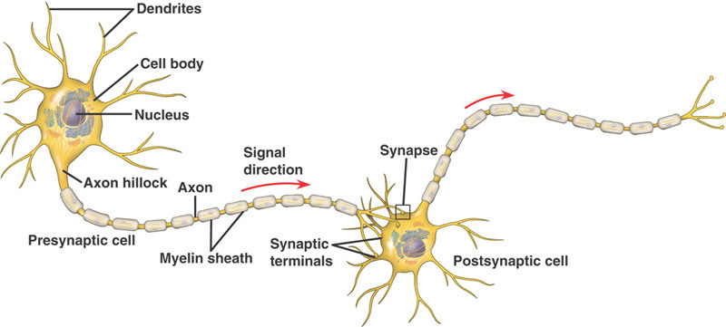
Neuropathway
Can a machine think like us if we can mimic the neuropathway?

Slide 10
Neuroscience and AI
Back-propagation algorithms in AI (how to tune the weights or parameters in an artificial neuro network) was proposed by neuroscientists and cognitive scientists in the 1980s.
Working memory, which is similar to short term memory (STM), was introduced in the 1970s
  STM holds information for a brief period of time.
  WM is concerned with the processing and manipulation of information that occurs during complex cognition.
  STM is a single component whereas WM consists of multiple parts.
Inspired by WM research AI researchers include a WM module into machine learning.
Notes:
Source: Jingtao Fan, Lu Fang, Jiamin Wua, Yuchen Guo, & Qionghai Dai (2020). From Brain Science to Artificial Intelligence. Engineering 6 (2020) 248–252

Slide 11
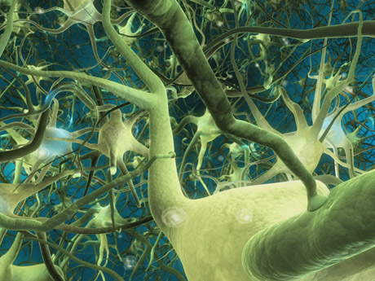
Neural networks, as the name implies, try to mimic interconnected neurons in the brain in order to make the algorithm capable of complex learning for extracting patterns and detecting trends.
But human brain neurons are much more complicated. ANN is just a simplification of human neural network.

Slide 12
It is built upon the premise that real world data structures are complex, and thus it necessitates complex learning systems.
Usually regression is “one-shot”; you cannot “train” a regression model. In other words, regression cannot “learn”.

Slide 13

A trained neural network can be viewed as an “expert” in the category of information it has been given to analyze. This expert system can provide projections given new solutions to a problem and answer "what if" questions.
More flexible models than regression and classification
Higher predictive power than regression and classification trees (CT will be discussed in Unit 5).

Slide 14
Machine learning
Unsupervised learning:
  try to find the hidden structure/pattern in unlabeled data (without examples).
Supervised learning:
  Train the algorithm by giving specific input and output values (labels and examples).
  How can the patterns/structures in the data be used to make predictions?

Slide 15
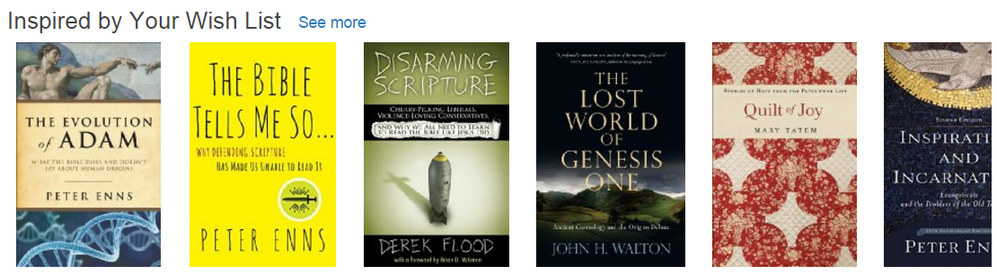
Examples of unsupervised machine learning
K-mean clustering (classify market segment)
Principal component analysis (reduce variables)
Association rules (When people buy X, they tend to buy Y)
Social network analysis (Viral marketing, epidemic modeling)

Slide 16
Example of supervised learning
Regression analysis (Generalized regression, penalization, regularization)
K-nearest neighbor (Non-parametric classifier)
Support vector machine (Classifier for ambiguous & extreme cases)
Decision tree (Recursive partition model)
Random forest (Resampling-based ensemble method)
Artificial neural network (nonlinear modeling)

Slide 17
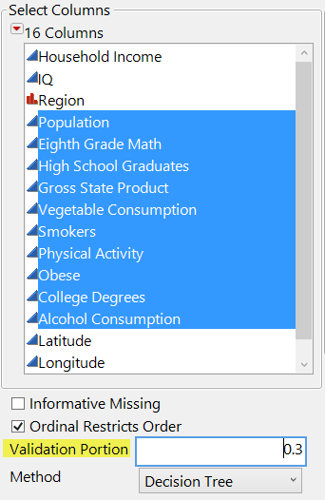
Machine learning: Validation
In resampling we can do cross-validation (CV).
CV is a form of supervised machine learning.
You can hold back a portion of your data (e.g. 30%).
The first subset is for training and the remaining is for validation.
You can further partition the sample into three subsets: training, validation, and testing.

Slide 18
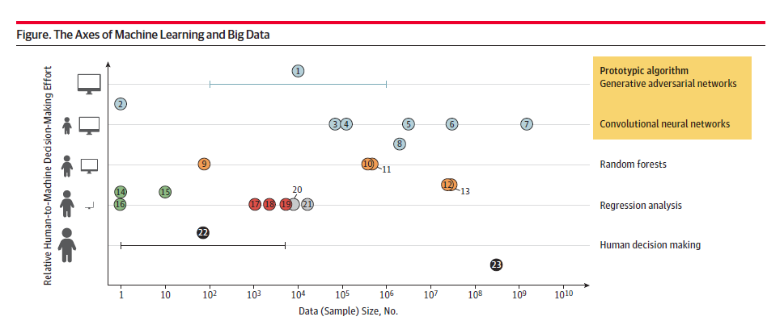
Big data is not the same as machine leaning, but related.
Usually research utilized ANN and big data are at the upper right corner.
Research based on smaller samples and human judgment are at the lower left corner.
Source: Bearn, A., & Kohane, I. S. (2018). Big data and machine learning in health care. JAMA, E1-E2.

Slide 19
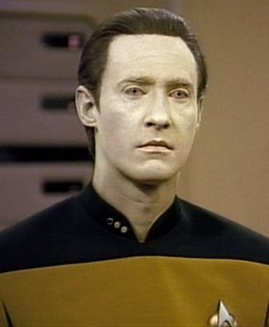

AI and Machine learning
Big data are too complicated to humans
Big data analytics can be more efficient and effective if we can count on a machine that can learn and improve (e.g. ANN).

Slide 20
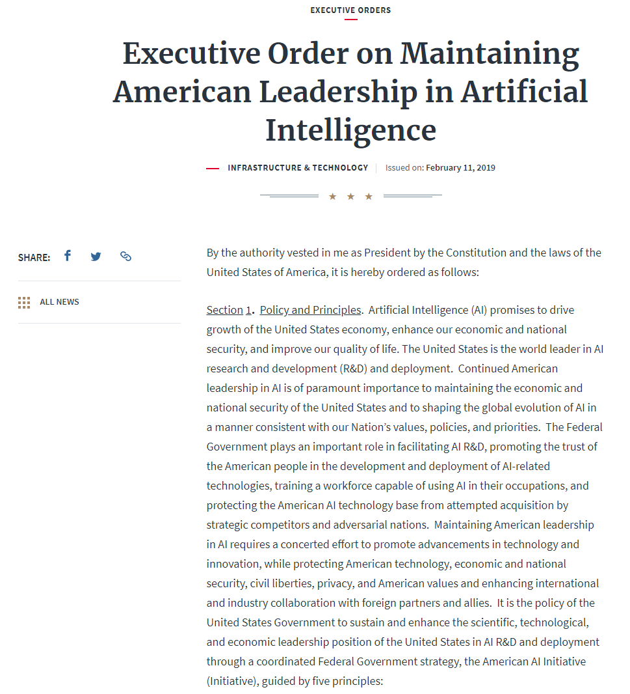
Many nations have a national task force on AI and machine learning
On Feb 2019 President Trump issued an executive order to establish a national AI imitative to drive technological breakthroughs in AI across the Federal Government, industry, and academia in order to promote scientific discovery, economic competitiveness, and national security.
https://www.whitehouse.gov/presidential-actions/executive-order-maintaining-american-leadership-artificial-intelligence/
Before the US, 18 other nations had some the same, including China, Japan, and South Korea.

Slide 21

US banned exporting top AI software to rival nations
The ban is limited only to software that uses artificial neural networks for machine learning to discover “points of interest” in geospatial imagery; objects like houses or vehicles.

Slide 22
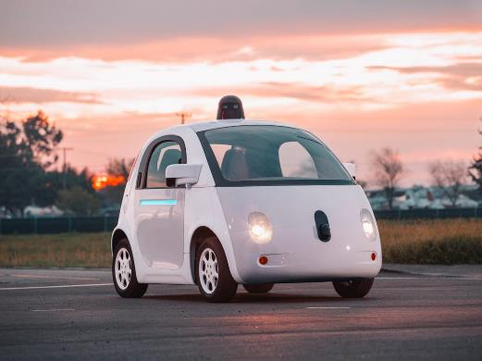
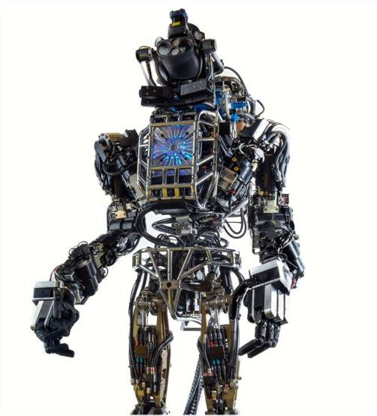
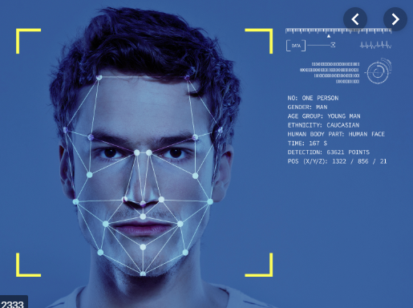
AI and Machine learning
Applications: facial recognition, expert system, self-drive car, natural language processing, robot/android, expert system, and data mining

Slide 23
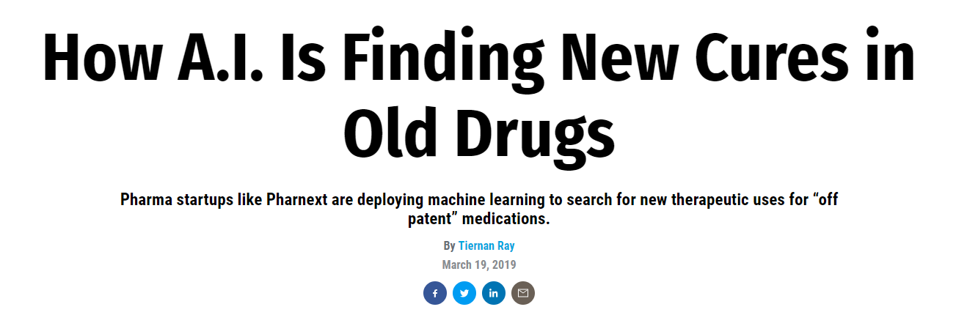
In theory, with repurposing “you don’t need to design new drugs,” says Cohen. “With 50 drugs, we can treat everything.”

Slide 24
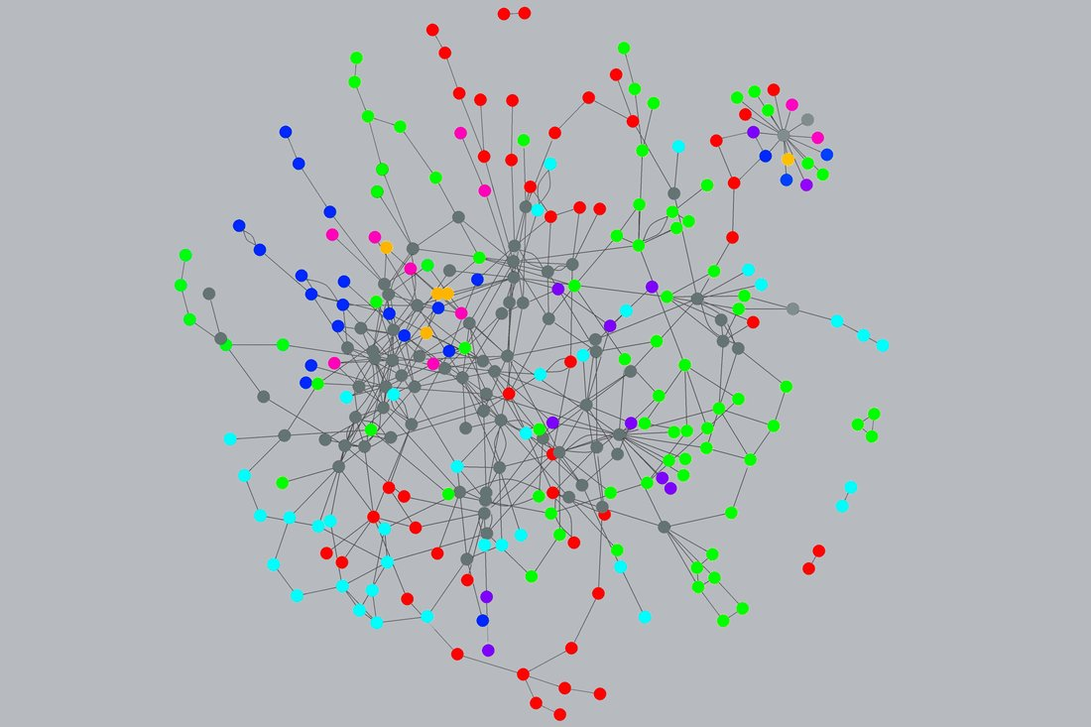
PATHWAYS: To help find therapies, A.I.-driven startups build maps that show how genes, proteins, and the body interact as diseases progress. This illustration depicts Pharnext’s map for CMT, a neurodegenerative condition.

Slide 25
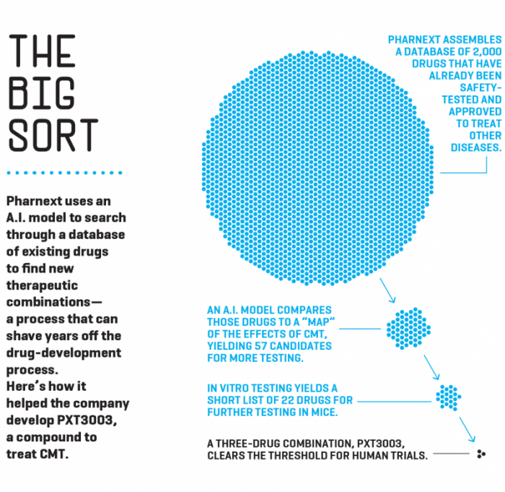

Slide 26
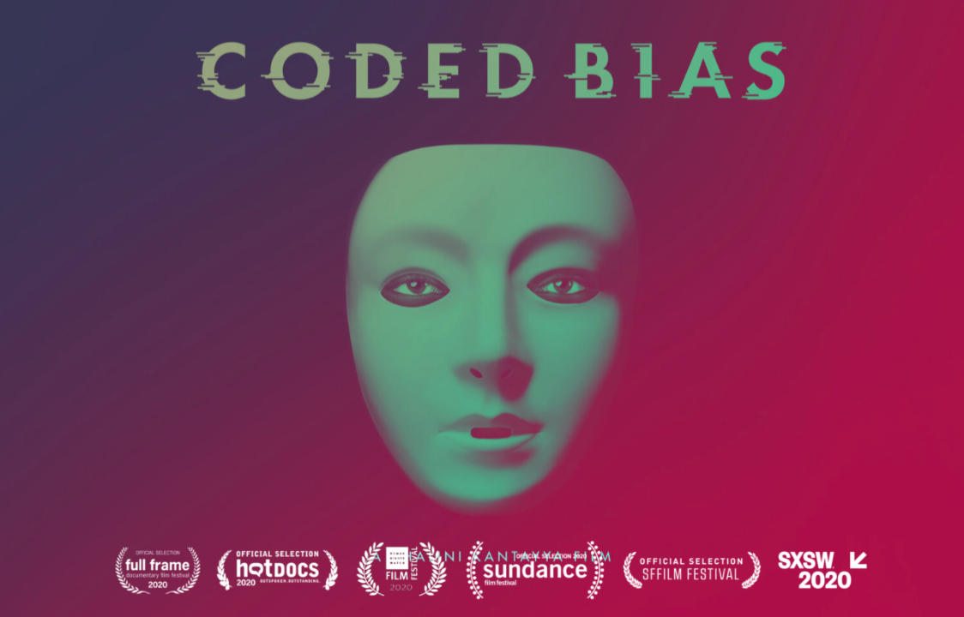
Ethical concerns

Slide 27
Types of ANN
Convolutional NN
  Traditional; this is what we will focus on
  Forward-feed: pass signals along the network in a single direction
  Used by Google to develop computer vision; identify unlabeled static images extracted from YouTube.
Recurrent NN
  Operate over sequences of vectors
  Used for handwriting recognition & speech recognition

Slide 28
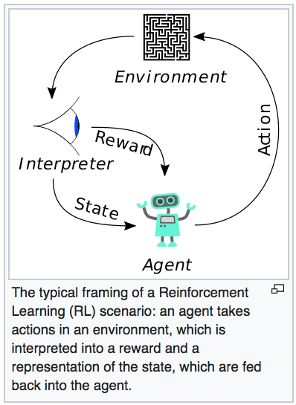
Types of ANN
Reinforcement NN
  Relatively new
  Inspired by the reinforcement theory in behavioral psychology (S-R model)
  automatically determine the ideal behavior or the max. reward based on feedback from the environment
  Used in economics and game theory: Your next move depends on how the other acts.
Source: Wikipedia

Slide 29

Types of ANN
Generative adversarial NN
  Very new (Goodfellow, 2014)
  Totally unsupervised learning
  Generate photos that look real to human viewers
  Used by Facebook
  https://code.facebook.com/posts/1587249151575490/a-path-to-unsupervised-learning-through-adversarial-networks/

Slide 30
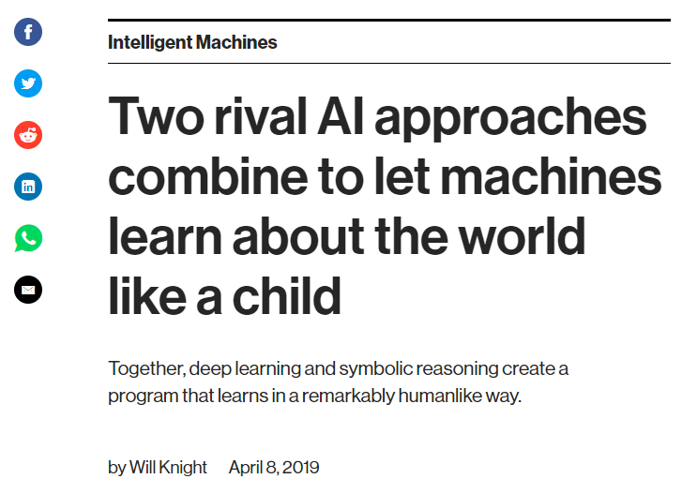
MIT Technology Review

Slide 31
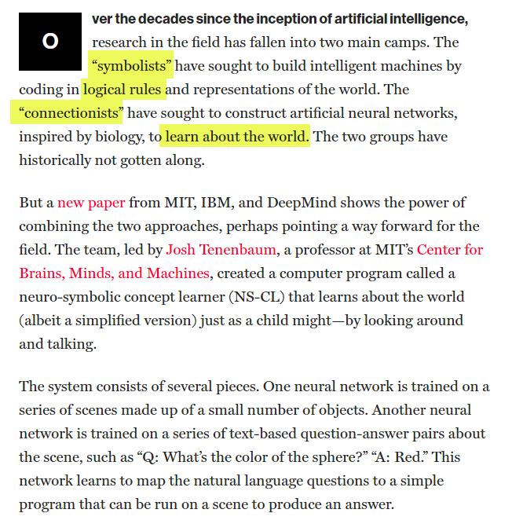

Slide 32
ANN can go beyond numeric data!
Computer vision/image recognition
Go to: https://www.clarifai.com/demo
Unit 3 folder: Images_for_computer vision
Use easy_image.jpg for the first test
Use complicated_image, tricky1, and tricky2 for more tests.
Ungraded exercise: Use other images or your own images for testing computer vision.

Slide 33
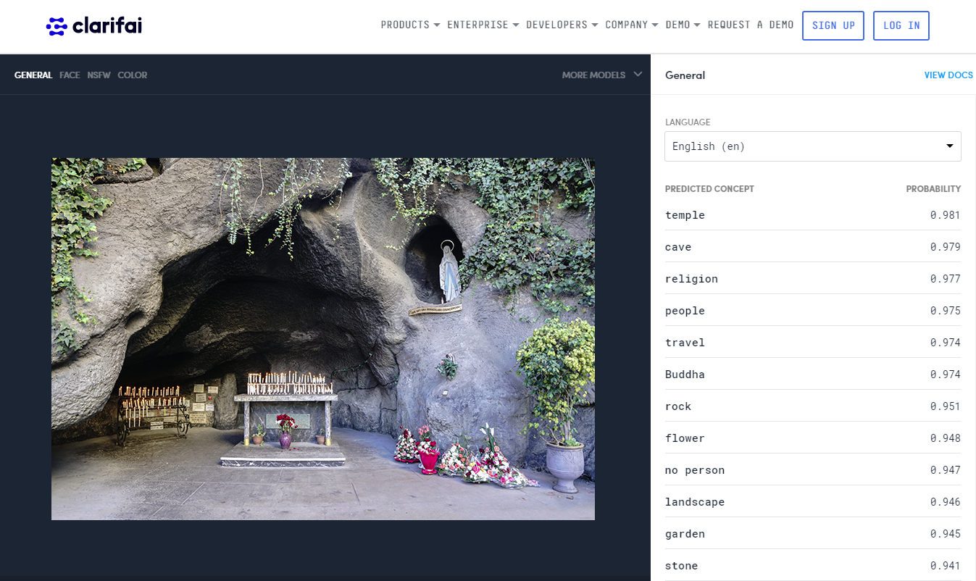
AI: Computer vision

Slide 34
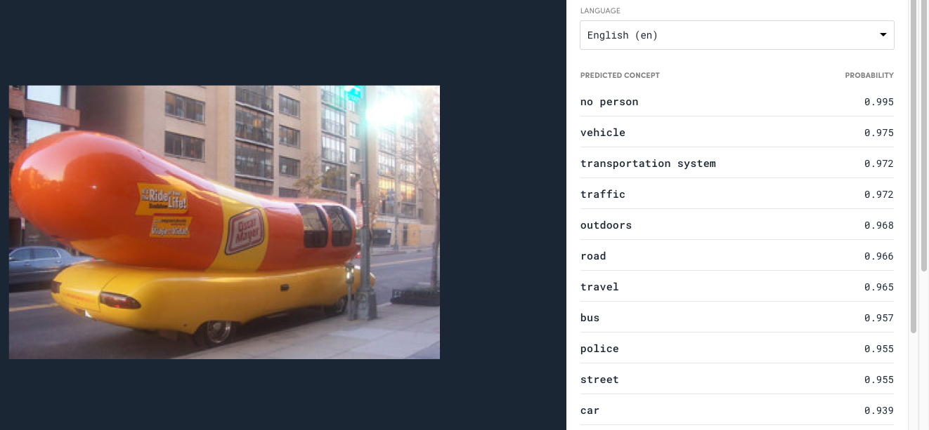
AI: Computer vision
A good CV system can tell that this is a car, not a hot dog.

Slide 35
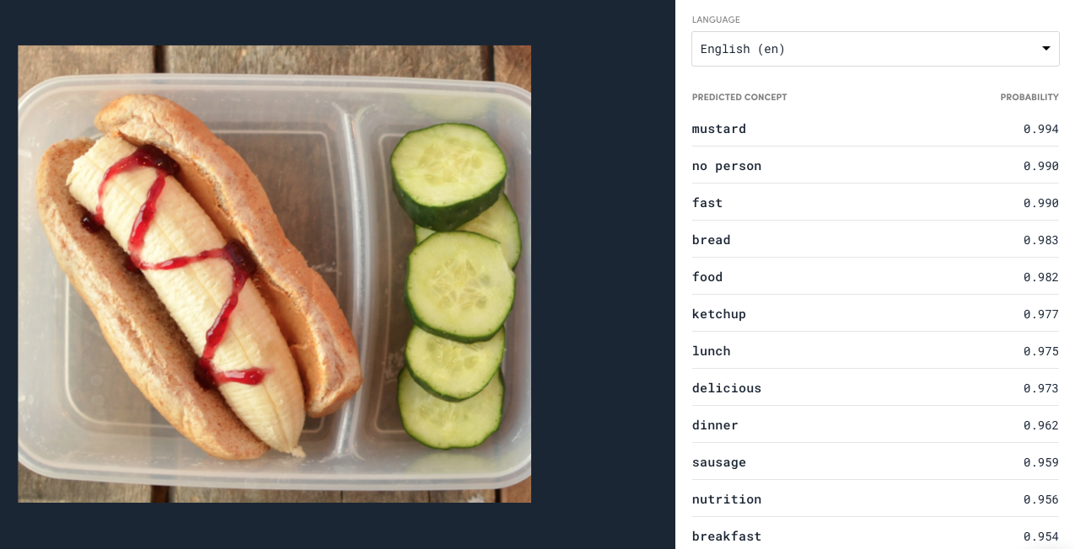
Machine learning is still imperfect
Image recognition learned from many example but you can still fool an AI system..

Slide 36
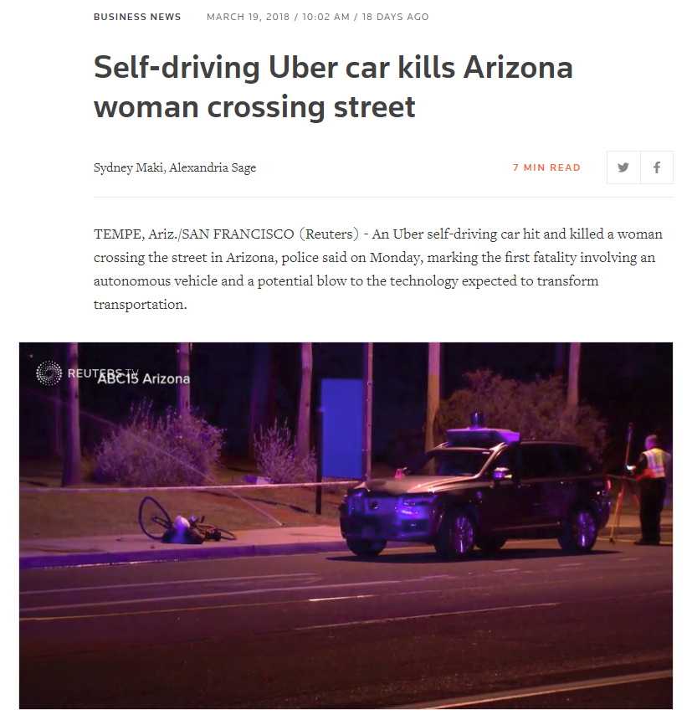
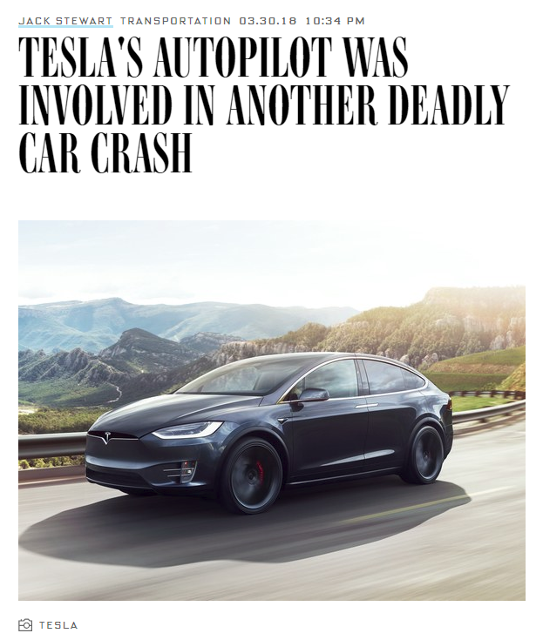
Self-drive car depends on computer vision but AI is not 100% fool-proof

Slide 37
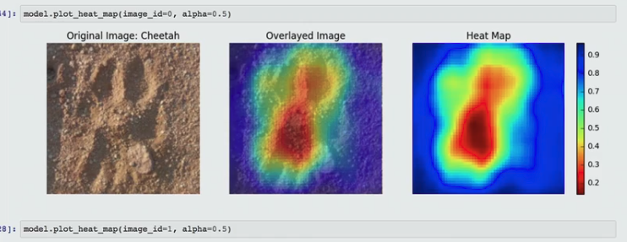
Creative way of using AI-based Computer Vision
Wildtrack: Track the footprints of endangered animals to locate and protect them.
https://www.sas.com/en_us/explore/analytics-in-action/impact/wildtrack.html
https://www.sas.com/en_us/solutions/ai.html

Slide 38
Why not regression?
In many cases ANN is better than conventional OLS regression.
OLS regression is linear; it imposes a simple structure on the data.
When you have collinear predictors, you need to “orthogonalize” the problematic variables (e.g. Gram-Schmidt method).
Non-linear regression may overfit the data if it is not done properly.

Slide 39
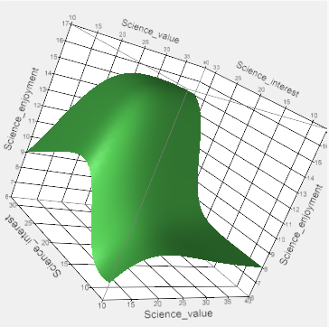
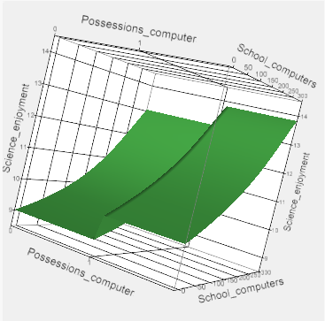
Why ANN? Advantages
Can handle different data types (nominal, ordinal, continuous).
Immune to outliers.
Perform data transformation for you. Artificial neural network can estimate ANY nonlinear functions no matter how many inputs and layers are entailed.
Learn and improve: ANN has stopping rules to prevent overfitting.
Researchers can go beyond numeric data by using image recognition, speech recognition…etc.
In the future an AI system might analyze a YouTube movie!

Slide 40
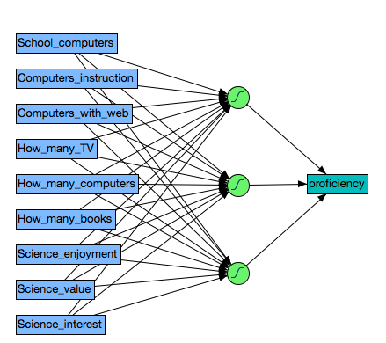
Structure of ANN
A typical neural network is composed of three types of layers
  input layer: data
  hidden layer: data transformation and manipulation
  output layer
If there are multiple hidden layers, it is called deep learning.
Data transformation? We were there before!

Slide 41
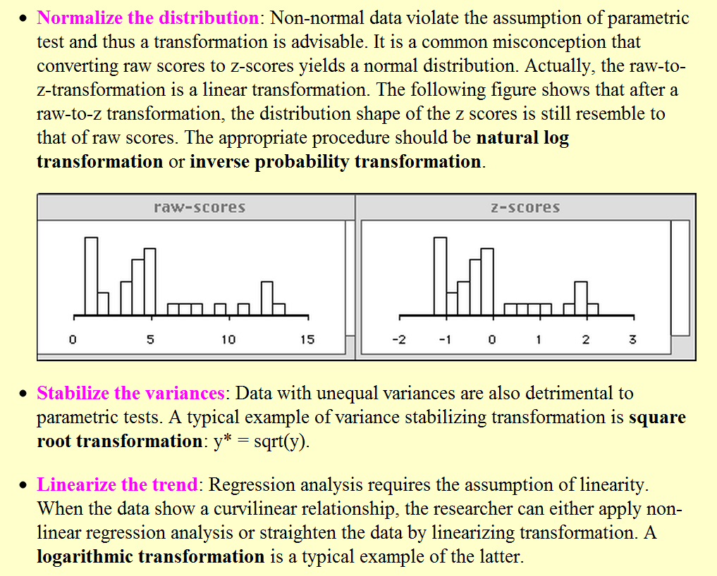

Slide 42
Example 1
In the first example we start with ONE input variable only.
Conventional statistical procedures often show unrealistic linear structure when the real world is often curvilinear.
Self-efficacy in science and self-report readiness to learn are correlated with test performance in a nonlinear fashion.
  Data sets collected from 2015 Programme for International Student Assessment (PISA)
  2016 Programme for International Assessment of Adult Competencies (PIAAC)

Slide 43
Limitations of Linear Models
“All models are wrong but some are useful” (George Box, 1987).
  A linear model might be wrong in that it oversimplifies a phenomenon, yet it could still have practical applications.
  Both a complicated/well-fitted model and a simple model may be appropriate at different times.
Psychological researchers should avoid using linear modeling prematurely.

Slide 44
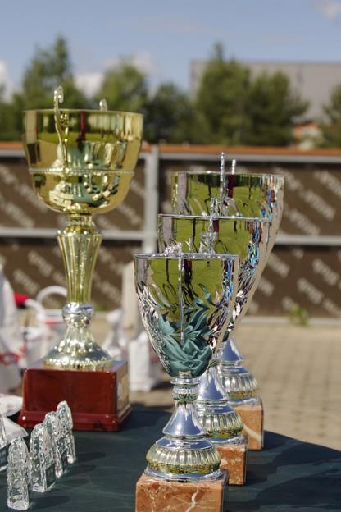
Debate in Self-Efficacy
Albert Bandura (1990, 1991, 1995, 1997) stressed the importance of self-efficacy in learning.
  One’s belief in one’s own ability can lead to success in accomplishing a task or fulfilling a goal.
Many educators boosted learners’ self-images regardless of their performance.
The ‘everybody gets a trophy’ mentality does not build true self-esteem (Twenge, 2010).
  Ego inflation and a sense of entitlement
Perhaps both views are right.

Slide 45
2015 Programme for International Student Assessment (PISA)
PISA is administered by Organization for Economic Cooperation and Development (OECD) every four years.
Assessment of student performance in literacy, math, and science, with a different focus in each round
The 2015 focus was on science learning:
  Science self-efficacy (SSE): student’s perception of their ability to successfully complete a science-related academic task
  Science Self-belief (SSB, aka self-concept): self-evaluation of one’s general ability in a domain (Marsh & Martin, 2011).
  Ambition: measured by the degree to the statement “I see myself as an ambitious person.”

Slide 46
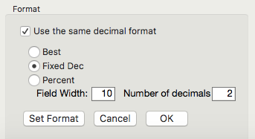
PISA 2015
Data set: PISA2015
Look at the descriptive statistics first
Analyze → Tabulate
Drag Country/region into Y-axis
Drag Math score, science score, science self-efficacy, self belief and motivation, Ambition into X-axis (top row)
Drag Mean and Std. Dev on top of summary
Set the decimal format
Use Save as (Windows) or Export (Mac) to output the table
These math and science scores are extracted from plausible values (PV)
PV: Each student has a distribution of possible scores (from low to high).

Slide 47
PISA 2015
 | Math scores |  | Science scores |  | Self-efficacy |  | Self-belief |  | Ambition
Country/Region | Mean | SD | Mean | SD | Mean | SD | Mean | SD | Mean | SD
China | 541.74 | 100.84 | 528.34 | 98.56 | 0.06 | 1.17 | 0.19 | 0.87 | 2.98 | 0.73
Hong Kong | 550.55 | 88.48 | 525.60 | 79.58 | -0.07 | 1.22 | 0.21 | 0.95 | 2.80 | 0.80
Japan | 533.30 | 88.18 | 539.03 | 93.28 | -0.46 | 1.22 | -0.51 | 1.02 | 2.64 | 0.82
Macau | 543.98 | 79.03 | 528.59 | 81.84 | -0.03 | 1.12 | -0.50 | 0.81 | 2.63 | 0.81
S Korea | 523.91 | 99.97 | 514.75 | 95.00 | -0.02 | 1.23 | 0.34 | 0.98 | 2.84 | 0.75
Singapore | 557.08 | 95.75 | 545.95 | 104.60 | 0.07 | 1.14 | 0.42 | 0.94 | 3.00 | 0.79
Taiwan | 539.20 | 103.79 | 530.85 | 99.85 | 0.19 | 1.19 | -0.01 | 0.89 | 2.92 | 0.76
USA | 474.35 | 87.92 | 502.60 | 98.04 | 0.29 | 1.29 | 0.65 | 0.95 | 3.25 | 0.72
Students in the U.S. have the lowest math and science scores but the highest scores in self efficacy in science, self-belief, and ambition.

Slide 48
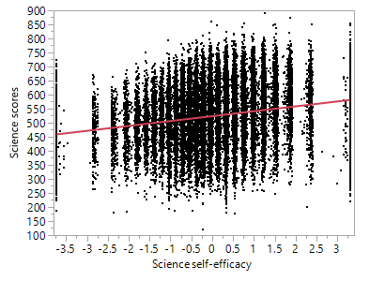
OLS Regression
The regression line is perfectly straight but this is misleading.
Due to overplotting (too many data), we cannot detect the real pattern.

Slide 49
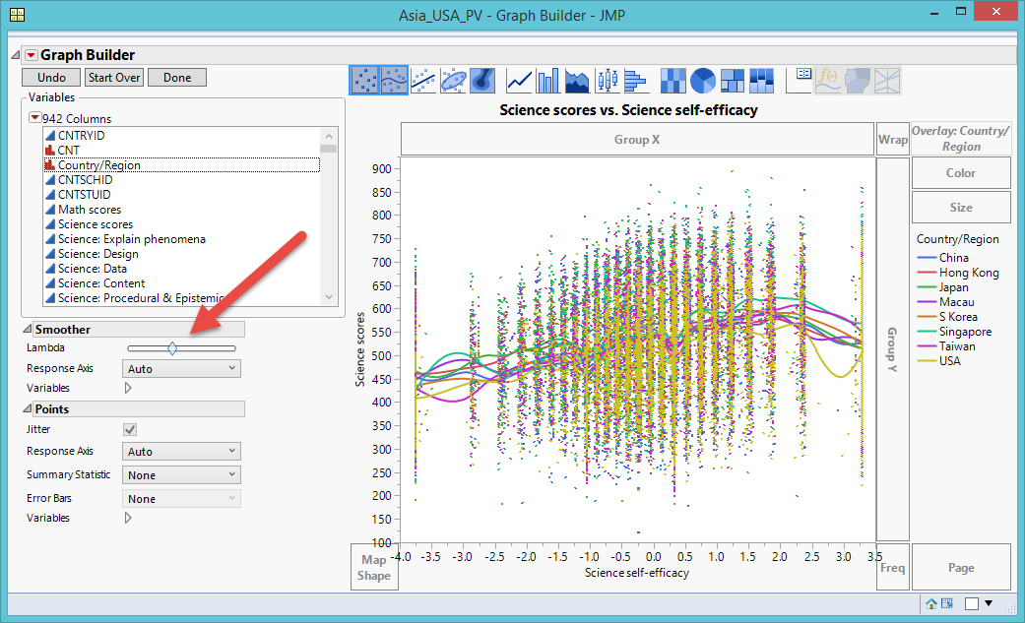
Lambda Smoothing:
Over-Complicated
Graphic Builder → Lambda smoother
Default = Middle
Too complicated
Notes:
Specialized modeling → Fit Curve
Nonlinear fitting techniques
However, counting on numeric criteria (e.g. AICc, BIC, SSE, R-square…etc.) could result in an erroneous conclusion.

Slide 50
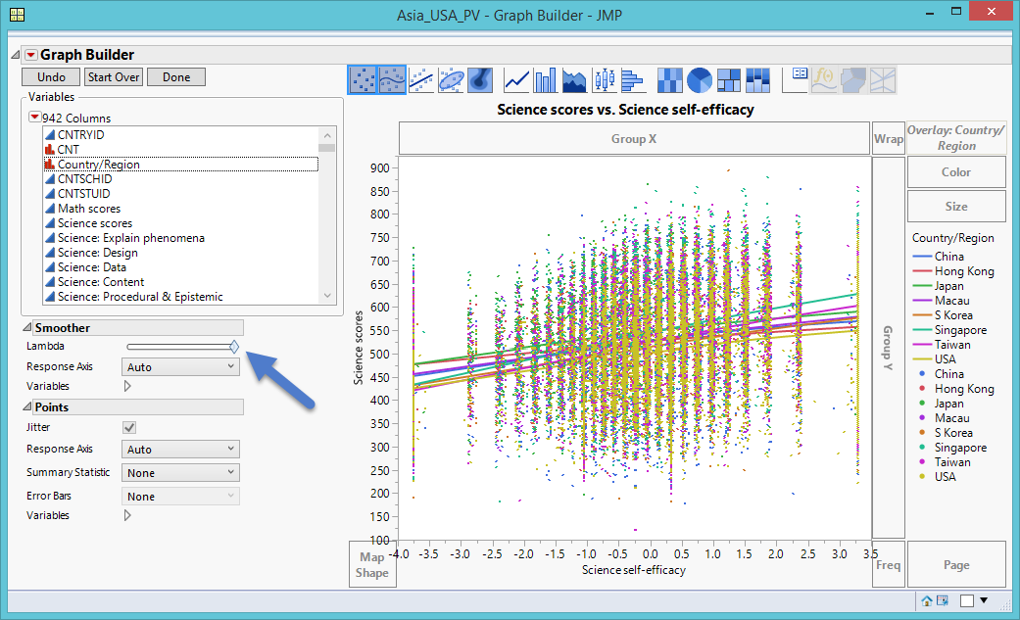
Lambda Smoothing: Over-Simplistic
Farthest Right: Shows all countries as perfectly straight
Too simplistic

Slide 51
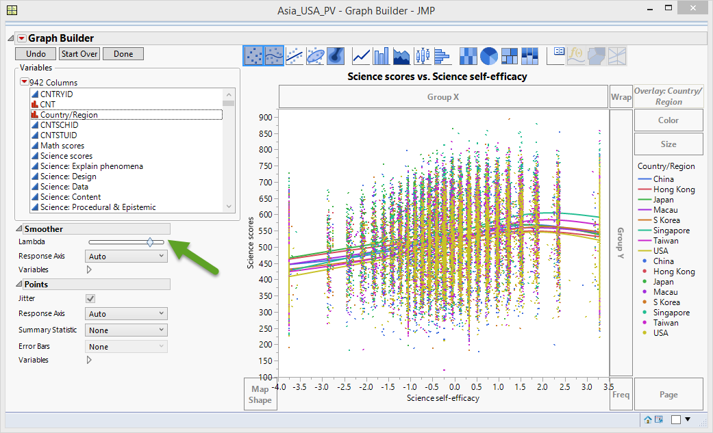
Lambda Smoothing: Non-Linear
Curvilinear relationship between science test performance and science self-efficacy
As self-efficacy improves, science test scores increase
After science self-efficacy passes a certain threshold, science test performance is reduced.

Slide 52
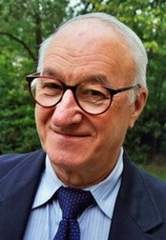
Benefits of Non-Linear
  Useful in two ways:
    It explains why educators implementing Bandura’s theory did not produce expected results
    Necessitates a reform in our pedagogical approaches
  But one may argue the preceding models are based on subject human judgment.
  Let’s turn to machine learning

Slide 53
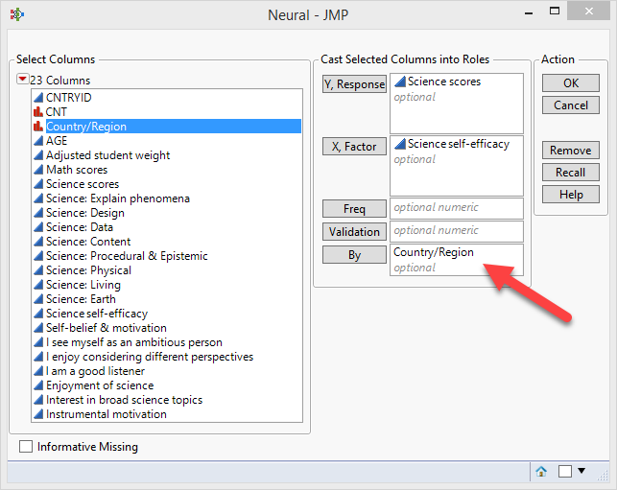
ANN
Analyze → Predictive Modeling → Neural
Run separate ANNs by Country/region
Accept all default settings and press Go
Select Profiler from the second inverted triangle in each ANN

Slide 54
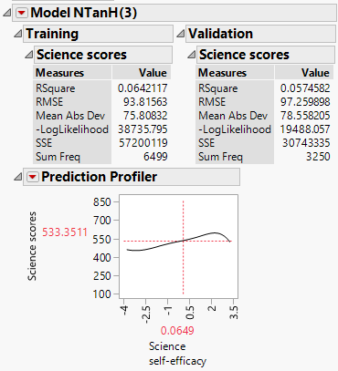
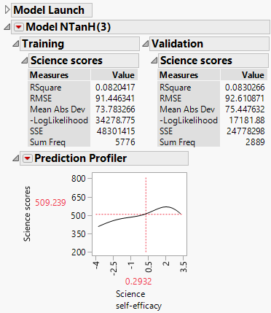
ANN
ANN suggests that while enhancing self-efficacy can improve performance initially, inflating one’s self-efficacy could drag down one’s actual performance.
Smoothing the nonlinear curves is not subjective

Slide 55
Assignment
Use PIAAC2016.
Open Graph Builder.
Put composite score into Y and readiness to learn into X.
Open Local data filter and add Country/region. Select a particular country.
Use Lambda smoother to smooth the curve.
Run ANN by putting composite score into Y, readiness to learn into X, and Country/region into By
Click Go in the same country.
Show Profiler
Compare the results of manual smoothing and automated ANN.

Slide 56
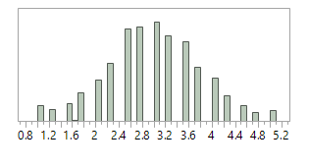
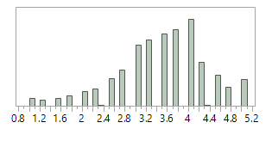
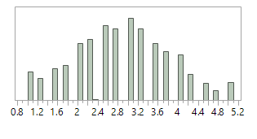
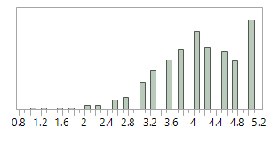
Example 2: 2016 PIAAC
Japan and South Korea: Fairly normal
Singapore: Slightly skewed.
  U.S.: Skewed towards high RTL values,
  The mode is 5, meaning that most of the U.S participants view themselves as being extremely ready to learn.
Distribution of RTL of Japan
Distribution of RTL of Singapore
Distribution of RTL of South Korea.
Distribution of RTL of USA.

Slide 57
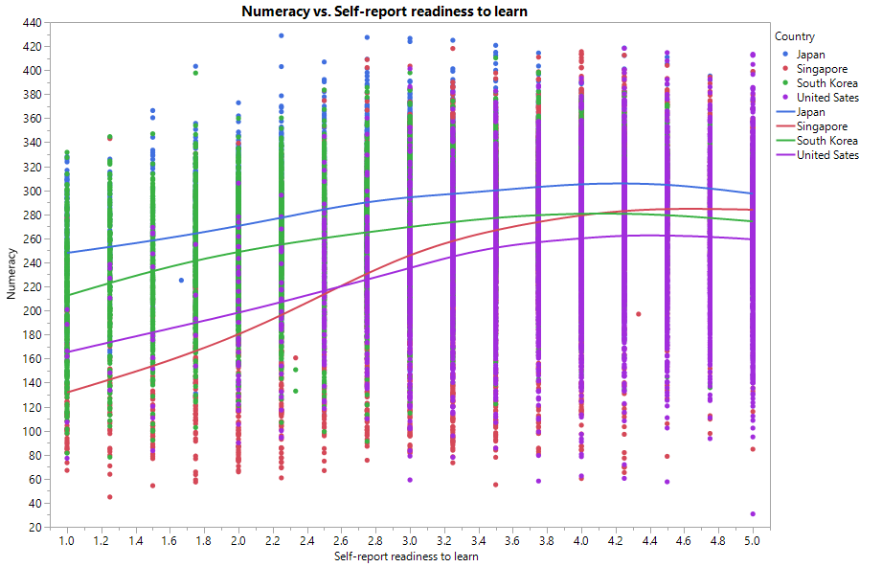
Lambda Smoothing
Curvilinear association between numeracy and RTL across all countries in the data set.
Increasing perceived RTL has less adverse effect on individual’s performance.

Slide 58
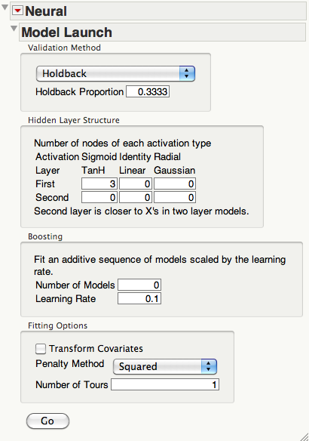
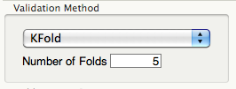
Cross-validation
For cross-validation (CV) you can hold back a certain portion of the data (usually 33% for validation and all the rest for training)
Or choose K-fold (Number of subsets and replications).

Slide 59
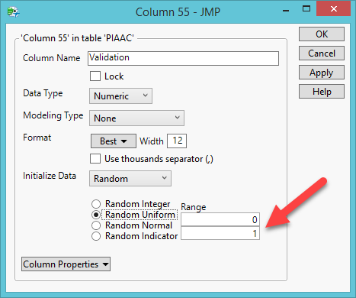
Create constant subsets
The previous methods allow the computer randomly select observations to create subsets. But when you re-run the procedure, you have different subsets.
You can randomly assign each observation to fixed groups. Next time when you re-run the procedure, you have the same subsets.
Create a validation variable using Random Uniform (50% for training and 50% validation sets)

Slide 60
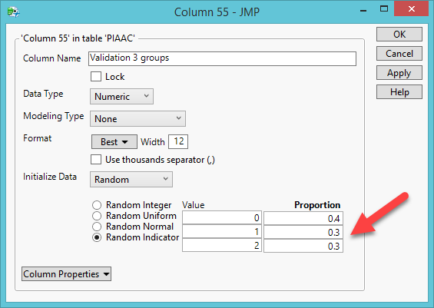
Create constant subsets
Create three subsets (training, validation, and testing) by Random Indicator.
Assign the proportion to each subset.
There is no universal rule.
Usually more data are needed for training (e.g. 40%)

Slide 61

Create constant subsets
When you run data analysis, put the validation variable into Validation.

Slide 62




Artificial Neural Network
The findings of Lambda smoothing and ANN were congruent to each other.
ANN of Japan
ANN of Singapore
ANN of South Korea
ANN of USA

Slide 63



Cross-validation
2 subsets
3 subsets
5 subsets

Slide 64
Cross-validation
When you have more and more subsets, it seems that it is getting “worse and worse”.
It is a blessing in disguise: The first or the first few may be over-fitted.
The latest model is more realistic.

Slide 65
Assignment 3.2
Create a validation variable with 2 groups.
Create another validation variable with 3 groups. Assign a larger proportion into the training set (the first group).
Run ANN by putting Problem-solving into Y, Self-report readiness to learn into X, Validation 2 groups into Validation, and Country into By.
Click Go in the Japan subset only.
Examine the Validation result (on the right)
Open Neural again and Press Recall.
Replace Validation 2 groups with Validation 3 groups.
Click Go in the Japan subset only.
Examine the Test result. Is it better or worse?

Slide 66
Example 3
Let’s try multiple input variables. There are three sets of potential factors for predicting 2006 science test performance in the US sample.
Dichotomous dependable variable: Proficient or not proficient.
School variables: How many computers at school? How many computers are used for instructions? How many computers are connected to the Internet?
Home variables: Do you have a computer at home? If so, how many? Do you have your own software? Is your home computer connected to the Internet? How many books at home?
Individual variables: Do you enjoy science? Is science valuable? Ae you interested in science?

Slide 67

Overall model adequacy
The confusion rates tells you the hit rate (accuracy of classifying students into proficient or non-proficient)
(0 & 0) or (1 & 1) = Hit
(1 & 0) or (0 & 1) = Miss
The results of the training set and the validation set are close.
Hit rate of predicting not proficient: 67.3%, 64.2%
Hit rate of predicting proficient: 63%, 64.1%

Slide 68

Surface profiler
From the second inverted red triangle, go to Surface Profiler.
You can explore the inter-relationships among many variables in a single panel.

Slide 69

Categorical profiler
Ask what-if questions
What if we put more computing resources at school?
What if we put more resources at home?
What if learners like science?

Slide 70

From JMP to Python
You can create the predictive model in Python after running ANN in JMP.
In the JMP’s ANN output, select Publish Prediction Formula from Model.

Slide 71

From JMP to Python
The previous step creates the Formula Depot.
From Formula Depot choose Generate Python code.
You can also generate the same program in JavaScript, SAS, and C (You can cheat!)

Slide 72

From JMP to Python
You can tell your boss, “I spent three hours to write the Python program!”

Slide 73
Assignment 3.3
Download the data set ‘PISA2006_USA.jmp’
Run a neural network.
Use ability as Y, use all school variables, home variables, and individual variables as Xs.
Open Profiler.
Are the curves linear or nonlinear?
Are the slopes steep or flat?
Why?

Slide 74

ANN in IBM SPSS Modeler
Use a flowchart interface
The trail (steps) is automatically documented.
You can go back to revise a step or certain steps
You can also create alternate models and compare them side by side

Slide 75

ANN in IBM SPSS Modeler
Sources → Statistics File
Double click to Edit
Double on the icon “…” and select the data file.

Slide 76

ANN in IBM SPSS Modeler
Field Operator → Type
Right click the data file to Connect
Double click Type to Edit
Make proficiency into Target

Slide 77

ANN in IBM SPSS Modeler
Modeling→ Neural Net
Connect Type and Proficiency
Double click Proficiency to Edit
The DV and IVs are automatically assigned but remove ability

Slide 78

ANN in IBM SPSS Modeler
Go to Build Options → Advanced
Partition the sample into training set and validation set to avoid overfitting
Put aside 33% of the data for validation
Enter 12345 for random seed
Impute missing data
Click Run

Slide 79

SPSS’s ANN output
Drawback; No dynamic graph; no linking and brushing

Slide 80


ANN output
Same as Confusion Matrix in JMP

Slide 81
Assignment 3.4
Open IBM Modeler
Use Sources → Statistics to import PISA2006_USA
Drag Field Ops → Type into the canvas
Connect the two icons
Edit type, assign ability as the target
Create a Neural Net from Modeling
Go to Build Options → Advanced, select impute missing data
Run the model
Examine the output. Is the predictive power better or worse than using proficiency? Why?

Slide 82
Less is more
In Unit 2 we discussed using domain knowledge to understand the data. For example, we can use age groups instead of age in spite of losing precision.
Ability is continuous-scaled and proficiency is dichotomous. Is higher precision always better than lower precision? Why or why not?

Slide 83
Drawbacks
There are three types of layers, not three layers, in the network. There may be more than one hidden layer and it depends on how complex the researcher wants the model to be.
Because the input and the output are mediated by the hidden layer, neural networks are commonly seen as a “black box.”
Harder to interpret and understand

Slide 84
Recommendations
Use it when predictive accuracy is the most important objective
When you need a non-linear fit but do not want over-fitting and want to avoid the tedious work of orthogonalization
When you have mixed data type, such as nominal, ordinal, and continuous, but want to avoid the laborious data transformation

