Slide 1
Ungraded quiz
Unit 3

Slide 2
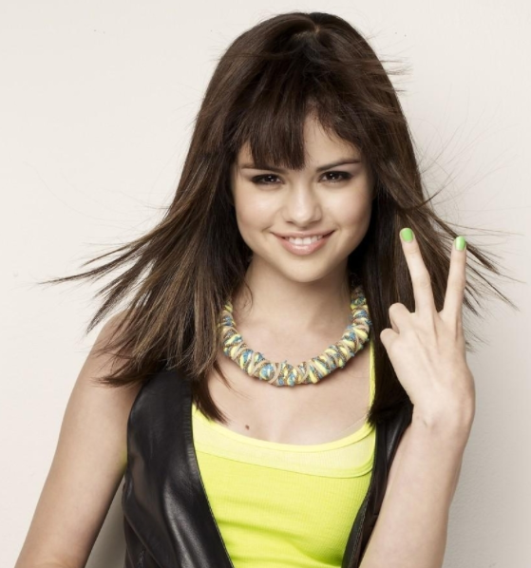
Show me your fingers
Do not shout out the answer, or your classmates will follow what you said.
Use your fingers
  One finger (the right finger) = A
  Two fingers = B
  Three fingers = C
  Four fingers = D
  No finger = I don’t know. I didn’t study

Slide 3
Which of the following is NOT a school of machine learning?
Symbolic approach
Connectionist approach
Fisherian approach
Evolutionist approach

Slide 4
Which of the following statement is true?
Supervised learning uses unlabeled data.
Unsupervised learning uses labelled data.
When a training data set is used, it is considered supervised learning.
All are true.

Slide 5
Which of the following statements is true?
Convolutional NN uses backward-feed to pass signals from start to end.
Recurrent NN is traditional.
Reinforcement NN is used by Facebook to create realistic images that can fool human eyes.
Generative adversarial NN is totally unsupervised.

Slide 6
Which of the following project is based on SAS’s AI technology?
Self-drive car
Wildtrack
Berkeley’s computer vision
All of the above

Slide 7
Deep learning consists of an input layer, a hidden layer, and an output layer
True
False

Slide 8
Which feature in JMP can be used for assigning observations into three fixed subsets?
Random integer
Random uniform
Random normal
Random indicator

Slide 9
Which of the following features in JMP can be used for checking the accuracy of the predictive model?
Generalized R-square
RMSE
Confusion matrix
Adjusted R-squared

Slide 10
What are the advantages of using the flowchart in SPSS Modeler?
The entire analytical process is documented.
The analyst can go back to any icon (step) to make changes.
The analyst can run alternate models and then compare them side by side.
All of the above.

Slide 11
In IBM SPSS Modeler what options do you have when there are missing data?
Delete casewise
Delete listwise
Impute missing values
B and C only

Slide 12
JMP can generate the program syntax of ______
C
JavaScript
SAS
Python
SQL
All of the above

