Slide 1
Ungraded quiz
Unit 4

Slide 2
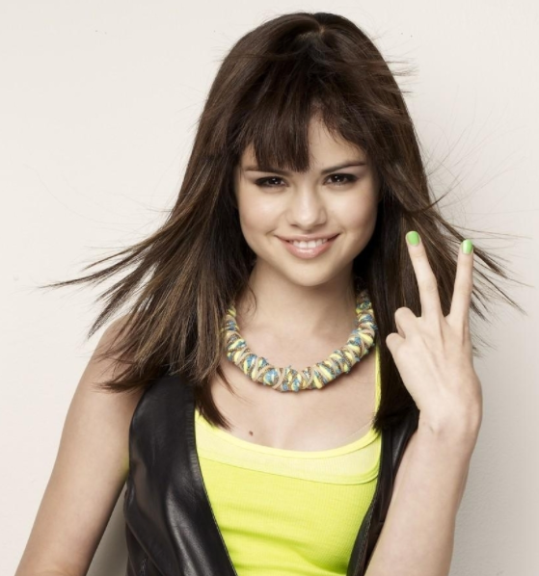
Show me your fingers
Do not shout out the answer, or your classmates will follow what you said.
Use your fingers
  One finger (the right finger) = A
  Two fingers = B
  Three fingers = C
  Four fingers = D
  No finger = I don’t know. I didn’t study

Slide 3
Which of the following is NOT a problem of traditional OLS regression?
Too many assumptions about the residuals and the predictors
It tends to overfit to the sample.
The model is unstable when some predictors are strongly correlated (collinearity)
There is only one unique solution when the sample size is large.
It must be a linear model.

Slide 4
Which of the following statement is NOT a characteristic of generalized regression?
Similar to abduction or IBE: don't fix on one single answer, consider a few.
It imposes penalty on the model to reduce complexity
Start with a full model model and then scale back the model.
It is also known as regularized regression.

Slide 5
Which of the following is NOT an option in JMP’s generalized regression?
Elastic Net
Lasso
Double Lasso
Ridge
Dante Selector

Slide 6
Elastic net combines the penalty methods of ….
Double lasso and Ridge
Lasso and Ridge
Double Lasso and Dantzig selector
Ridge and Dantzig selector

Slide 7
AIC or AICc is better than BIC because…
AIC and AICc is based on the principle of information loss.
The Bayesian approach requires a prior input but usually it is debatable.
AIC is asymptotically optimal in model selection in terms of the root mean square error, but BIC is not asymptotically optimal.
All of the above.

