Slide 1
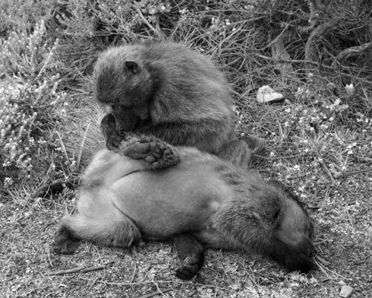
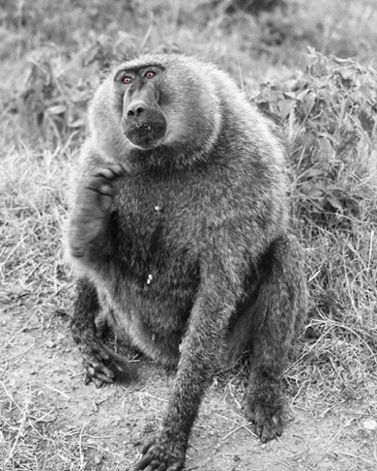
From OLS to
Generalized Regression
Chong Ho Yu
(I am regressing)

Slide 2


OLS regression has a long history
Ordinal least squares (OLS) regression, also known as standard least squares (SLS) regression, was discovered by Legendre (1805) and Gauss (1809) when our great grandparents were born.

Slide 3
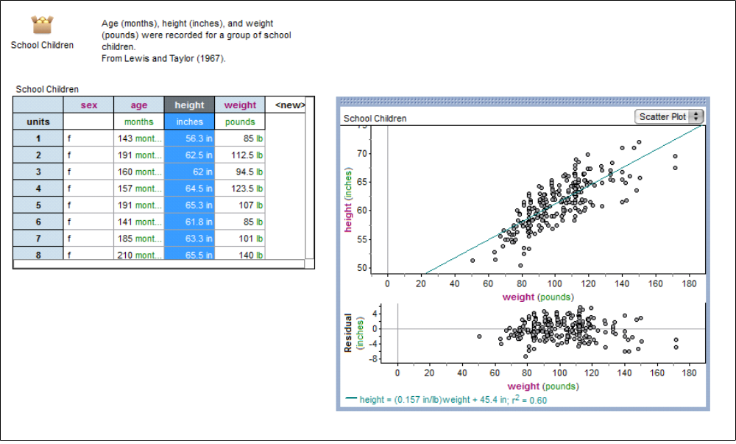
OLS regression
Least square = least square of residuals
Residual = distance between actual and predicted
Best fit

Slide 4

R square
The purpose of simple regression is to find a relationship (but not the one in the picture below).
When there are multiple predictors, the multiple-relationship is denoted by the R-square (variance explained).

Slide 5
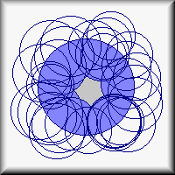
Inflated variance explained
Picture that the overlapping area between Y and Xs is the variance explained (multiple-relationship).
When you put more and more Xs on Y, the circle of Y is almost fully covered. R-square = .89! Wow! Voila! Allelujah!

Slide 6
Useless model
A student asked me how he could improve his grade. I told him that my fifty-variable regression model could predict almost 89% of test performance: study long hours, earn more money, buy a reliable car, watch less TV, browse more often on the Web, exercise more often, attend church more often, pray more often, go to fewer movies, play fewer video games, cut your hair more often, drink more milk and coffee...etc.
This complicated model is useless!

Slide 7
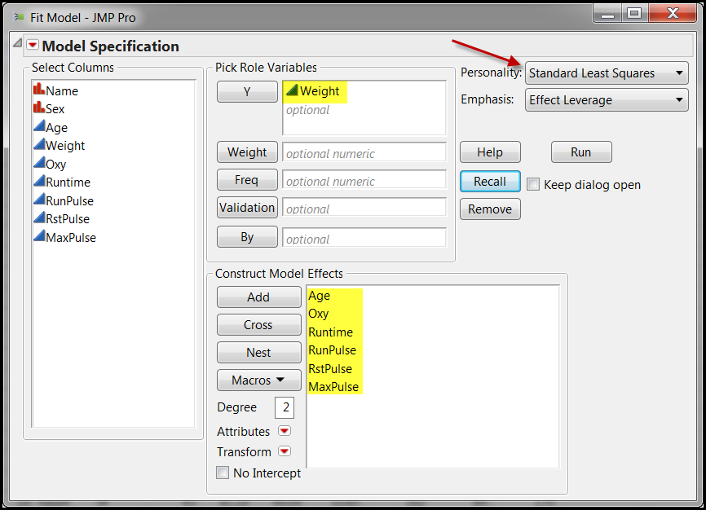
Fitness
In this example I want to use six variables in Fitness data (JMP sample library) to predict weight. The method is OLS regression.

Slide 8
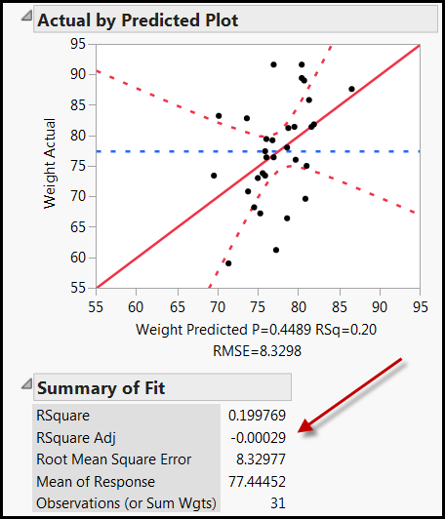
Negative adjusted R-square!
The R-square is .199. Not bad! This model can explain 20% of the weight variance.
But when many predictors are used, the program used adjusted R-square to adjust the inflated R-square.
It is negative! R-squared is r * r. It should not be negative. What is happening?

Slide 9
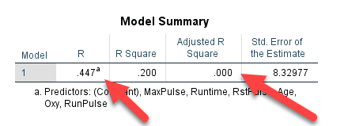
Regression in SPSS
If you run the same regression analysis in SPSS, r = .447, R = .2, and the adjusted R-squared is 0.
Zero means no variance is explained, but at least it is not negative.
Which one should I trust? SPSS or SAS (JMP)?

Slide 10
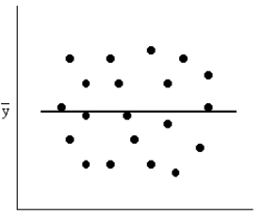

Negative R-squared
Zero is no variance explained.
If you fit a line to the data, the line is flat (horizontal).
If the model is worse than a horizontal line and contradicted with the data pattern, the adjusted R-squared can be negative.
There are too many predictors in the model. The model could be worse than no model.
Metaphor: if you are sick and take the wrong drug or the fake medicine, it is worse than no drug at all.

Slide 11
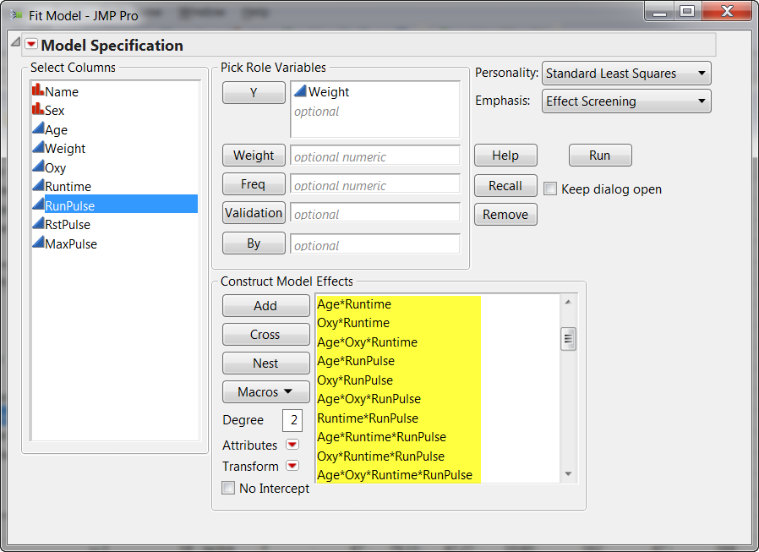
How about all possible interactions?

Slide 12
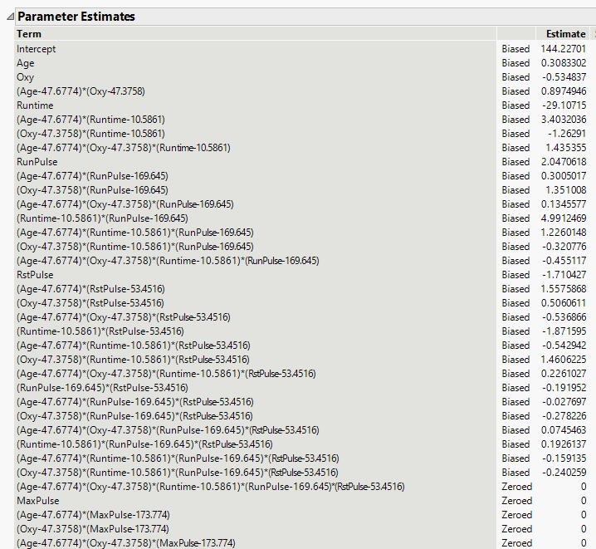
Biased or Zeroed out?
Every parameter estimate is either biased or zeroed out. What is happening?

Slide 13
Problems of OLS regression
Too many assumptions about the residuals and the predictors
It tends to overfit to the data.
The model is unstable when some predictors are strongly correlated (collinearity)
There is no unique solution with a large data set.
For sample size, the conventional rule of thumb is 1(predictor): 10 (observations); impossible to run OLS regression if p > n.
It must be a linear model.

Slide 14
Generalized regression
Introduced by Friedman (2008)
Similar to abduction or IBE: don't fix on one single answer, consider a few.
There may be many solutions to solve the problem. Why not explore different paths?
Start with no modeling or zero-coefficient.
Try out a series of models. The solution is elastic (changeable).
Pick the best (by the algorithm, not by you)!

Slide 15


KISS!
Also known as regularized regression (In SPSS).
Also known as Penalized regression
Give the model a penalty if it is too complicated or the fitness is inflated → Keep it simple, stupid (KISS)!

Slide 16
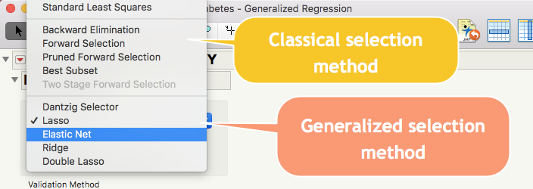
Options of model optimization
Most people ran Standard Least Squares and stopped!

Slide 17
Dantzig selector
Only can work when the specified distribution is normal and no intercept option is NOT selected.
Penalizes the sum of absolute values of the regression coefficients.

Slide 18

Lasso
Will zero out the regression coefficient → select variables by dropping some out.
Not good for wide data structure: If there are too many predictors and too few observations (high p, low n), LASSO will saturate very fast (stop further selection of variables).
When there are too many collinear predictors, LASSO select just one and ignore others.

Slide 19
Lasso
May not have the oracle property because of its bias problem.
An oracle knows the truth: The true subset of variables. Oracle property: The asymptotic distribution of the estimator is the same as the asymptotic distribution of the Max. Likelihood Estimator (MLE).

Slide 20
Double Lasso
Two stages
  Stage 1: A model is fit to generate the terms (the predictors and their slope estimates) for Stage 2.
  Stage 2: Use the terms in Stage 1 and make adjustment.
It is useful for wide data structure: When the sample size is smaller than the number of predictors.
Stage 2 would NOT overly penalize the terms that should be included.

Slide 21
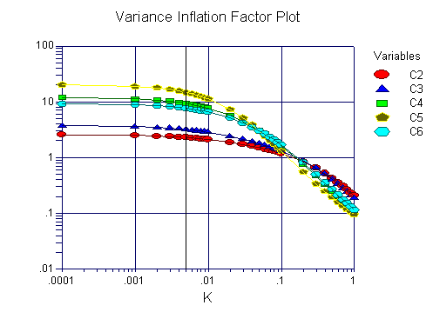
Ridge
Counter-measure against collinearity & variance inflation: Shrinking the regression coefficients towards zero.
But regression coefficients will not be exactly zero. You may end up with all the coefficients or none.
It controls the cancer cell, but won't remove it.

Slide 22

Elastic NET
Adaptive, versatile
It combines the penalties of the lasso and ridge approaches.
Why not use the best of both only?
It can be used for ultra-high dimensional data (p > n).
A small increase in bias but a substantial decrease in variance.

Slide 23
Penalize complexity against overfitting
Akaike's information criterion (AIC): used in comparison, no cut-off.
Given all things being equal, the simplest model tends to be the best one
Simplicity is a function of the number of adjustable parameters.
AIC = 2k – 2lnL where k is the number of parameters and L is the likelihood function of the estimated parameters.
AIC does not necessarily change by adding variables. It varies based upon the composition of the predictors and thus it is a better indicator of the model quality.

Slide 24
Penalize complexity against overfitting
AICc (correction) imposes a greater penalty for additional parameters.
AICc = AIC + (2K(K+1)/(n-k-1)) where n = sample size and k = the number of parameters.
Burnham & Anderson (2002) recommend using AICc, especially when the n is small and the k is large.
AICc converges to AIC as the n is getting larger and larger.
AICc should be used regardless of n and k.

Slide 25
Penalize complexity against overfitting
Bayesian information criterion (BIC) imposes heavier penalty.
But AIC and AICc are superior to BIC .
AIC and AICc is based on the principle of information gain.
The Bayesian approach requires a prior input but usually it is debatable.
AIC is asymptotically optimal in model selection in terms of the least squared mean error, but BIC is not asymptotically optimal (Burnham & Anderson, 2004; Yang, 2005)

Slide 26
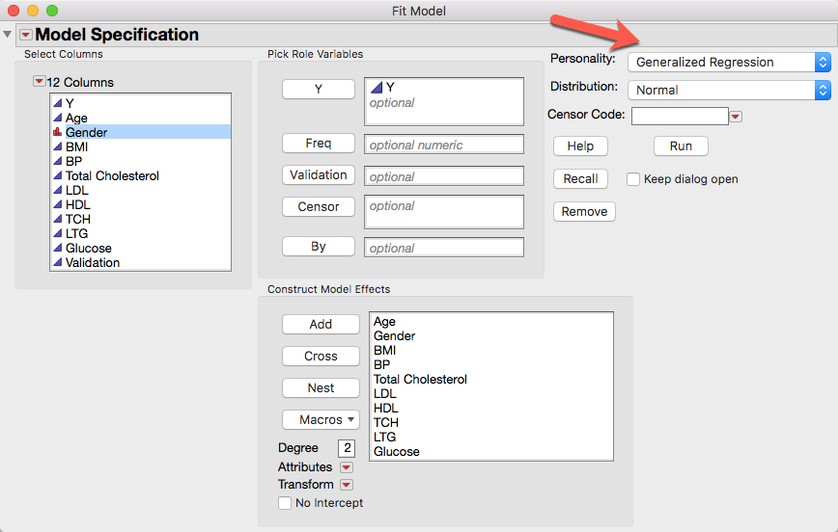
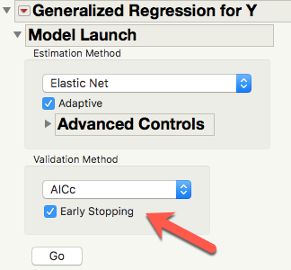
Example 1: Diabetics data (JMP library)
Use multiple predictors to predict diabetics progression (Y).

Slide 27
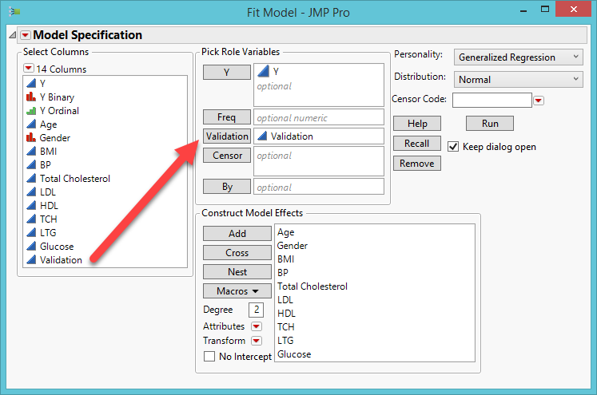
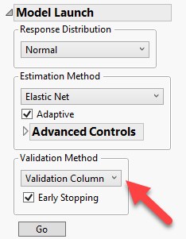
Example 1: Diabetics data (JMP library)
You can also use the validation column for the validation method

Slide 28
Multi-collinearity!
Total cholesterol
LDL (low-density lipoprotein cholesterol): bad cholesterol
HDL (high-density lipoprotein cholesterol): "good" cholesterol)
TCH (Triglycerides): fats carried in the blood from the food we eat. Excess calories, alcohol, or sugar are converted into TCH and stored in fat cells.

Slide 29
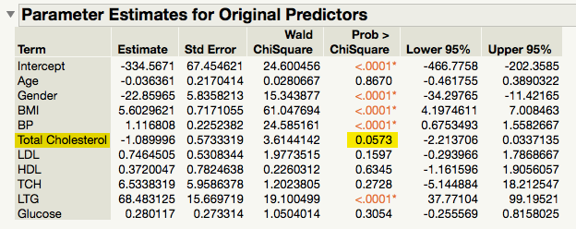
Example
Total Cholesterol, LDL, HDL, TCH are collinear.
OLS regression does NOT consider any one of those as an important predictor (Total Cholesterol, almost! P = .0573).

Slide 30
You cannot ignore cholesterol!
“People with Type 2 diabetes, regardless of blood sugar control, tend to have increased triglycerides, decreased HDL, and sometimes increased LDL…The American Diabetes Association recommends checking cholesterol levels at least once a year, or more often if they are high and not controlled by medication. For people with diabetes and no known coronary heart disease, it is recommended that LDL levels in the blood be below 100 milligrams per deciliter (mg/dL), that HDL levels be above 50 mg/dL, and triglycerides below 150 mg/dL. “
Source: https://www.verywellhealth.com/the-dangers-of-high-cholesterol-and-diabetes-3571713

Slide 31

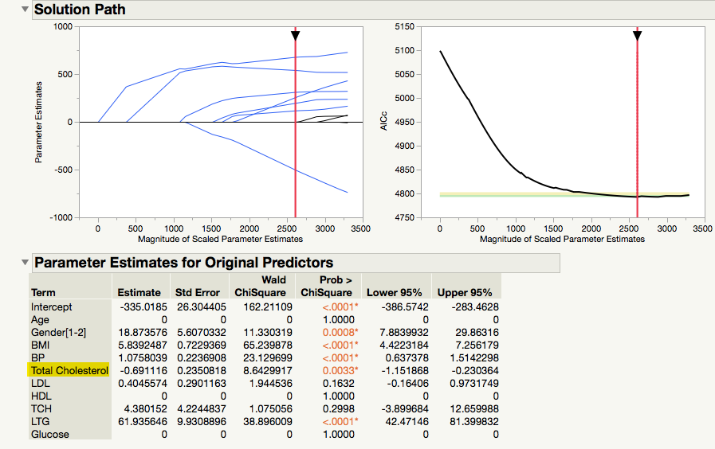
GR output
OLS regression AICc: 4797
GR AICc: 4793
Smaller is better

Slide 32
Why coefficient is 0 and p is 1?
In traditional statistics, the probability is an approximation based on sampling distributions, which is open-ended (the two-tails never touch down the x-axis). In this case the p value at most could only be .9999, but never be 1.
In GR regression coefficients of unimportant variable could be 0.
Y = bx; when b is 0, Y is Y! X is zero out!
When the data could be perfectly described by the null model, the probability of observing the data could be 1.

Slide 33
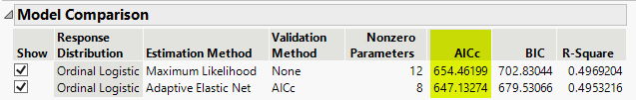
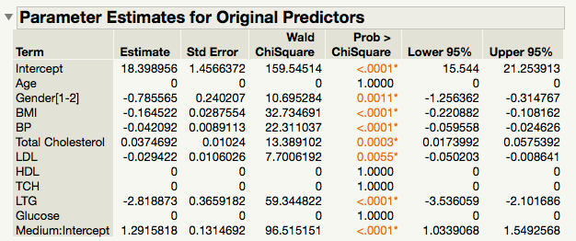
How about reducing precision?
Dependent: Y_ordinal.
High, medium, Low
AICc = 647
LDL is included.

Slide 34

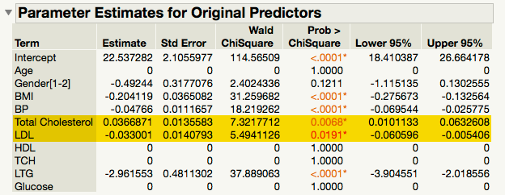
Less is more!
Dependent: Y_binary
High and low only
AICc = 328
The best!
LDL is included. It is more informative than total cholesterol only.

Slide 35
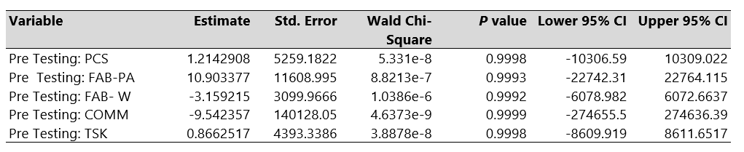
Example 2: stay away from opiates
Silva, M. J., Coffee, Z., Yu, C. H., & Martel, M. O. (2021). Anxiety and fear avoidance beliefs and behavior may be significant risk factors for chronic opioid analgesic therapy reliance for patients with chronic pain – results from a preliminary study. Pain Medicine, Article pnab069. https://doi.org/10.1093/pm/pnab069
None of the potential predictors was found to be significant in the classical ordinal logistic regression model.

Slide 36
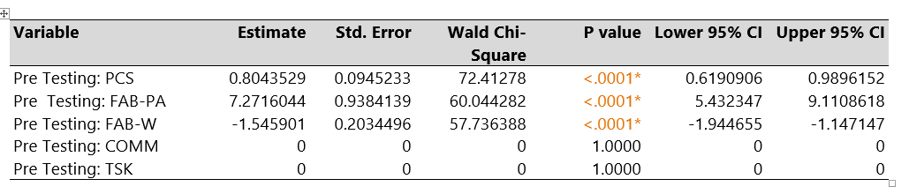
Example 2: stay away from opiates
Penalized regression shows that the pretests of PCS, FAB-PA, and FAB-W were significant.
The regression coefficients of COMM and TSK were shrank to zero, meaning that these two variables were excluded from the regression equation.

Slide 37
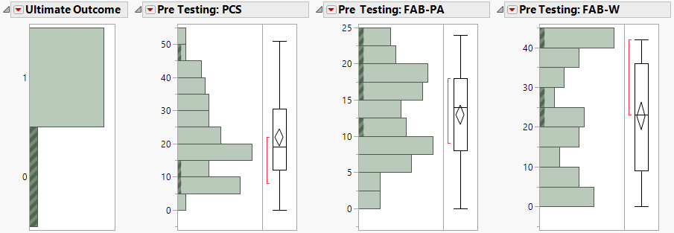
Example 2: stay away from opiates
Linking & brushing: All unsuccessful cases have high FAB-PA and FAB-W pretest scores.
In the same observations the PCS pretest scores were both high and low.
There is an association between FAB and unsuccessful cases, the relationship between PCA and failed cases is not clear cut.

Slide 38
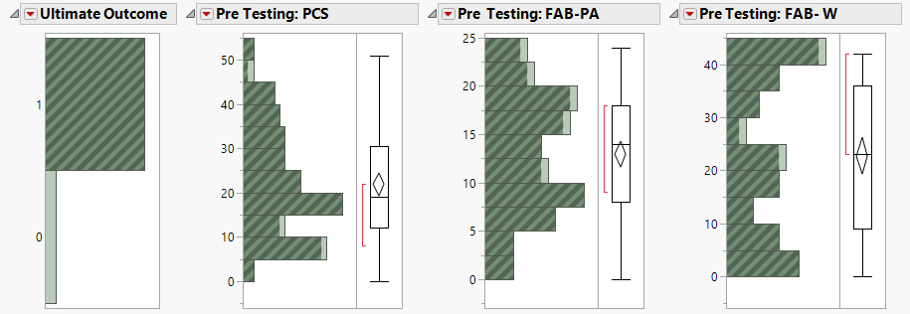
Example 2: stay away from opiates
There is no discernable pattern among successful cases (1) in relation to the significant predictors.
For these participants their pretest scores of PCA and FAB ranged from low to high, and thus this regression model has no predictive power for successful participants.

Slide 39
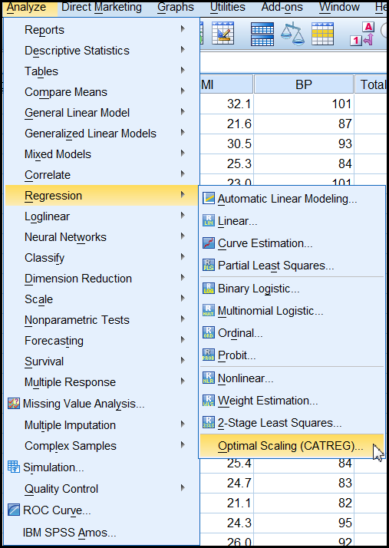
SPSS
You can access this feature from: Analyze → Regression → Optimal scaling (CATREG) → regularized.
Categorized regression: quantify categorical variables.
It is harder to interpret the SPSS output.

Slide 40
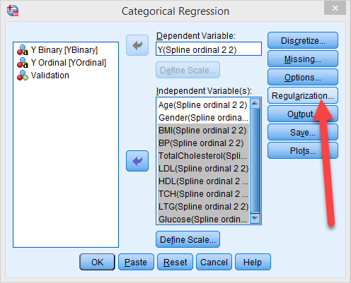
SPSS Statistics
Press “Regularization” to choose the method of regularization.

Slide 41
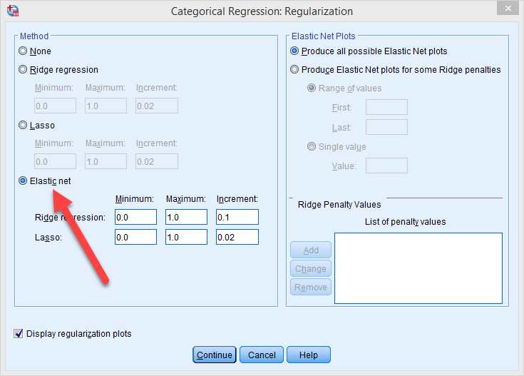
SPSS Statistics
Fewer options
And harder to use e.g. you need to specify the penalty values.
Alternatively, choose “produce all possible”

Slide 42
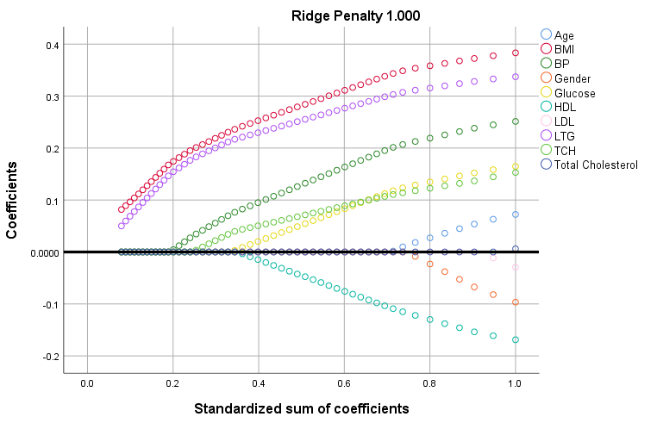
SPSS Regularized regression result

Slide 43
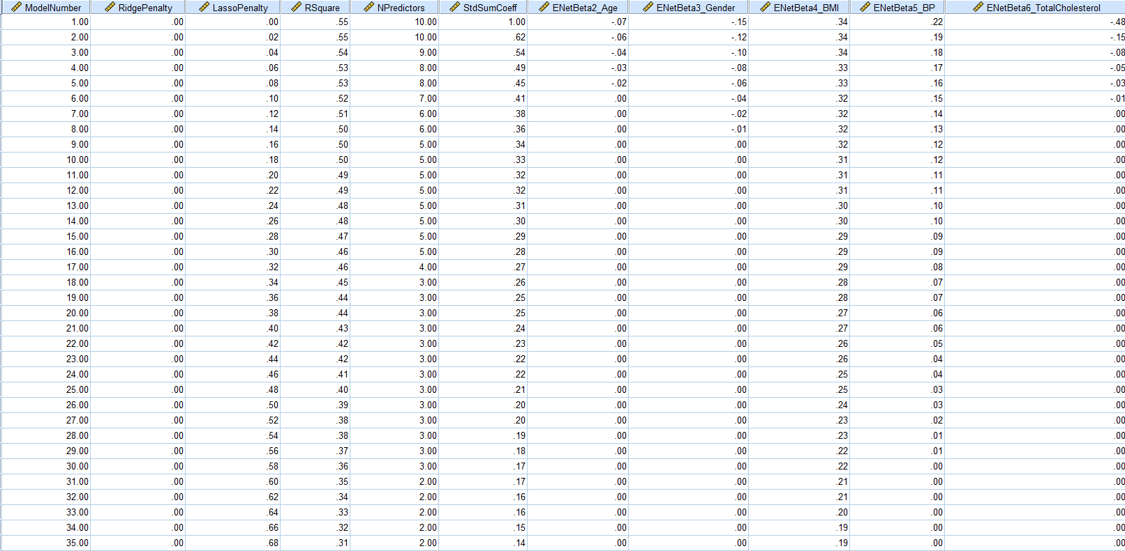
All possible results, pick the best one!

Slide 44
Pros and cons
Pros
  It accepts all types of data. GR can replace OLS and logistic
  It can solve the problem of collinearity.
  It can avoid ovefitting.
  It is the best of all possible paths.

Slide 45
Pros and cons
Cons
  It is still a global model (one size fits all). Unlike hierarchical regression, it cannot discover local structures or specific solutions for special population segments.
  It is still a linear model. What if the real relationship is non-linear?

Slide 46
Comparison
A cohort study (Kan, Kharrazi, Chang, Bodycombe, Lemke, & Weiner, 2019) included 81,106 Medicare Advantage patients with 5 years of continuous medical and pharmacy insurance from 2009 to 2013. Total health care costs in 2013 were predicted with comorbidity indicators from 2009 to 2012
Using 2012 data, OLS performed poorly (e.g., R2 = 16.3%) compared to penalized linear regression models (R2 ranging from 16.8 to 16.9%)
Using 2009–2012 predictors, the performance gap further increased (R2:15.0% versus 18.0–18.2%).

Slide 47
Recommendations
If your colleague or the reviewer wants a conventional solution (wants to see the term “regression”), use generalized regression.
If there are many predictors and some are collinear, use GR.
If the data structure is wide, use double lasso in GR.
If the data structure is tall, use elastic net in GR.
If the relationship is nonlinear, use artificial neural network (covered in Unit 3).

Slide 48
Assignment 4
Use PISA2006_USA in Unit 3 to run two Generalized regression models: LASSO and Ridge
Y = proficiency
X = all others, excluding ID, ability, and grade
Compare the two models. What are the differences and similarities? (Check AICc)

