Slide 1

SVM and Decision Tree
Chong Ho (Alex) Yu

Slide 2
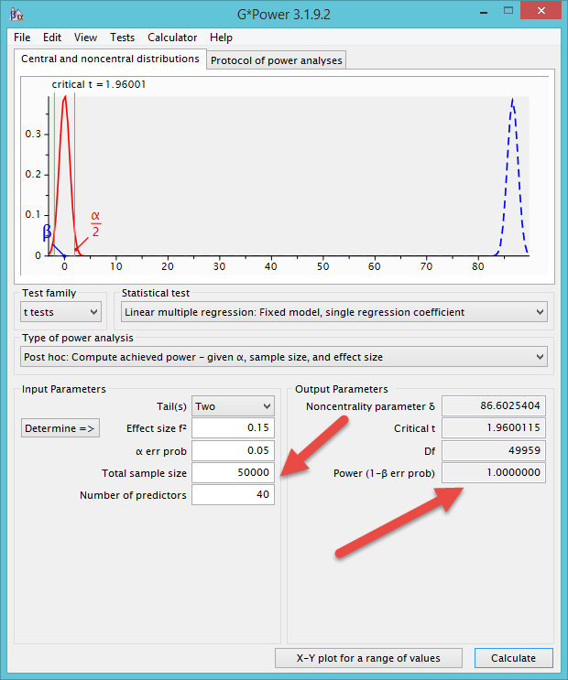
What not regression?
T-test and OLS regression are good for small-sample analysis.
If you have an extremely large sample (e.g. Archival data), the power level may aproach 1 (.99999, but it cannot be 1).
What is the problem?

Slide 3
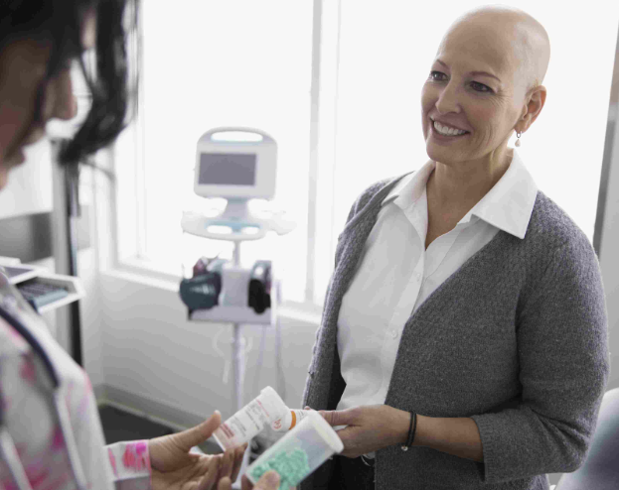
Example: Research problem
Utilizing the archival data obtained from National Cancer Institute, the researcher wants to find out whether there is a difference between cancer and non-cancer patients in terms of their perception of care.
A t-test should be used for comparing two-group, right?

Slide 4
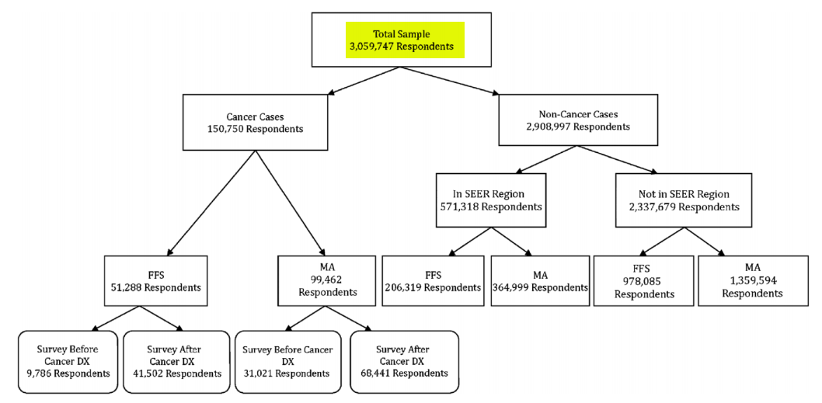
Example: Research problem
The sample size is 3 million!

Slide 5
Example: Research problem
We can reframe the question by turning it into a classification problem.
There are many survey items relating to the perception of care. Which can be used to classify patients into the cancer group and the non-cancer group?
If “Appropriate preventative antibiotics received for surgery” is found to be an important predictor of the patient type, then it means when I randomly select a patient, it is highly likely that I can correctly classify the patient into proper group.
In other words, there must be a substantive difference between cancer and non-cancer patients in terms of their rating in “Appropriate preventative antibiotics received for surgery.”

Slide 6

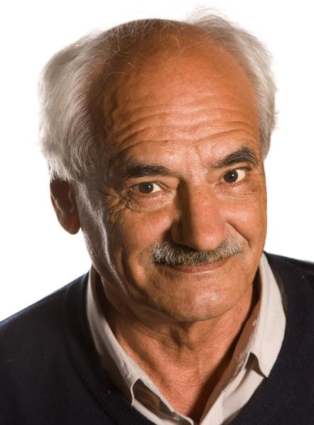
Classification tool:
Support vector machine
The idea was invented by Russian mathematicians Vladimir N. Vapnik and Alexey Chervonenkis in 1963.
It was refined by in 1992 and the current form of SVM was created in 1993.
Notes:
Source: SAS Institute

Slide 7
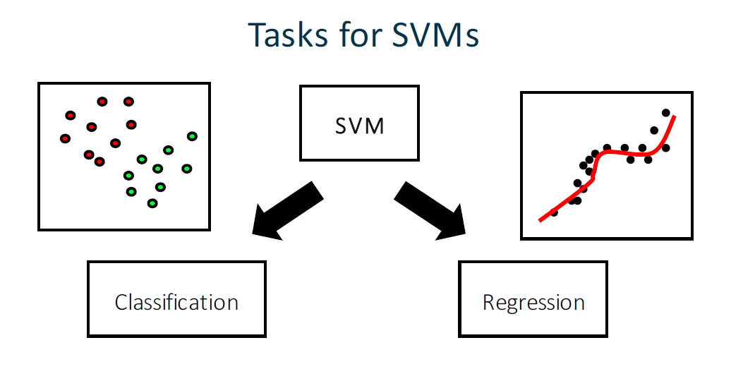
Support vector machine
SVM can be used for both regression and classification (discrete outcome) problems.
We will focus on classification only.
Notes:
Source: SAS Institute

Slide 8
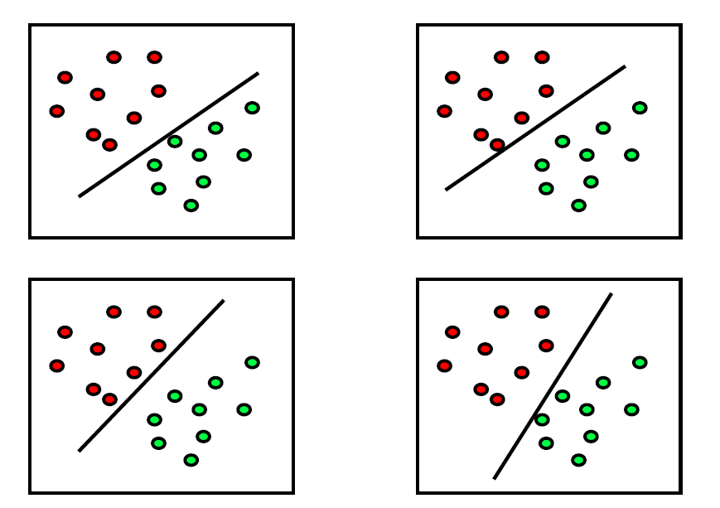
Support vector machine
Where do you draw the line to classify red vs. green.
https://www.youtube.com/watch?v=Y6RRHw9uN9o
Notes:
Source: SAS Institute

Slide 9
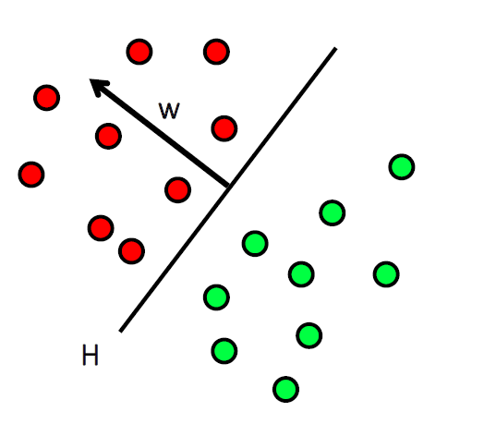
Support vector machine
A separating hyperplane H is given by
the normal vector w
The bias (b) parameter
Notes:
Source: SAS Institute

Slide 10
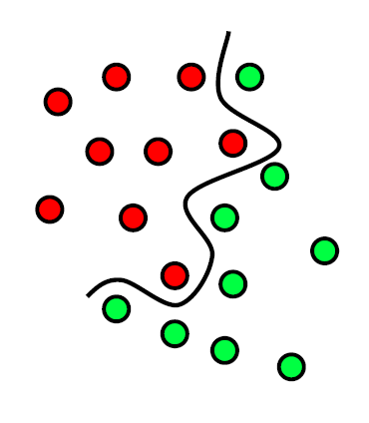
Support vector machine
What if the cases are not clear-cut?
The non-linear demarcation curve is too complicated!
Notes:
Source: SAS Institute

Slide 11
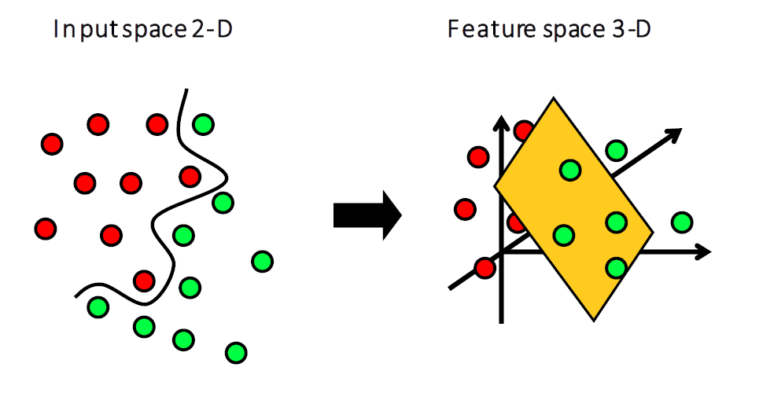
Support vector machine
Trick: if the data are not linearly separable in two dimensions, create a three-dimensional feature space.
SVM can be boiled down to: classify observations by optimizing the hyperplane.
Notes:
Source: SAS Institute

Slide 12
SVM in JMP
Select Help: Sample Data Library and open Diabetes.jmp.
This DV Y binary quantifies disease progression as either Low or High.
Task: Build a classification model to predict the disease progression for future patients as High or Low.

Slide 13
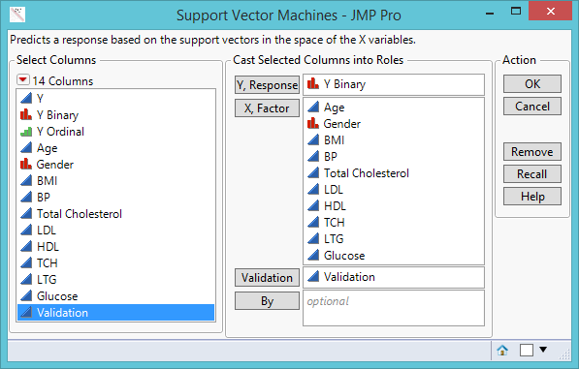
SVM in JMP
Open Support Vector Machine from Analyze: Predictive modeling.
Enter the variables as shown on the right.
Press OK

Slide 14
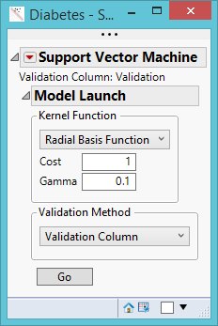
SVM in JMP
We will build at least two SVM models for comparison.
In the first dialog box accept the default Radial Basis Function.
Press Go.

Slide 15
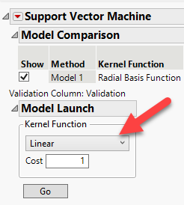
SVM in JMP
In the output click on Model Launch to build another model.
This time choose the Linear model.
In Model Comparison, the second model has the lowest misclassification rate and thus it is considered the best model.

Slide 16
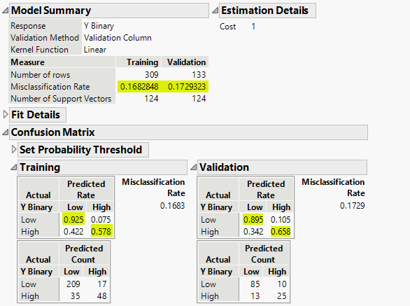
SVM in JMP
In Model 2 (Linear), the misclassification rates for the training and validation sets are very similar, implying that the model did not overfit the data.
The confusion matrices shows that the model correctly categorizes the Low responses 92% in training and 89.5% in validation.
But the prediction for High is weak: 57.8% in training and 65.8% in validation.

Slide 17
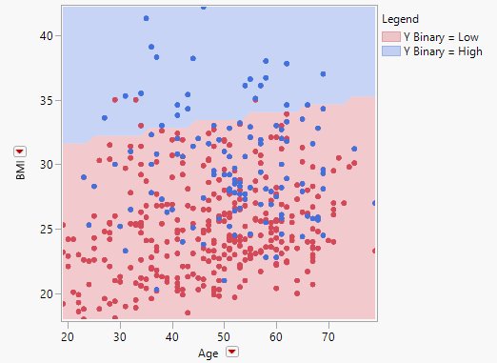
SVM in JMP: Response Profile Plot
BMI and Age can optimize the hyperplane to generate an accurate classification model for diabetic progression.
The line (the hyperplane) divides patients into two areas (the model).
Most blue dots (actual) are in the blue area (predicted) and most red dots are in the pink area.
Only a few red dots in the blue area.

Slide 18
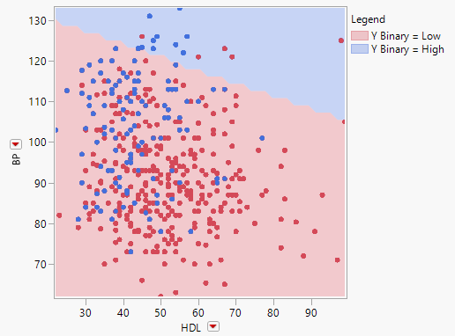
SVM in JMP
If I switch to two other factors: Blood Pressure (BP) and High Density Cholesterol (HDL), then the model is no longer optimal.
There are too many blue dots in the pink area.
There are several red dots in the blue area.

Slide 19
Ungraded exercise
In the Response Profile Plot switch to other variables.
It is known that the model is most optimal when BMI and age are included.
Do not look at the next slide.
Find the worst model.

Slide 20
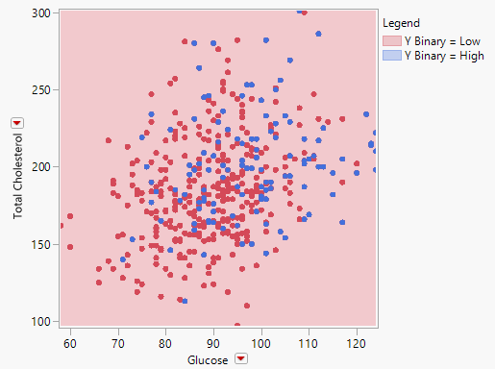
The worst!
If you put Total Cholesterol and Glucose together, every one is classified as Low risk.
A totally useless model!

Slide 21
SVM in JMP and Python
JMP’s SVM provides two kernels (model types) only: Linear and radial basis function (RBF). Python has more kernel types: linear, rbf, polynomial (poly), sigmond, and precomputed.
JMP evaluates the model by mis-classification rate. Python offers model accuracy, model precision, and model recall.
JMP’s dynamic and interactive data visualization is very user-friendly. Python requires complicated programming and the graphs are not dynamic.
Strategy: Choose the best in each

Slide 22

SVM in Python
Import the Excel and SAS version of Diabetics data fset rom the Python folder in Unit 5.
Open Anaconda Navigator
Launch Jupyter Notebook

Slide 23
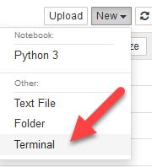
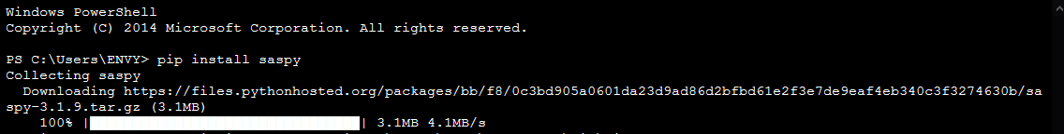
SVM in Python
Python can read Excel files, SAS data sets, and many others.
To import SAS data set into Python, you need to install SASPy. This module automatically generates SAS code from the Python environment.
To install SASPy, in the Jupyter notebook choose Terminal from New.
In the terminal type pip install saspy and press enter.
If you use SAS University Edition, please read: https://support.sas.com/software/products/university-edition/faq/jn_saspy_whatis.htm

Slide 24
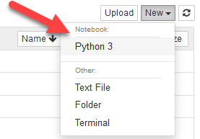
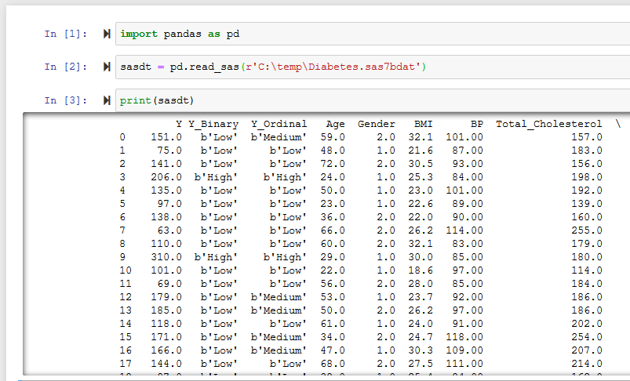
SVM in Python
Back to the notebook and open a Python 3 file from New.
Type the codes at the right. In each line press shift-enter to execute the code.
Pandas is a Python library for data manipulation and analysis.
“c:\temp” is the location (directory) of the file. Change it if you store the file in a different location.

Slide 25
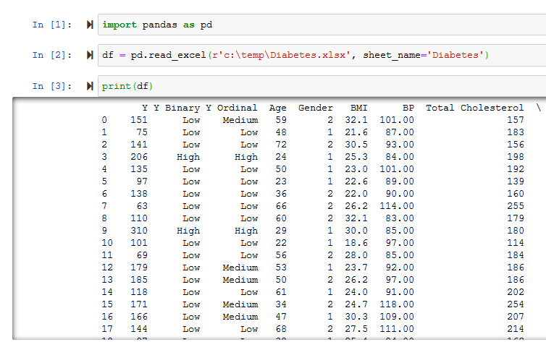
SVM in Python
Alternatively, you can import the Excel file.
Type the codes at the right and press Shift-Enter after each line.
“c:\temp” is the location (directory) of the file. Change it if you store the file in a different location.

Slide 26
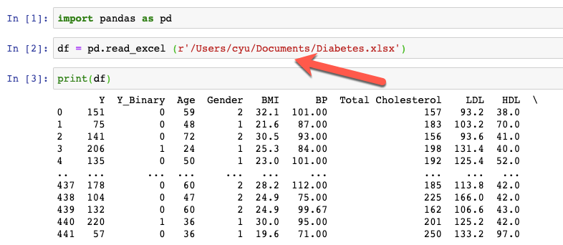
SVM in Python
For Mac users, the code for importing Excel data is the same.
You need to identify the path (directory).

Slide 27
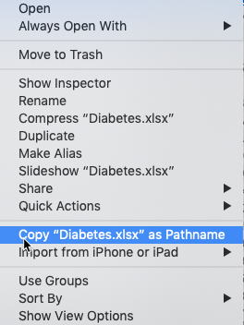
SVM in Python
For example, if you put the data set in the folder “document,” then you need to give this location to Python.
If you are not sure the name of the full path, right click on the file name, and then hold down the option key.
Select Copy XXX as Pathname.
Paste the pathname into the read statement of Python.

Slide 28
SVM in Python
Download and open svm.txt from the Python Folder in Unit 5.
The codes include import Scikit-learn. This is a machine learning library, which includes support vector machine, random forests, and many others.
Although you can paste all codes into the Python interpreter, it is advisable to run it line by line.

Slide 29
SVM in Python
In addition to model accuracy in terms of the overall hit rate (correct classification). Python also provides:
Model precision: True positive/(True positive + False positive)
Model recall: True positive/(True positive + False Negative)
What are the model accuracy, precision, and recall? Is it a god model?

Slide 30
Ungraded exercise
Both polynomial and RBF are useful for the non-linear hyperplane. In JMP we had learned that the linear kernel can work better than RBF for the diabetes data. But how about polynomial?
In the line clf = svm.SVC(kernel='linear', C=1000), replace “linear” with “poly” and then re-run the program.
Now what are the modal accuracy, precision, and recall? Is it better or worse?

Slide 31
What is decison tree?
Also known as Classification tree and recursive partition tree.
Developed by Breiman et al. (1984).
Aim to find which independent variable(s) can make successively a decisive partition of the data with reference to the dependent variable.

Slide 32

We need a quick decision!
When heart attack patients are admitted to a hospital, physiological measures, including heart rate, blood pressure, and background information of the patient, such as personal medical history and family medical history, are usually obtained.
But can you afford any delay? Do you need to run 20 tests before doing anything?

Slide 33
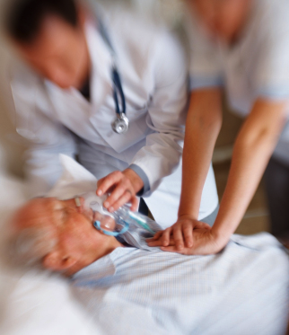
We need a decision tree!
Breiman et al. developed a three-question decision tree.
  What is the patient's minimum systolic blood pressure over the initial 24-hour period?
  What is his/her age?
  Does he/she display sinus tachycardia?

Slide 34
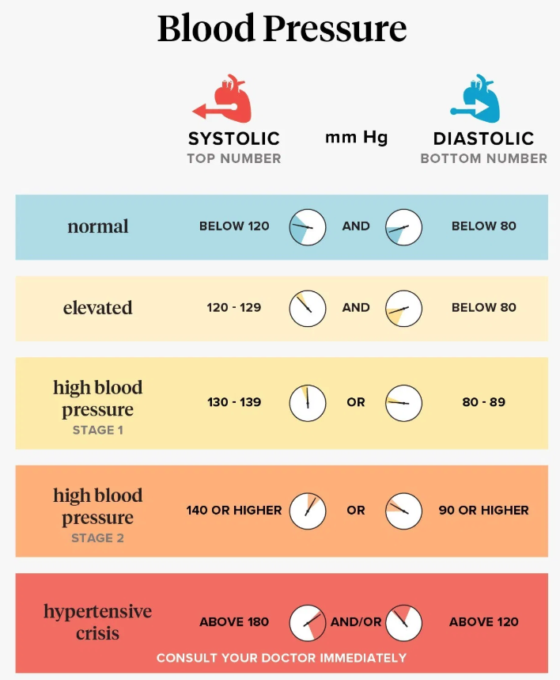
Nested-if logic
If the patient's minimum diastolic blood pressure over the initial 24 hour period is greater than 91, then
  if the patient's age is over 62.5 years,
    then if the patient displays sinus tachycardia (heart beat > 100 times per minute),
then and only then the patient is predicted not to survive for at least 30 days.

Slide 35

Titanic survivors
A night to remember!
After the disaster, people asked: What types of people tend to survive?
Sample data library → Titanic Passengers.jmp

Slide 36
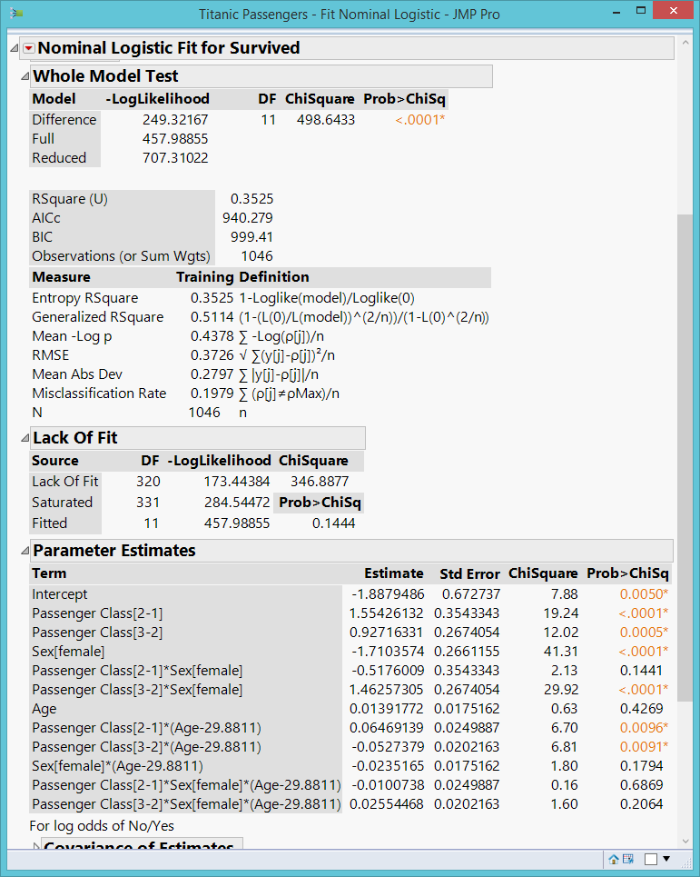
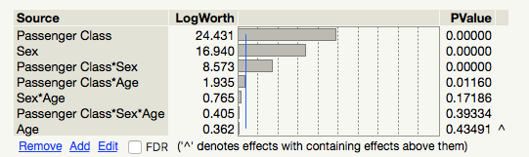
Titanic survivors
Use logistic regression (Fit Model)
Y = Survived
Xs = Sex, Age, Passenger class, interaction, and their interaction (Macros → full factorial)
Results are too complicated!

Slide 37
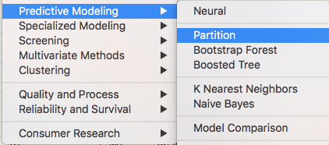
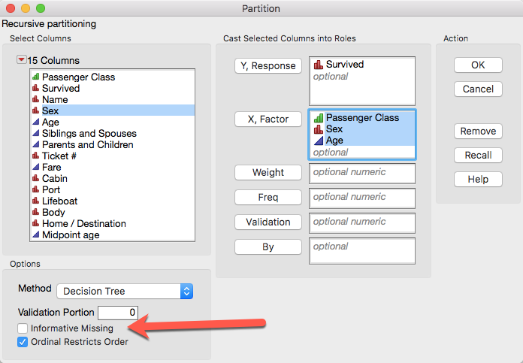
Decision tree
Much easier to run (no assumption) and to interpret.
Don’t include missing or it will create “missing” as a group.

Slide 38
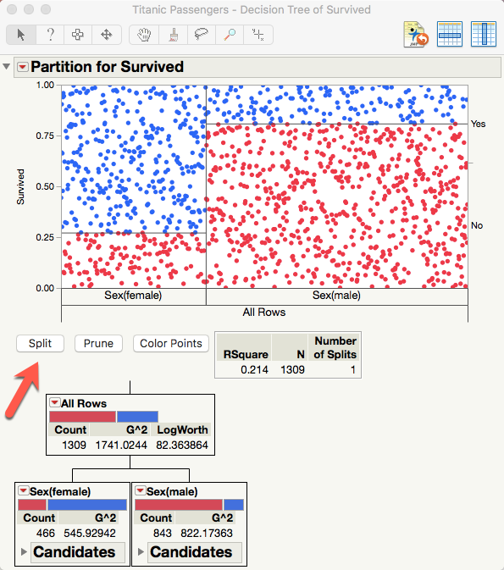
Decision tree
Split (partition) the tree variable by variable.
The first partition shows the most important variable.
Unlike what the logistic regression model suggests, the most crucial factor to survival is sex.

Slide 39
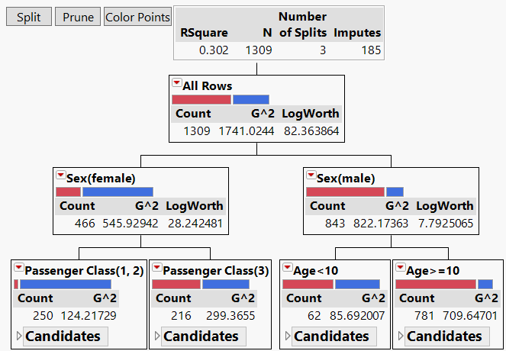
Decision tree model

Slide 40
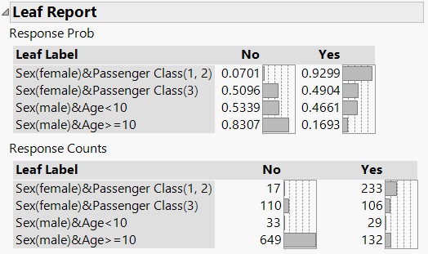
Leaf report:
Nested-if and interaction
If the passenger is a female and she has a first-class ticket, then the probability of survival is .9299 (sex X class interaction).
If the passenger is a male and he is not a young boy ( age > = 10), then his chance of survival is .1693 (sex and age interaction).
This is empirical probability based on the data at hand, not the p value with reference to the sampling distribution.

Slide 41


Leaf report:
Nested-if and interaction
How unfair! Prior research shows that women are more robust against hypothermia!

Slide 42
Splitting Criteria
Criteria based on statistical tests:
  LogWorth and G2: used in JMP
  CHAID criterion: used in SPSS
Criteria based on impurity:
  GINI: The default of Python
  Entropy: The default of SAS’s High Performance Split Procedure (HPSPLIT)

Slide 43
LogWorth and G²
Examines each independent variable to identify which one can decisively split the sample with reference to the dependent variable.
If the input is continuous (e.g. household income), every value of the variable could be a potential split point.
If the input is categorical (e.g. gender), then the average value of the outcome variable is taken for each level of the predictor variable.

Slide 44
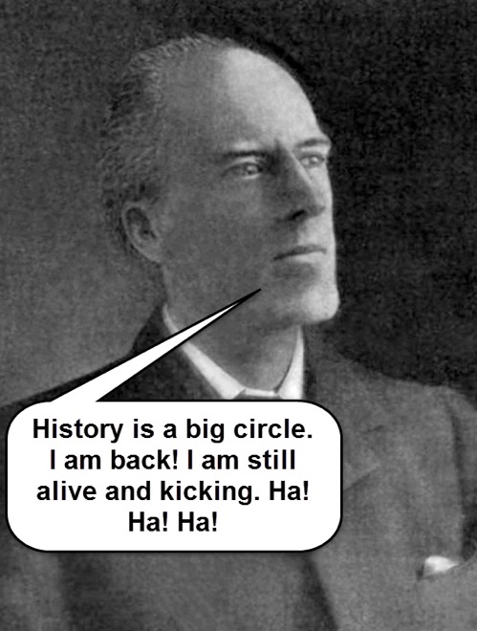
LogWorth and G²
Afterwards, a 2x2 crosstab table is formed (e.g. [‘proficient’ or ‘not proficient’] x [‘male’ or ‘female’]).
Next, Pearson’s Chi-square is used for examining the association between 2 variables.
But the result of Chi-square is dependent on the sample size. When the sample size is extremely large, the p-value is close to 0 and virtually everything appears to be ‘significant.’

Slide 45
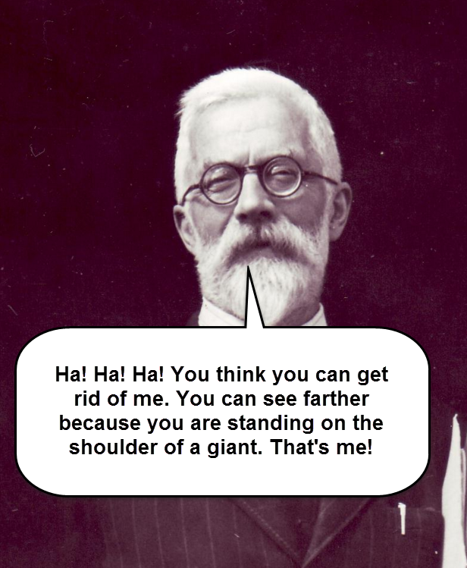
LogWorth and G²
LogWorth was invented by R. A. Fisher!
As a remedy, the quality of the split is reported by LogWorth, which is defined as –log10(p).
Because the LogWorth statistics is the inverse of the p value, a bigger LogWorth is considered better.
If the outcome variable is categorical, G^2 (the likelihood ratio of chi-square) is reported.

Slide 46
GINI
Based on Information Theory
Measure the impurity (heterogeneity) of the partitioned group.
GINI = 1 – (sum of squares of the proportion of each category)
Ideally a partitioned group should be pure (homogeneous)
10 apples (100%) in one Group 1 and 10 oranges (100%) in Group 2
GINI = 1 – (1)² = 0
If the group is absolutely pure, GINI = 0 → smaller is better

Slide 47
GINI
In reality nothing is pure, e.g.
  5 apples (.5 or 50%)
  3 bananas (.3 or 30%)
  2 oranges (.2 or 20%)
GINI = 1 – (.5)2 + (.3)2 + (.2)2 = .62
The algorithm examines all variables to determine which one can partition “purer” group.

Slide 48
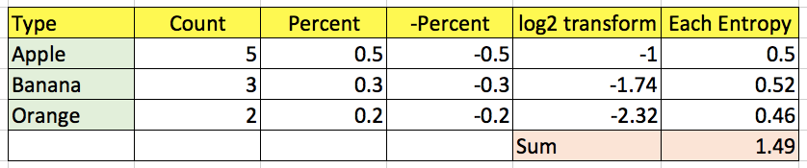
Entropy
Entropy = sum of (-percent of each category * log2 (percent))
Like GINI, smaller is better.

Slide 49
ROC
Receiver Operating Characteristic (ROC) Curve for examining “hit” rate
Originated from Signal Detection Theory
developed by electrical engineers and radar engineers during World War II.
to decide whether a blip on the radar screen signaling a hostile object, a friendly ship, or just noise.
In the 1970s it was adapted into medical tests.

Slide 50
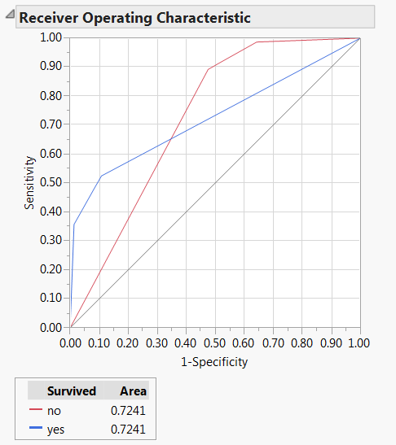
ROC curves and AUC
Inverted red triangle → ROC Curve
Area under curve (AUC)
4 possible outcomes:
  true positive (TP)
  false positive (FP)
  false negative (FN)
  true negative (TN).
Sensitivity = TP/(TP+FN)
1 - Specificity = 1 - [TN/(FP+TN)]
No model = 50% chance

Slide 51
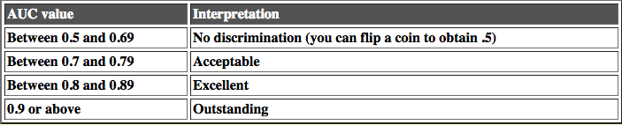
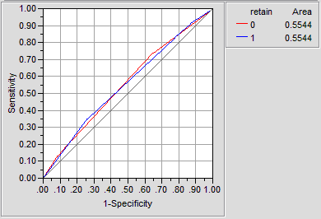
Criterion of judging ROC curves
The left is a coin-flipping model.
This cut-off is a suggestion only. Don't fall into the alpha < 0.05 reasoning.

Slide 52
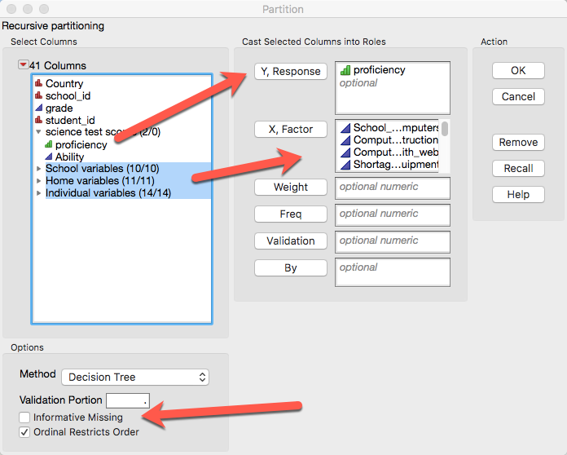
Example: PISA 2006 USA & Canada
Uncheck informative missing and missing data will be imputed.
Something no answer is an answer → missing is treated as a category.

Slide 53
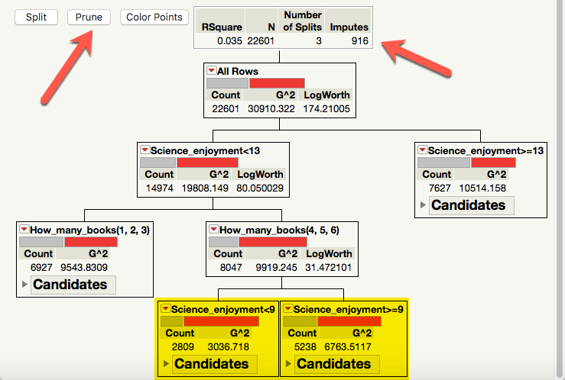
Example: PISA 2006 USA
Missing are automatically imputed.
The same variable (Science enjoyment) recurs.
It is saturated. You cannot add anything to make it better.
Prune it!

Slide 54
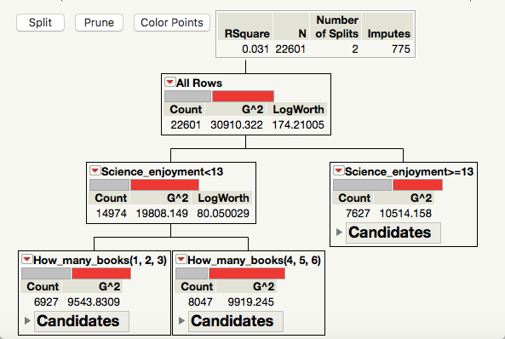
After pruning
A very simple model
Two variables can predict PISA science test performance!

Slide 55
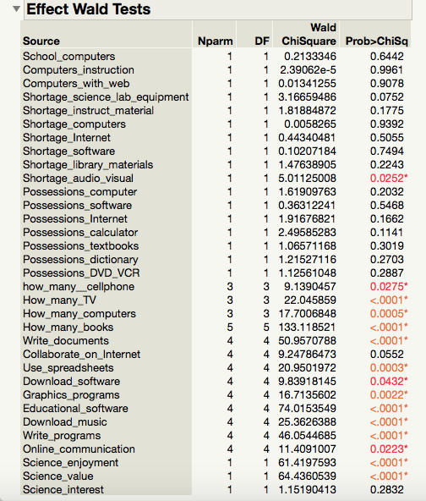
Compare DT with logistic regression
Too complicated!
If almost everything is important, then nothing is important!
No practical implications!
Remember the fifty ways of improving your grade?

Slide 56
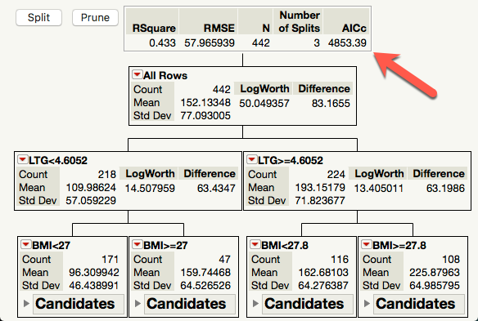
Compare DT & GR
Use Diabetics.jmp
Decision tree
Only two predictors are important for predicting diabetic progression.
AICc = 4853.39

Slide 57
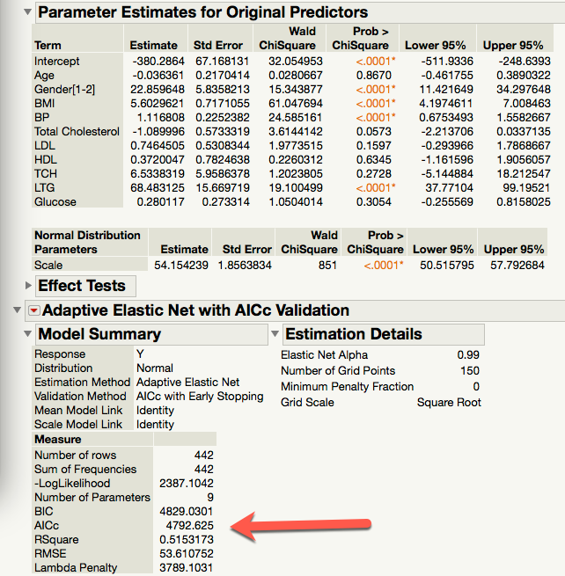
Compare DT & GR
Generalized regression
Elastic net
Four predictors are important for predicting diabetic progression.
AICc = 4792.625, smaller than that of DT
A 4-predictor model is still actionable and practical.
Sometimes DT is better and sometimes GR is better. Explore and compare!

Slide 58
Assignment 5.2
Run the decision tree using proficiency as the DV and all school, home, and individual variables as IVs.
Uncheck informative missing
Put country into by so that you can compare the US and the Canadian models
Prune the model when it is saturated (seeing the same predictor).
What are the differences and similarities between the two models?

Slide 59
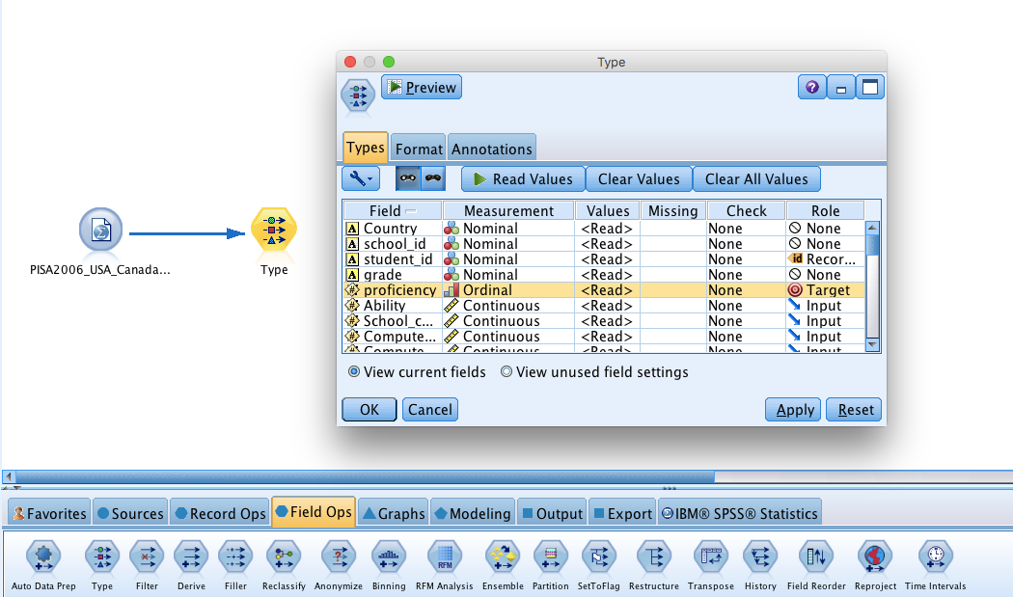
Decision trees in IBM Modeler

Slide 60
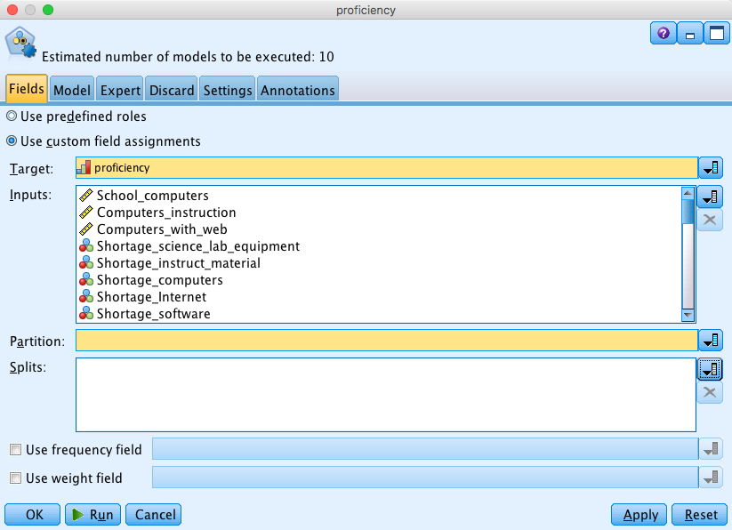
Decision trees in IBM Modeler

Slide 61
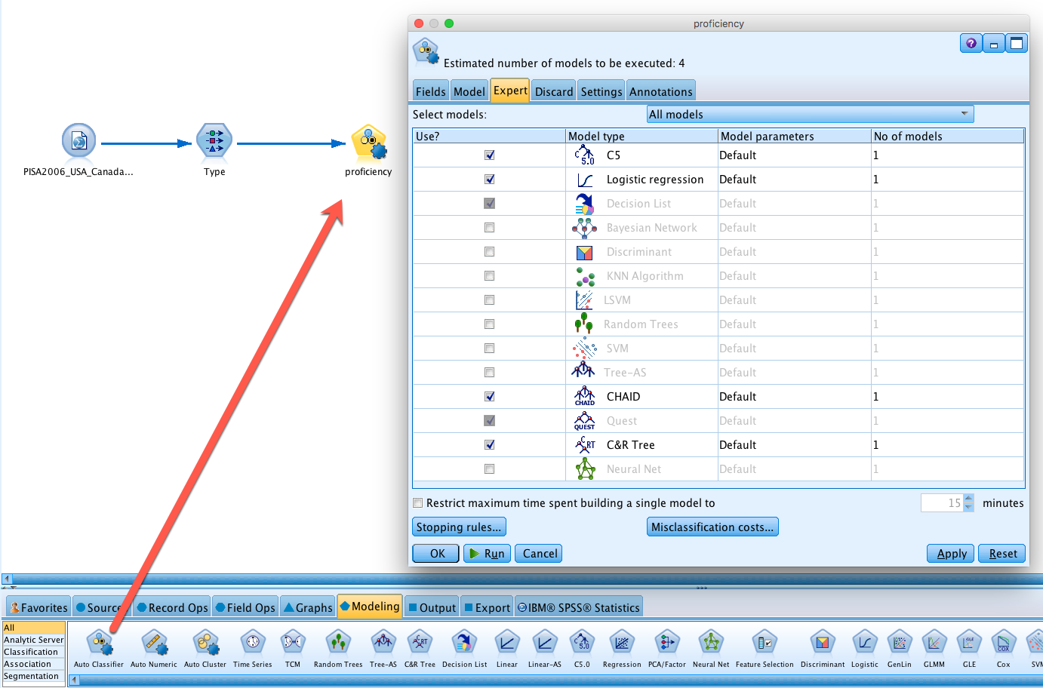
Decision trees in IBM Modeler

Slide 62
Decision trees in IBM Modeler
C5: C4.5 is ranked #1 in the Top 10 Algorithms in Data Mining pre-eminent paper published by Springer in 2008. C5 enhances C4.5.
Chi-square automatic interaction detection (CHAID): Pick the predictor that has the strongest interaction with the DV.
Exhaustive CHAID: modification of CHAID that examines all possible splits for each predictor
Quick, unbiased, efficient statistical tree (QUEST): Fast and avoids bias.
Classification tree and regression (CRT): try to make each subgroup as homogeneous as possible.

Slide 63
Decision trees in IBM Modeler
Shih (2004): when the Pearson chi-square statistic is used as the splitting criterion, in which the splits with the largest value is usually chosen to channel observations into corresponding subnodes, it may result in variable selection bias.
This problem is especially serious when the numbers of the available split points for each variable are different.
On many occasions CRT and JMP’s tree produce virtually the same results.

Slide 64
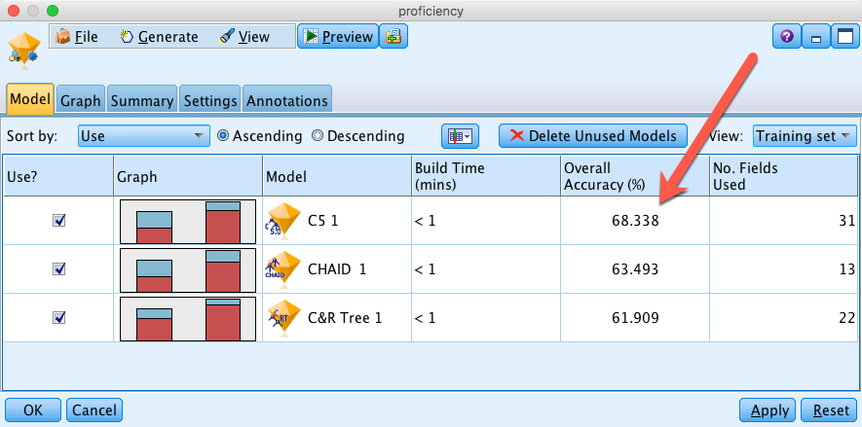
Rank the best three
Logistic regression is not even on the radar screen!

Slide 65
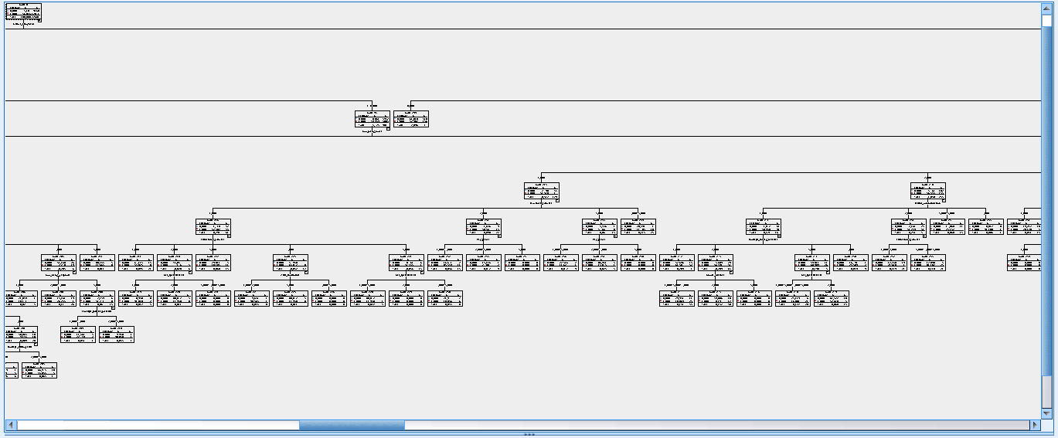
Drawbacks
Double-click on the model to view the details → Viewer
Unlike SAS/JMP, IBM SPSS graphs are static, not dynamic
You cannot prune the trees

Slide 66
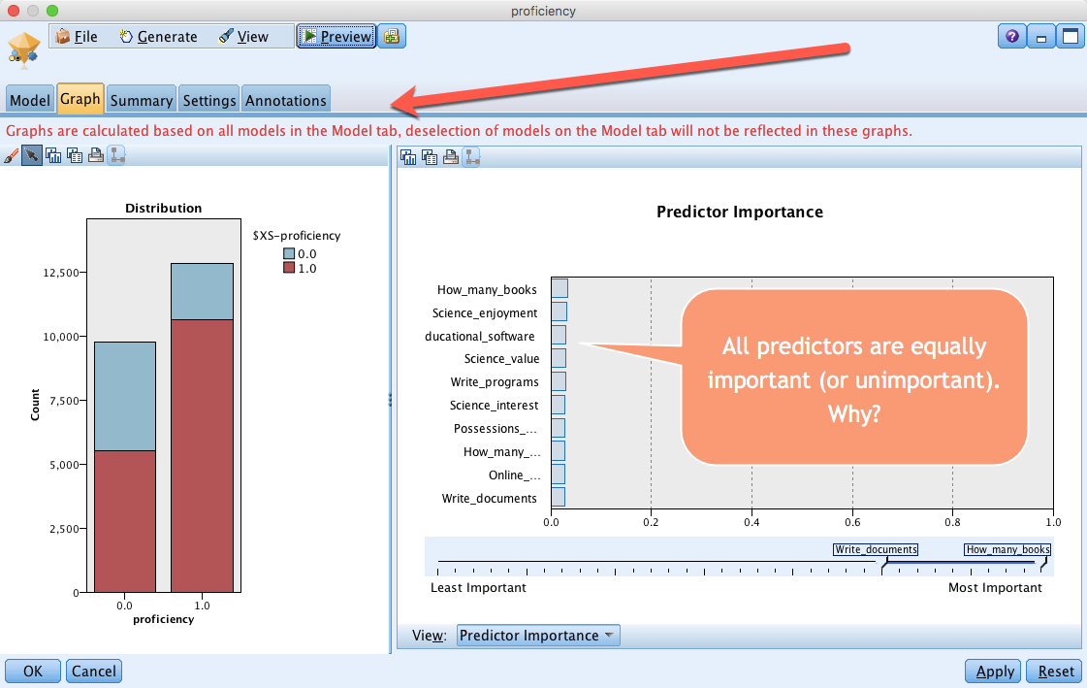
Drawbacks

Slide 67

Drawbacks
Even if you deleted unused models, it doesn’t change the disaply.

Slide 68


Go after C5
Solution: Run a C5 model
By default it uses the DV as the model name
Rename it to C5

Slide 69

Go after C5

Slide 70

Go after C5

Slide 71
Summary
Both SAS/JMP and IBM/SPSS have pros and cons
Only one type of decision tree can be done in JMP whereas there are different options (e.g. C5, CGAID, CRT, QUEST…etc.) in IBM/SPSS, and SPSS performs automatic comparison in Auto Classify
The graphs of JMP are dynamic and interactive whereas the counterparts of SPSS are static, disallowing manipulation.
The interactive model outline in SPSS shows much less details than the tree in JMP.
The hierarchy of the SPSS tree might not correspond to the rank of predictor importance. It is harder to interpret.

Slide 72
Assignment 5.3
Use PISA2006_USA_Canada.sav to run a CHAID model and a CRT model (You can put both on the same canvas)
Target = proficiency
IVs = all school, home, and individual variables.
Compare the two models. What are the differences and similarities between the two models?

