Slide 1
Resampling: Making up data?
Chong Ho Yu

Slide 2
Resampling and data mining
Resampling is NOT big data analytics.
In contrast, resampling was developed to deal with the problem of small sample size
  Lady‘s tasting tea: 8 observations
  Law school data: 15 observations
Two resampling methods, cross validation (CV) and bootstrapping, are commomly used in many big data analyitcs.

Slide 3

Definition
Reuse the same data
Root: Monte Carlo simulation – researchers "make up" data and draw conclusions based on many possible scenarios.
"Monte Carlo" comes from an analogy to the gambling houses on the French Riviera.
Study how to maximize their chances of winning by using simulations.

Slide 4
Common ground & difference
Common ground: Both find the probability by generating all or many possible scenarios.
Difference: Monte Carlo simulations create totally hypothetical data whereas resampling must start with some real data.
Application of MCS: test the test – If you want to know whether a robust test can accept a messy data structure, you can utilize MCS to generate different types of strange data to examine the robustness of the test.

Slide 5

Making up data?
Some people rejected resampling because the idea of 'making up' data seems very unethical.
Indeed we experience similar things everyday.

Slide 6

Extrapolation
You took a picture of Grand Canyon last summer. The picture is great!
Most camera sensors can capture an image with 24-45 mega pixels.
The picture will be very sharp even if you enlarge it to 16X20 IN.

Slide 7
Extrapolation
But if you want to enlarge your photo to the poster size or the billboard size, there will not be enough pixels to fill up the canvas. NP!
Some software package, such as OnOne's Perfect Resize, can sample from the existing pixels, duplicate them, and use the resampled pixels to populate the canvas.

Slide 8
Resampling in CLT
The idea is not completely new.
Remember the Central Limit Theorem (CLT) and sampling distributions?
Regardless of what the distribution of the underlying population is (mesa, camel back, skew, normal...etc), the distribution of the sample statistics approaches normality as repeated sampling is done.

Slide 9
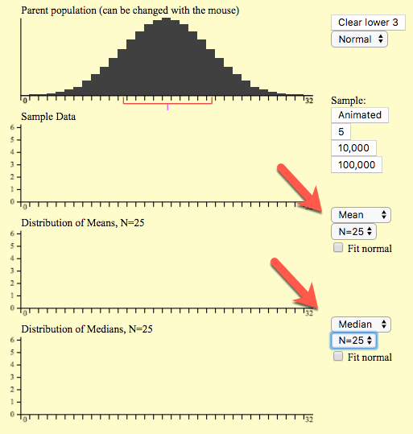
Theoretical sampling distribution
Go to http://onlinestatbook.com/stat_sim/sampling_dist/index.html
Click begin
Choose Mean and N = 25 for the middle panel.
Choose Median and N = 25 for the bottom panel.

Slide 10
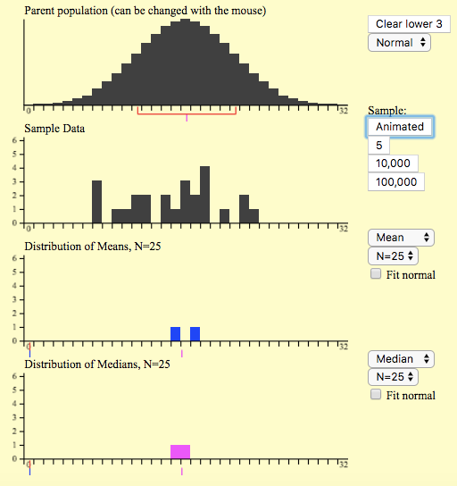
Theoretical sampling distribution
Click animated.
Click animated again.
What do you see?
Can you explain what is going on?
Caution: Sample size and the number of samples are different. In this example you have 2 sample and each sample size is 25.

Slide 11
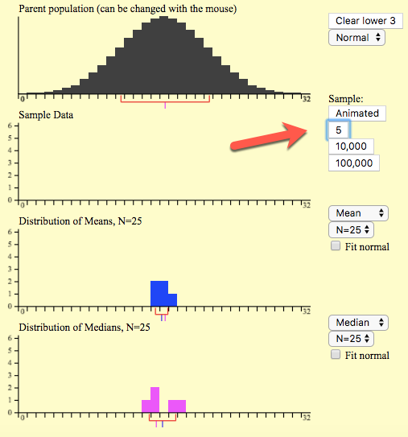
Theoretical sampling distribution
You can manually add more means and medians into the graphs.
To speed up the process you can click ”5,” which means select 5 samples and each consists of 25 subjects.
Now what do you see?

Slide 12
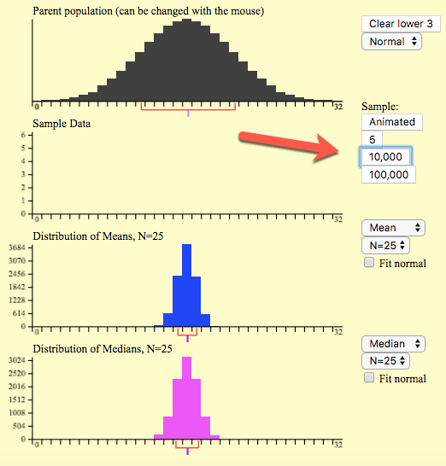
Theoretical sampling distribution
Probably 5 samples are not enough to make a normal distribution.
Now choose 10,000 sample.
What do you see?
Next, choose 100,000
Check “Fit normal”
What do you see?

Slide 13
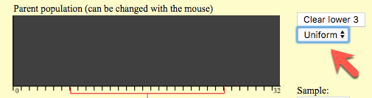
Theoretical sampling distribution
Press Clear lower 3
Choose a uniform population
Repeat the same process by clicking on 10,000 samples.
Check Fit Normal.
Now what do you see?

Slide 14
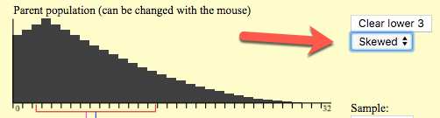
Theoretical sampling distribution
Press Clear lower 3
Choose a skewed population
Repeat the same process by clicking on 10,000 samples.
Check Fit Normal.
Now what do you see?

Slide 15
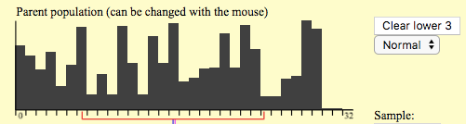
Theoretical sampling distribution
Press Clear lower 3
You can use your cursor to “paint” a customized population.
Click on 10,000 samples.
Check Fit Normal
Now what do you see?

Slide 16
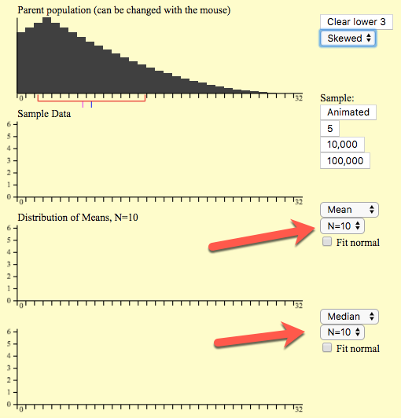
Theoretical sampling distribution
Go back to the skewed population.
Now reduce the sample size from 25 to 10
Click 10,000 samples.
Check Fit normal
What do you see?

Slide 17
Theoretical sampling distribution
Next, reduce the sample size to 5
Click on 10,000 samples.
What do you see?
Reduce the sample size to 5 and click on 10,000 sample.
Check Fit normal.
What do you see?

Slide 18
From theoretical to empirical
In classical statistics we compare the test statistics against the theoretical sampling distributions.
When we have big data, we can treat the sample as the virtual population, resample from it, and build the empirical sampling distribution.

Slide 19
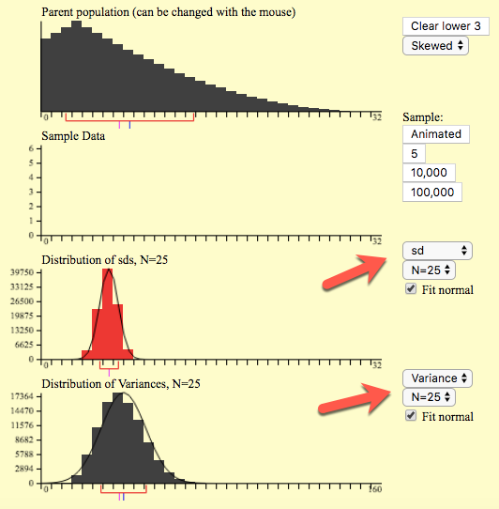
Theoretical sampling distribution
Change the statistics of the lower 2 panels from mean and median to SD and variance.
Change the sample size to 25
Click on 100,000 samples.
Check Fit Normal.
What do you see?

Slide 20
Why resampling?
Common criticisms of any research study
  The sample size is too small (Many dissertations end with a sentence like this: In the future more studies with a larger sample size is needed.)
  The data are not normally distributed and do not conform to the parametric assumptions.
  This is one study only. It can be capitalized on chance. You may not be able to replicate the finding next time.
  The n is too large. The test is over-powered.
Resampling can help.

Slide 21

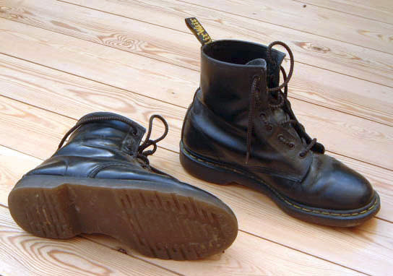
4 types of resampling
Randomization exact test: Permutate different possibilities
Cross-validation: divide one sample into 2 or more subsets.
Jackknife: leave one out
Bootstrap: one sample gives rise to many others by resampling (pulling yourself up by your own bootstrap)

Slide 22

Exact test
R. A. Fisher met a lady who insisted that her tongue was senstive enough to detect a subtle difference between a cup of tea with the milk being poured first and a cup of tea with the milk being added later.
He tested the lady with eight cups of tea. She was right 6 out of eight trials!

Slide 23
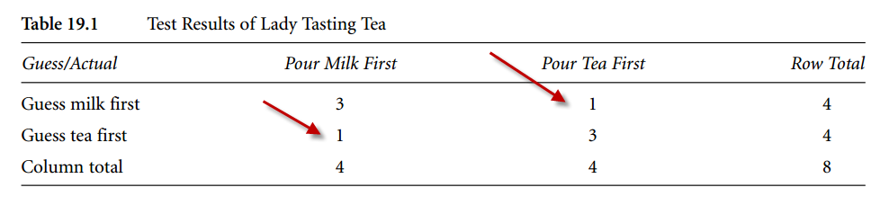
Exact test
With eight observations only, you cannot do a Pearson's chi-square test (some cell count is as low as one).
What can Fisher do?

Slide 24
Exact test
In classical tests we compare the sample statistics against the theoretical sampling distribution.
The p value tells you how rare the sample statistics is in the long run (sampling distributions).
Fisher permuted all possible scenarios to create an empirical sampling distribution.
Compare the observed data to the empircal distribution.

Slide 25
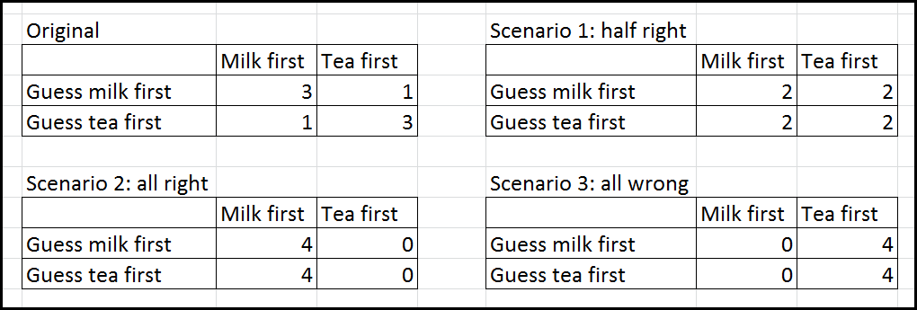
Exact test
Exact test is so named because in classical parametric tests you can obtain the approimate p value.
In Exact test you can know exactly how often or how rare the event can happen given all possible scenarios.

Slide 26
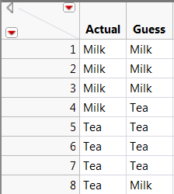
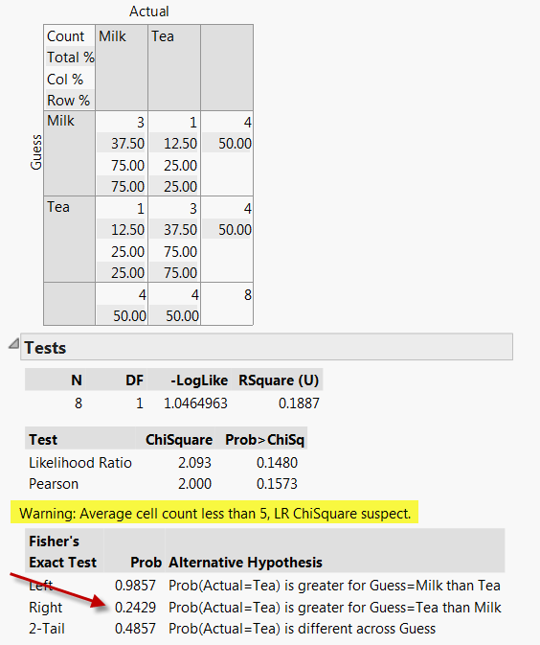
Exact test in JMP

Slide 27
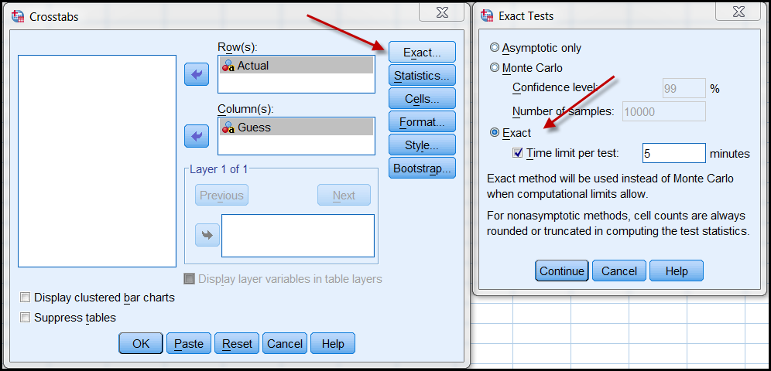
Exact test in SPSS

Slide 28
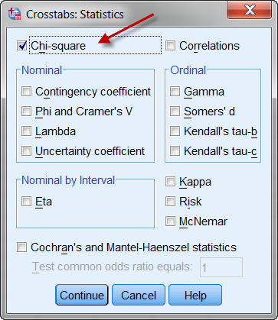
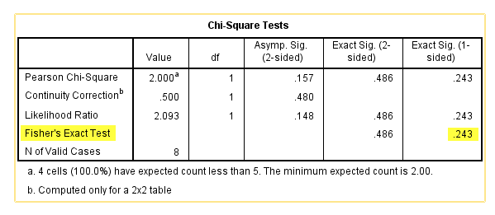
Exact test in SPSS

Slide 29
Cross-validation
Many conventional tests tend to overfit the model to a single sample.
How can you know the result can be replicated in another study?
You can hold back a portion of your data for cross-validation (CV).
CV is a precursor of machine learning, which divides the sample into training set and validation set.

Slide 30

Too much power can hurt you!

Slide 31
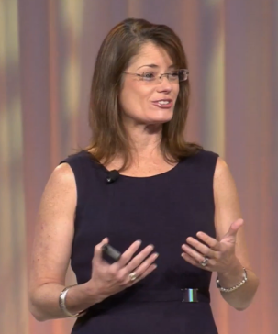
Problem of too many subjects!
“Tell someone to do a t-test with a billion subjects!”
If you have a huge sample size (e.g. 2000), you can easily reject the null hypothesis. Any trivial effect may be mis-identified as significant.
If you divide your large sample into 10 subsets for CV, then each subset contains 200 subjects only. No test is over-powered.
But if n = 50, then sub-dividing them may not be practical.

Slide 32
Jackknife
Co-invented by John Tukey, the Father of EDA.
Jackknife: all-purpose tool.
Leave out one observation at each analysis.
Re-do the analysis n-1 times. Why?
  To see how extreme cases and outliers influence the result (senstivity analysis)
  To counteract the issue of non-independent data.

Slide 33
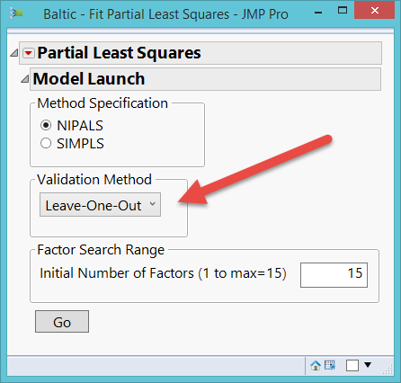
When to use Jackknife
Jackknife is available in many JMP procedures.
If the sample size is very huge, your CPU may burn.
e.g. 10,000 – 1 = re-running the test 9,999 times!
Use JF with a smaller sample.
Leave-one-out assumes every observation is treated equally (100%).

Slide 34
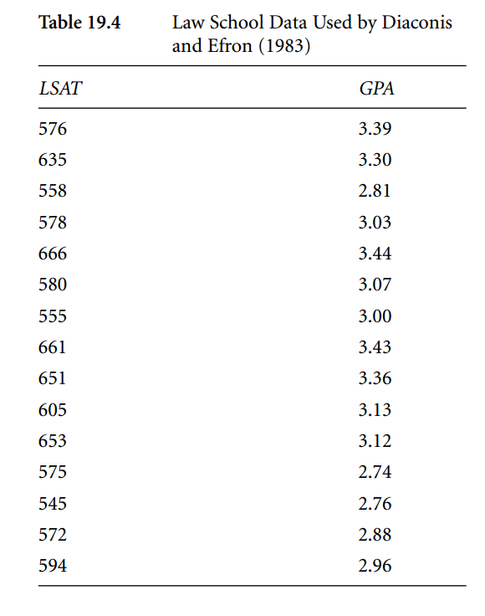
Bootstrap
The idea of bootstrapping originated from Bradley Efron (1979, 1981) and further developed by Efron and Tibshirani (1993).
"Bootstrap" means that one available sample gives rise to many others by resampling (a concept reminiscent of pulling yourself up by your own bootstrap).

Slide 35
Bootstrap
LSAT data: What can you do with 15 observations?
The Pearson' r of the original data set is .776.
Diaconis and Efron duplicated the data set 1 billion times. 15 → 15 billions.
Treated the new data set as the proxy or virtual population.

Slide 36
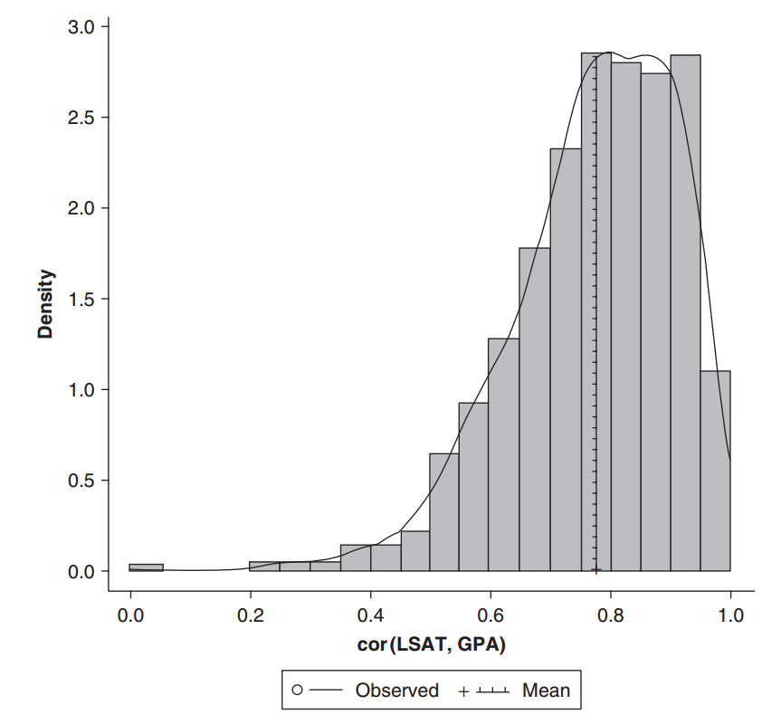
Bootstrap
Draw 1000 random samples from the virtual population (with replacement).
In each draw compute the Pearson's r.
Sometime the r is big, sometimes it is small. You have a sampling distribution, but it is not necessarily normal.

Slide 37
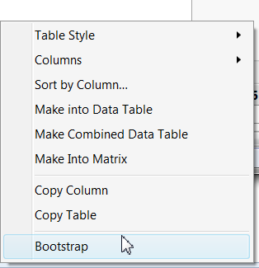
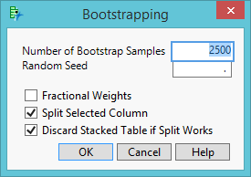
Bootstrap in JMP
Run a regular Pearson's r using multivariate methods
Go to pairwise correlations from the inversed red triangle.
Mouse over the correlation coeficient and right click to select bootstrap
The default # of bootsrap samples is 2500. If your computer is not powerful, reduce the number.

Slide 38
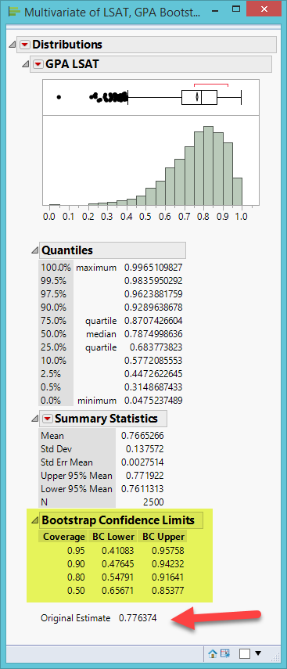
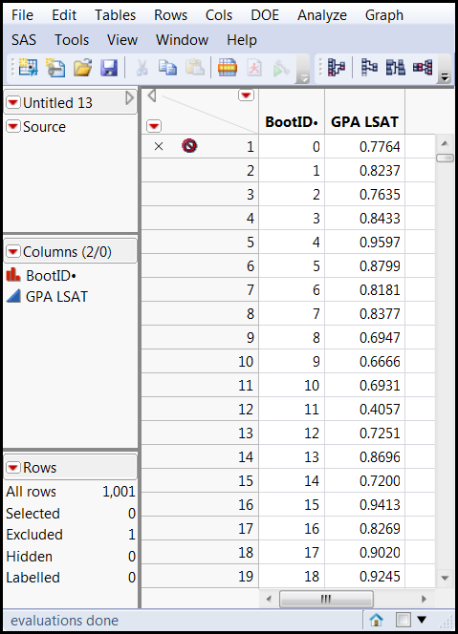
Bootstarp in JMP
The observed r is 0.7763.
In the bootstrapped distribution of r, the mean is .7665.
Check the bootstrap CI

Slide 39
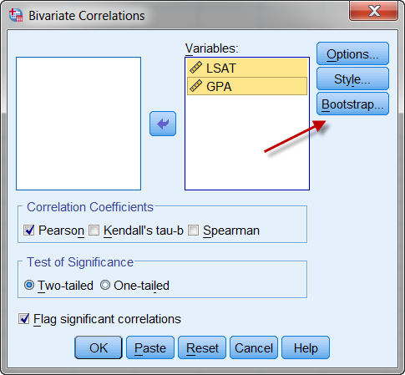
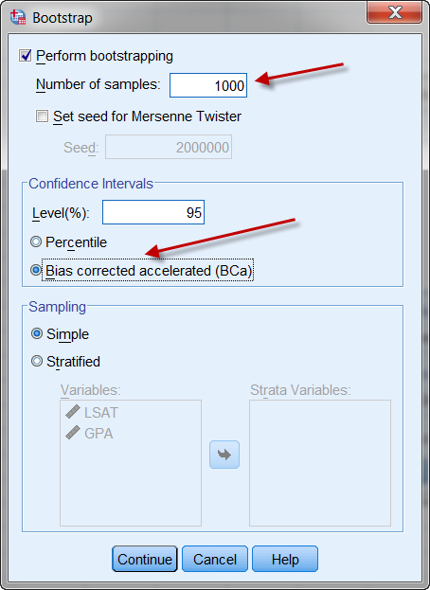
Bootstrap in SPSS

Slide 40
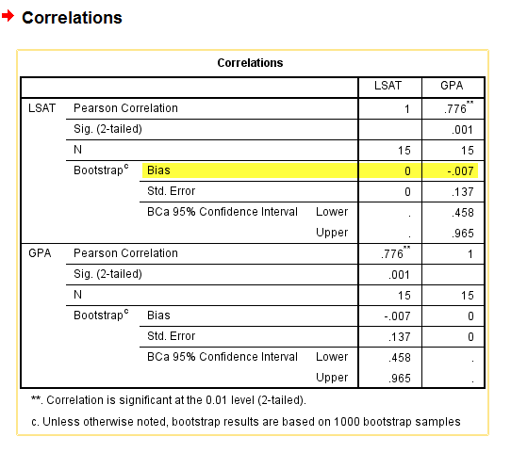
Bootstrap in SPSS
The bias is the distance between the observed and the resampled.
Very small (-0.007)

Slide 41
Bootstrap in R
JMP and R are integrated. You can connect JMP to R, sent a R program from JMP to R, get the result back from R, and then display it in JMP.
You need to install R Studio Desktop into the same computer in order to make it happen.
Download link: https://rstudio.com/products/rstudio/download/

Slide 42
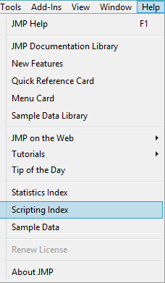
Bootstrap in R
In JMP open Scripting Index from Help.
On the left panel click on R Connection and Run the script by pressing the green button

Slide 43
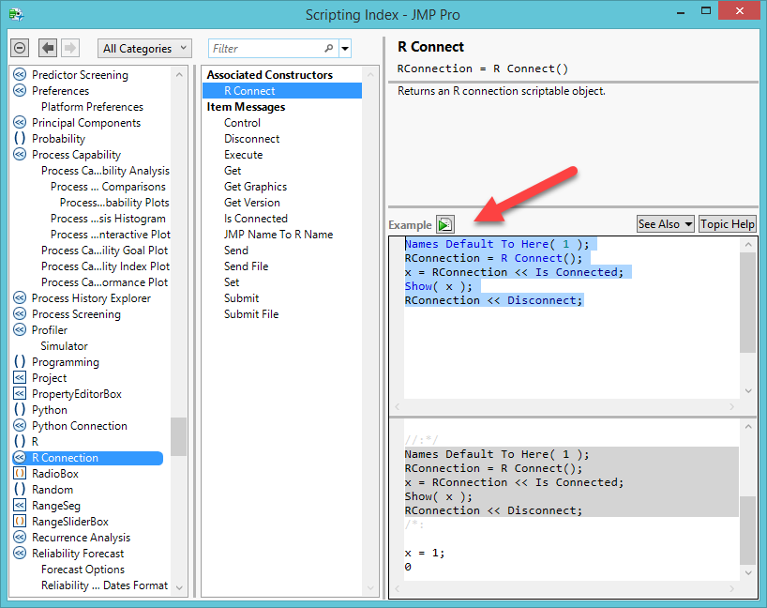
Bootstrap in R

Slide 44
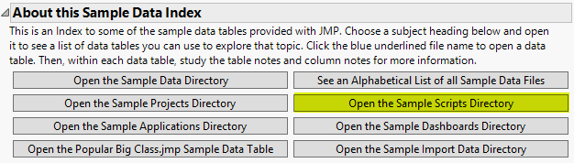
Bootstrap in R
Open the Sample Scripts Directory from Help: Sample Data.
Open JMPtoR_bootstrap.

Slide 45
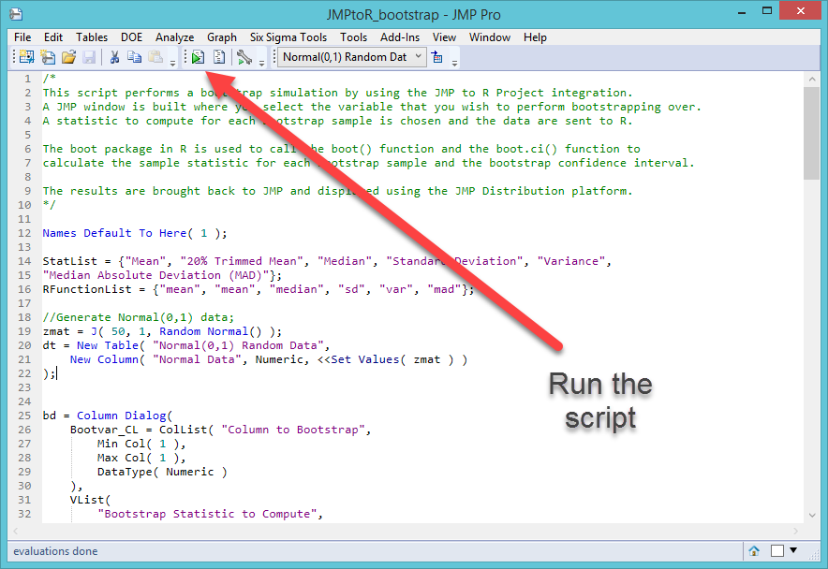
Bootstrap in R

Slide 46
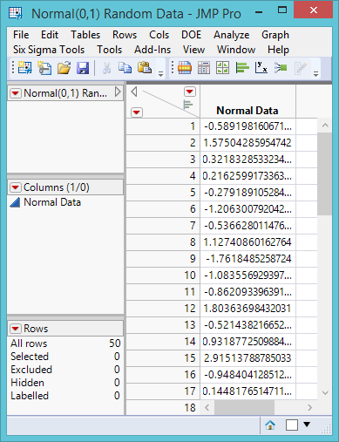
Bootstrap in R
A data set consisting of random numbers is created.
This will be the virtual population for bootstrapping.

Slide 47
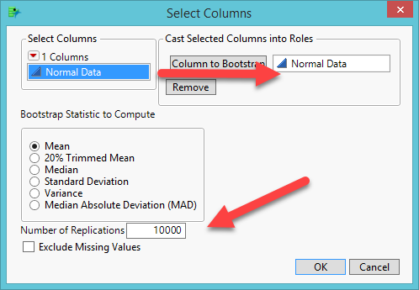
Bootstrap in R
A dialog box for user input is also created.
Put Normal data to Columns to Bootstrap.
Increase the number of Replications to 10000.

Slide 48
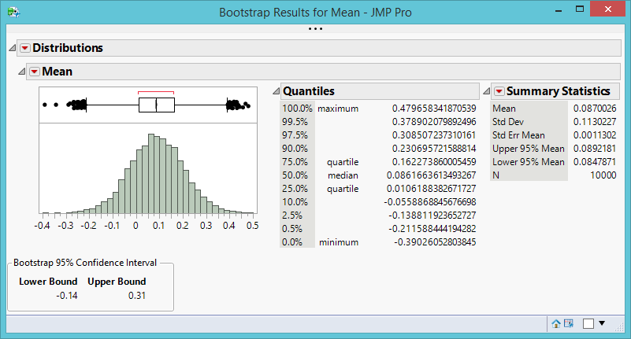
Bootstrap in R
The R bootstrap function created 10,000 re-samples in a second and also returned the bootstrap results to JMP.

Slide 49
Ungraded exercise (Optional)
Explore the JMP to R bootstrap module by choosing other statistics (e.g. 20% trimmed mean, median, SD…etc.)
You can also change the number of replications.

Slide 50
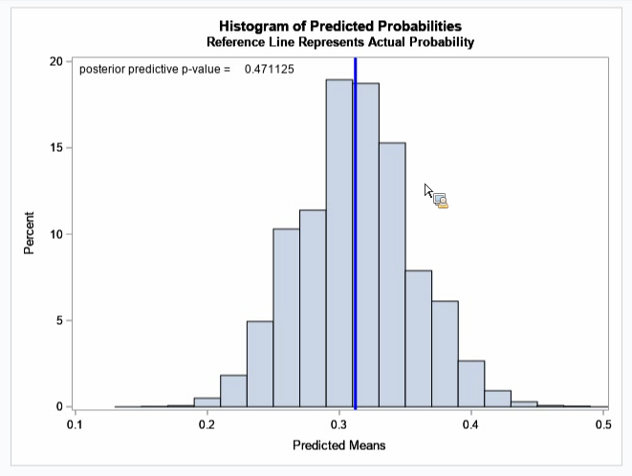
Resampling in Bayesian
The idea of resampling is used in the Bayesian methods e.g. Markov Chain Monte Carlo Simulation (PROC MCMC in SAS).
The actual mean of low-birth weights is compared again the simulated distribution of prediction.
Source: Danny Modlin (2019). Bayesian analysis using SAS. Cary, NC: SAS Institute.

Slide 51
Summary
Resampling is a way of systematically reusing the same observations.
Rather than counting on theoretical sampling distribution, resampling uses empirical distributions by treating the sample as the population. Its logic is fully compatible with data mining, which focuses in the data pattern at hand.
Cross-validation is used in almost all data mining procedures.
Bootstrapping is the building block of bootstrap forest, which will be introduced in the next unit.

Slide 52
Assignment
Use the data set 'visualization_data.jmp‘.
In JMP run an Generalized regression. Use GPA and SAT to predict college test scores.
Choose elastic net and early stopping.
Right click on parameter estimates and do a bootstrap with 1,000 samples (The default is 2500. If you have a powerful computer, go for it).
Use Distributions to examine the resampled results (Ignore the intercept).

