Slide 1
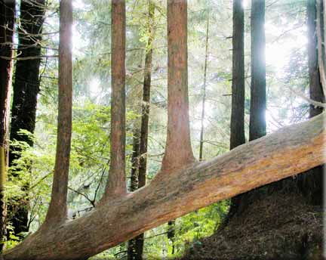
Ensemble methods: Bagging and boosting
Chong Ho (Alex) Yu

Slide 2
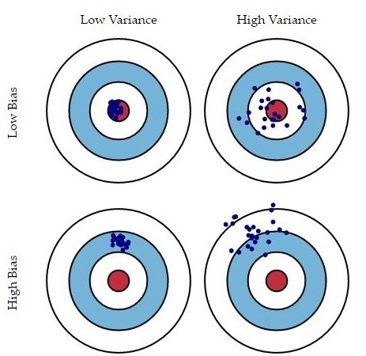
Problems of bias and variance
The bias is the error which results from missing a target.
For example, if an estimated mean is 3, but the actual population value is 3.5, then the bias value is 0.5.
The variance is the error which results from random noise.
When the variance of a model is high, this model is considered unstable.
A complicated model tends to have low bias but high variance.
A simple model is more likely to have a higher bias and a lower variance.

Slide 3
Solutions
Bagging (Bootstrap Aggregation): decrease the variance
Boosting (Gradient boosted tree): weaken the bias
Both bagging and boosting are resampling methods because the large sample is partitioned and re-used in a strategic fashion.
When different models are generated by resampling, some are high-bias model (underfit) while some are high-variance model (overfit).
Each model carries a certain degree of sampling bias, but In the end the ensemble cancels out these errors.
The results is more likely to be reproducible with new data.

Slide 4

Bootstrap forest (Bagging)
When you make many decision trees, you have a forest!
Bootstrap forest is built on the idea of bootstrapping (resampling).
Originally it is called random forest, and it is trademarked by the inventor Breiman (1928-2005) and the paper is published in the journal Machine Learning.
RF pick random predictors & random subjects.
SAS JMP calls it bootstrap forest (pick random subjects only)
IBM SPSS calls it random tree

Slide 5
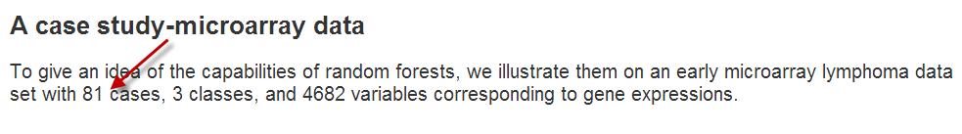
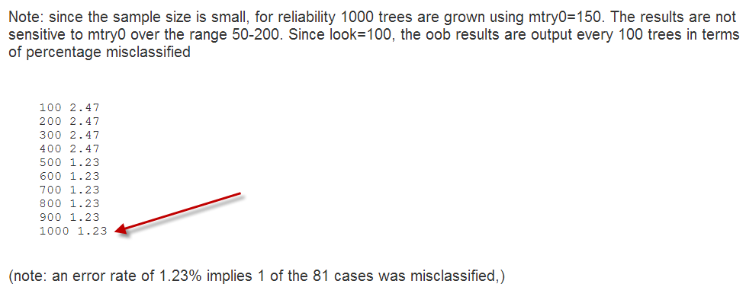
The power of random forest!

Slide 6
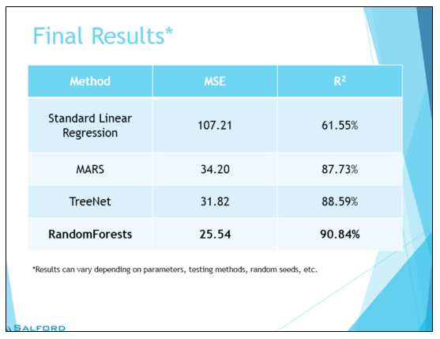
Much better than regression!
Salford systems (2015) compared several predictive modeling methods using an engineering data set.
It was found that OLS regression could explain 62% of the variance whereas the mean square error is 107!
In the random forest the R-square is 91% while the MSE is as low as 26%.

Slide 7
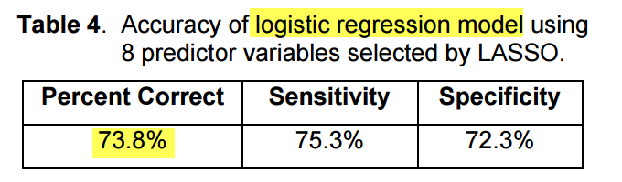

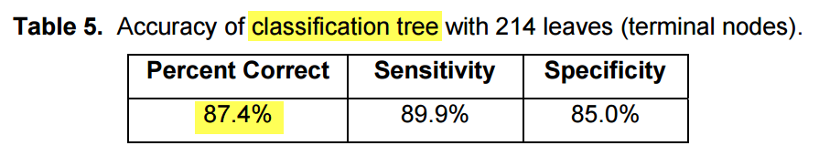
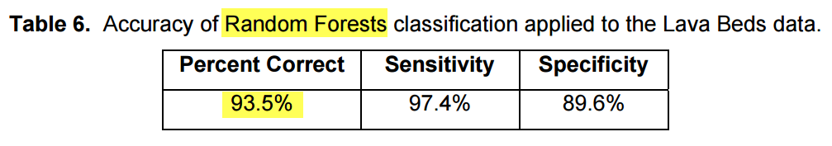
Much better than regression!
In a study about identifying predictors of the presence of mullein (an invasive plant species) in Lava Beds National Monument, random forests outperform a single classification while the classification tree outperforms logistic regression.
Cutler, R. (2017). What statisticians should know about machine learning? Proceedings of 2017 SAS Global Forum.

Slide 8
Bagging
All resamples are generated independently by resampling with replacement. In each bootstrap sample about 30% of the observations are set aside for later model validation. These observations are grouped as the out of bag sample (OOBS)
The algorithm converges these resampled results together by averaging them out. Consider this metaphor: After 100 independent researchers conducted his/her own analysis; this research assembly combines their findings as the best solution.

Slide 9
Bagging
The bootstrap forest is an ensemble of many classification trees resulting from repeated sampling from the same data set (with replacement). Afterward, the results are combined to reach a converged conclusion.
While the validity of one single analysis may be questionable due to a small sample size, the bootstrap can validate the results based on many samples.

Slide 10
Bagging
The bootstrap method works best when each model yielded from resampling is independent and thus these models are truly diverse.
If all researchers in the team think in the same way, then no one is thinking.
If the bootstrap replicates are not diverse, the result might not be as accurate as expected.
If there is a systematic bias and the classifiers are bad, bagging these bad classifiers can make the end model worse.

Slide 11

Boosting
A sequential and adaptive method
The previous model informs the next.
Initially, all observations are assigned the same weight. If the model fails to classify certain observations correctly, then these cases are assigned a heavier weight so that they are more likely to be selected in the next model.
In the subsequent steps, each model is constantly revised in an attempt to classify those observations successfully.
While bagging requires many independent models for convergence, boosting reaches a final solution after a few iterations.

Slide 12
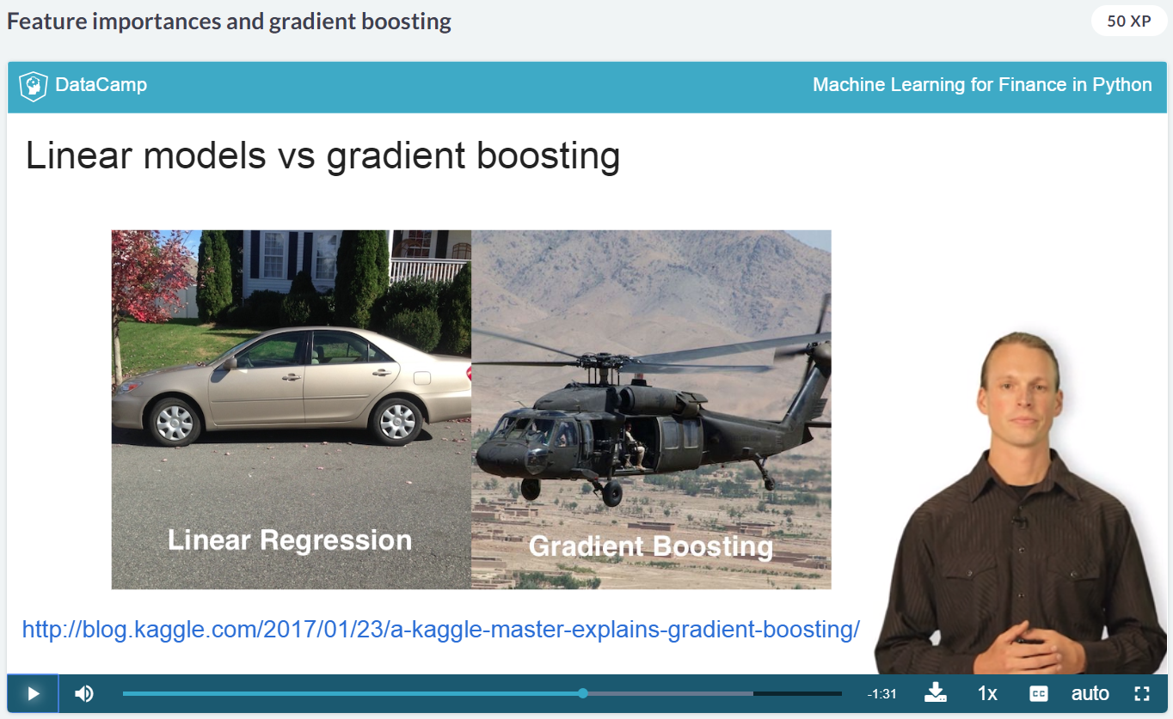
Boosting
Data scientist Nathan George: Regression is like a Toyota Camry while boosting is like a Black-hawk helicopter.
The former is less powerful but easy to drive while the latter is much more powerful but difficult.

Slide 13
Comparing bagging and boosting
 | Bagging | Boosting
Sequent | Two-step | Sequential
Partitioning data into subsets | Random | Give misclassified cases a heavier weight
Sampling method | Random sampling with replacement | Systematic sampling
Relations between models | Parallel ensemble: Each model is independent | Previous models inform subsequent models
Goal to achieve | Minimize variance | Minimize bias, improve predictive power
Method to combine models | Weighted average or majority vote | Majority vote
Requirement of computing resources | Highly computing intensive | Less computing intensive

Slide 14
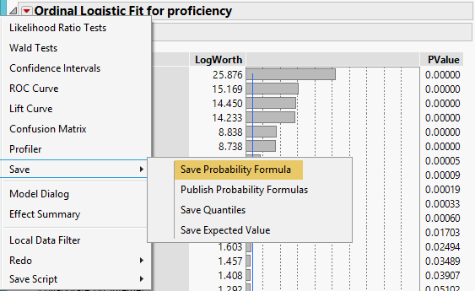
Example: PISA
PISA 2006 USA and Canada
Use Fit Model to run a logistic regression
Y = Proficiency
Xs = all school, home, and individual variables
From the inverted red triangle choose Save Probability Formula to output the prediction.
Every one is assigned the probability of proficient or not proficient.

Slide 15
Hit and Miss : (Mis-classification) rate
The misclassification rate is calculated by comparing the predicted and the actual outcomes.
Subject | Prob[0] | Prob[1] | Most Likely proficiency | Actual proficiency | Discrepancy?
1 | 0.709660358 | 0.290339642 | 0 | 1 | Miss
2 | 0.569153931 | 0.430846069 | 0 | 0 | Hit
3 | 0.266363358 | 0.733636642 | 1 | 1 | Hit
4 | 0.53063663 | 0.46936337 | 0 | 1 | Miss
5 | 0.507966808 | 0.492033192 | 0 | 1 | Miss
6 | 0.26676262 | 0.73323738 | 1 | 1 | Hit
7 | 0.535631438 | 0.464368562 | 0 | 0 | Miss
8 | 0.636997729 | 0.363002271 | 0 | 1 | Miss
9 | 0.136721803 | 0.863278197 | 1 | 1 | Hit
10 | 0.504198458 | 0.495801542 | 0 | 1 | Miss

Slide 16
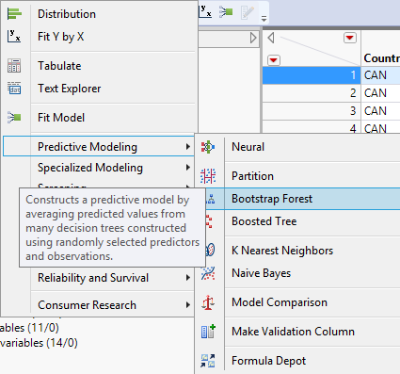
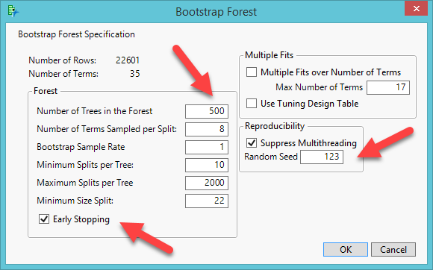
Example: PISA
Analyze → Predictive modeling → bootstrap forest
Validation portion= 30% and no informative missing
Enter the same random seed to enhance reproducibility and check early stopping.
Caution: If your computer is not powerful, stay with the default: 100 trees

Slide 17
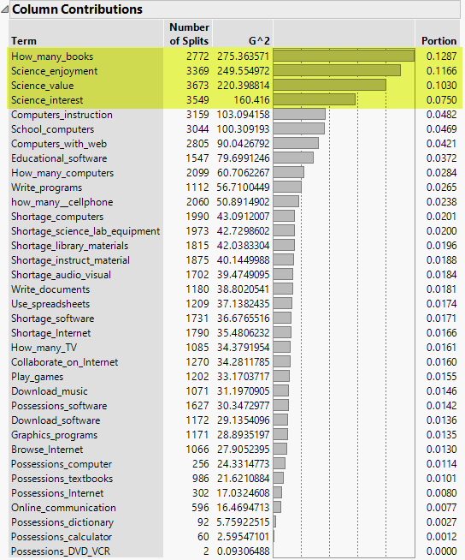
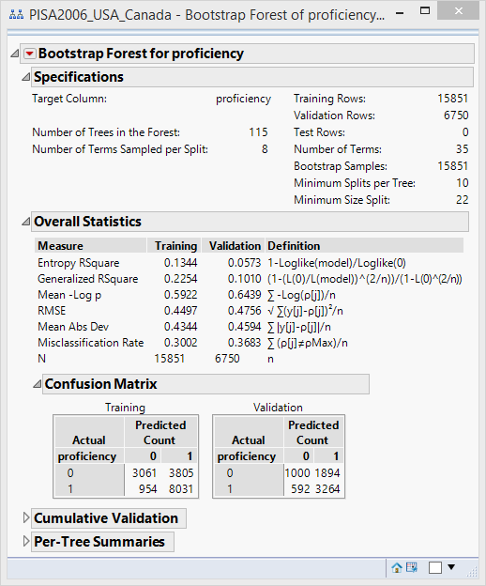
Bootstrap forest result
From the red triangle select Column Contributions.
No cut-off. Retain the predictors by inflection.
After three to four variables, there is a sharp drop.

Slide 18
Column contributions
The importance of the predictors is ranked by both the number of split, G2, and the portion.
The number of splits is simply a vote count: How often does this variable appear in all decision trees?
The portion is the percentage of this vaiable in all trees.

Slide 19
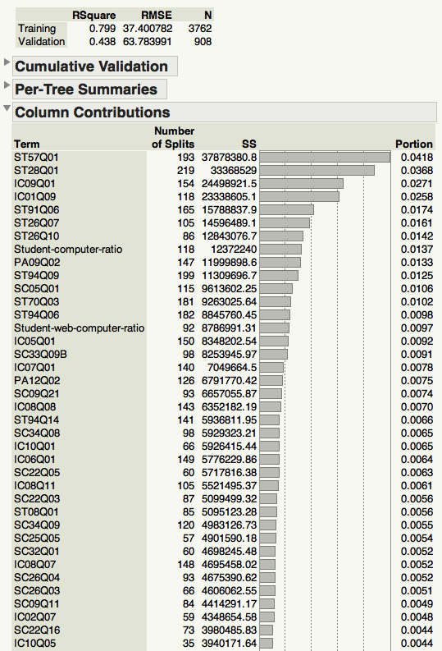
Column contributions
When the dependent variable is categorical, the importance is determined by G2, which is based on the LogWorth statistic.
When the DV is continuous, the importance is shown by Sum of Sqaures (SS).
If the DV is binary (1/0, Pass/Fail) or multi-nominal, we use majority or plurality rule voting (the number of splits)
If the DV is continuous, we use average predicted values (SS).

Slide 20
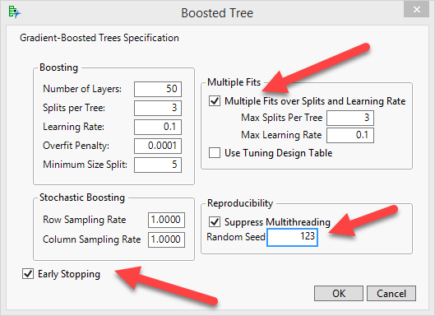
Boosting
Analyze → Predictive Modeling → Boosted Tree
Press Recall to get the same variables
Check multiple fits over splits and learning rate
Enter the same random seed to improve reproducibility

Slide 21
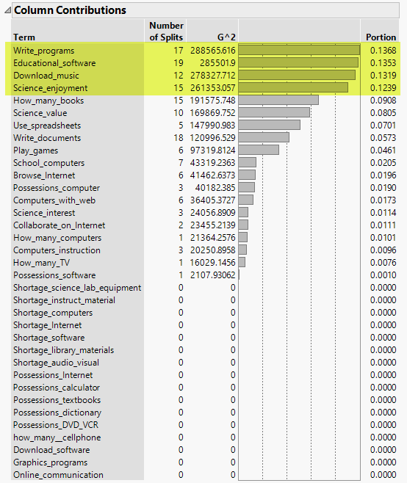
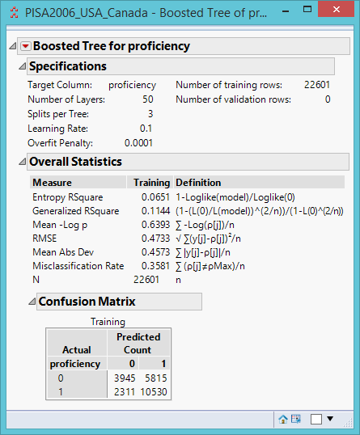
Boosting
Unlike bagging, boosting exclude many variables

Slide 22
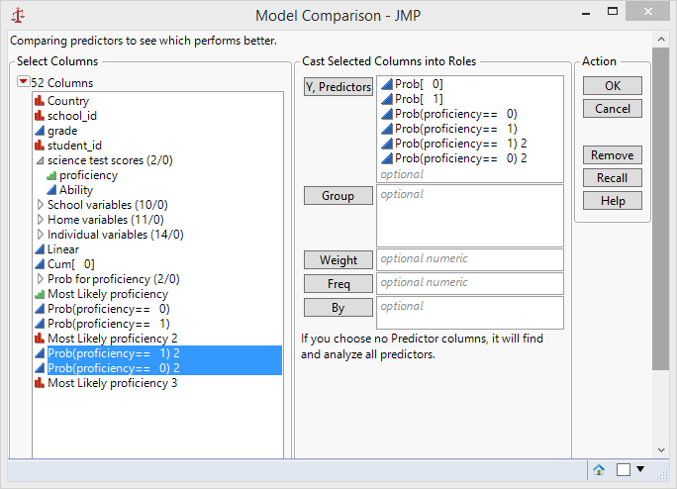
Model comparison
Analyze → Predictive Modeling → Model Comparison
In the output from the red triangle select AUC comparison (Area under curve).

Slide 23
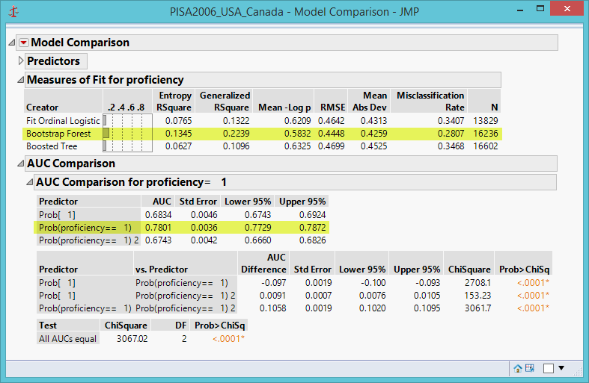
And the winner is…
Bagging!
Highest Entropy R-square (based on purity)
Lowest Root Mean Square Error
Lowest misclassification rate
Highest AUC for classifying proficient students: Prob(1)
Lowest standard error

Slide 24
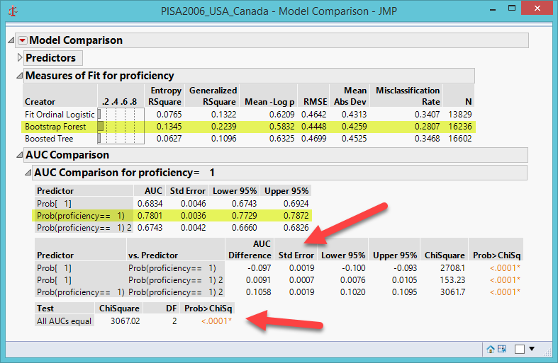
And the winner is…
The bottom table shows the test result of the null hypothesis: all AUCs are not significantly different from each other (all are equal) but they are not.
The table above shows the multiple comparison results (logistic vs. bagging; logistic vs. bagging; bagging vs. boosting) All pairs are significantly different from each other.

Slide 25
Ensemble of ensemble: Model averaging
There are three ways for Ensemble to merge results:
  Average: As the name implies, average the prediction estimates from all models.
  Maximum: Pick the highest estimates of all models.
  Voting: Return the proportion of the models that determine the outcome.
SAS offers all three options but JMP has Model Averaging only.

Slide 26
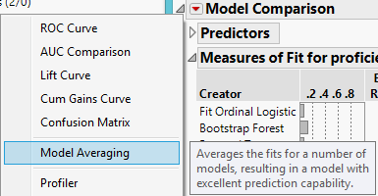
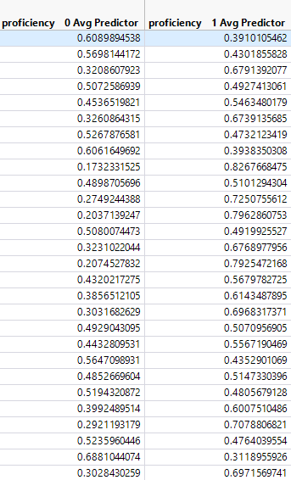
Ensemble of ensemble: Model averaging

Slide 27
Assignment 7.1
Use PISA2006_USA_Canada
Create a subset: Canada only
Y: Proficiency
Xs: All school, home, and individual variables
Run logistic regression, bagging and boosting
Run a model comparison
Which model is better?

Slide 28
SAS Enterprise Guide and Enterprise Miner
Ensemble methods can also be implemented in SAS EG and SAS EM.
Enterprise Guide: More for traditional statistics, but has a data mining component; for novices or busy people who need quick results.
Enterprise Miner: More for data mining; for experts who want to use his/her expertise to make decisions in each step.

Slide 29
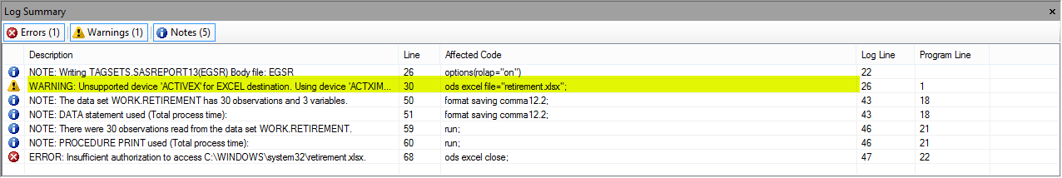
Traditional SAS programming environment vs. SAS Enterprise Guide
SAS programming environment can use Output Delivery System (ODS) to generate output in different formats e.g. Excel, RTF, PDF, ActiveX, Java…etc. But SAS EG does not support these output formats.

Slide 30
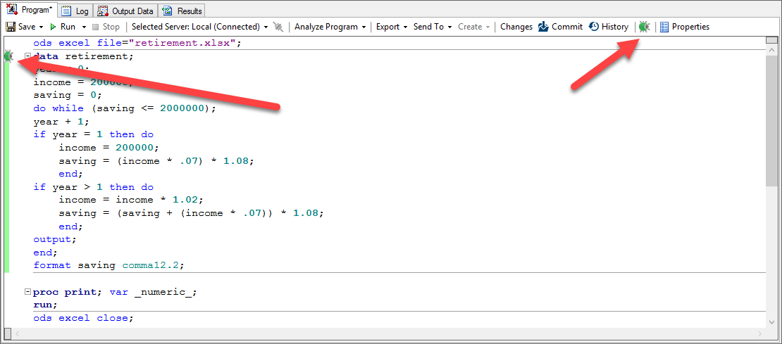
SAS programming environment relies on the log file for debugging whereas EG has a program debugger.

Slide 31
Traditional SAS programming environment vs. SAS Enterprise Guide
Retirement.sas: This program is not related to the ensemble method; it is for illustrating the difference between SAS programming environment and EG.
Your household income is $200,000 and each year you salary is raised by 2%.
Every year you put 7% of your income into your retirement account.
The annual yield of your investment is 8%.
How long would it take to save $2M?

Slide 32
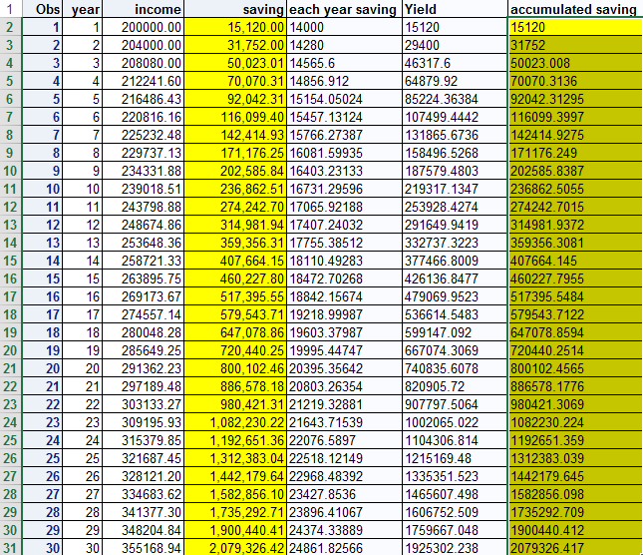
SAS programming environment vs. SAS Enterprise Guide
In the SAS programming environment you can output the file to Excel, and then use Excel functions to verify the results (see verify_retirement.xlsx).

Slide 33
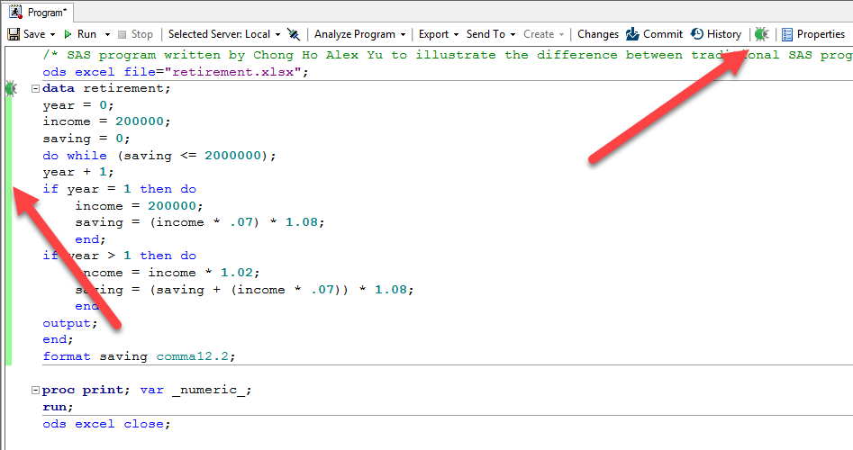
SAS programming environment vs. SAS Enterprise Guide
In EG open a new program from File: New: Program.
Copy and paste the program into EG.
Turn on the program debugger (The green bug button) at the upper right corner.
When the debugger is on, the program has a green bar at the left edge.

Slide 34
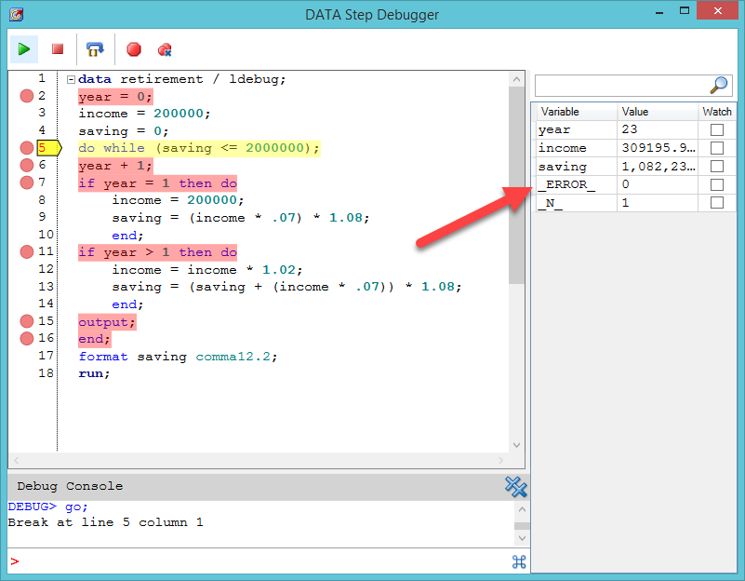
SAS programming environment vs. SAS Enterprise Guide
When the debugger go through the loop, you can see the value of each variable (e.g. year, income, saving) in each step, and also the error (if there is any)

Slide 35
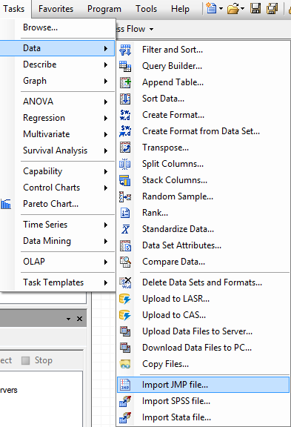
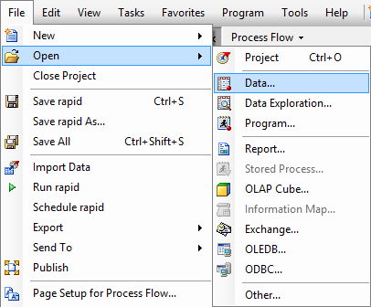
SAS Enterprise Guide
Open a new project
If you have a non-SAS file, you need to import it.
If you have a SAS file, simply open it.
From File open PISA2006_USA Canada in the SAS file folder Under Unit 7.

Slide 36
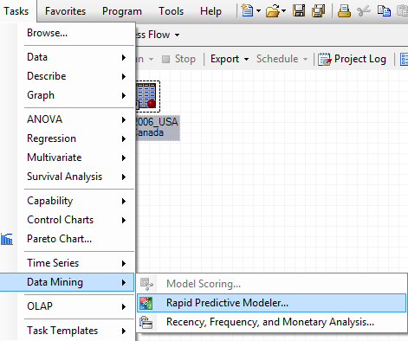
SAS Enterprise Guide
From Task choose Rapid Predictive Modeler.
The Modeler node (icon) will be connected to the data icon (PISA_USA_Canada) automatically.

Slide 37
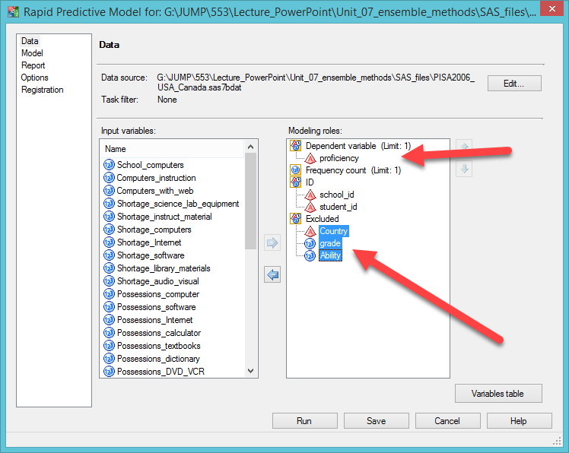
SAS
Enterprise Guide
Assign proficiency to dependent variable by dragging.
Drag Country, grade, and ability into Excluded.
All remaining variables become predictors.

Slide 38
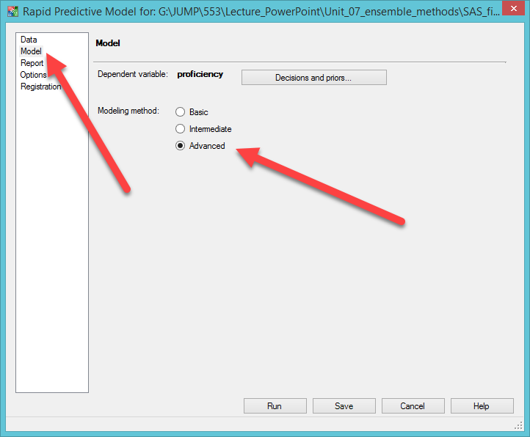
SAS
Enterprise Guide
Under the Model tab select the modeling method.
The default is basic (regression only).
If you want to obtain an advanced ensemble result, use Advanced.

Slide 39
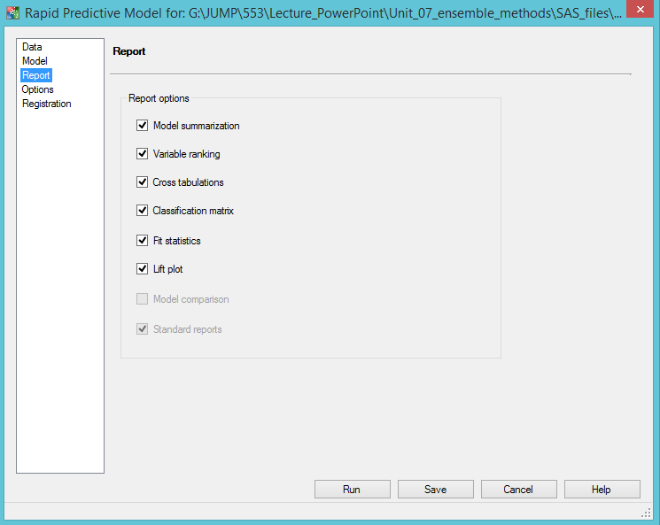
SAS
Enterprise Guide
If you are a busy manager, uncheck all options in the report. The default report has sufficient information for decision-making.
If you are a scholar who wants to write a paper for a journal, check everything.

Slide 40
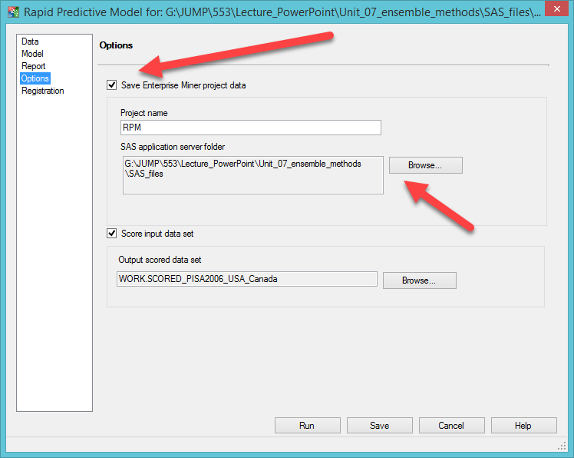
SAS
Enterprise Guide
If you save Enterprise project data (under options), you can open the EG project inside EM.
Specify where you want to store the file by clicking on Browse.
Why? You can see each step and fine tune it.
Click Save and then Run it by right-click.

Slide 41
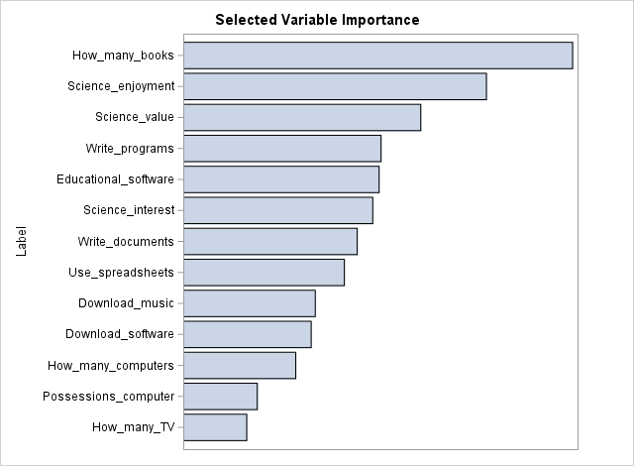
SAS Enterprise Guide

Slide 42
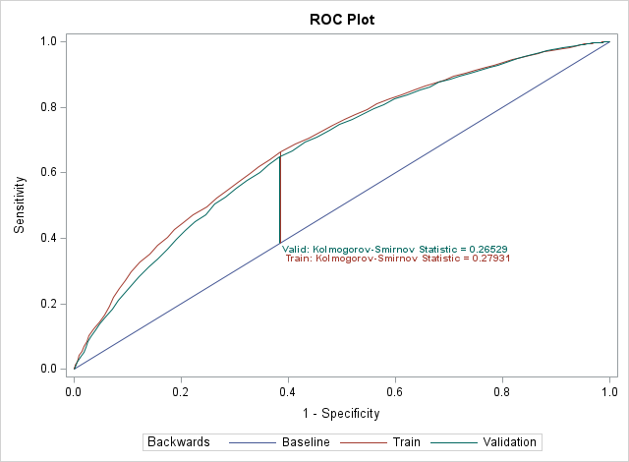
SAS Enterprise Guide

Slide 43
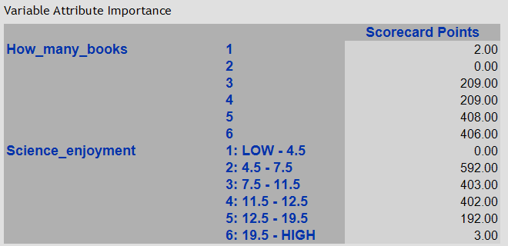
SAS Enterprise Guide
Caution: Due to random sub-setting in cross-validation, these scores may slightly different in different analyzes.
Scorecard points range from 0 to 1000; closer to 1000 is higher propensity.
If the student has more books at home (5, 6), it is more likely (408, 406) that he/she is proficient.
The relationship between science enjoyment and test performance is nonlinear. Why?

Slide 44
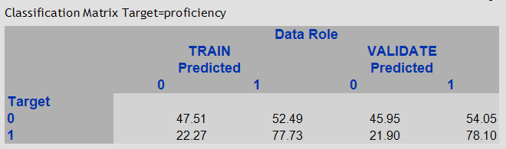
SAS Enterprise Guide
Confusion: This model is good at predicting proficient students (78.10%), but not good at predicting non-proficient students (45.95%).

Slide 45
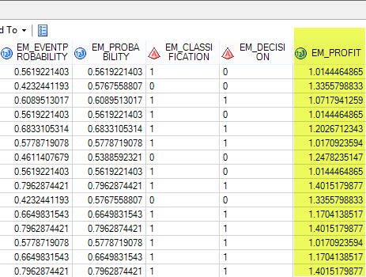
SAS Enterprise Guide
Like JMP, the output data set shows the probability of 1 (proficient) or 0 (no n-proficient) for each student.
Each student is assigned a “profit” score.
The software app is made for business. It means if you invest in this person, what is the return? You can sort this column by descending and then keep the most promising customers (No, you cannot do this in education!)

Slide 46
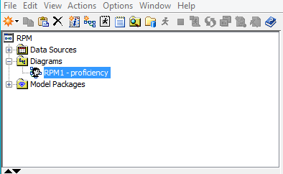
Open Enterprise Guide project in Enterprise Miner
In Enterprise Miner open Project.
Go to the location where you store the Enterprise Guide project. Find the folder RPM and open project.emp.
Click open the diagram.

Slide 47
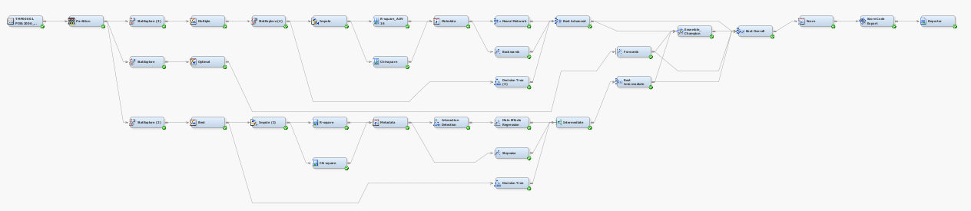
Open Enterprise Guide project in Enterprise Miner
If you can read this, you don’t need a pair of glass.
EG is a “black box” but EM shows everything under the hood. You can fine tune each step if necessary.

Slide 48
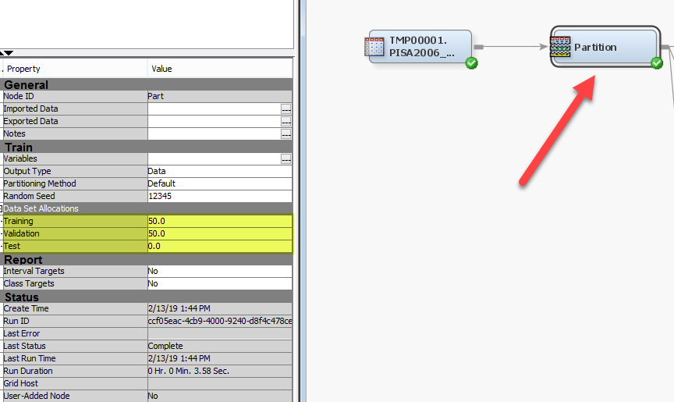
Open Enterprise Guide project in Enterprise Miner
Even if you don’t need to change anything, it is good to know what had been done in each step.
For example, click on the partition node and you can see that 50% of the data are assigned to training, 50% to validation, and none to testing.
You can re-allocate some observations to testing, and then re-run it.

Slide 49
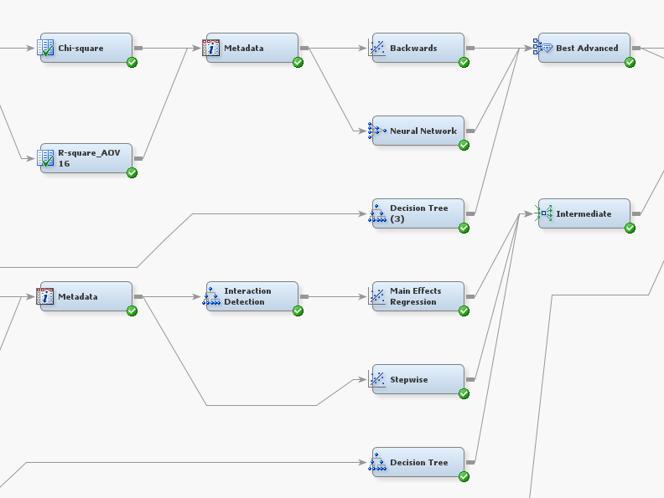
Open EG project in EM
You can see that there are two groups of models: intermediate and advanced e.g.
Backward selection, neural networks, decision tree, main effect regression, stepwise regression.

Slide 50
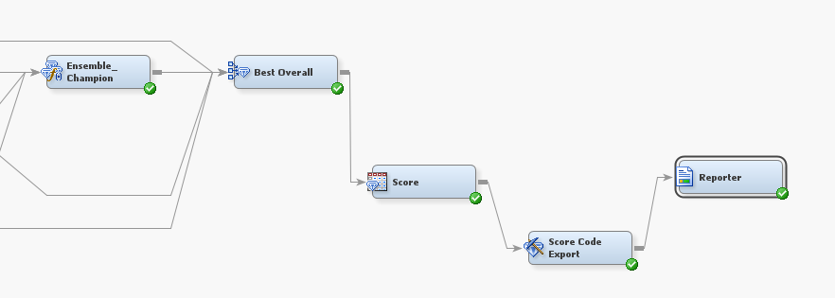
Open EG project in EM
At the end, all good models are merged into the Ensemble Champion.
The best results of all models are merged into the final report.

Slide 51
Assignment 7.2
If you area Mac user, you can use a Windows PC in any APU lab to do this exercise.
Open the SAS dataset “PISA2006_USA_Canada” in SAS Enterprise Guide.
Run Rapid Predictor Modeling.
Use ability instead of proficiency as the target
Choose the Advanced option so that it can perform ensemble and model comparison.
Briefly describe the result.
Open the project in Enterprise Miner. You can alter the configuration in some steps and then re-run it (optional).

Slide 52
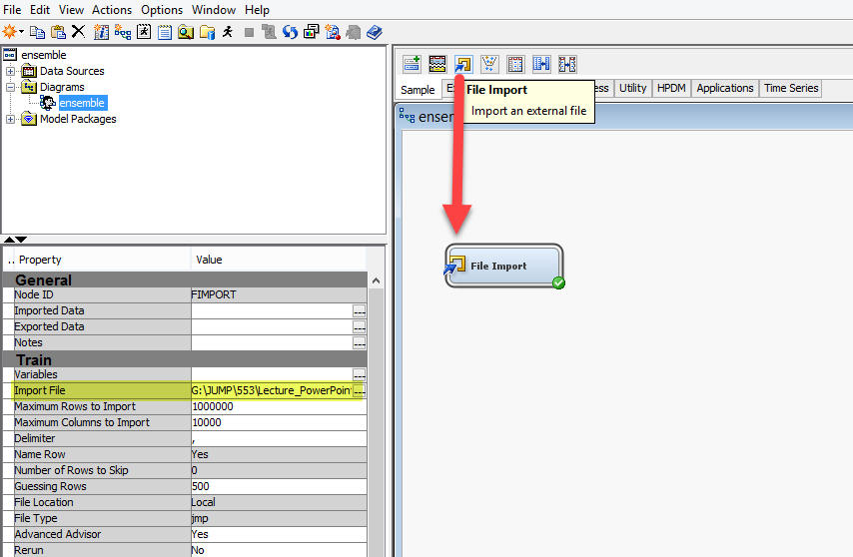
SAS Enterprise Miner
Open a new project
Open a new diagram
Drag the File Import icon (above Sample) into the canvas
In Import File, click on the icon with … to specify the location of the data file (Use JMP file in Unit 5)
Right click on File Import and select Run.

Slide 53
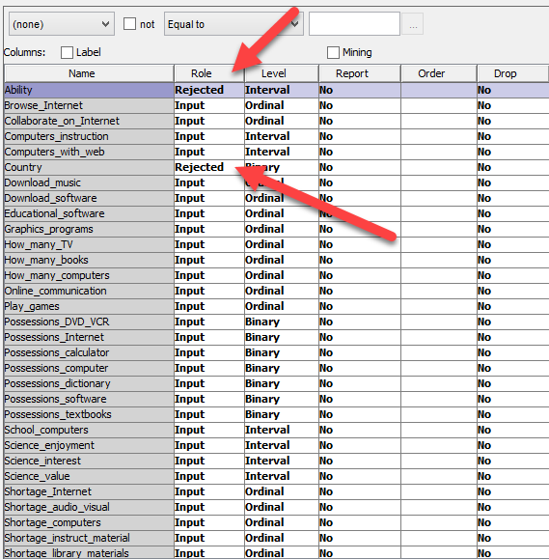
SAS Enterprise Miner
Right click to open Edit variables.
Set the role Ability to Rejected because we will use Proficiency as the DV. It won’t be read into the data set.
Set the role of Country to Rejected because in this analysis we treat American and Canadians as one population.
Reject Grade and Row-state at the end

Slide 54
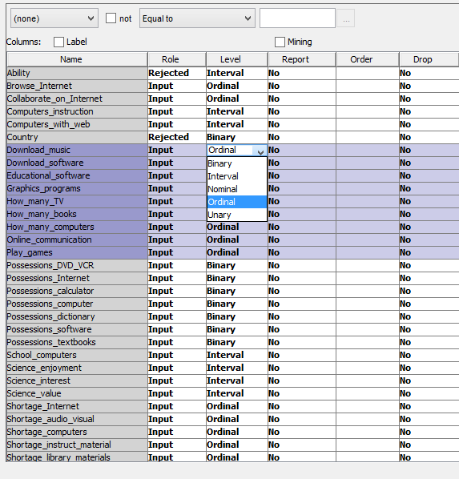
SAS Enterprise Miner
Change all nominal level variables to ordinal. You can hold down the shift key to select many.
Mouse over to the top of any of them,
Click and choose Ordinal from the pull-down menu.

Slide 55
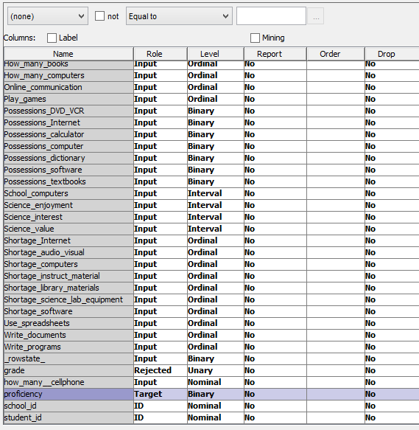
SAS Enterprise Miner
Change the role of proficiency to Target (DV).
Reject Grade
School ID and Student ID should be set to ID by default. If not, manually change their roles.

Slide 56
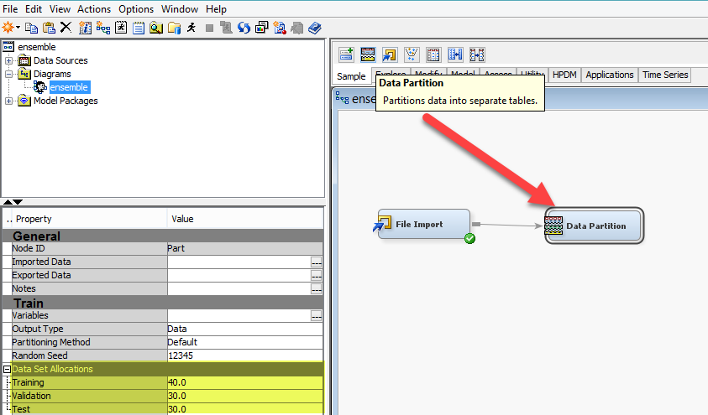
SAS Enterprise Miner
Drag the icon Data Partition (in Sample) to the canvas
Mouse over File Import and connect Data Partition with File Import
Under data set allocations assign the portions to training, validation, and test. You can accept the default or change the numbers.

Slide 57

SAS Enterprise Miner
Create nodes of Neural network, Gradient boosting, regression from the Model group.

Slide 58

SAS Enterprise Miner
Create the node of HP Forest from High Performance Data Mining (HPDM).

Slide 59

SAS Enterprise Miner
Create the Control Point from Utility. This node holds modeling results and it does not compute anything.

Slide 60

SAS Enterprise Miner
Create the Ensemble node from Model. This node will synthesize all modeling results.

Slide 61

SAS Enterprise Miner
Create the Model Comparison node from Access. This node will compare all modeling results and merge them into the final report.

Slide 62
SAS Enterprise Miner
The difference between ensemble and model comparison is that the former merges all modeling results whereas the later picks the best.
The ensemble result returned by EG is much easier to interpret than the ensemble by EM.

Slide 63
Assignment 7.3
This exercise is challenging and therefore the points ae double.
In JMP create a USA subset from PISA2006_USA_Canada.
Import the USA PISA data into SAS Enterprise Miner.
Use proficiency as the target. Reject Ability, Country, and Grade.
Partition the data into subsets.
Run neural network, gradient boosting, and HP forest (skip regression).
Gather all results into a central point.
Perform a model comparison (skip ensemble).
Which one is the best model? Briefly describe the result.

Slide 64

SAS Enterprise Miner
The best is HP Forest

Slide 65

Limitation
The output files of both SAS EG and SAS EM are non-dynamic and non-interactive.
For dynamic graph you need to use SAS Visual Analytics and SAS Visual Statistics in SAS Viya.

Slide 66

IBM SPSS Modeler
Random Tree: SPSS procedure
Random Forest: Python code run in Modeler
Like Random Forest, Random Trees generate many models.
Each time it grows on a random subset of the sample and based on a random subset of the input fields.

Slide 67


Slide 68



SPSS Random Tree’s result
The list of important predictors is different from that of JMP.
The mis-classification rate is VERY high.

Slide 69


Python Random Forest’s result
Didn’t provide the information of overall model accuracy.
The list of important predictor is similar to SAS & JMP.
The variable names are replaced by its own labels (e.g. F1, F2). You need to go back and forth.

Slide 70
Recommended strategies
Bagging is NOT always better. Th result may vary from study to study. Run both bagging and boosting in JMP, perform a model comparison, and then pick the best one.
If the journal is open to new methodologies, you can simply use ensemble approaches for data analysis.
If the journal is conservative, you can run both conventional and data mining procedures side by side, and then perform a model comparison to persuade the reviewer that the ensemble model is superior to the conventional regression model.
If you want quick results, use EG. If you want to customize each step (Node), use EM.

Slide 71

Recommended strategies
You can use two criteria (the number of splits and G2 or the number of splits and SS) to select variables if and only if the journal welcomes technical details (e.g. Journal of Data Science; Journal of Data Mining in Education...etc.)
If the journal does not like technical details, use the number of splits only. If the reviewers don't understand SS, Logworth, G2...etc., it is more likely that your paper will be rejected.

Slide 72


