Slide 1

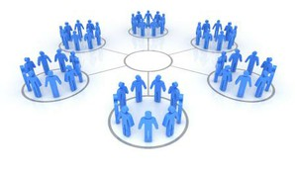
Cluster analysis
Chong Ho Yu

Slide 2
Data reduction
    Group variables into factors or components based on people’s response patterns
      PCA
      Factor analysis
    Group people into groups or clusters based on variable patterns
      Cluster analysis (unsupervised machine learning)

Slide 3

Why do we look at grouping (cluster) patterns?
A cancer researcher would like to group patients according to their attributes in order to provide personalized medicine.
Amazon would like to classify customers based on their browsing and buying habits in order to use differential marketing strategies.

Slide 4

Why do we look at grouping (cluster) patterns?
Google would like to classify users based on their search patterns in order to display customized search results and ads.
Netflix would like to cluster viewers by their explicit ratings and implicit patterns (viewing) in order to recommend movies to you, based on which cluster you belong to.

Slide 5
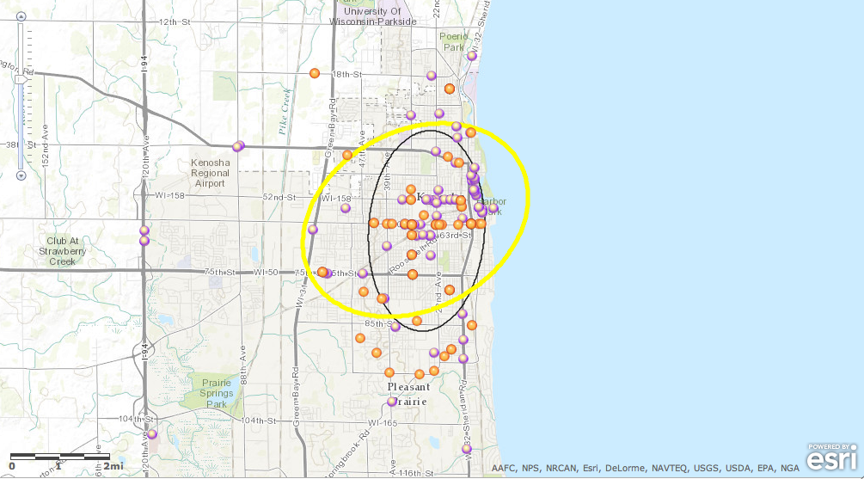
Crime hot spots
How can criminologists find the hot spots?

Slide 6
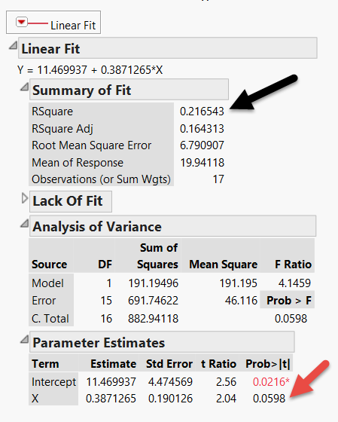
How about social scientists?
Consider this example: This regression model yields 21% variance explained.
The p value is not significant (p=0.0598).
But remember we must look at (visualize) the data pattern rather than reporting the numbers only.

Slide 7
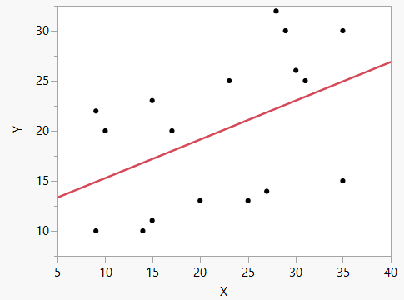
These are the data!

Slide 8
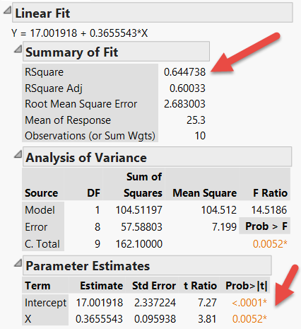
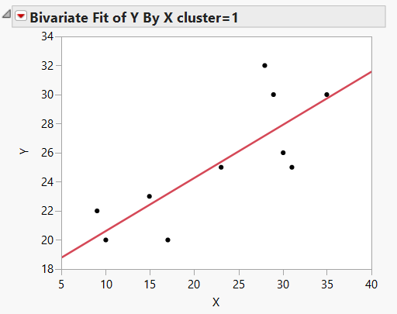
Regression by cluster
Fit a line for each cluster

Slide 9
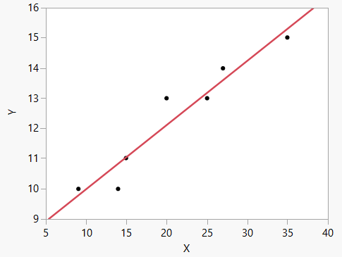
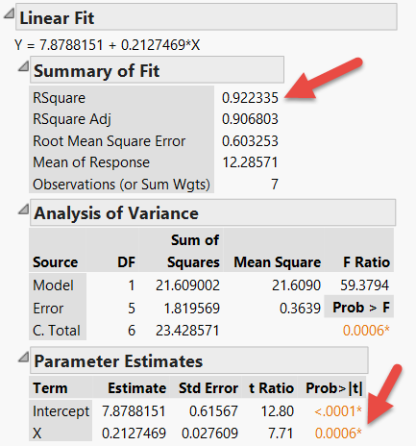
Regression by cluster

Slide 10
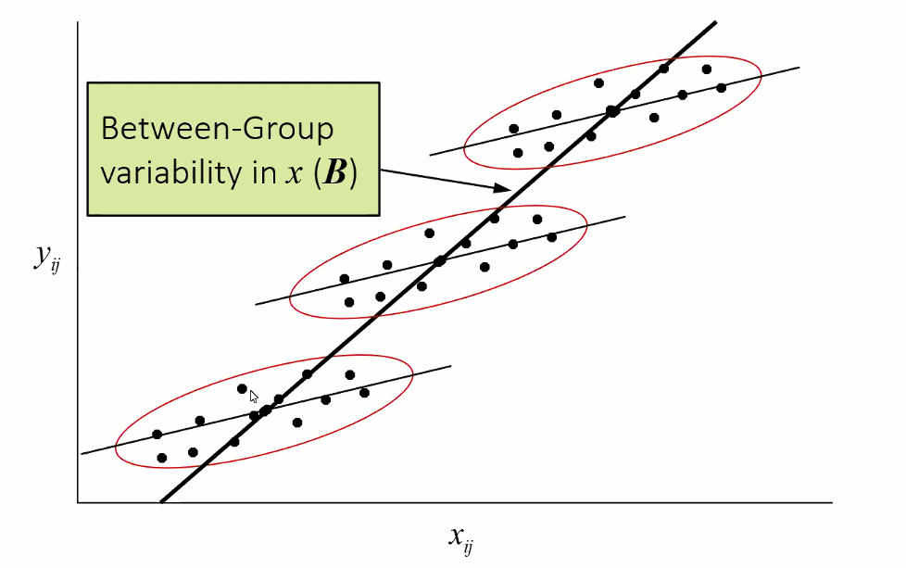
Example 2
Source: SAS Institute
The slopes of each cluster (group) are different from that of overall.

Slide 11
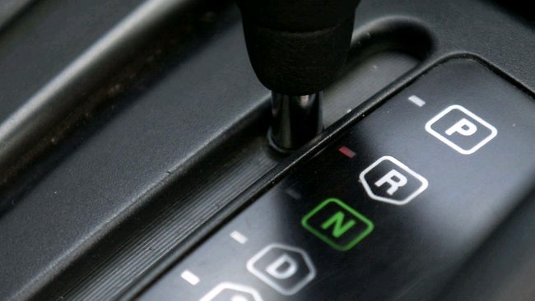
CA: ANOVA in reverse
In ANOVA participants are assigned into known groups.
In cluster analysis groups are created based on the attitudinal or behavioral patterns with reference to certain independent variables.

Slide 12
Discriminant analysis (DA)
There is a test procedure that is similar to cluster analysis: Discriminant analysis (DA)
But in DA both the number of groups (clusters) and their content are known. Based on the known information (examples), you assign the new or unknown observations into the existing groups.

Slide 13
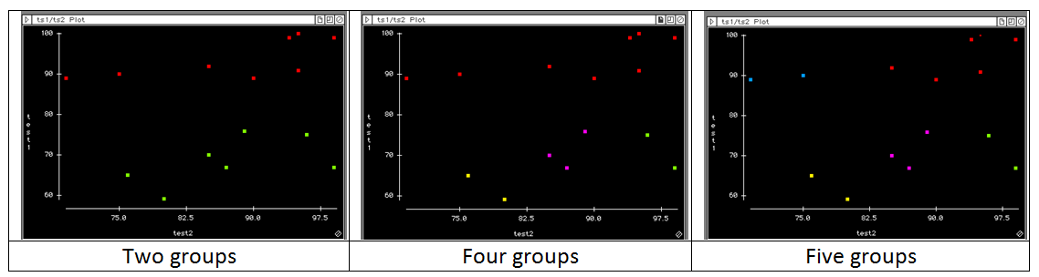
Eye-balling?
In a two-dimensional data set (X and Y only), you can “eye-ball” the graph to assign clusters. But it may be subjective.
When there are more than two dimensions, assigning by looking is almost impossible, and so we need cluster analytical algorithms.

Slide 14
Type of Cluster analysis
  Specific:
    Normal mixtures: need numeric variables and data come from a mixture of multivariate normal distribution.
    Latent class analysis: need categorical variables
  General:
    K-mean clustering
    Density-based clustering
    Hierarchical clustering
    Two-step clustering

Slide 15
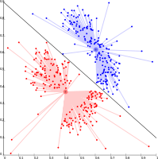
K-mean
Select K points as the initial centroids
Assign points to different centroids based upon proximity
Re-evaluate the centroid of each group
Repeat Step 2 and 3 until the best solution emerges (the centers are stable)

Slide 16
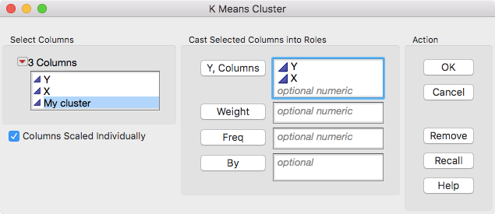
Sometimes it doesn’t make sense
Data set: regression by cluster.jmp
Analyze → Clustering → K means cluster

Slide 17
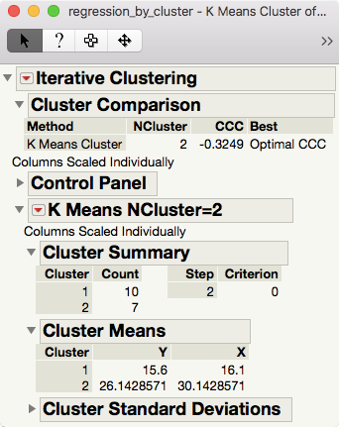
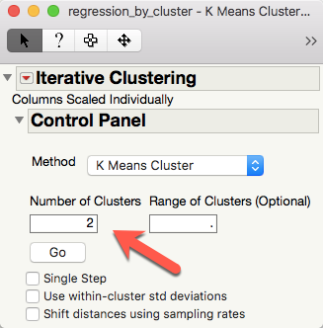

Slide 18
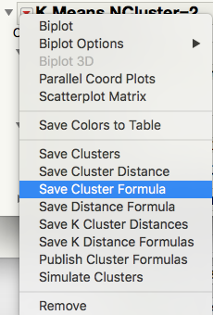
Do these 2 groups make sense?
Output the cluster result by Save Cluster Formula.
Graph → Graph Builder
Put Y into Y-axis
Put X into X-axis
Put Cluster Formula into overlay

Slide 19
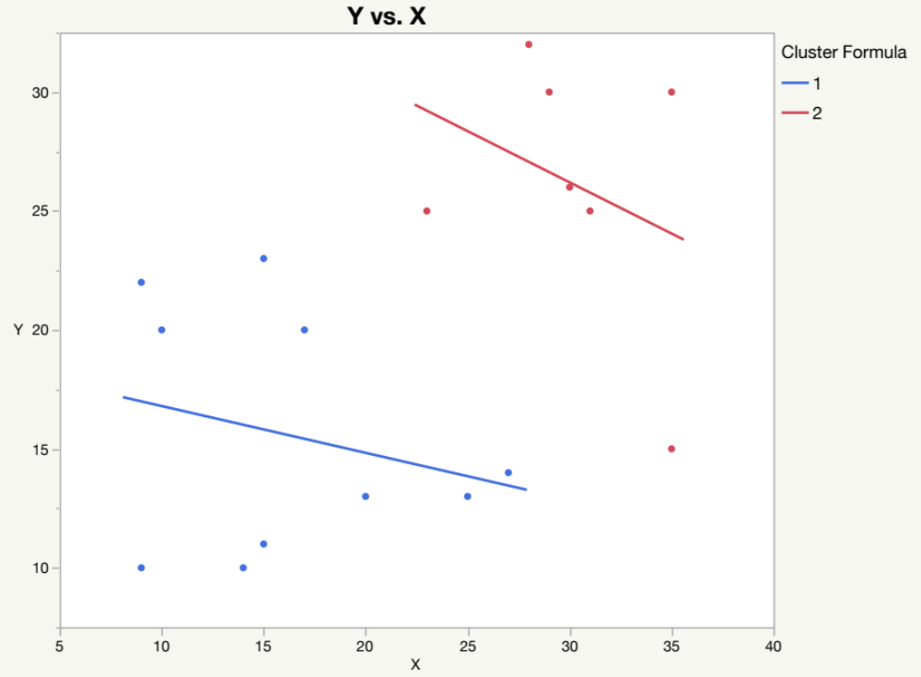
Do these 2 groups make sense?

Slide 20
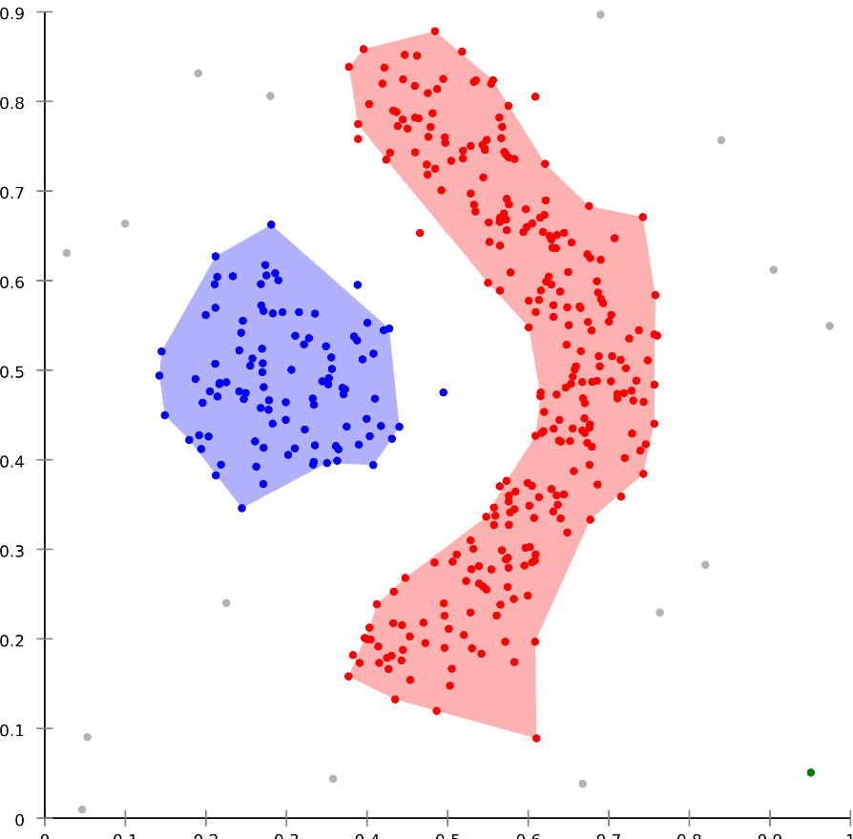
Density-based Spatial Clustering of Applications with Noise (DBSCAN)
Available in SAS/Stat
Invented in 1996
In 2014 the algorithm won the Test of Time Award at Knowledge Discovery and Data Mining Conference.

Slide 21
Density-based Spatial Clustering of Applications with Noise (DBSCAN)
Unlike K-mean, it can discover clusters in any shape, not necessarily an ellipse based on a centroid.
Clusters are grouped by data concentrations, meaning that dense and spare areas are separated.
Outlier/noise excluded

Slide 22
How DBSCAN works
Divides the data into n dimensions
For each point, DBSCAN forms an n-dimensional shape around that data point, and then counts how many points fall within that shape to form a cluster.
Iteratively expand the cluster by checking the points within the cluster and other data points near the cluster.

Slide 23
Disadvantages of DBSCAN
Work well when there are high and low densities, but have problems facing similar densities.
Cannot work when there are too many dimensions (variables/inputs)
Complicated.

Slide 24
DBSCAN in SAS
Complicated:
PROC RECOMMEND in SAS
http://support.sas.com/documentation/cdl/en/inmsref/67306/HTML/default/viewer.htm#p08w4hxeqsgklrn14aqs76gs01te.htm
https://documentation.sas.com/?docsetId=espcases&docsetTarget=n1sbaow4ktn0nwn1npgo4ua2mgix.htm&docsetVersion=4.2&locale=en

Slide 25
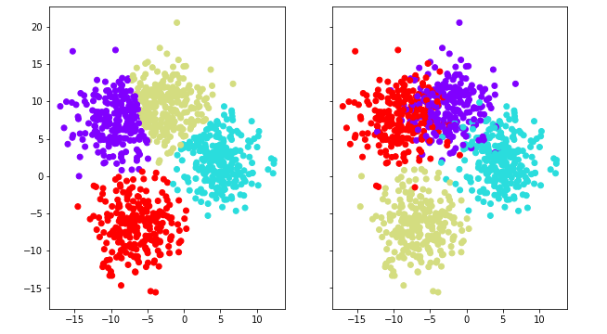
Elbow method in Python
K-mean clustering is subjective: The analyst chooses the number of clusters.
More Ks (number of clusters), shorter distance from the centroid.
Extreme scenario: When every data point is a centroid, then the distance is zero! But it is useless!
What is the optimal K?

Slide 26
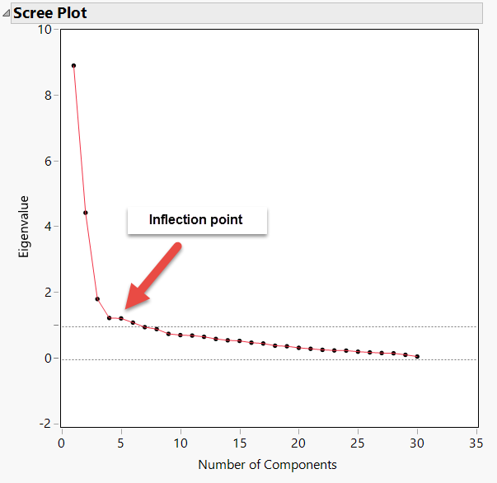
Elbow method in Python
In Python, the idea of the Elbow method is similar to the scree plot in factor analysis/PCA (will be introduced in the next unit)
Both use inflection point to find the optimal number.

Slide 27
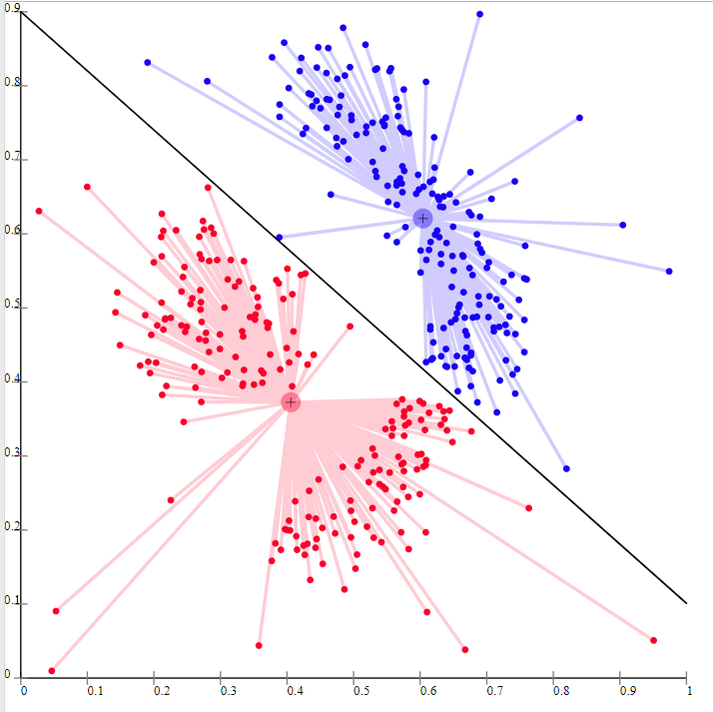
Elbow method in Python
To measure the overall distance from the centroid, we need the sum of squared distance (a.k.a. distortion)
If we sum the raw distances, it will be zero due to mutual cancelation.

Slide 28
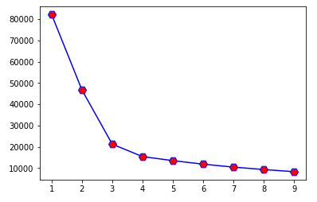
Elbow method in Python
You can explore different Ks and then plot Ks against the sum of squared distance In this example, the inflection point (the optimal point is 3).
You don’t need to do it manually. In Python you can use a loop to perform clustering with different ks and create the elbow graph.

Slide 29
Elbow method in Python
Can we cluster diabetes patients based on their profile?
Download the file “python_elbow” and “diabetes.xlsx” from ”Python_files” in Unit 8 folder.
Open a new Python interpreter from Anaconda.
Run the Python in the Python interpreter chunk by chunk.

Slide 30
Libraries in Python
Pandas: for structured data operations and manipulations; used for data preparation and mining.
Numpy: Numerical Python for standard linear algebra function, advanced random number capability
Scikit-learn: For machine learning.
Scipy: Scientific Python for scientific and engineering modules e.g. Linear Algebra and sparse matrices.
Matplotlib: For data visualization.

Slide 31
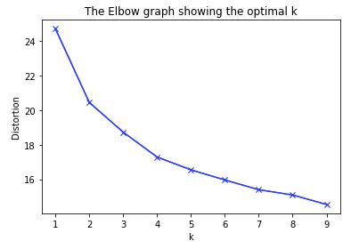
Elbow method in Python
The result of clustering patience. In this analysis there is a clear inflection point.

Slide 32
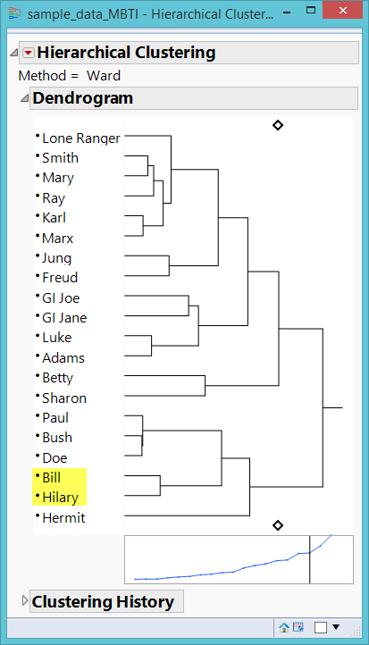
Hierarchical clustering
Grouping/matching people like what e-harmony and Christian-Mingle do.
Who is the best match?
Who is the second best? The third…etc.

Slide 33

Matching
How can a dating-service company (e.g. E-harmony, Christian Mangle, match.com) recommend a man or a woman that may match your personality to you?

Slide 34
Hierarchical clustering
Top-down or Divisive: start with one group and then partition the data step by step according to the matrices
Bottom-up or Agglomerative: start with one single piece of datum and then merge it with others to form larger groups

Slide 35
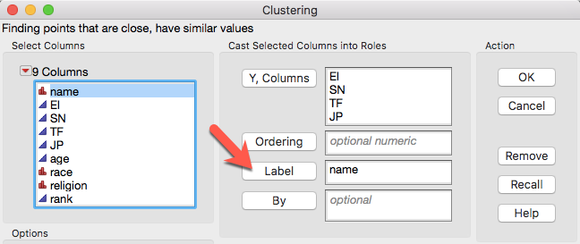
Hierarchical clustering
Data set: MBTI.jmp
MBTI is a measure of personality
Analyze → Clustering → Hierarchical clustering

Slide 36
Hierarchical clustering
HC can work with Multidimensional scaling (MDS) on some data sets.
MDS is a way of visualizing the level of similarity of individual cases of a data matrix (rows and columns are the same).
Bonney, L., & Yu, C. H. (2018, January). Sharing tacit knowledge for school improvement. Paper presented at International Congress for School Effectiveness and Improvement, Singapore.
Five superintendents reviewed 67 statements regarding leadership in education, and decided which concepts are related by pairing them.

Slide 37
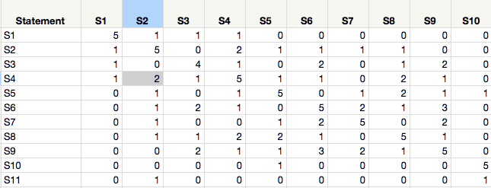
Hierarchical clustering
The numbers show the frequency of pairing.
e.g. Two superintendents said that S2 and S4 are conceptually related.
S4 is related to itself and so the default count is 5.

Slide 38

Hierarchical clustering
Like dragging the regression line in regression modeling, the presence of outliers might skew the grouping patterns.
if a column has outliers, then the estimate of the standard deviation is inflated.
Choose Standardize robustly
By doing so outliers stand out, resulting in more isolated clusters. However, those remaining columns can be used to form more accurate clusters

Slide 39
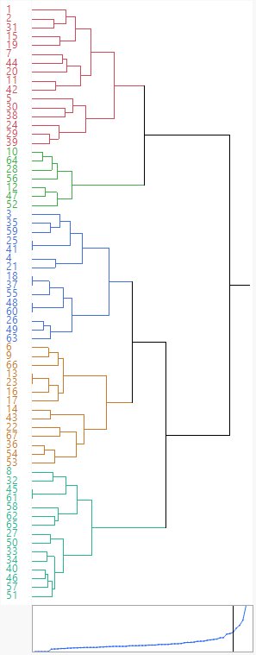
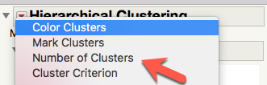
Hierarchical clustering
Based on the result it was decided that there should be 5 clusters.
Assign the number of clusters
Assign a different color to each cluster.

Slide 40
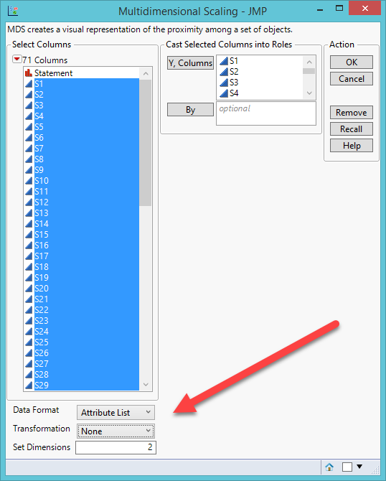
MDS
Analyze → Multivariate Methods → Multidimensional scaling
Data format = Attribute list (distance matrix is constructed from the correlation structure)

Slide 41
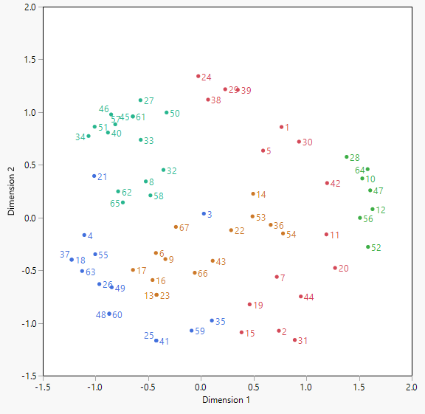
Compare HC and MDS
HC and MDS agree with each other to a large extent
But there are some discrepancies

Slide 42
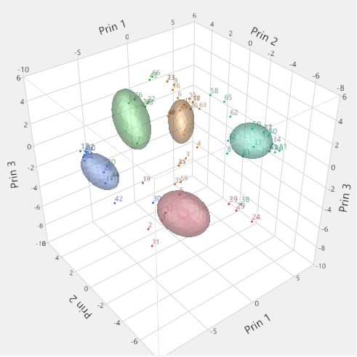
Biplot in K-mean clustering
To check HC and MDS, add K-mean clustering
Use Biplot as the third verifier.

Slide 43
Compare HC and MDS
Discrepancy is good! Always triangulate with more than one method.
The results are different. Should you side with HC or MDS?
Quantitative methods cannot resolve it.
Read the statements and determine which statement can conceptually (qualitatively) fit into which cluster.

Slide 44
Assignment 8.1
Use JMP sample data: Crime.jmp
Run a hierarchical clustering by including all crime rate.
Set the number of cluster to 5.
Assign a different color to each cluster.
Open Graph Builder and put state into Map Shape
Are crime rates clustered by location?
Subset the “orange” cluster
What are their common characteristics in terms of crime rate? Why?

Slide 45
Two-step clustering
Example: Clustering recovering mental patients
Tse, S., Murray, G., Chung, K. F., Davidson, L., Ng, J., Yu, C. H. (2014). Differences and similarities between functional and personal recovery in an Asian population: A cluster analytic approach. Psychiatry: Interpersonal and Biological Processes, 77(1), 41-56. DOI: 10.1521/psyc.2014.77.1.41

Slide 46
Two-step clustering
What are the relationships between subjective and objective measures of mental illness recovery?
What are the profiles of those recovered people in terms of their demographic and clinical attributes based on different configurations of the subjective and objective measures of recovery?

Slide 47
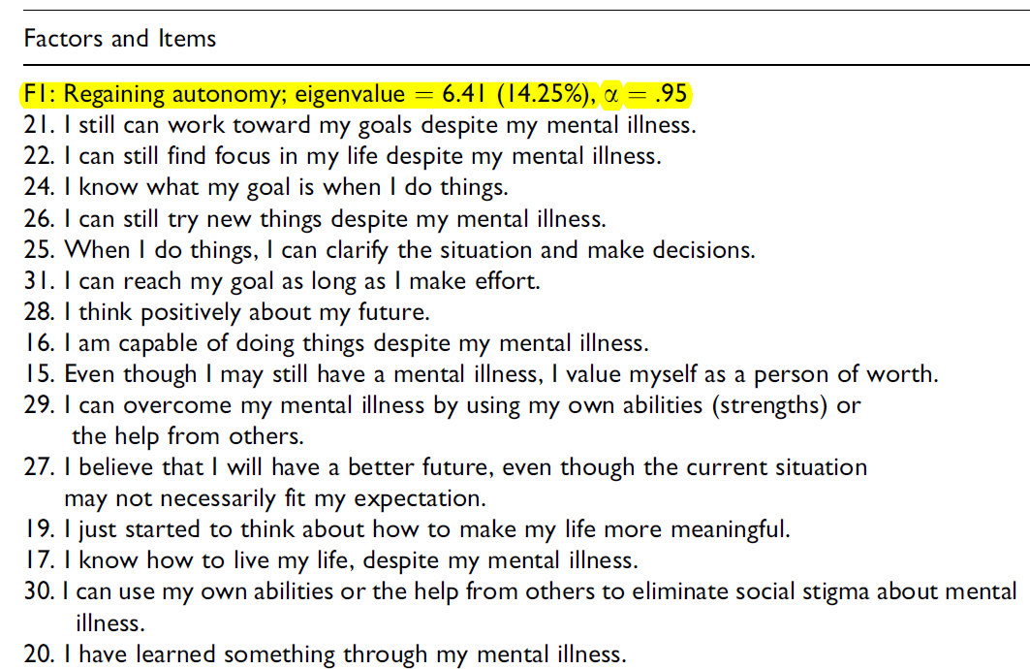
Subjective recovery scale
(E2 Stage model)

Slide 48
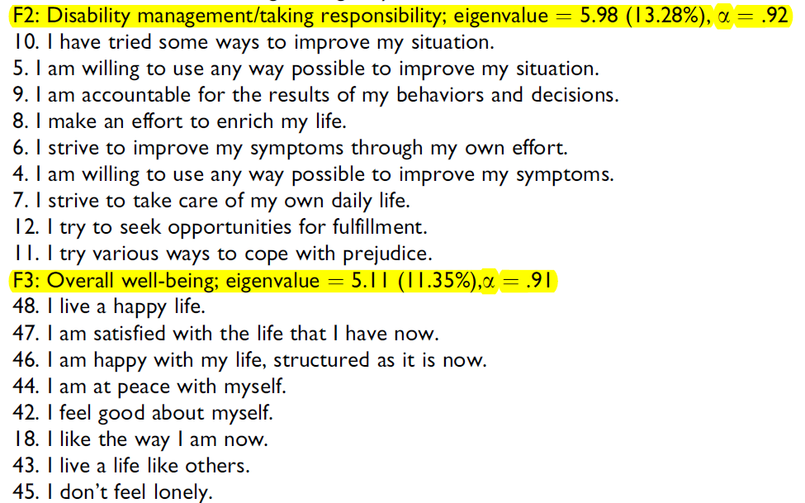
Subjective recovery scale

Slide 49
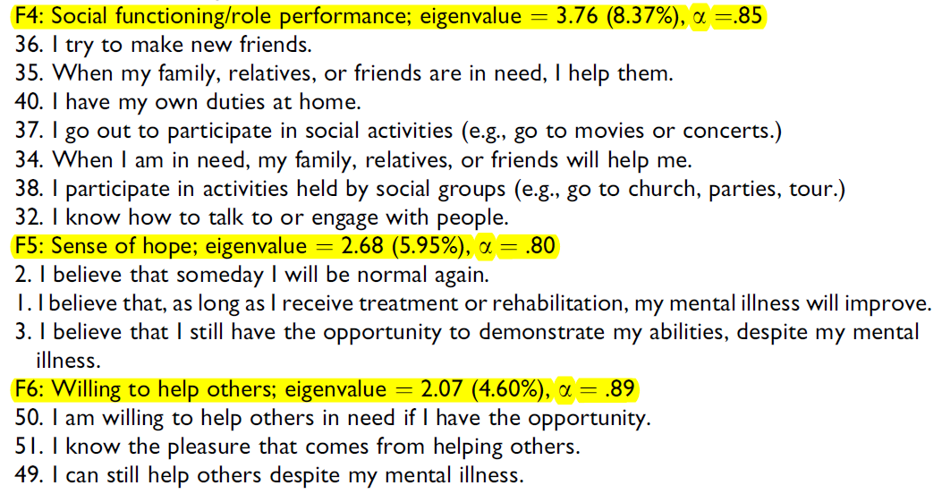
Subjective recovery scale

Slide 50
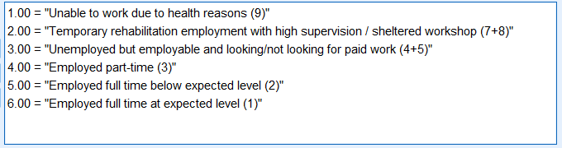
Objective scale 1:
Vocational status
The numbers on the right are the original codes. They were recoded to six levels so that the scale is ordinal. e.g. Employed full time at expected level is better than below expected level.

Slide 51
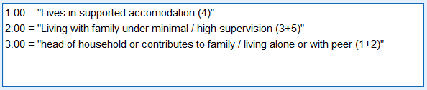
Objective recovery scale 2:
Living status
The numbers on the right are the original categories. They were collapsed and recoded so that the scale is converted from nominal to ordinal. e.g. Head of household is better than living with family under supervision.

Slide 52
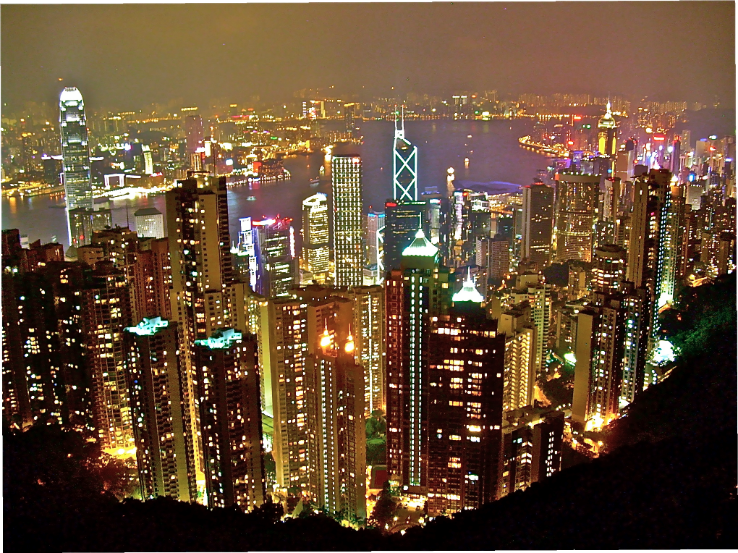
Participants
150 recovering or recovered patients (e.g. bipolar, schizophrenia) in Hong Kong.
Had not been hospitalized in the past 6 months.

Slide 53
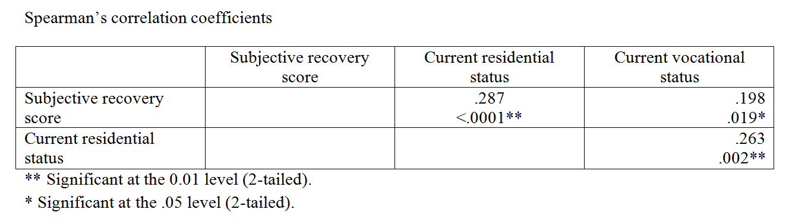
Analysis:
Correlations among the scales
The Spearman’s correlation coefficients are small but significant at the .05 or .01 level. However, the numbers alone might be misleading and further insight could be unveiled via data visualization.

Slide 54
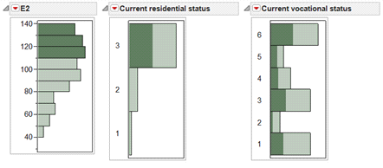
Data visualization: Linking and brushing
The participants who scored high in the subjective scale (E2) also ranked high in the current residential status
But they are all over the vocational status, implying that the association between the subjective scale and the vocational status is weak.

Slide 55
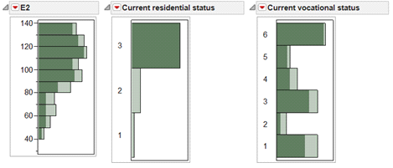
Data visualization: Linking and brushing
The reverse is not true. The subjects who scored high in the residential status (3) spread all over in the subjective scale (E2) and the vocational status

Slide 56
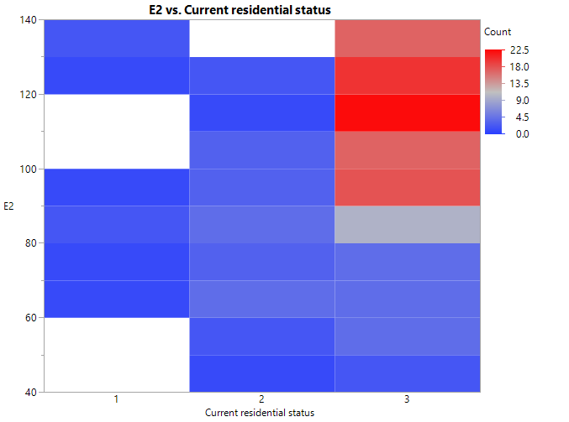
Data visualization: Heat map
View data concentration

Slide 57
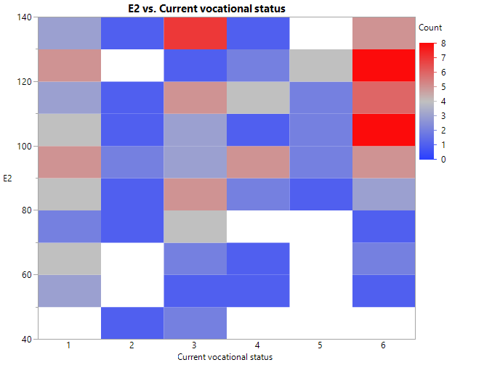
Data visualization: Heat map

Slide 58
Two-step cluster analysis
In this study one subjective and two objective measures of recovery were used to measure the rehab progress of the participants.
Two-step
  Step 1: To avoid unnecessary complexity, cluster analysis condenses the dependent variables by proposing certain initial clusters (pre-clusters).
  Step 2: Make final clusters

Slide 59
Two-step cluster analysis
Available in SPSS
Use AIC or BIC to avoid complexity
Can take both continuous and categorical data (vs. K-mean can take continuous data only)
Truly exploratory and data-driven (vs. K-mean prompts you to enter the number of clusters)
Group sizes are almost equal (vs. K-mean groups are highly asymmetrical)

Slide 60
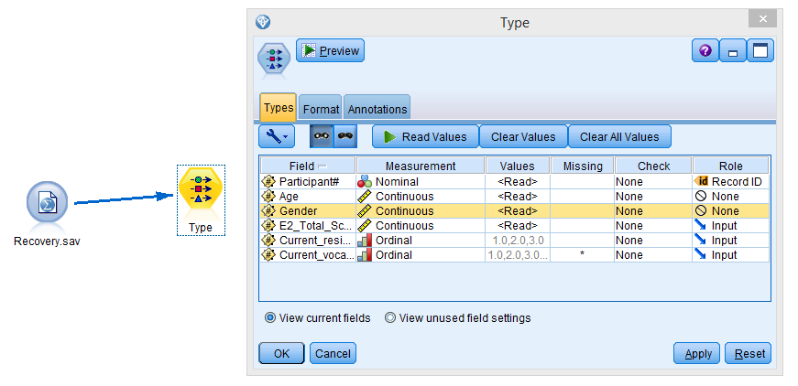
IBM SPSS Modeler

Slide 61
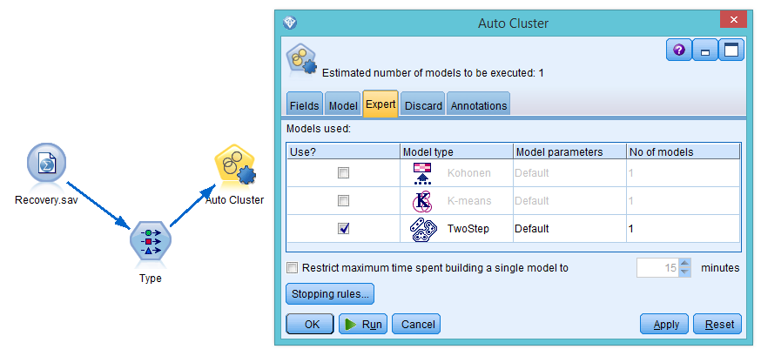
IBM SPSS Modeler

Slide 62
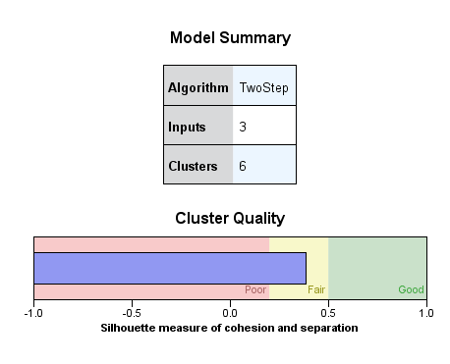
Cluster quality
Yellow or green: go ahead
Pink: pack and go home

Slide 63
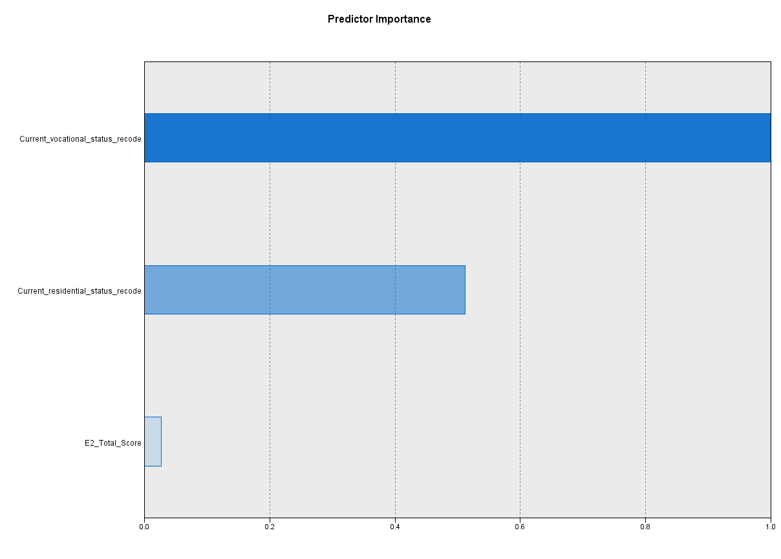
Predictor importance
Subjective feeling doesn’t matter!

Slide 64
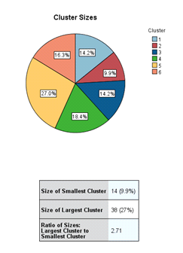
Number of clusters

Slide 65
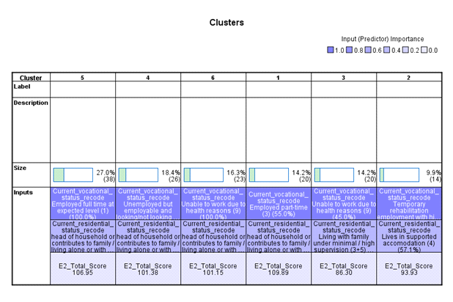

Slide 66
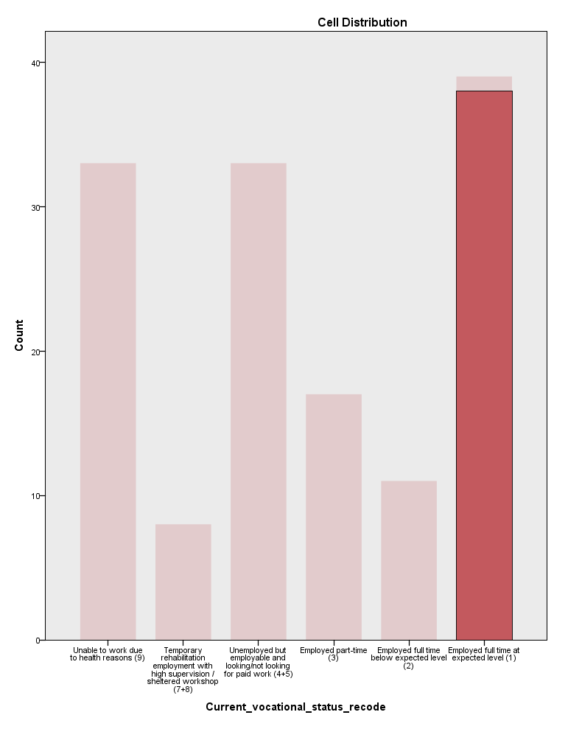
Cluster 5
In cluster 5 the grouping by vocational is very “clean” or decisive because almost all subjects in the group chose “employed full time at expected level”.

Slide 67
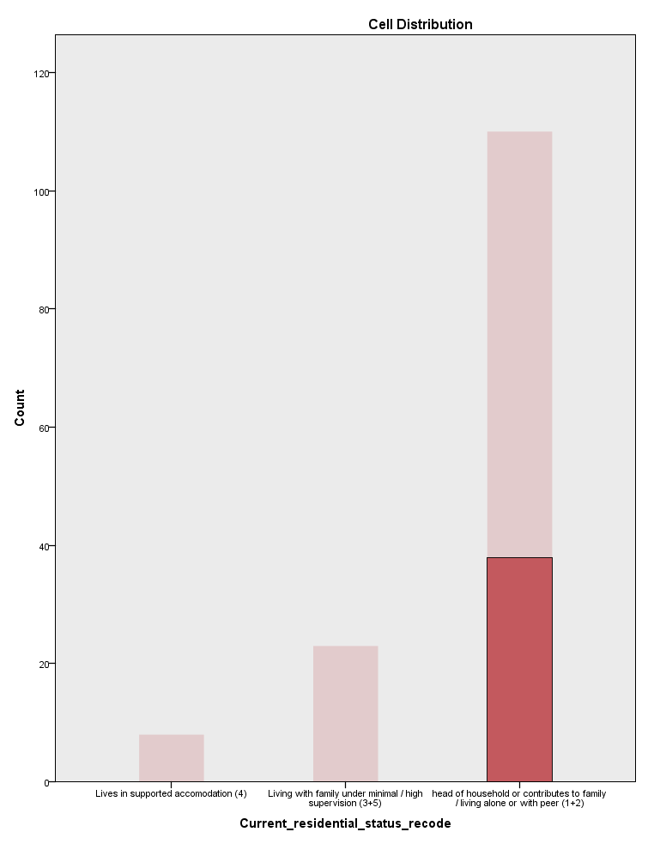

Cluster 5

Slide 68

Cluster 3: Messy

Slide 69
Cluster 5: The best
The clustering pattern suggests that Cluster 5 has the best cluster quality in terms of the homogeneity (purity) in the partition. In addition, the subjects in Cluster 5 did very well in all three measures, and therefore it is tantalizing to ask why they could recover so well.
But cluster analysis is a means rather than an end. Further analysis is needed based on the clusters. Our team found that family income can predict whether the subjects are in Group 5 or others.

Slide 70


Diamond plot

Slide 71
Family income: Cause or effect?
Cluster 5 (the best group in terms of both subject and objective recovery) has a significantly higher income level than all other groups.
Plausible explanation 1: they recovered and are able to find a full time job, resulting in more income.
Plausible explanation 2: the family have more money and thus more resources to speed up the recovery process.

Slide 72
Assignment 8.2
Data set: Best_college.sav
Lists 400 world’s best colleges and universities compiled by US News and World Report. The criteria include:
  Academic peer review score
  Employer review score
  Student to faculty score
  International faculty score
  International students score
  Citations per faculty score

Slide 73
Assignment 8.2
Educational researchers might not find the list helpful because the report ranks these institutions by the overall scores.
We want to find the grouping pattern (Categorizing the best schools by common threads).
Use IBM SPSS Modeler to run a two-step cluster analysis.
Use all criteria set by US News and World Report, plus geographical location.

