Slide 1
PCA, EFA, and PA
Chong Ho Yu

Slide 2
PCA and EFA
Principal components analysis: find the optimal way of collapsing many correlated variables into a small number of subsets so that the study is more manageable. The subsets do not need to make any theoretical sense. It is for convenience only.
Exploratory factor analysis: identify the underlying theoretical structure of diverse variables. If certain items are loaded into a subscale called intrinsic religious orientation, then the items must be related to this construct both mathematically and conceptually.

Slide 3
Example of PCA:
Insurance policy
The policy variables (Maitra & Yan):
Fire Protection Class
Number of Building in Policy
Number of Locations in Policy
Maximum Building Age
Building Coverage Indicator
Policy Age

Slide 4
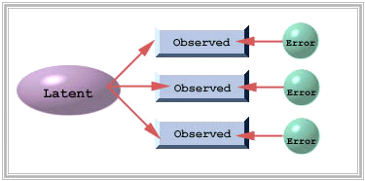
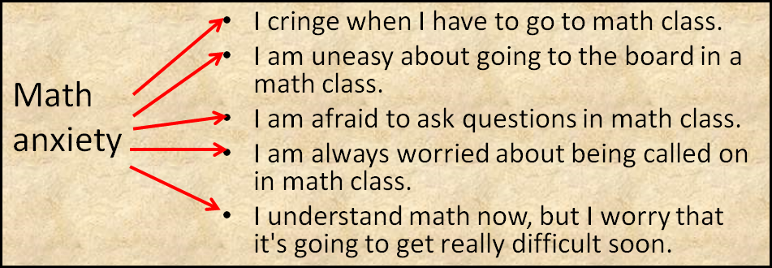
Example of factor analysis
Find out what observed items can indicate latent constructs.

Slide 5
Alternatives to PCA and EFA
Item response theory (IRT) and Rasch modeling
Not covered now; you need to take Psychometrics
Yu, C. H. (2020). Objective measurement: How Rasch modeling can simplify and enhance your assessment. In M. S. Khine (Ed.). Rasch measurement: Applications in quantitative educational research (pp. 47-73). Singapore: Springer. https://doi.org/10.1007/978-981-15-1800-3_4.

Slide 6
Alternatives to PCA and EFA
Yu, C. H. (2019). An Analysis of the relationship between Christian faith and mental wellbeing using item response theory. PEOPLE: International Journal of Social Sciences, 5, 565-586. DOI: https://doi.org/10.20319/pijss.2019.53.565586
Yu, C. H., Osborn-Popp, S., DiGangi, S., & Jannasch-Pennell, A. (2007). Assessing unidimensionality: A comparison of Rasch Modeling, Parallel Analysis, and TETRAD. Practical Assessment, Research and Evaluation, 12. Retrieved from http://pareonline.net/pdf/v12n14.pdf

Slide 7


Dimension reduction is not always good
PISA2018_HongKong.jmp
Use IRT to combine many observed items into a few latent constructs
Example: Body image
  I like my look just the way it is.
  I consider myself to be attractive.
  I am not concerned about my weight.
  I like my body.
  I like the way my clothes fit me

Slide 8
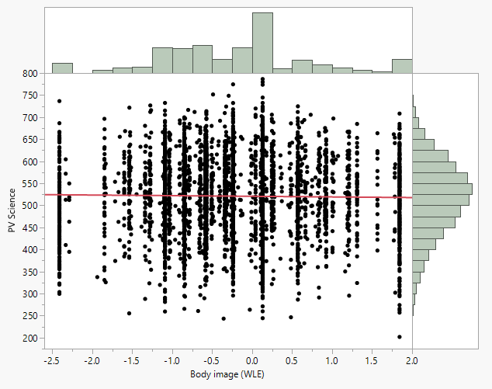
Is there a relationship between academic performance and body image?

Slide 9
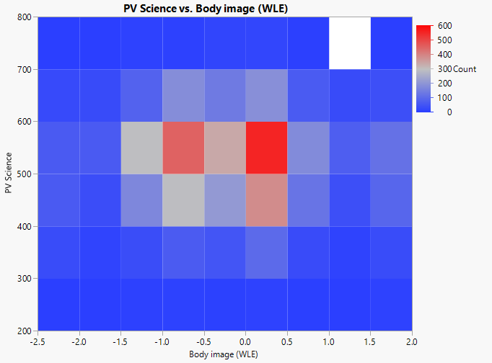
Heat map

Slide 10
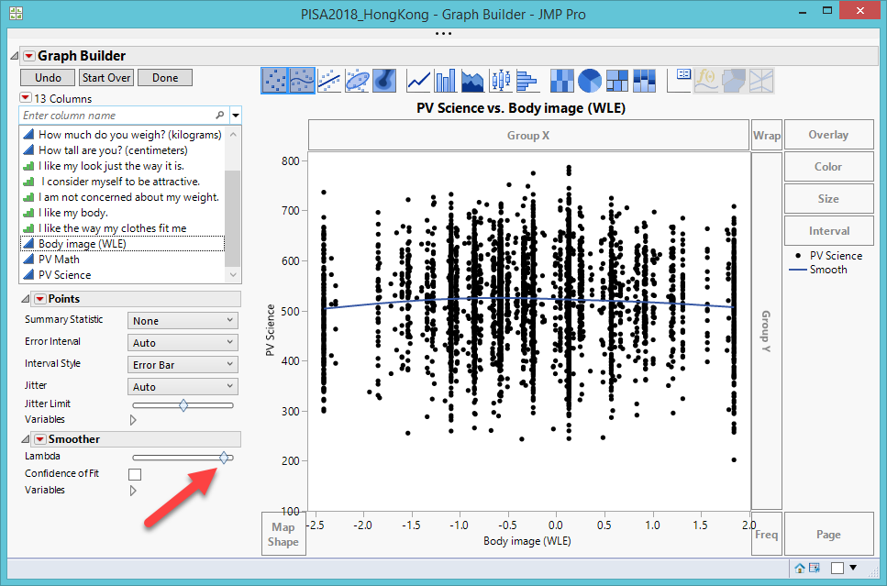
Lambda smoothing

Slide 11
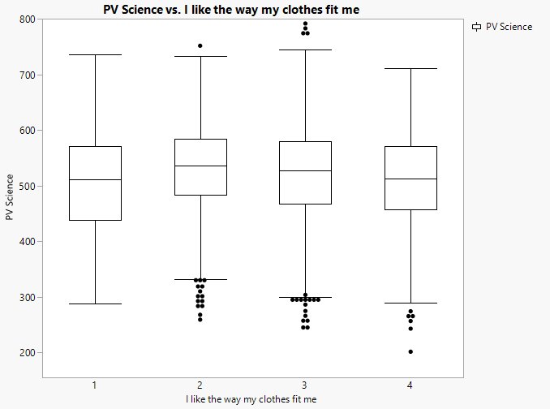
Median smoothing

Slide 12
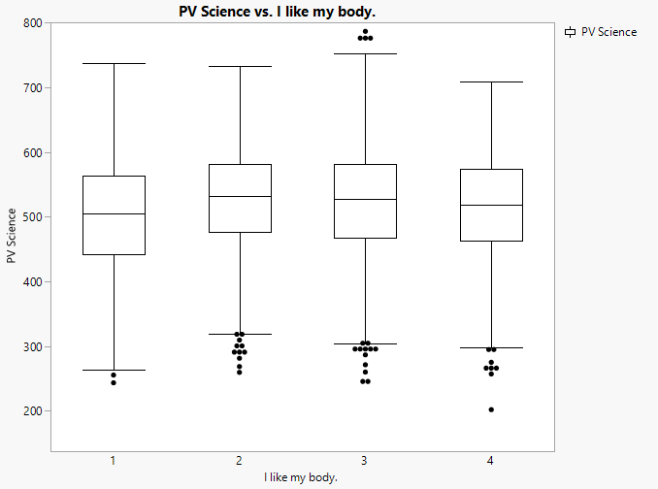
Median smoothing

Slide 13
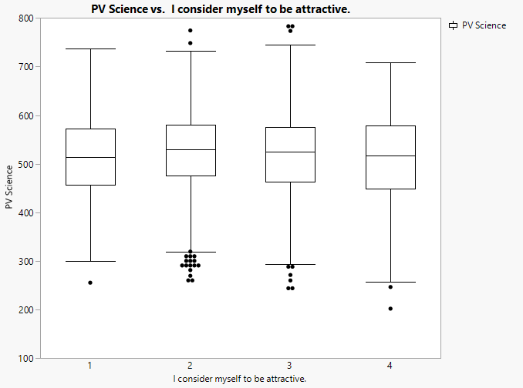
Median smoothing

Slide 14
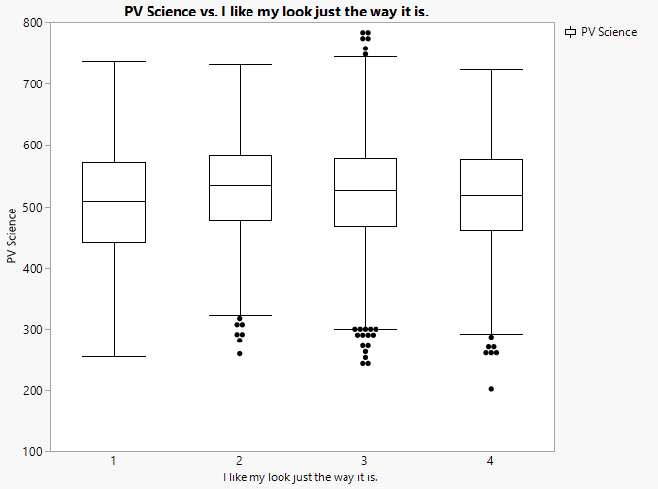
Median smoothing

Slide 15
Lesson from PISA 2018
When the data set is big, scatterplot plot with histograms, heat map, lambda smoothing cannot show the relationship between science test performance and the latent construct “body image.”
When science test score and each item related to body image are examined, a nonlinear relationship is discovered.

Slide 16
PCA and factor analysis
FA is more demanding than PCA
PCA is simply data reduction for convenience; you don’t need further psychometric validation.
FA → construct validity
You need a different sample for confirmatory factor analysis.

Slide 17
EFA is not enough
We need confirmatory factor analysis (CFA)? Why?
'EFA is an error-prone procedure even when the scale being analyzed has a strong factor structure, and even with large samples. Our analyses demonstrate that at a 20: 1 subject to item ratio there are error rates well above the field standard alpha = .05 level…It should be used only for exploring data, not hypothesis or theory testing, nor is it suited to “validation” of instruments.'
Osborne, J. W. (2014). Best practices in exploratory factor analysis (Kindle Locations 2305-2310). Amazon Digital Services.

Slide 18
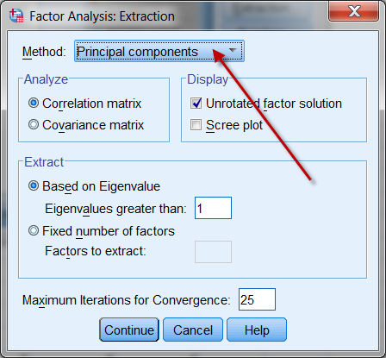
Confusion between PCA & EFA
Although factor analysis and PCA are two different procedures, some researchers found that the procedures yield almost identical results on many occasions. SPSS makes PCA as the default when EFA is requested.

Slide 19
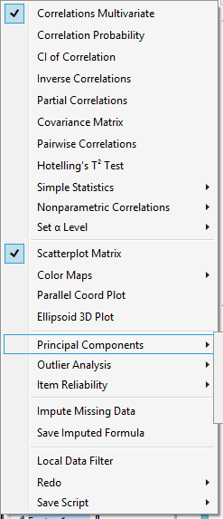
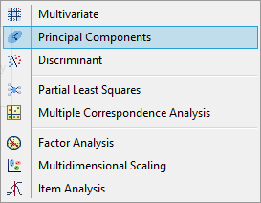
JMP
• In JMP there are different ways to do PCA
– Multivariate methods → Multivariate
– Multivariate methods → Principal Components

Slide 20
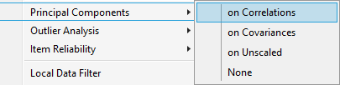
JMP
Consistency is required to put items together.
Item correlation: The stronger the items are inter-related, the more likely the scale is consistent.
Item covariance : Variance is a measure of how a distribution of a single variable (item) spreads out. Covariance is a measure of the distributions of two variables. The scores are standardized.

Slide 21
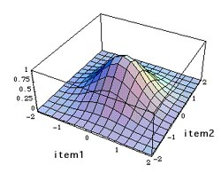
JMP
In one variable, the distribution is a bell-curve if it is normal. In two variables the distribution appears to be a mountain or a Mexican hat.
Both items has a mean of zero because the computation of covariance uses standardized scores (z-score).

Slide 22
JMP
From the shape of the "mountain," we can tell whether the response patterns of test taker or the survey participants to item1 and item 2 are consistent.
If the mountain peak is at or near 'zero' and the slopes of all directions spread out evenly, we can conclude that the items are consistent.

Slide 23
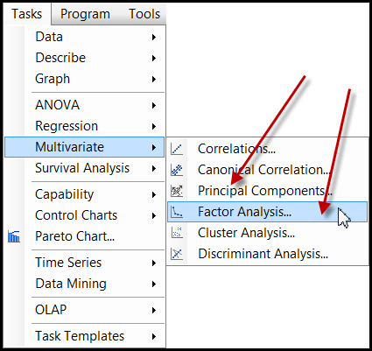
SAS
Less confusing in SAS. Both PCA and EFA are shown in the Tasks menu.
But if you do programming, PROC FACTOR in SAS makes PCA as the default method.

Slide 24
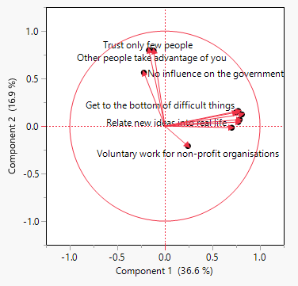
PCA
Data set: PIAAC_for_PCA.jmp
Analyze → multivariate methods → Principal components
Use all numeric variables except age, problem-solving, literacy, and numeracy.
Besides the scree plot, we can look at the loading plot.

Slide 25
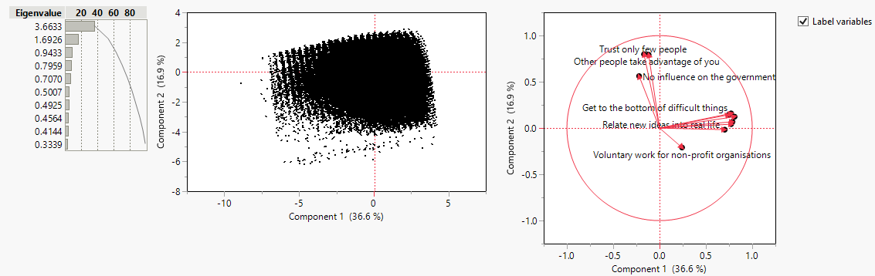
Vectors
Showing the directions and relationships.
Cos(the angle between two vectors) = r

Slide 26
Vector
A mathematical object with a numeric value is called a scalar.
A mathematical object that has both a numeric value and a direction is called a vector.
If I just tell you to drive 10 miles to reach my home, this instruction is definitely useless. I must say something like, "From Claremont drive 10 miles West to Azusa."

Slide 27
Vector
Vector-based graphics: the image is defined by the relationships among vectors instead of the composition of pixels.
For example, to construct a shape, the software stores the information like "Start from point A, draw a straight line at 45 degrees, stop at 10 units, draw another line at 35 degrees..."

Slide 28
Vector
In quantitative analysis, vectors help us to understand the relationships among variables.
The word eigen, coined by Hilbert in 1904, is a German word, which means "own“ or "peculiar“.
An Eigenvalue has a numeric property while an eigenvector has a directional property. They define the attributes of a variable.
“Eigen” emphasizes the unique nature of a specific transformation in Eigenvalues.

Slide 29
Data as matrix
 | GRE-Verbal | GRE-Quant
David | 550 | 575
Sandra | 600 | 580
The columns denote the subject space, which are {550, 600} and {575, 580}. The subject space tells you that how GRE-Verbal and GRE-Quantitative scores are distributed between two subjects, David and Sandra.
The rows reflect the variable space, which are {550, 575} and {600,580}. The variable space indicates that across the variables GRE-V and GRE-Q, how the scores of the subjects are distributed.

Slide 30
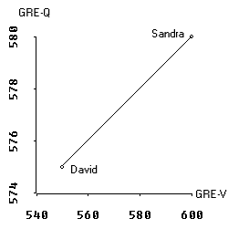
Variable space
In a scatterplot we deal with the variable space.
In the scatterplot GRE-V lies on the X-axis whereas GRE-Q is on the Y-axis.
The data points are the scores of David and Sandra. In a two data-point case, the regression line is perfect, of course.

Slide 31
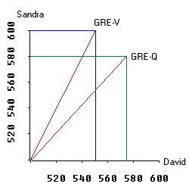
Subject space
The graph on the right is a plot of subject space.
The X axis and Y axis represent Sandra and David. In GRE-V David scores 550 and Sandra scores 600. A vector is drawn from 0 to the point where Sandra's and David's scores meet.

Slide 32
Subject space
The scale of the graph is not of the right proportion. Actually it starts from 500 rather than 0 in order to make other portions of the graph visible.
The vector for GRE-Q is constructed in the same manner.

Slide 33
Hyperspace
When subject space and variable space are combined, we call it the hyperspace.
In reality, a research project always involves more than two variables and two subjects.
In a multi-dimensional hyperspace, the vectors in the subject space can be combined to form an eigenvector, which depicts the Eigenvalue.
The longer the length of the eigenvector is, the higher the Eigenvalue is and the more variance it can explain.

Slide 34
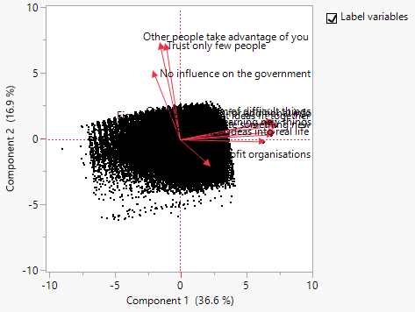
Biplot
You can depict bi-space (subject space and variable space) in a biplot.
But if you have many subjects, the biplot would be very cluttered.

Slide 35
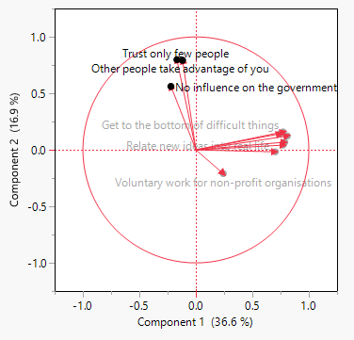
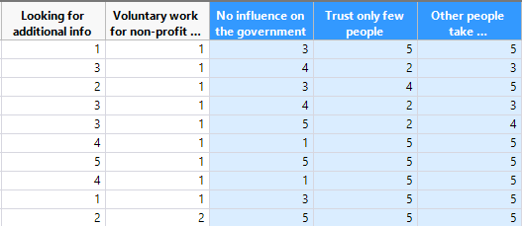
Data visualization
Use vectors to examine the clustering patterns and the inter-relationships between variables.
If the labels are obscured in the graph, you can “brush” the vectors to highlight the variables.

Slide 36
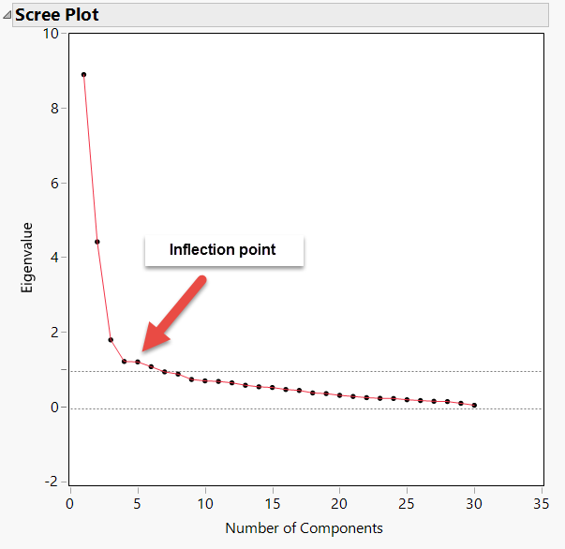
Scree plot
Determine the number of factors
How much additional information can I get by adding more complexity into the factor model?

Slide 37
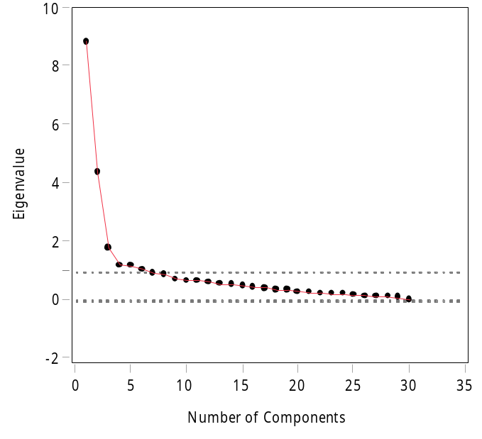
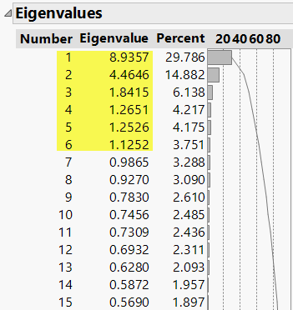
Kasier criterion
Just like the cutoff using p value < .05, Kasier criterion (Eigenvalue => 1) is just a convention.
If necessary, you should override it.
Dr. Shaynah Neshama developed a scale with two constructs, but EFA suggests six factors based on Kasier criterion => 1.

Slide 38
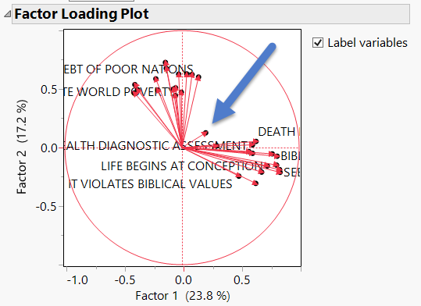

Factor loading plot
When the variables are represented as vectors, it is clear that there are two clusters. Only one item does not belong to any group. Cut it!

Slide 39
Assignment 9.1
Data set: PIAAC_for _PCA.jmp
Run a PCA with problem-solving, literacy, and numeracy.
Examine the loading plot
Can we put all three test scores together as a composite score? Are all vectors close to each other?

Slide 40
PCA in Python
Certain body characteristics are related. Can we reduce multiple body measurements into a few only?

Slide 41
PCA in Python
Download the files “python_PCA.txt” and “body_measurement.xlsx” from the folder “Python_files” in Unit 9.
Open a new Python interpreter.
Run the Python codes chunk by chunk.

Slide 42
PCA in Python
The number of components is optimal at 4.
After 4 the growth of variance explained is flattened.

Slide 43
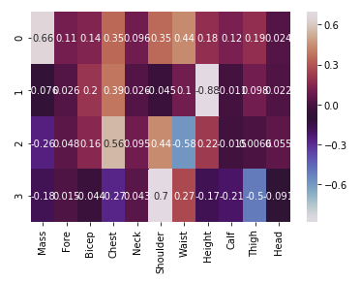
PCA in Python
The heat map shows the loadings of each item into the four components
e.g. Mass is loaded in Component 0, Chest is in Component 2.

Slide 44
Various criteria
Kasier criterion
The scree plot
Parallel analysis
Many studies had verified that by far PA is the most accurate method (Buja & Eyubuglu, 1992; Glorfeld, 1995; Horn, 1965; Hubbard & Allen, 1987; Humphreys & Montanelli, 1975; Velicer et al., 2000; Zwick & Velicer, 1986).

Slide 45
Parallel Analysis: Resampling
The logic of parallel analysis resembles that of resampling: the number of factors extracted should have eigenvalues greater than those in a random matrix.
The algorithm generates a set of random data correlation matrices by bootstrapping the data set (resampling with replacement), and then the average eigenvalues and the 95th percentile eigenvalues are computed.

Slide 46
PA: Resampling
The observed eigenvalues are compared against the re-sampled eigenvalues, and only factors with observed eigenvalues greater than those from re-sampling are retained.
The resampled result functions as an empirical sampling distribution, in which the observed is compared against.
The rationale of using the 95th percentile of the resampled data eigenvalues is that this is analogous to setting the value of alpha to .05 in hypothesis testing (Cho, Li, & Bandalos, 2009).

Slide 47
Underfactoring vs. overfactoring
Parallel analysis can be used with PCA or EFA. Which one should be used?
PA with PCA tends to under-factoring (extract fewer factors than what it should be).
PA with EFA tends to over-factoring (extract more factors than what it should be).

Slide 48
Underfactoring vs. overfactoring
Under-factoring is a more serious problem than over-factoring.
In the former scenario the researcher totally misses some information.
In the latter the result may include some meaningless factors (Crawford, Green, Levy, Lo, Scott, Svetina, & Thompson, 2010), but the researcher can always trim the redundant factors later.

Slide 49
Underfactoring vs. overfactoring
It is better to over-prepare than under-prepare.
Consider this analogy: I travel with 3-4 cameras. If I don't need the backup, it is fine. But if I have one camera only and it malfunctions, there is nothing I can do!
If your coauthor sends you a 50-page draft, you can remove the redundant information. If she sends you two pages only, there is nothing you can do!

Slide 50
Scree plot: Raw, PA means and 95th percent

Slide 51
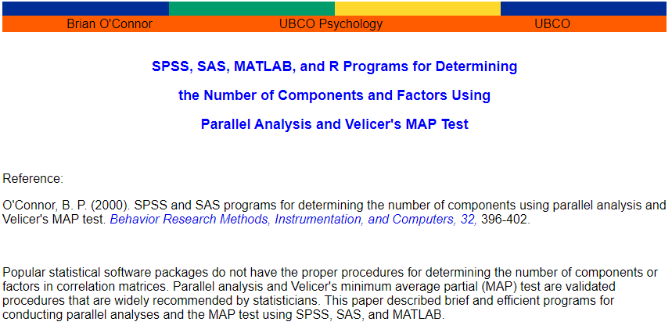
SAS, SPSS, Matlab, or R
https://people.ok.ubc.ca/brioconn/nfactors/nfactors.html

Slide 52

SAS
Caution: You must have clean data to run the PA program. If you have missing data, you have to remove those observations, otherwise it won't run.
It is better to retain only the items that will be used for PA. Nothing else. It will be much easier to read the data. e.g. read all numeric variables into the raw data set.

Slide 53
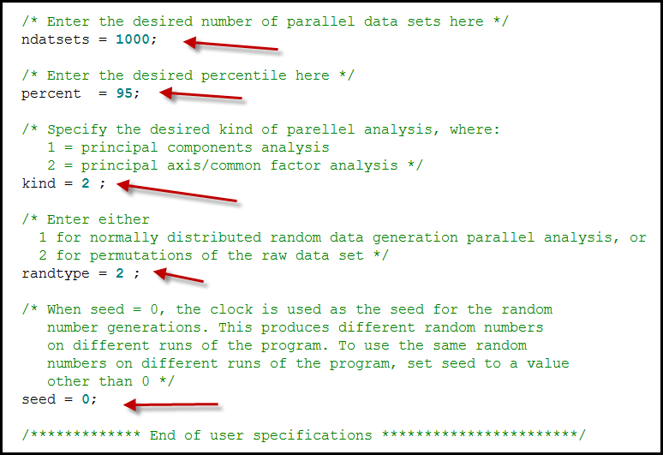
SAS

Slide 54
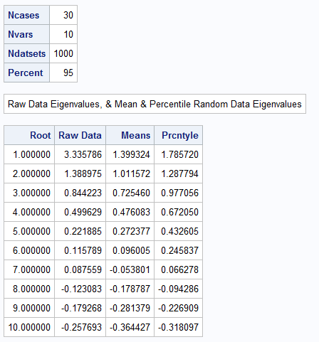
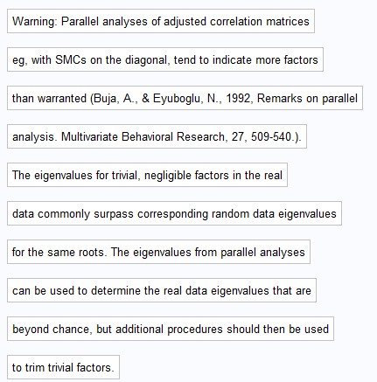
SAS output

Slide 55
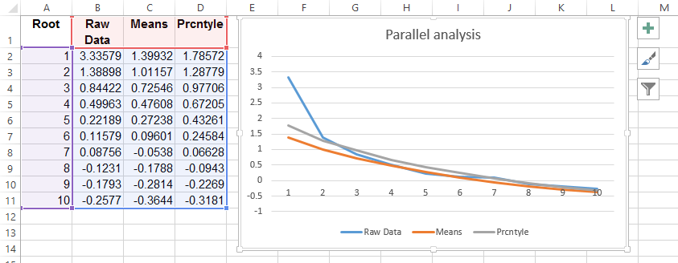
Scree plot in Excel

Slide 56
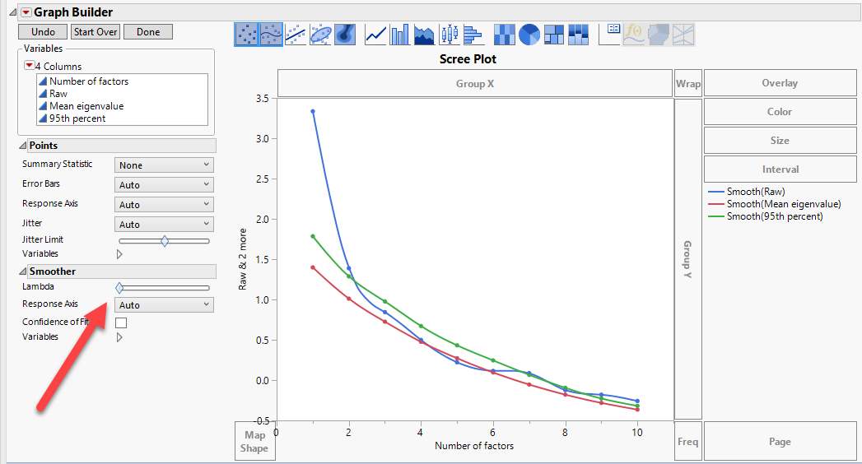
Scree plot in JMP
Move the Lambda to the left (no smoothing)

Slide 57
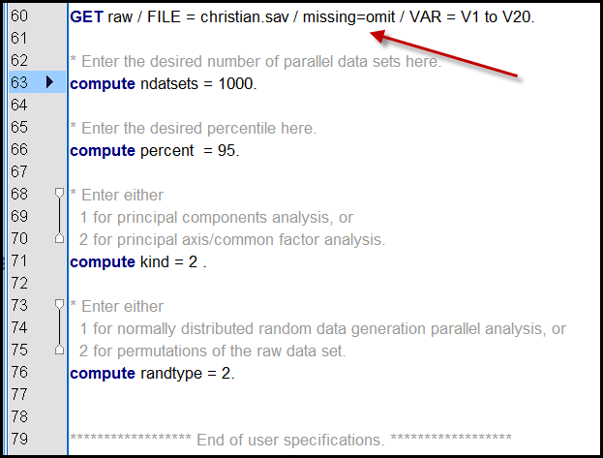
SPSS
SPSS can omit missing.

Slide 58
Assignment 9.2
Download the SAS program “pa.sas”
Change ndatasets to 2000
Change kind to 1 (PCA)
Change randtype to 2
Run the program and create the scree plot in Excel or JMP
Compare the demo result. Report their similarity and difference.

